Slide 1
CSE 421 Winter 2025
Lecture 18:
Max Flow Applications
Nathan Brunelle
http://www.cs.uw.edu/421

Slide 2
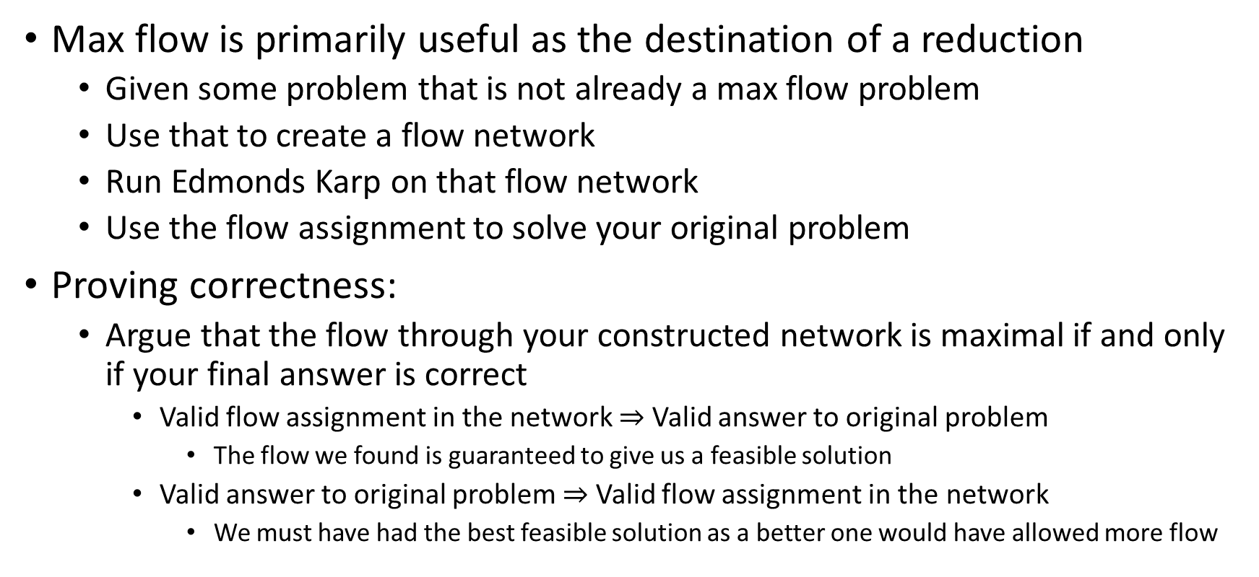
Today – Reductions and Max Flow
Max flow is primarily useful as the destination of a reduction
  Given some problem that is not already a max flow problem
  Use that to create a flow network
  Run Edmonds Karp on that flow network
  Use the flow assignment to solve your original problem
Proving correctness:
  Argue that the flow through your constructed network is maximal if and only if your final answer is correct
    Valid flow assignment in the network $⇒$ Valid answer to original problem
      The flow we found is guaranteed to give us a feasible solution
    Valid answer to original problem $⇒$ Valid flow assignment in the network
      We must have had the best feasible solution as a better one would have allowed more flow

Slide 3

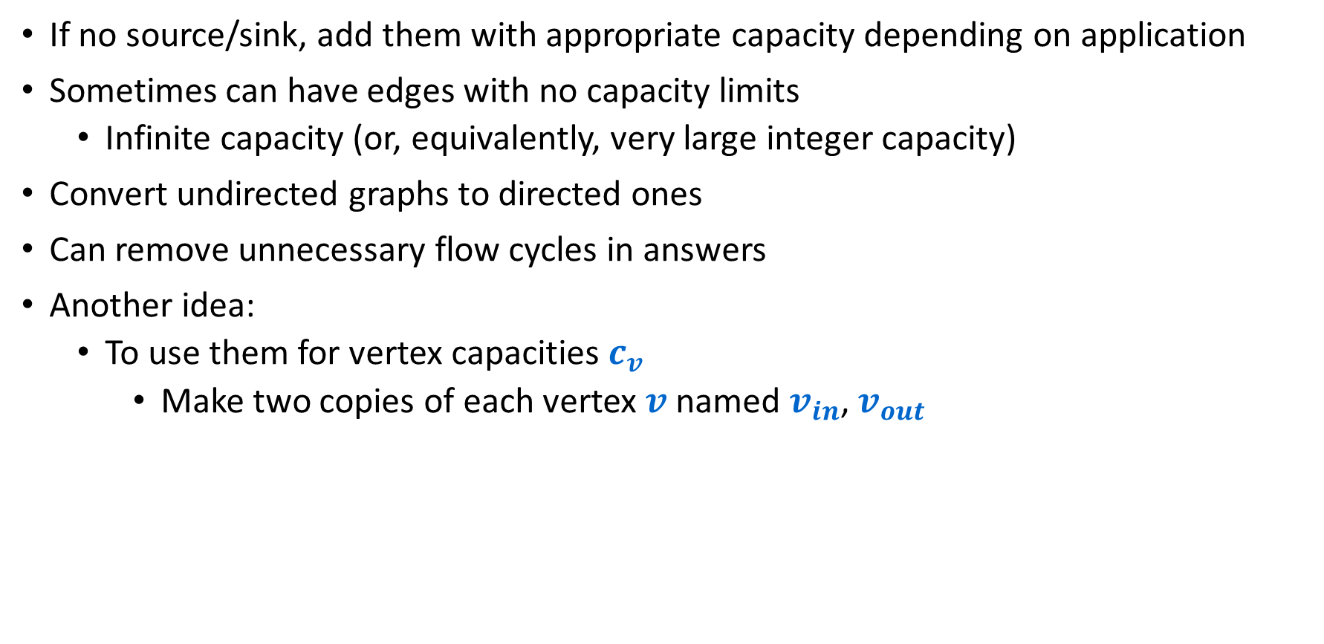
Some general ideas for using MaxFlow/MinCut
If no source/sink, add them with appropriate capacity depending on application
Sometimes can have edges with no capacity limits
  Infinite capacity (or, equivalently, very large integer capacity)
Convert undirected graphs to directed ones
Can remove unnecessary flow cycles in answers
Another idea:
  To use them for vertex capacities $c_{v}$
    Make two copies of each vertex $v$ named $v_{in}$, $v_{out}$
$$c_{v}$$
v
v_{in}
v_{out}

Slide 4
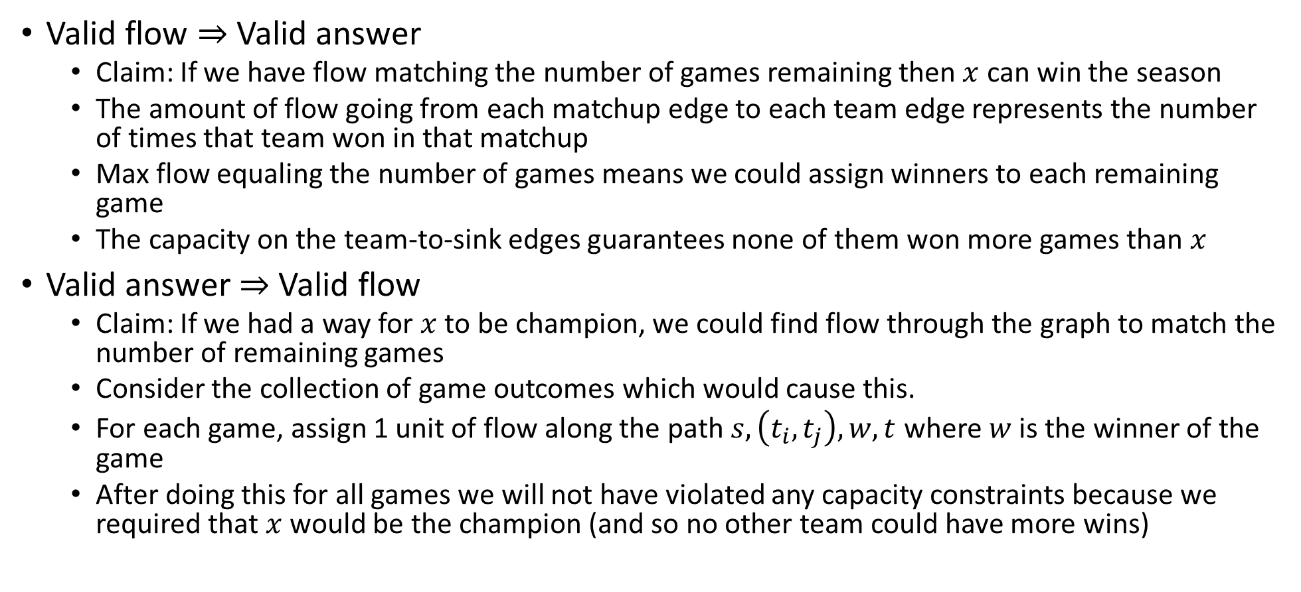
Correctness
Valid flow $⇒$ Valid answer
  Claim: If we have flow matching the number of games remaining then $x$ can win the season
  The amount of flow going from each matchup edge to each team edge represents the number of times that team won in that matchup
  Max flow equaling the number of games means we could assign winners to each remaining game
  The capacity on the team-to-sink edges guarantees none of them won more games than $x$
Valid answer $⇒$ Valid flow
  Claim: If we had a way for $x$ to be champion, we could find flow through the graph to match the number of remaining games
  Consider the collection of game outcomes which would cause this.
  For each game, assign 1 unit of flow along the path $s,\left(t_{i},t_{j}\right),w,t$ where $w$ is the winner of the game
  After doing this for all games we will not have violated any capacity constraints because we required that $x$ would be the champion (and so no other team could have more wins)

Slide 5
Circulation with Demands
Nodes have either a “supply” (negative value) or “demand” (positive value)
We want to transport from our supply to our demand through a transportation network
-8
-6
supply
7
7
10
6
4
9
-7
3
4
10
0
11
demand

Slide 6
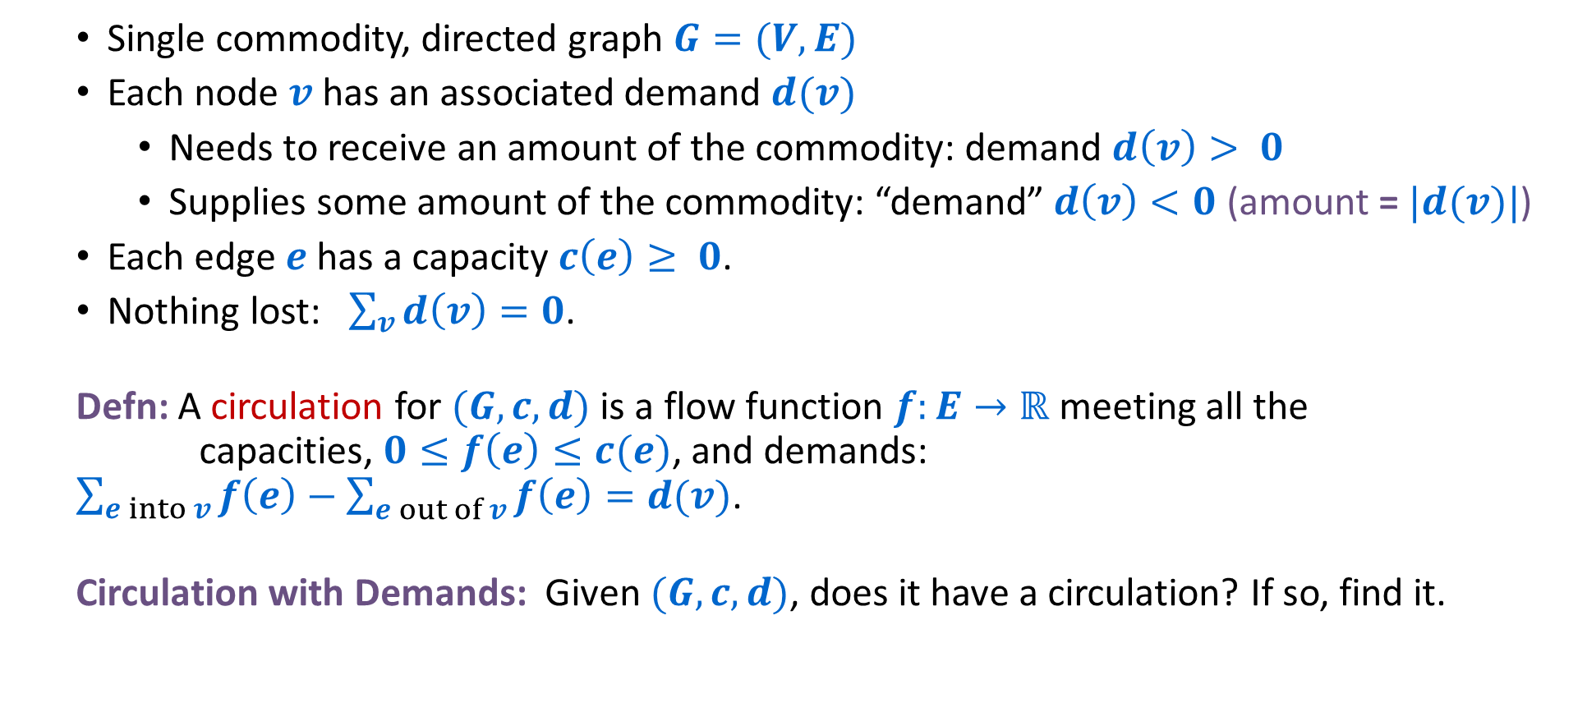
Circulation with Demands
Single commodity, directed graph $G=(V,E)$
Each node $v$ has an associated demand $d(v)$
  Needs to receive an amount of the commodity: demand $d\left(v\right)> 0$
  Supplies some amount of the commodity: “demand” $d\left(v\right)<0$ (amount = $|d(v)|$)
Each edge $e$ has a capacity $c\left(e\right)≥ 0$.
Nothing lost: $\sum_{v}{d\left(v\right)=0}$.
Defn: A circulation for $(G,c,d)$ is a flow function $f:E→ℝ$ meeting all the capacities, $0≤f\left(e\right)≤c(e)$, and demands: $\sum_{e into v}{f\left(e\right)−\sum_{e out of v}{f\left(e\right)}=d(v)}$.
Circulation with Demands: Given $(G,c,d)$, does it have a circulation? If so, find it.

Slide 7

Circulation with Demands
Defn: Total supply $D=\sum_{v: d\left(v\right)<0}{\left|d\left(v\right)\right|}=−$ $\sum_{v: d\left(v\right)<0}{d(v)}$.
Necessary condition: $\sum_{v: d\left(v\right)>0}{d\left(v\right)=D}$ (no supply is lost)
-8
-6
supply
7
7
10
6
4
9
-7
3
4
10
0
11
demand

Slide 8

Circulation with Demands using Network Flow
Add new source $s$ and sink $t$.
Add edge $(s,v)$ for all supply nodes $v$ with capacity $|d(v)|$.
Add edge $(v,t)$ for all demand nodes $v$ with capacity $d(v)$.
Compute MaxFlow.
6
-8
-6
8
7
7
10
6
4
9
-7
s
7
3
4
11
t
10
0
11
10

Slide 9

Circulation with Demands using Network Flow
MaxFlow $≤D$ based on cuts out of $s$ or into $t$.
If MaxFlow $=D$ then all supply/demands satisfied.
If.
Compute MaxFlow. Circulation iff value = $D$
6/6
-8
-6
8/8
6/7
1/7
4/10
6/6
2/4
7/9
-7
s
7/7
3/3
4/4
11/11
t
10
0
11
10/10

Slide 10
Circulation with Demands using Network Flow
Circulation = flow on original edges
Circulations only need integer flows
-8
-6
6/7
1/7
4/10
6/6
2/4
7/9
-7
3/3
4/4
10
0
11

Slide 11

Circulation with Demands using Network Flow
When does a circulation not exist? MaxFlow $<D$ iff MinCut $<D$.
If.
6/6
-8
-6
7/8
4/4
7
3/10
6/7
4
6/9
-7
s
7/7
4/4
4/4
10/11
t
10
0
11
10/10

Slide 12

Circulation with Demands using Network Flow
When does a circulation not exist? MaxFlow $<D$ iff MinCut $<D$.
Equivalent to excess supply on “source” side of cut smaller than cut capacity.
If.
-8
-6
Excess supply
15 – 10 = 5
4
7
10
7
4
9
-7
4
4
10
0
11
Cut capacity = 4 < 5 = Excess supply

Slide 13
Image Segmentation
Image segmentation:
  Given: an Image
      a grid of pixels with RGB values
  Divide image into coherent regions.
Example: Three people standing in front of complex background scene. Identify each person as a coherent object.

Slide 14
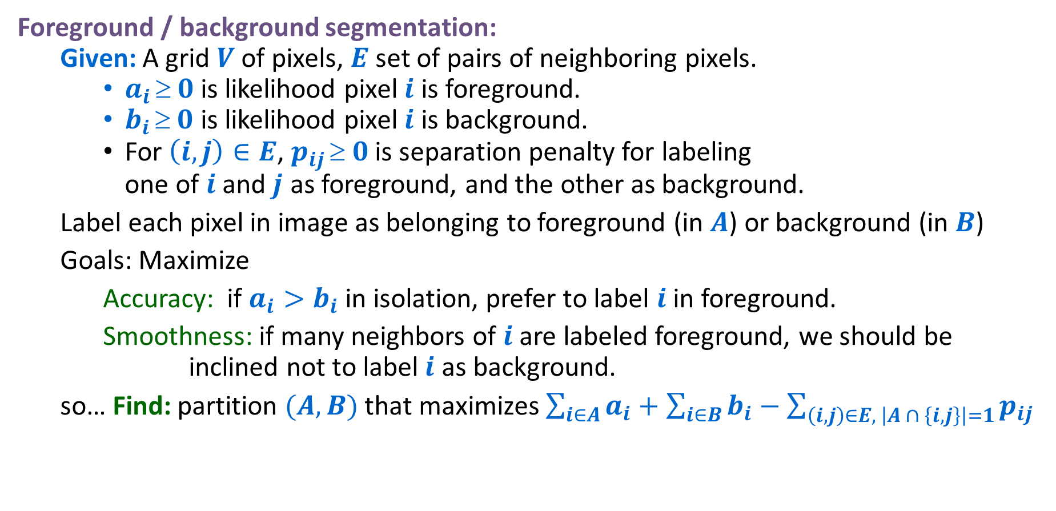
Image Segmentation
Foreground / background segmentation:
  Given: A grid $V$of pixels, $E$ set of pairs of neighboring pixels.
    $a_{i}  0$ is likelihood pixel $i$ is foreground.
    $b_{i}  0$ is likelihood pixel $i$ is background.
    For $\left(i,j\right)∈E$, $p_{ij}  0$ is separation penalty for labeling one of $i$and $j$ as foreground, and the other as background.
  Label each pixel in image as belonging to foreground (in $A$) or background (in $B$)
  Goals: Maximize
    Accuracy: if $a_{i}>b_{i}$ in isolation, prefer to label $i$ in foreground.
    Smoothness: if many neighbors of $i$ are labeled foreground, we should be inclined not to label$i$ as background.
  so… Find: partition $(A,B)$ that maximizes $\sum_{i∈A}{a_{i}+\sum_{i∈B}{b_{i}−\sum_{\left(i,j\right)∈E, \left|A ∩ \left\{i,j\right\}\right|=1}{p_{ij}}}}$

Slide 15
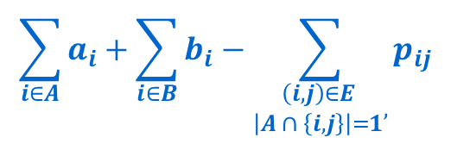
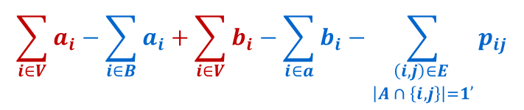
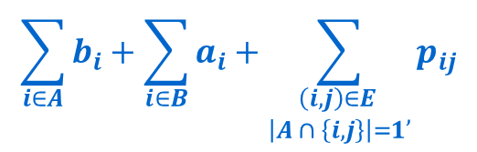
Image Segmentation
Issues with formulating as min cut problem:
  Maximization.
  No source or sink.
  Undirected graph.
But maximizing
is equivalent to maximizing
or, alternatively, minimizing
$$\sum_{i∈A}{a_{i}+\sum_{i∈B}{b_{i}−\sum_{\begin{matrix}\left(i,j\right)∈E \\ \left|A ∩ \left\{i,j\right\}\right|=1\end{matrix},}{p_{ij}}}}$$
The sum in red is a constant
$$\sum_{i∈V}{a_{i}−\sum_{i∈B}{a_{i}+\sum_{i∈V}{b_{i}}−\sum_{i∈a}{b_{i}}}−\sum_{\begin{matrix}\left(i,j\right)∈E \\ \left|A ∩ \left\{i,j\right\}\right|=1\end{matrix},}{p_{ij}}}$$
$$\sum_{i∈A}{b_{i}+\sum_{i∈B}{a_{i}+\sum_{\begin{matrix}\left(i,j\right)∈E \\ \left|A ∩ \left\{i,j\right\}\right|=1\end{matrix},}{p_{ij}}}}$$

Slide 16






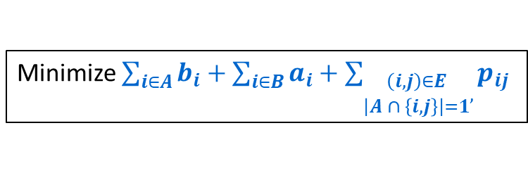
Image Segmentation
Minimize $\sum_{i∈A}{b_{i}+\sum_{i∈B}{a_{i}+\sum_{\begin{matrix}\left(i,j\right)∈E \\ \left|A ∩ \left\{i,j\right\}\right|=1\end{matrix},}{p_{ij}}}}$
Formulate as min cut problem.
  Use two anti-parallel edges instead of undirected edge, capacity $p_{ij}$.
  $G′ = (V′, E′)$.
$$a_{i}$$
$$a_{j}$$
i
$$p_{ij}$$
j
$$b_{i}$$
$$b_{j}$$

Slide 17






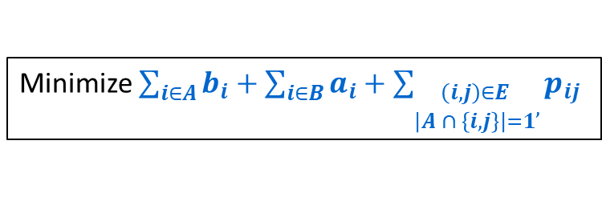
Image Segmentation
Minimize $\sum_{i∈A}{b_{i}+\sum_{i∈B}{a_{i}+\sum_{\begin{matrix}\left(i,j\right)∈E \\ \left|A ∩ \left\{i,j\right\}\right|=1\end{matrix},}{p_{ij}}}}$
Formulate as min cut problem.
  Add source $s$ to correspond to foreground, edges $(s,i)$ with capacity $a_{i}$;
  add sink$t$ to correspond to background, edges $(j,t)$ with capacity $b_{j}$.
  $G′ = (V′, E′)$.
$$a_{j}$$
$$a_{i}$$
s
i
$$p_{ij}$$
j
t
$$b_{j}$$
$$b_{i}$$

Slide 18




Image Segmentation
Minimize $\sum_{i∈A}{b_{i}+\sum_{i∈B}{a_{i}+\sum_{\begin{matrix}\left(i,j\right)∈E \\ \left|A ∩ \left\{i,j\right\}\right|=1\end{matrix},}{p_{ij}}}}$
Formulate as min cut problem.
  Add source $s$ to correspond to foreground, edges $(s,i)$ with capacity $a_{i}$;
  add sink$t$ to correspond to background, edges $(j,t)$ with capacity $b_{j}$.
  Use two anti-parallel edges instead of undirected edge, capacity $p_{ij}$.
  $G′ = (V′, E′)$.
$$a_{j}$$
$$a_{i}$$
$$p_{ij}$$
s
i
$$p_{ij}$$
j
t
$$b_{j}$$
$$b_{i}$$

Slide 19


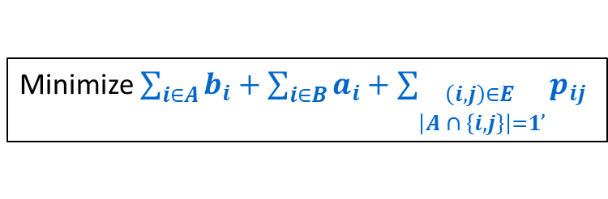
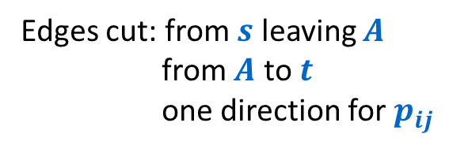



Image Segmentation
Minimize $\sum_{i∈A}{b_{i}+\sum_{i∈B}{a_{i}+\sum_{\begin{matrix}\left(i,j\right)∈E \\ \left|A ∩ \left\{i,j\right\}\right|=1\end{matrix},}{p_{ij}}}}$
Formulate as min cut problem.
  Add source $s$ to correspond to foreground, edges $(s,i)$ with capacity $a_{i}$;
  add sink$t$ to correspond to background, edges $(j,t)$ with capacity $b_{j}$.
  Use two anti-parallel edges instead of undirected edge, capacity $p_{ij}$.
  $G′ = (V′, E′)$.
Edges cut: from $s$ leaving $A$
from $A$ to $t$
one direction for $p_{ij}$
$$a_{j}$$
$$a_{i}$$
$$p_{ij}$$
s
i
$$p_{ij}$$
j
t
$$b_{j}$$
$$A$$
$$b_{i}$$
Min cut is exactly the quantity we want to minimize!

Slide 20
Baseball Elimination
Though you probably don’t care at all about baseball or sports in general, the way that the solution works is interesting.
  This particular problem is a bit old style since baseball scheduling doesn’t work this way any more…
Near the end of a season
  Sportswriters use simple notions to tell which teams can be eliminated from getting a top place finish:
    “magic number”, “elimination number”, etc.
These are not accurate
  We can do better with network flow

Slide 21

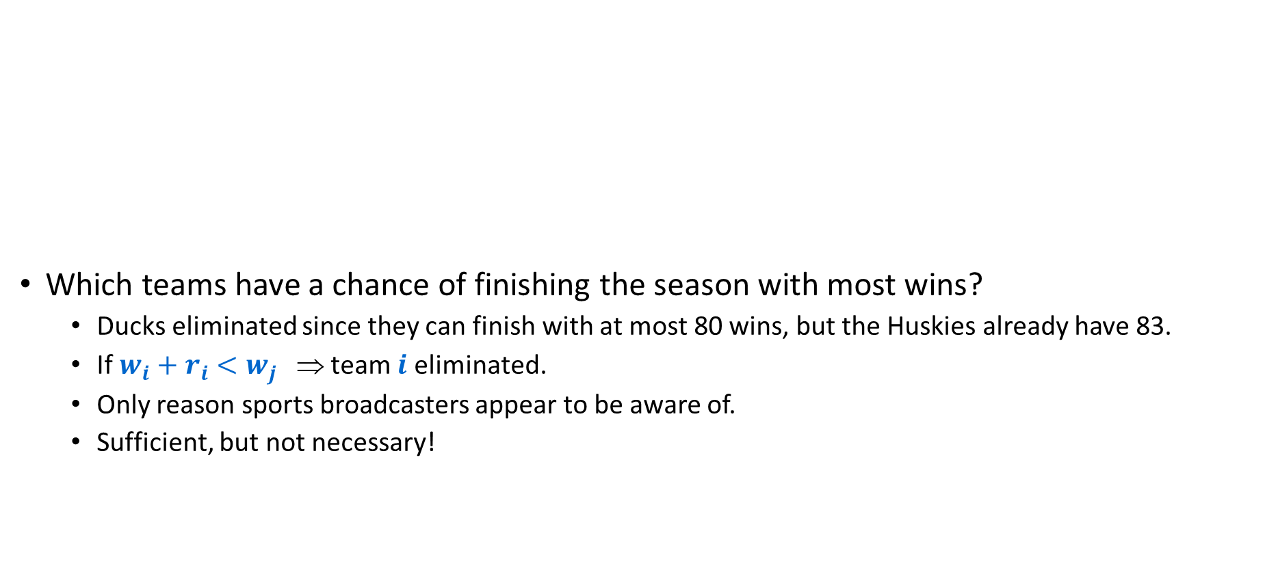




Baseball Elimination: Scenario
Team
$$i$$
Wins
$$wi$$
Losses
$$li$$
To play
$$ri$$
Against = $rij$
Which teams have a chance of finishing the season with most wins?
  Ducks eliminated since they can finish with at most 80 wins, but the Huskies already have 83.
  If $w_{i}+r_{i}<w_{j}$ ⇒ team $i$ eliminated.
  Only reason sports broadcasters appear to be aware of.
  Sufficient, but not necessary!
Tex
Hou
Sea
Oak
Huskies
83
71
8
-
1
6
1
Wolverines
80
79
3
1
-
0
2
Buckeyes
78
78
6
6
0
-
0
Ducks
77
82
3
1
2
0
-
Notes:
As season unfolds, sports fans are naturally interested in how their favorite teams are doing. Is there some outcome of remaining games in which your favorite team finishes the season with the most (or tied for most) wins?

Slide 22
Baseball Elimination: Scenario
Team
$$i$$
Wins
$$wi$$
Losses
$$li$$
To play
$$ri$$
Against = $rij$
Which teams have a chance of finishing the season with most wins?
  Wolverines can win 83 games, but are still eliminated . . .
  If the Huskies don’t get to 84 wins then the Buckeyes will get 6 more wins and finish with 84 wins.
The answer depends on more than current wins and # of remaining games
  It also depends on all the games that are being played.
Tex
Hou
Sea
Oak
Texas
83
71
8
-
1
6
1
Houston
80
79
3
1
-
0
2
Seattle
78
78
6
6
0
-
0
Oakland
77
82
3
1
2
0
-
Notes:
As season unfolds, sports fans are naturally interested in how their favorite teams are doing. Is there some outcome of remaining games in which your favorite team finishes the season with the most (or tied for most) wins?

Slide 23
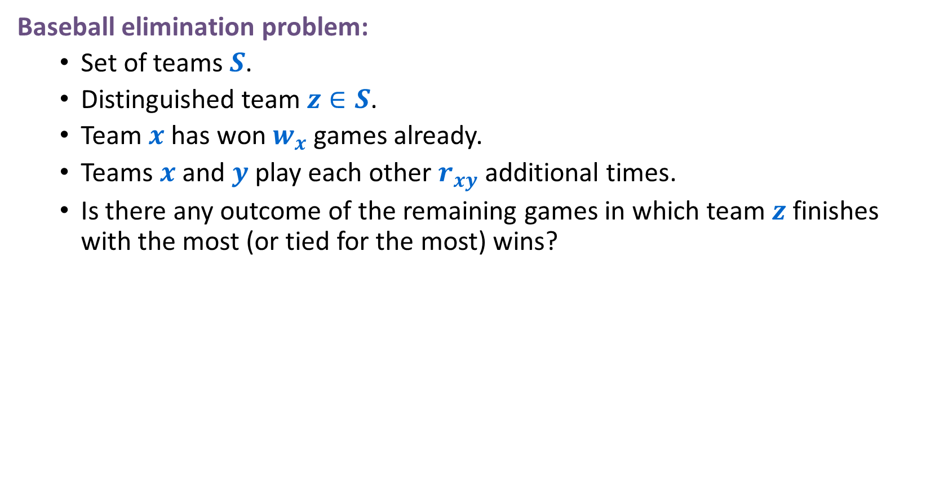
Baseball Elimination
Baseball elimination problem:
  Set of teams $S$.
  Distinguished team $z∈S$.
  Team $x$ has won $w_{x}$ games already.
  Teams $x$ and $y$ play each other $r_{xy}$ additional times.
  Is there any outcome of the remaining games in which team $z$ finishes with the most (or tied for the most) wins?

Slide 24



Baseball Elimination: Max Flow Formulation
Can team 3 finish with most wins?
  Assume team 3 wins all remaining games ⇒ $w_{3}+r_{3}$ wins.
  Divide up remaining games so that all teams have ${≤w}_{3}+r_{3}$ wins.
1-2
1
Max # of remaining games that team 4 can win without being ahead of team 3
1-4
games left
2
1-5
∞
s
$$r24=7$$
2-4
∞
4
$$w_{3}+r_{3}−w_{4}$$
t
2-5
5
matchup nodes
4-5
team nodes

Slide 25


Baseball Elimination: Max Flow Formulation
Theorem: Team 3 is not eliminated iff max flow equals capacity leaving source.
  Integrality implies that each remaining $x$-$y$ game counts as a win for $x$ or $y$.
  Capacity on $(x,t)$ edge ensures no team wins too many games.
1-2
1
Max # of remaining games that team 4 can win without being ahead of team 3
1-4
games left
2
1-5
∞
s
$$r24=7$$
2-4
∞
4
$$w_{3}+r_{3}−w_{4}$$
t
2-5
5
matchup nodes
4-5
team nodes

Slide 26
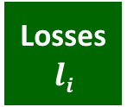
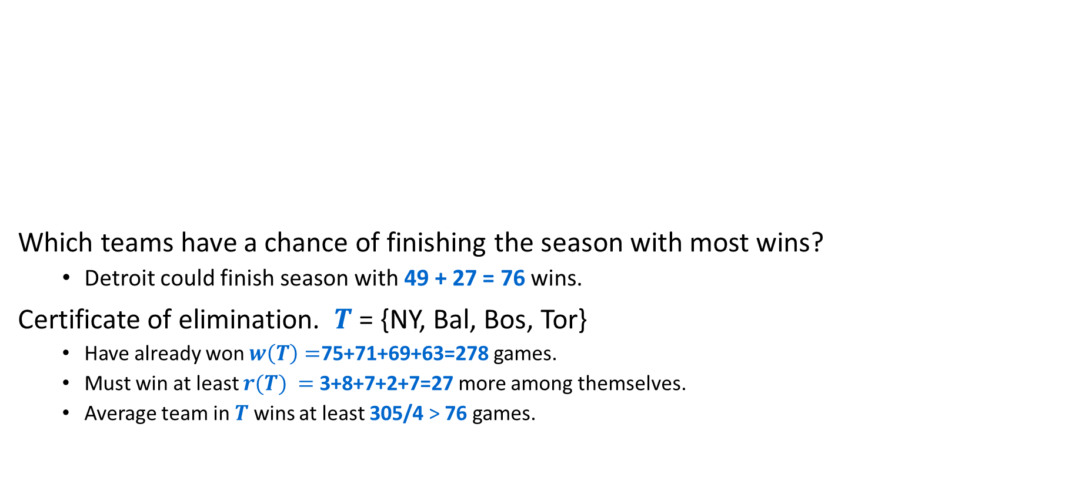




Baseball Elimination: Explanation for Sports Writers
Team
$$i$$
Wins
$$wi$$
Losses
$$li$$
To play
$$ri$$
Against = $rij$
NY
Bal
Bos
Tor
Det
Which teams have a chance of finishing the season with most wins?
  Detroit could finish season with 49 + 27 = 76 wins.
Certificate of elimination. $T$ = {NY, Bal, Bos, Tor}
  Have already won $w\left(T\right)=$75+71+69+63=278 games.
  Must win at least $r(T) =$3+8+7+2+7=27 more among themselves.
  Average team in $T$ wins at least 305/4 > 76 games.
NY
75
59
28
-
3
8
7
3
Baltimore
71
63
28
3
-
2
7
4
Boston
69
66
27
8
2
-
0
0
Toronto
63
72
27
7
7
0
-
-
Detroit
49
86
27
3
4
0
0
-
AL East: August 30, 1996

Slide 27
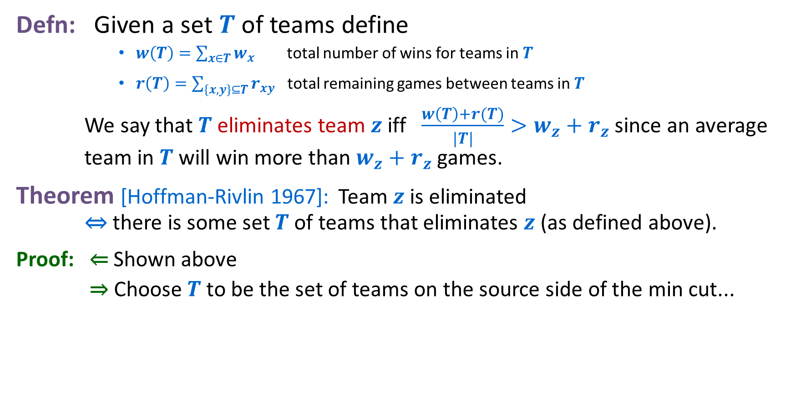
Baseball Elimination: Explanation for Sports Writers
Defn: Given a set $T$ of teams define
      $w\left(T\right)=\sum_{x∈T}{w_{x}}$ total number of wins for teams in $T$
      $r\left(T\right)=\sum_{\left\{x,y\right\}⊆T}{r_{xy}}$ total remaining games between teams in $T$
    We say that $T$ eliminates team $z$ iff $\frac{w\left(T\right)+r(T)}{|T|}>w_{z}+r_{z}$ since an average team in $T$ will win more than $w_{z}+r_{z}$ games.
Theorem [Hoffman-Rivlin 1967]: Team $z$ is eliminated ⇔ there is some set $T$ of teams that eliminates $z$ (as defined above).
Proof: ⇐ Shown above
⇒ Choose $T$ to be the set of teams on the source side of the min cut...

Slide 28
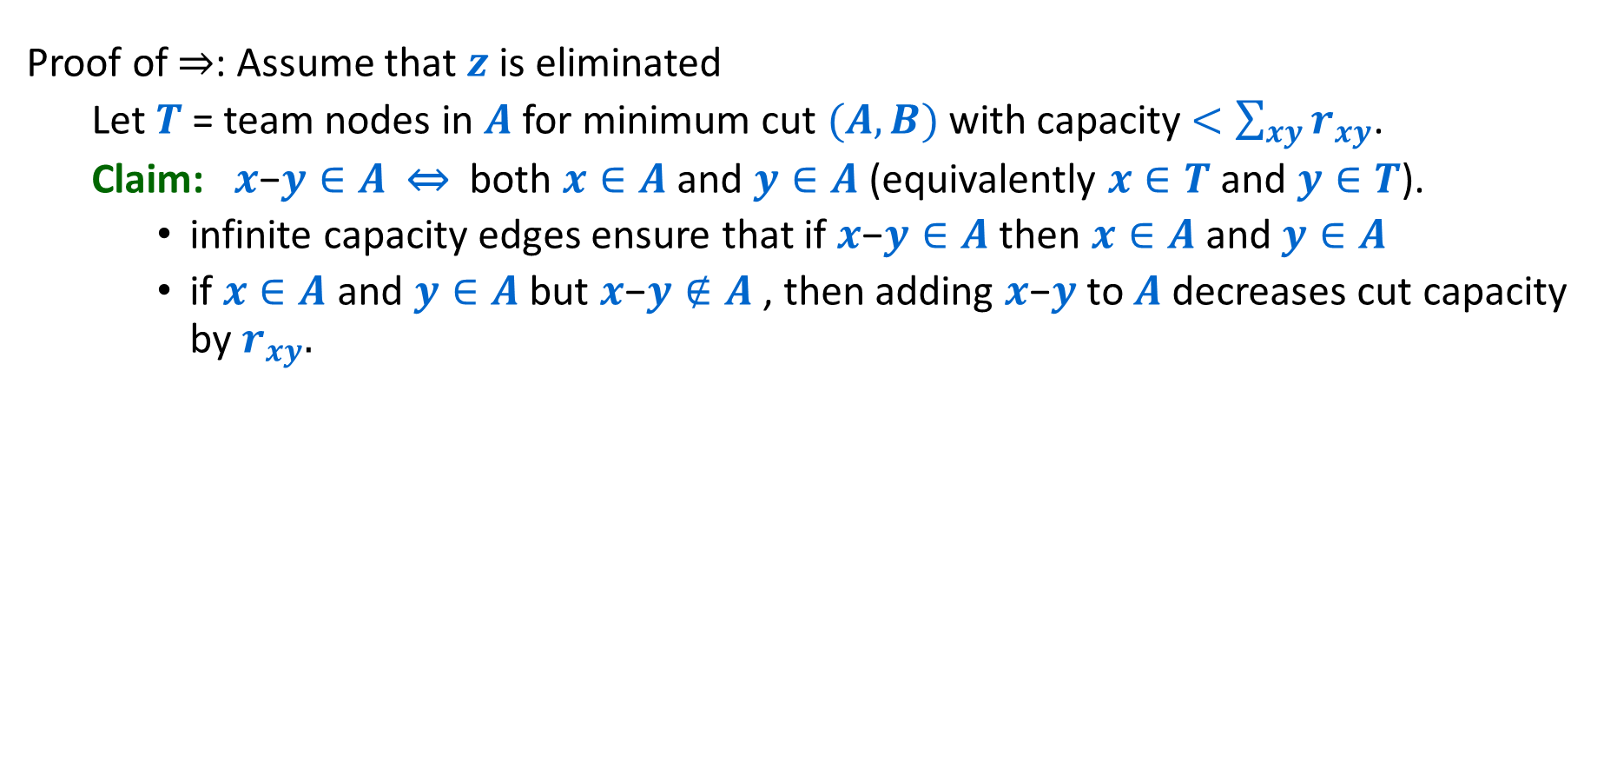


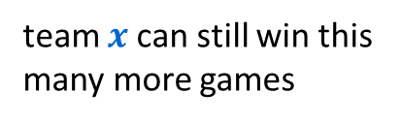
Baseball Elimination: Explanation for Sports Writers
Proof of ⇒: Assume that $z$ is eliminated
  Let $T$ = team nodes in $A$ for minimum cut $(A,B)$ with capacity $<\sum_{xy}{r_{xy}}$.
  Claim: $x\text{−}y∈A$ ⇔ both $x∈A$ and $y∈A$ (equivalently $x∈T$ and $y∈T$).
    infinite capacity edges ensure that if $x\text{−}y∈A$ then $x∈A$ and $y∈A$
    if $x∈A$ and $y∈A$ but $x\text{−}y∉A$ , then adding $x\text{−}y$ to $A$ decreases cut capacity by $r_{xy}.$
team $x$can still win this many more games
games left
y
∞
s
$$r24=7$$
x-y
∞
x
$$w_{z}+r_{z}−w_{x}$$
t

Slide 29
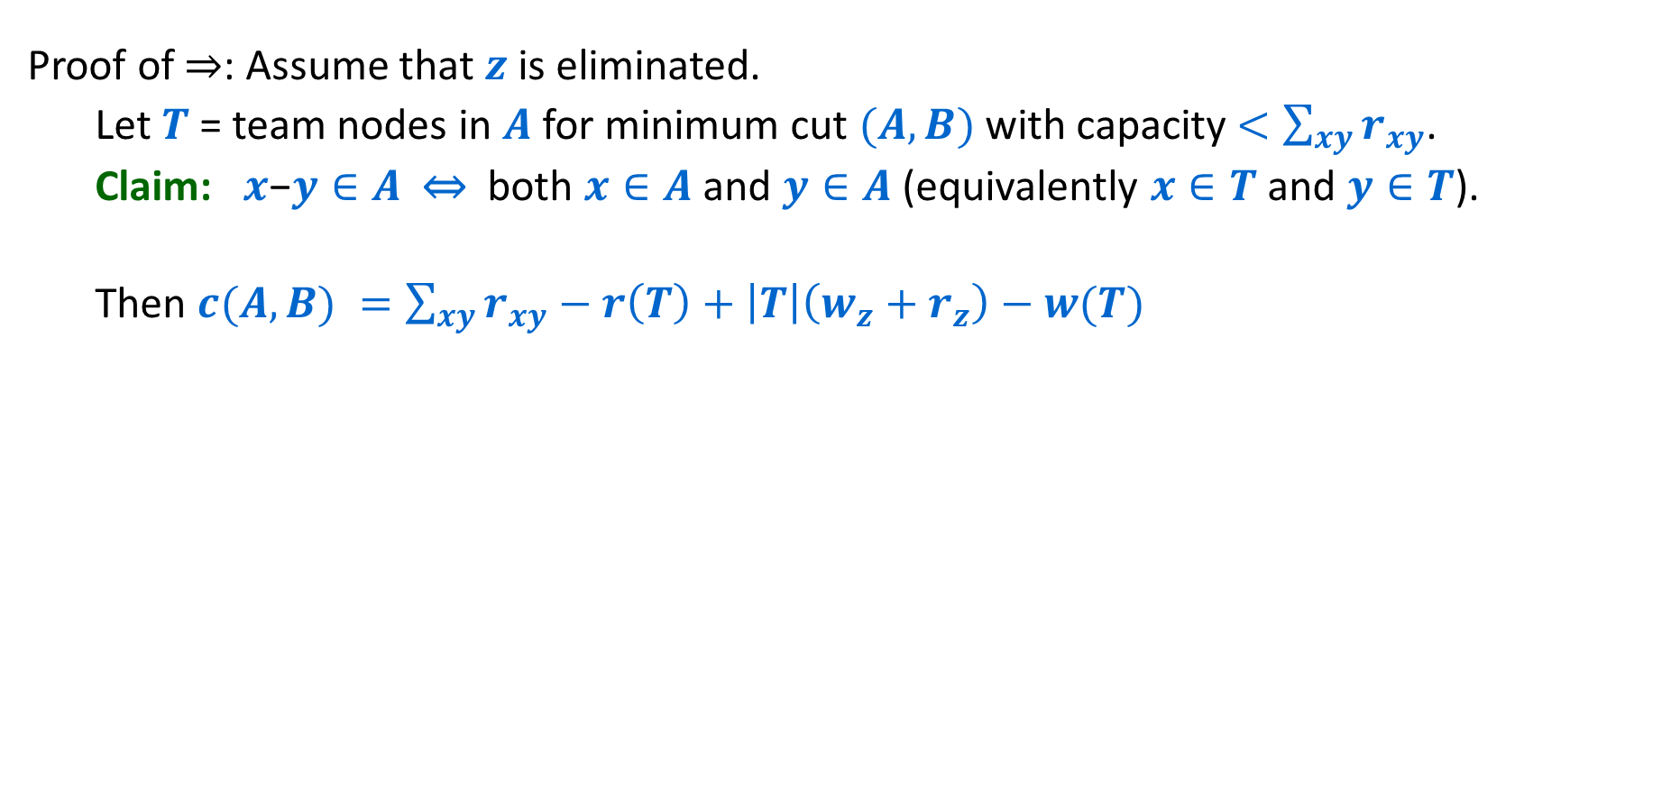
Baseball Elimination: Explanation for Sports Writers
Proof of ⇒: Assume that $z$is eliminated.
  Let $T$ = team nodes in $A$ for minimum cut $(A,B)$ with capacity $<\sum_{xy}{r_{xy}}$.
  Claim: $x\text{−}y∈A$ ⇔ both $x∈A$ and $y∈A$ (equivalently $x∈T$ and $y∈T$).
  Then $c(A,B) =\sum_{xy}{r_{xy}}−r\left(T\right)+\left|T\right|\left(w_{z}+r_{z}\right)−w(T)$
team $x$can still win this many more games
games left
y
∞
s
$$r24=7$$
x-y
∞
x
$$w_{z}+r_{z}−w_{x}$$
t

Slide 30
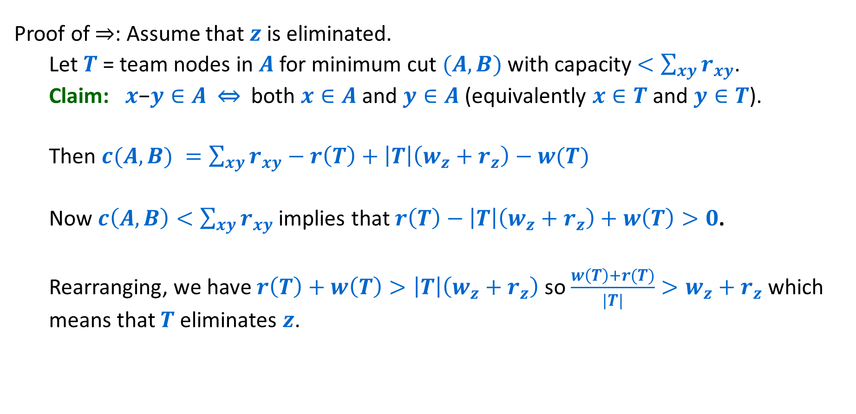
Baseball Elimination: Explanation for Sports Writers
Proof of ⇒: Assume that $z$is eliminated.
  Let $T$ = team nodes in $A$ for minimum cut $(A,B)$ with capacity $<\sum_{xy}{r_{xy}}$.
  Claim: $x\text{−}y∈A$ ⇔ both $x∈A$ and $y∈A$ (equivalently $x∈T$ and $y∈T$).
  Then $c(A,B) =\sum_{xy}{r_{xy}}−r\left(T\right)+\left|T\right|\left(w_{z}+r_{z}\right)−w(T)$
  Now $c\left(A,B\right)<\sum_{xy}{r_{xy}}$ implies that $r\left(T\right)−\left|T\right|\left(w_{z}+r_{z}\right)+w\left(T\right)>0$.
  Rearranging, we have $r\left(T\right)+w\left(T\right)>\left|T\right|\left(w_{z}+r_{z}\right)$ so $\frac{w\left(T\right)+r(T)}{|T|}>w_{z}+r_{z}$ which means that $T$ eliminates $z$.

