Slide 1
CSE 421 Winter 2025 Lecture 18: Max Flow Applications
Nathan Brunelle
http://www.cs.uw.edu/421

Slide 2
Max Flow Algorithm Summary
Ford-Fulkerson:
“Find an augmenting path, identify a bottleneck edge, add flow to fill the bottleneck”
Worst case running time: $Θ(\left|V\right|⋅\left|E\right|⋅C)$ where $C$ is the maximum capacity of any edge
Edmonds-Karp:
“Do Ford Fulkerson, but use the shortest augmenting path (with BFS)”
Worst case running time: $Θ\left({\left|E\right|}^{2}\left|V\right|\right)$
Observation:
Since Edmonds-Karp is just a special case of Ford-Fulkerson the running time of Edmonds-Karp should be:
$Θ\left(\min\left(\left|V\right|⋅\left|E\right|⋅C, {\left|E\right|}^{2}\left|V\right|\right)\right)$
Use the FF bound when $C>\left|E\right|$, otherwise use EK.

Slide 3
Today – Reductions and Max Flow
Max flow is primarily useful as the destination of a reduction
Given some problem that is not already a max flow problem
Use that to create a flow network
Run Edmonds Karp on that flow network
Use the flow assignment to solve your original problem
Proving correctness:
Argue that the flow through your constructed network is maximal if and only if your final answer is correct
Valid flow assignment in the network $⇒$ Valid answer to original problem
The flow we found is guaranteed to give us a feasible solution
Valid answer to original problem $⇒$ Valid flow assignment in the network
We must have had the best feasible solution as a better one would have allowed more flow

Slide 4
Recall: Bipartite Graph
Definition: An undirected graph $G$ is bipartite iff we can color its vertices red and green so each edge has different color endpoints
Alternative: A graph $G$ is bipartite iff we can find a cut $\left(L,R\right)$ such that every edge in the graph crosses the cut
On a cycle the two colors must alternate, so
green every 2nd vertex
red every 2nd vertex
Can’t have either if length is not divisible by 2.

Slide 5
Bipartite Matching
Input: Undirected Bipartite graph $G=(L∪R, E)$
Goal: Find the largest subset of edges $M⊆E$ such that ever vertex is adjacent to at most one edge

Slide 6
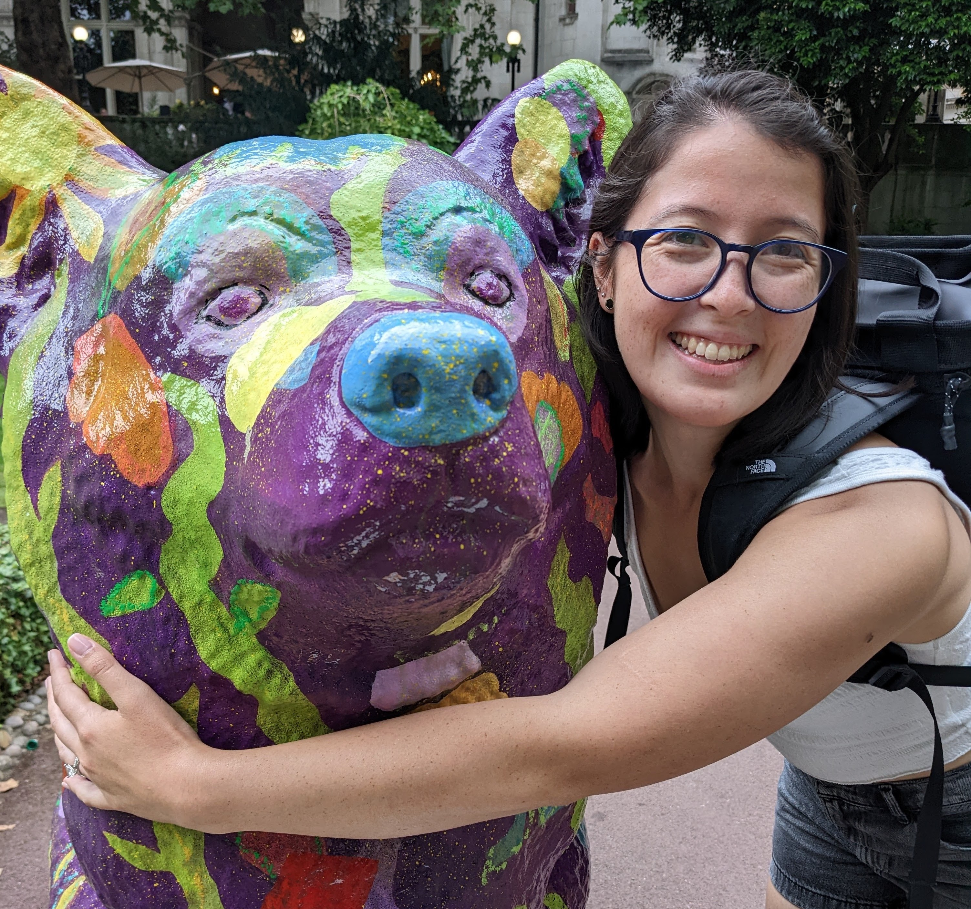
Maximum Bipartite Matching
Dog Lovers
Dogs

Slide 7
Maximum Bipartite Matching
Dog Lovers
Dogs
A (non-maximum) bipartite matching

Slide 8
Maximum Bipartite Matching
Dog Lovers
Dogs
A maximum bipartite matching!

Slide 9
Reducing to Max Flow
We need to create a flow network
Add/remove any edges/nodes as needed (must be directed)
Identify a source/sink
Give capacities to each edge

Slide 10
Reducing to Max Flow
We need to create a flow network
Add/remove any edges/nodes as needed
Make each edge directed from $L$ to $R$
Add nodes $s$ and $t$
Draw an edge from $s$ to each node in $L$
Draw an edge from each node in $R$ to $t$
Identify a source/sink
Make $s$ the source and $t$ the sink
Give capacities to each edge
Give each edge capacity 1
1
1
1
1
1
1
1
1
1
1
$$s$$
1
$$t$$
1
1
1
1
1
1
1

Slide 11
Reducing to Max Flow
Next, run Edmonds-Karp
Use the answer to select a Matching
$M=$ the set of $L$-to-$R$ edges with flow
$M=\left\{e :e∈L×R, f\left(e\right)=1\right\}$
Running Time:
Constructing the graph
$\left|V\right|+|E|$
Running Edmonds-Karp
$\left|V\right|⋅|E|$
Finding $M$
$\left|V\right|$
Overall
$Θ\left(\left|V\right|⋅\left|E\right|\right)$
1
1/1
1
1/1
1
1/1
1/1
1/1
1/1
1/1
$$s$$
1
$$t$$
1/1
1
1/1
1/1
1/1
1/1
1

Slide 12
Correctness
Valid flow $⇒$ Valid answer
Need to show: $M$ is a valid match
Requirement 1: $M⊆E$
Requirement 2: each node is part of at most one match
No node in $L$ is adjacent to more than one edge because the capacity of the edge from $s$ is 1
No node in $R$ is adjacent to more than one edge because the capacity of the edge to $t$ is 1
Valid answer $⇒$ Valid flow
Any matching $M$ enables a flow with value equal to $\left|M\right|$
Idea: “reverse” the construction to derive a flow from the match
For each edge in $M$, assign flow across that edge, then add flow incoming to each $L$ endpoint and outgoing form each $t$ endpoint
This must be a valid flow because
No edge exceeds its capacity (we only assign 1 unit)
All nodes (except $s$ and $t$) have $0$ net flow because each node is incident at most one edge in $M$
1
1/1
1
1/1
1
1/1
1/1
1/1
1/1
1/1
$$s$$
1
$$t$$
1/1
1
1/1
1/1
1/1
1/1
1

Slide 13
Edge-Disjoint Paths
Defn: Two paths in a graph are edge-disjoint iff they have no edge in common.
Edge disjoint path problem: Given: a directed graph $G=(V,E)$ and two vertices $s$ and $t$. Find: the maximum # of edge-disjoint simple $s$-$t$ paths in $G$.
a
d
s
b
e
t
c
f

Slide 14
Edge-Disjoint Paths – Example of size 2
Defn: Two paths in a graph are edge-disjoint iff they have no edge in common.
Edge disjoint path problem: Given: a directed graph $G=(V,E)$ and two vertices $s$ and $t$. Find: the maximum # of edge-disjoint simple $s$-$t$ paths in $G$.
a
d
s
b
e
t
c
f

Slide 15
Edge-Disjoint Paths
MaxFlow for edge-disjoint paths
Assign capacity $1$ to every edge
Add a source $s′$ and a sink $t′$
Connect $s′$ to $s$ and $t′$ to $t$ with capacity $∞$
Compute max flow
Running Time:
Constructing the flow network: $\left|V\right|+|E|$
Computing Max Flow: $\left|V\right|⋅{\left|E\right|}^{2}$
Overall: $Θ\left(\left|V\right|⋅{\left|E\right|}^{2}\right)$
a
1
d
1
1
1
1
1
$$s′$$
$$∞$$
1
1
$$∞$$
s
b
e
t
$$t′$$
1
1
1
1
1
c
1
f

Slide 16
Edge-Disjoint Paths
Theorem: MaxFlow $=$ # edge-disjoint paths
Valid flow $⇒$ Valid answer:
Need to show: no edge is used more than once all paths go from $s$ to $t$
Each edge has capacity 1, so its used once. To get from $s′$ to $t′$ we must go from $s$ to $t$ along the way
Valid answer $⇒$ Valid flow:
Need to show: Any set of edge-disjoint paths could be used to produce flow of the same amount.
Add 1 unit of flow along each path. Since no path uses the same edge twice, capacity constraint is satisfied. Because the indegree matches the outdegree for each node (except $s′$ and $t′$), the flow constraint is satisfied.
MaxFlow for edge-disjoint paths
Assign capacity $1$ to every edge
Add a source $s′$ and a sink $t′$
Connect $s′$ to $s$ and $t′$ to $t$ with capacity $∞$
Compute max flow
a
1
d
1/1
1/1
1
1
1
$$s′$$
$$∞$$
1/1
1/1
$$∞$$
$$t′$$
s
b
e
t
1
1/1
1/1
1/1
1/1
c
1/1
f

Slide 17
Vertex-Disjoint Paths
Defn: Two paths in a graph are vertex-disjoint iff they have no vertices in common, except their end points.
Vertex disjoint path problem: Given: a directed graph $G=(V,E)$ and two vertices $s$ and $t$.
Find: the maximum # of vertex-disjoint simple $s$-$t$ paths in $G$.
a
d
s
b
e
t
c
f

Slide 18
Vertex-Disjoint Paths
Defn: Two paths in a graph are vertex-disjoint iff they have no vertices in common.
Vertex disjoint path problem: Given: a directed graph $G=(V,E)$ and two vertices $s$ and $t$.
Find: the maximum # of vertex-disjoint simple $s$-$t$ paths in $G$.
a
d
Observation: Every vertex-disjoint path is also edge-disjoint.
(Two paths which share an edge also share that edge’s endpoints)
Idea: Modify the graph so that all edge-disjoint paths are also vertex disjoint
s
b
e
t
c
f
$$a$$
$$a_{out}$$

Slide 19
Vertex-Disjoint Paths
MaxFlow for vertex-disjoint paths
For each node $v$, add in $v_{out}$
For every outgoing edge from $v$, instead make it an outgoing edge from $v_{out}$
Add edge $(v, v_{out})$
Compute edge-disjoint paths
Running Time:
Constructing the new graph: $\left|V\right|+|E|$
Computing edge disjoint paths: $\left|V\right|⋅{\left|E\right|}^{2}$
Overall: $Θ\left(\left|V\right|⋅{\left|E\right|}^{2}\right)$
a
d
s
b
e
t
c
f

Slide 20
Shift Scheduling
The manager at a bagel shop needs to staff all shifts during the day.
We have the following constraints:
Shift $s_{i}$ must have at least $p_{i}$ people assigned to it
Each employee $e_{i}$ has a list of shifts that they are able to work
No employee is able to work more than $x$ shifts
Shifts:
6am, 2
9am, 2
12pm, 1
3pm, 1
Employees:
6am, 9am, 3pm
6am, 9am, 12pm
6am, 3pm
Solution:
Employee 1 assigned to 6am, 9am
Employee 2 assigned to 9am, 12pm
Employee 3 assigned to 6am, 3pm
$$x=2$$

Slide 21
Shift Scheduling problem
Given: A list of $n$ shifts $s_{1},…s_{n}$, the number of employees needed for each shift $p_{1},…p_{n}$, the availability of $m$ employees $e_{1},…,e_{m}$, and a number $x$
Find: whether it is possible to assign employees to their available shifts such that all shifts are full-staffed and no employee is assigned to more than $x$ shifts
Shifts:
6am, 2
9am, 2
12pm, 1
3pm, 1
Employees:
6am, 9am, 3pm
6am, 9am, 12pm
6am, 3pm
Solution:
Employee 1 assigned to 6am, 9am
Employee 2 assigned to 9am, 12pm
Employee 3 assigned to 6am, 3pm
$$x=2$$

Slide 22
Reducing to Max Flow
We need to create a flow network
One node per shift
One node per employee
A source node and a sink node
An edge from the source to each employee node with capacity $x$
An edge from each employee to each available shift with capacity 1
An edge from each shift node $s_{i}$ to the sink with capacity $p_{i}$
$$e_{1}$$
$$1$$
$$s_{1}$$
$$1$$
$$x$$
$$p_{1}$$
$$e_{2}$$
$$1$$
$$s_{2}$$
$$x$$
$$1$$
$$p_{2}$$
$$s$$
$$t$$
$$1$$
$$x$$
$$p_{3}$$
$$e_{3}$$
$$1$$
$$s_{3}$$
…
…
$$p_{n}$$
$$x$$
$$1$$
$$1$$
$$e_{m}$$
$$1$$
$$s_{n}$$

Slide 23
Reducing to Max Flow
Shifts:
6am, 2
9am, 2
12pm, 1
3pm, 1
Employees:
6am, 9am, 3pm
6am, 9am, 12pm
6am, 3pm
$$x=2$$
We need to create a flow network
One node per shift
One node per employee
A source node and a sink node
An edge from the source to each employee node with capacity $x$
An edge from each employee to each available shift with capacity 1
An edge from each shift node $s_{i}$ to the sink with capacity $p_{i}$
$$e_{1}$$
$$1$$
$$6$$
$$1$$
$$1$$
$$2$$
$$2$$
$$e_{2}$$
$$9$$
$$2$$
$$1$$
$$2$$
$$s$$
$$1$$
$$t$$
$$2$$
$$1$$
$$1$$
$$e_{3}$$
$$12$$
$$1$$
$$1$$
$$3$$

Slide 24
Running Time
Constructing the graph
$n⋅m$
Running Max Flow
Which bound to use depends on the value of $x$ and each $p_{i}$, so probably best to just use the Edmonds-Karp bound
$Θ\left({\left(n⋅m\right)}^{2}(n+m)\right)$
$$e_{1}$$
$$1$$
$$s_{1}$$
$$1$$
$$x$$
$$p_{1}$$
$$e_{2}$$
$$1$$
$$s_{2}$$
$$x$$
$$1$$
$$p_{2}$$
$$s$$
$$t$$
$$1$$
$$x$$
$$p_{3}$$
$$e_{3}$$
$$1$$
$$s_{3}$$
…
…
$$p_{n}$$
$$x$$
$$1$$
$$1$$
$$e_{m}$$
$$1$$
$$s_{n}$$

Slide 25
Correctness
Valid flow $⇒$ Valid answer
No employee is assigned to more than $x$ shifts (capacity on $s$ to $e_{i}$)
No employee is assigned to the same shift more than once (capacity of $e_{i}$ to $s_{j}$)
No employee is assigned to an unavailable shift (by selection of edges to draw)
All shifts staffed if flow value is $\sum{p_{i}}$
Valid answer $⇒$ Valid flow
Suppose we had a way of staffing the shifts, we will show that there must be flow through the graph whose value matches $∑p_{i}$
All capacity constraints will be observed
It will only use edges we drew
It will assign flow across $∑p_{i}$ $e_{i}$-to-$s_{j}$ shifts
$$e_{1}$$
$$1$$
$$s_{1}$$
$$1$$
$$x$$
$$p_{1}$$
$$e_{2}$$
$$1$$
$$s_{2}$$
$$x$$
$$1$$
$$p_{2}$$
$$s$$
$$t$$
$$1$$
$$x$$
$$p_{3}$$
$$e_{3}$$
$$1$$
$$s_{3}$$
…
…
$$p_{n}$$
$$x$$
$$1$$
$$1$$
$$e_{m}$$
$$1$$
$$s_{n}$$

Slide 26
Baseball Elimination
The champion will be the one with the most wins at the end of the season
A team is “eliminated” if it has become impossible for them to become the champion
Given a current win/loss record for each team, and the remaining games in the season, determine whether a team has been eliminated
Input: The win/loss record for each team $\left(w_{i}, ℓ_{i}\right)$, the number of games remaining between each pair of teams $r_{i,j}$, and the team $x$ that we’re checking
Goal: Determine whether $x$ can be the champion (i.e. there is a way to assign winners/losers to the remaining games such that $x$ has the most wins)

Slide 27
Baseball Elmination
If the Huskies lose all of these, then the Ducks win them all
 |  |  |  | Remaining Opponents
Team | Wins | Losses | Games Left | Huskies | Ducks | Bruins | Wolverines
Huskies | 83 | 71 | 8 | -- | 1 | 6 | 1
Ducks | 80 | 79 | 3 | 1 | -- | 0 | 2
Bruins | 78 | 78 | 6 | 6 | 0 | -- | 0
Wolverines | 77 | 82 | 3 | 1 | 2 | 0 | --
Idea: Can we “distribute” wins so that all are less than the Duck’s best possible record?

Slide 28
Can The Ducks Win the Season?
 |  |  |  | Remaining Opponents
Team | Wins | Losses | Games Left | Huskies | Ducks | Bruins | Wolverines
Huskies | 83 | 71 | 8 | -- | 1 | 6 | 1
Ducks | 80 | 79 | 3 | 1 | -- | 0 | 2
Bruins | 78 | 78 | 6 | 6 | 0 | -- | 0
Wolverines | 77 | 82 | 3 | 1 | 2 | 0 | --
Edge from Match-up to participating teams
Capacity = additional wins before overtaking Ducks’ max wins
Capacity = games remaining
$$∞$$
H
6
H,B
$$∞$$
83-83=0
1
$$∞$$
83-78=5
S
H,W
B
t
$$∞$$
$$∞$$
83-77=6
0
$$∞$$
W
B,W
Answer is “Yes” if max flow = total games remaining
Node per non-Ducks Match-up
Node per Team (except Ducks)

Slide 29
Constructing the flow network
Suppose we have $n$ total teams
Make a node for each team except for $x$
$n−1$ nodes
Make a node of each remaining matchup $(t_{i},t_{j})$ that does not involve $x$
${\left(n−1\right)}^{2}$ nodes
Add a source node $s$ and a sink node $t$
$2$ nodes
Draw an edge from $s$ to each matchup node $\left(t_{i},t_{j}\right)$ with capacity $r_{i,j}$
${\left(n−1\right)}^{2}$ edges
Draw an edge from each matchup node $\left(t_{i},t_{j}\right)$ to each team node $t_{i}$ and $t_{j}$ with capacity $∞$
$2{\left(n−1\right)}^{2}$ edges
Draw an edge from each team node $t_{i}$ to the sink $t$ with capacity representing the number of wins team $x$ has if they win all remaining games minus the number of wins $t_{i}$ currently has
$n−1$ edges
$\left|V\right|=Θ\left(n^{2}\right), \left|E\right|=Θ\left(n^{2}\right)$
Running time: $Θ\left(n^{6}\right)$

Slide 30
Correctness
Valid flow $⇒$ Valid answer
Claim: If we have flow matching the number of games remaining then $x$ can win the season
The amount of flow going from each matchup edge to each team edge represents the number of times that team won in that matchup
Max flow equaling the number of games means we could assign winners to each remaining game
The capacity on the team-to-sink edges guarantees none of them won more games than $x$
Valid answer $⇒$ Valid flow
Claim: If we had a way for $x$ to be champion, we could find flow through the graph to match the number of remaining games
Consider the collection of game outcomes which would cause this.
For each game, assign 1 unit of flow along the path $s,\left(t_{i},t_{j}\right),w,t$ where $w$ is the winner of the game
After doing this for all games we will not have violated any capacity constraints because we required that $x$ would be the champion (and so no other team could have more wins)

Slide 31
Circulation with Demands
Nodes have either a “supply” (negative value) or “demand” (positive value)
We want to transport from our supply to our demand through a transportation network
-8
-6
supply
7
7
10
6
4
9
-7
3
4
10
0
11
demand

Slide 32
Circulation with Demands
Single commodity, directed graph $G=(V,E)$
Each node $v$ has an associated demand $d(v)$
Needs to receive an amount of the commodity: demand $d\left(v\right)> 0$
Supplies some amount of the commodity: “demand” $d\left(v\right)<0$ (amount = $|d(v)|$)
Each edge $e$ has a capacity $c\left(e\right)≥ 0$.
Nothing lost: $\sum_{v}{d\left(v\right)=0}$.
Defn: A circulation for $(G,c,d)$ is a flow function $f:E→ℝ$ meeting all the capacities, $0≤f\left(e\right)≤c(e)$, and demands: $\sum_{e into v}{f\left(e\right)−\sum_{e out of v}{f\left(e\right)}=d(v)}$.
Circulation with Demands: Given $(G,c,d)$, does it have a circulation? If so, find it.

Slide 33
Circulation with Demands
Defn: Total supply $D=\sum_{v: d\left(v\right)<0}{\left|d\left(v\right)\right|}=−$ $\sum_{v: d\left(v\right)<0}{d(v)}$.
Necessary condition: $\sum_{v: d\left(v\right)>0}{d\left(v\right)=D}$ (no supply is lost)
-8
-6
supply
7
7
10
6
4
9
-7
3
4
10
0
11
demand

Slide 34
Circulation with Demands using Network Flow
Add new source $s$ and sink $t$.
Add edge $(s,v)$ for all supply nodes $v$ with capacity $|d(v)|$.
Add edge $(v,t)$ for all demand nodes $v$ with capacity $d(v)$.
Compute MaxFlow.
6
-8
-6
8
7
7
10
6
4
9
-7
s
7
3
4
11
t
10
0
11
10

Slide 35
Circulation with Demands using Network Flow
MaxFlow $≤D$ based on cuts out of $s$ or into $t$.
If MaxFlow $=D$ then all supply/demands satisfied.
If.
Compute MaxFlow. Circulation iff value = $D$
6/6
-8
-6
8/8
6/7
1/7
4/10
6/6
2/4
7/9
-7
s
7/7
3/3
4/4
11/11
t
10
0
11
10/10

Slide 36
Circulation with Demands using Network Flow
Circulation = flow on original edges
Circulations only need integer flows
-8
-6
6/7
1/7
4/10
6/6
2/4
7/9
-7
3/3
4/4
10
0
11

Slide 37
Circulation with Demands using Network Flow
When does a circulation not exist? MaxFlow $<D$ iff MinCut $<D$.
If.
6/6
-8
-6
7/8
4/44
7
3/10
6/7
4
6/9
-7
s
7/7
4/4
4/4
10/11
t
10
0
11
10/10

Slide 38
Circulation with Demands using Network Flow
When does a circulation not exist? MaxFlow $<D$ iff MinCut $<D$.
Equivalent to excess supply on “source” side of cut smaller than cut capacity.
If.
-8
-6
Excess supply
15 – 10 = 5
4
7
10
7
4
9
-7
4
4
10
0
11
Cut capacity = 4 < 5 = Excess supply

Slide 39
Some general ideas for using MaxFlow/MinCut
If no source/sink, add them with appropriate capacity depending on application
Sometimes can have edges with no capacity limits
Infinite capacity (or, equivalently, very large integer capacity)
Convert undirected graphs to directed ones
Can remove unnecessary flow cycles in answers
Another idea:
To use them for vertex capacities $c_{v}$
Make two copies of each vertex $v$ named $v_{in}$, $v_{out}$
$$c_{v}$$
v
v_{in}
v_{out}

