Slide 1
CSE 421 Winter 2025
Lecture 16:
Max Flow Min Cut
Nathan Brunelle
http://www.cs.uw.edu/421

Slide 2

Flow Network
Flow network:
  Abstraction for material flowing through the edges.
  $G=(V, E)$ directed graph, no parallel edges.
  Two distinguished nodes: $s$ = source, $t$= sink.
  $c(e)$ = capacity of edge$e≥0$.
a
9
d
10
4
15
15
10
source
s
5
b
8
e
10
t
sink
4
6
15
10
capacity
15
c
30
f
Notes:
source = where material originates, sink = where material goes.
We use cut to mean s-t cut.

Slide 3


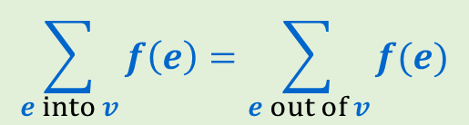
Flows
Defn: An $s$-$t$ flow in a flow network is a function $f: E  ℝ$ that satisfies:
    For each $e∈E$: $0≤ f\left(e\right)≤ c(e)$ [capacity constraints]
    For each $v∈V−\{s,t\}$:
Defn: The value of flow $f$,
$$\sum_{e into v}{f\left(e\right)=\sum_{e out of v}{f(e)}}$$
[flow conservation]
a
0/9
d
$$v\left(f\right)=\sum_{e out of s}{f\left(e\right)}$$
4/10
4/4
0/15
0/15
0/10
s
0/5
b
4/8
e
4/10
t
0/15
0/4
0/6
0/15
0/10
value = 4
c
0/30
f
Notes:
source = where material originates, sink = where material goes.
We use cut to mean s-t cut.

Slide 4
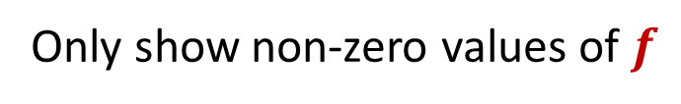

Flows
Defn: An $s$-$t$ flow in a flow network is a function $f: E  ℝ$ that satisfies:
    For each $e∈E$: $0≤ f\left(e\right)≤ c(e)$ [capacity constraints]
    For each $v∈V−\{s,t\}$:
Defn: The value of flow $f$,
$$\sum_{e into v}{f\left(e\right)=\sum_{e out of v}{f(e)}}$$
[flow conservation]
a
9
d
$$v\left(f\right)=\sum_{e out of s}{f\left(e\right)}$$
4/10
4/4
15
15
10
s
5
b
4/8
e
4/10
t
Only show non-zero values of $f$
15
4
6
15
10
value = 4
c
30
f
Notes:
source = where material originates, sink = where material goes.
We use cut to mean s-t cut.

Slide 5
Flows
Defn: An $s$-$t$ flow in a flow network is a function $f: E  ℝ$ that satisfies:
    For each $e∈E$: $0≤ f\left(e\right)≤ c(e)$ [capacity constraints]
    For each $v∈V−\{s,t\}$:
Defn: The value of flow $f$,
$$\sum_{e into v}{f\left(e\right)=\sum_{e out of v}{f(e)}}$$
[flow conservation]
a
6/9
d
$$v\left(f\right)=\sum_{e out of s}{f\left(e\right)}$$
10/10
4/4
15
15
6/10
s
3/5
b
8/8
e
8/10
t
Only show non-zero values of $f$
11/15
4
1/6
15
value = 24
10/10
c
11/30
f
Notes:
source = where material originates, sink = where material goes.
We use cut to mean s-t cut.

Slide 6

Maximum Flow Problem
Given: a flow network
Find: an $s$-$t$ flow of maximum value
a
6/9
d
10/10
4/4
15
15
6/10
s
3/5
b
8/8
e
8/10
t
11/15
4
1/6
15
value = 24
10/10
c
11/30
f
Notes:
source = where material originates, sink = where material goes.
We use cut to mean s-t cut.

Slide 7
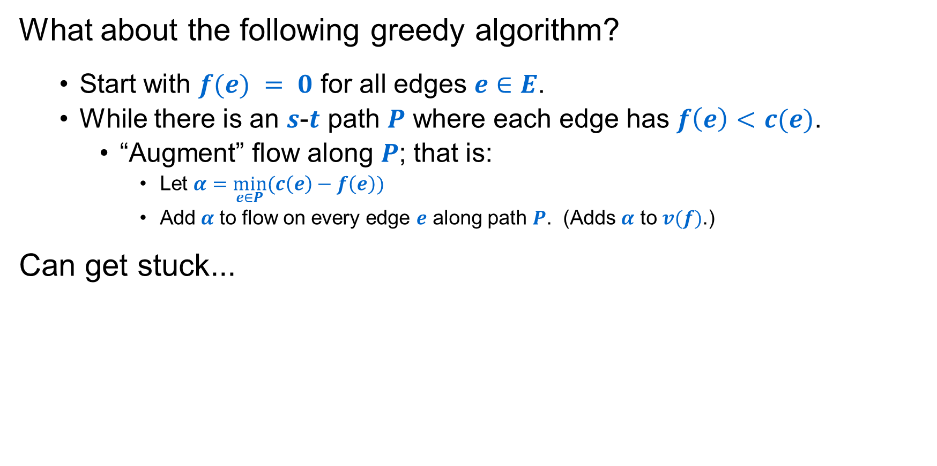
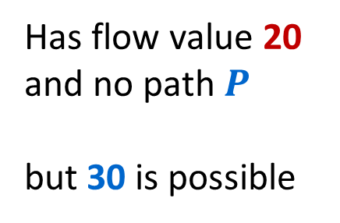
Towards a Max Flow Algorithm
What about the following greedy algorithm?
  Start with $f(e) = 0$ for all edges $e∈E$.
  While there is an $s$-$t$ path $P$ where each edge has $f\left(e\right)<c(e)$.
    “Augment” flow along $P$; that is:
      Let $α=\min_{e∈P}(c\left(e\right)−f\left(e\right))$
      Add$α$ to flow on every edge $e$ along path $P$. (Adds $α$ to $v(f)$.)
Can get stuck...
u
u
Has flow value 20
and no path $P$
but 30 is possible
20/20
10
20/20
10/10
s
20/30
t
s
10/30
t
10
20/20
10/10
20/20
v
v

Slide 8

Another “Stuck” Example
On every $s$-$t$ path there is some edge with $f\left(e\right)=c(e)$:
a
6/9
d
Value of flow = 24
10/10
4/4
15
15
6/10
s
3/5
b
8/8
e
8/10
t
11/15
4
1/6
15
10/10
c
11/30
f
Next idea: Ford-Fulkerson Algorithm, which applies greedy ideas to a “residual graph” that lets us reverse prior flow decisions from the basic greedy approach to get optimal results!
Notes:
source = where material originates, sink = where material goes.
We use cut to mean s-t cut.

Slide 9
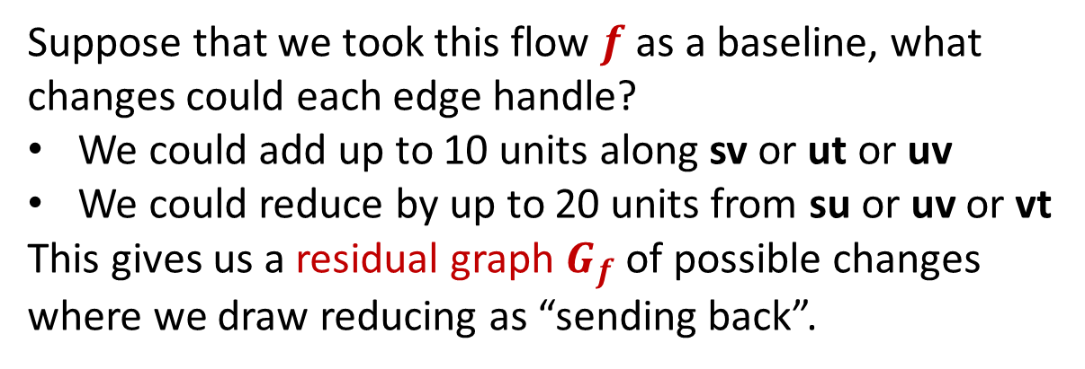
Greed Revisited: Residual Graph & Augmenting Paths
u
The only way we could route more flow from s to t would be to reduce the flow from u to v to make room for that amount of extra flow from s to v.
But to conserve flow we also would need to increase the flow from u to t by that same amount.
20/20
10
s
20/30
t
10
20/20
v
Suppose that we took this flow $f$ as a baseline, what changes could each edge handle?
We could add up to 10 units along sv or ut or uv
We could reduce by up to 20 units from su or uv or vt
This gives us a residual graph $G_{f}$ of possible changes where we draw reducing as “sending back”.
u
20
10
s
20
10
t
10
20
v

Slide 10

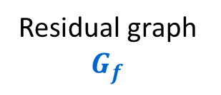
Greed Revisited: Residual Graph & Augmenting Paths
u
u
Augment flow along path
20/20
10
20/20
10/10
s
20/30
t
s
10/30
t
10
20/20
10/10
20/20
v
v
Residual graph $G_{f}$
u
Path in $G_{f}$
u
20
10
20
10
s
20
10
t
s
20
10
t
10
20
10
20
v
v

Slide 11

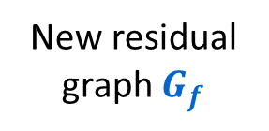
Greed Revisited: Residual Graph & Augmenting Paths
u
20/20
10/10
s
10/30
t
10/10
20/20
v
New residual graph $G_{f}$
u
20
10
s
10
20
t
No path can even leave $s$!
10
20
v

Slide 12
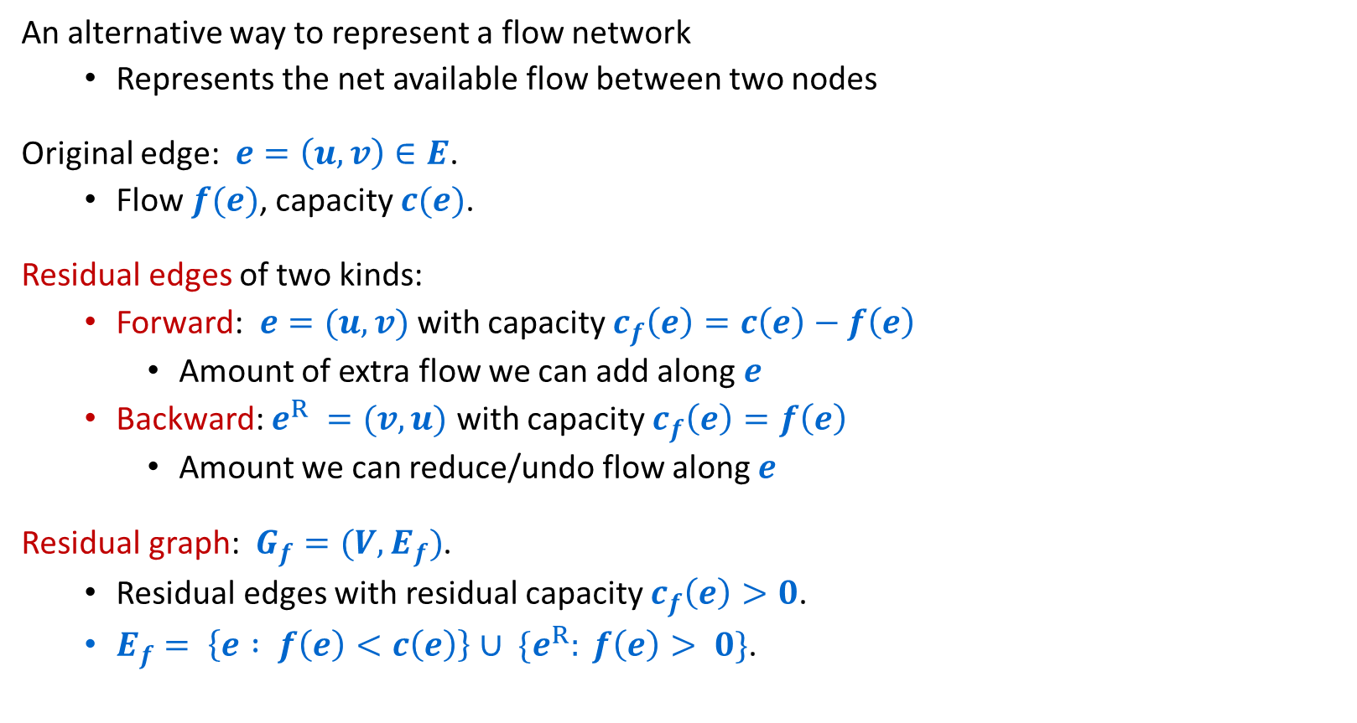
Residual Graphs
An alternative way to represent a flow network
  Represents the net available flow between two nodes
Original edge: $e=\left(u, v\right)∈E$.
  Flow $f(e)$, capacity $c(e)$.
Residual edges of two kinds:
  Forward: $e=(u, v)$ with capacity $c_{f}\left(e\right)=c\left(e\right)−f\left(e\right)$
    Amount of extra flow we can add along $e$
  Backward: $e^{R} =(v, u)$ with capacity $c_{f}\left(e\right)=f\left(e\right)$
    Amount we can reduce/undo flow along $e$
Residual graph: $G_{f}=(V, E_{f})$.
  Residual edges with residual capacity $c_{f}\left(e\right)>0$.
  $E_{f}= \left\{e : f\left(e\right)<c\left(e\right)\right\}∪ \{e^{R}: f\left(e\right)> 0\}$.
u
6/17
v
residual capacity
u
11
v
6
residual capacity

Slide 13
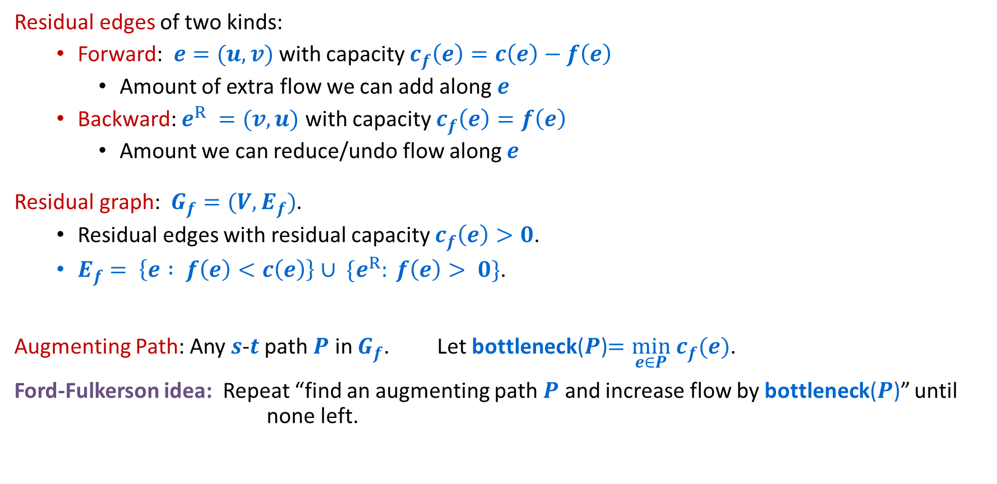
Residual Graphs and Augmenting Paths
residual capacity
Residual edges of two kinds:
  Forward: $e=(u, v)$ with capacity $c_{f}\left(e\right)=c\left(e\right)−f\left(e\right)$
    Amount of extra flow we can add along $e$
  Backward: $e^{R} =(v, u)$ with capacity $c_{f}\left(e\right)=f\left(e\right)$
    Amount we can reduce/undo flow along $e$
Residual graph: $G_{f}=(V, E_{f})$.
  Residual edges with residual capacity $c_{f}\left(e\right)>0$.
  $E_{f}= \left\{e : f\left(e\right)<c\left(e\right)\right\}∪ \{e^{R}: f\left(e\right)> 0\}$.
Augmenting Path: Any $s$-$t$ path $P$ in $G_{f}$. Let bottleneck($P$)$=\min_{e∈P} c_{f}(e)$.
Ford-Fulkerson idea: Repeat “find an augmenting path $P$ and increase flow by bottleneck($P$)” until none left.
u
11
v
6
residual capacity

Slide 14

Ford-Fulkerson Algorithm
a
4
b
capacity
$G$:
10
8
6
10
2
s
10
c
9
d
10
t

Slide 15

Ford-Fulkerson Algorithm
0 flows not shown
a
4
b
capacity
$G$:
10
8
6
10
Flow value = 0
2
s
10
c
9
d
10
t
a
4
b
residual capacity
$Gf$:
10
2
8
6
10
s
10
c
9
d
10
t

Slide 16
Ford-Fulkerson Algorithm
0 flows not shown
a
4
b
capacity
$G$:
8/
6
10
10
2
8/
Flow value = 0
8
+8=8
10
8/
s
c
9
d
10
t
a
4
b
residual capacity
$Gf$:
10
2
8
6
10
s
10
c
9
d
10
t

Slide 17
Ford-Fulkerson Algorithm
a
4
b
$G$:
8/10
8/8
6
10
Flow value = 8
2
s
10
c
9
d
8/10
t
a
4
b
$Gf$:
8
2
2
8
6
10
s
10
c
9
d
2
t
8

Slide 18
Ford-Fulkerson Algorithm
a
4
b
+2=10
$G$:
8/10
2/
8/8
6
10
Flow value = 8
2
+2=10
s
10
c
2/
d
8/10
t
9
+2=10
a
4
b
$Gf$:
8
2
2
8
6
10
s
10
c
9
d
2
t
8

Slide 19
Ford-Fulkerson Algorithm
a
4
b
$G$:
10/10
8/8
6
10
Flow value = 10
2/2
s
10
c
2/9
d
10/10
t
a
4
b
$Gf$:
10
2
8
6
10
s
10
c
7
d
10
t
2

Slide 20
Ford-Fulkerson Algorithm
a
4
b
$G$:
6/
6/
10/10
2/2
8/8
6
10
Flow value = 10
+6=16
6/
s
10
c
2/9
d
10/10
t
+6=8
a
4
b
$Gf$:
10
2
8
6
10
s
10
c
7
d
10
t
2

Slide 21
Ford-Fulkerson Algorithm
a
4
b
$G$:
10/10
8/8
6/6
6/10
Flow value = 16
2/2
s
6/10
c
8/9
d
10/10
t
a
4
b
$Gf$:
6
10
2
8
6
4
s
4
c
1
d
10
t
6
8

Slide 22
Ford-Fulkerson Algorithm
a
2/
b
4
$G$:
10/10
8/8
6/6
6/10
Flow value = 16
2/2
-2=0
+2=8
+2=18
s
6/10
c
8/9
d
10/10
t
+2=8
a
4
b
$Gf$:
6
10
2
8
6
4
s
4
c
1
d
10
t
6
8

Slide 23
Ford-Fulkerson Algorithm
a
2/4
b
$G$:
10/10
8/8
6/6
8/10
Flow value = 18
2
s
8/10
c
8/9
d
10/10
t
2
a
2
b
$Gf$:
8
10
2
8
6
2
s
2
c
1
d
10
t
8
8

Slide 24
Ford-Fulkerson Algorithm
+1=3
a
2/4
b
$G$:
10/10
8/8
6/6
8/10
Flow value = 18
2
-1=7
+1=9
+1=19
s
8/10
c
8/9
d
10/10
t
+1=9
+1=9
2
a
2
b
$Gf$:
8
10
2
8
6
2
s
2
c
1
d
10
t
8
8

Slide 25
Ford-Fulkerson Algorithm
a
3/4
b
$G$:
10/10
7/8
6/6
9/10
Flow value = 19
2
s
9/10
c
9/9
d
10/10
t
3
a
1
b
$Gf$:
9
1
10
2
7
6
1
s
1
c
9
d
10
t
9

Slide 26
Ford-Fulkerson Correctness
To show that Fork-Fulkerson correctly finds the maximum flow:
  Suffices to show that when there are no augmenting paths, flow is maximum.
  To show this, we will show the following:
  We can use the residual graph to find a cut whose cost matches the flow
  The “minimum-cost cut” must be greater than or equal to the maximum flow
  Or without using the vocab we haven’t defined yet (but are about to):
  When Ford Fulkerson terminates, the amount of flow going through the network will be found to exactly match some other metric of that graph
  That metric of the graph is guaranteed to be at least the maximum flow, so the fact that we got them to match must mean we both maximized flow and minimized this other metric.

Slide 27


Cuts
Defn: An $s$-$t$ cut is a partition $(A,B)$ of $V$ with $s∈A$ and $t∈B$.
  The capacity of cut $(A,B)$ is
  $$c\left(A,B\right)=\sum_{e out of A}{c(e)}$$
a
9
d
capacity 30
10
4
15
15
10
source
s
5
b
8
e
10
t
sink
$$A$$
4
6
15
15
10
c
30
f
Notes:
source = where material originates, sink = where material goes.
We use cut to mean s-t cut.

Slide 28


Cuts
Defn: An $s$-$t$ cut is a partition $(A,B)$ of $V$ with $s∈A$ and $t∈B$.
  The capacity of cut $(A,B)$ is
  $$c\left(A,B\right)=\sum_{e out of A}{c(e)}$$
a
9
d
capacity 48
10
4
15
15
10
source
s
5
b
8
e
10
t
sink
$$A$$
15
15
4
6
10
c
30
f
Notes:
source = where material originates, sink = where material goes.
We use cut to mean s-t cut.

Slide 29


Minimum Cut Problem
Minimum s-t cut problem:
Given: a flow network
Find: an $s$-$t$ cut of minimum capacity
a
9
d
capacity 28
10
4
15
15
10
source
s
5
b
8
e
10
t
sink
$$A$$
15
15
4
6
10
c
30
f
Notes:
source = where material originates, sink = where material goes.
We use cut to mean s-t cut.

Slide 30
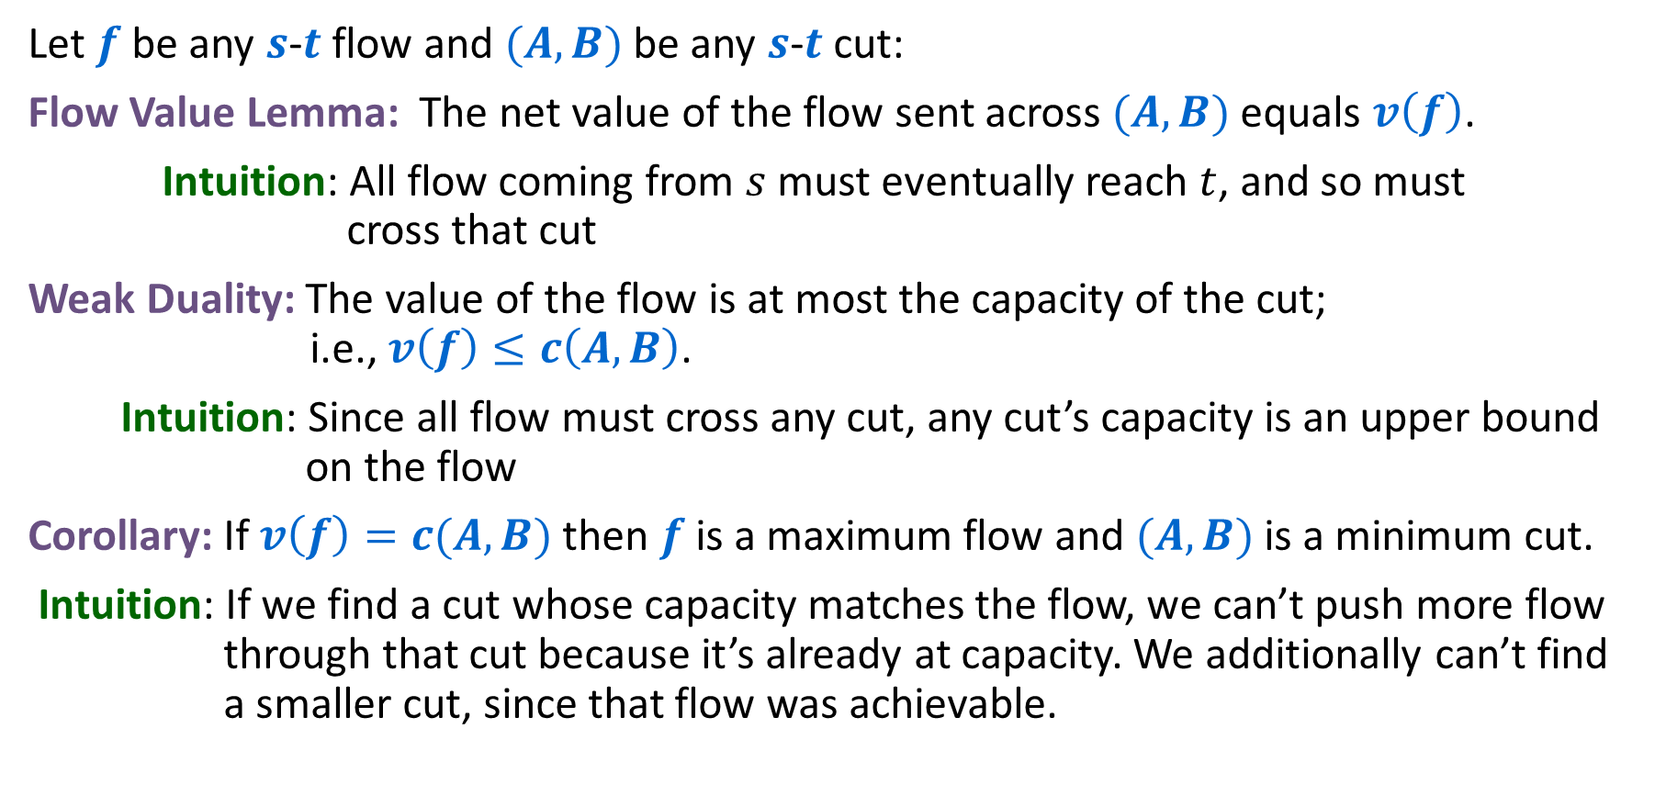
Flows and Cuts
Let $f$ be any $s$-$t$ flow and $(A,B)$ be any $s$-$t$ cut:
Flow Value Lemma: The net value of the flow sent across $(A,B)$ equals $v\left(f\right)$.
Intuition: All flow coming from $s$ must eventually reach $t$, and so must
cross that cut
Weak Duality: The value of the flow is at most the capacity of the cut; i.e., $v\left(f\right)≤c\left(A,B\right)$.
Intuition: Since all flow must cross any cut, any cut’s capacity is an upper bound
on the flow
Corollary: If $v\left(f\right)=c(A,B)$ then $f$ is a maximum flow and $(A,B)$ is a minimum cut.
Intuition: If we find a cut whose capacity matches the flow, we can’t push more flow
through that cut because it’s already at capacity. We additionally can’t find
a smaller cut, since that flow was achievable.

Slide 31


Certificate of Optimality
Let $f$ be any $s$-$t$ flow and $(A,B)$ be any $s$-$t$ cut.
If $v\left(f\right)=c(A,B)$ then $f$ is a max flow and $(A,B)$ is a min cut.
a
9/9
d
Value of flow = 28
10/10
4
1/15
15
9/10
Capacity of cut = 28
s
4/5
b
8/8
e
9/10
t
$$A$$
Both are optimal!
Each “certified” correctness of the other!
4
4/6
15
14/15
10/10
c
14/30
f
Notes:
source = where material originates, sink = where material goes.
We use cut to mean s-t cut.

Slide 32
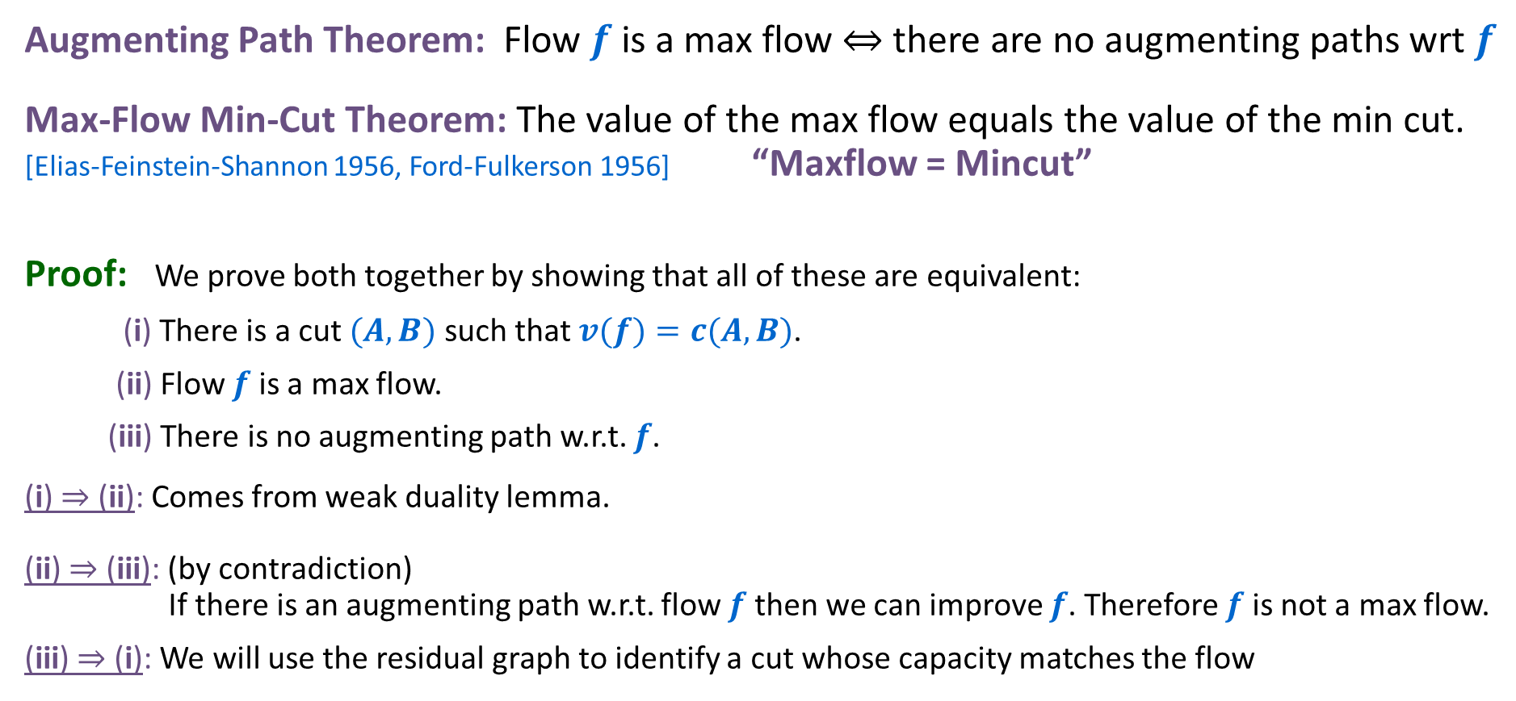
Max-Flow Min-Cut Theorem
Augmenting Path Theorem: Flow $f$ is a max flow ⇔ there are no augmenting paths wrt $f$
Max-Flow Min-Cut Theorem: The value of the max flow equals the value of the min cut.
[Elias-Feinstein-Shannon 1956, Ford-Fulkerson 1956] “Maxflow = Mincut”
Proof: We prove both together by showing that all of these are equivalent:
(i) There is a cut $(A, B)$ such that $v(f)=c(A, B)$.
(ii) Flow $f$ is a max flow.
(iii) There is no augmenting path w.r.t. $f$.
(i) ⇒ (ii): Comes from weak duality lemma.
(ii) ⇒ (iii): (by contradiction)
If there is an augmenting path w.r.t. flow $f$ then we can improve $f$. Therefore $f$ is not a max flow.
(iii) ⇒ (i): We will use the residual graph to identify a cut whose capacity matches the flow

Slide 33

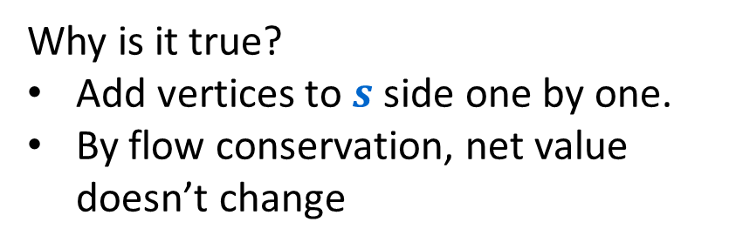
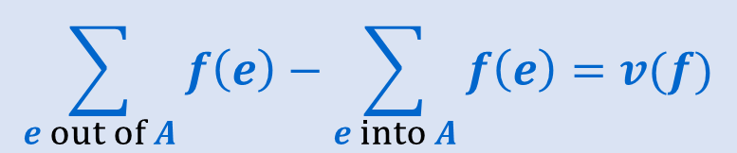

Flow Value Lemma – Idea
Flow Value Lemma: Let $f$ be any $s$-$t$ flow and $(A,B)$ be any $s$-$t$ cut. The net value of the flow sent across the cut equals $v(f)$:
$$\sum_{e out of A}{f\left(e\right)−\sum_{e into A}{f\left(e\right)=v(f)}}$$
Why is it true?
Add vertices to $s$ side one by one.
By flow conservation, net value doesn’t change
a
6/9
d
10/10
4/4
15
15
6/10
s
3/5
b
8/8
e
8/10
t
$$A$$
11/15
4
1/6
15
value = 24
10/10
= 28 - 4
c
11/30
f
Notes:
source = where material originates, sink = where material goes.
We use cut to mean s-t cut.

Slide 34




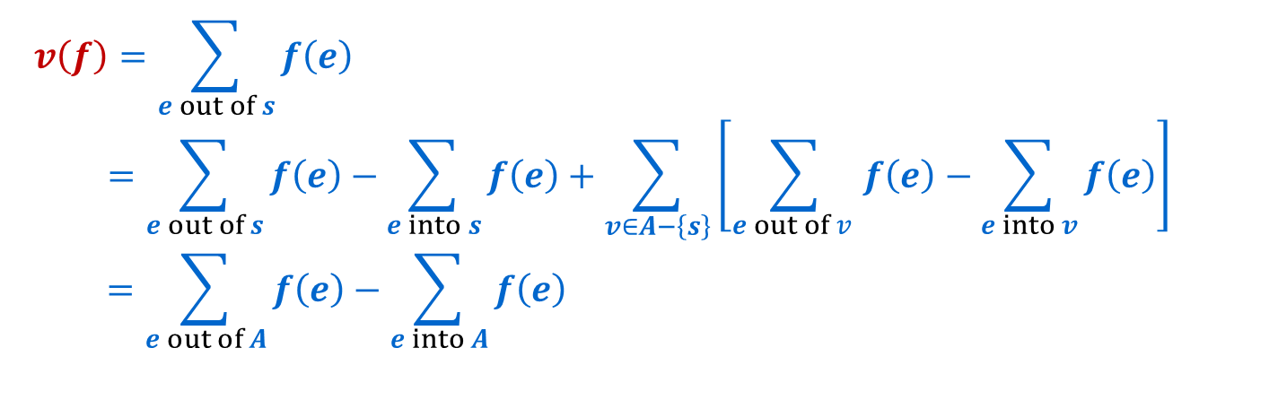
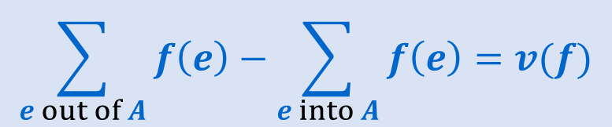
Flow Value Lemma – Proof
Flow Value Lemma: Let $f$ be any $s$-$t$ flow and $(A,B)$ be any $s$-$t$ cut. The net value of the flow sent across the cut equals $v(f)$:
Proof:
$$\sum_{e out of A}{f\left(e\right)−\sum_{e into A}{f\left(e\right)=v(f)}}$$
$$v\left(f\right)=\sum_{e out of s}{f\left(e\right) }$$
$$=\sum_{e out of s}{f\left(e\right)}−\sum_{e into s}{f\left(e\right)}+\sum_{v∈A−\left\{s\right\}}{\left[\sum_{e out of v }{f\left(e\right)−\sum_{e into v}{f\left(e\right)}}\right]}$$
$$=\sum_{e out of A}{f\left(e\right)−\sum_{e into A}{f\left(e\right) }}$$
$= 0$. No edges into $s$ since it is a source
$= 0$ by flow conservation.
Contributions from internal edges of $A$ cancel.
Notes:
source = where material originates, sink = where material goes.
We use cut to mean s-t cut.

Slide 35


Weak Duality - Idea
Weak Duality: Let $f$ be any $s$-$t$ flow and $(A,B)$ be any $s$-$t$ cut. The value of the flow is at most the capacity of the cut; i.e., $v\left(f\right)≤c(A,B)$:
a
6/9
d
Value of flow = 24 = 28 - 4
10/10
4/4
15
15
6/10
Capacity of cut = 28
s
3/5
b
8/8
e
8/10
t
$$A$$
11/15
4
1/6
15
10/10
c
11/30
f
Notes:
source = where material originates, sink = where material goes.
We use cut to mean s-t cut.

Slide 36

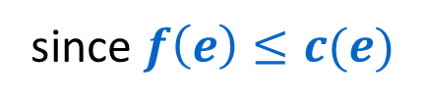
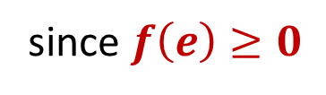

Weak Duality - Proof
Weak Duality: Let $f$ be any $s$-$t$ flow and $(A,B)$ be any $s$-$t$ cut. The value of the flow is at most the capacity of the cut; i.e., $v\left(f\right)≤c\left(A,B\right)$.
Proof:
$$v\left(f\right)=\sum_{e out of A}{f\left(e\right)−\sum_{e into A}{f\left(e\right) }}$$
$$≤\sum_{e out of A}{f\left(e\right) }$$
$$≤\sum_{e out of A}{c\left(e\right) }$$
$=c\left(A,B\right)$
since $f\left(e\right)≥0$
since $f\left(e\right)≤c(e)$
Notes:
source = where material originates, sink = where material goes.
We use cut to mean s-t cut.

Slide 37

Proof of Max-Flow Min-Cut Theorem
(iii) ⇒ (i):
Claim: If there is no augmenting path w.r.t. $f$, there is a cut $(A, B)$ s.t. $v(f)=c(A, B)$.
Proof of Claim: Let $f$ be a flow with no augmenting paths.
  Let $A$ be the set of vertices reachable from $s$ in residual graph $G_{f}$.
  By definition of $A$, $s∈A$.
  Since no augmenting path ($s$-$t$ path in $G_{f}$), $t∉A$.
A
B
t
s
original network
A
B
t
s
residual graph

Slide 38

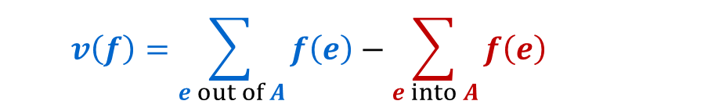
Proof: Identifying the Min Cut
(iii) ⇒ (i):
Claim: If there is no augmenting path w.r.t. $f$, there is a cut $(A, B)$ s.t. $v(f)=c(A, B)$.
Proof of Claim: Let $f$ be a flow with no augmenting paths.
  Let $A$ be the set of vertices reachable from $s$ in residual graph $G_{f}$.
  By definition of $A$, $s∈A$.
  Since no augmenting path ($s$-$t$ path in $G_{f}$), $t∉A$.
Then
A
B
t
s
  $$v\left(f\right)=\sum_{e out of A}{f\left(e\right)−\sum_{e into A}{f\left(e\right) }}$$
(by Flow-Value Lemma)
original network
A
B
t
s
residual graph

Slide 39





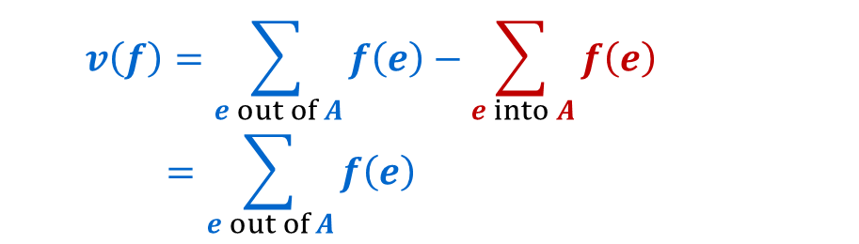
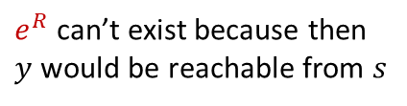
Identifying the Min Cut: No Inflow
(iii) ⇒ (i):
Claim: If there is no augmenting path w.r.t. $f$, there is a cut $(A, B)$ s.t. $v(f)=c(A, B)$.
Proof of Claim: Let $f$ be a flow with no augmenting paths.
  Let $A$ be the set of vertices reachable from $s$ in residual graph $G_{f}$.
  By definition of $A$, $s∈A$.
  Since no augmenting path ($s$-$t$ path in $G_{f}$), $t∉A$.
Then
$$f(e)=0$$
A
$$e$$
B
x
y
t
s
  $$v\left(f\right)=\sum_{e out of A}{f\left(e\right)−\sum_{e into A}{f\left(e\right) }}$$
  $$=\sum_{e out of A}{f\left(e\right) }$$
original network
$e^{R}$ can’t exist because then $y$ would be reachable from $s$
(By contradiction: If an edge going into $A$ had flow then the backward edge would be in the residual graph, so the edge should not cross the cut)
A
$$e^{R}$$
B
x
y
t
s
residual graph

Slide 40




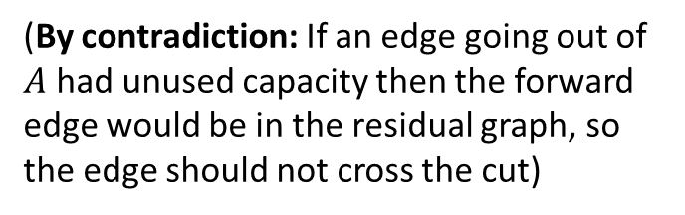



Identifying the Min Cut: Saturated Outflow
“$e$ is saturated”
(iii) ⇒ (i):
Claim: If there is no augmenting path w.r.t. $f$, there is a cut $(A, B)$ s.t. $v(f)=c(A, B)$.
Proof of Claim: Let $f$ be a flow with no augmenting paths.
  Let $A$ be the set of vertices reachable from $s$ in residual graph $G_{f}$.
  By definition of $A$, $s∈A$.
  Since no augmenting path ($s$-$t$ path in $G_{f}$), $t∉A$.
Then
No unused capacity on $e$
$$f\left(e\right)=c(e)$$
A
B
t
s
$$e$$
  $$v\left(f\right)=\sum_{e out of A}{f\left(e\right)−\sum_{e into A}{f\left(e\right) }}$$
  $$=\sum_{e out of A}{f\left(e\right) }$$
  $$=\sum_{e out of A}{c\left(e\right) }$$
original network
$e^{R}$ can’t exist because then $y$ would be reachable from $s$
A
B
(By contradiction: If an edge going out of $A$ had unused capacity then the forward edge would be in the residual graph, so the edge should not cross the cut)
t
$$e$$
s
y
residual graph

Slide 41


Identifying the Min Cut: Conclusion
(iii) ⇒ (i):
Claim: If there is no augmenting path w.r.t. $f$, there is a cut $(A, B)$ s.t. $v(f)=c(A, B)$.
Proof of Claim: Let $f$ be a flow with no augmenting paths.
  Let $A$ be the set of vertices reachable from $s$ in residual graph $G_{f}$.
  By definition of $A$, $s∈A$.
  Since no augmenting path ($s$-$t$ path in $G_{f}$), $t∉A$.
Then
A
B
t
  $$v\left(f\right)=\sum_{e out of A}{f\left(e\right)−\sum_{e into A}{f\left(e\right) }}$$
  $$=\sum_{e out of A}{f\left(e\right) }$$
  $$=\sum_{e out of A}{c\left(e\right) =c(A,B) }$$
s
original network
A
B
(by Definition)
t
s
residual graph

