Slide 1
CSE 421 Winter 2025
Lecture 15: Bellman-Ford
Max Flow
Nathan Brunelle
http://www.cs.uw.edu/421

Slide 2
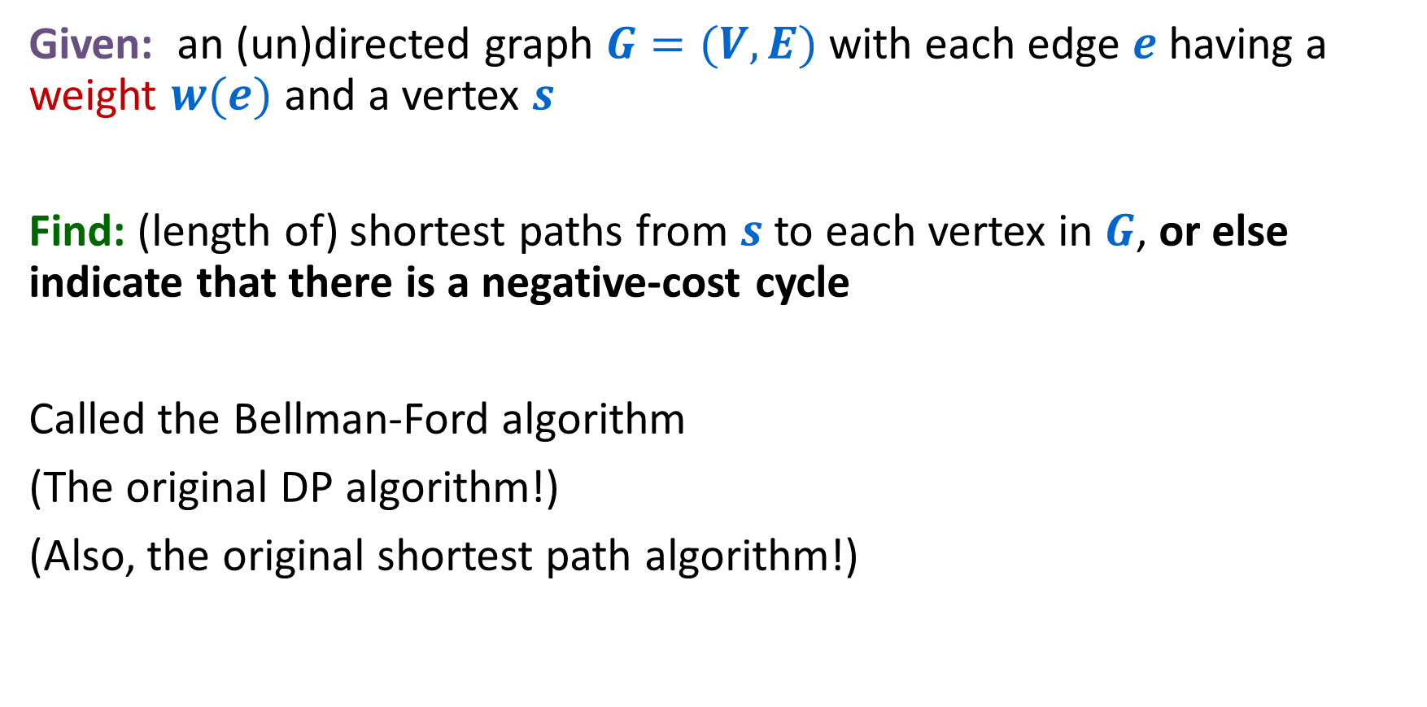
Single-source shortest paths, with negative edge weights
Given: an (un)directed graph $G=(V,E)$with each edge $e$ having a weight $w(e)$ and a vertex $s$
Find: (length of) shortest paths from $s$ to each vertex in $G$, or else indicate that there is a negative-cost cycle
Called the Bellman-Ford algorithm
(The original DP algorithm!)
(Also, the original shortest path algorithm!)

Slide 3
Bellman Ford– Four Steps
Formulate the answer with a recursive structure
  What are the options for the last choice?
  For each such option, what does the subproblem look like? How do we use it?
Choose a memory structure.
  Figure out the possible values of all parameters in the recursive calls.
  How many subproblems (options for last choice) are there?
  What are the parameters needed to identify each?
  How many different values could there be per parameter?
Specify an order of evaluation.
  Want to guarantee that the necessary subproblem solutions are in memory when you need them.
  With this step: a “Bottom-up” (iterative) algorithm
  Without this step: a “Top-down” (recursive) algorithm
See if there’s a way to save space
  Is it possible to reuse some memory locations?

Slide 4





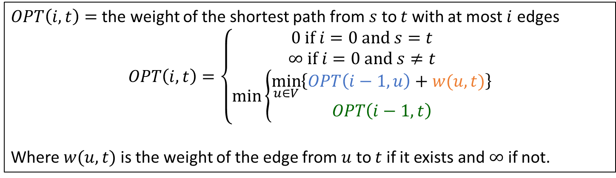






Final Recursive Structure
$OPT\left(i,t\right)=$ the weight of the shortest path from $s$ to $t$ with at most $i$ edges
$$OPT\left(i,t\right)=\left\{\begin{aligned}0 if i=0 and s=t \\ ∞ if i=0 and s≠t \\ \min\left\{\begin{aligned}\min_{u∈V}\left\{OPT\left(i−1,u\right)+w(u,t)\right\} \\ OPT\left(i−1, t\right)\end{aligned}\right.\end{aligned}\right.$$
Where $w(u,t)$ is the weight of the edge from $u$ to $t$ if it exists and $∞$ if not.
$$s$$
$$u$$
$$t$$
$$s$$
$$=min$$
$i−1$ edges
$$t$$
$≤i$ edges
$$s$$
$$t$$
$≤i−1$ edges

Slide 5








Bellman Ford– Four Steps
$$s$$
$$u$$
$$t$$
$i−1$ edges
Formulate the answer with a recursive structure
  What are the options for the last choice?
  For each such option, what does the subproblem look like? How do we use it?
Choose a memory structure.
  Figure out the possible values of all parameters in the recursive calls.
  How many subproblems (options for last choice) are there?
  What are the parameters needed to identify each?
  How many different values could there be per parameter?
Specify an order of evaluation.
  Want to guarantee that the necessary subproblem solutions are in memory when you need them.
  With this step: a “Bottom-up” (iterative) algorithm
  Without this step: a “Top-down” (recursive) algorithm
See if there’s a way to save space
  Is it possible to reuse some memory locations?
$$min$$
$$s$$
$$t$$
$≤i−1$ edges

Slide 6













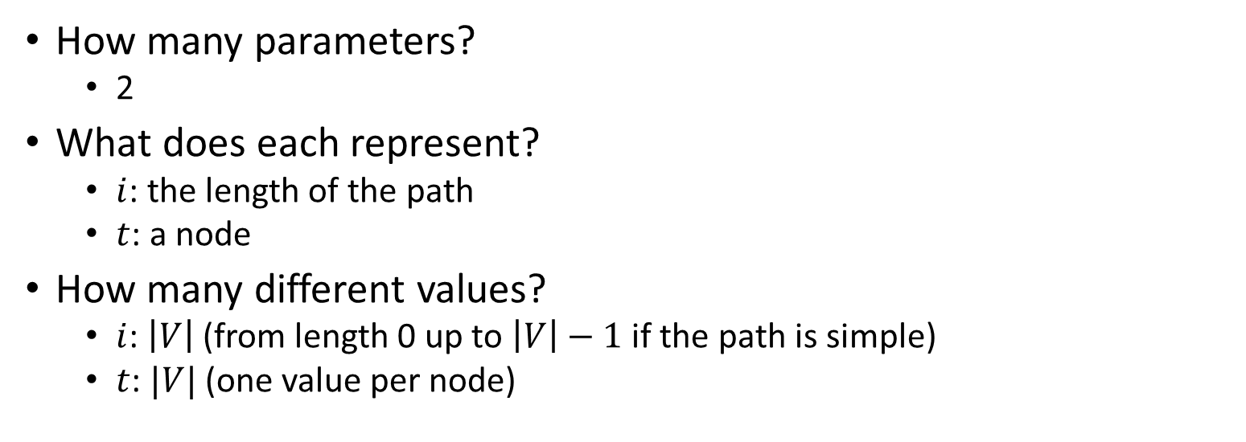


Identifying the Memory Structure
$$OPT\left(i,t\right)=\left\{\begin{aligned}0 if i=0 and s=t \\ ∞ if i=0 and s≠t \\ \min\left\{\begin{aligned}\min_{u∈V}\left\{OPT\left(i−1,u\right)+w(u,t)\right\} \\ OPT\left(i−1, t\right)\end{aligned}\right.\end{aligned}\right.$$
How many parameters?
  2
What does each represent?
  $i$: the length of the path
  $t$: a node
How many different values?
  $i$: $\left|V\right|$ (from length 0 up to $\left|V\right|−1$ if the path is simple)
  $t$: $|V|$ (one value per node)
$$1$$
$$2$$
$$3$$
$$4$$
$$5$$
$$6$$
$$7$$
$$0$$
$$1$$
$$2$$
$$3$$
$$4$$
$$5$$
$$6$$

Slide 7
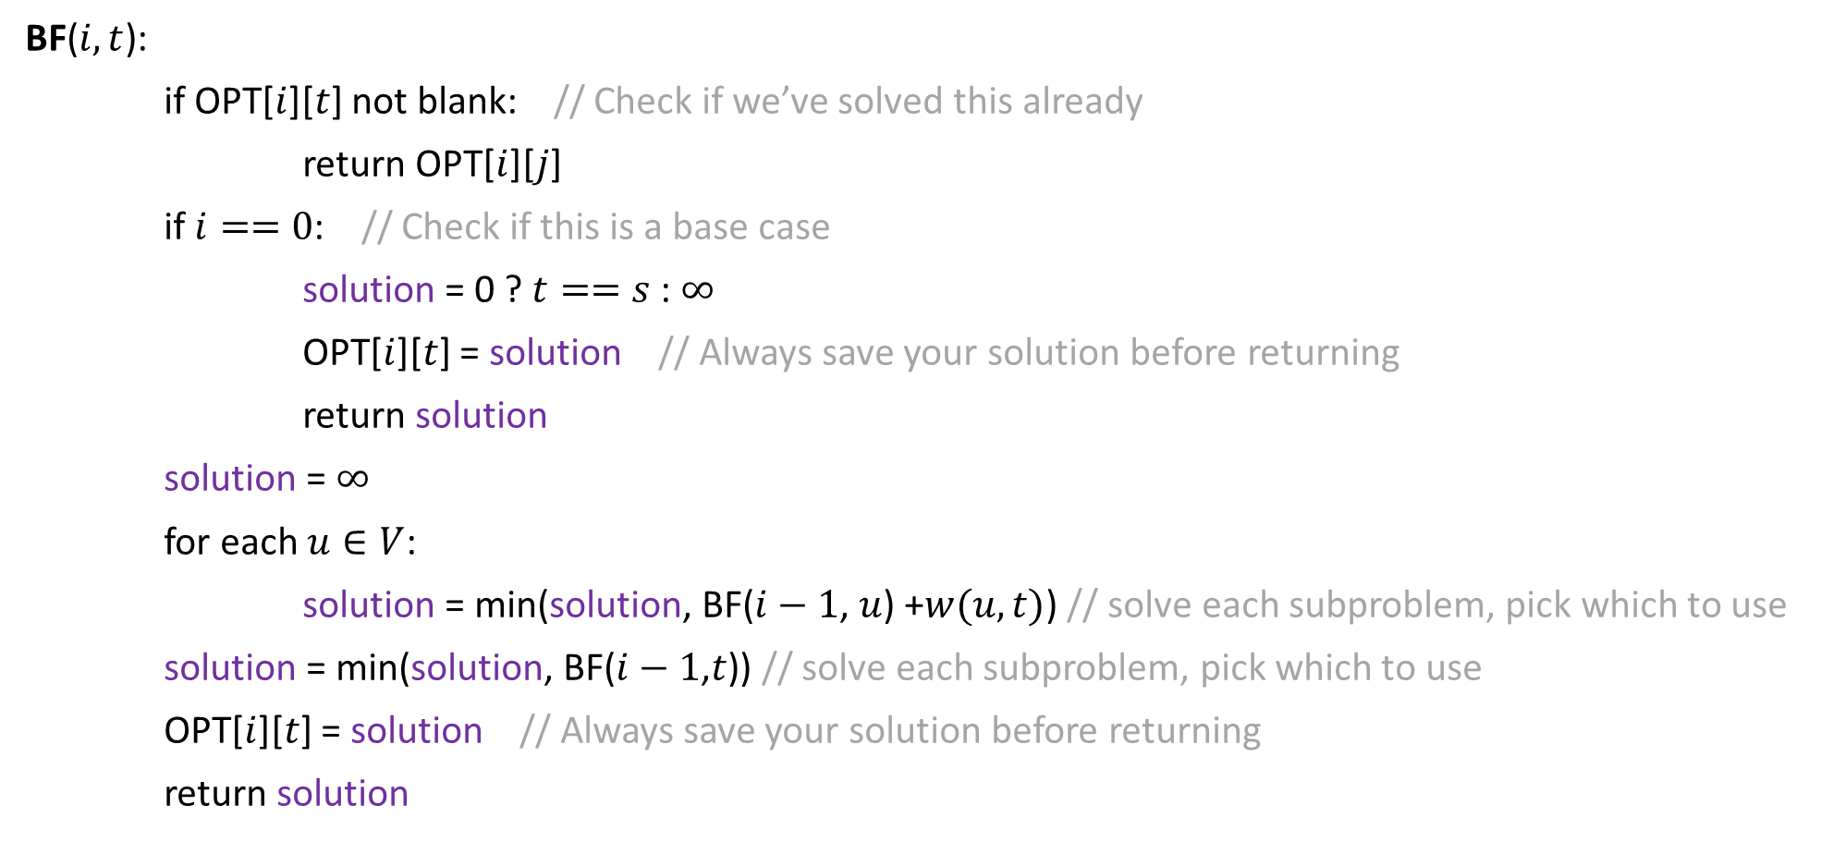
Top-Down Bellman-Ford
This algorithm correctly finds shortest paths when there are no negative-cost cycles
How can we check for negative cost cycles?
BF($i,t$):
if OPT[$i$][$t$] not blank: // Check if we’ve solved this already
return OPT[$i$][$j$]
if $i==0$: // Check if this is a base case
solution = 0 ? $t==s$ : $∞$
OPT[$i$][$t$] = solution // Always save your solution before returning
return solution
solution = $∞$
for each $u∈V$:
solution = min(solution, BF($i−1$, $u$) +$w(u,t)$) // solve each subproblem, pick which to use
solution = min(solution, BF($i−1$,$t$)) // solve each subproblem, pick which to use
OPT[$i$][$t$] = solution // Always save your solution before returning
return solution

Slide 8

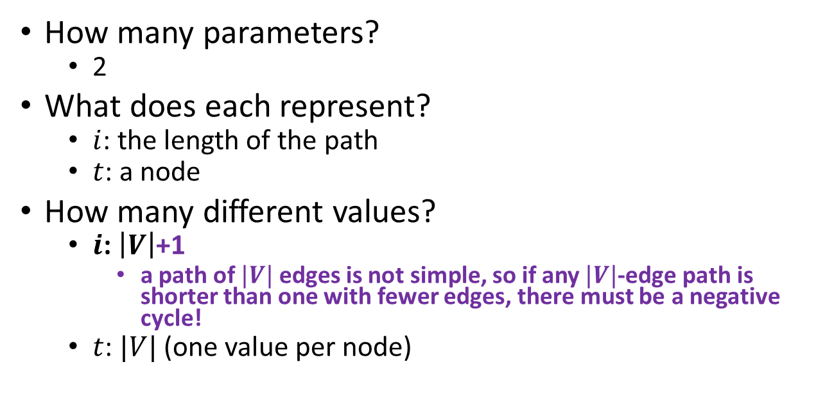
Checking for Negative Cycles
$$OPT\left(i,t\right)=\left\{\begin{aligned}0 if i=0 and s=t \\ ∞ if i=0 and s≠t \\ \min\left\{\begin{aligned}\min_{u∈V}\left\{OPT\left(i−1,u\right)+w(u,t)\right\} \\ OPT\left(i−1, t\right)\end{aligned}\right.\end{aligned}\right.$$
How many parameters?
  2
What does each represent?
  $i$: the length of the path
  $t$: a node
How many different values?
  $i$: $\left|V\right|$+1
    a path of $|V|$ edges is not simple, so if any $|V|$-edge path is shorter than one with fewer edges, there must be a negative cycle!
  $t$: $|V|$ (one value per node)
$$1$$
$$2$$
$$3$$
$$4$$
$$5$$
$$6$$
$$7$$
$$0$$
$$1$$
$$2$$
$$3$$
$$4$$
$$5$$
$$6$$
$$7$$

Slide 9
Bellman Ford– Four Steps
$$s$$
$$u$$
$$t$$
$i−1$ edges
Formulate the answer with a recursive structure
  What are the options for the last choice?
  For each such option, what does the subproblem look like? How do we use it?
Choose a memory structure.
  Figure out the possible values of all parameters in the recursive calls.
  How many subproblems (options for last choice) are there?
  What are the parameters needed to identify each?
  How many different values could there be per parameter?
Specify an order of evaluation.
  Want to guarantee that the necessary subproblem solutions are in memory when you need them.
  With this step: a “Bottom-up” (iterative) algorithm
  Without this step: a “Top-down” (recursive) algorithm
See if there’s a way to save space
  Is it possible to reuse some memory locations?
$$min$$
$$s$$
$$t$$
$≤i−1$ edges

Slide 10



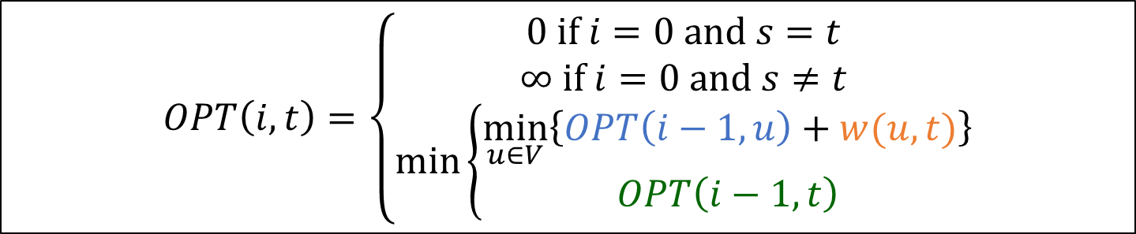













Order of Evaluations
$$OPT\left(i,t\right)=\left\{\begin{aligned}0 if i=0 and s=t \\ ∞ if i=0 and s≠t \\ \min\left\{\begin{aligned}\min_{u∈V}\left\{OPT\left(i−1,u\right)+w(u,t)\right\} \\ OPT\left(i−1, t\right)\end{aligned}\right.\end{aligned}\right.$$
$$1$$
$$2$$
$$3$$
$$4$$
$$5$$
$$6$$
$$7$$
$$0$$
Each cell depends on every value in the previous row
Solve in order of $i$
$$1$$
$$2$$
$$3$$
$$4$$
$$5$$
$$6$$
$$7$$

Slide 11
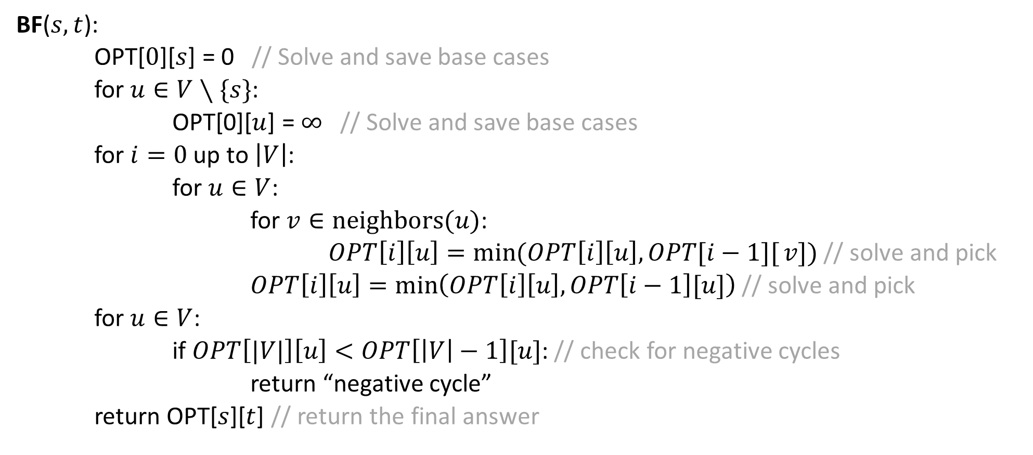
Bottom-Up Bellman-Ford
BF($s,t$):
OPT[$0$][$s$] = 0 // Solve and save base cases
for $u∈V∖\{s\}$:
OPT[0][$u$] = $∞$ // Solve and save base cases
for $i=0$ up to $\left|V\right|$:
for $u∈V$:
for $v∈neighbors(u)$:
$OPT\left[i\right]\left[u\right]=\min{(OPT\left[i\right]\left[u\right], OPT[i−1][}v])$ // solve and pick
$OPT\left[i\right]\left[u\right]=\min\left(OPT\left[i\right]\left[u\right],OPT\left[i−1\right][u]\right)$ // solve and pick
for $u∈V$:
if $OPT\left[|V|\right]\left[u\right]<OPT\left[\left|V\right|−1\right][u]$: // check for negative cycles
return “negative cycle”
return OPT[$s$][$t$] // return the final answer

Slide 12





Bottom-Up Bellman-Ford
BF($s,t$):
OPT[$0$][$s$] = 0 // Solve and save base cases
for $u∈V∖\{s\}$:
OPT[0][$u$] = $∞$ // Solve and save base cases
for $i=0$ up to $\left|V\right|$:
for $u∈V$:
for $v∈neighbors(u)$:
$OPT\left[i\right]\left[u\right]=\min{(OPT\left[i\right]\left[u\right], OPT[i−1][}v])$ // solve and pick
$OPT\left[i\right]\left[u\right]=\min\left(OPT\left[i\right]\left[u\right],OPT\left[i−1\right][u]\right)$ // solve and pick
for $u∈V$:
if $OPT\left[|V|\right]\left[u\right]<OPT\left[\left|V\right|−1\right][u]$: // check for negative cycles
return “negative cycle”
return OPT[$s$][$t$] // return the final answer
$$Θ(1)$$
$$Θ(|V|)$$
$$Θ(|V||E|)$$
$$Θ(|V|)$$
$$Θ(1)$$

Slide 13
Bellman Ford– Four Steps
$$s$$
$$u$$
$$t$$
$i−1$ edges
Formulate the answer with a recursive structure
  What are the options for the last choice?
  For each such option, what does the subproblem look like? How do we use it?
Choose a memory structure.
  Figure out the possible values of all parameters in the recursive calls.
  How many subproblems (options for last choice) are there?
  What are the parameters needed to identify each?
  How many different values could there be per parameter?
Specify an order of evaluation.
  Want to guarantee that the necessary subproblem solutions are in memory when you need them.
  With this step: a “Bottom-up” (iterative) algorithm
  Without this step: a “Top-down” (recursive) algorithm
See if there’s a way to save space
  Is it possible to reuse some memory locations?
$$min$$
$$s$$
$$t$$
$≤i−1$ edges

Slide 14
Order of Evaluations
$$OPT\left(i,t\right)=\left\{\begin{aligned}0 if i=0 and s=t \\ ∞ if i=0 and s≠t \\ \min\left\{\begin{aligned}\min_{u∈V}\left\{OPT\left(i−1,u\right)+w(u,t)\right\} \\ OPT\left(i−1, t\right)\end{aligned}\right.\end{aligned}\right.$$
$$1$$
$$2$$
$$3$$
$$4$$
$$5$$
$$6$$
$$7$$
$$0$$
Each cell depends only on values in the previous row
We only need two rows!
$$1$$
$$2$$
$$3$$
$$4$$
$$5$$
$$6$$
$$7$$

Slide 15
Bellman Ford– Four Steps
$$s$$
$$u$$
$$t$$
$i−1$ edges
Formulate the answer with a recursive structure
  What are the options for the last choice?
  For each such option, what does the subproblem look like? How do we use it?
Choose a memory structure.
  Figure out the possible values of all parameters in the recursive calls.
  How many subproblems (options for last choice) are there?
  What are the parameters needed to identify each?
  How many different values could there be per parameter?
Specify an order of evaluation.
  Want to guarantee that the necessary subproblem solutions are in memory when you need them.
  With this step: a “Bottom-up” (iterative) algorithm
  Without this step: a “Top-down” (recursive) algorithm
See if there’s a way to save space
  Is it possible to reuse some memory locations?
$$min$$
$$s$$
$$t$$
$≤i−1$ edges

Slide 16
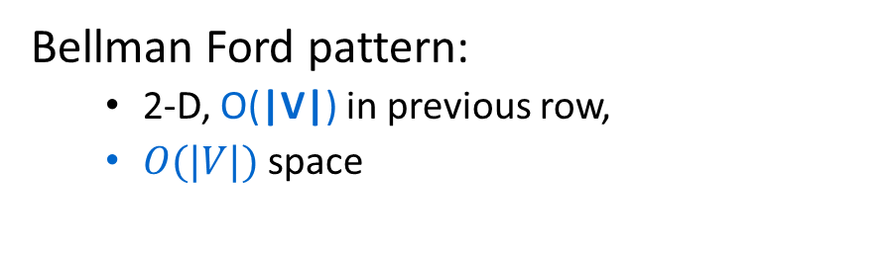


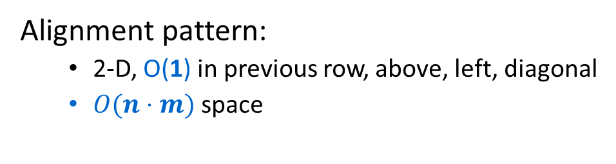




Dynamic Programming Patterns
Alignment pattern:
  2-D, O(1) in previous row, above, left, diagonal
  $O(n⋅m)$ space
Fibonacci pattern:
  1-D, $O(1)$ immediately prior
  $O(1)$ space
Weighted interval scheduling pattern:
  1-D, $O(1)$ arbitrary prior
  $O(n)$ space
Longest increasing subsequence pattern:
  1-D, all $n−1$ prior
  $O(n)$ space
$$O(n)$$
$$O(nm)$$
$$O(n)$$
Bellman Ford pattern:
  2-D, O(|V|) in previous row,
  $O(|V|)$ space
$$O(n^{2})$$
$$O(|V||E|)$$

Slide 17

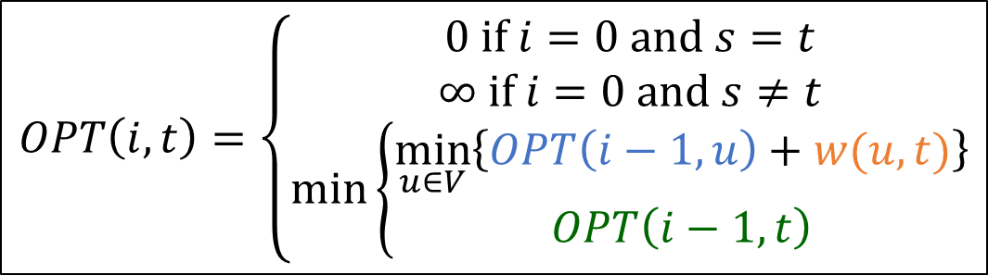






Example Execution
-7
5
4
1
4
2
1
3
1
2
3
7
$$1$$
$$2$$
$$3$$
$$4$$
$$5$$
$$6$$
$$7$$
8
-8
6
$$0$$
$$0$$
$$∞$$
$$∞$$
$$∞$$
$$∞$$
$$∞$$
$$∞$$
$$1$$
$$2$$
$$OPT\left(i,t\right)=\left\{\begin{aligned}0 if i=0 and s=t \\ ∞ if i=0 and s≠t \\ \min\left\{\begin{aligned}\min_{u∈V}\left\{OPT\left(i−1,u\right)+w(u,t)\right\} \\ OPT\left(i−1, t\right)\end{aligned}\right.\end{aligned}\right.$$
$$3$$
$$4$$
$$5$$
$$6$$
$$7$$

Slide 18







Example Execution
-7
5
4
1
4
2
1
3
1
2
3
7
$$1$$
$$2$$
$$3$$
$$4$$
$$5$$
$$6$$
$$7$$
8
-8
6
$$0$$
$$0$$
$$∞$$
$$∞$$
$$∞$$
$$∞$$
$$∞$$
$$∞$$
$$1$$
$$0$$
$$2$$
$$∞$$
$$∞$$
$$∞$$
$$8$$
$$∞$$
$$2$$
$$OPT\left(i,t\right)=\left\{\begin{aligned}0 if i=0 and s=t \\ ∞ if i=0 and s≠t \\ \min\left\{\begin{aligned}\min_{u∈V}\left\{OPT\left(i−1,u\right)+w(u,t)\right\} \\ OPT\left(i−1, t\right)\end{aligned}\right.\end{aligned}\right.$$
$$3$$
$$4$$
$$5$$
$$6$$
$$7$$

Slide 19









Example Execution
-7
5
4
1
4
2
1
3
1
2
3
7
$$1$$
$$2$$
$$3$$
$$4$$
$$5$$
$$6$$
$$7$$
8
-8
6
$$0$$
$$0$$
$$∞$$
$$∞$$
$$∞$$
$$∞$$
$$∞$$
$$∞$$
$$1$$
$$0$$
$$2$$
$$∞$$
$$∞$$
$$∞$$
$$8$$
$$∞$$
$$2$$
$$0$$
$$2$$
$$3$$
$$∞$$
$$∞$$
$$8$$
$$0$$
$$OPT\left(i,t\right)=\left\{\begin{aligned}0 if i=0 and s=t \\ ∞ if i=0 and s≠t \\ \min\left\{\begin{aligned}\min_{u∈V}\left\{OPT\left(i−1,u\right)+w(u,t)\right\} \\ OPT\left(i−1, t\right)\end{aligned}\right.\end{aligned}\right.$$
$$3$$
$$4$$
$$5$$
$$6$$
$$7$$

Slide 20









Example Execution
-7
5
4
1
4
2
1
3
1
2
3
7
$$1$$
$$2$$
$$3$$
$$4$$
$$5$$
$$6$$
$$7$$
8
-8
6
$$0$$
$$0$$
$$∞$$
$$∞$$
$$∞$$
$$∞$$
$$∞$$
$$∞$$
$$1$$
$$0$$
$$2$$
$$∞$$
$$∞$$
$$∞$$
$$8$$
$$∞$$
$$2$$
$$0$$
$$2$$
$$3$$
$$∞$$
$$∞$$
$$8$$
$$0$$
$$OPT\left(i,t\right)=\left\{\begin{aligned}0 if i=0 and s=t \\ ∞ if i=0 and s≠t \\ \min\left\{\begin{aligned}\min_{u∈V}\left\{OPT\left(i−1,u\right)+w(u,t)\right\} \\ OPT\left(i−1, t\right)\end{aligned}\right.\end{aligned}\right.$$
$$3$$
$$0$$
$$2$$
$$3$$
$$7$$
$$∞$$
$$8$$
$$0$$
$$4$$
$$5$$
$$6$$
$$7$$

Slide 21








Example Execution
-7
5
4
1
4
2
1
3
1
2
3
7
$$1$$
$$2$$
$$3$$
$$4$$
$$5$$
$$6$$
$$7$$
8
-8
6
$$0$$
$$0$$
$$∞$$
$$∞$$
$$∞$$
$$∞$$
$$∞$$
$$∞$$
$$1$$
$$0$$
$$2$$
$$∞$$
$$∞$$
$$∞$$
$$8$$
$$∞$$
$$2$$
$$0$$
$$2$$
$$3$$
$$∞$$
$$∞$$
$$8$$
$$0$$
$$OPT\left(i,t\right)=\left\{\begin{aligned}0 if i=0 and s=t \\ ∞ if i=0 and s≠t \\ \min\left\{\begin{aligned}\min_{u∈V}\left\{OPT\left(i−1,u\right)+w(u,t)\right\} \\ OPT\left(i−1, t\right)\end{aligned}\right.\end{aligned}\right.$$
$$3$$
$$0$$
$$2$$
$$3$$
$$7$$
$$∞$$
$$8$$
$$0$$
$$4$$
$$0$$
$$2$$
$$3$$
$$7$$
$$0$$
$$8$$
$$0$$
$$5$$
$$6$$
$$7$$

Slide 22








Example Execution
-7
5
4
1
4
2
1
3
1
2
3
7
$$1$$
$$2$$
$$3$$
$$4$$
$$5$$
$$6$$
$$7$$
8
-8
6
$$0$$
$$0$$
$$∞$$
$$∞$$
$$∞$$
$$∞$$
$$∞$$
$$∞$$
$$1$$
$$0$$
$$2$$
$$∞$$
$$∞$$
$$∞$$
$$8$$
$$∞$$
$$2$$
$$0$$
$$2$$
$$3$$
$$∞$$
$$∞$$
$$8$$
$$0$$
$$OPT\left(i,t\right)=\left\{\begin{aligned}0 if i=0 and s=t \\ ∞ if i=0 and s≠t \\ \min\left\{\begin{aligned}\min_{u∈V}\left\{OPT\left(i−1,u\right)+w(u,t)\right\} \\ OPT\left(i−1, t\right)\end{aligned}\right.\end{aligned}\right.$$
$$3$$
$$0$$
$$2$$
$$3$$
$$7$$
$$∞$$
$$8$$
$$0$$
$$4$$
$$0$$
$$2$$
$$3$$
$$7$$
$$0$$
$$8$$
$$0$$
$$5$$
$$0$$
$$1$$
$$3$$
$$7$$
$$0$$
$$8$$
$$0$$
$$6$$
$$7$$

Slide 23







Example Execution
-7
5
4
1
4
2
1
3
1
2
3
7
$$1$$
$$2$$
$$3$$
$$4$$
$$5$$
$$6$$
$$7$$
8
-8
6
$$0$$
$$0$$
$$∞$$
$$∞$$
$$∞$$
$$∞$$
$$∞$$
$$∞$$
$$1$$
$$0$$
$$2$$
$$∞$$
$$∞$$
$$∞$$
$$8$$
$$∞$$
$$2$$
$$0$$
$$2$$
$$3$$
$$∞$$
$$∞$$
$$8$$
$$0$$
$$OPT\left(i,t\right)=\left\{\begin{aligned}0 if i=0 and s=t \\ ∞ if i=0 and s≠t \\ \min\left\{\begin{aligned}\min_{u∈V}\left\{OPT\left(i−1,u\right)+w(u,t)\right\} \\ OPT\left(i−1, t\right)\end{aligned}\right.\end{aligned}\right.$$
$$3$$
$$0$$
$$2$$
$$3$$
$$7$$
$$∞$$
$$8$$
$$0$$
$$4$$
$$0$$
$$2$$
$$3$$
$$7$$
$$0$$
$$8$$
$$0$$
$$5$$
$$0$$
$$1$$
$$3$$
$$7$$
$$0$$
$$8$$
$$0$$
$$6$$
$$0$$
$$1$$
$$2$$
$$7$$
$$0$$
$$8$$
$$0$$
$$7$$

Slide 24








Example Execution
-7
5
4
1
4
2
1
3
1
2
3
7
$$1$$
$$2$$
$$3$$
$$4$$
$$5$$
$$6$$
$$7$$
8
-8
6
$$0$$
$$0$$
$$∞$$
$$∞$$
$$∞$$
$$∞$$
$$∞$$
$$∞$$
$$1$$
$$0$$
$$2$$
$$∞$$
$$∞$$
$$∞$$
$$8$$
$$∞$$
$$2$$
$$0$$
$$2$$
$$3$$
$$∞$$
$$∞$$
$$8$$
$$0$$
$$OPT\left(i,t\right)=\left\{\begin{aligned}0 if i=0 and s=t \\ ∞ if i=0 and s≠t \\ \min\left\{\begin{aligned}\min_{u∈V}\left\{OPT\left(i−1,u\right)+w(u,t)\right\} \\ OPT\left(i−1, t\right)\end{aligned}\right.\end{aligned}\right.$$
$$3$$
$$0$$
$$2$$
$$3$$
$$7$$
$$∞$$
$$8$$
$$0$$
$$4$$
$$0$$
$$2$$
$$3$$
$$7$$
$$0$$
$$8$$
$$0$$
$$5$$
$$0$$
$$1$$
$$3$$
$$7$$
$$0$$
$$8$$
$$0$$
$$6$$
$$0$$
$$1$$
$$2$$
$$7$$
$$0$$
$$8$$
$$0$$
$$7$$
$$0$$
$$1$$
$$2$$
$$3$$
$$0$$
$$8$$
$$0$$

Slide 25
Example Execution
-7
5
4
1
4
2
1
3
1
2
3
7
$$1$$
$$2$$
$$3$$
$$4$$
$$5$$
$$6$$
$$7$$
8
-8
6
$$0$$
$$0$$
$$∞$$
$$∞$$
$$∞$$
$$∞$$
$$∞$$
$$∞$$
$$1$$
$$0$$
$$2$$
$$∞$$
$$∞$$
$$∞$$
$$8$$
$$∞$$
$$2$$
$$0$$
$$2$$
$$3$$
$$∞$$
$$∞$$
$$8$$
$$0$$
$$OPT\left(i,t\right)=\left\{\begin{aligned}0 if i=0 and s=t \\ ∞ if i=0 and s≠t \\ \min\left\{\begin{aligned}\min_{u∈V}\left\{OPT\left(i−1,u\right)+w(u,t)\right\} \\ OPT\left(i−1, t\right)\end{aligned}\right.\end{aligned}\right.$$
$$3$$
$$0$$
$$2$$
$$3$$
$$7$$
$$∞$$
$$8$$
$$0$$
$$4$$
$$0$$
$$2$$
$$3$$
$$7$$
$$0$$
$$8$$
$$0$$
$$5$$
$$0$$
$$1$$
$$3$$
$$7$$
$$0$$
$$8$$
$$0$$
$$6$$
$$0$$
$$1$$
$$2$$
$$7$$
$$0$$
$$8$$
$$0$$
$$7$$
$$0$$
$$1$$
$$2$$
$$3$$
$$0$$
$$8$$
$$0$$
Negative Cycle Found!

Slide 26
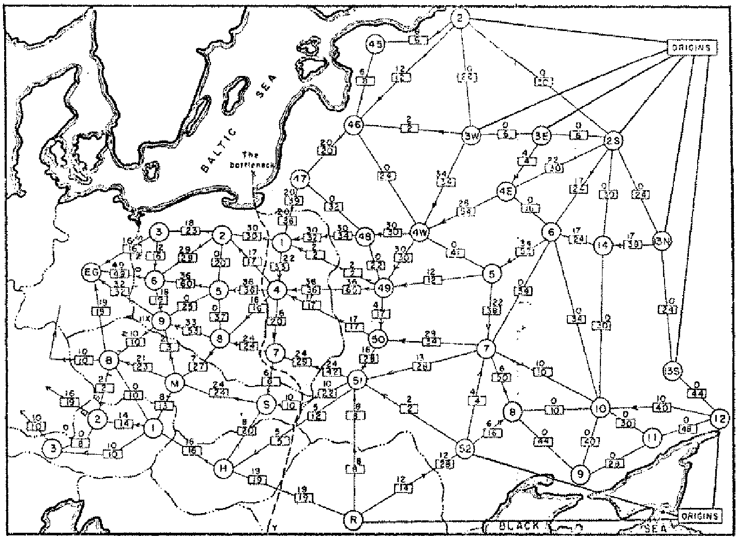
Origins of Max Flow and Min Cut Problems
Max Flow problem formulation:
  [Tolstoy 1930] Rail transportation planning for the Soviet Union
Min Cut problem formulation:
  Cold War: US military planners want to find a way to cripple Soviet supply routes
  [Harris 1954] Secret RAND corp report for US Air Force
[Ford-Fulkerson 1955] Problems are equivalent
Soviet Rail Network 1955
Reference: On the history of the transportation and maximum flow problems.
Alexander Schrijver in Math Programming, 91: 3, 2002.
Notes:
Russian scientist A. N. Tolstoi investigated soviet rail network. Wanted to optimize amount of cargo that could be shipped from origins in Soviet Union (right) to destination satellite counties (Poland, Czechoslovakia, Austria, Eastern Germany) (left). American scientists Harris and Ross were also interested in Soviet rail system but from a different perspective. In a secret report (declassified at Schrijver's request in 1999), Harris and Ross calculated a "minimum interdiction" of 163,000 tons.
after aggregation, 44 vertices, 105 edges

Slide 27

Flow Network
Flow network:
  Abstraction for material flowing through the edges.
  $G=(V, E)$ directed graph, no parallel edges.
  Two distinguished nodes: $s$ = source, $t$= sink.
  $c(e)$ = capacity of edge$e≥0$.
a
9
d
10
4
15
15
10
source
s
5
b
8
e
10
t
sink
4
6
15
10
capacity
15
c
30
f
Notes:
source = where material originates, sink = where material goes.
We use cut to mean s-t cut.

Slide 28


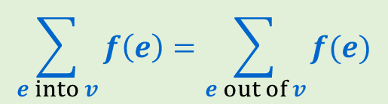
Flows
Defn: An $s$-$t$ flow in a flow network is a function $f: E  ℝ$ that satisfies:
    For each $e∈E$: $0≤ f\left(e\right)≤ c(e)$ [capacity constraints]
    For each $v∈V−\{s,t\}$:
Defn: The value of flow $f$,
$$\sum_{e into v}{f\left(e\right)=\sum_{e out of v}{f(e)}}$$
[flow conservation]
a
0/9
d
$$v\left(f\right)=\sum_{e out of s}{f\left(e\right)}$$
4/10
4/4
0/15
0/15
0/10
s
0/5
b
4/8
e
4/10
t
0/15
0/4
0/6
0/15
0/10
value = 4
c
0/30
f
Notes:
source = where material originates, sink = where material goes.
We use cut to mean s-t cut.

Slide 29
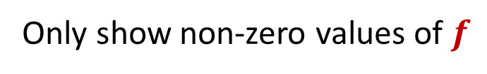

Flows
Defn: An $s$-$t$ flow in a flow network is a function $f: E  ℝ$ that satisfies:
    For each $e∈E$: $0≤ f\left(e\right)≤ c(e)$ [capacity constraints]
    For each $v∈V−\{s,t\}$:
Defn: The value of flow $f$,
$$\sum_{e into v}{f\left(e\right)=\sum_{e out of v}{f(e)}}$$
[flow conservation]
a
9
d
$$v\left(f\right)=\sum_{e out of s}{f\left(e\right)}$$
4/10
4/4
15
15
10
s
5
b
4/8
e
4/10
t
Only show non-zero values of $f$
15
4
6
15
10
value = 4
c
30
f
Notes:
source = where material originates, sink = where material goes.
We use cut to mean s-t cut.

Slide 30
Flows
Defn: An $s$-$t$ flow in a flow network is a function $f: E  ℝ$ that satisfies:
    For each $e∈E$: $0≤ f\left(e\right)≤ c(e)$ [capacity constraints]
    For each $v∈V−\{s,t\}$:
Defn: The value of flow $f$,
$$\sum_{e into v}{f\left(e\right)=\sum_{e out of v}{f(e)}}$$
[flow conservation]
a
6/9
d
$$v\left(f\right)=\sum_{e out of s}{f\left(e\right)}$$
10/10
4/4
15
15
6/10
s
3/5
b
8/8
e
8/10
t
Only show non-zero values of $f$
11/15
4
1/6
15
value = 24
10/10
c
11/30
f
Notes:
source = where material originates, sink = where material goes.
We use cut to mean s-t cut.

Slide 31

Maximum Flow Problem
Given: a flow network
Find: an $s$-$t$ flow of maximum value
a
6/9
d
10/10
4/4
15
15
6/10
s
3/5
b
8/8
e
8/10
t
11/15
4
1/6
15
value = 24
10/10
c
11/30
f
Notes:
source = where material originates, sink = where material goes.
We use cut to mean s-t cut.

Slide 32
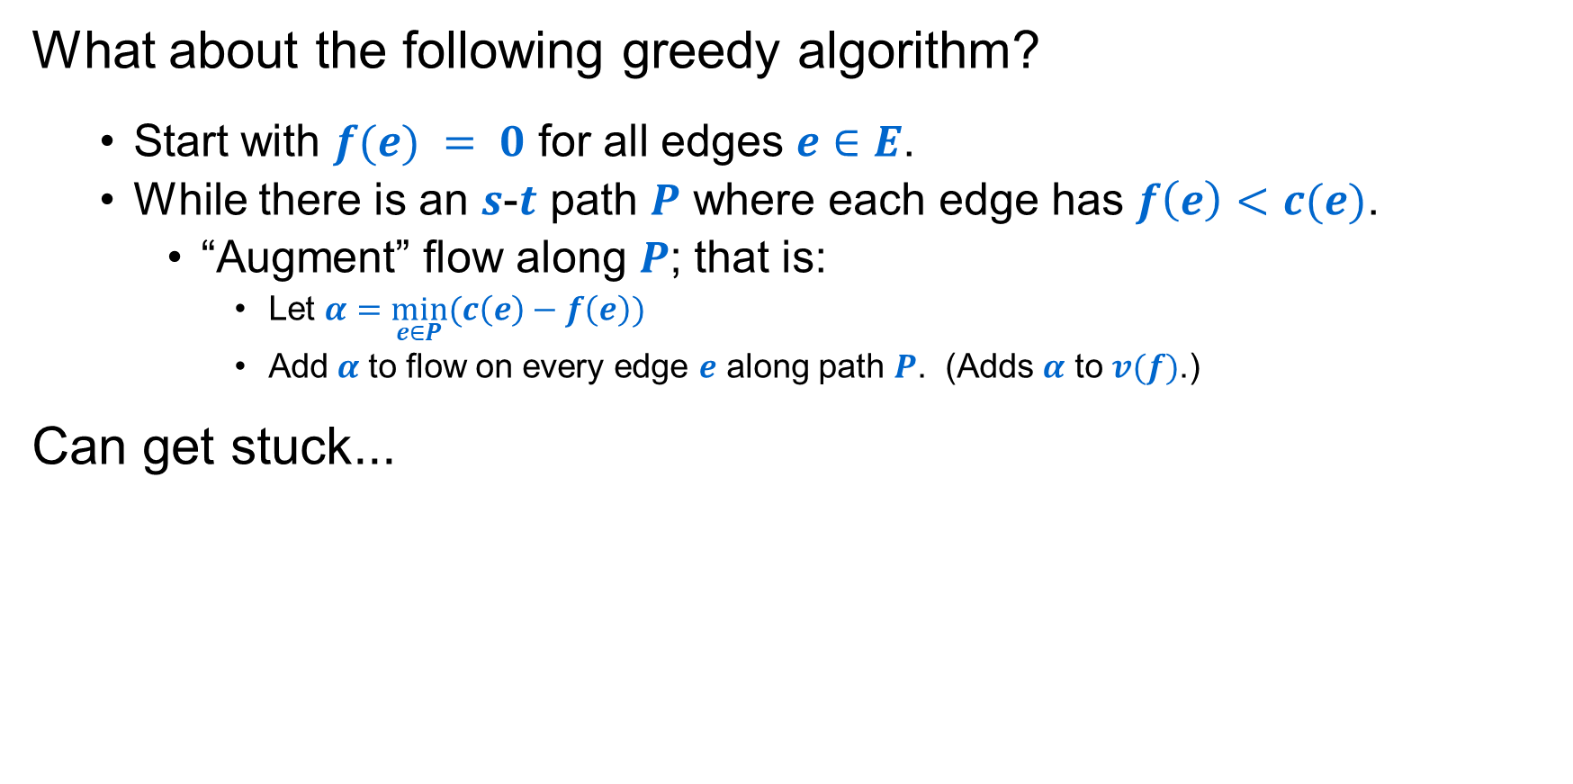
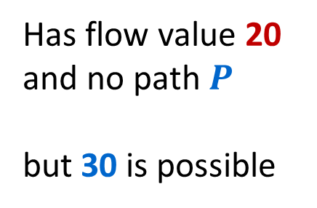
Towards a Max Flow Algorithm
What about the following greedy algorithm?
  Start with $f(e) = 0$ for all edges $e∈E$.
  While there is an $s$-$t$ path $P$ where each edge has $f\left(e\right)<c(e)$.
    “Augment” flow along $P$; that is:
      Let $α=\min_{e∈P}(c\left(e\right)−f\left(e\right))$
      Add$α$ to flow on every edge $e$ along path $P$. (Adds $α$ to $v(f)$.)
Can get stuck...
u
u
Has flow value 20
and no path $P$
but 30 is possible
20/20
10
20/20
10/10
s
20/30
t
s
10/30
t
10
20/20
10/10
20/20
v
v

Slide 33

Another “Stuck” Example
On every $s$-$t$ path there is some edge with $f\left(e\right)=c(e)$:
a
6/9
d
Value of flow = 24
10/10
4/4
15
15
6/10
s
3/5
b
8/8
e
8/10
t
11/15
4
1/6
15
10/10
c
11/30
f
Next idea: Ford-Fulkerson Algorithm, which applies greedy ideas to a “residual graph” that lets us reverse prior flow decisions from the basic greedy approach to get optimal results!
Notes:
source = where material originates, sink = where material goes.
We use cut to mean s-t cut.

Slide 34
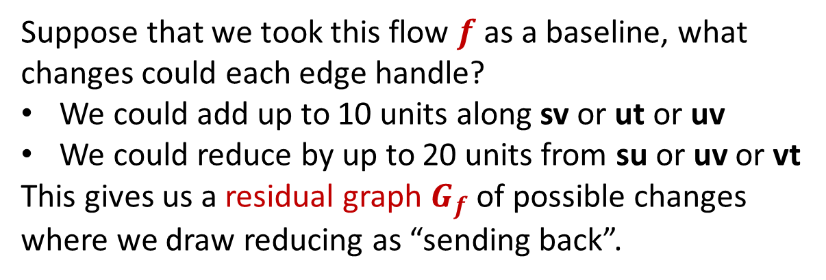
Greed Revisited: Residual Graph & Augmenting Paths
u
The only way we could route more flow from s to t would be to reduce the flow from u to v to make room for that amount of extra flow from s to v.
But to conserve flow we also would need to increase the flow from u to t by that same amount.
20/20
10
s
20/30
t
10
20/20
v
Suppose that we took this flow $f$ as a baseline, what changes could each edge handle?
We could add up to 10 units along sv or ut or uv
We could reduce by up to 20 units from su or uv or vt
This gives us a residual graph $G_{f}$ of possible changes where we draw reducing as “sending back”.
u
20
10
s
20
10
t
10
20
v

Slide 35

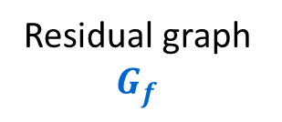
Greed Revisited: Residual Graph & Augmenting Paths
u
u
Augment flow along path
20/20
10
20/20
10/10
s
20/30
t
s
10/30
t
10
20/20
10/10
20/20
v
v
Residual graph $G_{f}$
u
Path in $G_{f}$
u
20
10
20
10
s
20
10
t
s
20
10
t
10
20
10
20
v
v

Slide 36

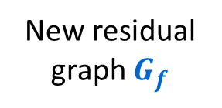
Greed Revisited: Residual Graph & Augmenting Paths
u
20/20
10/10
s
10/30
t
10/10
20/20
v
New residual graph $G_{f}$
u
20
10
s
10
20
t
No path can even leave $s$!
10
20
v

Slide 37
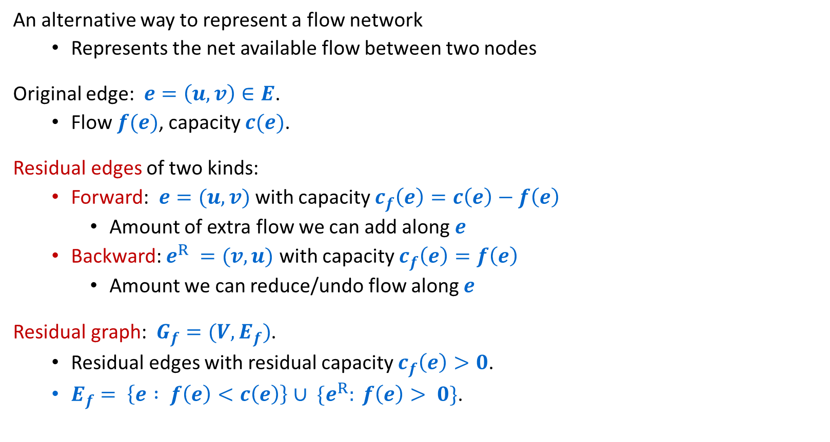
Residual Graphs
An alternative way to represent a flow network
  Represents the net available flow between two nodes
Original edge: $e=\left(u, v\right)∈E$.
  Flow $f(e)$, capacity $c(e)$.
Residual edges of two kinds:
  Forward: $e=(u, v)$ with capacity $c_{f}\left(e\right)=c\left(e\right)−f\left(e\right)$
    Amount of extra flow we can add along $e$
  Backward: $e^{R} =(v, u)$ with capacity $c_{f}\left(e\right)=f\left(e\right)$
    Amount we can reduce/undo flow along $e$
Residual graph: $G_{f}=(V, E_{f})$.
  Residual edges with residual capacity $c_{f}\left(e\right)>0$.
  $E_{f}= \left\{e : f\left(e\right)<c\left(e\right)\right\}∪ \{e^{R}: f\left(e\right)> 0\}$.
u
6/17
v
residual capacity
u
11
v
6
residual capacity

Slide 38
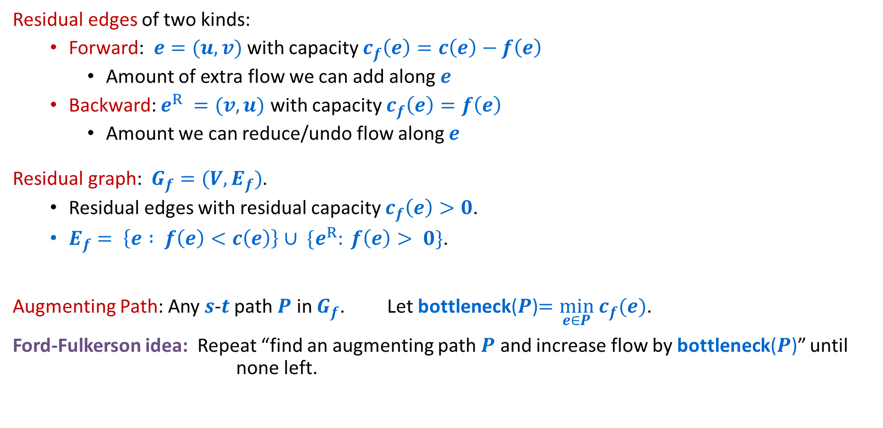
Residual Graphs and Augmenting Paths
residual capacity
Residual edges of two kinds:
  Forward: $e=(u, v)$ with capacity $c_{f}\left(e\right)=c\left(e\right)−f\left(e\right)$
    Amount of extra flow we can add along $e$
  Backward: $e^{R} =(v, u)$ with capacity $c_{f}\left(e\right)=f\left(e\right)$
    Amount we can reduce/undo flow along $e$
Residual graph: $G_{f}=(V, E_{f})$.
  Residual edges with residual capacity $c_{f}\left(e\right)>0$.
  $E_{f}= \left\{e : f\left(e\right)<c\left(e\right)\right\}∪ \{e^{R}: f\left(e\right)> 0\}$.
Augmenting Path: Any $s$-$t$ path $P$ in $G_{f}$. Let bottleneck($P$)$=\min_{e∈P} c_{f}(e)$.
Ford-Fulkerson idea: Repeat “find an augmenting path $P$ and increase flow by bottleneck($P$)” until none left.
u
11
v
6
residual capacity

Slide 39

Ford-Fulkerson Algorithm
a
4
b
capacity
$G$:
10
8
6
10
2
s
10
c
9
d
10
t

Slide 40

Ford-Fulkerson Algorithm
0 flows not shown
a
4
b
capacity
$G$:
10
8
6
10
Flow value = 0
2
s
10
c
9
d
10
t
a
4
b
residual capacity
$Gf$:
10
2
8
6
10
s
10
c
9
d
10
t

Slide 41
Ford-Fulkerson Algorithm
0 flows not shown
a
4
b
capacity
$G$:
8/
6
10
10
2
8/
Flow value = 0
8
+8=8
10
8/
s
c
9
d
10
t
a
4
b
residual capacity
$Gf$:
10
2
8
6
10
s
10
c
9
d
10
t

Slide 42
Ford-Fulkerson Algorithm
a
4
b
$G$:
8/10
8/8
6
10
Flow value = 8
2
s
10
c
9
d
8/10
t
a
4
b
$Gf$:
8
2
2
8
6
10
s
10
c
9
d
2
t
8

Slide 43
Ford-Fulkerson Algorithm
a
4
b
+2=10
$G$:
8/10
2/
8/8
6
10
Flow value = 8
2
+2=10
s
10
c
2/
d
8/10
t
9
+2=10
a
4
b
$Gf$:
8
2
2
8
6
10
s
10
c
9
d
2
t
8

Slide 44
Ford-Fulkerson Algorithm
a
4
b
$G$:
10/10
8/8
6
10
Flow value = 10
2/2
s
10
c
2/9
d
10/10
t
a
4
b
$Gf$:
10
2
8
6
10
s
10
c
7
d
10
t
2

Slide 45
Ford-Fulkerson Algorithm
a
4
b
$G$:
6/
6/
10/10
2/2
8/8
6
10
Flow value = 10
+6=16
6/
s
10
c
2/9
d
10/10
t
+6=8
a
4
b
$Gf$:
10
2
8
6
10
s
10
c
7
d
10
t
2

Slide 46
Ford-Fulkerson Algorithm
a
4
b
$G$:
10/10
8/8
6/6
6/10
Flow value = 16
2/2
s
6/10
c
8/9
d
10/10
t
a
4
b
$Gf$:
6
10
2
8
6
4
s
4
c
1
d
10
t
6
8

Slide 47
Ford-Fulkerson Algorithm
a
2/
b
4
$G$:
10/10
8/8
6/6
6/10
Flow value = 16
2/2
-2=0
+2=8
+2=18
s
6/10
c
8/9
d
10/10
t
+2=8
a
4
b
$Gf$:
6
10
2
8
6
4
s
4
c
1
d
10
t
6
8

Slide 48
Ford-Fulkerson Algorithm
a
2/4
b
$G$:
10/10
8/8
6/6
8/10
Flow value = 18
2
s
8/10
c
8/9
d
10/10
t
2
a
2
b
$Gf$:
8
10
2
8
6
2
s
2
c
1
d
10
t
8
8

Slide 49
Ford-Fulkerson Algorithm
+1=3
a
2/4
b
$G$:
10/10
8/8
6/6
8/10
Flow value = 18
2
-1=7
+1=9
+1=19
s
8/10
c
8/9
d
10/10
t
+1=9
+1=9
2
a
2
b
$Gf$:
8
10
2
8
6
2
s
2
c
1
d
10
t
8
8

Slide 50
Ford-Fulkerson Algorithm
a
3/4
b
$G$:
10/10
7/8
6/6
9/10
Flow value = 19
2
s
9/10
c
9/9
d
10/10
t
3
a
1
b
$Gf$:
9
1
10
2
7
6
1
s
1
c
9
d
10
t
9

