Slide 1
CSE 421 Winter 2025
Lecture 13: DP2
Nathan Brunelle
http://www.cs.uw.edu/421

Slide 2

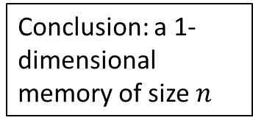

Four Steps to Dynamic Programming
Formulate the answer with a recursive structure
  What are the options for the last choice?
  For each such option, what does the subproblem look like? How do we use it?
Choose a memory structure.
  Figure out the possible values of all parameters in the recursive calls.
  How many subproblems (options for last choice) are there?
  What are the parameters needed to identify each?
  How many different values could there be per parameter?
Specify an order of evaluation.
  Want to guarantee that the necessary subproblem solutions are in memory when you need them.
  With this step: a “Bottom-up” (iterative) algorithm
  Without this step: a “Top-down” (recursive) algorithm
See if there’s a way to save space
  Is it possible to reuse some memory locations?
$$n−1$$
M
$$n−2$$
0
1
Conclusion: a 1-dimensional memory of size $n$
2
3
4
5
M
6
0
1
2
3
4
5
6
M
0
1

Slide 3
Top-Down DP Idea
def myDPalgo(problem):
if mem[problem] not blank: // Check if we’ve solved this already
return mem[problem]
if baseCase(problem): // Check if this is a base case
solution = solve(problem)
mem[problem] = solution // Always save your solution before returning
return solution
for subproblem of problem:
subsolutions.append(myDPalgo(subproblem)) // solve each subproblem
solution = selectAndExtend(subsolutions) // Pick the subproblem to use
mem[problem] = solution // Always save your solution before returning
return solution

Slide 4
Bottom-Up DP Idea
def myDPalgo(problem):
for each baseCase: // Identify which subproblems are base cases
solution = solve(baseCase)
mem[baseCase] = solution // Save the solution for reuse
for each subproblem in bottom-up order:
// The order should be chosen so that every subsolution is
// guaranteed to already be in memory when it’s needed
solution = selectAndExtend(subsolutions)
mem[subproblem] = solution // Save the solution for reuse
return mem[problem]

Slide 5
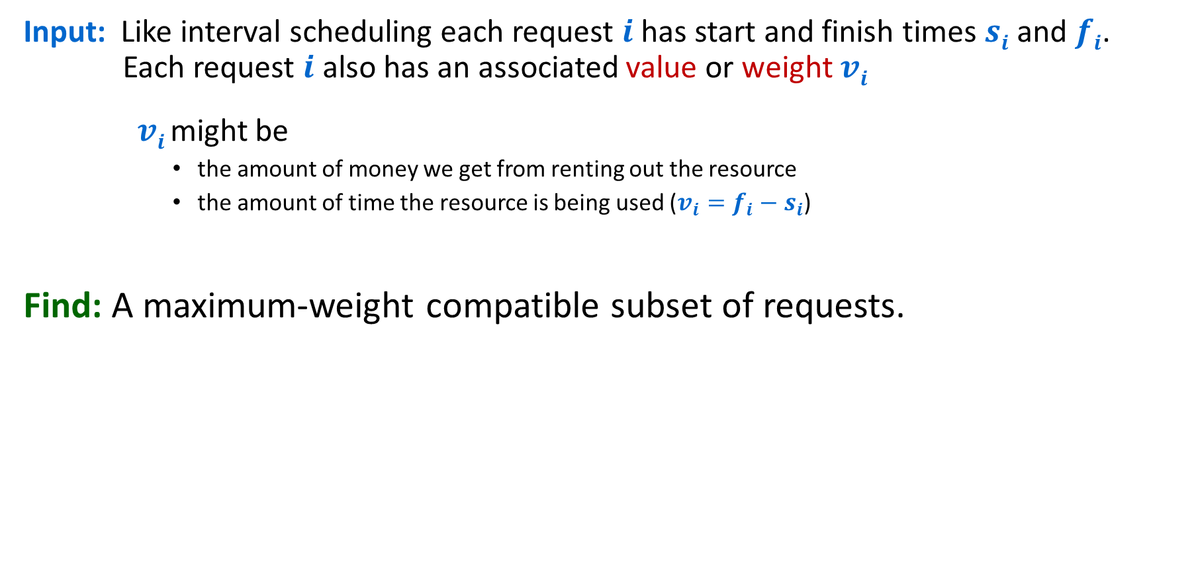
Weighted Interval Scheduling
Input: Like interval scheduling each request $i$has start and finish times $si$ and $fi$. Each request $i$ also has an associated value or weight $vi$
    $vi$ might be
      the amount of money we get from renting out the resource
      the amount of time the resource is being used ($v_{i}=f_{i}−s_{i}$)
Find: A maximum-weight compatible subset of requests.

Slide 6
Weighted Interval Scheduling
Input: Set of jobs with start times, finish times, and weights
Goal: Find maximum weight subset of mutually compatible jobs.
6
3
2
Optimal yields 10
5
3
4
4
3
Time
0
1
2
3
4
5
6
7
8
9
10
Notes:
Activity selection = interval scheduling
OPT = B, E, H
Note: smallest job (C) is not in any optimal solution, job that starts first (A) is not in any optimal solution.

Slide 7

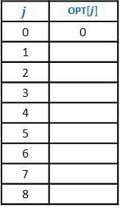
Weighted Interval Scheduling – Four Steps
1
2
1
2
Formulate the answer with a recursive structure
  What are the options for the last choice?
  For each such option, what does the subproblem look like? How do we use it?
Choose a memory structure.
  Figure out the possible values of all parameters in the recursive calls.
  How many subproblems (options for last choice) are there?
  What are the parameters needed to identify each?
  How many different values could there be per parameter?
Specify an order of evaluation.
  Want to guarantee that the necessary subproblem solutions are in memory when you need them.
  With this step: a “Bottom-up” (iterative) algorithm
  Without this step: a “Top-down” (recursive) algorithm
See if there’s a way to save space
  Is it possible to reuse some memory locations?
3
3
4
4
5
5
6
6
7
7
8
8
$$\max\left\{OPT\left(p\left(j\right)\right)+v_{j},OPT\left(j−1\right)\right\}$$
$$j$$ | OPT$[j]$
0 | 0
1
2
3
4
5
6
7
8

Slide 8
Weighted Interval Scheduling Top-Down DP
WIS(j):
if OPT[j] not blank: // Check if we’ve solved this already
return OPT[j]
if j==0: // Check if this is a base case
mem[j] = 0 // Always save your solution before returning
return mem[j]
includej = WIS(p(j)) // Solve each subproblem
excludej = WIS(j -1) // Solve each subproblem
solution = max(includej+value[j], excludej) // Pick the subproblem to use
mem[j] = solution // Always save your solution before returning
return solution

Slide 9
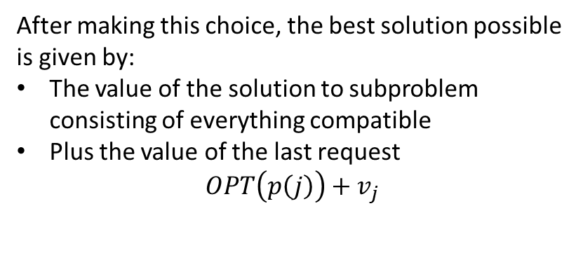
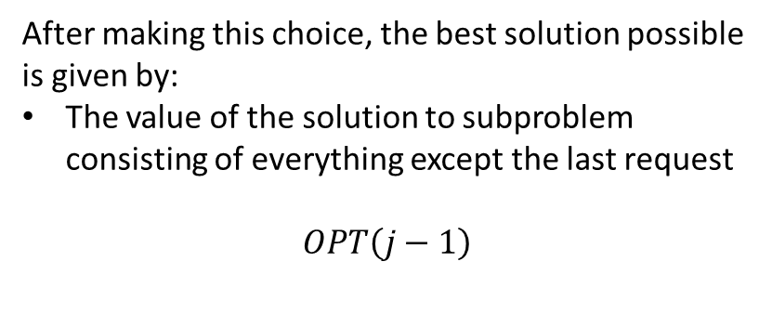
Towards Dynamic Programming: Step 1 – Recursive Algorithm
Option 1: Include the last request
Option 2: Exclude the last request
1
1
2
2
3
3
4
4
5
5
6
6
7
7
8
Time
8
Time
0
1
2
3
4
5
6
7
8
9
10
11
0
1
2
3
4
5
6
7
8
9
10
11
After making this choice, the best solution possible is given by:
The value of the solution to subproblem consisting of everything compatible
Plus the value of the last request
$$OPT\left(p\left(j\right)\right)+v_{j}$$
After making this choice, the best solution possible is given by:
The value of the solution to subproblem consisting of everything except the last request
$$OPT\left(j−1\right)$$
$$OPT\left(j\right)=\max\left\{OPT\left(p\left(j\right)\right)+v_{j}, OPT\left(j−1\right)\right\}$$

Slide 10
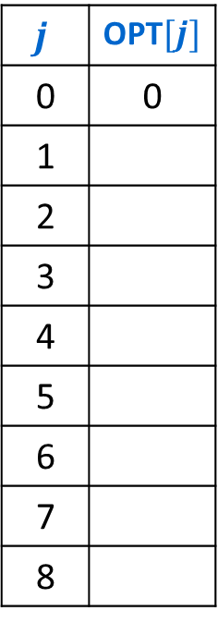
Towards Dynamic Programming: Step 2 – Memory Structure
$$OPT\left(j\right)=\max\left\{OPT\left(p\left(j\right)\right)+v_{j}, OPT\left(j−1\right)\right\}$$
Subproblems are identified by a single parameter
1-dimensional array
That parameter is the last-ending compatible request
length is the number of requests
$$j$$ | OPT$[j]$
0 | 0
1
2
3
4
5
6
7
8

Slide 11
Weighted Interval Scheduling – Four Steps
1
2
1
2
Formulate the answer with a recursive structure
  What are the options for the last choice?
  For each such option, what does the subproblem look like? How do we use it?
Choose a memory structure.
  Figure out the possible values of all parameters in the recursive calls.
  How many subproblems (options for last choice) are there?
  What are the parameters needed to identify each?
  How many different values could there be per parameter?
Specify an order of evaluation.
  Want to guarantee that the necessary subproblem solutions are in memory when you need them.
  With this step: a “Bottom-up” (iterative) algorithm
  Without this step: a “Top-down” (recursive) algorithm
See if there’s a way to save space
  Is it possible to reuse some memory locations?
3
3
4
4
5
5
6
6
7
7
8
8
$$\max\left\{OPT\left(p\left(j\right)\right)+v_{j},OPT\left(j−1\right)\right\}$$
$$j$$ | OPT$[j]$
0 | 0
1
2
3
4
5
6
7
8

Slide 12
Weighted Interval Scheduling – Four Steps
1
2
1
2
Formulate the answer with a recursive structure
  What are the options for the last choice?
  For each such option, what does the subproblem look like? How do we use it?
Choose a memory structure.
  Figure out the possible values of all parameters in the recursive calls.
  How many subproblems (options for last choice) are there?
  What are the parameters needed to identify each?
  How many different values could there be per parameter?
Specify an order of evaluation.
  Want to guarantee that the necessary subproblem solutions are in memory when you need them.
  With this step: a “Bottom-up” (iterative) algorithm
  Without this step: a “Top-down” (recursive) algorithm
See if there’s a way to save space
  Is it possible to reuse some memory locations?
3
3
4
4
5
5
6
6
7
7
8
8
$$\max\left\{OPT\left(p\left(j\right)\right)+v_{j},OPT\left(j−1\right)\right\}$$
$$j$$ | OPT$[j]$
0 | 0
1
2
3
4
5
6
7
8

Slide 13
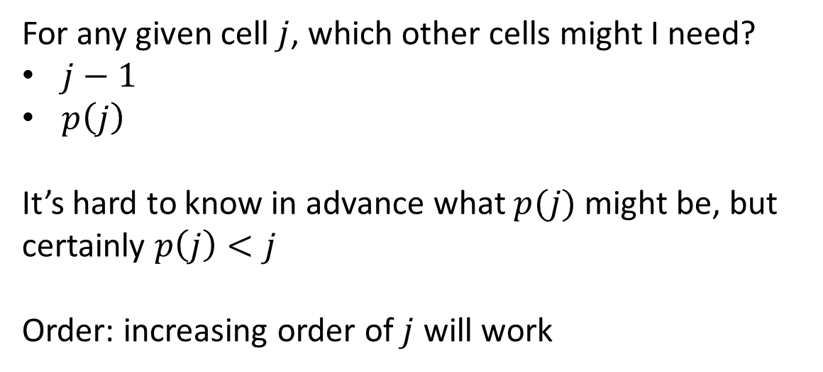
Towards Dynamic Programming: Step 3 – Order of Evaluation
$$OPT\left(j\right)=\max\left\{OPT\left(p\left(j\right)\right)+v_{j}, OPT\left(j−1\right)\right\}$$
For any given cell $j$, which other cells might I need?
$j−1$
$p\left(j\right)$
It’s hard to know in advance what $p(j)$ might be, but certainly $p\left(j\right)<j$
Order: increasing order of $j$ will work
$$j$$ | OPT$[j]$
0 | 0
1
2
3
4
5
6
7
8

Slide 14
Bottom-Up DP Idea
def myDPalgo(problem):
for each baseCase: // Identify which subproblems are base cases
solution = solve(baseCase)
mem[baseCase] = solution // Save the solution for reuse
for each subproblem in bottom-up order:
// The order should be chosen so that every subsolution is
// guaranteed to already be in memory when it’s needed
solution = selectAndExtend(subsolutions)
mem[subproblem] = solution // Save the solution for reuse
return mem[problem]

Slide 15
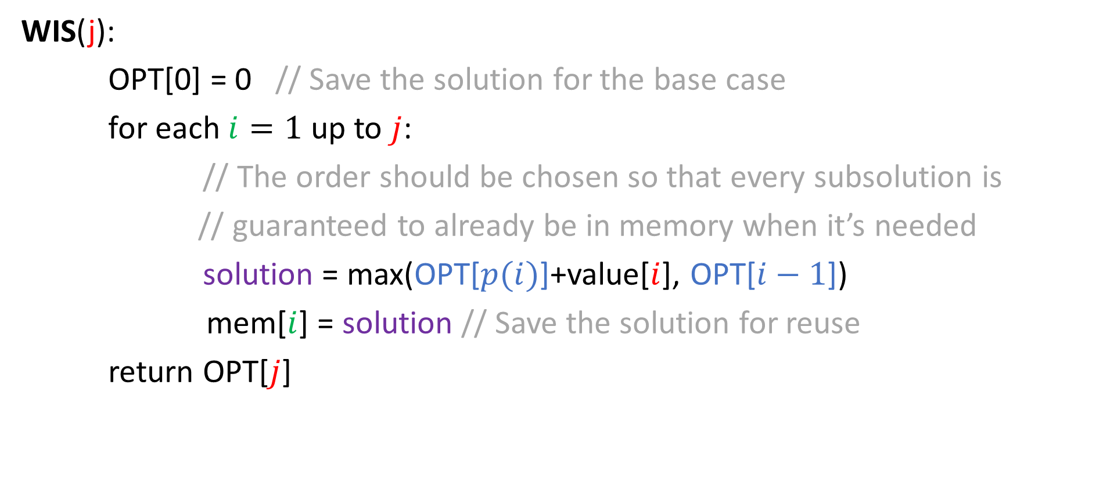
Weighted Interval Scheduling Bottom-Up DP
WIS(j):
OPT[0] = 0 // Save the solution for the base case
for each $i=1$ up to $j$:
// The order should be chosen so that every subsolution is
// guaranteed to already be in memory when it’s needed
solution = max(OPT[$p(i)$]+value[$i$], OPT[$i−1$])
mem[$i$] = solution // Save the solution for reuse
return OPT[$j$]

Slide 16

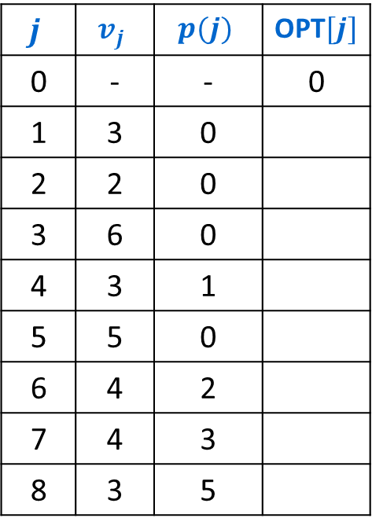
Example Execution (iterative)
Notation: Label jobs by finishing time: $f_{1}≤f_{2}≤…≤f_{n}$.
Defn: $p(j)$ = largest index $i<j$ s.t. job $i$ is compatible with $j$.
$OPT\left(j\right)=\max\left\{OPT\left(p\left(j\right)\right)+v_{j}, OPT\left(j−1\right)\right\}$
$$j$$ | $$v_{j}$$ | $$p(j)$$ | OPT$[j]$
0 | - | - | 0
1 | 3 | 0
2 | 2 | 0
3 | 6 | 0
4 | 3 | 1
5 | 5 | 0
6 | 4 | 2
7 | 4 | 3
8 | 3 | 5
1
2
3
4
5
6
7
8
Time
0
1
2
3
4
5
6
7
8
9
10
11

Slide 17

Example Execution (iterative)
Notation: Label jobs by finishing time: $f_{1}≤f_{2}≤…≤f_{n}$.
Defn: $p(j)$ = largest index $i<j$ s.t. job $i$ is compatible with $j$.
$OPT\left(j\right)=\max\left\{OPT\left(p\left(j\right)\right)+v_{j}, OPT\left(j−1\right)\right\}$
$$j$$ | $$v_{j}$$ | $$p(j)$$ | OPT$[j]$
0 | - | - | 0
1 | 3 | 0 | 3
2 | 2 | 0
3 | 6 | 0
4 | 3 | 1
5 | 5 | 0
6 | 4 | 2
7 | 4 | 3
8 | 3 | 5
1
2
3
4
5
6
7
8
Time
0
1
2
3
4
5
6
7
8
9
10
11

Slide 18
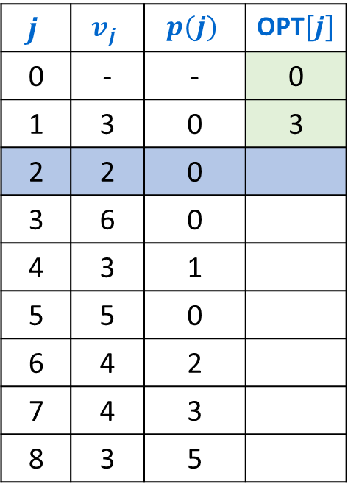
Example Execution (iterative)
Notation: Label jobs by finishing time: $f_{1}≤f_{2}≤…≤f_{n}$.
Defn: $p(j)$ = largest index $i<j$ s.t. job $i$ is compatible with $j$.
$OPT\left(j\right)=\max\left\{OPT\left(p\left(j\right)\right)+v_{j}, OPT\left(j−1\right)\right\}$
$$j$$ | $$v_{j}$$ | $$p(j)$$ | OPT$[j]$
0 | - | - | 0
1 | 3 | 0 | 3
2 | 2 | 0
3 | 6 | 0
4 | 3 | 1
5 | 5 | 0
6 | 4 | 2
7 | 4 | 3
8 | 3 | 5
1
2
3
4
5
6
7
8
Time
0
1
2
3
4
5
6
7
8
9
10
11

Slide 19

Example Execution (iterative)
Notation: Label jobs by finishing time: $f_{1}≤f_{2}≤…≤f_{n}$.
Defn: $p(j)$ = largest index $i<j$ s.t. job $i$ is compatible with $j$.
$OPT\left(j\right)=\max\left\{OPT\left(p\left(j\right)\right)+v_{j}, OPT\left(j−1\right)\right\}$
$$j$$ | $$v_{j}$$ | $$p(j)$$ | OPT$[j]$
0 | - | - | 0
1 | 3 | 0 | 3
2 | 2 | 0 | 3
3 | 6 | 0
4 | 3 | 1
5 | 5 | 0
6 | 4 | 2
7 | 4 | 3
8 | 3 | 5
1
2
3
4
5
6
7
8
Time
0
1
2
3
4
5
6
7
8
9
10
11

Slide 20
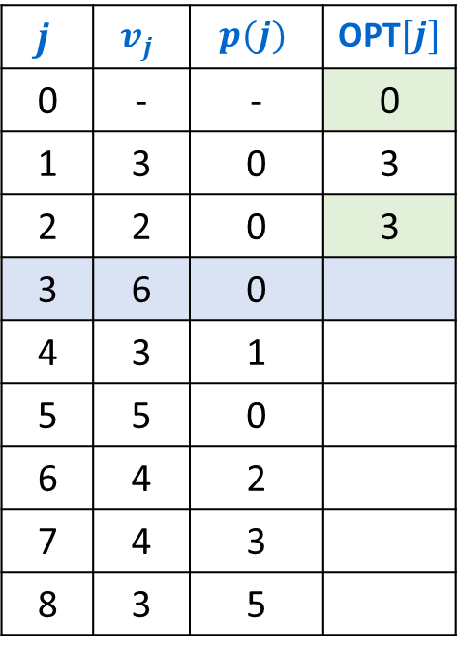
Example Execution (iterative)
Notation: Label jobs by finishing time: $f_{1}≤f_{2}≤…≤f_{n}$.
Defn: $p(j)$ = largest index $i<j$ s.t. job $i$ is compatible with $j$.
$OPT\left(j\right)=\max\left\{OPT\left(p\left(j\right)\right)+v_{j}, OPT\left(j−1\right)\right\}$
$$j$$ | $$v_{j}$$ | $$p(j)$$ | OPT$[j]$
0 | - | - | 0
1 | 3 | 0 | 3
2 | 2 | 0 | 3
3 | 6 | 0
4 | 3 | 1
5 | 5 | 0
6 | 4 | 2
7 | 4 | 3
8 | 3 | 5
1
2
3
4
5
6
7
8
Time
0
1
2
3
4
5
6
7
8
9
10
11

Slide 21
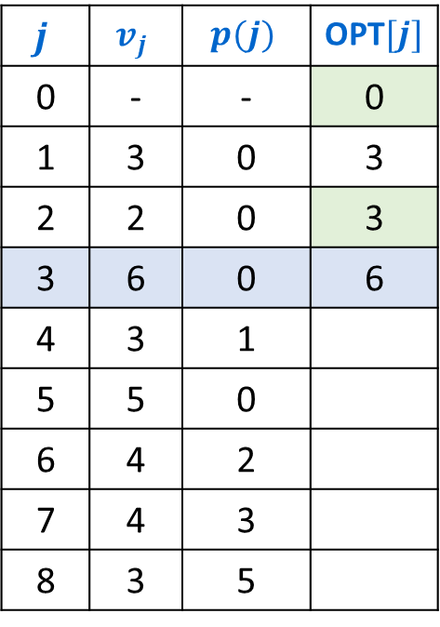
Example Execution (iterative)
Notation: Label jobs by finishing time: $f_{1}≤f_{2}≤…≤f_{n}$.
Defn: $p(j)$ = largest index $i<j$ s.t. job $i$ is compatible with $j$.
$OPT\left(j\right)=\max\left\{OPT\left(p\left(j\right)\right)+v_{j}, OPT\left(j−1\right)\right\}$
$$j$$ | $$v_{j}$$ | $$p(j)$$ | OPT$[j]$
0 | - | - | 0
1 | 3 | 0 | 3
2 | 2 | 0 | 3
3 | 6 | 0 | 6
4 | 3 | 1
5 | 5 | 0
6 | 4 | 2
7 | 4 | 3
8 | 3 | 5
1
2
3
4
5
6
7
8
Time
0
1
2
3
4
5
6
7
8
9
10
11

Slide 22
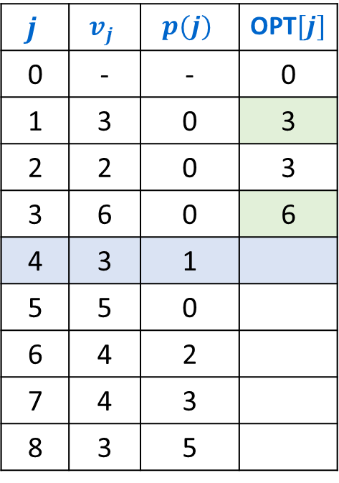
Example Execution (iterative)
Notation: Label jobs by finishing time: $f_{1}≤f_{2}≤…≤f_{n}$.
Defn: $p(j)$ = largest index $i<j$ s.t. job $i$ is compatible with $j$.
$OPT\left(j\right)=\max\left\{OPT\left(p\left(j\right)\right)+v_{j}, OPT\left(j−1\right)\right\}$
$$j$$ | $$v_{j}$$ | $$p(j)$$ | OPT$[j]$
0 | - | - | 0
1 | 3 | 0 | 3
2 | 2 | 0 | 3
3 | 6 | 0 | 6
4 | 3 | 1
5 | 5 | 0
6 | 4 | 2
7 | 4 | 3
8 | 3 | 5
1
2
3
4
5
6
7
8
Time
0
1
2
3
4
5
6
7
8
9
10
11

Slide 23
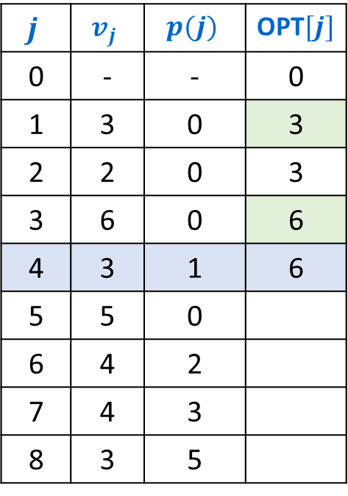
Example Execution (iterative)
Notation: Label jobs by finishing time: $f_{1}≤f_{2}≤…≤f_{n}$.
Defn: $p(j)$ = largest index $i<j$ s.t. job $i$ is compatible with $j$.
$OPT\left(j\right)=\max\left\{OPT\left(p\left(j\right)\right)+v_{j}, OPT\left(j−1\right)\right\}$
$$j$$ | $$v_{j}$$ | $$p(j)$$ | OPT$[j]$
0 | - | - | 0
1 | 3 | 0 | 3
2 | 2 | 0 | 3
3 | 6 | 0 | 6
4 | 3 | 1 | 6
5 | 5 | 0
6 | 4 | 2
7 | 4 | 3
8 | 3 | 5
1
2
3
4
5
6
7
8
Time
0
1
2
3
4
5
6
7
8
9
10
11

Slide 24
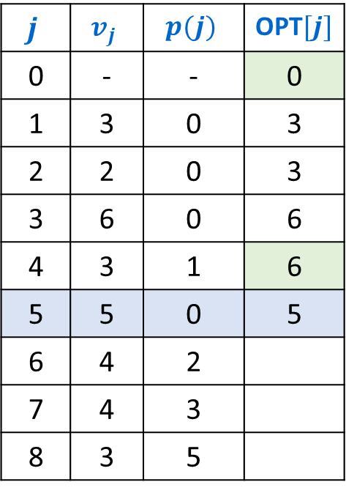
Example Execution (iterative)
Notation: Label jobs by finishing time: $f_{1}≤f_{2}≤…≤f_{n}$.
Defn: $p(j)$ = largest index $i<j$ s.t. job $i$ is compatible with $j$.
$OPT\left(j\right)=\max\left\{OPT\left(p\left(j\right)\right)+v_{j}, OPT\left(j−1\right)\right\}$
$$j$$ | $$v_{j}$$ | $$p(j)$$ | OPT$[j]$
0 | - | - | 0
1 | 3 | 0 | 3
2 | 2 | 0 | 3
3 | 6 | 0 | 6
4 | 3 | 1 | 6
5 | 5 | 0 | 5
6 | 4 | 2
7 | 4 | 3
8 | 3 | 5
1
2
3
4
5
6
7
8
Time
0
1
2
3
4
5
6
7
8
9
10
11

Slide 25
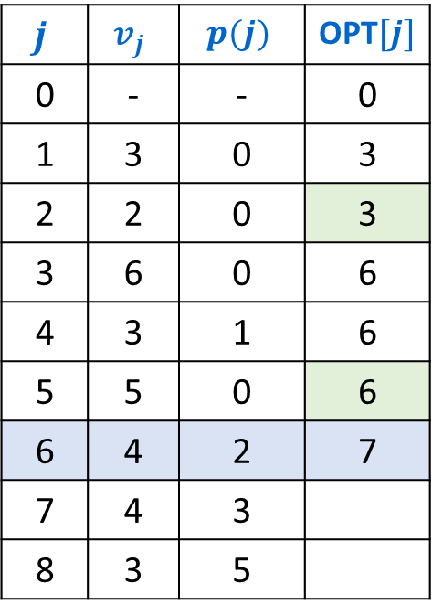
Example Execution (iterative)
Notation: Label jobs by finishing time: $f_{1}≤f_{2}≤…≤f_{n}$.
Defn: $p(j)$ = largest index $i<j$ s.t. job $i$ is compatible with $j$.
$OPT\left(j\right)=\max\left\{OPT\left(p\left(j\right)\right)+v_{j}, OPT\left(j−1\right)\right\}$
$$j$$ | $$v_{j}$$ | $$p(j)$$ | OPT$[j]$
0 | - | - | 0
1 | 3 | 0 | 3
2 | 2 | 0 | 3
3 | 6 | 0 | 6
4 | 3 | 1 | 6
5 | 5 | 0 | 6
6 | 4 | 2 | 7
7 | 4 | 3
8 | 3 | 5
1
2
3
4
5
6
7
8
Time
0
1
2
3
4
5
6
7
8
9
10
11

Slide 26
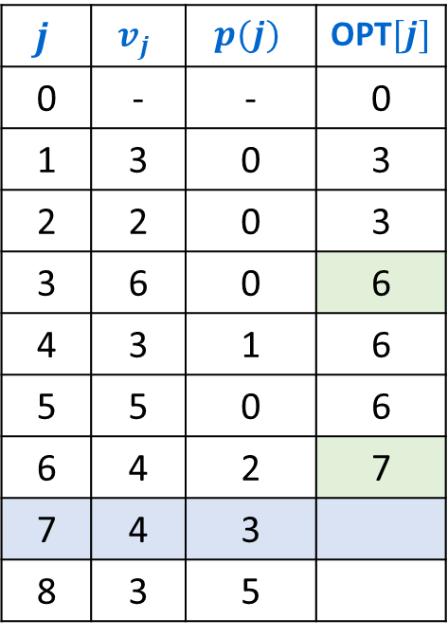
Example Execution (iterative)
Notation: Label jobs by finishing time: $f_{1}≤f_{2}≤…≤f_{n}$.
Defn: $p(j)$ = largest index $i<j$ s.t. job $i$ is compatible with $j$.
$OPT\left(j\right)=\max\left\{OPT\left(p\left(j\right)\right)+v_{j}, OPT\left(j−1\right)\right\}$
$$j$$ | $$v_{j}$$ | $$p(j)$$ | OPT$[j]$
0 | - | - | 0
1 | 3 | 0 | 3
2 | 2 | 0 | 3
3 | 6 | 0 | 6
4 | 3 | 1 | 6
5 | 5 | 0 | 6
6 | 4 | 2 | 7
7 | 4 | 3
8 | 3 | 5
1
2
3
4
5
6
7
8
Time
0
1
2
3
4
5
6
7
8
9
10
11

Slide 27
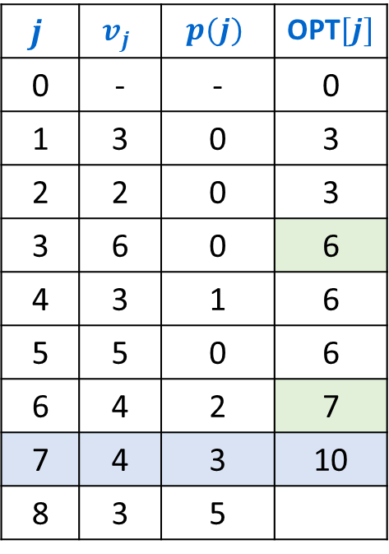
Example Execution (iterative)
Notation: Label jobs by finishing time: $f_{1}≤f_{2}≤…≤f_{n}$.
Defn: $p(j)$ = largest index $i<j$ s.t. job $i$ is compatible with $j$.
$OPT\left(j\right)=\max\left\{OPT\left(p\left(j\right)\right)+v_{j}, OPT\left(j−1\right)\right\}$
$$j$$ | $$v_{j}$$ | $$p(j)$$ | OPT$[j]$
0 | - | - | 0
1 | 3 | 0 | 3
2 | 2 | 0 | 3
3 | 6 | 0 | 6
4 | 3 | 1 | 6
5 | 5 | 0 | 6
6 | 4 | 2 | 7
7 | 4 | 3 | 10
8 | 3 | 5
1
2
3
4
5
6
7
8
Time
0
1
2
3
4
5
6
7
8
9
10
11

Slide 28
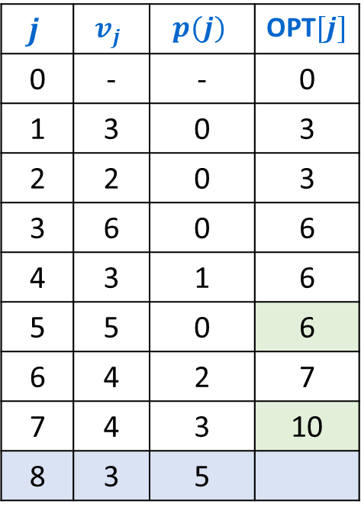
Example Execution (iterative)
Notation: Label jobs by finishing time: $f_{1}≤f_{2}≤…≤f_{n}$.
Defn: $p(j)$ = largest index $i<j$ s.t. job $i$ is compatible with $j$.
$OPT\left(j\right)=\max\left\{OPT\left(p\left(j\right)\right)+v_{j}, OPT\left(j−1\right)\right\}$
$$j$$ | $$v_{j}$$ | $$p(j)$$ | OPT$[j]$
0 | - | - | 0
1 | 3 | 0 | 3
2 | 2 | 0 | 3
3 | 6 | 0 | 6
4 | 3 | 1 | 6
5 | 5 | 0 | 6
6 | 4 | 2 | 7
7 | 4 | 3 | 10
8 | 3 | 5
1
2
3
4
5
6
7
8
Time
0
1
2
3
4
5
6
7
8
9
10
11

Slide 29
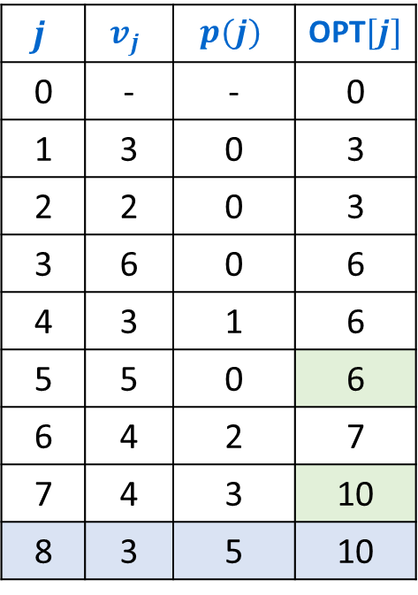
Example Execution (iterative)
Notation: Label jobs by finishing time: $f_{1}≤f_{2}≤…≤f_{n}$.
Defn: $p(j)$ = largest index $i<j$ s.t. job $i$ is compatible with $j$.
$OPT\left(j\right)=\max\left\{OPT\left(p\left(j\right)\right)+v_{j}, OPT\left(j−1\right)\right\}$
$$j$$ | $$v_{j}$$ | $$p(j)$$ | OPT$[j]$
0 | - | - | 0
1 | 3 | 0 | 3
2 | 2 | 0 | 3
3 | 6 | 0 | 6
4 | 3 | 1 | 6
5 | 5 | 0 | 6
6 | 4 | 2 | 7
7 | 4 | 3 | 10
8 | 3 | 5 | 10
1
2
3
4
5
6
7
8
Time
0
1
2
3
4
5
6
7
8
9
10
11

Slide 30
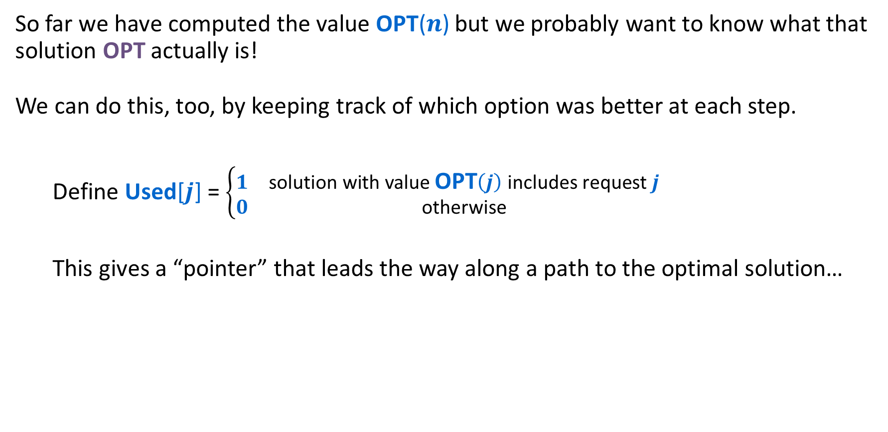
Weighted Interval Scheduling: Finding the Solution
So far we have computed the value OPT($n$) but we probably want to know what that solution OPT actually is!
We can do this, too, by keeping track of which option was better at each step.
  Define Used[$j$] = $\left\{\begin{matrix}1 & \text{solution} \text{with} \text{value} \text{OPT}\left(j\right) \text{includes} \text{request} j \\ 0 & \text{otherwise}\end{matrix}\right.$
  This gives a “pointer” that leads the way along a path to the optimal solution…

Slide 31
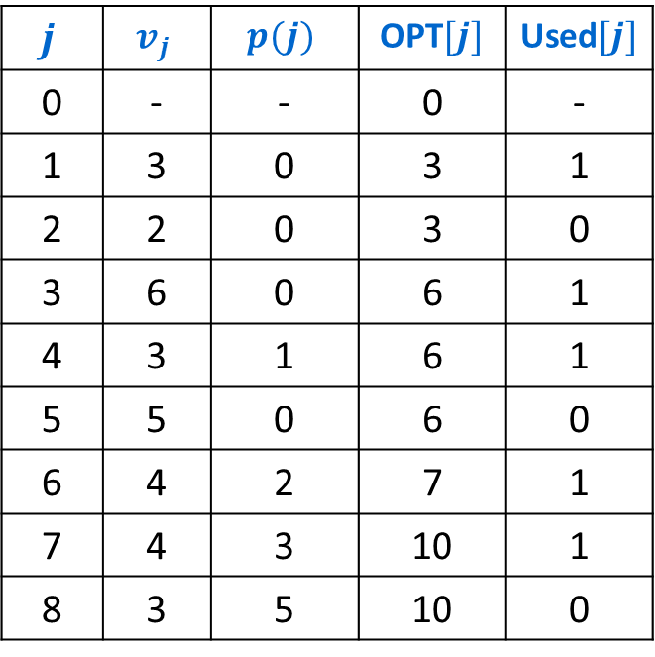
Weighted Interval Scheduling: Finding the Solution
Notation: Label jobs by finishing time: $f_{1}≤f_{2}≤…≤f_{n}$.
Defn: $p(j)$ = largest index $i<j$ s.t. job $i$ is compatible with $j$.
$OPT\left(j\right)=\max\left\{OPT\left(p\left(j\right)\right)+v_{j}, OPT\left(j−1\right)\right\}$
$$j$$ | $$v_{j}$$ | $$p(j)$$ | OPT$[j]$ | Used$[j]$
0 | - | - | 0 | -
1 | 3 | 0 | 3 | 1
2 | 2 | 0 | 3 | 0
3 | 6 | 0 | 6 | 1
4 | 3 | 1 | 6 | 1
5 | 5 | 0 | 6 | 0
6 | 4 | 2 | 7 | 1
7 | 4 | 3 | 10 | 1
8 | 3 | 5 | 10 | 0
1
2
3
4
5
6
7
8
Time
0
1
2
3
4
5
6
7
8
9
10
11

Slide 32
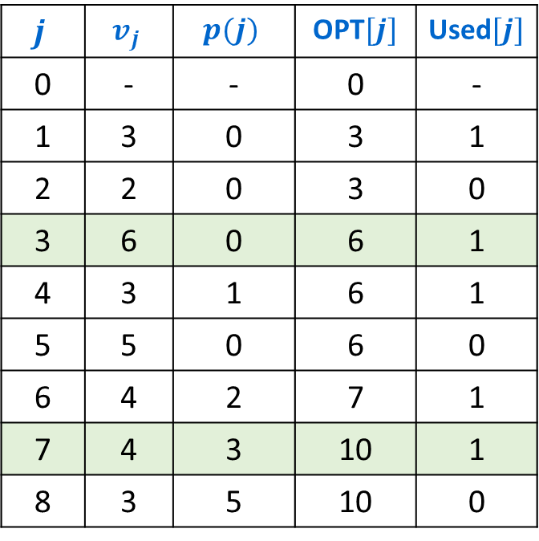
Weighted Interval Scheduling: Iterative Solution
Notation: Label jobs by finishing time: $f_{1}≤f_{2}≤…≤f_{n}$.
Defn: $p(j)$ = largest index $i<j$ s.t. job $i$ is compatible with $j$.
$OPT\left(j\right)=\max\left\{OPT\left(p\left(j\right)\right)+v_{j}, OPT\left(j−1\right)\right\}$
$$j$$ | $$v_{j}$$ | $$p(j)$$ | OPT$[j]$ | Used$[j]$
0 | - | - | 0 | -
1 | 3 | 0 | 3 | 1
2 | 2 | 0 | 3 | 0
3 | 6 | 0 | 6 | 1
4 | 3 | 1 | 6 | 1
5 | 5 | 0 | 6 | 0
6 | 4 | 2 | 7 | 1
7 | 4 | 3 | 10 | 1
8 | 3 | 5 | 10 | 0
1
2
3
4
5
6
7
8
Time
0
1
2
3
4
5
6
7
8
9
10
11

Slide 33
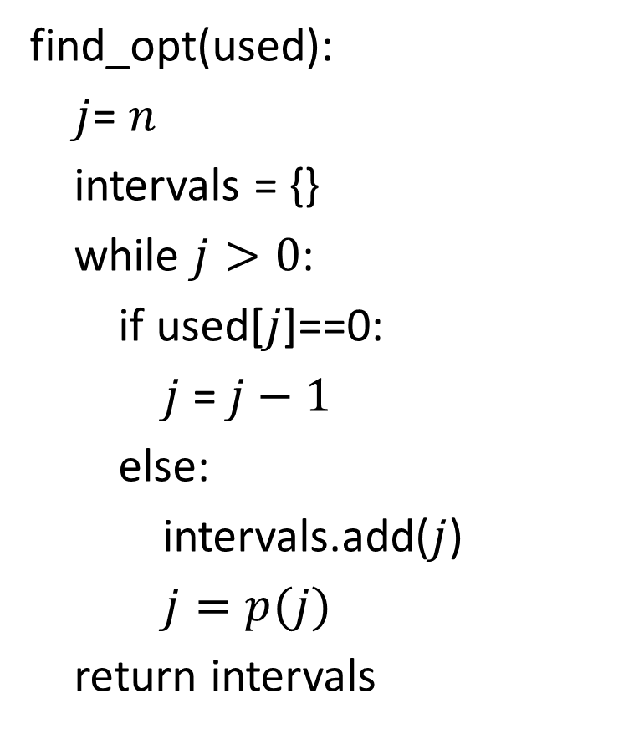
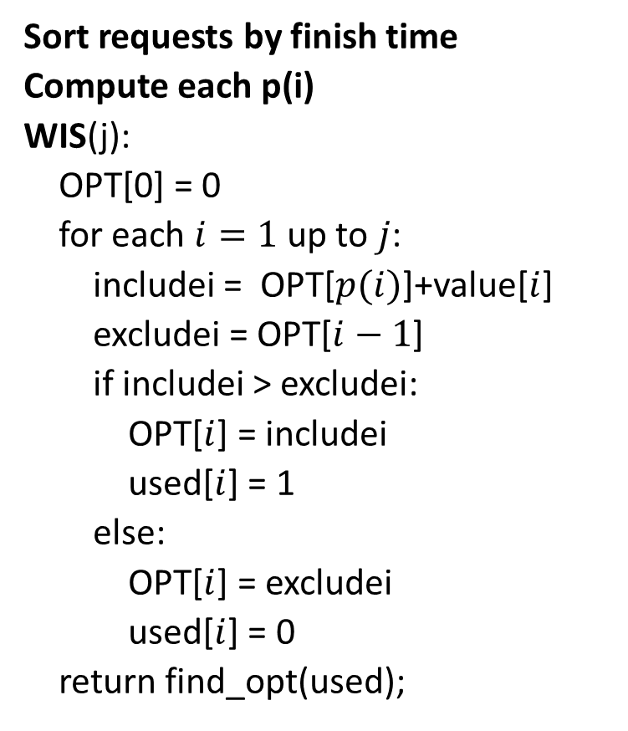
Weighted Interval Scheduling - Complete
Sort requests by finish time
Compute each p(i)
WIS(j):
OPT[0] = 0
for each $i=1$ up to $j$:
includei = OPT[$p(i)$]+value[$i$]
excludei = OPT[$i−1$]
if includei > excludei:
OPT[$i$] = includei
used[$i$] = 1
else:
OPT[$i$] = excludei
used[$i$] = 0
return find_opt(used);
find_opt(used):
$j$= $n$
intervals = {}
while $j>0$:
if used[$j$]==0:
$j$ = $j−1$
else:
intervals.add($j$)
$j=p(j)$
return intervals

Slide 34

Weighted Interval Scheduling – Four Steps
1
2
1
2
Formulate the answer with a recursive structure
  What are the options for the last choice?
  For each such option, what does the subproblem look like? How do we use it?
Choose a memory structure.
  Figure out the possible values of all parameters in the recursive calls.
  How many subproblems (options for last choice) are there?
  What are the parameters needed to identify each?
  How many different values could there be per parameter?
Specify an order of evaluation.
  Want to guarantee that the necessary subproblem solutions are in memory when you need them.
  With this step: a “Bottom-up” (iterative) algorithm
  Without this step: a “Top-down” (recursive) algorithm
See if there’s a way to save space
  Is it possible to reuse some memory locations?
3
3
4
4
5
5
6
6
7
7
8
8
$$\max\left\{OPT\left(p\left(j\right)\right)+v_{j},OPT\left(j−1\right)\right\}$$
$$j$$ | OPT$[j]$
0 | 0
1
2
3
4
5
6
7
8
$$j$$ | OPT$[j]$
0 | 0
1
2
3
4
5
6
7
8

Slide 35
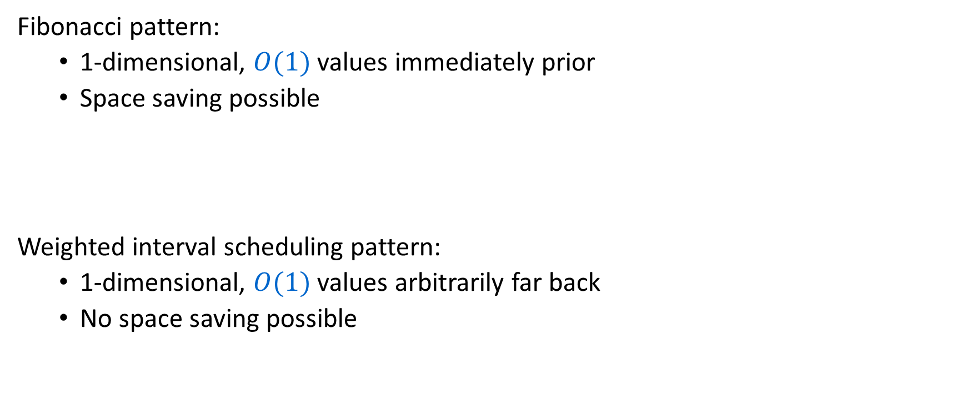
Dynamic Programming Patterns
Fibonacci pattern:
  1-dimensional, $O(1)$ values immediately prior
  Space saving possible
Weighted interval scheduling pattern:
  1-dimensional, $O(1)$values arbitrarily far back
  No space saving possible

Slide 36

Longest Increasing Subsequence (LIS)
Given: An array $A$ of $n$ integers.
Find: A longest possible sequence $i_{1}<i_{2}<…<i_{k}$ such that $A\left[i_{1}\right]<A\left[i_{2}\right]<⋯<A[i_{k}]$.
6 | 3 | 4 | 2 | 7 | 5 | 10 | 6 | 8 | 5
3
4
5
6
8
10 | 9 | 8 | 7 | 6 | 5 | 4 | 3 | 2 | 8

Slide 37
Weighted Interval Scheduling – Four Steps
Formulate the answer with a recursive structure
  What are the options for the last choice?
  For each such option, what does the subproblem look like? How do we use it?
Choose a memory structure.
  Figure out the possible values of all parameters in the recursive calls.
  How many subproblems (options for last choice) are there?
  What are the parameters needed to identify each?
  How many different values could there be per parameter?
Specify an order of evaluation.
  Want to guarantee that the necessary subproblem solutions are in memory when you need them.
  With this step: a “Bottom-up” (iterative) algorithm
  Without this step: a “Top-down” (recursive) algorithm
See if there’s a way to save space
  Is it possible to reuse some memory locations?

Slide 38
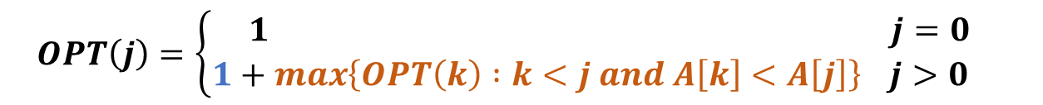
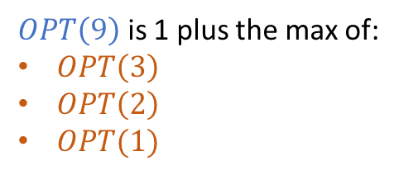
Step 1: Finding a Recursive Structure
Given: An array $A$ of $n$ integers.
Find: A longest possible sequence $i_{1}<i_{2}<…<i_{k}$ such that $A\left[i_{1}\right]<A\left[i_{2}\right]<⋯<A[i_{k}]$.
If the value at the last index were included, then best solution would look like:
The longest sequence ending with something less than that value,
Followed by that value
$OPT\left(9\right)$ is 1 plus the max of:
$OPT\left(3\right)$
$OPT\left(2\right)$
$OPT(1)$
6 | 3 | 4 | 2 | 7 | 5 | 10 | 6 | 8 | 5
Extend the longest solution that ends with something less than 5
$$OPT\left(j\right)=\left\{\begin{aligned}1 j=0 \\ 1+\max\left\{OPT\left(k\right) :k<j and A\left[k\right]<A\left[j\right]\right\} j>0 \end{aligned}\right.$$

Slide 39
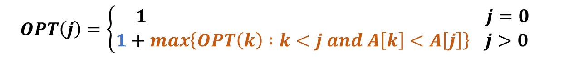

Step 1: Finding a Recursive Structure
Given: An array $A$ of $n$ integers.
Find: A longest possible sequence $i_{1}<i_{2}<…<i_{k}$ such that $A\left[i_{1}\right]<A\left[i_{2}\right]<⋯<A[i_{k}]$.
If the value at the last index were included, then best solution would look like:
The longest sequence ending with something less than that value,
Followed by that value
$OPT\left(8\right)$ is 1 plus the max of:
$OPT\left(7\right)$
$OPT\left(5\right)$
$OPT\left(4\right)$
$OPT(3)$
$OPT(2)$
$OPT(1)$
$OPT(0)$
6 | 3 | 4 | 2 | 7 | 5 | 10 | 6 | 8 | 5
$$OPT\left(j\right)=\left\{\begin{aligned}1 j=0 \\ 1+\max\left\{OPT\left(k\right) :k<j and A\left[k\right]<A\left[j\right]\right\} j>0 \end{aligned}\right.$$

Slide 40
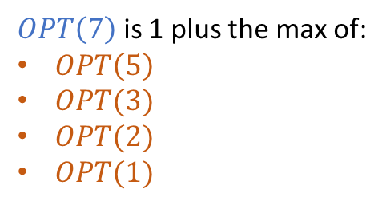
Step 1: Finding a Recursive Structure
Given: An array $A$ of $n$ integers.
Find: A longest possible sequence $i_{1}<i_{2}<…<i_{k}$ such that $A\left[i_{1}\right]<A\left[i_{2}\right]<⋯<A[i_{k}]$.
If the value at the last index were included, then best solution would look like:
The longest sequence ending with something less than that value,
Followed by that value
$OPT\left(7\right)$ is 1 plus the max of:
$OPT\left(5\right)$
$OPT(3)$
$OPT(2)$
$OPT(1)$
6 | 3 | 4 | 2 | 7 | 5 | 10 | 6 | 8 | 5
$$OPT\left(j\right)=\left\{\begin{aligned}1 j=0 \\ 1+\max\left\{OPT\left(k\right) :k<j and A\left[k\right]<A\left[j\right]\right\} j>0 \end{aligned}\right.$$

Slide 41
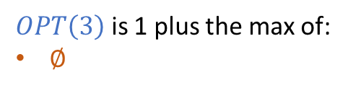
Step 1: Finding a Recursive Structure
Given: An array $A$ of $n$ integers.
Find: A longest possible sequence $i_{1}<i_{2}<…<i_{k}$ such that $A\left[i_{1}\right]<A\left[i_{2}\right]<⋯<A[i_{k}]$.
If the value at the last index were included, then best solution would look like:
The longest sequence ending with something less than that value,
Followed by that value
$OPT\left(3\right)$ is 1 plus the max of:
$∅$
6 | 3 | 4 | 2 | 7 | 5 | 10 | 6 | 8 | 5
$$OPT\left(j\right)=\left\{\begin{aligned}1 j=0 \\ 1+\max\left\{OPT\left(k\right) :k<j and A\left[k\right]<A\left[j\right]\right\} j>0 \end{aligned}\right.$$

Slide 42
LIS – Four Steps
Formulate the answer with a recursive structure
  What are the options for the last choice?
  For each such option, what does the subproblem look like? How do we use it?
Choose a memory structure.
  Figure out the possible values of all parameters in the recursive calls.
  How many subproblems (options for last choice) are there?
  What are the parameters needed to identify each?
  How many different values could there be per parameter?
Specify an order of evaluation.
  Want to guarantee that the necessary subproblem solutions are in memory when you need them.
  With this step: a “Bottom-up” (iterative) algorithm
  Without this step: a “Top-down” (recursive) algorithm
See if there’s a way to save space
  Is it possible to reuse some memory locations?
6 | 3 | 4 | 2 | 7 | 5 | 10 | 6 | 8 | 5
$$1+\max\left\{OPT\left(k\right) :k<j and A\left[k\right]<A\left[j\right]\right\}$$

Slide 43

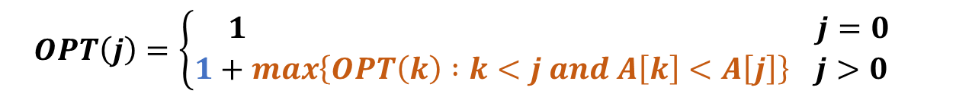
Step 2: Memory Structure
$$OPT\left(j\right)=\left\{\begin{aligned}1 j=0 \\ 1+\max\left\{OPT\left(k\right) :k<j and A\left[k\right]<A\left[j\right]\right\} j>0 \end{aligned}\right.$$
How many parameters?
  Just 1
What does each represent?
  An index in the array
How many different values?
  Length of the array
$$OPT=$$

Slide 44
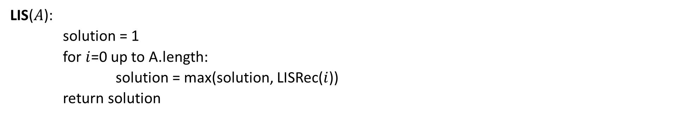
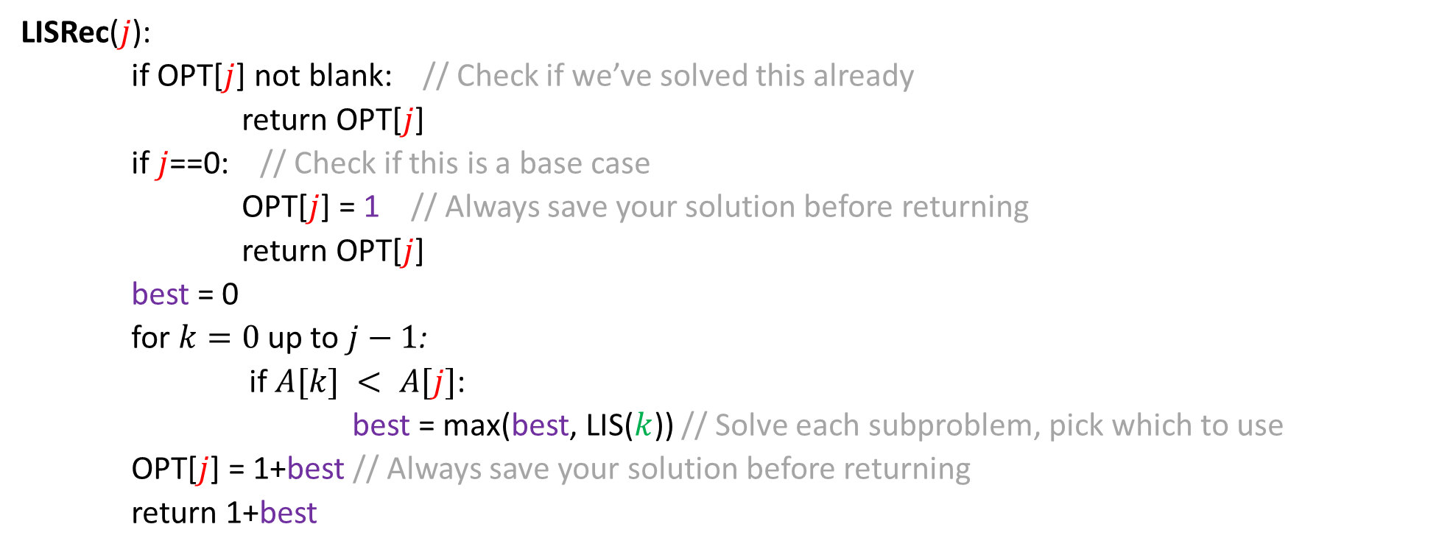
LIS Top-Down DP
LISRec($j$):
if OPT[$j$] not blank: // Check if we’ve solved this already
return OPT[$j$]
if $j$==0: // Check if this is a base case
OPT[$j$] = 1 // Always save your solution before returning
return OPT[$j$]
best = 0
for $k=0$ up to $j−1$:
if $A[k] < A[j]$:
best = max(best, LIS($k$)) // Solve each subproblem, pick which to use
OPT[$j$] = 1+best // Always save your solution before returning
return 1+best
LIS($A$):
solution = 1
for $i$=0 up to A.length:
solution = max(solution, LISRec($i$))
return solution

Slide 45
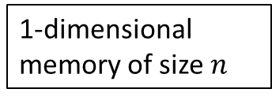
LIS – Four Steps
Formulate the answer with a recursive structure
  What are the options for the last choice?
  For each such option, what does the subproblem look like? How do we use it?
Choose a memory structure.
  Figure out the possible values of all parameters in the recursive calls.
  How many subproblems (options for last choice) are there?
  What are the parameters needed to identify each?
  How many different values could there be per parameter?
Specify an order of evaluation.
  Want to guarantee that the necessary subproblem solutions are in memory when you need them.
  With this step: a “Bottom-up” (iterative) algorithm
  Without this step: a “Top-down” (recursive) algorithm
See if there’s a way to save space
  Is it possible to reuse some memory locations?
6 | 3 | 4 | 2 | 7 | 5 | 10 | 6 | 8 | 5
$$1+\max\left\{OPT\left(k\right) :k<j and A\left[k\right]<A\left[j\right]\right\}$$
1-dimensional memory of size $n$

Slide 46


Step 2: Memory Structure
$$OPT\left(j\right)=\left\{\begin{aligned}1 j=0 \\ 1+\max\left\{OPT\left(k\right) :k<j and A\left[k\right]<A\left[j\right]\right\} j>0 \end{aligned}\right.$$
$$OPT=$$
For each choice of $j$ we might need any solution before it
Solve in order of increasing index.

Slide 47
LIS – Four Steps
Formulate the answer with a recursive structure
  What are the options for the last choice?
  For each such option, what does the subproblem look like? How do we use it?
Choose a memory structure.
  Figure out the possible values of all parameters in the recursive calls.
  How many subproblems (options for last choice) are there?
  What are the parameters needed to identify each?
  How many different values could there be per parameter?
Specify an order of evaluation.
  Want to guarantee that the necessary subproblem solutions are in memory when you need them.
  With this step: a “Bottom-up” (iterative) algorithm
  Without this step: a “Top-down” (recursive) algorithm
See if there’s a way to save space
  Is it possible to reuse some memory locations?
6 | 3 | 4 | 2 | 7 | 5 | 10 | 6 | 8 | 5
$$1+\max\left\{OPT\left(k\right) :k<j and A\left[k\right]<A\left[j\right]\right\}$$
1-dimensional memory of size $n$
Increasing order of index

Slide 48
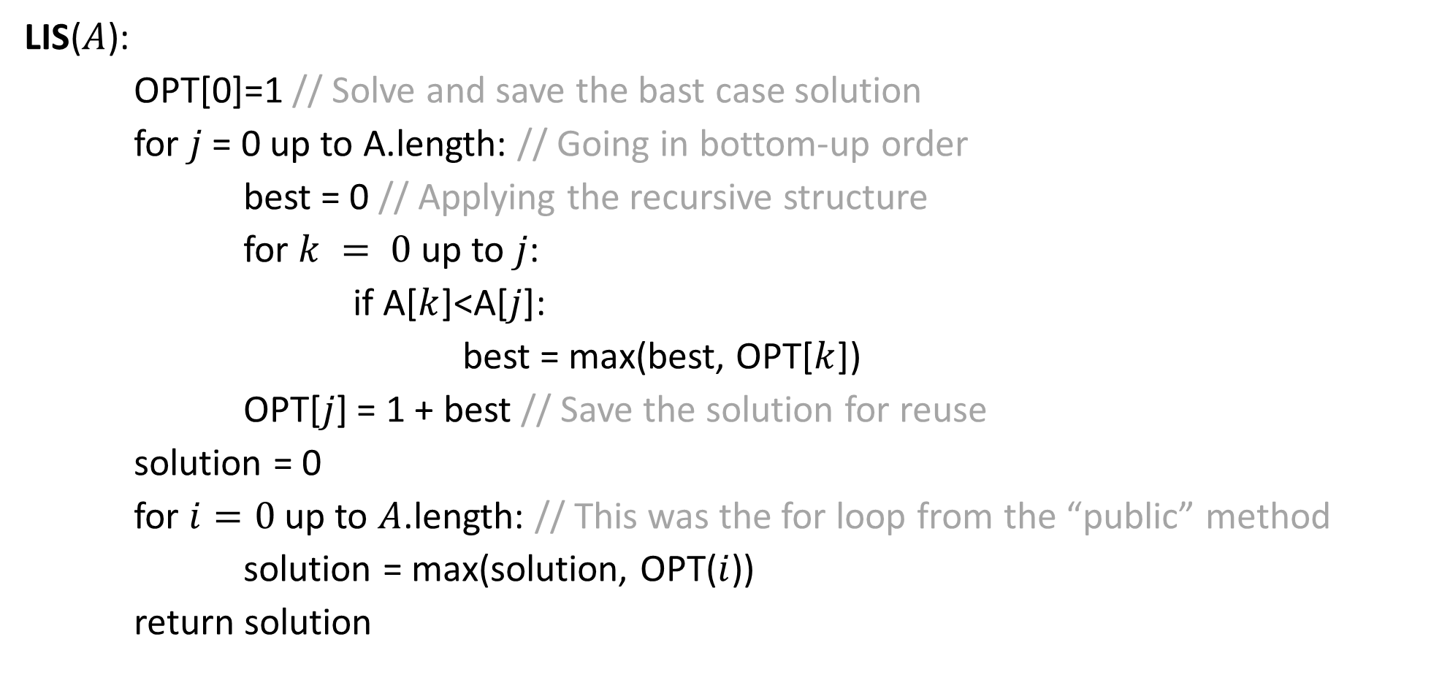
LIS Bottom-up DP
LIS($A$):
OPT[0]=1 // Solve and save the bast case solution
for $j$ = 0 up to A.length: // Going in bottom-up order
best = 0 // Applying the recursive structure
for $k = 0$ up to $j$:
if A[$k$]<A[$j$]:
best = max(best, OPT[$k$])
OPT[$j$] = 1 + best // Save the solution for reuse
solution = 0
for $i=0$ up to $A$.length: // This was the for loop from the “public” method
solution = max(solution, OPT($i$))
return solution

Slide 49
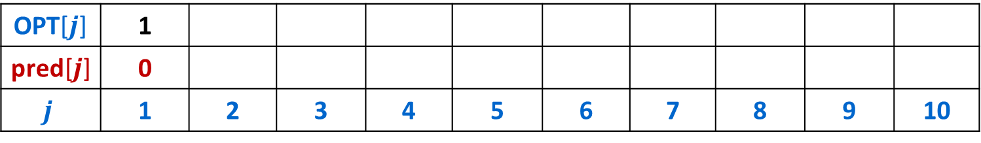

Longest Increasing Subsequence (LIS)
Given: An array $A$ of $n$ integers.
Find: A longest possible sequence $i_{1}<i_{2}<…<i_{k}$ such that $A\left[i_{1}\right]<A\left[i_{2}\right]<⋯<A[i_{k}]$.
6 | 3 | 4 | 2 | 7 | 5 | 10 | 6 | 8 | 5
OPT[$j$] | 1
pred[$j$] | 0
$$j$$ | 1 | 2 | 3 | 4 | 5 | 6 | 7 | 8 | 9 | 10

Slide 50
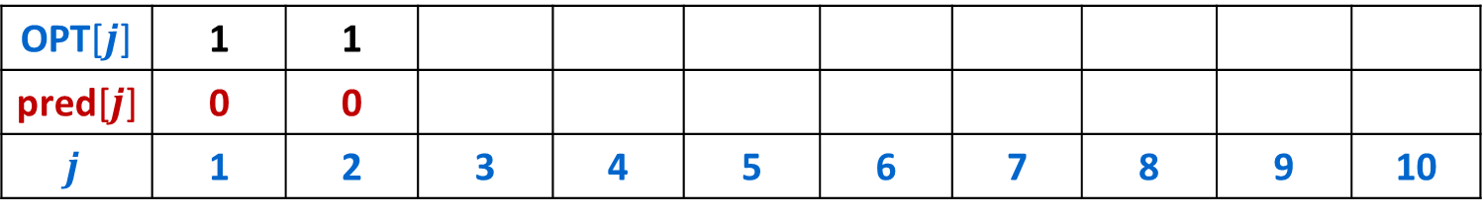

Longest Increasing Subsequence (LIS)
Given: An array $A$ of $n$ integers.
Find: A longest possible sequence $i_{1}<i_{2}<…<i_{k}$ such that $A\left[i_{1}\right]<A\left[i_{2}\right]<⋯<A[i_{k}]$.
6 | 3 | 4 | 2 | 7 | 5 | 10 | 6 | 8 | 5
OPT[$j$] | 1 | 1
pred[$j$] | 0 | 0
$$j$$ | 1 | 2 | 3 | 4 | 5 | 6 | 7 | 8 | 9 | 10

Slide 51
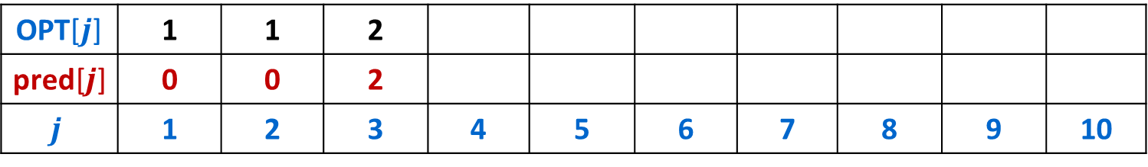
Longest Increasing Subsequence (LIS)
Given: An array $A$ of $n$ integers.
Find: A longest possible sequence $i_{1}<i_{2}<…<i_{k}$ such that $A\left[i_{1}\right]<A\left[i_{2}\right]<⋯<A[i_{k}]$.
6 | 3 | 4 | 2 | 7 | 5 | 10 | 6 | 8 | 5
OPT[$j$] | 1 | 1 | 2
pred[$j$] | 0 | 0 | 2
$$j$$ | 1 | 2 | 3 | 4 | 5 | 6 | 7 | 8 | 9 | 10

Slide 52
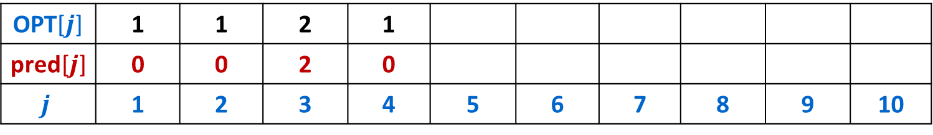

Longest Increasing Subsequence (LIS)
Given: An array $A$ of $n$ integers.
Find: A longest possible sequence $i_{1}<i_{2}<…<i_{k}$ such that $A\left[i_{1}\right]<A\left[i_{2}\right]<⋯<A[i_{k}]$.
6 | 3 | 4 | 2 | 7 | 5 | 10 | 6 | 8 | 5
OPT[$j$] | 1 | 1 | 2 | 1
pred[$j$] | 0 | 0 | 2 | 0
$$j$$ | 1 | 2 | 3 | 4 | 5 | 6 | 7 | 8 | 9 | 10

Slide 53
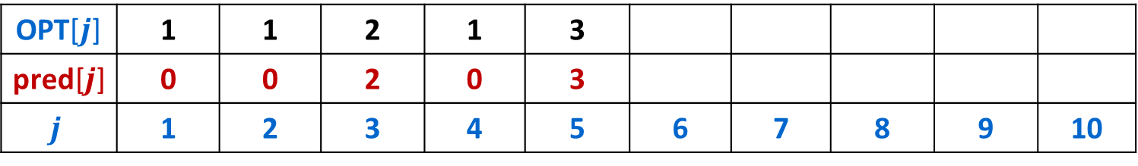
Longest Increasing Subsequence (LIS)
Given: An array $A$ of $n$ integers.
Find: A longest possible sequence $i_{1}<i_{2}<…<i_{k}$ such that $A\left[i_{1}\right]<A\left[i_{2}\right]<⋯<A[i_{k}]$.
6 | 3 | 4 | 2 | 7 | 5 | 10 | 6 | 8 | 5
OPT[$j$] | 1 | 1 | 2 | 1 | 3
pred[$j$] | 0 | 0 | 2 | 0 | 3
$$j$$ | 1 | 2 | 3 | 4 | 5 | 6 | 7 | 8 | 9 | 10

Slide 54
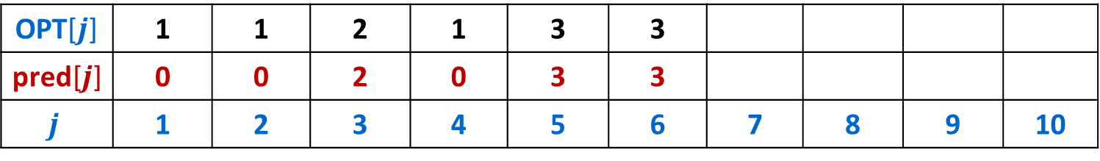

Longest Increasing Subsequence (LIS)
Given: An array $A$ of $n$ integers.
Find: A longest possible sequence $i_{1}<i_{2}<…<i_{k}$ such that $A\left[i_{1}\right]<A\left[i_{2}\right]<⋯<A[i_{k}]$.
6 | 3 | 4 | 2 | 7 | 5 | 10 | 6 | 8 | 5
OPT[$j$] | 1 | 1 | 2 | 1 | 3 | 3
pred[$j$] | 0 | 0 | 2 | 0 | 3 | 3
$$j$$ | 1 | 2 | 3 | 4 | 5 | 6 | 7 | 8 | 9 | 10

Slide 55
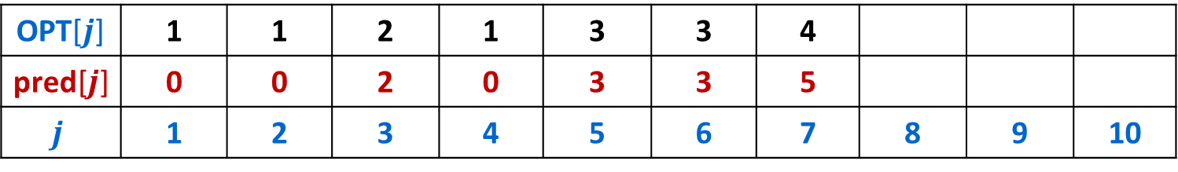
Longest Increasing Subsequence (LIS)
Given: An array $A$ of $n$ integers.
Find: A longest possible sequence $i_{1}<i_{2}<…<i_{k}$ such that $A\left[i_{1}\right]<A\left[i_{2}\right]<⋯<A[i_{k}]$.
6 | 3 | 4 | 2 | 7 | 5 | 10 | 6 | 8 | 5
OPT[$j$] | 1 | 1 | 2 | 1 | 3 | 3 | 4
pred[$j$] | 0 | 0 | 2 | 0 | 3 | 3 | 5
$$j$$ | 1 | 2 | 3 | 4 | 5 | 6 | 7 | 8 | 9 | 10

Slide 56
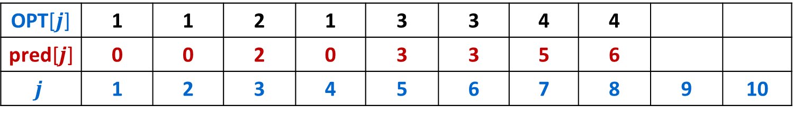

Longest Increasing Subsequence (LIS)
Given: An array $A$ of $n$ integers.
Find: A longest possible sequence $i_{1}<i_{2}<…<i_{k}$ such that $A\left[i_{1}\right]<A\left[i_{2}\right]<⋯<A[i_{k}]$.
6 | 3 | 4 | 2 | 7 | 5 | 10 | 6 | 8 | 5
OPT[$j$] | 1 | 1 | 2 | 1 | 3 | 3 | 4 | 4
pred[$j$] | 0 | 0 | 2 | 0 | 3 | 3 | 5 | 6
$$j$$ | 1 | 2 | 3 | 4 | 5 | 6 | 7 | 8 | 9 | 10

Slide 57
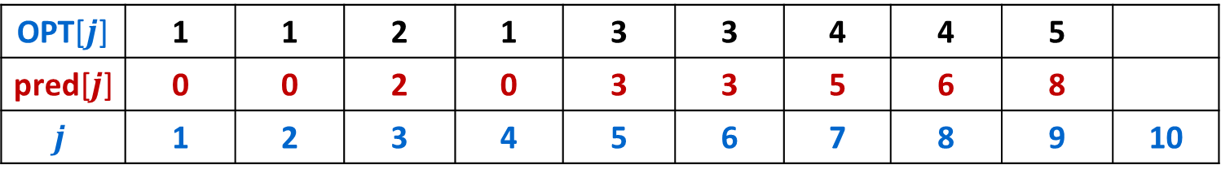

Longest Increasing Subsequence (LIS)
Given: An array $A$ of $n$ integers.
Find: A longest possible sequence $i_{1}<i_{2}<…<i_{k}$ such that $A\left[i_{1}\right]<A\left[i_{2}\right]<⋯<A[i_{k}]$.
6 | 3 | 4 | 2 | 7 | 5 | 10 | 6 | 8 | 5
OPT[$j$] | 1 | 1 | 2 | 1 | 3 | 3 | 4 | 4 | 5
pred[$j$] | 0 | 0 | 2 | 0 | 3 | 3 | 5 | 6 | 8
$$j$$ | 1 | 2 | 3 | 4 | 5 | 6 | 7 | 8 | 9 | 10

Slide 58
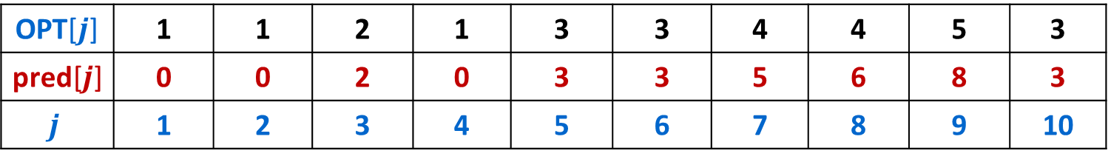
Longest Increasing Subsequence (LIS)
Given: An array $A$ of $n$ integers.
Find: A longest possible sequence $i_{1}<i_{2}<…<i_{k}$ such that $A\left[i_{1}\right]<A\left[i_{2}\right]<⋯<A[i_{k}]$.
6 | 3 | 4 | 2 | 7 | 5 | 10 | 6 | 8 | 5
OPT[$j$] | 1 | 1 | 2 | 1 | 3 | 3 | 4 | 4 | 5 | 3
pred[$j$] | 0 | 0 | 2 | 0 | 3 | 3 | 5 | 6 | 8 | 3
$$j$$ | 1 | 2 | 3 | 4 | 5 | 6 | 7 | 8 | 9 | 10

Slide 59


Longest Increasing Subsequence (LIS)
Given: An array $A$ of $n$ integers.
Find: A longest possible sequence $i_{1}<i_{2}<…<i_{k}$ such that $A\left[i_{1}\right]<A\left[i_{2}\right]<⋯<A[i_{k}]$.
6 | 3 | 4 | 2 | 7 | 5 | 10 | 6 | 8 | 5
OPT[$j$] | 1 | 1 | 2 | 1 | 3 | 3 | 4 | 4 | 5 | 3
pred[$j$] | 0 | 0 | 2 | 0 | 3 | 3 | 5 | 6 | 8 | 3
$$j$$ | 1 | 2 | 3 | 4 | 5 | 6 | 7 | 8 | 9 | 10

Slide 60




Dynamic Programming Patterns
Fibonacci pattern:
  1-D, $O(1)$ immediately prior
  $O(1)$ space
Weighted interval scheduling pattern:
  1-D, $O(1)$ arbitrary prior
  $O(n)$ space
Longest increasing subsequence pattern:
  1-D, all $n−1$ prior
  $O(n)$ space
$$O(n)$$
$$O(n)$$
$$O(n^{2})$$

Slide 61
Dynamic Programming Patterns
Fibonacci pattern:
  1-dimensional, $O(1)$ values immediately prior
  Space saving possible
Weighted interval scheduling pattern:
  1-dimensional, $O(1)$values arbitrarily far back
  No space saving possible

Slide 62
String Similarity
o
c
u
r
r
a
n
c
e
-
How similar are two strings?
  ocurrance
  occurrence
o
c
c
u
r
r
e
n
c
e
6 mismatches, 1 gap
Clearly a better matching
o
c
-
u
r
r
a
n
c
e
o
c
c
u
r
r
e
n
c
e
1 mismatch, 1 gap
Maybe a better matching
depends on cost of gaps vs mismatches
o
c
-
u
r
r
-
a
n
c
e
o
c
c
u
r
r
e
-
n
c
e
0 mismatches, 3 gaps

Slide 63



Edit Distance
Applications:
  Basis for Unix diff.
  Speech recognition.
  Computational biology.
  autocorrect
Edit distance: [Levenshtein 1966, Needleman-Wunsch 1970]
  Gap penalty $δ$; mismatch penalty $α_{pq}$ if symbol $p$ is replaced by symbol $q$.
  Cost = gap penalties + mismatch penalties.
C
T
G
A
C
C
T
A
C
C
T
-
C
T
G
A
C
C
T
A
C
C
T
C
C
T
G
A
C
T
A
C
A
T
C
C
T
G
A
C
-
T
A
C
A
T
$$α_{\text{TC}}+α_{\text{GT}}+α_{\text{AG}}+2α_{\text{CA}}$$
$$2δ+α_{\text{CA}}$$
Notes:
Levenshtein introduced concept of edit-distance; Needleman-Wunsch first applied it to aligning biological sequences; our algorithm is closest in spirit to Smith-Waterman (but their algorithm is for local alignment)
Presumably alpha_pp = 0, but assumption not needed (could be a profit instead of penalty)
bonus application: spam filter - compare message with known spam messages

Slide 64
















Sequence Alignment
Sequence Alignment:
  Given: Two strings $X=x_{1}x_{2}…x_{m}$ and $Y=y_{1}y_{2}…y_{n}$
  Find: “Alignment” of $X$ and $Y$ of minimum edit cost.
Defn: An alignment $M$ of $X$ and $Y$ is a set of ordered pairs $x_{i}$-$y_{j}$ s.t. each symbol of $X$ and $Y$ occurs in at most one pair with no “crossing pairs”.
  The pairs $x_{i}$-$y_{j}$ and $x_{i^{′}}$-$y_{j^{′}}$ cross iff $i<i′$ but $j>j′$.
Example:
CTACCG vs TACATG
$$x_{1}$$
$$x_{2}$$
$$x_{3}$$
$$x_{4}$$
$$x_{5}$$
$$x_{6}$$
C
T
A
C
C
-
G
$$cost\left(M\right)=\sum_{\left(x_{i},y_{j}\right)∈M}{α_{x_{i}y_{j}}}+\sum_{i :{ x}_{i} unmatched}{δ}+\sum_{j:{ y}_{j} unmatched}{δ}$$
-
T
A
C
A
T
G
$$y_{1}$$
$$y_{2}$$
$$y_{3}$$
$$y_{4}$$
$$y_{5}$$
$$y_{6}$$
mismatch
gap
$M=\{x_{2}\text{−}y_{1}$, $x_{3}$-$y_{2}$, $x_{4}$-$y_{3}$, $x_{5}$-$y_{4}$, $x_{6}$-$y_{6}$}
Note: if $x_{i}=y_{j}$ then $α_{x_{i}y_{j}}=0$

Slide 65
Edit Distance – Four Steps
Formulate the answer with a recursive structure
  What are the options for the last choice?
  For each such option, what does the subproblem look like? How do we use it?
Choose a memory structure.
  Figure out the possible values of all parameters in the recursive calls.
  How many subproblems (options for last choice) are there?
  What are the parameters needed to identify each?
  How many different values could there be per parameter?
Specify an order of evaluation.
  Want to guarantee that the necessary subproblem solutions are in memory when you need them.
  With this step: a “Bottom-up” (iterative) algorithm
  Without this step: a “Top-down” (recursive) algorithm
See if there’s a way to save space
  Is it possible to reuse some memory locations?

Slide 66































Step 1: Identify Recursive Structure
$$x_{1}$$
$$x_{2}$$
$$x_{3}$$
$$x_{4}$$
$$x_{5}$$
$$x_{6}$$
C
T
A
C
C
G
Consider the last two indices $x_{i}$ and $y_{j}$
Options for what to do with them:
T
A
C
A
T
G
$$y_{1}$$
$$y_{2}$$
$$y_{3}$$
$$y_{4}$$
$$y_{5}$$
$$y_{6}$$
$$x_{1}$$
$$x_{2}$$
$$x_{3}$$
$$x_{4}$$
$$x_{5}$$
$$x_{6}$$
C
T
A
C
C
G
We use up one index from $x$ and $y$
Accrue a mismatch penalty
$$OPT\left(i−1,j−1\right)+α_{x_{i}y_{j}}$$
Option 1:
Match them
T
A
C
A
T
G
$$OPT\left(i,j\right)=\left\{\begin{aligned}j⋅δ if i=0 \\ i⋅δ if j=0 \\ \min\left\{\begin{aligned}OPT\left(i−1,j−1\right)+α_{x_{i}y_{j}} \\ OPT\left(i−1,j\right)+δ \\ OPT\left(i,j−1\right)+δ\end{aligned}\right.\end{aligned}\right.$$
$$y_{1}$$
$$y_{2}$$
$$y_{3}$$
$$y_{4}$$
$$y_{5}$$
$$y_{6}$$
$$x_{1}$$
$$x_{2}$$
$$x_{3}$$
$$x_{4}$$
$$x_{5}$$
$$x_{6}$$
C
T
A
C
C
G
We use up one index from $x$ only
Accrue a gap penalty
$$OPT\left(i−1,j\right)+δ$$
Option 2:
Don’t match $x_{i}$
T
A
C
A
T
G
-
$$y_{1}$$
$$y_{2}$$
$$y_{3}$$
$$y_{4}$$
$$y_{5}$$
$$y_{6}$$
$$x_{1}$$
$$x_{2}$$
$$x_{3}$$
$$x_{4}$$
$$x_{5}$$
$$x_{6}$$
Option 3:
Don’t match $y_{i}$
-
We use up one index from $y$ only
Accrue a gap penalty
$$OPT\left(i,j−1\right)+δ$$
C
T
A
C
C
G
T
A
C
A
T
G
$$y_{1}$$
$$y_{2}$$
$$y_{3}$$
$$y_{4}$$
$$y_{5}$$
$$y_{6}$$

Slide 67
Edit Distance – Four Steps
C
T
A
C
C
G
Formulate the answer with a recursive structure
  What are the options for the last choice?
  For each such option, what does the subproblem look like? How do we use it?
Choose a memory structure.
  Figure out the possible values of all parameters in the recursive calls.
  How many subproblems (options for last choice) are there?
  What are the parameters needed to identify each?
  How many different values could there be per parameter?
Specify an order of evaluation.
  Want to guarantee that the necessary subproblem solutions are in memory when you need them.
  With this step: a “Bottom-up” (iterative) algorithm
  Without this step: a “Top-down” (recursive) algorithm
See if there’s a way to save space
  Is it possible to reuse some memory locations?
T
A
C
A
T
G
-
C
T
A
C
C
G
C
T
A
C
C
G
-
T
A
C
A
T
G
T
A
C
A
T
G

Slide 68
















Step 2: Identify Memory Structure
$$x_{1}$$
$$x_{2}$$
$$x_{3}$$
$$x_{4}$$
$$x_{5}$$
$$x_{6}$$
C
T
A
C
C
G
T
A
C
A
T
G
$$OPT\left(i,j\right)=\left\{\begin{aligned}j⋅δ if i=0 \\ i⋅δ if j=0 \\ \min\left\{\begin{aligned}OPT\left(i−1,j−1\right)+α_{x_{i}y_{j}} \\ OPT\left(i−1,j\right)+δ \\ OPT\left(i,j−1\right)+δ\end{aligned}\right.\end{aligned}\right.$$
$$y_{1}$$
$$y_{2}$$
$$y_{3}$$
$$y_{4}$$
$$y_{5}$$
$$y_{6}$$
How many parameters?
  2
What does each represent?
  The number of items in each sequence
How many different values?
  Length of sequence $x$ for $i$
  Length of sequence $y$ for $j$
  $n⋅m$ overall
$$y_{1}$$
$$y_{2}$$
$$y_{3}$$
$$y_{4}$$
$$y_{5}$$
$$y_{6}$$
$$y_{7}$$
$$y_{8}$$
$$x_{1}$$
$$x_{2}$$
$$x_{3}$$
$$x_{4}$$
$$x_{5}$$
$$x_{6}$$

Slide 69

Top-Down Sequence Alignment
align($i,j$):
if OPT[$i$][$j$] not blank: // Check if we’ve solved this already
return OPT[$i$][$j$]
if $i⋅j==0$: // Check if this is a base case
solution = $(i+j)⋅δ$
OPT[$i$][$j$] = solution // Always save your solution before returning
return solution
match = align($i−1,j−1$) // solve each subproblem
gapx = align($i−1$,$j$) // solve each subproblem
gapy = align($j,i−1$) // solve each subproblem
solution = min(match + $α_{x_{i}y_{j}}$, gapx + $δ$, gapy+ $δ$) // Pick the subproblem to use
OPT[$i$][$j$] = solution // Always save your solution before returning
return solution

Slide 70
Edit Distance – Four Steps
C
T
A
C
C
G
Formulate the answer with a recursive structure
  What are the options for the last choice?
  For each such option, what does the subproblem look like? How do we use it?
Choose a memory structure.
  Figure out the possible values of all parameters in the recursive calls.
  How many subproblems (options for last choice) are there?
  What are the parameters needed to identify each?
  How many different values could there be per parameter?
Specify an order of evaluation.
  Want to guarantee that the necessary subproblem solutions are in memory when you need them.
  With this step: a “Bottom-up” (iterative) algorithm
  Without this step: a “Top-down” (recursive) algorithm
See if there’s a way to save space
  Is it possible to reuse some memory locations?
T
A
C
A
T
G
-
C
T
A
C
C
G
C
T
A
C
C
G
-
T
A
C
A
T
G
T
A
C
A
T
G

Slide 71
















Step 3: Identify Order of Evaluation
$$y_{1}$$
$$y_{2}$$
$$y_{3}$$
$$y_{4}$$
$$y_{5}$$
$$y_{6}$$
$$y_{7}$$
$$y_{8}$$
$$OPT\left(i,j\right)=\left\{\begin{aligned}j⋅δ if i=0 \\ i⋅δ if j=0 \\ \min\left\{\begin{aligned}OPT\left(i−1,j−1\right)+α_{x_{i}y_{j}} \\ OPT\left(i−1,j\right)+δ \\ OPT\left(i,j−1\right)+δ\end{aligned}\right.\end{aligned}\right.$$
$$x_{1}$$
$$x_{2}$$
$$x_{3}$$
$$x_{4}$$
4,6
$$x_{5}$$
$$x_{6}$$
Any of these orders will work:
Top-to-bottom, then left-to-right
Left-to-right, then top-to-bottom
Diagonally
Each index depends on 3 others:
The one above it: $\left(i−1,j\right)$
The one to its left: $\left(i,j−1\right)$
The one to it’s upper left: $\left(i−1,j−1\right)$

Slide 72

Bottom-Up Sequence Alignment
align($x,y$):
for $i=0$ up to $n$:
OPT[$i$][$0$] = 0 // Solve and save base cases
for $j=0$ up to $m$:
OPT[0][$j$] = 0 // Solve and save base cases
for $i=1$ up to $n$:
for $j=1$ up to $m$:
match = OPT[$i−1$][$j−1$] // solve each subproblem
gapx = OPT[$i$][$j−1$] // solve each subproblem
gapy = OPT[$i−1$][$j$] // solve each subproblem
solution = min(match + $α_{x_{i}y_{j}}$, gapx + $δ$, gapy+ $δ$) // pick solution
OPT[$i$][$j$] = solution // save solution
return OPT[$n$][$m$]

Slide 73
Edit Distance – Four Steps
C
T
A
C
C
G
Formulate the answer with a recursive structure
  What are the options for the last choice?
  For each such option, what does the subproblem look like? How do we use it?
Choose a memory structure.
  Figure out the possible values of all parameters in the recursive calls.
  How many subproblems (options for last choice) are there?
  What are the parameters needed to identify each?
  How many different values could there be per parameter?
Specify an order of evaluation.
  Want to guarantee that the necessary subproblem solutions are in memory when you need them.
  With this step: a “Bottom-up” (iterative) algorithm
  Without this step: a “Top-down” (recursive) algorithm
See if there’s a way to save space
  Is it possible to reuse some memory locations?
T
A
C
A
T
G
-
C
T
A
C
C
G
C
T
A
C
C
G
-
T
A
C
A
T
G
T
A
C
A
T
G

Slide 74

Example run with AGACATTG and GAGTTA: $δ=α_{mis}=1$
A
G
A
C
A
T
T
G
0
1
2
3
4
5
6
7
8
G
1
A
2
G
3
T
4
T
5
A
6

Slide 75
Example run with AGACATTG and GAGTTA: $δ=α_{mis}=1$
A
G
A
C
A
T
T
G
0
1
2
3
4
5
6
7
8
G
1
1
1
2
3
4
5
6
7
A
2
G
3
T
4
T
5
A
6

Slide 76
Example run with AGACATTG and GAGTTA: $δ=α_{mis}=1$
A
G
A
C
A
T
T
G
0
1
2
3
4
5
6
7
8
G
1
1
1
2
3
4
5
6
7
A
2
1
2
1
G
3
T
4
T
5
A
6

Slide 77
Example run with AGACATTG and GAGTTA: $δ=α_{mis}=1$
A
G
A
C
A
T
T
G
0
1
2
3
4
5
6
7
8
G
1
1
1
2
3
4
5
6
7
A
2
1
2
1
2
3
4
5
6
G
3
2
1
2
2
3
4
5
5
T
4
T
5
A
6

Slide 78
Example run with AGACATTG and GAGTTA: $δ=α_{mis}=1$
A
G
A
C
A
T
T
G
0
1
2
3
4
5
6
7
8
G
1
1
1
2
3
4
5
6
7
A
2
1
2
1
2
3
4
5
6
G
3
2
1
2
2
3
4
5
5
T
4
3
2
2
3
3
3
4
5
T
5
4
3
3
3
4
3
3
4
A
6
5
4
3
4
3
4
4
4

Slide 79
Example run with AGACATTG and GAGTTA: $δ=α_{mis}=1$
A
G
A
C
A
T
T
G
0
1
2
3
4
5
6
7
8
G
1
1
1
2
3
4
5
6
7
A
2
1
2
1
2
3
4
5
6
G
3
2
1
2
2
3
4
5
5
T
4
3
2
2
3
3
3
4
5
T
5
4
3
3
3
4
3
3
4
A
6
5
4
3
4
3
4
4
4

Slide 80
Example run with AGACATTG and GAGTTA: $δ=α_{mis}=1$
A
G
A
C
A
T
T
G
0
1
2
3
4
5
6
7
8
G
1
1
1
2
3
4
5
6
7
A
2
1
2
1
2
3
4
5
6
Optimal Alignment
A G A C A T T G
_ G A G _ T T A
G
3
2
1
2
2
3
4
5
5
T
4
3
2
2
3
3
3
4
5
T
5
4
3
3
3
4
3
3
4
A
6
5
4
3
4
3
4
4
4

Slide 81






Dynamic Programming Patterns
Fibonacci pattern:
  1-D, $O(1)$ immediately prior
  $O(1)$ space
Weighted interval scheduling pattern:
  1-D, $O(1)$ arbitrary prior
  $O(n)$ space
Longest increasing subsequence pattern:
  1-D, all $n−1$ prior
  $O(n)$ space
Alignment pattern:
  2-D, O(1) in previous row, above and arbitrary prior
  $O(n⋅m)$ space
$$O(n)$$
$$O(n)$$
$$O(nm)$$
$$O(n^{2})$$

