Slide 1
CSE 421 Winter 2025
Lecture 12: Dynamic Programming
Nathan Brunelle
http://www.cs.uw.edu/421

Slide 2
Algorithmic Paradigms
Greedy: Build up a solution incrementally, myopically optimizing some local criterion.
Divide-and-conquer: Break up a problem into sub-problems (each typically a constant factor smaller), solve each sub-problem independently, and combine solution to sub-problems to form solution to original problem.
Dynamic programming: Break up a problem into a series of overlapping sub-problems, and build up solutions to larger and larger sub-problems.
Notes:
overlapping sub-problem = sub-problem whose results can be reused several times

Slide 3
Algorithm Design Techniques
Dynamic Programming:
  Technique for making building solution to a problem based on solutions to smaller subproblems (recursive ideas).
  The subproblems just have to be smaller, but don’t need to be a constant-factor smaller like divide and conquer.
  Useful when the same subproblems show up over and over again
  The final solution is simple iterative code when the following holds:
    The parameters to all the subproblems are predictable in advance

Slide 4
Dynamic Programming History
Bellman. [1950s] Pioneered the systematic study of dynamic programming.
Etymology
  Dynamic programming = planning over time.
  Secretary of Defense was hostile to mathematical research.
  Bellman sought an impressive name to avoid confrontation.
"it's impossible to use dynamic in a pejorative sense"
"something not even a Congressman could object to"
Reference: Bellman, R. E. Eye of the Hurricane, An Autobiography.

Slide 5


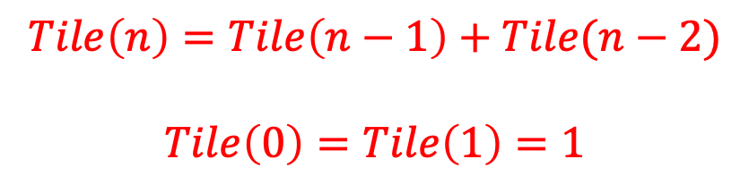

How many ways are there to tile a $2×n$ board with dominoes?
Two ways to fill the final column:
$$Tile\left(n\right)=Tile\left(n−1\right)+Tile(n−2)$$
$$Tile\left(0\right)=Tile\left(1\right)=1$$
$$n−1$$
$$n−2$$

Slide 6

How to compute $Tile(n)$?
Tile(n):
if n < 2:
return 1
return Tile(n-1)+Tile(n-2)
Running Time?

Slide 7
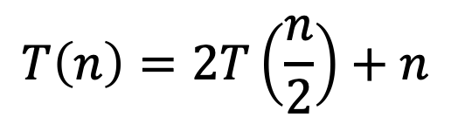
Recursion Tree
Tile(5)
Tile(4)
Tile(3)
Tile(3)
Tile(2)
Tile(2)
Tile(1)
Tile(2)
Tile(1)
Tile(1)
Tile(0)
Tile(1)
Tile(0)
Tile(1)
Tile(0)
Many redundant calls!
Run time: $Ω(2^{n})$
Better way: Use Memory!

Slide 8
Recursion Tree
Tile(5)
Tile(4)
Tile(3)
Tile(3)
Tile(2)
Tile(2)
Tile(1)
Tile(2)
Tile(1)
Tile(1)
Tile(0)
Tile(1)
Tile(0)
Tile(1)
Tile(0)
Many redundant calls!
Run time: $Ω(2^{n})$
Better way: Use Memory!

Slide 9

Computing $Tile(n)$ with Memory
Initialize Memory M
Tile(n):
if n < 2:
return 1
if M[n] is filled:
return M[n]
M[n] = Tile(n-1)+Tile(n-2)
return M[n]
M
0
1
2
3
4
5
6
Technique: “memoization” (note no “r”)

Slide 10
Computing $Tile(n)$ with Memory - “Top Down”
Initialize Memory M
Tile(n):
if n < 2:
return 1
if M[n] is filled:
return M[n]
M[n] = Tile(n-1)+Tile(n-2)
return M[n]
M
1
0
1
1
2
2
3
3
5
4
8
5
13
6

Slide 11
Computing $Tile(n)$ with Memory - “Top Down”
Initialize Memory M
Tile(n):
if n < 2:
return 1
if M[n] is filled:
return M[n]
M[n] = Tile(n-1)+Tile(n-2)
return M[n]
M
1
0
1
1
2
2
3
3
5
4
8
5
13
6
Recursive calls happen in a predictable order

Slide 12
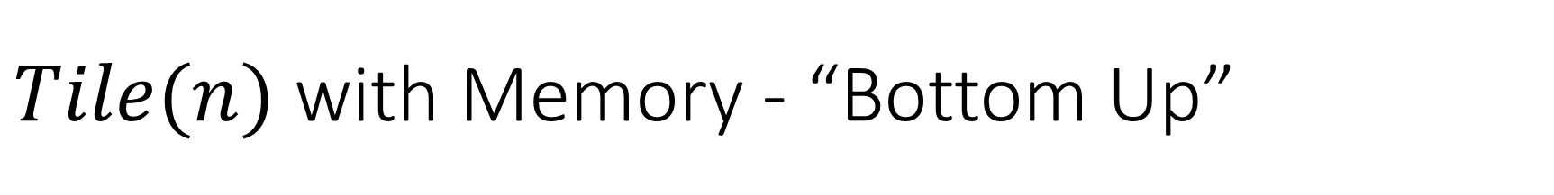
$Tile(n)$ with Memory - “Bottom Up”
Tile(n):
Initialize Memory M
M[0] = 1
M[1] = 1
for i = 2 to n:
M[i] = M[i-1] + M[i-2]
return M[n]
M
0
1
2
3
4
5
6

Slide 13

Better $Tile(n)$ with Memory - “Bottom Up”
Tile(n):
M[0] = 1
M[1] = 1
answer = -1
for i = 2 to n:
answer = M[0]+M[1]
M[0] = M[1]
M[1] = answer
return M[1]
M
0
1
Observation: We only need to remember the last two subproblems!

Slide 14

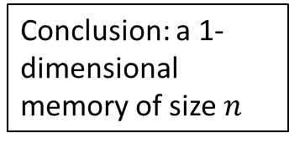

Four Steps to Dynamic Programming
Formulate the answer with a recursive structure
  What are the options for the last choice?
  For each such option, what does the subproblem look like? How do we use it?
Choose a memory structure.
  Figure out the possible values of all parameters in the recursive calls.
  How many subproblems (options for last choice) are there?
  What are the parameters needed to identify each?
  How many different values could there be per parameter?
Specify an order of evaluation.
  Want to guarantee that the necessary subproblem solutions are in memory when you need them.
  With this step: a “Bottom-up” (iterative) algorithm
  Without this step: a “Top-down” (recursive) algorithm
See if there’s a way to save space
  Is it possible to reuse some memory locations?
$$n−1$$
M
$$n−2$$
0
1
Conclusion: a 1-dimensional memory of size $n$
2
3
4
5
M
6
0
1
2
3
4
5
6
M
0
1

Slide 15
Top-Down DP Idea
def myDPalgo(problem):
if mem[problem] not blank: // Check if we’ve solved this already
return mem[problem]
if baseCase(problem): // Check if this is a base case
solution = solve(problem)
mem[problem] = solution // Always save your solution before returning
return solution
for subproblem of problem:
subsolutions.append(myDPalgo(subproblem)) // solve each subproblem
solution = selectAndExtend(subsolutions) // Pick the subproblem to use
mem[problem] = solution // Always save your solution before returning
return solution

Slide 16
Bottom-Up DP Idea
def myDPalgo(problem):
for each baseCase: // Identify which subproblems are base cases
solution = solve(baseCase)
mem[baseCase] = solution // Save the solution for reuse
for each subproblem in bottom-up order:
// The order should be chosen so that every subsolution is
// guaranteed to already be in memory when it’s needed
solution = selectAndExtend(subsolutions)
mem[subproblem] = solution // Save the solution for reuse
return mem[problem]

Slide 17
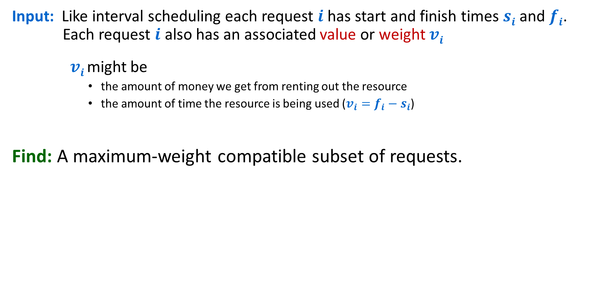
Weighted Interval Scheduling
Input: Like interval scheduling each request $i$has start and finish times $si$ and $fi$. Each request $i$ also has an associated value or weight $vi$
    $vi$ might be
      the amount of money we get from renting out the resource
      the amount of time the resource is being used ($v_{i}=f_{i}−s_{i}$)
Find: A maximum-weight compatible subset of requests.

Slide 18
Weighted Interval Scheduling
Input: Set of jobs with start times, finish times, and weights
Goal: Find maximum weight subset of mutually compatible jobs.
6
3
2
5
3
4
4
3
Time
0
1
2
3
4
5
6
7
8
9
10
Notes:
Activity selection = interval scheduling
OPT = B, E, H
Note: smallest job (C) is not in any optimal solution, job that starts first (A) is not in any optimal solution.

Slide 19
Weighted Interval Scheduling
Input: Set of jobs with start times, finish times, and weights
Goal: Find maximum weight subset of mutually compatible jobs.
6
3
2
Greedy by finish times would give 9
5
3
4
4
3
Time
0
1
2
3
4
5
6
7
8
9
10
Notes:
Activity selection = interval scheduling
OPT = B, E, H
Note: smallest job (C) is not in any optimal solution, job that starts first (A) is not in any optimal solution.

Slide 20
Weighted Interval Scheduling
Input: Set of jobs with start times, finish times, and weights
Goal: Find maximum weight subset of mutually compatible jobs.
6
3
2
Optimal yields 10
5
3
4
4
3
Time
0
1
2
3
4
5
6
7
8
9
10
Notes:
Activity selection = interval scheduling
OPT = B, E, H
Note: smallest job (C) is not in any optimal solution, job that starts first (A) is not in any optimal solution.

Slide 21
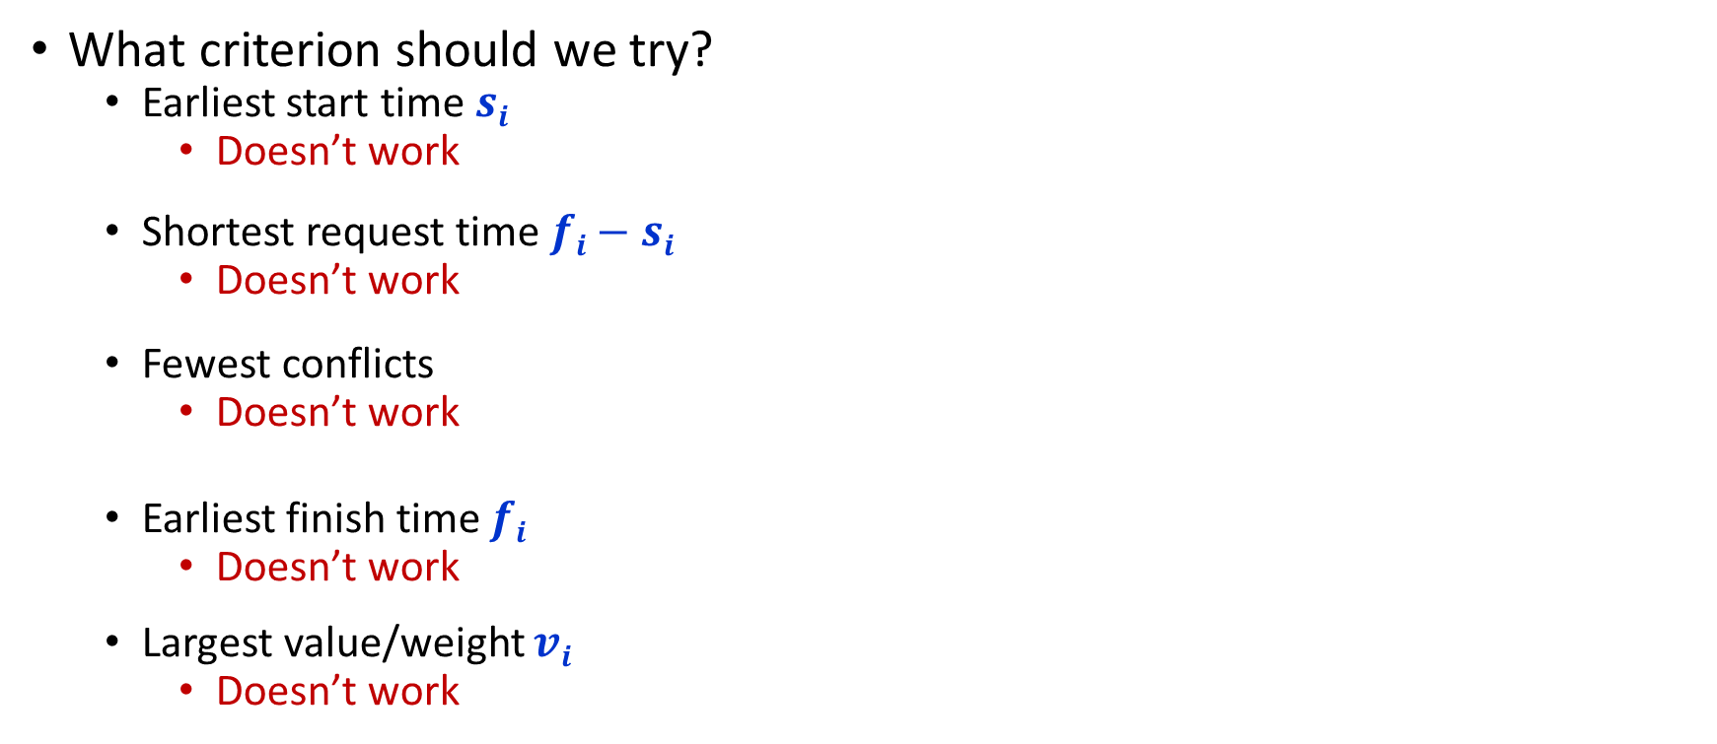
Greedy Algorithms for Weighted Interval Scheduling?
What criterion should we try?
  Earliest start time $si$
    Doesn’t work
  Shortest request time $fi−si$
    Doesn’t work
  Fewest conflicts
    Doesn’t work
  Earliest finish time $fi$
    Doesn’t work
  Largest value/weight $vi$
    Doesn’t work

Slide 22

Weighted Interval Scheduling
Notation: Label jobs by finishing time: $f_{1}≤f_{2}≤…≤f_{n}$.
3
1
2
5
4
6
7
8
Time
0
1
2
3
4
5
6
7
8
9
10
11

Slide 23

Weighted Interval Scheduling
Notation: Label jobs by finishing time: $f_{1}≤f_{2}≤…≤f_{n}$.
1
2
3
4
5
6
7
8
Time
0
1
2
3
4
5
6
7
8
9
10
11

Slide 24
Weighted Interval Scheduling – Four Steps
Formulate the answer with a recursive structure
  What are the options for the last choice?
  For each such option, what does the subproblem look like? How do we use it?
Choose a memory structure.
  Figure out the possible values of all parameters in the recursive calls.
  How many subproblems (options for last choice) are there?
  What are the parameters needed to identify each?
  How many different values could there be per parameter?
Specify an order of evaluation.
  Want to guarantee that the necessary subproblem solutions are in memory when you need them.
  With this step: a “Bottom-up” (iterative) algorithm
  Without this step: a “Top-down” (recursive) algorithm
See if there’s a way to save space
  Is it possible to reuse some memory locations?

Slide 25

Towards Dynamic Programming: Step 1 – Recursive Algorithm
Suppose that we first sort the requests by finish time $fi$ so $f1 f2 … fn$.
We now want
  a recursive solution that makes calls to smaller problems and
  the indices for those smaller problems to be convenient,
so we first focus on the options for the last request, request $n$.
Option 1: Include the last request
Option 2: Exclude the last request
1
1
2
2
3
3
4
4
5
5
6
6
7
7
8
Time
8
Time
0
1
2
3
4
5
6
7
8
9
10
11
0
1
2
3
4
5
6
7
8
9
10
11

Slide 26
Towards Dynamic Programming: Step 1 – Recursive Algorithm
Option 1: Include the last request
Option 2: Exclude the last request
1
1
2
2
3
3
4
4
5
5
6
6
7
7
8
Time
8
Time
0
1
2
3
4
5
6
7
8
9
10
11
0
1
2
3
4
5
6
7
8
9
10
11
After making this choice, the best solution possible is given by:
The value of the solution to subproblem consisting of everything compatible
Plus the value of the last request
After making this choice, the best solution possible is given by:
The value of the solution to subproblem consisting of everything except the last request
It will be convenient to be able to prune incompatible requests quickly…

Slide 27

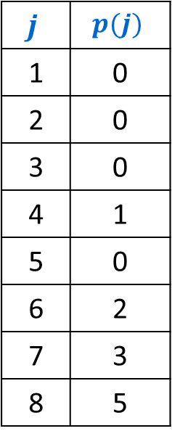
Weighted Interval Scheduling
Notation: Label jobs by finishing time: $f_{1}≤f_{2}≤…≤f_{n}$.
Defn: $p(j)$ = largest index $i<j$ s.t. job $i$ is compatible with $j$.
Example: $p(8)=5$, $p(7)=3$, $p(2)=0$
$$j$$ | $$p(j)$$
1 | 0
2 | 0
3 | 0
4 | 1
5 | 0
6 | 2
7 | 3
8 | 5
1
2
3
4
5
6
7
8
Time
0
1
2
3
4
5
6
7
8
9
10
11

Slide 28
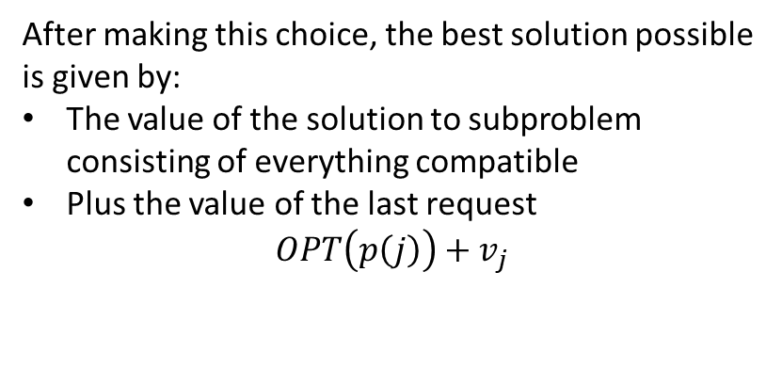
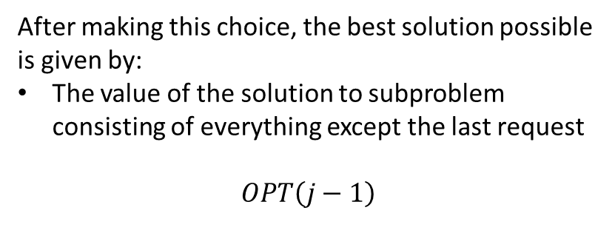
Towards Dynamic Programming: Step 1 – Recursive Algorithm
Option 1: Include the last request
Option 2: Exclude the last request
1
1
2
2
3
3
4
4
5
5
6
6
7
7
8
Time
8
Time
0
1
2
3
4
5
6
7
8
9
10
11
0
1
2
3
4
5
6
7
8
9
10
11
After making this choice, the best solution possible is given by:
The value of the solution to subproblem consisting of everything compatible
Plus the value of the last request
$$OPT\left(p\left(j\right)\right)+v_{j}$$
After making this choice, the best solution possible is given by:
The value of the solution to subproblem consisting of everything except the last request
$$OPT\left(j−1\right)$$
$$OPT\left(j\right)=\max\left\{OPT\left(p\left(j\right)\right)+v_{j}, OPT\left(j−1\right)\right\}$$

Slide 29

Weighted Interval Scheduling – Four Steps
1
2
1
2
Formulate the answer with a recursive structure
  What are the options for the last choice?
  For each such option, what does the subproblem look like? How do we use it?
Choose a memory structure.
  Figure out the possible values of all parameters in the recursive calls.
  How many subproblems (options for last choice) are there?
  What are the parameters needed to identify each?
  How many different values could there be per parameter?
Specify an order of evaluation.
  Want to guarantee that the necessary subproblem solutions are in memory when you need them.
  With this step: a “Bottom-up” (iterative) algorithm
  Without this step: a “Top-down” (recursive) algorithm
See if there’s a way to save space
  Is it possible to reuse some memory locations?
3
3
4
4
5
5
6
6
7
7
8
8
$$\max\left\{OPT\left(p\left(j\right)\right)+v_{j},OPT\left(j−1\right)\right\}$$

Slide 30
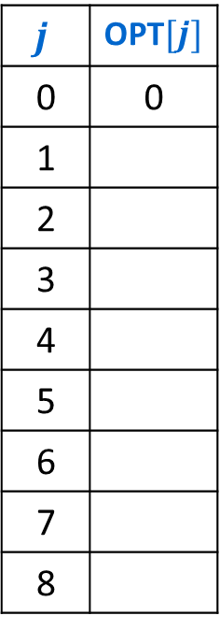
Towards Dynamic Programming: Step 2 – Memory Structure
$$OPT\left(j\right)=\max\left\{OPT\left(p\left(j\right)\right)+v_{j}, OPT\left(j−1\right)\right\}$$
Subproblems are identified by a single parameter
1-dimensional array
That parameter is the last-ending compatible request
length is the number of requests
$$j$$ | OPT$[j]$
0 | 0
1
2
3
4
5
6
7
8

Slide 31
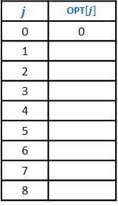
Weighted Interval Scheduling – Four Steps
1
2
1
2
Formulate the answer with a recursive structure
  What are the options for the last choice?
  For each such option, what does the subproblem look like? How do we use it?
Choose a memory structure.
  Figure out the possible values of all parameters in the recursive calls.
  How many subproblems (options for last choice) are there?
  What are the parameters needed to identify each?
  How many different values could there be per parameter?
Specify an order of evaluation.
  Want to guarantee that the necessary subproblem solutions are in memory when you need them.
  With this step: a “Bottom-up” (iterative) algorithm
  Without this step: a “Top-down” (recursive) algorithm
See if there’s a way to save space
  Is it possible to reuse some memory locations?
3
3
4
4
5
5
6
6
7
7
8
8
$$\max\left\{OPT\left(p\left(j\right)\right)+v_{j},OPT\left(j−1\right)\right\}$$
$$j$$ | OPT$[j]$
0 | 0
1
2
3
4
5
6
7
8

Slide 32
Top-Down DP Idea
def myDPalgo(problem):
if mem[problem] not blank: // Check if we’ve solved this already
return mem[problem]
if baseCase(problem): // Check if this is a base case
solution = solve(problem)
mem[problem] = solution // Always save your solution before returning
return solution
for subproblem of problem:
subsolutions.append(myDPalgo(subproblem)) // solve each subproblem
solution = selectAndExtend(subsolutions) // Pick the subproblem to use
mem[problem] = solution // Always save your solution before returning
return solution

Slide 33
Weighted Interval Scheduling Top-Down DP
WIS(j):
if OPT[j] not blank: // Check if we’ve solved this already
return OPT[j]
if j==0: // Check if this is a base case
mem[j] = 0 // Always save your solution before returning
return mem[j]
includej = WIS(p(j)) // Solve each subproblem
excludej = WIS(j -1) // Solve each subproblem
solution = max(includej+value[j], excludej) // Pick the subproblem to use
mem[j] = solution // Always save your solution before returning
return solution

Slide 34
Weighted Interval Scheduling – Four Steps
1
2
1
2
Formulate the answer with a recursive structure
  What are the options for the last choice?
  For each such option, what does the subproblem look like? How do we use it?
Choose a memory structure.
  Figure out the possible values of all parameters in the recursive calls.
  How many subproblems (options for last choice) are there?
  What are the parameters needed to identify each?
  How many different values could there be per parameter?
Specify an order of evaluation.
  Want to guarantee that the necessary subproblem solutions are in memory when you need them.
  With this step: a “Bottom-up” (iterative) algorithm
  Without this step: a “Top-down” (recursive) algorithm
See if there’s a way to save space
  Is it possible to reuse some memory locations?
3
3
4
4
5
5
6
6
7
7
8
8
$$\max\left\{OPT\left(p\left(j\right)\right)+v_{j},OPT\left(j−1\right)\right\}$$
$$j$$ | OPT$[j]$
0 | 0
1
2
3
4
5
6
7
8

Slide 35
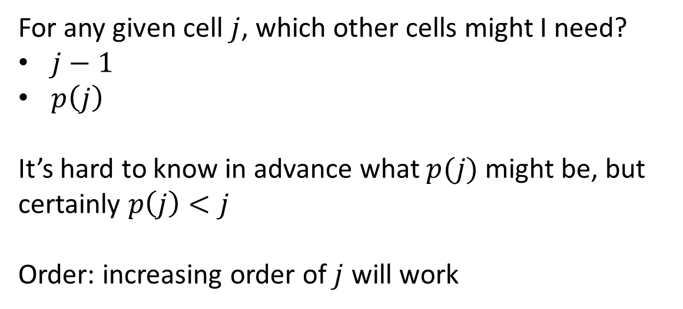
Towards Dynamic Programming: Step 3 – Order of Evaluation
$$OPT\left(j\right)=\max\left\{OPT\left(p\left(j\right)\right)+v_{j}, OPT\left(j−1\right)\right\}$$
For any given cell $j$, which other cells might I need?
$j−1$
$p\left(j\right)$
It’s hard to know in advance what $p(j)$ might be, but certainly $p\left(j\right)<j$
Order: increasing order of $j$ will work
$$j$$ | OPT$[j]$
0 | 0
1
2
3
4
5
6
7
8

Slide 36
Bottom-Up DP Idea
def myDPalgo(problem):
for each baseCase: // Identify which subproblems are base cases
solution = solve(baseCase)
mem[baseCase] = solution // Save the solution for reuse
for each subproblem in bottom-up order:
// The order should be chosen so that every subsolution is
// guaranteed to already be in memory when it’s needed
solution = selectAndExtend(subsolutions)
mem[subproblem] = solution // Save the solution for reuse
return mem[problem]

Slide 37
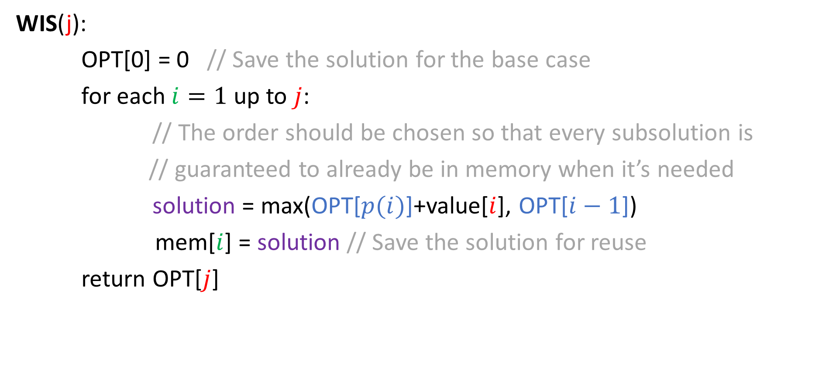
Weighted Interval Scheduling Bottom-Up DP
WIS(j):
OPT[0] = 0 // Save the solution for the base case
for each $i=1$ up to $j$:
// The order should be chosen so that every subsolution is
// guaranteed to already be in memory when it’s needed
solution = max(OPT[$p(i)$]+value[$i$], OPT[$i−1$])
mem[$i$] = solution // Save the solution for reuse
return OPT[$j$]

Slide 38

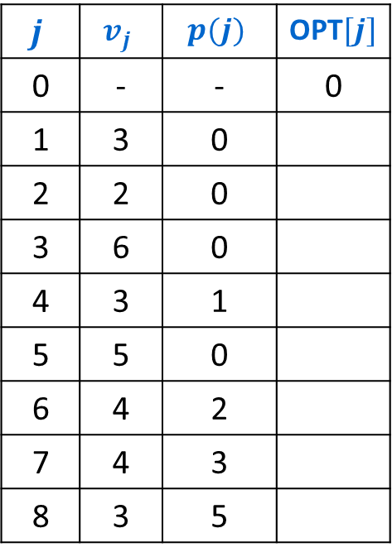
Example Execution (iterative)
Notation: Label jobs by finishing time: $f_{1}≤f_{2}≤…≤f_{n}$.
Defn: $p(j)$ = largest index $i<j$ s.t. job $i$ is compatible with $j$.
$OPT\left(j\right)=\max\left\{OPT\left(p\left(j\right)\right)+v_{j}, OPT\left(j−1\right)\right\}$
$$j$$ | $$v_{j}$$ | $$p(j)$$ | OPT$[j]$
0 | - | - | 0
1 | 3 | 0
2 | 2 | 0
3 | 6 | 0
4 | 3 | 1
5 | 5 | 0
6 | 4 | 2
7 | 4 | 3
8 | 3 | 5
1
2
3
4
5
6
7
8
Time
0
1
2
3
4
5
6
7
8
9
10
11

Slide 39

Example Execution (iterative)
Notation: Label jobs by finishing time: $f_{1}≤f_{2}≤…≤f_{n}$.
Defn: $p(j)$ = largest index $i<j$ s.t. job $i$ is compatible with $j$.
$OPT\left(j\right)=\max\left\{OPT\left(p\left(j\right)\right)+v_{j}, OPT\left(j−1\right)\right\}$
$$j$$ | $$v_{j}$$ | $$p(j)$$ | OPT$[j]$
0 | - | - | 0
1 | 3 | 0 | 3
2 | 2 | 0
3 | 6 | 0
4 | 3 | 1
5 | 5 | 0
6 | 4 | 2
7 | 4 | 3
8 | 3 | 5
1
2
3
4
5
6
7
8
Time
0
1
2
3
4
5
6
7
8
9
10
11

Slide 40
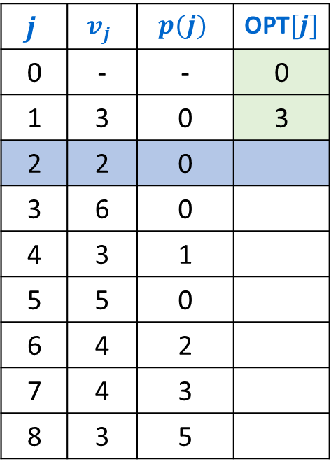
Example Execution (iterative)
Notation: Label jobs by finishing time: $f_{1}≤f_{2}≤…≤f_{n}$.
Defn: $p(j)$ = largest index $i<j$ s.t. job $i$ is compatible with $j$.
$OPT\left(j\right)=\max\left\{OPT\left(p\left(j\right)\right)+v_{j}, OPT\left(j−1\right)\right\}$
$$j$$ | $$v_{j}$$ | $$p(j)$$ | OPT$[j]$
0 | - | - | 0
1 | 3 | 0 | 3
2 | 2 | 0
3 | 6 | 0
4 | 3 | 1
5 | 5 | 0
6 | 4 | 2
7 | 4 | 3
8 | 3 | 5
1
2
3
4
5
6
7
8
Time
0
1
2
3
4
5
6
7
8
9
10
11

Slide 41

Example Execution (iterative)
Notation: Label jobs by finishing time: $f_{1}≤f_{2}≤…≤f_{n}$.
Defn: $p(j)$ = largest index $i<j$ s.t. job $i$ is compatible with $j$.
$OPT\left(j\right)=\max\left\{OPT\left(p\left(j\right)\right)+v_{j}, OPT\left(j−1\right)\right\}$
$$j$$ | $$v_{j}$$ | $$p(j)$$ | OPT$[j]$
0 | - | - | 0
1 | 3 | 0 | 3
2 | 2 | 0 | 3
3 | 6 | 0
4 | 3 | 1
5 | 5 | 0
6 | 4 | 2
7 | 4 | 3
8 | 3 | 5
1
2
3
4
5
6
7
8
Time
0
1
2
3
4
5
6
7
8
9
10
11

Slide 42
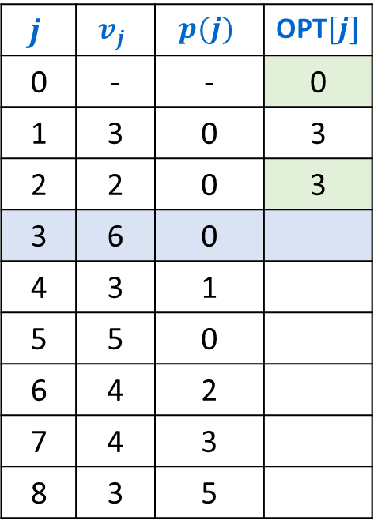
Example Execution (iterative)
Notation: Label jobs by finishing time: $f_{1}≤f_{2}≤…≤f_{n}$.
Defn: $p(j)$ = largest index $i<j$ s.t. job $i$ is compatible with $j$.
$OPT\left(j\right)=\max\left\{OPT\left(p\left(j\right)\right)+v_{j}, OPT\left(j−1\right)\right\}$
$$j$$ | $$v_{j}$$ | $$p(j)$$ | OPT$[j]$
0 | - | - | 0
1 | 3 | 0 | 3
2 | 2 | 0 | 3
3 | 6 | 0
4 | 3 | 1
5 | 5 | 0
6 | 4 | 2
7 | 4 | 3
8 | 3 | 5
1
2
3
4
5
6
7
8
Time
0
1
2
3
4
5
6
7
8
9
10
11

Slide 43
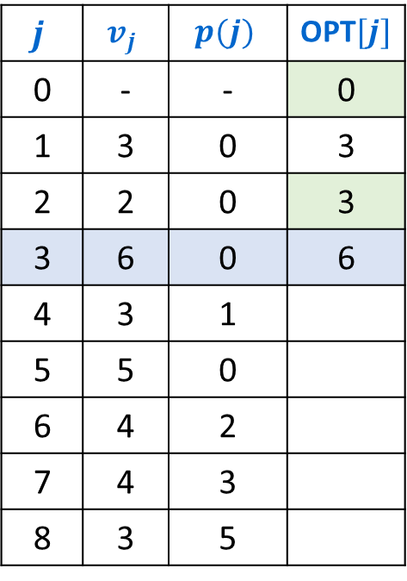
Example Execution (iterative)
Notation: Label jobs by finishing time: $f_{1}≤f_{2}≤…≤f_{n}$.
Defn: $p(j)$ = largest index $i<j$ s.t. job $i$ is compatible with $j$.
$OPT\left(j\right)=\max\left\{OPT\left(p\left(j\right)\right)+v_{j}, OPT\left(j−1\right)\right\}$
$$j$$ | $$v_{j}$$ | $$p(j)$$ | OPT$[j]$
0 | - | - | 0
1 | 3 | 0 | 3
2 | 2 | 0 | 3
3 | 6 | 0 | 6
4 | 3 | 1
5 | 5 | 0
6 | 4 | 2
7 | 4 | 3
8 | 3 | 5
1
2
3
4
5
6
7
8
Time
0
1
2
3
4
5
6
7
8
9
10
11

Slide 44
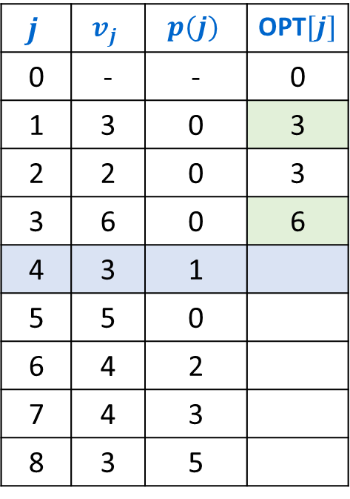
Example Execution (iterative)
Notation: Label jobs by finishing time: $f_{1}≤f_{2}≤…≤f_{n}$.
Defn: $p(j)$ = largest index $i<j$ s.t. job $i$ is compatible with $j$.
$OPT\left(j\right)=\max\left\{OPT\left(p\left(j\right)\right)+v_{j}, OPT\left(j−1\right)\right\}$
$$j$$ | $$v_{j}$$ | $$p(j)$$ | OPT$[j]$
0 | - | - | 0
1 | 3 | 0 | 3
2 | 2 | 0 | 3
3 | 6 | 0 | 6
4 | 3 | 1
5 | 5 | 0
6 | 4 | 2
7 | 4 | 3
8 | 3 | 5
1
2
3
4
5
6
7
8
Time
0
1
2
3
4
5
6
7
8
9
10
11

Slide 45
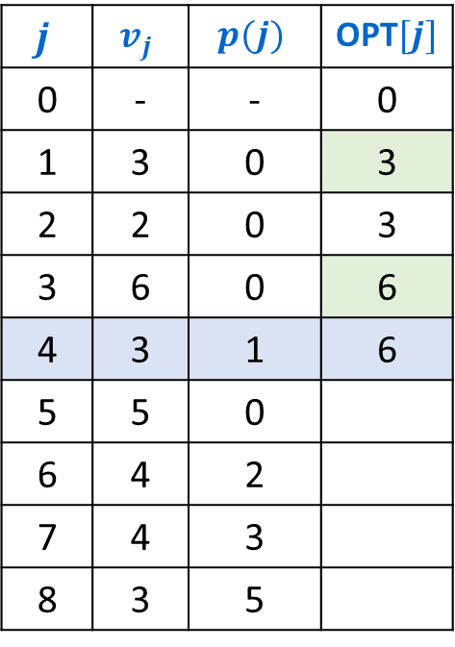
Example Execution (iterative)
Notation: Label jobs by finishing time: $f_{1}≤f_{2}≤…≤f_{n}$.
Defn: $p(j)$ = largest index $i<j$ s.t. job $i$ is compatible with $j$.
$OPT\left(j\right)=\max\left\{OPT\left(p\left(j\right)\right)+v_{j}, OPT\left(j−1\right)\right\}$
$$j$$ | $$v_{j}$$ | $$p(j)$$ | OPT$[j]$
0 | - | - | 0
1 | 3 | 0 | 3
2 | 2 | 0 | 3
3 | 6 | 0 | 6
4 | 3 | 1 | 6
5 | 5 | 0
6 | 4 | 2
7 | 4 | 3
8 | 3 | 5
1
2
3
4
5
6
7
8
Time
0
1
2
3
4
5
6
7
8
9
10
11

Slide 46
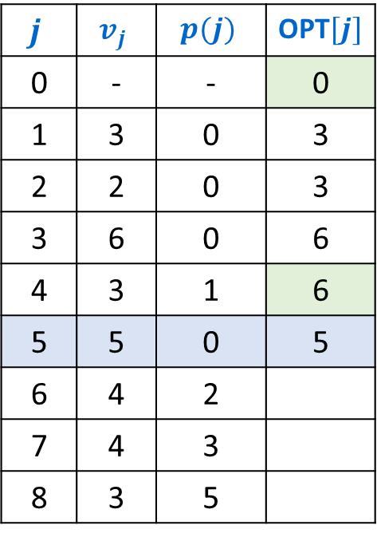
Example Execution (iterative)
Notation: Label jobs by finishing time: $f_{1}≤f_{2}≤…≤f_{n}$.
Defn: $p(j)$ = largest index $i<j$ s.t. job $i$ is compatible with $j$.
$OPT\left(j\right)=\max\left\{OPT\left(p\left(j\right)\right)+v_{j}, OPT\left(j−1\right)\right\}$
$$j$$ | $$v_{j}$$ | $$p(j)$$ | OPT$[j]$
0 | - | - | 0
1 | 3 | 0 | 3
2 | 2 | 0 | 3
3 | 6 | 0 | 6
4 | 3 | 1 | 6
5 | 5 | 0 | 5
6 | 4 | 2
7 | 4 | 3
8 | 3 | 5
1
2
3
4
5
6
7
8
Time
0
1
2
3
4
5
6
7
8
9
10
11

Slide 47
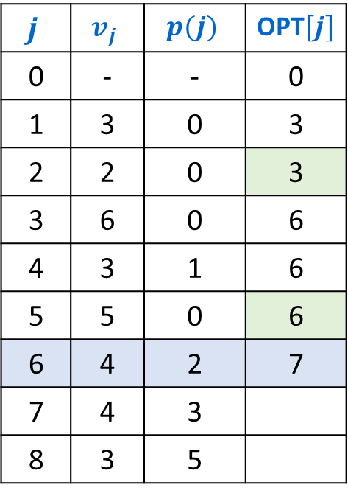
Example Execution (iterative)
Notation: Label jobs by finishing time: $f_{1}≤f_{2}≤…≤f_{n}$.
Defn: $p(j)$ = largest index $i<j$ s.t. job $i$ is compatible with $j$.
$OPT\left(j\right)=\max\left\{OPT\left(p\left(j\right)\right)+v_{j}, OPT\left(j−1\right)\right\}$
$$j$$ | $$v_{j}$$ | $$p(j)$$ | OPT$[j]$
0 | - | - | 0
1 | 3 | 0 | 3
2 | 2 | 0 | 3
3 | 6 | 0 | 6
4 | 3 | 1 | 6
5 | 5 | 0 | 6
6 | 4 | 2 | 7
7 | 4 | 3
8 | 3 | 5
1
2
3
4
5
6
7
8
Time
0
1
2
3
4
5
6
7
8
9
10
11

Slide 48
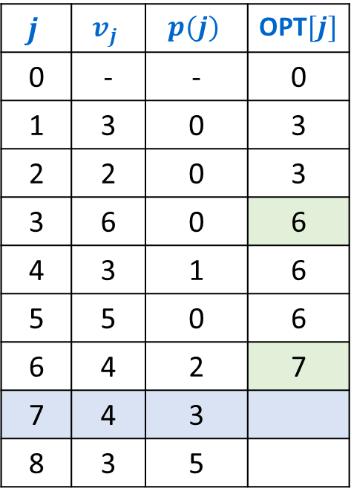
Example Execution (iterative)
Notation: Label jobs by finishing time: $f_{1}≤f_{2}≤…≤f_{n}$.
Defn: $p(j)$ = largest index $i<j$ s.t. job $i$ is compatible with $j$.
$OPT\left(j\right)=\max\left\{OPT\left(p\left(j\right)\right)+v_{j}, OPT\left(j−1\right)\right\}$
$$j$$ | $$v_{j}$$ | $$p(j)$$ | OPT$[j]$
0 | - | - | 0
1 | 3 | 0 | 3
2 | 2 | 0 | 3
3 | 6 | 0 | 6
4 | 3 | 1 | 6
5 | 5 | 0 | 6
6 | 4 | 2 | 7
7 | 4 | 3
8 | 3 | 5
1
2
3
4
5
6
7
8
Time
0
1
2
3
4
5
6
7
8
9
10
11

Slide 49
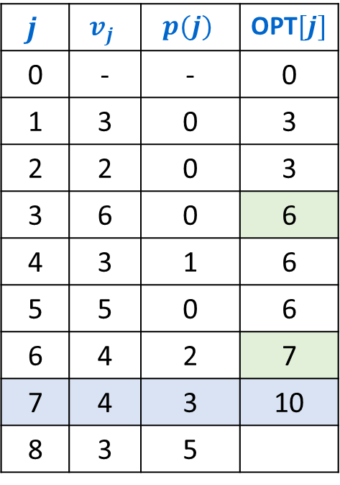
Example Execution (iterative)
Notation: Label jobs by finishing time: $f_{1}≤f_{2}≤…≤f_{n}$.
Defn: $p(j)$ = largest index $i<j$ s.t. job $i$ is compatible with $j$.
$OPT\left(j\right)=\max\left\{OPT\left(p\left(j\right)\right)+v_{j}, OPT\left(j−1\right)\right\}$
$$j$$ | $$v_{j}$$ | $$p(j)$$ | OPT$[j]$
0 | - | - | 0
1 | 3 | 0 | 3
2 | 2 | 0 | 3
3 | 6 | 0 | 6
4 | 3 | 1 | 6
5 | 5 | 0 | 6
6 | 4 | 2 | 7
7 | 4 | 3 | 10
8 | 3 | 5
1
2
3
4
5
6
7
8
Time
0
1
2
3
4
5
6
7
8
9
10
11

Slide 50
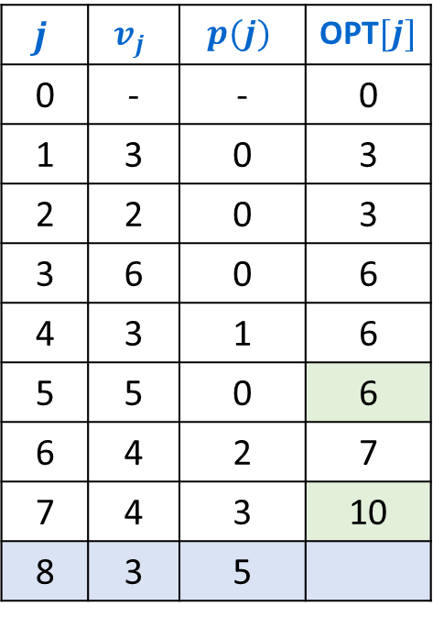
Example Execution (iterative)
Notation: Label jobs by finishing time: $f_{1}≤f_{2}≤…≤f_{n}$.
Defn: $p(j)$ = largest index $i<j$ s.t. job $i$ is compatible with $j$.
$OPT\left(j\right)=\max\left\{OPT\left(p\left(j\right)\right)+v_{j}, OPT\left(j−1\right)\right\}$
$$j$$ | $$v_{j}$$ | $$p(j)$$ | OPT$[j]$
0 | - | - | 0
1 | 3 | 0 | 3
2 | 2 | 0 | 3
3 | 6 | 0 | 6
4 | 3 | 1 | 6
5 | 5 | 0 | 6
6 | 4 | 2 | 7
7 | 4 | 3 | 10
8 | 3 | 5
1
2
3
4
5
6
7
8
Time
0
1
2
3
4
5
6
7
8
9
10
11

Slide 51
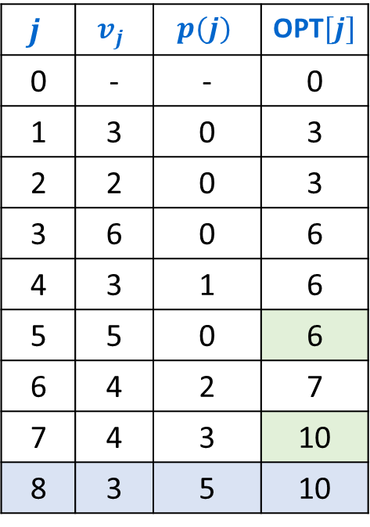
Example Execution (iterative)
Notation: Label jobs by finishing time: $f_{1}≤f_{2}≤…≤f_{n}$.
Defn: $p(j)$ = largest index $i<j$ s.t. job $i$ is compatible with $j$.
$OPT\left(j\right)=\max\left\{OPT\left(p\left(j\right)\right)+v_{j}, OPT\left(j−1\right)\right\}$
$$j$$ | $$v_{j}$$ | $$p(j)$$ | OPT$[j]$
0 | - | - | 0
1 | 3 | 0 | 3
2 | 2 | 0 | 3
3 | 6 | 0 | 6
4 | 3 | 1 | 6
5 | 5 | 0 | 6
6 | 4 | 2 | 7
7 | 4 | 3 | 10
8 | 3 | 5 | 10
1
2
3
4
5
6
7
8
Time
0
1
2
3
4
5
6
7
8
9
10
11

Slide 52
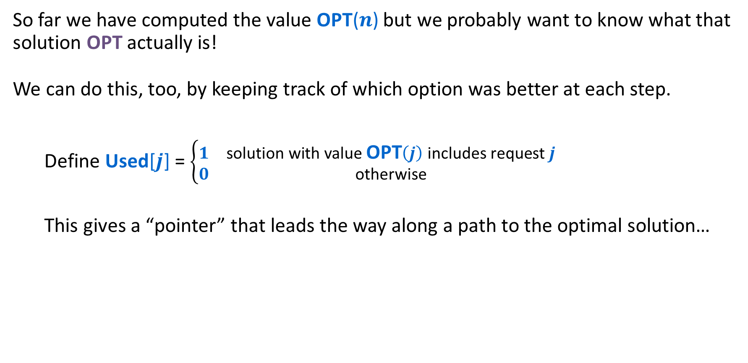
Weighted Interval Scheduling: Finding the Solution
So far we have computed the value OPT($n$) but we probably want to know what that solution OPT actually is!
We can do this, too, by keeping track of which option was better at each step.
  Define Used[$j$] = $\left\{\begin{matrix}1 & \text{solution} \text{with} \text{value} \text{OPT}\left(j\right) \text{includes} \text{request} j \\ 0 & \text{otherwise}\end{matrix}\right.$
  This gives a “pointer” that leads the way along a path to the optimal solution…

Slide 53
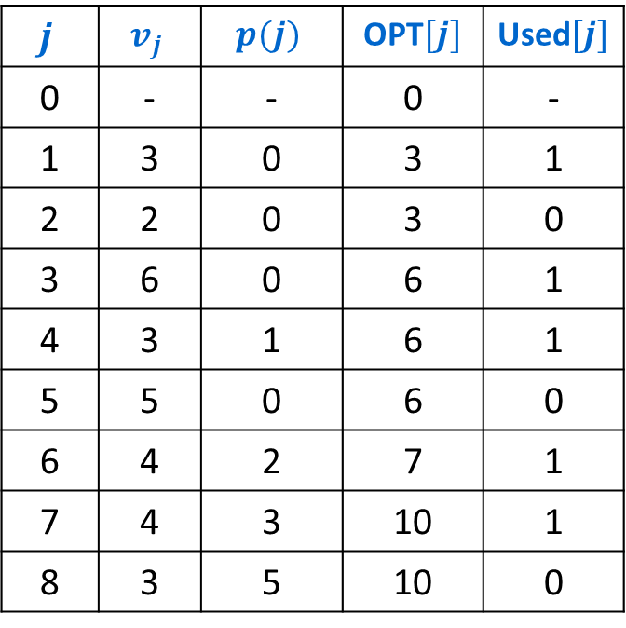
Weighted Interval Scheduling: Finding the Solution
Notation: Label jobs by finishing time: $f_{1}≤f_{2}≤…≤f_{n}$.
Defn: $p(j)$ = largest index $i<j$ s.t. job $i$ is compatible with $j$.
$OPT\left(j\right)=\max\left\{OPT\left(p\left(j\right)\right)+v_{j}, OPT\left(j−1\right)\right\}$
$$j$$ | $$v_{j}$$ | $$p(j)$$ | OPT$[j]$ | Used$[j]$
0 | - | - | 0 | -
1 | 3 | 0 | 3 | 1
2 | 2 | 0 | 3 | 0
3 | 6 | 0 | 6 | 1
4 | 3 | 1 | 6 | 1
5 | 5 | 0 | 6 | 0
6 | 4 | 2 | 7 | 1
7 | 4 | 3 | 10 | 1
8 | 3 | 5 | 10 | 0
1
2
3
4
5
6
7
8
Time
0
1
2
3
4
5
6
7
8
9
10
11

Slide 54
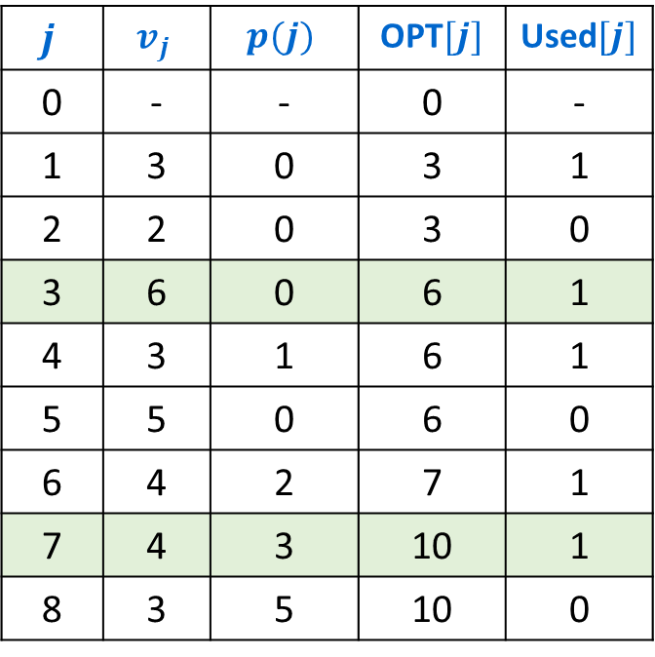
Weighted Interval Scheduling: Iterative Solution
Notation: Label jobs by finishing time: $f_{1}≤f_{2}≤…≤f_{n}$.
Defn: $p(j)$ = largest index $i<j$ s.t. job $i$ is compatible with $j$.
$OPT\left(j\right)=\max\left\{OPT\left(p\left(j\right)\right)+v_{j}, OPT\left(j−1\right)\right\}$
$$j$$ | $$v_{j}$$ | $$p(j)$$ | OPT$[j]$ | Used$[j]$
0 | - | - | 0 | -
1 | 3 | 0 | 3 | 1
2 | 2 | 0 | 3 | 0
3 | 6 | 0 | 6 | 1
4 | 3 | 1 | 6 | 1
5 | 5 | 0 | 6 | 0
6 | 4 | 2 | 7 | 1
7 | 4 | 3 | 10 | 1
8 | 3 | 5 | 10 | 0
1
2
3
4
5
6
7
8
Time
0
1
2
3
4
5
6
7
8
9
10
11

Slide 55
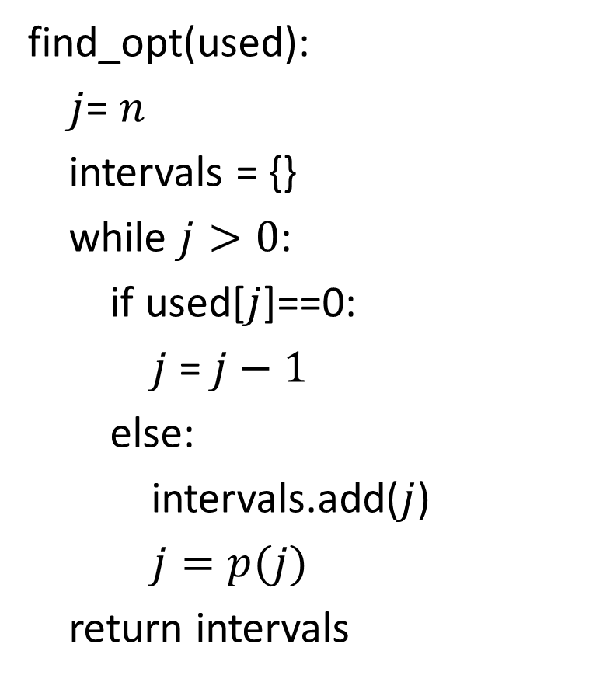
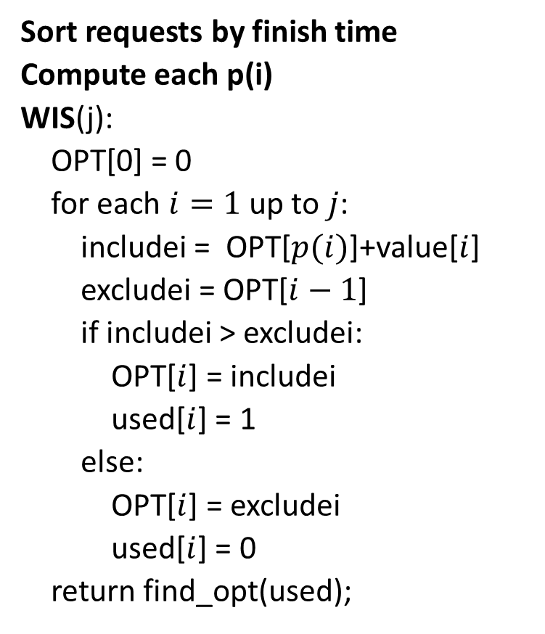
Weighted Interval Scheduling - Complete
Sort requests by finish time
Compute each p(i)
WIS(j):
OPT[0] = 0
for each $i=1$ up to $j$:
includei = OPT[$p(i)$]+value[$i$]
excludei = OPT[$i−1$]
if includei > excludei:
OPT[$i$] = includei
used[$i$] = 1
else:
OPT[$i$] = excludei
used[$i$] = 0
return find_opt(used);
find_opt(used):
$j$= $n$
intervals = {}
while $j>0$:
if used[$j$]==0:
$j$ = $j−1$
else:
intervals.add($j$)
$j=p(j)$
return intervals

Slide 56

Weighted Interval Scheduling – Four Steps
1
2
1
2
Formulate the answer with a recursive structure
  What are the options for the last choice?
  For each such option, what does the subproblem look like? How do we use it?
Choose a memory structure.
  Figure out the possible values of all parameters in the recursive calls.
  How many subproblems (options for last choice) are there?
  What are the parameters needed to identify each?
  How many different values could there be per parameter?
Specify an order of evaluation.
  Want to guarantee that the necessary subproblem solutions are in memory when you need them.
  With this step: a “Bottom-up” (iterative) algorithm
  Without this step: a “Top-down” (recursive) algorithm
See if there’s a way to save space
  Is it possible to reuse some memory locations?
3
3
4
4
5
5
6
6
7
7
8
8
$$\max\left\{OPT\left(p\left(j\right)\right)+v_{j},OPT\left(j−1\right)\right\}$$
$$j$$ | OPT$[j]$
0 | 0
1
2
3
4
5
6
7
8
$$j$$ | OPT$[j]$
0 | 0
1
2
3
4
5
6
7
8

Slide 57
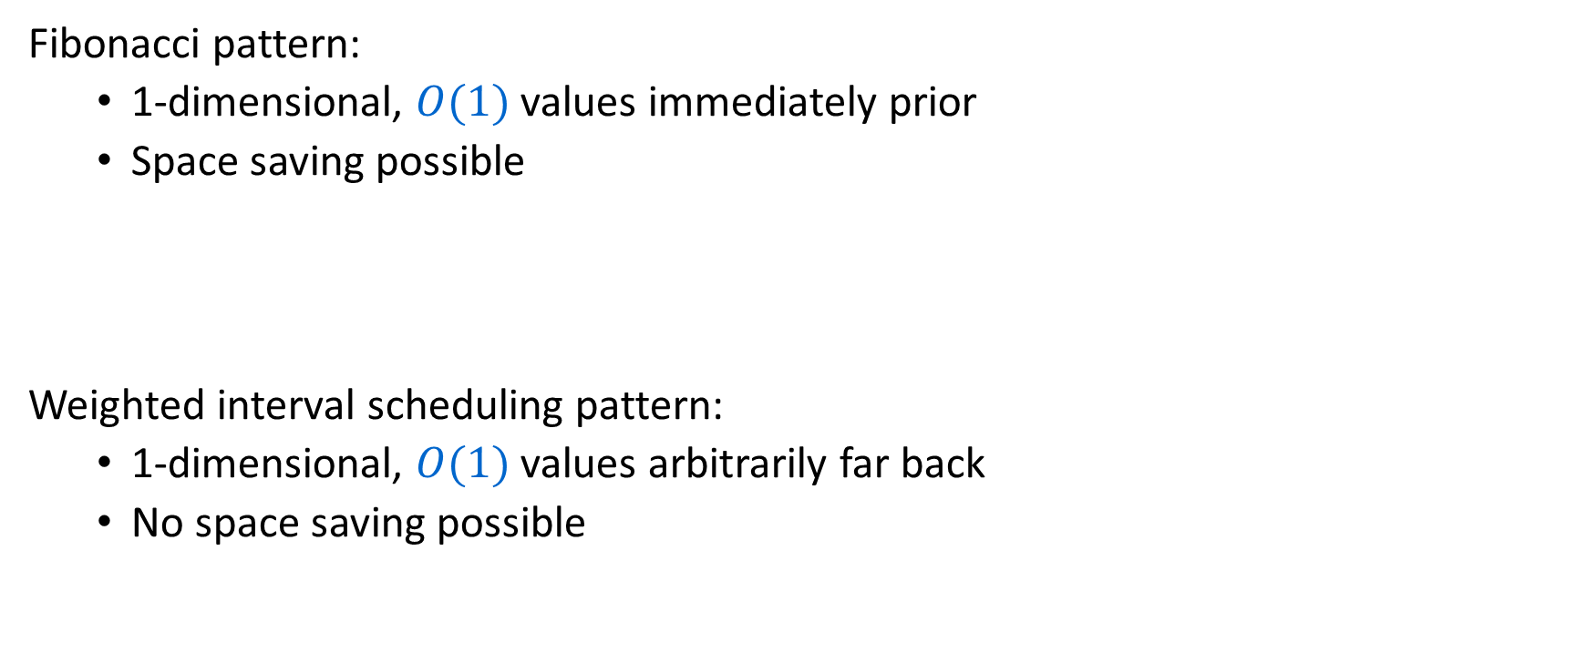
Dynamic Programming Patterns
Fibonacci pattern:
  1-dimensional, $O(1)$ values immediately prior
  Space saving possible
Weighted interval scheduling pattern:
  1-dimensional, $O(1)$values arbitrarily far back
  No space saving possible

