Slide 1
CSE 421 Winter 2025 Lecture 11: Quicksort and Medians
Nathan Brunelle
http://www.cs.uw.edu/421

Slide 2
$f\left(n+m\right)$ vs. $f\left(n\right)+f(m)$
When is each true?
$f\left(n+m\right)=f\left(n\right)+f(m)$
$f\left(n+m\right)<f\left(n\right)+f(m)$
$f\left(n+m\right)>f\left(n\right)+f(m)$

Slide 3
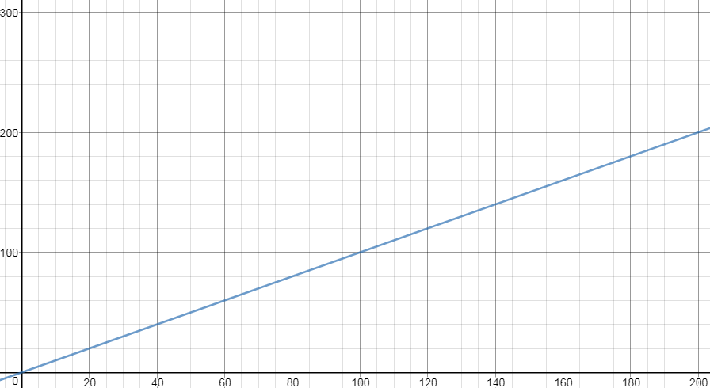
$$f\left(n\right)=Θ(n)$$
$$f\left(n+m\right)=f\left(n\right)+f(m)$$
$$f(m)$$
$$f\left(x\right)=x$$
$$f(n)$$
$$f(m)$$
$$f(n)$$
$$n$$
$$m$$
$$n+m$$

Slide 4
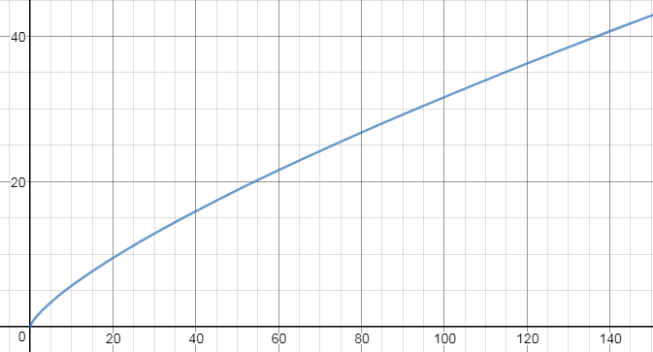
$$f\left(n\right)∈O(n)$$
$$f(m)$$
$$f\left(x\right)=x^{0.75}$$
$$f(n)$$
$$f(m)$$
$$f(n)$$
$$n$$
$$m$$
$$n+m$$
$$f\left(n+m\right)≤f\left(n\right)+f(m)$$

Slide 5
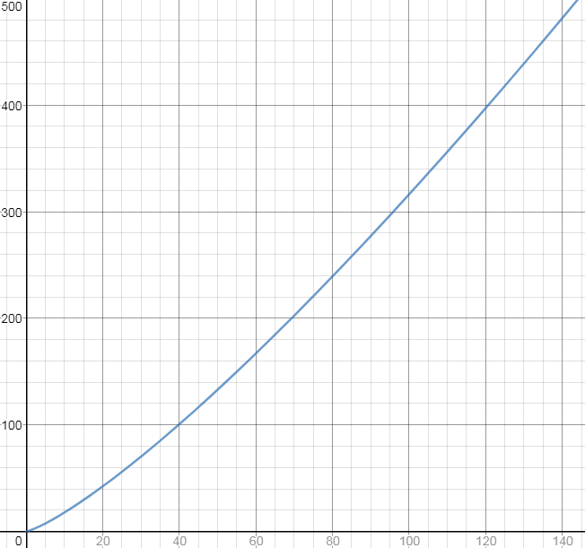
$$f\left(n\right)∈Ω(n)$$
$$f\left(n+m\right)≥f\left(n\right)+f(m)$$
$$f(m)$$
$$f\left(x\right)=x^{1.25}$$
$$f(m)$$
$$f(n)$$
$$f(n)$$
$$n$$
$$m$$
$$n+m$$

Slide 6
Divide and Conquer (Quick Sort)
Base Case:
If the list is of length 1 or 0, it’s already sorted, so just return
(Alternative: when length is $≤15$, use insertion sort)
Divide:
Select an element to use as a “pivot”
Partition: rearrange the list so that all elements less than the pivot are to the left of the pivot, all elements greater are to the right
Conquer:
Sort the sublists to the left and right of the pivot recursively.
Combine:
Nothing!
5
2
5
3
5
7
8
9
8
2
3
5
5
8
8
9
2
3
5
5
7
8
8
9

Slide 7
Partition
Put $p$ at beginning of list
Put a pointer (Begin) just after $p$, and a pointer (End) at the end of the list
While Begin < End:
If Begin value $< p$, move Begin right
Else swap Begin value with End value, move End Left
If pointers meet at element $<p$: Swap $p$ with pointer position
Else If pointers meet at element $>p$: Swap $p$ with value to the left
Run time?
$$O(n)$$

Slide 8
Partition, Procedure
If Begin value $< p$, move Begin right
Else swap Begin value with End value, move End Left
Done when Begin = End
8
5
7
3
12
10
1
2
4
9
6
11
8
5
7
3
12
10
1
2
4
9
6
11
8
5
7
3
12
10
1
2
4
9
6
11
8
5
7
3
11
10
1
2
4
9
6
12

Slide 9
Partition, Procedure
If Begin value $< p$, move Begin right
Else swap Begin value with End value, move End Left
Done when Begin = End
8
5
7
3
11
10
1
2
4
9
6
12
8
5
7
3
6
10
1
2
4
9
11
12
8
5
7
3
6
10
1
2
4
9
11
12
8
5
7
3
6
10
1
2
4
9
11
12

Slide 10
Partition, Procedure
If Begin value $< p$, move Begin right
Else swap Begin value with End value, move End Left
Done when Begin = End
8
5
7
3
6
4
1
2
10
9
11
12
Case 1: meet at element $<p$
Swap $p$ with pointer position (2 in this case)
2
5
7
3
6
4
1
8
10
9
11
12

Slide 11
Partition, Procedure
If Begin value $< p$, move Begin right
Else swap Begin value with End value, move End Left
Done when Begin = End
8
5
7
3
6
4
1
2
10
9
11
12
Case 2: meet at element $>p$
Swap $p$ with value to the left (2 in this case)
2
5
7
3
6
4
1
8
10
9
11
12

Slide 12
Quick Sort Running Time
Master Theorem: Suppose that $T\left(n\right)=a⋅T(n/b)+O(nk)$ for $n>b$.
If $a<bk$ then $T(n)$ is $O(nk)$
Cost is dominated by work at top level of recursion
If $a=bk$ then $T(n)$ is $O(n^{k }log n)$
Total cost is the same for all $\log_{b}{n}$ levels of recursion
If $a>bk$ then $T(n)$ is $O(n^{\log_{b}{a}})$
Note that $\log_{b}{a>k}$ in this case
Cost is dominated by total work at lowest level of recursion
Ideally: $T\left(n\right)=2T\left(\frac{n}{2}\right)+n$
$a=2$,$b=2$, $k=1$ so $a=b^{k}:$ Solution: $O\left(nlog n\right)$
Worst Case: $T\left(n\right)=T\left(n−1\right)+n$
The master theorem does not apply, but the solution is $O(n^{2})$
Expected: $O\left(nlog n\right)$ … Our first task today is to show this!

Slide 13
Expected Runtime for QuickSort: “Global analysis”
Runtime is the # of comparisons
Recurrence & Master Theorem kind of analysis won’t work ...
Instead, use a “global” analysis:
Number elements $a_{1},a_{2},…,a_{n}$ based on final sorted order
Let $p_{i,j}$ = Probability that QuickSort compares $a_{i}$ and $a_{j}$
Expected number of comparisons:
$\sum_{i=1}^{n−1}{\sum_{j=i+1}^{n}{p_{i,j}}}$

Slide 14
Observation – We only compare to pivot
Put $p$ at beginning of list
Put a pointer (Begin) just after $p$, and a pointer (End) at the end of the list
While Begin < End:
If Begin value $< p$, move Begin right
Else swap Begin value with End value, move End Left
If pointers meet at element $<p$: Swap $p$ with pointer position
Else If pointers meet at element $>p$: Swap $p$ with value to the left
Conclusion: we only compare $a_{i}$ with $a_{j}$ when both of these are true:
$a_{i}$ and $a_{j}$ are in the same subproblem (no previous pivot fell between them)
One of $a_{i}$ and $a_{j}$ is the pivot

Slide 15
Finding $p_{i,j}$ - Adjacent Values
We always compare consecutive elements
$$a_{1}$$
$$a_{2}$$
$$a_{3}$$
$$a_{4}$$
$$a_{5}$$
$$a_{6}$$
$$a_{7}$$
$$a_{8}$$
$$a_{9}$$
$$a_{10}$$
$$a_{11}$$
$$a_{12}$$
$p_{i,i+1}=1$
Why?
Intuitively, we MUST compare adjacent items to guarantee we get them in the right order
Precisely, $a_{i}$ and $a_{i+1}$ can’t be on opposite sides of any third value, so they’ll only end up in separate subproblems when one was the pivot

Slide 16
Finding $p_{i,j}$ - Extreme Values
We rarely compare the min and the max
$$a_{1}$$
$$a_{2}$$
$$a_{3}$$
$$a_{4}$$
$$a_{5}$$
$$a_{6}$$
$$a_{7}$$
$$a_{8}$$
$$a_{9}$$
$$a_{10}$$
$$a_{11}$$
$$a_{12}$$
$p_{1,n}=\frac{2}{n}$
Why?
The only way we will compare the smallest and largest items is if one or the other was the very first pivot chosen ($\frac{1}{n}$ chance of each)

Slide 17
Finding $p_{i,j}$ - In General
For any pair of elements, the probability we compare them in proportional to their distance
$$a_{1}$$
$$a_{2}$$
$$a_{3}$$
$$a_{4}$$
$$a_{5}$$
$$a_{6}$$
$$a_{7}$$
$$a_{8}$$
$$a_{9}$$
$$a_{10}$$
$$a_{11}$$
$$a_{12}$$
$p_{i,j}=\frac{2}{j−i+1}$ if $i<j$
Why?
$a_{i}$ and $a_{j}$ will only be compared if one of them was the very first pivot chosen from among the range $a_{i},a_{i+1},…,a_{j}$
There are $j−i+1$ items in this range, two of which result in this comparison

Slide 18
Expected Runtime for QuickSort: “Global analysis”
For $i<j$ we have $p_{i,j}=\frac{2}{j−i+1}$.
Expected number of comparisons:
$\sum_{i=1}^{n−1}{\sum_{j=i+1}^{n}{p_{i,j}}}$ $=$ $\sum_{i=1}^{n−1}{\sum_{j=i+1}^{n}{\frac{2}{j−i+1}}}$
$=$ $\sum_{i=1}^{n−1}{\sum_{k=1}^{n−i+1}{\frac{2}{k+1}}}$
$<$ $2$ $\sum_{i=1}^{n−1}{\sum_{k=1}^{n}{\frac{1}{k}}}$
$<$ $2$ $n H_{n}$
$=$ $2$ $n ln n+O\left(n\right)≤\text{1.387}$ $n log_{2} n$
Harmonic series sum:
$H_{n}=\sum_{k=1}^{n}{\frac{1}{k}}=1+\frac{1}{2}+\frac{1}{3}+\frac{1}{4}+…+\frac{1}{n}$
Fact: $H_{n}=ln n+O(1)$
for $k=j−i$

Slide 19
QuickSelect
Finds $k$^{th} order statistic
$k$^{th} smallest element in the list
1st order statistic: minimum
$n$^{th} order statistic: maximum
$\left\lfloor \frac{n}{2}\right\rfloor$^{th} order statistic: median (for odd $n$)

Slide 20
QuickSelect($S$, $k$)
Base Case:
If $k=0$ then return $S[0]$
Divide:
Select an element to use as a “pivot”
Partition: rearrange $S$ so that all elements less than the pivot are to the left of the pivot, all elements greater are to the right
Conquer:
Let $i_{pivot}$ be the index of the pivot after partitioning
If $k<i_{pivot}$ then call QuickSelect($S_{left}$, $k$)
Otherwise call Quickselect($S_{right}$,$k−i_{pivot}$)
Combine:
Nothing!
5
7
2
9
8
3
5
8
$$k=0$$
2
5
3
5
7
8
9
8
$$k=0$$
2
3
5
5
OR
7
8
8
9
$$k=i$$
$$k=k−i_{pivot}$$

Slide 21
QuickSelect Running Time
Master Theorem: Suppose that $T\left(n\right)=a⋅T(n/b)+O(nk)$ for $n>b$.
If $a<bk$ then $T(n)$ is $O(nk)$
Cost is dominated by work at top level of recursion
If $a=bk$ then $T(n)$ is $O(n^{k }log n)$
Total cost is the same for all $\log_{b}{n}$ levels of recursion
If $a>bk$ then $T(n)$ is $O(n^{\log_{b}{a}})$
Note that $\log_{b}{a>k}$ in this case
Cost is dominated by total work at lowest level of recursion
Ideally: $T\left(n\right)=T\left(\frac{n}{2}\right)+n$
$a=1$,$b=2$, $k=1$ so $a<b^{k}:$ Solution: $O\left(n\right)$
Worst Case: $T\left(n\right)=T\left(n−1\right)+n$
The master theorem does not apply, but the solution is $O(n^{2})$

Slide 22
We don’t need the “ideal” for $O(n)$!
Master Theorem: Suppose that $T\left(n\right)=a⋅T(n/b)+O(nk)$ for $n>b$.
If $a<bk$ then $T(n)$ is $O(nk)$
Cost is dominated by work at top level of recursion
If $a=bk$ then $T(n)$ is $O(n^{k }log n)$
Total cost is the same for all $\log_{b}{n}$ levels of recursion
If $a>bk$ then $T(n)$ is $O(n^{\log_{b}{a}})$
Note that $\log_{b}{a>k}$ in this case
Cost is dominated by total work at lowest level of recursion
$$T\left(n\right)=T\left(\frac{3n}{4}\right)+n$$
$a=1$,$b=4/3$, $k=1$ so $a<b^{k}:$ Solution: $O\left(n\right)$

Slide 23
QuickSelect: Random Choice of Pivot
Consider a call to QuickSelect. We will say the pivot is “good enough” if it is among the middle half of the value
With probability $≥1/2$ pivot $p$ is good enough
For any good enough pivot the recursive call has subproblem size $≤3n/4$
After 2 calls, QuickSelect has expected problem size $≤3n/4$
So $T\left(n\right)≤2T′(n)$ where
$T′\left(n\right)= T′\left(\frac{3n}{4}\right)+n$ for $b=4/3>1$
Elements of $S$ listed in sorted order
Say $p$ is “good enough” iff
it is in the middle half
bad $p$
good $p$
good $p$
bad $p$
⇒ Expected $O(n)$ time

Slide 24
Doing Quickselect in $O(n)$ Worst Case
We can make adapt Quickselect by running in $O(n)$ worst case by applying some tricky extra recursion!
Median-of-Medians:
Break $S$ into chunks of size 5
Sort each chunk by its median value (i.e. value at index 2)
Use Quickselect to find the median of these medians, use that as the pivot

Slide 25
M-o-M, Step 1: Construct sets of size 5; Step 2: sort each set
Input:
13, 15, 32, 14, 95, 5, 16, 45, 86, 65, 62, 41, 81, 52, 32, 32, 12, 73, 25, 81, 47, 8, 69, 9, 7, 81, 18, 25, 42, 91, 64, 98, 96, 91, 6, 51, 21, 12, 36, 11, 11, 9, 5, 17, 77
13 | 5 | 62 | 32 | 47 | 81 | 64 | 51 | 11
15 | 16 | 41 | 12 | 8 | 18 | 98 | 21 | 9
32 | 45 | 81 | 73 | 69 | 25 | 96 | 12 | 5
14 | 86 | 52 | 25 | 9 | 42 | 91 | 36 | 17
95 | 65 | 32 | 81 | 7 | 91 | 6 | 11 | 77
Group:
95 | 86 | 81 | 81 | 69 | 91 | 98 | 51 | 77
32 | 65 | 62 | 73 | 47 | 81 | 96 | 36 | 17
15 | 45 | 52 | 32 | 9 | 42 | 91 | 21 | 11
14 | 16 | 41 | 25 | 8 | 25 | 64 | 12 | 9
13 | 5 | 32 | 12 | 7 | 18 | 6 | 11 | 5
Sort each group:
$$O\left(n\right)$$

Slide 26
M-o-M, Step 3: Find median of column medians
95 | 86 | 81 | 81 | 69 | 91 | 98 | 51 | 77
32 | 65 | 62 | 73 | 47 | 81 | 96 | 36 | 17
15 | 45 | 52 | 32 | 9 | 42 | 91 | 21 | 11
14 | 16 | 41 | 25 | 8 | 25 | 64 | 12 | 9
13 | 5 | 32 | 12 | 7 | 18 | 6 | 11 | 5
Column medians:
$$T(n/5)$$
Choose pivot to be that median of medians
95 | 86 | 81 | 81 | 69 | 91 | 98 | 51 | 77
32 | 65 | 62 | 73 | 47 | 81 | 96 | 36 | 17
15 | 45 | 52 | 32 | 9 | 42 | 91 | 21 | 11
14 | 16 | 41 | 25 | 8 | 25 | 64 | 12 | 9
13 | 5 | 32 | 12 | 7 | 18 | 6 | 11 | 5

Slide 27
This Pivot is “Good Enough”!
95 | 86 | 81 | 81 | 69 | 91 | 98 | 51 | 77
32 | 65 | 62 | 73 | 47 | 81 | 96 | 36 | 17
15 | 45 | 52 | 32 | 9 | 42 | 91 | 21 | 11
14 | 16 | 41 | 25 | 8 | 25 | 64 | 12 | 9
13 | 5 | 32 | 12 | 7 | 18 | 6 | 11 | 5
Column medians:
$$T(n/5)$$
Imagining rearranging columns by columns’ medians
95 | 51 | 77 | 69 | 81 | 91 | 98 | 86 | 81
32 | 36 | 17 | 47 | 73 | 81 | 96 | 65 | 62
15 | 21 | 11 | 9 | 32 | 42 | 91 | 45 | 52
14 | 12 | 9 | 8 | 25 | 25 | 64 | 16 | 41
13 | 11 | 5 | 7 | 12 | 18 | 6 | 5 | 32

Slide 28
This Pivot is “Good Enough”!
95 | 86 | 81 | 81 | 69 | 91 | 98 | 51 | 77
32 | 65 | 62 | 73 | 47 | 81 | 96 | 36 | 17
15 | 45 | 52 | 32 | 9 | 42 | 91 | 21 | 11
14 | 16 | 41 | 25 | 8 | 25 | 64 | 12 | 9
13 | 5 | 32 | 12 | 7 | 18 | 6 | 11 | 5
Column medians:
$$T(n/5)$$
Choose pivot to be that median of medians
95 | 51 | 77 | 69 | 81 | 91 | 98 | 86 | 81
32 | 36 | 17 | 47 | 73 | 81 | 96 | 65 | 62
15 | 21 | 11 | 9 | 32 | 42 | 91 | 45 | 52
14 | 12 | 9 | 8 | 25 | 25 | 64 | 16 | 41
13 | 11 | 5 | 7 | 12 | 18 | 6 | 5 | 32
All $≤$ pivot
Not in $S_{right}$
Size $≥n/4$
Size of $S_{right}$ is $≤\frac{3n}{4}$

Slide 29
This Pivot is “Good Enough”!
95 | 86 | 81 | 81 | 69 | 91 | 98 | 51 | 77
32 | 65 | 62 | 73 | 47 | 81 | 96 | 36 | 17
15 | 45 | 52 | 32 | 9 | 42 | 91 | 21 | 11
14 | 16 | 41 | 25 | 8 | 25 | 64 | 12 | 9
13 | 5 | 32 | 12 | 7 | 18 | 6 | 11 | 5
Column medians:
$$T(n/5)$$
Choose pivot to be that median of medians
95 | 51 | 77 | 69 | 81 | 91 | 98 | 86 | 81
32 | 36 | 17 | 47 | 73 | 81 | 96 | 65 | 62
15 | 21 | 11 | 9 | 32 | 42 | 91 | 45 | 52
14 | 12 | 9 | 8 | 25 | 25 | 64 | 16 | 41
13 | 11 | 5 | 7 | 12 | 18 | 6 | 5 | 32
All $≥$ pivot
Not in $S_{left}$
Size $≥n/4$
Size of $S_{left}$ is $≤\frac{3n}{4}$

Slide 30
QuickSelect With Median-of-Medians
Base Case:
If $i=0$ then return $S[0]$
Divide:
Use median-of-medians to select an element to use as a “pivot”
Break $S$ into $\frac{n}{5}$ chunks of size 5 each
Sort each chunk
Make a new list $M$ containing all chunks’ medians
Use QuickSelect($M$, $\frac{n}{10}$) as the pivot
Partition
Conquer:
Let $i_{pivot}$ be the index of the pivot after partitioning
If $i<i_{pivot}$ then call QuickSelect($S_{left}$, $i$)
Otherwise call Quickselect($S_{right}$,$i−i_{pivot}$)
Combine:
Nothing!
5
7
2
9
8
3
5
8
$$i=0$$
$$T\left(\frac{n}{5}\right)+n$$
2
5
3
5
7
8
9
8
$$i=0$$
$$n$$
2
3
5
5
OR
7
8
8
9
$$T\left(\frac{3n}{4}\right)$$
$$i=i$$
$$i=i−i_{pivot}$$
$$T\left(n\right)=T\left(\frac{n}{5}\right)+T\left(\frac{3n}{4}\right)+n$$

Slide 31
Solving the QS with MoM Recurrence
Master Theorem: Suppose that $T\left(n\right)=a⋅T(n/b)+O(nk)$ for $n>b$.
If $a<bk$ then $T(n)$ is $O(nk)$
Cost is dominated by work at top level of recursion
If $a=bk$ then $T(n)$ is $O(n^{k }log n)$
Total cost is the same for all $\log_{b}{n}$ levels of recursion
If $a>bk$ then $T(n)$ is $O(n^{\log_{b}{a}})$
Note that $\log_{b}{a>k}$ in this case
Cost is dominated by total work at lowest level of recursion
$$T\left(n\right)=T\left(\frac{n}{5}\right)+T\left(\frac{3n}{4}\right)+n$$
$$T\left(n\right)≤T\left(\frac{19n}{20}\right)+n$$
$a=1$,$b=20/19$, $k=1$ so $a<b^{k}:$ Solution: $O\left(n\right)$

