Slide 1
CSE 421 Winter 2025
Lecture 10: Divide and Conquer 2
Nathan Brunelle
http://www.cs.uw.edu/421

Slide 2
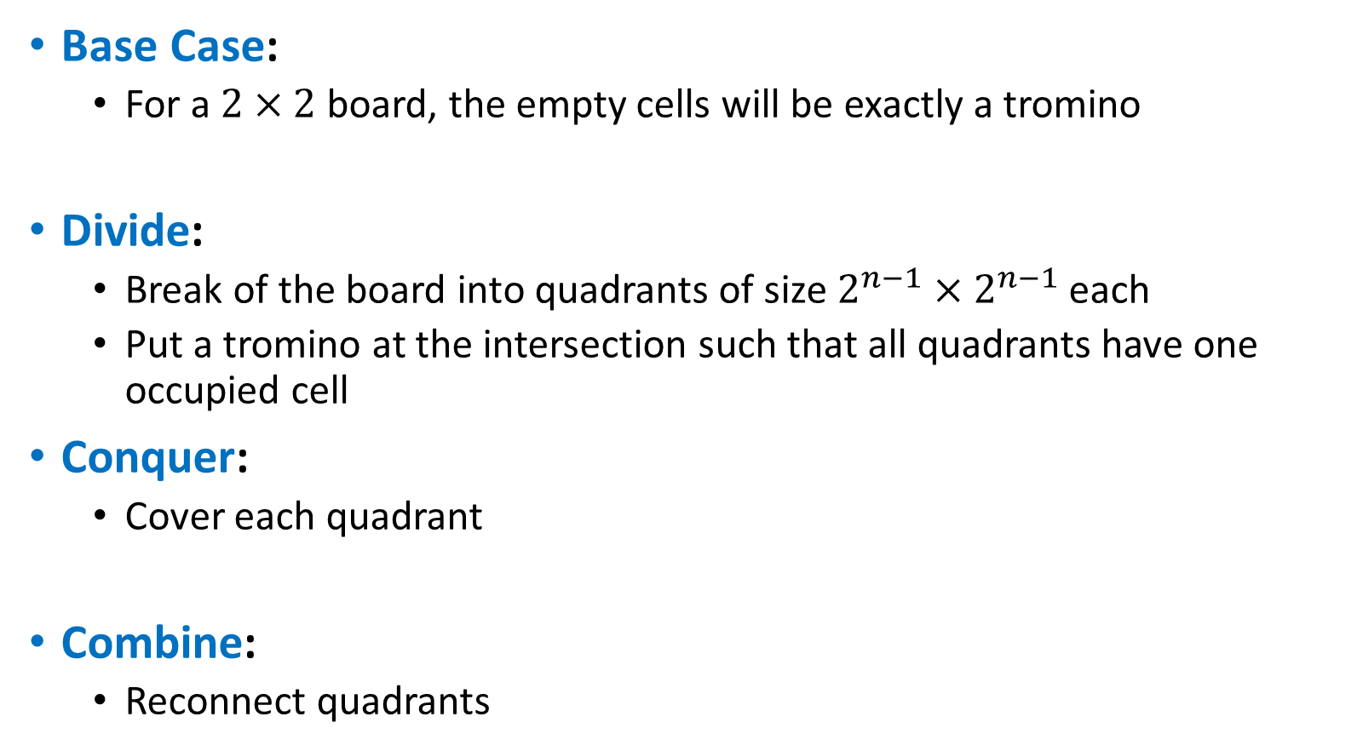
Divide and Conquer (Trominoes)
Base Case:
  For a $2×2$ board, the empty cells will be exactly a tromino
Divide:
  Break of the board into quadrants of size $2^{n−1}×2^{n−1}$ each
  Put a tromino at the intersection such that all quadrants have one occupied cell
Conquer:
  Cover each quadrant
Combine:
  Reconnect quadrants

Slide 3
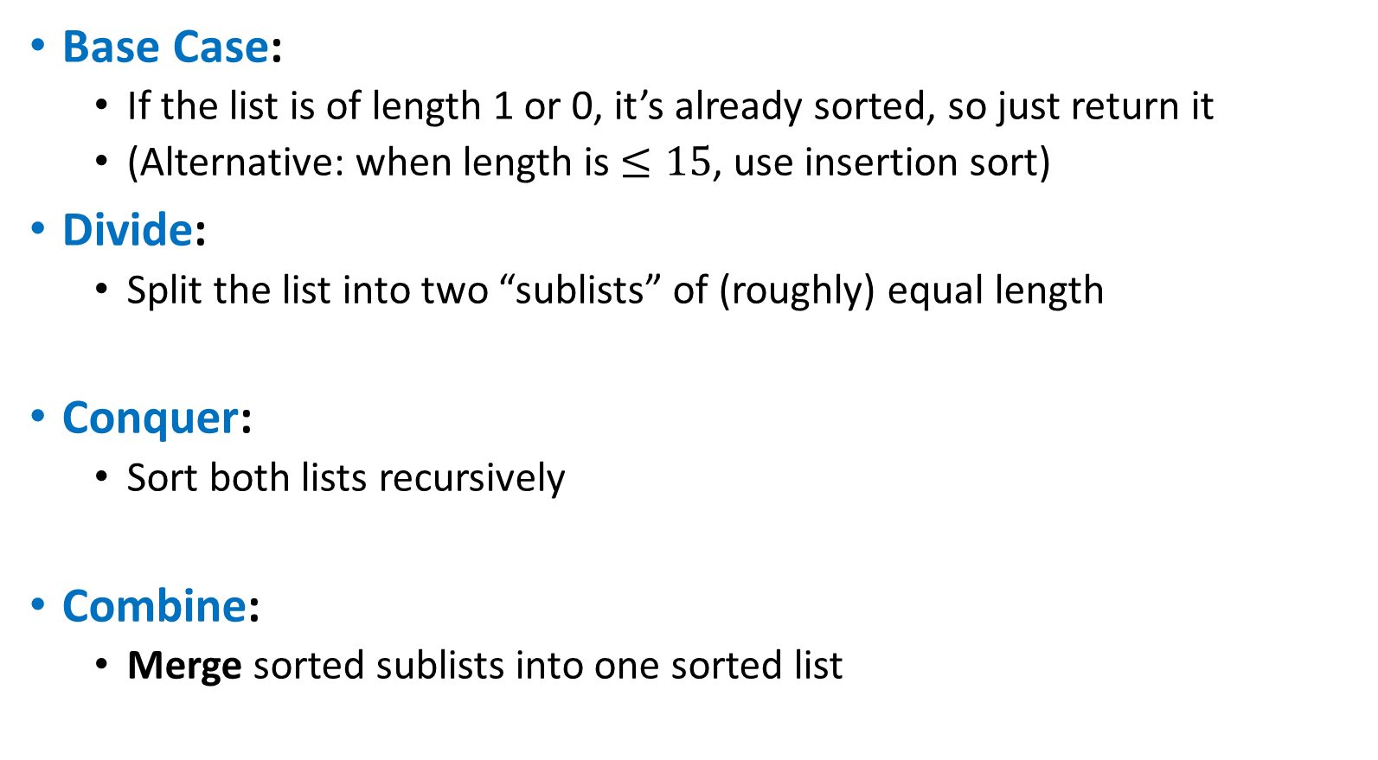
Divide and Conquer (Merge Sort)
Base Case:
  If the list is of length 1 or 0, it’s already sorted, so just return it
  (Alternative: when length is $≤15$, use insertion sort)
Divide:
  Split the list into two “sublists” of (roughly) equal length
Conquer:
  Sort both lists recursively
Combine:
  Merge sorted sublists into one sorted list
5
5
8
2
9
4
1
2
5
8
1
4
9
2
5
8
1
4
9
1
2
4
5
8
9

Slide 4

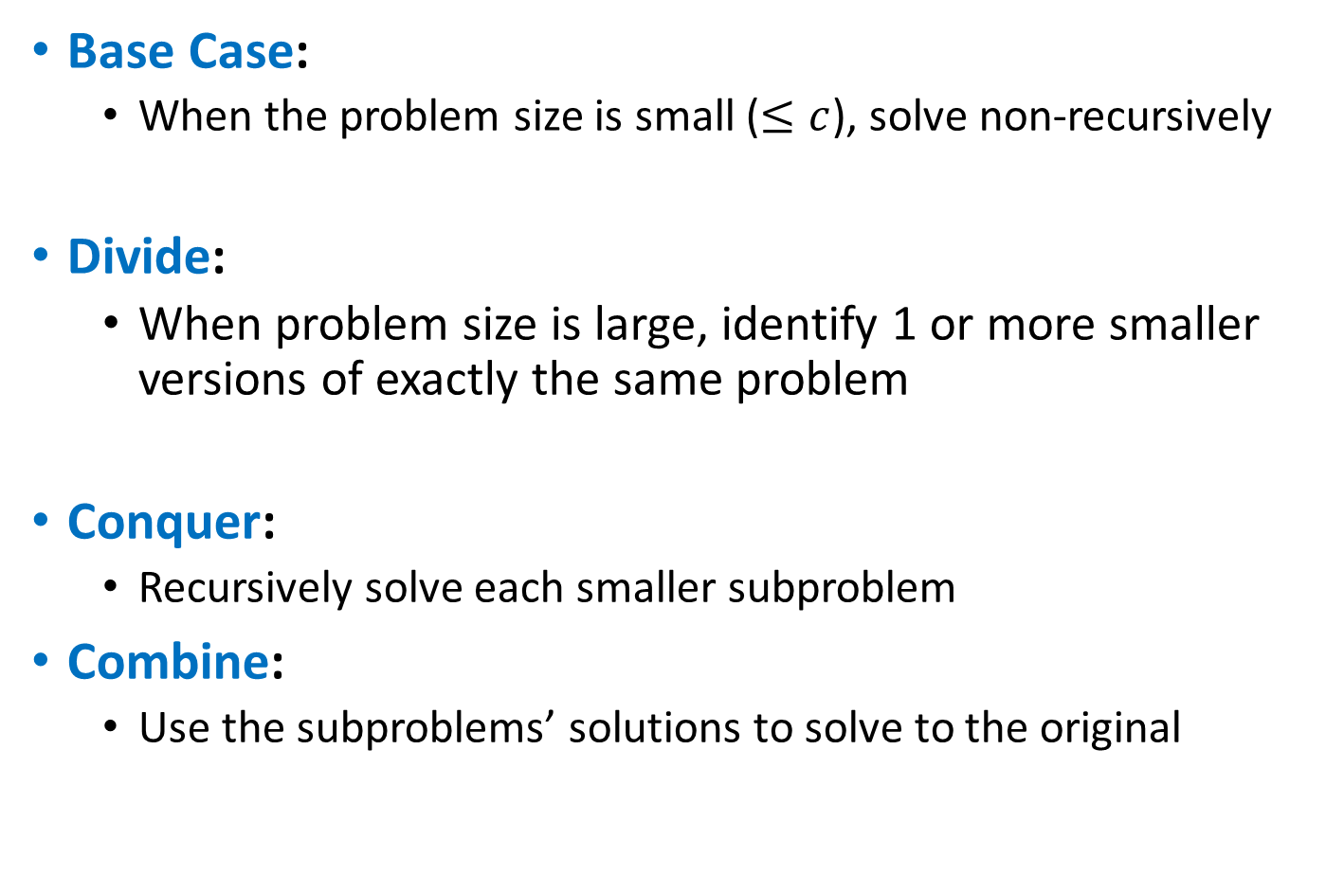
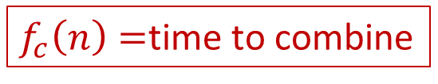

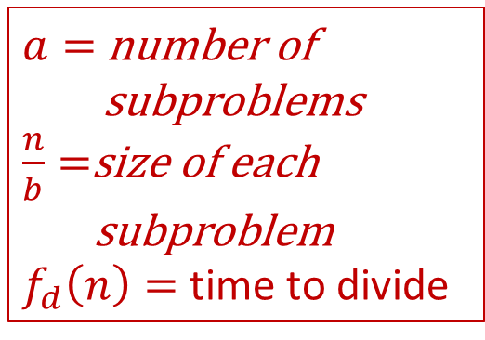
Divide and Conquer (Running Time)
$$T\left(c\right)=k$$
Base Case:
  When the problem size is small ($≤c$), solve non-recursively
Divide:
  When problem size is large, identify 1 or more smaller versions of exactly the same problem
Conquer:
  Recursively solve each smaller subproblem
Combine:
  Use the subproblems’ solutions to solve to the original
$a=$ number of
subproblems
$\frac{n}{b}=$size of each
subproblem
$f_{d}\left(n\right)=$ time to divide
$$a⋅T\left(\frac{n}{b}\right)$$
$f_{c}\left(n\right)=$time to combine
Overall: $T\left(n\right)=aT\left(\frac{n}{b}\right)+f\left(n\right)$ where $f\left(n\right)=f_{d}\left(n\right)+f_{c}(n)$

Slide 5
Divide and Conquer (Running Time)
$$T\left(c\right)=k$$
Base Case:
  When the problem size is small ($≤c$), solve non-recursively
Divide:
  When problem size is large, identify 1 or more smaller versions of exactly the same problem
Conquer:
  Recursively solve each smaller subproblem
Combine:
  Use the subproblems’ solutions to solve to the original
$a=$ number of
subproblems
$\frac{n}{b}=$size of each
subproblem
$f_{d}\left(n\right)=$ time to divide
$$a⋅T\left(\frac{n}{b}\right)$$
$f_{c}\left(n\right)=$time to combine
Overall: $T\left(n\right)=aT\left(\frac{n}{b}\right)+Θ\left(n^{k}\right)$ where $f_{d}\left(n\right)+f_{c}\left(n\right)∈Θ\left(n^{k}\right)$

Slide 6
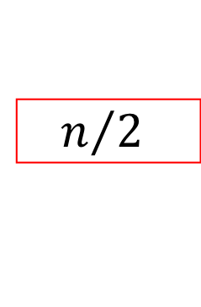


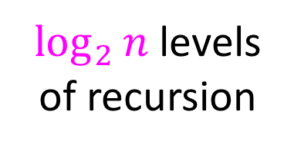




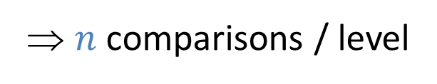


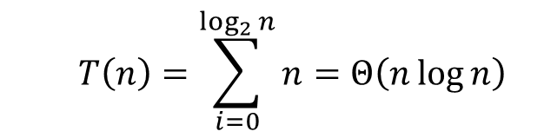
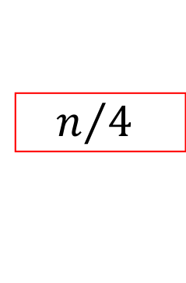
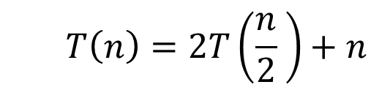








Tree Method (Merge Sort)
  $$T\left(n\right)=2T\left(\frac{n}{2} \right)+n$$
Red box represents a problem instance
Blue value represents time spent at that level of recursion
$$n$$
⇒ $n$ comparisons / level
$$n$$
$$n/2$$
$$\frac{n}{2}$$
$$n/2$$
$$\frac{n}{2}$$
$$\frac{n}{4}$$
$$\frac{n}{4}$$
$$\frac{n}{4}$$
$$\frac{n}{4}$$
$\log_{2}⁡n$ levels
of recursion
$$n/4$$
$$n/4$$
$$n/4$$
$$n/4$$
…
…
…
…
…
$$1$$
$$1$$
$$1$$
$$1$$
$$1$$
$$1$$
$$1$$
$$1$$
$$1$$
$$1$$
$$1$$
$$1$$
  $$T\left(n\right)=\sum_{i=0}^{\log_{2}{n}}{n}=Θ\left(n\log{n}\right)$$

Slide 7



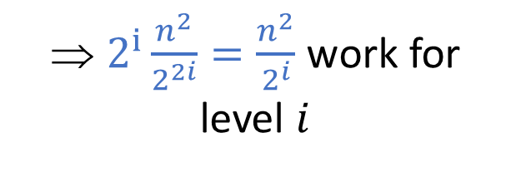


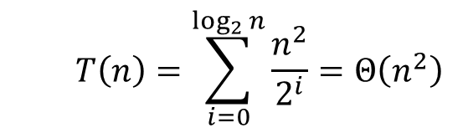
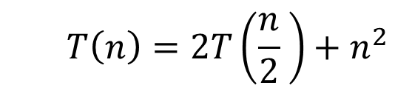


Tree Method (Slow CPP from last time)
  $$T\left(n\right)=2T\left(\frac{n}{2} \right)+n^{2}$$
Red box represents a problem instance
Blue value represents time spent at that level of recursion
$$n^{2}$$
⇒ $2^{i}\frac{n^{2}}{2^{2i}}=\frac{n^{2}}{2^{i}}$ work for level $i$
$$n$$
$$n/2$$
$$\frac{n^{2}}{2^{2}}$$
$$n/2$$
$$\frac{n^{2}}{2^{2}}$$
$$\frac{n^{2}}{4^{2}}$$
$$\frac{n^{2}}{4^{2}}$$
$$\frac{n^{2}}{4^{2}}$$
$$\frac{n^{2}}{4^{2}}$$
$\log_{2}⁡n$ levels
of recursion
$$n/4$$
$$n/4$$
$$n/4$$
$$n/4$$
…
…
…
…
…
$$1$$
$$1$$
$$1$$
$$1$$
$$1$$
$$1$$
$$1$$
$$1$$
$$1$$
$$1$$
$$1$$
$$1$$
  $$T\left(n\right)=\sum_{i=0}^{\log_{2}{n}}{\frac{n^{2}}{2^{i}}}=Θ\left(n^{2}\right)$$

Slide 8











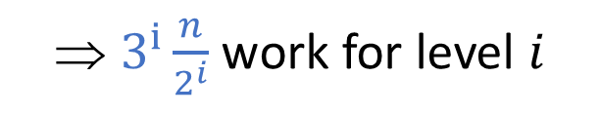



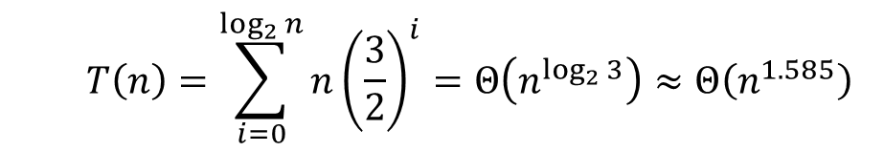





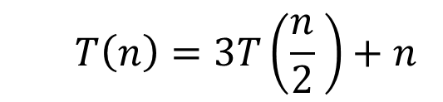














Tree Method (More Subproblems)
  $$T\left(n\right)=3T\left(\frac{n}{2} \right)+n$$
Red box represents a problem instance
Blue value represents time spent at that level of recursion
$$n$$
⇒ $3^{i}\frac{n}{2^{i}}$ work for level $i$
$$n$$
$$n/2$$
$$\frac{n}{2}$$
$$\frac{n}{2}$$
$$n/2$$
$$\frac{n}{2}$$
$$n/2$$
$$n/4$$
$$\frac{n}{4}$$
$$n/4$$
$$\frac{n}{4}$$
$$\frac{n}{4}$$
$$\frac{n}{4}$$
$$n/4$$
$$\frac{n}{4}$$
$$n/4$$
$$\frac{n}{4}$$
$$n/4$$
$$n/4$$
…
…
…
…
…
…
…
…
$$1$$
$$1$$
$$1$$
$$1$$
$$1$$
$$1$$
$$1$$
$$1$$
$$1$$
$$1$$
$$1$$
$$1$$
$$1$$
$$1$$
$$1$$
$$1$$
$$1$$
$$1$$
  $$T\left(n\right)=\sum_{i=0}^{\log_{2}{n}}{n{\left(\frac{3}{2}\right)}^{i}}=Θ\left(n^{\log_{2}{3}}\right)≈Θ\left(n^{1.585}\right)$$

Slide 9



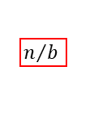
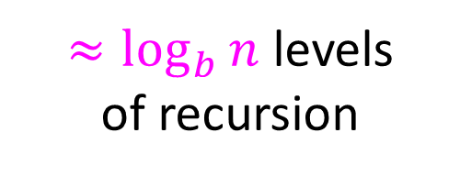




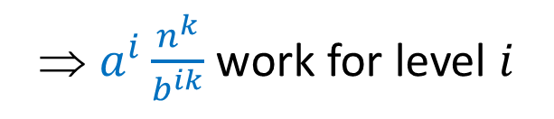






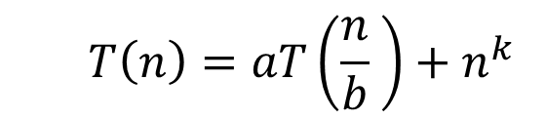
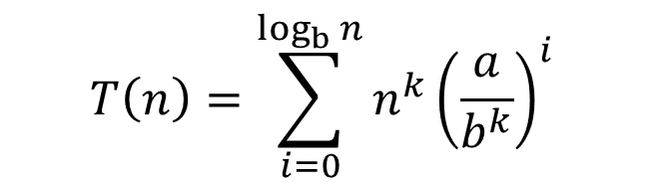












Tree Method
  $$T\left(n\right)=aT\left(\frac{n}{b} \right)+n^{k}$$
Red box represents a problem instance
$$n^{k}$$
$$n$$
Blue value represents time spent at that level of recursion
⇒ $a^{i}\frac{n^{k}}{b^{ik}}$ work for level $i$
…
$a$ children
$$\frac{n^{k}}{b^{k}}$$
$$n/b$$
$$n/b$$
$$\frac{n^{k}}{b^{k}}$$
$$n/b$$
$$n/b$$
…
…
$$\frac{n^{k}}{b^{2k}}$$
$$\frac{n^{k}}{b^{2k}}$$
$≈\log_{b}⁡n$ levels
of recursion
$$n/{b^{2}}$$
$$\frac{n^{k}}{b^{2k}}$$
$$n/{b^{2}}$$
$$\frac{n^{k}}{b^{2k}}$$
$$n/{b^{2}}$$
$$n/{b^{2}}$$
…
…
…
…
…
$$x$$
$$c$$
$$x$$
$$c$$
$$x$$
c
$$x$$
$$c$$
$$x$$
$$c$$
$$x$$
$$c$$
  $$T\left(n\right)=\sum_{i=0}^{\log_{b}{n}}{n^{k}{\left(\frac{a}{b^{k}}\right)}^{i}}$$

Slide 10






























Work Stays Constant
  $$T\left(n\right)=2T\left(\frac{n}{2} \right)+n$$
  $$\frac{a}{b^{k}}=\frac{2}{2^{1}}=1$$
  $$T\left(n\right)=\sum_{i=0}^{\log_{2}{n}}{n{\left(1\right)}^{i}}=Θ\left(n\log{n}\right)$$
$$n$$
$$n$$
$$n$$
$$n/2$$
$$\frac{n}{2}$$
$$n/2$$
$$\frac{n}{2}$$
$$n$$
Total work is the work for any level, times the height
$$n/4$$
$$\frac{n}{4}$$
$$n/4$$
$$\frac{n}{4}$$
$$n/4$$
$$\frac{n}{4}$$
$$n/4$$
$$\frac{n}{4}$$
$$n$$
…
…
…
…
…
$$1$$
$$1$$
$$1$$
$$1$$
$$1$$
$$1$$
$$1$$
$$1$$
$$1$$
$$1$$
$$1$$
$$1$$
$$n$$

Slide 11










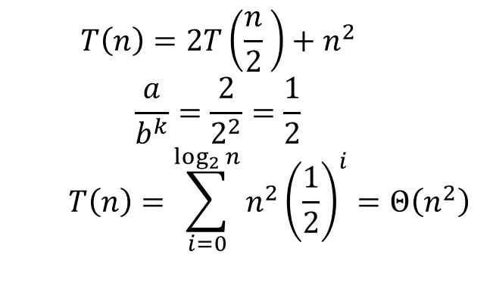


















Work Decreases
  $$T\left(n\right)=2T\left(\frac{n}{2} \right)+n^{2}$$
  $$\frac{a}{b^{k}}=\frac{2}{2^{2}}=\frac{1}{2}$$
  $$T\left(n\right)=\sum_{i=0}^{\log_{2}{n}}{n^{2}{\left(\frac{1}{2}\right)}^{i}}=Θ\left(n^{2}\right)$$
$$n^{2}$$
$$n^{2}$$
$$n$$
$$n/2$$
$$\frac{n^{2}}{2^{2}}$$
$$n/2$$
$$\frac{n^{2}}{2^{2}}$$
$$n^{2}\frac{1}{2}$$
Total work is asymptotically dominated by the root
$$n/4$$
$$\frac{n^{2}}{4^{2}}$$
$$n/4$$
$$\frac{n^{2}}{4^{2}}$$
$$n/4$$
$$\frac{n^{2}}{4^{2}}$$
$$n/4$$
$$\frac{n^{2}}{4^{2}}$$
$$n^{2}{\left(\frac{1}{2}\right)}^{2}$$
…
…
…
…
…
$$1$$
$$1$$
$$1$$
$$1$$
$$1$$
$$1$$
$$1$$
$$1$$
$$1$$
$$1$$
$$1$$
$$1$$

Slide 12








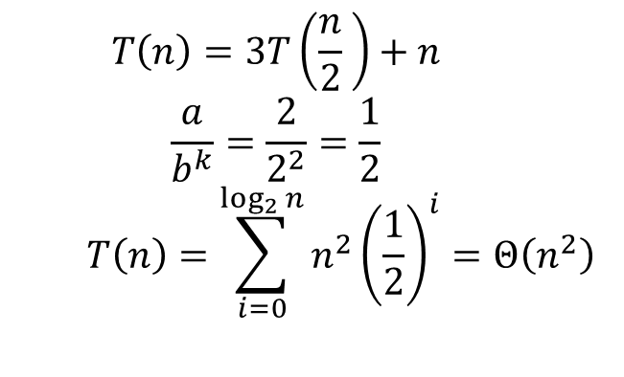


































Work Increases
  $$T\left(n\right)=3T\left(\frac{n}{2} \right)+n$$
  $$\frac{a}{b^{k}}=\frac{2}{2^{2}}=\frac{1}{2}$$
  $$T\left(n\right)=\sum_{i=0}^{\log_{2}{n}}{n^{2}{\left(\frac{1}{2}\right)}^{i}}=Θ\left(n^{2}\right)$$
$$n$$
$$n$$
$$n$$
$$\frac{n}{2}$$
$$\frac{n}{2}$$
$$n\frac{3}{2}$$
$$n/2$$
$$n/2$$
$$\frac{n}{2}$$
$$n/2$$
Total work is asymptotically dominated by the leaves
$$n/4$$
$$\frac{n}{4}$$
$$n/4$$
$$\frac{n}{4}$$
$$n/4$$
$$\frac{n}{4}$$
$$n/4$$
$$\frac{n}{4}$$
$$n/4$$
$$\frac{n}{4}$$
$$n/4$$
$$\frac{n}{4}$$
$$n{\left(\frac{3}{2}\right)}^{2}$$
…
…
…
…
…
…
…
…
$$1$$
$$1$$
$$1$$
$$1$$
$$1$$
$$1$$
$$1$$
$$1$$
$$1$$
$$1$$
$$1$$
$$1$$
$$1$$
$$1$$
$$1$$
$$a^{\log_{b}{n}}$$
$$1$$
$$1$$
$$1$$

Slide 13







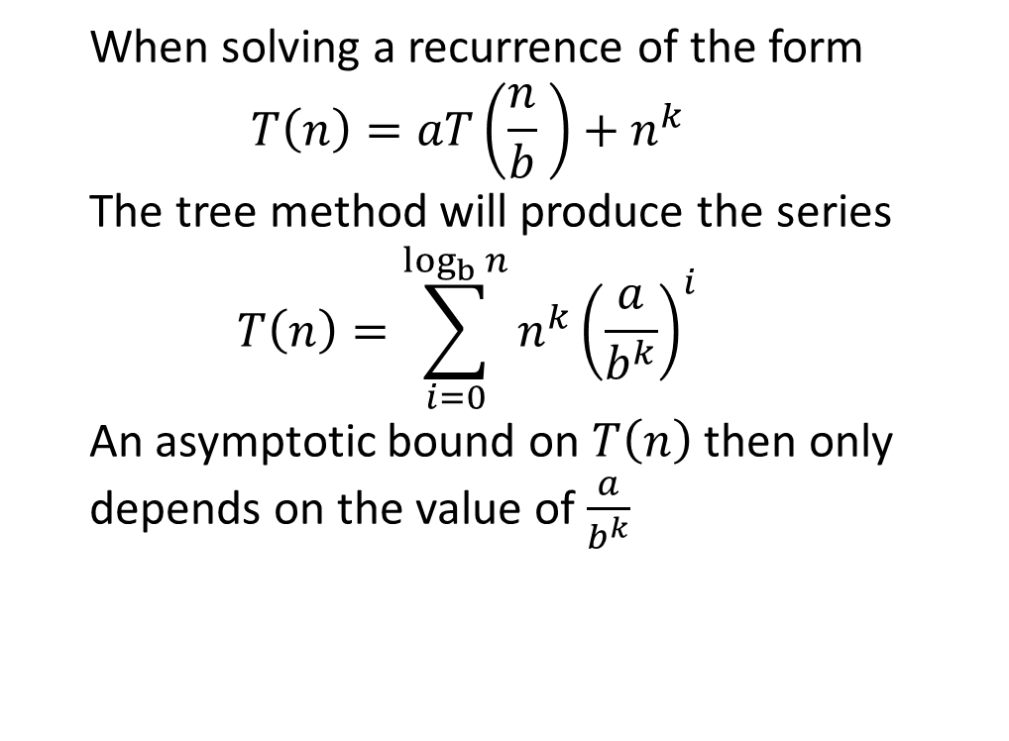











Summary
$$\frac{a}{b^{k}}=1$$
$$\frac{a}{b^{k}}<1$$
$$\frac{a}{b^{k}}>1$$
$$n^{k}$$
$$n^{k}{\left(\frac{a}{b}\right)}^{0}$$
$$n^{k}$$
  When solving a recurrence of the form
  $$T\left(n\right)=aT\left(\frac{n}{b} \right)+n^{k}$$
  The tree method will produce the series
  $$T\left(n\right)=\sum_{i=0}^{\log_{b}{n}}{n^{k}{\left(\frac{a}{b^{k}}\right)}^{i}}$$
  An asymptotic bound on $T\left(n\right)$ then only depends on the value of $\frac{a}{b^{k}}$
$$n^{k}$$
$$n^{k}{\left(\frac{a}{b}\right)}^{1}$$
$$n^{k}{\left(\frac{a}{b}\right)}^{1}$$
$$n^{k}$$
$$n^{k}{\left(\frac{a}{b}\right)}^{2}$$
$$n^{k}{\left(\frac{a}{b}\right)}^{2}$$
$$n^{k}$$
$$1$$
$$a^{\log_{b}{n}}=n^{\log_{b}{a}}$$
$$Θ(n^{k}\log{n})$$
$$Θ(n^{k})$$
$$Θ(n^{\log_{b}{a}})$$

Slide 14
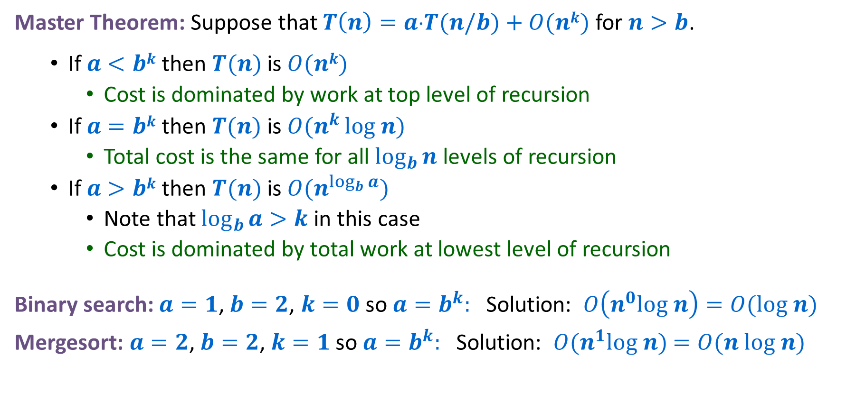
Solving Divide and Conquer Recurrences
Master Theorem: Suppose that $T\left(n\right)=a⋅T(n/b)+O(nk)$ for $n>b$.
  If $a<bk$ then $T(n)$ is $O(nk)$
    Cost is dominated by work at top level of recursion
  If $a=bk$ then $T(n)$ is $O(n^{k }log n)$
    Total cost is the same for all $\log_{b}{n}$ levels of recursion
  If $a>bk$ then $T(n)$ is $O(n^{\log_{b}{a}})$
    Note that $\log_{b}{a>k}$ in this case
    Cost is dominated by total work at lowest level of recursion
Binary search: $a=1$,$b=2$, $k=0$ so $a=b^{k}:$ Solution: $O\left(n^{0}log n\right)=O(log n)$
Mergesort: $a=2$,$b=2$, $k=1$ so $a=b^{k}:$ Solution: $O(n^{1}log n)$ $=O(n log n)$

Slide 15
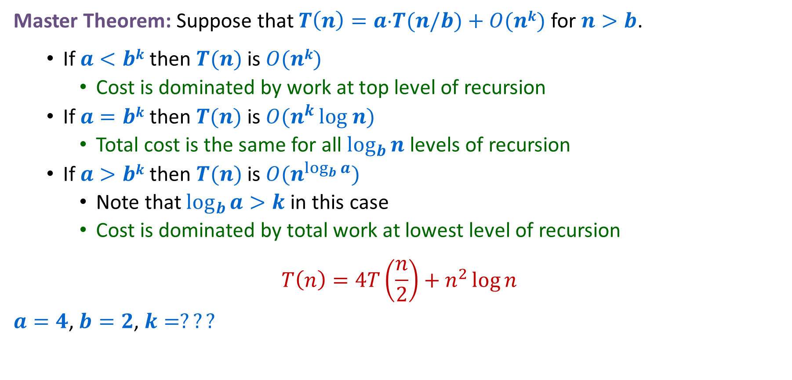
Beware! It doesn’t always apply!
Master Theorem: Suppose that $T\left(n\right)=a⋅T(n/b)+O(nk)$ for $n>b$.
  If $a<bk$ then $T(n)$ is $O(nk)$
    Cost is dominated by work at top level of recursion
  If $a=bk$ then $T(n)$ is $O(n^{k }log n)$
    Total cost is the same for all $\log_{b}{n}$ levels of recursion
  If $a>bk$ then $T(n)$ is $O(n^{\log_{b}{a}})$
    Note that $\log_{b}{a>k}$ in this case
    Cost is dominated by total work at lowest level of recursion
$$T\left(n\right)=4T\left(\frac{n}{2}\right)+n^{2}\log{n}$$
$a=4$,$b=2$, $k=???$

Slide 16
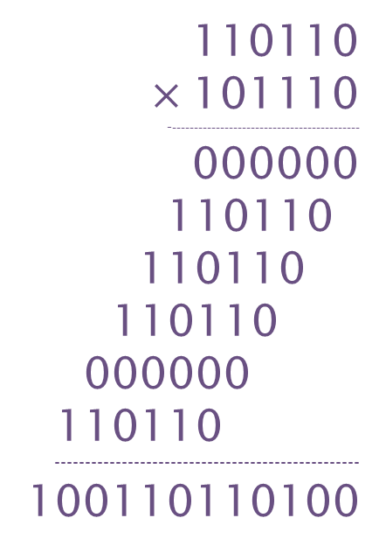
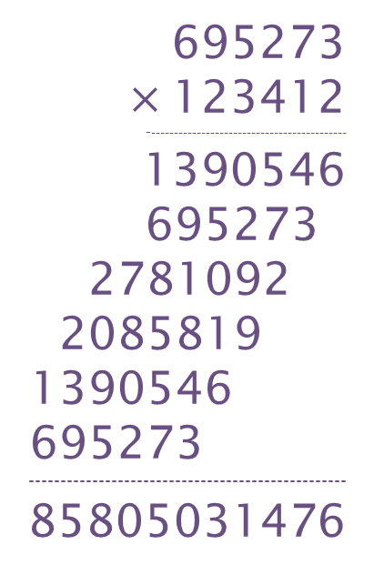
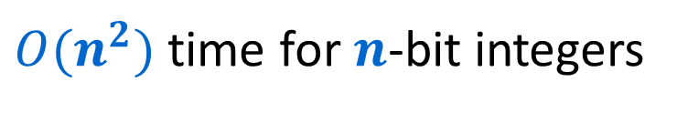
Integer Multiplication
695273
$×$123412
--------------------------------------------
1390546
695273
2781092
2085819
1390546
695273
--------------------------------------------------
85805031476
110110
$×$101110
--------------------------------------------
000000
110110
110110
110110
000000
110110
--------------------------------------------------
100110110100
Elementary school algorithm
$O(n^{2})$ time for $n$-bit integers
Decimal
Binary

Slide 17






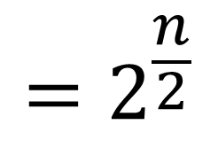


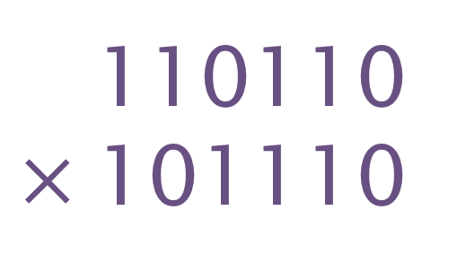
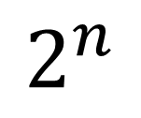





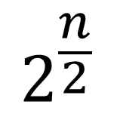

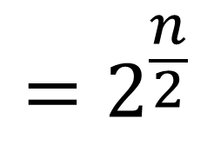


Divide and Conquer method
$$=2^{\frac{n}{2}}$$
110110
$×$101110
$$x_{1}$$
+
$$x_{2}$$
$$x_{1}$$
$$x_{2}$$
$$=2^{\frac{n}{2}}$$
$$y_{1}$$
$$y_{2}$$
$$y_{1}$$
+
$$y_{2}$$
$$2^{n}$$
( )
+
$$x_{1}$$
$$×$$
$$y_{1}$$
$$2^{\frac{n}{2}}$$
( )
+
$$x_{1}$$
$$×$$
$$y_{2}$$
+
$$x_{2}$$
$$×$$
$$y_{1}$$
( )
$$x_{2}$$
$$×$$
$$y_{2}$$

Slide 18







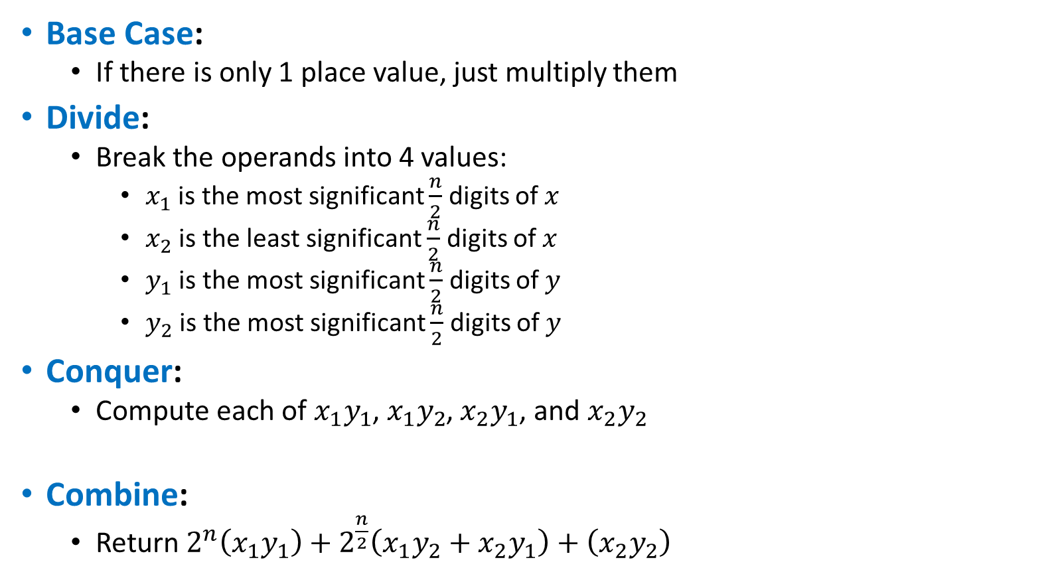









Divide and Conquer (Integer Multiplication)
Base Case:
  If there is only 1 place value, just multiply them
Divide:
  Break the operands into 4 values:
    $x_{1}$ is the most significant $\frac{n}{2}$ digits of $x$
    $x_{2}$ is the least significant $\frac{n}{2}$ digits of $x$
    $y_{1}$ is the most significant $\frac{n}{2}$ digits of $y$
    $y_{2}$ is the most significant $\frac{n}{2}$ digits of $y$
Conquer:
  Compute each of $x_{1}y_{1}$, $x_{1}y_{2}$, $x_{2}y_{1}$, and $x_{2}y_{2}$
Combine:
  Return $2^{n}\left(x_{1}y_{1}\right)+2^{\frac{n}{2}}\left(x_{1}y_{2}+x_{2}y_{1}\right)+\left(x_{2}y_{2}\right)$
$$x_{1}$$
$$x_{2}$$
$$×$$
$$y_{1}$$
$$y_{2}$$
$$x_{1}y_{1}$$
$$x_{1}y_{2}$$
$$x_{2}y_{1}$$
$$x_{2}y_{2}$$
$$x_{1}y_{1}$$
$$+$$
$$x_{1}y_{2}$$
$$+$$
$$x_{2}y_{1}$$
$$+$$
$$x_{2}y_{2}$$

Slide 19
Divide and Conquer (Integer Multiplication)
Base Case:
  If there is only 1 place value, just multiply them
Divide:
  Break the operands into 4 values:
    $x_{1}$ is the most significant $\frac{n}{2}$ digits of $x$
    $x_{2}$ is the least significant $\frac{n}{2}$ digits of $x$
    $y_{1}$ is the most significant $\frac{n}{2}$ digits of $y$
    $y_{2}$ is the most significant $\frac{n}{2}$ digits of $y$
Conquer:
  Compute each of $x_{1}y_{1}$, $x_{1}y_{2}$, $x_{2}y_{1}$, and $x_{2}y_{2}$
Combine:
  Return $2^{n}\left(x_{1}y_{1}\right)+2^{\frac{n}{2}}\left(x_{1}y_{2}+x_{2}y_{1}\right)+\left(x_{2}y_{2}\right)$
$$x_{1}$$
$$x_{2}$$
$$×$$
$$y_{1}$$
$$y_{2}$$
$$x_{1}y_{1}$$
$$x_{1}y_{2}$$
$$x_{2}y_{1}$$
$$x_{2}y_{2}$$
$$x_{1}y_{1}$$
$$+$$
$$x_{1}y_{2}$$
$$+$$
$$x_{2}y_{1}$$
$$+$$
$$x_{2}y_{2}$$

Slide 20
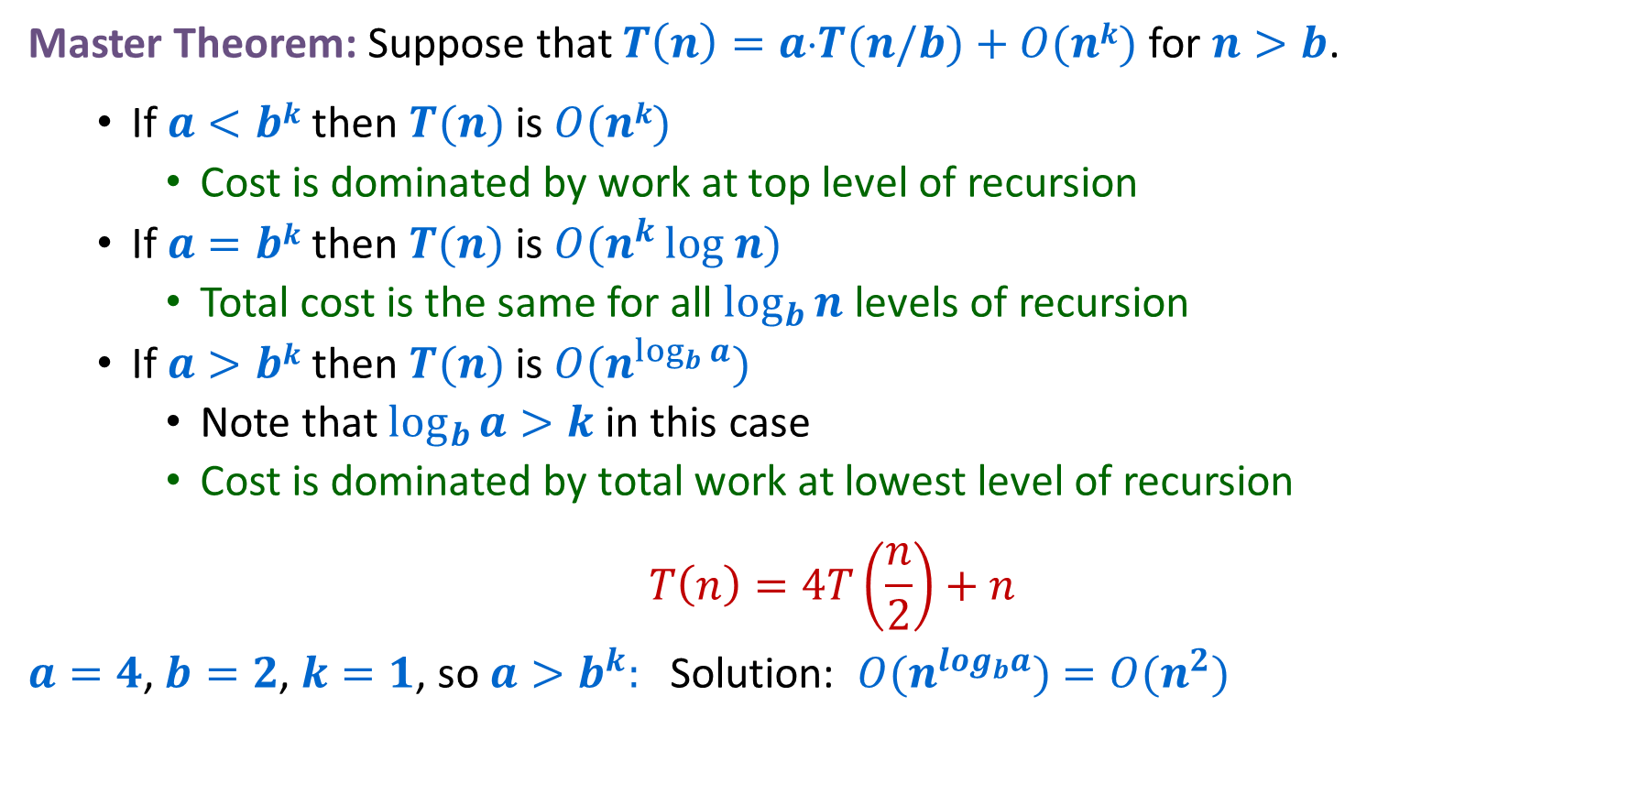
Integer Multiplication Recurrence Solution
Master Theorem: Suppose that $T\left(n\right)=a⋅T(n/b)+O(nk)$ for $n>b$.
  If $a<bk$ then $T(n)$ is $O(nk)$
    Cost is dominated by work at top level of recursion
  If $a=bk$ then $T(n)$ is $O(n^{k }log n)$
    Total cost is the same for all $\log_{b}{n}$ levels of recursion
  If $a>bk$ then $T(n)$ is $O(n^{\log_{b}{a}})$
    Note that $\log_{b}{a>k}$ in this case
    Cost is dominated by total work at lowest level of recursion
$$T\left(n\right)=4T\left(\frac{n}{2}\right)+n$$
$a=4$,$b=2$, $k=1$, so $a>b^{k}:$ Solution: $O(n^{log_{b}a})$ $=O(n^{2})$

Slide 21
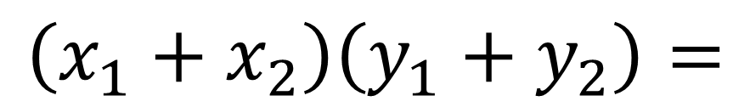
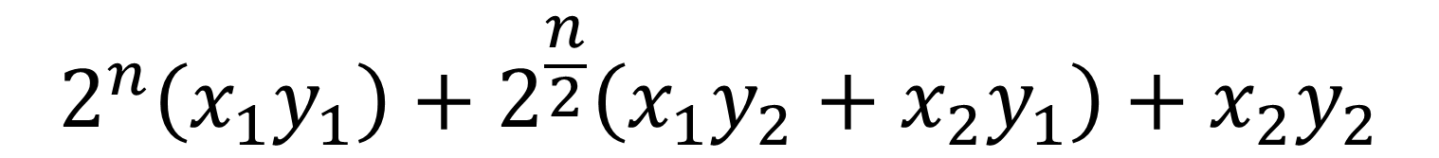
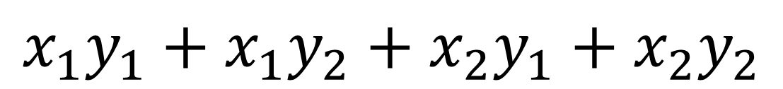
Karatsuba Method
Can’t avoid these
$$2^{n}\left(x_{1}y_{1}\right)+2^{\frac{n}{2}}\left(x_{1}y_{2}+x_{2}y_{1}\right)+x_{2}y_{2}$$
Can we do this with one multiplication?
$$\left(x_{1}+x_{2}\right)\left(y_{1}+y_{2}\right)=$$
$$x_{1}y_{1}+x_{1}y_{2}+x_{2}y_{1}+x_{2}y_{2}$$
$$x_{1}y_{2}+x_{2}y_{1}=\left(x_{1}+x_{2}\right)\left(y_{1}+y_{2}\right)−x_{1}y_{1}−x_{2}y_{2}$$
Two multiplications
One multiplication

Slide 22





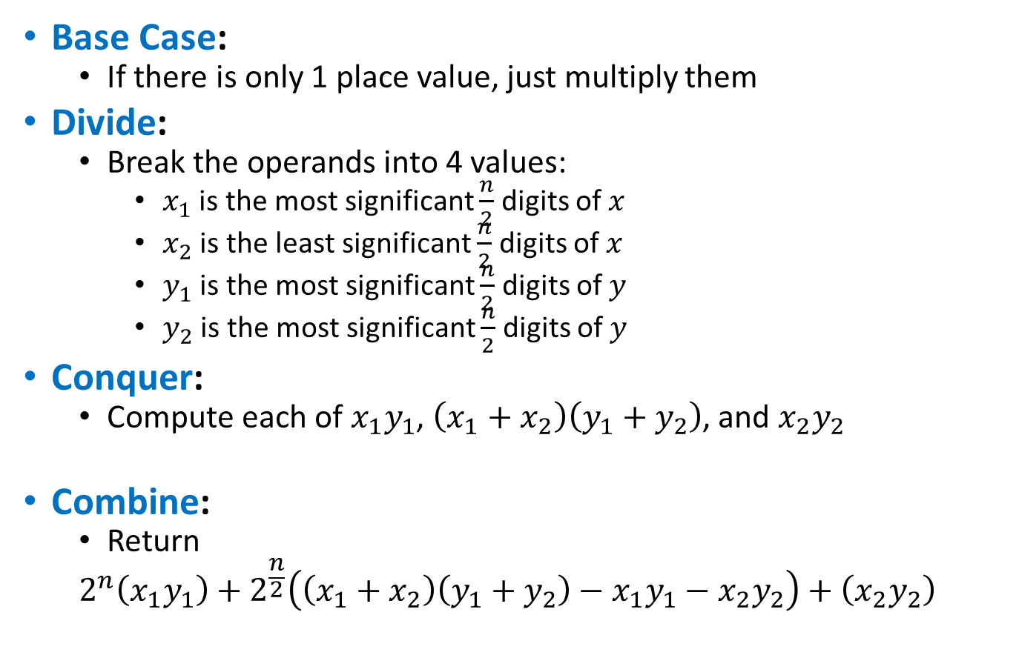








Divide and Conquer (Karatsuba Method)
Base Case:
  If there is only 1 place value, just multiply them
Divide:
  Break the operands into 4 values:
    $x_{1}$ is the most significant $\frac{n}{2}$ digits of $x$
    $x_{2}$ is the least significant $\frac{n}{2}$ digits of $x$
    $y_{1}$ is the most significant $\frac{n}{2}$ digits of $y$
    $y_{2}$ is the most significant $\frac{n}{2}$ digits of $y$
Conquer:
  Compute each of $x_{1}y_{1}$, $\left(x_{1}+x_{2}\right)\left(y_{1}+y_{2}\right)$, and $x_{2}y_{2}$
Combine:
  Return
  $$2^{n}\left(x_{1}y_{1}\right)+2^{\frac{n}{2}}\left(\left(x_{1}+x_{2}\right)\left(y_{1}+y_{2}\right)−x_{1}y_{1}−x_{2}y_{2}\right)+\left(x_{2}y_{2}\right)$$
$$x_{1}$$
$$x_{2}$$
$$×$$
$$y_{1}$$
$$y_{2}$$
$$x_{1}y_{1}$$
$$x_{1}y_{2}$$
$$\left(x_{1}+x_{2}\right)$$
$$\left(y_{1}+y_{2}\right)$$
$$x_{2}y_{2}$$
$$x_{1}y_{1}$$
$$+$$
$$\left(x_{1}+x_{2}\right)$$
$$\left(y_{1}+y_{2}\right)$$
$$−$$
$$x_{1}y_{1}$$
$$−$$
$$x_{2}y_{2}$$
$$+$$
$$x_{2}y_{2}$$

Slide 23
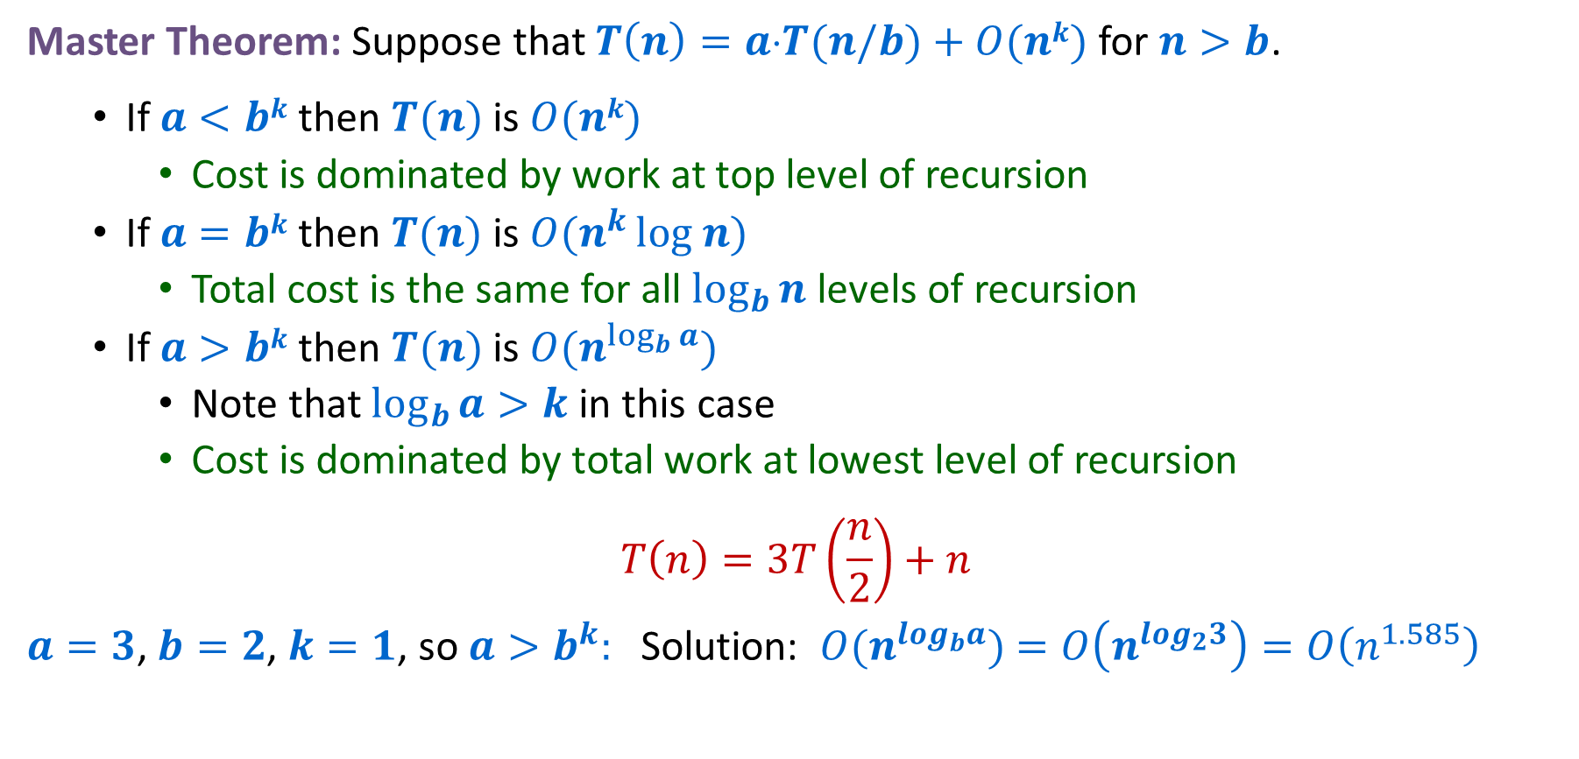
Karatsuba Method Recurrence Solution
Master Theorem: Suppose that $T\left(n\right)=a⋅T(n/b)+O(nk)$ for $n>b$.
  If $a<bk$ then $T(n)$ is $O(nk)$
    Cost is dominated by work at top level of recursion
  If $a=bk$ then $T(n)$ is $O(n^{k }log n)$
    Total cost is the same for all $\log_{b}{n}$ levels of recursion
  If $a>bk$ then $T(n)$ is $O(n^{\log_{b}{a}})$
    Note that $\log_{b}{a>k}$ in this case
    Cost is dominated by total work at lowest level of recursion
$$T\left(n\right)=3T\left(\frac{n}{2}\right)+n$$
$a=3$,$b=2$, $k=1$, so $a>b^{k}:$ Solution: $O(n^{log_{b}a})$ $=O\left(n^{log_{2}3}\right)=O\left(n^{1.585}\right)$

Slide 24
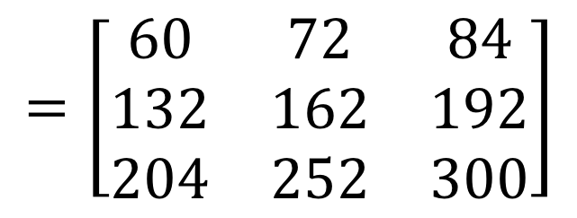

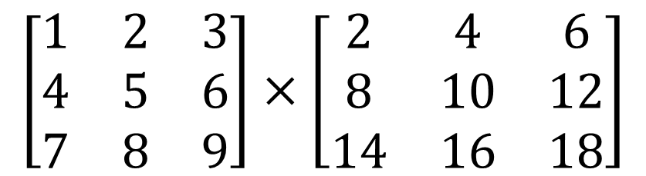

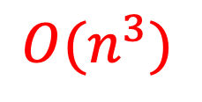
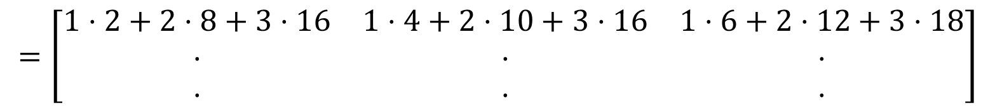
Matrix Multiplication
$$n$$
$$\left[\begin{matrix}1 & 2 & 3 \\ 4 & 5 & 6 \\ 7 & 8 & 9\end{matrix}\right]×\left[\begin{matrix}2 & 4 & 6 \\ 8 & 10 & 12 \\ 14 & 16 & 18\end{matrix}\right]$$
$$n$$
$$=\left[\begin{matrix}1⋅2+2⋅8+3⋅16 & 1⋅4+2⋅10+3⋅16 & 1⋅6+2⋅12+3⋅18 \\ ⋅ & ⋅ & ⋅ \\ ⋅ & ⋅ & ⋅\end{matrix}\right]$$
$$=\left[\begin{matrix}60 & 72 & 84 \\ 132 & 162 & 192 \\ 204 & 252 & 300\end{matrix}\right]$$
Run time?
$$O(n^{3})$$

Slide 25

Multiplying Matrices
for $i$ ← $1$ to $n$
for $j$← $1$ to $n$
$C[i,j]$ ← $0$
for $k$ ← $1$ to $n$
$C[i,j]$ ← $C[i,j]+A[i,k]B[k,j]$
endfor
endfor
endfor
Can we improve this with divide and conquer?

Slide 26







We can see subproblems!
$$A_{11}$$
$$B_{11}$$
$$A=\left[\begin{matrix}a_{11} & a_{12} & a_{13} & a_{14} \\ a_{21} & a_{22} & a_{23} & a_{24} \\ a_{31} & a_{32} & a_{33} & a_{34} \\ a_{41} & a_{42} & a_{43} & a_{44}\end{matrix}\right]$$
$$B=\left[\begin{matrix}b_{11} & b_{12} & b_{13} & b_{14} \\ b_{21} & b_{22} & b_{23} & b_{24} \\ b_{31} & b_{32} & b_{33} & b_{34} \\ b_{41} & b_{42} & b_{43} & b_{44}\end{matrix}\right]$$
$A×B=$
$\left[\begin{matrix}a_{11}b_{11}+a_{12}b_{21}+a_{13}b_{31}+a_{14}b_{41} & a_{11}b_{12}+a_{12}b_{22}+a_{13}b_{32}+a_{14}b_{42} & ⋅ & ⋅ \\ a_{21}b_{11}+a_{22}b_{21}+a_{23}b_{31}+a_{24}b_{41} & a_{21}b_{12}+a_{22}b_{22}+a_{23}b_{32}+a_{24}b_{42} & ⋅ & ⋅ \\ a_{31}b_{11}+a_{32}b_{21}+a_{33}b_{31}+a_{34}b_{41} & a_{31}b_{12}+a_{32}b_{22}+a_{33}b_{32}+a_{34}b_{42} & ⋅ & ⋅ \\ a_{41}b_{11}+a_{42}b_{21}+a_{43}b_{31}+a_{44}b_{41} & a_{41}b_{12}+a_{42}b_{22}+a_{43}b_{32}+a_{44}b_{42} & ⋅ & ⋅\end{matrix}\right]$
$$A_{11}×B_{11}$$
$$A_{11}×B_{11}$$

Slide 27











Matrix Multiplication D&C
Multiply $n×n$ matrices ($A$ and $B$)
$$B=\left[\begin{matrix}b_{11} & b_{12} & b_{13} & b_{14} \\ b_{21} & b_{22} & b_{23} & b_{24} \\ b_{31} & b_{32} & b_{33} & b_{34} \\ b_{41} & b_{42} & b_{43} & b_{44}\end{matrix}\right]$$
$$A=\left[\begin{matrix}a_{11} & a_{12} & a_{13} & a_{14} \\ a_{21} & a_{22} & a_{23} & a_{24} \\ a_{31} & a_{32} & a_{33} & a_{34} \\ a_{41} & a_{42} & a_{43} & a_{44}\end{matrix}\right]$$
$$B_{11}$$
$$B_{12}$$
$$A_{11}$$
$$A_{12}$$
$$A_{21}$$
$$A_{22}$$
$$B_{21}$$
$$B_{22}$$
$$A×B=\left[\begin{matrix}A_{11}×B_{11}+A_{12}×B_{21} & A_{11}×B_{12}+A_{12}×B_{22} \\ A_{21}×B_{11}+A_{22}×B_{21} & A_{21}×B_{12}+A_{22}×B_{22}\end{matrix}\right]$$

Slide 28























Divide and Conquer Matrix Multiplication
Base Case:
  For a $1×1$ matrices, return the product in a $1×1$ matrix
Divide:
  Use each quadrant of the input $n×n$ matrices as it’s own $\frac{n}{2}×\frac{n}{2}$matrix
Conquer:
  Compute each of:
Combine:
  Compute the value of each quadrant by summing $P_{1}…P_{8}$ as shown
$$A_{11}$$
$$A_{12}$$
$$B_{11}$$
$$B_{12}$$
$$A_{21}$$
$$A_{22}$$
$$B_{21}$$
$$B_{22}$$
$$P_{1}=A_{11}×B_{11}$$
$$P_{2}=A_{12}×B_{21}$$
$$P_{3}=A_{11}×B_{12}$$
$$P_{4}=A_{12}×B_{22}$$
$$P_{5}=A_{21}×B_{11}$$
$$P_{6}=A_{22}×B_{21}$$
$$P_{7}=A_{21}×B_{12}$$
$$P_{8}=A_{22}×B_{22}$$
$$P_{1}$$
$$P_{2}$$
$$P_{3}$$
$$P_{4}$$
$$P_{5}$$
$$P_{6}$$
$$P_{7}$$
$$P_{8}$$
$$P_{1}+P_{2}$$
$$P_{3}+P_{4}$$
$$P_{5}+P_{6}$$
$$P_{7}+P_{8}$$

Slide 29

Karatsuba Method Recurrence Solution
Master Theorem: Suppose that $T\left(n\right)=a⋅T(n/b)+O(nk)$ for $n>b$.
  If $a<bk$ then $T(n)$ is $O(nk)$
    Cost is dominated by work at top level of recursion
  If $a=bk$ then $T(n)$ is $O(n^{k }log n)$
    Total cost is the same for all $\log_{b}{n}$ levels of recursion
  If $a>bk$ then $T(n)$ is $O(n^{\log_{b}{a}})$
    Note that $\log_{b}{a>k}$ in this case
    Cost is dominated by total work at lowest level of recursion
$$T\left(n\right)=8T\left(\frac{n}{2}\right)+n^{2}$$
$a=8$,$b=2$, $k=2$, so $a>b^{k}:$ Solution: $O(n^{log_{b}a})$ $=O\left(n^{log_{2}8}\right)=O\left(n^{3}\right)$

Slide 30
How to Improve?
Multiply $n×n$ matrices ($A$ and $B$)
$$B=\left[\begin{matrix}b_{11} & b_{12} & b_{13} & b_{14} \\ b_{21} & b_{22} & b_{23} & b_{24} \\ b_{31} & b_{32} & b_{33} & b_{34} \\ b_{41} & b_{42} & b_{43} & b_{44}\end{matrix}\right]$$
$$A=\left[\begin{matrix}a_{11} & a_{12} & a_{13} & a_{14} \\ a_{21} & a_{22} & a_{23} & a_{24} \\ a_{31} & a_{32} & a_{33} & a_{34} \\ a_{41} & a_{42} & a_{43} & a_{44}\end{matrix}\right]$$
$$B_{11}$$
$$B_{12}$$
$$A_{11}$$
$$A_{12}$$
$$A_{21}$$
$$A_{22}$$
$$B_{21}$$
$$B_{22}$$
$$A×B=\left[\begin{matrix}A_{11}×B_{11}+A_{12}×B_{21} & A_{11}×B_{12}+A_{12}×B_{22} \\ A_{21}×B_{11}+A_{22}×B_{21} & A_{21}×B_{12}+A_{22}×B_{22}\end{matrix}\right]$$
Idea: Use an idea like Karatsuba! Can we derive these products using addition/subtraction?

Slide 31




















Strassen’s Algorithm
$$B=\left[\begin{matrix}b_{11} & b_{12} & b_{13} & b_{14} \\ b_{21} & b_{22} & b_{23} & b_{24} \\ b_{31} & b_{32} & b_{33} & b_{34} \\ b_{41} & b_{42} & b_{43} & b_{44}\end{matrix}\right]$$
$$A=\left[\begin{matrix}a_{11} & a_{12} & a_{13} & a_{14} \\ a_{21} & a_{22} & a_{23} & a_{24} \\ a_{31} & a_{32} & a_{33} & a_{34} \\ a_{41} & a_{42} & a_{43} & a_{44}\end{matrix}\right]$$
$$B_{11}$$
$$B_{12}$$
$$A_{11}$$
$$A_{12}$$
$$A_{21}$$
$$A_{22}$$
$$B_{21}$$
$$B_{22}$$
Calculate:
Find $A×B$:
$$Q_{1}=\left(A_{11}+A_{22}\right)×(B_{11}+B_{22})$$
$$\left[\begin{matrix}A_{1,1}B_{1,1}+A_{1,2}B_{2,1} & A_{1,1}B_{1,2}+A_{1,2}B_{2,2} \\ A_{2,1}B_{1,1}+A_{2,2}B_{2,1} & A_{2,1}B_{1,2}+A_{2,2}B_{2,2}\end{matrix}\right]=$$
$$Q_{2}=\left(A_{21}+A_{22}\right)×B_{11}$$
$$Q_{3}=A_{11}×(B_{12} −B_{22})$$
$$Q_{4}=A_{22}×(B_{21}−B_{11})$$
$$\left[\begin{matrix}Q_{1}+Q_{4}−Q_{5}+Q_{7} & Q_{3}+Q_{5} \\ Q_{2}+Q_{4} & Q_{1}−Q_{2}+Q_{3}+Q_{6}\end{matrix}\right]$$
$$Q_{5}=\left(A_{11}+A_{12}\right)×B_{22}$$
$$Q_{6}=\left(A_{21}−A_{11}\right)×(B_{11}+B_{12})$$
$$Q_{7}=\left(A_{12}−A_{22}\right)×(B_{21}+B_{22})$$

Slide 32













Divide and Conquer Matrix Multiplication
Base Case:
  For a $32×32$ matrices, use the textbook algorithm
Divide:
  Use each quadrant of the input $n×n$ matrices as it’s own $\frac{n}{2}×\frac{n}{2}$matrix
Conquer:
  Compute each of:
Combine:
  Compute the value of each quadrant by summing $Q_{1}…Q_{8}$ as shown
$$A_{11}$$
$$A_{12}$$
$$B_{11}$$
$$B_{12}$$
$$A_{21}$$
$$A_{22}$$
$$B_{21}$$
$$B_{22}$$
$Q_{1}=\left(A_{11}+A_{22}\right)×(B_{11}+B_{22})$
$Q_{2}=\left(A_{21}+A_{22}\right)×B_{11}$
$Q_{3}=A_{11}×(B_{12} −B_{22})$
$Q_{4}=A_{22}×(B_{21}−B_{11})$
$Q_{5}=\left(A_{11}+A_{12}\right)×B_{22}$
$Q_{6}=\left(A_{21}−A_{11}\right)×(B_{11}+B_{12})$
$Q_{7}=\left(A_{12}−A_{22}\right)×(B_{21}+B_{22})$
$$Q_{1}$$
$$Q_{2}$$
$$Q_{3}$$
$$Q_{4}$$
$$Q_{5}$$
$$Q_{6}$$
$$Q_{7}$$
$$Q_{1}+Q_{4}−Q_{5}+Q_{7}$$
$$Q_{3}+Q_{5}$$
$$Q_{2}+Q_{4}$$
$$Q_{1}−Q_{2}+Q_{3}+Q_{6}$$

Slide 33

Karatsuba Method Recurrence Solution
Master Theorem: Suppose that $T\left(n\right)=a⋅T(n/b)+O(nk)$ for $n>b$.
  If $a<bk$ then $T(n)$ is $O(nk)$
    Cost is dominated by work at top level of recursion
  If $a=bk$ then $T(n)$ is $O(n^{k }log n)$
    Total cost is the same for all $\log_{b}{n}$ levels of recursion
  If $a>bk$ then $T(n)$ is $O(n^{\log_{b}{a}})$
    Note that $\log_{b}{a>k}$ in this case
    Cost is dominated by total work at lowest level of recursion
$$T\left(n\right)=7T\left(\frac{n}{2}\right)+n^{2}$$
$a=7$,$b=2$, $k=2$, so $a>b^{k}:$ Solution: $O(n^{log_{b}a})$ $=O\left(n^{log_{2}7}\right)=O\left(n^{2.807}\right)$

Slide 34



Strassen’s Algorithm
$$n^{3}$$
$$n^{\log_{2}{7}}$$

Slide 35


Is this the fastest?
Every few years someone comes up with an asymptotically faster algorithm
Current best is $O\left(n^{2.3728596}\right)$, but it requires input sizes in the millions to actually be faster
We know there is no algorithm with running time $o\left(n^{2}\right)$
The best possible running time is unknown!
(and weirdly, may not exist!)

