Slide 1
CSE 421 Section 9
NP-completeness

Slide 2
Administrivia
Notes:
Administrivia ~2 mins

Slide 3
Announcements & Reminders
HW6 regrade requests are open
HW7
  Due tomorrow 11/22 @ 11:59pm
  Late submissions will be open until Sunday, 11/24 @ 11:59pm
HW8
  Will be released over the weekend
  Due Wednesday, December 4th @ 11:59pm
No section next week, happy Thanksgiving!

Slide 4
Definition review
Notes:
~10 min microteach? Maybe shorter maybe longer?

Slide 5
Definition review
There were many new definitions in lecture recently that we’ll review now.
To check your understanding, for each definition starting next slide, give an example of the definition!

Slide 6
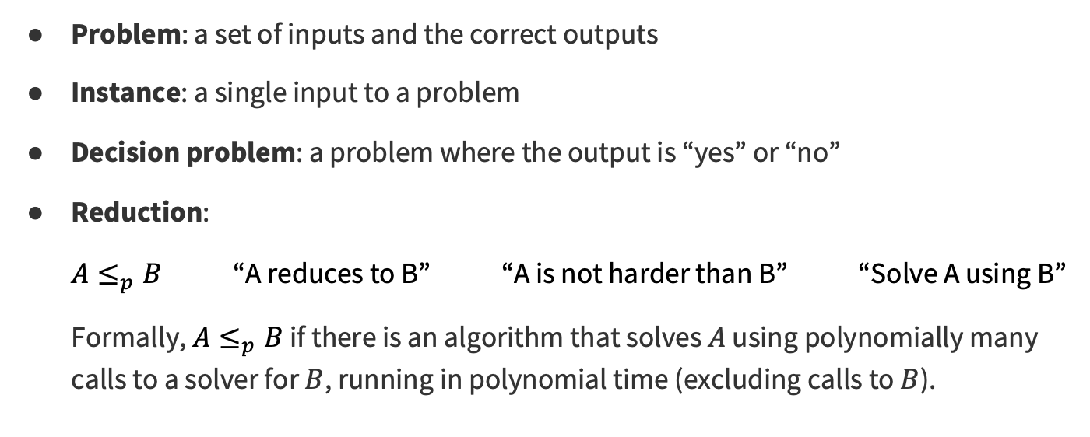
Definition review
Problem: a set of inputs and the correct outputs
Instance: a single input to a problem
Decision problem: a problem where the output is “yes” or “no”
Reduction:
$A≤_{p}B$ “A reduces to B” “A is not harder than B” “Solve A using B”
Formally, $A≤_{p}B$ if there is an algorithm that solves $A$ using polynomially many calls to a solver for $B$, running in polynomial time (excluding calls to $B$).

Slide 7
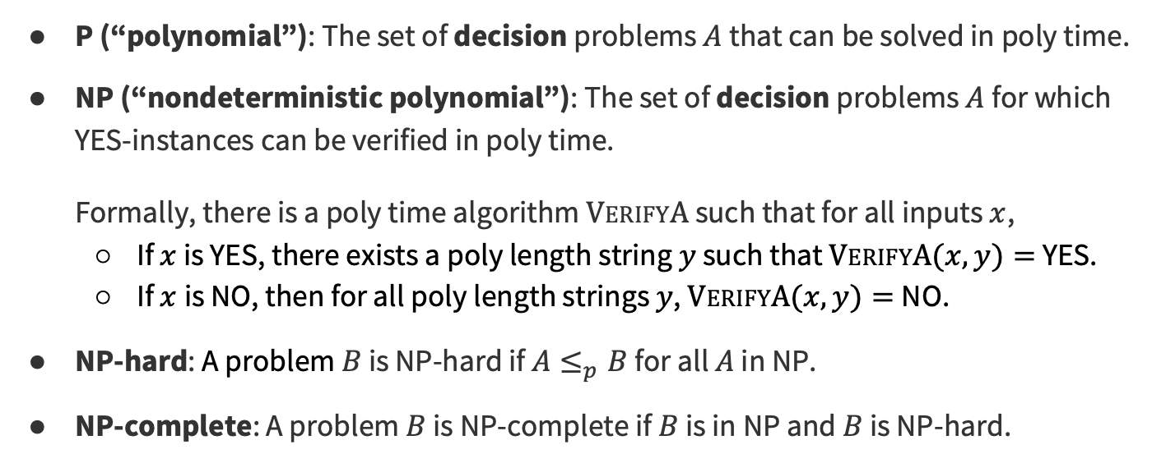
Definition review
P (“polynomial”): The set of decision problems $A$ that can be solved in poly time.
NP (“nondeterministic polynomial”): The set of decision problems $A$ for which YES-instances can be verified in poly time.
Formally, there is a poly time algorithm $VerifyA$ such that for all inputs $x$,
  If $x$ is YES, there exists a poly length string $y$ such that $VerifyA(x,y)=$ YES.
  If $x$is NO, then for all poly length strings $y$, $VerifyA(x,y)=$NO.
NP-hard: A problem $B$ is NP-hard if $A≤_{p}B$ for all $A$ in NP.
NP-complete: A problem $B$ is NP-complete if $B$ is in NP and $B$ is NP-hard.

Slide 8
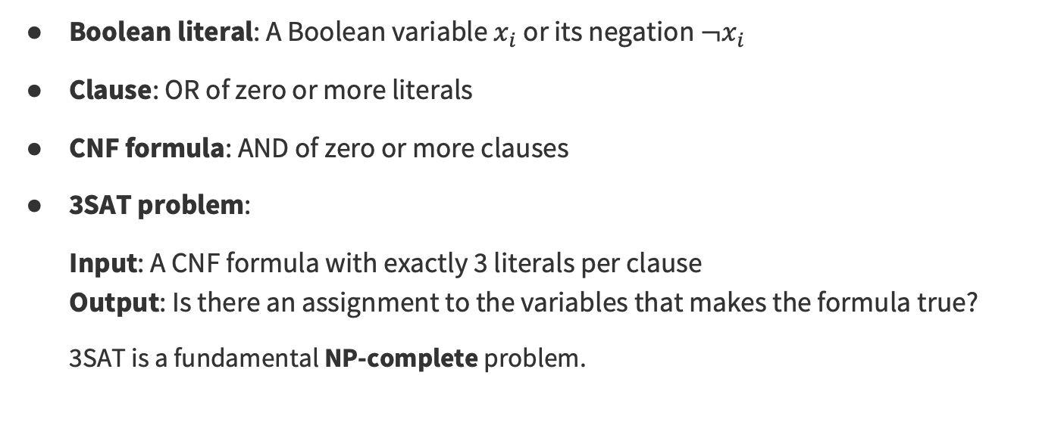
Definition review
Boolean literal: A Boolean variable $x_{i}$ or its negation ${¬x}_{i}$
Clause: OR of zero or more literals
CNF formula: AND of zero or more clauses
3SAT problem:
Input: A CNF formula with exactly 3 literals per clause
Output: Is there an assignment to the variables that makes the formula true?
3SAT is a fundamental NP-complete problem.

Slide 9
Practice with SAT
Notes:
~5 mins

Slide 10
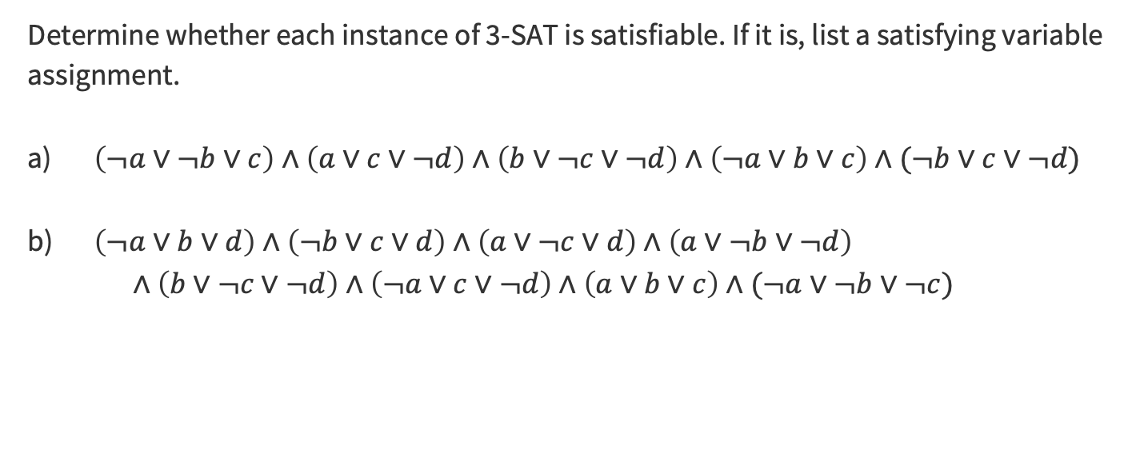
Problem 1 – SATisfy This
Determine whether each instance of 3-SAT is satisfiable. If it is, list a satisfying variable assignment.
$\left(¬a∨¬b∨c\right)∧\left(a∨c∨¬d\right)∧\left(b∨¬c∨¬d\right)∧\left(¬a∨b∨c\right)∧(¬b∨c∨¬d)$
$\left(¬a∨b∨d\right)∧\left(¬b∨c∨d\right)∧\left(a∨¬c∨d\right)∧\left(a∨¬b∨¬d\right)$
$∧\left(b∨¬c∨¬d\right)∧\left(¬a∨c∨¬d\right)∧\left(a∨b∨c\right)∧(¬a∨¬b∨¬c)$
Think about it with the people around you, then we’ll discuss!
Notes:
Give ~2-3 minutes to think

Slide 11
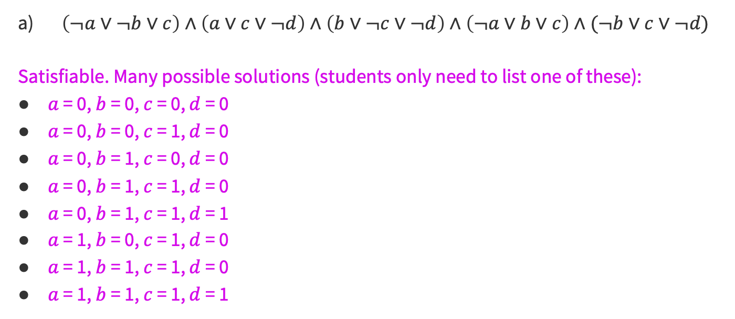
Problem 1 – SATisfy This
Solution
$\left(¬a∨¬b∨c\right)∧\left(a∨c∨¬d\right)∧\left(b∨¬c∨¬d\right)∧\left(¬a∨b∨c\right)∧(¬b∨c∨¬d)$
Satisfiable. Many possible solutions (students only need to list one of these):
$a$ = 0, $b$ = 0, $c$ = 0, $d$ = 0
$a$ = 0, $b$ = 0, $c$ = 1, $d$ = 0
$a$ = 0, $b$ = 1, $c$ = 0, $d$ = 0
$a$ = 0, $b$ = 1, $c$ = 1, $d$ = 0
$a$ = 0, $b$ = 1, $c$ = 1, $d$ = 1
$a$ = 1, $b$ = 0, $c$ = 1, $d$ = 0
$a$ = 1, $b$ = 1, $c$ = 1, $d$ = 0
$a$ = 1, $b$ = 1, $c$ = 1, $d$ = 1
Notes:
Give ~2-3 minutes to think

Slide 12
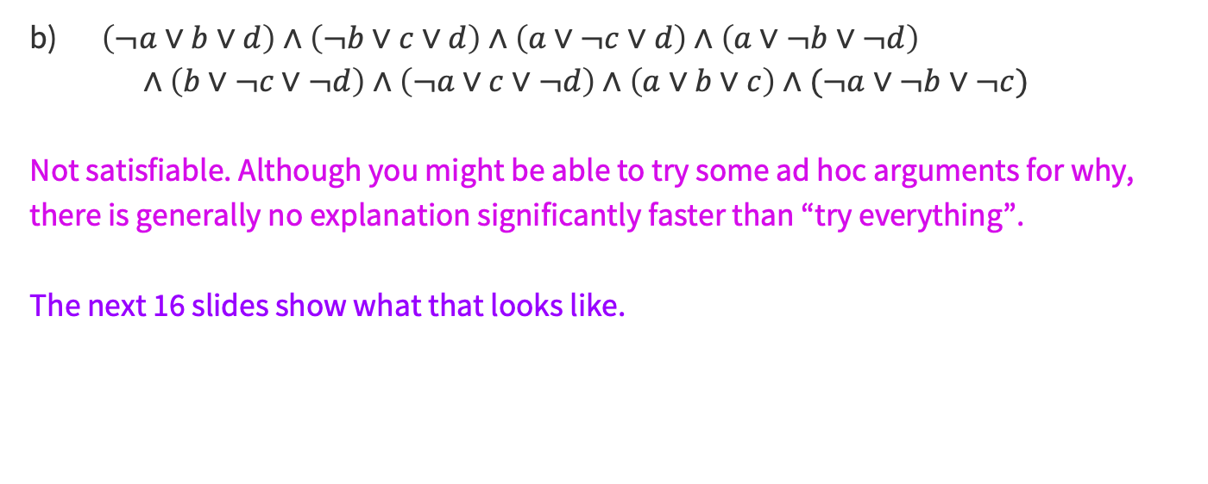
Problem 1 – SATisfy This
Solution
$\left(¬a∨b∨d\right)∧\left(¬b∨c∨d\right)∧\left(a∨¬c∨d\right)∧\left(a∨¬b∨¬d\right)$
$∧\left(b∨¬c∨¬d\right)∧\left(¬a∨c∨¬d\right)∧\left(a∨b∨c\right)∧(¬a∨¬b∨¬c)$
Not satisfiable. Although you might be able to try some ad hoc arguments for why, there is generally no explanation significantly faster than “try everything”.
The next 16 slides show what that looks like.
Notes:
Give ~2-3 minutes to think

Slide 13


Problem 1 – SATisfy This
Solution
$\left(¬a∨b∨d\right)∧\left(¬b∨c∨d\right)∧\left(a∨¬c∨d\right)∧\left(a∨¬b∨¬d\right)$
$∧\left(b∨¬c∨¬d\right)∧\left(¬a∨c∨¬d\right)∧\left(a∨b∨c\right)∧(¬a∨¬b∨¬c)$
Checking assignment: $a$ = 0, $b$ = 0, $c$ = 0, $d$ = 0
$\left(¬a∨b∨d\right)∧\left(¬b∨c∨d\right)∧\left(a∨¬c∨d\right)∧\left(a∨¬b∨¬d\right) ∧\left(b∨¬c∨¬d\right)$
$∧(¬a∨c∨¬d)∧(a∨b∨c)∧(¬a∨¬b∨¬c)$
$\left(¬0∨0∨0\right)∧\left(¬0∨0∨0\right)∧\left(0∨¬0∨0\right)∧\left(0∨¬0∨¬0\right) ∧\left(0∨¬0∨¬0\right)$
$∧(¬0∨0∨¬0)∧(0∨0∨0)∧(¬0∨¬0∨¬0)$
$\left(1∨0∨0\right)∧\left(1∨0∨0\right)∧\left(0∨1∨0\right)∧\left(0∨1∨1\right) ∧\left(0∨1∨1\right)$
$∧(1∨0∨1)∧(0∨0∨0)∧(1∨1∨1)$
Notes:
Give ~2-3 minutes to think

Slide 14

Problem 1 – SATisfy This
Solution
$\left(¬a∨b∨d\right)∧\left(¬b∨c∨d\right)∧\left(a∨¬c∨d\right)∧\left(a∨¬b∨¬d\right)$
$∧\left(b∨¬c∨¬d\right)∧\left(¬a∨c∨¬d\right)∧\left(a∨b∨c\right)∧(¬a∨¬b∨¬c)$
Checking assignment: $a$ = 0, $b$ = 0, $c$ = 0, $d$ = 1
$\left(¬a∨b∨d\right)∧\left(¬b∨c∨d\right)∧\left(a∨¬c∨d\right)∧\left(a∨¬b∨¬d\right) ∧\left(b∨¬c∨¬d\right)$
$∧(¬a∨c∨¬d)∧(a∨b∨c)∧(¬a∨¬b∨¬c)$
$\left(¬0∨0∨1\right)∧\left(¬0∨0∨1\right)∧\left(0∨¬0∨1\right)∧\left(0∨¬0∨¬1\right) ∧\left(0∨¬0∨¬1\right)$
$∧(¬0∨0∨¬1)∧(0∨0∨0)∧(¬0∨¬0∨¬0)$
$\left(1∨0∨1\right)∧\left(1∨0∨1\right)∧\left(0∨1∨1\right)∧\left(0∨1∨0\right) ∧\left(0∨1∨0\right)$
$∧(1∨0∨0)∧(0∨0∨0)∧(1∨1∨1)$
Notes:
Give ~2-3 minutes to think

Slide 15

Problem 1 – SATisfy This
Solution
$\left(¬a∨b∨d\right)∧\left(¬b∨c∨d\right)∧\left(a∨¬c∨d\right)∧\left(a∨¬b∨¬d\right)$
$∧\left(b∨¬c∨¬d\right)∧\left(¬a∨c∨¬d\right)∧\left(a∨b∨c\right)∧(¬a∨¬b∨¬c)$
Checking assignment: $a$ = 0, $b$ = 0, $c$ = 1, $d$ = 0
$\left(¬a∨b∨d\right)∧\left(¬b∨c∨d\right)∧\left(a∨¬c∨d\right)∧\left(a∨¬b∨¬d\right) ∧\left(b∨¬c∨¬d\right)$
$∧(¬a∨c∨¬d)∧(a∨b∨c)∧(¬a∨¬b∨¬c)$
$\left(¬0∨0∨0\right)∧\left(¬0∨1∨0\right)∧\left(0∨¬1∨0\right)∧\left(0∨¬0∨¬0\right) ∧\left(0∨¬1∨¬0\right)$
$∧(¬0∨1∨¬0)∧(0∨0∨1)∧(¬0∨¬0∨¬1)$
$\left(1∨0∨0\right)∧\left(1∨1∨0\right)∧\left(0∨0∨0\right)∧\left(0∨1∨1\right) ∧\left(0∨0∨1\right)$
$∧(1∨1∨1)∧(0∨0∨1)∧(1∨1∨0)$
Notes:
Give ~2-3 minutes to think

Slide 16

Problem 1 – SATisfy This
Solution
$\left(¬a∨b∨d\right)∧\left(¬b∨c∨d\right)∧\left(a∨¬c∨d\right)∧\left(a∨¬b∨¬d\right)$
$∧\left(b∨¬c∨¬d\right)∧\left(¬a∨c∨¬d\right)∧\left(a∨b∨c\right)∧(¬a∨¬b∨¬c)$
Checking assignment: $a$ = 0, $b$ = 0, $c$ = 1, $d$ = 1
$\left(¬a∨b∨d\right)∧\left(¬b∨c∨d\right)∧\left(a∨¬c∨d\right)∧\left(a∨¬b∨¬d\right) ∧\left(b∨¬c∨¬d\right)$
$∧(¬a∨c∨¬d)∧(a∨b∨c)∧(¬a∨¬b∨¬c)$
$\left(¬0∨0∨1\right)∧\left(¬0∨1∨1\right)∧\left(0∨¬1∨1\right)∧\left(0∨¬0∨¬1\right) ∧\left(0∨¬1∨¬1\right)$
$∧(¬0∨1∨¬1)∧(0∨0∨1)∧(¬0∨¬0∨¬1)$
$\left(1∨0∨1\right)∧\left(1∨1∨1\right)∧\left(0∨0∨1\right)∧\left(0∨1∨0\right) ∧\left(0∨0∨0\right)$
$∧(1∨1∨0)∧(0∨0∨1)∧(1∨1∨0)$
Notes:
Give ~2-3 minutes to think

Slide 17

Problem 1 – SATisfy This
Solution
$\left(¬a∨b∨d\right)∧\left(¬b∨c∨d\right)∧\left(a∨¬c∨d\right)∧\left(a∨¬b∨¬d\right)$
$∧\left(b∨¬c∨¬d\right)∧\left(¬a∨c∨¬d\right)∧\left(a∨b∨c\right)∧(¬a∨¬b∨¬c)$
Checking assignment: $a$ = 0, $b$ = 1, $c$ = 0, $d$ = 0
$\left(¬a∨b∨d\right)∧\left(¬b∨c∨d\right)∧\left(a∨¬c∨d\right)∧\left(a∨¬b∨¬d\right) ∧\left(b∨¬c∨¬d\right)$
$∧(¬a∨c∨¬d)∧(a∨b∨c)∧(¬a∨¬b∨¬c)$
$\left(¬0∨1∨0\right)∧\left(¬1∨0∨0\right)∧\left(0∨¬0∨0\right)∧\left(0∨¬1∨¬0\right) ∧\left(1∨¬0∨¬0\right)$
$∧(¬0∨0∨¬0)∧(0∨1∨0)∧(¬0∨¬1∨¬0)$
$\left(1∨1∨0\right)∧\left(0∨0∨0\right)∧\left(0∨1∨0\right)∧\left(0∨0∨1\right) ∧\left(1∨1∨1\right)$
$∧(1∨0∨1)∧(0∨1∨0)∧(1∨0∨1)$
Notes:
Give ~2-3 minutes to think

Slide 18

Problem 1 – SATisfy This
Solution
$\left(¬a∨b∨d\right)∧\left(¬b∨c∨d\right)∧\left(a∨¬c∨d\right)∧\left(a∨¬b∨¬d\right)$
$∧\left(b∨¬c∨¬d\right)∧\left(¬a∨c∨¬d\right)∧\left(a∨b∨c\right)∧(¬a∨¬b∨¬c)$
Checking assignment: $a$ = 0, $b$ = 1, $c$ = 0, $d$ = 1
$\left(¬a∨b∨d\right)∧\left(¬b∨c∨d\right)∧\left(a∨¬c∨d\right)∧\left(a∨¬b∨¬d\right) ∧\left(b∨¬c∨¬d\right)$
$∧(¬a∨c∨¬d)∧(a∨b∨c)∧(¬a∨¬b∨¬c)$
$\left(¬0∨1∨1\right)∧\left(¬1∨0∨1\right)∧\left(0∨¬0∨1\right)∧\left(0∨¬1∨¬1\right) ∧\left(1∨¬0∨¬1\right)$
$∧(¬0∨0∨¬1)∧(0∨1∨0)∧(¬0∨¬1∨¬0)$
$\left(1∨1∨1\right)∧\left(0∨0∨1\right)∧\left(0∨1∨1\right)∧\left(0∨0∨0\right) ∧\left(1∨1∨0\right)$
$∧(1∨0∨0)∧(0∨1∨0)∧(1∨0∨1)$
Notes:
Give ~2-3 minutes to think

Slide 19

Problem 1 – SATisfy This
Solution
$\left(¬a∨b∨d\right)∧\left(¬b∨c∨d\right)∧\left(a∨¬c∨d\right)∧\left(a∨¬b∨¬d\right)$
$∧\left(b∨¬c∨¬d\right)∧\left(¬a∨c∨¬d\right)∧\left(a∨b∨c\right)∧(¬a∨¬b∨¬c)$
Checking assignment: $a$ = 0, $b$ = 1, $c$ = 1, $d$ = 0
$\left(¬a∨b∨d\right)∧\left(¬b∨c∨d\right)∧\left(a∨¬c∨d\right)∧\left(a∨¬b∨¬d\right) ∧\left(b∨¬c∨¬d\right)$
$∧(¬a∨c∨¬d)∧(a∨b∨c)∧(¬a∨¬b∨¬c)$
$\left(¬0∨1∨0\right)∧\left(¬1∨1∨0\right)∧\left(0∨¬1∨0\right)∧\left(0∨¬1∨¬0\right) ∧\left(1∨¬1∨¬0\right)$
$∧(¬0∨1∨¬0)∧(0∨1∨1)∧(¬0∨¬1∨¬1)$
$\left(1∨1∨0\right)∧\left(0∨1∨0\right)∧\left(0∨0∨0\right)∧\left(0∨0∨1\right) ∧\left(1∨0∨1\right)$
$∧(1∨1∨1)∧(0∨1∨1)∧(1∨0∨0)$
Notes:
Give ~2-3 minutes to think

Slide 20

Problem 1 – SATisfy This
Solution
$\left(¬a∨b∨d\right)∧\left(¬b∨c∨d\right)∧\left(a∨¬c∨d\right)∧\left(a∨¬b∨¬d\right)$
$∧\left(b∨¬c∨¬d\right)∧\left(¬a∨c∨¬d\right)∧\left(a∨b∨c\right)∧(¬a∨¬b∨¬c)$
Checking assignment: $a$ = 0, $b$ = 1, $c$ = 1, $d$ = 1
$\left(¬a∨b∨d\right)∧\left(¬b∨c∨d\right)∧\left(a∨¬c∨d\right)∧\left(a∨¬b∨¬d\right) ∧\left(b∨¬c∨¬d\right)$
$∧(¬a∨c∨¬d)∧(a∨b∨c)∧(¬a∨¬b∨¬c)$
$\left(¬0∨1∨1\right)∧\left(¬1∨1∨1\right)∧\left(0∨¬1∨1\right)∧\left(0∨¬1∨¬1\right) ∧\left(1∨¬1∨¬1\right)$
$∧(¬0∨1∨¬1)∧(0∨1∨1)∧(¬0∨¬1∨¬1)$
$\left(1∨1∨1\right)∧\left(0∨1∨1\right)∧\left(0∨0∨1\right)∧\left(0∨0∨0\right) ∧\left(1∨0∨0\right)$
$∧(1∨1∨0)∧(0∨1∨1)∧(1∨0∨0)$
Notes:
Give ~2-3 minutes to think

Slide 21

Problem 1 – SATisfy This
Solution
$\left(¬a∨b∨d\right)∧\left(¬b∨c∨d\right)∧\left(a∨¬c∨d\right)∧\left(a∨¬b∨¬d\right)$
$∧\left(b∨¬c∨¬d\right)∧\left(¬a∨c∨¬d\right)∧\left(a∨b∨c\right)∧(¬a∨¬b∨¬c)$
Checking assignment: $a$ = 1, $b$ = 0, $c$ = 0, $d$ = 0
$\left(¬a∨b∨d\right)∧\left(¬b∨c∨d\right)∧\left(a∨¬c∨d\right)∧\left(a∨¬b∨¬d\right) ∧\left(b∨¬c∨¬d\right)$
$∧(¬a∨c∨¬d)∧(a∨b∨c)∧(¬a∨¬b∨¬c)$
$\left(¬1∨0∨0\right)∧\left(¬0∨0∨0\right)∧\left(1∨¬0∨0\right)∧\left(1∨¬0∨¬0\right) ∧\left(0∨¬0∨¬0\right)$
$∧(¬1∨0∨¬0)∧(1∨0∨0)∧(¬1∨¬0∨¬0)$
$\left(0∨0∨0\right)∧\left(1∨0∨0\right)∧\left(1∨1∨0\right)∧\left(1∨1∨1\right) ∧\left(0∨1∨1\right)$
$∧(0∨0∨1)∧(1∨0∨0)∧(0∨1∨1)$
Notes:
Give ~2-3 minutes to think

Slide 22

Problem 1 – SATisfy This
Solution
$\left(¬a∨b∨d\right)∧\left(¬b∨c∨d\right)∧\left(a∨¬c∨d\right)∧\left(a∨¬b∨¬d\right)$
$∧\left(b∨¬c∨¬d\right)∧\left(¬a∨c∨¬d\right)∧\left(a∨b∨c\right)∧(¬a∨¬b∨¬c)$
Checking assignment: $a$ = 1, $b$ = 0, $c$ = 0, $d$ = 1
$\left(¬a∨b∨d\right)∧\left(¬b∨c∨d\right)∧\left(a∨¬c∨d\right)∧\left(a∨¬b∨¬d\right) ∧\left(b∨¬c∨¬d\right)$
$∧(¬a∨c∨¬d)∧(a∨b∨c)∧(¬a∨¬b∨¬c)$
$\left(¬1∨0∨1\right)∧\left(¬0∨0∨1\right)∧\left(1∨¬0∨1\right)∧\left(1∨¬0∨¬1\right) ∧\left(0∨¬0∨¬1\right)$
$∧(¬1∨0∨¬1)∧(1∨0∨0)∧(¬1∨¬0∨¬0)$
$\left(0∨0∨1\right)∧\left(1∨0∨1\right)∧\left(1∨1∨1\right)∧\left(1∨1∨0\right) ∧\left(0∨1∨0\right)$
$∧(0∨0∨0)∧(1∨0∨0)∧(0∨1∨1)$
Notes:
Give ~2-3 minutes to think

Slide 23

Problem 1 – SATisfy This
Solution
$\left(¬a∨b∨d\right)∧\left(¬b∨c∨d\right)∧\left(a∨¬c∨d\right)∧\left(a∨¬b∨¬d\right)$
$∧\left(b∨¬c∨¬d\right)∧\left(¬a∨c∨¬d\right)∧\left(a∨b∨c\right)∧(¬a∨¬b∨¬c)$
Checking assignment: $a$ = 1, $b$ = 0, $c$ = 1, $d$ = 0
$\left(¬a∨b∨d\right)∧\left(¬b∨c∨d\right)∧\left(a∨¬c∨d\right)∧\left(a∨¬b∨¬d\right) ∧\left(b∨¬c∨¬d\right)$
$∧(¬a∨c∨¬d)∧(a∨b∨c)∧(¬a∨¬b∨¬c)$
$\left(¬1∨0∨0\right)∧\left(¬0∨1∨0\right)∧\left(1∨¬1∨0\right)∧\left(1∨¬0∨¬0\right) ∧\left(0∨¬1∨¬0\right)$
$∧(¬1∨1∨¬0)∧(1∨0∨1)∧(¬1∨¬0∨¬1)$
$\left(0∨0∨0\right)∧\left(1∨1∨0\right)∧\left(1∨0∨0\right)∧\left(1∨1∨1\right) ∧\left(0∨0∨1\right)$
$∧(0∨1∨1)∧(1∨0∨1)∧(0∨1∨0)$
Notes:
Give ~2-3 minutes to think

Slide 24

Problem 1 – SATisfy This
Solution
$\left(¬a∨b∨d\right)∧\left(¬b∨c∨d\right)∧\left(a∨¬c∨d\right)∧\left(a∨¬b∨¬d\right)$
$∧\left(b∨¬c∨¬d\right)∧\left(¬a∨c∨¬d\right)∧\left(a∨b∨c\right)∧(¬a∨¬b∨¬c)$
Checking assignment: $a$ = 1, $b$ = 0, $c$ = 1, $d$ = 1
$\left(¬a∨b∨d\right)∧\left(¬b∨c∨d\right)∧\left(a∨¬c∨d\right)∧\left(a∨¬b∨¬d\right) ∧\left(b∨¬c∨¬d\right)$
$∧(¬a∨c∨¬d)∧(a∨b∨c)∧(¬a∨¬b∨¬c)$
$\left(¬1∨0∨1\right)∧\left(¬0∨1∨1\right)∧\left(1∨¬1∨1\right)∧\left(1∨¬0∨¬1\right) ∧\left(0∨¬1∨¬1\right)$
$∧(¬1∨1∨¬1)∧(1∨0∨1)∧(¬1∨¬0∨¬1)$
$\left(0∨0∨1\right)∧\left(1∨1∨1\right)∧\left(1∨0∨1\right)∧\left(1∨1∨0\right) ∧\left(0∨0∨0\right)$
$∧(0∨1∨0)∧(1∨0∨1)∧(0∨1∨0)$
Notes:
Give ~2-3 minutes to think

Slide 25

Problem 1 – SATisfy This
Solution
$\left(¬a∨b∨d\right)∧\left(¬b∨c∨d\right)∧\left(a∨¬c∨d\right)∧\left(a∨¬b∨¬d\right)$
$∧\left(b∨¬c∨¬d\right)∧\left(¬a∨c∨¬d\right)∧\left(a∨b∨c\right)∧(¬a∨¬b∨¬c)$
Checking assignment: $a$ = 1, $b$ = 1, $c$ = 0, $d$ = 0
$\left(¬a∨b∨d\right)∧\left(¬b∨c∨d\right)∧\left(a∨¬c∨d\right)∧\left(a∨¬b∨¬d\right) ∧\left(b∨¬c∨¬d\right)$
$∧(¬a∨c∨¬d)∧(a∨b∨c)∧(¬a∨¬b∨¬c)$
$\left(¬1∨1∨0\right)∧\left(¬1∨0∨0\right)∧\left(1∨¬0∨0\right)∧\left(1∨¬1∨¬0\right) ∧\left(1∨¬0∨¬0\right)$
$∧(¬1∨0∨¬0)∧(1∨1∨0)∧(¬1∨¬1∨¬0)$
$\left(0∨1∨0\right)∧\left(0∨0∨0\right)∧\left(1∨1∨0\right)∧\left(1∨0∨1\right) ∧\left(1∨1∨1\right)$
$∧(0∨0∨1)∧(1∨1∨0)∧(0∨0∨1)$
Notes:
Give ~2-3 minutes to think

Slide 26

Problem 1 – SATisfy This
Solution
$\left(¬a∨b∨d\right)∧\left(¬b∨c∨d\right)∧\left(a∨¬c∨d\right)∧\left(a∨¬b∨¬d\right)$
$∧\left(b∨¬c∨¬d\right)∧\left(¬a∨c∨¬d\right)∧\left(a∨b∨c\right)∧(¬a∨¬b∨¬c)$
Checking assignment: $a$ = 1, $b$ = 1, $c$ = 0, $d$ = 1
$\left(¬a∨b∨d\right)∧\left(¬b∨c∨d\right)∧\left(a∨¬c∨d\right)∧\left(a∨¬b∨¬d\right) ∧\left(b∨¬c∨¬d\right)$
$∧(¬a∨c∨¬d)∧(a∨b∨c)∧(¬a∨¬b∨¬c)$
$\left(¬1∨1∨1\right)∧\left(¬1∨0∨1\right)∧\left(1∨¬0∨1\right)∧\left(1∨¬1∨¬1\right) ∧\left(1∨¬0∨¬1\right)$
$∧(¬1∨0∨¬1)∧(1∨1∨0)∧(¬1∨¬1∨¬0)$
$\left(0∨1∨1\right)∧\left(0∨0∨1\right)∧\left(1∨1∨1\right)∧\left(1∨0∨0\right) ∧\left(1∨1∨0\right)$
$∧(0∨0∨0)∧(1∨1∨0)∧(0∨0∨1)$
Notes:
Give ~2-3 minutes to think

Slide 27

Problem 1 – SATisfy This
Solution
$\left(¬a∨b∨d\right)∧\left(¬b∨c∨d\right)∧\left(a∨¬c∨d\right)∧\left(a∨¬b∨¬d\right)$
$∧\left(b∨¬c∨¬d\right)∧\left(¬a∨c∨¬d\right)∧\left(a∨b∨c\right)∧(¬a∨¬b∨¬c)$
Checking assignment: $a$ = 1, $b$ = 1, $c$ = 1, $d$ = 0
$\left(¬a∨b∨d\right)∧\left(¬b∨c∨d\right)∧\left(a∨¬c∨d\right)∧\left(a∨¬b∨¬d\right) ∧\left(b∨¬c∨¬d\right)$
$∧(¬a∨c∨¬d)∧(a∨b∨c)∧(¬a∨¬b∨¬c)$
$\left(¬1∨1∨0\right)∧\left(¬1∨1∨0\right)∧\left(1∨¬1∨0\right)∧\left(1∨¬1∨¬0\right) ∧\left(1∨¬1∨¬0\right)$
$∧(¬1∨1∨¬0)∧(1∨1∨1)∧(¬1∨¬1∨¬1)$
$\left(0∨1∨0\right)∧\left(0∨1∨0\right)∧\left(1∨0∨0\right)∧\left(1∨0∨1\right) ∧\left(1∨0∨1\right)$
$∧(0∨1∨1)∧(1∨1∨1)∧(0∨0∨0)$
Notes:
Give ~2-3 minutes to think

Slide 28

Problem 1 – SATisfy This
Solution
$\left(¬a∨b∨d\right)∧\left(¬b∨c∨d\right)∧\left(a∨¬c∨d\right)∧\left(a∨¬b∨¬d\right)$
$∧\left(b∨¬c∨¬d\right)∧\left(¬a∨c∨¬d\right)∧\left(a∨b∨c\right)∧(¬a∨¬b∨¬c)$
Checking assignment: $a$ = 1, $b$ = 1, $c$ = 1, $d$ = 1
$\left(¬a∨b∨d\right)∧\left(¬b∨c∨d\right)∧\left(a∨¬c∨d\right)∧\left(a∨¬b∨¬d\right) ∧\left(b∨¬c∨¬d\right)$
$∧(¬a∨c∨¬d)∧(a∨b∨c)∧(¬a∨¬b∨¬c)$
$\left(¬1∨1∨1\right)∧\left(¬1∨1∨1\right)∧\left(1∨¬1∨1\right)∧\left(1∨¬1∨¬1\right) ∧\left(1∨¬1∨¬1\right)$
$∧(¬1∨1∨¬1)∧(1∨1∨1)∧(¬1∨¬1∨¬1)$
$\left(0∨1∨1\right)∧\left(0∨1∨1\right)∧\left(1∨0∨1\right)∧\left(1∨0∨0\right) ∧\left(1∨0∨0\right)$
$∧(0∨1∨0)∧(1∨1∨1)∧(0∨0∨0)$
Notes:
Give ~2-3 minutes to think

Slide 29
Reductions
Notes:
~5 mins

Slide 30

How to prove NP-hardness
In previous weeks of this class, you’ve seen reductions of the following form:
$$A≤_{p}B$$
“My problem is easy to solve, because I can just use $B$.”
your problem
an algorithm to be used as a library,
i.e. stable matching, network flow

Slide 31
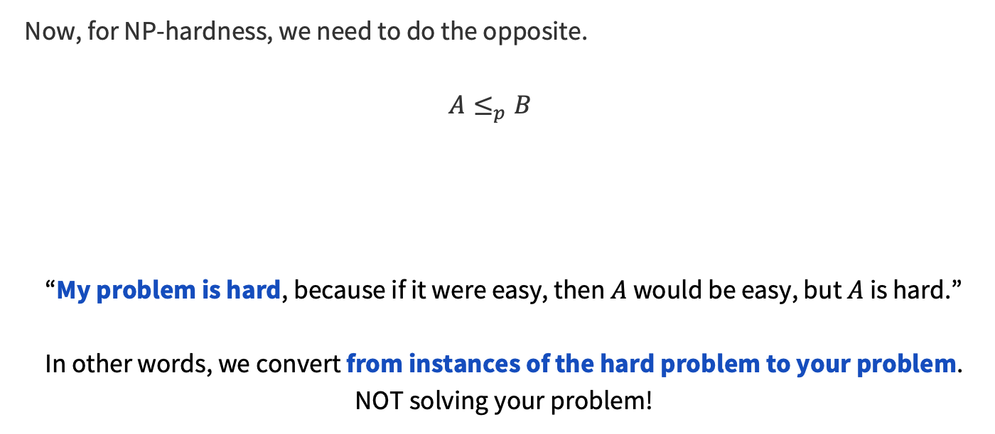
How to prove NP-hardness
Now, for NP-hardness, we need to do the opposite.
$$A≤_{p}B$$
“My problem is hard, because if it were easy, then $A$ would be easy, but $A$ is hard.”
In other words, we convert from instances of the hard problem to your problem.
NOT solving your problem!
a problem that is
known to be hard
your problem

Slide 32
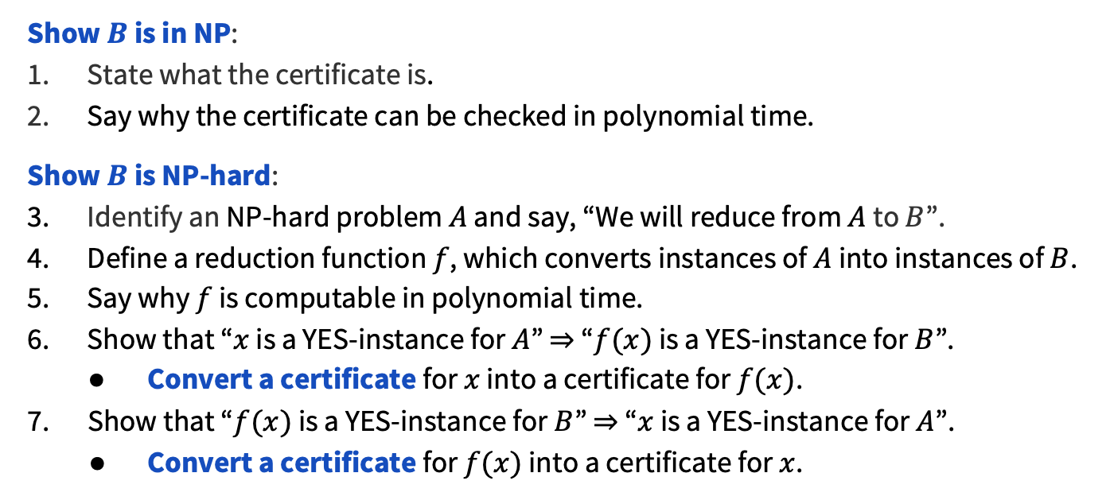
How to prove NP-completeness
​Show $B$ is in NP:
State what the certificate is.
Say why the certificate can be checked in polynomial time.
​Show $B$ is NP-hard:
Identify an NP-hard problem $A$ and say, “We will reduce from $A$ to $B$”.
Define a reduction function $f$, which converts instances of $A$ into instances of $B$.
Say why $f$ is computable in polynomial time.
Show that “$x$ is a YES-instance for $A$” $⇒$ “$f(x)$ is a YES-instance for $B$”.
Convert a certificate for $x$ into a certificate for $f(x)$.
Show that “$f(x)$ is a YES-instance for $B$” $⇒$ “$x$ is a YES-instance for $A$”.
Convert a certificate for $f(x)$ into a certificate for $x$.

Slide 33
Problem 2 – 5SAT
Define the problem 5SAT to be:
Input: A CNF formula with exactly 5 literals per clause
Output: Is there an assignment to the variables that makes the formula true?
We will show that 5SAT is NP-complete.
First, we will show that 5SAT is in NP.
State what the certificate is.
Say why the certificate can be checked in polynomial time.
Think about this briefly!
Notes:
Give ~2-3 minutes to think

Slide 34
Problem 2 – 5SAT
Solution
State what the certificate is.
Certificate: An assignment to the variables that makes the formula true.
Say why the certificate can be checked in polynomial time.
Verifier: Takes as input the original 5SAT input and the certificate (the assignment). Just apply the assignment to every clause, and return whether all clauses are satisfied.
Runs in linear time.
Notes:
Give ~2-3 minutes to think

Slide 35
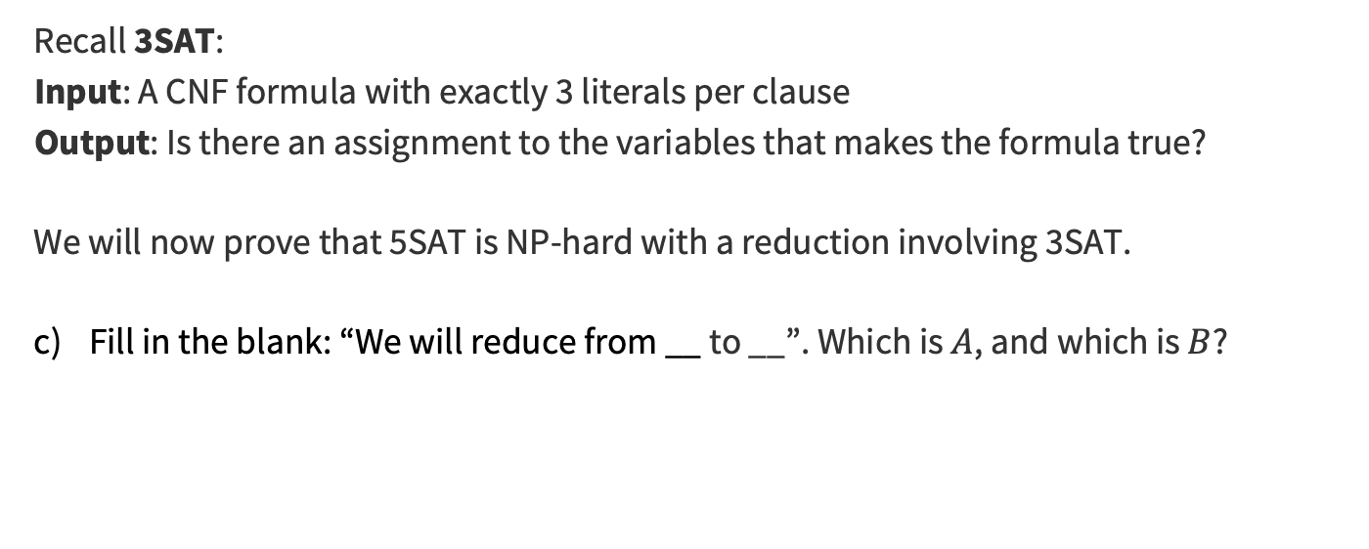
Problem 2 – 5SAT
Recall 3SAT:
Input: A CNF formula with exactly 3 literals per clause
Output: Is there an assignment to the variables that makes the formula true?
We will now prove that 5SAT is NP-hard with a reduction involving 3SAT.
Fill in the blank: “We will reduce from __ to __”. Which is $A$, and which is $B$?
Think about this briefly!
Notes:
Give ~2-3 minutes to think

Slide 36
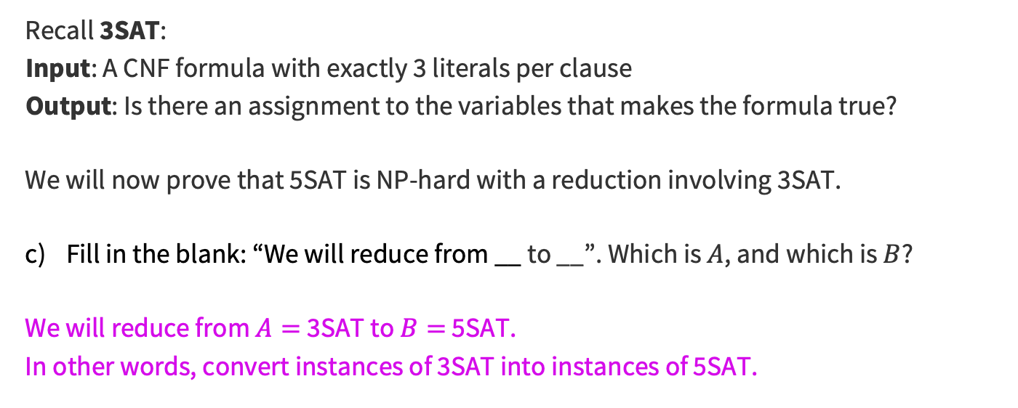
Problem 2 – 5SAT
Solution
Recall 3SAT:
Input: A CNF formula with exactly 3 literals per clause
Output: Is there an assignment to the variables that makes the formula true?
We will now prove that 5SAT is NP-hard with a reduction involving 3SAT.
Fill in the blank: “We will reduce from __ to __”. Which is $A$, and which is $B$?
We will reduce from $A=$3SAT to $B=$ 5SAT.
In other words, convert instances of 3SAT into instances of 5SAT.
Notes:
Give ~2-3 minutes to think

Slide 37

Problem 2 – 5SAT
Fill in the blank: “We will reduce from __ to __”. Which is $A$, and which is $B$?
Define a reduction function $f$, which converts instances of $A$ into $B$.
Notes:
Give ~2-3 minutes to think

Slide 38

Problem 2 – 5SAT
Previous Solution
Fill in the blank: “We will reduce from __ to __”. Which is $A$, and which is $B$?
We will reduce from $A=$3SAT to $B=$ 5SAT.
In other words, convert instances of 3SAT into instances of 5SAT.
Define a reduction function $f$, which converts instances of $A$ into $B$.
Think about it with the people around you, then we’ll discuss!
Notes:
Give ~2-3 minutes to think

Slide 39
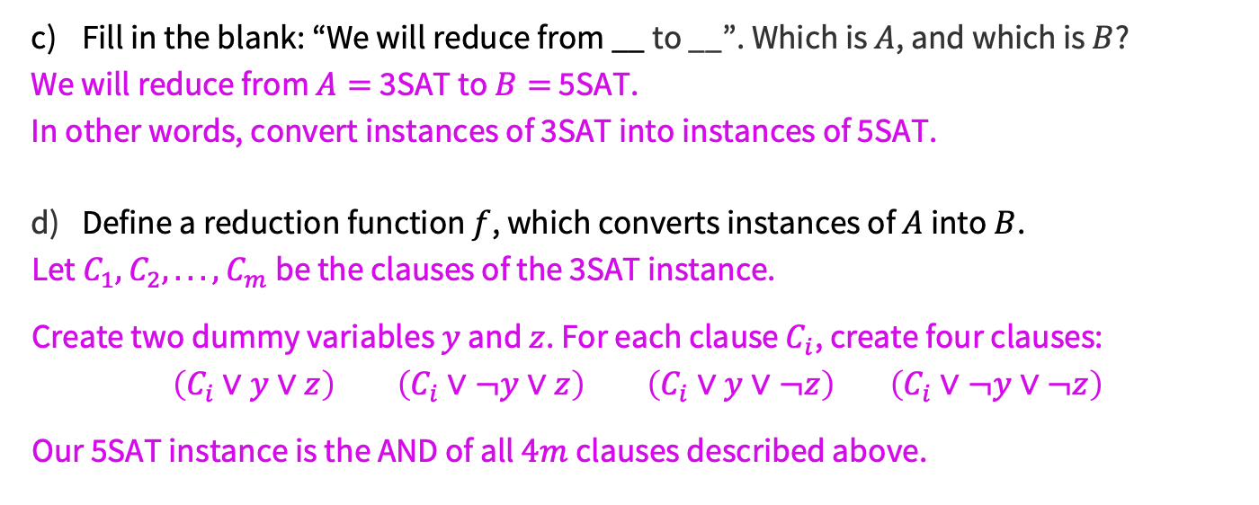
Problem 2 – 5SAT
Solution
Fill in the blank: “We will reduce from __ to __”. Which is $A$, and which is $B$?
We will reduce from $A=$3SAT to $B=$ 5SAT.
In other words, convert instances of 3SAT into instances of 5SAT.
Define a reduction function $f$, which converts instances of $A$ into $B$.
Let $C_{1},C_{2}, . . . ,C_{m}$ be the clauses of the 3SAT instance.
Create two dummy variables $y$ and $z$. For each clause $C_{i}$, create four clauses:
$\left(C_{i}∨y∨z\right)$ $\left(C_{i}∨¬y∨z\right)$ $\left(C_{i}∨y∨¬z\right)$ $\left(C_{i}∨¬y∨¬z\right)$
Our 5SAT instance is the AND of all $4m$ clauses described above.
Notes:
Give ~2-3 minutes to think

Slide 40
Problem 2 – 5SAT
Say why 𝑓 is computable in polynomial time.
Think about this briefly!
Notes:
Give ~2-3 minutes to think

Slide 41
Problem 2 – 5SAT
Solution
Say why 𝑓 is computable in polynomial time.
We loop through the clauses and create a constant number of new clauses for each, thus linear time.
Notes:
Give ~2-3 minutes to think

Slide 42

Problem 2 – 5SAT
To prove the correctness:
Show that “$x$ is a YES-instance for $A$” ⇒ “$f(x)$is a YES-instance for $B$”.
(Remember: convert a certificate for $x$ into a certificate for $f(x)$!)
Think about it with the people around you, then we’ll discuss!
Notes:
Give ~2-3 minutes to think

Slide 43
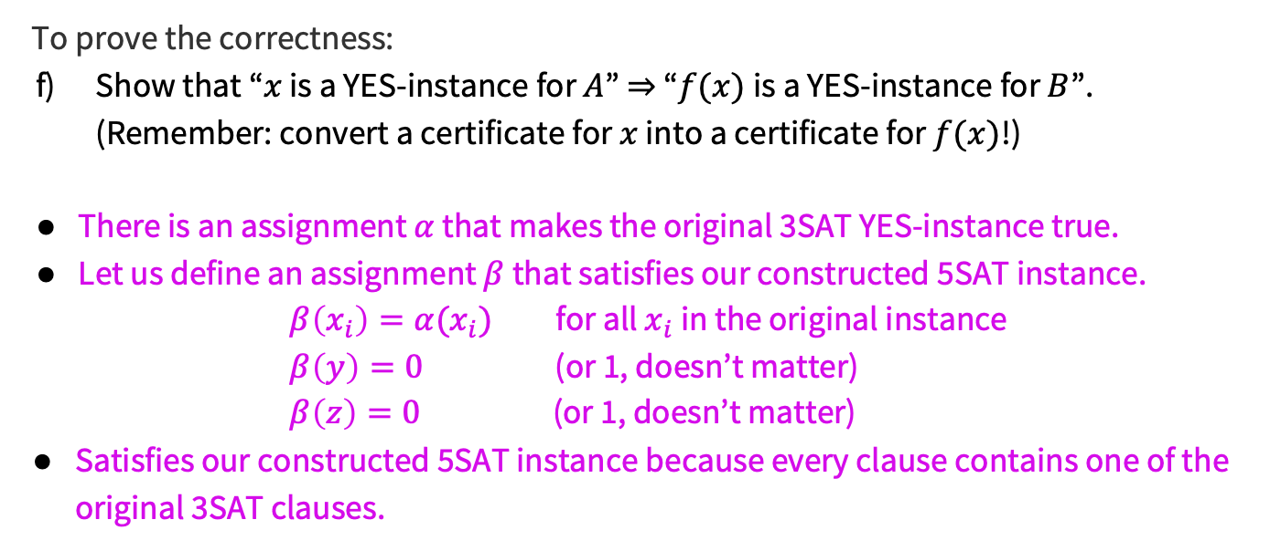
Problem 2 – 5SAT
Solution
To prove the correctness:
Show that “$x$ is a YES-instance for $A$” ⇒ “$f(x)$is a YES-instance for $B$”.
(Remember: convert a certificate for $x$ into a certificate for $f(x)$!)
There is an assignment $α$ that makes the original 3SAT YES-instance true.
Let us define an assignment $β$ that satisfies our constructed 5SAT instance.
$β\left(x_{i}\right)=α(x_{i})$ for all $x_{i}$ in the original instance
$β\left(y\right)=0$ (or 1, doesn’t matter)
$β\left(z\right)=0$ (or 1, doesn’t matter)
Satisfies our constructed 5SAT instance because every clause contains one of the original 3SAT clauses.
Notes:
Give ~2-3 minutes to think

Slide 44

Problem 2 – 5SAT
To prove the correctness:
Show that “$f(x)$ is a YES-instance for $B$” ⇒ “$x$ is a YES-instance for $A$”.
(Remember: convert a certificate for $f(x)$ into a certificate for $x$!)
Think about it with the people around you, then we’ll discuss!
Notes:
Give ~2-3 minutes to think

Slide 45
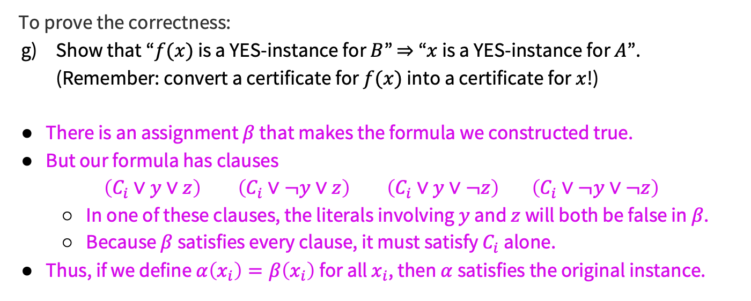
Problem 2 – 5SAT
Solution
To prove the correctness:
Show that “$f(x)$ is a YES-instance for $B$” ⇒ “$x$ is a YES-instance for $A$”.
(Remember: convert a certificate for $f(x)$ into a certificate for $x$!)
There is an assignment $β$ that makes the formula we constructed true.
But our formula has clauses
$\left(C_{i}∨y∨z\right)$ $\left(C_{i}∨¬y∨z\right)$ $\left(C_{i}∨y∨¬z\right)$ $\left(C_{i}∨¬y∨¬z\right)$
  In one of these clauses, the literals involving $y$ and $z$ will both be false in $β$.
  Because $β$ satisfies every clause, it must satisfy $C_{i}$ alone.
Thus, if we define $α\left(x_{i}\right)=β\left(x_{i}\right)$ for all $x_{i}$, then $α$satisfies the original instance.
Notes:
Give ~2-3 minutes to think

Slide 46
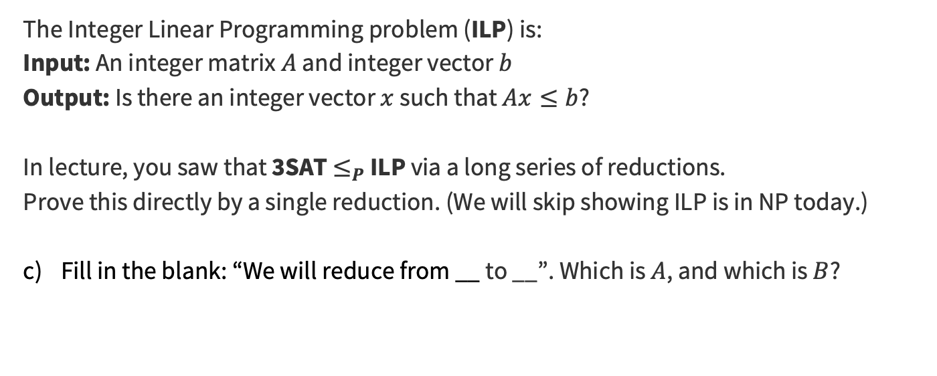
Problem 3 – Reduction with different types
The Integer Linear Programming problem (ILP) is:
Input: An integer matrix $A$ and integer vector $b$
Output: Is there an integer vector $x$ such that $Ax≤b$?
In lecture, you saw that 3SAT $≤_{P}$ ILP via a long series of reductions.
Prove this directly by a single reduction. (We will skip showing ILP is in NP today.)
Fill in the blank: “We will reduce from __ to __”. Which is $A$, and which is $B$?
Decision version!
Nothing to optimize for.
Think about this briefly!
Notes:
Give ~2-3 minutes to think

Slide 47
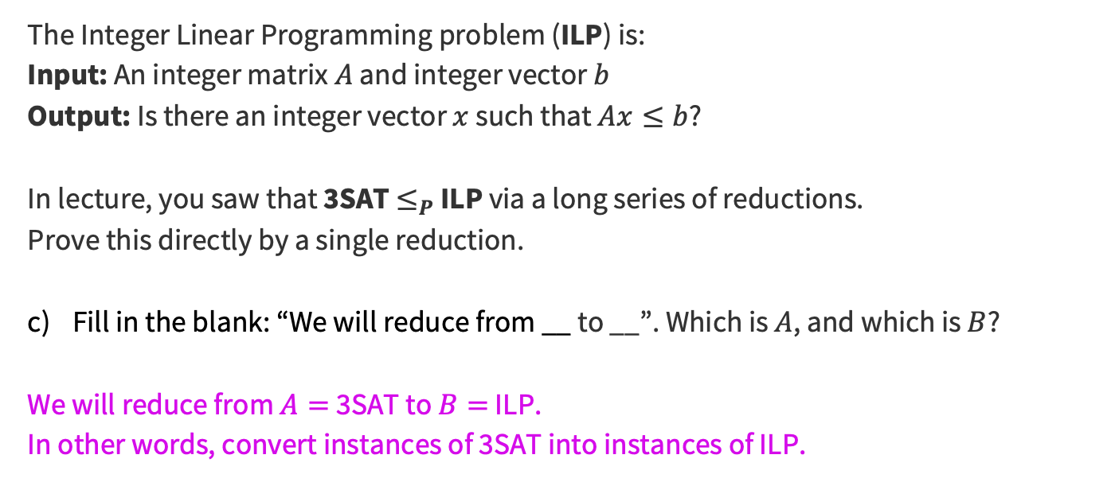
Problem 3 – Reduction with different types
Solution
The Integer Linear Programming problem (ILP) is:
Input: An integer matrix $A$ and integer vector $b$
Output: Is there an integer vector $x$ such that $Ax≤b$?
In lecture, you saw that 3SAT $≤_{P}$ ILP via a long series of reductions.
Prove this directly by a single reduction.
Fill in the blank: “We will reduce from __ to __”. Which is $A$, and which is $B$?
We will reduce from $A=$3SAT to $B=$ ILP.
In other words, convert instances of 3SAT into instances of ILP.
Decision version!
Nothing to optimize for.
Notes:
Give ~2-3 minutes to think

Slide 48
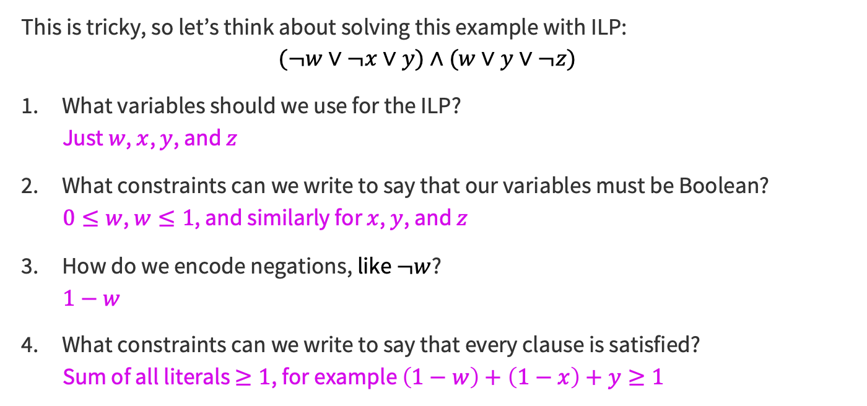
Problem 3 – Reduction with different types
Solution
This is tricky, so let’s think about solving this example with ILP:
$$(¬w∨¬x∨y)∧(w∨y∨¬z)$$
What variables should we use for the ILP?
Just $w$, $x$, $y$, and $z$
What constraints can we write to say that our variables must be Boolean?
$0≤w$, $w≤1$, and similarly for $x$, $y$, and $z$
How do we encode negations, like $¬w$?
$$1−w$$
What constraints can we write to say that every clause is satisfied?
Sum of all literals $≥1$, for example $\left(1−w\right)+\left(1−x\right)+y≥1$
These are fairly generic steps for ANY reduction from 3SAT!
Notes:
Give ~2-3 minutes to think

Slide 49

Problem 3 – Reduction with different types
Define a reduction function $f$, which converts instances of $A$ into $B$.
(We did an example on the previous slide, so the question is just: how to write this generally?)
Think about it with the people around you, then we’ll discuss!
Notes:
Give ~2-3 minutes to think

Slide 50
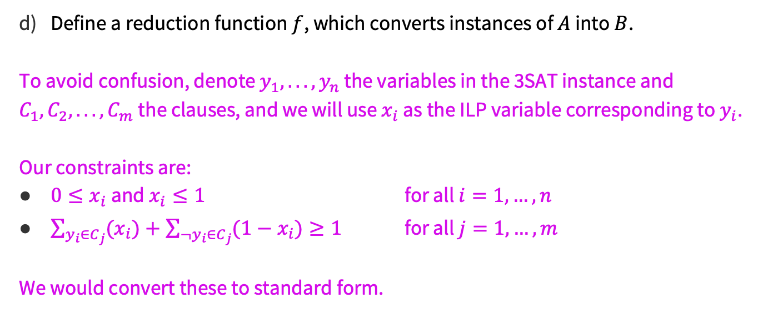
Problem 3 – Reduction with different types
Solution
Define a reduction function $f$, which converts instances of $A$ into $B$.
To avoid confusion, denote $y_{1}, . . .,y_{n}$ the variables in the 3SAT instance and $C_{1},C_{2}, . . . ,C_{m}$ the clauses, and we will use $x_{i}$ as the ILP variable corresponding to $y_{i}$.
Our constraints are:
$0≤x_{i}$ and $x_{i}≤1$ for all $i=1,…,n$
$\sum_{y_{i}∈C_{j}}{{(x}_{i})}+\sum_{¬y_{i}∈C_{j}}{(1−x_{i})}≥1$ for all $j=1,…,m$
We would convert these to standard form.
Notes:
Give ~2-3 minutes to think

Slide 51
Problem 3 – Reduction with different types
Say why 𝑓 is computable in polynomial time.
Think about this briefly!
Notes:
Give ~2-3 minutes to think

Slide 52

Problem 3 – Reduction with different types
Solution
Say why 𝑓 is computable in polynomial time.
We create 2 constraints for every variable and 1 constraint for every clause. Every constraint is a row in the ILP input matrix $A$, so the reduction takes $\left(m+n\right)n$ time, which is polynomial.
Notes:
Give ~2-3 minutes to think

Slide 53
Problem 3 – Reduction with different types
To prove the correctness:
Show that “$x$ is a YES-instance for $A$” ⇒ “$f(x)$is a YES-instance for $B$”.
(Remember: convert a certificate for $x$ into a certificate for $f(x)$!)
Think about it with the people around you, then we’ll discuss!
Notes:
Give ~2-3 minutes to think

Slide 54
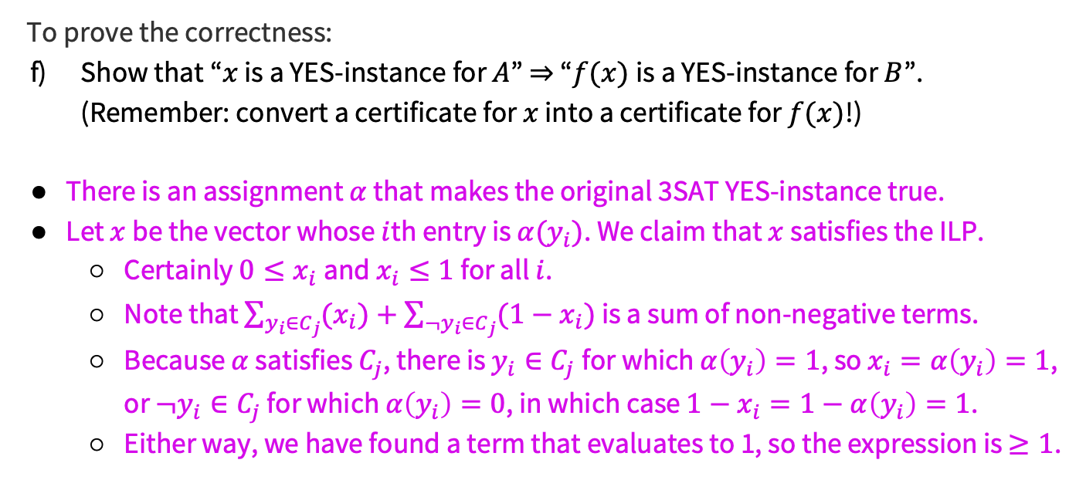
Problem 3 – Reduction with different types
Solution
To prove the correctness:
Show that “$x$ is a YES-instance for $A$” ⇒ “$f(x)$is a YES-instance for $B$”.
(Remember: convert a certificate for $x$ into a certificate for $f(x)$!)
There is an assignment $α$ that makes the original 3SAT YES-instance true.
Let $x$ be the vector whose $i$th entry is $α(y_{i})$. We claim that $x$ satisfies the ILP.
  Certainly $0≤x_{i}$ and $x_{i}≤1$ for all $i$.
  Note that $\sum_{y_{i}∈C_{j}}{{(x}_{i})}+\sum_{¬y_{i}∈C_{j}}{(1−x_{i})}$ is a sum of non-negative terms.
  Because $α$ satisfies $C_{j}$, there is $y_{i}∈C_{j}$for which $α\left(y_{i}\right)=1$, so $x_{i}=α\left(y_{i}\right)=1$, or $¬y_{i}∈C_{j}$ for which $α\left(y_{i}\right)=0$, in which case $1−x_{i}=1−α\left(y_{i}\right)=1$.
  Either way, we have found a term that evaluates to 1, so the expression is $≥1$.
Notes:
Give ~2-3 minutes to think

Slide 55
Problem 3 – Reduction with different types
To prove the correctness:
Show that “$f(x)$ is a YES-instance for $B$” ⇒ “$x$ is a YES-instance for $A$”.
(Remember: convert a certificate for $f(x)$ into a certificate for $x$!)
Think about it with the people around you, then we’ll discuss!
Notes:
Give ~2-3 minutes to think

Slide 56
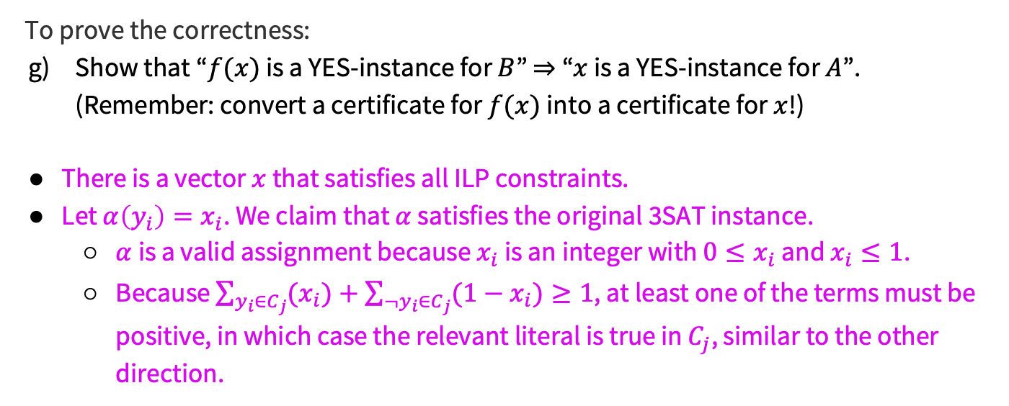
Problem 3 – Reduction with different types
Solution
To prove the correctness:
Show that “$f(x)$ is a YES-instance for $B$” ⇒ “$x$ is a YES-instance for $A$”.
(Remember: convert a certificate for $f(x)$ into a certificate for $x$!)
There is a vector $x$ that satisfies all ILP constraints.
Let $α\left(y_{i}\right)=x_{i}$. We claim that $α$ satisfies the original 3SAT instance.
  $α$ is a valid assignment because $x_{i}$ is an integer with $0≤x_{i}$ and $x_{i}≤1$.
  Because $\sum_{y_{i}∈C_{j}}{{(x}_{i})}+\sum_{¬y_{i}∈C_{j}}{(1−x_{i})}≥1$, at least one of the terms must be positive, in which case the relevant literal is true in $C_{j}$, similar to the other direction.
Notes:
Give ~2-3 minutes to think

Slide 57

Summary
When you want to show $B$ is NP-complete, do NOT solve $B$!
  Convert instances of another NP-hard problem $A$ into instances of $B$.
For the reduction proof, convert certificates of each problem to certificates of the other problem.
Thanks for coming to section this week!

