Slide 1
CSE 421 Section 7
Network Flows

Slide 2
Administrivia

Slide 3
Announcements & Reminders
Midterm exam
Congrats on finishing half of the course!
We’ll be grading it over the next several days.
HW6
Due Wednesday 11/13 @ 11:59pm

Slide 4
Algorithms for network flows

Slide 5
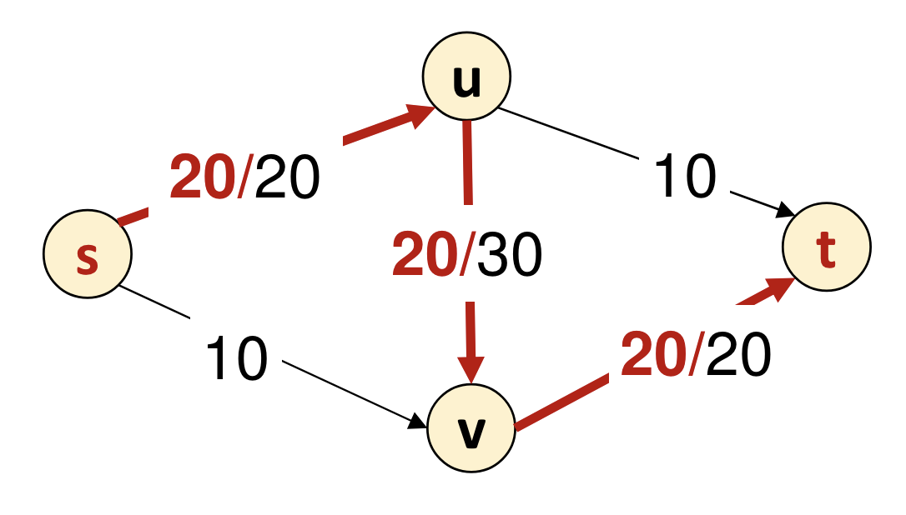
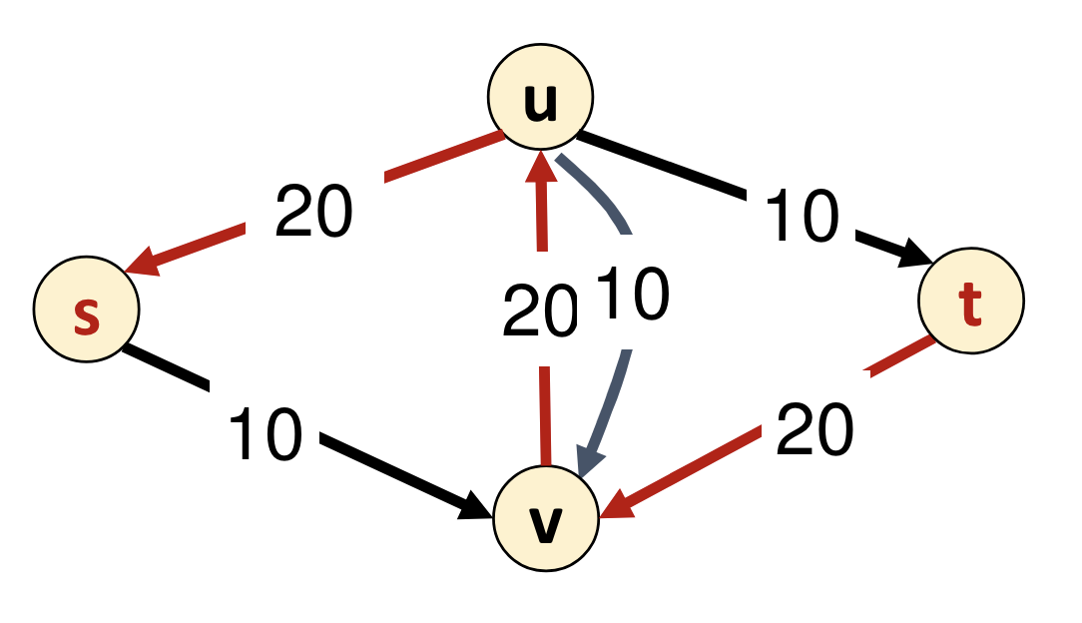
Algorithms for network flows
Ford–Fulkerson is a class of algorithms to compute maximum flow.
Let the residual graph $G_{f}$ be initialized to $G$.
While there exists an $s$-$t$ path $P$ in $G_{f}$,
Let $c$ be the minimum capacity along this path.
Update $f$ to push $c$ flow along $P$.
Update edges in $G_{f}$ along $P$.
Warmup: How does the update work?

Slide 6
Algorithms for network flows
Solution
Ford–Fulkerson is a class of algorithms to compute maximum flow.
Let the residual graph $G_{f}$ be initialized to $G$.
While there exists an $s$-$t$ path $P$ in $G_{f}$,
Let $c$ be the minimum capacity along this path.
Update $f$ to push $c$ flow along $P$.
Update edges in $G_{f}$ along $P$.
If $e∈P$ is a forward edge, increase $f(e)$ by $c$.
If $e∈P$ is a backward edge, decrease $f(e)$ by $c$.
Ex: next step of this

Slide 7
Algorithms for network flows
Ford–Fulkerson is a class of algorithms to compute maximum flow.
Edmonds–Karp implementation: BFS (unweighted shortest path) to select $s$-$t$ path
Capacity scaling algorithm: Process capacities one bit at a time
Ford–Fulkerson with BFS |  | Capacity scaling
Ford–Fulkerson bound | Edmonds–Karp bound
$$O(mnC)$$ | $$O(m^{2}n)$$ | $$O(m^{2}log⁡C)$$
good when all capacities are small | good with many large capacities | good when there are a few large capacities

Slide 8
Flow algorithms practice

Slide 9
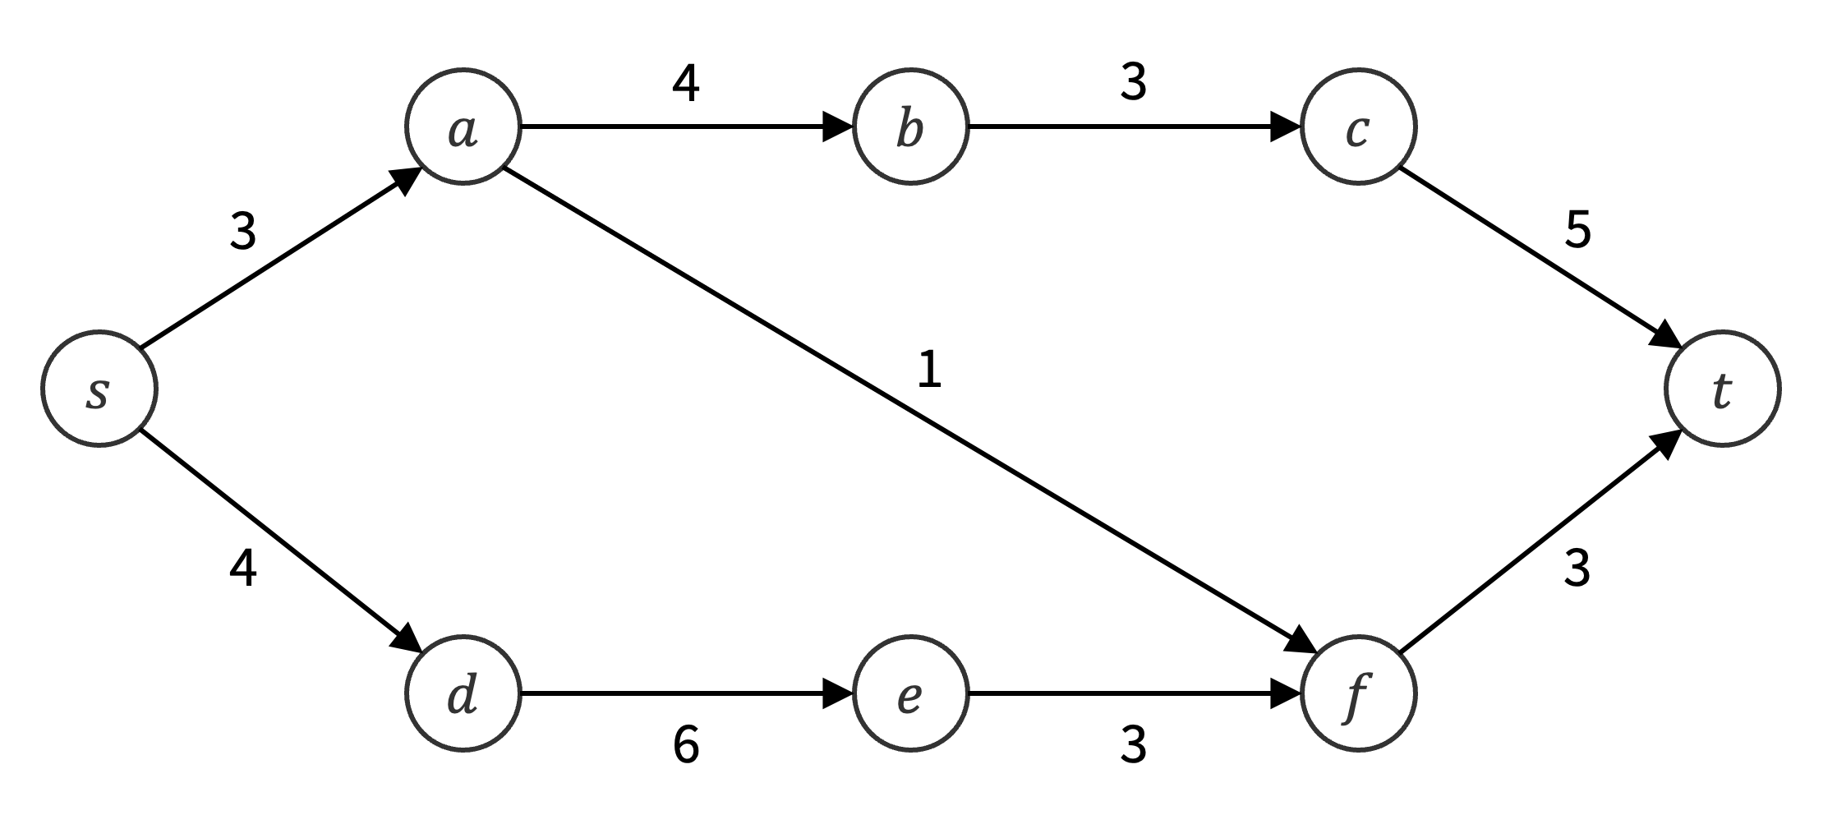
Problem 1 – Flow algorithms practice
Using Ford–Fulkerson with BFS, find the maximum $s$-$t$ flow in the graph $G$ below, the corresponding residual graph, and minimum cut.
Work on this with the people around you, then we’ll check!

Slide 10
Problem 1 – Flow algorithms practice
Solution
4
3
$$a$$
$$b$$
$$c$$
3
5
$$s$$
1
$$t$$
4
3
$$d$$
$$e$$
$$f$$
6
3
Here is our starting residual graph.

Slide 11
Problem 1 – Flow algorithms practice
Solution
4
3
$$a$$
$$b$$
$$c$$
3
5
$$s$$
1
$$t$$
4
3
$$d$$
$$e$$
$$f$$
6
3
Find the shortest $s$-$t$ path.

Slide 12
Problem 1 – Flow algorithms practice
Solution
4
3
$$a$$
$$b$$
$$c$$
2
5
1
$$s$$
$$t$$
1
1
4
2
$$d$$
$$e$$
$$f$$
6
3
Update the residual graph.

Slide 13
Problem 1 – Flow algorithms practice
Solution
0/4
0/3
$$a$$
$$b$$
$$c$$
1/3
0/5
$$s$$
1/1
$$t$$
0/4
1/3
$$d$$
$$e$$
$$f$$
0/6
0/3
Update the flow.

Slide 14
Problem 1 – Flow algorithms practice
Solution
4
3
$$a$$
$$b$$
$$c$$
2
5
1
$$s$$
$$t$$
1
1
4
2
$$d$$
$$e$$
$$f$$
6
3
Here is our current residual graph.

Slide 15
Problem 1 – Flow algorithms practice
Solution
4
3
$$a$$
$$b$$
$$c$$
2
5
1
$$s$$
$$t$$
1
1
4
2
$$d$$
$$e$$
$$f$$
6
3
Find the shortest $s$-$t$ path.

Slide 16
Problem 1 – Flow algorithms practice
Solution
2
1
$$a$$
$$b$$
$$c$$
2
2
3
3
2
$$s$$
$$t$$
1
1
4
2
$$d$$
$$e$$
$$f$$
6
3
Update the residual graph.

Slide 17
Problem 1 – Flow algorithms practice
Solution
2/4
2/3
$$a$$
$$b$$
$$c$$
3/3
2/5
$$s$$
1/1
$$t$$
0/4
1/3
$$d$$
$$e$$
$$f$$
0/6
0/3
Update the flow.

Slide 18
Problem 1 – Flow algorithms practice
Solution
2
1
$$a$$
$$b$$
$$c$$
2
2
3
3
2
$$s$$
$$t$$
1
1
4
2
$$d$$
$$e$$
$$f$$
6
3
Here is our current residual graph.

Slide 19
Problem 1 – Flow algorithms practice
Solution
2
1
$$a$$
$$b$$
$$c$$
2
2
3
3
2
$$s$$
$$t$$
1
1
4
2
$$d$$
$$e$$
$$f$$
6
3
Find the shortest $s$-$t$ path.

Slide 20
Problem 1 – Flow algorithms practice
Solution
2
1
$$a$$
$$b$$
$$c$$
2
2
3
3
2
$$s$$
$$t$$
1
2
3
2
2
2
$$d$$
$$e$$
$$f$$
4
1
Update the residual graph.

Slide 21
Problem 1 – Flow algorithms practice
Solution
2/4
2/3
$$a$$
$$b$$
$$c$$
3/3
2/5
$$s$$
1/1
$$t$$
2/4
3/3
$$d$$
$$e$$
$$f$$
2/6
2/3
Update the flow.

Slide 22
Problem 1 – Flow algorithms practice
Solution
2
1
$$a$$
$$b$$
$$c$$
2
2
3
3
2
$$s$$
$$t$$
1
2
3
2
2
2
$$d$$
$$e$$
$$f$$
4
1
Here is our current residual graph.

Slide 23
Problem 1 – Flow algorithms practice
Solution
2
1
$$a$$
$$b$$
$$c$$
2
2
3
3
2
$$s$$
$$t$$
1
2
3
2
2
2
$$d$$
$$e$$
$$f$$
4
1
Find the shortest $s$-$t$ path.

Slide 24
Problem 1 – Flow algorithms practice
Solution
1
$$a$$
$$b$$
$$c$$
3
3
2
3
3
$$s$$
1
$$t$$
3
3
1
3
3
$$d$$
$$e$$
$$f$$
3
Update the residual graph.

Slide 25
Problem 1 – Flow algorithms practice
Solution
3/4
3/3
$$a$$
$$b$$
$$c$$
3/3
3/5
$$s$$
0/1
$$t$$
3/4
3/3
$$d$$
$$e$$
$$f$$
3/6
3/3
Update the flow.

Slide 26
Problem 1 – Flow algorithms practice
Solution
1
$$a$$
$$b$$
$$c$$
3
3
2
3
3
$$s$$
1
$$t$$
3
3
1
3
3
$$d$$
$$e$$
$$f$$
3
There are no more $s$-$t$ paths.

Slide 27
Problem 1 – Flow algorithms practice
Solution
3/4
3/3
$$a$$
$$b$$
$$c$$
3/3
3/5
$$s$$
0/1
$$t$$
3/4
3/3
$$d$$
$$e$$
$$f$$
3/6
3/3
Max flow is flow out of $s$, which is 6.

Slide 28
Problem 1 – Flow algorithms practice
Solution
1
$$a$$
$$b$$
$$c$$
3
3
2
3
3
$$s$$
1
$$t$$
3
3
1
3
3
$$d$$
$$e$$
$$f$$
3
Min cut is reachable set from $s$, also has value 6

Slide 29
Problem solving with flows

Slide 30
Problem solving strategy overview
Read and summarize the problem
Decide to use known algorithm or techniques from scratch
Preprocess the input into the form required by the technique
not covered this section
Postprocess the technique’s output into what you want
Write pseudocode, proof, and running time analysis

Slide 31
Three common preprocessing tricks
To preprocess for network flows:
If you want “multiple sources/sinks,” add dummy vertices.
If you want “vertex capacities,” split vertices into two.
If you want “unconstrained capacity,” just set capacity to infinity.
We’ll see examples of each.

Slide 32
Problem 2 – Reservoir balancing
You have a set of overfilled reservoirs $O=\{o_{1},…,o_{m}\}$ and a set of underfilled reservoirs $U=\{u_{1},…,u_{n}\}$, and want to move 10,000 gallons of water from reservoirs in $O$ to reservoirs in $U$. You only care about the total amount of water moved, not each individual reservoir. You have a directed graph $G=(V,E)$ describing the one-way pipes connecting the reservoirs, where $O⊆V$ and $U⊆V$. This graph may include intermediate reservoirs, whose water levels should not change through your solution. Each pipe $e∈E$ has an integer maximum rate of flow $c(e)$ in gallons per minute. Find a method to move the water in the shortest amount of time.
Write a summary of the problem.
Work on this with the people around you, then we’ll check!

Slide 33
Problem 2 – Reservoir balancing
Solution
Write a summary of the problem.
Input: Directed graph $G=(V,E)$ with maximum flow rates $c(e)$, sets $O,U⊆V$
Output: Time/method to push 10,000 gallons from $O$ to $U$ while respecting flow rates

Slide 34
Problem 2 – Reservoir balancing
Write a summary of the problem.
Think about the three tricks. Use them to preprocess our input into something suitable as input for a network flows algorithm.
If you want “multiple sources/sinks,” add dummy vertices.
If you want “vertex capacities,” split vertices into two.
If you want “unconstrained capacity,” just set capacity to infinity.

Slide 35
Problem 2 – Reservoir balancing
Previous Solution
Write a summary of the problem.
Input: Directed graph $G=(V,E)$ with maximum flow rates $c(e)$, sets $O,U⊆V$
Output: Time/method to push 10,000 gallons from $O$ to $U$ while respecting flow rates
Think about the three tricks. Use them to preprocess our input into something suitable as input for a network flows algorithm.
If you want “multiple sources/sinks,” add dummy vertices.
If you want “vertex capacities,” split vertices into two.
If you want “unconstrained capacity,” just set capacity to infinity.
Work on this with the people around you, then we’ll check!

Slide 36
Problem 2 – Reservoir balancing
Solution
Think about the three tricks. Use them to preprocess our input into something suitable as input for a network flows algorithm.
Create dummy vertices $s$ and $t$, as well as edges $(s,o_{i})$ and $(u_{i},t)$ for all $o_{i}∈O$ and $u_{i}∈U$. Give these new edges infinite capacity, and leave the rest of the graph alone.
$$o_{1}$$
$$∞$$
$$∞$$
$$u_{1}$$
dummy source
$$∞$$
dummy sink
$$s$$
$$o_{2}$$
. . . . .
$$t$$
$$∞$$
$$∞$$
$$u_{2}$$
$$o_{3}$$

Slide 37
Problem 2 – Reservoir balancing
After running a max flow algorithm, what do you get? What postprocessing is needed to get the solution?
Work on this with the people around you, then we’ll check!

Slide 38
Problem 2 – Reservoir balancing
Solution
After running a max flow algorithm, what do you get? What postprocessing is needed to get the solution?
We get the maximum flow $r$ from $s$ to $t$ as well as the flow $f:E′→ℝ$ that achieves it, where $E′$ is the edge set of our new graph.
Denote $f{\left.​\right|}_{E}$ the restriction of $f$ to the original edge set $E$, and our solution will be to push water at rates according to $f{\left.​\right|}_{E}$ for $\frac{10,000}{r}$ minutes.

Slide 39
Network flows proofs
In a network flow problem, the main claim in your proof will probably be:
“The maximum flow in the graph that I constructed
is equal to the maximum solution in the original problem.”
It should be intuitive, but to write thing formally, the strategy is to prove two things:
We can turn any solution of our network into a solution of the original problem of same quality.
We can turn any solution of the original problem into a solution of our network of same quality.
Then, your output works because (1), and no other solution of the original problem is better, by applying (2) and the fact that we found the max flow of our network.

Slide 40
Problem 2 – Reservoir balancing
Prove your solution is correct.
Work on this with the people around you, then we’ll check!

Slide 41
Problem 2 – Reservoir balancing
Solution
Prove your solution is correct.
Turn solution of our network into a solution of original problem of same quality:
Simply restrict to the original edge set (note that this is valid for original problem).
By flow conservation, the flow out of $s$ is equal to the sum of all flow leaving $O$, so the quality is the same.
Turn solution of original problem into a solution of our network of same quality:
Set $f(s,o_{i})$ to be the sum of all flow out of $o_{i}$ (valid because infinite capacity).
Then, the flow out of $s$ is the sum of all flow leaving $O$, thus same quality.
Thus, the best solution of our network is equivalent to the best solution of the original.

Slide 42
Problem 2 – Reservoir balancing
Solution
Prove your solution is correct.
Lastly, the previous slide only showed that we compute the maximum water pumping rate from $O$ to $U$, not yet the “best method to move water”.
To finish, we just note that the best strategy for filling the reservoirs must have the form “run a fixed strategy with flow rate $r$ for $\frac{10,000}{r}$ minutes” (no changes over time).
Suppose a strategy changed over time. Then, we can improve it by taking the strategy at the point in time where flow rate is fastest, and use that the whole time.

Slide 43
Problem 2 – Reservoir balancing
Which flow algorithm is best for this problem? Then analyze your running time. (Assume $\left|V\right|=n$, $\left|E\right|=m$, and $n≤m$.)
Work on this with the people around you, then we’ll check!

Slide 44
Problem 2 – Reservoir balancing
Solution
Which flow algorithm is best for this problem? Then analyze your running time. (Assume $\left|V\right|=n$, $\left|E\right|=m$, and $n≤m$.)
Because we have no control over how large the capacities are, Ford–Fulkerson with BFS and the Edmonds–Karp bound is best for this problem.
The graph we constructed has:
$\left|V^{′}\right|=n+2$ vertices, and
$\left|E^{′}\right|=m+\left|O\right|+\left|U\right|<m+n≤2m$ edges.
Thus, the running time is $O\left(\left|V^{′}\right|{\left|E^{′}\right|}^{2}\right)=O(nm^{2})$.

Slide 45
Problem 3 – Traffic modeling
In most cities, traffic congestion happens only at intersections – segments without intersections are free-flowing. An extremely rough model is that the capacity of an intersection (the total number of vehicles per hour that flow through the intersection in any direction) is proportional to the number of traffic lanes at the intersection. You are given the road network of a city as a graph $G=(V,E)$(consisting of directed edges, i.e. one-way streets), as well as the number of lanes $c(v)$ at each intersection. Suppose each lane adds a capacity of 300 vehicles per hour, and there are no intersections with more than 12 lanes. Given an origin $s$ and destination $t$ (which also do have limited capacity), compute how many vehicles per hour can move from $s$ to $t$.
Write a summary of the problem.
Work on this with the people around you, then we’ll check!

Slide 46
Problem 3 – Traffic modeling
Solution
Write a summary of the problem.
Input: Directed graph $G=(V,E)$ with vertex capacities $c(v)≤12$, and $s$ and $t$
Output: Maximum flow rate from $s$ to $t$

Slide 47
Problem 3 – Traffic modeling
Write a summary of the problem.
Think about the three tricks. Use them to preprocess our input into something suitable as input for a network flows algorithm.
If you want “multiple sources/sinks,” add dummy vertices.
If you want “vertex capacities,” split vertices into two.
If you want “unconstrained capacity,” just set capacity to infinity.

Slide 48
Problem 3 – Traffic modeling
Previous Solution
Write a summary of the problem.
Input: Directed graph $G=(V,E)$ with vertex capacities $c(v)≤12$, and $s$ and $t$
Output: Maximum flow rate from $s$ to $t$
Think about the three tricks. Use them to preprocess our input into something suitable as input for a network flows algorithm.
If you want “multiple sources/sinks,” add dummy vertices.
If you want “vertex capacities,” split vertices into two.
If you want “unconstrained capacity,” just set capacity to infinity.
Work on this with the people around you, then we’ll check!

Slide 49
Problem 3 – Traffic modeling
Solution
Think about the three tricks. Use them to preprocess our input into something suitable as input for a network flows algorithm.
First, put infinite capacity on all edges in the original graph.
Then, split every vertex $v$ into $v_{in}$ and $v_{out}$, and change all $(u,v)$ into $(u_{out},v_{in})$, (as well as $(v,w)$ into $(v_{out},w_{in})$). Put capacity $c(v)$ on the new edge $(v_{in},v_{out})$.
Lastly, we will compute the flow between $s^{′}=s_{in}$ and $t^{′}=t_{out}$.
$$c(v)$$
$$v$$
$$vin$$
$$vout$$

Slide 50
Problem 3 – Traffic modeling
After running a max flow algorithm, what do you get? What postprocessing is needed to get the solution?
This should be quick – what can we do?

Slide 51
Problem 3 – Traffic modeling
Solution
After running a max flow algorithm, what do you get? What postprocessing is needed to get the solution?
We get the maximum total flow rate $r$, and we should return $300r$.

Slide 52
Problem 3 – Traffic modeling
Prove your solution is correct.
Work on this with the people around you, then we’ll check!

Slide 53
Problem 3 – Traffic modeling
Solution
Prove your solution is correct.
Turn solution of our network into a solution of original problem of same quality:
For every edge $(u_{out},v_{in})$, give flow $f(u_{out},v_{in})$ to original edge $(u,v)$.
By flow conservation at $v_{in}$ and $c\left(v_{in},v_{out}\right)=c(v)$, the original vertex $v$ has at most $c(v)$ flow through it, so it is a valid solution.
By flow conservation, flow out of $s_{in}$ is the same as flow out of $s_{out}$, which by construction is the flow out of $s$, so the quality is the same.

Slide 54
Problem 3 – Traffic modeling
Solution
Prove your solution is correct.
Turn solution of original problem into a solution of our network of same quality:
Set $f(u_{out},v_{in})$ to be the traffic flow from $u$ to $v$, and set $f(v_{in},v_{out})$ as necessary to maintain flow conservation.
Edges of type ${(u}_{out},v_{in})$ have infinite capacity, so they are fine, and edges of type $(v_{in},v_{out})$ have capacity $c(v)$, so they are fine by vertex capacities.
The quality is the same, since by construction we set the the flow out of $s_{in}$ to be equal to the flow out of $s_{out}$, which was the flow out of $s$.

Slide 55
Problem 3 – Traffic modeling
Which flow algorithm is best for this problem? Then analyze your running time. (Assume $\left|V\right|=n$, $\left|E\right|=m$, and $n≤m$.)
Work on this with the people around you, then we’ll check!

Slide 56
Problem 3 – Traffic modeling
Solution
Which flow algorithm is best for this problem? Then analyze your running time. (Assume $\left|V\right|=n$, $\left|E\right|=m$, and $n≤m$.)
Because all (non-infinite) capacities are at most 12, Ford–Fulkerson with BFS and the original Ford–Fulkerson analysis is best for this problem.
The graph we constructed has:
$\left|V^{′}\right|=2n$ vertices, and
$\left|E^{′}\right|=m+n≤2m$ edges.
Since $\left|V^{′}\right|\left|E^{′}\right|C=48nm$, the running time is $O\left(\left|V^{′}\right|\left|E^{′}\right|C\right)=O(nm)$.

Slide 57
Summary
Three tricks: dummy $s$/$t$, split vertices for vertex capacity, and infinite capacity
When using Ford–Fulkerson with BFS, pick original FF bound if small capacities, and pick Edmonds–Karp bound if large capacities.
Proof by converting solutions both ways: between solutions to your constructed flow network and solutions to the original problem.
Thanks for coming to section this week!

