Slide 1
CSE 421 Section 6
Midterm Review

Slide 2
Announcements & Reminders
HW4 regrade requests are open
HW5 will be due 2/14
There is no homework this week.
Your midterm exam is on Wednesday, 2/19 @ 6:00–7:30pm, BAG131
  Let us know ASAP if you cannot make it
  Review session on 2/18 @ 4:30 - 6:30, Location TBD

Slide 3
Midterm format
Several multiple choice/short answer problems
3 long-form problems
  Similar in style to homework
90 minutes
You will be given a standard reference sheet, view it on Ed
You may bring one sheet of double sided 8.5x11” paper containing your own handwritten notes.
  Must write name, student number, and UW NetID
  Must turn in with exam

Slide 4
Option 1
(35 min) 6 stations around the room with practice problems
  Station 1: Short answer
  Station 2: Stable matching reduction*
  Station 3: Graph algorithms
  Station 4: Greedy algorithms*
  Station 5: Divide and conquer*
  Station 6: Dynamic programming
(10 min) Go over some of these problems
*the problem at this station was an extra problem on a previous section handout

Slide 5
Option 2
(35 min) Form small groups (1-5 people) and work on problems
  Station 1: Short answer
  Station 2: Stable matching reduction*
  Station 3: Graph algorithms
  Station 4: Greedy algorithms*
  Station 5: Divide and conquer*
  Station 6: Dynamic programming
(10 min) Go over some of these problems
*the problem at this station was an extra problem on a previous section handout

Slide 6
Option 3
(6.5 min) Work on a problem
  Station 1: Short answer
  Station 2: Stable matching reduction*
  Station 3: Graph algorithms
  Station 4: Greedy algorithms*
  Station 5: Divide and conquer*
  Station 6: Dynamic programming
(5 min) Go over some of the problem
Repeat!
*the problem at this station was an extra problem on a previous section handout

Slide 7
Problems
1
2
3
4
5
6

Slide 8

Problem 1 – Short answer
If $p$ ranks $r$ first and $r$ ranks $p$ first, then $(p,r)$ must be in every stable matching.

Slide 9

Problem 1 – Short answer
Solution
If $p$ ranks $r$ first and $r$ ranks $p$ first, then $(p,r)$ must be in every stable matching.
True. If $p$ and $r$ were not matched, then they prefer each other over the current matches, so this is an instability.

Slide 10
Problem 1 – Short answer
Running DFS on a directed acyclic graph may produce:
Tree edges
Back edges
Forward edges
Cross edges

Slide 11
Problem 1 – Short answer
Solution
Running DFS on a directed acyclic graph may produce:
Tree edges
Back edges
Forward edges
Cross edges
All except back edges, since they create cycles.
1/8
F
T
T
2/5
6/7
T
C
3/4

Slide 12

Problem 1 – Short answer
The recurrence $T(n)=2T(n/3)+Θ(n^{2})$simplifies to…?

Slide 13

Problem 1 – Short answer
Solution
The recurrence $T(n)=2T(n/3)+Θ(n^{2})$simplifies to…?
$Θ(n^{2})$. By master theorem, since $2<3^{2}$.

Slide 14

Problem 1 – Short answer
Suppose $G$ has positive, distinct edge costs. If $T$ is an MST of $G$, then it is still an MST after replacing each edge cost $c_{e}$ with $c_{e}^{2}$.

Slide 15
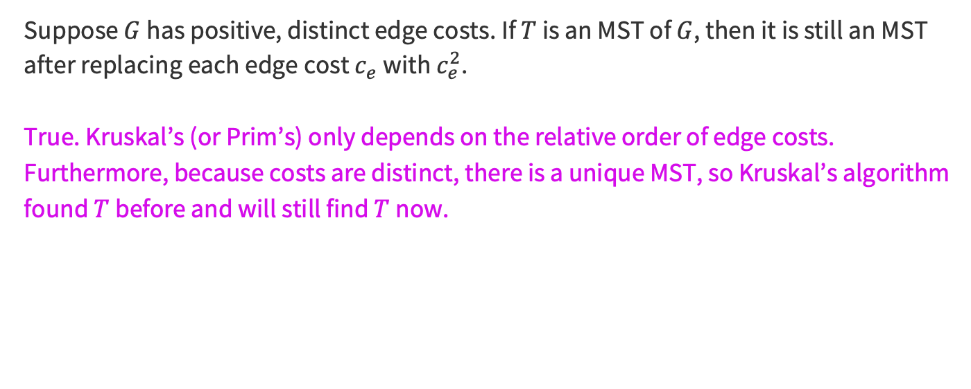
Problem 1 – Short answer
Solution
Suppose $G$ has positive, distinct edge costs. If $T$ is an MST of $G$, then it is still an MST after replacing each edge cost $c_{e}$ with $c_{e}^{2}$.
True. Kruskal’s (or Prim’s) only depends on the relative order of edge costs. Furthermore, because costs are distinct, there is a unique MST, so Kruskal’s algorithm found $T$ before and will still find $T$ now.

Slide 16

Problem 1 – Short answer
Let $G=(V,E)$ be a weighted, undirected graph. Consider any cut $S⊆V$, and let $e$ be an edge of minimum weight across the cut $S$. Then every MST contains $e$.

Slide 17

Problem 1 – Short answer
Solution
Let $G=(V,E)$ be a weighted, undirected graph. Consider any cut $S⊆V$, and let $e$ be an edge of minimum weight across the cut $S$. Then every MST contains $e$.
False. The theorem requires edge weights be distinct. Consider:
1
1
1
1
Return to problem select

Slide 18

Problem 2 – Stable matching reduction
There are $R$ riders, $H$ horses with $2H<R<3H$. Riders and horses have preferences for each other. Also, riders prefer the first 2 rounds. Horses prefer to ride every round.
Set up 3 rounds of rides, so that every rider will ride a horse exactly once, every horse does exactly 2 or 3 rides, and there are no unstable matches.

Slide 19
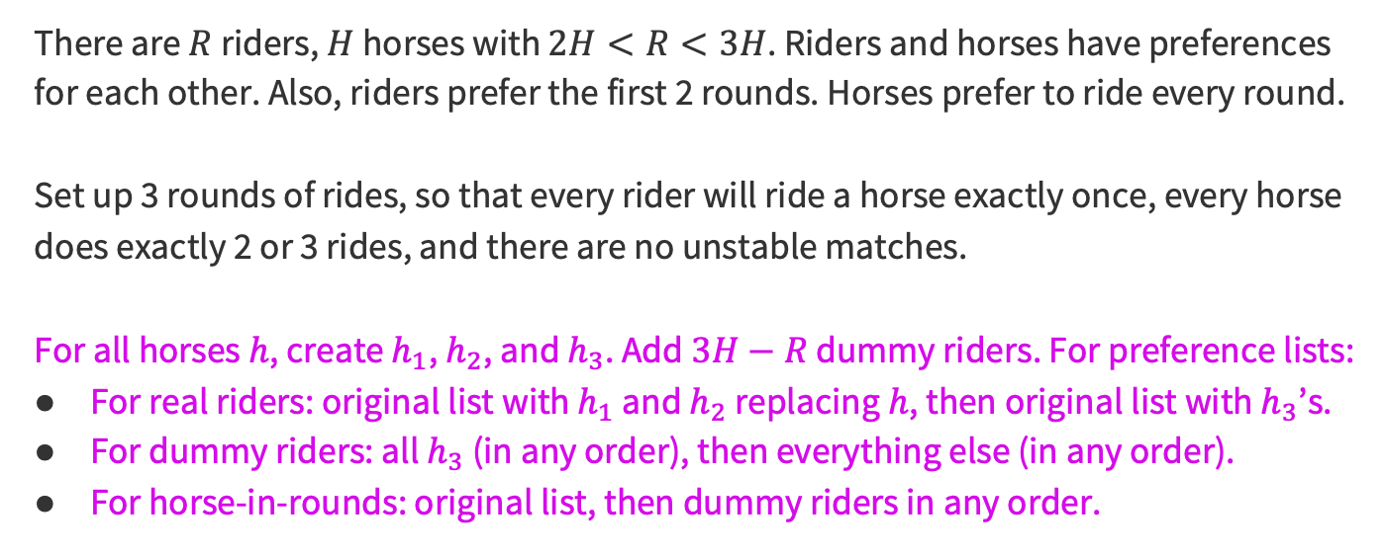
Problem 2 – Stable matching reduction
Solution
There are $R$ riders, $H$ horses with $2H<R<3H$. Riders and horses have preferences for each other. Also, riders prefer the first 2 rounds. Horses prefer to ride every round.
Set up 3 rounds of rides, so that every rider will ride a horse exactly once, every horse does exactly 2 or 3 rides, and there are no unstable matches.
For all horses $h$, create $h_{1}$, $h_{2}$, and $h_{3}$. Add $3H−R$ dummy riders. For preference lists:
For real riders: original list with $h_{1}$ and $h_{2}$ replacing $h$, then original list with $h_{3}$’s.
For dummy riders: all $h_{3}$ (in any order), then everything else (in any order).
For horse-in-rounds: original list, then dummy riders in any order.

Slide 20
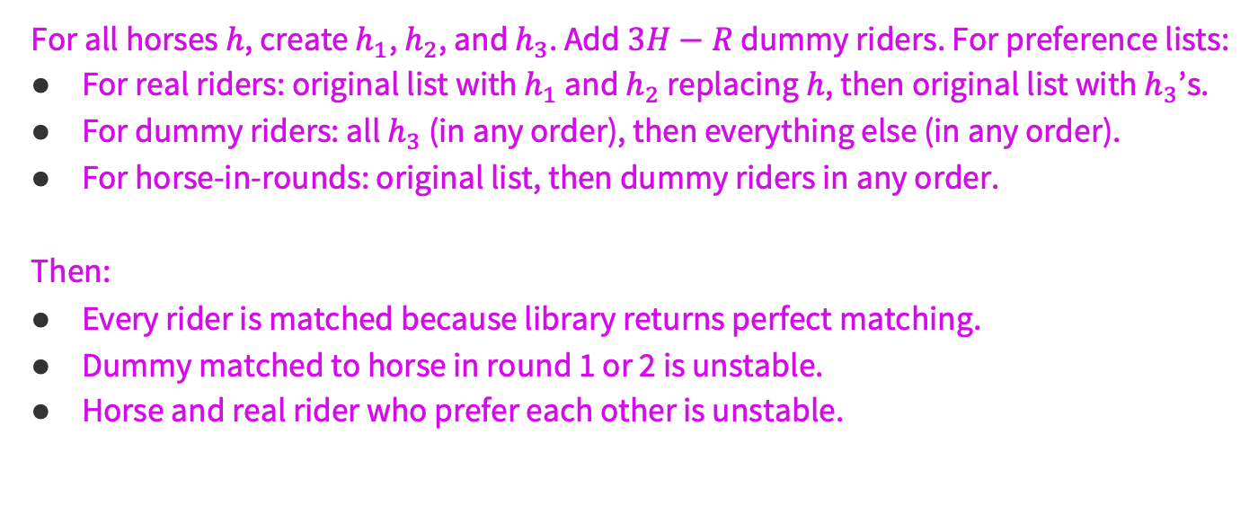
Problem 2 – Stable matching reduction
Solution
For all horses $h$, create $h_{1}$, $h_{2}$, and $h_{3}$. Add $3H−R$ dummy riders. For preference lists:
For real riders: original list with $h_{1}$ and $h_{2}$ replacing $h$, then original list with $h_{3}$’s.
For dummy riders: all $h_{3}$ (in any order), then everything else (in any order).
For horse-in-rounds: original list, then dummy riders in any order.
Then:
Every rider is matched because library returns perfect matching.
Dummy matched to horse in round 1 or 2 is unstable.
Horse and real rider who prefer each other is unstable.
Return to problem select

Slide 21

Problem 3 – Graph modeling
Given $\left(a_{1},b_{1}\right),…,(a_{n},b_{n})$, the person living in unit $a_{i}$ is moving to $b_{i}$. Some people may be new arrivals ($a_{i}=$ null) or moving out ($b_{i}=$ null). Give an algorithm that returns a valid moving order (every unit is vacated before someone moves in), or “not possible” and a minimal list of pairs that explains why.

Slide 22






Problem 3 – Graph modeling
Solution
Given $\left(a_{1},b_{1}\right),…,(a_{n},b_{n})$, the person living in unit $a_{i}$ is moving to $b_{i}$. Some people may be new arrivals ($a_{i}=$ null) or moving out ($b_{i}=$ null). Give an algorithm that returns a valid moving order (every unit is vacated before someone moves in), or “not possible” and a minimal list of pairs that explains why.
$$\left(2, null\right)$$
$$\left(1, 2\right)$$
$$\left(null,1\right)$$
$A→B$ iff $A$ must happen before $B$
$$\left(3, 4\right)$$
$$\left(4, 3\right)$$

Slide 23
Problem 3 – Graph modeling
Solution
Given $\left(a_{1},b_{1}\right),…,(a_{n},b_{n})$, the person living in unit $a_{i}$ is moving to $b_{i}$. Some people may be new arrivals ($a_{i}=$ null) or moving out ($b_{i}=$ null). Give an algorithm that returns a valid moving order (every unit is vacated before someone moves in), or “not possible” and a minimal list of pairs that explains why.
$$\left(2, null\right)$$
$$\left(1, 2\right)$$
$$\left(null,1\right)$$
Check for cycles with B/DFS.
  If there is a cycle, not possible.
$$\left(3, 4\right)$$
$$\left(4, 3\right)$$

Slide 24

Problem 3 – Graph modeling
Solution
Given $\left(a_{1},b_{1}\right),…,(a_{n},b_{n})$, the person living in unit $a_{i}$ is moving to $b_{i}$. Some people may be new arrivals ($a_{i}=$ null) or moving out ($b_{i}=$ null). Give an algorithm that returns a valid moving order (every unit is vacated before someone moves in), or “not possible” and a minimal list of pairs that explains why.
$$\left(2, null\right)$$
$$\left(1, 2\right)$$
$$\left(null,1\right)$$
Check for cycles with B/DFS.
  If there is a cycle, not possible.
  If there is no cycle, topo sort.
$$\left(3, 5\right)$$
$$\left(4, 3\right)$$
Return to problem select

Slide 25

Problem 4 – Greedy algorithms
Given a set $𝒳$ of integer intervals $[a,b]⊆ℤ$, find the smallest set $𝒴⊆𝒳$ such that every point in any interval of $𝒳$ belongs to some interval of $𝒴$ (i.e. $𝒴$ covers $𝒳$).

Slide 26
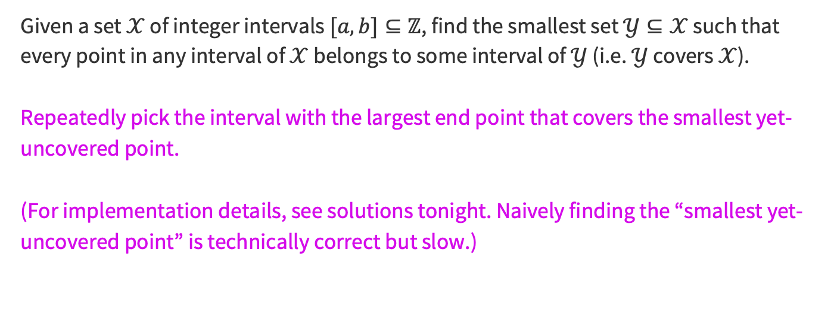
Problem 4 – Greedy algorithms
Solution
Given a set $𝒳$ of integer intervals $[a,b]⊆ℤ$, find the smallest set $𝒴⊆𝒳$ such that every point in any interval of $𝒳$ belongs to some interval of $𝒴$ (i.e. $𝒴$ covers $𝒳$).
Repeatedly pick the interval with the largest end point that covers the smallest yet-uncovered point.
(For implementation details, see solutions tonight. Naively finding the “smallest yet-uncovered point” is technically correct but slow.)

Slide 27
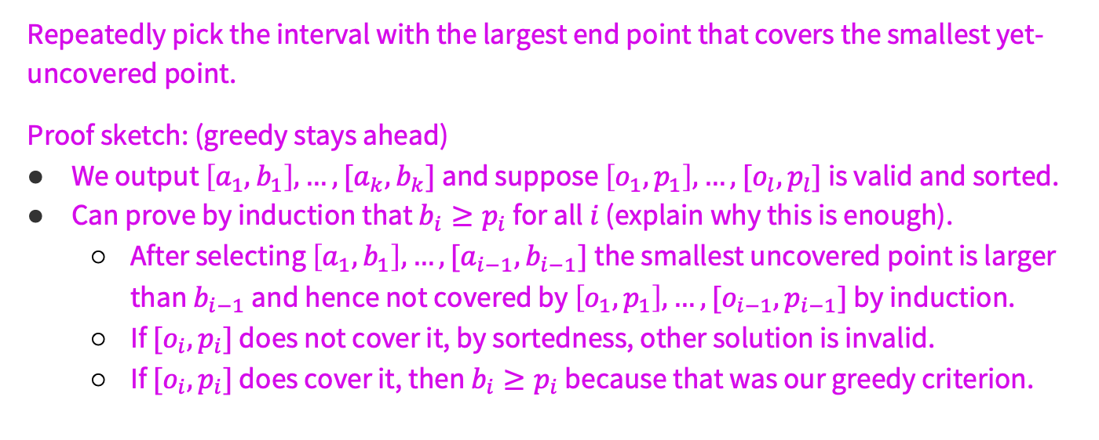
Problem 4 – Greedy algorithms
Solution
Repeatedly pick the interval with the largest end point that covers the smallest yet-uncovered point.
Proof sketch: (greedy stays ahead)
We output $\left[a_{1},b_{1}\right],…,[a_{k},b_{k}]$ and suppose $\left[o_{1},p_{1}\right],…,[o_{l},p_{l}]$ is valid and sorted.
Can prove by induction that $b_{i}≥p_{i}$ for all $i$ (explain why this is enough).
  After selecting $\left[a_{1},b_{1}\right],…,[a_{i−1},b_{i−1}]$the smallest uncovered point is larger than $b_{i−1}$ and hence not covered by $\left[o_{1},p_{1}\right],…,[o_{i−1},p_{i−1}]$ by induction.
  If $[o_{i},p_{i}]$ does not cover it, by sortedness, other solution is invalid.
  If $[o_{i},p_{i}]$ does cover it, then $b_{i}≥p_{i}$ because that was our greedy criterion.
Return to problem select

Slide 28

Problem 5 – Divide and conquer
$A[1..n]$is a mountain if there is a peak $i$ such that
$A\left[1\right]<…<A\left[i−1\right]<A[i]$ and $A\left[i\right]>A\left[i+1\right]>…>A[n]$.
The peak may be at 1 or $n$. Given a mountain, find the peak in $O(\log{n})$ time.

Slide 29
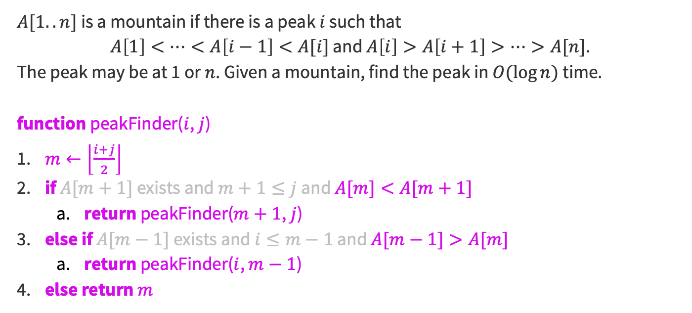
Problem 5 – Divide and conquer
Solution
$A[1..n]$is a mountain if there is a peak $i$ such that
$A\left[1\right]<…<A\left[i−1\right]<A[i]$ and $A\left[i\right]>A\left[i+1\right]>…>A[n]$.
The peak may be at 1 or $n$. Given a mountain, find the peak in $O(\log{n})$ time.
function peakFinder($i$, $j$)
​$m←\left\lfloor \frac{i+j}{2}\right\rfloor$
​if $A[m+1]$ exists and $m+1≤j$ and $A[m]<A[m+1]$
  ​return peakFinder($m+1$, $j$)
​else if $A[m−1]$ exists and $i≤m−1$ and $A[m−1]>A[m]$
  ​return peakFinder($i$, $m−1$)
​else return $m$
(base case omitted for slide brevity)
(checking for edge cases)

Slide 30
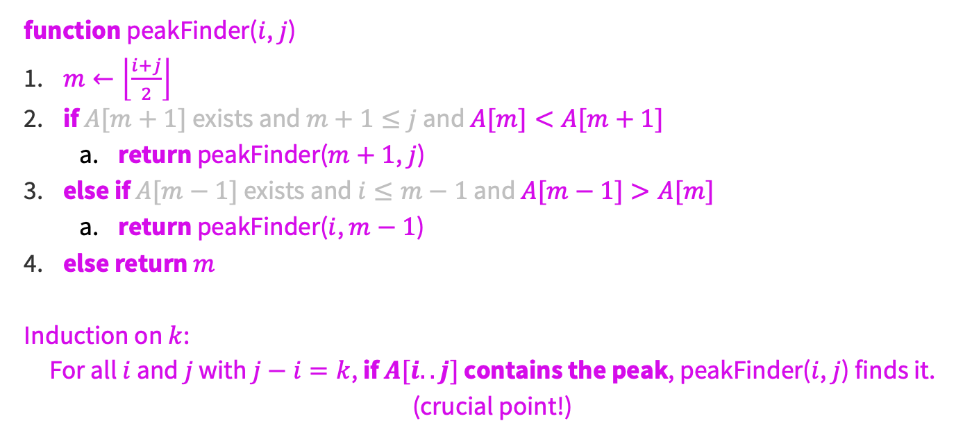
Problem 5 – Divide and conquer
Solution
function peakFinder($i$, $j$)
​$m←\left\lfloor \frac{i+j}{2}\right\rfloor$
​if $A[m+1]$ exists and $m+1≤j$ and $A[m]<A[m+1]$
  ​return peakFinder($m+1$, $j$)
​else if $A[m−1]$ exists and $i≤m−1$ and $A[m−1]>A[m]$
  ​return peakFinder($i$, $m−1$)
​else return $m$
Induction on $k$:
For all $i$ and $j$ with $j−i=k$, if $A[i..j]$ contains the peak, peakFinder($i$, $j$) finds it.
(crucial point!)

Slide 31
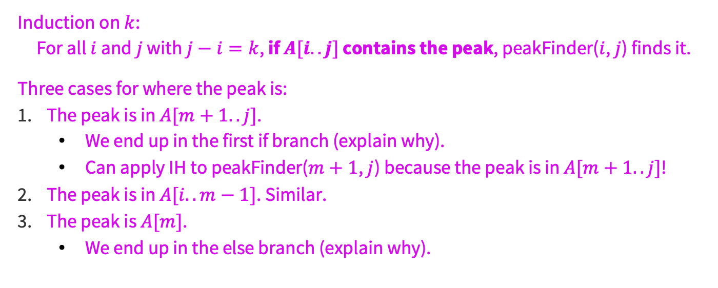
Problem 5 – Divide and conquer
Solution
Induction on $k$:
For all $i$ and $j$ with $j−i=k$, if $A[i..j]$ contains the peak, peakFinder($i$, $j$) finds it.
Three cases for where the peak is:
The peak is in $A[m+1..j]$.
  We end up in the first if branch (explain why).
  Can apply IH to peakFinder($m+1$, $j$) because the peak is in $A[m+1..j]$!
The peak is in $A[i..m−1]$. Similar.
The peak is $A[m]$.
  We end up in the else branch (explain why).
Return to problem select

Slide 32

Problem 6 – Dynamic programming
Compute the maximum reward going from $(1, 1)$ to $(m,n)$ on a grid, where you gain $R[i,j]$ whenever passing through $(i,j)$. Starting/ending count as passing through. $R[i,j]$ may be negative (penalty) or $−∞$ (impassible).

Slide 33
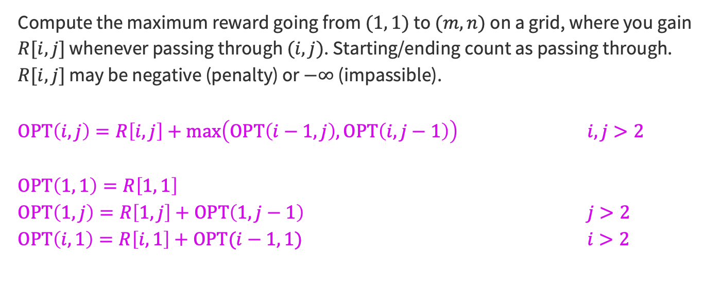
Problem 6 – Dynamic programming
Solution
Compute the maximum reward going from $(1, 1)$ to $(m,n)$ on a grid, where you gain $R[i,j]$ whenever passing through $(i,j)$. Starting/ending count as passing through. $R[i,j]$ may be negative (penalty) or $−∞$ (impassible).
$OPT\left(i,j\right)=R\left[i,j\right]+\max\left(OPT\left(i−1,j\right),OPT\left(i,j−1\right)\right)$ $i,j>2$
$$OPT\left(1, 1\right)=R\left[1, 1\right]$$
$OPT\left(1,j\right)=R\left[1,j\right]+OPT\left(1,j−1\right)$ $j>2$
$OPT\left(i,1\right)=R\left[i,1\right]+OPT(i−1, 1)$ $i>2$
Return to problem select

