Slide 1
CSE 421 Section 4
Divide and Conquer

Slide 2
Administrivia
Notes:
Administrivia ~2 mins

Slide 3
Announcements & Reminders
HW2
Regrade requests are open
Answer keys available on Ed
HW3
Was due yesterday, 10/16
Remember the late problems policy (NOT assignments)
Total of up to 10 late problem days
At most 2 late days per problem
HW4
Due Wednesday 10/23 @ 11:59pm

Slide 4
Ideas for divide and conquer

Slide 5
Problem solving strategy overview
Read and summarize the problem
Decide to use known algorithm or techniques from scratch
not covered this section
no idea
have idea
Check that idea isn’t easily falsified or slow
Solve examples to get ideas
Write pseudocode, proof, and running time analysis
…in a “divide and conquer” mindset

Slide 6
Problem 1 – Maximum subarray sum
Input: An array of integers A $=a_{1},…,a_{n}$ (possibly both positive and negative)
Expected output: The largest sum of any contiguous subarray A[i..j]
Notation: Denote A[i..j] the subarray $a_{i},a_{i+1},…,a_{j}$.
Notes:
The list of no elements is a valid subarray (the sum is 0).
The expected output is the sum of the elements, not the actual subarray.
For divide and conquer word problems: Summary is extremely important, because recursion demands that you understand exactly what the input and output are.

Slide 7
Problem solving strategy overview
Read and summarize the problem
Decide to use known algorithm or techniques from scratch
not covered this section
no idea
have idea
Check that idea isn’t easily falsified or slow
Solve examples to get ideas
Write pseudocode, proof, and running time analysis
…in a “divide and conquer” mindset

Slide 8
Problem 1 – Maximum subarray sum
For problems that can be solved with divide and conquer, there will almost always be an easy but slow baseline idea that you can try first.
Input: An array of integers $a_{1},…,a_{n}$ (possibly both positive and negative)
Expected output: The largest sum of any contiguous subarray A[i..j]
Let’s come up with an easy baseline solution (no divide and conquer yet).
What is the simplest idea that you can try? What is the running time?
Feel free to work with the people around you!

Slide 9
Problem 1 – Maximum subarray sum
Solution
For problems that can be solved with divide and conquer, there will almost always be an easy but slow baseline idea that you can try first.
Input: An array of integers $a_{1},…,a_{n}$ (possibly both positive and negative)
Expected output: The largest sum of any contiguous subarray A[i..j]
Let’s come up with an easy baseline solution (no divide and conquer yet).
What is the simplest idea that you can try? What is the running time?
Check the sum of every possible subarray A[i..j]. There are $O(n^{2})$ different subarrays (pick $i$ and $j$), and sum takes $O(n)$ time per subarray, for a total of $O\left(n^{3}\right)$.

Slide 10
Problem 1 – Maximum subarray sum
Let’s come up with an easy baseline solution (no divide and conquer yet).
What is the simplest idea that you can try? What is the running time?
Are there any inefficiencies with this idea that can be easily fixed (still no divide and conquer)? If so, what is the running time after fixing?

Slide 11
Problem 1 – Maximum subarray sum
Previous Solution
Let’s come up with an easy baseline solution (no divide and conquer yet).
What is the simplest idea that you can try? What is the running time?
Check the sum of every possible subarray A[i..j]. There are $O(n^{2})$ different subarrays (pick $i$ and $j$), and sum takes $O(n)$ time per subarray, for a total of $O\left(n^{3}\right)$.
Are there any inefficiencies with this idea that can be easily fixed (still no divide and conquer)? If so, what is the running time after fixing?
Feel free to work with the people around you!

Slide 12
Problem 1 – Maximum subarray sum
Solution
Let’s come up with an easy baseline solution (no divide and conquer yet).
What is the simplest idea that you can try? What is the running time?
Check the sum of every possible subarray A[i..j]. There are $O(n^{2})$ different subarrays (pick $i$ and $j$), and sum takes $O(n)$ time per subarray, for a total of $O\left(n^{3}\right)$.
Are there any inefficiencies with this idea that can be easily fixed (still no divide and conquer)? If so, what is the running time after fixing?
To compute the sum of A[i..j+1], you don’t need to spend $O(n)$, just use $O(1)$ time to add $a_{j+1}$ to the sum of A[i..j], which is already computed. Now it’s $O\left(n^{2}\right)$.

Slide 13
Problem solving strategy overview
Read and summarize the problem
Decide to use known algorithm or techniques from scratch
not covered this section
no idea
have idea
Check that idea isn’t easily falsified or slow
Solve examples to get ideas
Write pseudocode, proof, and running time analysis
…in a “divide and conquer” mindset

Slide 14
Problem 1 – Maximum subarray sum
Now, we know that $O\left(n^{2}\right)$is easy. Thus, we should aim around $O\left(n\log{n}\right)$.
Here are some basic questions to always ask yourself for divide and conquer:
How do you want to split up the problem?
What is returned from the recursive calls?
How much work can you do in each call, in order to get $O\left(n\log{n}\right)$?
Feel free to work with the people around you!

Slide 15
Problem 1 – Maximum subarray sum
Solution
Now, we know that $O\left(n^{2}\right)$is easy. Thus, we should aim around $O\left(n\log{n}\right)$.
Here are some basic questions to always ask yourself for divide and conquer:
How do you want to split up the problem?
Two halves, A[1..m] and A[m+1..n], where $m=\left\lfloor \frac{n}{2}\right\rfloor$. (need to call both)
What is returned from the recursive calls?
The largest sum of any contiguous subarray in each half.
Up to how much work is allowed in each call, in order to get $O\left(n\log{n}\right)$?
Up to $O(n)$ work per recursive call gets $O\left(n\log{n}\right)$, like in merge sort.

Slide 16
Problem 1 – Maximum subarray sum
Solve these examples by hand, as well as the two recursive subproblems in each example (just one level of recursion). Then, think about the following to get ideas: “How can I use the two answers to the subproblems to get the final answer?” Remember how much work you are allowed to do.
2, -10, -5, 8, -1, 7
6, -3, -4, 4, 2, 1, -7, 5
-3, 2, 4, -1, 3, -10, 6, -4
Continue trying more examples until you have an idea.
Feel free to work with the people around you!

Slide 17
Problem 1 – Maximum subarray sum
Solution
2, -10, -5, 8, -1, 7
Full solution: [8, -1, 7] with sum 14
Left half: [2] with sum 2
Right half: [8, -1, 7] with sum 14
How to combine: We took the solution from the right half.

Slide 18
Problem 1 – Maximum subarray sum
Solution
6, -3, -4, 4, 2, 1, -7, 5
Full solution: [4, 2, 1] with sum 7
Left half: [6] with sum 6
Right half: [5] with sum 5
How to combine: Both answers to subproblems were smaller than the full solution, which crossed the boundary.

Slide 19
Problem 1 – Maximum subarray sum
Solution
-3, 2, 4, -1, 3, -10, 6, -4
Full solution: [2, 4, -1, 3] with sum 8
Left half: [2, 4] with sum 6
Right half: [6] with sum 6
How to combine: Both answers to subproblems were smaller than the full solution, which crossed the boundary.

Slide 20
Problem 1 – Maximum subarray sum
Previous Solution
The largest subarray sum is either in the left or right half, or crosses the boundary.
So, can we find the largest subarray sum that crosses the boundary in $O(n)$ time?
If you haven’t gotten it yet, take a moment to think. Feel free to work with the people around you!

Slide 21
Problem 1 – Maximum subarray sum
Solution
The largest subarray sum is either in the left or right half, or crosses the boundary.
So, can we find the largest subarray sum that crosses the boundary in $O(n)$ time?
Yes! From the middle, search down for the largest sum of all arrays of the form A[i..m] (where $1≤i≤m$), and similarly search up for arrays of the form A[m+1..j] (where $m+1≤j≤n$), then put them together.

Slide 22
Writing about divide and conquer

Slide 23
Divide and conquer pseudocode
Reminders for divide and conquer pseudocode:
Always give your function a name, since you will need to call it recursively.
In pseudocode, our default will be that function parameters pass by value.
If you pass arrays by value, you automatically use $O(n)$ time.
To achieve sub-$O(n)$, you must use references, pointers, global variables (or generally variables scoped outside the function), or other equivalents.
These slides use global variables, but it’s subjective.
Not relevant for this problem since we use $O(n)$ time anyways.

Slide 24
Problem 1 – Maximum subarray sum
Write the pseudocode for your solution.

Slide 25
Problem 1 – Maximum subarray sum
Previous Solution
The largest subarray sum is either in the left or right half, or crosses the boundary.
For crossing the boundary, from the middle, search down for the largest sum of all arrays of the form A[i..m] (where $1≤i≤m$), and similarly search up for arrays of the form A[m+1..j] (where $m+1≤j≤n$), then put them together.
Write the pseudocode for your solution.
Feel free to work with the people around you!

Slide 26
Problem 1 – Maximum subarray sum
Solution

Slide 27
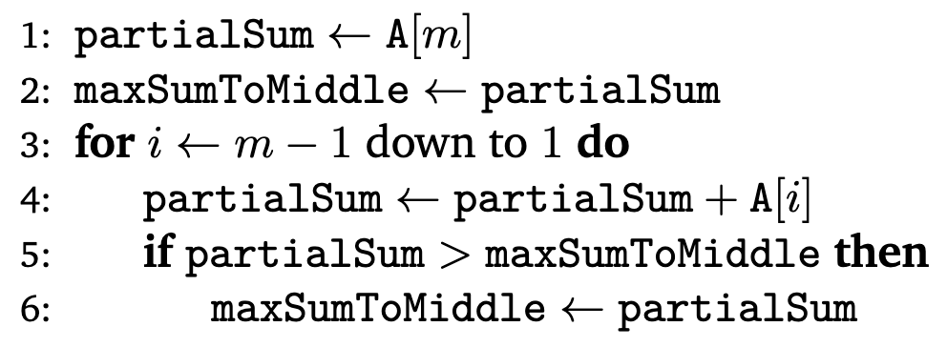
Problem 1 – Maximum subarray sum
Solution

Slide 28
Problem 1 – Maximum subarray sum
Solution
This passes the array by value!
Fine this time because we are doing $O(n)$ work per iteration anyway, but would be bad if we trying to be faster.

Slide 29
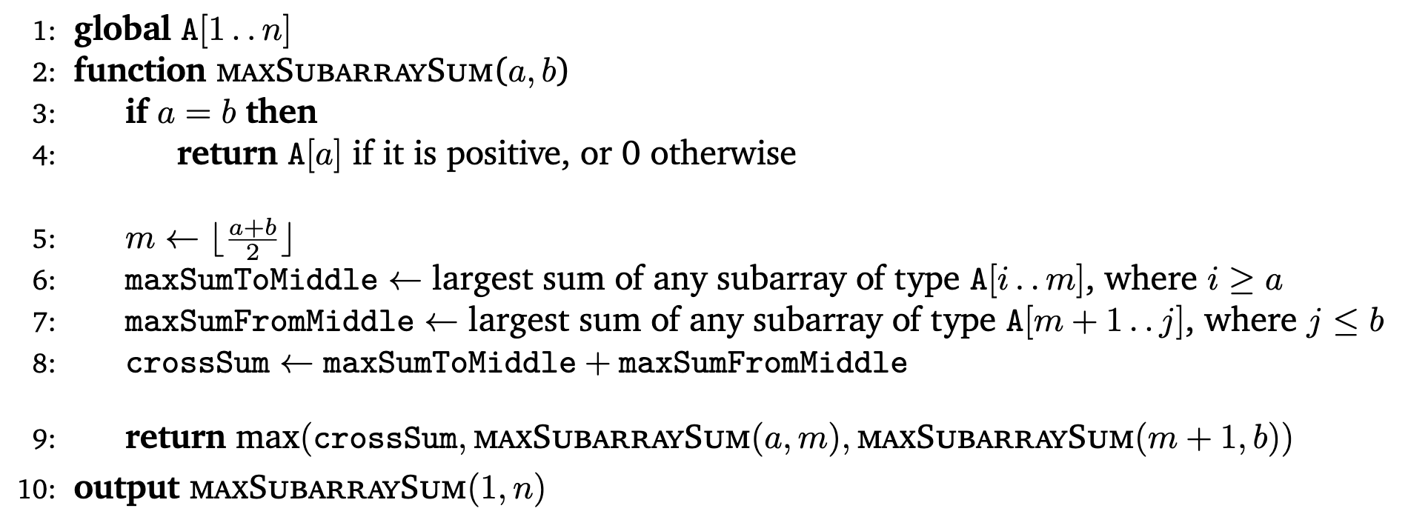
Problem 1 – Maximum subarray sum
Solution
For future reference, we can fix it by using a global variable and passing indices instead, which takes $O(1)$time!

Slide 30
Divide and conquer proofs
Reminders for divide and conquer proofs:
Always use strong induction. Your IH should be: “My core function outputs its expected output for all inputs of size $≤k$.”
The structure can be inspired by your code, which already has a “base case” and “recursive (inductive) step”.
Also, if your code branches on anything (if, max, min, etc.), your proof should have cases based on what kinds of inputs end up at each branch.
You should explain:
Why your output is the expected output, AND
If the input is “X such that Y holds”, explain why Y holds for recursive calls.

Slide 31
Problem 1 – Maximum subarray sum
Write the proof that your pseudocode works.

Slide 32
Problem 1 – Maximum subarray sum
Previous Solution
Write the proof that your pseudocode works.
Feel free to work with the people around you!

Slide 33
Problem 1 – Maximum subarray sum
Solution
BC: The largest subarray sum of a length 1 array is itself if positive, or 0 if negative.
IH: maxSubarraySum returns the maximum subarray sum for all arrays of length $≤k$.
IS: Let A be an array of length $k+1$.
Case 1: The maximum subarray is entirely in the left or right subarray.
By IH, we find this subarray and return it.
Case 2: The maximum subarray crosses from the left to the right.
All subarrays A[i..j] that cross can be divided into A[i..m] and A[m+1..j].
But we know that maxSumToMiddle $≥$ sum(A[i..m]) and similarly maxSumFromMiddle $≥$ sum(A[m+1..j]).
Adding these, crossSum$≥$sum(A[i..j]) for all subarrays A[i..j] that cross, and it certainly represents some subarray, so it is the max subarray sum.

Slide 34
Problem 1 – Maximum subarray sum
Solution
BC: The largest subarray sum of a length 1 array is itself if positive, or 0 if negative.
IH: maxSubarraySum returns the maximum subarray sum for all arrays of length $≤k$.
IS: Let A be an array of length $k+1$.
Case 1: The maximum subarray is entirely in the left or right subarray.
By IH, we find this subarray and return it.
Case 2: The maximum subarray crosses from the left to the right.
All subarrays A[i..j] that cross can be divided into A[i..m] and A[m+1..j].
But we know that maxSumToMiddle $≥$ sum(A[i..m]) and similarly maxSumFromMiddle $≥$ sum(A[m+1..j]).
Adding these, crossSum$≥$sum(A[i..j]) for all subarrays A[i..j] that cross, and it certainly represents some subarray, so it is the max subarray sum.
Note how cases are only inspired by code, not regurgitating code.
The cases are high-level: what kinds of inputs end up at each branch? NOT necessarily the specific criteria you check in code.

Slide 35
Problem 1 – Maximum subarray sum
Solution
BC: The largest subarray sum of a length 1 array is itself if positive, or 0 if negative.
IH: maxSubarraySum returns the maximum subarray sum for all arrays of length $≤k$.
IS: Let A be an array of length $k+1$.
We compute maxSumToMiddle and maxSumFromMiddle, the largest sum of any subarray of type A[i..m] and A[m+1..j], respectively. Then, we add them together to get crossSum, and return the biggest between crossSum, maxSubarraySum(A[1..m]), and maxSubarraySum(A[m+1..n]).
Case 1: crossSum was the biggest.
Since we were asked to return the maximum, we returned it, which was correct.
Case 2: maxSubarraySum(A[1..m]) was the biggest. …
Here is a sample BAD proof:

Slide 36
Problem 1 – Maximum subarray sum
Solution
BC: The largest subarray sum of a length 1 array is itself if positive, or 0 if negative.
IH: maxSubarraySum returns the maximum subarray sum for all arrays of length $≤k$.
IS: Let A be an array of length $k+1$.
We compute maxSumToMiddle and maxSumFromMiddle, the largest sum of any subarray of type A[i..m] and A[m+1..j], respectively. Then, we add them together to get crossSum, and return the biggest between crossSum, maxSubarraySum(A[1..m]), and maxSubarraySum(A[m+1..n]).
Case 1: crossSum was the biggest.
Since we were asked to return the maximum, we returned it, which was correct.
Case 2: maxSubarraySum(A[1..m]) was the biggest. …
Here is a sample BAD proof:
Unnecessarily regurgitates the pseudocode

Slide 37
Problem 1 – Maximum subarray sum
Solution
BC: The largest subarray sum of a length 1 array is itself if positive, or 0 if negative.
IH: maxSubarraySum returns the maximum subarray sum for all arrays of length $≤k$.
IS: Let A be an array of length $k+1$.
We compute maxSumToMiddle and maxSumFromMiddle, the largest sum of any subarray of type A[i..m] and A[m+1..j], respectively. Then, we add them together to get crossSum, and return the biggest between crossSum, maxSubarraySum(A[1..m]), and maxSubarraySum(A[m+1..n]).
Case 1: crossSum was the biggest.
Since we were asked to return the maximum, we returned it, which was correct.
Case 2: maxSubarraySum(A[1..m]) was the biggest. …
Here is a sample BAD proof:
Doesn’t explain why crossSum is bigger than all other subarray sums (only that it’s bigger than the recursive calls).
Also, these cases are low-level criteria copied from the code. It’s possible to make them work, but they will be much wordier.

Slide 38
Problem 1 – Maximum subarray sum
Analyze the running time of your code by solving a recurrence.

Slide 39
Problem 1 – Maximum subarray sum
Previous Solution
Analyze the running time of your code by solving a recurrence.
Feel free to work with the people around you!

Slide 40
Problem 1 – Maximum subarray sum
Solution
Analyze the running time of your code by solving a recurrence.
Lines 5 and 6 take $O(n)$ time each.
Since we then make a recursive call on each half, we have the recurrence:
$$T\left(n\right)=2T\left(\frac{n}{2}\right)+O\left(n\right)$$
By the Master Theorem, this means $T(n)=O(n\log{n})$.

Slide 41
Final thoughts
How to choose between divide and conquer vs. greedy?
Try easy algorithms first, like baselines or greedy.
If easy ones are slow and subproblems seem useful, try divide and conquer.
Sometimes, it will be useful to compute more than what’s asked for.
Examples:
Problem 2 in your section packet
Problem 2 on your homework: today’s problem in $O(n)$! It will guide you.
In this case, your IH should reflect what you actually compute, not what you were asked to compute.
Try the usual thing first, only compute more if it doesn’t work/is too slow.

Slide 42
Summary
First, try an easy but slow baseline algorithm.
Use this to estimate how much time you can take per recursive call, in order to still get an improvement.
Ask yourself: How can I use answers to subproblems to find the full answer?
Keep in mind the cost of copying arrays, and avoid this with global variables.
Prove using strong induction.
Thanks for coming to section this week!

