Slide 1
CSE 421 Section 2
Graph Traversal and Algorithm Proofs

Slide 2
Administrivia

Slide 3
Announcements & Reminders
HW1
Was due yesterday, 1/15
Remember the late problems policy (NOT assignments)
Total of up to 10 late problem days
At most 2 late days per problem
HW2
Due Wednesday 1/22 @ 11:59pm
Don’t wait to start
Pseudocode handout
Read it at home

Slide 4
Warmup: BFS/DFS

Slide 5
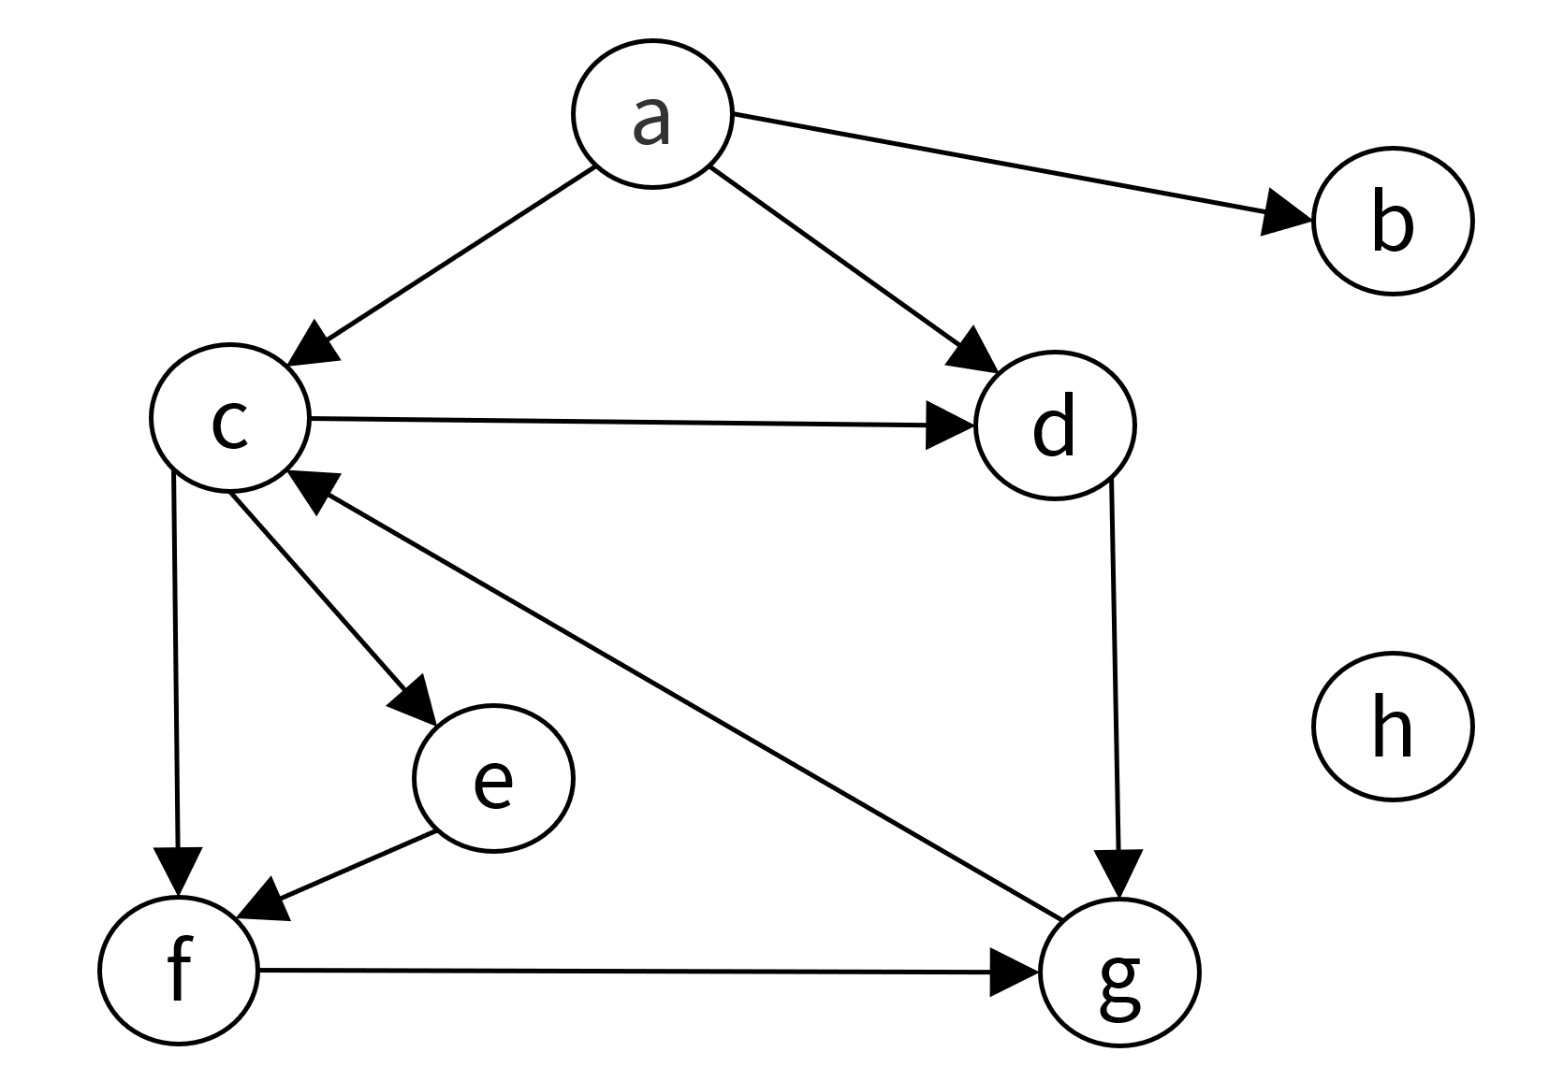
Problem 1 – BFS/DFS review
Run BFS and record the layer of each vertex, starting with $a$ in layer 0.
Run DFS, record the start/end times, and classify the edges. When there are multiple choices for the next vertex, pick the alphabetically earliest one.
Feel free to work with the people around you!

Slide 6
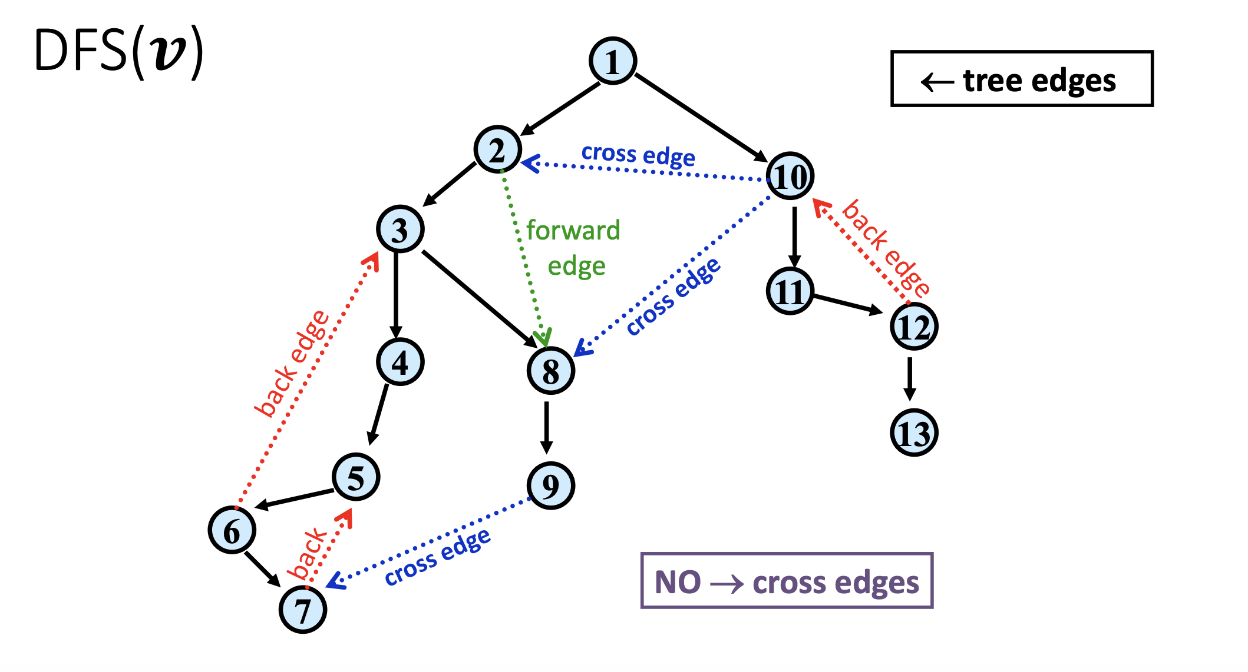
As a reminder...
To track start/end time for a DFS traversal, start at time 1 and increment by one each time a node is visited or finished processing.
Start time: when DFS first visits a node
End time: when DFS finishes processing a node entirely

Slide 7
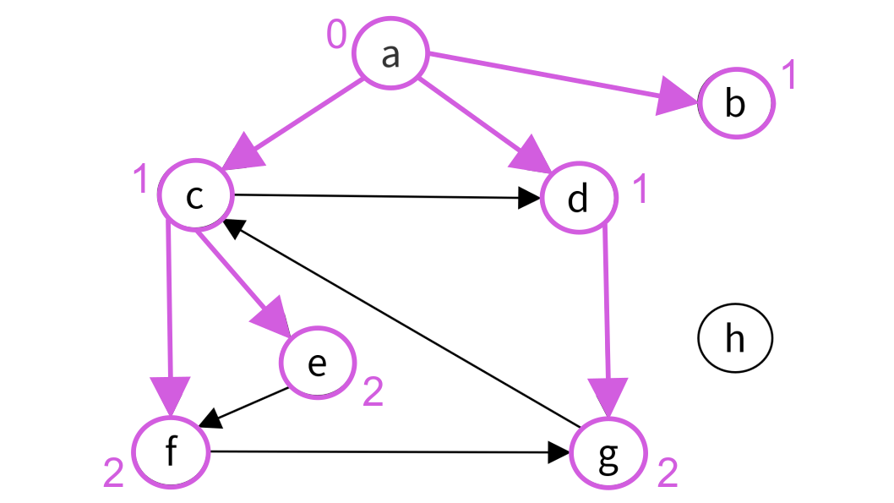
Problem 1 – BFS/DFS review
Solution
Run BFS and record the layer of each vertex, starting with $a$ in layer 0.

Slide 8
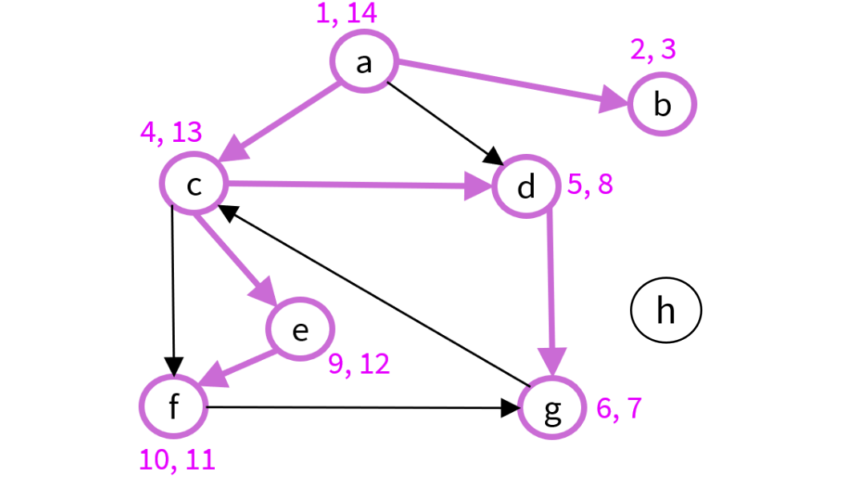
Problem 1 – BFS/DFS review
Solution
Run DFS, record the start/end times, and classify the edges. When there are multiple choices for the next vertex, pick the alphabetically earliest one.
Tree edges: | $(a,b)$, $(a,c)$, $(c,d)$, $(d,g)$, $(c,e)$, $(e,f)$
Back edges: | $$(g,c)$$
Forward edges: | $(a,d)$, $(c,f)$
Cross edges: | $$(f,g)$$

Slide 9
Proving algorithms correct

Slide 10
Problem 2 – Investigating algorithm proofs
The purpose of this problem is to help you:
Figure out how to start a proof about algorithms.
Check the correctness of proofs.
We will take a proof that you have already seen in lecture and critically analyze it to check correctness.

Slide 11
Problem 2 – Investigating algorithm proofs
Dive right in, and we’ll summarize the takeaways afterwards.
Answer the questions embedded in the proof in your packet as you read. They are marked with ▷ and italics.
Discuss with people near you:
What is the general structure of a proof that an algorithm is correct?
How is the proof related to the pseudocode?
Feel free to work with the people around you!

Slide 12
Problem 2 – Investigating algorithm proofs
Solution
​Claim. The algorithm terminates.
​▷ What quantity increases every iteration, but is bounded? Why does it increase? Refer to particular line(s) in the code.
​​▷ Conclude that there are a bounded number of iterations.
$|R|$increases every iteration, and is bounded by $|V|$.
In every iteration, we add $v$ to $R$ (line 3) where $v∉R$ (line 2),
and never remove elements from $R$.
There can be at most $|V|$ iterations, by above.

Slide 13
Problem 2 – Investigating algorithm proofs
Solution
​Claim. At termination, $v∈R$ iff there exists a path from $s$ to $v$.
​(⇒) Claim. If $v∈R$, then there exists a path from $s$ to $v$.
▷ Prove this fact. Refer to particular line(s) in the code.
By induction on iterations.
BC: By (line 1), before the first iteration, $R=\{s\}$, and there is a path from $s$ to $s$.
IH: Before/after every iteration, if $v∈R$, then there exists a path from $s$ to $v$.
IS: Assume IH at start of this iteration.
In current iteration, because $u∈R$ (line 2), there is a path from $s$ to $u$ by IH.
Because $\{u,v\}∈E$ (line 2), we get a path from $s$ to $v$.
We only add $v$ to $R$ (line 3), so IH is true at end of this iteration.

Slide 14
Problem 2 – Investigating algorithm proofs
Solution
​(⇐) Claim. If there exists a path from $s$ to $v$, then $v∈R$.
Suppose for contradiction $w∉R$, but there is a path from $P$ from $s$ to $w$.
In this case, we may take $v$ to be the first node on $P$ such that $v∉R$. ▷ Why is this allowed?
If there are multiple of any object, we can always look at the first one.
$$s$$
$$v$$
$$w$$
Common technique!
$$R$$

Slide 15
Problem 2 – Investigating algorithm proofs
Solution
The predecessor $u$ of $v$ in $P$ satisfies $u∈R$ and $\{u,v\}∈E$. ▷ Why does the predecessor exist? Refer to particular line(s) in the code. Why is $u∈R$ and $\{u,v\}∈E$?
Predecessor exists because $v≠s$, as $v∉R$ but $s∈R$.
To show $s∈R$ at loop end, formally induction on iterations:
BC: $R=\{s\}$ before first iteration by (line 1).
IH: $s∈R$ before/after every iteration.
IS: We never remove vertices from $R$, so IH is true at end of iteration.
Lastly, $u∈R$ because $v$ was first vertex not in $R$, and $\{u,v\}∈E$ because $u$ is the predecessor of $v$.

Slide 16
Problem 2 – Investigating algorithm proofs
Solution
This is a contradiction. ▷ What is the contradiction? Refer to particular line(s) in the code.
▷ Is it possible to directly prove this claim by induction on iterations, as you did for the ⇒ direction, instead of contradiction?
We found $u$ and $v$ such that $u∈R$, $v∉R$, and $\{u,v\}∈E$.
Contradicts loop exit condition in (line 2).
No, the claim “If there exists a path from $s$ to $v$, then $v∈R$.” is not true until the loop exits.

Slide 17
Problem 2 – Investigating algorithm proofs
A loop invariant is a property that is true before, during, and after the loop.
They are very useful!
Formally prove with induction, but you can omit proof on HW/exams if trivial.
Examples:
If $v∈R$, then there exists a path from $s$ to $v$.
$s∈R$.
Non-examples:
If there exists a path from $s$ to $v$, then $v∈R$.
Only true after loop end, so need to use loop exit condition to prove.

Slide 18
Problem 2 – Investigating algorithm proofs
The structure of an algorithm proof
Validity:
Make sure that every line is possible, may require ad-hoc methods.
Termination (if you have while-loops):
Find a measure of progress that increases/decreases every iteration, but is bounded by the problem setup.
Correctness:
Start with “We will show that the output matches the desired result,” then unwrap definitions.
Combine loop invariants and the loop exit condition to prove results.
Prove invariants by induction, if non-obvious.

Slide 19
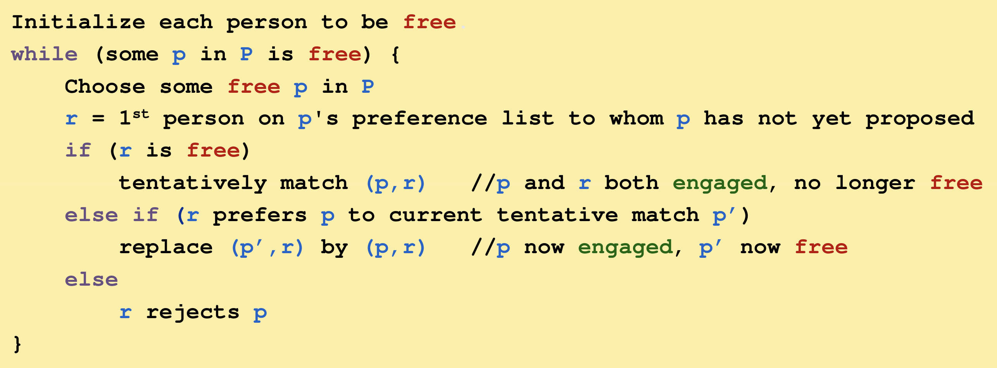
Problem 2 – Investigating algorithm proofs
Validity was obvious in our case, but not all algorithms.
existence not obvious!

Slide 20
Problem 2 – Investigating algorithm proofs
How to solve HW problems
Think of an algorithm (we’ll give more tips for this next section)
Prove its validity, termination, and correctness as in the last slide.
Write the same level of detail as in sections/lectures.
Just for yourself, expand the details like we did today to check that it’s correct.
If you can’t, your TAs probably can’t either (and will mark your proof as wrong or incomplete).
Go back to step 1 or step 2 and try again.
Remember, if your algorithm is wrong, it’s impossible to prove it to be correct!

Slide 21
Applications of graph algorithms

Slide 22
Tips for algorithms with graphs
Ask yourself the following questions:
What are the vertices?
What are the edges?
What am I looking for in the graph?

Slide 23
Problem 3 – Water jugs
You have a 5-gallon jug and 3-gallon jug, which start out empty. Your goal is to have 4 gallons of water in the 5-gallon jug and 0 gallons of water in the 3-gallon jug. Unfortunately, you are only allowed the following operations:
Fill any of your jugs completely.
Pour one of your jugs into the other, until the first jug is empty or the second is full.
Empty out all the water in a jug.
Describe a method to reach the goal. (No need to use any general algorithm yet, just solve the puzzle however you like.)
Feel free to work with the people around you.

Slide 24
Problem 3 – Water jugs
Solution
Describe a method to reach the goal. (No need to use any general algorithm yet, just solve the puzzle however you like.)
Let $(m, n)$ denote $m$ gallons in the 5-gallon jug and $n$ gallons in the 3-gallon jug.
(0, 0) → (5, 0) → (2, 3) → (2, 0) → (0, 2) → (5, 2) → (4, 3) → (4, 0)
OR
(0, 0) → (0, 3) → (3, 0) → (3, 3) → (5, 1) → (0, 1) → (1, 0) → (1, 3) → (4, 0)
or other solutions.

Slide 25
Problem 3 – Water jugs
Solve with a graph algorithm and state the running time (no proof during section):
Input: Jug sizes $a$ and $b$, with target amounts $x$ and $y$, respectively.
Expected output: The minimum number of steps to reach the target amount, or “unreachable”.
What are the vertices?
What are the edges?
What am I looking for in the graph?
Feel free to work with the people around you.

Slide 26
Problem 3 – Water jugs
Solution
Solve with a graph algorithm and state the running time (no proof during section):
Input: Jug sizes $a$ and $b$, with target amounts $x$ and $y$, respectively.
Expected output: The minimum number of steps to reach the target amount, or “unreachable”.
What are the vertices?
What are the edges?
What am I looking for in the graph?
pairs $(m,n)$ of the current amounts in each jug
all allowed steps in the problem
length of shortest path $(0, 0)$to $(x,y)$
or “unreachable”

Slide 27
Problem 3 – Water jugs
Solution
Algorithm:
Construct a graph $G=(V, E)$where $V$ is a list of all pairs $(m,n)$ for $0≤m≤a$ and $0≤n≤b$, and $E$ is all possible transitions according to the rules.
Use BFS to compute the shortest path from $(0, 0)$to $(x,y)$ and output it, or “unreachable” if BFS terminates before reaching $(x,y)$.
Running time:
BFS runs in $Θ(|V|+|E|)$, where $|V|=(a+1)(b+1)$ and $|E|≤6|V|$ (since there are 3 types of transitions from every state, which you can do with either jug). Thus, $Θ(ab)$.
Extra: Can you tweak this solution to be a bit faster?

Slide 28
Problem 3 – Water jugs
Solution
Slight improvement!
Notice that all transitions result in one of the jugs being full or empty.
Algorithm:
Construct a graph $G=(V, E)$where $V$ is a list of all pairs $(0,n)$, $(a,n)$, $(m,0)$, $(m,b)$ for $0≤m≤a$ and $0≤n≤b$, and $E$ is all possible transitions according to the rules.
Use BFS to compute the shortest path from $(0, 0)$to $(x,y)$ and output it, or “unreachable” if BFS terminates before reaching $(x,y)$ or $(x,y)$ is not in the graph.
Running time:
BFS runs in $Θ(|V|+|E|)$, where $\left|V\right|=2\left(a+1\right)+2(b+1)$ and $|E|≤6|V|$ (since there are 3 types of transitions from every state, which you can do with either jug). Thus, $Θ(a+b)$.

Slide 29
Problem 4 – Judging books
You have a large collection of books and want to arrange them by color. You wish to put only books of a single color on any given shelf. Every pair of books is either “same color” or “not same color”, and this relation is an equivalence relation (reflexive, symmetric, and transitive).
Input: A list of books, and a list of pairs that are the same color
Expected output: The best upper bound on the number of shelves you will need
Example input: books $u$, $v$, $w$, $x$, and pairs $(u,v)$, $(v, w)$
Output: 2

Slide 30
Problem 4 – Judging books
Input: A list of books, and a list of pairs that are the same color
Expected output: The best upper bound on the number of shelves you will need
What are the vertices?
What are the edges?
What am I looking for in the graph?
Feel free to work with the people around you.

Slide 31
Problem 4 – Judging books
Solution
Input: A list of books, and a list of pairs that are the same color
Expected output: The best upper bound on the number of shelves you will need
What are the vertices?
What are the edges?
What am I looking for in the graph?
books
pairs that are the same color
number of connected components

Slide 32
Problem 4 – Judging books
You have a large collection of books and want to arrange them by color. You wish to put only books of a single color on any given shelf. Every pair of books is either “same color” or “not same color”, and this relation is an equivalence relation (reflexive, symmetric, and transitive).
Input: A list of books, and a list of pairs that are the same color
Expected output: The best upper bound on the number of shelves you will need
Now write the algorithm (two sentences) and think about the proof.
Feel free to work with the people around you.

Slide 33
Problem 4 – Judging books
Solution
Algorithm:
Construct a graph $G=(V, E)$where $V$ is the list of books and $E$ is the list of pairs.
Use BFS or DFS to compute the number of connected components and output it.
Proof:
Termination is clear, and all lines are valid.
We will show that the number of connected components is the best upper bound on the number of shelves needed.
Is an upper bound
All upper bounds are at least this big
Purely 311-type claim, no algorithm needed —
can rely on knowledge that B/DFS computes # conn. comp.

Slide 34
Problem 4 – Judging books
Solution
The number of connected components is an upper bound.
Give each connected component its own shelf.
Because “same color” is transitive, if there is a path from $u$ to $v$, then $u$ and $v$ are the same color (formally by induction).
Thus, it was valid to put them on the same shelf.
All upper bounds are at least the number of connected components.
The input is compatible with the situation where every connected component has books of different colors.
Thus, every upper bound must output at least the number of connected components.

Slide 35
Last note on applying graph algorithms
In section today, we saw two examples of directly calling a graph algorithm, as if it were a library function.
Sometimes, in other problems, you might need to reimplement a graph algorithm and tweak a line or two to solve the problem.

Slide 36
Summary
For algorithms, prove validity, termination, and correctness.
Make sure that you can expand all details in your head.
Find a measure of progress to prove termination.
Start with “We will show that the output matches the desired result,” then expand definitions, use observations that are true in every iteration, and use the loop exit condition to prove correctness.
Model problems using graphs, then apply or tweak algorithms like BFS/DFS/etc.
Thanks for coming to section this week!

