Slide 1
CSE 421 Section 1
Stable Matchings and Proofs Workshop

Slide 2
Administrivia and introductions

Slide 3
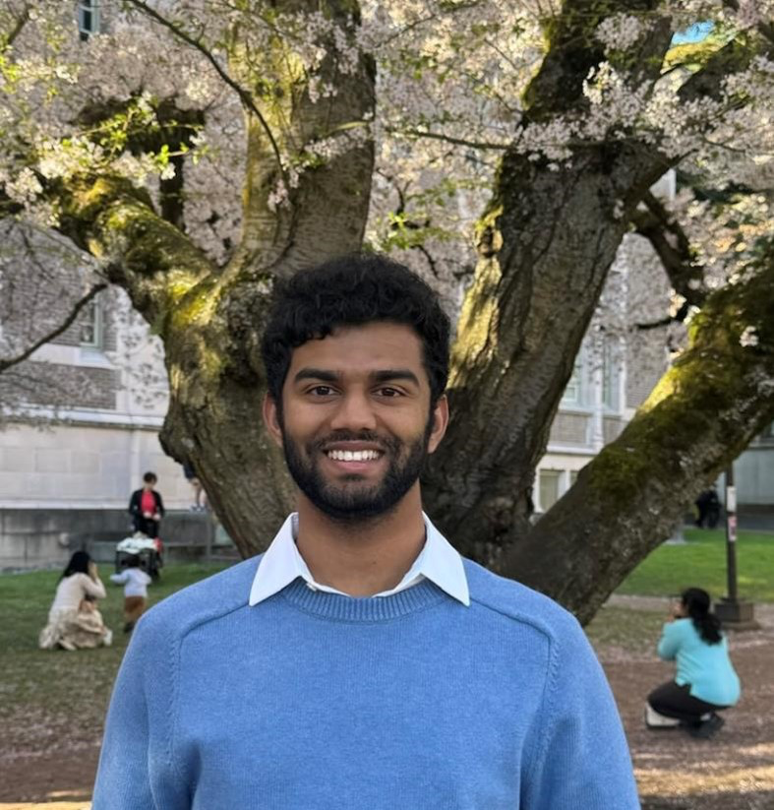
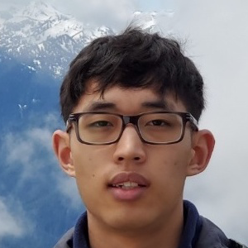
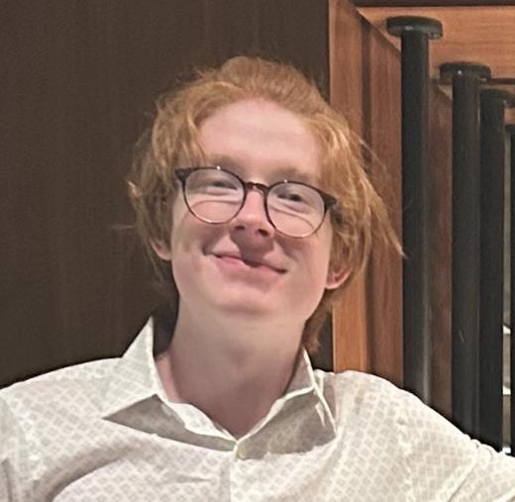
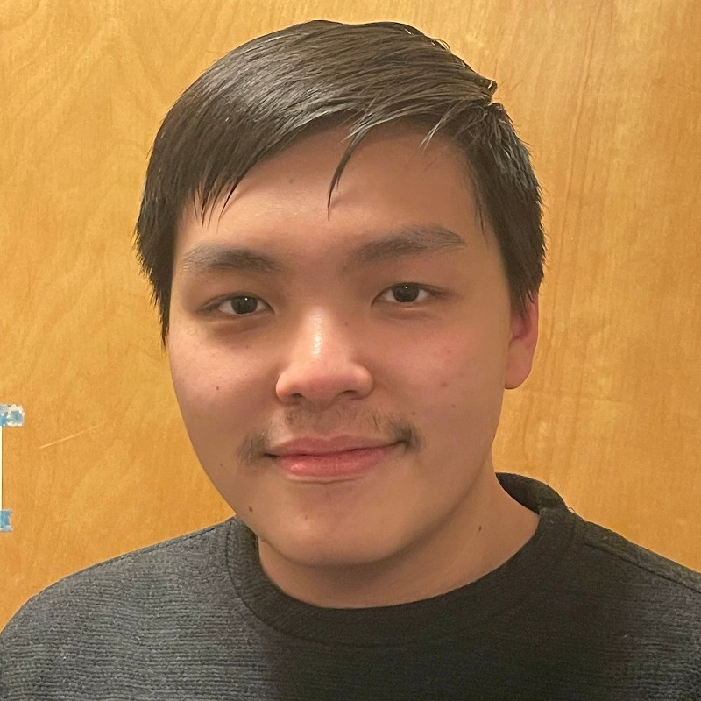
Your Section TAs
Runs your section
Default TA for general questions
All Course TAs
Homework/exam grading
Office hours and Ed questions
TA1 photo here
TA2 photo here
Ajay Harilal
Edward Qin
Glenn Sun
Paul Han
TA1 name
[TA1 Email]@cs.washington.edu
OH: [time/day/location]
TA2 name
[TA2 Email]@cs.washington.edu
OH: [time/day/location]
Owen Boseley
Jonathan Ly
Grant Tannert
Weizi Wu
Atri Banerjee
Robert Stevens

Slide 4
Announcements
Section materials
Handouts will be provided in each section
Solutions and slides on course webpage the evening after section
HW1
Due Wednesday, 1/15 @ 11:59pm

Slide 5
Homework
LaTeX (preferred) | Google Docs/Word | Handwritten
overleaf.com Template available Ask us for syntax help | Use equation editor for math and variables | Write neatly Great for diagrams Use B/W scanning app
No matter what format…
Turn in via Gradescope
Due Wednesdays at 11:59pm (except midterm day)
Late problems policy (NOT assignments)
Up to 10 total problem late days
Use up to 2 late days per problem
Each part of a late day counts as a day

Slide 6
Stable matchings

Slide 7
Stable matching problem
Input: Two sets $P$ and $R$ of $n$ people each, with each person having a preference list for members of the other group
Output: A stable matching between the two groups
Stable matching: perfect matching with no unstable pairs
everyone matched to exactly one person from other group
two people who prefer each other to their current matches

Slide 8
Gale–Shapley algorithm
We call $P$ the proposers and $R$ the receivers.
Initialize the status of all $p∈P$and $r∈R$to free.
While there is a free $p∈P$,
Let $r$ be the highest person on $p$’s list that $p$ has not yet proposed to.
If $r$ is free,
Match $p$ and $r$.
Otherwise, if $r$ prefers $p$ over their current match $p’$,
Unmatch $p’$ and $r$.
Match $p$ and $r$.

Slide 9
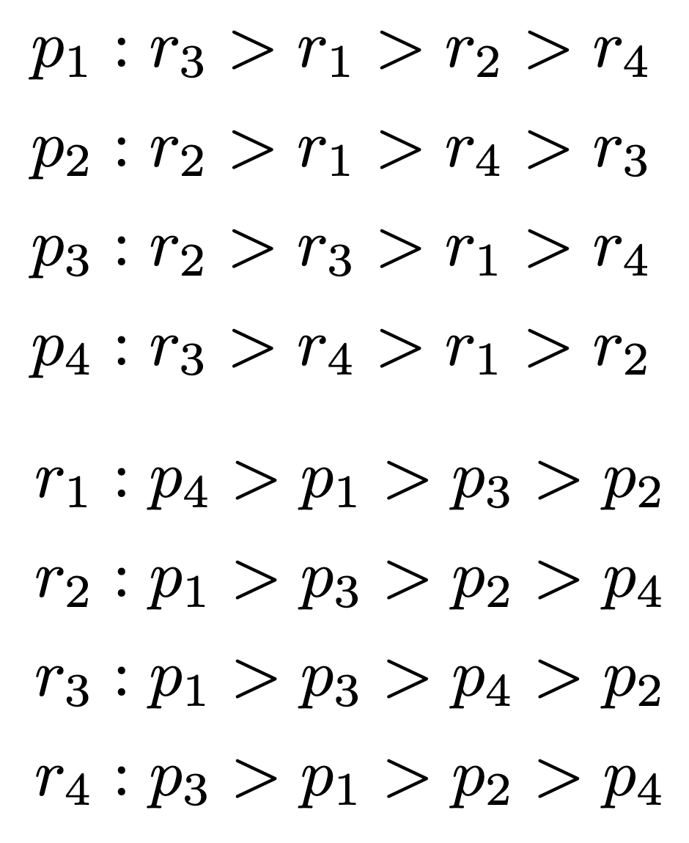
Problem 1 – Gale–Shapley review
Initialize the status of all $p∈P$and $r∈R$to free.
While there is a free $p∈P$,
Let $r$ be the highest person on $p$’s list that $p$ has not yet proposed to.
If $r$ is free,
Match $p$ and $r$.
Otherwise, if $r$ prefers $p$ over their current match $p’$,
Unmatch $p’$ and $r$.
Match $p$ and $r$.
Run the Gale–Shapley algorithm on the instance shown. When multiple $p_{i}$ are free to propose, choose the one with the smallest index (e.g., if $p1$ and $p2$ are both free, have $p1$ propose).
Taking 8 volunteers!

Slide 10
Problem 1 – Gale–Shapley review
Solution
Run the Gale–Shapley algorithm on the instance shown. When multiple $p_{i}$ are free to propose, choose the one with the smallest index (e.g., if $p1$ and $p2$ are both free, have $p1$ propose).
$p1$ chooses $r3$ $(p1, r3)$
$p2$ chooses $r2$ $(p1, r3), (p2, r2)$
$p3$ chooses $r2$ $(p1, r3), (p2, r2), (p3, r2)$
$p2$ chooses $r1$ $(p1, r3), (p2, r1), (p3, r2)$
$p4$chooses $r3$ $\left(p1, r3\right), \left(p2, r1\right), \left(p3, r2\right),(p4, r3)$ fails
$p4$ chooses $r4$ $(p1, r3), (p2, r1), (p3, r2), (p4, r4)$

Slide 11
Problem 1 – Gale–Shapley review
Initialize the status of all $p∈P$and $r∈R$to free.
While there is a free $p∈P$,
Let $r$ be the highest person on $p$’s list that $p$ has not yet proposed to.
If $r$ is free,
Match $p$ and $r$.
Otherwise, if $r$ prefers $p$ over their current match $p’$,
Unmatch $p’$ and $r$.
Match $p$ and $r$.
What if you default to the one with the largest index? Does the answer change?
What if the $r_{i}$ propose instead of the $p_{i}$? Does the answer change?

Slide 12
Problem 1 – Gale–Shapley review
Solution
Initialize the status of all $p∈P$and $r∈R$to free.
While there is a free $p∈P$,
Let $r$ be the highest person on $p$’s list that $p$ has not yet proposed to.
If $r$ is free,
Match $p$ and $r$.
Otherwise, if $r$ prefers $p$ over their current match $p’$,
Unmatch $p’$ and $r$.
Match $p$ and $r$.
What if you default to the one with the largest index? Does the answer change?
What if the $r_{i}$ propose instead of the $p_{i}$? Does the answer change?
No change!
Different result!
Turns out, (b) is always true! (You saw this in lecture yesterday).

Slide 13
Problem 1 – Gale–Shapley review
Solution
What if the $r_{i}$ propose instead of the $p_{i}$? Does the answer change?
$r1$ chooses $p4$ $(p4, r1)$
$r2$ chooses $p1$ $(p1, r2),(p4, r1)$
$r3$ chooses $p1$ $(p1, r3),(p1, r2),(p4, r1)$
$r2$ chooses $p3$ $(p1, r3),(p3, r2),(p4, r1)$
$r4$ chooses $p3$ $(p1, r3),(p3, r2),(p4, r1),(p3, r4)$ fails
$r4$chooses $p1$ $(p1, r3),(p3, r2),(p4, r1),(p1, r4)$fails
$r4$ chooses $p2$ $(p1, r3),(p2, r4),(p3, r2),(p4, r1)$

Slide 14
Problem 1 – Gale–Shapley review
Solution
What if you default to the one with the largest index? Does the answer change?
$p4$ chooses $r3$ $(p4, r3)$
$p3$chooses $r2$ $(p3, r2),(p4, r3)$
$p2$ chooses $r2$ $(p3, r2),(p4, r3),(p2, r2)$ fails
$p2$ chooses $r1$ $(p2, r1),(p3, r2),(p4, r3)$
$p1$ chooses $r3$ $(p1, r3),(p2, r1),(p3, r2),(p4, r3)$
$p4$chooses $r4$ $(p1, r3),(p2, r1),(p3, r2),(p4, r4)$

Slide 15
Problem 2 – Number of stable matchings
We saw an instance of stable matching with two stable matchings.
Is there an instance with more than two? Give example (if yes) or proof (if no).
Take 3 minutes to brainstorm with the people around you, then we’ll discuss.

Slide 16
Problem 2 – Number of stable matchings
Solution
Is there an instance with more than two? Give example (if yes) or proof (if no).
Try smaller examples. What’s an easy instance with two stable matchings?
$$A:1>2$$
$$B:2>1$$
$$1:B>A$$
$$2:A>B$$
both matchings stable
A
1
A
1
B
2
B
2

Slide 17
Problem 2 – Number of stable matchings
Solution
Is there an instance with more than two? Give example (if yes) or proof (if no).
Now generalize to three. One possible solution:
$$A:1>2>3$$
$$B:2>3>1$$
$$C:3>1>2$$
$$1:B>C>A$$
$$2:C>A>B$$
$$3:A>B>C$$
A
1
A
1
B
2
B
2
C
3
C
3
A
1
B
2
C
3

Slide 18
Problem 2 – Number of stable matchings
Alternative Solution
Is there an instance with more than two? Give example (if yes) or proof (if no).
Now generalize to four. One possible solution:
$$A:1>2>3>4$$
$$B:2>1>3>4$$
$$C:3>4>1>2$$
$$D:4>3>1>2$$
$$1:B>A>C>D$$
$$2:A>B>C>D$$
$$3:D>C>A>B$$
$$4:C>D>A>B$$
A
1
A
1
A
1
A
1
B
2
B
2
B
2
B
2
C
3
C
3
C
3
C
3
D
4
D
4
D
4
D
4

Slide 19
Proof-writing workshop

Slide 20
Graph theory review
degree: number of edges connected to a vertex
path (walk): list of vertices $v_{1},v_{2},…,v_{k}$ such that each $\{v_{i}, v_{i+1}\}$ is an edge
for directed graphs, $(v_{i}, v_{i+1})$
cycle (closed walk): path with same first and last vertex
simple path (path): path with all distinct vertices
simple cycle (cycle): cycle with all distinct vertices, except first/last
connected: there is a path between any two vertices
tree: connected acyclic (no cycles) graph
rooted tree: tree with a designated vertex called the root
Note that “parent” and “child” are not defined unless the tree is rooted!

Slide 21
Problem 3 – Proof-writing workshop
In this problem, you will read many proofs of the following claim:
Claim. Every tree with at least 2 vertices has at least 2 vertices of degree 1.
a) First, take 3 minutes to think about the problem yourself. How would you prove it?

Slide 22
Problem 3 – Proof-writing workshop
Qualities of a good proof
Correct | Complete | Concise | Clear
No false statements | Claims justified Hypotheses used Notation defined | No excessive details No unnecessary notation | Main ideas are evident Good stylistic choices
b) Read Sample Solution 1. Discuss with people around you —
is it clear, complete, concise, clear? What would you change?

Slide 23
Problem 3 – Proof-writing workshop
Qualities of a good proof
Correct | Complete | Concise | Clear
No false statements | Claims justified Hypotheses used Notation defined | No excessive details No unnecessary notation | Main ideas are evident Good stylistic choices
b) Read Sample Solution 2. Discuss with people around you —
is it clear, complete, concise, clear? What would you change?

Slide 24
Problem 3 – Proof-writing workshop
Qualities of a good proof
Correct | Complete | Concise | Clear
No false statements | Claims justified Hypotheses used Notation defined | No excessive details No unnecessary notation | Main ideas are evident Good stylistic choices
b) Read Sample Solution 3. Discuss with people around you —
is it clear, complete, concise, clear? What would you change?

Slide 25
Problem 3 – Proof-writing workshop
Qualities of a good proof
Correct | Complete | Concise | Clear
No false statements | Claims justified Hypotheses used Notation defined | No excessive details No unnecessary notation | Main ideas are evident Good stylistic choices
b) Read Sample Solution 4. Discuss with people around you —
is it clear, complete, concise, clear? What would you change?

Slide 26
Summary
When stuck, look for small examples.
When writing a proof, revise it to be correct, complete, concise, and clear.
Thanks for coming to section this week!

