Slide 1
CSE 421 Section 10
Final Review

Slide 2
Announcements & Reminders
HW8
Due tomorrow, June 6
Final exam next week!

Slide 3
Final exam format
Similar to midterm exam, but longer
120 minutes
You may bring one sheet of double sided 8.5x11” paper containing your own handwritten notes.
Must write name, student number, and UW NetID
Must turn in with exam

Slide 4
Today’s plan
(35 min) 6 problems (focused on second half of course, but exam is cumulative)
Station 1: Short answer
Station 2: Dynamic programming*
Station 3: Network flow
Station 4: Linear programming*
Station 5: Reduction
Station 6: Bonus problem
(10 min) Go over some of these problems
*this problem was an extra problem on a previous section handout

Slide 5
Problems
1
2
3
4
5
6

Slide 6
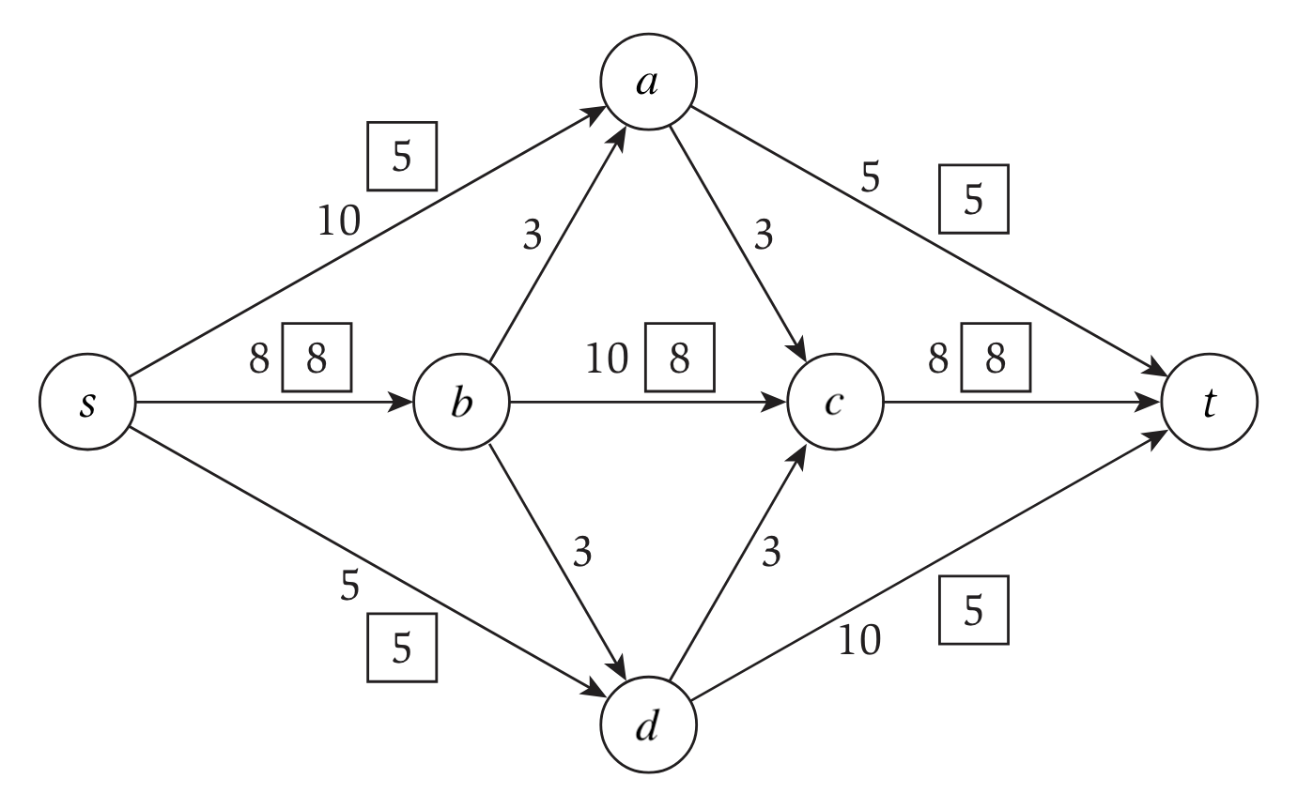
Problem 1 – Short answer
In the network flow below, is the depicted flow a maximum flow?

Slide 7
Problem 1 – Short answer
Solution
In the network flow below, is the depicted flow a maximum flow?
Not maximum.
8/10
3/3
5/10
3/3
can push 3 more units
8/10
(you were not required to calculate the new flow, it’s just here for reference)

Slide 8
Problem 1 – Short answer
Recall Interval Scheduling: Given a collection of intervals and an integer $k$, determine if the collection contains at least $k$ nonoverlapping intervals.
Does Interval Scheduling $≤_{p}$ Vertex Cover?

Slide 9
Problem 1 – Short answer
Solution
Recall Interval Scheduling: Given a collection of intervals and an integer $k$, determine if the collection contains at least $k$ nonoverlapping intervals.
Does Interval Scheduling $≤_{p}$ Vertex Cover?
Yes. Many possible reasons:
Vertex Cover is NP-complete, in particular NP-hard, and Interval Scheduling is clearly in NP (the certificate is the list of $k$ nonoverlapping intervals). $A≤_{p}B$ whenever $B$ is NP-hard and $A$ is in NP.
Interval Scheduling is in P, as we solved it with a greedy algorithm earlier in this class. $A≤_{p}B$ is always true when $A$ is in P.

Slide 10
Problem 1 – Short answer
Recall Interval Scheduling: Given a collection of intervals and an integer $k$, determine if the collection contains at least $k$ nonoverlapping intervals.
Does Independent Set $≤_{p}$ Interval Scheduling ?

Slide 11
Problem 1 – Short answer
Solution
Recall Interval Scheduling: Given a collection of intervals and an integer $k$, determine if the collection contains at least $k$ nonoverlapping intervals.
Does Independent Set $≤_{p}$ Interval Scheduling ?
Unknown. Because Independent Set is NP-complete and Interval Scheduling is in P, Independent Set $≤_{p}$ Interval Scheduling would imply that an NP-complete problem is solvable in polynomial time, which is unknown.

Slide 12
Problem 1 – Short answer
A greedy attempt at Set Cover is:
while there exists an uncovered object do
choose a set that covers the most number of still-uncovered objects
Suppose you are given an instance where every set contains exactly 2 elements. Then this algorithm returns a set cover that is at most a factor 2 larger than the minimum.

Slide 13
Problem 1 – Short answer
Solution
A greedy attempt at Set Cover is:
while there exists an uncovered object do
choose a set that covers the most number of still-uncovered objects
Suppose you are given an instance where every set contains exactly 2 elements. Then this algorithm returns a set cover that is at most a factor 2 larger than the minimum.
True. If there are $n$ objects, the algorithm returns at most $n$ sets because every set chosen contains at least 1 new object. Since every object must be covered, and every set contains only 2 elements, we require $n/2$ sets. Thus the approximation ratio is 2.
Return to problem select

Slide 14
Problem 2 – Dynamic programming
Given two strings, $s=s_{1},…,s_{m}$ with length $m$ and $t=t_{1},…,t_{n}$ with length $n$, find the length of their longest common subsequence.

Slide 15
Problem 2 – Dynamic programming
Solution
Given two strings, $s=s_{1},…,s_{m}$ with length $m$ and $t=t_{1},…,t_{n}$ with length $n$, find the length of their longest common subsequence.
Let $OPT(i,j)$ be the longest common subsequence between $s_{1},…,s_{i}$ and $t_{1},…,t_{j}$.
$$OPT\left(i,j\right)=\left\{\begin{aligned}1+OPT(i−1,j−1) \\ &max⁡(OPT\left(i−1, j\right), OPT\left(i,j−1\right)) \end{aligned}{if s_{i}=t_{j} \atop if s_{i}≠t_{j}}\right.$$
The base cases are $OPT\left(i,0\right)=OPT\left(0,j\right)=0$ for all $i$ and $j$.
Return to problem select

Slide 16
Problem 3 – Network flows
The bank has $C_{j}$ of currency $j$, and the exchange rate is $R_{j}$ of currency $j$ for every 1 Franc. Trader $i$ has $T_{i}$ Francs to convert and is willing to convert between $L_{ij}$ and $H_{ij}$ of their Francs to currency $j$. Determine if the bank can satisfy all requests, and if so, how to maximize the amount of Francs it collects.

Slide 17
Problem 3 – Network flows
Solution
Determine if the bank can satisfy all requests, and if so, how to maximize the amount of Francs it collects.
First, give all traders their minimum request: check if $C_{j}/R_{j}≥\sum_{i}{L_{ij}}$ for all $j$. Then,
$$H_{ij}−L_{ij}$$
$T_{i}−\sum_{j}{L_{ij}}$
$C_{j}/R_{j}−\sum_{i}{L_{ij}}$
$$s$$
$$t$$
traders
currencies
bank
Return to problem select

Slide 18
Problem 4 – Linear programming
There are $k$ groups and $m_{i}$ voters in group $i$, of which $a_{i}$ are already voting for you. If you spend $1000 advertising issue $j$, then $d_{ij}$ more voters in group $i$ will vote for you. Determine the minimum spending so that at least half of each group votes for you.

Slide 19
Problem 4 – Linear programming
Solution
There are $k$ groups and $m_{i}$ voters in group $i$, of which $a_{i}$ are already voting for you. If you spend $1000 advertising issue $j$, then $d_{ij}$ more voters in group $i$ will vote for you. Determine the minimum spending so that at least half of each group votes for you.
Let $x_{j}$ be the amount of money, in thousands, spent on issue $j$.
$$minimize x_{1}+…+x_{n} \\ subject to d_{i1}x_{1}+…+d_{in}x_{n}+a_{i}≥\frac{m_{i}}{2} for all i \\ x_{j}≥0 for all j$$

Slide 20
Problem 4 – Linear programming
Solution
There are $k$ groups and $m_{i}$ voters in group $i$, of which $a_{i}$ are already voting for you. If you spend $1000 advertising issue $j$, then $d_{ij}$ more voters in group $i$ will vote for you. Determine the minimum spending so that at least half of each group votes for you.
Let $x_{j}$ be the amount of money, in thousands, spent on issue $j$.
$$maximize −x_{1}−…−x_{n} \\ subject to −d_{i1}x_{1}−…−d_{in}x_{n}≤a_{i}−\frac{m_{i}}{2} for all i \\ x_{j}≥0 for all j$$
Return to problem select

Slide 21
Problem 5 – Reduction
A Hamiltonian path/cycle is a path/cycle that visits every vertex exactly once. Suppose that HamiltonianPath is NP-hard. Show that HamiltonianCycle is NP-hard.

Slide 22
Problem 5 – Reduction
Solution
A Hamiltonian path/cycle is a path/cycle that visits every vertex exactly once. Suppose that HamiltonianPath is NP-hard. Show that HamiltonianCycle is NP-hard.
We show HamiltonianPath $≤_{p}$ HamiltonianCycle. Consider any input for HamiltonianPath. Create the following graph for HamiltonianCycle:

Slide 23
Problem 5 – Reduction
Solution
A Hamiltonian path/cycle is a path/cycle that visits every vertex exactly once. Suppose that HamiltonianPath is NP-hard. Show that HamiltonianCycle is NP-hard.
To prove, convert certificate for HamPath to certificate for HamCycle.

Slide 24
Problem 5 – Reduction
Solution
A Hamiltonian path/cycle is a path/cycle that visits every vertex exactly once. Suppose that HamiltonianPath is NP-hard. Show that HamiltonianCycle is NP-hard.
To prove, convert certificate for HamPath to certificate for HamCycle.
two new blue edges exist by construction, form the cycle

Slide 25
Problem 5 – Reduction
Solution
A Hamiltonian path/cycle is a path/cycle that visits every vertex exactly once. Suppose that HamiltonianPath is NP-hard. Show that HamiltonianCycle is NP-hard.
To convert back, consider any Hamiltonian cycle in the graph we created.

Slide 26
Problem 5 – Reduction
Solution
A Hamiltonian path/cycle is a path/cycle that visits every vertex exactly once. Suppose that HamiltonianPath is NP-hard. Show that HamiltonianCycle is NP-hard.
To convert back, consider any Hamiltonian cycle in the graph we created.
removing these edges gives a Hamiltonian path
Return to problem select

Slide 27
Problem 6 – Bonus problem
In a country with $n$ states and $p_{i}$ people voting in state $i$, the winner of state $i$ receives $v_{i}$ electoral college votes. In a two-candidate election with no state-level ties, determine the minimum percent of the total popular vote necessary to win at least $V=\left\lfloor \left(\sum_{i}{v_{i}}\right)/2\right\rfloor +1$ electoral votes.

Slide 28
Problem 6 – Bonus problem
Solution
In a country with $n$ states and $p_{i}$ people voting in state $i$, the winner of state $i$ receives $v_{i}$ electoral college votes. In a two-candidate election with no state-level ties, determine the minimum percent of the total popular vote necessary to win at least $V=\left\lfloor \left(\sum_{i}{v_{i}}\right)/2\right\rfloor +1$ electoral votes.
Let $OPT(i,v)$ be the minimum number of popular votes from states $1,…,i$ in order to obtain at least $v$ electoral votes.
$$OPT\left(i,v\right)=min⁡(OPT\left(i−1,v\right),OPT\left(i−1,v−v_{i}\right)+\left\lfloor p_{i}/2\right\rfloor +1)$$
Base cases are $OPT\left(i,v\right)=0$ for all $i$ and all $v≤0$, and $OPT\left(0,v\right)=∞$ for all $v≥1$.
Return to problem select

