Slide 1
CSE 421 Section 5
Dynamic Programming

Slide 2
Administrivia
Notes:
Administrivia ~2 mins

Slide 3
Announcements & Reminders
HW5
  Due yesterday 1/31
Midterm Exam: Friday February 9 In Class
  Make sure you have it saved on your calendar!

Slide 4
Writing a Dynamic Programming Algo
Notes:
~5 min intro

Slide 5
Dynamic Programming
Take recursive ideas from divide and conquer, but speed up finding the solution by optimizing the work by reordering and saving the results so we don’t have to repeat anything!
Key idea:
  use English words to explain the output of the recursive function
  write a recurrence for the output of the recursive function
Memoization: save results of intermediate calculations so we don’t need to repeat

Slide 6
The Strategy (SLIGHTLY DIFFERENT FOR DP)
Read and Understand the Problem
Generate Examples
Write the Dynamic Program
Analyze the Dynamic Program
Notes:
Same strategy as last week, but we’ll focus on some different parts!

Slide 7
Dynamic Programming Process (from lecture)
This is what we’ll do in parts 3 and 4 of our strategy:
Define the object you’re looking for.
Write a recurrence to say how to find it.
Design a memoization structure.
Write an iterative algorithm.

Slide 8
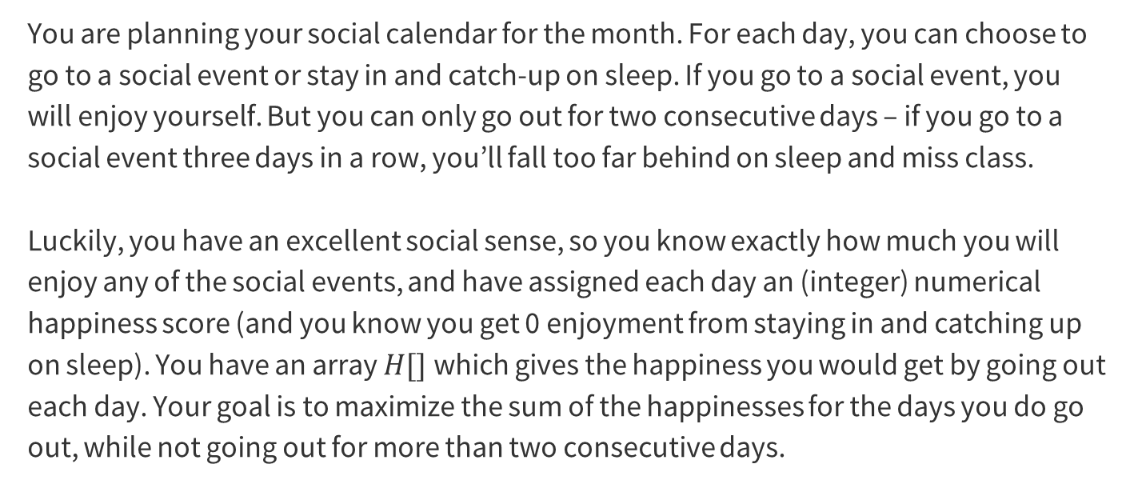
Problem 1 – Lots of fun, with a normal sleep schedule
You are planning your social calendar for the month. For each day, you can choose to go to a social event or stay in and catch-up on sleep. If you go to a social event, you will enjoy yourself. But you can only go out for two consecutive days – if you go to a social event three days in a row, you’ll fall too far behind on sleep and miss class.
Luckily, you have an excellent social sense, so you know exactly how much you will enjoy any of the social events, and have assigned each day an (integer) numerical happiness score (and you know you get 0 enjoyment from staying in and catching up on sleep). You have an array $H[]$which gives the happiness you would get by going out each day. Your goal is to maximize the sum of the happinesses for the days you do go out, while not going out for more than two consecutive days.

Slide 9
1. Read and Understand the Problem
Notes:
~5 mins

Slide 10
Problem 1.1 – Fun & Sleep
Are there any technical terms, or words that seem technical?
What is the input type? (Array? Graph? Integer? Something else?)
What is your return type? (Integer? List?)

Slide 11
Problem 1.1 – Fun & Sleep
Are there any technical terms, or words that seem technical?
What is the input type? (Array? Graph? Integer? Something else?)
What is your return type? (Integer? List?)

Slide 12
Problem 1.1 – Fun & Sleep
Are there any technical terms, or words that seem technical?
What is the input type? (Array? Graph? Integer? Something else?)
What is your return type? (Integer? List?)
“consecutive” means in a row
“maximize the sum of the happinesses” is semi-technical?

Slide 13
Problem 1.1 – Fun & Sleep
Are there any technical terms, or words that seem technical?
What is the input type? (Array? Graph? Integer? Something else?)
What is your return type? (Integer? List?)
“consecutive” means in a row
“maximize the sum of the happinesses” is semi-technical?
int[]

Slide 14
Problem 1.1 – Fun & Sleep
Are there any technical terms, or words that seem technical?
What is the input type? (Array? Graph? Integer? Something else?)
What is your return type? (Integer? List?)
“consecutive” means in a row
“maximize the sum of the happinesses” is semi-technical?
int[]
int (the maximum sum of happinesses)

Slide 15
2. Generate Examples
Notes:
~5 mins

Slide 16
Good Examples Help!
You should generate two or three sample instances and the correct associated outputs.
It’s a good idea to have some “abnormal” examples – consecutive negative numbers, very large negative numbers, only positive numbers, etc.
Note: You should not think of these examples as debugging examples – null or the empty list is not a good example for this step. You can worry about edge cases at the end, once you have the main algorithm idea. You should be focused on the “typical” (not edge) case.
Notes:
~7 minutes for this section, MAKE SURE they actually brainstorm, but be less crazy about it than last week

Slide 17
Problem 1.2 – Fun & Sleep
Generate two examples with their associated outputs. Put some effort into these! The more different from each other they are, the more likely you are to catch mistakes later.
Work through generating some examples, and then we’ll go over it together!

Slide 18
Problem 1.2 – Fun & Sleep
Generate two examples with their associated outputs. Put some effort into these! The more different from each other they are, the more likely you are to catch mistakes later.
Notes:
Depending on how you’re doing on time, you could write down some of the examples they’ve generated here, otherwise just move on to the examples we’ve generated

Slide 19
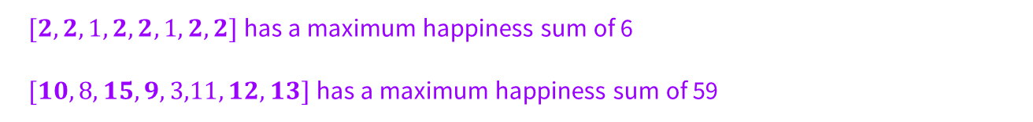
Problem 1.2 – Fun & Sleep
Generate two examples with their associated outputs. Put some effort into these! The more different from each other they are, the more likely you are to catch mistakes later.
$[2,2,1,2,2,1,2,2]$has a maximum happiness sum of 6
$[10,8,15,9,3,11,12,13]$has a maximum happiness sum of 59
Notes:
Flash up these examples, but the content isn’t super relevant, just showing that you can/should think of lots of options to get a better sense of the problem

Slide 20
3. Write the Dynamic Program
Notes:
~15-20 minutes, really

Slide 21
Problem 1.3 – Fun & Sleep
Formulate the problem recursively – what are you looking for (in English!!), and what parameters will you need as you’re doing the calculation?
Write a recurrence for solving the problem you defined in the last part (the recurrence is for the answer, not the running time).
What is your final answer (e.g. what parameters for the recurrence do you need? Is it a single value or the max/min of a set of values?)?
Give a brief justification for why your recurrence is correct. You do not need a formal inductive proof, but your intuition will likely resemble one.
Start brainstorming some answers to these questions.
Notes:
Give them ~8-10 minutes to start thinking, walking through the group to hear ideas, before you talk through each part taking student answers and working through their ideas

Slide 22
Problem 1.3 – Fun & Sleep
Formulate the problem recursively – what are you looking for (in English!!), and what parameters will you need as you’re doing the calculation?
Write a recurrence for solving the problem you defined in the last part (the recurrence is for the answer, not the running time).
First, let’s take some time to brainstorm about what the recurrence could be. What is our OPT finding? How many parameters do we need to calculate it? What are those parameters for?
Notes:
Get their input here! If they give you OPT(i) instead of OPT(i,j), spend some time thinking through why that wouldn’t work

Slide 23
Problem 1.3 – Fun & Sleep
Formulate the problem recursively – what are you looking for (in English!!), and what parameters will you need as you’re doing the calculation?
Notes:
Get their input here! If they give you OPT(i) instead of OPT(i,j), spend some time thinking through why that wouldn’t work

Slide 24
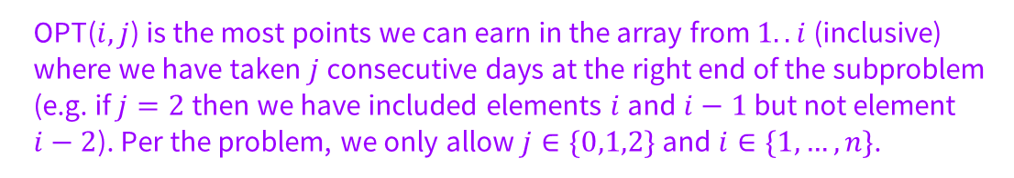
Problem 1.3 – Fun & Sleep
Formulate the problem recursively – what are you looking for (in English!!), and what parameters will you need as you’re doing the calculation?
OPT($i, j$) is the most points we can earn in the array from $1..i$(inclusive) where we have taken $j$ consecutive days at the right end of the subproblem (e.g. if $j=2$then we have included elements $i$ and $i−1$but not element $i−2$). Per the problem, we only allow $j∈\{0,1,2\}$and $i∈\{1,…,n\}$.
Notes:
STOP HERE and go over examples until they are convinced that OPT(i,j) is really necessary!!! Once they understand why we need i and j, again give them ~5 more minutes to try to think through the recurrence and explain why they think it would work

Slide 25
Problem 1.3 – Fun & Sleep
Write a recurrence for solving the problem you defined in the last part (the recurrence is for the answer, not the running time).
Notes:
Make sure they had time to think, then solicit answers for b, c, d and talk through each one

Slide 26
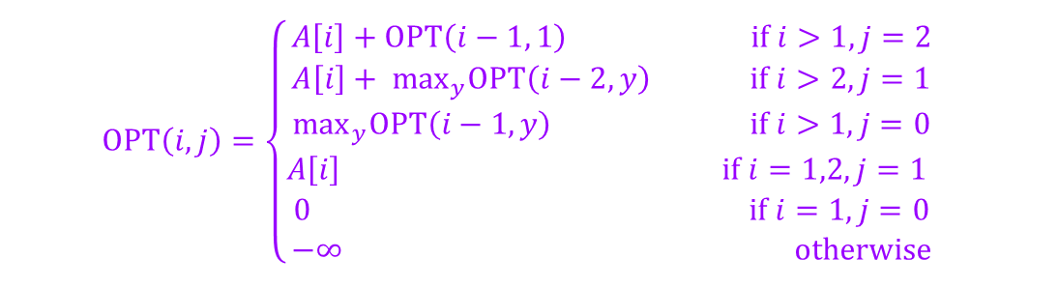
Problem 1.3 – Fun & Sleep
Write a recurrence for solving the problem you defined in the last part (the recurrence is for the answer, not the running time).
$$OPT\left(i, j\right)=\left\{\begin{aligned}A\left[i\right]+OPT\left(i−1, 1\right) if i>1, j=2 \\ A\left[i\right]+ \max_{y}OPT\left(i−2, y\right) if i>2, j=1 \\ \max_{y}OPT\left(i−1, y\right) if i>1, j=0 \\ A\left[i\right] if i=1,2,j=1 \\ 0 if i=1, j=0 \\ −∞ otherwise\end{aligned}\right.$$
Notes:
Once they have given their ideas

Slide 27
Problem 1.3 – Fun & Sleep
What is your final answer (e.g. what parameters for the recurrence do you need? Is it a single value or the max/min of a set of values?)?

Slide 28
Problem 1.3 – Fun & Sleep
What is your final answer (e.g. what parameters for the recurrence do you need? Is it a single value or the max/min of a set of values?)?
$$\max_{j}OPT(n,j)$$

Slide 29
Problem 1.3 – Fun & Sleep
Give a brief justification for why your recurrence is correct. You do not need a formal inductive proof, but your intuition will likely resemble one.

Slide 30
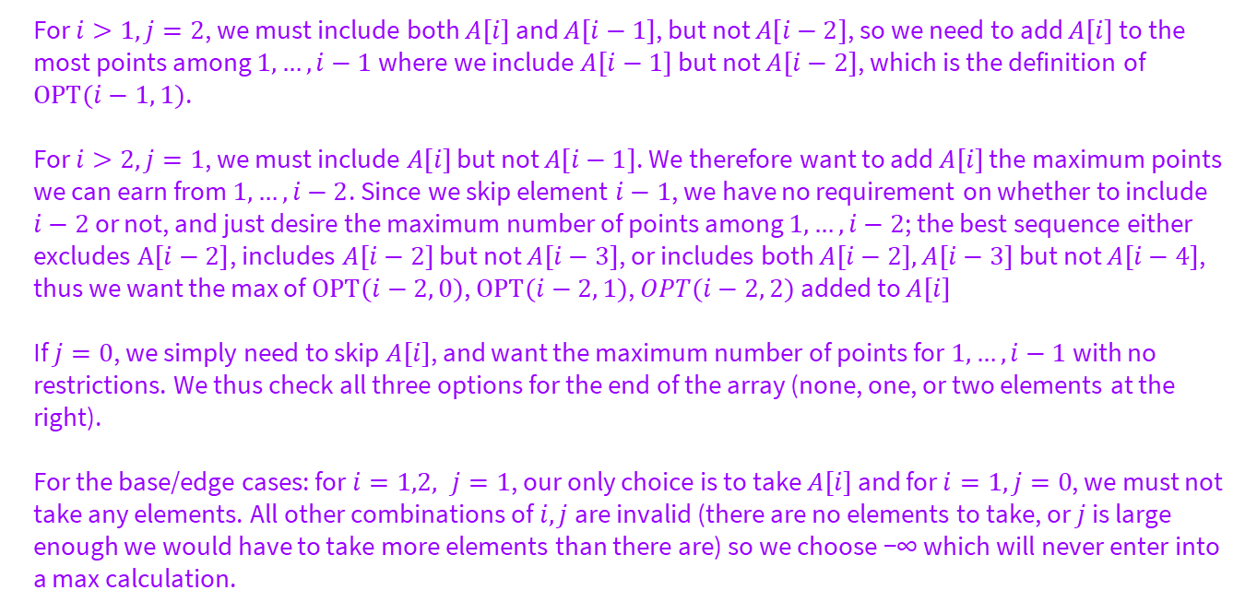
Problem 1.3 – Fun & Sleep
Give a brief justification for why your recurrence is correct. You do not need a formal inductive proof, but your intuition will likely resemble one.
For $i>1, j=2$, we must include both $A[i]$ and $A[i−1]$, but not $A[i−2]$, so we need to add $A[i]$ to the most points among $1,…, i−1$where we include $A[i−1]$ but not $A[i−2]$, which is the definition of $OPT(i−1, 1)$.
For $i>2, j=1$, we must include $A[i]$ but not $A[i−1]$. We therefore want to add $A[i]$ the maximum points we can earn from $1,…,i−2$. Since we skip element $i−1$, we have no requirement on whether to include $i−2$ or not, and just desire the maximum number of points among $1, …, i−2$; the best sequence either excludes $A[i−2]$, includes $A[i−2]$ but not $A[i−3]$, or includes both $A[i−2], A[i−3]$ but not $A[i−4]$, thus we want the max of $OPT(i−2, 0)$, $OPT(i−2, 1)$, $OPT(i−2, 2)$added to $A[i]$
If $j=0$, we simply need to skip $A[i]$, and want the maximum number of points for $1,…,i−1$with no restrictions. We thus check all three options for the end of the array (none, one, or two elements at the right).
For the base/edge cases: for $i=1,2, j=1$, our only choice is to take $A[i]$ and for $i=1, j=0$, we must not take any elements. All other combinations of $i, j$are invalid (there are no elements to take, or $j$ is large enough we would have to take more elements than there are) so we choose −∞ which will never enter into a max calculation.

Slide 31
4. Analyze the Dynamic Program
Notes:
~10 minutes

Slide 32
Problem 1.4 – Fun & Sleep
Describe a memoization structure for your algorithm.
Describe a filling order for your memoization structure.
State and justify the running time of an iterative solution.
Start brainstorming some answers to these questions.
Notes:
Give them ~6ish minutes to start thinking, walking through the group to hear ideas, before you talk through each part taking student answers and working through their ideas

Slide 33
Problem 1.4 – Fun & Sleep
Describe a memoization structure for your algorithm.
Describe a filling order for your memoization structure.
State and justify the running time of an iterative solution.

Slide 34
Problem 1.4 – Fun & Sleep
Describe a memoization structure for your algorithm.
Describe a filling order for your memoization structure.
State and justify the running time of an iterative solution.
We need an $n$ × 3 array, where entry $i, j$is $OPT(i, j)$.

Slide 35
Problem 1.4 – Fun & Sleep
Describe a memoization structure for your algorithm.
Describe a filling order for your memoization structure.
State and justify the running time of an iterative solution.
We need an $n$ × 3 array, where entry $i, j$is $OPT(i, j)$.
Outer loop $i$ from 1 to $n$
Inner loop $j$ from 0 to 2

Slide 36
Problem 1.4 – Fun & Sleep
Describe a memoization structure for your algorithm.
Describe a filling order for your memoization structure.
State and justify the running time of an iterative solution.
We need an $n$ × 3 array, where entry $i, j$is $OPT(i, j)$.
Outer loop $i$ from 1 to $n$
Inner loop $j$ from 0 to 2
In each recursive case, we check at most 3 entries, and we have $𝒪(n)$entries to fill, so our total running time is $𝒪(n)$.

Slide 37
Problem 2:
Longest Increasing Subsequence AGAIN
Notes:
May have 5-15 minutes left, if so, take a look at problem 2

Slide 38
Problem 2 – Longest Increasing Subsequence
We’ve already seen a recurrence for Longest Increasing Subsequence. Let’s write another!
As before, [10, −2, 5, 0, 3, 11, 8] has a longest increasing subsequence of 4 elements: [−2, 0, 3, 8]

Slide 39
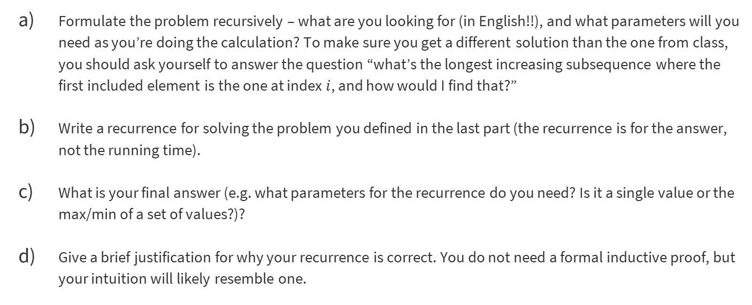
Problem 2.1 – Write the Dynamic Program
Formulate the problem recursively – what are you looking for (in English!!), and what parameters will you need as you’re doing the calculation? To make sure you get a different solution than the one from class, you should ask yourself to answer the question “what’s the longest increasing subsequence where the first included element is the one at index $i$, and how would I find that?”
Write a recurrence for solving the problem you defined in the last part (the recurrence is for the answer, not the running time).
What is your final answer (e.g. what parameters for the recurrence do you need? Is it a single value or the max/min of a set of values?)?
Give a brief justification for why your recurrence is correct. You do not need a formal inductive proof, but your intuition will likely resemble one.

Slide 40

Problem 2.1 – Write the Dynamic Program
Formulate the problem recursively – what are you looking for (in English!!), and what parameters will you need as you’re doing the calculation? To make sure you get a different solution than the one from class, you should ask yourself to answer the question “what’s the longest increasing subsequence where the first included element is the one at index $i$, and how would I find that?”

Slide 41
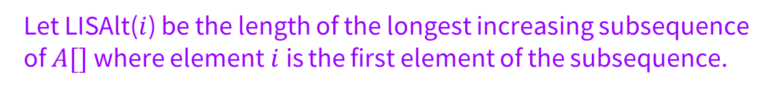
Problem 2.1 – Write the Dynamic Program
Formulate the problem recursively – what are you looking for (in English!!), and what parameters will you need as you’re doing the calculation? To make sure you get a different solution than the one from class, you should ask yourself to answer the question “what’s the longest increasing subsequence where the first included element is the one at index $i$, and how would I find that?”
Let LISAlt($i$) be the length of the longest increasing subsequence of $A[]$where element$i$is the first element of the subsequence.

Slide 42
Problem 2.1 – Write the Dynamic Program
Write a recurrence for solving the problem you defined in the last part (the recurrence is for the answer, not the running time).

Slide 43
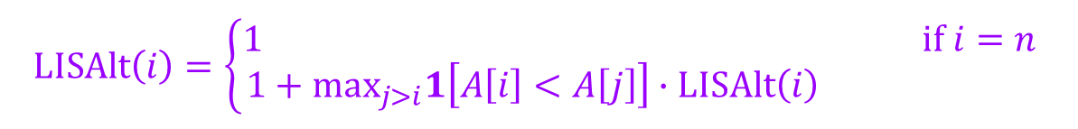
Problem 2.1 – Write the Dynamic Program
Write a recurrence for solving the problem you defined in the last part (the recurrence is for the answer, not the running time).
$$LISAlt\left(i\right)=\left\{\begin{aligned}1 if i=n \\ 1+\max_{j>i}1\left[A\left[i\right]<A\left[j\right]\right]∙LISAlt\left(i\right) \end{aligned}\right.$$

Slide 44
Problem 2.1 – Write the Dynamic Program
What is your final answer (e.g. what parameters for the recurrence do you need? Is it a single value or the max/min of a set of values?)?

Slide 45
Problem 2.1 – Write the Dynamic Program
What is your final answer (e.g. what parameters for the recurrence do you need? Is it a single value or the max/min of a set of values?)?
$$\max_{i}LISAlt(i)$$

Slide 46
Problem 2.1 – Write the Dynamic Program
Give a brief justification for why your recurrence is correct. You do not need a formal inductive proof, but your intuition will likely resemble one.

Slide 47

Problem 2.1 – Write the Dynamic Program
Give a brief justification for why your recurrence is correct. You do not need a formal inductive proof, but your intuition will likely resemble one.
For the base case, since $n$ is the farthest right element, it is the only element in a subsequence starting from that location.
If we begin at element $i$, then either it is the only element or there is an element after. The recurrence checks all elements after – if they are the second element in that sequence, they must be after $i$, have the element be greater than $A[i]$. That new location $j$ will then start the rest of the increasing subsequence, so making all those recursive calls suffices to find the best one

Slide 48
Problem 2.2 – Analyze the Dynamic Program
Describe a memoization structure for your algorithm.
Describe a filling order for your memoization structure.
State and justify the running time of an iterative solution.
Start brainstorming some answers to these questions.

Slide 49
Problem 2.2 – Analyze the Dynamic Program
Describe a memoization structure for your algorithm.

Slide 50
Problem 2.2 – Analyze the Dynamic Program
Describe a memoization structure for your algorithm.
We need a (1D) array of size $n$.

Slide 51
Problem 2.2 – Analyze the Dynamic Program
Write a recurrence for solving the problem you defined in the last part (the recurrence is for the answer, not the running time).

Slide 52
Problem 2.2 – Analyze the Dynamic Program
Write a recurrence for solving the problem you defined in the last part (the recurrence is for the answer, not the running time).
We fill from $n$ down to 1.

Slide 53
Problem 2.2 – Analyze the Dynamic Program
What is your final answer (e.g. what parameters for the recurrence do you need? Is it a single value or the max/min of a set of values?)?

Slide 54
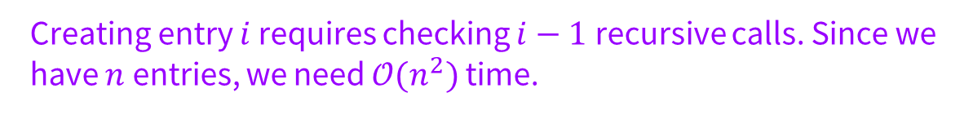
Problem 2.2 – Analyze the Dynamic Program
What is your final answer (e.g. what parameters for the recurrence do you need? Is it a single value or the max/min of a set of values?)?
Creating entry $i$ requires checking $i−1$ recursive calls. Since we have $n$ entries, we need $𝒪(n^{2})$ time.

Slide 55
Problem 3:
Delete and Earn
Notes:
May have 5-15 minutes left, if so, take a look at problem 2

Slide 56
Problem 3 Delete and Earn (Leetcode 740)
You are given an integer array “nums”. You want to maximize the number of points you get by performing the following operation any number of times:
Pick any nums[i] and delete it to earn nums[i] points. Afterwards, you must delete every element equal to nums[i] - 1 and every element equal to nums[i] + 1.
Return the maximum number of points you can earn by applying the above operation some number of times.

Slide 57
Problem 3.1 – Write the Dynamic Program
Formulate the problem recursively:

Slide 58
Problem 3.1 – Write the Dynamic Program
First, we notice that the order of nums don’t really matter, we only care about it values. So we can turn nums into vals, vals[k] represent the number of nums[i]==k.

Slide 59
Problem 3.1 – Write the Dynamic Program
Formulate the problem recursively:
Let F($i$) be the maximum number of points of vals$[0…i]$

Slide 60
Problem 3.1 – Write the Dynamic Program
Write a recurrence for solving the problem you defined in the last part (the recurrence is for the answer, not the running time).

Slide 61
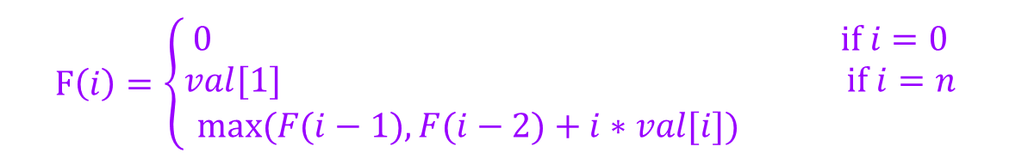
Problem 3.1 – Write the Dynamic Program
Write a recurrence for solving the problem you defined in the last part (the recurrence is for the answer, not the running time).
$$F\left(i\right)=\left\{\begin{aligned}0 if i=0 \\ val[1] if i=n \\ max⁡(F(i−1),F(i−2)+i∗val[i]) \end{aligned}\right.$$

Slide 62
Problem 3.1 – Write the Dynamic Program
Give a brief justification for why your recurrence is correct. You do not need a formal inductive proof, but your intuition will likely resemble one.

Slide 63
Problem 3.1 – Write the Dynamic Program
Give a brief justification for why your recurrence is correct. You do not need a formal inductive proof, but your intuition will likely resemble one.
No matter what we choose from [0…i-2], it won’t affect our decision on i.
If we choose value i-1, we can’t choose value i.
If value i-1 is not choose, F[i-1] == F[i]

Slide 64
Problem 3.2 – Analyze the Dynamic Program
Describe a memoization structure for your algorithm.
Describe a filling order for your memoization structure.
State and justify the running time of an iterative solution.

Slide 65
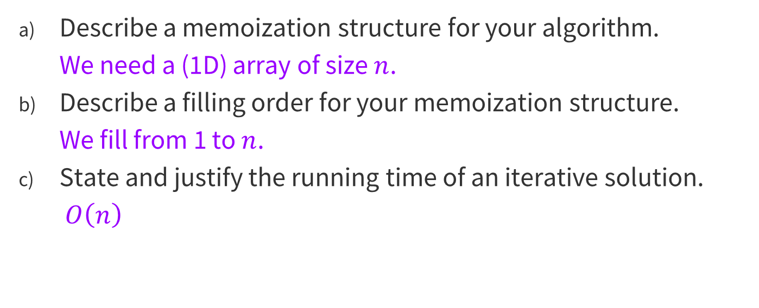
Problem 3.2 – Analyze the Dynamic Program
Describe a memoization structure for your algorithm.
We need a (1D) array of size $n$.
Describe a filling order for your memoization structure.
We fill from 1 to $n$.
State and justify the running time of an iterative solution.
$O\left(n\right)$

Slide 66
That’s All, Folks!
Thanks for coming to section this week!
Any questions?

