Slide 1
CSE 421 Section 3
Greedy Algorithms

Slide 2
Administrivia
Notes:
Administrivia ~2 mins

Slide 3
Announcements & Reminders
HW1
  If you feel something was graded incorrectly, submit a regrade request!
HW2
  Was due yesterday, 1/17
  5 late days total
HW3
  Due Wednesday, 1/24

Slide 4
How to Approach Writing an Algorithm
Notes:
Quick intro, ~2 mins

Slide 5
Writing an Algorithm
Throughout this course, you will learn how to write several different kinds of algorithms.
(Ex: greedy algorithms, more kinds to come)
It can be difficult to understand what a problem actually needs you to do, which makes picking what kind of algorithm might solve the problem challenging as well!
Today, we will work through a problem using an algorithm-writing strategy that you can apply to all the problems throughout this course and beyond

Slide 6
The Strategy
Read and Understand the Problem
Generate Examples
Come Up with a Baseline
Brainstorm and Analyze Possible Algorithms
Write an Algorithm
Show Your Algorithm is Correct
Optimize and Analyze the Run Time

Slide 7
1.1. Read and Understand the Problem
Notes:
Should be ~10 mins, give them 5 mins to think to themselves about answering the questions and then discuss terms together

Slide 8
No really, we mean it!
You can’t solve a problem if you don’t know what you’re supposed to do!
Remember that problems are written in mathematical English, which is likely to be much more dense than, say, a paragraph from a novel. You’ll have to read more slowly (this advice still applies for our ridiculous word problems).
As you’re reading, underline anything you don’t understand.
Rereading the problem a few times can often help (it’s easier to understand details once you have the big picture in your brain).

Slide 9
Ask Yourself some Questions:
Are there any technical terms in the problem you don’t understand?
What is the input type? (Array? Graph? Integer? Something else?)
What is your return type? (Integer? List?)
Are there any words that look like normal words, but are secretly technical terms (like “subsequence” or “list”)? These words sometimes subtly add restrictions to the problem and can be easily missed.

Slide 10
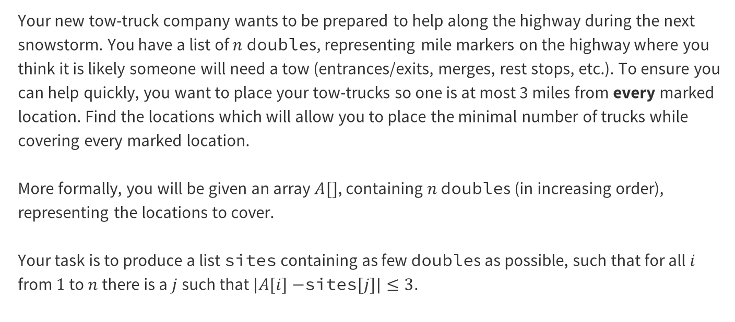
Problem 1 – Line Covering
Your new tow-truck company wants to be prepared to help along the highway during the next snowstorm. You have a list of $n$ doubles, representing mile markers on the highway where you think it is likely someone will need a tow (entrances/exits, merges, rest stops, etc.). To ensure you can help quickly, you want to place your tow-trucks so one is at most 3 miles from every marked location. Find the locations which will allow you to place the minimal number of trucks while covering every marked location.
More formally, you will be given an array $A[]$, containing $n$ doubles (in increasing order), representing the locations to cover.
Your task is to produce a list sites containing as few doubles as possible, such that for all $i$ from $1$ to $n$ there is a $j$ such that $|A[i]−$sites$[j]|≤3$.
Notes:
Give them ~5 mins to work on it, may want to flip to next slide to show what the 4 questions are

Slide 11
Problem 1.1 – Line Covering
Are there any technical terms in the problem you don’t understand?
What is the input type? (Array? Graph? Integer? Something else?)
What is your return type? (Integer? List?)
Are there any words that look like normal words, but are secretly technical terms (like “subsequence” or “list”)? These words sometimes subtly add restrictions to the problem and can be easily missed.
Work reading through this problem with the people around you and answering the four questions, and then we’ll go over it together!

Slide 12
Problem 1.1 – Line Covering
Are there any technical terms in the problem you don’t understand?
What is the input type? (Array? Graph? Integer? Something else?)
What is your return type? (Integer? List?)
Are there any words that look like normal words, but are secretly technical terms (like “subsequence” or “list”)? These words sometimes subtly add restrictions to the problem and can be easily missed.
“cover” means “place a truck at most 3 miles from”

Slide 13
Problem 1.1 – Line Covering
Are there any technical terms in the problem you don’t understand?
What is the input type? (Array? Graph? Integer? Something else?)
What is your return type? (Integer? List?)
Are there any words that look like normal words, but are secretly technical terms (like “subsequence” or “list”)? These words sometimes subtly add restrictions to the problem and can be easily missed.
“cover” means “place a truck at most 3 miles from”
double[]

Slide 14
Problem 1.1 – Line Covering
Are there any technical terms in the problem you don’t understand?
What is the input type? (Array? Graph? Integer? Something else?)
What is your return type? (Integer? List?)
Are there any words that look like normal words, but are secretly technical terms (like “subsequence” or “list”)? These words sometimes subtly add restrictions to the problem and can be easily missed.
“cover” means “place a truck at most 3 miles from”
double[]
double[]

Slide 15
Problem 1.1 – Line Covering
Are there any technical terms in the problem you don’t understand?
What is the input type? (Array? Graph? Integer? Something else?)
What is your return type? (Integer? List?)
Are there any words that look like normal words, but are secretly technical terms (like “subsequence” or “list”)? These words sometimes subtly add restrictions to the problem and can be easily missed.
“cover” means “place a truck at most 3 miles from”
double[]
double[]
list

Slide 16
1.2. Generate Examples
Notes:
~10 minutes for this section (REALLY)

Slide 17
Examples Help us Understand!
You should generate two or three sample instances and the correct associated outputs.
If you’re working with others, these instances help make sure you’ve all interpreted the problem the same way.
Your second goal is to get better intuition on the problem. You’ll have to find the right answer to these instances. In doing so you might notice some patterns that will help you later
Note: You should not think of these examples as debugging examples – null or the empty list is not a good example for this step. You can worry about edge cases at the end, once you have the main algorithm idea. You should be focused on the “normal” (not edge) case.
Notes:
~10 minutes for this section, MAKE SURE they actually brainstorm

Slide 18
Problem 1.2 – Line Covering
Generate two examples with their associated outputs. Put some effort into these! The more different from each other they are, the more likely you are to catch mistakes later.
Work through reading this problem with the people around you and answering the four questions, and then we’ll go over it together!
Notes:
~5-8 minutes at least for them to think and discuss, MAKE SURE they actually brainstorm

Slide 19
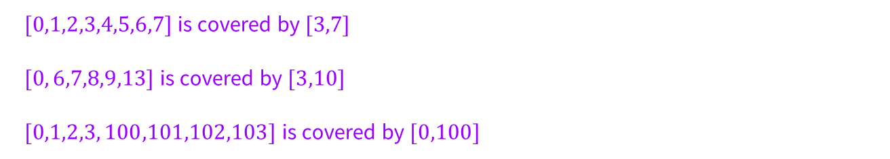
Problem 1.2 – Line Covering
Generate two examples with their associated outputs. Put some effort into these! The more different from each other they are, the more likely you are to catch mistakes later.
$[0,1,2,3,4,5,6,7]$is covered by $[3,7]$
$[0, 6,7,8,9,13]$is covered by $[3,10]$
$[0,1,2,3, 100,101,102,103]$is covered by $[0,100]$
Notes:
Flash up these examples, but the content isn’t super relevant, just showing that you can/should think of lots of options to get a better sense of the problem

Slide 20
1.3. Come Up with a Baseline
Notes:
Talk through, should be like ~2 mins at most

Slide 21
Inefficient but Effective First Attempt
In a time-constrained setting (like a technical interview or an exam) you often want a “baseline” algorithm.
This should be an algorithm that you can implement and will give you the right answer, even if it might be slow.
We’re going to skip this step in this question, but you’ll see it in future examples and in lectures.

Slide 22
1.4. Brainstorm and Analyze
Possible Algorithms
Notes:
10 mins, really

Slide 23
Think about Algorithm Possibilities
It sometimes helps to ask, “what kind of algorithm could I design?”
(This week the answer is going to be “a greedy algorithm” because we’re learning about greedy algorithms)
By the end of the quarter, you’ll have a list of possible techniques.
Questions to help you pick:
  Does this problem remind me of any algorithms from class? What technique did we use there?
  Do I see a modeling opportunity (say a graph we could run an algorithm on, or a stable matching instance we could write)?
  Is there a way to improve the baseline algorithm (if you have one) to something faster?

Slide 24
Remember: Your First Guess Might Not Be Right!
You may want to try multiple different algorithm paradigms if you’re not sure what might work best / be fastest
Even if you’re pretty sure of the algorithm type you want to use, it helps to brainstorm multiple different possibilities
Then, we can test these possibilities, using the examples we came up with in part 2, to see which choice gives the correct output

Slide 25
Problem 1.4 – Line Covering
For this problem today, you should use a greedy algorithm.
Come up with at least two greedy ideas (which may or may not work). Run each of your ideas through the examples you generated in part 2.
Think of some greedy ideas with the people around you, and then we’ll go over it together!
Notes:
~5-8 minutes at least for them to think and discuss, MAKE SURE they actually brainstorm

Slide 26
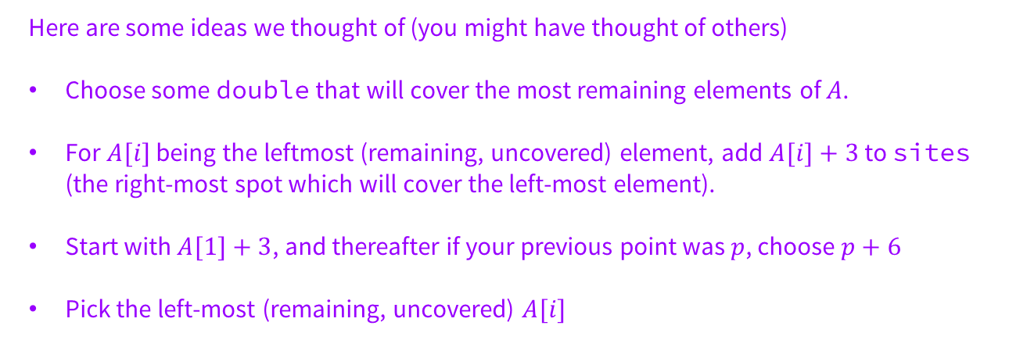
Problem 1.4 – Line Covering
Come up with at least two greedy ideas (which may or may not work). Run each of your ideas through the examples you generated in part 2.
Here are some ideas we thought of (you might have thought of others)
Choose some double that will cover the most remaining elements of $A$.
For $A[i]$ being the leftmost (remaining, uncovered) element, add $A[i]+3$to sites (the right-most spot which will cover the left-most element).
Start with $A[1]+3$, and thereafter if your previous point was $p$, choose $p+6$
Pick the left-most (remaining, uncovered) $A[i]$
Notes:
Flash up these examples, but the content isn’t super relevant, just showing that you can/should think of lots of options to get a better sense of the problem

Slide 27
Try your Algorithm Ideas on your Examples
Now that you have some (hopefully) good ideas, you want to test them out on actual example inputs and see if you get the expected output
Generate a few more instances and narrow down to just one possibility:
  If you eliminate all of your ideas, go back to the last step and generate a new rule
  If you can’t eliminate down to one choice after multiple examples, try specifically to create an instance where they should behave differently
  If you still can’t make them behave differently, just pick one to try
This will help you determine which algorithm to pursue!

Slide 28
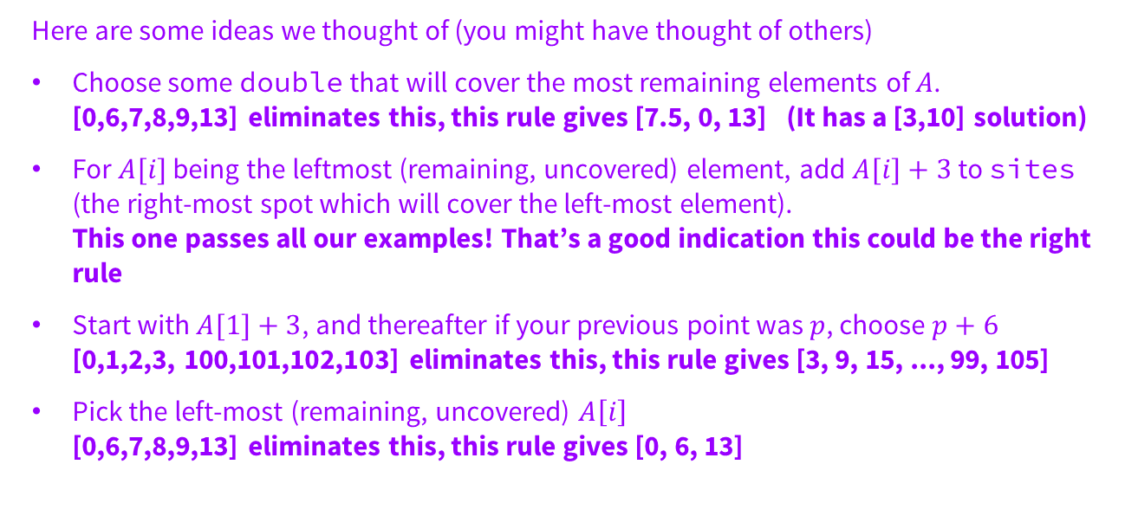
Problem 1.4 – Line Covering
Come up with at least two greedy ideas (which may or may not work). Run each of your ideas through the examples you generated in part 2.
Here are some ideas we thought of (you might have thought of others)
Choose some double that will cover the most remaining elements of $A$.
[0,6,7,8,9,13] eliminates this, this rule gives [7.5, 0, 13] (It has a [3,10] solution)
For $A[i]$ being the leftmost (remaining, uncovered) element, add $A[i]+3$to sites (the right-most spot which will cover the left-most element).
This one passes all our examples! That’s a good indication this could be the right rule
Start with $A[1]+3$, and thereafter if your previous point was $p$, choose $p+6$
[0,1,2,3, 100,101,102,103] eliminates this, this rule gives [3, 9, 15, ..., 99, 105]
Pick the left-most (remaining, uncovered) $A\left[i\right]$
[0,6,7,8,9,13] eliminates this, this rule gives [0, 6, 13]
Notes:
Flash up these examples, but the content isn’t super relevant, just showing that you can/should think of lots of options to get a better sense of the problem

Slide 29
1.5. Write an Algorithm
Notes:
<5 mins, just you showing them the tips and the algorithm for the greedy rule that we saw was correct

Slide 30
Write That Pseudocode!
Now that you’ve determined which of your ideas is (probably) correct, you need to formalize your algorithm into pseudocode
Some pseudocode tips:
  Pseudocode should be somewhere between a paragraph and actual (java/python/c/whatever) code
  You can have English phrases and sentences in your pseudocode!
  It can be helpful to name the variables you want to use in a paragraph before your actual pseudocode
  You don’t need to be very specific about data structures
  You should (sparingly) add comments to help explain anything that may be confusing

Slide 31
Problem 1.5 – Line Covering
Greedy Rule: For $A[i]$being the leftmost (remaining, uncovered) element, add $A[i]+3$to sites (the right-most spot which will cover the left-most element)
function Placements(A[1..n])
uncoveredIndex ← 1
sites ← empty list
while uncoveredIndex ≤ n do
newSite ← A[uncoveredIndex] + 3
append newSite to sites.
while uncoveredIndex ≤ n and |A[uncoveredIndex] − newSite| ≤ 3 do
uncoveredIndex++
return sites
Notes:
quickly talk through the algorithm if they’re confused, but it’s basically just doing the greedy rule

Slide 32
1.6. Show Your Algorithm is Correct
Notes:
~10 mins

Slide 33
Writing the Algo isn’t Enough…
We Need to Prove that it Works!
In general, you’ll be often writing some kind of induction proof, or proving some implications to show that your algorithm is correct
For greedy algorithms specifically, we have three common proof strategies:
  greedy stays ahead
  exchange arguments
  structural arguments

Slide 34
Problem 1.6 – Line Covering
Write a proof of correctness.
Try to use one of those greedy proof techniques with the people around you, and then we’ll go over it together!
Notes:
~5-8 minutes at least for them to think and discuss, MAKE SURE they actually brainstorm

Slide 35
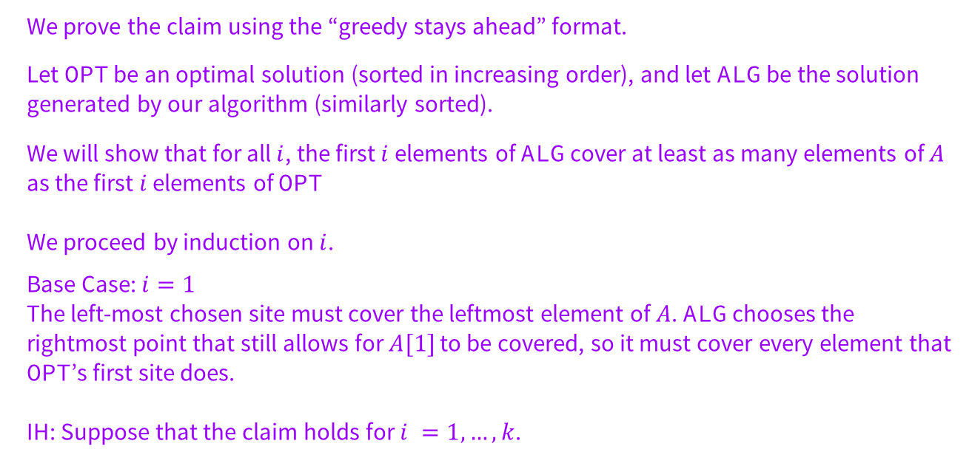
Problem 1.6 – Line Covering
We prove the claim using the “greedy stays ahead” format.
Let OPT be an optimal solution (sorted in increasing order), and let ALG be the solution generated by our algorithm (similarly sorted).
We will show that for all $i$, the first $i$ elements of ALG cover at least as many elements of $A$ as the first $i$ elements of OPT
We proceed by induction on $i$.
Base Case: $i=1$
The left-most chosen site must cover the leftmost element of $A$. ALG chooses the rightmost point that still allows for $A[1]$ to be covered, so it must cover every element that OPT’s first site does.
IH: Suppose that the claim holds for $i =1, …, k$.
Notes:
Take ideas of which greedy approach to use, then tell them that “greedy stays ahead” is the one we went with. Talk through proof if you have time, otherwise remind them that it will be on the solutions to help them as they work through their homework

Slide 36
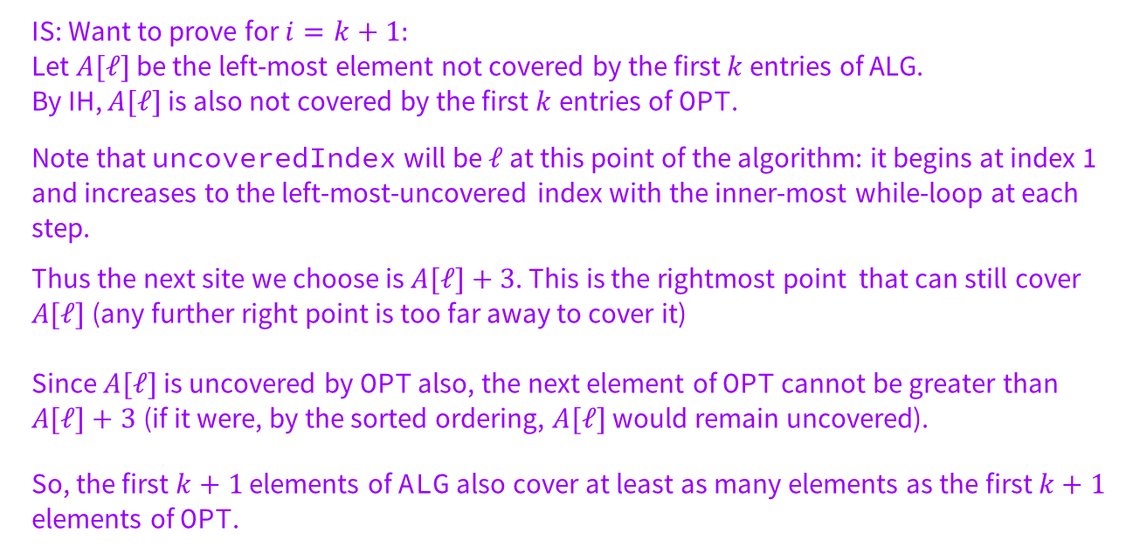
Problem 1.6 – Line Covering
IS: Want to prove for $i=k+1:$
Let $A[ℓ]$be the left-most element not covered by the first $k$ entries of ALG.
By IH, $A[ℓ]$ is also not covered by the first $k$entries of OPT.
Note that uncoveredIndex will be $ℓ$ at this point of the algorithm: it begins at index 1 and increases to the left-most-uncovered index with the inner-most while-loop at each step.
Thus the next site we choose is $A[ℓ]+3$. This is the rightmost point that can still cover $A[ℓ]$(any further right point is too far away to cover it)
Since $A[ℓ]$ is uncovered by OPT also, the next element of OPT cannot be greater than $A[ℓ]+3$(if it were, by the sorted ordering, $A[ℓ]$would remain uncovered).
So, the first $k+1$ elements of ALG also cover at least as many elements as the first $k+1$ elements of OPT.
Notes:
Take ideas of which greedy approach to use, then tell them that “greedy stays ahead” is the one we went with. Talk through proof if you have time, otherwise remind them that it will be on the solutions to help them as they work through their homework

Slide 37
1.7. Optimize and Analyze the Run Time
Notes:
Probably won’t have time for this, but remind them this will be in the solutions so they can use it when they’re working on homework

Slide 38
Just Like Back in 332…
Make your algorithm as efficient as possible.
Flesh out any pseudocode you’ve written with enough detail to analyze the running time (do you need particular data structures?).
Write and justify the big-O running time.
  Can you make your code more efficient?
  Can you give a reason why you shouldn’t expect the code to be any faster?

Slide 39
Problem 1.7 – Line Covering
Write the big-O of your code and justify the running time with a few sentences.
Notes:
~5-8 minutes at least for them to think and discuss, MAKE SURE they actually brainstorm

Slide 40

Problem 1.7 – Line Covering
Write the big-O of your code and justify the running time with a few sentences.
The loop runs in $O(n)$time.
It might look worse at first glance, but it’s not! (Think of two markers moving down the highway.)
Every iteration of the inner loop increases uncoveredIndex, so those lines run at most $n$ times total (across all iterations of the outer-loop).
Similarly, every line in the outer-loop executes at most $n$ times, since every new site covers at least one element of $A$ and therefore increases uncoveredIndex.
Each step can be implemented in $O(1)$ time, so the total time is $O(n)$.
Notes:
~5-8 minutes at least for them to think and discuss, MAKE SURE they actually brainstorm

Slide 41
2.1. Read and Understand the Problem
Notes:
Should be ~10 mins, give them 5 mins to think to themselves about answering the questions and then discuss terms together

Slide 42
Problem 2 – Another Greedy Algorithm
You have a set, A , of (possibly overlapping) intervals. You wish to choose a subset B of the intervals to cover the full set. Here, cover means every interval X in A is contained in some interval Y in B.
Describe (and prove correct) an algorithm which gives you a cover with the fewest intervals.

Slide 43
Problem 2.1 – Another Greedy Algorithm
Are there any technical terms in the problem you don’t understand?
What is the input type? (Array? Graph? Integer? Something else?)
What is your return type? (Integer? List?)
Work reading through this problem with the people around you and answering the questions, and then we’ll go over it together!

Slide 44
Problem 2.1 – Another Greedy Algorithm
Are there any technical terms in the problem you don’t understand?
What is the input type? (Array? Graph? Integer? Something else?)
What is your return type? (Integer? List?)
“cover” means that every interval in X is contained in some interval in B
A list of intervals
A list of intervals

Slide 45
2.2. Generate Examples
Notes:
~10 minutes for this section (REALLY)

Slide 46
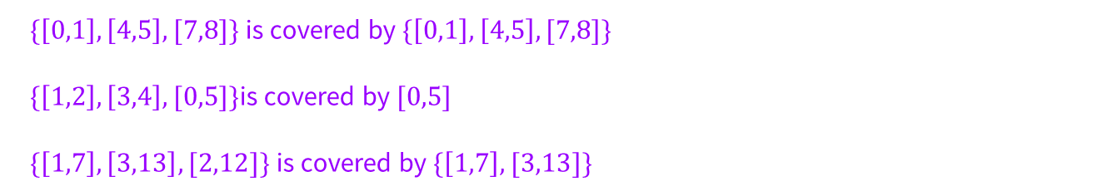
Problem 2.2 – Another Greedy Algorithm
Generate two examples with their associated outputs. Put some effort into these! The more different from each other they are, the more likely you are to catch mistakes later.
$\{\left[0,1\right],\left[4,5\right],[7,8]\}$is covered by $\{\left[0,1\right],\left[4,5\right],[7,8]\}$
$\{\left[1,2\right],\left[3,4\right],[0,5]\}$is covered by $[0,5]$
$\{\left[1,7\right],\left[3,13\right],[2,12]\}$is covered by $\{\left[1,7\right],[3,13]\}$
Notes:
Flash up these examples, but the content isn’t super relevant, just showing that you can/should think of lots of options to get a better sense of the problem

Slide 47
2.3. Come Up with a Baseline
Notes:
Talk through, should be like ~2 mins at most

Slide 48
Inefficient but Effective First Attempt
In a time-constrained setting (like a technical interview or an exam) you often want a “baseline” algorithm.
This should be an algorithm that you can implement and will give you the right answer, even if it might be slow.
What would be a baseline for this question?

Slide 49
Problem 2.3 – Another Greedy Algorithm
Baseline Algorithm (Exponential Time):
Iterate through all subsets of B and check if each subset covers the whole set. Keep track of the smallest such subset, and return it.
Notes:
Flash up these examples, but the content isn’t super relevant, just showing that you can/should think of lots of options to get a better sense of the problem

Slide 50
2.4. Brainstorm and Analyze
Possible Algorithms
Notes:
10 mins, really

Slide 51
Problem 2.4 – Another Greedy Algorithm
For this problem today, you should use a greedy algorithm.
Come up with at least two greedy ideas (which may or may not work). Run each of your ideas through the examples you generated in part 2.
Think of some greedy ideas with the people around you, and then we’ll go over it together!
Notes:
~5-8 minutes at least for them to think and discuss, MAKE SURE they actually brainstorm

Slide 52
Problem 2.4 – Another Greedy Algorithm
Come up with at least two greedy ideas (which may or may not work). Run each of your ideas through the examples you generated in part 2.
Here are some ideas we thought of (you might have thought of others)
Choose the longest remaining interval.
Choose the remaining interval that covers the most other intervals
Choose the remaining interval with the smallest left endpoint, breaking ties by choosing the interval with the largest right endpoint.
Pick the remaining interval intersecting the last chosen interval with largest right endpoint. If no intervals intersect the last chosen one (or this is the first chosen interval), instead pick amongst the intervals with smallest left endpoint.
Notes:
Flash up these examples, but the content isn’t super relevant, just showing that you can/should think of lots of options to get a better sense of the problem

Slide 53
2.5. Write an Algorithm
Notes:
<5 mins, just you showing them the tips and the algorithm for the greedy rule that we saw was correct

Slide 54
Write That Pseudocode!
Now that you’ve determined which of your ideas is (probably) correct, you need to formalize your algorithm into pseudocode
Some pseudocode tips:
  Pseudocode should be somewhere between a paragraph and actual (java/python/c/whatever) code
  You can have English phrases and sentences in your pseudocode!
  It can be helpful to name the variables you want to use in a paragraph before your actual pseudocode
  You don’t need to be very specific about data structures
  You should (sparingly) add comments to help explain anything that may be confusing

Slide 55
Problem 2.5 – Another Greedy Algorithm
Greedy Rule: Pick the remaining interval intersecting the last chosen interval with largest right endpoint. If no intervals intersect the last chosen one (or this is the first chosen interval), instead pick amongst the intervals with smallest left endpoint.
function Covering(A[])
sort A by increasing start, breaking ties by decreasing end
Let y be the start time of the first element of A
covering ← empty list
while A is not empty do
Let I = [s,e] be the element in A with latest end time among those starting y or earlier
add I to covering
remove all elements of A with end time e or earlier
if any remaining elements of A start before e
y ← e
else
y ← the earliest start time of all remaining elements in A
return covering
Notes:
quickly talk through the algorithm if they’re confused, but it’s basically just doing the greedy rule

Slide 56
2.6. Show Your Algorithm is Correct
Notes:
~10 mins

Slide 57
Problem 2.6 – Another Greedy Algorithm
Write a proof of correctness.
Try to use one of those greedy proof techniques with the people around you, and then we’ll go over it together!
Notes:
~5-8 minutes at least for them to think and discuss, MAKE SURE they actually brainstorm

Slide 58
Problem 2.6 – Another Greedy Algorithm
Let ALG be the list of intervals found by the algorithm, and let OPT be the list of intervals in an optimal cover. In both cases, let these lists be sorted by increasing start time. We claim the following:
Lemma 1. for all i, END(ALG(i)) ≥ END(OPT(i)).
Base Case:
Let t be the left-most point of any interval in X . To be valid covers, both ALG and OPT must cover t. In the first while loop, END(ALG(1)) is chosen as the right-most point in any interval containing t. Since OPT also covers t, in sorted order OPT(1) must be an interval covering t, thus END(ALG(1)) ≥ END(OPT(1)).
IH: Suppose END(ALG(i)) ≥ END(OPT(i)).
Notes:
Take ideas of which greedy approach to use, then tell them that “greedy stays ahead” is the one we went with. Talk through proof if you have time, otherwise remind them that it will be on the solutions to help them as they work through their homework

Slide 59
Problem 2.6 – Another Greedy Algorithm
IS: Let y be the left-most point in some interval in A not covered by any of ALG[1],ALG[2],…,ALG[i].
By IH, OPT[i] also does not cover y. Since OPT is a valid cover and sorted, OPT[i+1] must start before y. Now, consider the execution of the algorithm: when it added ALG[i+1], it deleted all elements that would not cover a new point, thus it considered only intervals containing y and chose the one with the latest end time. Thus either OPT[i+1] contains y, was considered in this choice and thus ends before ALG[i+1], or OPT[i+1] ends before y and thus certainly must end before ALG[i+1]. This proves the statement by induction.
With the Lemma proven, we argue that ALG is a minimum-sized cover. By construction, ALG covers every point in X. Letting ALG[k] be the last interval in ALG, we have END(ALG[k]) > END(ALG[k-1]) ≥ END(OPT[k-1]). So the first k-1 intervals in OPT do not cover END(ALG[k]). Thus there are at least k intervals in OPT, so OPT has at least as many intervals as ALG, and thus ALG is optimal.
Notes:
Take ideas of which greedy approach to use, then tell them that “greedy stays ahead” is the one we went with. Talk through proof if you have time, otherwise remind them that it will be on the solutions to help them as they work through their homework

Slide 60
2.7. Optimize and Analyze the Run Time
Notes:
Probably won’t have time for this, but remind them this will be in the solutions so they can use it when they’re working on homework

Slide 61
Problem 2.7 – Another Greedy Algorithm
Write the big-O of your code and justify the running time with a few sentences.
Notes:
~5-8 minutes at least for them to think and discuss, MAKE SURE they actually brainstorm

Slide 62
Problem 2.7 – Another Greedy Algorithm
Write the big-O of your code and justify the running time with a few sentences.
Note that apart from sorting, the whole algorithm, including the deletion step, can be performed with a simple iteration — intervals in A will overlap with I if and only if their start time is before I’s end-time.
After A is sorted by start time, every element is either added to the covering or is deleted in O(1) time by the deletion command, so apart from sorting, the function takes O(n) time. Thus with the sort, the function takes O(nlog(n)) time.
Notes:
~5-8 minutes at least for them to think and discuss, MAKE SURE they actually brainstorm

Slide 63
3.1. Read and Understand the Problem
Notes:
Should be ~10 mins, give them 5 mins to think to themselves about answering the questions and then discuss terms together

Slide 64
Problem 3 – Art Comissions
You’ve just started a new one-person art company. You’ve convinced n of your friends to each put $c of their current money to supporting your dreams by commissioning you to make art. It takes you one month to finish a commissioned piece (you are only working in your limited free-time). One of your friends will pay you at the beginning of the month to make their artwork. While waiting for you to start their commission, your friends are going to place their money into bank accounts, which earn small (and varying!) rates of interest.
Friend i earns interest at the rate of ri , compounding monthly. I.e., the amount in their bank account is ri times what it was at the start of the last month (until they withdraw their money; ri > 1). Your friends generously decide to pay you both the principal and the interest earned at the time you start their commission. Describe an ordering to take the commissions that will maximize the amount you are paid (you may assume you know the ri for each of your friends).

Slide 65
Problem 2.1 – Another Greedy Algorithm
Are there any technical terms in the problem you don’t understand?
What is the input type? (Array? Graph? Integer? Something else?)
What is your return type? (Integer? List?)
Work reading through this problem with the people around you and answering the questions, and then we’ll go over it together!

Slide 66
Problem 3.1 – Art Comissions
Are there any technical terms in the problem you don’t understand?
What is the input type? (Array? Graph? Integer? Something else?)
What is your return type? (Integer? List?)
N/A
C, and a list R[1..n] of interest rates
An ordering of the friends

Slide 67
3.2. Generate Examples
Notes:
~10 minutes for this section (REALLY)

Slide 68
Problem 3.2 – Art Comissions
Generate two examples with their associated outputs. Put some effort into these! The more different from each other they are, the more likely you are to catch mistakes later.
Notes:
Flash up these examples, but the content isn’t super relevant, just showing that you can/should think of lots of options to get a better sense of the problem

Slide 69
Problem 3.2 – Art Comissions
Generate two examples with their associated outputs. Put some effort into these! The more different from each other they are, the more likely you are to catch mistakes later.
If the interest rates are [1.1,2.2,2.5], the friends should be in the order [3,2,1].
If the interest rates are [3,2,6], the friends should be in the order [3,1,2].
Notes:
Flash up these examples, but the content isn’t super relevant, just showing that you can/should think of lots of options to get a better sense of the problem

Slide 70
3.3. Come Up with a Baseline
Notes:
Talk through, should be like ~2 mins at most

Slide 71
Inefficient but Effective First Attempt
In a time-constrained setting (like a technical interview or an exam) you often want a “baseline” algorithm.
This should be an algorithm that you can implement and will give you the right answer, even if it might be slow.
What would be a baseline for this question?

Slide 72
Problem 3.3 – Art Comissions
Baseline Algorithm (Exponential Time):
Try all orderings, compute how much each ordering earns, and return the one that earns the most.
Notes:
Flash up these examples, but the content isn’t super relevant, just showing that you can/should think of lots of options to get a better sense of the problem

Slide 73
3.4. Brainstorm and Analyze
Possible Algorithms
Notes:
10 mins, really

Slide 74
Problem 3.4 – Art Comissions
For this problem today, you should use a greedy algorithm.
Come up with at least two greedy ideas (which may or may not work). Run each of your ideas through the examples you generated in part 2.
Think of some greedy ideas with the people around you, and then we’ll go over it together!
Notes:
~5-8 minutes at least for them to think and discuss, MAKE SURE they actually brainstorm

Slide 75
Problem 3.4 – Art Comissions
Come up with at least two greedy ideas (which may or may not work). Run each of your ideas through the examples you generated in part 2.
Here are some ideas we thought of (you might have thought of others)
Largest interest rate first
Smallest interest rate first
Notes:
Flash up these examples, but the content isn’t super relevant, just showing that you can/should think of lots of options to get a better sense of the problem

Slide 76
3.5. Write an Algorithm
Notes:
<5 mins, just you showing them the tips and the algorithm for the greedy rule that we saw was correct

Slide 77
Write That Pseudocode!
Now that you’ve determined which of your ideas is (probably) correct, you need to formalize your algorithm into pseudocode
Some pseudocode tips:
  Pseudocode should be somewhere between a paragraph and actual (java/python/c/whatever) code
  You can have English phrases and sentences in your pseudocode!
  It can be helpful to name the variables you want to use in a paragraph before your actual pseudocode
  You don’t need to be very specific about data structures
  You should (sparingly) add comments to help explain anything that may be confusing

Slide 78
Problem 3.5 – Art Comissions
function Commisions(c, R[1..n])
ordering ← list of friends, represented as indices from 1 to n, sorted descending by interest rate
return ordering
Notes:
quickly talk through the algorithm if they’re confused, but it’s basically just doing the greedy rule

Slide 79
3.6. Show Your Algorithm is Correct
Notes:
~10 mins

Slide 80
Problem 3.6 – Art Comissions
Write a proof of correctness.
Try to use one of those greedy proof techniques with the people around you, and then we’ll go over it together!
Notes:
~5-8 minutes at least for them to think and discuss, MAKE SURE they actually brainstorm

Slide 81
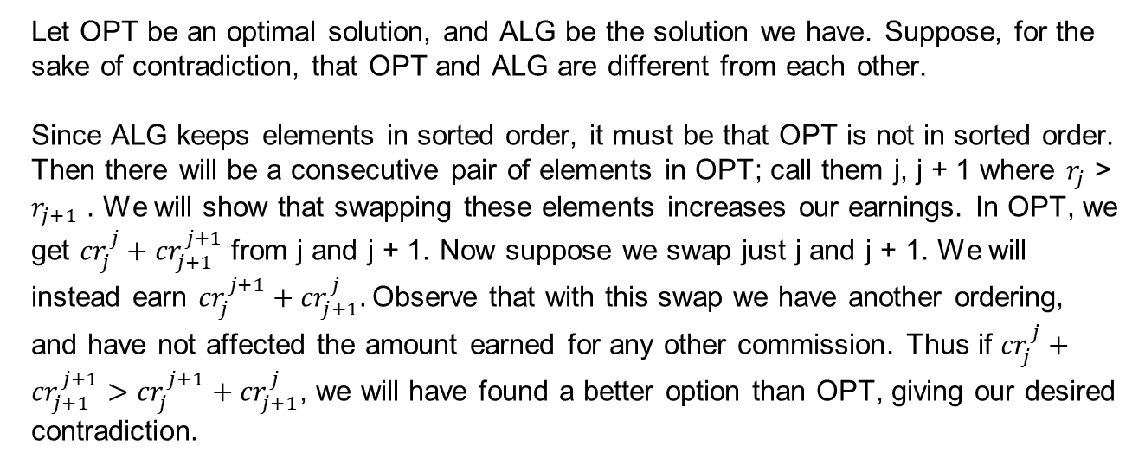
Problem 3.6 – Art Comissions
Let OPT be an optimal solution, and ALG be the solution we have. Suppose, for the sake of contradiction, that OPT and ALG are different from each other.
Since ALG keeps elements in sorted order, it must be that OPT is not in sorted order. Then there will be a consecutive pair of elements in OPT; call them j, j + 1 where $r_{j}$ > $r_{j+1}$ . We will show that swapping these elements increases our earnings. In OPT, we get ${cr}_{j}^{j}+{cr}_{j+1}^{j+1}$ from j and j + 1. Now suppose we swap just j and j + 1. We will instead earn ${cr}_{j}^{j+1}+{cr}_{j+1}^{j}.$Observe that with this swap we have another ordering, and have not affected the amount earned for any other commission. Thus if ${cr}_{j}^{j}+{cr}_{j+1}^{j+1}>{cr}_{j}^{j+1}+{cr}_{j+1}^{j}$, we will have found a better option than OPT, giving our desired contradiction.
Notes:
Take ideas of which greedy approach to use, then tell them that “greedy stays ahead” is the one we went with. Talk through proof if you have time, otherwise remind them that it will be on the solutions to help them as they work through their homework

Slide 82
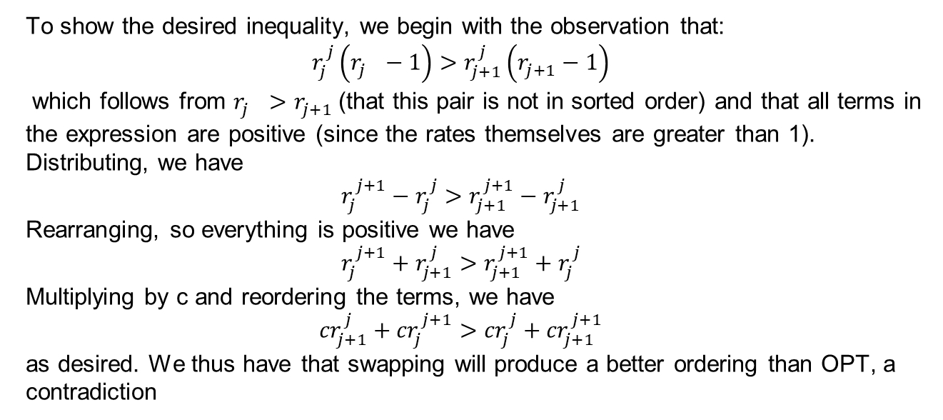
Problem 3.6 – Art Comissions
To show the desired inequality, we begin with the observation that:
$$r_{j}^{j}\left(r_{j}^{}−1\right)>r_{j+1}^{j}\left(r_{j+1}^{}−1\right)$$
which follows from $r_{j}^{}>r_{j+1}^{}$(that this pair is not in sorted order) and that all terms in the expression are positive (since the rates themselves are greater than 1). Distributing, we have
$$r_{j}^{j+1}−r_{j}^{j}>r_{j+1}^{j+1}−r_{j+1}^{j}$$
Rearranging, so everything is positive we have
$$r_{j}^{j+1}+r_{j+1}^{j}>r_{j+1}^{j+1}+r_{j}^{j}$$
Multiplying by c and reordering the terms, we have
$${cr}_{j+1}^{j}+{cr}_{j}^{j+1}>{cr}_{j}^{j}+{cr}_{j+1}^{j+1}$$
as desired. We thus have that swapping will produce a better ordering than OPT, a contradiction
Notes:
Take ideas of which greedy approach to use, then tell them that “greedy stays ahead” is the one we went with. Talk through proof if you have time, otherwise remind them that it will be on the solutions to help them as they work through their homework

Slide 83
3.7. Optimize and Analyze the Run Time
Notes:
Probably won’t have time for this, but remind them this will be in the solutions so they can use it when they’re working on homework

Slide 84
Problem 3.7 – Art Comissions
Write the big-O of your code and justify the running time with a few sentences.
Notes:
~5-8 minutes at least for them to think and discuss, MAKE SURE they actually brainstorm

Slide 85
Problem 3.7 – Another Greedy Algorithm
Write the big-O of your code and justify the running time with a few sentences.
The entire algorithm is a sort, which runs in O(nlog(n)) time.
Notes:
~5-8 minutes at least for them to think and discuss, MAKE SURE they actually brainstorm

Slide 86
That’s All, Folks!
Thanks for coming to section this week!
Any questions?

