Slide 1
CSE 421 Section 1
Stable Matching

Slide 2
Administrivia & Introductions

Slide 3
Your Section TAs
TA 1
  Anything you want to say about yourself
TA 2
  content

Slide 4
Homework
Submissions
  LaTeX
  Word Editor that supports mathematical equations
All homeworks will be turned in via Gradescope
Homeworks typically due on Wednesdays at 11:59pm
Late day policy – 5 late days. Maximum 2 days late per assignment. Otherwise 25% per day.

Slide 5
Announcements & Reminders
Section Materials
  Handouts will be provided in each section
  Worksheets and sample solutions will be available on the course calendar later this evening
HW1
  Due Wednesday 1/10 @ 11:59pm

Slide 6
Stable Matching

Slide 7
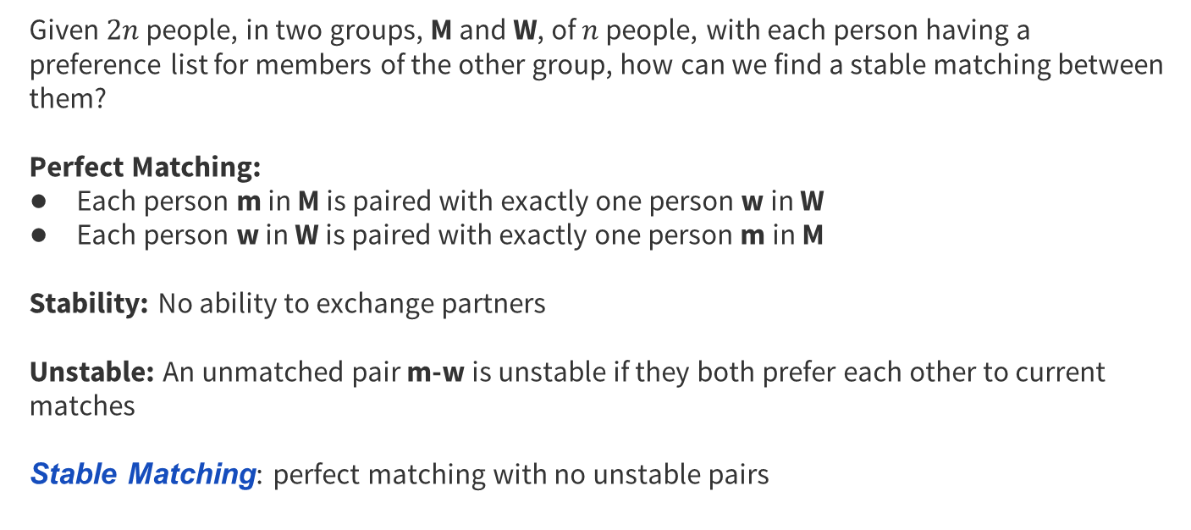
Stable Matching
Given $2n$ people, in two groups, M and W, of $n$ people, with each person having a preference list for members of the other group, how can we find a stable matching between them?
Perfect Matching:
Each person m in M is paired with exactly one person w in W
Each person w in W is paired with exactly one person m in M
Stability: No ability to exchange partners
Unstable: An unmatched pair m-w is unstable if they both prefer each other to current matches
Stable Matching: perfect matching with no unstable pairs

Slide 8
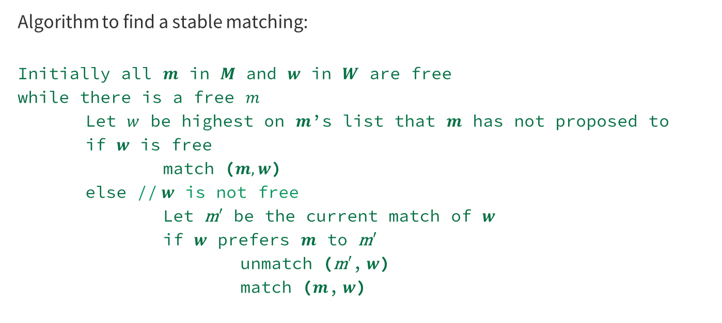
Gale-Shapley Algorithm
Algorithm to find a stable matching:
Initially all $m$ in $M$ and $w$ in $W$ are free
while there is a free $m$
Let $w$ be highest on $m$’s list that $m$ has not proposed to
if $w$ is free
match ($m, w$)
else // $w$ is not free
Let m$′$ be the current match of $w$
if $w$ prefers $m$ to m$′$
unmatch (m$′$, $w$)
match ($m$, $w$)

Slide 9
Problem 1 – Gale-Shapley
Consider the following stable matching instance:
m₁: w₃, w₁, w₂, w₄
m₂: w₂, w₁, w₄, w₃
m₃: w₂, w₃, w₁, w₄
m₄: w₃, w₄, w₁, w₂
w₁: m₄, m₁, m₃, m₂
w₂: m₁, m₃, m₂, m₄
w₃: m₁, m₃, m₄, m₂
w₄: m₃, m₁, m₂, m₄
Run the Gale-Shapley Algorithm on the instance above. When choosing which free m in M to propose next, always choose the one with the smallest index (e.g., if m₁ and m₂ are both free, always choose m₁).

Slide 10
Problem 1 – Gale-Shapley
Run the Gale-Shapley Algorithm on the instance above. When choosing which free m in M to propose next, always choose the one with the smallest index (e.g., if m₁ and m₂ are both free, always choose m₁).
m₁: w₃, w₁, w₂, w₄
m₂: w₂, w₁, w₄, w₃
m₃: w₂, w₃, w₁, w₄
m₄: w₃, w₄, w₁, w₂
w₁: m₄, m₁, m₃, m₂
w₂: m₁, m₃, m₂, m₄
w₃: m₁, m₃, m₄, m₂
w₄: m₃, m₁, m₂, m₄
m₁ chooses w₃ (m₁, w₃)

Slide 11
Problem 1 – Gale-Shapley
Run the Gale-Shapley Algorithm on the instance above. When choosing which free m in M to propose next, always choose the one with the smallest index (e.g., if m₁ and m₂ are both free, always choose m₁).
m₁: w₃, w₁, w₂, w₄
m₂: w₂, w₁, w₄, w₃
m₃: w₂, w₃, w₁, w₄
m₄: w₃, w₄, w₁, w₂
w₁: m₄, m₁, m₃, m₂
w₂: m₁, m₃, m₂, m₄
w₃: m₁, m₃, m₄, m₂
w₄: m₃, m₁, m₂, m₄
m₁ chooses w₃ (m₁, w₃)
m₂ chooses w₂ (m₁, w₃), (m₂, w₂)

Slide 12
Problem 1 – Gale-Shapley
Run the Gale-Shapley Algorithm on the instance above. When choosing which free m in M to propose next, always choose the one with the smallest index (e.g., if m₁ and m₂ are both free, always choose m₁).
m₁: w₃, w₁, w₂, w₄
m₂: w₂, w₁, w₄, w₃
m₃: w₂, w₃, w₁, w₄
m₄: w₃, w₄, w₁, w₂
w₁: m₄, m₁, m₃, m₂
w₂: m₁, m₃, m₂, m₄
w₃: m₁, m₃, m₄, m₂
w₄: m₃, m₁, m₂, m₄
m₁ chooses w₃ (m₁, w₃)
m₂ chooses w₂ (m₁, w₃), (m₂, w₂)
m₃ chooses w₂ (m₁, w₃), (m₂, w₂), (m₃, w₂)?

Slide 13
Problem 1 – Gale-Shapley
Run the Gale-Shapley Algorithm on the instance above. When choosing which free m in M to propose next, always choose the one with the smallest index (e.g., if m₁ and m₂ are both free, always choose m₁).
m₁: w₃, w₁, w₂, w₄
m₂: w₂, w₁, w₄, w₃
m₃: w₂, w₃, w₁, w₄
m₄: w₃, w₄, w₁, w₂
w₁: m₄, m₁, m₃, m₂
w₂: m₁, m₃, m₂, m₄
w₃: m₁, m₃, m₄, m₂
w₄: m₃, m₁, m₂, m₄
m₁ chooses w₃ (m₁, w₃)
m₂ chooses w₂ (m₁, w₃), (m₂, w₂)
m₃ chooses w₂ (m₁, w₃), (m₂, w₂), (m₃, w₂)

Slide 14
Problem 1 – Gale-Shapley
Run the Gale-Shapley Algorithm on the instance above. When choosing which free m in M to propose next, always choose the one with the smallest index (e.g., if m₁ and m₂ are both free, always choose m₁).
m₁: w₃, w₁, w₂, w₄
m₂: w₂, w₁, w₄, w₃
m₃: w₂, w₃, w₁, w₄
m₄: w₃, w₄, w₁, w₂
w₁: m₄, m₁, m₃, m₂
w₂: m₁, m₃, m₂, m₄
w₃: m₁, m₃, m₄, m₂
w₄: m₃, m₁, m₂, m₄
m₁ chooses w₃ (m₁, w₃)
m₂ chooses w₂ (m₁, w₃), (m₂, w₂)
m₃ chooses w₂ (m₁, w₃), (m₂, w₂), (m₃, w₂)
m₂ chooses w₁ (m₁, w₃), (m₂, w₁), (m₃, w₂)

Slide 15
Problem 1 – Gale-Shapley
Run the Gale-Shapley Algorithm on the instance above. When choosing which free m in M to propose next, always choose the one with the smallest index (e.g., if m₁ and m₂ are both free, always choose m₁).
m₁: w₃, w₁, w₂, w₄
m₂: w₂, w₁, w₄, w₃
m₃: w₂, w₃, w₁, w₄
m₄: w₃, w₄, w₁, w₂
w₁: m₄, m₁, m₃, m₂
w₂: m₁, m₃, m₂, m₄
w₃: m₁, m₃, m₄, m₂
w₄: m₃, m₁, m₂, m₄
m₁ chooses w₃ (m₁, w₃)
m₂ chooses w₂ (m₁, w₃), (m₂, w₂)
m₃ chooses w₂ (m₁, w₃), (m₂, w₂), (m₃, w₂)
m₂ chooses w₁ (m₁, w₃), (m₂, w₁), (m₃, w₂)
m₄ chooses w₃ (m₁, w₃), (m₂, w₁), (m₃, w₂), (m₄, w₃)?

Slide 16
Problem 1 – Gale-Shapley
Run the Gale-Shapley Algorithm on the instance above. When choosing which free m in M to propose next, always choose the one with the smallest index (e.g., if m₁ and m₂ are both free, always choose m₁).
m₁: w₃, w₁, w₂, w₄
m₂: w₂, w₁, w₄, w₃
m₃: w₂, w₃, w₁, w₄
m₄: w₃, w₄, w₁, w₂
w₁: m₄, m₁, m₃, m₂
w₂: m₁, m₃, m₂, m₄
w₃: m₁, m₃, m₄, m₂
w₄: m₃, m₁, m₂, m₄
m₁ chooses w₃ (m₁, w₃)
m₂ chooses w₂ (m₁, w₃), (m₂, w₂)
m₃ chooses w₂ (m₁, w₃), (m₂, w₂), (m₃, w₂)
m₂ chooses w₁ (m₁, w₃), (m₂, w₁), (m₃, w₂)
m₄ chooses w₃ (m₁, w₃), (m₂, w₁), (m₃, w₂) (m₄, w₃) failed

Slide 17
Problem 1 – Gale-Shapley
Run the Gale-Shapley Algorithm on the instance above. When choosing which free m in M to propose next, always choose the one with the smallest index (e.g., if m₁ and m₂ are both free, always choose m₁).
m₁: w₃, w₁, w₂, w₄
m₂: w₂, w₁, w₄, w₃
m₃: w₂, w₃, w₁, w₄
m₄: w₃, w₄, w₁, w₂
w₁: m₄, m₁, m₃, m₂
w₂: m₁, m₃, m₂, m₄
w₃: m₁, m₃, m₄, m₂
w₄: m₃, m₁, m₂, m₄
m₁ chooses w₃ (m₁, w₃)
m₂ chooses w₂ (m₁, w₃), (m₂, w₂)
m₃ chooses w₂ (m₁, w₃), (m₂, w₂), (m₃, w₂)
m₂ chooses w₁ (m₁, w₃), (m₂, w₁), (m₃, w₂)
m₄ chooses w₃ (m₁, w₃), (m₂, w₁), (m₃, w₂) (m₄, w₃) failed
m₄ chooses w₄ (m₁, w₃), (m₂, w₁), (m₃, w₂), (m₄, w₄)

Slide 18
Problem 1 – Gale-Shapley
Run the Gale-Shapley Algorithm on the instance above. When choosing which free m in M to propose next, always choose the one with the smallest index (e.g., if m₁ and m₂ are both free, always choose m₁).
m₁: w₃, w₁, w₂, w₄
m₂: w₂, w₁, w₄, w₃
m₃: w₂, w₃, w₁, w₄
m₄: w₃, w₄, w₁, w₂
w₁: m₄, m₁, m₃, m₂
w₂: m₁, m₃, m₂, m₄
w₃: m₁, m₃, m₄, m₂
w₄: m₃, m₁, m₂, m₄
m₁ chooses w₃ (m₁, w₃)
m₂ chooses w₂ (m₁, w₃), (m₂, w₂)
m₃ chooses w₂ (m₁, w₃), (m₂, w₂), (m₃, w₂)
m₂ chooses w₁ (m₁, w₃), (m₂, w₁), (m₃, w₂)
m₄ chooses w₃ (m₁, w₃), (m₂, w₁), (m₃, w₂) (m₄, w₃) failed
m₄ chooses w₄ (m₁, w₃), (m₂, w₁), (m₃, w₂), (m₄, w₄)
(m₁, r₃), (m₂, r₁), (m₃, r₂), (m₄, r₄)

Slide 19
Problem 1 – Gale-Shapley
Run the Gale-Shapley Algorithm on the instance above. When choosing which free m in M to propose next, always choose the one with the largest index (e.g., if m₁ and m₂ are both free, always choose m₂). Do you get the same result?
m₁: w₃, w₁, w₂, w₄
m₂: w₂, w₁, w₄, w₃
m₃: w₂, w₃, w₁, w₄
m₄: w₃, w₄, w₁, w₂
w₁: m₄, m₁, m₃, m₂
w₂: m₁, m₃, m₂, m₄
w₃: m₁, m₃, m₄, m₂
w₄: m₃, m₁, m₂, m₄
Now run the algorithm with the same preferences but with the roles of M and W reversed (that is the w_{i} do the proposing) breaking ties by taking the free w_{i} with the smallest index i. Do you get the same result?
Work on parts b and c of this problem with the people around you, and then we’ll go over it together!

Slide 20
Problem 1 – Gale-Shapley
Run the Gale-Shapley Algorithm on the instance above. When choosing which free m in M to propose next, always choose the one with the largest index (e.g., if m₁ and m₂ are both free, always choose m₂). Do you get the same result?
m₁: w₃, w₁, w₂, w₄
m₂: w₂, w₁, w₄, w₃
m₃: w₂, w₃, w₁, w₄
m₄: w₃, w₄, w₁, w₂
w₁: m₄, m₁, m₃, m₂
w₂: m₁, m₃, m₂, m₄
w₃: m₁, m₃, m₄, m₂
w₄: m₃, m₁, m₂, m₄

Slide 21
Problem 1 – Gale-Shapley
Run the Gale-Shapley Algorithm on the instance above. When choosing which free m in M to propose next, always choose the one with the largest index (e.g., if m₁ and m₂ are both free, always choose m₂). Do you get the same result?
The steps of the Gale-Shapley Algorithm with the free m in M with largest index proposing first:
m₄ chooses w₃ (m₄, w₃)
m₃ chooses w₂ (m₃, w₂),(m₄, w₃)
m₂ chooses w₂ (m₃, w₂),(m₄, w₃) (m₂, w₂) failed
m₂ chooses w₁ (m₂, w₁),(m₃, w₂),(m₄, w₃)
m₁ chooses w₃ (m₁, w₃),(m₂, w₁),(m₃, w₂),(m₄, w₃)
m₄ chooses w₄ (m₁, w₃),(m₂, w₁),(m₃, w₂),(m₄, w₄)
We ended up with the same result!
m₁: w₃, w₁, w₂, w₄
m₂: w₂, w₁, w₄, w₃
m₃: w₂, w₃, w₁, w₄
m₄: w₃, w₄, w₁, w₂
w₁: m₄, m₁, m₃, m₂
w₂: m₁, m₃, m₂, m₄
w₃: m₁, m₃, m₄, m₂
w₄: m₃, m₁, m₂, m₄

Slide 22
Problem 1 – Gale-Shapley
Now run the algorithm with the people in W proposing, breaking ties by taking the free w_{i} with the smallest index. Do you get the same result?
m₁: w₃, w₁, w₂, w₄
m₂: w₂, w₁, w₄, w₃
m₃: w₂, w₃, w₁, w₄
m₄: w₃, w₄, w₁, w₂
w₁: m₄, m₁, m₃, m₂
w₂: m₁, m₃, m₂, m₄
w₃: m₁, m₃, m₄, m₂
w₄: m₃, m₁, m₂, m₄

Slide 23
Problem 1 – Gale-Shapley
Now run the algorithm with the people in W proposing, breaking ties by taking the free w_{i} with the smallest index. Do you get the same result?
The steps of the Gale-Shapley Algorithm with the w in W proposing:
w₁ chooses p₄ (m₄, w₁)
w₂ chooses p₁ (m₁, w₂),(m₄, w₁)
w₃ chooses p₁ (m₁, w₃),(m₁, w₂),(m₄, w₁)
w₂ chooses p₃ (m₁, w₃),(m₃, w₂),(m₄, w₁)
w₄ chooses p₃ (m₁, w₃),(m₃, w₂),(m₄, w₁) (m₃, w₄) failed
w₄ chooses p₁ (m₁, w₃),(m₃, w₂),(m₄, w₁) (m₁, w₄) failed
w₄ chooses p₂ (m₁, w₃),(m₂, w₄),(m₃, w₂),(m₄, w₁)
No, the result is different when we have the w in W propose as opposed to the m in M.
m₁: w₃, w₁, w₂, w₄
m₂: w₂, w₁, w₄, w₃
m₃: w₂, w₃, w₁, w₄
m₄: w₃, w₄, w₁, w₂
w₁: m₄, m₁, m₃, m₂
w₂: m₁, m₃, m₂, m₄
w₃: m₁, m₃, m₄, m₂
w₄: m₃, m₁, m₂, m₄

Slide 24
Problem 2 – True/False
Determine if the following statements are true or false:
True or false? In every instance of the stable matching problem, there is a stable matching containing a pair (m,w) such that m is ranked first on the preference list of w and w is ranked first on the preference list of m.
Work on this problem with the people around you, and then we’ll go over it together!

Slide 25




Problem 2 – True/False
Determine if the following statements are true or false:
True or false? In every instance of the stable matching problem, there is a stable matching containing a pair (m,w) such that m is ranked first on the preference list of w and w is ranked first on the preference list of m.
False. Note the following counterexample. In both purple and green matchings, this pair does not exist:
$$m_{1}:w_{1}>w_{2}$$
$$w_{1}:m_{2}>m_{1}$$
$$m_{2}:w_{2}>w_{1}$$
$$w_{2}:m_{1}>m_{2}$$

Slide 26
Problem 2 – True/False
Determine if the following statements are true or false:
Consider an instance of the stable matching problem in which there exists a man m and a woman w such that m is ranked first on the preference list of w and w is ranked first on the preference list of m. Then in every stable matching S for this instance, the pair (m,w) belong to S.
Work on this problem with the people around you, and then we’ll go over it together!

Slide 27
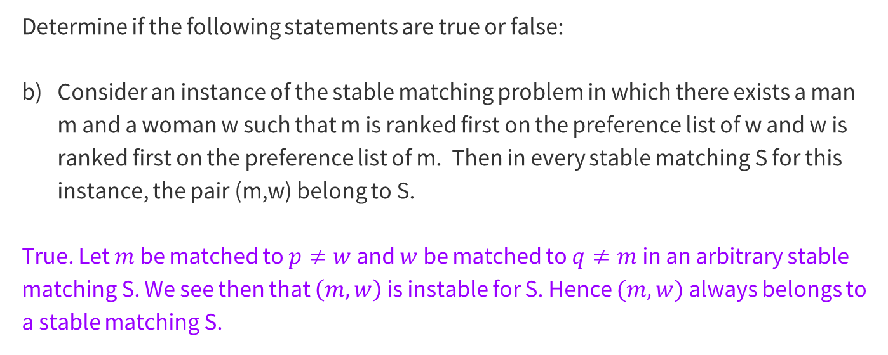
Problem 2 – True/False
Determine if the following statements are true or false:
Consider an instance of the stable matching problem in which there exists a man m and a woman w such that m is ranked first on the preference list of w and w is ranked first on the preference list of m. Then in every stable matching S for this instance, the pair (m,w) belong to S.
True. Let $m$ be matched to $p≠w$ and $w$ be matched to $q≠m$ in an arbitrary stable matching S. We see then that $\left(m, w\right)$ is instable for S. Hence $(m, w)$ always belongs to a stable matching S.

Slide 28
Induction

Slide 29
Induction
You will be writing induction proofs in this class.
The style requirements for proofs in this class are less stringent than the style requirements from 311.

Slide 30
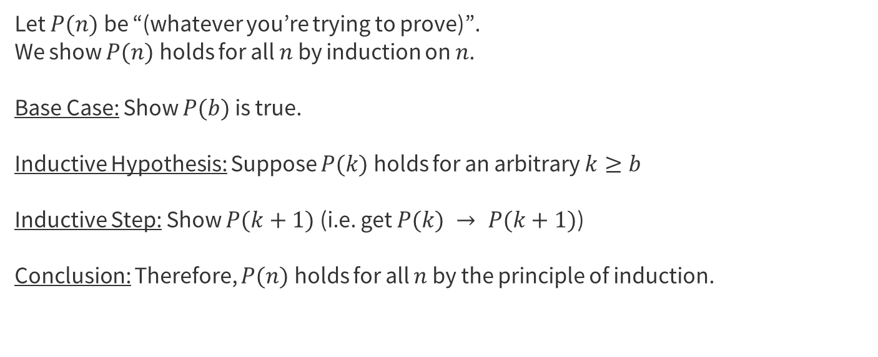
Induction Template
Let $P(n)$ be “(whatever you’re trying to prove)”.
We show $P(n)$ holds for all $n$ by induction on $n$.
Base Case: Show $P(b)$ is true.
Inductive Hypothesis: Suppose $P(k)$ holds for an arbitrary $k≥b$
Inductive Step: Show $P(k+1)$ (i.e. get $P(k) → P(k+1)$)
Conclusion: Therefore, $P(n)$ holds for all $n$ by the principle of induction.

Slide 31
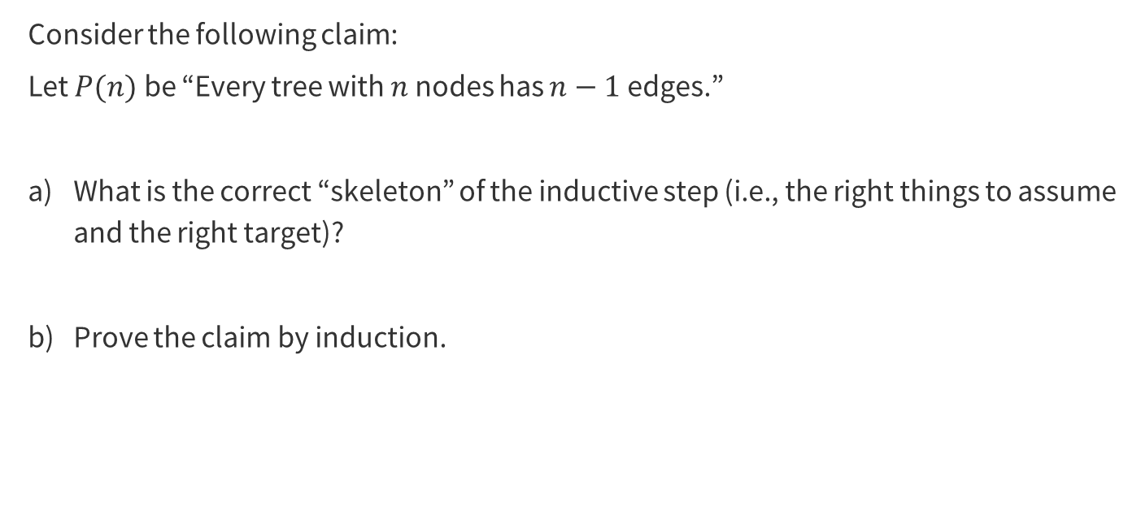
Problem 3 – Induction Review
Consider the following claim:
Let $P(n)$ be “Every tree with $n$ nodes has $n−1$ edges.”
What is the correct “skeleton” of the inductive step (i.e., the right things to assume and the right target)?
Prove the claim by induction.

Slide 32

Problem 3 – Induction Review
Consider the following claim:
Let $P(n)$ be “Every tree with $n$ nodes has $n−1$ edges.”
What is the correct “skeleton” of the inductive step (i.e., the right things to assume and the right target)?
Work on this problem with the people around you, and then we’ll go over it together!

Slide 33
Problem 3 – Induction Review
Consider the following claim:
Let $P(n)$ be “Every tree with $n$ nodes has $n−1$ edges.”
What is the correct “skeleton” of the inductive step (i.e., the right things to assume and the right target)?

Slide 34
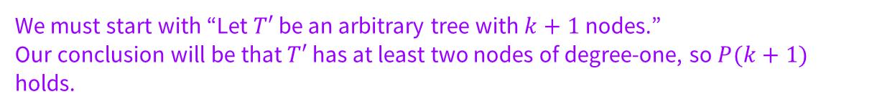
Problem 3 – Induction Review
Consider the following claim:
Let $P(n)$ be “Every tree with $n$ nodes has $n−1$ edges.”
What is the correct “skeleton” of the inductive step (i.e., the right things to assume and the right target)?
We must start with “Let $T′$ be an arbitrary tree with $k+1$ nodes.”
Our conclusion will be that $T′$ has at least two nodes of degree-one, so $P(k+1)$ holds.

Slide 35
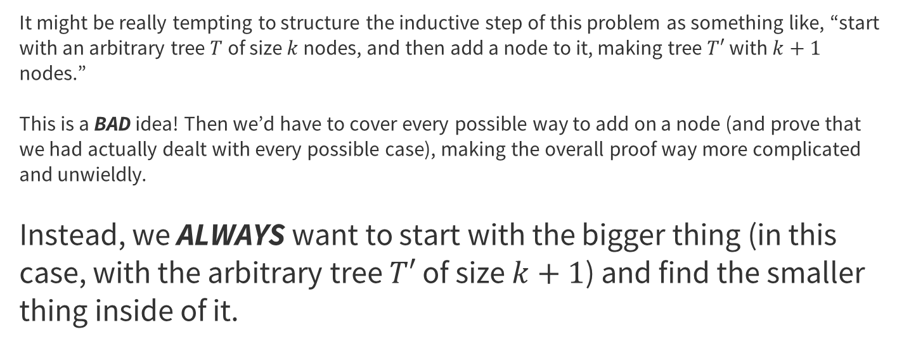
KEY Induction Concept
It might be really tempting to structure the inductive step of this problem as something like, “start with an arbitrary tree $T$ of size $k$ nodes, and then add a node to it, making tree $T′$ with $k+1$ nodes.”
This is a BAD idea! Then we’d have to cover every possible way to add on a node (and prove that we had actually dealt with every possible case), making the overall proof way more complicated and unwieldly.
Instead, we ALWAYS want to start with the bigger thing (in this case, with the arbitrary tree $T′$ of size $k+1$) and find the smaller thing inside of it.

Slide 36

Problem 3 – Induction Review
Consider the following claim:
Let $P(n)$ be “Every tree with $n$ nodes has $n−1$ edges.”
Prove the claim by induction.
Work on this problem with the people around you, and then we’ll go over it together!

Slide 37

Problem 3 – Induction Review
Prove the claim by induction.
Let P(n) be “Every tree with 𝑛 nodes has 𝑛−1 edges.” We prove the claim by induction on $n$.
Base Case: $n=1$. This tree clearly has 1 – 1 = 0 edges.
Inductive Hypothesis: Suppose $P(n)$ holds for $n=1, …, k$ for an arbitrary $k≥1$.
Inductive Step: Let T be a tree with $k+1$ nodes. Let $d$ denote the node that is a leaf in the tree T. Let T’ be the graph we get after we remove $d$ and its connected edges. We see T’ is still connected and undirected, and still acyclic as the removal of the node has not created a cycle. Hence, T’ is a tree.
By IH, we see that T’ has $k−1$ edges. Let us add the node $d$ back to the tree. Since it is a leaf node, it only has one edge, and therefore T has $\left(k−1\right)+1=k$ edges.

Slide 38
Proof or Counterexample?

Slide 39
Prove or Disprove?
Often, you will be given a statement, and then asked to either prove or disprove it. This can be stressful! How do you know which you should start with?
The best way to begin, especially when you don’t know if the claim is even true, is to try to understand it better by producing some examples. This has two main benefits that will help, whether you end up proving or disproving the claim:
You get a better understanding of the statement so now you have a clear method of approach, OR
You find a counterexample, which allows you to easily write a quick proof that the statement is false!

Slide 40
Problem 2 – A Quick Proof
Is it possible to have a stable matching instance with more than 2 stable matchings? If so, give an instance and at least 3 stable matchings. If not, prove that every instance has at most 2 stable matchings.
Work on this problem with the people around you, and then we’ll go over it together!

Slide 41
Problem 2 – A Quick Proof
Is it possible to have a stable matching instance with more than 2 stable matchings? If so, give an instance and at least 3 stable matchings. If not, prove that every instance has at most 2 stable matchings.

Slide 42
Problem 2 – A Quick Proof
Is it possible to have a stable matching instance with more than 2 stable matchings? If so, give an instance and at least 3 stable matchings. If not, prove that every instance has at most 2 stable matchings.
Consider the following instance:
m₁ : w₁, w₂, w₃, w₄
m₂ : w₂, w₁, w₄, w₃
m₃ : w₃, w₄, w₁, w₂
m₄ : w₄, w₃, w₂, w₁
w₁ : m₂, m₁, m₄, m₃
w₂ : m₁, m₂, m₃, m₄
w₃ : m₄, m₃, m₂, m₁
w₄ : m₃, m₄, m₁, m₂
This instance has four stable matchings:
(m₁, w₁),(m₂, w₂),(m₃, w₃),(m₄, w₄)
(m₁, w₁),(m₂, w₂),(m₃, w₄),(m₄, w₃)
(m₁, w₂),(m₂, w₁),(m₃, w₃),(m₄, w₄)
(m₁, w₂),(m₂, w₁),(m₃, w₄),(m₄, w₃)

Slide 43
That’s All, Folks!
Thanks for coming to section this week!
Any questions?

