Slide 1
CSE 421 Introduction to Algorithms
NP-Complete
P
Winter 2024
Lecture 26
NP-Completeness and Beyond

Slide 2
Announcements
Final Exam: Monday, March 11, 2:30-4:20 PM
One Hour Fifty Minutes
Comprehensive (but roughly 60% post midterm)
Topics will include: dynamic programming, network flow, network flow reductions, NP-completeness, and other stuff
Daylight Saving Time starts 2:00 AM, March 10

Slide 3
NP-Completeness Proofs
Prove that problem X is NP-Complete
Show that X is in NP (usually easy)
Pick a known NP complete problem Y
Show Y <_{P} X

Slide 4
What we don’t know
P vs. NP
NP-Complete
P = NP
P

Slide 5
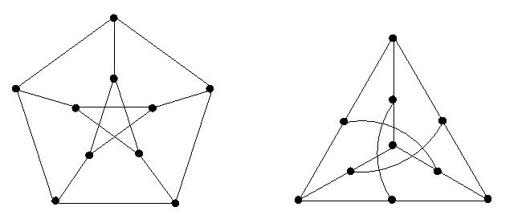
If P ≠ NP, is there anything in between
Yes, Ladner [1975]
Problems not known to be in P or NP Complete
Shortest Vector in a Lattice
Factorization
Discrete Log
Graph Isomorphism
Solve g^{k} = b over a finite group

Slide 6
What if?
3-SAT can be solved in O(n³) time
3-SAT can be solved in O(n⁵⁰⁰⁰) time
Factorization can be solved in O(n³) time

Slide 7
What about Quantum?
Computing with Quantum Devices
Superposition of states
Complexity Theory: BQP - Bounded Error Quantum Polynomial Time
Factorization is in BQP Time (Shor’s Algorithm)
NP-Complete
P
BQP

Slide 8
Cryptography
Standard cryptography depends on number theory problems being hard
Keeping factorization secret
Practical Quantum computing would break RSA
Post-Quantum Cryptography
Find other hard problems to base cryptography on

Slide 9
Shortest Vector in a Lattice
Given a set of vectors L, what is the shortest non-zero vector that can be formed by integer linear combinations of the vectors?
The problem is NP-Complete under randomized polynomial time reductions
NP-Complete
P

Slide 10
Complexity Theory
Computational requirements to recognize languages
Models of Computation
Resources
Hierarchies
All Languages
Decidable Languages
Context Free Languages
Regular Languages

Slide 11
Time complexity
P: (Deterministic) Polynomial Time
NP: Non-deterministic Polynomial Time
EXP: Exponential Time

Slide 12
Space Complexity
Amount of Space (Exclusive of Input)
L: Logspace, problems that can be solved in O(log n) space for input of size n
Related to Parallel Complexity
PSPACE, problems that can be required in a polynomial amount of space

Slide 13
So what is beyond NP?

Slide 14
NP vs. Co-NP
Given a Boolean formula, is it true for some choice of inputs
Given a Boolean formula, is it true for all choices of inputs

Slide 15
Problems beyond NP
Exact TSP, Given a graph with edge lengths and an integer K, does the minimum tour have length K
Minimum circuit, Given a circuit C, is it true that there is no smaller circuit that computes the same function a C

Slide 16
Polynomial Hierarchy
Level 1
∃X₁ Φ(X₁), ∀X₁ Φ(X₁)
Level 2
∀X₁∃X₂ Φ(X₁,X₂), ∃X₁∀X₂ Φ(X₁,X₂)
Level 3
∀X₁∃X₂∀X₃ Φ(X₁,X₂,X₃), ∃X₁∀X₂∃X₃ Φ(X₁,X₂,X₃)

Slide 17
Polynomial Space
Quantified Boolean Expressions
∃X₁∀X₂∃X₃...∃X_{n-1}∀X_{n} Φ(X₁,X₂,X₃…X_{n-1}X_{n})
Space bounded games
Competitive Facility Location Problem
N x N Chess
Counting problems
The number of Hamiltonian Circuits
PSpace-Complete
Log Space
P

Slide 18
N X N Chess

Slide 19
Even Harder Problems
public int[] RecolorSwap(int[] coloring) {
int k = maxColor(coloring);
for (int v = 0; v < nVertices; v++) {
if (coloring[v] == k) {
int[] nbdColorCount = ColorCount(v, k, coloring);
List<Edge> edges1 = vertices[v].Edges;
foreach (Edge e1 in edges1) {
int w = e1.Head;
if (nbdColorCount[coloring[w]] == 1)
if (RecolorSwap(v, w, k, coloring))
break;
}
}
}
return coloring;
}
Is this code correct?

Slide 20
Halting Problem
Given a program P that does not take any inputs, does P eventually exit?

Slide 21
Impossibility of solving the Halting Problem
Suppose Halt(P) returns true if P halts, and false otherwise
Consider the program G:
What is Halt(G)?
Define G {
if (Halt(G)){
while (true) ;
}
else {
exit();
}
}

Slide 22
Undecidable Problems
The Halting Problem is undecidable
Impossible problems are hard . . .

