Slide 1
CSE 421 Introduction to Algorithms
Lecture 25
Coping with NP-Completeness

Slide 2
Announcements
Today, Coping with NP-Completeness
Chapters 11 and 12
Friday, Beyond NP-Completeness
Section 8.9, Chapter 9
Homework 9, Due Friday, March 8
Final exam,
Monday, March 11, 2:30-4:20 pm PDT
Comprehensive (~60% post midterm, ~40% pre midterm)
Old finals / answers on home page

Slide 3
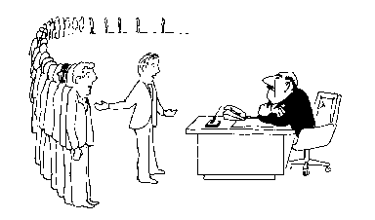
Coping with NP-Completeness
Approximation Algorithms
Exact solution via Branch and Bound
Local Search
I can’t find an efficient algorithm, but neither can all these famous people.

Slide 4
Approximation Algorithms
K-Approximation Algorithm
Worst case ratio of solution and optimal as input size goes to infinity
Minimization problems
Find a solution at most K times the optimum
Maximization problems
Find a solution at least 1/K times the optimum

Slide 5
Vertex Cover
A vertex cover is a subset of the vertices that is adjacent to every edge
VC is NP-Complete
W = {};
E’= E
while E’ is not empty
Select e = (u,v) from E’
Add u and v to W
Remove all edges adjacent to u or v from E’

Slide 6
W = {};
E’= E
while E’ is not empty
Select e = (u,v) from E’
Add u and v to W
Remove all edges adjacent to u or v from E’

Slide 7
VC 2-Opt Bound
When edge e = (u,v) is selected, neither u nor v is in W
At least one of u or v must be in the VC to cover e
Thus, at least ½ the vertices placed in W are necessary

Slide 8
Multiprocessor Scheduling
Unit execution tasks
Precedence graph
K-Processors
Polynomial time for k=2
Open for k = constant
NP-complete if k is part of the problem

Slide 9
Highest level first is 2-Optimal
Choose k items on the highest level
Claim: number of rounds is at least twice the optimal.
Suppose the maximum height of a task is H
A partial round removes < k elements
A full round removes k elements

Slide 10
2-Opt Proof for HLF
The number of partial rounds is at most H
Opt ≥ H
The number of full rounds is at most N / k
Opt ≥ N / k
Partial + Full ≤ H + N / K ≤ 2 Opt

Slide 11
MST Bound for TSP
Undirected graph satisfying triangle inequality
MST Cost ≤ TSP Cost ≤ 2 MST Cost
4
3
4
3
4
1
4
1
2
2
5
5
3
5
3
5
6
4
6
3
3
4
4
3
2
4
3
2
5
6
5
6

Slide 12
Christofides TSP Algorithm
Undirected graph satisfying triangle inequality
Find MST
Add additional edges so that all vertices have even degree
Build Eulerian Tour
4
3
4
1
2
5
5
3/2 Approximation
3
6
4
3
4
3
2
5
6

Slide 13
Christofides Algorithm
4
3
4
3
4
1
4
1
2
2
5
5
5
3
5
3
6
6
4
4
3
3
4
3
4
3
2
2
5
6
5
6
3
4
1
2
5
3
4
4
3
2
6

Slide 14
Bin Packing
Given N items with weight w_{i}, pack the items into as few unit capacity bins as possible
Example: .3, .3, .3, .3, .4, .4

Slide 15
First Fit Packing
First Fit
Theorem: FF(I) is at most 17/10 Opt(I) + 2
First Fit Decreasing
Theorem: FFD(I) is at most 11/9 Opt (I) + 4

Slide 16
Knapsack
Items {I₁, I₂, … I_{n}}
Weights {w₁, w₂, …,w_{n}}, Values {v₁, v₂, …, v_{n}}
Find set S of indices to maximize:
Σ_{iεS}v_{i} such that Σ_{iεS}w_{i} ≤ K
Dynamic Programming solution:
Find the smallest set of a given value
Runtime O(nV) where V is the sum of the values
Goal – for any ε > 0, we want a polynomial time algorithm that finds a solution of at least (1-ε) Opt

Slide 17
PTAS (Polynomial time approximation scheme)
Idea for approximation algorithm*
Scale values so that ½ ≤ Opt ≤ 1
Let ε = 2^{-k}
Round the values down to multiples of ε²
Solve the DP using ε² values
Runtime O(nε²), Approximation (1-ε)
*Some details omitted in dealing with very small items.

Slide 18
Branch and Bound
Brute force search – tree of all possible solutions
Branch and bound – compute a lower bound on all possible extensions
Prune sub-trees that cannot be better than optimal

Slide 19
Branch and Bound for SAT
Solving SAT by setting one variable at a time
Setting a literal to 1 removes the clause
Setting a literal to 0 removes the literal
Removing the last literal kills the subtree
Heuristics for variable ordering
Very important algorithms in practice, especially for software verification

Slide 20
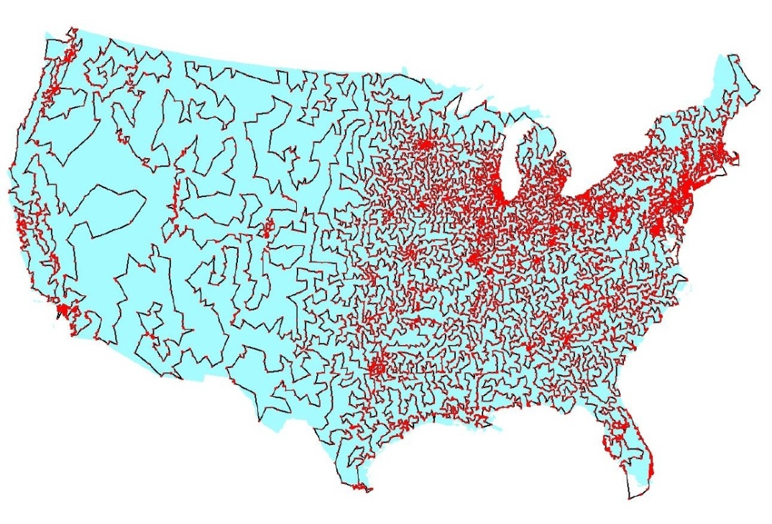
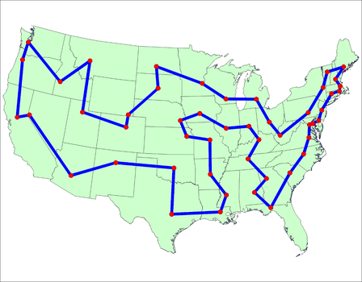
Branch and Bound for TSP
Enumerate all possible paths
Lower bound, Current path cost plus MST of remaining points
Euclidean TSP
Points on the plane with Euclidean Distance
Sample data set: State Capitals

Slide 21
Local Optimization
Improve an optimization problem by local improvement
Neighborhood structure on solutions
Travelling Salesman 2-Opt (or K-Opt)
Independent Set Local Replacement

Slide 22
Enhancements to Local Search
Randomized Local Search
Start from lots of places
Metropolis Algorithm
Choose random neighbor
Move if cheaper
If worse, move with some probability
Simulated Annealing
Like Metropolis, but adjust probabilities to simulate cooling

