Slide 1
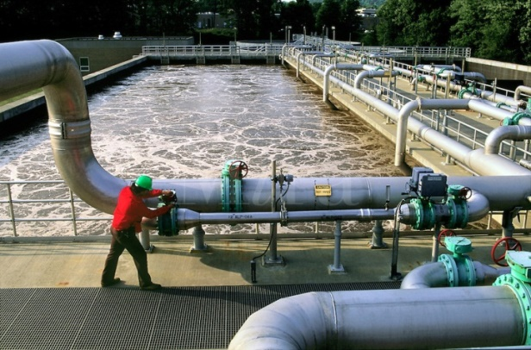
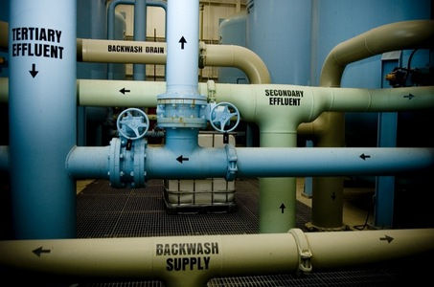
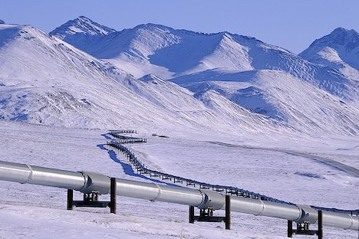
CSE 421 Introduction to Algorithms
Winter 2024
Lecture 20
Network Flow Applications

Slide 2
Today’s topics
Network flow reductions
Multi source flow
Reviewer Assignment
Baseball Scheduling
Image Segmentation
Task Selection
Reading: 7.5, 7.6, 7.10-7.12

Slide 3
Multi-source network flow
Multi-source network flow
Sources s₁, s₂, . . ., s_{k}
Sinks t₁, t₂, . . . , t_{j}
Solve with Single source network flow

Slide 4
Resource Allocation: Assignment of reviewers
A set of papers P₁, . . ., P_{n}
A set of reviewers R₁, . . ., R_{m}
Paper P_{i} requires A_{i} reviewers
Reviewer R_{j} can review B_{j} papers
For each reviewer R_{j}, there is a list of paper L_{j1}, . . ., L_{jk} that R_{j} is qualified to review

Slide 5
Resource Allocation: Illegal Campaign Donations
Candidates C_{i}, . . ., C_{n}
Donate b_{i} to C_{i}
With a little help from your friends
Friends F₁, . . ., F_{m}
F_{i} can give a_{ij} to candidate C_{j}
You can give at most M_{i} to F_{i}

Slide 6
Baseball elimination
Can the Dinosaurs win the league?
Remaining games:
AB, AC, AD, AD, AD, BC, BC, BC, BD, CD
 | W | L
Ants | 4 | 2
Bees | 4 | 2
Cockroaches | 3 | 3
Dinosaurs | 1 | 5
A team wins the league if it has strictly more wins than any other team at the end of the season
A team ties for first place if no team has more wins, and there is some other team with the same
number of wins

Slide 7
Baseball elimination
Can the Fruit Flies win or tie the league?
Remaining games:
AC, AD, AD, AD, AF, BC, BC, BC, BC, BC, BD, BE, BE, BE, BE, BF, CE, CE, CE, CF, CF, DE, DF, EF, EF
 | W | L
Ants | 17 | 12
Bees | 16 | 7
Cockroaches | 16 | 7
Dinosaurs | 14 | 13
Earthworms | 14 | 10
Fruit Flies | 12 | 15

Slide 8
Assume Fruit Flies win remaining games
Fruit Flies are tied for first place if no team wins more than 19 games
Allowable wins
Ants (2)
Bees (3)
Cockroaches (3)
Dinosaurs (5)
Earthworms (5)
18 games to play
AC, AD, AD, AD, BC, BC, BC, BC, BC, BD, BE, BE, BE, BE, CE, CE, CE, DE
 | W | L
Ants | 17 | 13
Bees | 16 | 8
Cockroaches | 16 | 9
Dinosaurs | 14 | 14
Earthworms | 14 | 12
Fruit Flies | 19 | 15

Slide 9
Remaining games
AC, AD, AD, AD, BC, BC, BC, BC, BC, BD, BE, BE, BE, BE, CE, CE, CE, DE
s
AC
AD
BC
BD
BE
CE
DE
A
B
C
D
E
t

Slide 10
Minimum Cut Applications
Image Segmentation
Open Pit Mining / Task Selection Problem
Reduction to Min Cut problem
S, T is a cut if S, T is a partition of the vertices with
s in S and t in T
The capacity of an S, T cut is the sum of the capacities of
all edges going from S to T

Slide 11
Image Segmentation

Slide 12
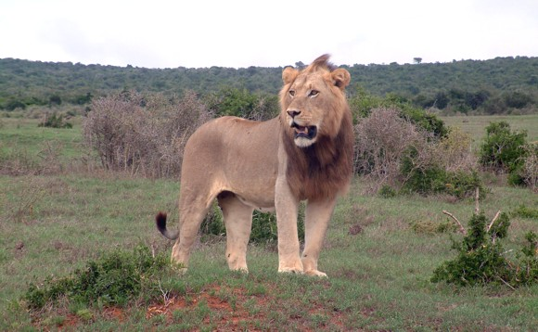
Separate Lion from Savana

Slide 14
Image analysis
a_{i}: value of assigning pixel i to the foreground
b_{i}: value of assigning pixel i to the background
p_{ij}: penalty for assigning i to the foreground, j to the background or vice versa
A: foreground, B: background
Q(A,B) = Σ_{{i in A}}a_{i} + Σ_{{j in B}}b_{j} - Σ_{{(i,j) in E, i in A, j in} _{B}}p_{ij}

Slide 15
Pixel graph to flow graph
s
t

Slide 16
Mincut Construction
s
a_{v}
p_{vu}
u
v
p_{uv}
b_{v}
t

Slide 17
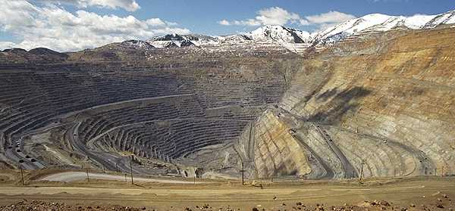
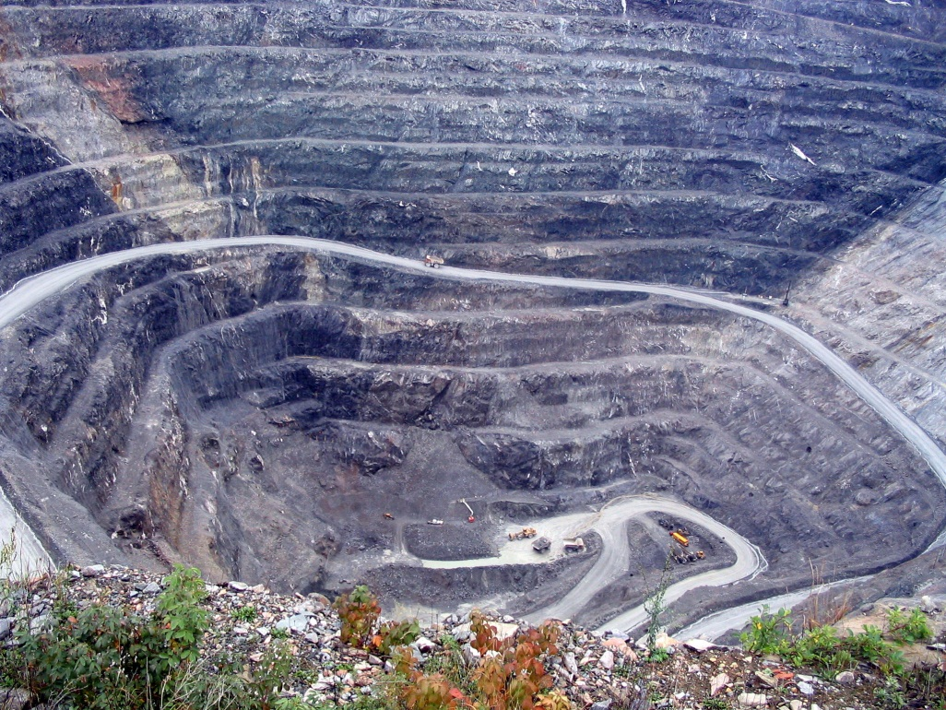
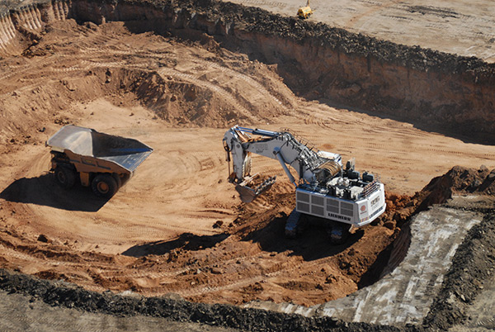
Open Pit Mining

Slide 18
Application of Min-cut
Open Pit Mining Problem
Task Selection Problem
Reduction to Min Cut problem
S, T is a cut if S, T is a partition of the vertices with
s in S and t in T
The capacity of an S, T cut is the sum of the capacities of
all edges going from S to T

Slide 19
Open Pit Mining
Each unit of earth has a profit (possibly negative)
Getting to the ore below the surface requires removing the dirt above
Test drilling gives reasonable estimates of costs
Plan an optimal mining operation

Slide 20
Mine Graph
-4
-3
-2
-1
-1
-3
3
-1
4
-7
-10
-2
8
3
-10

Slide 21
Determine an optimal mine
-5
-3
-4
-4
2
-4
3
-1
-7
-10
-1
-3
-3
3
4
4
-3
-10
-10
-10
4
7
-2
-10
3
-10
-10
-10
-10
6
8
6
-3
-10
-10
-10
-10
-10
-10
1
4
4
-10
-10
-10
-10
-10
-10
-10
-10
-10
-10
-10
-10

Slide 22
Generalization
Precedence graph G=(V,E)
Each v in V has a profit p(v)
A set F is feasible if when w in F, and (v,w) in E, then v in F.
Find a feasible set to maximize the profit
6
-4
-2
-3
5
-1
-10
4

Slide 23
Min cut algorithm for profit maximization
Construct a flow graph where the minimum cut identifies a feasible set that maximizes profit

Slide 24
Precedence graph construction
Precedence graph G=(V,E)
Each edge in E has infinite capacity
Add vertices s, t
Each vertex in V is attached to s and t with finite capacity edges

Slide 25
Find a finite value cut with at least two vertices on each side of the cut
s
Infinite
Finite
t

Slide 26
The sink side of a finite cut is a feasible set
No edges permitted from S to T
If a vertex is in T, all of its ancestors are in T

Slide 27
Setting the costs
s
If p(v) > 0,
cap(v,t) = p(v)
cap(s,v) = 0
If p(v) < 0
cap(s,v) = -p(v)
cap(v,t) = 0
If p(v) = 0
cap(s,v) = 0
cap(v,t) = 0
3
3
1
1
-3
-3
-1
0
2
3
2
1
3
t

Slide 28
Minimum cut gives optimal solution Why?
s
2
2
-2
1
2
-2
1
1
2
1
t

Slide 29
Computing the Profit
Cost(W) = Σ_{{w in W; p(w) < 0}}-p(w)
Benefit(W) = Σ_{{w in W; p(w) > 0}} p(w)
Profit(W) = Benefit(W) – Cost(W)
Maximum cost and benefit
C = Cost(V)
B = Benefit(V)

Slide 30
Express Cap(S,T) in terms of B, C, Cost(T), Benefit(T), and Profit(T)
Cap(S,T) = Cost(T) + Ben(S) = Cost(T) + Ben(S) + Ben(T) – Ben(T)
= B + Cost(T) – Ben(T) = B – Profit(T)

