Slide 1
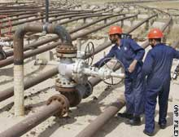
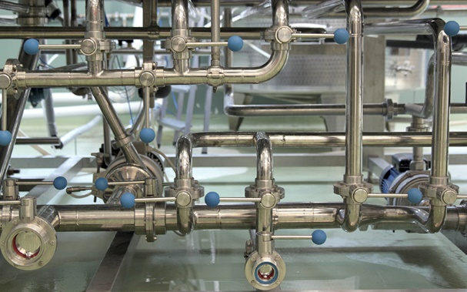
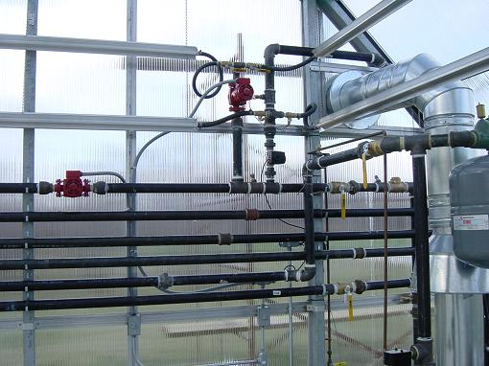
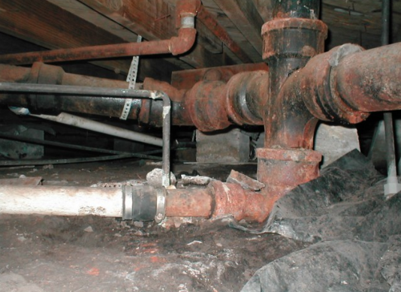
CSE 421 Introduction to Algorithms
Lecture 18
Winter 2024
Network Flow, Part 2

Slide 2
Outline
Network flow definitions
Flow examples
Augmenting Paths
Residual Graph
Ford Fulkerson Algorithm
Cuts
Maxflow-MinCut Theorem
Worst Case Runtime for FF
Improving Runtime bounds
Capacity Scaling
Fully Polynomial Time Algorithms

Slide 3
Network Flow Definitions
Flowgraph: Directed graph with distinguished vertices s (source) and t (sink)
Capacities on the edges, c(e) ≥ 0
Problem, assign flows f(e) to the edges such that:
0 ≤ f(e) ≤ c(e)
Flow is conserved at vertices other than s and t
Flow conservation: flow going into a vertex equals the flow going out
The flow leaving the source is a large as possible

Slide 4
Residual Graph
Flow graph showing the remaining capacity
Flow graph G, Residual Graph G_{R}
G: edge e from u to v with capacity c and flow f
G_{R}: edge e’ from u to v with capacity c – f
G_{R}: edge e’’ from v to u with capacity f
u
u
15/20
0/10
5
10
15
s
15/30
t
s
15
15
t
5
5/10
20/20
5
20
v
v

Slide 5
Augmenting Path Algorithm
Augmenting path in residual graph
Vertices v₁,v₂,…,v_{k}
v₁ = s, v_{k} = t
Possible to add b units of flow between v_{j} and v_{j+1} for j = 1 … k-1
u
u
15/20
0/10
5
10
15
s
15/30
t
s
15
15
t
5
5/10
20/20
5
20
v
v

Slide 6
Ford-Fulkerson Algorithm (1956)
while not done
Construct residual graph G_{R}
Find an s-t path P in G_{R} with capacity b > 0
Add b units of flow along path P in G

Slide 7
Runtime Analysis
Assume the capacities are integers*
Let C be the sum of edge capacities leaving s
The total flow F is at most C
Every iteration increases flow by at least 1, so there are at most C iterations
Cost per iteration is O(m+n)
Runtime is O(C(m+n))
* This is actually a very important assumption, but we are not going to explore this rabbit hole

Slide 8
Flow Example
20
20
a
d
g
5
20
5
5
10
5
5
5
20
s
20
b
20
e
h
30
t
20
10
5
5
20
5
20
20
c
f
i
20
20

Slide 9
Cuts in a graph
Cut: Partition of V into disjoint sets S, T with s in S and t in T.
Cap(S,T): sum of the capacities of edges from S to T
Flow(S,T): net flow out of S
Sum of flows out of S minus sum of flows into S
Flow(S,T) ≤ Cap(S,T)

Slide 10
What is Cap(S,T) and Flow(S,T)
S={s, a, b, e, h}, T = {c, f, i, d, g, t}
20/20
20/20
a
d
g
0/5
0/5
20/20
20/20
5/5
0/5
0/5
5/5
0/20
s
25/30
b
20/20
e
h
30/30
t
20/20
0/5
5/5
20/20
0/5
0/10
15/20
15/25
c
f
i
20/20
10/10

Slide 11
What is Cap(S,T) and Flow(S,T)
S={s, a, b, e, h}, T = {c, f, i, d, g, t}
20/20
20/20
a
d
g
0/5
0/5
20/20
20/20
5/5
0/5
0/5
5/5
0/20
s
25/30
b
20/20
e
h
30/30
t
20/20
0/5
5/5
20/20
0/5
0/10
15/20
15/25
c
f
i
20/20
10/10
Cap(S,T) = 95, Flow(S,T) = 80 – 15 = 65

Slide 12
Minimum value cut
u
40
10
s
10
t
10
40
v

Slide 13
Find a minimum value cut
6
6
5
8
10
3
6
s
7
2
t
4
5
3
8
5
4

Slide 14
Find a minimum value cut
6
6
5
8
10
3
6
s
7
2
t
4
5
3
8
5
4

Slide 15
Find a minimum value cut
6:5
6:5
5:5
8
10:3
3:3
6:5
s
7:6
2:2
t
4:4
5:4
3:3
8:3
5
4:3

Slide 16
MaxFlow – MinCut Theorem
There exists a flow which has the same value as the minimum cut
Proof: Consider a flow where the residual graph has no s-t path with positive capacity
Let S be the set of vertices in G_{R} reachable from s with paths of positive capacity
s
t

Slide 17
Let S be the set of vertices in G_{R} reachable from s with paths of positive capacity
s
u
v
t
S
T
Cap(u,v) = 0 in G_{R}
Cap(u,v) = Flow(u,v) in G
Flow(v,u) = 0 in G
What can we say about the flows and capacity
between u and v?

Slide 18
Max Flow - Min Cut Theorem
Ford-Fulkerson algorithm finds a flow where the residual graph is disconnected, hence FF finds a maximum flow.
If we want to find a minimum cut, we begin by looking for a maximum flow.

Slide 19
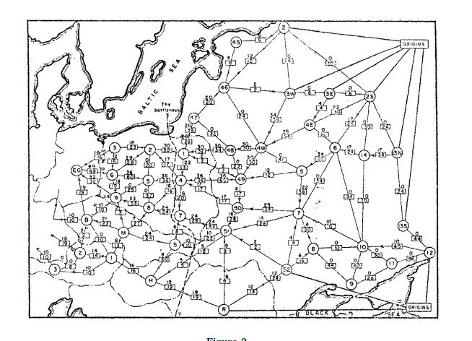
History
Ford / Fulkerson studied network flow in the context of the Soviet Rail Network

Slide 20
Ford Fulkerson Runtime
Cost per phase X number of phases
Phases
Capacity leaving source: C
Add at least one unit per phase
Cost per phase
Build residual graph: O(m)
Find s-t path in residual: O(m)

Slide 21
Performance
The worst case performance of the Ford-Fulkerson algorithm is horrible
u
1000
1000
s
1
t
1000
1000
v

Slide 22
Improving path selection
u
M
M
s
1
t
M
M
v

Slide 23
Better methods of finding augmenting paths
Find the maximum capacity augmenting path
O(m²log(C)) time algorithm for network flow
Find the shortest augmenting path
O(m²n) time algorithm for network flow
Find a blocking flow in the residual graph
O(mnlog n) time algorithm for network flow

Slide 24
Polynomial Time Algorithms
Input of size n, runtime T(n) = O(n^{k})
Input size measures
Bits of input
Number of data items
Maximum item magnitude C
O(Cn^{k}): Exponential
O(n^{k} log C): Polynomial
O(n^{k}): Fully polynomial

Slide 25
Capacity Scaling Algorithm
Choose Δ = 2^{k} such that all edges in G_{R} have capacity less than 2Δ
while Δ ≥ 1
while there is a path P in G_{R} with capacity Δ
Add Δ units of flow along path P in G
Update G_{R}
Δ = Δ / 2
Edmonds-Karp: Easier analysis than Max Capacity First

Slide 26
Analysis
If capacities are integers, then graph is disconnected when Δ = ½
If largest edge capacity is C, then there are at most log C outer phases
At the start of each outer phase, the flow is within 2mΔ of the maximum
So there are at most 2m inner phases for each Δ

Slide 27
Shortest Augmenting Path
Find augmenting paths by BFS
for k = 1 to n
while there is a path P in G_{R} of length k and capacity b > 0
Add b units of flow along path P in G
Update G_{R}
Need to show:
The length of the shortest augmenting path is non-decreasing
Each while loop finds at most m paths

Slide 28
Analysis
Augmenting along shortest path from s to t does not decrease distance from s to t

Slide 29
Analysis
The distance from s to t must increase in G_{R} after m augmentations by shortest paths

Slide 30
Improving the shortest augmenting path algorithm
Find a blocking flow in one phase to increase the length of augmenting paths
Dinitz (Ефим Абрамович Диниц) Algorithm
O(n²m)
Dynamic Trees to decrease cost per augmentation
O(nm log n)

