Slide 1
CSE 421, Introduction to Algorithms
Lecture 15, Winter 2024
Dynamic Programming
Longest Common Subsequence

Slide 2
Announcements
Dynamic Programming Reading:
Weighted Interval Scheduling, Segmented Least Squares, Knapsack and Subset Sum
6.6 String Alignment
6.8 Shortest Paths (Bellman-Ford)
Midterm, Friday, Feb 9
Material through 6.3 and HW 5
Feb 8 Section will be Midterm review
Old exam problems on course homepage
Homework 6 due Feb 14

Slide 3
Longest Common Subsequence
C=c₁…c_{g} is a subsequence of A=a₁…a_{m} if C can be obtained by removing elements from A (but retaining order)
LCS(A, B): A maximum length sequence that is a subsequence of both A and B
LCS(BARTHOLEMEWSIMPSON, KRUSTYTHECLOWN)
= RTHOWN

Slide 4
Optimization recurrence
If a_{j} = b_{k}, Opt[ j,k ] = 1 + Opt[ j-1, k-1 ]
If a_{j} ≠ b_{k}, Opt[ j,k] = max(Opt[ j-1,k], Opt[ j,k-1])

Slide 5
Dynamic Programming Computation

Slide 6
Code to compute Opt[ n, m]
for (int i = 0; i < n; i++)
for (int j = 0; j < m; j++)
if (A[ i ] == B[ j ] )
Opt[ i,j ] = Opt[ i-1, j-1 ] + 1;
else if (Opt[ i-1, j ] >= Opt[ i, j-1 ])
Opt[ i, j ] := Opt[ i-1, j ];
else
Opt[ i, j ] := Opt[ i, j-1];

Slide 7
Storing the path information
A[1..m], B[1..n]
for i := 1 to m Opt[i, 0] := 0;
for j := 1 to n Opt[0,j] := 0;
Opt[0,0] := 0;
for i := 1 to m
for j := 1 to n
if A[i] = B[j] { Opt[i,j] := 1 + Opt[i-1,j-1]; Best[i,j] := Diag; }
else if Opt[i-1, j] >= Opt[i, j-1]
{ Opt[i, j] := Opt[i-1, j], Best[i,j] := Left; }
else { Opt[i, j] := Opt[i, j-1], Best[i,j] := Down; }
b₁…b_{n}
a₁…a_{m}

Slide 8
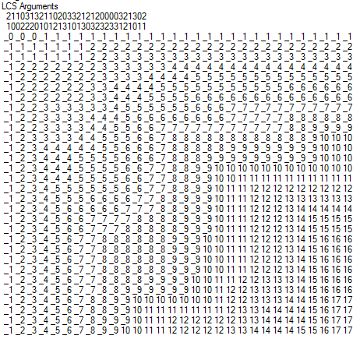
Reconstructing Path from Distances

Slide 9
How good is this algorithm?
Is it feasible to compute the LCS of two strings of length 300,000 on a standard desktop PC? Why or why not.

Slide 10
Implementation 1
public int ComputeLCS() {
int n = str1.Length;
int m = str2.Length;
int[,] opt = new int[n + 1, m + 1];
for (int i = 0; i <= n; i++)
opt[i, 0] = 0;
for (int j = 0; j <= m; j++)
opt[0, j] = 0;
for (int i = 1; i <= n; i++)
for (int j = 1; j <= m; j++)
if (str1[i-1] == str2[j-1])
opt[i, j] = opt[i - 1, j - 1] + 1;
else if (opt[i - 1, j] >= opt[i, j - 1])
opt[i, j] = opt[i - 1, j];
else
opt[i, j] = opt[i, j - 1];
return opt[n,m];
}

Slide 11
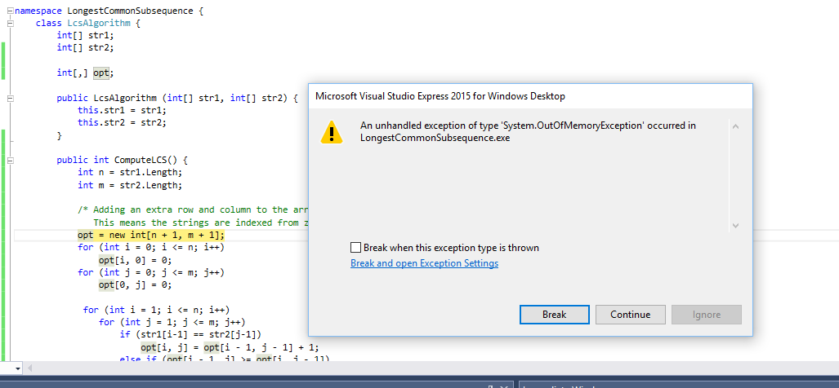
N = 17000
Runtime should be about 5 seconds*
* Personal PC, 10 years old

Slide 12
Implementation 2
public int SpaceEfficientLCS() {
int n = str1.Length;
int m = str2.Length;
int[] prevRow = new int[m + 1];
int[] currRow = new int[m + 1];
for (int j = 0; j <= m; j++)
prevRow[j] = 0;
for (int i = 1; i <= n; i++) {
currRow[0] = 0;
for (int j = 1; j <= m; j++) {
if (str1[i - 1] == str2[j - 1])
currRow[j] = prevRow[j - 1] + 1;
else if (prevRow[j] >= currRow[j - 1])
currRow[j] = prevRow[j];
else
currRow[j] = currRow[j - 1];
}
for (int j = 1; j <= m; j++)
prevRow[j] = currRow[j];
}
return currRow[m];
}

Slide 13
N = 300000
N: 10000 Base 2 Length: 8096 Gamma: 0.8096 Runtime:00:00:01.86
N: 20000 Base 2 Length: 16231 Gamma: 0.81155 Runtime:00:00:07.45
N: 30000 Base 2 Length: 24317 Gamma: 0.8105667 Runtime:00:00:16.82
N: 40000 Base 2 Length: 32510 Gamma: 0.81275 Runtime:00:00:29.84
N: 50000 Base 2 Length: 40563 Gamma: 0.81126 Runtime:00:00:46.78
N: 60000 Base 2 Length: 48700 Gamma: 0.8116667 Runtime:00:01:08.06
N: 70000 Base 2 Length: 56824 Gamma: 0.8117715 Runtime:00:01:33.36
N: 300000 Base 2 Length: 243605 Gamma: 0.8120167 Runtime:00:28:07.32
Chvatal-Sankoff Constant: γ_{k}

Slide 14
Observations about the Algorithm
The computation can be done in O(m+n) space if we only need one column of the Opt values or Best Values
The algorithm can be run from either end of the strings

Slide 15
Computing LCS in O(nm) time and O(n+m) space
Divide and conquer algorithm
Recomputing values used to save space

Slide 16
Divide and Conquer Algorithm
Where does the best path cross the middle column?
For a fixed i, and for each j, compute the LCS that has a_{i} matched with b_{j}

Slide 17
Constrained LCS
LCS_{i,j}(A,B): The LCS such that
a₁,…,a_{i} paired with elements of b₁,…,b_{j}
a_{i+1},…a_{m} paired with elements of b_{j+1},…,b_{n}
LCS_{4,3}(abbacbb, cbbaa)

Slide 18
A = RRSSRTTRTS B=RTSRRSTST
Compute LCS_{5,0}(A,B), LCS_{5,1}(A,B),…,LCS_{5,9}(A,B)

Slide 19
A = RRSSRTTRTS B=RTSRRSTST
Compute LCS_{5,0}(A,B), LCS_{5,1}(A,B),…,LCS_{5,9}(A,B)
j | left | right
0 | 0 | 4
1 | 1 | 4
2 | 1 | 3
3 | 2 | 3
4 | 3 | 3
5 | 3 | 2
6 | 3 | 2
7 | 3 | 1
8 | 4 | 1
9 | 4 | 0

Slide 20
Computing the middle column
From the left, compute LCS(a₁…a_{m/2},b₁…b_{j})
From the right, compute LCS(a_{m/2+1}…a_{m},b_{j+1}…b_{n})
Add values for corresponding j’s
Note – this is space efficient

Slide 21
Divide and Conquer
A = a₁,…,a_{m} B = b₁,…,b_{n}
Find j such that
LCS(a₁…a_{m/2}, b₁…b_{j}) and
LCS(a_{m/2+1}…a_{m},b_{j+1}…b_{n}) yield optimal solution
Recurse

Slide 22
Algorithm Analysis
T(m,n) = T(m/2, j) + T(m/2, n-j) + cnm

Slide 23
Prove by induction that T(m,n) <= 2cmn
T(m,n) = T(m/2, j) + T(m/2, n-j) + cnm

Slide 24
Memory Efficient LCS Summary
We can afford O(nm) time, but we can’t afford O(nm) space
If we only want to compute the length of the LCS, we can easily reduce space to O(n+m)
Avoid storing the value by recomputing values
Divide and conquer used to reduce problem sizes

Slide 25
String Alignment Problem
Align sequences with gaps
Charge δ_{x} if character x is unmatched
Charge γ_{xy} if character x is matched to character y
CAT TGA AT
CAGAT AGGA
Note: the problem is often expressed as a minimization problem,
with γ_{xx} = 0 and δ_{x} > 0

Slide 26
Give the Optimization Recurrence for the String Alignment Problem
Charge δ_{x} if character x is unmatched
Charge γ_{xy} if character x is matched to character y
Opt[ j, k] =
Let a_{j} = x and b_{k} = y
Express as minimization
Opt[j,k] = max(γ_{xy} + Opt[j-1,k-1], δ_{x} + Opt[j-1, k], δ_{y} + Opt[j, k-1])

Slide 27
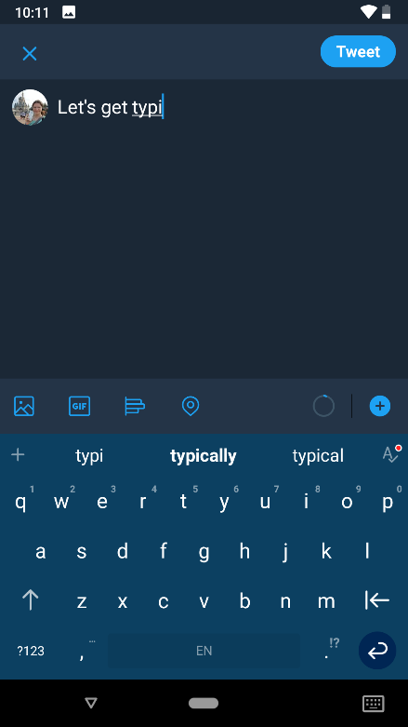
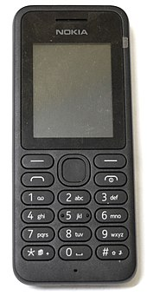
String edit with Typo Distance
Find closest dictionary word to typed word
Dist(‘a’, ‘s’) = 1
Dist(‘a’, ‘u’) = 6
Capture the likelihood of mistyping characters

