Slide 1
CSE 421, Introduction to Algorithms
Lecture 14, Winter 2024
Dynamic Programming
Subset Sum, Longest Common Subsequence

Slide 2
Announcements
Dynamic Programming Reading:
6.1-6.2, Weighted Interval Scheduling
6.3 Segmented Least Squares
6.4 Knapsack and Subset Sum
6.6 String Alignment
6.8 Shortest Paths (Bellman-Ford)
Midterm, Friday, Feb 9
Material through 6.3 and HW 5
Feb 8 Section will be Midterm review

Slide 3
What is the largest sum you can make of the following integers that is ≤ 20
{4, 5, 8, 10, 13, 14, 17, 18, 21, 23, 28, 31, 37}

Slide 4
What is the largest sum you can make of the following integers that is ≤ 2000
{78, 101, 122, 133, 137, 158, 189, 201, 220, 222, 267, 271, 281, 289, 296, 297, 301, 311, 315, 321, 322, 341, 349, 353, 361, 385, 396 }

Slide 5
Subset Sum Problem
Given integers {w₁,…,w_{n}} and an integer K
Find a subset that is as large as possible that does not exceed K
Dynamic Programming: Express as an optimization over sub-problems.
New idea: Represent at a sub problems depending on K and n
Two dimensional grid
6, 8, 9, 11, 16

Slide 6
Subset Sum Optimization
Opt[ j, K ] the largest subset of {w₁, …, w_{j}} that sums to at most K
Opt[ j, K] = max(Opt[ j – 1, K], Opt[ j – 1, K – w_{j}] + w_{j})

Slide 7
Subset Sum Grid
Opt[ j, K] = max(Opt[ j – 1, K], Opt[ j – 1, K – w_{j}] + w_{j})
4
3
2
1
 | 0 | 0 | 0 | 0 | 0 | 0 | 0 | 0 | 0 | 0 | 0 | 0 | 0 | 0 | 0 | 0 | 0
{2, 4, 7, 10}

Slide 8
Subset Sum Grid
Opt[ j, K] = max(Opt[ j – 1, K], Opt[ j – 1, K – w_{j}] + w_{j})
4 | 0 | 2 | 2 | 4 | 4 | 6 | 7 | 7 | 9 | 10 | 11 | 12 | 13 | 14 | 14 | 16 | 17
3 | 0 | 2 | 2 | 4 | 4 | 6 | 7 | 7 | 9 | 9 | 11 | 11 | 13 | 13 | 13 | 13 | 13
2 | 0 | 2 | 2 | 4 | 4 | 6 | 6 | 6 | 6 | 6 | 6 | 6 | 6 | 6 | 6 | 6 | 6
1 | 0 | 2 | 2 | 2 | 2 | 2 | 2 | 2 | 2 | 2 | 2 | 2 | 2 | 2 | 2 | 2 | 2
 | 0 | 0 | 0 | 0 | 0 | 0 | 0 | 0 | 0 | 0 | 0 | 0 | 0 | 0 | 0 | 0 | 0
{2, 4, 7, 10}

Slide 9
Subset Sum Code
for j = 1 to n
for k = 1 to W
Opt[j, k] = max(Opt[j-1, k], Opt[j-1, k-w_{j}] + w_{j})
Opt[ j, K] = max(Opt[ j – 1, K], Opt[ j – 1, K – w_{j}] + w_{j})

Slide 10
Knapsack Problem
Items have weights and values
The problem is to maximize total value subject to a bound on weght
Items {I₁, I₂, … I_{n}}
Weights {w₁, w₂, …,w_{n}}
Values {v₁, v₂, …, v_{n}}
Bound K
Find set S of indices to:
Maximize Σ_{iεS}v_{i} such that Σ_{iεS}w_{i} <= K

Slide 11
Knapsack Recurrence
Subset Sum Recurrence:
Opt[ j, K] = max(Opt[ j – 1, K], Opt[ j – 1, K – w_{j}] + w_{j})
Knapsack Recurrence:

Slide 12
Knapsack Grid
Opt[ j, K] = max(Opt[ j – 1, K], Opt[ j – 1, K – w_{j}] + v_{j})
4
3
2
1
 | 0 | 0 | 0 | 0 | 0 | 0 | 0 | 0 | 0 | 0 | 0 | 0 | 0 | 0 | 0 | 0 | 0
Weights {2, 4, 7, 10} Values: {3, 5, 9, 16}

Slide 13
Knapsack Grid
Opt[ j, K] = max(Opt[ j – 1, K], Opt[ j – 1, K – w_{j}] + v_{j})
4 | 0 | 3 | 3 | 5 | 5 | 8 | 9 | 9 | 12 | 16 | 16 | 18 | 18 | 21 | 21 | 24 | 25
3 | 0 | 3 | 3 | 5 | 5 | 8 | 9 | 9 | 12 | 12 | 14 | 14 | 17 | 17 | 17 | 17 | 17
2 | 0 | 3 | 3 | 5 | 5 | 8 | 8 | 8 | 8 | 8 | 8 | 8 | 8 | 8 | 8 | 8 | 8
1 | 0 | 3 | 3 | 3 | 3 | 3 | 3 | 3 | 3 | 3 | 3 | 3 | 3 | 3 | 3 | 3 | 3
 | 0 | 0 | 0 | 0 | 0 | 0 | 0 | 0 | 0 | 0 | 0 | 0 | 0 | 0 | 0 | 0 | 0
Weights {2, 4, 7, 10} Values: {3, 5, 9, 16}

Slide 14
Alternate approach for Subset Sum
Alternate formulation of Subset Sum dynamic programming algorithm
Sum[i, K] = true if there is a subset of {w₁,…w_{i}} that sums to exactly K, false otherwise
Sum [i, K] = Sum [i -1, K] OR Sum[i - 1, K - w_{i}]
Sum [0, 0] = true; Sum[i, 0] = false for i != 0
To allow for negative numbers, we need to fill in the array between K_{min} and K_{max}

Slide 15
Run time for Subset Sum
With n items and target sum K, the run time is O(nK)
If K is 1,000,000,000,000,000,000,000,000 this is very slow
Alternate brute force algorithm: examine all subsets: O(n2^{n})
Point of confusion: Subset sum is NP Complete

Slide 16
Two dimensional dynamic programming
Subset sum and knapsack
Opt[ j, K] = max(Opt[ j – 1, K], Opt[ j – 1, K – w_{j}] + w_{j})
Opt[ j, K] = max(Opt[ j – 1, K], Opt[ j – 1, K – w_{j}] + v_{j})
4 | 0
3 | 0
2 | 0
1 | 0
 | 0 | 0 | 0 | 0 | 0 | 0 | 0 | 0 | 0 | 0 | 0 | 0 | 0 | 0 | 0 | 0 | 0

Slide 17
Reducing dimensions
Computing values in the array only requires the previous row
Easy to reduce this to just tracking two rows
And sometimes can be implemented in a single row
Space savings is significant in practice
Reconstructing values is harder

Slide 18
Longest Common Subsequence
C=c₁…c_{g} is a subsequence of A=a₁…a_{m} if C can be obtained by removing elements from A (but retaining order)
LCS(A, B): A maximum length sequence that is a subsequence of both A and B
ocurranec
occurrence
attacggct
tacgacca

Slide 19
Determine the LCS of the following strings
BARTHOLEMEWSIMPSON
KRUSTYTHECLOWN

Slide 20
LCS Optimization
A = a₁a₂…a_{m}
B = b₁b₂…b_{n}
Opt[ j, k] is the length of LCS(a₁a₂…a_{j}, b₁b₂…b_{k})

Slide 21
Optimization recurrence
If a_{j} = b_{k}, Opt[ j,k ] = 1 + Opt[ j-1, k-1 ]
If a_{j} ≠ b_{k}, Opt[ j,k] = max(Opt[ j-1,k], Opt[ j,k-1])

Slide 22
Code to compute Opt[ n, m]
for (int i = 0; i < n; i++)
for (int j = 0; j < m; j++)
if (A[ i ] == B[ j ] )
Opt[ i,j ] = Opt[ i-1, j-1 ] + 1;
else if (Opt[ i-1, j ] >= Opt[ i, j-1 ])
Opt[ i, j ] := Opt[ i-1, j ];
else
Opt[ i, j ] := Opt[ i, j-1];

Slide 23
Storing the path information
A[1..m], B[1..n]
for i := 1 to m Opt[i, 0] := 0;
for j := 1 to n Opt[0,j] := 0;
Opt[0,0] := 0;
for i := 1 to m
for j := 1 to n
if A[i] = B[j] { Opt[i,j] := 1 + Opt[i-1,j-1]; Best[i,j] := Diag; }
else if Opt[i-1, j] >= Opt[i, j-1]
{ Opt[i, j] := Opt[i-1, j], Best[i,j] := Left; }
else { Opt[i, j] := Opt[i, j-1], Best[i,j] := Down; }
b₁…b_{n}
a₁…a_{m}

Slide 24
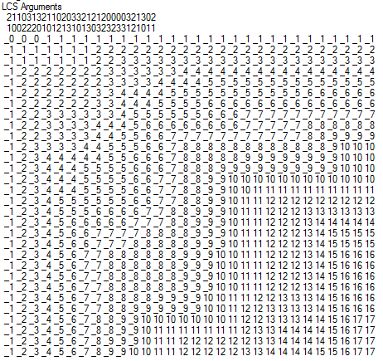
Reconstructing Path from Distances

Slide 25
How good is this algorithm?
Is it feasible to compute the LCS of two strings of length 300,000 on a standard desktop PC? Why or why not.

Slide 26
Implementation 1
public int ComputeLCS() {
int n = str1.Length;
int m = str2.Length;
int[,] opt = new int[n + 1, m + 1];
for (int i = 0; i <= n; i++)
opt[i, 0] = 0;
for (int j = 0; j <= m; j++)
opt[0, j] = 0;
for (int i = 1; i <= n; i++)
for (int j = 1; j <= m; j++)
if (str1[i-1] == str2[j-1])
opt[i, j] = opt[i - 1, j - 1] + 1;
else if (opt[i - 1, j] >= opt[i, j - 1])
opt[i, j] = opt[i - 1, j];
else
opt[i, j] = opt[i, j - 1];
return opt[n,m];
}

Slide 27
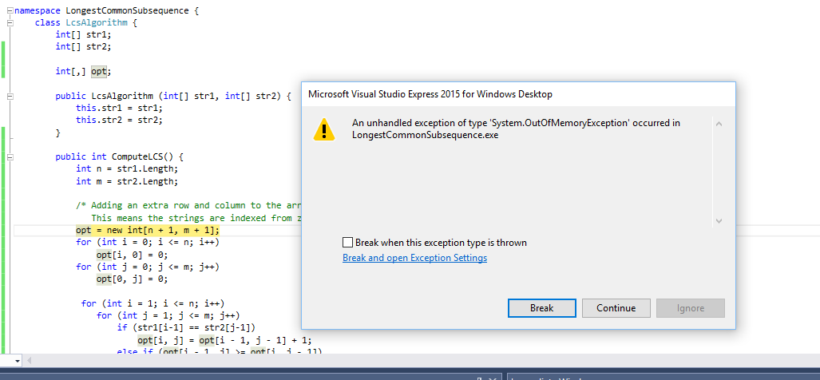
N = 17000
Runtime should be about 5 seconds*
* Personal PC, 10 years old

Slide 28
Implementation 2
public int SpaceEfficientLCS() {
int n = str1.Length;
int m = str2.Length;
int[] prevRow = new int[m + 1];
int[] currRow = new int[m + 1];
for (int j = 0; j <= m; j++)
prevRow[j] = 0;
for (int i = 1; i <= n; i++) {
currRow[0] = 0;
for (int j = 1; j <= m; j++) {
if (str1[i - 1] == str2[j - 1])
currRow[j] = prevRow[j - 1] + 1;
else if (prevRow[j] >= currRow[j - 1])
currRow[j] = prevRow[j];
else
currRow[j] = currRow[j - 1];
}
for (int j = 1; j <= m; j++)
prevRow[j] = currRow[j];
}
return currRow[m];
}

Slide 29
N = 300000
N: 10000 Base 2 Length: 8096 Gamma: 0.8096 Runtime:00:00:01.86
N: 20000 Base 2 Length: 16231 Gamma: 0.81155 Runtime:00:00:07.45
N: 30000 Base 2 Length: 24317 Gamma: 0.8105667 Runtime:00:00:16.82
N: 40000 Base 2 Length: 32510 Gamma: 0.81275 Runtime:00:00:29.84
N: 50000 Base 2 Length: 40563 Gamma: 0.81126 Runtime:00:00:46.78
N: 60000 Base 2 Length: 48700 Gamma: 0.8116667 Runtime:00:01:08.06
N: 70000 Base 2 Length: 56824 Gamma: 0.8117715 Runtime:00:01:33.36
N: 300000 Base 2 Length: 243605 Gamma: 0.8120167 Runtime:00:28:07.32

Slide 30
Observations about the Algorithm
The computation can be done in O(m+n) space if we only need one column of the Opt values or Best Values
The computation requires O(nm) space if we store all of the string information

