Slide 1
CSE 421 Introduction to Algorithms
Richard Anderson
Lecture 11, Winter 2024
Divide and Conquer

Slide 2
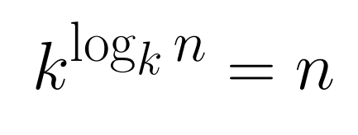
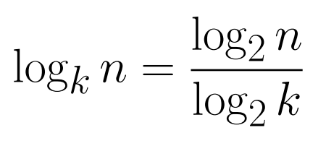
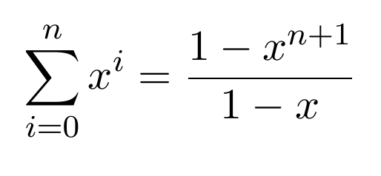
Announcements
Divide and Conquer and Recurrences
Recurrence Techniques
Fast Matrix Multiplication
Counting Inversions (5.3)
Closest Pair (5.4)
Integer Multiplication (5.5)
Quicksort and Median Finding
Dynamic Programming
Midterm, Friday, February 9

Slide 3
Integer Arithmetic
9715480283945084383094856701043643845790217965702956767
+ 1242431098234099057329075097179898430928779579277597977
Runtime for standard algorithm to add two n digit numbers:
2095067093034680994318596846868779409766717133476767930
X 5920175091777634709677679342929097012308956679993010921
Runtime for standard algorithm to multiply two n digit numbers:

Slide 4
Recursive Multiplication Algorithm (First attempt)
x = x₁ 2^{n/2} + x₀
y = y₁ 2^{n/2} + y₀
xy = (x₁ 2^{n/2} + x₀) (y₁ 2^{n/2} + y₀)
= x₁y₁ 2^{n} + (x₁y₀ + x₀y₁)2^{n/2} + x₀y₀
Recurrence:
Run time:

Slide 5
Simple algebra
x = x₁ 2^{n/2} + x₀
y = y₁ 2^{n/2} + y₀
xy = x₁y₁ 2^{n} + (x₁y₀ + x₀y₁) 2^{n/2} + x₀y₀
p = (x₁ + x₀)(y₁ + y₀) = x₁y₁ + x₁y₀ + x₀y₁ + x₀y₀

Slide 6
Karatsuba’s Algorithm
Multiply n-digit integers x and y
Let x = x₁ 2^{n/2} + x₀ and y = y₁ 2^{n/2} + y₀
Recursively compute
a = x₁y₁
b = x₀y₀
p = (x₁ + x₀)(y₁ + y₀)
Return a2^{n} + (p – a – b)2^{n/2} + b
Recurrence: T(n) = 3T(n/2) + cn
log₂ 3 = 1.58496250073…

Slide 7
Quicksort [Tony Hoare, 1959]
QuickSort(S):
Pick an element v in S. This is the pivot value.
Partition S-{v} into two disjoint subsets, S₁ and S₂ such that:
elements in S₁ are all < v
elements in S₂ are all > v
Return concatenation of QuickSort(S₁), v, QuickSort(S₂)
Recursion ends if Quicksort( ) receives an array of length 0 or 1.

Slide 8
Quicksort – worst case
Pivot selection: choose first element
Sort [1,2,3,4,5,6,. . . N]

Slide 9
Quicksort - pragmatics
Pivot selection rules
Median of first, middle, and last
Choose random element
In place implementation
Algorithm engineering for partitioning
Recursion cutoff for small problems

Slide 10
Average case analysis for Quicksort
All inputs equally likely
Or random elements used for pivot
Or input is randomly shuffled
QS(n) = average number of comparisons for Quicksort on input of size n.

Slide 11
Building a recurrence
Pivot chosen at random. The chance of having i elements less than the pivot is 1/n.
Solution: T(N) ≈ 2 n ln n

Slide 12
Computing the Median
Given n numbers, find the number of rank n/2
One approach is sorting
Sort the elements, and choose the middle one
Can you do better?

Slide 13
Problem generalization
Selection, given n numbers and an integer k, find the k-th largest

Slide 14
Select(A, k)
Select(A, k){
Choose element x from A
S₁ = {y in A | y < x}
S₂ = {y in A | y > x}
S₃ = {y in A | y = x}
if (|S₂| >= k)
return Select(S₂, k)
else if (|S₂| + |S₃| >= k)
return x
else
return Select(S₁, k - |S₂| - |S₃|)
}
S₁
S₃
S₂

Slide 15
Randomized Selection
Choose the element at random
Analysis can show that the algorithm has expected run time O(n)

Slide 16
Deterministic Selection
What is the run time of select if we can guarantee that choose finds an x such that |S₁| < 3n/4 and |S₂| < 3n/4 in O(n) time

Slide 17
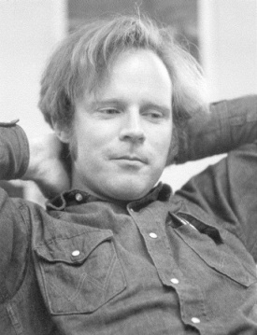
BFPRT Algorithm
1986
1995
A very clever choose algorithm . . .
Split into n/5 sets of size 5
M be the set of medians of these sets
Let x be the median of M
1978
2002

Slide 18
BFPRT runtime
|S₁| < 3n/4, |S₂| < 3n/4
Split into n/5 sets of size 5
M be the set of medians of these sets
x be the median of M
Construct S₁ and S₂
Recursive call in S₁ or S₂

Slide 19
BFPRT Recurrence
T(n) ≤ T(3n/4) + T(n/5) + c n
Prove that T(n) ≤ 20 c n

Slide 20
A theoretical aside
How many comparisons are needed in the worst case to find the median?
BFPRT showed that this is at most 18 n
Best known results in 3 n (but its complicated)
The lower bound was shown to be at least 2 n by Bent and John
Improved to 2.01 n by Zwick

