Slide 1
CSE 421 Introduction to Algorithms
Richard Anderson
Lecture 9, Winter 2024
Recurrences

Slide 2
Announcements
Divide and Conquer and Recurrences
Recurrence Techniques
Fast Matrix Multiplication
Counting Inversions (5.3)
Closest Pair (5.4)
Multiplication (5.5)
Quicksort and Median Finding
Dynamic Programming
Midterm, Friday, February 9

Slide 3
Divide and Conquer
Array Mergesort(Array a){
n = a.Length;
if (n <= 1)
return a;
b = Mergesort(a[0 .. n/2]);
c = Mergesort(a[n/2+1 .. n-1]);
return Merge(b, c);
}

Slide 4
Algorithm Analysis
Cost of Merge
Cost of Mergesort

Slide 5
T(n) = 2T(n/2) + cn; T(1) = c;

Slide 6
Recurrence Analysis
Solution methods
Unrolling recurrence
Guess and verify
Plugging in to a “Master Theorem”

Slide 7
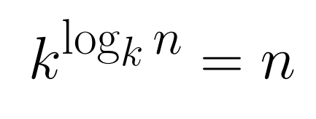
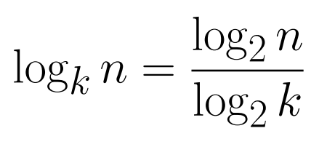
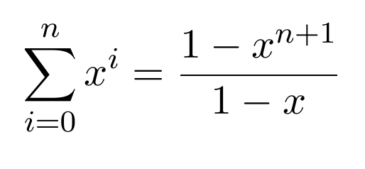
Useful Math Facts

Slide 8
Unrolling the recurrence

Slide 9
Substitution
T(n) = 2T(n/2) + n; T(1) = 1;
Prove T(n) ≤ n (log₂n + 1) for n ≥ 1
Induction:
Base Case:
Induction Hypothesis:
T(n/2) <= c(n/2) log₂(n/2)

Slide 10
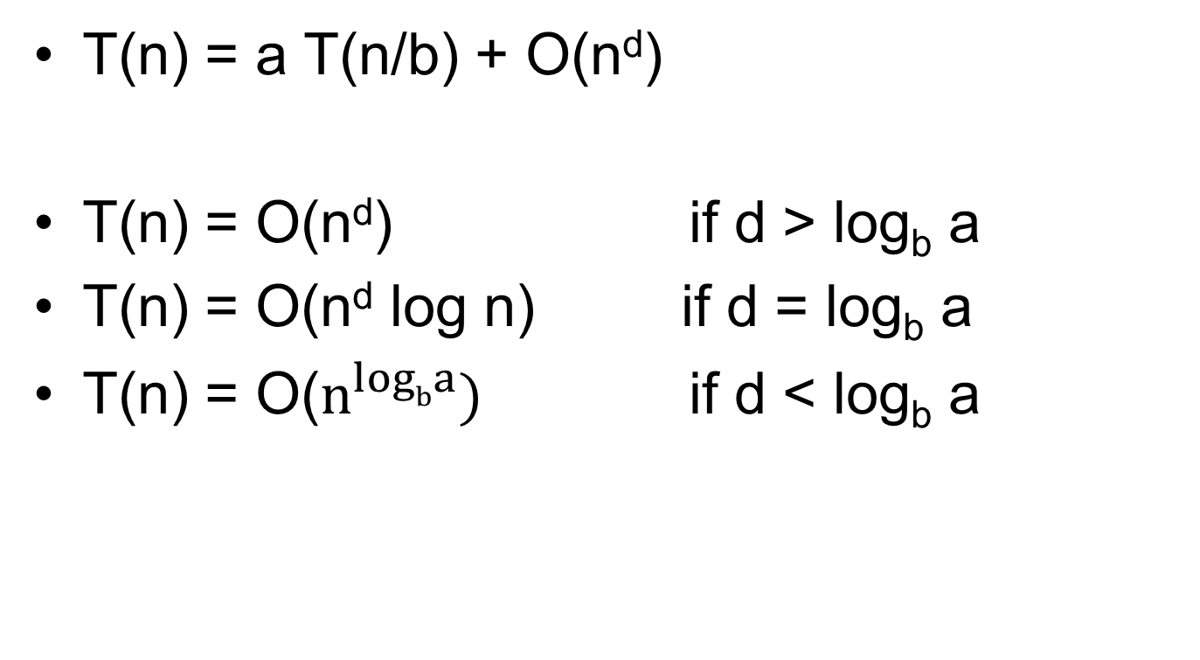
Master Theorem
T(n) = a T(n/b) + O(n^{d})
T(n) = O(n^{d}) if d > log_{b} a
T(n) = O(n^{d} log n) if d = log_{b} a
T(n) = O($n^{logba})$ if d < log_{b} a

Slide 11
A better mergesort (?)
Divide into 3 subarrays and recursively sort
Apply 3-way merge
What is the recurrence?

Slide 12
Unroll recurrence for T(n) = 3T(n/3) + dn

Slide 13
T(n) = aT(n/b) + f(n)

Slide 14
T(n) = T(n/2) + cn
Where does this recurrence arise?

Slide 15
Recursive Matrix Multiplication
Multiply 2 x 2 Matrices:
| r s | | a b| |e g|
| t u | | c d| | f h|
r = ae + bf
s = ag + bh
t = ce + df
u = cg + dh
A N x N matrix can be viewed as a 2 x 2 matrix with entries that are (N/2) x (N/2) matrices.
The recursive matrix multiplication algorithm recursively multiplies the (N/2) x (N/2) matrices and combines them using the equations for multiplying 2 x 2 matrices
=

Slide 16
Recursive Matrix Multiplication
How many recursive calls are made at each level?
How much work in combining the results?
What is the recurrence?

Slide 17
What is the run time for the recursive Matrix Multiplication Algorithm?
Recurrence:

Slide 18
T(n) = 4T(n/2) + n
Total Work
n
n/2
n/2
n/2
n/2
n/4
n/4
n/4
n/4
n/4
n/4
n/4
n/4
n/4
n/4
n/4
n/4
n/4
n/4
n/4
n/4

Slide 19
T(n) = 2T(n/2) + n²

Slide 20
T(n) = 2T(n/2) + n^{1/2}

Slide 21
Recurrences
Three basic behaviors
Dominated by initial case
Dominated by base case
All cases equal – we care about the depth

Slide 22
What you really need to know about recurrences
Work per level changes geometrically with the level
Geometrically increasing (x > 1)
The bottom level wins
Geometrically decreasing (x < 1)
The top level wins
Balanced (x = 1)
Equal contribution

Slide 23
Classify the following recurrences (Increasing, Decreasing, Balanced)
T(n) = n + 5T(n/8)
T(n) = n + 9T(n/8)
T(n) = n² + 4T(n/2)
T(n) = n³ + 7T(n/2)
T(n) = n^{1/2} + 3T(n/4)

