Slide 1
CSE 421 Introduction to Algorithms
Winter 2024
Dijkstra’s algorithm

Slide 2
Readings
Topics
Dijkstra’s Algorithm (Section 4.4)
Monday: Minimum Spanning Trees
Wednesday: Divide and Conquer
Reading
4.4, 4.5, 4.7, 4.8

Slide 3
Single Source Shortest Path Problem
Given a graph and a start vertex s
Determine distance of every vertex from s
Identify shortest paths to each vertex
Express concisely as a “shortest paths tree”
Each vertex has a pointer to a predecessor on shortest path
1
u
u
1
2
3
5
s
x
s
x
3
4
3
v
v

Slide 4
Construct Shortest Path Tree from s
2
d
d
a
1
5
a
4
4
4
e
e
-3
c
s
-2
c
3
s
3
2
6
g
g
b
b
7
3
f
f

Slide 5
Warmup
If P is a shortest path from s to v, and if t is on the path P, the segment from s to t is a shortest path between s and t
WHY?
v
t
s

Slide 6
Dijkstra’s Algorithm
Assume all edges have non-negative cost
S = { }; d[s] = 0; d[v] = infinity for v != s
While S != V
Choose v in V-S with minimum d[v]
Add v to S
For each w in the neighborhood of v
d[w] = min(d[w], d[v] + c(v, w))
4
3
y
1
1
u
1
0
1
s
4
2
2
x
2
2
v
2
3
z
5

Slide 7
Simulate Dijkstra’s algorithm (starting from s) on the graph
Round
Vertex Added
s
a
b
c
d
1
c
1
2
3
4
5
a
1
3
2
s
4
1
4
6
1
b
d
3

Slide 8
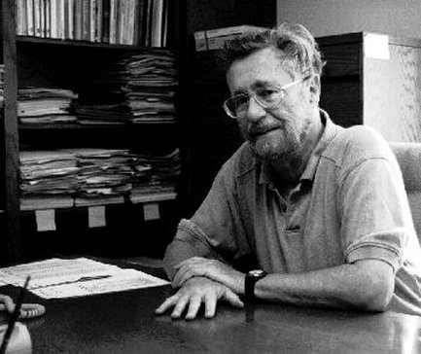
Who was Dijkstra?
What were his major contributions?

Slide 9
http://www.cs.utexas.edu/users/EWD/
Edsger Wybe Dijkstra was one of the most influential members of computing science's founding generation. Among the domains in which his scientific contributions are fundamental are
algorithm design
programming languages
program design
operating systems
distributed processing
formal specification and verification
design of mathematical arguments

Slide 10
Dijkstra’s Algorithm as a greedy algorithm
Elements committed to the solution by order of minimum distance

Slide 11
Correctness Proof
Elements in S have the correct label
Key to proof: when v is added to S, it has the correct distance label.
y
x
s
u
v

Slide 12
Proof
Let v be a vertex in V-S with minimum d[v]
Let P_{v} be a path of length d[v], with an edge (u,v)
Let P be some other path to v. Suppose P first leaves S on the edge (x, y)
P = P_{sx} + c(x,y) + P_{yv}
Len(P_{sx}) + c(x,y) >= d[y]
Len(P_{yv}) >= 0
Len(P) >= d[y] + 0 >= d[v]
y
x
s
u
v

Slide 13
Negative Cost Edges
Draw a small example a negative cost edge and show that Dijkstra’s algorithm fails on this example

Slide 14
Bottleneck Shortest Path
Define the bottleneck distance for a path to be the maximum cost edge along the path
u
6
5
s
2
5
x
3
4
v

Slide 15
Compute the bottleneck shortest paths
6
d
d
a
6
5
a
4
4
4
e
e
-3
c
s
-2
c
3
s
3
2
6
g
g
b
b
7
4
f
f

Slide 16
How do you adapt Dijkstra’s algorithm to handle bottleneck distances
Does the correctness proof still apply?

