Slide 1
Approximation Algorithms and Victory Lap
CSE 421 Fall 2023
Lecture 26

Slide 2


A Linear Program
A linear program is defined by:
Real-valued variables
Subject to satisfying everything in a list of linear constraints
Maximizing or minimizing a linear objective function
A linear constraint is a statement of the form: $∑a_{i}x_{i}≤c_{i}$
where $a_{i}$ are constants, the $x_{i}$ are variables and $c_{i}$ is a constant.
A linear objective function is a function of the form: $∑b_{i}x_{i}$
where $b_{i}$ are constants and the $x_{i}$ are variables.

Slide 3
Solving LPs
A solution (or point) is a setting of all the variables
A feasible point is a point that satisfies all the constraints.
An optimal point is a point that is feasible and has at least as good of an objective value as every other feasible point.
There are polynomial time algorithms which return an optimal point of an LP in polynomial time.
But the optimal point might have fractional values.

Slide 4
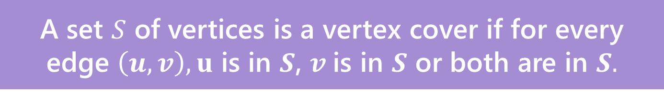
A nicer example
Sometimes we can round fractional solutions into integral ones.
Minimum Weight Vertex Cover
We’ve seen how to solve the problem with DP on trees.
Let’s try it now with linear programming.
A set $S$ of vertices is a vertex cover if for every edge $\left(u,v\right), u$ is in $S$, $v$is in $S$ or both are in $S.$

Slide 5

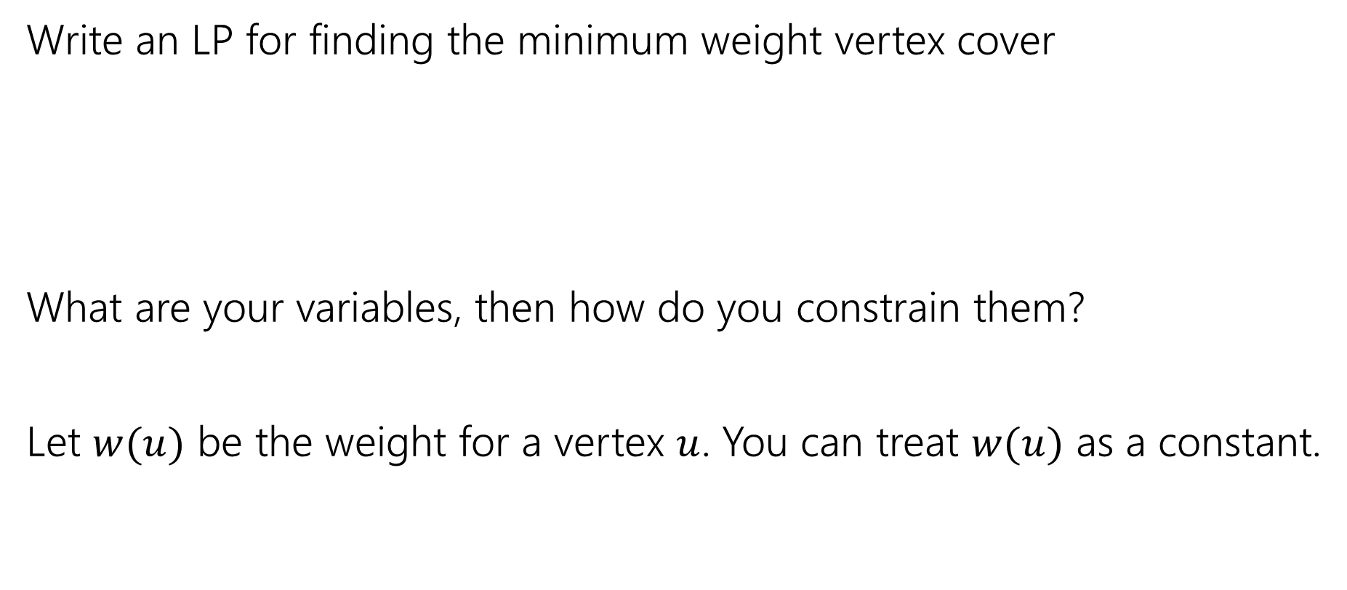
Vertex Cover LP
Write an LP for finding the minimum weight vertex cover
What are your variables, then how do you constrain them?
Let $w(u)$ be the weight for a vertex $u$. You can treat $w(u)$ as a constant.
A set $S$ of vertices is a vertex cover if for every edge $\left(u,v\right), u$ is in $S$, $v$is in $S$ or both are in $S.$

Slide 6

Vertex Cover LP
Minimize $∑w\left(u\right)⋅x_{u}$
Subject to:
$x_{u}+x_{v}≥1$ for all $\left(u,v\right)∈E$
$0≤x_{u}≤1$ for all $u$.

Slide 7
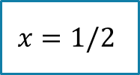
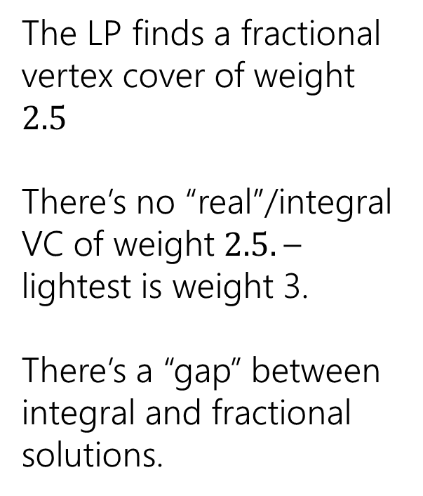
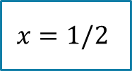

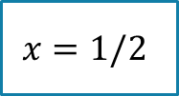

Non-Bipartite
The LP finds a fractional vertex cover of weight $2.5$
There’s no “real”/integral VC of weight $2.5.$– lightest is weight 3.
There’s a “gap” between integral and fractional solutions.
1
1
$$x=1/2$$
1
$$x=1/2$$
$$x=1/2$$
1
1
$$x=1/2$$
$$x=1/2$$

Slide 8
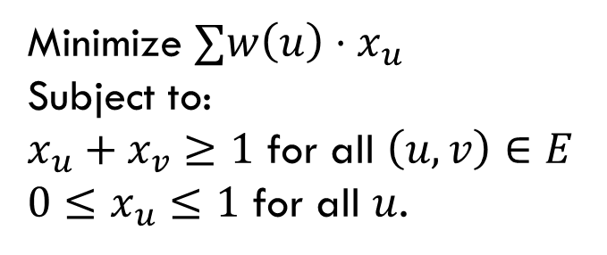

So, what if the graph isn’t bipartite?
Pollev.com/robbie
Big idea:
Just round!
If $x_{u}≥\frac{1}{2}$, round up to $1$.
If $x_{u}<\frac{1}{2},$round down to $0$
Two questions – is it a vertex cover? How far are we from the true minimum?
Minimize $∑w\left(u\right)⋅x_{u}$
Subject to:
$x_{u}+x_{v}≥1$ for all $\left(u,v\right)∈E$
$0≤x_{u}≤1$ for all $u$.

Slide 9
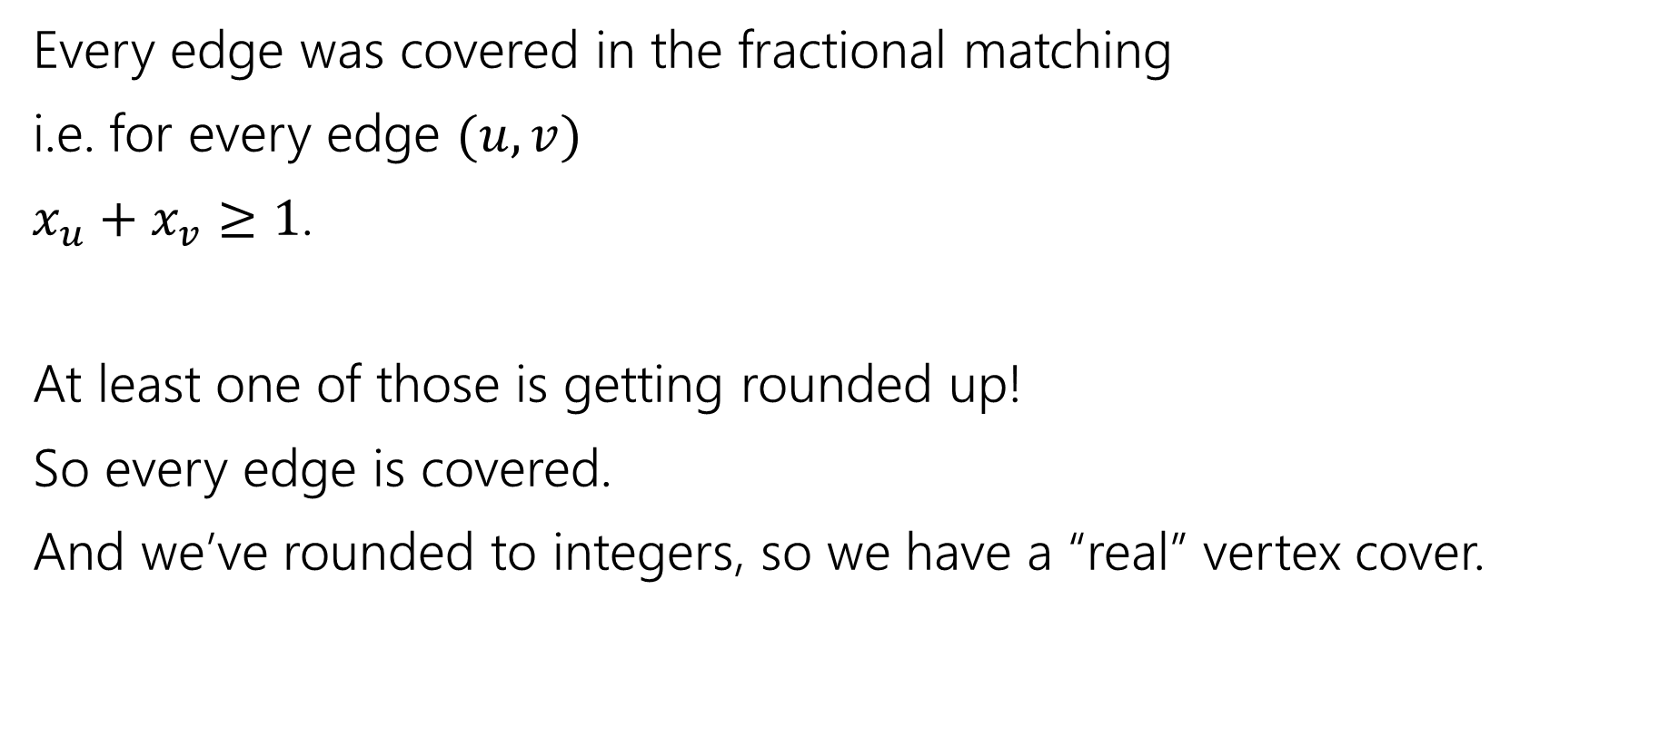
Is it a vertex cover?
Every edge was covered in the fractional matching
i.e. for every edge $(u,v)$
$x_{u}+x_{v}≥1$.
At least one of those is getting rounded up!
So every edge is covered.
And we’ve rounded to integers, so we have a “real” vertex cover.

Slide 10
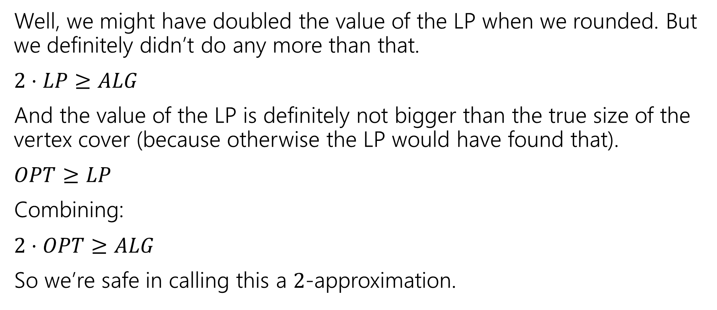
How good of an approximation is it?
Well, we might have doubled the value of the LP when we rounded. But we definitely didn’t do any more than that.
$2⋅LP≥ALG$
And the value of the LP is definitely not bigger than the true size of the vertex cover (because otherwise the LP would have found that).
$OPT≥LP$
Combining:
$2⋅OPT≥ALG$
So we’re safe in calling this a $2$-approximation.

Slide 11
Comparing to the LP value
We did a weird thing on that last slide.
We were supposed to compare the value of our vertex cover to the best vertex cover.
But instead we compared it to the value of the LP…which we know isn’t always the value of the vertex cover!
That wasn’t laziness, it’s a very common technique. We know very little about the true value of the vertex cover (if we knew what it looked like VERY VERY precisely, why couldn’t we just write an algorithm to find it? We actually won’t know much). So we start with what the algorithm gave us (that we do understand).

Slide 12
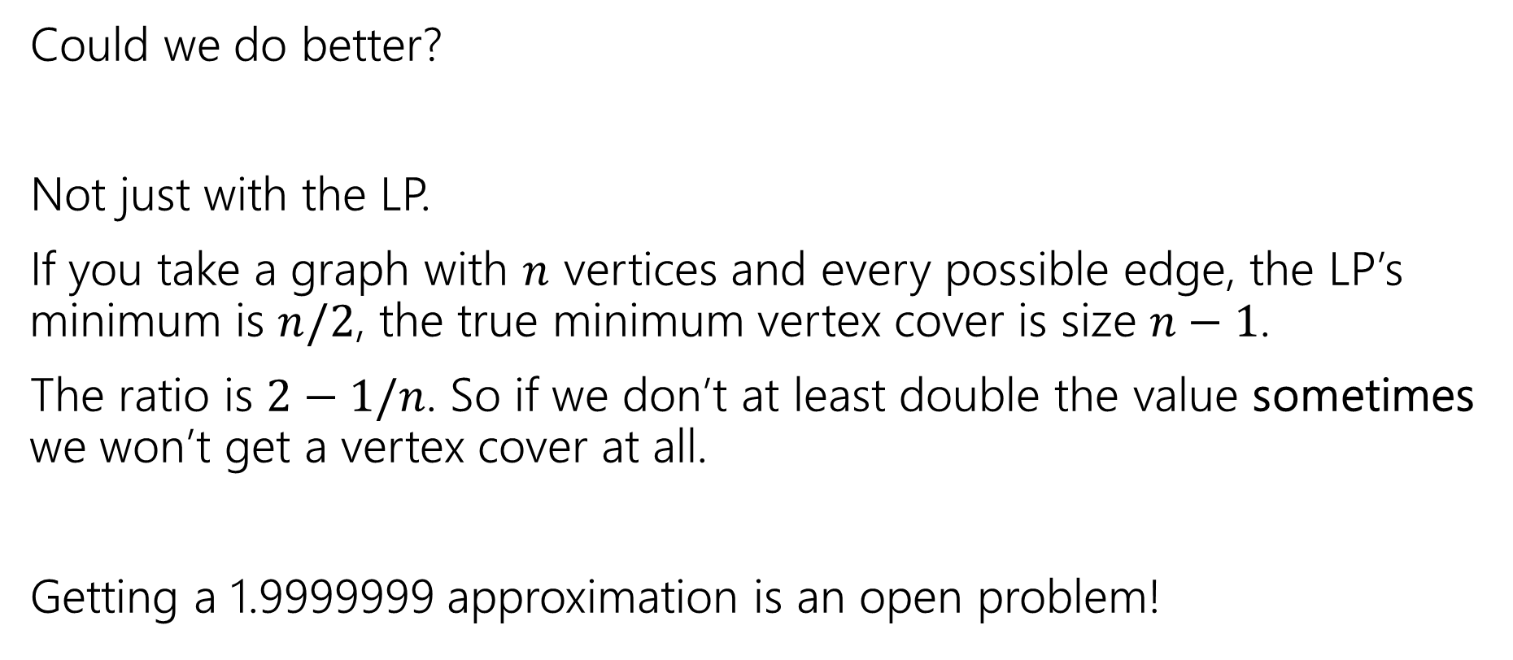
Side Note
Could we do better?
Not just with the LP.
If you take a graph with $n$ vertices and every possible edge, the LP’s minimum is $n/2$, the true minimum vertex cover is size $n−1$.
The ratio is $2−1/n$. So if we don’t at least double the value sometimes we won’t get a vertex cover at all.
Getting a 1.9999999 approximation is an open problem!

Slide 13
Another Approximation Algorithm

Slide 14
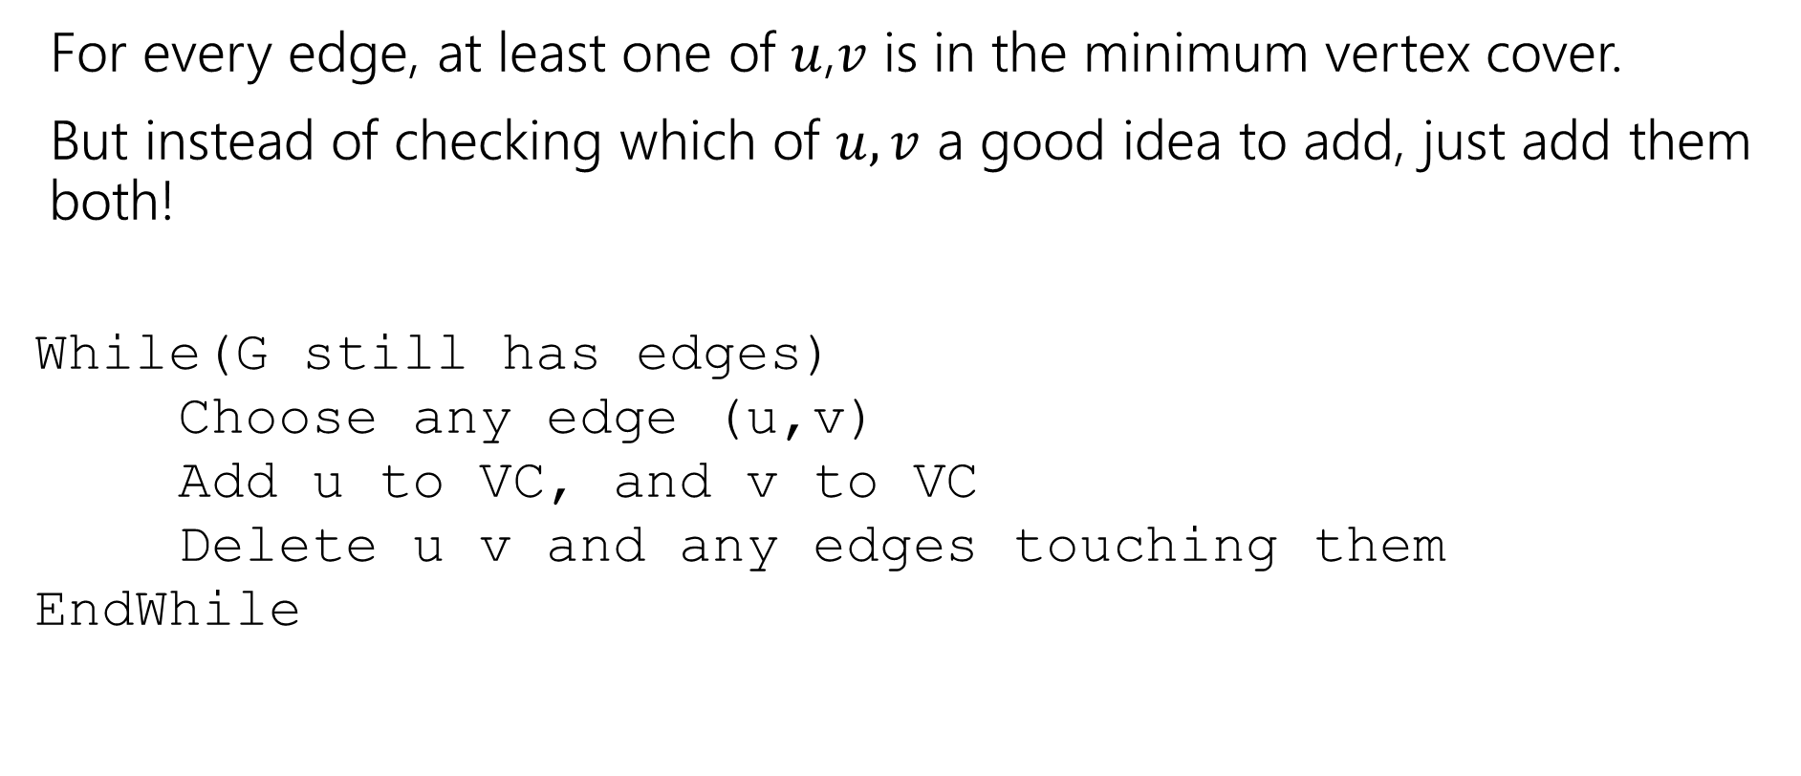
Recall: Finding an approximation for VC
For every edge, at least one of $u$,$v$ is in the minimum vertex cover.
But instead of checking which of $u,v$ a good idea to add, just add them both!
While(G still has edges)
Choose any edge (u,v)
Add u to VC, and v to VC
Delete u v and any edges touching them
EndWhile

Slide 15
Does it work?
Do we find a vertex cover?
Is it close to the smallest one?
Does it run in polynomial time?

Slide 16

Do we find a vertex cover?
When we delete an edge, it is covered (because we added both $u$ and $v$. And we only stop the algorithm when every edge has been deleted. So every edge is covered (i.e. we really have a vertex cover).

Slide 17
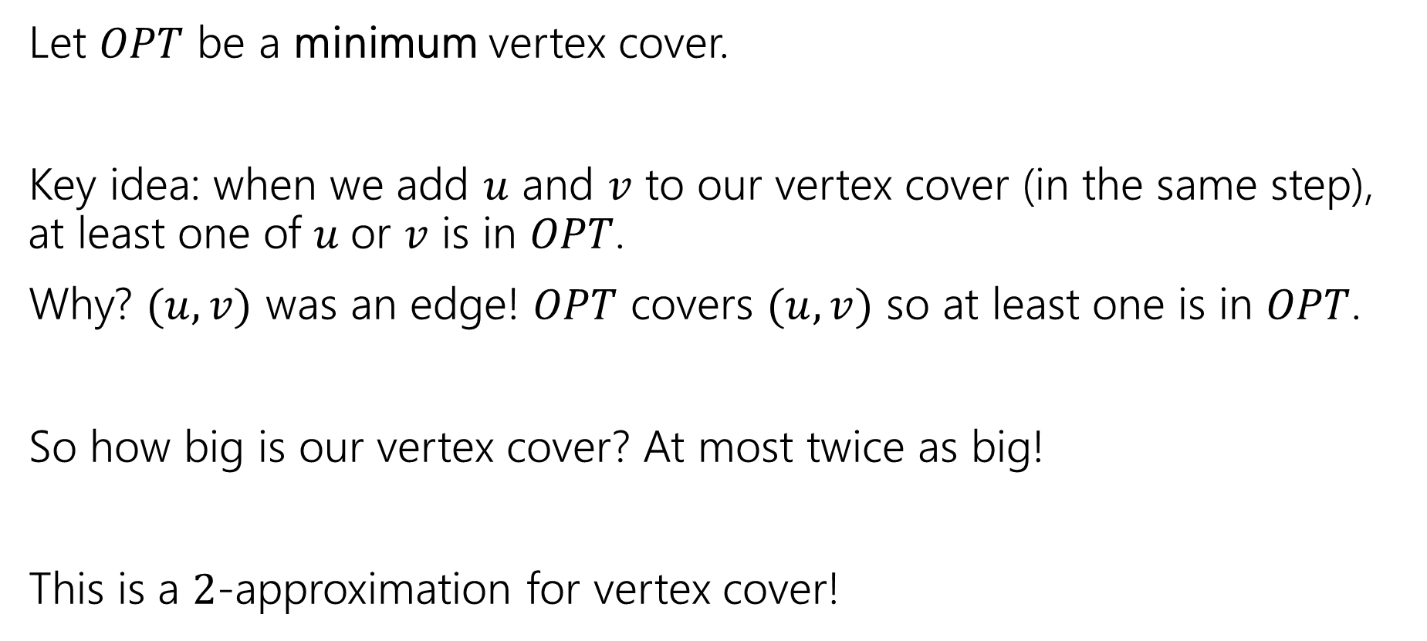
How big is it?
Let $OPT$ be a minimum vertex cover.
Key idea: when we add $u$ and $v$ to our vertex cover (in the same step), at least one of $u$or $v$ is in $OPT$.
Why? $(u,v)$ was an edge! $OPT$ covers $(u,v)$ so at least one is in $OPT$.
So how big is our vertex cover? At most twice as big!
This is a $2$-approximation for vertex cover!

Slide 18
Hard to approximate

Slide 19
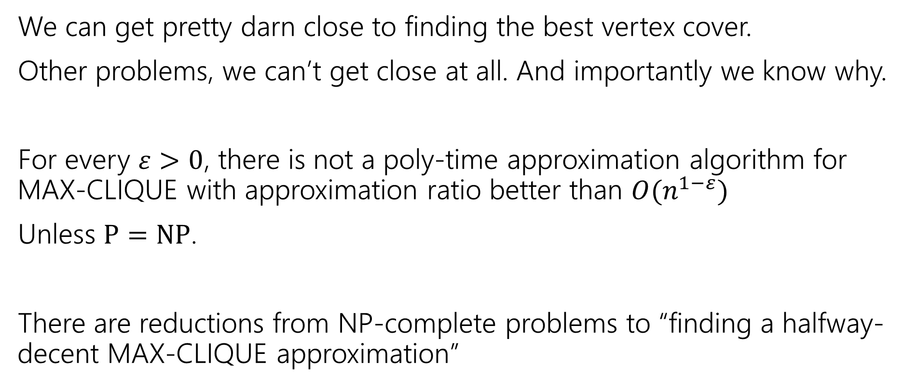
Inapproximability
We can get pretty darn close to finding the best vertex cover.
Other problems, we can’t get close at all. And importantly we know why.
For every $ε>0$, there is not a poly-time approximation algorithm for MAX-CLIQUE with approximation ratio better than $O(n^{1−ε})$
Unless $P=NP$.
There are reductions from NP-complete problems to “finding a halfway-decent MAX-CLIQUE approximation”

Slide 20
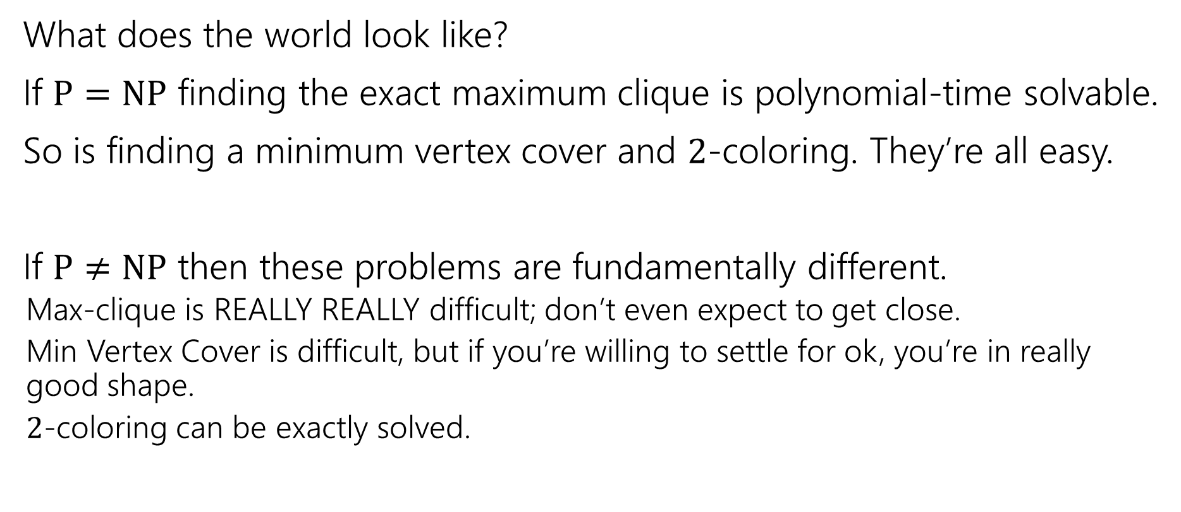
P vs. NP
What does the world look like?
If $P=NP$ finding the exact maximum clique is polynomial-time solvable.
So is finding a minimum vertex cover and $2$-coloring. They’re all easy.
If $P≠NP$ then these problems are fundamentally different.
  Max-clique is REALLY REALLY difficult; don’t even expect to get close.
  Min Vertex Cover is difficult, but if you’re willing to settle for ok, you’re in really good shape.
  $2$-coloring can be exactly solved.

Slide 21
Victory Lap

Slide 22
What have we seen this quarter?
Stable Matchings
Graph Search
  BFS/DFS
  Graph modeling
Greedy Algorithms
Divide and Conquer
Dynamic Programming
  DP on arrays
  Adding parameters
  DP on trees
Network Flow
  Using Max-Flow
  Using Min Cuts
  Assignment problems
  NP-completeness
  Reductions
  Showing a problem is NP-hard
  P vs. NP
  Linear Programming
  Approximation Algorithms

Slide 23
Stable Matchings
Modeling matters!
  It’s better to be a proposer than a chooser!
Algorithms can be used to prove ‘non-computational’ facts
  Stable Matchings always exist is easiest to prove by saying “here’s how to find one.”
Reductions
  Sometimes there’s a clever way to use an existing library (we’ll need these a lot later in the quarter).

Slide 24
Graph Search
BFS and DFS search through a graph differently
  So you can adapt them to solve different problems!
Use libraries
Finding SCCs and Topological sorting are “almost free” preprocessing
2-Coloring can be performed in linear time.

Slide 25
Greedy
Code is easy; proofs are hard.
Generating examples is extremely important.
To frame your thinking for proofs
  Greedy stays ahead
  Exchange argument
  Structural result

Slide 26
Divide and Conquer
Trust the recursion.
Don’t be afraid to change what the recursive call gives you!
  Add extra parameters!
State in English what the recursive call gives you.
In your “combine” step, make sure you’re beating baseline!

Slide 27
Dynamic Programming
Focus on solving the problem recursively; everything else is (mostly) formulaic once you’ve done that.
Write exactly the problem you’re solving in English.
It’s better to get down a “guess” at the problem and then see where you get stuck.
  Don’t be afraid to add a second recurrence or extra parameters.
Don’t try to cleverly figure out which option is best. Try them all.
  The magic of recursion tells you which is best for a particular situation.
  DP is very useful on trees!

Slide 28
Network Flow
The value of the maximum flow is always equal to the capacity of the minimum cut.
  Ford-Fulkerson finds you both.
Useful for modeling (“assigning” things)
  Can the Mariners make the playoffs? (Assign who wins games)
  Who does which chores?
And solving other problems
  Especially on bipartite graphs, like vertex cover and maximum matching.

Slide 29
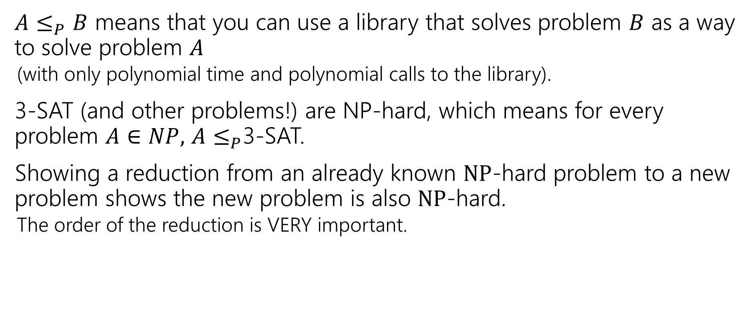
NP-completeness
$A≤_{P}B$ means that you can use a library that solves problem $B$ as a way to solve problem $A$
  (with only polynomial time and polynomial calls to the library).
3-SAT (and other problems!) are NP-hard, which means for every problem $A∈NP,$ $A≤_{P}$3-SAT.
Showing a reduction from an already known $NP$-hard problem to a new problem shows the new problem is also $NP$-hard.
  The order of the reduction is VERY important.

Slide 30
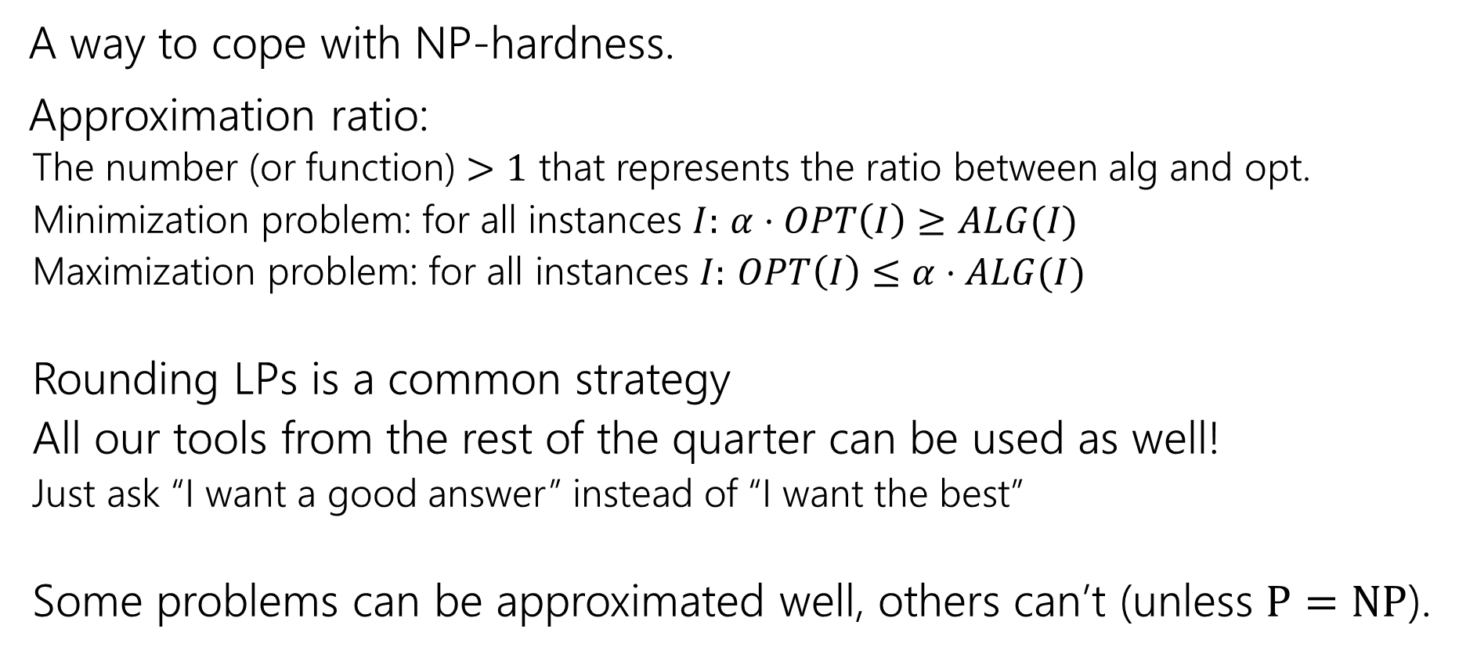
Approximation Algorithms
A way to cope with NP-hardness.
Approximation ratio:
  The number (or function) $>1$ that represents the ratio between alg and opt.
  Minimization problem: for all instances $I:$ $α⋅OPT\left(I\right)≥ALG(I)$
  Maximization problem: for all instances $I:$ $OPT\left(I\right)≤α⋅ALG(I)$
  Rounding LPs is a common strategy
  All our tools from the rest of the quarter can be used as well!
  Just ask “I want a good answer” instead of “I want the best”
  Some problems can be approximated well, others can’t (unless $P=NP$).

Slide 31
How To Approach Problems
In section, we’ve made you follow these steps:
1. Read the problem carefully (make sure you know what problem you’re actually solving)
2. Make some sample inputs/outputs
3. Set a “baseline.”
4. Then try to generate the algorithm.
It’s hard to take the time to do these in an exam, but at least make sure you do #1. Solving the wrong problem is not good for test-taking.
PLEASE do these steps in real life.

Slide 32
What have you learned?
Algorithm design techniques/paradigms
  Ways to frame your thinking to design a new algorithm
Methods of modeling new problems in terms of familiar ones.
  Solve a new problem without (many) new ideas.
How to approach a problem
  Techniques to avoid getting stuck or get yourself un-stuck.
Some famous algorithms
  You’ll know Ford-Fulkerson, Bellman-Ford, etc. when you see them in libraries.
  Or at least where to look them up.

Slide 33
What should you do next?
CSE 431 (complexity theory)
  What can’t you do? (in polynomial time, at all, or in limited memory)
CSE 422
  Toolkit for modern algorithms: algorithmic principles behind modern stats and ML
CSE 426 [490C]
  Cryptography: a mix of math, algorithms, and complexity.
CSE 521 and 525
  Graduate level courses in algorithms and randomized algorithms.
  Look ahead! These courses usually run once-per-year.

