Slide 1
Linear Programming
CSE 421 23Winter
Lecture 25

Slide 2
Today
Everything we can cover about a topic in one day.
Linear programming!
Tomorrow we’ll use them for an approximation algorithm.
Goal today is just understand what they are and why they might be interesting.

Slide 3
Linear Programming
Used WIDELY in business and operations research.
Excel has a linear program solver.
A very expressive language for problem-solving
Can represent a wide-variety of problems, including some we’ve already seen.
Deep, beautiful theory…that we do not have time to cover.

Slide 4
Outline of LPs
What is a linear program?
A simple example LP
Computational Issues

Slide 5
Example Problem
You’re laying down soil for a bunch of new gardens. You got a few big piles of soil delivered (more than enough to cover the gardens)
$1.5/unit
1.5
$2/unit
7
5
$4/unit
$4/unit
10
$1.5/unit
$3/unit
$8/unit
4
$2/unit
2.5
3
$4.5/unit

Slide 6
Example Problem
What variables should we use?
$1.5/unit
1.5
$2/unit
7
5
$4/unit
$4/unit
10
$1.5/unit
$3/unit
$8/unit
4
$2/unit
2.5
3
$4.5/unit

Slide 7

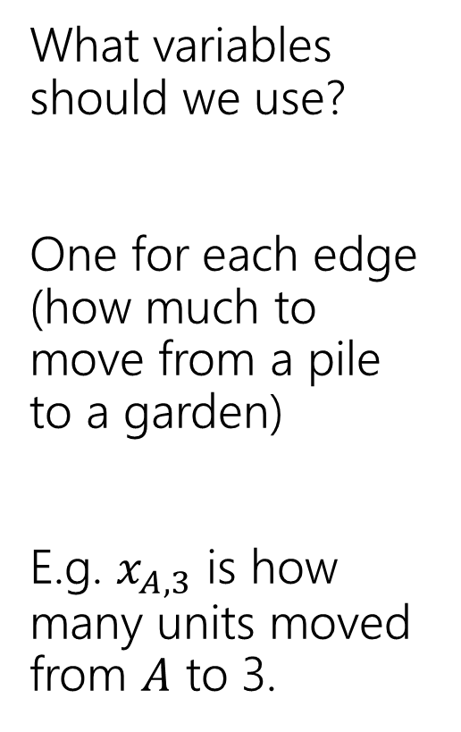
Example Problem
What variables should we use?
One for each edge (how much to move from a pile to a garden)
E.g. $x_{A,3}$ is how many units moved from $A$ to 3.
3
$$x_{A,3}$$
$1.5/unit
1.5
A
$2/unit
7
5
C
$4/unit
$4/unit
2
10
$1.5/unit
$3/unit
$8/unit
4
4
$2/unit
2.5
1
3
B
$4.5/unit

Slide 8
Example Problem
What constraints are there on the variables?
3
$$x_{A,3}$$
$1.5/unit
1.5
A
$2/unit
7
5
C
$4/unit
$4/unit
2
10
$1.5/unit
$3/unit
$8/unit
4
4
$2/unit
2.5
1
3
B
$4.5/unit

Slide 9
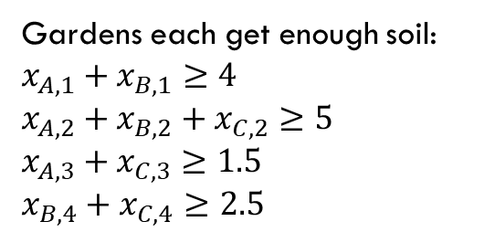
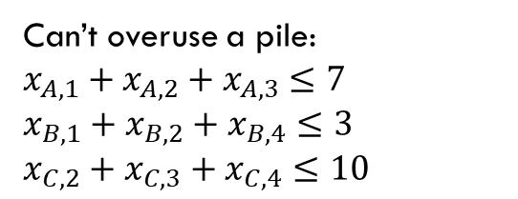
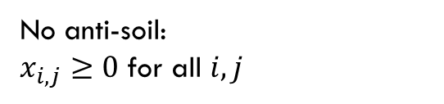
Example Problem
Gardens each get enough soil:
$x_{A,1}+x_{B,1}≥4$
$x_{A,2}+x_{B,2}+x_{C,2}≥5$
$x_{A,3}+x_{C,3}≥1.5$
$x_{B,4}+x_{C,4}≥2.5$
No anti-soil:
$x_{i,j}≥0$ for all $i,j$
What constraints are there on the variables?
Can’t overuse a pile:
$x_{A,1}+x_{A,2}+x_{A,3}≤7$
$x_{B,1}+x_{B,2}+x_{B,4}≤3$
$x_{C,2}+x_{C,3}+x_{C,4}≤10$
3
$$x_{A,3}$$
$1.5/unit
1.5
A
$2/unit
7
5
C
$4/unit
$4/unit
2
10
$1.5/unit
$3/unit
$8/unit
4
4
$2/unit
2.5
1
3
B
$4.5/unit

Slide 10
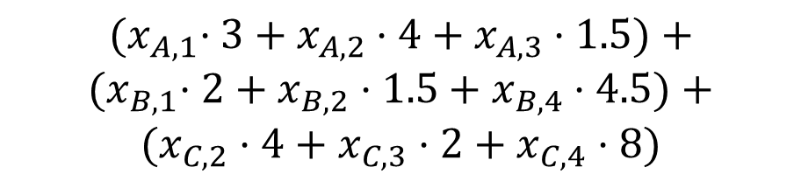
Example Problem
$${(x}_{A,1}⋅3+x_{A,2}⋅4+x_{A,3}⋅1.5)+$$
$${(x}_{B,1}⋅2+x_{B,2}⋅1.5+x_{B,4}⋅4.5)+$$
$$(x_{C,2}⋅4+x_{C,3}⋅2+x_{C,4}⋅8)$$
What’s the cost (in terms of the variables)?
Sum cost*var for all the variables
3
$$x_{A,3}$$
$1.5/unit
1.5
A
$2/unit
7
5
C
$4/unit
$4/unit
2
10
$1.5/unit
$3/unit
$8/unit
4
4
$2/unit
2.5
1
3
B
$4.5/unit

Slide 11

Full Definition
Minimize: ${(x}_{A,1}⋅3+x_{A,2}⋅4+x_{A,3}⋅1.5)+{(x}_{B,1}⋅2+x_{B,2}⋅1.5+x_{B,4}⋅4.5)+(x_{C,2}⋅4+x_{C,3}⋅2+x_{C,4}⋅8)$
Subject To:
$x_{A,1}+x_{B,1}≥4$
$x_{A,2}+x_{B,2}+x_{C,2}≥5$
$x_{A,3}+x_{C,3}≥1.5$
$x_{B,4}+x_{C,4}≥2.5$
$x_{A,1}+x_{A,2}+x_{A,3}≤7$
$x_{B,1}+x_{B,2}+x_{B,4}≤3$
$x_{C,2}+x_{C,3}+x_{C,4}≤10$
$x_{i,j}≥0$ for all $i,j$

Slide 12


A Linear Program
A linear program is defined by:
Real-valued variables
Subject to satisfying everything in a list of linear constraints
Maximizing or minimizing a linear objective function
A linear constraint is a statement of the form: $∑a_{i}x_{i}≤c_{i}$
where $a_{i}$ are constants, the $x_{i}$ are variables and $c_{i}$ is a constant.
A linear objective function is a function of the form: $∑b_{i}x_{i}$
where $b_{i}$ are constants and the $x_{i}$ are variables.

Slide 13

Linear constraints
Pollev.com/robbie
Can you write each of these requirements as linear constraint(s)?
Some of these are tricks…
$x_{i}$ times $x_{j}$ is at least $5$
${5x}_{i}$ is equal to $1$
$x_{i}≤5$ OR $x_{i}≥7$
$x_{i}$ is non-negative.
$x_{i}$ is an integer.

Slide 14
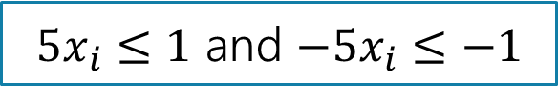

Linear constraints
Can you write each of these requirements as linear constraint(s)?
Some of these are tricks…
$x_{i}$ times $x_{j}$ is at least $5$
${5x}_{i}$ is equal to $1$
$x_{i}≤5$ OR $x_{i}≥7$
$x_{i}$ is non-negative.
$x_{i}$ is an integer.
No way to represent ☹
$5x_{i}≤1$ and $−5x_{i}≤−1$
No way to represent ☹
$$x_{i}≥0$$
No way to represent ☹

Slide 15
What are we looking for?
A solution (or point) is a setting of all the variables
A feasible point is a point that satisfies all the constraints.
An optimal point is a point that is feasible and has at least as good of an objective value as every other feasible point.

Slide 16
Example Problem
Gardens each get enough soil:
$x_{A,1}+x_{B,1}≥4$
$x_{A,2}+x_{B,2}+x_{C,2}≥5$
$x_{A,3}+x_{C,3}≥1.5$
$x_{B,4}+x_{C,4}≥2.5$
No anti-soil:
$x_{i,j}≥0$ for all $i,j$
Can’t overuse a pile:
$x_{A,1}+x_{A,2}+x_{A,3}≤7$
$x_{B,1}+x_{B,2}+x_{B,4}≤3$
$x_{C,2}+x_{C,3}+x_{C,4}≤10$
3
A
$1.5/unit
1.5
1.5
A feasible point.
Objective: 55
$2/unit
7
5
5
C
$4/unit
$4/unit
2
10
$1.5/unit
$3/unit
2.5
$8/unit
4
4
4
$2/unit
2.5
1
3
B
$4.5/unit

Slide 17
Example Problem
Gardens each get enough soil:
$x_{A,1}+x_{B,1}≥4$
$x_{A,2}+x_{B,2}+x_{C,2}≥5$
$x_{A,3}+x_{C,3}≥1.5$
$x_{B,4}+x_{C,4}≥2.5$
No anti-soil:
$x_{i,j}≥0$ for all $i,j$
Can’t overuse a pile:
$x_{A,1}+x_{A,2}+x_{A,3}≤7$
$x_{B,1}+x_{B,2}+x_{B,4}≤3$
$x_{C,2}+x_{C,3}+x_{C,4}≤10$
3
1.5
$1.5/unit
1.5
A
A feasible point.
Objective: 44.25
$2/unit
7
5
C
$4/unit
$4/unit
2
10
0.5
4.5
This is an optimal point. There are others!
$1.5/unit
$3/unit
$8/unit
4
4
4
$2/unit
2.5
2.5
1
3
B
$4.5/unit

Slide 18
Example Problem
Gardens each get enough soil:
$x_{A,1}+x_{B,1}≥4$
$x_{A,2}+x_{B,2}+x_{C,2}≥5$
$x_{A,3}+x_{C,3}≥1.5$
$x_{B,4}+x_{C,4}≥2.5$
No anti-soil:
$x_{i,j}≥0$ for all $i,j$
Can’t overuse a pile:
$x_{A,1}+x_{A,2}+x_{A,3}≤7$
$x_{B,1}+x_{B,2}+x_{B,4}≤3$
$x_{C,2}+x_{C,3}+x_{C,4}≤10$
3
1.5
$1.5/unit
1.5
A
A feasible point.
Objective: 44.25
$2/unit
7
1
5
C
$4/unit
$4/unit
2
10
0.5
3.5
Here’s another optimal point!!
$1.5/unit
$3/unit
$8/unit
4
4
4
$2/unit
2.5
2.5
1
3
B
$4.5/unit

Slide 19
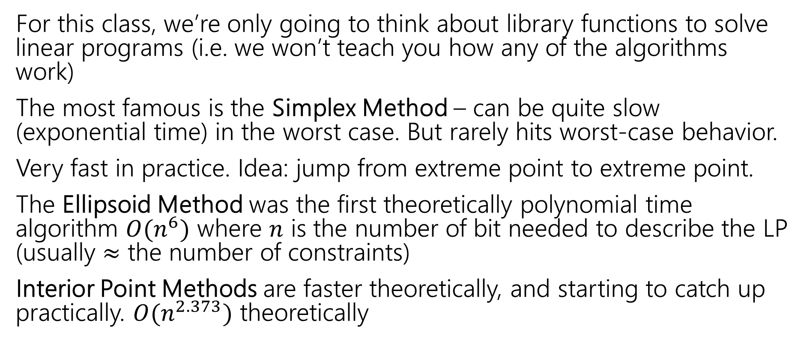
Solving LPs
For this class, we’re only going to think about library functions to solve linear programs (i.e. we won’t teach you how any of the algorithms work)
The most famous is the Simplex Method – can be quite slow (exponential time) in the worst case. But rarely hits worst-case behavior.
Very fast in practice. Idea: jump from extreme point to extreme point.
The Ellipsoid Method was the first theoretically polynomial time algorithm $O(n^{6})$ where $n$ is the number of bit needed to describe the LP (usually $≈$ the number of constraints)
Interior Point Methods are faster theoretically, and starting to catch up practically. $O(n^{2.373})$ theoretically

Slide 20
Some Practice

Slide 21

Write an LP for finding the biggest flow
Let $c\left(e\right)$ be the capacity on edge $e$
What are your variables? (How do you represent a flow)
What are your constraints? (When is a flow valid)
What is your objective? (what do you want to maximize or minimize)

Slide 22

Write an LP for finding the biggest flow
Let $c\left(e\right)$ be the capacity on edge $e$
Max $\sum_{e:e enters t}{x_{e}}$
Subject to:
$\sum_{e:e enters u}{x_{e}}=\sum_{e:e leaves u}{x_{e}}$ for every $u$ other than $s$ and $t$
$0≤x_{e}≤c(e)$ for every edge $e$

Slide 23
Integrality

Slide 24
Another Question
Change the problem
Instead of infinitely divisible dirt…
What if instead we’re moving whole unit things (the dirt is in bags we can’t open or we’re moving bikes or plants or anything else that can’t be split)
Or if we’re assigning people to shifts (can have 1/3 of a person on a shift)
Well, the constraints will change (your “demand” and “supplies” will be integers)

Slide 25
Non-Integrality
Some linear programs only have optimal solutions that have some (or all) variables as non-integers (even with only integers in the objective function and constraints).
For dirt or water or anything arbitrarily divisible, no big deal!
For cell phones or bicycles…only possibly a big deal!
In practice: if the optimal thing to manufacture 999,999.8 widgets per day, rounding up or down probably isn’t going to make a huge difference in your profits.
But sometimes rounding isn’t ok…

Slide 26
What do you do if you need integers?
Integer Programs are linear programs where you can mark some variables as needing to be integers.
In practice – often still solvable (Excel also has a solver for these problems). But no longer guaranteed to be efficient.
Indeed, solving an integer program is NP-hard.
Lots of theory has been done for when the optimum will be all integers. (MATH 407 or MATH 514)
But sometimes you get a fractional solution…what can you do?

Slide 27

A nicer example
Sometimes we can round fractional solutions into integral ones.
Minimum Weight Vertex Cover
We’ve seen how to solve the problem with DP on trees.
Let’s try it now with linear programming.
A set $S$ of vertices is a vertex cover if for every edge $\left(u,v\right), u$ is in $S$, $v$is in $S$ or both are in $S.$

Slide 28
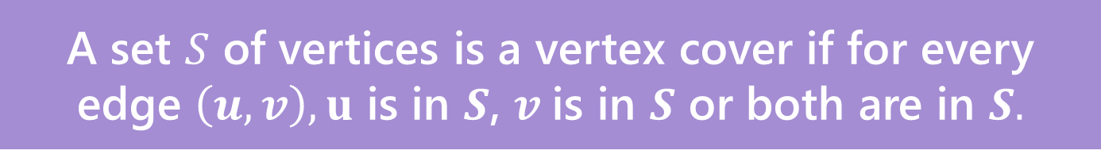
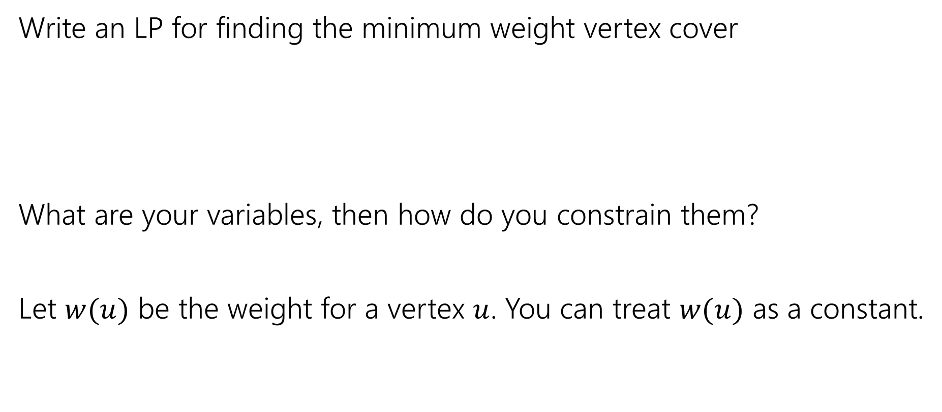
Vertex Cover LP
Pollev.com/robbie
Write an LP for finding the minimum weight vertex cover
What are your variables, then how do you constrain them?
Let $w(u)$ be the weight for a vertex $u$. You can treat $w(u)$ as a constant.
A set $S$ of vertices is a vertex cover if for every edge $\left(u,v\right), u$ is in $S$, $v$is in $S$ or both are in $S.$

Slide 29

Vertex Cover LP
Minimize $∑w\left(u\right)⋅x_{u}$
Subject to:
$x_{u}+x_{v}≥1$ for all $\left(u,v\right)∈E$
$0≤x_{u}≤1$ for all $u$.

Slide 30
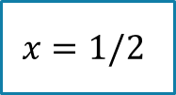
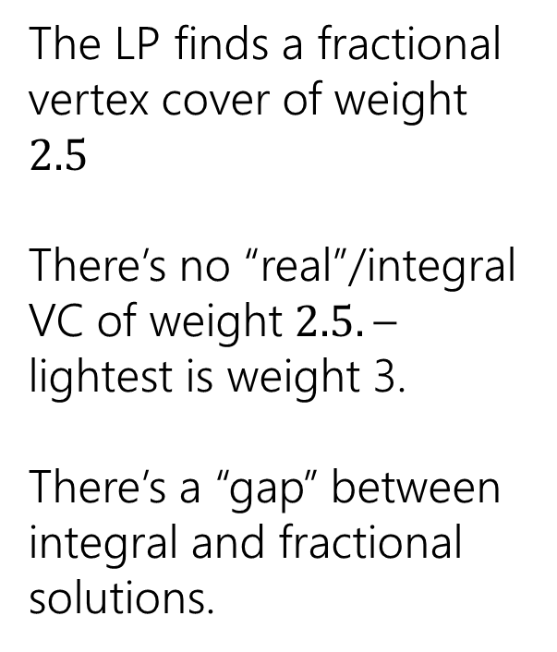
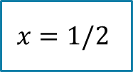

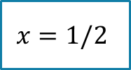

Non-Bipartite
The LP finds a fractional vertex cover of weight $2.5$
There’s no “real”/integral VC of weight $2.5.$– lightest is weight 3.
There’s a “gap” between integral and fractional solutions.
1
1
$$x=1/2$$
1
$$x=1/2$$
$$x=1/2$$
1
1
$$x=1/2$$
$$x=1/2$$

Slide 31
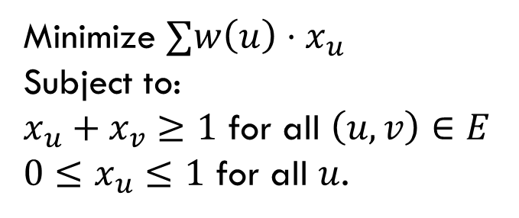

So, what if the graph isn’t bipartite?
Pollev.com/robbie
Big idea:
Just round!
If $x_{u}≥\frac{1}{2}$, round up to $1$.
If $x_{u}<\frac{1}{2},$round down to $0$
Two questions – is it a vertex cover? How far are we from the true minimum?
Minimize $∑w\left(u\right)⋅x_{u}$
Subject to:
$x_{u}+x_{v}≥1$ for all $\left(u,v\right)∈E$
$0≤x_{u}≤1$ for all $u$.

Slide 32
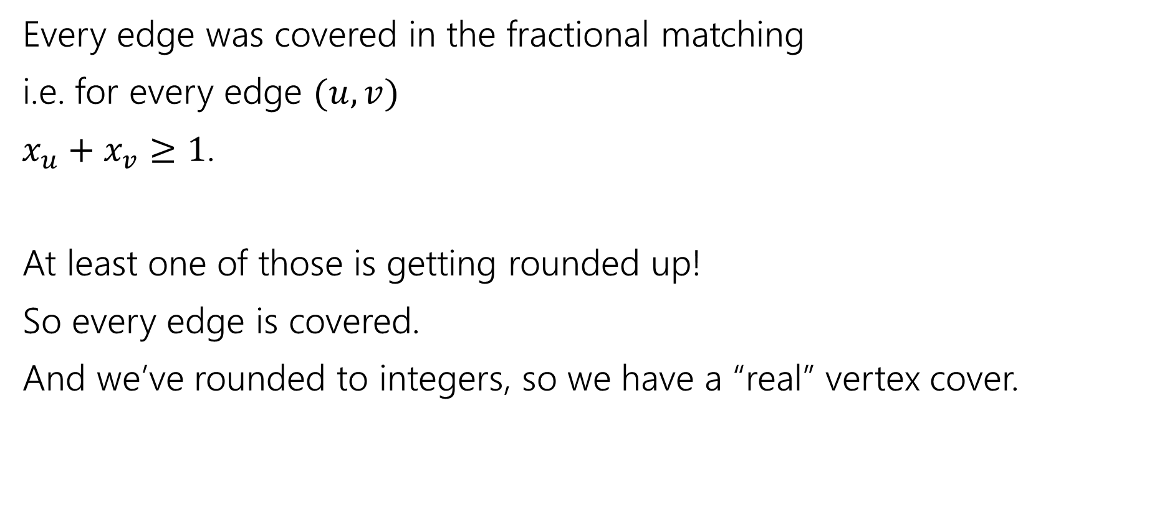
Is it a vertex cover?
Every edge was covered in the fractional matching
i.e. for every edge $(u,v)$
$x_{u}+x_{v}≥1$.
At least one of those is getting rounded up!
So every edge is covered.
And we’ve rounded to integers, so we have a “real” vertex cover.

Slide 33
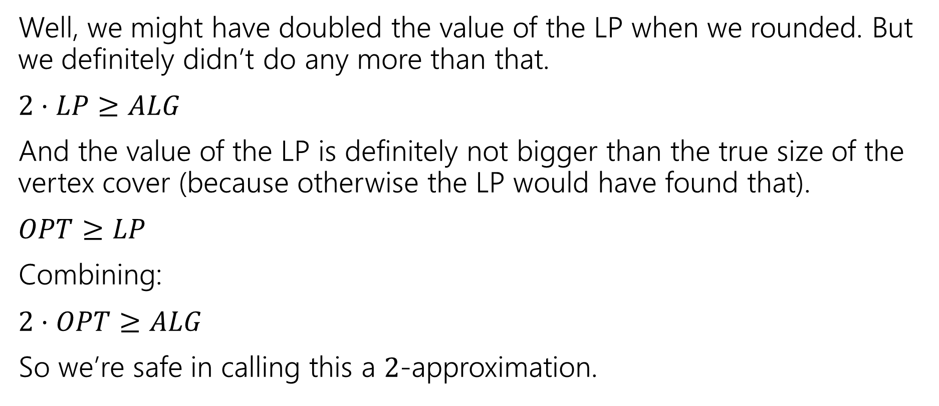
How good of an approximation is it?
Well, we might have doubled the value of the LP when we rounded. But we definitely didn’t do any more than that.
$2⋅LP≥ALG$
And the value of the LP is definitely not bigger than the true size of the vertex cover (because otherwise the LP would have found that).
$OPT≥LP$
Combining:
$2⋅OPT≥ALG$
So we’re safe in calling this a $2$-approximation.

Slide 34
Comparing to the LP value
We did a weird thing on that last slide.
We were supposed to compare the value of our vertex cover to the best vertex cover.
But instead we compared it to the value of the LP…which we know isn’t always the value of the vertex cover!
That wasn’t laziness, it’s a very common technique. We know very little about the true value of the vertex cover (if we knew what it looked like VERY VERY precisely, why couldn’t we just write an algorithm to find it? We actually won’t know much). So we start with what the algorithm gave us (that we do understand).

Slide 35
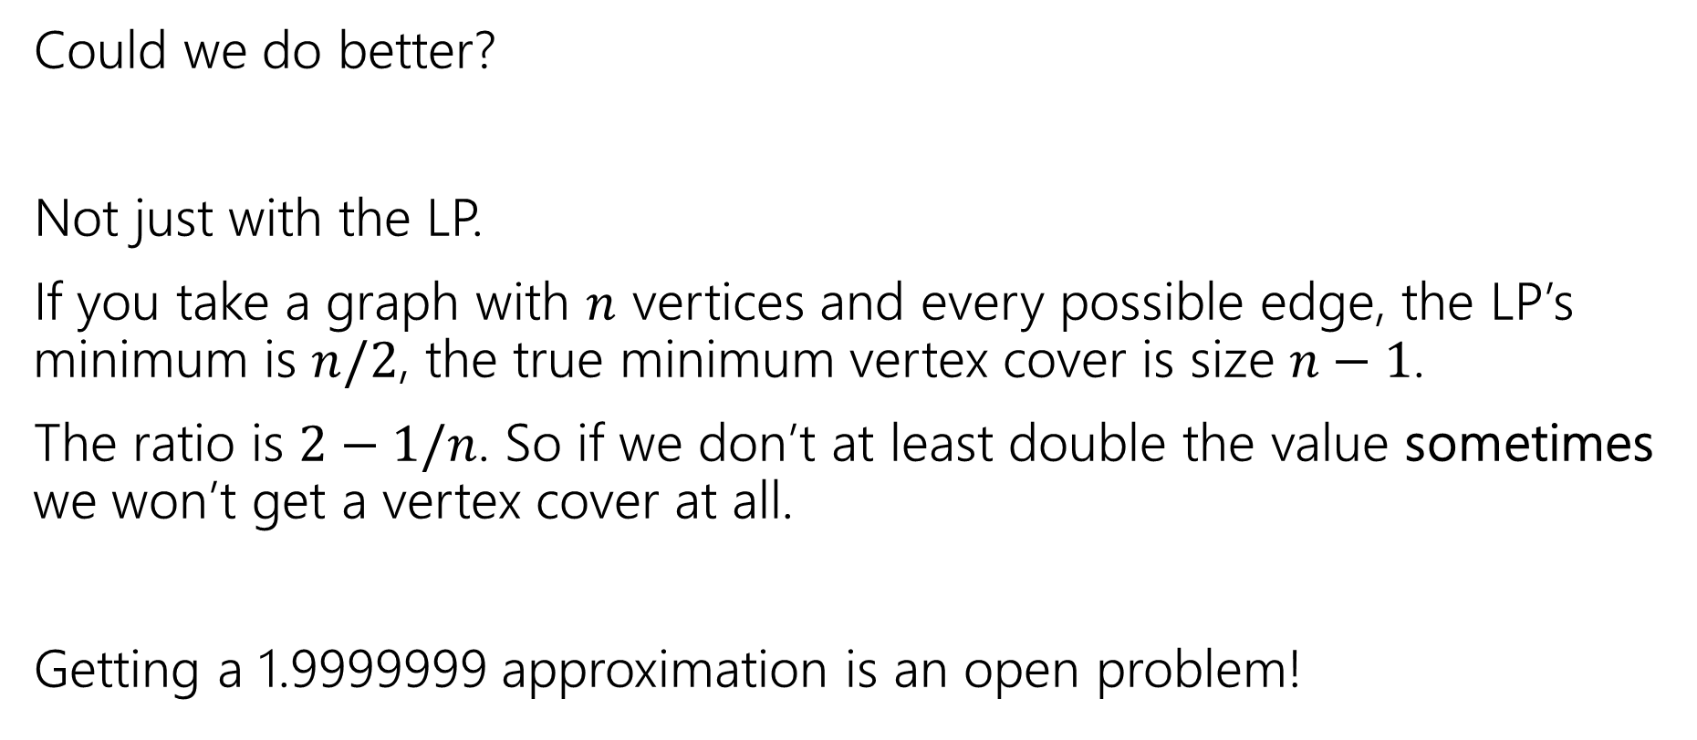
Side Note
Could we do better?
Not just with the LP.
If you take a graph with $n$ vertices and every possible edge, the LP’s minimum is $n/2$, the true minimum vertex cover is size $n−1$.
The ratio is $2−1/n$. So if we don’t at least double the value sometimes we won’t get a vertex cover at all.
Getting a 1.9999999 approximation is an open problem!

