Slide 1
Somehow,
Still More Flow
CSE 421 Winter 2023
Lecture 20

Slide 2



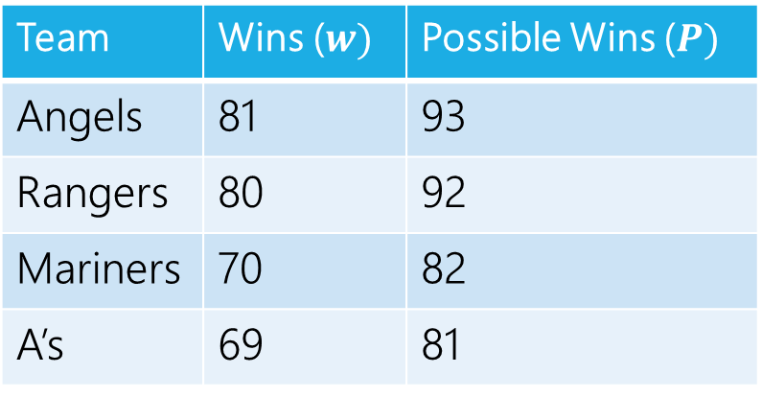



Making a Network
 | Angels | Rangers | Mariners | A’s
Angels | - | 5 | 3 | 4
Rangers | 5 | - | 4 | 3
Mariners | 3 | 4 | - | 5
A’s | 4 | 3 | 5 | -
Angels vs. Rangers
Angels
Team | Wins ($w)$ | Possible Wins ($P)$
Angels | 81 | 93
Rangers | 80 | 92
Mariners | 70 | 82
A’s | 69 | 81
$$∞$$
$$∞$$
1
5
$$∞$$
Angels vs.
A’s
Rangers
4
2
$$∞$$
We’re done!
$$∞$$
13
3
Rangers vs.
A’s
A’s
$$∞$$

Slide 3
Interpreting the answer
If the max flow has value equal to number of games, we know how the Mariners can still win the division.
If the max flow is less than that, the Mariners can’t win the division!
(if they could win the division, then there is a way that the remaining games could play out with the mariners having as many wins as anyone else, but then we could make a feasible flow by assigning a unit of flow for each winner).

Slide 4






Max Flow
 | Angels | Rangers | Mariners | A’s
Angels | - | 5 | 3 | 4
Rangers | 5 | - | 4 | 3
Mariners | 3 | 4 | - | 5
A’s | 4 | 3 | 5 | -
Angels vs. Rangers
Angels
Team | Wins ($w)$ | Possible Wins ($P)$
Angels | 81 | 93
Rangers | 80 | 92
Mariners | 70 | 82
A’s | 69 | 81
1/
$$∞$$
$$∞$$
2/
1/
3/
1
5
$$∞$$
Angels vs.
A’s
Rangers
4/
4
2
2/
$$∞$$
This is the maximum flow. What’s the min-cut?
{s, Angels vs. Rangers, Angels, Rangers} is one side of the cut.
The Angels and Rangers were enough to prove that the Mariners couldn’t win!
7/
4/
13
3/
$$∞$$
3
Rangers vs.
A’s
A’s
3/
$$∞$$

Slide 5
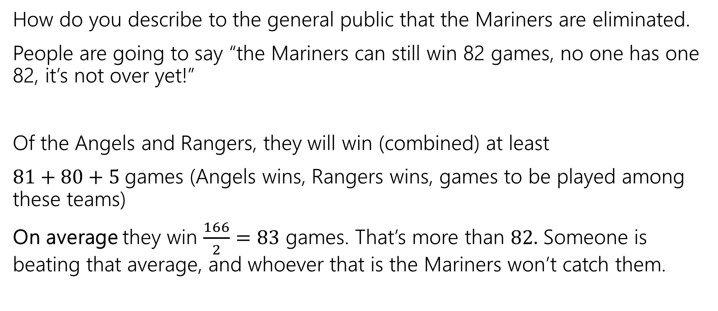
Generating Proof that you’re eliminated
How do you describe to the general public that the Mariners are eliminated.
People are going to say “the Mariners can still win 82 games, no one has one 82, it’s not over yet!”
Of the Angels and Rangers, they will win (combined) at least
$81+80+5$games (Angels wins, Rangers wins, games to be played among these teams)
On average they win $\frac{166}{2}=83$ games. That’s more than $82.$ Someone is beating that average, and whoever that is the Mariners won’t catch them.

Slide 6
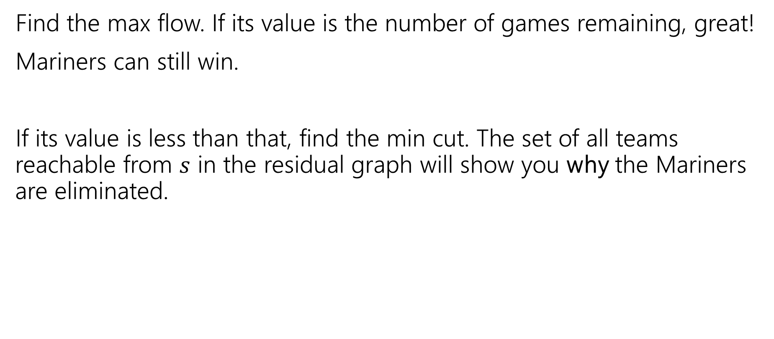
In General
Find the max flow. If its value is the number of games remaining, great!
Mariners can still win.
If its value is less than that, find the min cut. The set of all teams reachable from $s$ in the residual graph will show you why the Mariners are eliminated.

Slide 7
Takeaways
If you want to “assign” things, max-flow might be a good option.
If you say “at most” you can probably just make a capacity constraint
Once you can do an “exactly equal” or “at least” by checking the value of the max-flow.
Sometimes you want an extra layer or two if you have a multiple types of assignments.
Sometimes you can convert an “at least” in one group into an “at most” on another group.

Slide 8
Optional: Why is there always an explanation?

Slide 9



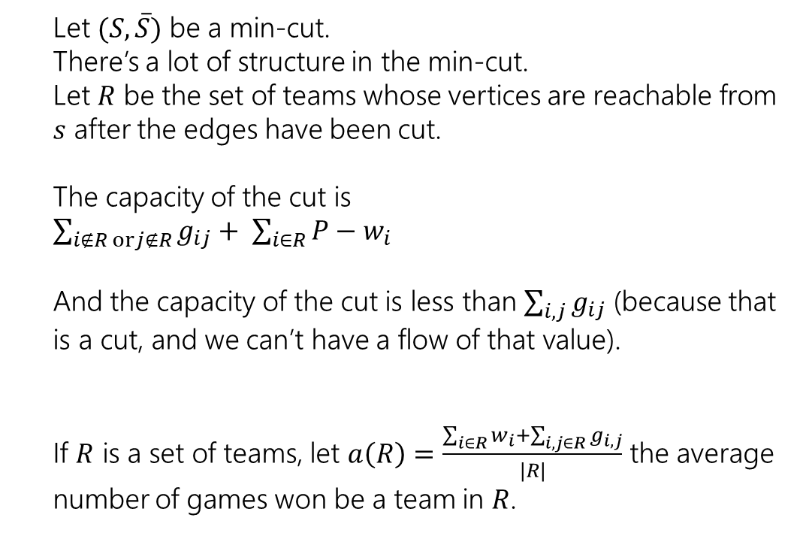



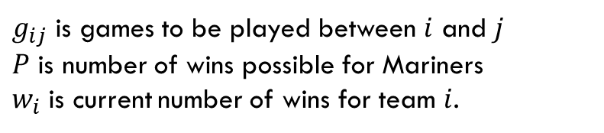
An Explanation Always Exists
$g_{ij}$ is games to be played between $i$ and $j$
$P$ is number of wins possible for Mariners
$w_{i}$ is current number of wins for team $i$.
Let $(S, \overline{S})$ be a min-cut.
There’s a lot of structure in the min-cut.
Let $R$ be the set of teams whose vertices are reachable from $s$ after the edges have been cut.
The capacity of the cut is
$\sum_{i∉R orj∉R}{g_{ij}}+ \sum_{i∈R}{P−w_{i}}$
And the capacity of the cut is less than $\sum_{i,j}{g_{ij}}$ (because that is a cut, and we can’t have a flow of that value).
If $R$ is a set of teams, let $a\left(R\right)=\frac{\sum_{i∈R}{w_{i}}+\sum_{i,j∈R}{g_{i,j}}}{|R|}$ the average number of games won be a team in $R$.
Angels vs. Rangers
Angels
$$∞$$
$$∞$$
1
5
$$∞$$
Angels vs.
A’s
Rangers
4
2
$$∞$$
$$∞$$
13
3
Rangers vs.
A’s
A’s
$$∞$$

Slide 10
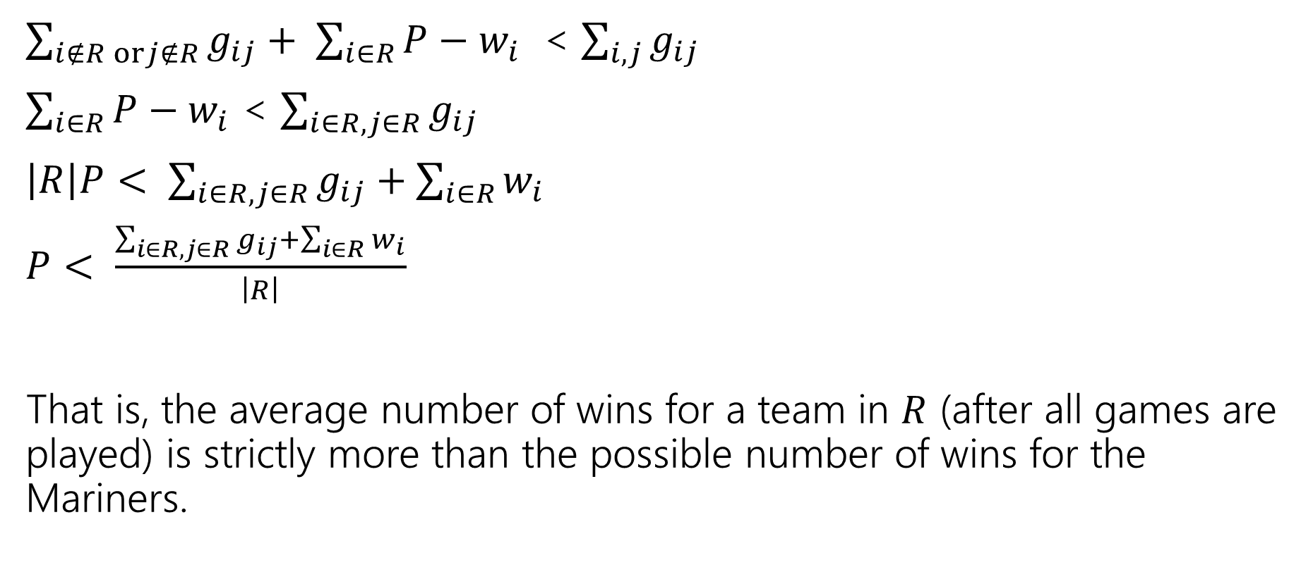
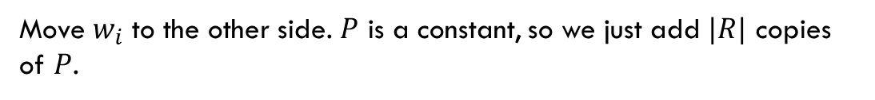
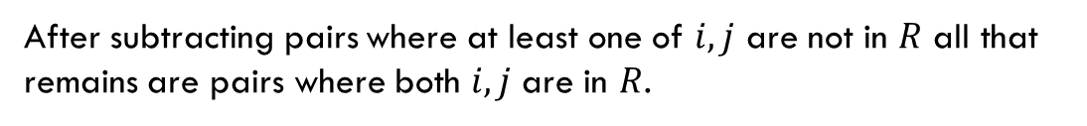
An Explanation Always Exists
$g_{ij}$ is games to be played between $i$ and $j$
$P$ is number of wins possible for Mariners
$w_{i}$ is current number of wins for team $i$.
$\sum_{i∉R orj∉R}{g_{ij}}+ \sum_{i∈R}{P−w_{i}}$ < $\sum_{i,j}{g_{ij}}$
$\sum_{i∈R}{P−w_{i}}$ < $\sum_{i∈R, j∈R}{g_{ij}}$
$\left|R\right|P< \sum_{i∈R, j∈R}{g_{ij}}+\sum_{i∈R}{w_{i}}$
$P< \frac{\sum_{i∈R, j∈R}{g_{ij}}+\sum_{i∈R}{w_{i}}}{\left|R\right|}$
That is, the average number of wins for a team in $R$ (after all games are played) is strictly more than the possible number of wins for the Mariners.
After subtracting pairs where at least one of $i,j$ are not in $R$ all that remains are pairs where both $i,j$ are in $R$.
Move $w_{i}$ to the other side. $P$ is a constant, so we just add $|R|$ copies of $P$.

Slide 11

Summary
To tell whether your favorite team is eliminated, you can run a max-flow computation on a graph with $O(n^{2})$ vertices and $O(n^{2})$ edges.
If your team is eliminated, there is a witness set of teams that must average more wins than is possible for your team.

Slide 12
Bipartite Applications

Slide 13
Today
One last day of max-flow.
Two new problems we can solve with max-flow/min-cut.
Today’s proofs are short but subtle; I’m intentionally taking us through slowly. Please ask questions.

Slide 14
A (possibly) simple problem
Given a bipartite graph, find a maximum matching.
Think of it as matching the endpoints of the edges to each other.
A stable matching is a particular matching on a complete bipartite graph.
A matching is a set of edges that do not share an endpoint.

Slide 15
A (possibly) simple problem
Given a bipartite graph, find a maximum matching.
For example, on this graph the red edges are a maximum matching. There is no way to get 4 edges in a matching.
A matching is a set of edges that do not share an endpoint.

Slide 16
A (possibly) simple problem
Design an algorithm to find a maximum matching on a bipartite graph.
(hint: what if the vertices on one side are chores and the other are housemates).

Slide 17
Algorithm for Bipartite Maximum Matching
Use the “tuple selection/assignment” we did last week!

Slide 18
Algorithm for Bipartite Maximum Matching
Add a dummy source and sink. Attach each to one side.

Slide 19
Algorithm for Bipartite Maximum Matching
Add a dummy source and sink. Attach each to one side.
Direct (previously undirected) edges toward sink

Slide 20


Algorithm for Bipartite Maximum Matching
Add a dummy source and sink. Attach each to one side.
Direct (previously undirected) edges toward sink.
Capacity 1 entering and leaving each (real) vertex ensures matching
$$?/1$$
$$?/1$$

Slide 21
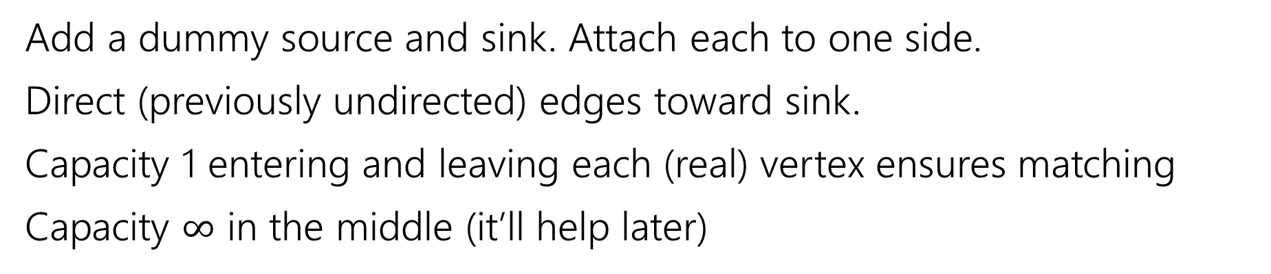

Algorithm for Bipartite Maximum Matching
Add a dummy source and sink. Attach each to one side.
Direct (previously undirected) edges toward sink.
Capacity 1 entering and leaving each (real) vertex ensures matching
Capacity $∞$ in the middle (it’ll help later)
$$?/∞$$
$$?/1$$
$$?/1$$

Slide 22
Algorithm for Bipartite Maximum Matching
Add a dummy source and sink. Attach each to one side.
Direct (previously undirected) edges toward sink.
Capacity 1 entering and leaving each (real) vertex ensures matching
Capacity $∞$ in the middle (it’ll help later)
$$?/∞$$
$$?/1$$
$$?/1$$

Slide 23
Algorithm for Bipartite Maximum Matching
Add a dummy source and sink. Attach each to one side.
Direct (previously undirected) edges toward sink.
Capacity 1 entering and leaving each (real) vertex ensures matching
Capacity $∞$ in the middle (it’ll help later)
Red edges have flow.
Take edges with flow for the matching.
$$?/∞$$
$$?/1$$
$$?/1$$

Slide 24
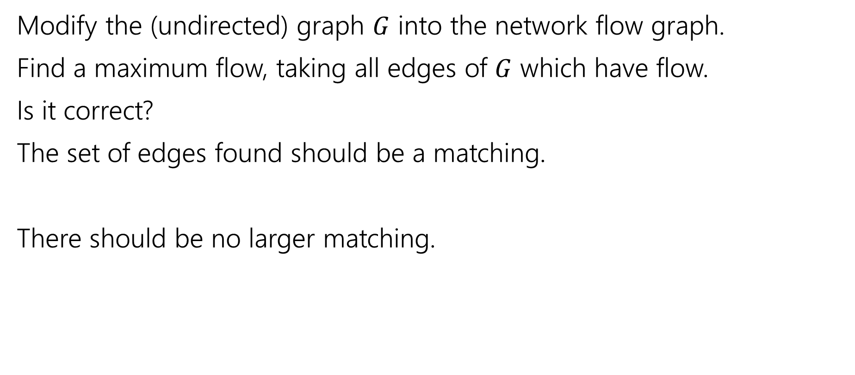
Algorithm for Bipartite Matching
Modify the (undirected) graph $G$ into the network flow graph.
Find a maximum flow, taking all edges of $G$ which have flow.
Is it correct?
The set of edges found should be a matching.
There should be no larger matching.

Slide 25
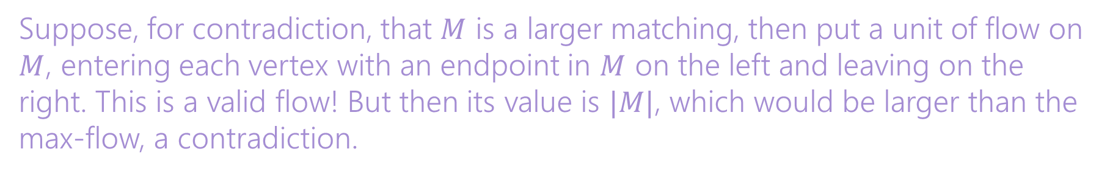
Algorithm for Bipartite Matching
Modify the (undirected) graph $G$ into the network flow graph.
Find a maximum flow, taking all edges of $G$ which have flow.
Is it correct?
The set of edges found should be a matching.
There should be no larger matching.
Capacities ensure no edge has more than one unit of flow through it. By integrality of flow, we have only one edge.
Suppose, for contradiction, that $M$ is a larger matching, then put a unit of flow on $M$, entering each vertex with an endpoint in $M$ on the left and leaving on the right. This is a valid flow! But then its value is $|M|$, which would be larger than the max-flow, a contradiction.

Slide 26

Solving a new problem (with matchings)
Let $G$ be an undirected graph.
A minimum vertex cover is the smallest set of vertices such that every edge has at least one of its endpoints in the set.
Here’s an algorithm to find a minimum vertex cover in a bipartite graph…

Slide 27
Vertex Cover
How to find a vertex cover?
Well a max-flow says “you can’t use this edge; (at least) one of its endpoints is already used by the matching.
Here’s a vertex cover (in gold). Notice something about it?
$$?/∞$$
$$?/1$$
$$?/1$$

Slide 28
Vertex Cover
Here’s a vertex cover (in gold). Find the min-cut (write residual graph)
$$?/∞$$
$$?/1$$
$$?/1$$

Slide 29
Vertex Cover
$$?/∞$$
Flow graph
$$?/1$$
$$?/1$$
Residual;
Cut in blue X’s

Slide 30
Vertex Cover
How to find a vertex cover?
Well a max-flow says “you can’t use this unsaturated edge; (at least) one of its endpoints is already used by the matching.
Here’s a vertex cover (in gold). Notice something about it? It looks a lot like the min cut.
$$?/∞$$
$$?/1$$
$$?/1$$

Slide 31

Vertex Cover
Let $A$ be the left bipartition, $B$ the right side. Let $(S,T)$ be the min-cut.
$A_{S}=A∩S;$ $A_{T},B_{S},B_{T}$ defined correspondingly.
Here, $A_{T}$ and $B_{S}$ form a vertex cover
$$?/∞$$
$$?/1$$
$$?/1$$

Slide 32

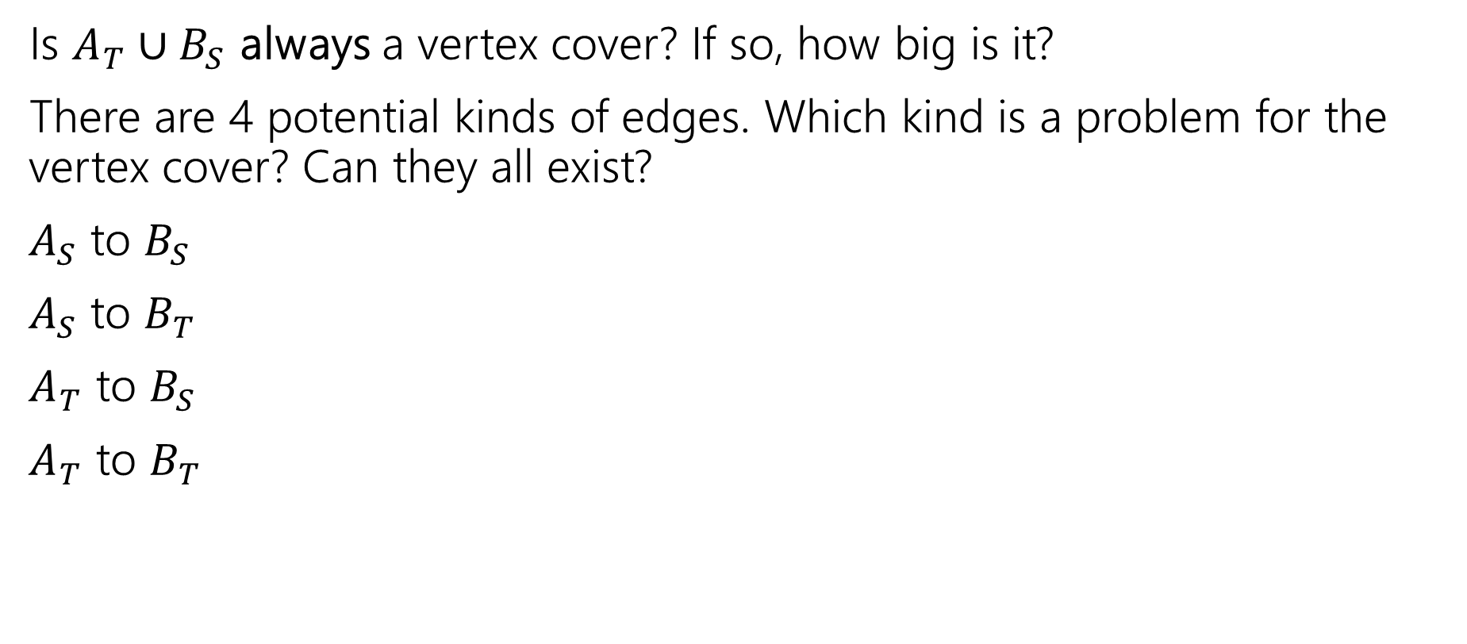


Vertex Cover
Is $A_{T}∪B_{S}$ always a vertex cover? If so, how big is it?
There are 4 potential kinds of edges. Which kind is a problem for the vertex cover? Can they all exist?
$A_{S}$ to $B_{S}$
$A_{S}$ to $B_{T}$
$A_{T}$ to $B_{S}$
$A_{T}$ to $B_{T}$
$$?/∞$$
$$?/1$$
$$?/1$$

Slide 33
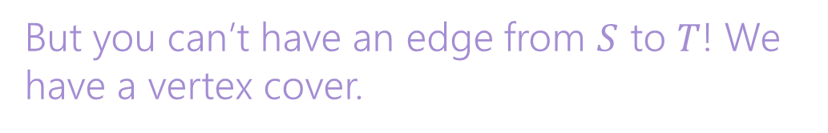
Vertex Cover
Is $A_{T}∪B_{S}$ always a vertex cover? If so, how big is it?
There are 4 potential kinds of edges. Which kind is a problem for the vertex cover? Can they all exist?
$A_{S}$ to $B_{S}$
$A_{S}$ to $B_{T}$
$A_{T}$ to $B_{S}$
$A_{T}$ to $B_{T}$
Only kind we have to worry about!!
But you can’t have an edge from $S$ to $T$! We have a vertex cover.
$$?/∞$$
$$?/1$$
$$?/1$$

Slide 34

Vertex Cover
How big is $A_{T}∪B_{S}$?
Well, it looks a lot like the min-cut. $\left(s,A_{T}\right)$ and $(B_{S},t)$ are cut.
Each of those edges is capacity $1$. Each has an endpoint we put in the vertex cover! $\left|A_{T}∪B_{S}\right|=cap\left(S,T\right)=|f|$.
$$?/∞$$
$$?/1$$
$$?/1$$

Slide 35

But is it a minimum VC?
So it’s a vertex cover, of size equal to the min-cut…what if there’s a smaller vertex cover?
Let $X$ be any vertex cover, define $A_{X},B_{X}$ as before.

Slide 36
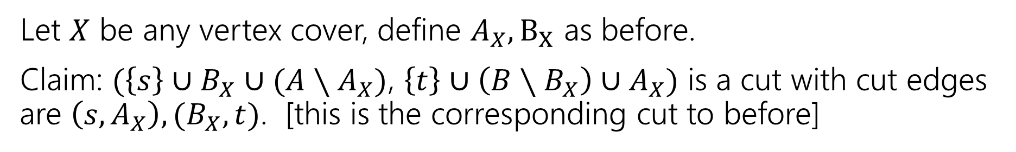
No smaller VC
Let $X$ be any vertex cover, define $A_{X},B_{X}$ as before.
Claim: $(\left\{s\right\}∪B_{X}∪(A∖A_{X})$, $\left\{t\right\}∪\left(B∖B_{X}\right)∪A_{X})$ is a cut with cut edges are $\left(s,A_{X}\right),(B_{X},t)$. [this is the corresponding cut to before]
$$?/∞$$
$$?/1$$
$$?/1$$

Slide 37
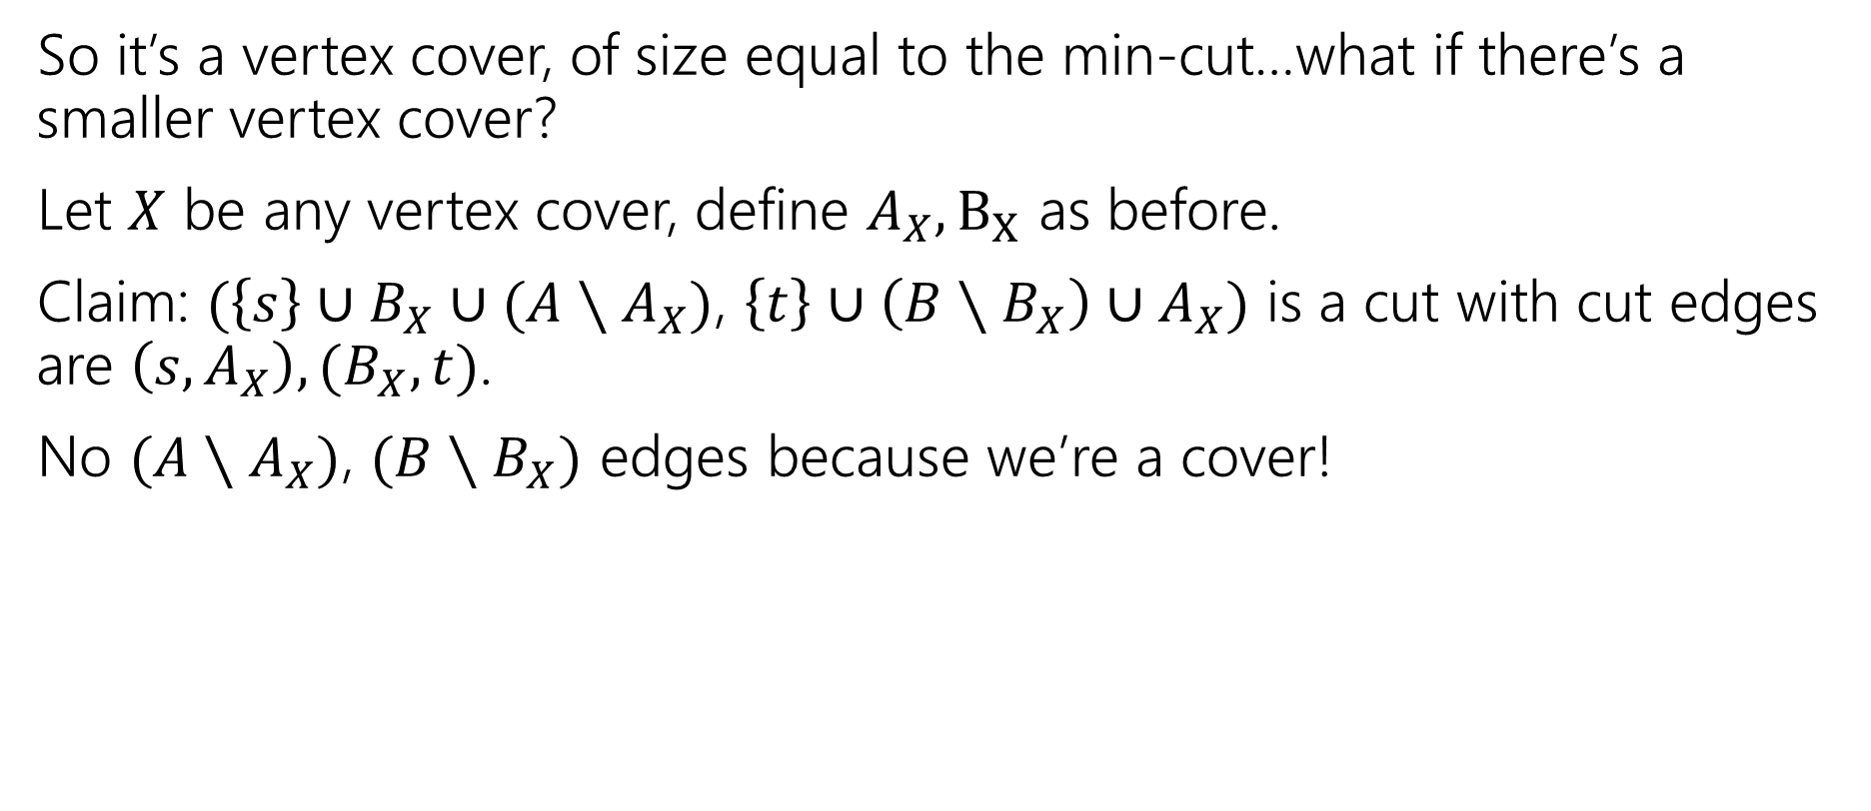
But is it a minimum VC?
So it’s a vertex cover, of size equal to the min-cut…what if there’s a smaller vertex cover?
Let $X$ be any vertex cover, define $A_{X},B_{X}$ as before.
Claim: $(\left\{s\right\}∪B_{X}∪(A∖A_{X})$, $\left\{t\right\}∪\left(B∖B_{X}\right)∪A_{X})$ is a cut with cut edges are $\left(s,A_{X}\right),(B_{X},t)$.
No $(A∖A_{X})$, $(B∖B_{X})$ edges because we’re a cover!

Slide 38
No smaller VC
Every vertex cover lets you discover a cut of the same size.
Our algorithm found a VC of size equal to the minimum cut! A smaller VC would give a smaller cut! But there isn’t one. So we have found the min VC.
$$?/∞$$
$$?/1$$
$$?/1$$

Slide 39
Wrapping it up
You can find the following of a bipartite graph (using only flow)
Maximum matching
Minimum Vertex cover
And their value is equal to the size of the max-flow (and the min-cut) in the modified graph.
“Kőnig’s Theorem” (aka Kőnig-Egevary Theorem)
In a bipartite graph, the size of the maximum matching is equal to the size of the minimum vertex cover.

Slide 40
Wrapping It Up
We’ve found maximum matchings and minimum vertex covers in bipartite graphs using flow.
If your graph isn’t bipartite:
Efficiently finding a maximum matching is still possible.
  but more complicated. Look up “Edmond’s Blossom Algorithm”
Efficiently finding a minimum vertex cover, is a taller task.
  It’s an NP-complete problem. We’ll more clearly define what that means next week.

Slide 41
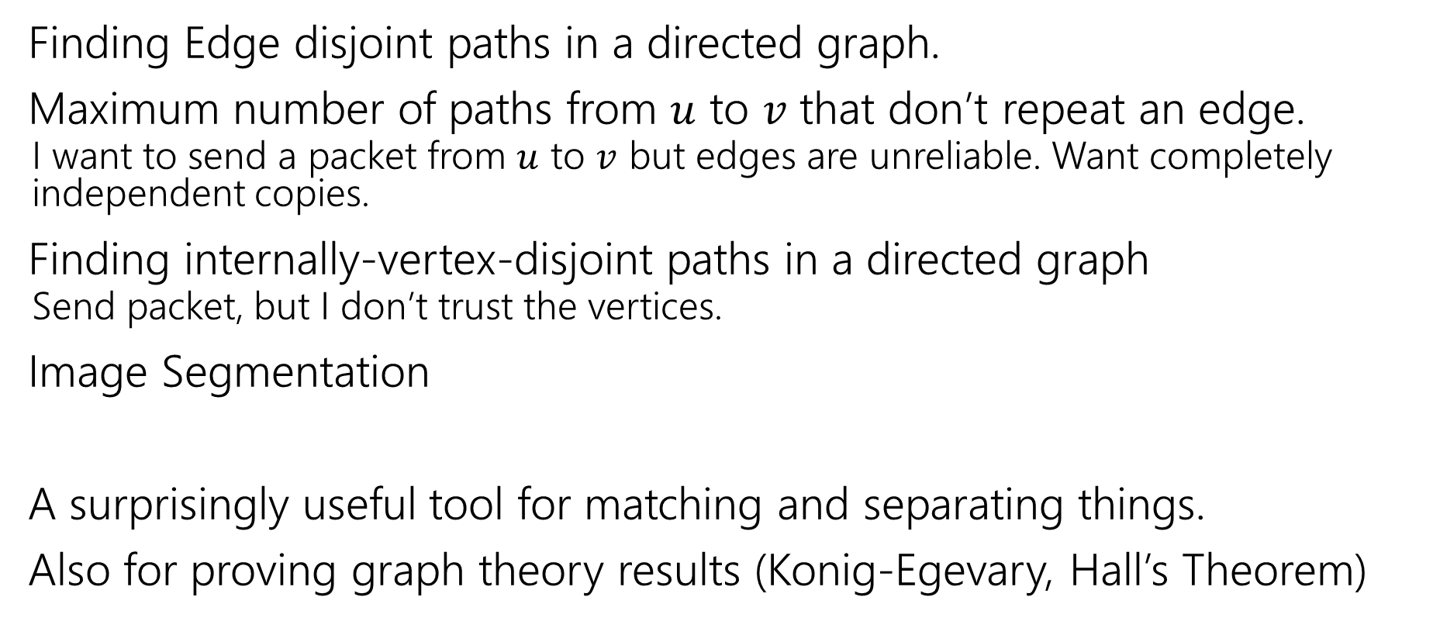
But Wait, There’s More Applications!
Finding Edge disjoint paths in a directed graph.
Maximum number of paths from $u$ to $v$ that don’t repeat an edge.
  I want to send a packet from $u$ to $v$ but edges are unreliable. Want completely independent copies.
Finding internally-vertex-disjoint paths in a directed graph
  Send packet, but I don’t trust the vertices.
Image Segmentation
A surprisingly useful tool for matching and separating things.
Also for proving graph theory results (Konig-Egevary, Hall’s Theorem)

