Slide 1
Max Flow Min Cut Modeling
CSE 421 Fall 22
Lecture 22

Slide 2
Applications of Max-Flow-Min-Cut
Max-Flow and Min-Cut are useful if you work for the water company…
But they’re also useful if you don’t.
The most common application is assignment problems.
You have jobs and people who can do jobs – who is going to do which?
Big idea:
Let one unit of flow mean “assigning” one job to a person.

Slide 3
Hey Wait…
Isn’t this what stable matching is for?
Stable matching is very versatile, and it lets you encode preferences.
Max-flow assignment is even more versatile on the types of assignments.
But there’s not an easy way to encode preferences.

Slide 4
Example Problem
You and your housemates need to decide who is going to do each of the chores this week.
Some of your housemates are unable to do some chores.
Housemates: 1,2,3
Chores:
Arrange furniture, clean the Bathroom, Cook dinner, do the Dishes
Housemate 1 is unable to arrange furniture, 2 is unable to cook.

Slide 5
Example Problem
Housemate 1 is unable to arrange furniture, 2 is unable to cook.
Vertex for each housemate and chore.
Edge if the housemate could do the chore
A
1
B
2
C
3
D

Slide 6
Example Problem
Housemate 1 is unable to arrange furniture, 2 is unable to cook.
Vertex for each housemate and chore.
Edge if the housemate could do the chore
A
1
B
2
C
3
D

Slide 7
Example Problem
Housemate 1 is unable to arrange furniture, 2 is unable to cook.
Vertex for each housemate and chore.
Edge if the housemate could do the chore
A
1
B
2
C
3
D

Slide 8
Example Problem
Housemate 1 is unable to arrange furniture, 2 is unable to cook.
Vertex for each housemate and chore.
Edge if the housemate could do the chore
A
1
B
2
C
3
D

Slide 9
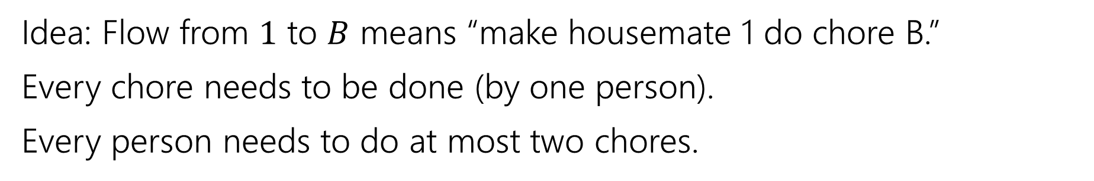
Example Problem
Idea: Flow from $1$ to $B$ means “make housemate 1 do chore B.”
Every chore needs to be done (by one person).
Every person needs to do at most two chores.
A
1
B
2
C
3
D

Slide 10
Example Problem
Idea: Flow from $1$ to $B$ means “make housemate 1 do chore B.”
Every chore needs to be done (by one person).
Every person needs to do at most two chores.
A
1
“dummy” source
B
s
2
t
C
3
“dummy” target
D

Slide 11

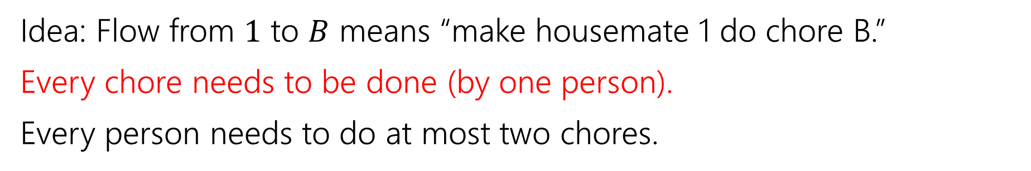



Example Problem
Idea: Flow from $1$ to $B$ means “make housemate 1 do chore B.”
Every chore needs to be done (by one person).
Every person needs to do at most two chores.
A
1
$$?/1$$
B
$$?/1$$
s
2
t
$$?/1$$
C
$$?/1$$
3
D

Slide 12



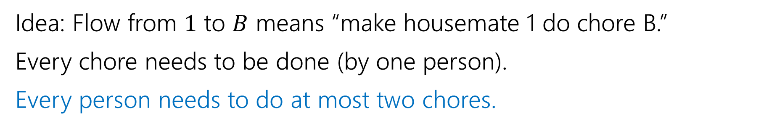




Example Problem
Idea: Flow from $1$ to $B$ means “make housemate 1 do chore B.”
Every chore needs to be done (by one person).
Every person needs to do at most two chores.
A
1
$$?/1$$
$$?/2$$
$$?/2$$
B
$$?/1$$
s
2
t
$$?/2$$
$$?/1$$
C
$$?/1$$
3
D

Slide 13


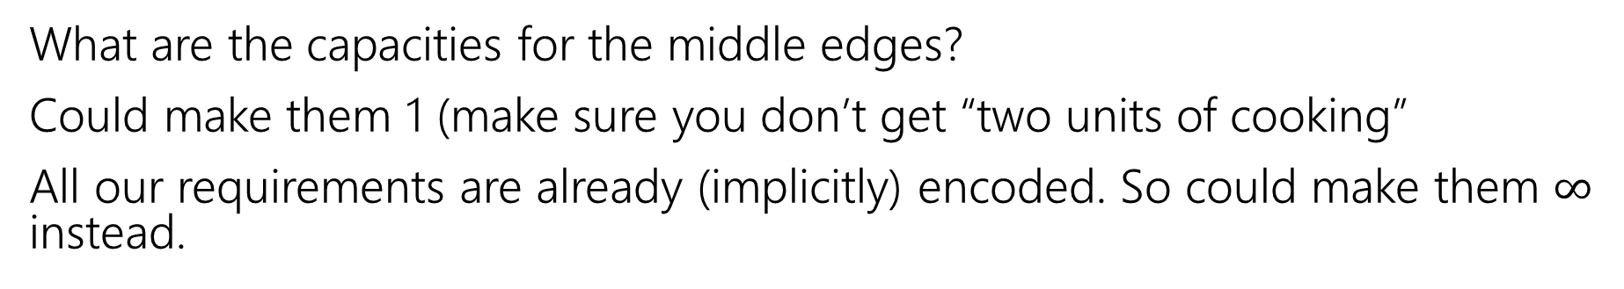

Example Problem
What are the capacities for the middle edges?
Could make them 1 (make sure you don’t get “two units of cooking”
All our requirements are already (implicitly) encoded. So could make them $∞$ instead.
A
1
$$?/1$$
$$?/2$$
$$?/2$$
B
$$?/1$$
s
2
t
$$?/2$$
$$?/1$$
C
$$?/1$$
3
D

Slide 14







Example Problem
Find a max flow…And read off the assignment!
Full color: 1 unit of flow, faded: 0 units of flow
1 cleans the bathroom and does the dishes, 2 arranges furniture, 3 cooks.
A
1
$$1/1$$
$$2/2$$
$$1/2$$
B
$$1/1$$
s
2
t
$$1/2$$
$$1/1$$
C
$$1/1$$
3
D

Slide 15
Why are all of our constraints met?
Every chore gets done
No one does more than 2 chores
People only do chores they’re capable of

Slide 16
Why are all of our constraints met?
Every chore gets done
No one does more than 2 chores
People only do chores they’re capable of
A flow of value 4 sends one unit of flow through each of A,B,C,D (because the edges to $t$ are all capacity $1$), so a max-flow ensures if possible we’ll find an assignment.
Only 2 units of flow can go through any person vertex (because edges from $s$ to people are all capacity $2).$
There is only an edge from a person to a chore if they can do that chore.

Slide 17
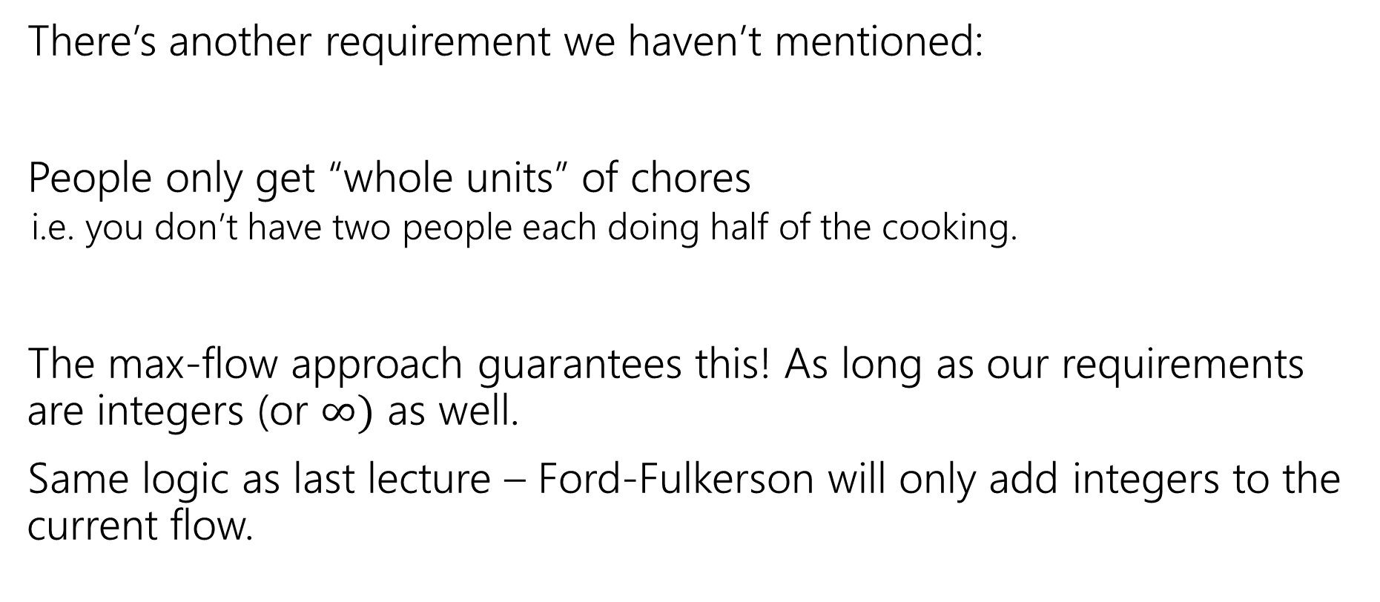
One More Requirement…
There’s another requirement we haven’t mentioned:
People only get “whole units” of chores
  i.e. you don’t have two people each doing half of the cooking.
The max-flow approach guarantees this! As long as our requirements are integers (or $∞)$ as well.
Same logic as last lecture – Ford-Fulkerson will only add integers to the current flow.

Slide 18
Key Ideas
Use different vertices to represent different jobs (even if they look related).
You can (once per problem) use the value of the flow to evaluate whether you’ve met some minimum number (one “at least” or “exactly equal to” requirement)
Otherwise, use capacities to limit the options. One unit of flow usually represents one “assignment.”

Slide 19
One More Application
A classic example
We’ll also be able to use the min-cut in addition to the flow!
Question: Can the Mariners still win* the division?
*or at least tie for first place.
And if they can’t, can you explain why.

Slide 20
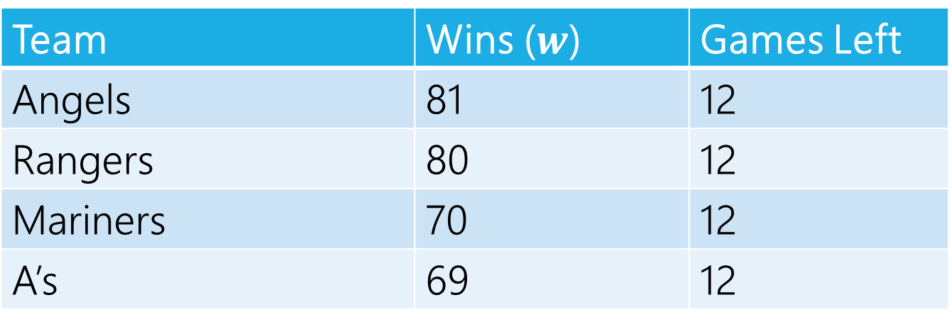
Can The Mariners Win The Division?
It’s late at night September 14, 1998.
You’re working for the Seattle Times.
The Mariners won! But the Angels did too.
How do you frame the Mariners current situation in your postgame article?
Team | Wins ($w$) | Games Left
Angels | 81 | 12
Rangers | 80 | 12
Mariners | 70 | 12
A’s | 69 | 12
MLB rules say all games will be played (if they end up mattering) so you can assume those will happen.

Slide 21
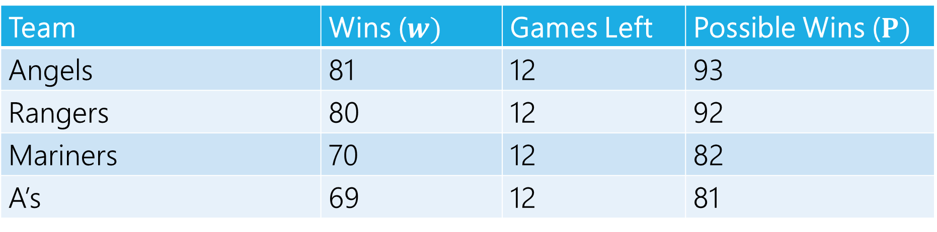
Can The Mariners Win The Division?
Team | Wins ($w)$ | Games Left | Possible Wins ($P)$
Angels | 81 | 12 | 93
Rangers | 80 | 12 | 92
Mariners | 70 | 12 | 82
A’s | 69 | 12 | 81
$P_{MARINERS}≥w_{i}$ for all $i$, so the Mariners can win the division, right?

Slide 22
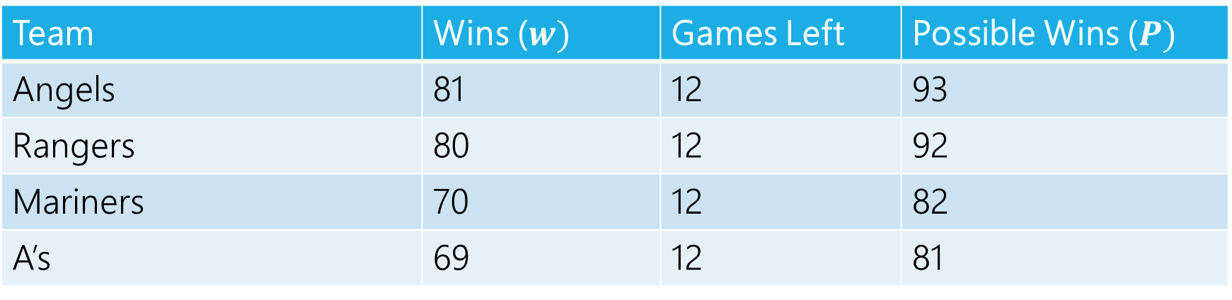
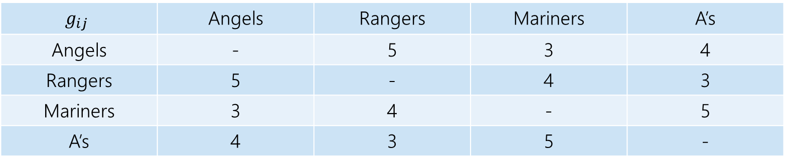
Well…No
The teams will play each other, here are the number of games to be played against each other.
$$g_{ij}$$ | Angels | Rangers | Mariners | A’s
Angels | - | 5 | 3 | 4
Rangers | 5 | - | 4 | 3
Mariners | 3 | 4 | - | 5
A’s | 4 | 3 | 5 | -
Team | Wins ($w)$ | Games Left | Possible Wins ($P)$
Angels | 81 | 12 | 93
Rangers | 80 | 12 | 92
Mariners | 70 | 12 | 82
A’s | 69 | 12 | 81

Slide 23
Well…No
At least one of the Angels and Rangers is going to win at least 83 games
  someone wins at least three of the five they play against each other.
The Mariners can only win 82 games.

Slide 24
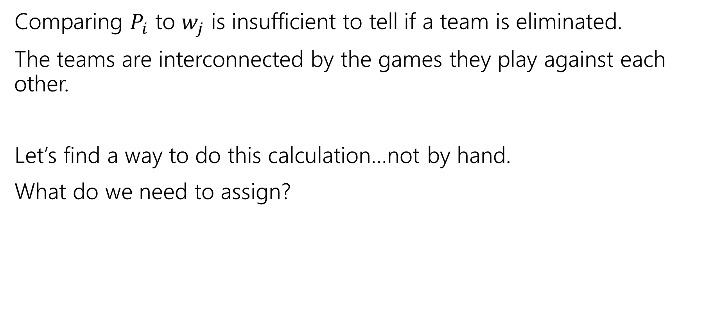
Lessons
Comparing $P_{i}$ to $w_{j}$ is insufficient to tell if a team is eliminated.
The teams are interconnected by the games they play against each other.
Let’s find a way to do this calculation…not by hand.
What do we need to assign?

Slide 25
Assignment
We need to assign who wins each of the remaining games.
Safe to assume the Mariners will win them all.
Just need to figure out the others.
One unit of flow represents one win.

Slide 26
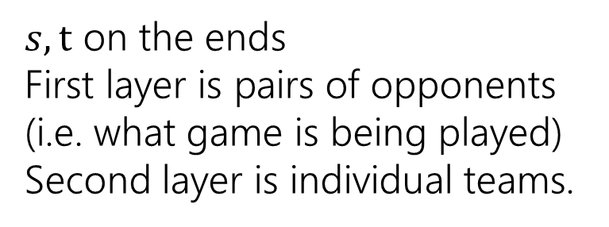
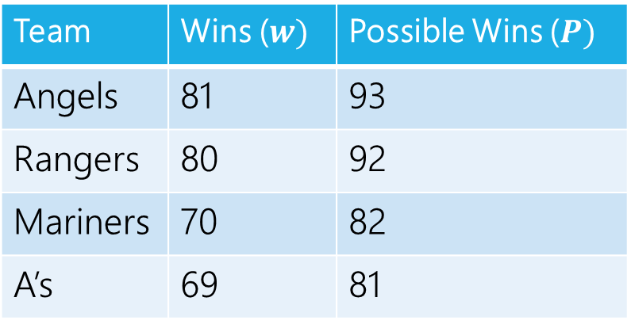
Making a Network
 | Angels | Rangers | Mariners | A’s
Angels | - | 5 | 3 | 4
Rangers | 5 | - | 4 | 3
Mariners | 3 | 4 | - | 5
A’s | 4 | 3 | 5 | -
Angels vs. Rangers
Angels
Team | Wins ($w)$ | Possible Wins ($P)$
Angels | 81 | 93
Rangers | 80 | 92
Mariners | 70 | 82
A’s | 69 | 81
Angels vs.
A’s
Rangers
$s,t$ on the ends
First layer is pairs of opponents (i.e. what game is being played)
Second layer is individual teams.
Rangers vs.
A’s
A’s

Slide 27
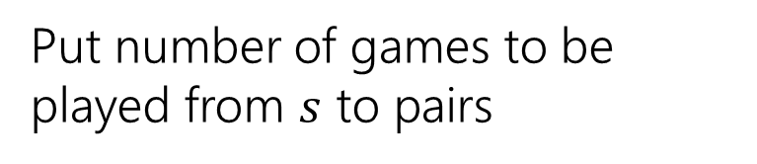
Making a Network
 | Angels | Rangers | Mariners | A’s
Angels | - | 5 | 3 | 4
Rangers | 5 | - | 4 | 3
Mariners | 3 | 4 | - | 5
A’s | 4 | 3 | 5 | -
Angels vs. Rangers
Angels
Team | Wins ($w)$ | Possible Wins ($P)$
Angels | 81 | 93
Rangers | 80 | 92
Mariners | 70 | 82
A’s | 69 | 81
5
Angels vs.
A’s
Rangers
4
Put number of games to be played from $s$ to pairs
3
Rangers vs.
A’s
A’s

Slide 28
Making a Network
 | Angels | Rangers | Mariners | A’s
Angels | - | 5 | 3 | 4
Rangers | 5 | - | 4 | 3
Mariners | 3 | 4 | - | 5
A’s | 4 | 3 | 5 | -
Angels vs. Rangers
Angels
Team | Wins ($w)$ | Possible Wins ($P)$
Angels | 81 | 93
Rangers | 80 | 92
Mariners | 70 | 82
A’s | 69 | 81
5
Angels vs.
A’s
Rangers
4
How do we make sure Mariners win? They’ll end the season with 82 wins (current + games left).
How many more can each team win?
Mariners poss total – team current
3
Rangers vs.
A’s
A’s

Slide 29
Making a Network
 | Angels | Rangers | Mariners | A’s
Angels | - | 5 | 3 | 4
Rangers | 5 | - | 4 | 3
Mariners | 3 | 4 | - | 5
A’s | 4 | 3 | 5 | -
Angels have 81 wins, 1 more is ok (total matches Mariners possible) 2 is not. Capacity is 1.
Angels vs. Rangers
Angels
Team | Wins ($w)$ | Possible Wins ($P)$
Angels | 81 | 93
Rangers | 80 | 92
Mariners | 70 | 82
A’s | 69 | 81
5
1
Angels vs.
A’s
Rangers
4
How do we make sure Mariners win? They’ll end the season with 82 wins (current + games left).
How many more can each team win?
Mariners poss total – team current
3
Rangers vs.
A’s
A’s

Slide 30
Making a Network
 | Angels | Rangers | Mariners | A’s
Angels | - | 5 | 3 | 4
Rangers | 5 | - | 4 | 3
Mariners | 3 | 4 | - | 5
A’s | 4 | 3 | 5 | -
Angels vs. Rangers
Angels
Team | Wins ($w)$ | Possible Wins ($P)$
Angels | 81 | 93
Rangers | 80 | 92
Mariners | 70 | 82
A’s | 69 | 81
5
1
Angels vs.
A’s
Rangers
4
2
How do we make sure Mariners win? They’ll end the season with 82 wins (current + games left).
How many more can each team win?
Mariners poss total – team current
13
3
Rangers vs.
A’s
A’s

Slide 31
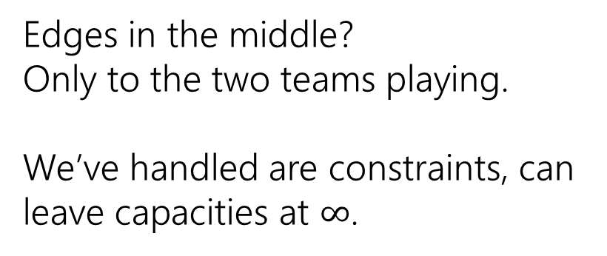
Making a Network
 | Angels | Rangers | Mariners | A’s
Angels | - | 5 | 3 | 4
Rangers | 5 | - | 4 | 3
Mariners | 3 | 4 | - | 5
A’s | 4 | 3 | 5 | -
Angels vs. Rangers
Angels
Team | Wins ($w)$ | Possible Wins ($P)$
Angels | 81 | 93
Rangers | 80 | 92
Mariners | 70 | 82
A’s | 69 | 81
5
1
Angels vs.
A’s
Rangers
4
2
Edges in the middle?
Only to the two teams playing.
We’ve handled are constraints, can leave capacities at $∞$.
13
3
Rangers vs.
A’s
A’s

Slide 32






Making a Network
 | Angels | Rangers | Mariners | A’s
Angels | - | 5 | 3 | 4
Rangers | 5 | - | 4 | 3
Mariners | 3 | 4 | - | 5
A’s | 4 | 3 | 5 | -
Angels vs. Rangers
Angels
Team | Wins ($w)$ | Possible Wins ($P)$
Angels | 81 | 93
Rangers | 80 | 92
Mariners | 70 | 82
A’s | 69 | 81
$$∞$$
$$∞$$
1
5
$$∞$$
Angels vs.
A’s
Rangers
4
2
$$∞$$
Edges in the middle?
Only to the two teams playing.
We’ve handled are constraints, can leave capacities at $∞$.
$$∞$$
13
3
Rangers vs.
A’s
A’s
$$∞$$

Slide 33
Making a Network
 | Angels | Rangers | Mariners | A’s
Angels | - | 5 | 3 | 4
Rangers | 5 | - | 4 | 3
Mariners | 3 | 4 | - | 5
A’s | 4 | 3 | 5 | -
Angels vs. Rangers
Angels
Team | Wins ($w)$ | Possible Wins ($P)$
Angels | 81 | 93
Rangers | 80 | 92
Mariners | 70 | 82
A’s | 69 | 81
$$∞$$
$$∞$$
1
5
$$∞$$
Angels vs.
A’s
Rangers
4
2
$$∞$$
We’re done!
$$∞$$
13
3
Rangers vs.
A’s
A’s
$$∞$$

Slide 34

Why are all the constraints met?
How many games are there to play? Equal to the capacities leaving $s$.
Why will the Mariners win with this assignment?
No “half-wins” or anything weird?

Slide 35
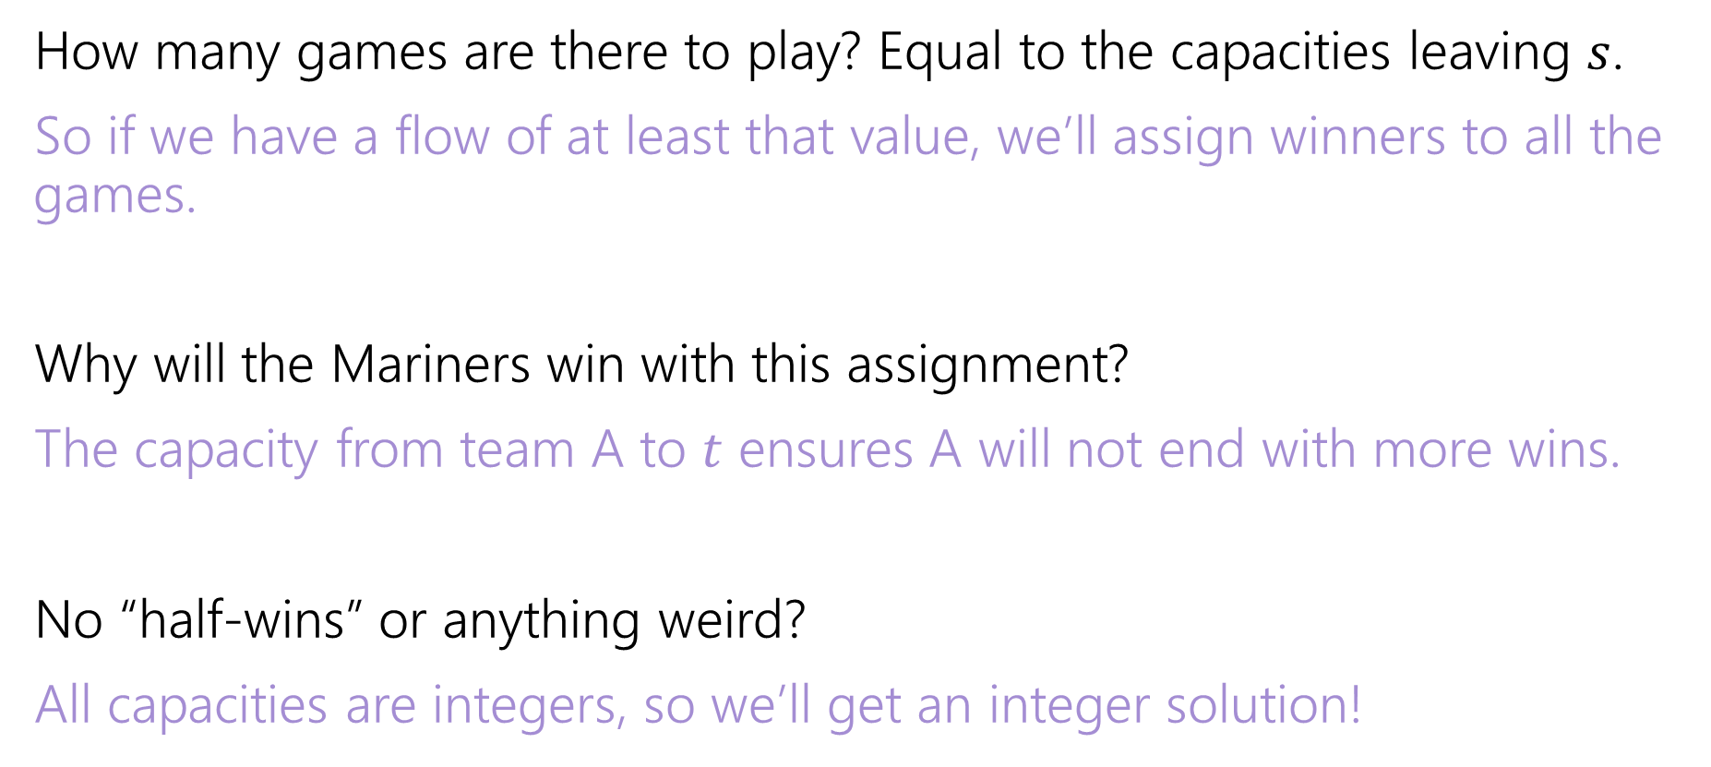
Why are all the constraints met?
How many games are there to play? Equal to the capacities leaving $s$.
So if we have a flow of at least that value, we’ll assign winners to all the games.
Why will the Mariners win with this assignment?
The capacity from team A to $t$ ensures A will not end with more wins.
No “half-wins” or anything weird?
All capacities are integers, so we’ll get an integer solution!

Slide 36
Interpreting the answer
If the max flow has value equal to number of games, we know how the Mariners can still win the division.
If the max flow is less than that, the Mariners can’t win the division!
(if they could win the division, then there is a way that the remaining games could play out with the mariners having as many wins as anyone else, but then we could make a feasible flow by assigning a unit of flow for each winner).

Slide 37






Max Flow
 | Angels | Rangers | Mariners | A’s
Angels | - | 5 | 3 | 4
Rangers | 5 | - | 4 | 3
Mariners | 3 | 4 | - | 5
A’s | 4 | 3 | 5 | -
Angels vs. Rangers
Angels
Team | Wins ($w)$ | Possible Wins ($P)$
Angels | 81 | 93
Rangers | 80 | 92
Mariners | 70 | 82
A’s | 69 | 81
1/
$$∞$$
$$∞$$
2/
1/
3/
1
5
$$∞$$
Angels vs.
A’s
Rangers
4/
4
2
2/
$$∞$$
This is the maximum flow. What’s the min-cut?
{s, Angels vs. Rangers, Angels, Rangers} is one side of the cut.
The Angels and Rangers were enough to prove that the Mariners couldn’t win!
7/
4/
13
3/
$$∞$$
3
Rangers vs.
A’s
A’s
3/
$$∞$$

Slide 38
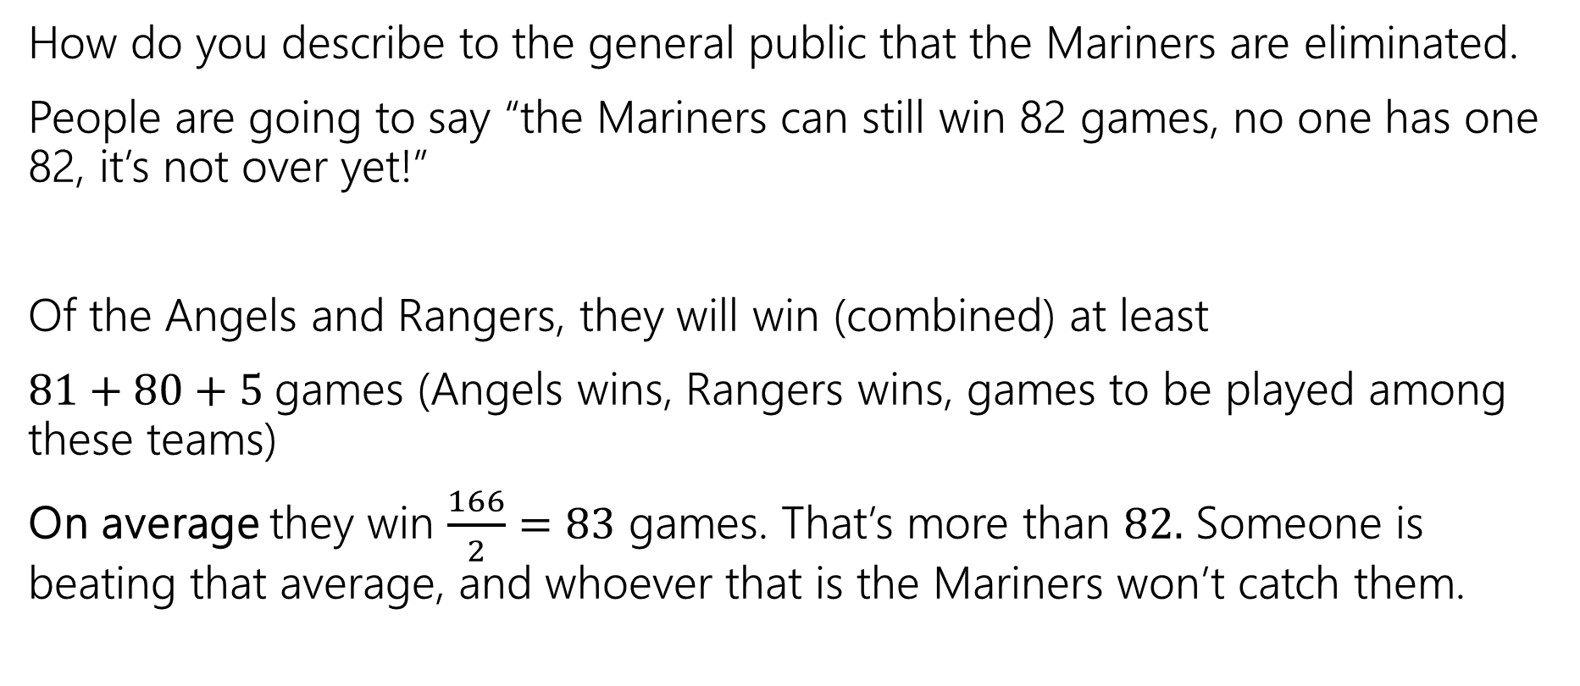
Generating Proof that you’re eliminated
How do you describe to the general public that the Mariners are eliminated.
People are going to say “the Mariners can still win 82 games, no one has one 82, it’s not over yet!”
Of the Angels and Rangers, they will win (combined) at least
$81+80+5$games (Angels wins, Rangers wins, games to be played among these teams)
On average they win $\frac{166}{2}=83$ games. That’s more than $82.$ Someone is beating that average, and whoever that is the Mariners won’t catch them.

Slide 39
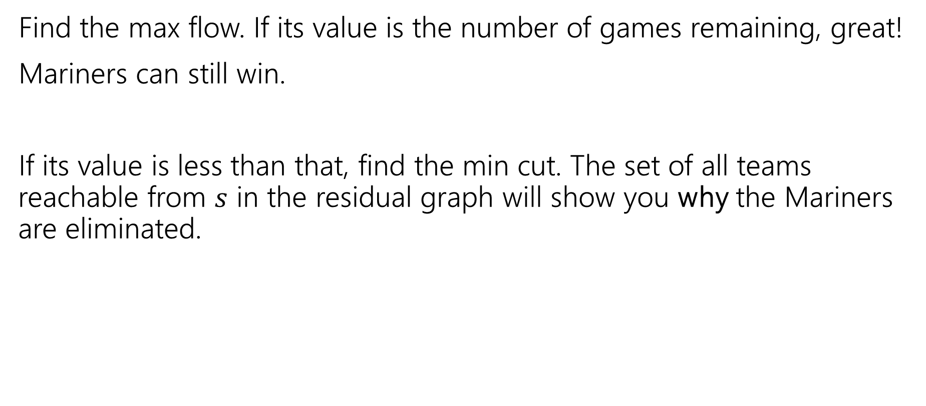
In General
Find the max flow. If its value is the number of games remaining, great!
Mariners can still win.
If its value is less than that, find the min cut. The set of all teams reachable from $s$ in the residual graph will show you why the Mariners are eliminated.

Slide 40
Takeaways
If you want to “assign” things, max-flow might be a good option.
If you say “at most” you can probably just make a capacity constraint
Once you can do an “exactly equal” or “at least” by checking the value of the max-flow.
Sometimes you want an extra layer or two if you have a multiple types of assignments.
Sometimes you can convert an “at least” in one group into an “at most” on another group.

Slide 41
Why is there always an explanation?

Slide 42



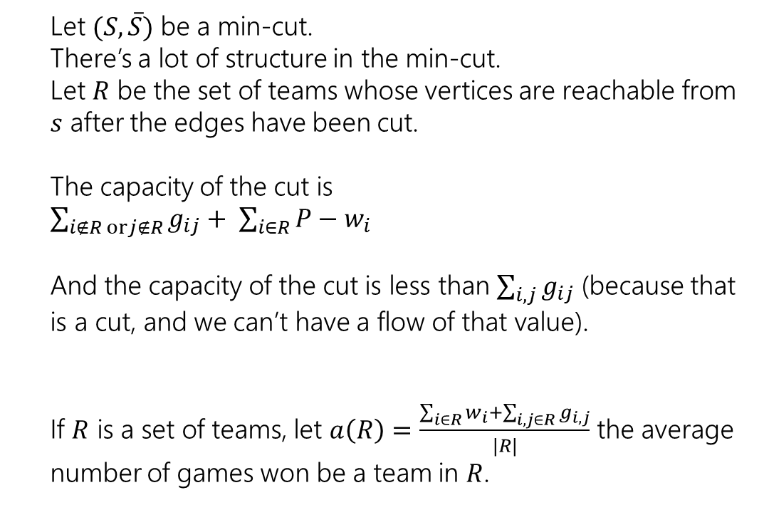



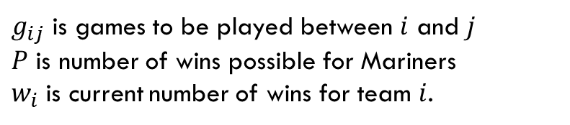
An Explanation Always Exists
$g_{ij}$ is games to be played between $i$ and $j$
$P$ is number of wins possible for Mariners
$w_{i}$ is current number of wins for team $i$.
Let $(S, \overline{S})$ be a min-cut.
There’s a lot of structure in the min-cut.
Let $R$ be the set of teams whose vertices are reachable from $s$ after the edges have been cut.
The capacity of the cut is
$\sum_{i∉R orj∉R}{g_{ij}}+ \sum_{i∈R}{P−w_{i}}$
And the capacity of the cut is less than $\sum_{i,j}{g_{ij}}$ (because that is a cut, and we can’t have a flow of that value).
If $R$ is a set of teams, let $a\left(R\right)=\frac{\sum_{i∈R}{w_{i}}+\sum_{i,j∈R}{g_{i,j}}}{|R|}$ the average number of games won be a team in $R$.
Angels vs. Rangers
Angels
$$∞$$
$$∞$$
1
5
$$∞$$
Angels vs.
A’s
Rangers
4
2
$$∞$$
$$∞$$
13
3
Rangers vs.
A’s
A’s
$$∞$$

Slide 43
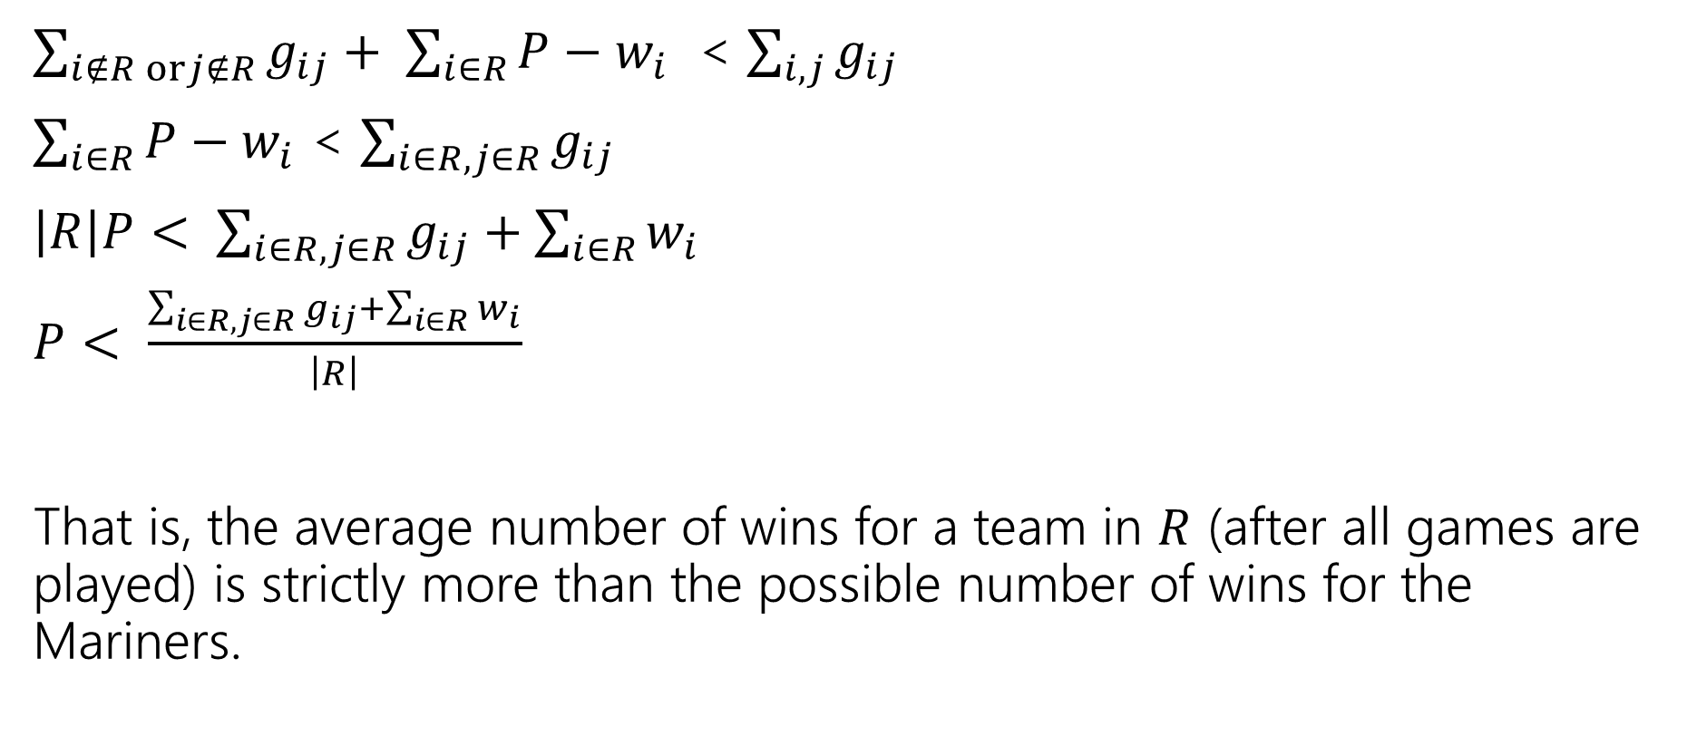
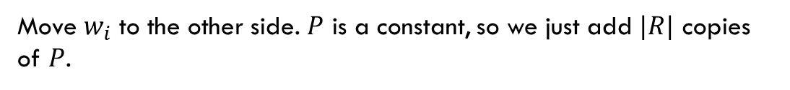
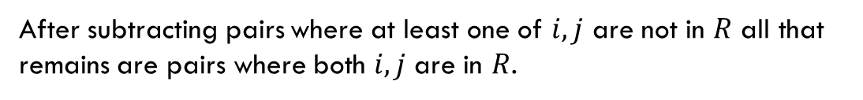
An Explanation Always Exists
$g_{ij}$ is games to be played between $i$ and $j$
$P$ is number of wins possible for Mariners
$w_{i}$ is current number of wins for team $i$.
$\sum_{i∉R orj∉R}{g_{ij}}+ \sum_{i∈R}{P−w_{i}}$ < $\sum_{i,j}{g_{ij}}$
$\sum_{i∈R}{P−w_{i}}$ < $\sum_{i∈R, j∈R}{g_{ij}}$
$\left|R\right|P< \sum_{i∈R, j∈R}{g_{ij}}+\sum_{i∈R}{w_{i}}$
$P< \frac{\sum_{i∈R, j∈R}{g_{ij}}+\sum_{i∈R}{w_{i}}}{\left|R\right|}$
That is, the average number of wins for a team in $R$ (after all games are played) is strictly more than the possible number of wins for the Mariners.
After subtracting pairs where at least one of $i,j$ are not in $R$ all that remains are pairs where both $i,j$ are in $R$.
Move $w_{i}$ to the other side. $P$ is a constant, so we just add $|R|$ copies of $P$.

Slide 44

Summary
To tell whether your favorite team is eliminated, you can run a max-flow computation on a graph with $O(n^{2})$ vertices and $O(n^{2})$ edges.
If your team is eliminated, there is a witness set of teams that must average more wins than is possible for your team.

Slide 45
More Practice

Slide 46
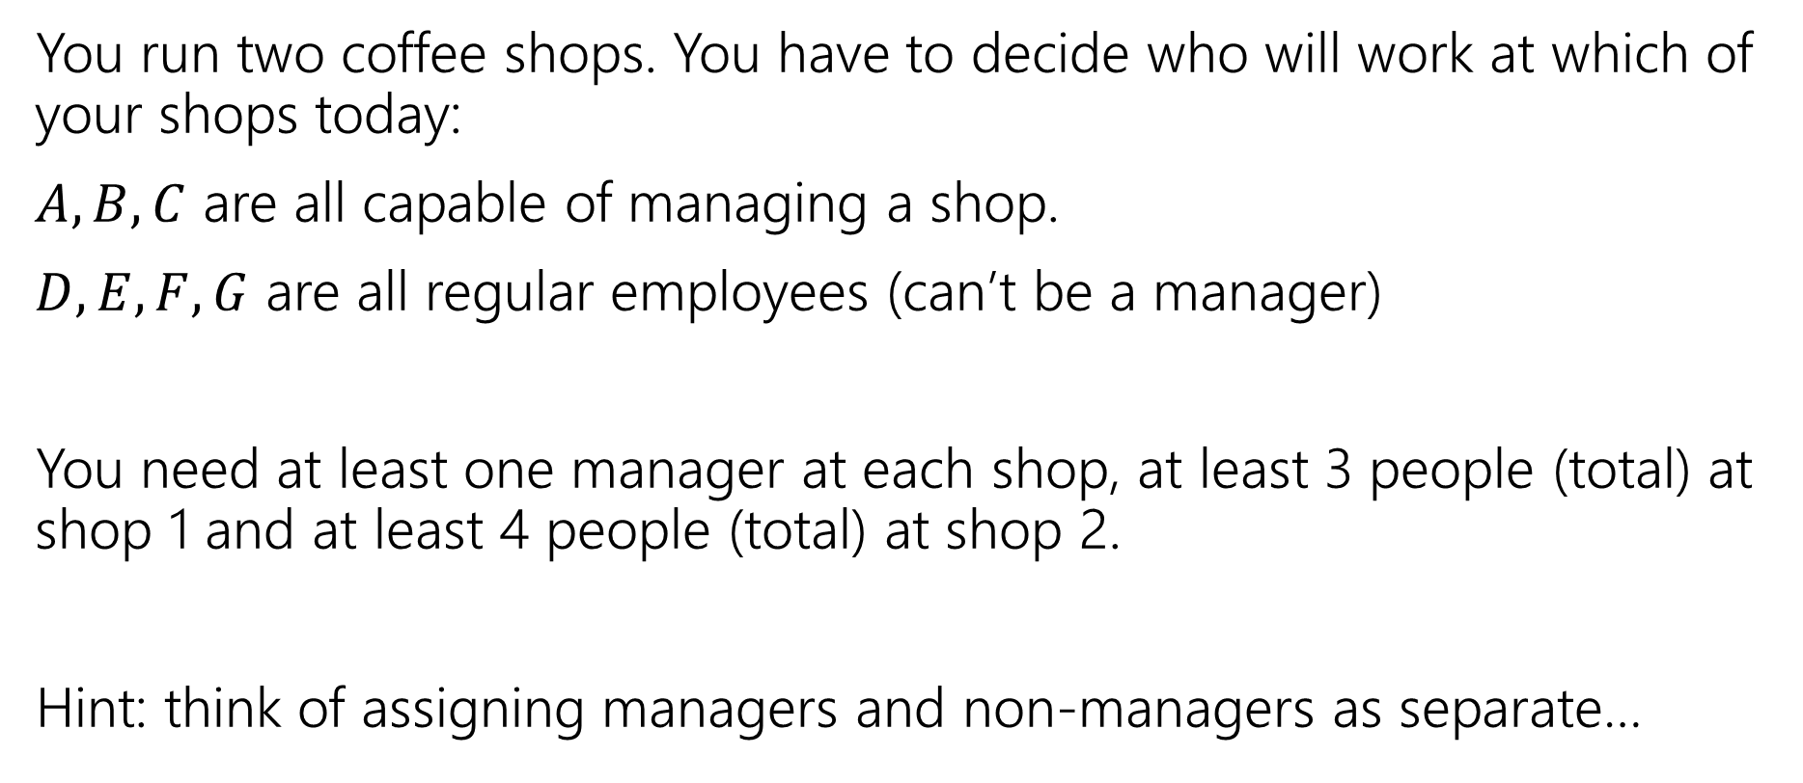
Another Problem
You run two coffee shops. You have to decide who will work at which of your shops today:
$A,B,C$ are all capable of managing a shop.
$D,E,F,G$ are all regular employees (can’t be a manager)
You need at least one manager at each shop, at least 3 people (total) at shop 1 and at least 4 people (total) at shop 2.
Hint: think of assigning managers and non-managers as separate…

Slide 47
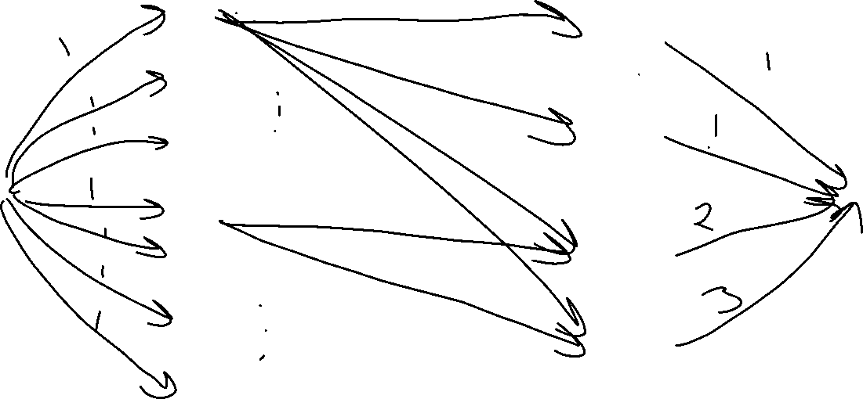
A
Manage
1
B
Manage
2
C
D
Work
1
E
F
Work
2
G

Slide 48
Key Ideas
Use different vertices to represent different jobs (even if they look related).
You can (once per problem) use the value of the flow to evaluate whether you’ve met some minimum number (one “at least” or “exactly equal to” requirement)
Otherwise, use capacities to limit the options. One unit of flow usually represents one “assignment.”

Slide 49








Some Small Examples
$$?/5$$
s
a
$$?/4$$
$$?/2$$
b
c
$$?/1$$
$$?/2$$
$$?/1$$
$$?/2$$
d
t
$$?/2$$

Slide 50




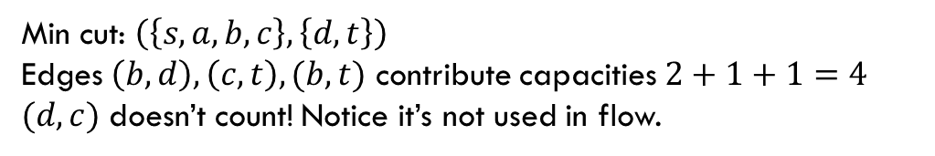















Some Small Examples
$$1/5$$
$$4$$
s
a
s
a
$$1$$
$$3/4$$
$$1/2$$
$$1$$
$$3$$
$$1$$
$$1$$
b
c
b
c
$$1/1$$
$$1$$
$$2/2$$
$$1/1$$
$$2$$
$$1$$
$$0/2$$
$$2$$
d
t
d
t
$$2/2$$
$$2$$
Min cut: $\left(\left\{s,a,b,c\right\},\left\{d,t\right\}\right)$
Edges $\left(b,d\right),\left(c,t\right),(b,t)$ contribute capacities $2+1+1=4$
$(d,c)$ doesn’t count! Notice it’s not used in flow.

Slide 51
Some Small Examples
$$1/5$$
$$4$$
s
a
s
a
$$1$$
$$3/4$$
$$1/2$$
$$1$$
$$3$$
$$1$$
$$1$$
b
c
b
c
$$1/1$$
$$1$$
$$2/2$$
$$1/1$$
$$2$$
$$1$$
$$0/2$$
$$2$$
d
t
d
t
$$2/2$$
$$2$$
Min cut: $\left(\left\{s,a,b,c\right\},\left\{d,t\right\}\right)$
Edges $\left(b,d\right),\left(c,t\right),(b,t)$ contribute capacities $2+1+1=4$
$(d,c)$ doesn’t count! Notice it’s not used in flow.

Slide 52













Some Small Examples
Multiple equivalent max-flows is possible.
Sometimes they give the same min-cut.
$$1/5$$
$$0/5$$
s
a
s
a
$$3/4$$
$$1/1$$
$$4/4$$
$$0/1$$
b
c
b
c
$$1/1$$
$$1/1$$
$$2/3$$
$$1/1$$
$$3/3$$
$$1/1$$
$$0/2$$
$$1/2$$
d
t
d
t
$$2/2$$
$$2/2$$

Slide 53








Using The Min Cut
From last time, imagine we’re doing 2 days worth of chores.
Want everyone to still do 2
Every chore done twice
Have to get different chores (variety)
A
1
$$?/2$$
$$?/2$$
$$?/1$$
$$?/2$$
B
$$?/2$$
s
2
t
$$?/2$$
$$?/2$$
C
$$?/2$$
3
D

Slide 54



Using The Min Cut
From last time, imagine we’re doing 2 days worth of chores.
Want everyone to still do 2
Every chore done twice
Have to get different chores (variety)
A
1
$$?/2$$
$$2/2$$
$$2/2$$
B
$$?/2$$
s
2
t
$$2/2$$
$$?/2$$
C
$$?/2$$
3
D

Slide 55

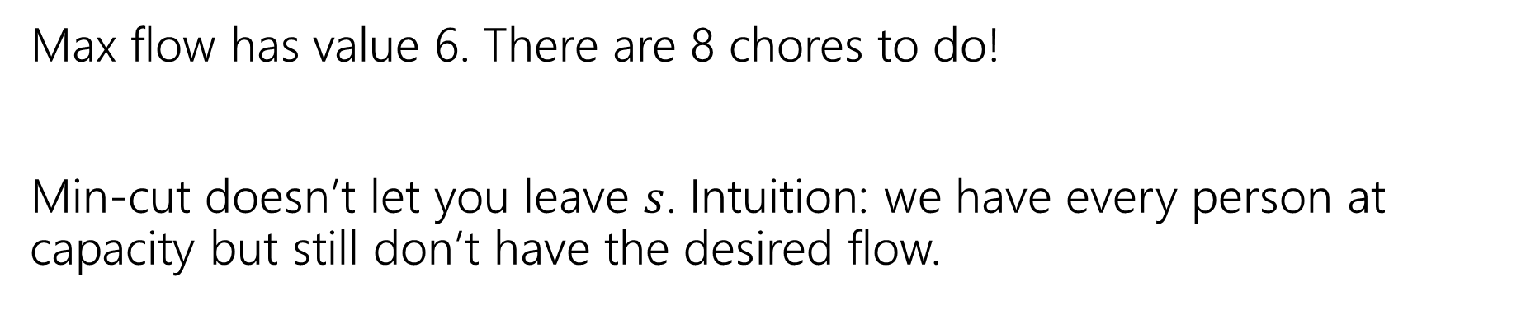



Using The Min Cut
Max flow has value 6. There are 8 chores to do!
Min-cut doesn’t let you leave $s$. Intuition: we have every person at capacity but still don’t have the desired flow.
A
1
$$1/2$$
$$2/2$$
$$2/2$$
B
$$2/2$$
s
2
t
$$2/2$$
$$2/2$$
C
$$1/2$$
3
D

Slide 56


Using The Min Cut
Edit a little to see a different cut…
A
1
$$?/2$$
$$?/2$$
$$?/1$$
$$?/2$$
B
$$?/2$$
s
2
t
$$?/2$$
$$?/2$$
C
$$?/2$$
3
$$?/2$$
D
4

Slide 57


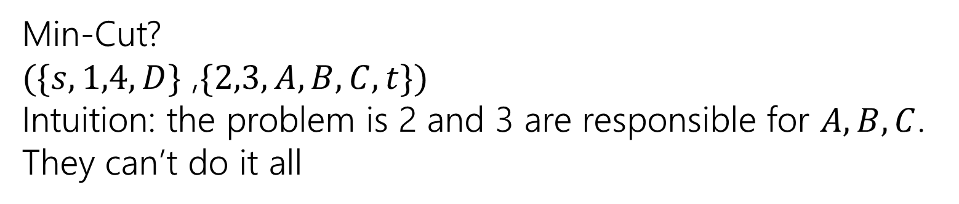



Using The Min Cut
Edit a little to see a different cut…
Min-Cut?
$(\{s,1,4,D\}$ ,$\{2,3,A,B,C,t\})$
Intuition: the problem is 2 and 3 are responsible for $A,B,C$. They can’t do it all
A
1
$$2/2$$
$$1/2$$
$$?/1$$
$$2/2$$
B
$$2/2$$
s
2
t
$$2/2$$
$$0/2$$
C
$$2/2$$
3
$$1/2$$
D
4

