Slide 1
Max-Flow Min-Cut
CSE 421 Fall 22
Lecture 20

Slide 2
Announcements
HW6 is out, due on Wednesday the 22nd.
It’s more dynamic programming (what we were doing last week).
On Friday we’ll ‘close the loop’ on a few things from Ken’s feedback session, but one thing to say today:
If you were hoping for “how do I know which technique to use?”
Go to tomorrow’s section!

Slide 3
Our next topic
Max-flow/min-cut
Two (closely related) graph problems.
We’ll use them for a number of modeling applications.

Slide 4
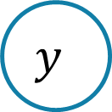



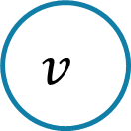


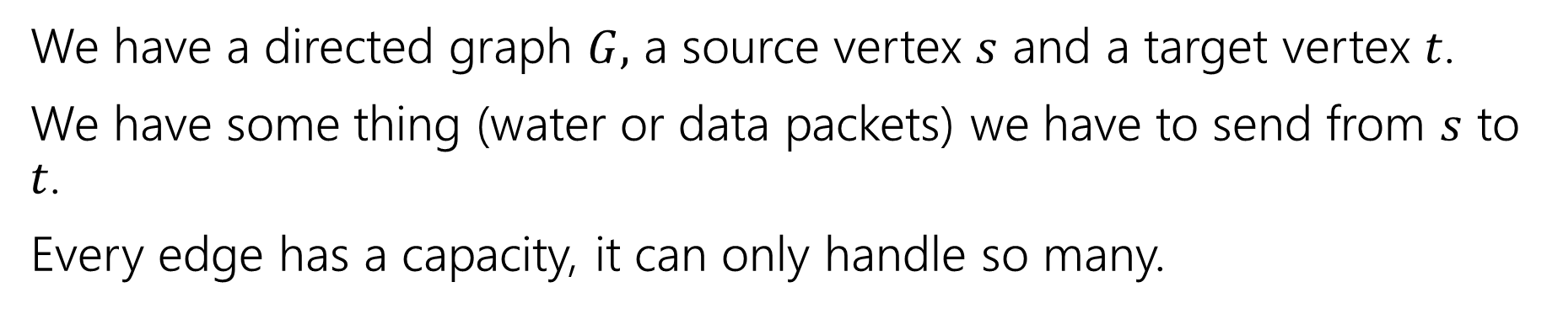

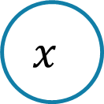








Max Flow
We have a directed graph $G,$ a source vertex $s$ and a target vertex $t$.
We have some thing (water or data packets) we have to send from $s$ to $t$.
Every edge has a capacity, it can only handle so many.
$$2$$
$$v$$
$$4$$
$$1$$
$$t$$
$$2$$
$$s$$
$$x$$
$$2$$
$$2$$
$$1$$
$$5$$
$$4$$
$$u$$
$$w$$
$$y$$
$$2$$

Slide 5

Flows
A flow moves units of water from $s$ to $t.$
Water can only be created at $s$ and only disappear at $t$.
And you cannot move more water than the capacity on any edge.
$$2$$
$$v$$
$$4$$
$$1$$
$$t$$
$$2$$
$$s$$
$$x$$
$$2$$
$$2$$
$$1$$
$$5$$
$$4$$
$$u$$
$$w$$
$$y$$
$$2$$

Slide 6










Flows
A flow moves units of water from $s$ to $t.$
Water can only be created at $s$ and only disappear at $t$.
And you cannot move more water than the capacity on any edge.
$$1/2$$
$$v$$
$$2/4$$
$$1/1$$
$$t$$
$$2/2$$
$$s$$
$$x$$
$$0/2$$
$$1/2$$
$$1/1$$
$$2/5$$
$$2/4$$
$$u$$
$$w$$
$$y$$
$$1/2$$

Slide 7
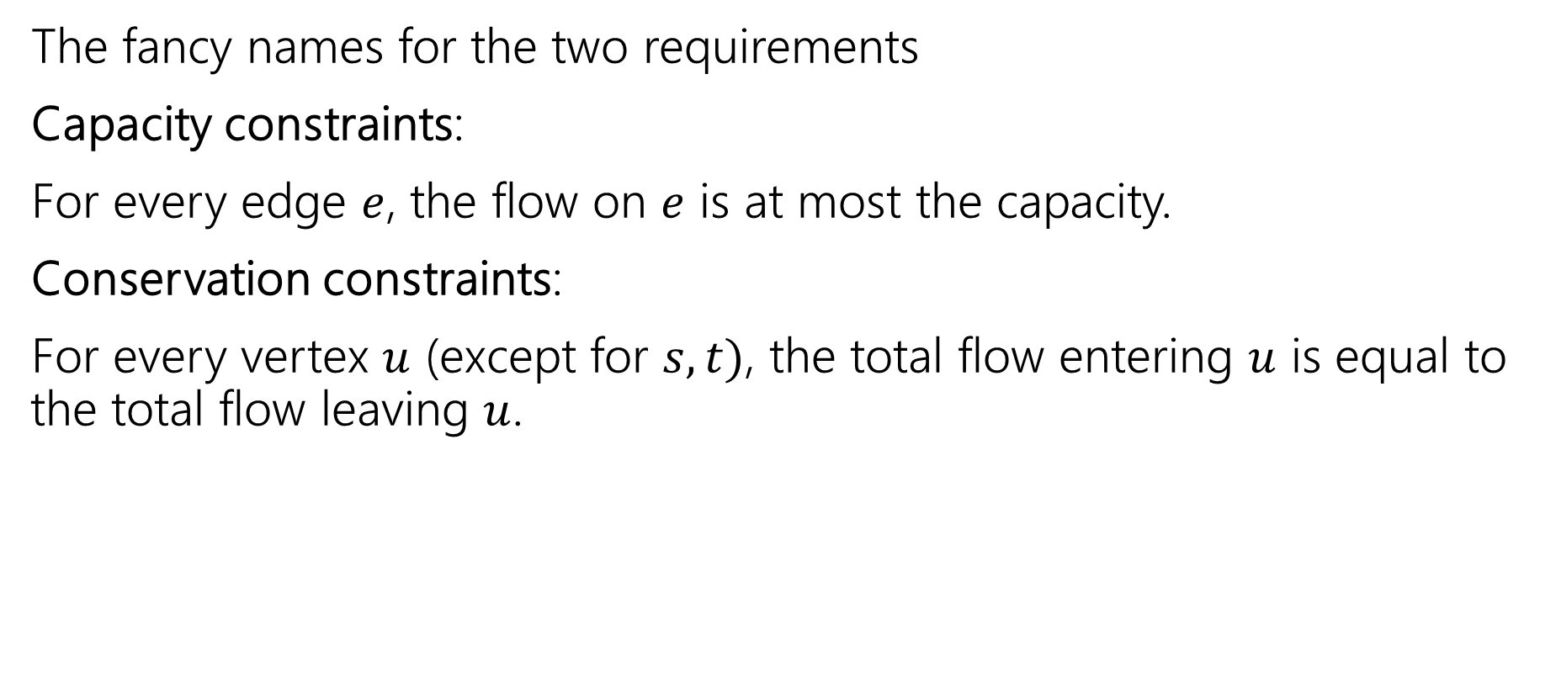
Technical terms
The fancy names for the two requirements
Capacity constraints:
For every edge $e$, the flow on $e$ is at most the capacity.
Conservation constraints:
For every vertex $u$ (except for $s,t)$, the total flow entering $u$ is equal to the total flow leaving $u$.

Slide 8
Finding Max Flows

Slide 9





Flows
The value or size of a flow is the net flow leaving $s$
Or, equivalently the net flow entering $t$.
Value of this flow is $5$.
$$2/2$$
$$v$$
$$3/4$$
$$1/1$$
$$t$$
$$2/2$$
$$s$$
$$x$$
$$0/2$$
$$1/1$$
$$1/1$$
$$2/5$$
$$2/4$$
$$u$$
$$w$$
$$y$$
$$1/1$$

Slide 10
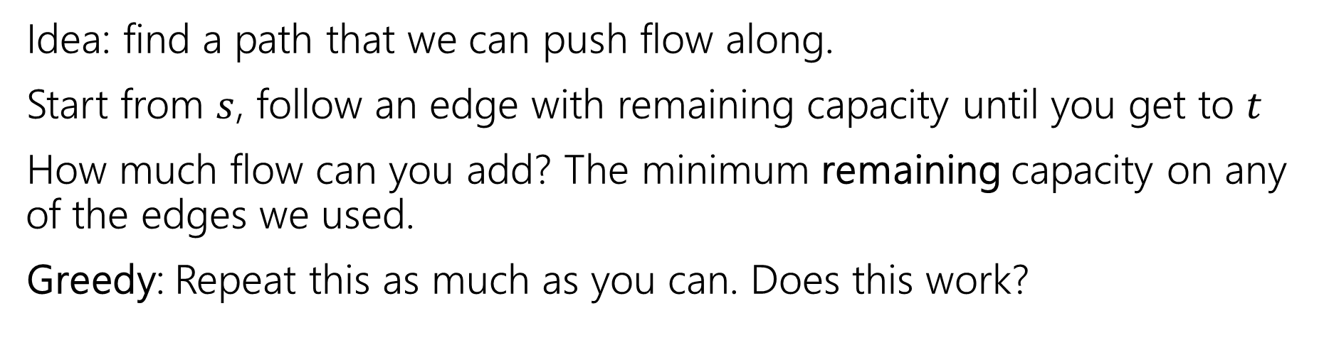
Finding the Max Flow
Idea: find a path that we can push flow along.
Start from $s$, follow an edge with remaining capacity until you get to $t$
How much flow can you add? The minimum remaining capacity on any of the edges we used.
Greedy: Repeat this as much as you can. Does this work?
0/20
0/10
s
0/20
t
0/10
0/20

Slide 11
Finding the Max Flow
Idea: find a path that we can push flow along.
Start from $s$, follow an edge with remaining capacity until you get to $t$
How much flow can you add? The minimum remaining capacity on any of the edges we used.
Greedy: Repeat this as much as you can. Does this work?
0/20
0/10
s
0/20
t
0/10
0/20

Slide 12
Finding the Max Flow
Idea: find a path that we can push flow along.
Start from $s$, follow an edge with remaining capacity until you get to $t$
How much flow can you add? The minimum remaining capacity on any of the edges we used.
Greedy: Repeat this as much as you can. Does this work?
20/20
0/10
s
20/20
t
0/10
20/20

Slide 13
Finding the Max Flow
Idea: find a path that we can push flow along.
Start from $s$, follow an edge with remaining capacity until you get to $t$
How much flow can you add? The minimum remaining capacity on any of the edges we used.
Greedy: Repeat this as much as you can. Does this work?
20/20
0/10
s
20/20
t
0/10
20/20

Slide 14
Finding the Max Flow
We find a valid flow…but it might not be the maximum one.
What greedy found
The true optimum
20/20
0/10
20/20
10/10
s
20/20
t
s
10/20
t
0/10
20/20
10/10
20/20

Slide 15
Finding the Max Flow
How would we fix what our first idea found?
What greedy found
The true optimum
20/20
0/10
20/20
10/10
s
20/20
t
s
10/20
t
0/10
20/20
10/10
20/20

Slide 16
Finding the Max Flow
Try to send more flow
What greedy found
The true optimum
20/20
0/10
20/20
10/10
s
20/20
t
s
10/20
t
10/10
20/20
10/10
20/20
Try to send flow
Too much flow going in! (violates conservation)
There’s no room to push the added flow out.
Will have to redirect it.

Slide 17
Finding the Max Flow
Try to send more flow
What greedy found
Now too much flow coming in here!
The true optimum
20/20
0/10
20/20
10/10
s
10/20
t
s
10/20
t
10/10
20/20
10/10
20/20
Try to send flow
Flow conserved here now
There’s no room to push the added flow out.
Will have to redirect it.

Slide 18

Finding the Max Flow
Try to send more flow
What greedy found
Flow conserved here now
The true optimum
20/20
10/10
20/20
10/10
s
10/20
t
s
10/20
t
Made it to $t$.
Value of flow increased.
10/10
20/20
10/10
20/20
Try to send flow
Flow conserved here now
There’s no room to push the added flow out.
Will have to redirect it.

Slide 19
Fixing Our First Idea
When can we send flow in a direction?
When there is unused capacity OR
When there is flow going the other direction we can redirect it.
Let’s update the graph to take that into account.
Have an edge weight demonstrate the changeable capacity (the “residual”)

Slide 20
An Example
Graph, with flow
“Residual Graph”
0/20
0/10
20
10
s
0/20
t
s
20
t
0/10
0/20
10
20
20/20
0/10
20
10
s
20/20
t
s
20
t
0/10
20/20
10
20

Slide 21
An Example
Graph, with flow
“Residual Graph”
20/20
0/10
20
10
s
20/20
t
s
20
t
0/10
20/20
10
20
20/20
10/10
20
10
s
10/20
t
s
10
10
t
10/10
20/20
10
20

Slide 22
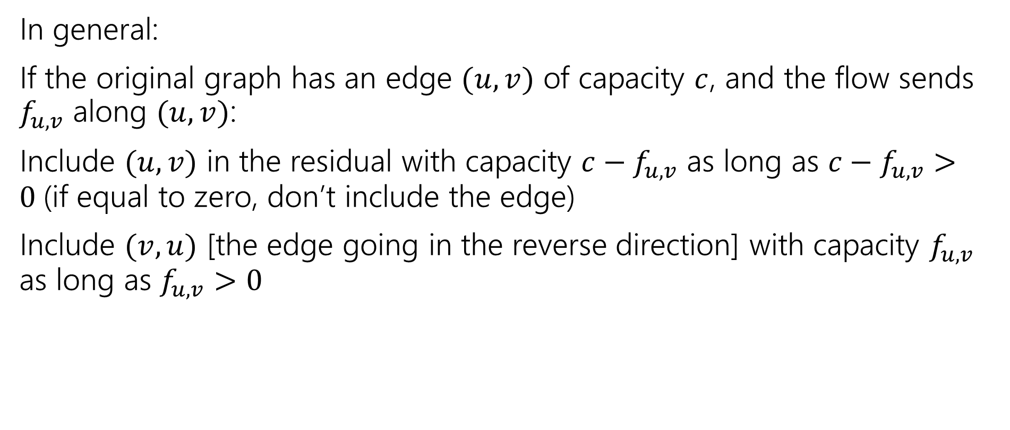
Residual Graph
In general:
If the original graph has an edge $(u,v)$ of capacity $c$, and the flow sends $f_{u,v}$ along $(u,v)$:
Include $(u,v)$ in the residual with capacity $c−f_{u,v}$ as long as $c−f_{u,v}>0$(if equal to zero, don’t include the edge)
Include $(v,u)$ [the edge going in the reverse direction] with capacity $f_{u,v}$ as long as $f_{u,v}>0$

Slide 23




































Example
Residual graph
Flow graph
$$u$$
$$u$$
$$y$$
$$2$$
$$2$$
$$y$$
$$0/2$$
$$0/2$$
$$0/2$$
$$3$$
$$2$$
$$0/3$$
$$t$$
$$t$$
$$x$$
$$s$$
$$x$$
$$s$$
$$0/1$$
$$0/5$$
$$1$$
$$5$$
$$0/2$$
$$2$$
$$2$$
$$0/2$$
$$y$$
$$v$$
$$y$$
$$v$$
$$0/1$$
$$0/1$$
$$1$$
$$w$$
$$1$$
$$w$$
Residual starts with same edges and capacities as the flow graph.

Slide 24

Example
Residual graph
Flow graph
$$u$$
$$u$$
$$y$$
$$2$$
$$2$$
$$y$$
$$0/2$$
$$0/2$$
$$0/2$$
$$3$$
$$2$$
$$0/3$$
$$t$$
$$t$$
$$x$$
$$s$$
$$x$$
$$s$$
$$0/1$$
$$0/5$$
$$1$$
$$5$$
$$0/2$$
$$2$$
$$2$$
$$0/2$$
$$y$$
$$v$$
$$y$$
$$v$$
$$0/1$$
$$0/1$$
$$1$$
$$w$$
$$1$$
$$w$$
Find an $s$-$t$ path in the residual.
Min residual capacity is what you augment by (here: 2)

Slide 25








Example
Residual graph
Flow graph
$$u$$
$$u$$
$$y$$
$$2$$
$$2$$
$$y$$
$$2/2$$
$$0/2$$
$$0/2$$
$$1$$
$$2$$
$$2/3$$
$$t$$
$$2$$
$$t$$
$$x$$
$$s$$
$$x$$
$$s$$
$$0/1$$
$$2/5$$
$$1$$
$$3$$
$$2/2$$
$$2$$
$$2$$
$$0/2$$
$$y$$
$$v$$
$$y$$
$$v$$
$$2$$
$$0/1$$
$$0/1$$
$$1$$
$$w$$
$$1$$
$$w$$
Update flow and residual

Slide 26

Example
Residual graph
Flow graph
$$u$$
$$u$$
$$y$$
$$2$$
$$2$$
$$y$$
$$2/2$$
$$0/2$$
$$0/2$$
$$1$$
$$2$$
$$2/3$$
$$t$$
$$2$$
$$t$$
$$x$$
$$s$$
$$x$$
$$s$$
$$0/1$$
$$2/5$$
$$1$$
$$3$$
$$2/2$$
$$2$$
$$2$$
$$0/2$$
$$y$$
$$v$$
$$y$$
$$v$$
$$2$$
$$0/1$$
$$0/1$$
$$1$$
$$w$$
$$1$$
$$w$$
Find another path

Slide 27
Example
Residual graph
Flow graph
$$u$$
$$u$$
$$y$$
$$2$$
$$2$$
$$y$$
$$2/2$$
$$0/2$$
$$0/2$$
$$1$$
$$2$$
$$2/3$$
$$t$$
$$2$$
$$t$$
$$x$$
$$s$$
$$x$$
$$s$$
$$0/1$$
$$2/5$$
$$1$$
$$3$$
$$2/2$$
$$2$$
$$2$$
$$0/2$$
$$y$$
$$v$$
$$y$$
$$v$$
$$2$$
$$0/1$$
$$0/1$$
$$1$$
$$w$$
$$1$$
$$w$$
Find another path and update the flow by min (residual) capacity, which is 1

Slide 28










Example
Residual graph
Flow graph
$$u$$
$$u$$
$$y$$
$$2$$
$$1$$
$$y$$
$$2/2$$
$$1/2$$
$$1/2$$
$$1$$
$$1$$
$$2/3$$
$$2$$
$$1$$
$$t$$
$$t$$
$$s$$
$$x$$
$$1$$
$$s$$
$$x$$
$$1/1$$
$$2/5$$
$$1$$
$$1$$
$$3$$
$$2/2$$
$$2$$
$$1/2$$
$$y$$
$$v$$
$$y$$
$$1$$
$$v$$
$$2$$
$$0/1$$
$$0/1$$
$$1$$
$$w$$
$$1$$
$$w$$
Find another path and update the flow by min (residual) capacity, which is 1

Slide 29





Example
Residual graph
Flow graph
$$u$$
$$u$$
$$y$$
$$2$$
$$1$$
$$y$$
$$2/2$$
$$1/2$$
$$1/2$$
$$1$$
$$1$$
$$2/3$$
$$2$$
$$1$$
$$t$$
$$t$$
$$s$$
$$x$$
$$1$$
$$s$$
$$x$$
$$1/1$$
$$2/5$$
$$1$$
$$1$$
$$3$$
$$2/2$$
$$2$$
$$1/2$$
$$y$$
$$v$$
$$y$$
$$1$$
$$v$$
$$2$$
$$0/1$$
$$0/1$$
$$1$$
$$w$$
$$1$$
$$w$$
Update completed, let’s do another…

Slide 30

Example
Residual graph
Flow graph
$$u$$
$$u$$
$$y$$
$$2$$
$$1$$
$$y$$
$$2/2$$
$$1/2$$
$$1/2$$
$$1$$
$$1$$
$$2/3$$
$$2$$
$$1$$
$$t$$
$$t$$
$$s$$
$$x$$
$$1$$
$$s$$
$$x$$
$$1/1$$
$$2/5$$
$$1$$
$$1$$
$$3$$
$$2/2$$
$$2$$
$$1/2$$
$$y$$
$$v$$
$$y$$
$$1$$
$$v$$
$$2$$
$$0/1$$
$$0/1$$
$$1$$
$$w$$
$$1$$
$$w$$
Find another path!

Slide 31






Example
Residual graph
Flow graph
$$u$$
$$u$$
$$y$$
$$2$$
$$1$$
$$y$$
$$2/2$$
$$2/2$$
$$2/2$$
$$1$$
$$1$$
$$2/3$$
$$2$$
$$1$$
$$t$$
$$t$$
$$s$$
$$x$$
$$1$$
$$s$$
$$x$$
$$1/1$$
$$1/5$$
$$1$$
$$1$$
$$3$$
$$2/2$$
$$2$$
$$2/2$$
$$y$$
$$v$$
$$y$$
$$1$$
$$v$$
$$2$$
$$1/1$$
$$1/1$$
$$1$$
$$w$$
$$1$$
$$w$$
Find another path! Augment by the minimum redisual capacity (1). When residual edge is “wrong direction” decrease in flow graph.

Slide 32





Example
Residual graph
Flow graph
$$u$$
$$u$$
$$y$$
$$2$$
$$y$$
$$2/2$$
$$2/2$$
$$2/2$$
$$1$$
$$2/3$$
$$2$$
$$2$$
$$t$$
$$t$$
$$s$$
$$x$$
$$2$$
$$s$$
$$x$$
$$1/1$$
$$1/5$$
$$1$$
$$4$$
$$2/2$$
$$2$$
$$2/2$$
$$y$$
$$v$$
$$y$$
$$2$$
$$v$$
$$1$$
$$1/1$$
$$1/1$$
$$1$$
$$w$$
$$1$$
$$w$$
Then update residual

Slide 33
Example
Residual graph
Flow graph
$$u$$
$$u$$
$$y$$
$$2$$
$$y$$
$$2/2$$
$$2/2$$
$$2/2$$
$$1$$
$$2/3$$
$$2$$
$$2$$
$$t$$
$$t$$
$$s$$
$$x$$
$$2$$
$$s$$
$$x$$
$$1/1$$
$$1/5$$
$$1$$
$$4$$
$$2/2$$
$$2$$
$$2/2$$
$$y$$
$$v$$
$$y$$
$$2$$
$$v$$
$$1$$
$$1/1$$
$$1/1$$
$$1$$
$$w$$
$$1$$
$$w$$
No more $s$-$t$ path in the residual. We’re done!

Slide 34
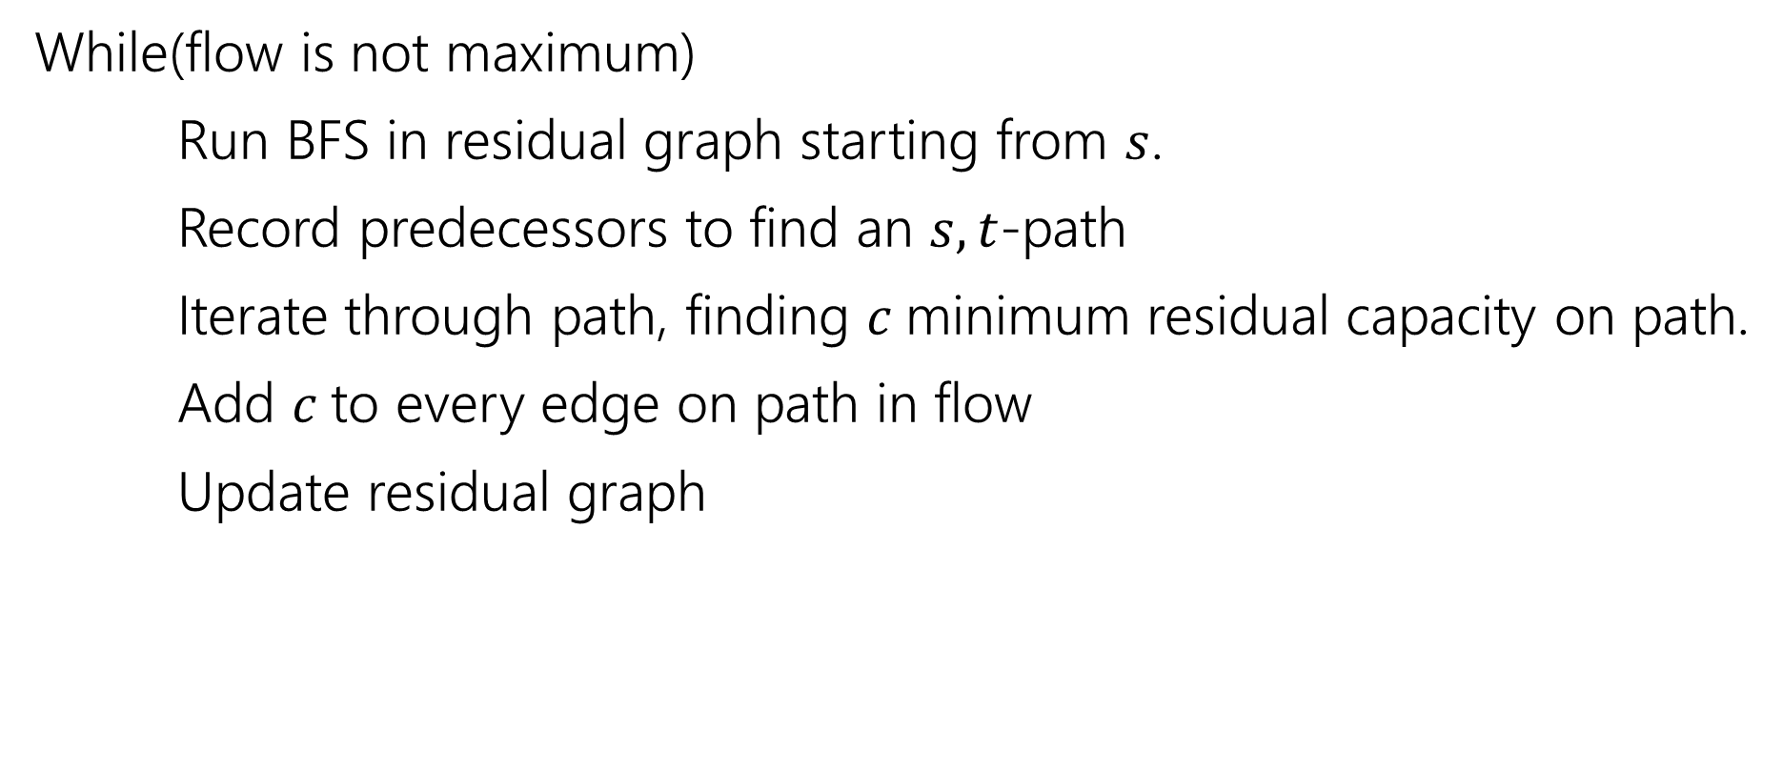
Ford-Fulkerson Algorithm
While(flow is not maximum)
Run BFS in residual graph starting from $s$.
Record predecessors to find an $s,t$-path
Iterate through path, finding $c$minimum residual capacity on path.
Add $c$to every edge on path in flow
Update residual graph

Slide 35
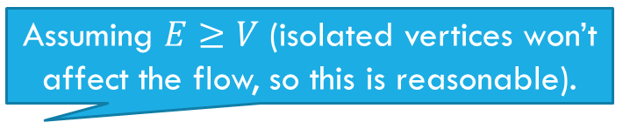
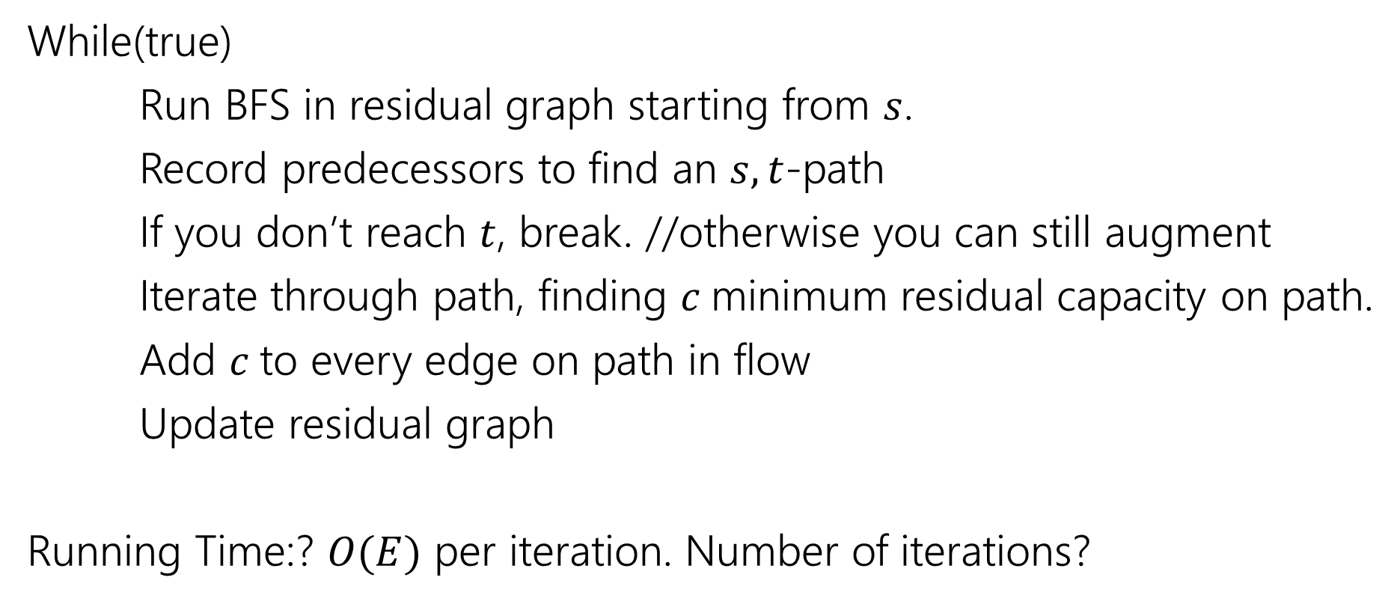
Ford-Fulkerson Algorithm
While(true)
Run BFS in residual graph starting from $s$.
Record predecessors to find an $s,t$-path
If you don’t reach $t$, break. //otherwise you can still augment
Iterate through path, finding $c$minimum residual capacity on path.
Add $c$to every edge on path in flow
Update residual graph
Running Time:? $O(E)$ per iteration. Number of iterations?
Assuming $E≥V$ (isolated vertices won’t affect the flow, so this is reasonable).

Slide 36
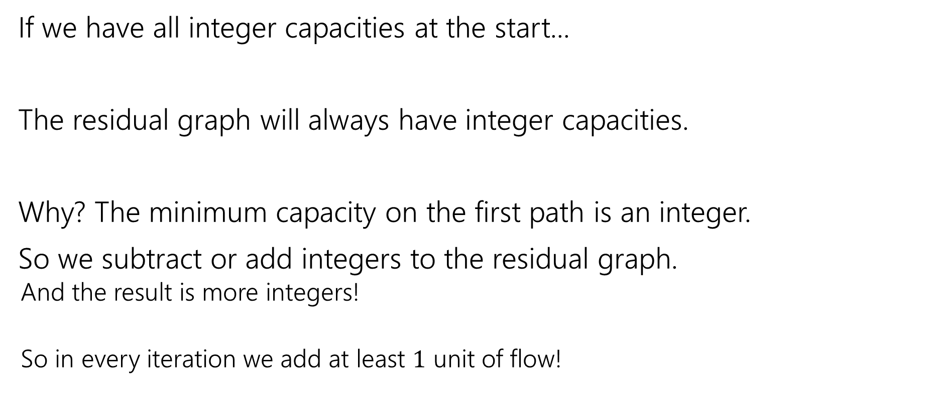
Ford-Fulkerson Algorithm
If we have all integer capacities at the start...
The residual graph will always have integer capacities.
Why? The minimum capacity on the first path is an integer.
So we subtract or add integers to the residual graph.
And the result is more integers!
So in every iteration we add at least $1$ unit of flow!

Slide 37
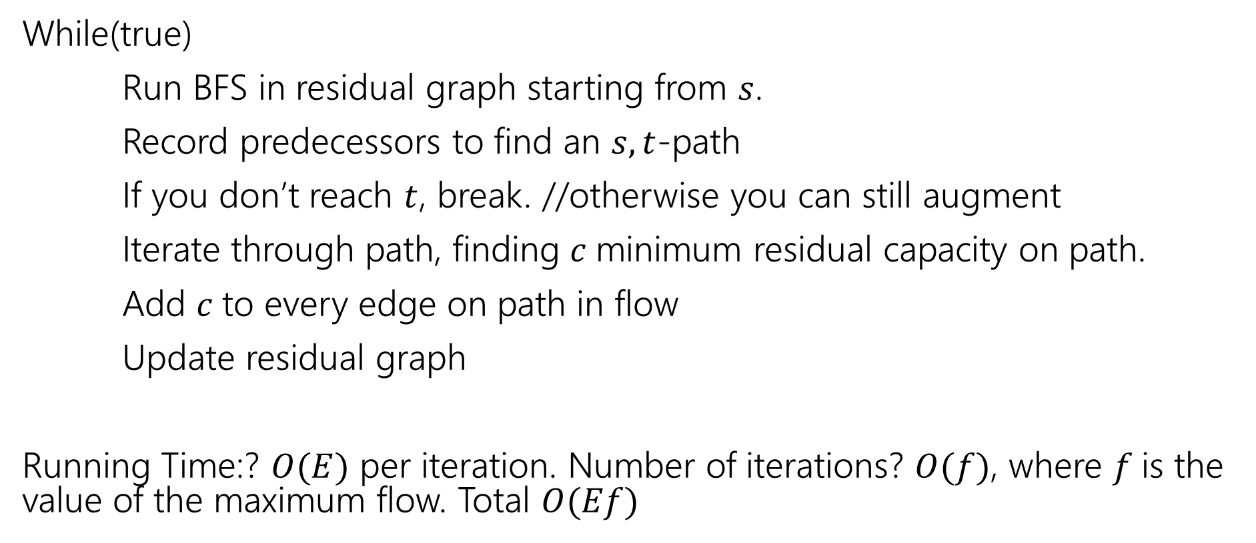
Ford-Fulkerson Algorithm
While(true)
Run BFS in residual graph starting from $s$.
Record predecessors to find an $s,t$-path
If you don’t reach $t$, break. //otherwise you can still augment
Iterate through path, finding $c$minimum residual capacity on path.
Add $c$to every edge on path in flow
Update residual graph
Running Time:? $O(E)$ per iteration. Number of iterations? $O(f)$, where $f$is the value of the maximum flow. Total $O(Ef)$

Slide 38
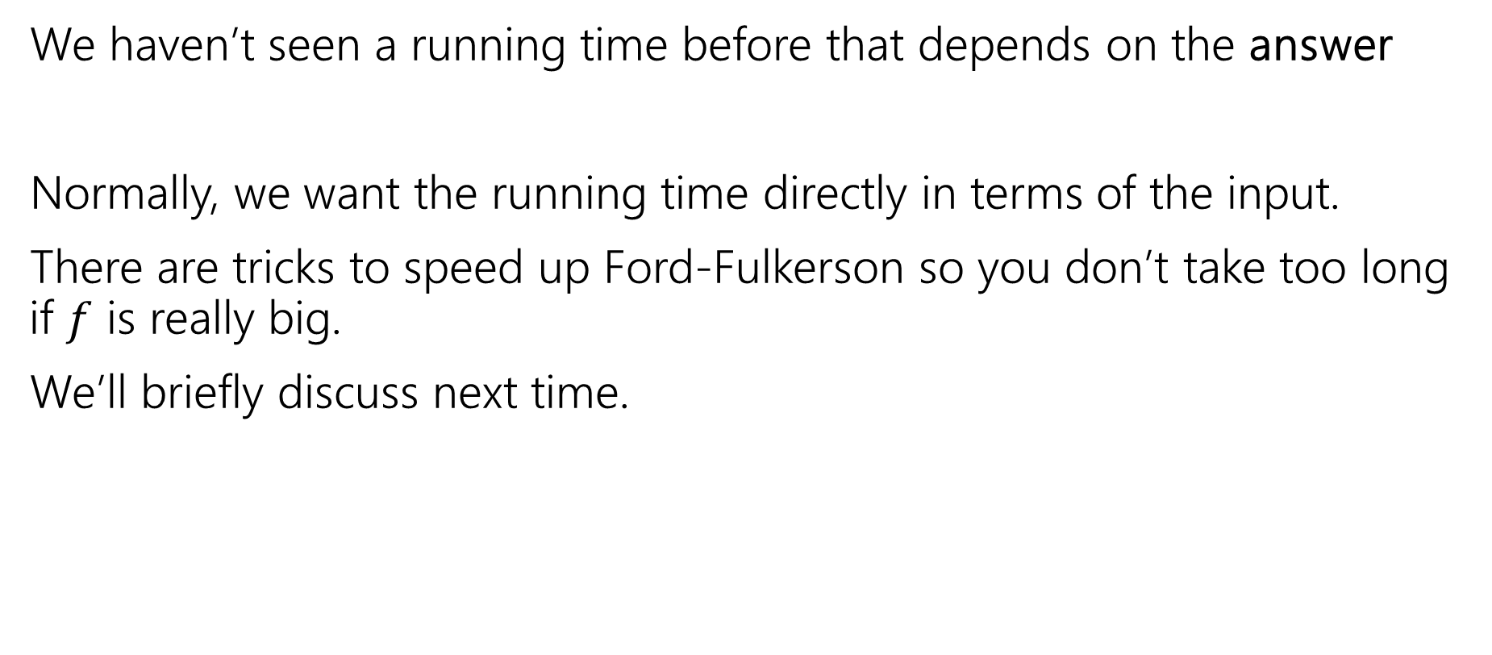

Wait…$f$?
We haven’t seen a running time before that depends on the answer
Normally, we want the running time directly in terms of the input.
There are tricks to speed up Ford-Fulkerson so you don’t take too long if $f$ is really big.
We’ll briefly discuss next time.

Slide 39
Minimum Cut

Slide 40
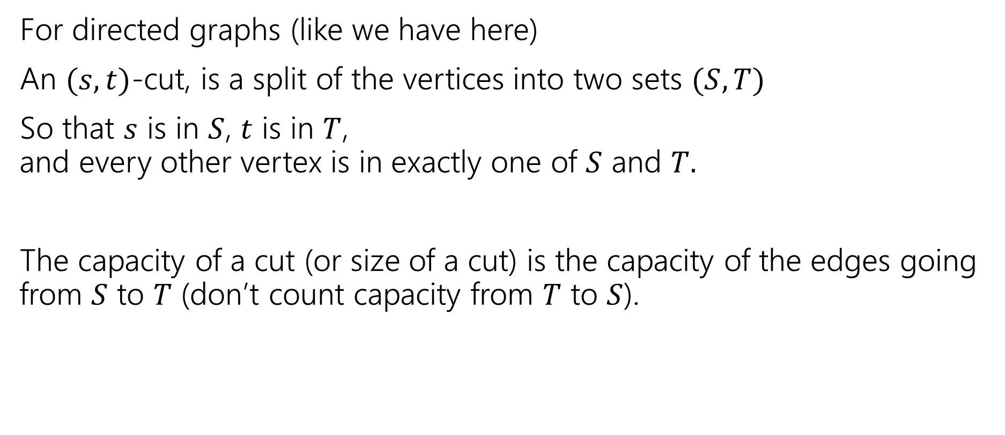
What’s a Cut?
For directed graphs (like we have here)
An $(s,t)$-cut, is a split of the vertices into two sets $(S,T)$
So that $s$ is in $S$, $t$ is in $T$, and every other vertex is in exactly one of $S$ and $T.$
The capacity of a cut (or size of a cut) is the capacity of the edges going from $S$ to $T$ (don’t count capacity from $T$ to $S$).

Slide 41
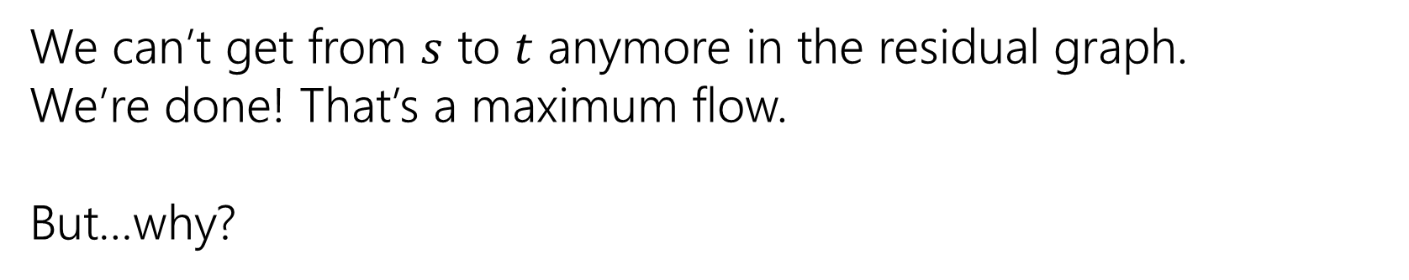
An Example
Graph, with flow
“Residual Graph”
20/20
10/10
20
10
s
10/20
t
s
10
10
t
10/10
20/20
10
20
We can’t get from $s$ to $t$ anymore in the residual graph.
We’re done! That’s a maximum flow.
But…why?

Slide 42
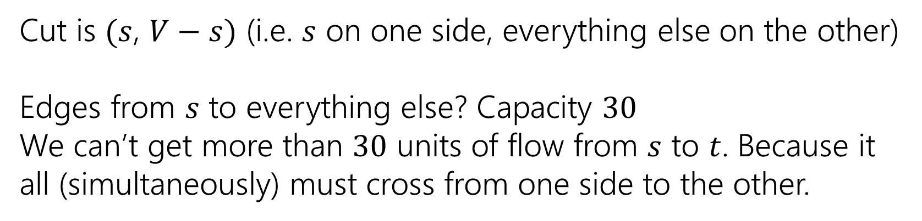
An Example
Graph, with flow
“Residual Graph”
20/20
10/10
20
10
s
10/20
t
s
10
10
t
10/10
20/20
10
20
Cut is $(s$, $V−s)$ (i.e. $s$ on one side, everything else on the other)
Edges from $s$ to everything else? Capacity $30$
We can’t get more than $30$ units of flow from $s$ to $t$. Because it all (simultaneously) must cross from one side to the other.

Slide 43
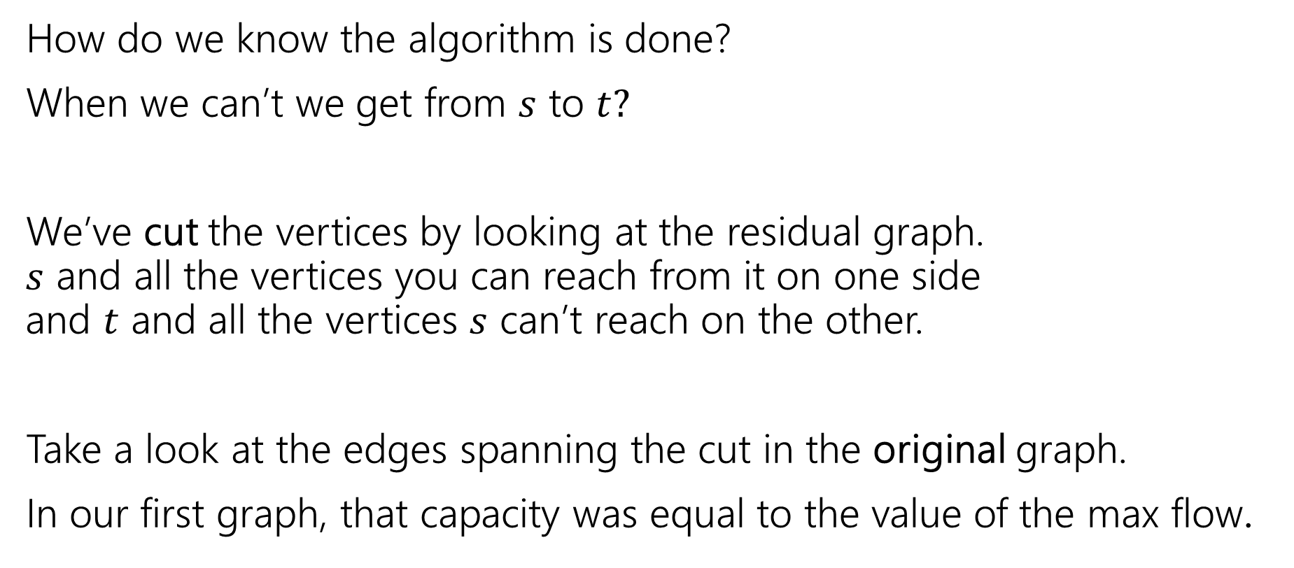
How Do We Know?
How do we know the algorithm is done?
When we can’t we get from $s$ to $t?$
We’ve cut the vertices by looking at the residual graph. $s$ and all the vertices you can reach from it on one side and $t$ and all the vertices $s$ can’t reach on the other.
Take a look at the edges spanning the cut in the original graph.
In our first graph, that capacity was equal to the value of the max flow.

Slide 44
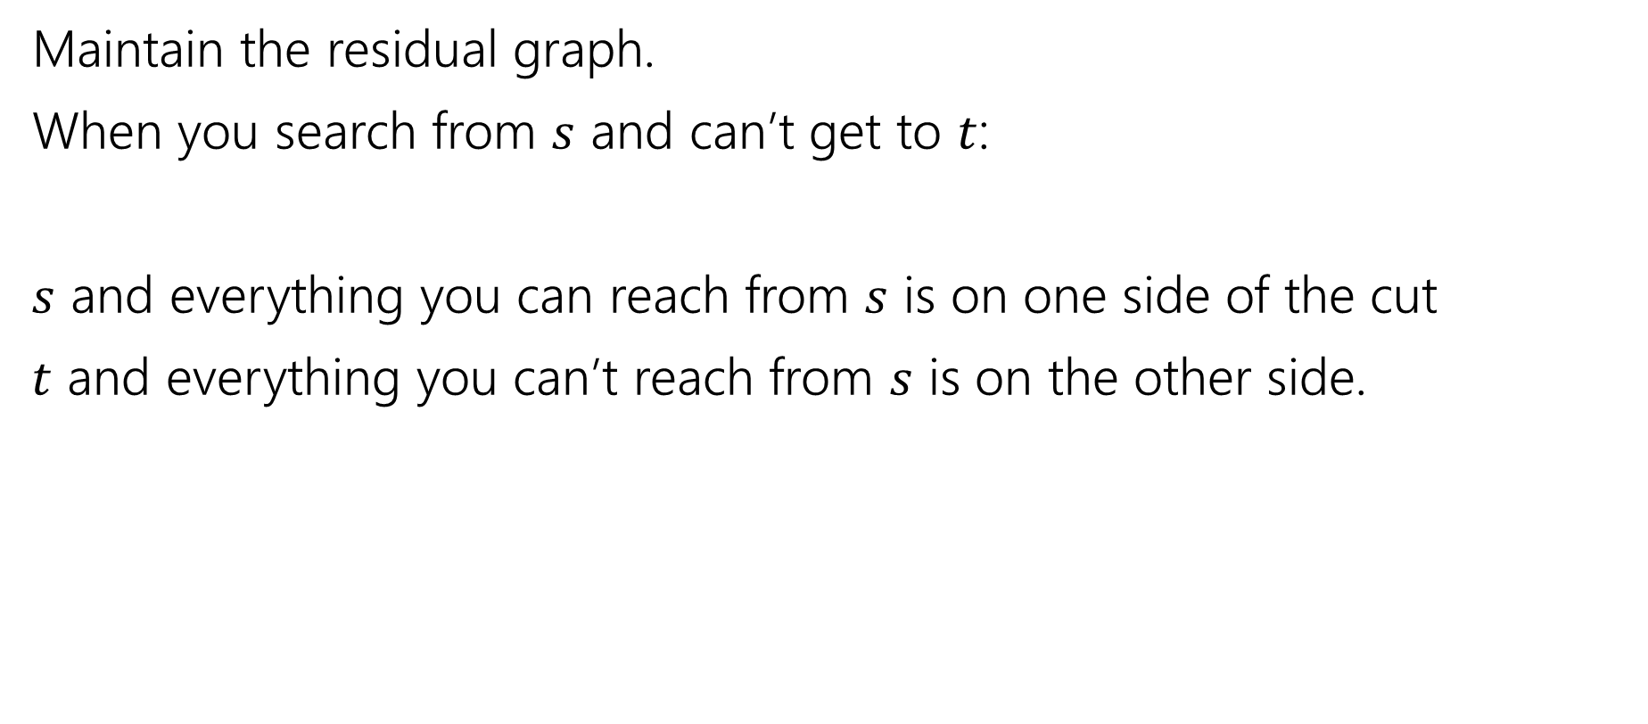
Finding the min-cut
Maintain the residual graph.
When you search from $s$ and can’t get to $t$:
$s$ and everything you can reach from $s$ is on one side of the cut
$t$ and everything you can’t reach from $s$ is on the other side.

Slide 45
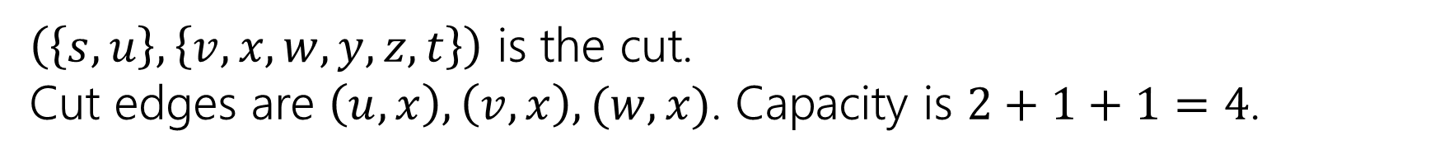
Example
Residual graph
Flow graph
$$u$$
$$u$$
$$y$$
$$2$$
$$y$$
$$2/2$$
$$2/2$$
$$2/2$$
$$1$$
$$2/3$$
$$2$$
$$2$$
$$t$$
$$t$$
$$s$$
$$x$$
$$2$$
$$s$$
$$x$$
$$1/1$$
$$1/5$$
$$1$$
$$4$$
$$2/2$$
$$2$$
$$2/2$$
$$y$$
$$v$$
$$y$$
$$2$$
$$v$$
$$1$$
$$1/1$$
$$1/1$$
$$1$$
$$w$$
$$1$$
$$w$$
$\left(\left\{s,u\right\},\left\{v,x,w,y,z,t\right\}\right)$ is the cut.
Cut edges are $\left(u,x\right),\left(v,x\right),(w,x)$. Capacity is $2+1+1=4$.

Slide 46
Another Example
We started lecture with this flow.
What’s the residual graph? What’s the cut?
$$2/2$$
$$v$$
$$3/4$$
$$1/1$$
$$t$$
$$2/2$$
$$s$$
$$x$$
$$0/2$$
$$1/1$$
$$1/1$$
$$2/5$$
$$2/4$$
$$u$$
$$w$$
$$y$$
$$1/1$$

Slide 47
























Another Example
$$v$$
Residual
Flow
$$t$$
$$s$$
$$x$$
$$u$$
$$w$$
$$y$$
$$2/2$$
$$v$$
$$3/4$$
$$1/1$$
$$t$$
$$2/2$$
$$s$$
$$x$$
$$0/2$$
$$1/1$$
$$1/1$$
$$2/5$$
$$2/4$$
$$u$$
$$w$$
$$y$$
$$1/1$$

Slide 48







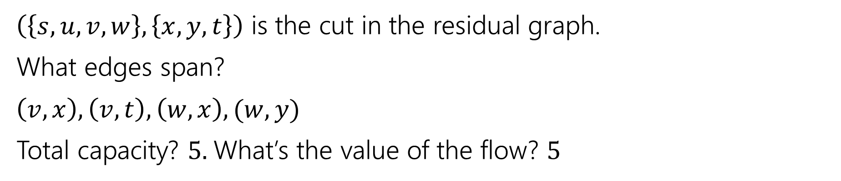










Another Example
$$2/2$$
$$v$$
$$3/4$$
$$1/1$$
$$t$$
$$2/2$$
$$s$$
$$x$$
$$0/2$$
$$1/1$$
$$1/1$$
$$2/5$$
$$2/4$$
$$u$$
$$w$$
$$y$$
$$1/1$$
$\left(\left\{s,u,v,w\right\}, \left\{x,y,t\right\}\right)$ is the cut in the residual graph.
What edges span?
$\left(v,x\right),\left(v,t\right),\left(w,x\right),(w,y)$
Total capacity? $5.$What’s the value of the flow? $5$

Slide 49
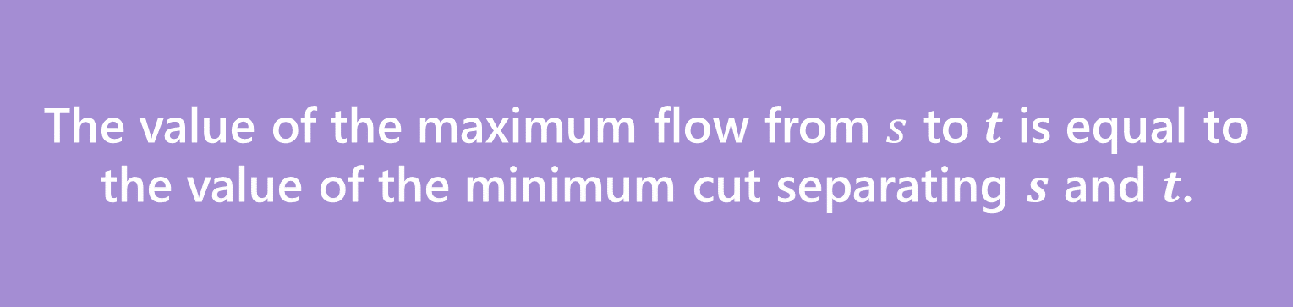
Max Flow-Min Cut Theorem
The value of the maximum flow from $s$ to $t$ is equal to the value of the minimum cut separating $s$ and $t$.
Max-Flow-Min-Cut Theorem
The full proof is VERY notation heavy.
Focus on the words and intuition. The notation is there to support your intuition; the notation is not the main point.
We’re going to skip a few steps for the sake of minimizing notation. See any textbook for all the details.

Slide 50
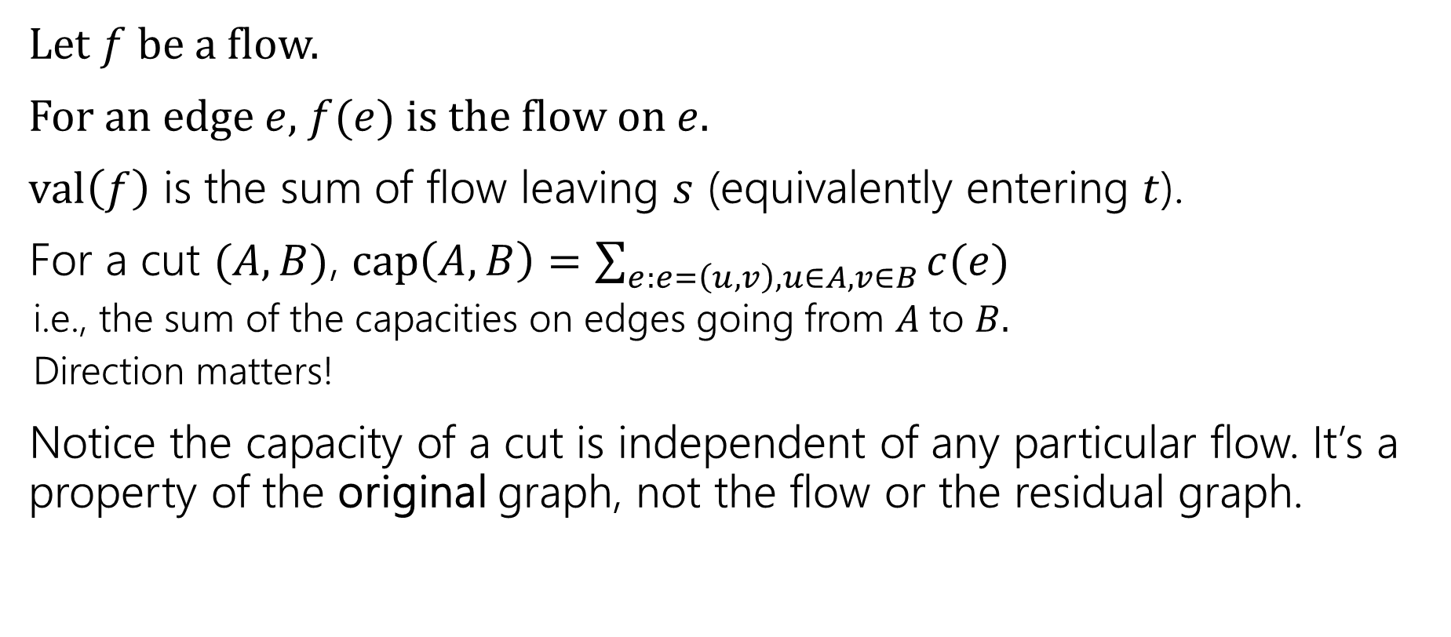
Some notation (more formally)
Let $f$ be a flow.
For an edge $e$, $f(e)$ is the flow on $e$.
$val\left(f\right)$ is the sum of flow leaving $s$ (equivalently entering $t$).
For a cut $(A,B)$, $cap\left(A,B\right)=\sum_{e:e=\left(u,v\right),u∈A,v∈B}{c(e)}$
i.e., the sum of the capacities on edges going from $A$to $B.$
Direction matters!
Notice the capacity of a cut is independent of any particular flow. It’s a property of the original graph, not the flow or the residual graph.

Slide 51
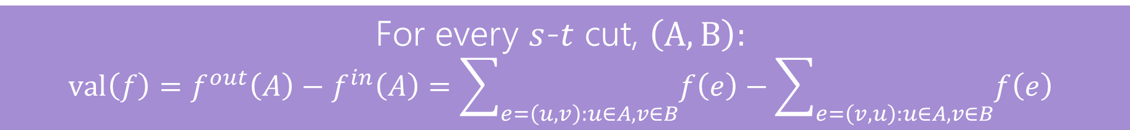
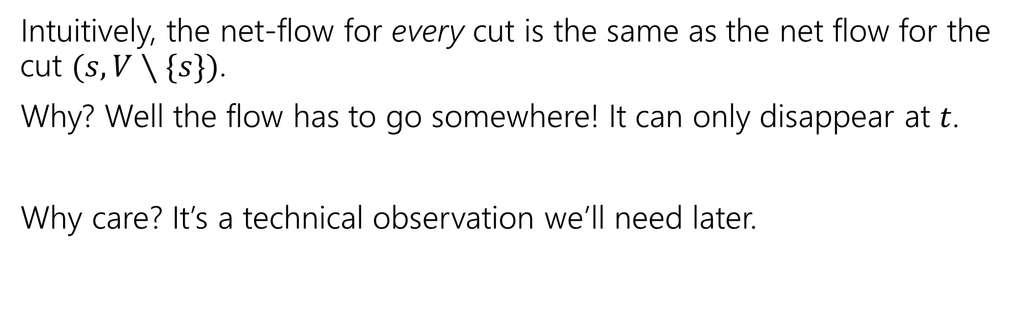
Step 1: The Flow Goes Somewhere
For every $s$-$t$ cut, $\left(A,B\right):$ $$val\left(f\right)=f^{out}\left(A\right)−f^{in}\left(A\right)=\sum_{e=\left(u,v\right):u∈A,v∈B}{f\left(e\right)}−\sum_{e=\left(v,u\right):u∈A,v∈B}{f\left(e\right)}$$
Intuitively, the net-flow for every cut is the same as the net flow for the cut $(s,V∖\{s\})$.
Why? Well the flow has to go somewhere! It can only disappear at $t$.
Why care? It’s a technical observation we’ll need later.

Slide 52
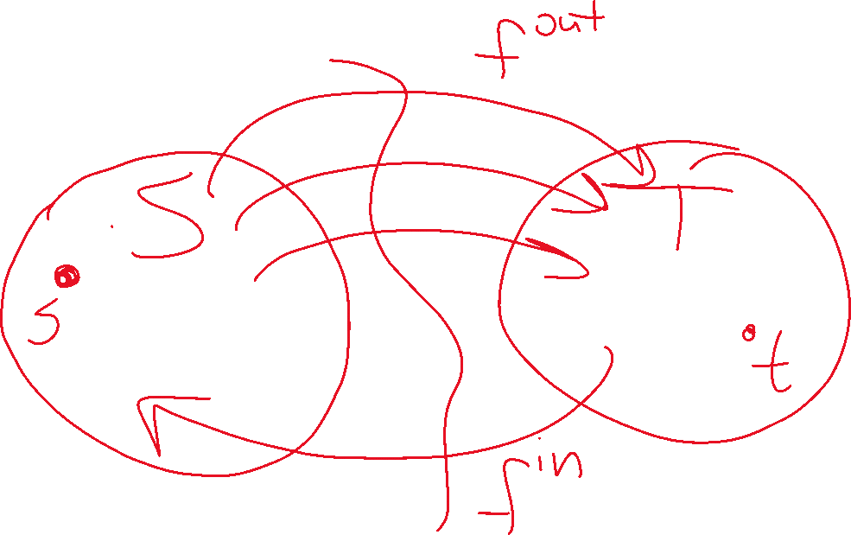



Slide 53

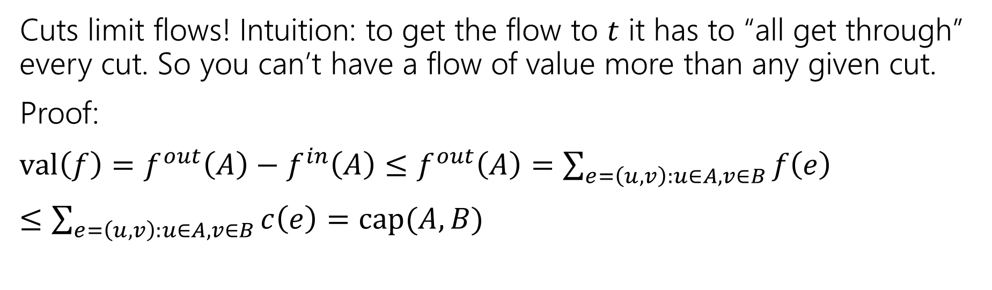
Step 2: Cuts limit flows (‘weak duality’)
Let $f$ be any $s$-$t$ flow, and $(A,B)$ be any $s$-$t$ cut.
Then $val\left(f\right)≤cap(A,B)$
Cuts limit flows! Intuition: to get the flow to $t$ it has to “all get through” every cut. So you can’t have a flow of value more than any given cut.
Proof:
$val\left(f\right)=f^{out}\left(A\right)−f^{in}\left(A\right)≤f^{out}\left(A\right)=\sum_{e=\left(u,v\right):u∈A,v∈B}{f\left(e\right)}$
$≤\sum_{e=\left(u,v\right):u∈A,v∈B}{c\left(e\right)}=cap(A,B)$

Slide 54

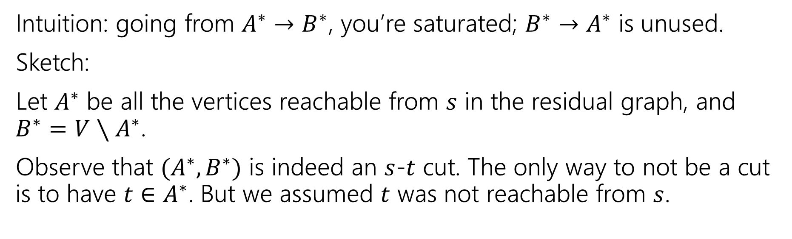
Step 3: Cuts are the only things that limit flows
Let $f^{∗}$ be an $s$-$t$ flow such that there is no $s$-$t$ path in the residual graph.
Then there is a cut $(A^{∗},B^{∗})$ such that $val\left(f^{∗}\right)=cap(A^{∗},B^{∗})$
Intuition: going from $A^{∗}→B^{∗}$, you’re saturated; $B^{∗}→A^{∗}$ is unused.
Sketch:
Let $A^{∗}$ be all the vertices reachable from $s$ in the residual graph, and $B^{∗}=V∖A^{∗}$.
Observe that $(A^{∗},B^{∗})$ is indeed an $s$-$t$ cut. The only way to not be a cut is to have $t∈A^{∗}$. But we assumed $t$ was not reachable from $s$.

Slide 55
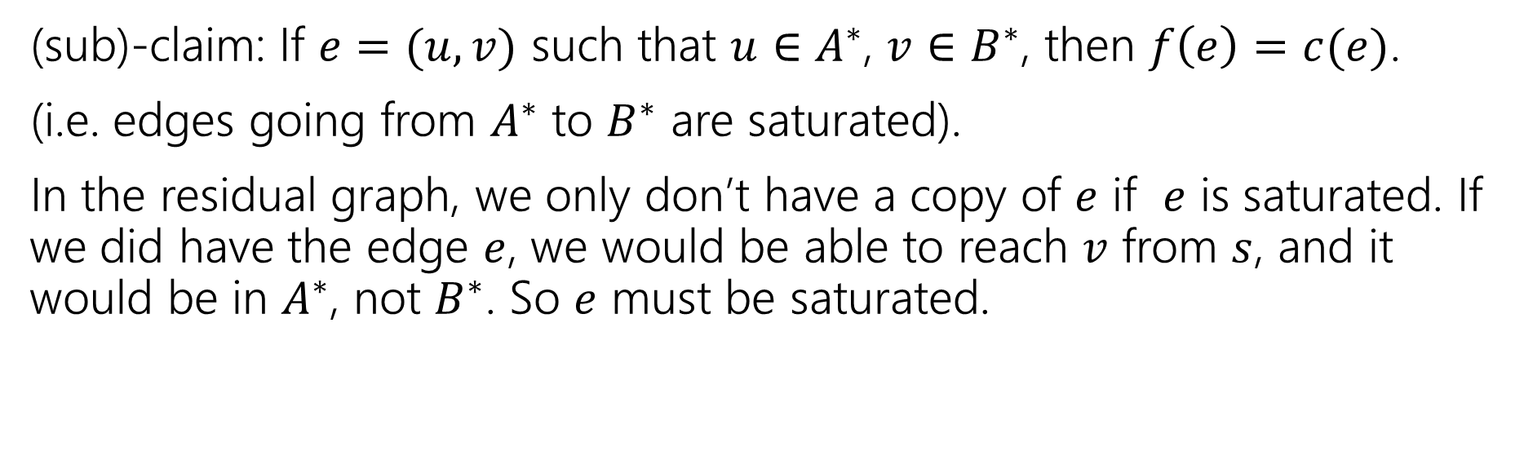


Step 3: Cuts are the only things that limit flows
Let $f^{∗}$ be an $s$-$t$ flow such that there is no $s$-$t$ path in the residual graph.
Then there is a cut $(A^{∗},B^{∗})$ such that $val\left(f^{∗}\right)=cap(A^{∗},B^{∗})$
(sub)-claim: If $e=(u,v)$ such that $u∈A^{∗}$, $v∈B^{∗}$, then $f\left(e\right)=c(e)$.
(i.e. edges going from $A^{∗}$ to $B^{∗}$ are saturated).
In the residual graph, we only don’t have a copy of $e$ if $e$ is saturated. If we did have the edge $e$, we would be able to reach $v$ from $s$, and it would be in $A^{∗}$, not $B^{∗}$. So $e$ must be saturated.
$$v$$
$$u$$

Slide 56
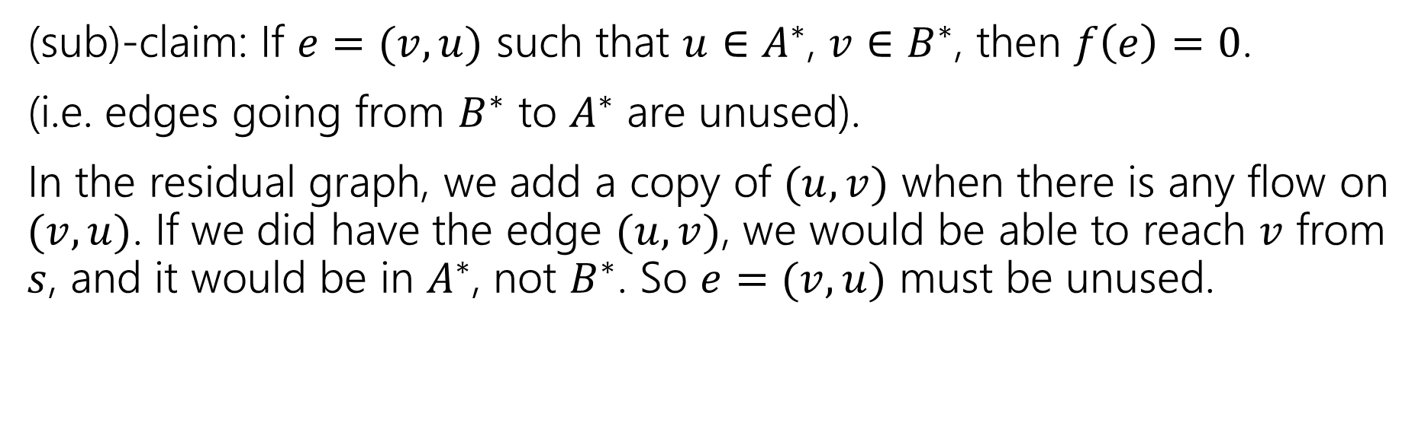

Step 3: Cuts are the only things that limit flows
Let $f^{∗}$ be an $s$-$t$ flow such that there is no $s$-$t$ path in the residual graph.
Then there is a cut $(A^{∗},B^{∗})$ such that $val\left(f^{∗}\right)=cap(A^{∗},B^{∗})$
(sub)-claim: If $e=(v,u)$ such that $u∈A^{∗}$, $v∈B^{∗}$, then $f\left(e\right)=0$.
(i.e. edges going from $B^{∗}$ to $A^{∗}$ are unused).
In the residual graph, we add a copy of $(u,v)$ when there is any flow on $(v,u)$. If we did have the edge $(u,v)$, we would be able to reach $v$ from $s$, and it would be in $A^{∗}$, not $B^{∗}$. So $e=(v,u)$ must be unused.
$$v$$
$$u$$

Slide 57
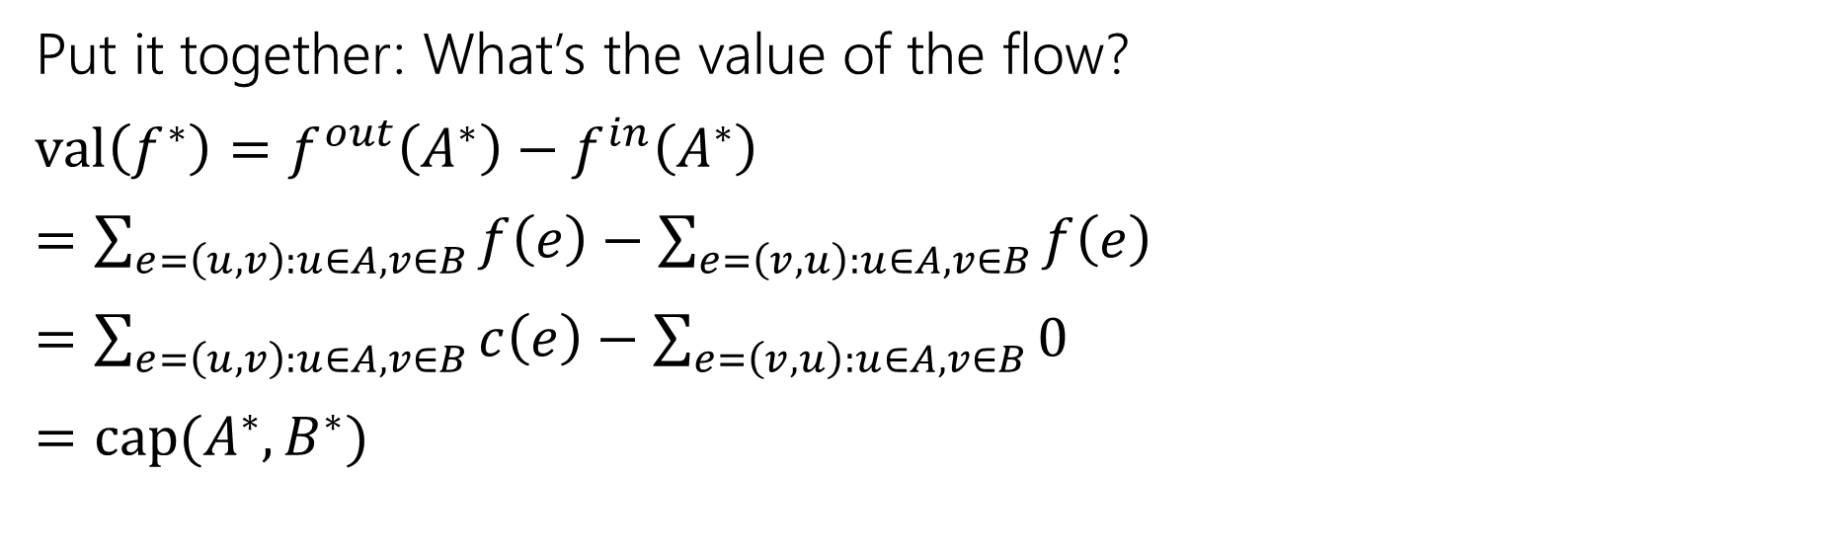
Step 3: Cuts are the only things that limit flows
Let $f^{∗}$ be an $s$-$t$ flow such that there is no $s$-$t$ path in the residual graph.
Then there is a cut $(A^{∗},B^{∗})$ such that $val\left(f^{∗}\right)=cap(A^{∗},B^{∗})$
Put it together: What’s the value of the flow?
$val\left(f^{∗}\right)=f^{out}\left(A^{∗}\right)−f^{in}\left(A^{∗}\right)$
$=\sum_{e=\left(u,v\right):u∈A,v∈B}{f\left(e\right)}−\sum_{e=\left(v,u\right):u∈A,v∈B}{f\left(e\right)}$
$=\sum_{e=\left(u,v\right):u∈A,v∈B}{c\left(e\right)}−\sum_{e=\left(v,u\right):u∈A,v∈B}{0}$
$=cap(A^{∗},B^{∗})$
Step 1’s lemma
Net is flow out minus flow in.
Last 2 slides
Definition of capacity.

Slide 58
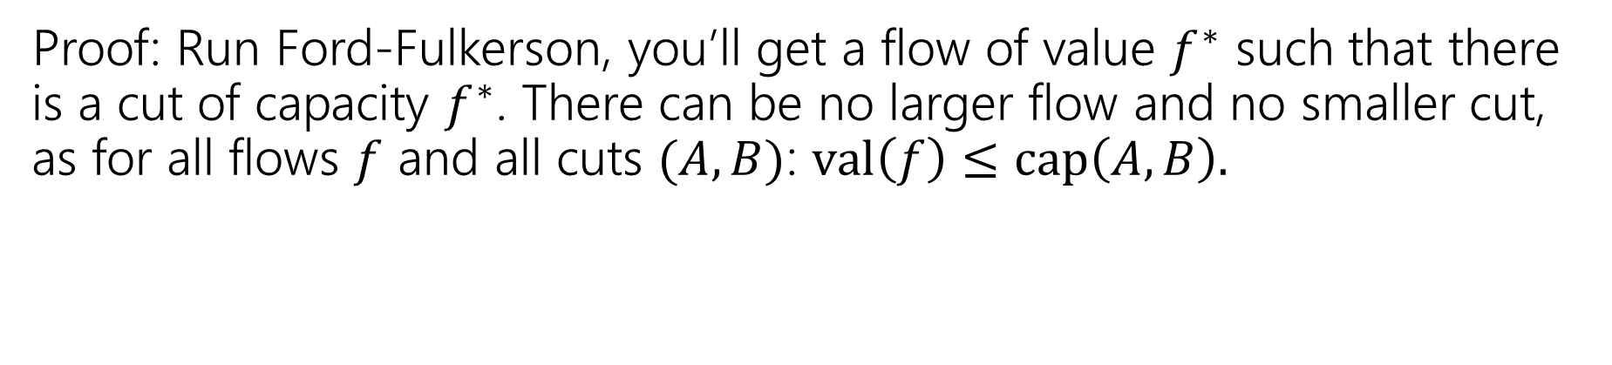
Concluding The Theorem
The value of the maximum flow from $s$ to $t$ is equal to the value of the minimum cut separating $s$ and $t$.
Max-Flow-Min-Cut Theorem
Proof: Run Ford-Fulkerson, you’ll get a flow of value $f^{∗}$ such that there is a cut of capacity $f^{∗}$. There can be no larger flow and no smaller cut, as for all flows $f$ and all cuts $(A,B)$: $val\left(f\right)≤cap\left(A,B\right).$

Slide 59
Isn’t This Cool?
Another instance where we prove a big theorem using an algorithm.
The max-flow min-cut theorem doesn’t mention an algorithm, but it can be proved via analyzing Ford-Fulkerson!

Slide 60
So What?
Max-flow and min-cut are each interesting algorithmic problems.
They were first studied in the 1950s
The U.S. military wanted to know how much the Soviets could ship on their rail network.
And also which rail lines they would target to disrupt the network.

Slide 61
So What?
Great quick check for if you’ve found the maximum flow (or min-cut).
Check the other and see if the value is the same!
We’ll see examples next time of max-flow used for modeling. In those cases the min-cut can be interpreted as a “barrier” to a good assignment.
It’s also a nice example of duality
In a few weeks we’ll see another instance of this phenomenon with LPs.

Slide 62
Applications

Slide 63
Applications of Max-Flow-Min-Cut
Max-Flow and Min-Cut are useful if you work for the water company…
But they’re also useful if you don’t.
The most common application is assignment problems.
You have jobs and people who can do jobs – who is going to do which?
Big idea:
Let one unit of flow mean “assigning” one job to a person.

Slide 64
Hey Wait…
Isn’t this what stable matching is for?
Stable matching is very versatile, and it lets you encode preferences.
Max-flow assignment is even more versatile on the types of assignments.
But there’s not an easy way to encode preferences.

Slide 65
Example Problem
You and your housemates need to decide who is going to do each of the chores this week.
Some of your housemates are unable to do some chores.
Housemates: 1,2,3
Chores:
Arrange furniture, clean the Bathroom, Cook dinner, do the Dishes
Housemate 1 is unable to arrange furniture, 2 is unable to cook.

Slide 66
Example Problem
Housemate 1 is unable to arrange furniture, 2 is unable to cook.
Vertex for each housemate and chore.
Edge if the housemate could do the chore
A
1
B
2
C
3
D

Slide 67
Example Problem
Housemate 1 is unable to arrange furniture, 2 is unable to cook.
Vertex for each housemate and chore.
Edge if the housemate could do the chore
A
1
B
2
C
3
D

Slide 68
Example Problem
Housemate 1 is unable to arrange furniture, 2 is unable to cook.
Vertex for each housemate and chore.
Edge if the housemate could do the chore
A
1
B
2
C
3
D

Slide 69
Example Problem
Housemate 1 is unable to arrange furniture, 2 is unable to cook.
Vertex for each housemate and chore.
Edge if the housemate could do the chore
A
1
B
2
C
3
D

Slide 70
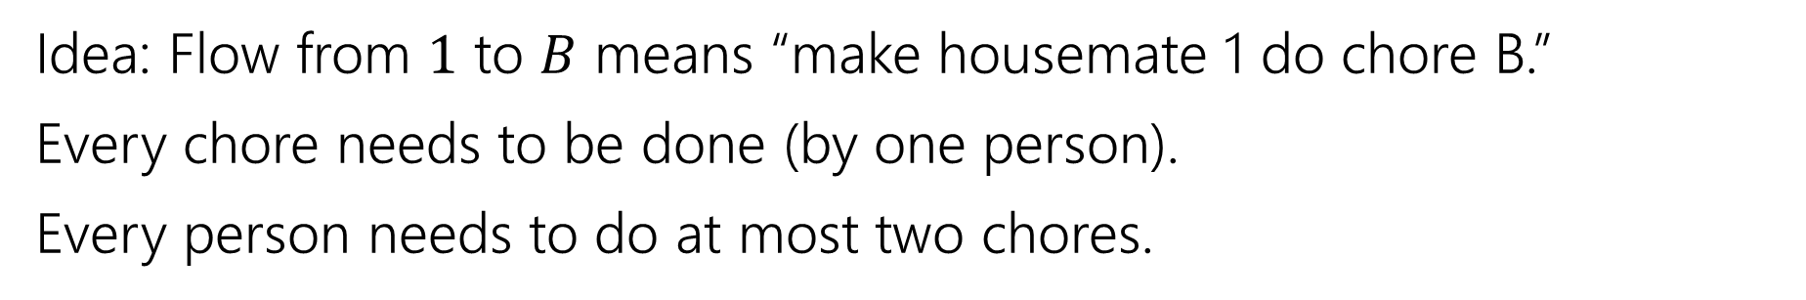
Example Problem
Idea: Flow from $1$ to $B$ means “make housemate 1 do chore B.”
Every chore needs to be done (by one person).
Every person needs to do at most two chores.
A
1
B
2
C
3
D

Slide 71
Example Problem
Idea: Flow from $1$ to $B$ means “make housemate 1 do chore B.”
Every chore needs to be done (by one person).
Every person needs to do at most two chores.
A
1
“dummy” source
B
s
2
t
C
3
“dummy” target
D

Slide 72

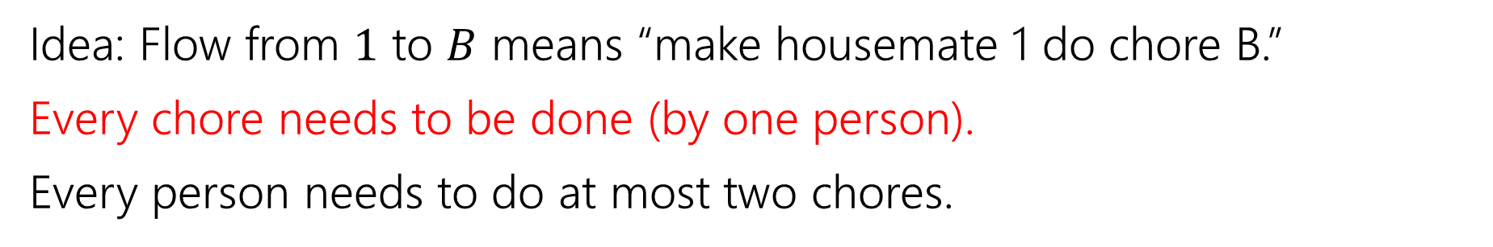



Example Problem
Idea: Flow from $1$ to $B$ means “make housemate 1 do chore B.”
Every chore needs to be done (by one person).
Every person needs to do at most two chores.
A
1
$$?/1$$
B
$$?/1$$
s
2
t
$$?/1$$
C
$$?/1$$
3
D

Slide 73



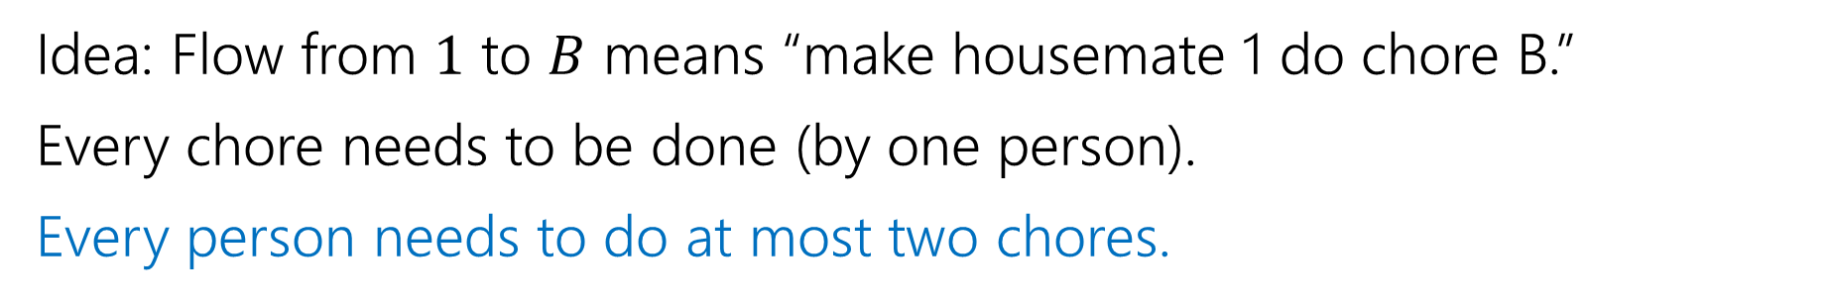




Example Problem
Idea: Flow from $1$ to $B$ means “make housemate 1 do chore B.”
Every chore needs to be done (by one person).
Every person needs to do at most two chores.
A
1
$$?/1$$
$$?/2$$
$$?/2$$
B
$$?/1$$
s
2
t
$$?/2$$
$$?/1$$
C
$$?/1$$
3
D

Slide 74


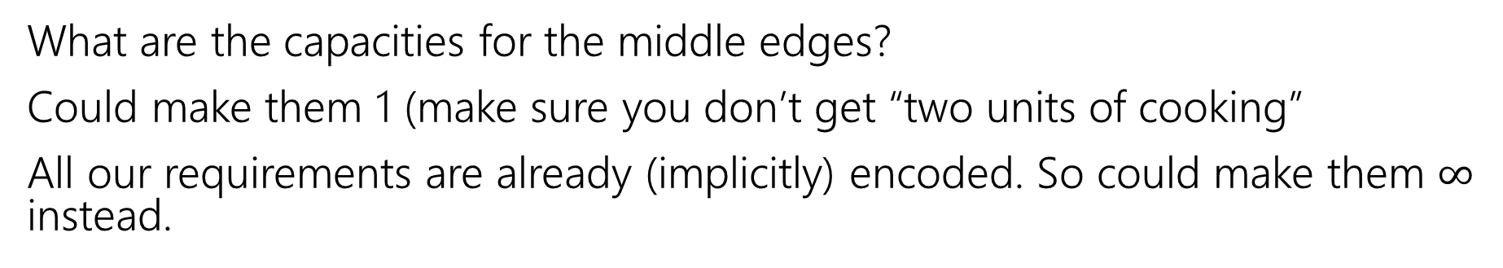

Example Problem
What are the capacities for the middle edges?
Could make them 1 (make sure you don’t get “two units of cooking”
All our requirements are already (implicitly) encoded. So could make them $∞$ instead.
A
1
$$?/1$$
$$?/2$$
$$?/2$$
B
$$?/1$$
s
2
t
$$?/2$$
$$?/1$$
C
$$?/1$$
3
D

Slide 75







Example Problem
Find a max flow…And read off the assignment!
Full color: 1 unit of flow, faded: 0 units of flow
1 cleans the bathroom and does the dishes, 2 arranges furniture, 3 cooks.
A
1
$$1/1$$
$$2/2$$
$$1/2$$
B
$$1/1$$
s
2
t
$$1/2$$
$$1/1$$
C
$$1/1$$
3
D

Slide 76
Why are all of our constraints met?
Every chore gets done
No one does more than 2 chores
People only do chores they’re capable of

Slide 77
Why are all of our constraints met?
Every chore gets done
No one does more than 2 chores
People only do chores they’re capable of
A flow of value 4 sends one unit of flow through each of A,B,C,D (because the edges to $t$ are all capacity $1$), so a max-flow ensures if possible we’ll find an assignment.
Only 2 units of flow can go through any person vertex (because edges from $s$ to people are all capacity $2).$
There is only an edge from a person to a chore if they can do that chore.

Slide 78
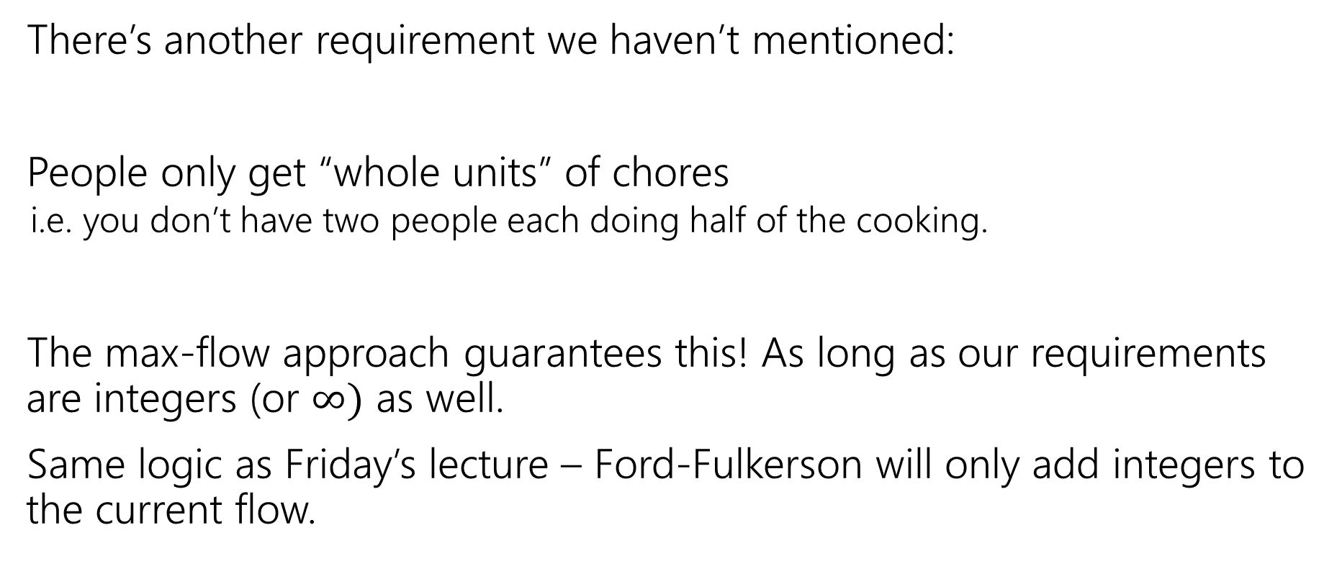
One More Requirement…
There’s another requirement we haven’t mentioned:
People only get “whole units” of chores
i.e. you don’t have two people each doing half of the cooking.
The max-flow approach guarantees this! As long as our requirements are integers (or $∞)$ as well.
Same logic as Friday’s lecture – Ford-Fulkerson will only add integers to the current flow.

Slide 79
Speeding Up Ford-Fulkerson

Slide 80
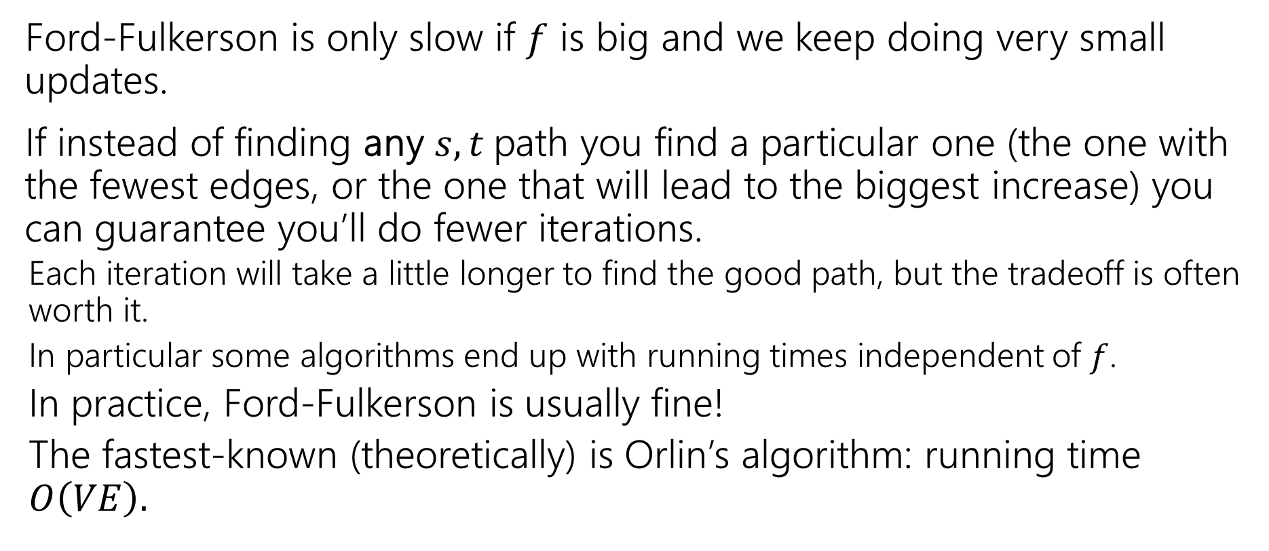
Speeding Up Ford-Fulkerson
Ford-Fulkerson is only slow if $f$ is big and we keep doing very small updates.
If instead of finding any $s,t$path you find a particular one (the one with the fewest edges, or the one that will lead to the biggest increase) you can guarantee you’ll do fewer iterations.
Each iteration will take a little longer to find the good path, but the tradeoff is often worth it.
In particular some algorithms end up with running times independent of $f$.
In practice, Ford-Fulkerson is usually fine!
The fastest-known (theoretically) is Orlin’s algorithm: running time $O\left(VE\right).$

