Slide 1
DP5
End of Arrays; DP on trees
CSE 421 Winter 23
Lecture 14

Slide 2
Midterm Information
Practice Midterm is posted, along with some other resources.
  Section Thursday will be “pick what problems you want to practice”
  Second-half of Friday’s lecture will be a “what have we seen so far?” review (not new problems, but at least a list of what you’ve seen).
  Monday, the TAs will spend the lecture slot answering questions on the practice midterm (or anything else you want to ask about).
Please fill out the conflict form today so we can work on scheduling.
If you are sick for the exam, we’ll schedule a conflict once you’re well (we’ll have a separate mode of telling us, not that form).

Slide 3
Please come in-person tomorrow
Ken Yasuhara (from College of Engineering’s Center for Teaching and Learning) will do a mid-quarter feedback session Wednesday.
It’ll take the first about 20 minutes; we’ll have a normal half-of-a-lecture slot after that.
Feedback is super useful to us!

Slide 4
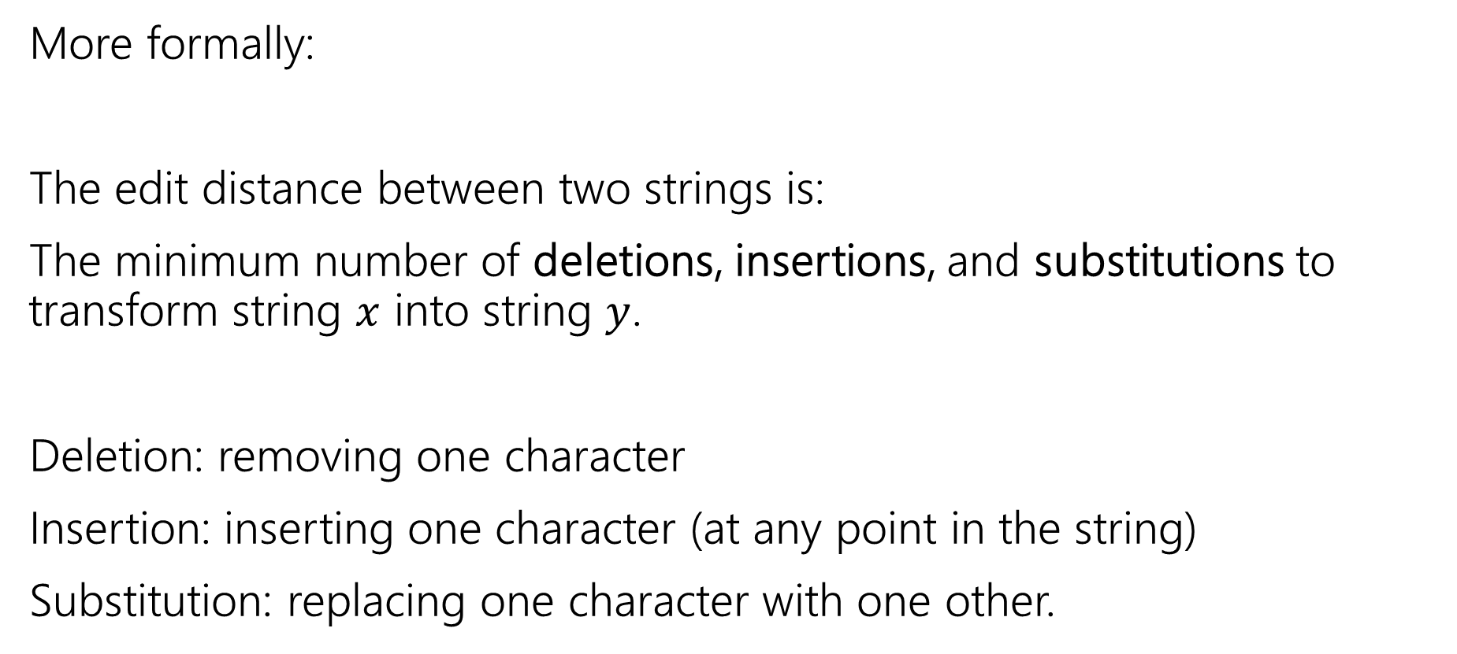
Edit Distance
More formally:
The edit distance between two strings is:
The minimum number of deletions, insertions, and substitutions to transform string $x$ into string $y$.
Deletion: removing one character
Insertion: inserting one character (at any point in the string)
Substitution: replacing one character with one other.

Slide 5
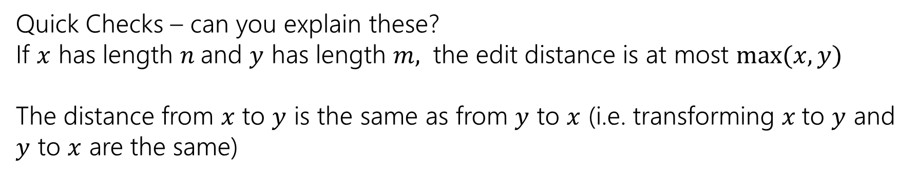
Example
What’s the distance between babyyodas and tastysoda?
B | A | B |  | Y | Y | O | D | A | S
sub |  | sub | ins |  | sub |  |  |  | del
T | A | S | T | Y | S | O | D | A
Distance: 5, one point for each colored box
Quick Checks – can you explain these?
If $x$ has length $n$and $y$ has length $m,$ the edit distance is at most $\max{(x,y)}$
The distance from $x$ to $y$ is the same as from $y$ to $x$ (i.e. transforming $x$to $y$ and $y$ to $x$ are the same)

Slide 6
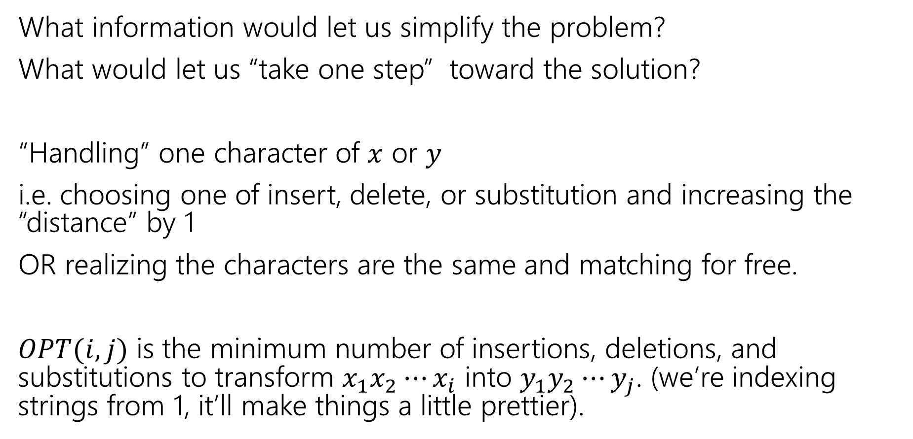
Finding a recurrence
What information would let us simplify the problem?
What would let us “take one step” toward the solution?
“Handling” one character of $x$ or $y$
i.e. choosing one of insert, delete, or substitution and increasing the “distance” by 1
OR realizing the characters are the same and matching for free.
$OPT(i,j)$ is the minimum number of insertions, deletions, and substitutions to transform $x_{1}x_{2}⋯x_{i}$ into $y_{1}y_{2}⋯y_{j}$. (we’re indexing strings from 1, it’ll make things a little prettier).

Slide 7
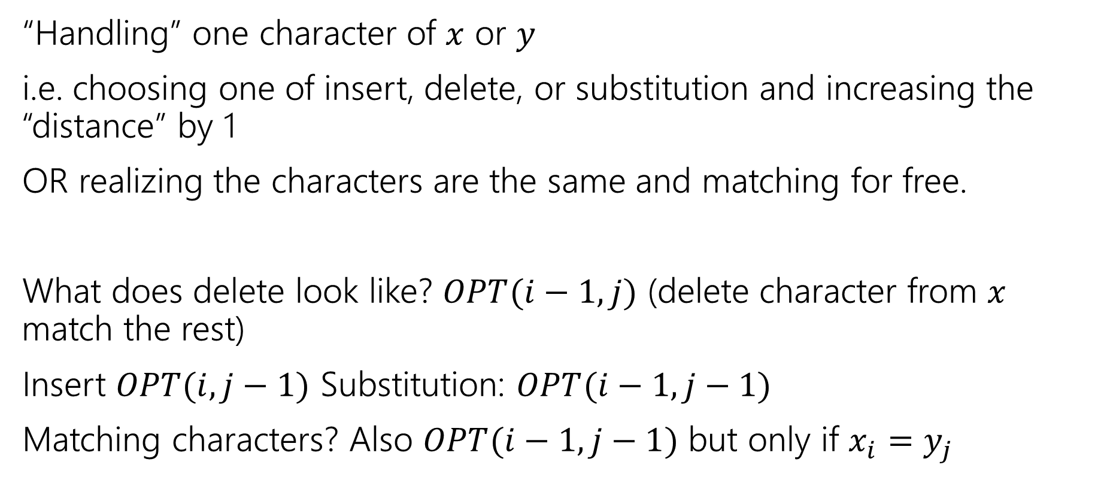
The recurrence
“Handling” one character of $x$ or $y$
i.e. choosing one of insert, delete, or substitution and increasing the “distance” by 1
OR realizing the characters are the same and matching for free.
What does delete look like? $OPT(i−1, j)$ (delete character from $x$ match the rest)
Insert $OPT(i,j−1)$ Substitution: $OPT(i−1,j−1)$
Matching characters? Also $OPT(i−1,j−1)$ but only if $x_{i}=y_{j}$

Slide 8
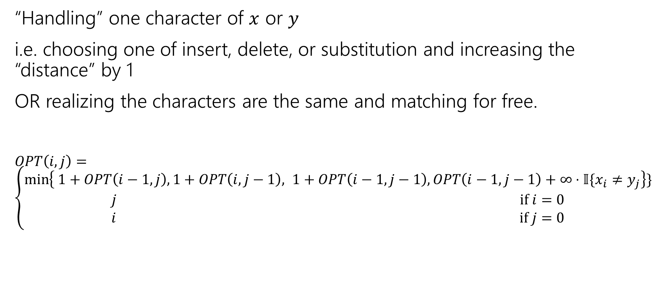
The recurrence (v1, we’ll improve soon)
“Handling” one character of $x$ or $y$
i.e. choosing one of insert, delete, or substitution and increasing the “distance” by 1
OR realizing the characters are the same and matching for free.
$OPT\left(i,j\right)=\left\{\begin{aligned}\min\left\{ 1+OPT\left(i−1,j\right), 1+OPT\left(i,j−1\right), 1+OPT\left(i−1,j−1\right), OPT\left(i−1,j−1\right)+∞⋅𝕀\{x_{i}≠y_{j}\right\}\} \\ j if i=0 \\ i if j=0\end{aligned}\right.$
Delete
Insert
Substitution
TODO: Just Match

Slide 9
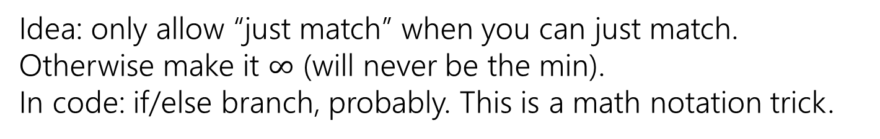
The recurrence (v1, we’ll improve soon)
“Handling” one character of $x$ or $y$
i.e. choosing one of insert, delete, or substitution and increasing the “distance” by 1
OR realizing the characters are the same and matching for free.
$OPT\left(i,j\right)=\left\{\begin{aligned}\min\left\{ 1+OPT\left(i−1,j\right), 1+OPT\left(i,j−1\right), 1+OPT\left(i−1,j−1\right), OPT\left(i−1,j−1\right)+∞⋅𝕀\{x_{i}≠y_{j}\right\}\} \\ j if i=0 \\ i if j=0\end{aligned}\right.$
Delete
Insert
Substitution
Just Match
Idea: only allow “just match” when you can just match. Otherwise make it $∞$ (will never be the min).
In code: if/else branch, probably. This is a math notation trick.
“Indicator” like from 312

Slide 10
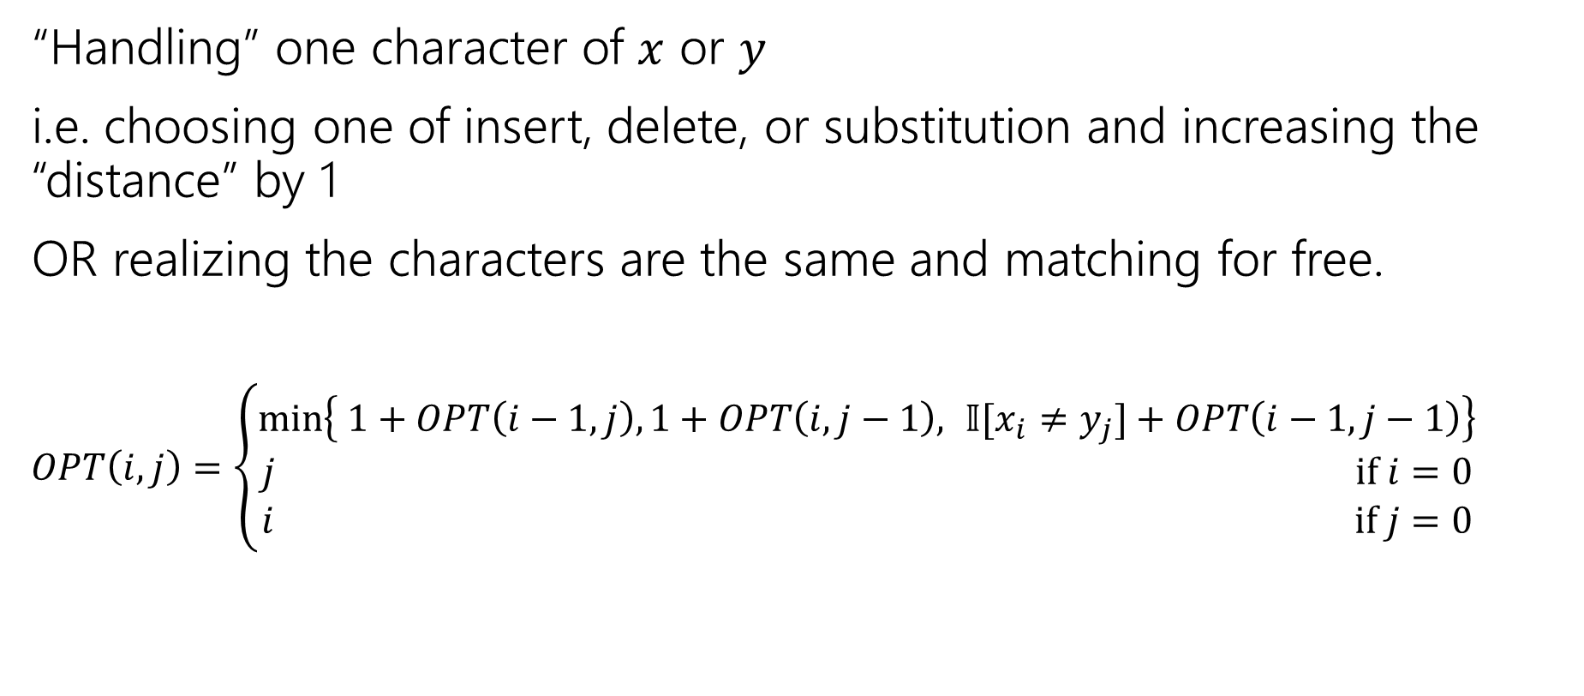
The recurrence
“Handling” one character of $x$ or $y$
i.e. choosing one of insert, delete, or substitution and increasing the “distance” by 1
OR realizing the characters are the same and matching for free.
$OPT\left(i,j\right)=\left\{\begin{aligned}\min\left\{ 1+OPT\left(i−1,j\right), 1+OPT\left(i,j−1\right), 𝕀[x_{i}≠y_{j}]+OPT\left(i−1,j−1\right)\right\} \\ j if i=0 \\ i if j=0\end{aligned}\right.$
Delete
Insert
Sub and matching
When we could match, we will never substitute; matching will always give us a better score! Still have to check delete, insert (those could be better).

Slide 11
The recurrence
“Handling” one character of $x$ or $y$
i.e. choosing one of insert, delete, or substitution and increasing the “distance” by 1
OR realizing the characters are the same and matching for free.
$OPT\left(i,j\right)=\left\{\begin{aligned}\min\left\{ 1+OPT\left(i−1,j\right), 1+OPT\left(i,j−1\right), 𝕀[x_{i}≠y_{j}]+OPT\left(i−1,j−1\right)\right\} \\ j if i=0 \\ i if j=0\end{aligned}\right.$
Delete
Insert
Sub and matching

Slide 12
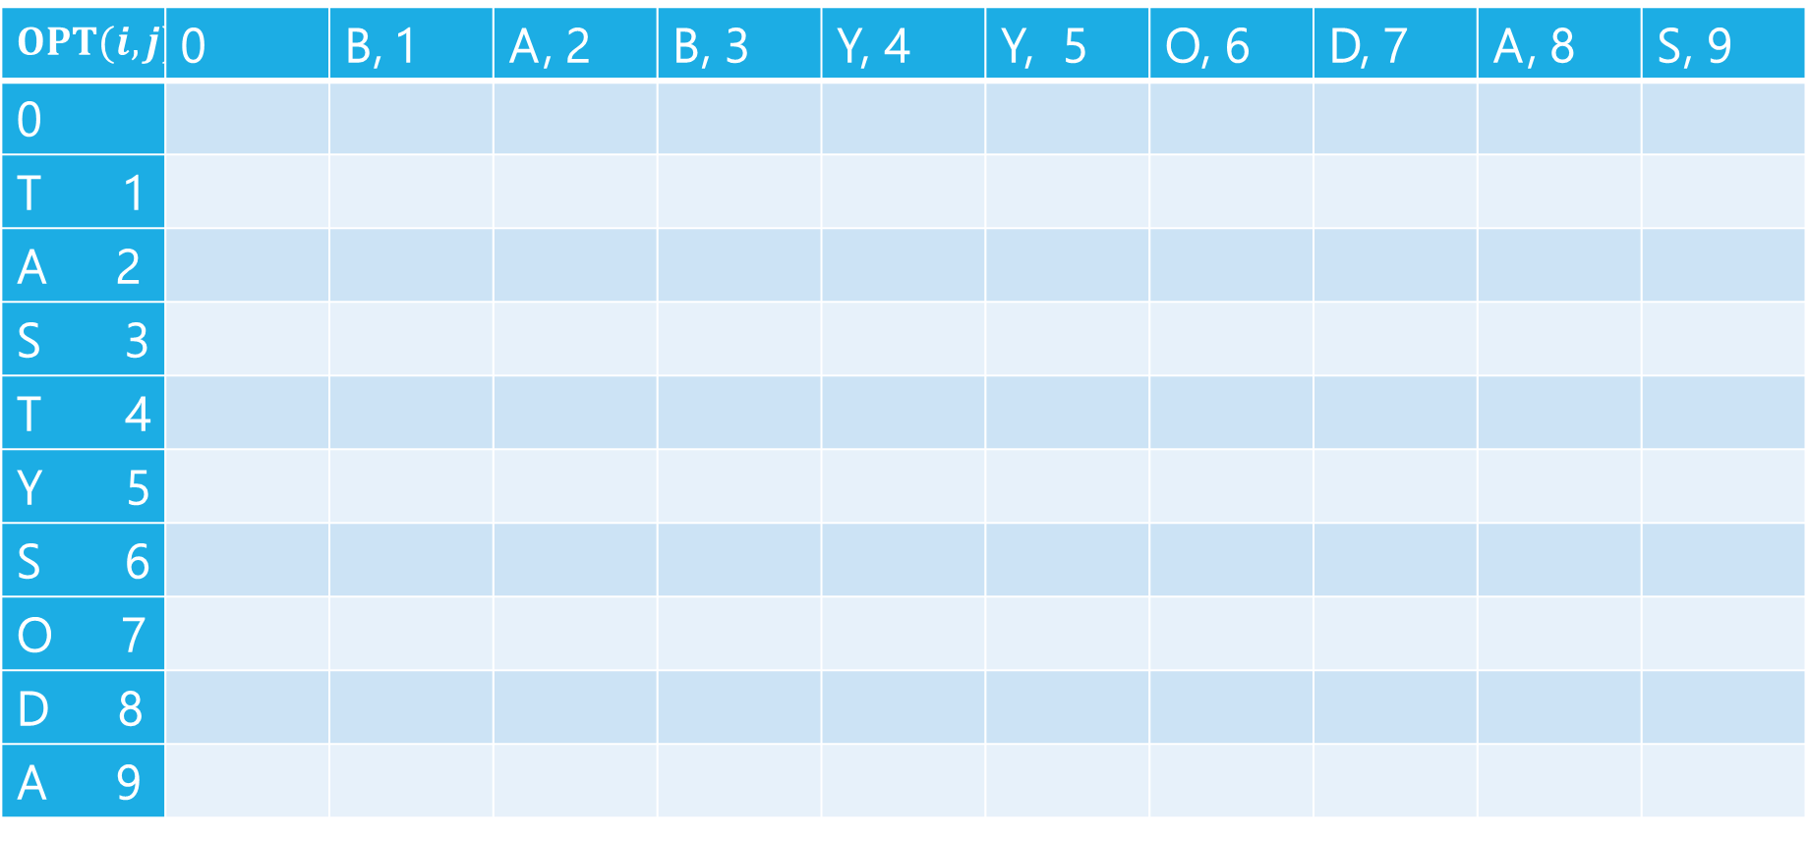
Edit Distance
$$OPT(i,j)$$ | 0 | B, 1 | A, 2 | B, 3 | Y, 4 | Y, 5 | O, 6 | D, 7 | A, 8 | S, 9
0
T 1
A 2
S 3
T 4
Y 5
S 6
O 7
D 8
A 9

Slide 13
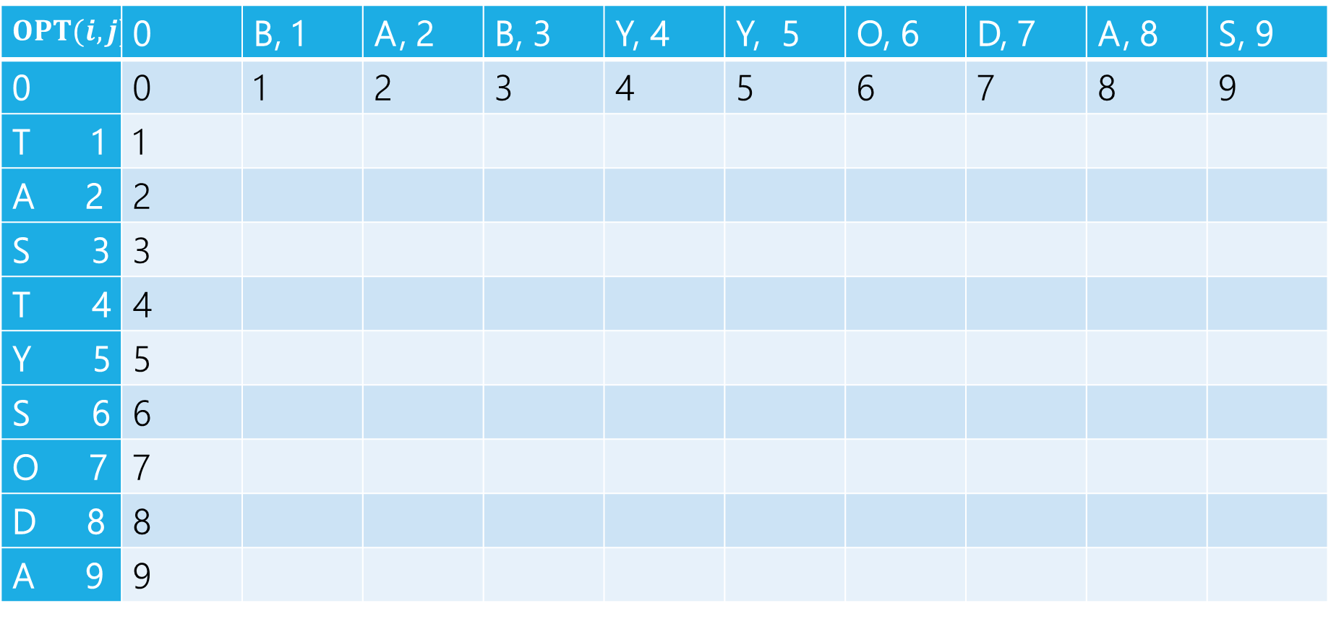
Edit Distance
$$OPT(i,j)$$ | 0 | B, 1 | A, 2 | B, 3 | Y, 4 | Y, 5 | O, 6 | D, 7 | A, 8 | S, 9
0 | 0 | 1 | 2 | 3 | 4 | 5 | 6 | 7 | 8 | 9
T 1 | 1
A 2 | 2
S 3 | 3
T 4 | 4
Y 5 | 5
S 6 | 6
O 7 | 7
D 8 | 8
A 9 | 9

Slide 14
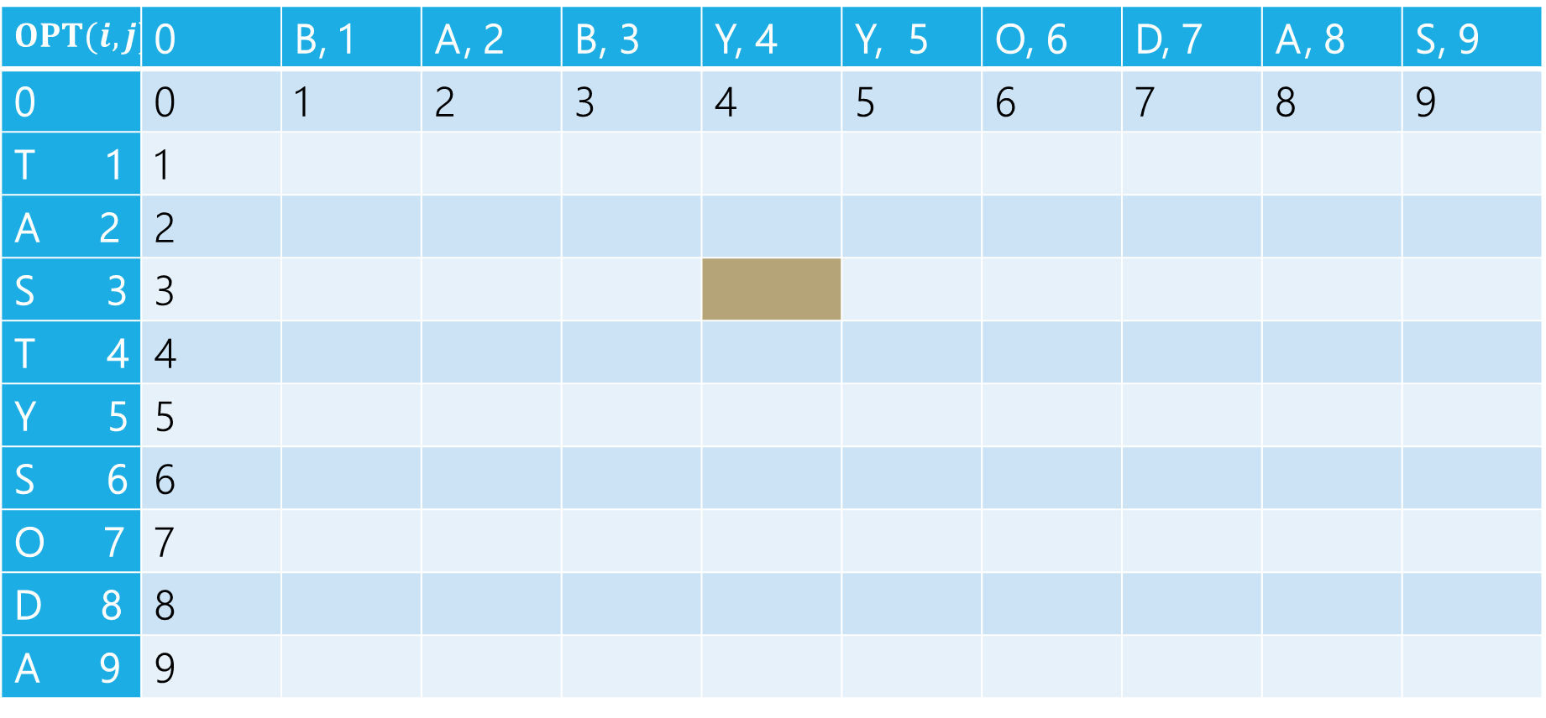
Edit Distance
B | A | B | Y
T | A | S
Current subproblem: edit dist between BABY and TAS
$$OPT(i,j)$$ | 0 | B, 1 | A, 2 | B, 3 | Y, 4 | Y, 5 | O, 6 | D, 7 | A, 8 | S, 9
0 | 0 | 1 | 2 | 3 | 4 | 5 | 6 | 7 | 8 | 9
T 1 | 1
A 2 | 2
S 3 | 3
T 4 | 4
Y 5 | 5
S 6 | 6
O 7 | 7
D 8 | 8
A 9 | 9

Slide 15
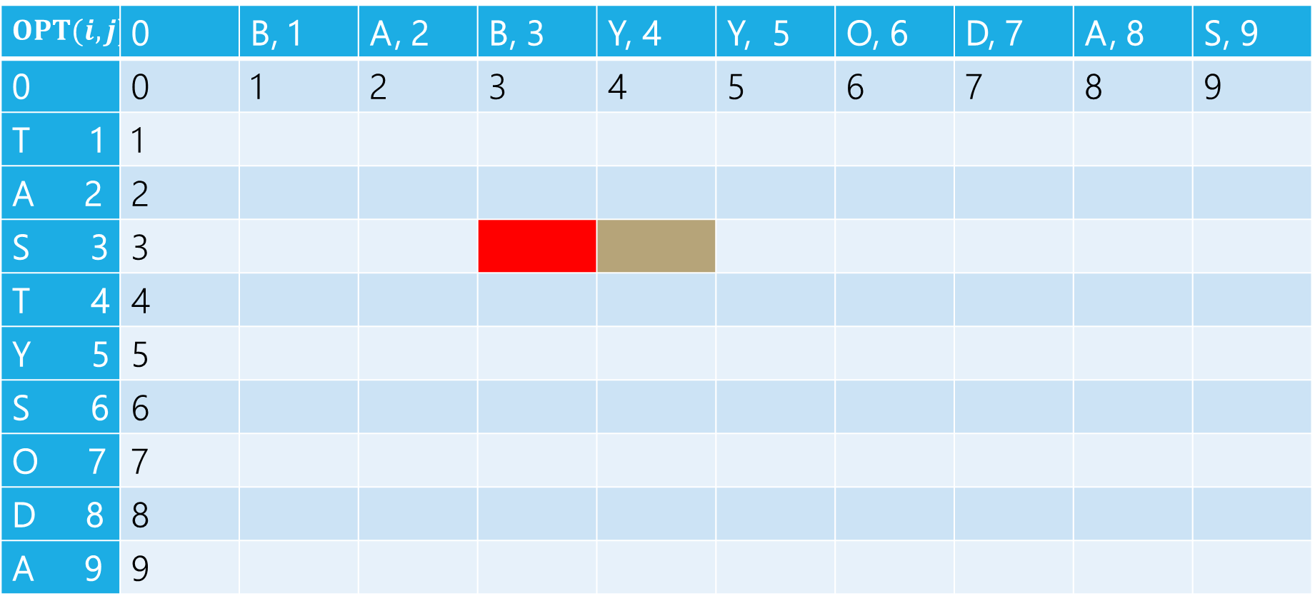
Edit Distance
B | A | B | Y
T | A | S
Delete: get rid of Y (cost 1)
BAB
TAS
$$OPT(i,j)$$ | 0 | B, 1 | A, 2 | B, 3 | Y, 4 | Y, 5 | O, 6 | D, 7 | A, 8 | S, 9
0 | 0 | 1 | 2 | 3 | 4 | 5 | 6 | 7 | 8 | 9
T 1 | 1
A 2 | 2
S 3 | 3
T 4 | 4
Y 5 | 5
S 6 | 6
O 7 | 7
D 8 | 8
A 9 | 9

Slide 16
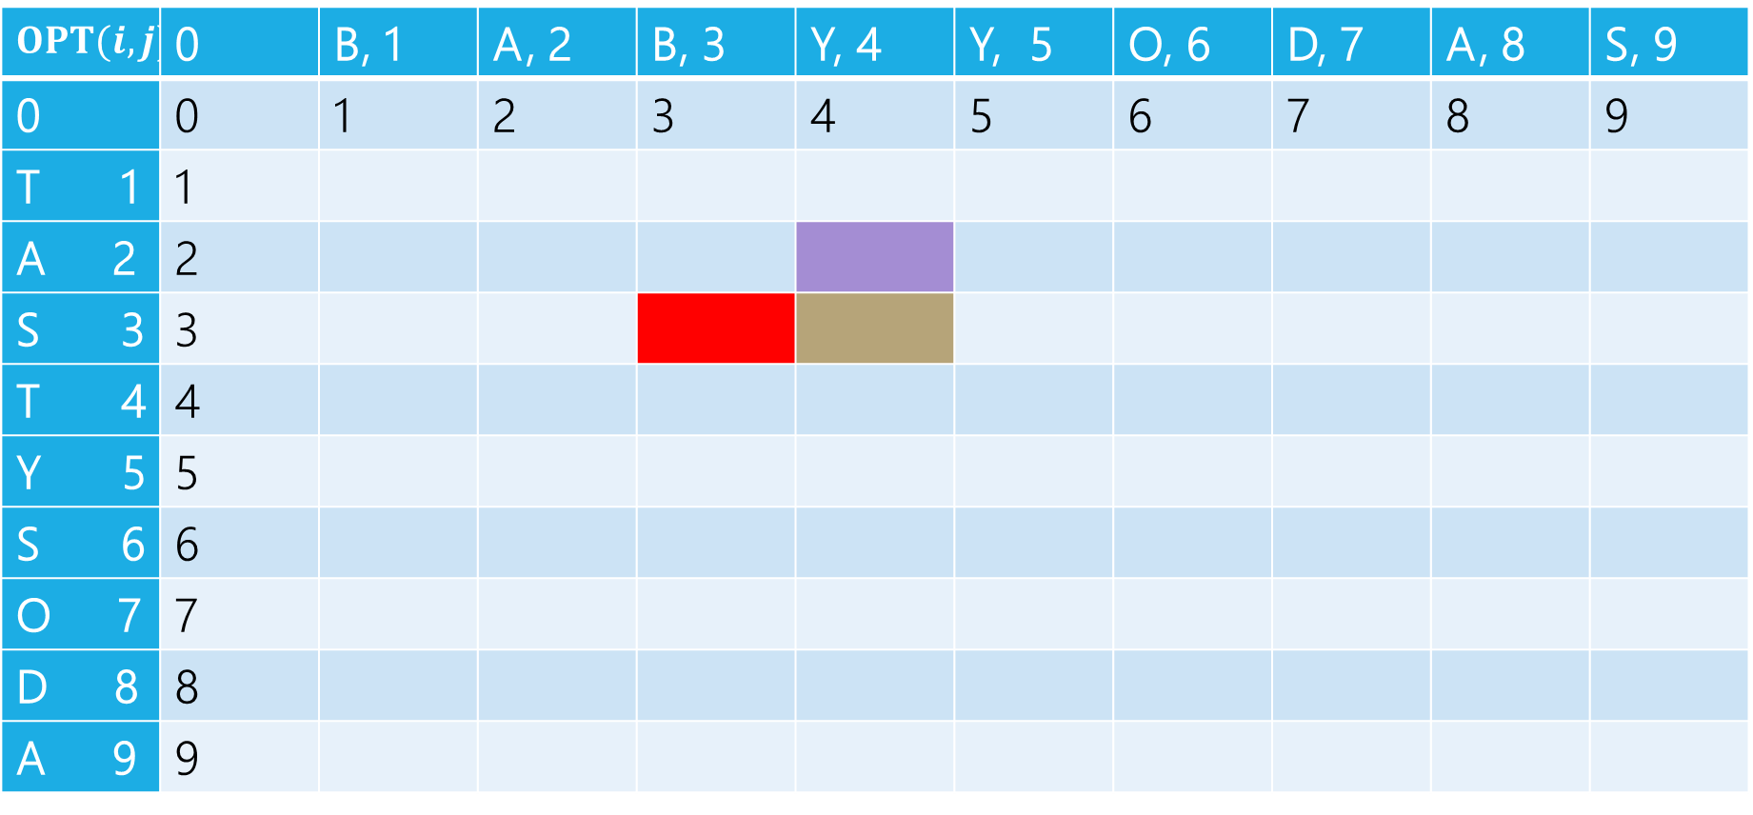
Edit Distance
B | A | B | Y
T | A | S
Insert: insert S (cost 1)
BABY
TA
$$OPT(i,j)$$ | 0 | B, 1 | A, 2 | B, 3 | Y, 4 | Y, 5 | O, 6 | D, 7 | A, 8 | S, 9
0 | 0 | 1 | 2 | 3 | 4 | 5 | 6 | 7 | 8 | 9
T 1 | 1
A 2 | 2
S 3 | 3
T 4 | 4
Y 5 | 5
S 6 | 6
O 7 | 7
D 8 | 8
A 9 | 9

Slide 17
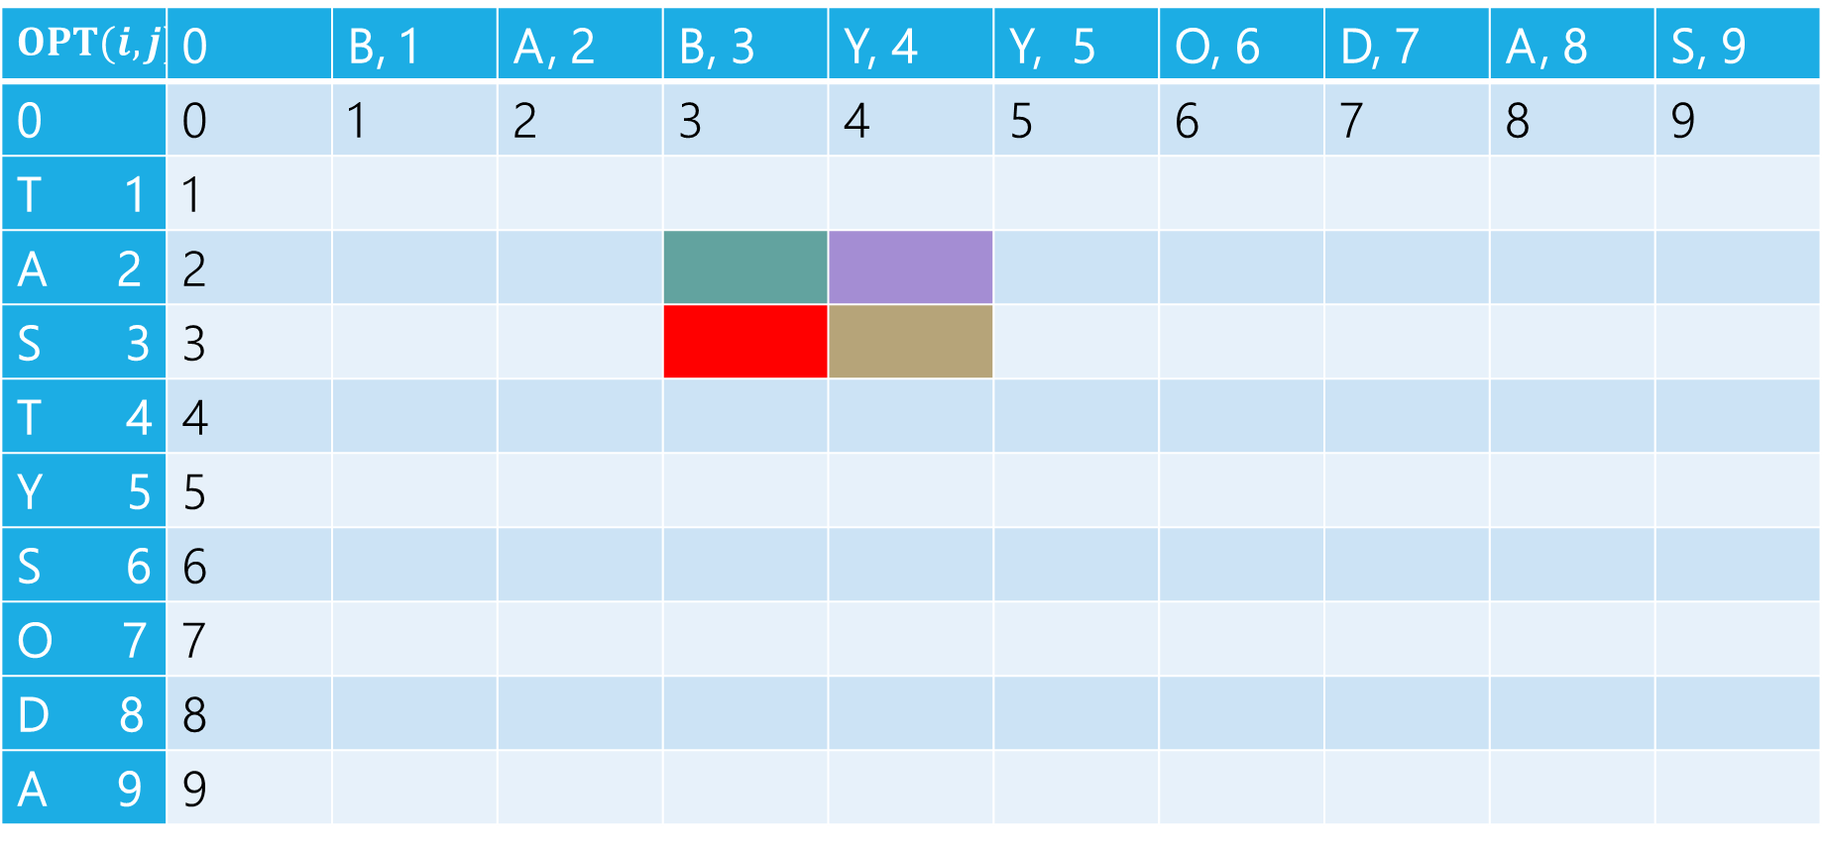
Edit Distance
B | A | B | Y
T | A | S
Sub: Transform Y to S (cost 1)
BAB
TA
$$OPT(i,j)$$ | 0 | B, 1 | A, 2 | B, 3 | Y, 4 | Y, 5 | O, 6 | D, 7 | A, 8 | S, 9
0 | 0 | 1 | 2 | 3 | 4 | 5 | 6 | 7 | 8 | 9
T 1 | 1
A 2 | 2
S 3 | 3
T 4 | 4
Y 5 | 5
S 6 | 6
O 7 | 7
D 8 | 8
A 9 | 9

Slide 18
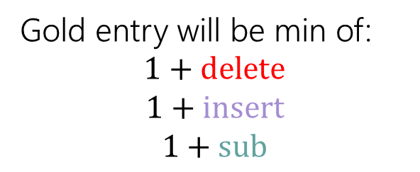
Edit Distance
Gold entry will be min of:
$$1+delete$$
$$1+insert$$
$$1+sub$$
B | A | B | Y
T | A | S
$$OPT(i,j)$$ | 0 | B, 1 | A, 2 | B, 3 | Y, 4 | Y, 5 | O, 6 | D, 7 | A, 8 | S, 9
0 | 0 | 1 | 2 | 3 | 4 | 5 | 6 | 7 | 8 | 9
T 1 | 1
A 2 | 2
S 3 | 3
T 4 | 4
Y 5 | 5
S 6 | 6
O 7 | 7
D 8 | 8
A 9 | 9

Slide 19
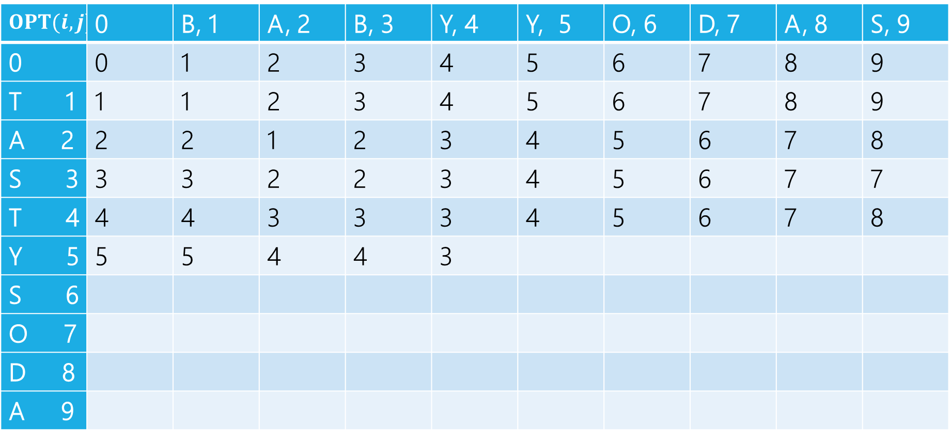

Edit Distance
$$1+2$$
$$1+3$$
$$1+2$$
Min: $3$
Gold entry will be min of:
$$1+delete$$
$$1+insert$$
$$1+sub$$
$$OPT(i,j)$$ | 0 | B, 1 | A, 2 | B, 3 | Y, 4 | Y, 5 | O, 6 | D, 7 | A, 8 | S, 9
0 | 0 | 1 | 2 | 3 | 4 | 5 | 6 | 7 | 8 | 9
T 1 | 1 | 1 | 2 | 3 | 4 | 5 | 6 | 7 | 8 | 9
A 2 | 2 | 2 | 1 | 2 | 3 | 4 | 5 | 6 | 7 | 8
S 3 | 3 | 3 | 2 | 2 | 3 | 4 | 5 | 6 | 7 | 7
T 4 | 4 | 4 | 3 | 3 | 3 | 4 | 5 | 6 | 7 | 8
Y 5 | 5 | 5 | 4 | 4 | 3
S 6
O 7
D 8
A 9

Slide 20
Edit Distance
Fill in the next two entries. Be careful with the sub/match distinction!
$$OPT(i,j)$$ | 0 | B, 1 | A, 2 | B, 3 | Y, 4 | Y, 5 | O, 6 | D, 7 | A, 8 | S, 9
0 | 0 | 1 | 2 | 3 | 4 | 5 | 6 | 7 | 8 | 9
T 1 | 1 | 1 | 2 | 3 | 4 | 5 | 6 | 7 | 8 | 9
A 2 | 2 | 2 | 1 | 2 | 3 | 4 | 5 | 6 | 7 | 8
S 3 | 3 | 3 | 2 | 2 | 3 | 4 | 5 | 6 | 7 | 7
T 4 | 4 | 4 | 3 | 3 | 3 | 4 | 5 | 6 | 7 | 8
Y 5 | 5 | 5 | 4 | 4 | 3
S 6
O 7
D 8
A 9

Slide 21
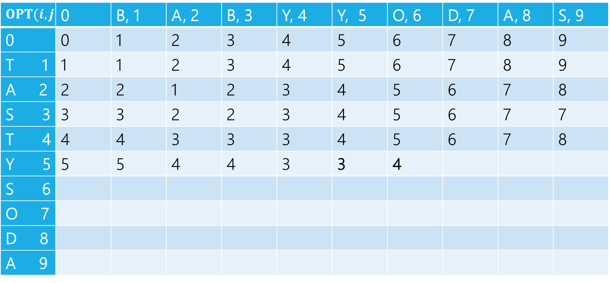
Edit Distance
Fill in the next two entries. Be careful with the sub/match distinction!
$$OPT(i,j)$$ | 0 | B, 1 | A, 2 | B, 3 | Y, 4 | Y, 5 | O, 6 | D, 7 | A, 8 | S, 9
0 | 0 | 1 | 2 | 3 | 4 | 5 | 6 | 7 | 8 | 9
T 1 | 1 | 1 | 2 | 3 | 4 | 5 | 6 | 7 | 8 | 9
A 2 | 2 | 2 | 1 | 2 | 3 | 4 | 5 | 6 | 7 | 8
S 3 | 3 | 3 | 2 | 2 | 3 | 4 | 5 | 6 | 7 | 7
T 4 | 4 | 4 | 3 | 3 | 3 | 4 | 5 | 6 | 7 | 8
Y 5 | 5 | 5 | 4 | 4 | 3 | 3 | 4
S 6
O 7
D 8
A 9
Y’s match, so sub is free!

Slide 22
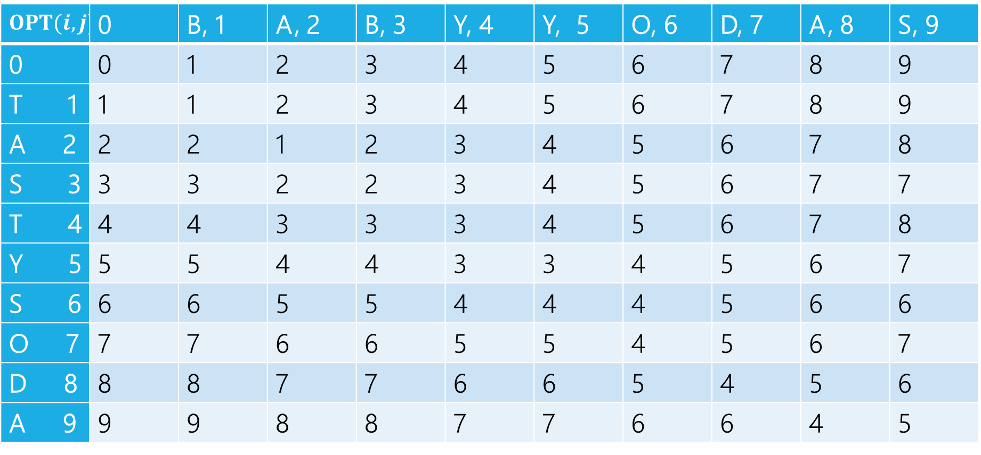
Edit Distance
$$OPT(i,j)$$ | 0 | B, 1 | A, 2 | B, 3 | Y, 4 | Y, 5 | O, 6 | D, 7 | A, 8 | S, 9
0 | 0 | 1 | 2 | 3 | 4 | 5 | 6 | 7 | 8 | 9
T 1 | 1 | 1 | 2 | 3 | 4 | 5 | 6 | 7 | 8 | 9
A 2 | 2 | 2 | 1 | 2 | 3 | 4 | 5 | 6 | 7 | 8
S 3 | 3 | 3 | 2 | 2 | 3 | 4 | 5 | 6 | 7 | 7
T 4 | 4 | 4 | 3 | 3 | 3 | 4 | 5 | 6 | 7 | 8
Y 5 | 5 | 5 | 4 | 4 | 3 | 3 | 4 | 5 | 6 | 7
S 6 | 6 | 6 | 5 | 5 | 4 | 4 | 4 | 5 | 6 | 6
O 7 | 7 | 7 | 6 | 6 | 5 | 5 | 4 | 5 | 6 | 7
D 8 | 8 | 8 | 7 | 7 | 6 | 6 | 5 | 4 | 5 | 6
A 9 | 9 | 9 | 8 | 8 | 7 | 7 | 6 | 6 | 4 | 5

Slide 23
Edit Distance – what operations?
$$OPT(i,j)$$ | 0 | B, 1 | A, 2 | B, 3 | Y, 4 | Y, 5 | O, 6 | D, 7 | A, 8 | S, 9
0 | 0 | 1 | 2 | 3 | 4 | 5 | 6 | 7 | 8 | 9
T 1 | 1 | 1 | 2 | 3 | 4 | 5 | 6 | 7 | 8 | 9
A 2 | 2 | 2 | 1 | 2 | 3 | 4 | 5 | 6 | 7 | 8
S 3 | 3 | 3 | 2 | 2 | 3 | 4 | 5 | 6 | 7 | 7
T 4 | 4 | 4 | 3 | 3 | 3 | 4 | 5 | 6 | 7 | 8
Y 5 | 5 | 5 | 4 | 4 | 3 | 3 | 4 | 5 | 6 | 7
S 6 | 6 | 6 | 5 | 5 | 4 | 4 | 4 | 5 | 6 | 6
O 7 | 7 | 7 | 6 | 6 | 5 | 5 | 4 | 5 | 6 | 7
D 8 | 8 | 8 | 7 | 7 | 6 | 6 | 5 | 4 | 5 | 6
A 9 | 9 | 9 | 8 | 8 | 7 | 7 | 6 | 6 | 4 | 5

Slide 24
Edit Distance – what operations?
$$OPT(i,j)$$ | 0 | B, 1 | A, 2 | B, 3 | Y, 4 | Y, 5 | O, 6 | D, 7 | A, 8 | S, 9
0 | 0 | 1 | 2 | 3 | 4 | 5 | 6 | 7 | 8 | 9
T 1 | 1 | 1 | 2 | 3 | 4 | 5 | 6 | 7 | 8 | 9
A 2 | 2 | 2 | 1 | 2 | 3 | 4 | 5 | 6 | 7 | 8
S 3 | 3 | 3 | 2 | 2 | 3 | 4 | 5 | 6 | 7 | 7
T 4 | 4 | 4 | 3 | 3 | 3 | 4 | 5 | 6 | 7 | 8
Y 5 | 5 | 5 | 4 | 4 | 3 | 3 | 4 | 5 | 6 | 7
S 6 | 6 | 6 | 5 | 5 | 4 | 4 | 4 | 5 | 6 | 6
O 7 | 7 | 7 | 6 | 6 | 5 | 5 | 4 | 5 | 6 | 7
D 8 | 8 | 8 | 7 | 7 | 6 | 6 | 5 | 4 | 5 | 6
A 9 | 9 | 9 | 8 | 8 | 7 | 7 | 6 | 6 | 4 | 5

Slide 25
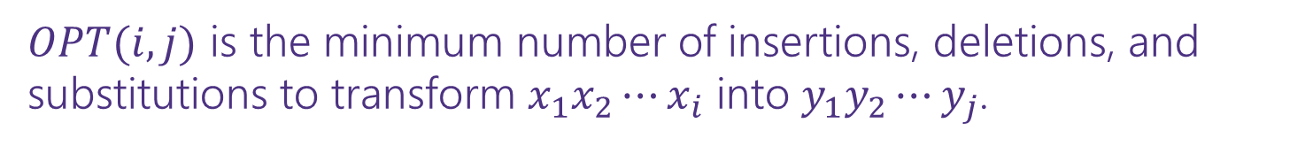

Dynamic Programming Process
1. Define the object you’re looking for
2. Write a recurrence to say how to find it
3. Design a memoization structure
4. Write an iterative algorithm
$OPT(i,j)$ is the minimum number of insertions, deletions, and substitutions to transform $x_{1}x_{2}⋯x_{i}$ into $y_{1}y_{2}⋯y_{j}$.
✅
$m×n$ Array
Outer loop: increasing $j$ (starting from 1)
Inner loop: increasing $i$ (starting from 1)

Slide 26
DP Proofs
We generally won’t ask you for proofs of correctness on dynamic programming problems. (maybe one after the midterm)
Why?
The proofs are always inductive proofs where you say
“my recurrence checks all the possibilities” or, equivalently
“The maximum thing has to be made up of the best thing for all these other subproblems.“
The proof itself is a lot of boilerplate and hard to write clearly (you have to differentiate between your recurrence and what your recurrence intends to calculate, which can be tricky).

Slide 27
DP Proofs
One example in the slides, another proof will appear in section solutions sometime in the next few week so you know what you’re (not) missing.
Instead, we’re usually going to ask for your intuition on what your recurrence is doing (what do all the cases correspond to/why are they exhaustive)?
The proof is just a lot of formalism on that key idea. So we’re going to have you focus on the idea, not the formalism.

Slide 28
Goal of DP
Just try all the (reasonable) possibilities.
Don’t worry about greedily choosing the best, use recursion to “look ahead” for all the best options, and pick the best one.
There is a “greedy-ish” alteration to the Edit Distance recurrence…
It turns out, if the two characters match, that will always be at least as good as the insert/delete options.
But it’s fine to not notice! And if you thought it was safe but wasn’t, well….

Slide 29
DP on Trees

Slide 30
DP on Trees
Trees are recursive structures
A tree is a root node, with zero or more children
Each of which are roots of trees
Since DP is “smart recursion” (recursion where we save values)
Recursive functions/calculations are really common.

Slide 31
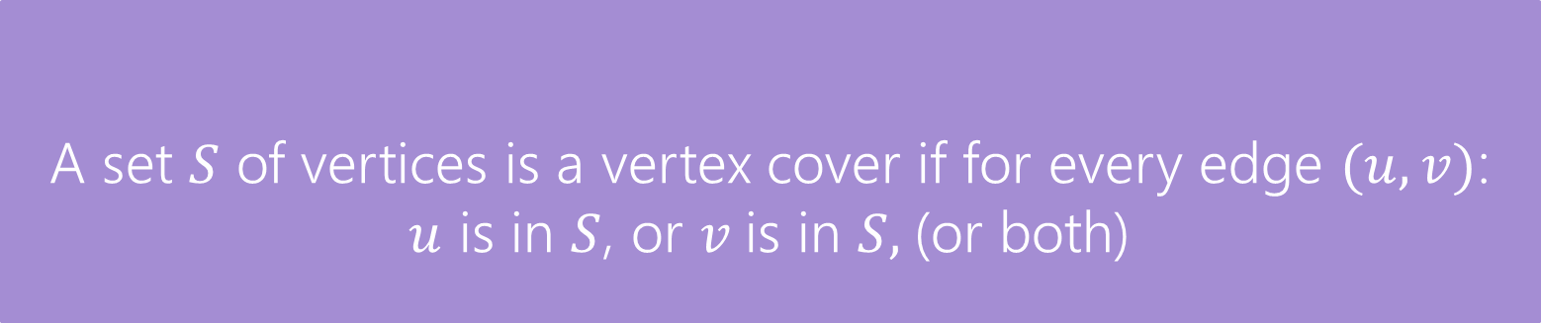
DP on Trees
Find the minimum vertex cover in a tree.
Give every vertex a weight, find the minimum weight vertex cover
Vertex Cover
A set $S$ of vertices is a vertex cover if for every edge $(u,v)$:
$u$ is in $S$, or $v$is in $S,$(or both)
The weight of a vertex cover is just the sum of the weights of the vertices in the set.
We want to find the minimum weight vertex cover.

Slide 32
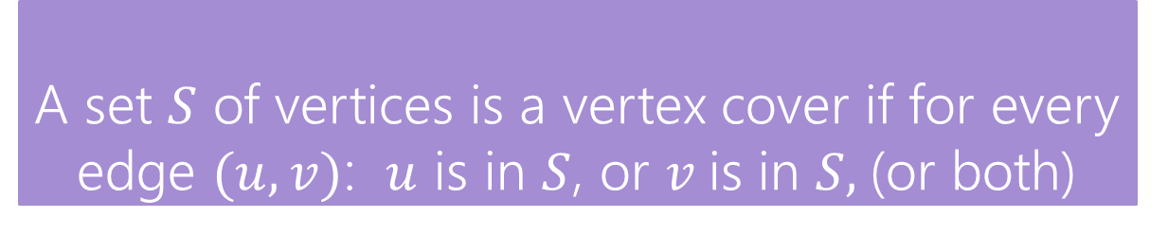
Vertex Cover
Vertex Cover
A set $S$ of vertices is a vertex cover if for every edge $(u,v)$: $u$ is in $S$, or $v$is in $S,$(or both)
Find the minimum vertex cover in a tree.
Give every vertex a weight, find the minimum weight vertex cover
1
10
8
5
3
20

Slide 33
Vertex Cover
Vertex Cover
A set $S$ of vertices is a vertex cover if for every edge $(u,v)$: $u$ is in $S$, or $v$is in $S,$(or both)
Find the minimum vertex cover in a tree.
Give every vertex a weight, find the minimum weight vertex cover
1
10
8
A valid vertex cover! (just take everything)
Definitely not the minimum though.
5
3
20

Slide 34
Vertex Cover
Vertex Cover
A set $S$ of vertices is a vertex cover if for every edge $(u,v)$: $u$ is in $S$, or $v$is in $S,$(or both)
Find the minimum vertex cover in a tree.
Give every vertex a weight, find the minimum weight vertex cover
1
10
8
A better vertex cover – weight 18
5
3
20

Slide 35
Vertex Cover
Vertex Cover
A set $S$ of vertices is a vertex cover if for every edge $(u,v)$: $u$ is in $S$, or $v$is in $S,$(or both)
Find the minimum vertex cover in a tree.
Give every vertex a weight, find the minimum weight vertex cover
1
10
8
The minimum vertex cover: weight 17
5
3
20

Slide 36
Vertex Cover
Vertex Cover
A set $S$ of vertices is a vertex cover if for every edge $(u,v)$: $u$ is in $S$, or $v$is in $S,$(or both)
Notice, the minimum weight vertex cover might have both endpoints of some edges
Even though only one of 1, 8 is required on the edge between them, they are both required for other edges.
1
10
8
5
3
20

Slide 37
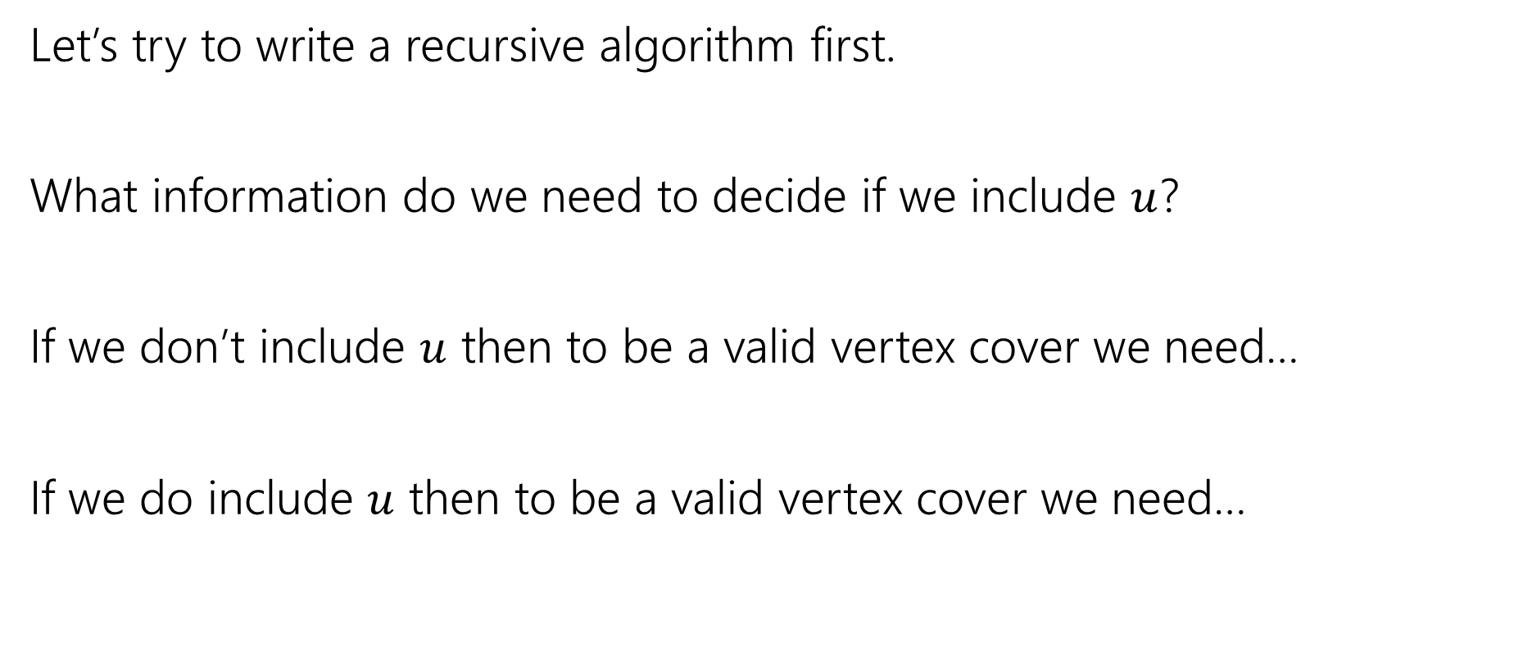
Vertex Cover – Recursively
Let’s try to write a recursive algorithm first.
What information do we need to decide if we include $u$?
If we don’t include $u$ then to be a valid vertex cover we need…
If we do include $u$ then to be a valid vertex cover we need…

Slide 38
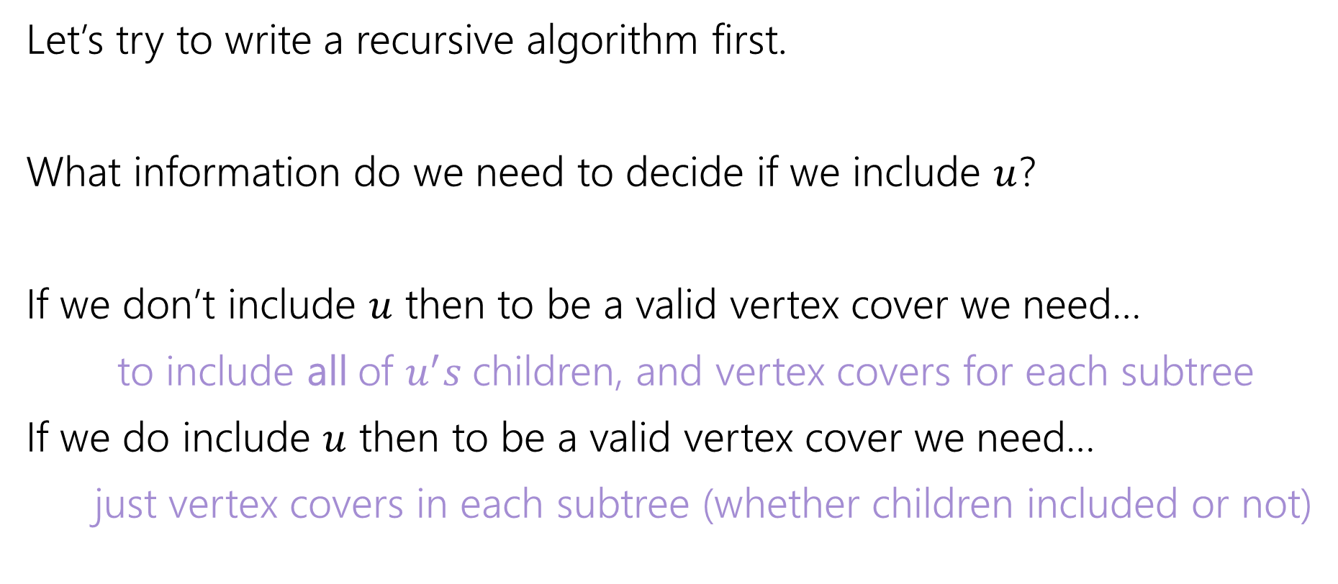
Vertex Cover – Recursively
Let’s try to write a recursive algorithm first.
What information do we need to decide if we include $u$?
If we don’t include $u$ then to be a valid vertex cover we need…
to include all of $u^{′}s$children, and vertex covers for each subtree
If we do include $u$ then to be a valid vertex cover we need…
just vertex covers in each subtree (whether children included or not)

Slide 39

Recurrence
Let $OPT(v)$ be the weight of a minimum weight vertex cover for the subtree rooted at $v$.
Write a recurrence for $OPT()$
Then figure out how to calculate it

Slide 40
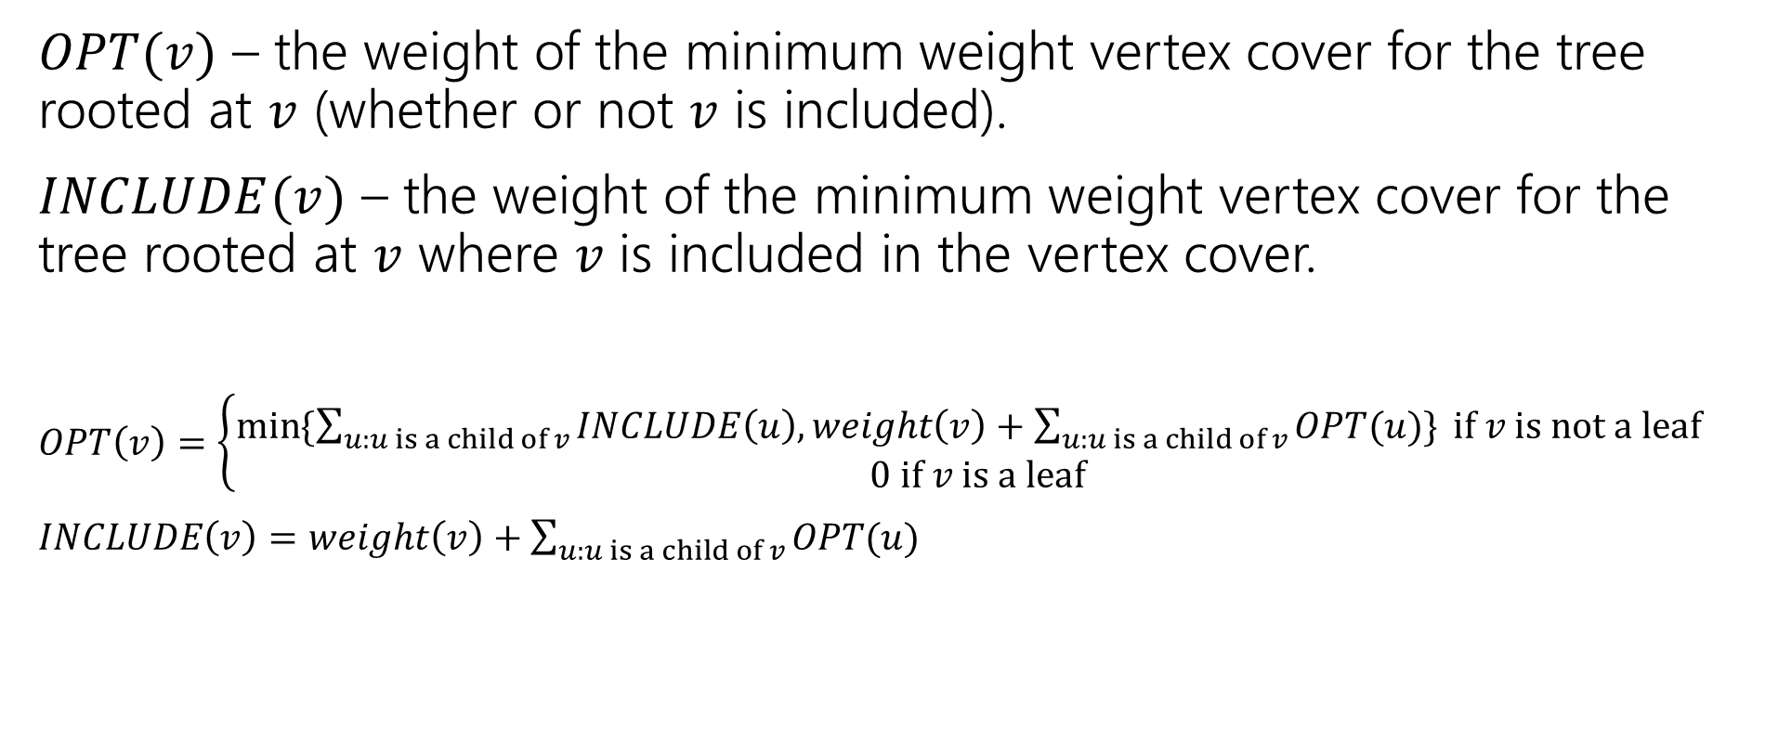
Recurrence
$OPT(v)$ – the weight of the minimum weight vertex cover for the tree rooted at $v$ (whether or not $v$ is included).
$INCLUDE(v)$ – the weight of the minimum weight vertex cover for the tree rooted at $v$ where $v$ is included in the vertex cover.
$OPT\left(v\right)=\left\{\begin{aligned}\min{⁡\{\sum_{u:u is a child of v}{INCLUDE\left(u\right), weight\left(v\right)+\sum_{u:u is a child of v}{OPT(u)\}} if v is not a leaf} } \\ 0 if v is a leaf\end{aligned}\right.$
$INCLUDE\left(v\right)=weight\left(v\right)+\sum_{u:u is a child of v}{OPT(u)}$

Slide 41
Vertex Cover Dynamic Program
What memoization structure should we use?
What code should we write?
What’s the running time?

Slide 42
Vertex Cover Dynamic Program
What memoization structure should we use?
the tree itself!
What code should we write?
What’s the running time?

Slide 43
Vertex Cover
What order do we do the calculation?
1
10
8
5
3
20

Slide 44
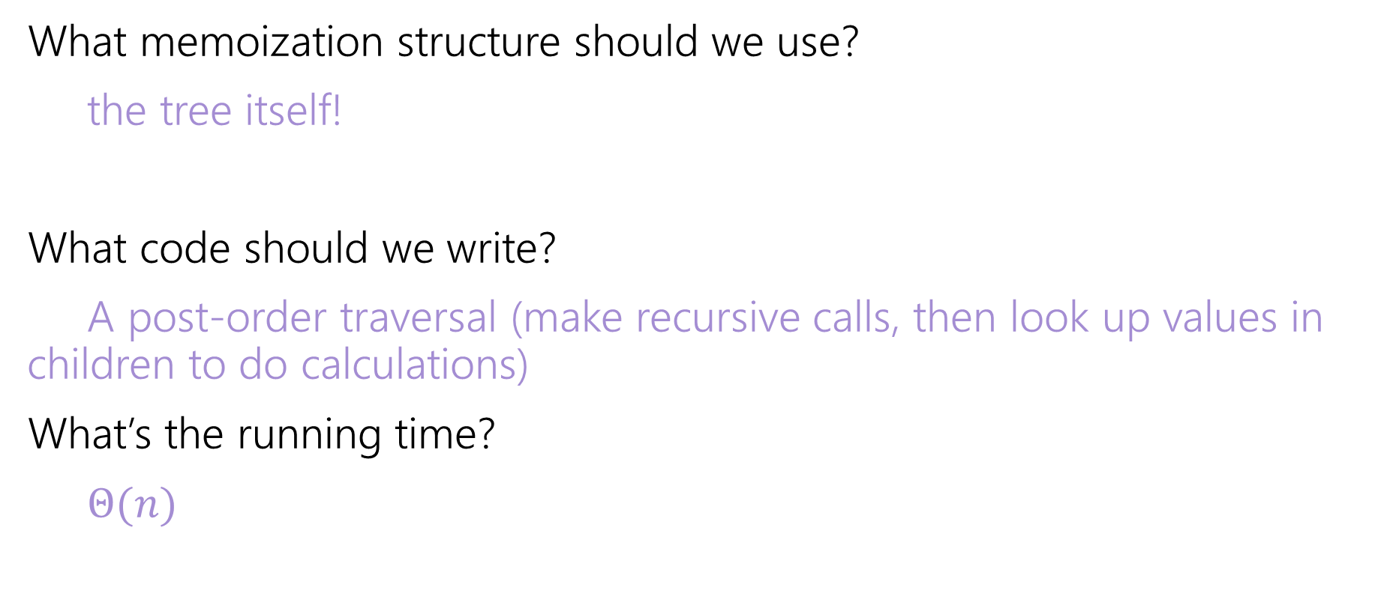
Vertex Cover Dynamic Program
What memoization structure should we use?
the tree itself!
What code should we write?
A post-order traversal (make recursive calls, then look up values in children to do calculations)
What’s the running time?
$Θ(n)$

