Slide 1
DP4 More Arrays and Strings
CSE 421 23Wi
Lecture 13

Slide 2
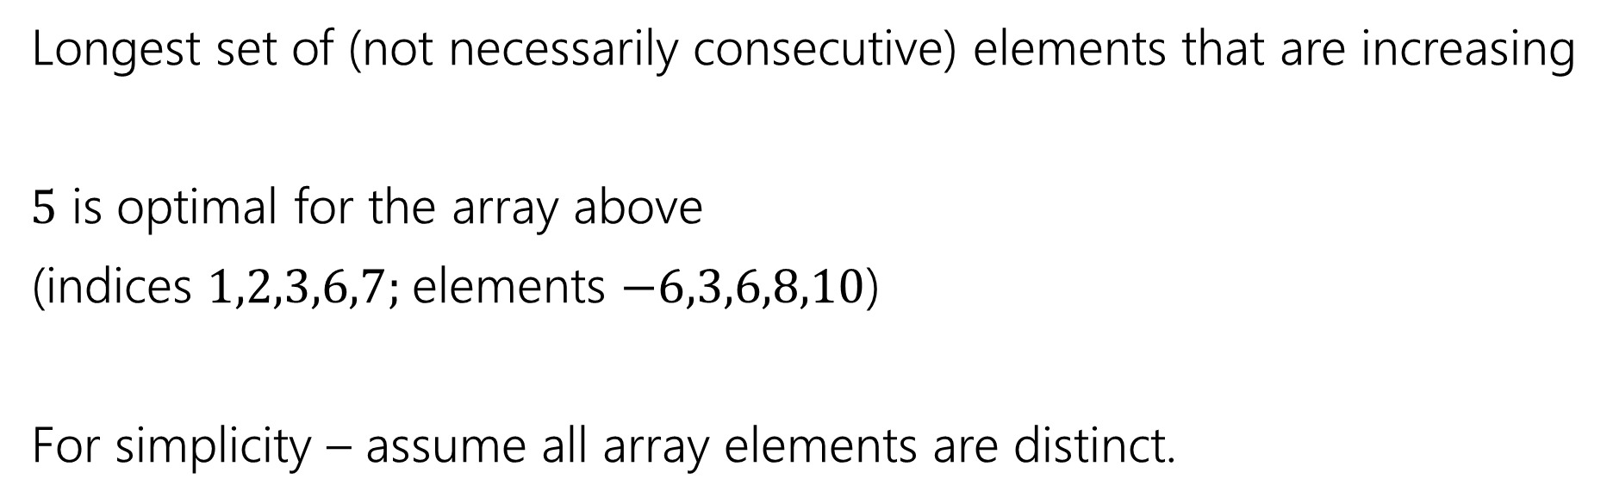
Longest Increasing Subsequence
0 | 1 | 2 | 3 | 4 | 5 | 6 | 7
5 | -6 | 3 | 6 | -5 | 2 | 8 | 10
Longest set of (not necessarily consecutive) elements that are increasing
$5$ is optimal for the array above
(indices $1,2,3,6,7;$elements $−6,3,6,8,10$)
For simplicity – assume all array elements are distinct.

Slide 3

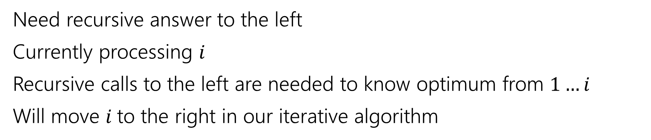
Recurrence
0 | 1 | 2 | 3 | 4 | 5 | 6 | 7
5 | -6 | 3 | 6 | -5 | 2 | 8 | 10
Recursive call is best value in this area
Current $i$
Ignored for now.
Need recursive answer to the left
Currently processing $i$
Recursive calls to the left are needed to know optimum from $1…i$
Will move $i$to the right in our iterative algorithm

Slide 4
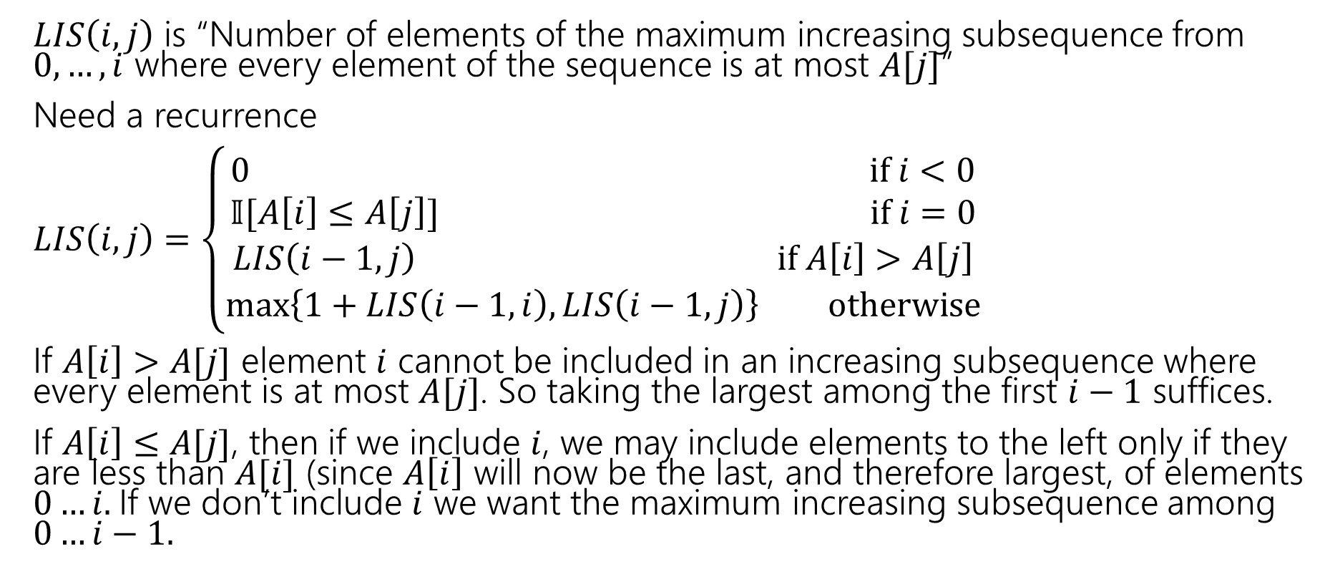
Longest Increasing Subsequence
$LIS\left(i,j\right)$ is “Number of elements of the maximum increasing subsequence from $0,…,i$ where every element of the sequence is at most $A[j]$”
Need a recurrence
$LIS\left(i,j\right)=\left\{\begin{aligned}0 if i<0 \\ 𝕀[A\left[i\right]≤A\left[j\right]] if i=0 \\ LIS\left(i−1,j\right) if A\left[i\right]>A\left[j\right] \\ \max\left\{1+LIS\left(i−1,i\right), LIS\left(i−1,j\right)\right\} otherwise\end{aligned}\right.$
If $A\left[i\right]>A[j]$ element $i$ cannot be included in an increasing subsequence where every element is at most $A[j]$. So taking the largest among the first $i−1$ suffices.
If $A\left[i\right]≤A[j]$, then if we include $i$, we may include elements to the left only if they are less than $A[i]$ (since $A\left[i\right]$ will now be the last, and therefore largest, of elements $0…i.$If we don’t include $i$ we want the maximum increasing subsequence among $0…i−1.$

Slide 5

Longest Increasing Subsequence
$LIS\left(i,j\right)=\left\{\begin{aligned}0 if i<0 \\ 𝕀[A\left[i\right]≤A\left[j\right]] if i=0 \\ LIS\left(i−1,j\right) if A\left[i\right]>A\left[j\right] \\ \max\left\{1+LIS\left(i−1,i\right), LIS\left(i−1,j\right)\right\} otherwise\end{aligned}\right.$
Memoization structure? $n×n$ array.
Filling order?

Slide 6


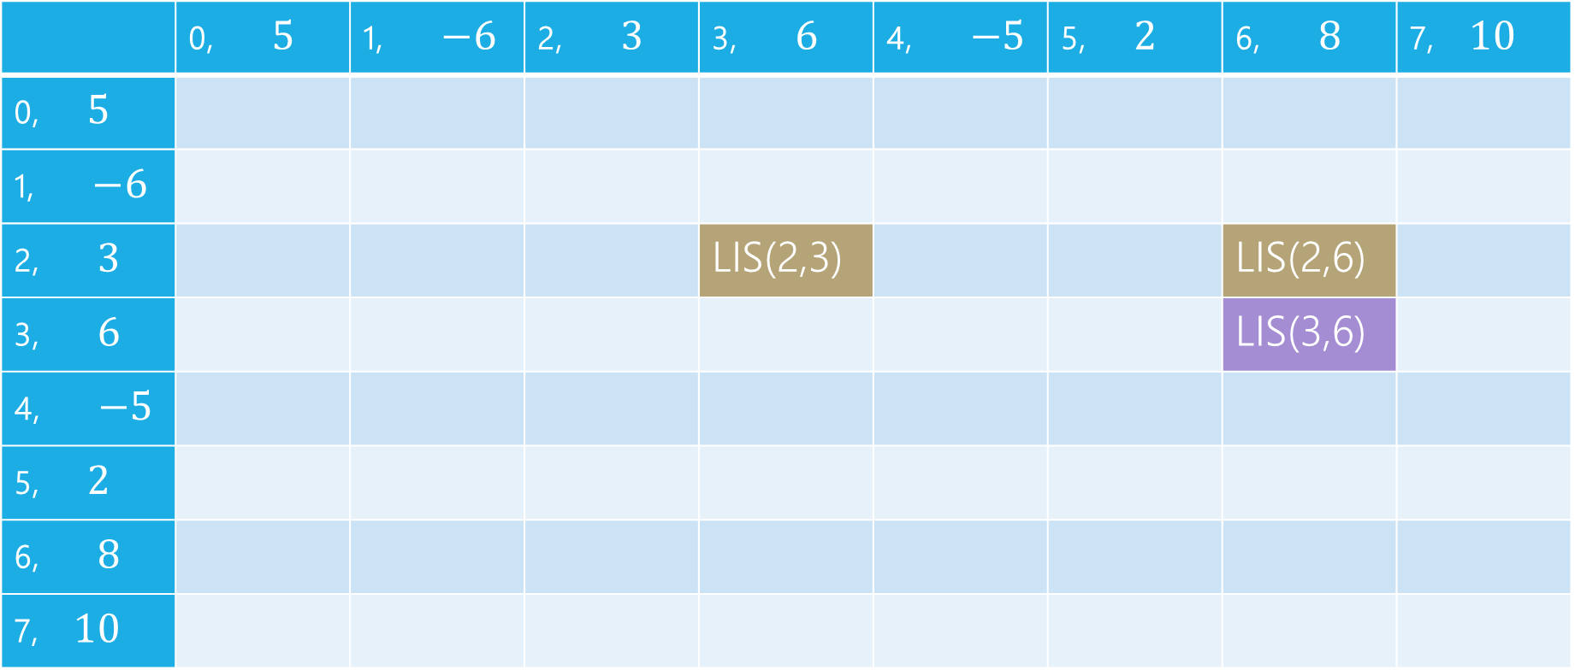

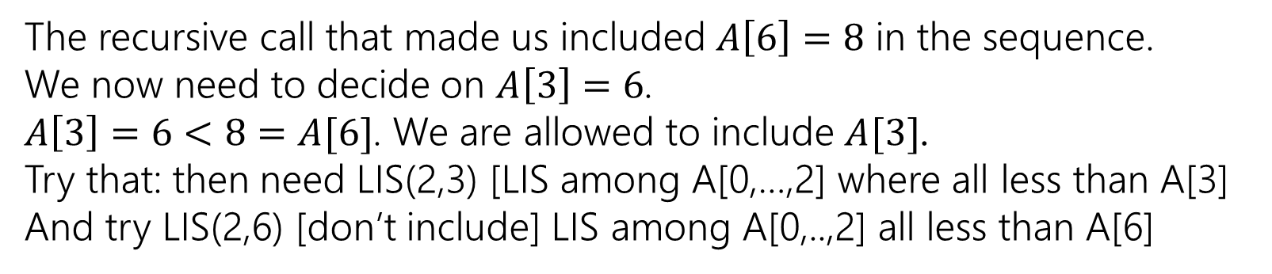
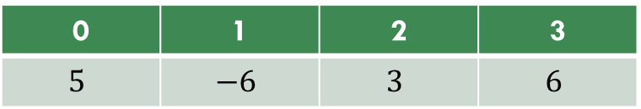

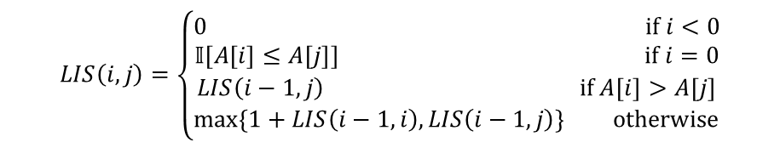
LIS
0 | 1 | 2 | 3
$$5$$ | $$−6$$ | $$3$$ | $$6$$
$$LIS\left(i,j\right)=\left\{\begin{aligned}0 if i<0 \\ 𝕀[A\left[i\right]≤A\left[j\right]] if i=0 \\ LIS\left(i−1,j\right) if A\left[i\right]>A\left[j\right] \\ \max\left\{1+LIS\left(i−1,i\right), LIS\left(i−1,j\right)\right\} otherwise\end{aligned}\right.$$
$$j$$
 | 0, $5$ | 1, $−6$ | 2, $3$ | 3, $6$ | 4, $−5$ | 5, $2$ | 6, $8$ | 7, $10$
0, $5$
1, $−6$
2, $3$ |  |  |  | LIS(2,3) |  |  | LIS(2,6)
3, $6$ |  |  |  |  |  |  | LIS(3,6)
4, $−5$
5, $2$
6, $8$
7, $10$
$$i$$
The recursive call that made us included $A\left[6\right]=8$ in the sequence.
We now need to decide on $A\left[3\right]=6$.
$A\left[3\right]=6<8=A[6]$. We are allowed to include $A[3]$.
Try that: then need LIS(2,3) [LIS among A[0,…,2] where all less than A[3]
And try LIS(2,6) [don’t include] LIS among A[0,..,2] all less than A[6]

Slide 7
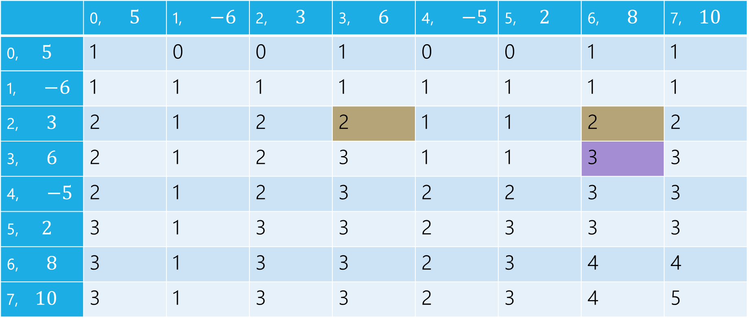
LIS
0 | 1 | 2 | 3
$$5$$ | $$−6$$ | $$3$$ | $$6$$
$$LIS\left(i,j\right)=\left\{\begin{aligned}0 if i<0 \\ 𝕀[A\left[i\right]≤A\left[j\right]] if i=0 \\ LIS\left(i−1,j\right) if A\left[i\right]>A\left[j\right] \\ \max\left\{1+LIS\left(i−1,i\right), LIS\left(i−1,j\right)\right\} otherwise\end{aligned}\right.$$
$$j$$
 | 0, $5$ | 1, $−6$ | 2, $3$ | 3, $6$ | 4, $−5$ | 5, $2$ | 6, $8$ | 7, $10$
0, $5$ | 1 | 0 | 0 | 1 | 0 | 0 | 1 | 1
1, $−6$ | 1 | 1 | 1 | 1 | 1 | 1 | 1 | 1
2, $3$ | 2 | 1 | 2 | 2 | 1 | 1 | 2 | 2
3, $6$ | 2 | 1 | 2 | 3 | 1 | 1 | 3 | 3
4, $−5$ | 2 | 1 | 2 | 3 | 2 | 2 | 3 | 3
5, $2$ | 3 | 1 | 3 | 3 | 2 | 3 | 3 | 3
6, $8$ | 3 | 1 | 3 | 3 | 2 | 3 | 4 | 4
7, $10$ | 3 | 1 | 3 | 3 | 2 | 3 | 4 | 5
$$i$$

Slide 8
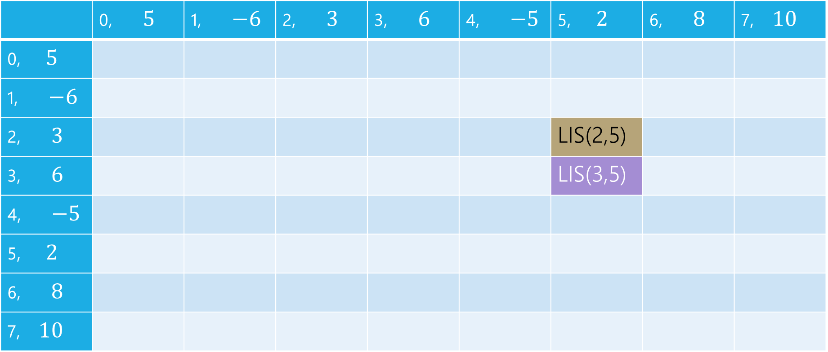
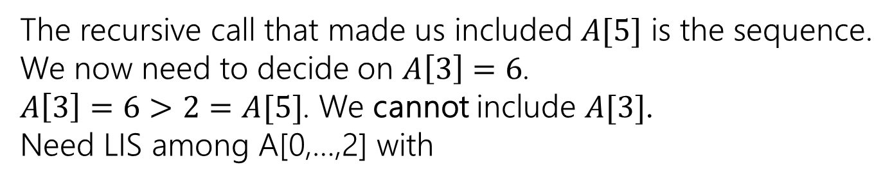
LIS
0 | 1 | 2 | 3
$$5$$ | $$−6$$ | $$3$$ | $$6$$
$$LIS\left(i,j\right)=\left\{\begin{aligned}0 if i<0 \\ 𝕀[A\left[i\right]≤A\left[j\right]] if i=0 \\ LIS\left(i−1,j\right) if A\left[i\right]>A\left[j\right] \\ \max\left\{1+LIS\left(i−1,i\right), LIS\left(i−1,j\right)\right\} otherwise\end{aligned}\right.$$
$$j$$
 | 0, $5$ | 1, $−6$ | 2, $3$ | 3, $6$ | 4, $−5$ | 5, $2$ | 6, $8$ | 7, $10$
0, $5$
1, $−6$
2, $3$ |  |  |  |  |  | LIS(2,5)
3, $6$ |  |  |  |  |  | LIS(3,5)
4, $−5$
5, $2$
6, $8$
7, $10$
$$i$$
The recursive call that made us included $A[5]$ is the sequence.
We now need to decide on $A\left[3\right]=6$.
$A\left[3\right]=6>2=A[5]$. We cannot include $A[3]$.
Need LIS among A[0,…,2] with

Slide 9
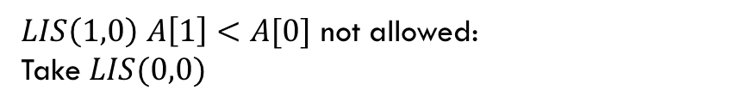
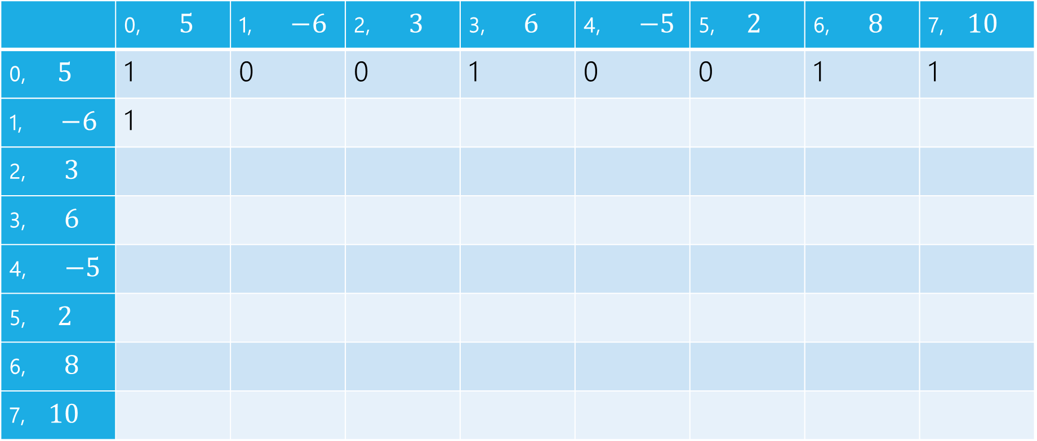
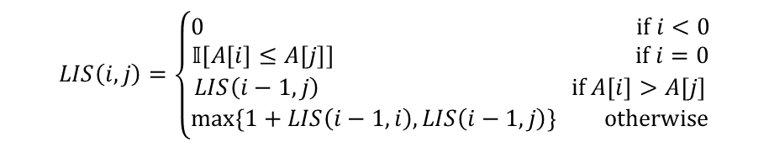
LIS
$LIS\left(1,0\right)$ $A\left[1\right]<A[0]$ not allowed:
Take $LIS(0,0)$
$$LIS\left(i,j\right)=\left\{\begin{aligned}0 if i<0 \\ 𝕀[A\left[i\right]≤A\left[j\right]] if i=0 \\ LIS\left(i−1,j\right) if A\left[i\right]>A\left[j\right] \\ \max\left\{1+LIS\left(i−1,i\right), LIS\left(i−1,j\right)\right\} otherwise\end{aligned}\right.$$
$$j$$
 | 0, $5$ | 1, $−6$ | 2, $3$ | 3, $6$ | 4, $−5$ | 5, $2$ | 6, $8$ | 7, $10$
0, $5$ | 1 | 0 | 0 | 1 | 0 | 0 | 1 | 1
1, $−6$ | 1
2, $3$
3, $6$
4, $−5$
5, $2$
6, $8$
7, $10$
$$i$$

Slide 10

LIS
$LIS\left(1,1\right)$ $A\left[1\right]≤A[1]$ can add, $1+LIS(0,1)$ or $LIS(0,1)$
$$LIS\left(i,j\right)=\left\{\begin{aligned}0 if i<0 \\ 𝕀[A\left[i\right]≤A\left[j\right]] if i=0 \\ LIS\left(i−1,j\right) if A\left[i\right]>A\left[j\right] \\ \max\left\{1+LIS\left(i−1,i\right), LIS\left(i−1,j\right)\right\} otherwise\end{aligned}\right.$$
$$j$$
 | 0, $5$ | 1, $−6$ | 2, $3$ | 3, $6$ | 4, $−5$ | 5, $2$ | 6, $8$ | 7, $10$
0, $5$ | 1 | 0 | 0 | 1 | 0 | 0 | 1 | 1
1, $−6$ | 1 | 1
2, $3$
3, $6$
4, $−5$
5, $2$
6, $8$
7, $10$
$$i$$

Slide 11

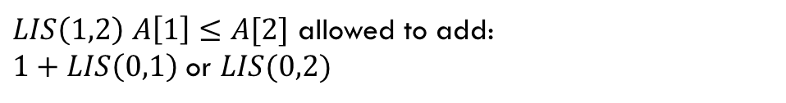
LIS
$LIS\left(1,2\right)$ $A\left[1\right]≤A[2]$ allowed to add:
$1+LIS\left(0,1\right)$ or $LIS(0,2)$
$$LIS\left(i,j\right)=\left\{\begin{aligned}0 if i<0 \\ 𝕀[A\left[i\right]≤A\left[j\right]] if i=0 \\ LIS\left(i−1,j\right) if A\left[i\right]>A\left[j\right] \\ \max\left\{1+LIS\left(i−1,i\right), LIS\left(i−1,j\right)\right\} otherwise\end{aligned}\right.$$
$$j$$
 | 0, $5$ | 1, $−6$ | 2, $3$ | 3, $6$ | 4, $−5$ | 5, $2$ | 6, $8$ | 7, $10$
0, $5$ | 1 | 0 | 0 | 1 | 0 | 0 | 1 | 1
1, $−6$ | 1 | 1 | 1
2, $3$
3, $6$
4, $−5$
5, $2$
6, $8$
7, $10$
$$i$$

Slide 12
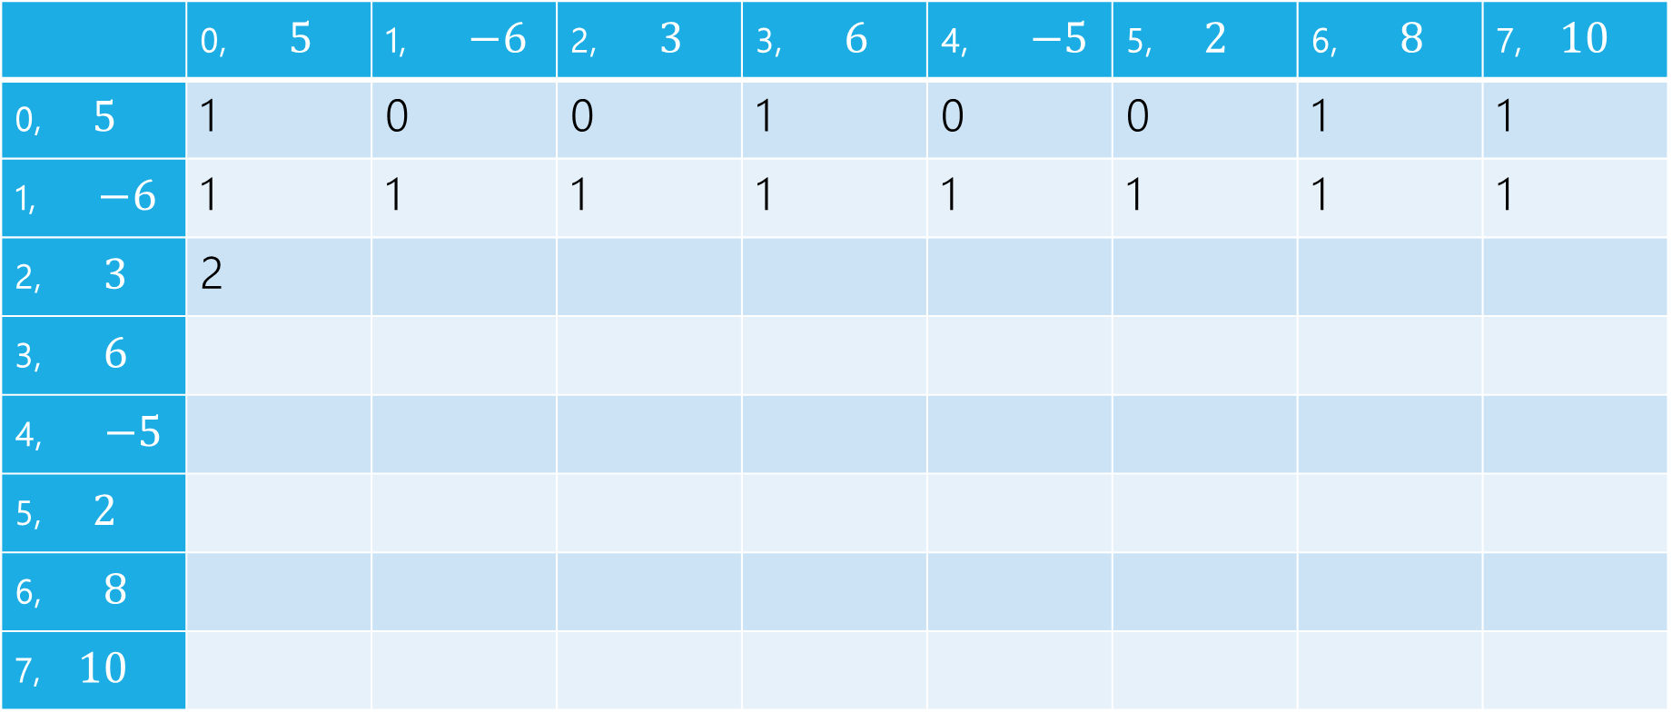
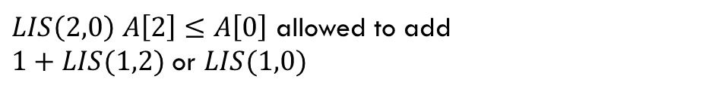
LIS
$LIS\left(2,0\right)$ $A\left[2\right]≤A\left[0\right]$ allowed to add
$1+LIS(1,2)$ or $LIS(1,0)$
$$LIS\left(i,j\right)=\left\{\begin{aligned}0 if i<0 \\ 𝕀[A\left[i\right]≤A\left[j\right]] if i=0 \\ LIS\left(i−1,j\right) if A\left[i\right]>A\left[j\right] \\ \max\left\{1+LIS\left(i−1,i\right), LIS\left(i−1,j\right)\right\} otherwise\end{aligned}\right.$$
$$j$$
 | 0, $5$ | 1, $−6$ | 2, $3$ | 3, $6$ | 4, $−5$ | 5, $2$ | 6, $8$ | 7, $10$
0, $5$ | 1 | 0 | 0 | 1 | 0 | 0 | 1 | 1
1, $−6$ | 1 | 1 | 1 | 1 | 1 | 1 | 1 | 1
2, $3$ | 2
3, $6$
4, $−5$
5, $2$
6, $8$
7, $10$
$$i$$

Slide 13
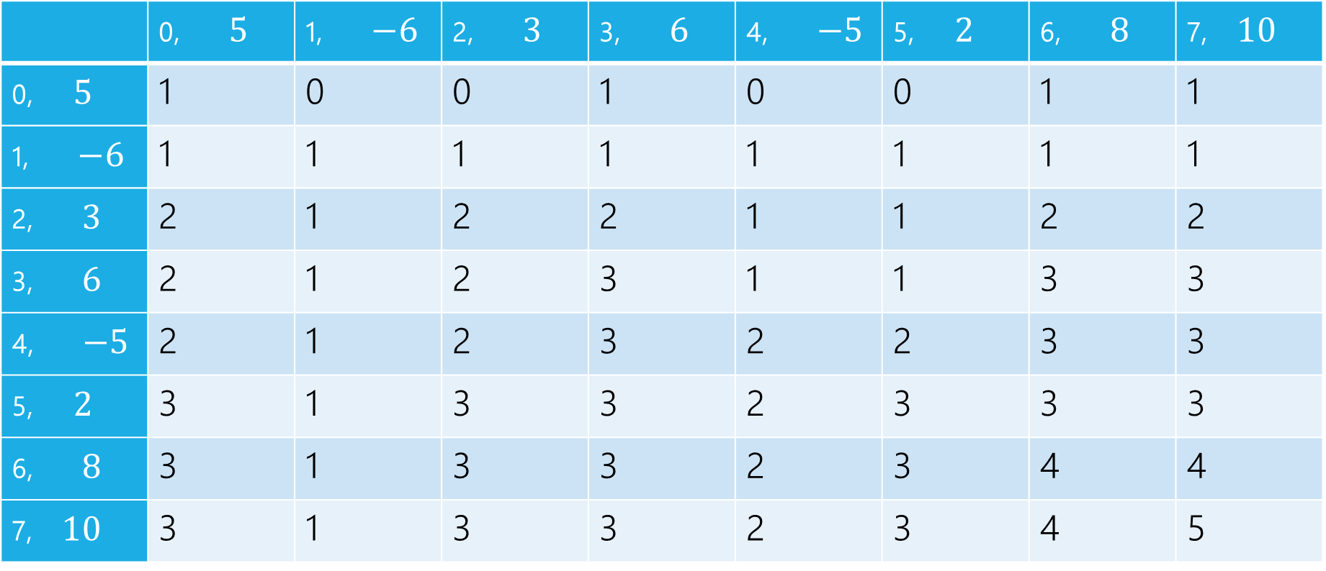
LIS
$$LIS\left(i,j\right)=\left\{\begin{aligned}0 if i<0 \\ 𝕀[A\left[i\right]≤A\left[j\right]] if i=0 \\ LIS\left(i−1,j\right) if A\left[i\right]>A\left[j\right] \\ \max\left\{1+LIS\left(i−1,i\right), LIS\left(i−1,j\right)\right\} otherwise\end{aligned}\right.$$
$$j$$
 | 0, $5$ | 1, $−6$ | 2, $3$ | 3, $6$ | 4, $−5$ | 5, $2$ | 6, $8$ | 7, $10$
0, $5$ | 1 | 0 | 0 | 1 | 0 | 0 | 1 | 1
1, $−6$ | 1 | 1 | 1 | 1 | 1 | 1 | 1 | 1
2, $3$ | 2 | 1 | 2 | 2 | 1 | 1 | 2 | 2
3, $6$ | 2 | 1 | 2 | 3 | 1 | 1 | 3 | 3
4, $−5$ | 2 | 1 | 2 | 3 | 2 | 2 | 3 | 3
5, $2$ | 3 | 1 | 3 | 3 | 2 | 3 | 3 | 3
6, $8$ | 3 | 1 | 3 | 3 | 2 | 3 | 4 | 4
7, $10$ | 3 | 1 | 3 | 3 | 2 | 3 | 4 | 5
$$i$$

Slide 14
pseudocode
//real code snippet that actually generated the table on the last slide
for(int j=0; j < n; j++){
vals[0][j] = (A[0] <= A[j]) ? 1 : 0;
}
for(int i = 1; i < 8; i++){
for(int j = 0; j < n; j++){
if(A[i] > A[j])
vals[i][j] = vals[i-1][j];
else{
vals[i][j] = Math.max(1+vals[i-1][i], vals[i-1][j]);
}
}
}

Slide 15
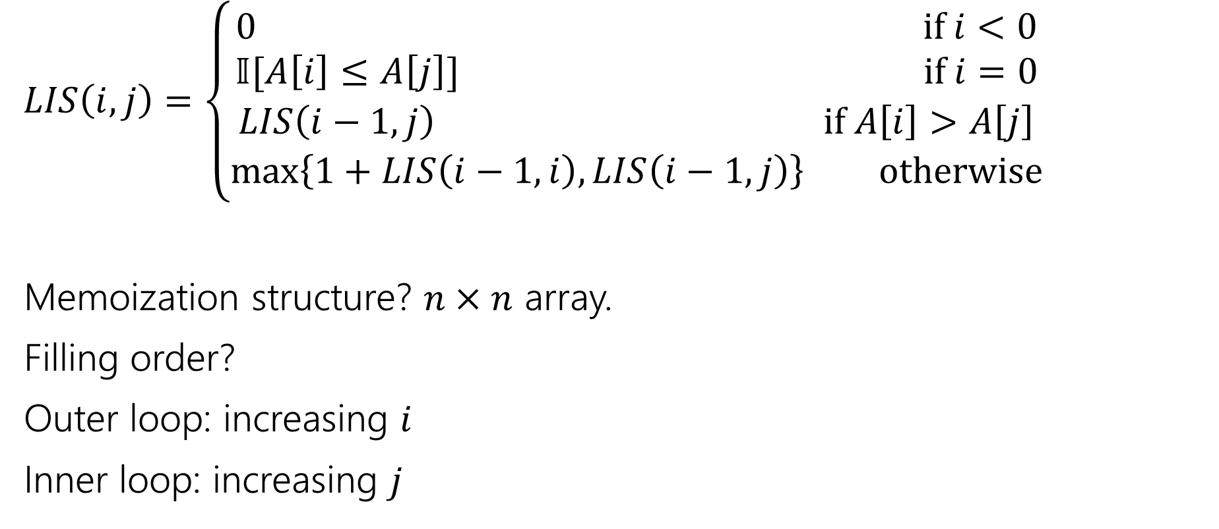
Longest Increasing Subsequence
$LIS\left(i,j\right)=\left\{\begin{aligned}0 if i<0 \\ 𝕀[A\left[i\right]≤A\left[j\right]] if i=0 \\ LIS\left(i−1,j\right) if A\left[i\right]>A\left[j\right] \\ \max\left\{1+LIS\left(i−1,i\right), LIS\left(i−1,j\right)\right\} otherwise\end{aligned}\right.$
Memoization structure? $n×n$ array.
Filling order?
Outer loop: increasing $i$
Inner loop: increasing $j$

Slide 16
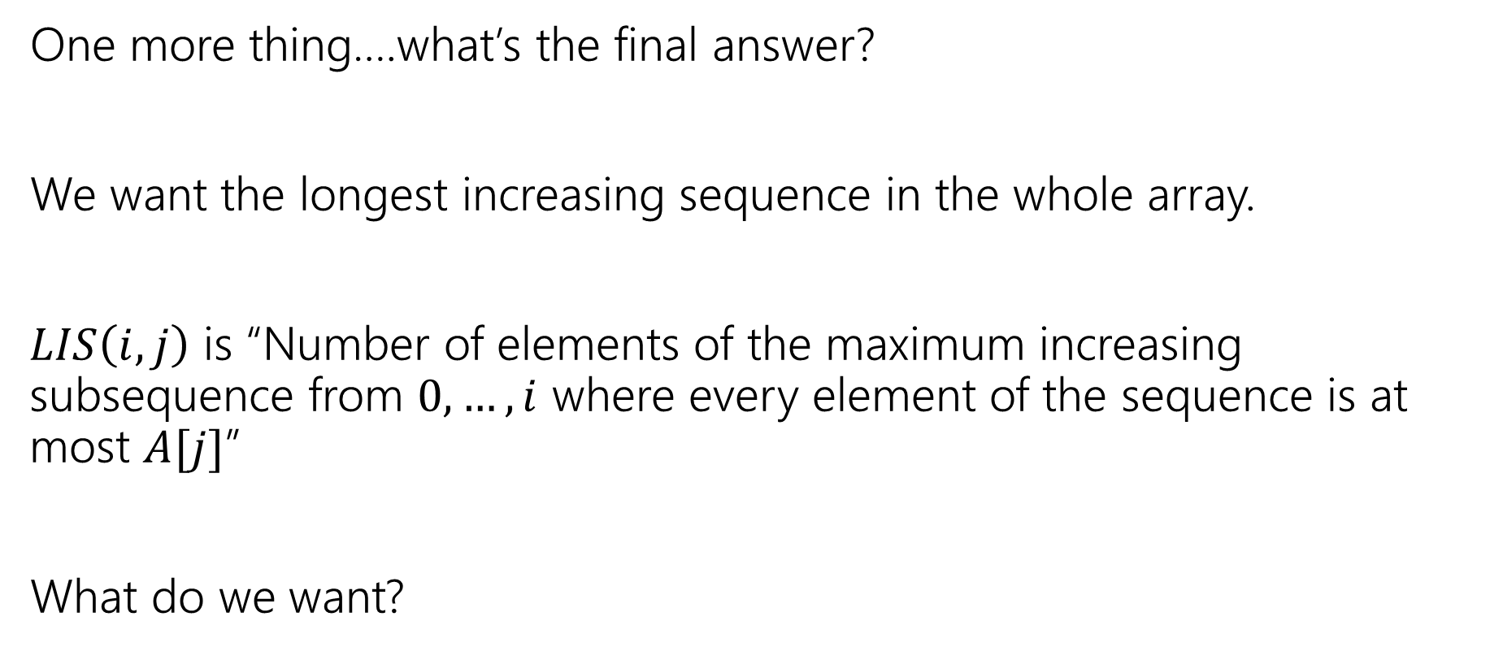
LIS
One more thing….what’s the final answer?
We want the longest increasing sequence in the whole array.
$LIS\left(i,j\right)$ is “Number of elements of the maximum increasing subsequence from $0,…,i$ where every element of the sequence is at most $A[j]$”
What do we want?

Slide 17
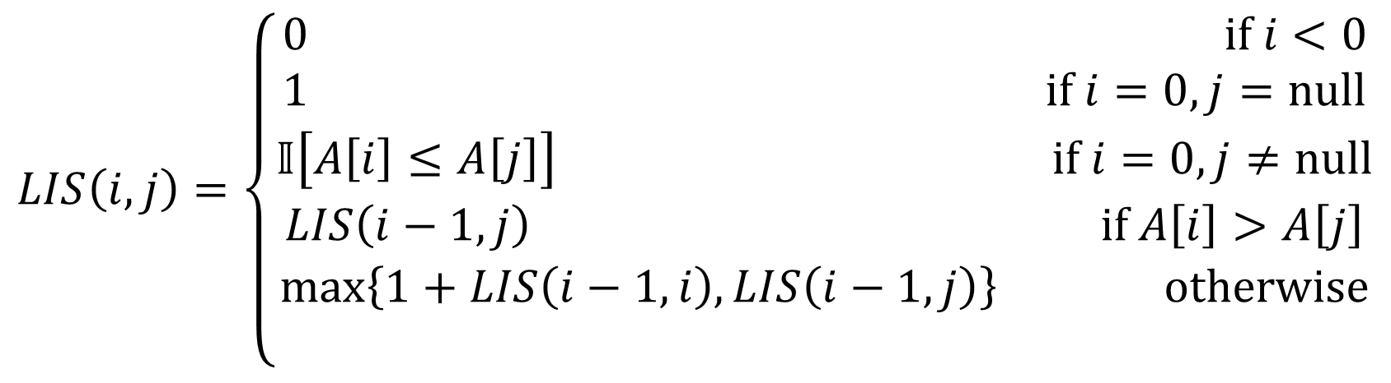

Final Answer (option 1)
The principled approach:
What does $j$ mean? It’s an already added element to our right.
There’s nothing already on our right at the start. In recursive code, we’d probably call $LIS(n,$null$)$. So do that…just tweak the recurrence
$$LIS\left(i,j\right)=\left\{\begin{aligned}0 if i<0 \\ 1 if i=0, j=null \\ 𝕀\left[A\left[i\right]≤A\left[j\right]\right] if i=0,j≠null \\ LIS\left(i−1,j\right) if A\left[i\right]>A\left[j\right] \\ \max\left\{1+LIS\left(i−1,i\right), LIS\left(i−1,j\right)\right\} otherwise \\ \end{aligned}\right.$$

Slide 18
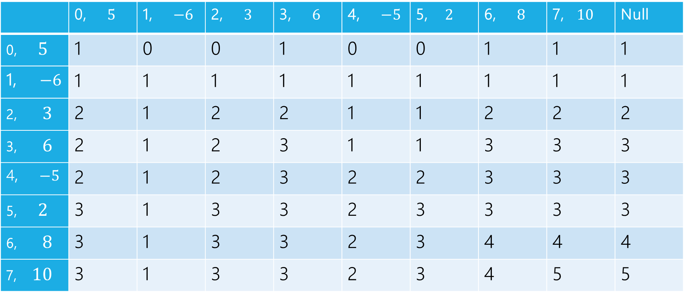
LIS
$$LIS\left(i,j\right)=\left\{\begin{aligned}0 if i<0 \\ 𝕀[A\left[i\right]≤A\left[j\right]] if i=0 \\ LIS\left(i−1,j\right) if A\left[i\right]>A\left[j\right] \\ \max\left\{1+LIS\left(i−1,i\right), LIS\left(i−1,j\right)\right\} otherwise\end{aligned}\right.$$
$$j$$
 | 0, $5$ | 1, $−6$ | 2, $3$ | 3, $6$ | 4, $−5$ | 5, $2$ | 6, $8$ | 7, $10$ | Null
0, $5$ | 1 | 0 | 0 | 1 | 0 | 0 | 1 | 1 | 1
1, $−6$ | 1 | 1 | 1 | 1 | 1 | 1 | 1 | 1 | 1
2, $3$ | 2 | 1 | 2 | 2 | 1 | 1 | 2 | 2 | 2
3, $6$ | 2 | 1 | 2 | 3 | 1 | 1 | 3 | 3 | 3
4, $−5$ | 2 | 1 | 2 | 3 | 2 | 2 | 3 | 3 | 3
5, $2$ | 3 | 1 | 3 | 3 | 2 | 3 | 3 | 3 | 3
6, $8$ | 3 | 1 | 3 | 3 | 2 | 3 | 4 | 4 | 4
7, $10$ | 3 | 1 | 3 | 3 | 2 | 3 | 4 | 5 | 5
$$i$$

Slide 19
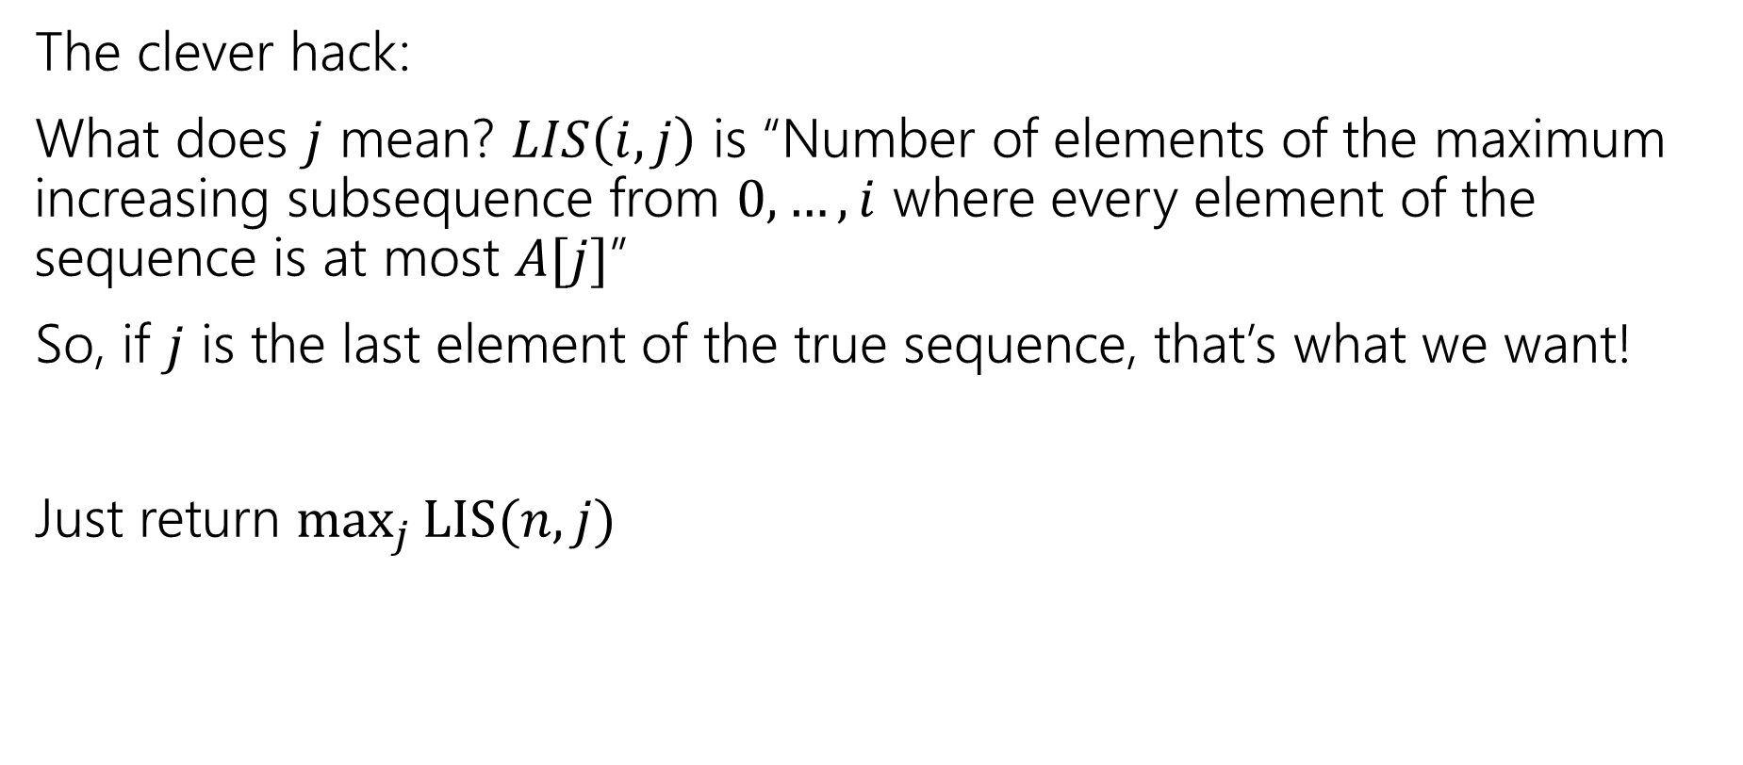
Final Answer (option 2)
The clever hack:
What does $j$ mean? $LIS\left(i,j\right)$ is “Number of elements of the maximum increasing subsequence from $0,…,i$ where every element of the sequence is at most $A[j]$”
So, if $j$ is the last element of the true sequence, that’s what we want!
Just return $\max_{j}{LIS(n,j)}$

Slide 20
LIS
$$LIS\left(i,j\right)=\left\{\begin{aligned}0 if i<0 \\ 𝕀[A\left[i\right]≤A\left[j\right]] if i=0 \\ LIS\left(i−1,j\right) if A\left[i\right]>A\left[j\right] \\ \max\left\{1+LIS\left(i−1,i\right), LIS\left(i−1,j\right)\right\} otherwise\end{aligned}\right.$$
$$j$$
 | 0, $5$ | 1, $−6$ | 2, $3$ | 3, $6$ | 4, $−5$ | 5, $2$ | 6, $8$ | 7, $10$
0, $5$ | 1 | 0 | 0 | 1 | 0 | 0 | 1 | 1
1, $−6$ | 1 | 1 | 1 | 1 | 1 | 1 | 1 | 1
2, $3$ | 2 | 1 | 2 | 2 | 1 | 1 | 2 | 2
3, $6$ | 2 | 1 | 2 | 3 | 1 | 1 | 3 | 3
4, $−5$ | 2 | 1 | 2 | 3 | 2 | 2 | 3 | 3
5, $2$ | 3 | 1 | 3 | 3 | 2 | 3 | 3 | 3
6, $8$ | 3 | 1 | 3 | 3 | 2 | 3 | 4 | 4
7, $10$ | 3 | 1 | 3 | 3 | 2 | 3 | 4 | 5
$$i$$

Slide 21
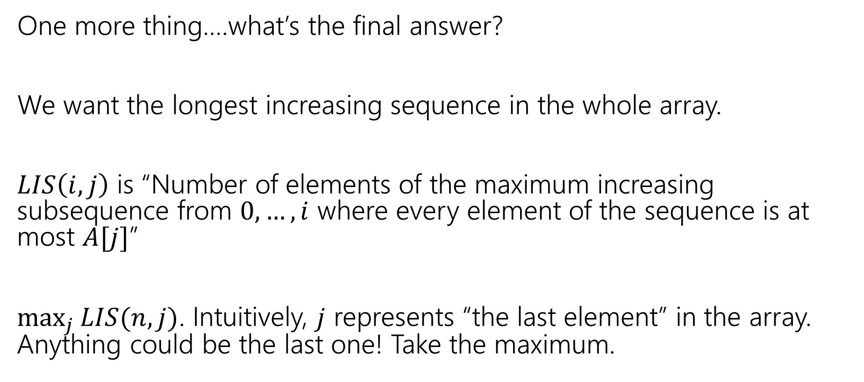
LIS
One more thing….what’s the final answer?
We want the longest increasing sequence in the whole array.
$LIS\left(i,j\right)$ is “Number of elements of the maximum increasing subsequence from $0,…,i$ where every element of the sequence is at most $A[j]$”
$\max_{j}{LIS(n,j)}$. Intuitively, $j$ represents “the last element” in the array. Anything could be the last one! Take the maximum.

Slide 22
Takeaways
Sometimes you need to add an extra recurrence
Or add an extra parameter.
You need to write a recursive function!
That’s all DP is.
But the recursion itself can be tricky.

Slide 23
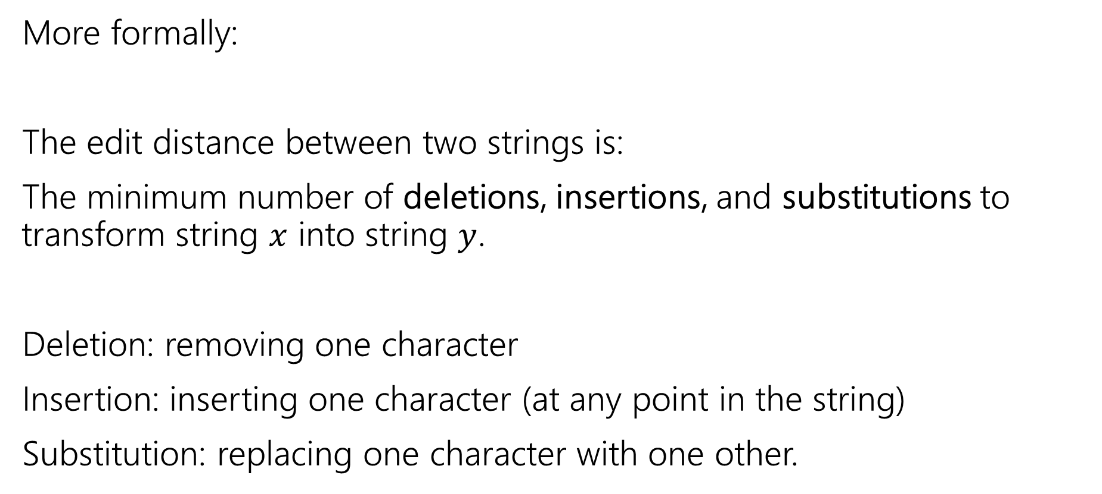
Edit Distance
More formally:
The edit distance between two strings is:
The minimum number of deletions, insertions, and substitutions to transform string $x$ into string $y$.
Deletion: removing one character
Insertion: inserting one character (at any point in the string)
Substitution: replacing one character with one other.

Slide 24
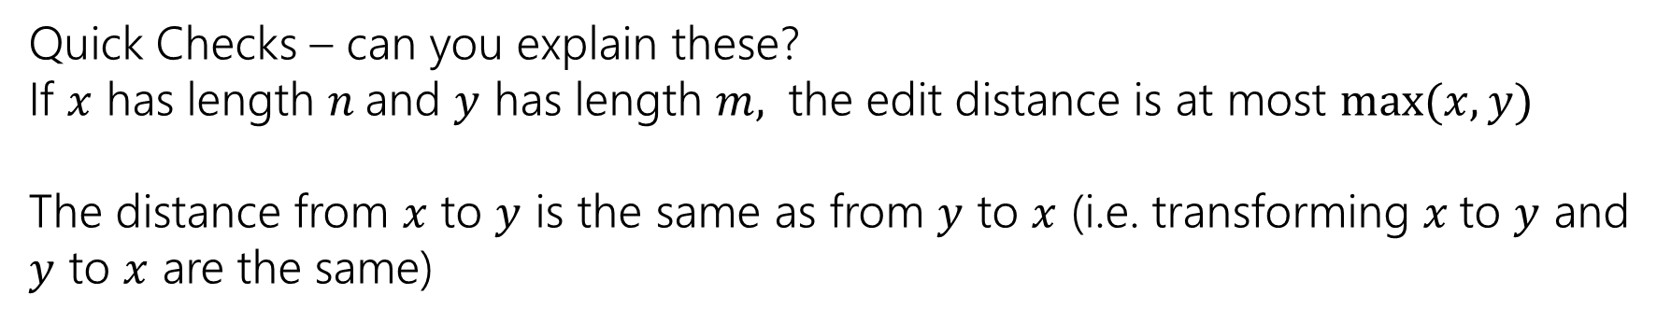
Example
What’s the distance between babyyodas and tastysoda?
B | A | B |  | Y | Y | O | D | A | S
sub |  | sub | ins |  | sub |  |  |  | del
T | A | S | T | Y | S | O | D | A
Distance: 5, one point for each colored box
Quick Checks – can you explain these?
If $x$ has length $n$and $y$ has length $m,$ the edit distance is at most $\max{(x,y)}$
The distance from $x$ to $y$ is the same as from $y$ to $x$ (i.e. transforming $x$to $y$ and $y$ to $x$ are the same)

Slide 25
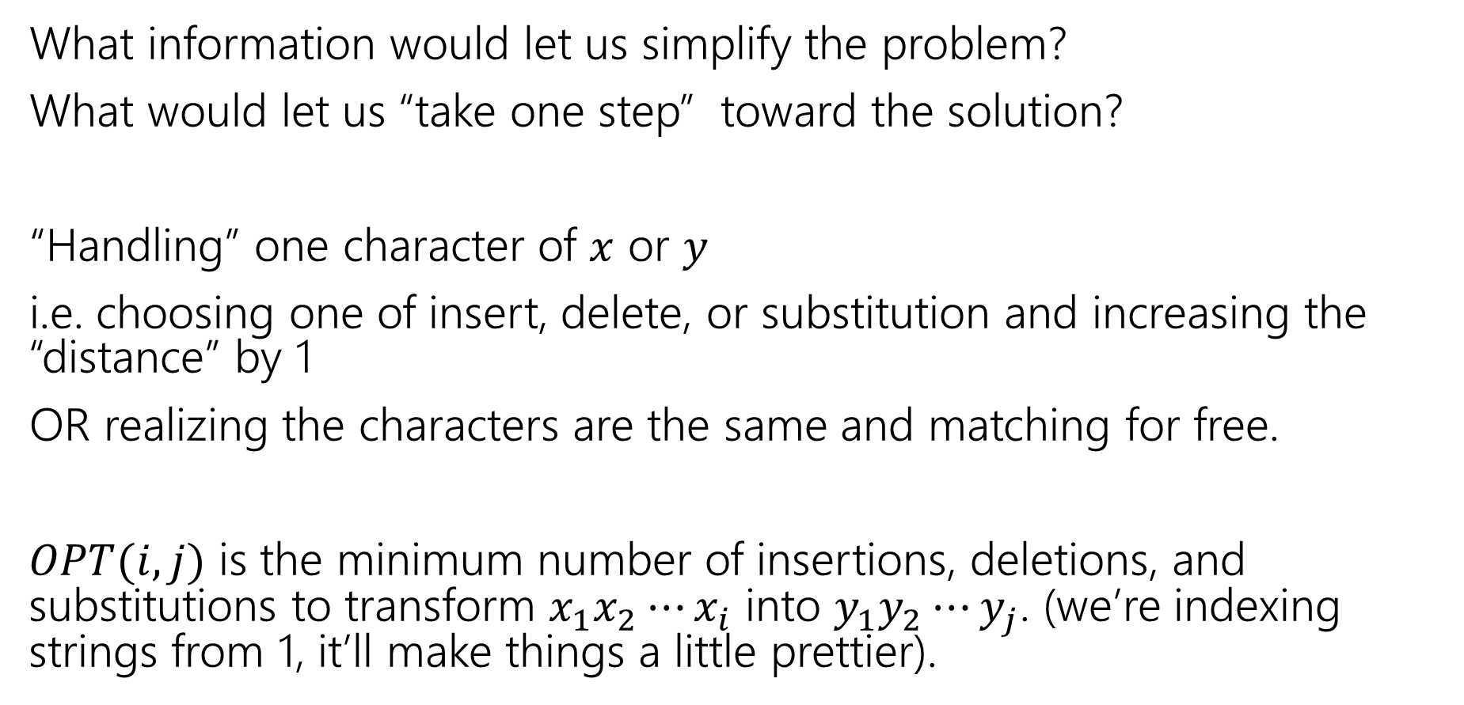
Finding a recurrence
What information would let us simplify the problem?
What would let us “take one step” toward the solution?
“Handling” one character of $x$ or $y$
i.e. choosing one of insert, delete, or substitution and increasing the “distance” by 1
OR realizing the characters are the same and matching for free.
$OPT(i,j)$ is the minimum number of insertions, deletions, and substitutions to transform $x_{1}x_{2}⋯x_{i}$ into $y_{1}y_{2}⋯y_{j}$. (we’re indexing strings from 1, it’ll make things a little prettier).

Slide 26
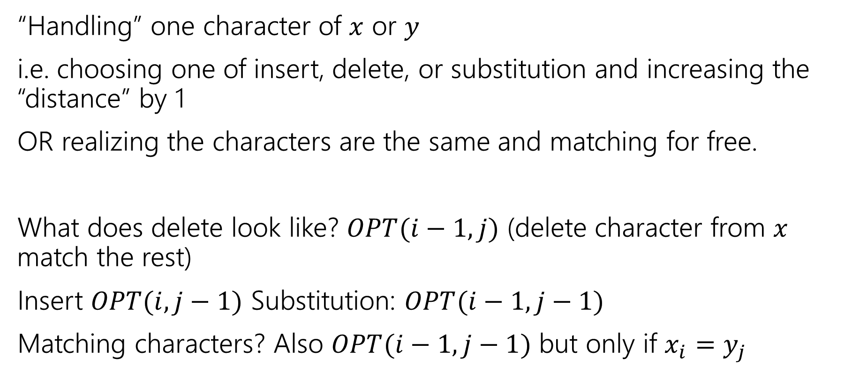
The recurrence
“Handling” one character of $x$ or $y$
i.e. choosing one of insert, delete, or substitution and increasing the “distance” by 1
OR realizing the characters are the same and matching for free.
What does delete look like? $OPT(i−1, j)$ (delete character from $x$ match the rest)
Insert $OPT(i,j−1)$ Substitution: $OPT(i−1,j−1)$
Matching characters? Also $OPT(i−1,j−1)$ but only if $x_{i}=y_{j}$

Slide 27
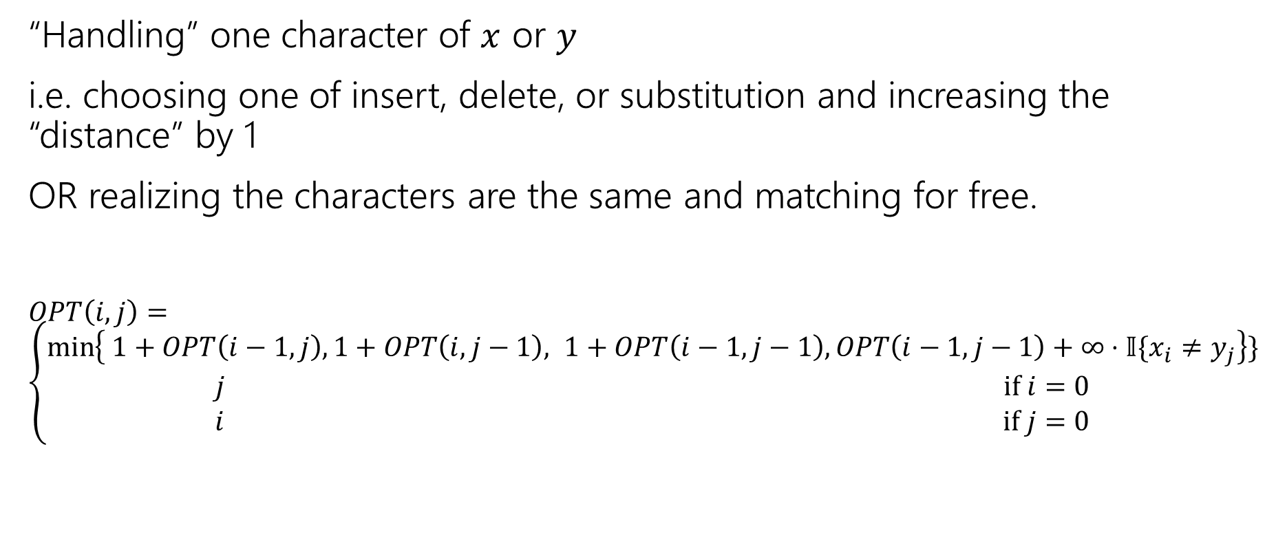
The recurrence (v1, we’ll improve soon)
“Handling” one character of $x$ or $y$
i.e. choosing one of insert, delete, or substitution and increasing the “distance” by 1
OR realizing the characters are the same and matching for free.
$OPT\left(i,j\right)=\left\{\begin{aligned}\min\left\{ 1+OPT\left(i−1,j\right), 1+OPT\left(i,j−1\right), 1+OPT\left(i−1,j−1\right), OPT\left(i−1,j−1\right)+∞⋅𝕀\{x_{i}≠y_{j}\right\}\} \\ j if i=0 \\ i if j=0\end{aligned}\right.$
Delete
Insert
Substitution
TODO: Just Match

Slide 28
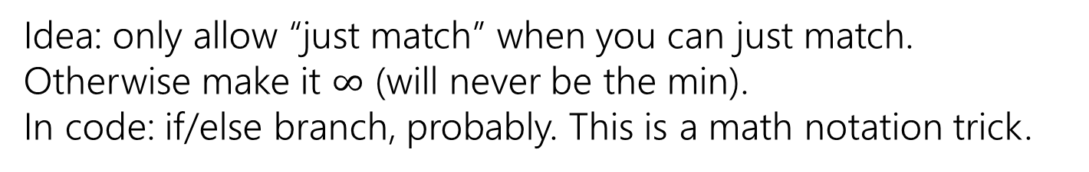
The recurrence (v1, we’ll improve soon)
“Handling” one character of $x$ or $y$
i.e. choosing one of insert, delete, or substitution and increasing the “distance” by 1
OR realizing the characters are the same and matching for free.
$OPT\left(i,j\right)=\left\{\begin{aligned}\min\left\{ 1+OPT\left(i−1,j\right), 1+OPT\left(i,j−1\right), 1+OPT\left(i−1,j−1\right), OPT\left(i−1,j−1\right)+∞⋅𝕀\{x_{i}≠y_{j}\right\}\} \\ j if i=0 \\ i if j=0\end{aligned}\right.$
Delete
Insert
Substitution
Just Match
Idea: only allow “just match” when you can just match. Otherwise make it $∞$ (will never be the min).
In code: if/else branch, probably. This is a math notation trick.
“Indicator” like from 312

Slide 29
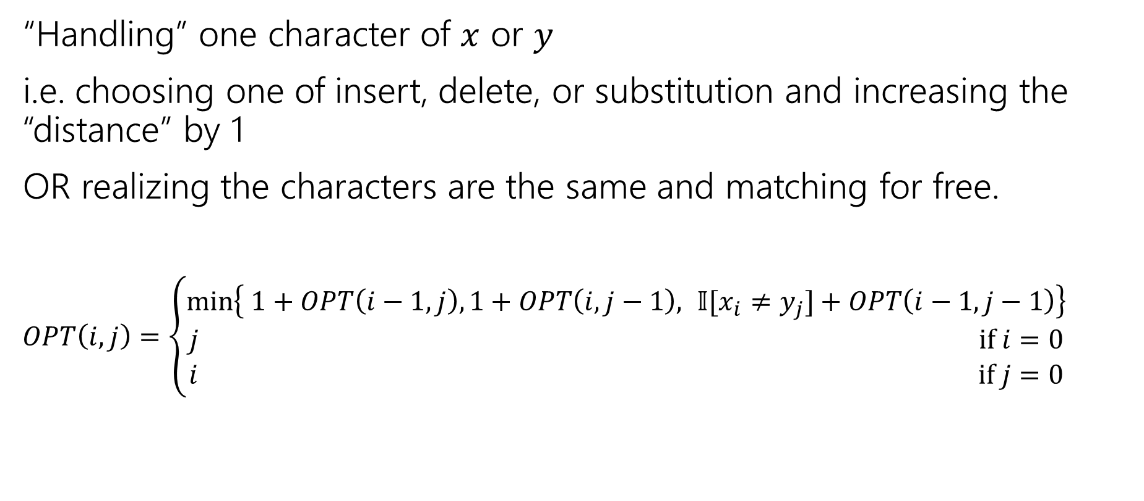
The recurrence
“Handling” one character of $x$ or $y$
i.e. choosing one of insert, delete, or substitution and increasing the “distance” by 1
OR realizing the characters are the same and matching for free.
$OPT\left(i,j\right)=\left\{\begin{aligned}\min\left\{ 1+OPT\left(i−1,j\right), 1+OPT\left(i,j−1\right), 𝕀[x_{i}≠y_{j}]+OPT\left(i−1,j−1\right)\right\} \\ j if i=0 \\ i if j=0\end{aligned}\right.$
Delete
Insert
Sub and matching
When we could match, we will never substitute; matching will always give us a better score! Still have to check delete, insert (those could be better).

Slide 30
The recurrence
“Handling” one character of $x$ or $y$
i.e. choosing one of insert, delete, or substitution and increasing the “distance” by 1
OR realizing the characters are the same and matching for free.
$OPT\left(i,j\right)=\left\{\begin{aligned}\min\left\{ 1+OPT\left(i−1,j\right), 1+OPT\left(i,j−1\right), 𝕀[x_{i}≠y_{j}]+OPT\left(i−1,j−1\right)\right\} \\ j if i=0 \\ i if j=0\end{aligned}\right.$
Delete
Insert
Sub and matching

Slide 31
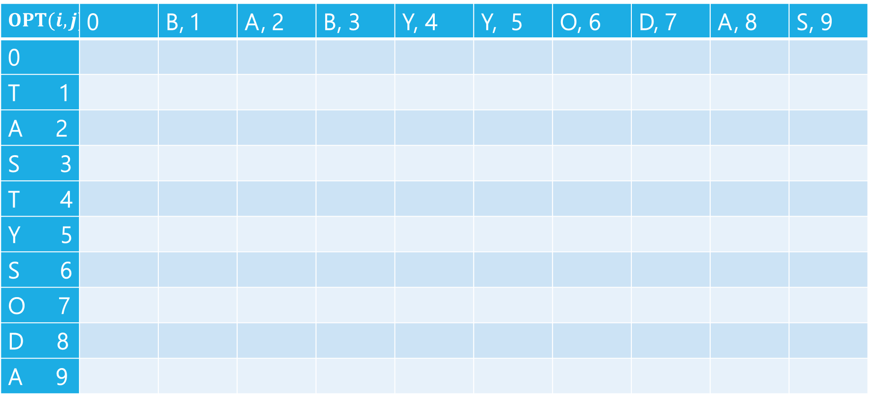
Edit Distance
$$OPT(i,j)$$ | 0 | B, 1 | A, 2 | B, 3 | Y, 4 | Y, 5 | O, 6 | D, 7 | A, 8 | S, 9
0
T 1
A 2
S 3
T 4
Y 5
S 6
O 7
D 8
A 9

Slide 32
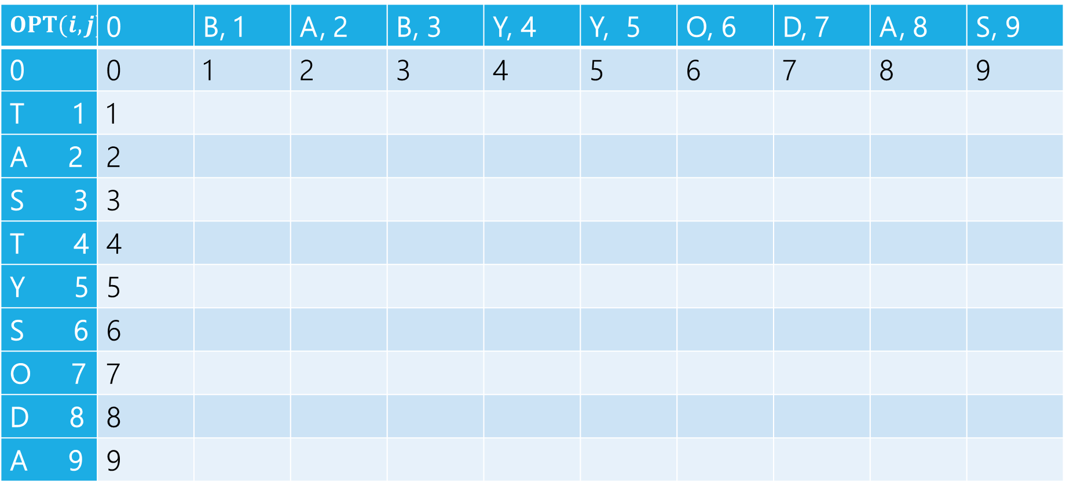
Edit Distance
$$OPT(i,j)$$ | 0 | B, 1 | A, 2 | B, 3 | Y, 4 | Y, 5 | O, 6 | D, 7 | A, 8 | S, 9
0 | 0 | 1 | 2 | 3 | 4 | 5 | 6 | 7 | 8 | 9
T 1 | 1
A 2 | 2
S 3 | 3
T 4 | 4
Y 5 | 5
S 6 | 6
O 7 | 7
D 8 | 8
A 9 | 9

Slide 33
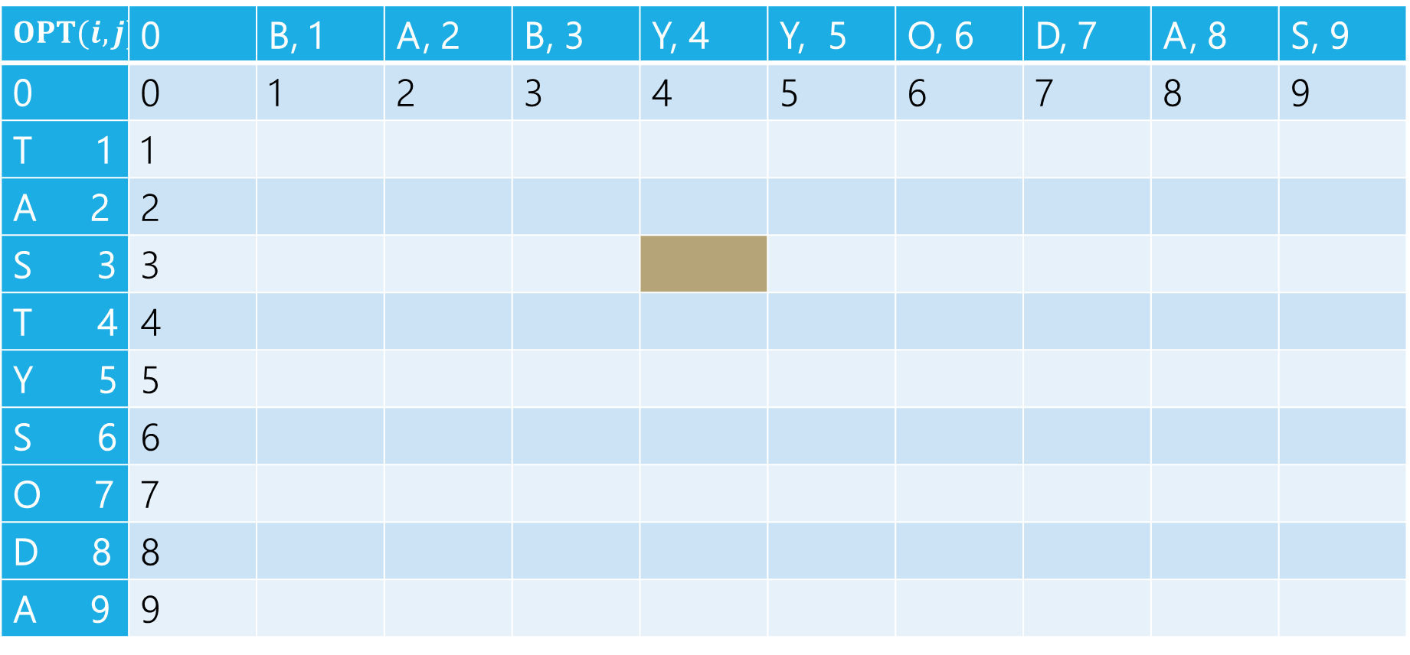
Edit Distance
B | A | B | Y
T | A | S
Current subproblem: edit dist between BABY and TAS
$$OPT(i,j)$$ | 0 | B, 1 | A, 2 | B, 3 | Y, 4 | Y, 5 | O, 6 | D, 7 | A, 8 | S, 9
0 | 0 | 1 | 2 | 3 | 4 | 5 | 6 | 7 | 8 | 9
T 1 | 1
A 2 | 2
S 3 | 3
T 4 | 4
Y 5 | 5
S 6 | 6
O 7 | 7
D 8 | 8
A 9 | 9

Slide 34
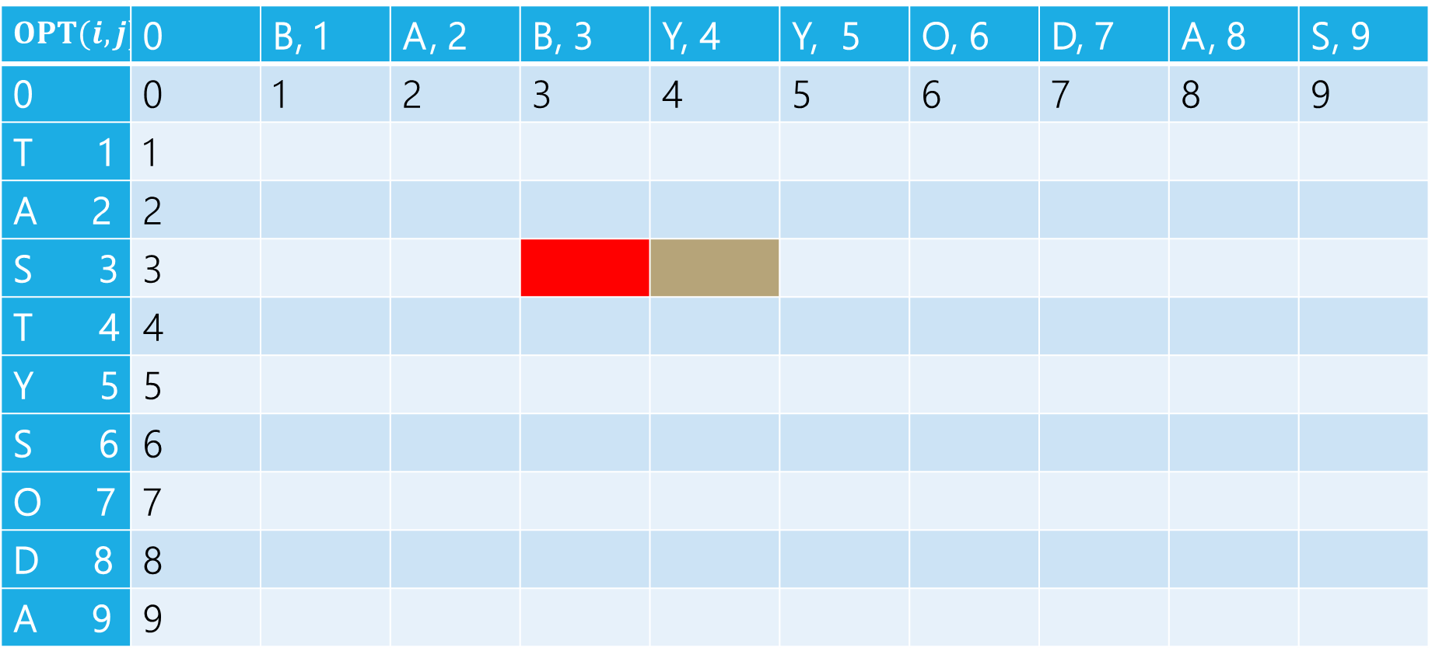
Edit Distance
B | A | B | Y
T | A | S
Delete: get rid of Y (cost 1)
BAB
TAS
$$OPT(i,j)$$ | 0 | B, 1 | A, 2 | B, 3 | Y, 4 | Y, 5 | O, 6 | D, 7 | A, 8 | S, 9
0 | 0 | 1 | 2 | 3 | 4 | 5 | 6 | 7 | 8 | 9
T 1 | 1
A 2 | 2
S 3 | 3
T 4 | 4
Y 5 | 5
S 6 | 6
O 7 | 7
D 8 | 8
A 9 | 9

Slide 35
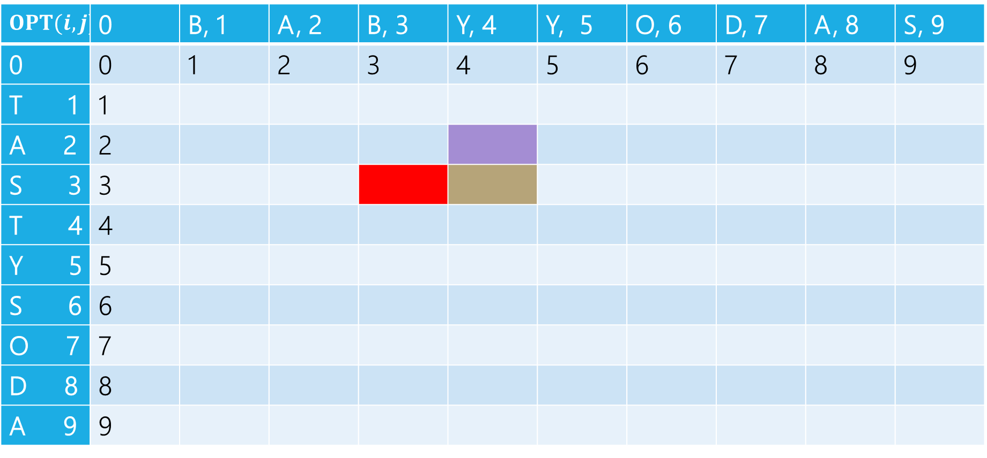
Edit Distance
B | A | B | Y
T | A | S
Insert: insert S (cost 1)
BABY
TA
$$OPT(i,j)$$ | 0 | B, 1 | A, 2 | B, 3 | Y, 4 | Y, 5 | O, 6 | D, 7 | A, 8 | S, 9
0 | 0 | 1 | 2 | 3 | 4 | 5 | 6 | 7 | 8 | 9
T 1 | 1
A 2 | 2
S 3 | 3
T 4 | 4
Y 5 | 5
S 6 | 6
O 7 | 7
D 8 | 8
A 9 | 9

Slide 36
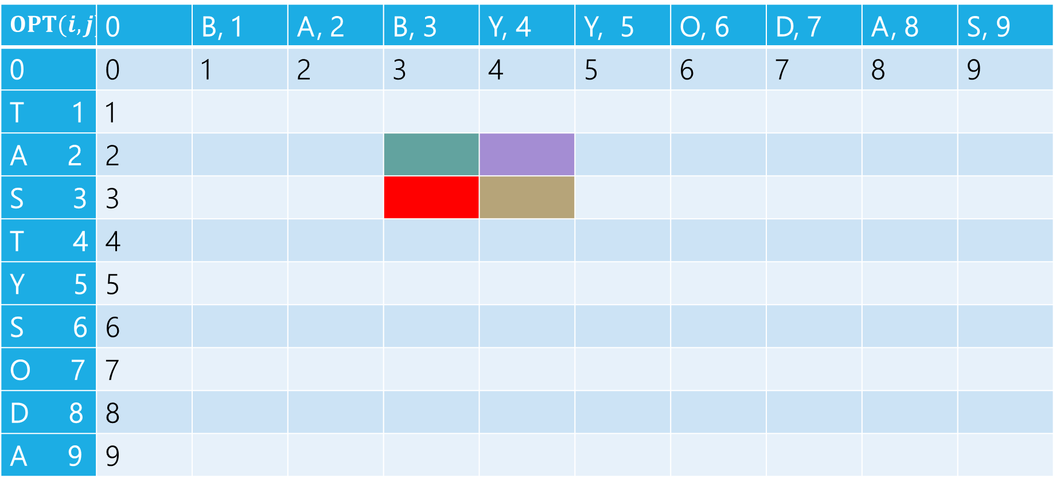
Edit Distance
B | A | B | Y
T | A | S
Sub: Transform Y to S (cost 1)
BAB
TA
$$OPT(i,j)$$ | 0 | B, 1 | A, 2 | B, 3 | Y, 4 | Y, 5 | O, 6 | D, 7 | A, 8 | S, 9
0 | 0 | 1 | 2 | 3 | 4 | 5 | 6 | 7 | 8 | 9
T 1 | 1
A 2 | 2
S 3 | 3
T 4 | 4
Y 5 | 5
S 6 | 6
O 7 | 7
D 8 | 8
A 9 | 9

Slide 37
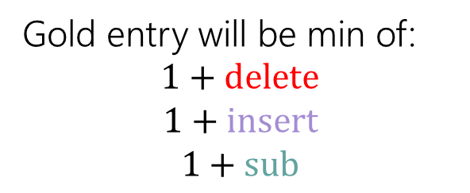
Edit Distance
Gold entry will be min of:
$$1+delete$$
$$1+insert$$
$$1+sub$$
B | A | B | Y
T | A | S
$$OPT(i,j)$$ | 0 | B, 1 | A, 2 | B, 3 | Y, 4 | Y, 5 | O, 6 | D, 7 | A, 8 | S, 9
0 | 0 | 1 | 2 | 3 | 4 | 5 | 6 | 7 | 8 | 9
T 1 | 1
A 2 | 2
S 3 | 3
T 4 | 4
Y 5 | 5
S 6 | 6
O 7 | 7
D 8 | 8
A 9 | 9

Slide 38
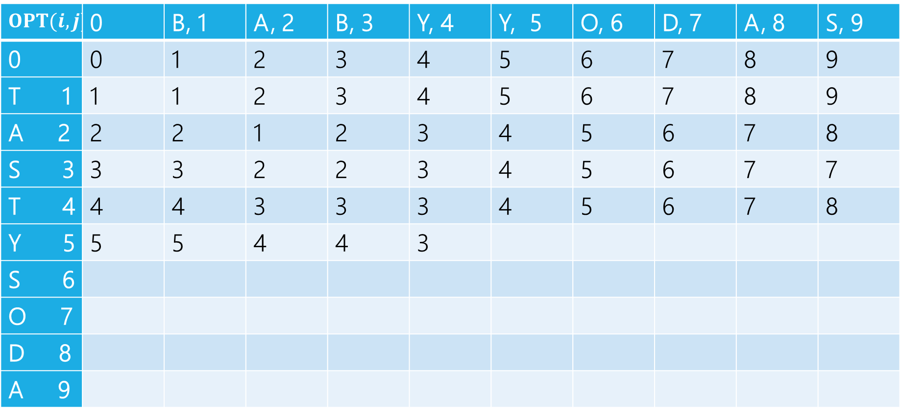

Edit Distance
$$1+2$$
$$1+3$$
$$1+2$$
Min: $3$
Gold entry will be min of:
$$1+delete$$
$$1+insert$$
$$1+sub$$
$$OPT(i,j)$$ | 0 | B, 1 | A, 2 | B, 3 | Y, 4 | Y, 5 | O, 6 | D, 7 | A, 8 | S, 9
0 | 0 | 1 | 2 | 3 | 4 | 5 | 6 | 7 | 8 | 9
T 1 | 1 | 1 | 2 | 3 | 4 | 5 | 6 | 7 | 8 | 9
A 2 | 2 | 2 | 1 | 2 | 3 | 4 | 5 | 6 | 7 | 8
S 3 | 3 | 3 | 2 | 2 | 3 | 4 | 5 | 6 | 7 | 7
T 4 | 4 | 4 | 3 | 3 | 3 | 4 | 5 | 6 | 7 | 8
Y 5 | 5 | 5 | 4 | 4 | 3
S 6
O 7
D 8
A 9

Slide 39
Edit Distance
Fill in the next two entries. Be careful with the sub/match distinction!
$$OPT(i,j)$$ | 0 | B, 1 | A, 2 | B, 3 | Y, 4 | Y, 5 | O, 6 | D, 7 | A, 8 | S, 9
0 | 0 | 1 | 2 | 3 | 4 | 5 | 6 | 7 | 8 | 9
T 1 | 1 | 1 | 2 | 3 | 4 | 5 | 6 | 7 | 8 | 9
A 2 | 2 | 2 | 1 | 2 | 3 | 4 | 5 | 6 | 7 | 8
S 3 | 3 | 3 | 2 | 2 | 3 | 4 | 5 | 6 | 7 | 7
T 4 | 4 | 4 | 3 | 3 | 3 | 4 | 5 | 6 | 7 | 8
Y 5 | 5 | 5 | 4 | 4 | 3
S 6
O 7
D 8
A 9

Slide 40
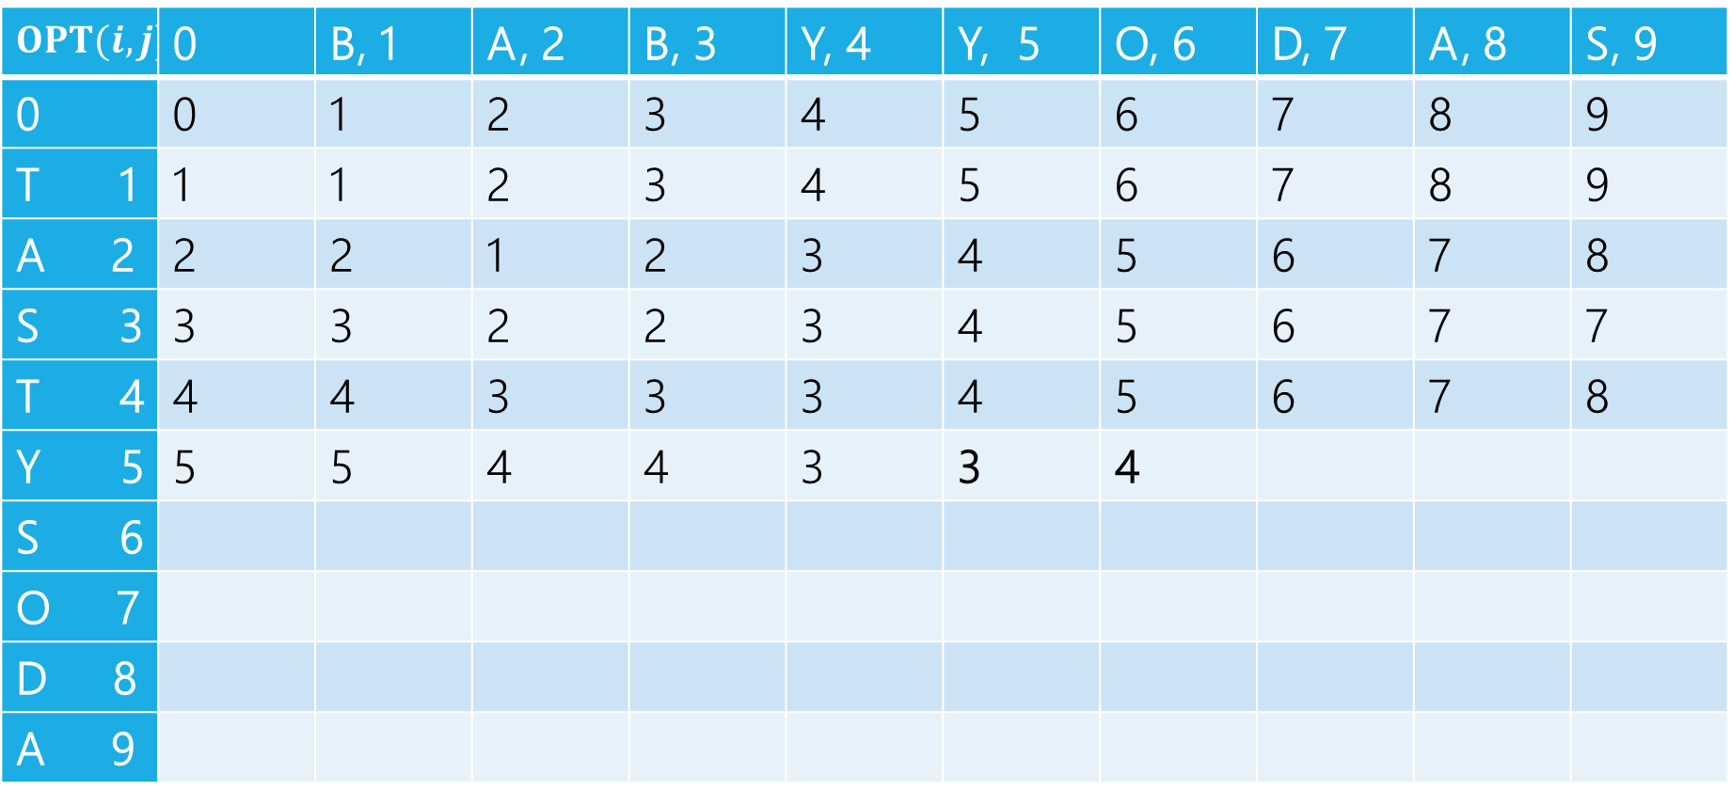
Edit Distance
Fill in the next two entries. Be careful with the sub/match distinction!
$$OPT(i,j)$$ | 0 | B, 1 | A, 2 | B, 3 | Y, 4 | Y, 5 | O, 6 | D, 7 | A, 8 | S, 9
0 | 0 | 1 | 2 | 3 | 4 | 5 | 6 | 7 | 8 | 9
T 1 | 1 | 1 | 2 | 3 | 4 | 5 | 6 | 7 | 8 | 9
A 2 | 2 | 2 | 1 | 2 | 3 | 4 | 5 | 6 | 7 | 8
S 3 | 3 | 3 | 2 | 2 | 3 | 4 | 5 | 6 | 7 | 7
T 4 | 4 | 4 | 3 | 3 | 3 | 4 | 5 | 6 | 7 | 8
Y 5 | 5 | 5 | 4 | 4 | 3 | 3 | 4
S 6
O 7
D 8
A 9
Y’s match, so sub is free!

Slide 41
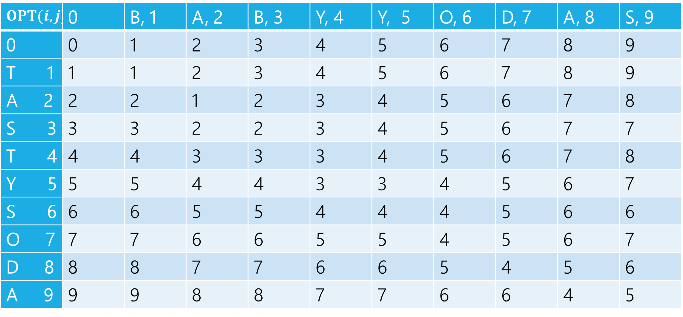
Edit Distance
$$OPT(i,j)$$ | 0 | B, 1 | A, 2 | B, 3 | Y, 4 | Y, 5 | O, 6 | D, 7 | A, 8 | S, 9
0 | 0 | 1 | 2 | 3 | 4 | 5 | 6 | 7 | 8 | 9
T 1 | 1 | 1 | 2 | 3 | 4 | 5 | 6 | 7 | 8 | 9
A 2 | 2 | 2 | 1 | 2 | 3 | 4 | 5 | 6 | 7 | 8
S 3 | 3 | 3 | 2 | 2 | 3 | 4 | 5 | 6 | 7 | 7
T 4 | 4 | 4 | 3 | 3 | 3 | 4 | 5 | 6 | 7 | 8
Y 5 | 5 | 5 | 4 | 4 | 3 | 3 | 4 | 5 | 6 | 7
S 6 | 6 | 6 | 5 | 5 | 4 | 4 | 4 | 5 | 6 | 6
O 7 | 7 | 7 | 6 | 6 | 5 | 5 | 4 | 5 | 6 | 7
D 8 | 8 | 8 | 7 | 7 | 6 | 6 | 5 | 4 | 5 | 6
A 9 | 9 | 9 | 8 | 8 | 7 | 7 | 6 | 6 | 4 | 5

Slide 42
Edit Distance – what operations?
$$OPT(i,j)$$ | 0 | B, 1 | A, 2 | B, 3 | Y, 4 | Y, 5 | O, 6 | D, 7 | A, 8 | S, 9
0 | 0 | 1 | 2 | 3 | 4 | 5 | 6 | 7 | 8 | 9
T 1 | 1 | 1 | 2 | 3 | 4 | 5 | 6 | 7 | 8 | 9
A 2 | 2 | 2 | 1 | 2 | 3 | 4 | 5 | 6 | 7 | 8
S 3 | 3 | 3 | 2 | 2 | 3 | 4 | 5 | 6 | 7 | 7
T 4 | 4 | 4 | 3 | 3 | 3 | 4 | 5 | 6 | 7 | 8
Y 5 | 5 | 5 | 4 | 4 | 3 | 3 | 4 | 5 | 6 | 7
S 6 | 6 | 6 | 5 | 5 | 4 | 4 | 4 | 5 | 6 | 6
O 7 | 7 | 7 | 6 | 6 | 5 | 5 | 4 | 5 | 6 | 7
D 8 | 8 | 8 | 7 | 7 | 6 | 6 | 5 | 4 | 5 | 6
A 9 | 9 | 9 | 8 | 8 | 7 | 7 | 6 | 6 | 4 | 5

Slide 43
Edit Distance – what operations?
$$OPT(i,j)$$ | 0 | B, 1 | A, 2 | B, 3 | Y, 4 | Y, 5 | O, 6 | D, 7 | A, 8 | S, 9
0 | 0 | 1 | 2 | 3 | 4 | 5 | 6 | 7 | 8 | 9
T 1 | 1 | 1 | 2 | 3 | 4 | 5 | 6 | 7 | 8 | 9
A 2 | 2 | 2 | 1 | 2 | 3 | 4 | 5 | 6 | 7 | 8
S 3 | 3 | 3 | 2 | 2 | 3 | 4 | 5 | 6 | 7 | 7
T 4 | 4 | 4 | 3 | 3 | 3 | 4 | 5 | 6 | 7 | 8
Y 5 | 5 | 5 | 4 | 4 | 3 | 3 | 4 | 5 | 6 | 7
S 6 | 6 | 6 | 5 | 5 | 4 | 4 | 4 | 5 | 6 | 6
O 7 | 7 | 7 | 6 | 6 | 5 | 5 | 4 | 5 | 6 | 7
D 8 | 8 | 8 | 7 | 7 | 6 | 6 | 5 | 4 | 5 | 6
A 9 | 9 | 9 | 8 | 8 | 7 | 7 | 6 | 6 | 4 | 5

Slide 44


Dynamic Programming Process
1. Define the object you’re looking for
2. Write a recurrence to say how to find it
3. Design a memoization structure
4. Write an iterative algorithm
$OPT(i,j)$ is the minimum number of insertions, deletions, and substitutions to transform $x_{1}x_{2}⋯x_{i}$ into $y_{1}y_{2}⋯y_{j}$.
✅
$m×n$ Array
Outer loop: increasing $j$ (starting from 1)
Inner loop: increasing $i$ (starting from 1)

Slide 45
DP Proofs
We generally won’t ask you for proofs of correctness on dynamic programming problems. (maybe one after the midterm)
Why?
The proofs are always inductive proofs where you say
“my recurrence checks all the possibilities” or, equivalently
“The maximum thing has to be made up of the best thing for all these other subproblems.“
The proof itself is a lot of boilerplate and hard to write clearly (you have to differentiate between your recurrence and what your recurrence intends to calculate, which can be tricky).

Slide 46
DP Proofs
There’s one example proof sometime in the next few week so you know what you’re (not) missing.
Instead, we’re going to ask for your intuition on what your recurrence is doing (what do all the cases correspond to/why are they exhaustive)?
The proof is just a lot of formalism on that key idea. So we’re going to have you focus on the idea, not the formalism.

Slide 47
Goal of DP
Just try all the (reasonable) possibilities.
Don’t worry about greedily choosing the best, use recursion to “look ahead” for all the best options, and pick the best one.
There is a “greedy-ish” alteration to the Edit Distance recurrence…
It turns out, if the two characters match, that will always be at least as good as the insert/delete options.
But it’s fine to not notice! And if you thought it was safe but wasn’t, well….

Slide 48
More on LIS

Slide 49
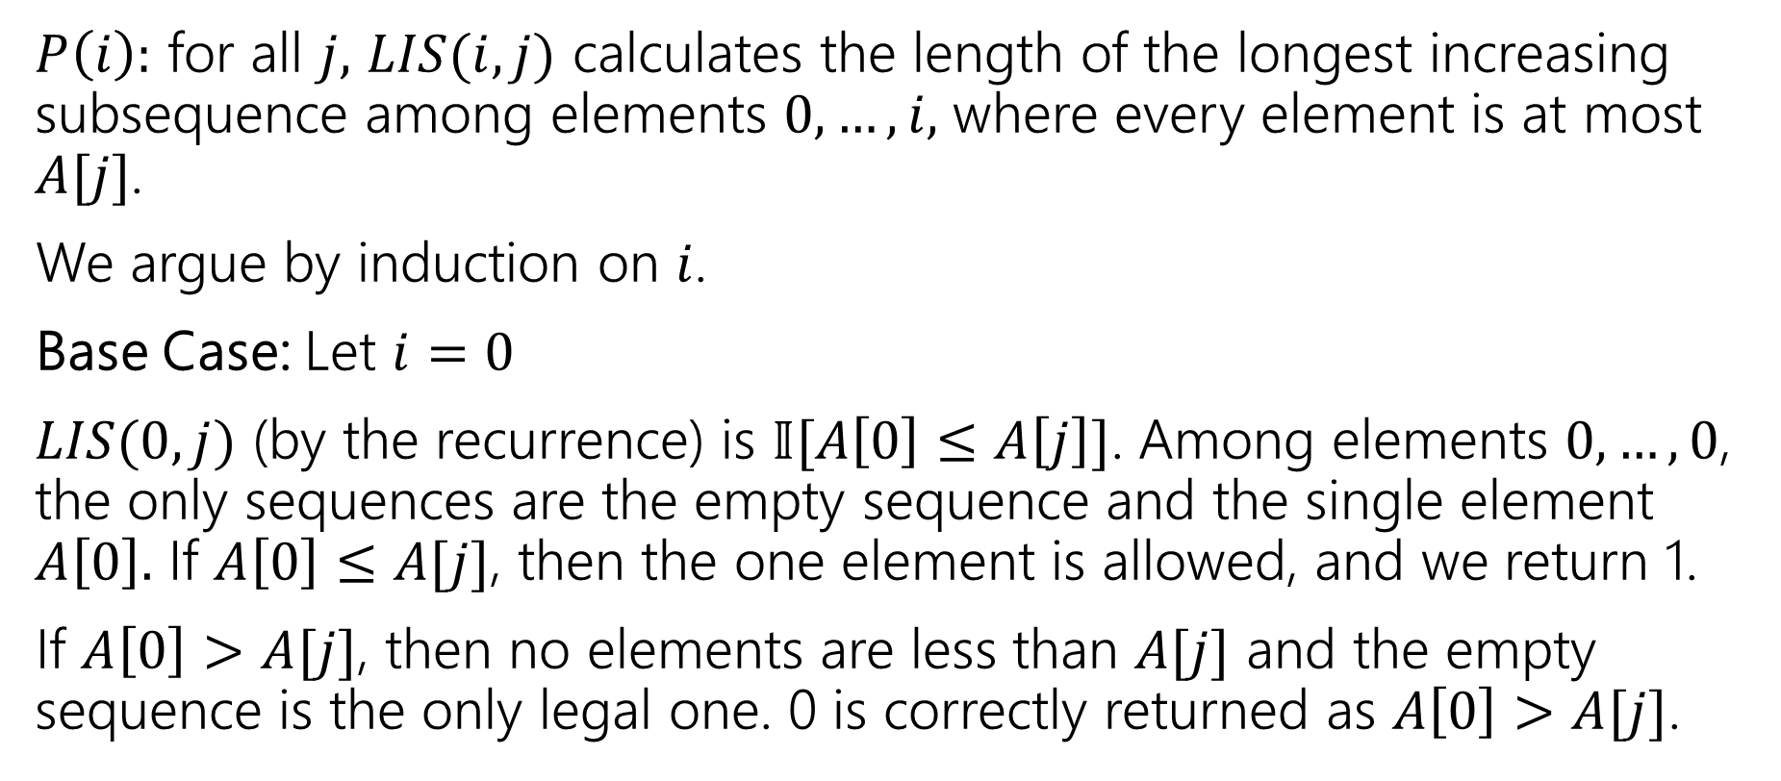
What would a proof look like?
$P\left(i\right):$ for all $j,$ $LIS(i,j)$ calculates the length of the longest increasing subsequence among elements $0,…,i,$ where every element is at most $A[j]$.
We argue by induction on $i$.
Base Case: Let $i=0$
$LIS(0,j)$ (by the recurrence) is $𝕀[A\left[0\right]≤A\left[j\right]]$. Among elements $0,…,0$, the only sequences are the empty sequence and the single element $A\left[0\right].$ If $A\left[0\right]≤A[j]$, then the one element is allowed, and we return 1.
If $A\left[0\right]>A[j]$, then no elements are less than $A[j]$ and the empty sequence is the only legal one. 0 is correctly returned as $A\left[0\right]>A[j]$.

Slide 50
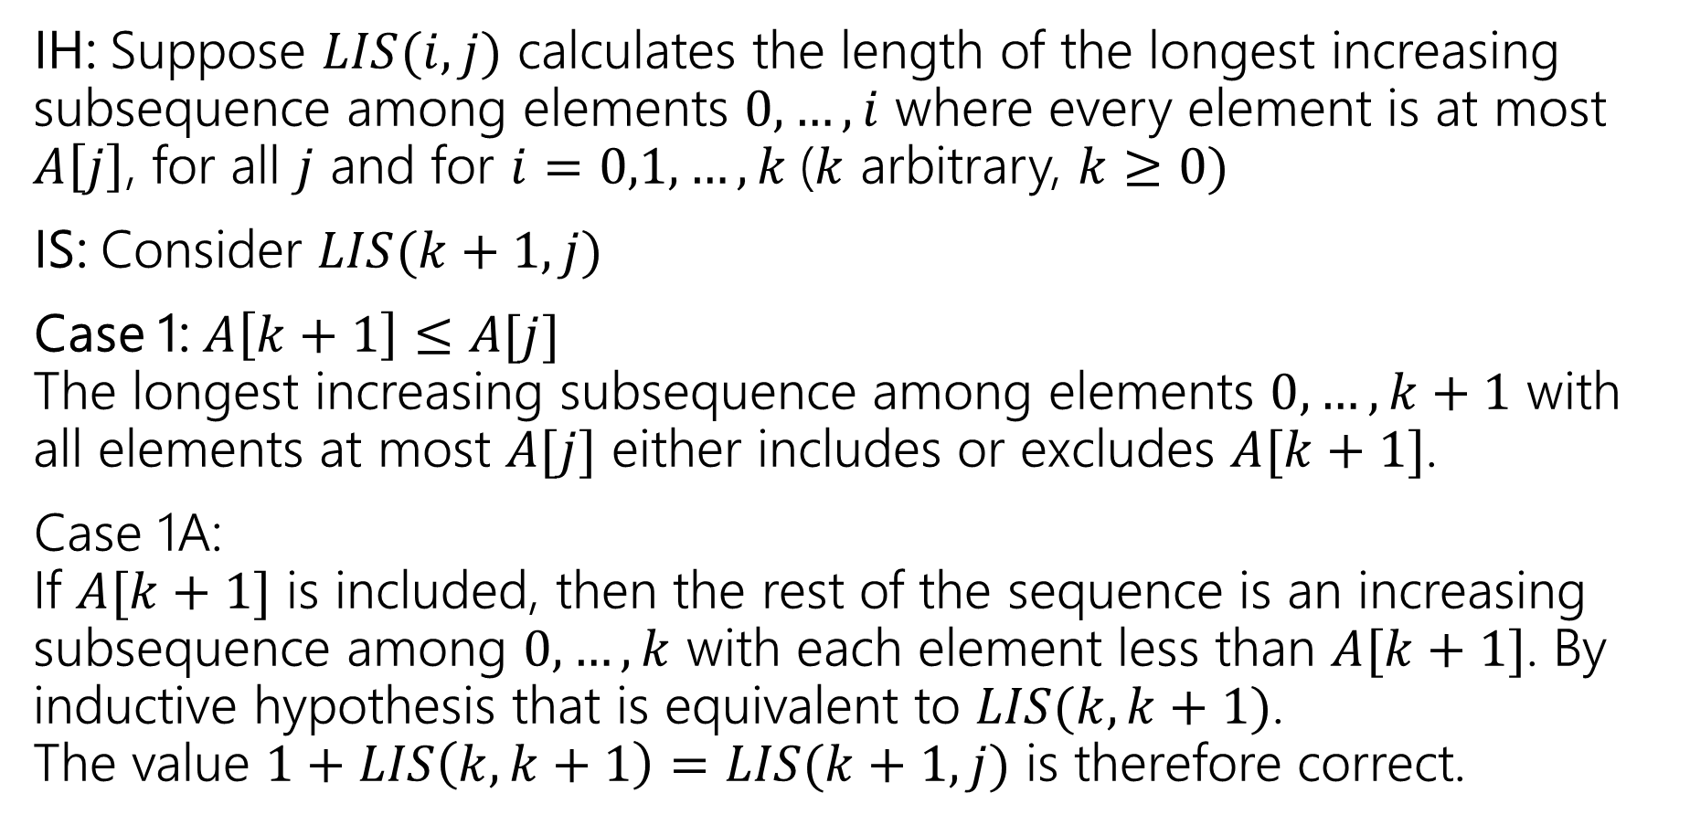
What would a proof look like?
IH: Suppose $LIS(i,j)$ calculates the length of the longest increasing subsequence among elements $0,…,i$ where every element is at most $A\left[j\right]$, for all $j$ and for $i=0,1,…,k$($k$ arbitrary, $k≥0)$
IS: Consider $LIS(k+1, j)$
Case 1: $A\left[k+1\right]≤A[j]$ The longest increasing subsequence among elements $0,…,k+1$ with all elements at most $A[j]$ either includes or excludes $A[k+1]$.
Case 1A: If $A[k+1]$ is included, then the rest of the sequence is an increasing subsequence among $0,…,k$ with each element less than $A[k+1]$. By inductive hypothesis that is equivalent to $LIS(k,k+1)$. The value $1+LIS\left(k,k+1\right)=LIS(k+1,j)$ is therefore correct.

Slide 51
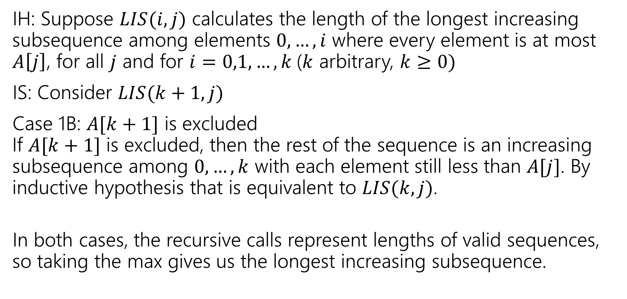
What would a proof look like?
IH: Suppose $LIS(i,j)$ calculates the length of the longest increasing subsequence among elements $0,…,i$ where every element is at most $A\left[j\right]$, for all $j$ and for $i=0,1,…,k$($k$ arbitrary, $k≥0)$
IS: Consider $LIS(k+1, j)$
Case 1B: $A[k+1]$ is excluded If $A[k+1]$ is excluded, then the rest of the sequence is an increasing subsequence among $0,…,k$ with each element still less than $A[j]$. By inductive hypothesis that is equivalent to $LIS(k,j)$.
In both cases, the recursive calls represent lengths of valid sequences, so taking the max gives us the longest increasing subsequence.

Slide 52
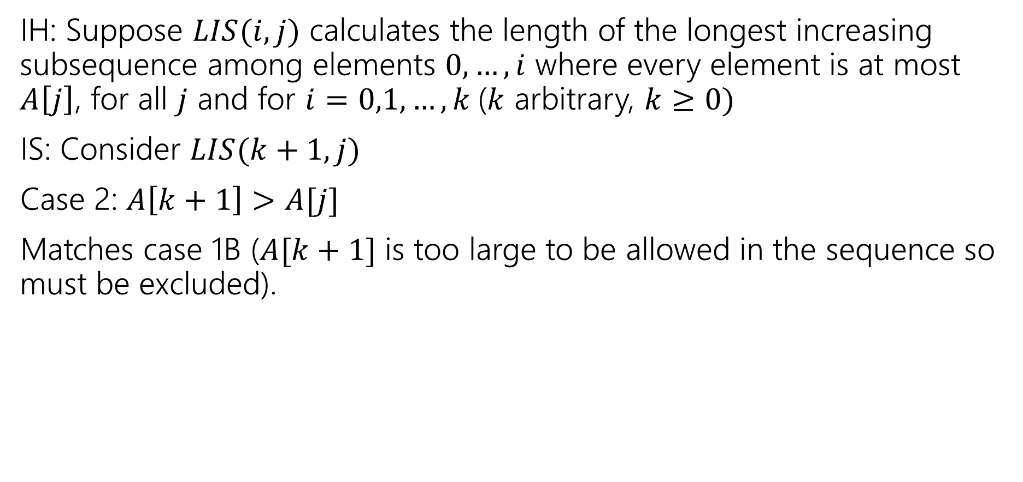
What would a proof look like?
IH: Suppose $LIS(i,j)$ calculates the length of the longest increasing subsequence among elements $0,…,i$ where every element is at most $A\left[j\right]$, for all $j$ and for $i=0,1,…,k$($k$ arbitrary, $k≥0)$
IS: Consider $LIS(k+1, j)$
Case 2: $A\left[k+1\right]>A[j]$
Matches case 1B ($A[k+1]$ is too large to be allowed in the sequence so must be excluded).

Slide 53
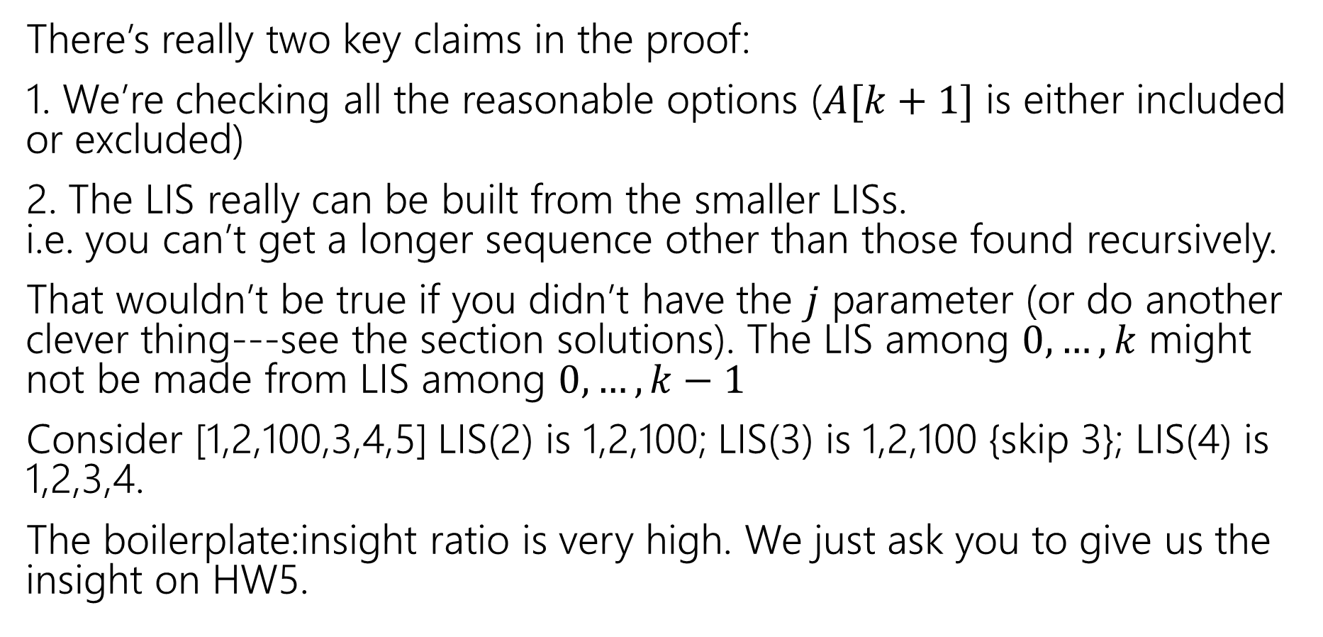
Key Insights
There’s really two key claims in the proof:
1. We’re checking all the reasonable options ($A[k+1]$ is either included or excluded)
2. The LIS really can be built from the smaller LISs. i.e. you can’t get a longer sequence other than those found recursively.
That wouldn’t be true if you didn’t have the $j$ parameter (or do another clever thing---see the section solutions). The LIS among $0,…,k$ might not be made from LIS among $0,…,k−1$
Consider [1,2,100,3,4,5] LIS(2) is 1,2,100; LIS(3) is 1,2,100 {skip 3}; LIS(4) is 1,2,3,4.
The boilerplate:insight ratio is very high. We just ask you to give us the insight on HW5.

