Slide 1
More Dynamic Programming
CSE 421 Winter 23
Lecture 11

Slide 2
Announcements
The midterm exam is two weeks from today. (Mon. Nov. 7)
Remember it’s in the evening. 90 minutes, 6-7:30 PM.
We’ll be in this room!
Form coming to let us know if you can’t make the main exam
Request a conflict (work/family responsibilities or something else immovable)
Have a COVID-related reason where you know now you should not be in a big lecture hall? We’ll see what we can do.
We’ll have conflicts if you’re sick the night of.

Slide 3
Announcements
We’ll have a reference sheet for you for the midterm (including, e.g., a list of some algorithms from 332 that you’ve been able to reference)
You’ll also be able to bring your own 8.5x11 inch piece of paper with handwritten notes.
Practice materials, topics list, contents of the provided reference, etc. all coming next week.

Slide 4
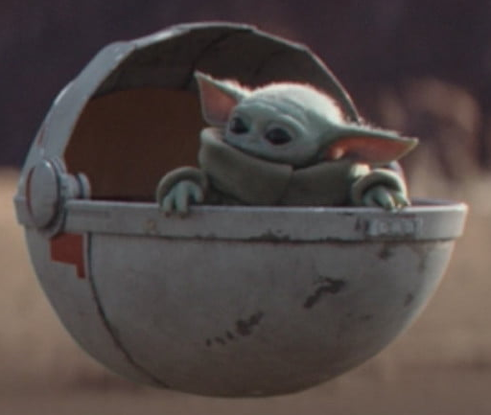
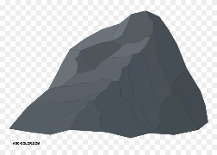
Baby Yoda Searching
Baby Yoda has to get from the upper-right corner to the lower left.
His cradle will only let him go left and down.
He can’t get past the rocks (too high) – he has to go around them (but still only going left and down)
As usual…he’s hungry.
He wants to eat as many frog eggs as possible on the way.

Slide 5
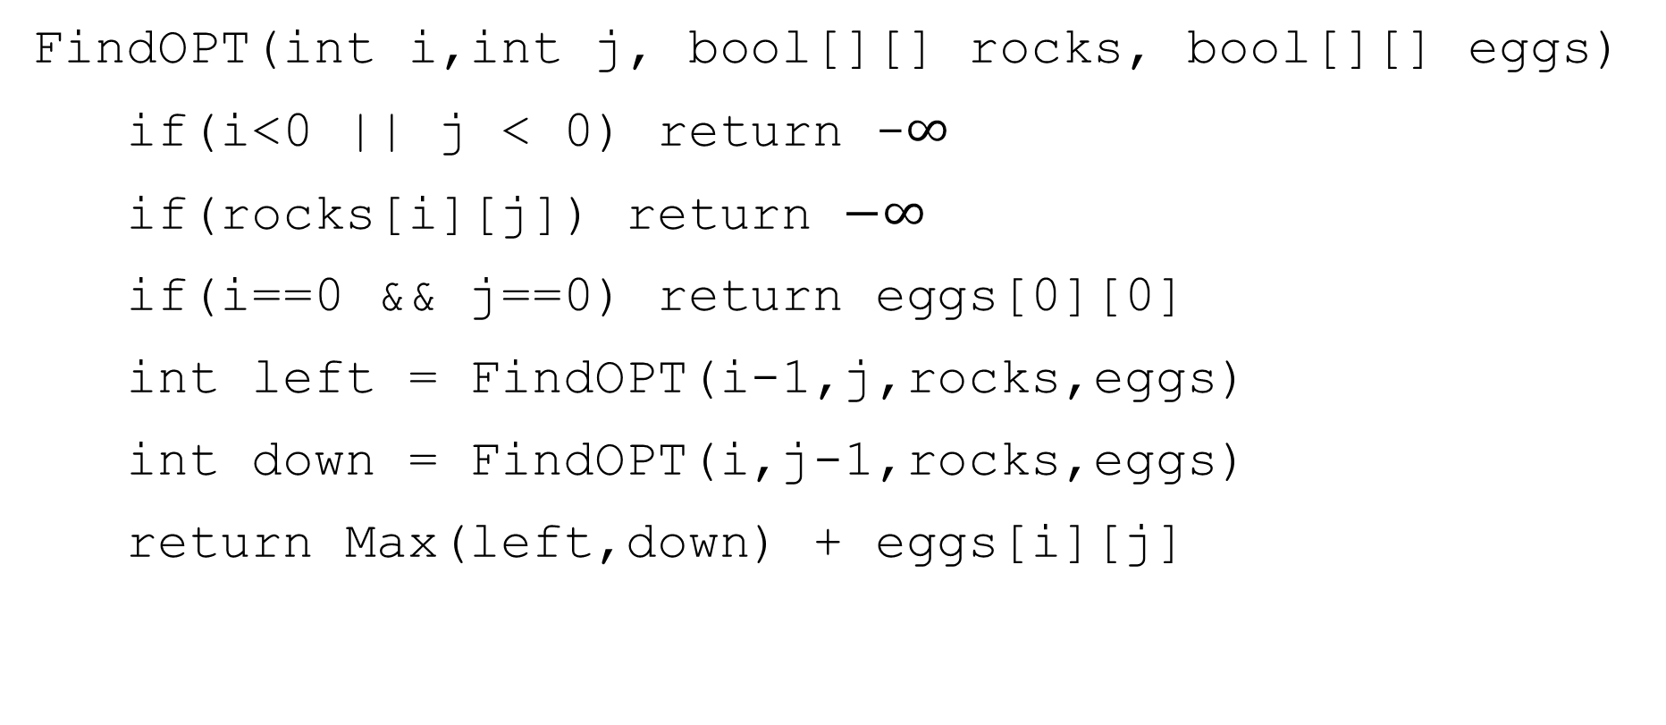
A Recursive Function
FindOPT(int i,int j, bool[][] rocks, bool[][] eggs)
if(i<0 || j < 0) return -$∞$
if(rocks[i][j]) return $−∞$
if(i==0 && j==0) return eggs[0][0]
int left = FindOPT(i-1,j,rocks,eggs)
int down = FindOPT(i,j-1,rocks,eggs)
return Max(left,down) + eggs[i][j]

Slide 6
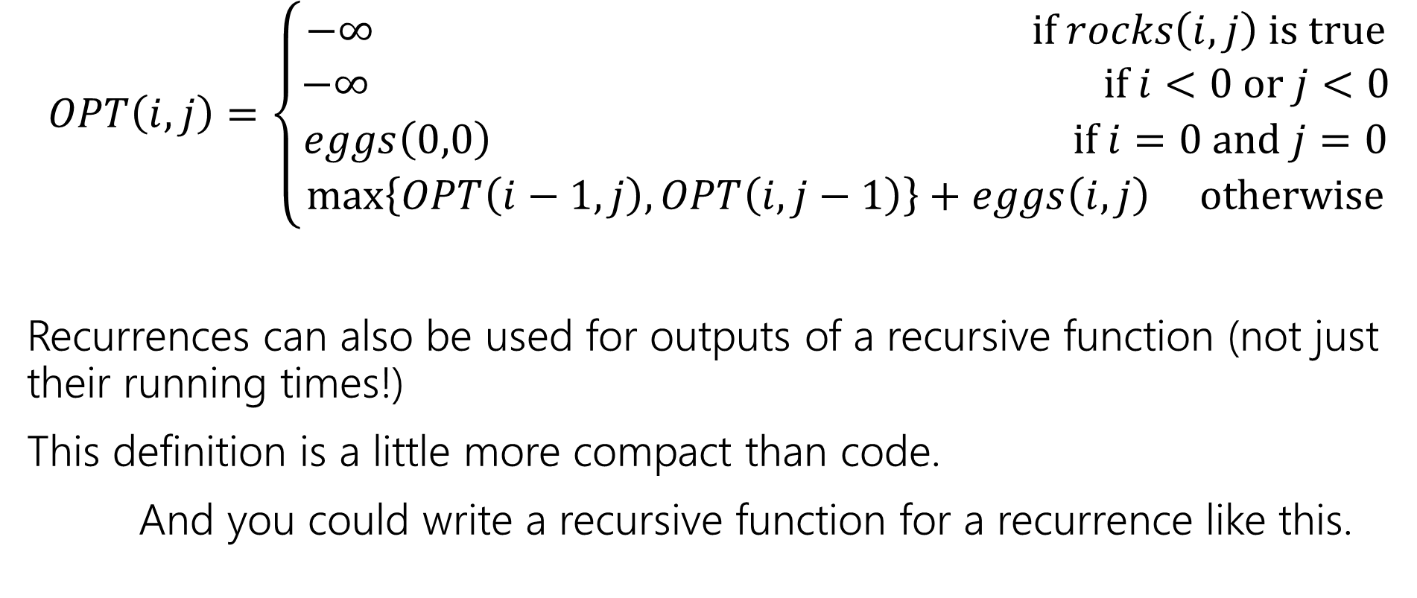
Recurrence Form
$$OPT\left(i,j\right)=\left\{\begin{aligned}−∞ if rocks\left(i,j\right) is true \\ −∞ if i<0 or j<0 \\ eggs\left(0,0\right) if i=0 and j=0 \\ \max\left\{OPT\left(i−1,j\right), OPT\left(i,j−1\right)\right\}+eggs\left(i,j\right) otherwise\end{aligned}\right.$$
Recurrences can also be used for outputs of a recursive function (not just their running times!)
This definition is a little more compact than code.
And you could write a recursive function for a recurrence like this.

Slide 7
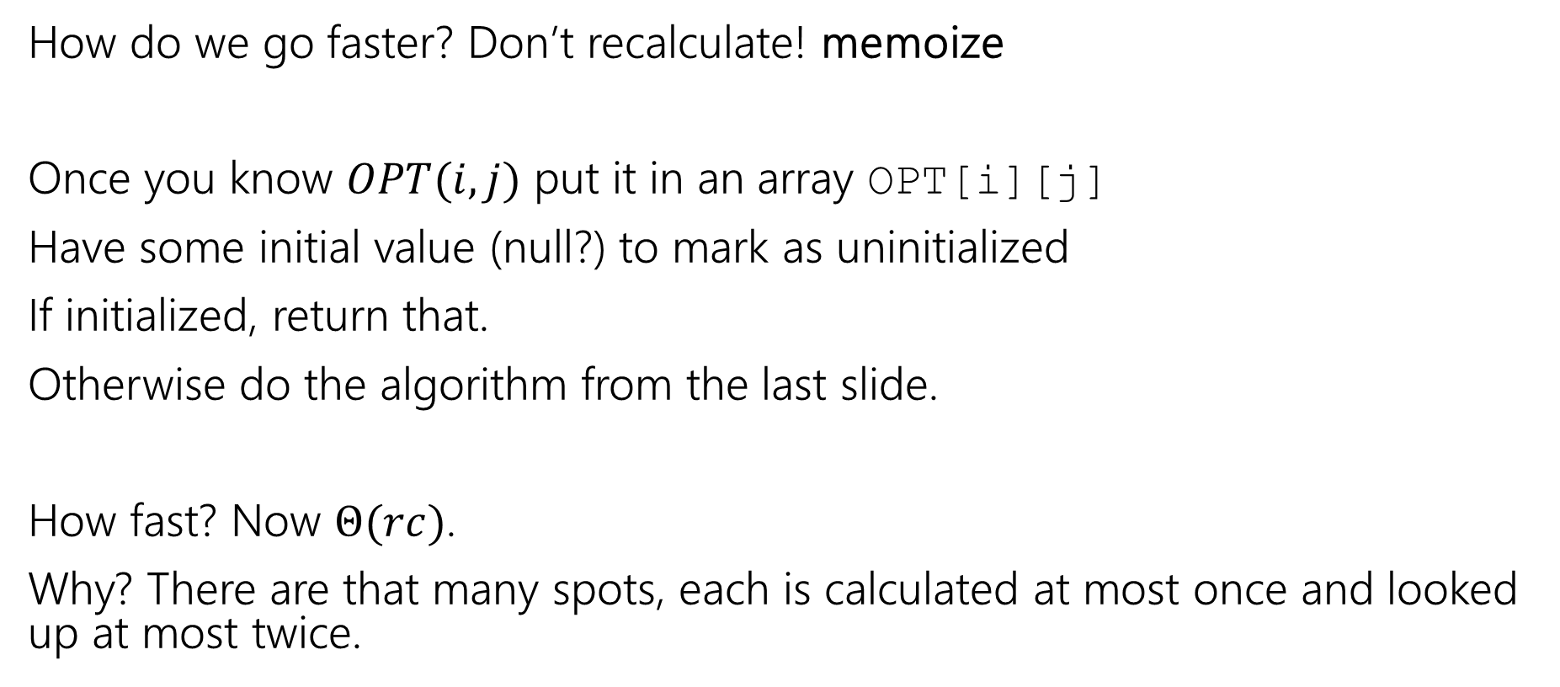
Speedup
How do we go faster? Don’t recalculate! memoize
Once you know $OPT(i,j)$ put it in an array OPT[i][j]
Have some initial value (null?) to mark as uninitialized
If initialized, return that.
Otherwise do the algorithm from the last slide.
How fast? Now $Θ(rc)$.
Why? There are that many spots, each is calculated at most once and looked up at most twice.

Slide 8
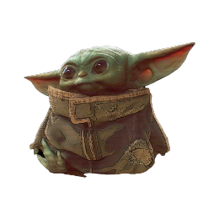



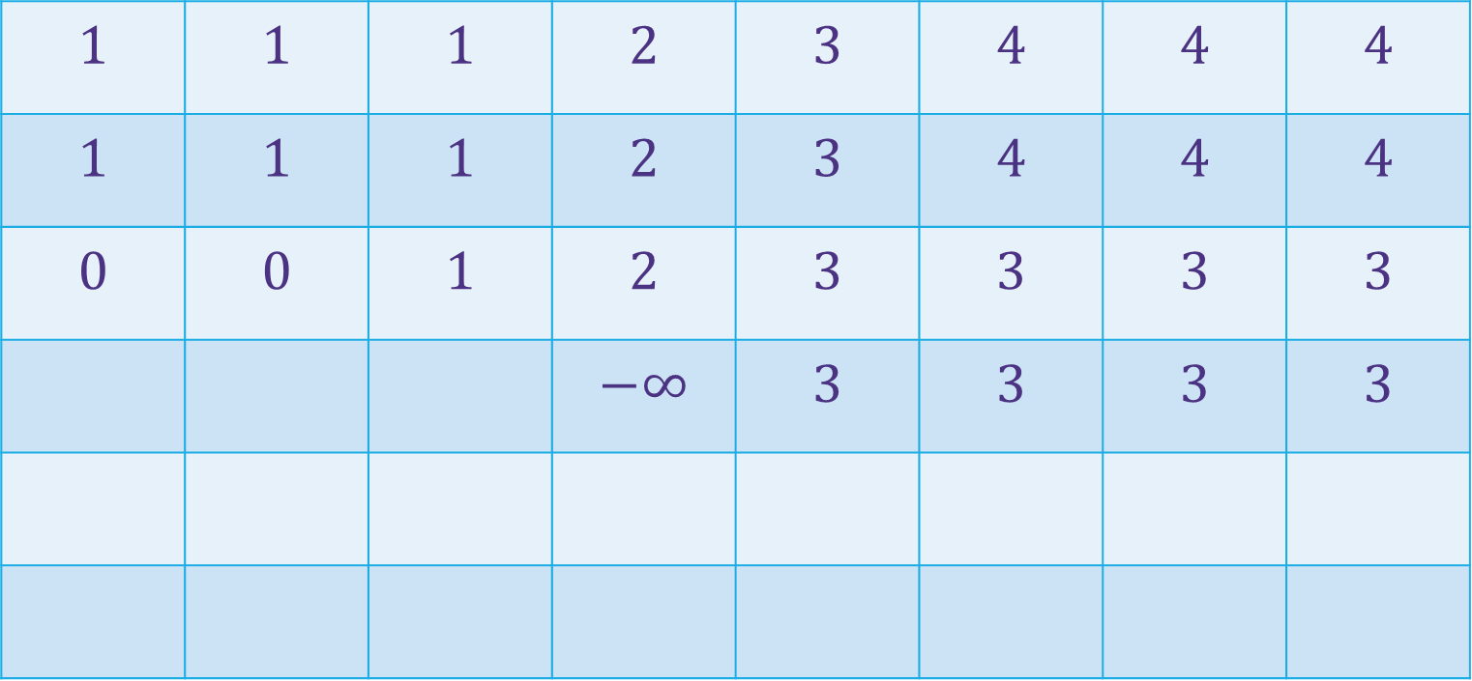
















Baby Yoda Searching
(c-1,r-1)
$$1$$ | $$1$$ | $$1$$ | $$2$$ | $$3$$ | $$4$$ | $$4$$ | $$4$$
$$1$$ | $$1$$ | $$1$$ | $$2$$ | $$3$$ | $$4$$ | $$4$$ | $$4$$
$$0$$ | $$0$$ | $$1$$ | $$2$$ | $$3$$ | $$3$$ | $$3$$ | $$3$$
 |  |  | $$−∞$$ | $$3$$ | $$3$$ | $$3$$ | $$3$$
r-1
Where’s the final answer?
In the top right. Where Baby Yoda starts.
Y-coordinate
$$0$$
$$−∞$$
$$−∞$$
$$0$$
$$1$$
$$−∞$$
$$2$$
$$2$$
$$2$$
$$2$$
$$2$$
0
$$0$$
$$1$$
$$2$$
$$2$$
$$2$$
$$2$$
$$2$$
$$2$$
X-coordinate
0
c-1
Notes:
https://1.bp.blogspot.com/-XxfNI65zLnU/Xc98O96LVnI/AAAAAAAAGFY/Xsmd7IMlIrEltYONCdGKk1hqPw1BgL3ggCLcBGAsYHQ/s1600/Mandalorian.jpg
http://www.pngmart.com/image/161116/png/161115
https://www.pikpng.com/pngvi/hiTxbbR_clip-art-rock-rock-clipart-transparent-background-png-download/

Slide 9
Going Bottom-up
So how does that recursion work?
What’s the first entry of the table that we fill?
OPT[0][0]
Why not just start filling in there?

Slide 10
Robustness

Slide 11
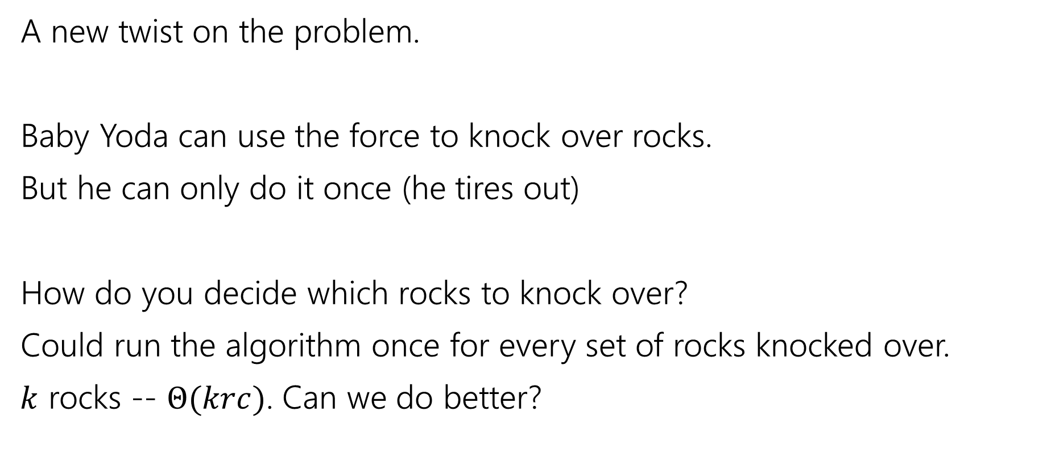
Updating the Problem
A new twist on the problem.
Baby Yoda can use the force to knock over rocks.
But he can only do it once (he tires out)
How do you decide which rocks to knock over?
Could run the algorithm once for every set of rocks knocked over.
$k$ rocks -- $Θ(krc)$. Can we do better?

Slide 12
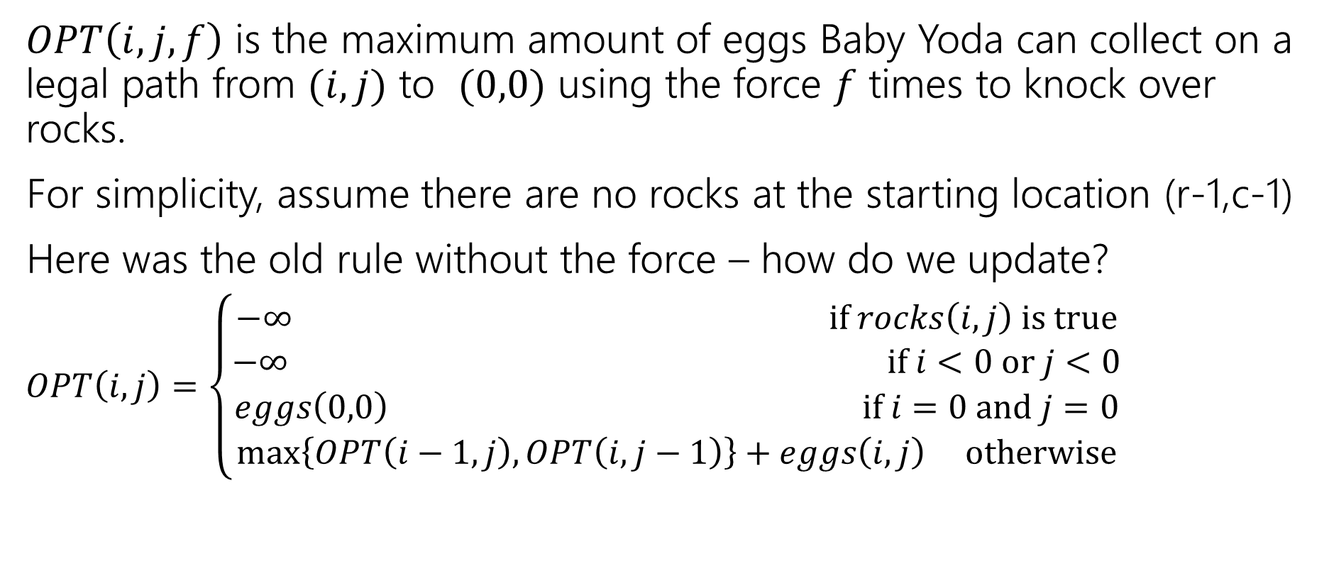
Updating the Problem
$OPT\left(i,j,f\right)$ is the maximum amount of eggs Baby Yoda can collect on a legal path from $(i,j)$ to $(0,0)$ using the force $f$ times to knock over rocks.
For simplicity, assume there are no rocks at the starting location (r-1,c-1)
Here was the old rule without the force – how do we update?
$OPT\left(i,j\right)=\left\{\begin{aligned}−∞ if rocks\left(i,j\right) is true \\ −∞ if i<0 or j<0 \\ eggs\left(0,0\right) if i=0 and j=0 \\ \max\left\{OPT\left(i−1,j\right), OPT\left(i,j−1\right)\right\}+eggs\left(i,j\right) otherwise\end{aligned}\right.$

Slide 13
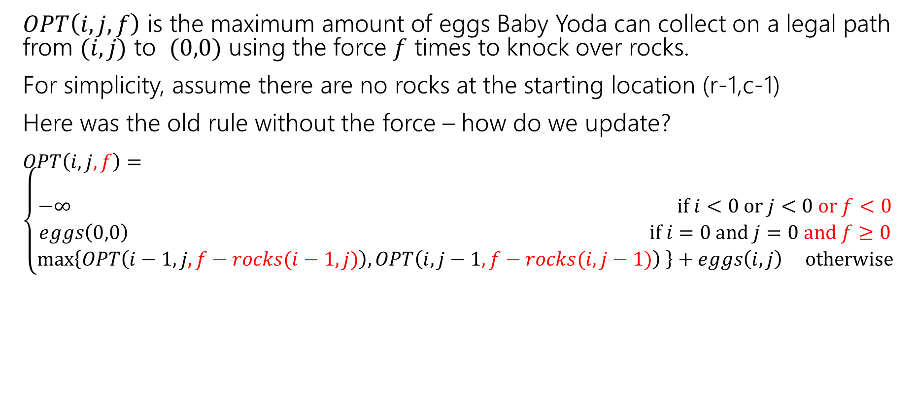
Updating the Problem
$OPT\left(i,j,f\right)$ is the maximum amount of eggs Baby Yoda can collect on a legal path from $(i,j)$ to $(0,0)$ using the force $f$ times to knock over rocks.
For simplicity, assume there are no rocks at the starting location (r-1,c-1)
Here was the old rule without the force – how do we update?
$OPT\left(i,j,f\right)=\left\{\begin{aligned} \\ −∞ if i<0 or j<0 or f<0 \\ eggs\left(0,0\right) if i=0 and j=0 and f≥0 \\ \max\left\{OPT\left(i−1,j,f−rocks(i−1,j)\right), OPT\left(i,j−1,f−rocks(i,j−1)\right) \right\}+eggs\left(i,j\right) otherwise\end{aligned}\right.$
Casting Boolean as an integer
(subtract 1 if you would need to knock over rocks)

Slide 14
Updating the Problem
$OPT\left(i,j,f\right)$ is the maximum amount of eggs Baby Yoda can collect on a legal path from $(i,j)$ to $(0,0)$ using the force $f$ times to knock over rocks.
For simplicity, assume there are no rocks at the starting location (r-1,c-1)
Here was the old rule without the force – how do we update?
$OPT\left(i,j,f\right)=\left\{\begin{aligned} \\ −∞ if i<0 or j<0 or f<0 \\ eggs\left(0,0\right) if i=0 and j=0 and f≥0 \\ \max\left\{OPT\left(i−1,j,f−rocks(i−1,j)\right), OPT\left(i,j−1,f−rocks(i,j−1)\right) \right\}+eggs\left(i,j\right) otherwise\end{aligned}\right.$
rocks(i,j) doesn’t guarantee $−∞$ anymore. Only if you were out of force uses before trying to jump onto that location.

Slide 15
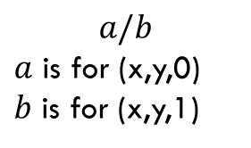
Baby Yoda Searching
(c-1,r-1)
r-1
What can we fill in?
Y-coordinate
$$a/b$$
$a$ is for (x,y,0) $b$ is for (x,y,1)
0
X-coordinate
0
c-1
Notes:
https://1.bp.blogspot.com/-XxfNI65zLnU/Xc98O96LVnI/AAAAAAAAGFY/Xsmd7IMlIrEltYONCdGKk1hqPw1BgL3ggCLcBGAsYHQ/s1600/Mandalorian.jpg
http://www.pngmart.com/image/161116/png/161115
https://www.pikpng.com/pngvi/hiTxbbR_clip-art-rock-rock-clipart-transparent-background-png-download/

Slide 16








Baby Yoda Searching
(c-1,r-1)
r-1
What can we fill in?
Y-coordinate
$$a/b$$
$a$ is for (x,y,0) $b$ is for (x,y,1)
0
$$0/?$$
$$1/?$$
$$2/?$$
$$2/?$$
$$2/?$$
$$2/?$$
$$2/?$$
$$2/?$$
X-coordinate
0
c-1
Notes:
https://1.bp.blogspot.com/-XxfNI65zLnU/Xc98O96LVnI/AAAAAAAAGFY/Xsmd7IMlIrEltYONCdGKk1hqPw1BgL3ggCLcBGAsYHQ/s1600/Mandalorian.jpg
http://www.pngmart.com/image/161116/png/161115
https://www.pikpng.com/pngvi/hiTxbbR_clip-art-rock-rock-clipart-transparent-background-png-download/

Slide 17





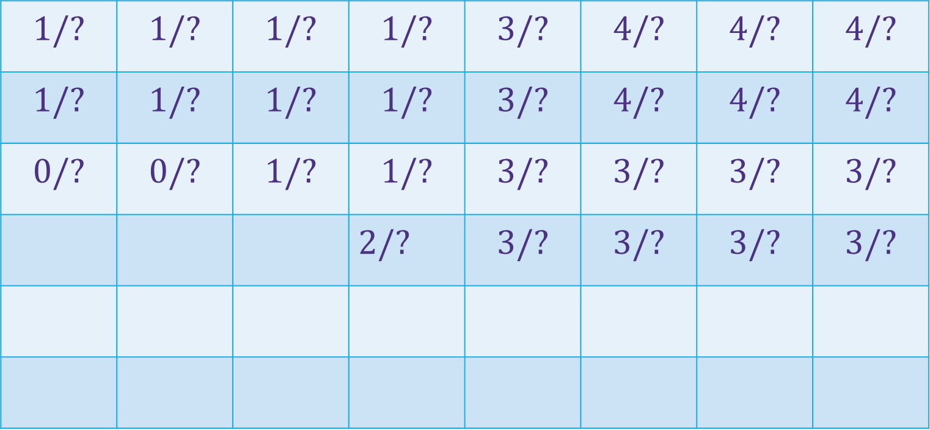





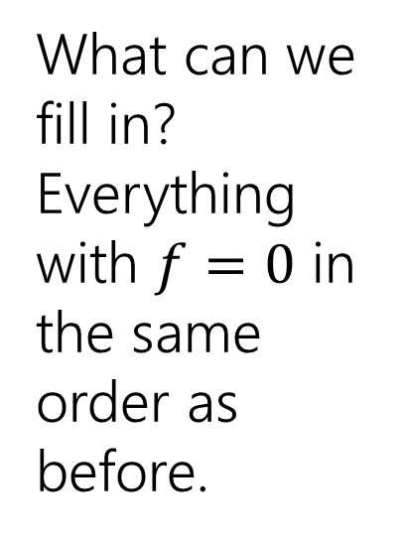







Baby Yoda Searching
(c-1,r-1)
$$1/?$$ | $$1/?$$ | $$1/?$$ | $$1/?$$ | $$3/?$$ | $$4/?$$ | $$4/?$$ | $$4/?$$
$$1/?$$ | $$1/?$$ | $$1/?$$ | $$1/?$$ | $$3/?$$ | $$4/?$$ | $$4/?$$ | $$4/?$$
$$0/?$$ | $$0/?$$ | $$1/?$$ | $$1/?$$ | $$3/?$$ | $$3/?$$ | $$3/?$$ | $$3/?$$
 |  |  | $2/?$ | $$3/?$$ | $$3/?$$ | $$3/?$$ | $$3/?$$
r-1
What can we fill in?
Everything with $f=0$ in the same order as before.
Y-coordinate
$$0/?$$
$$1/?$$
$$−∞/?$$
$$0/?$$
$$1/?$$
$$2/?$$
$$2/?$$
$$2/?$$
$$2/?$$
$$2/?$$
$$2/?$$
0
$$0/?$$
$$1/?$$
$$2/?$$
$$2/?$$
$$2/?$$
$$2/?$$
$$2/?$$
$$2/?$$
Entries are slightly different – we’re handling rocks differently.
X-coordinate
0
c-1
Notes:
https://1.bp.blogspot.com/-XxfNI65zLnU/Xc98O96LVnI/AAAAAAAAGFY/Xsmd7IMlIrEltYONCdGKk1hqPw1BgL3ggCLcBGAsYHQ/s1600/Mandalorian.jpg
http://www.pngmart.com/image/161116/png/161115
https://www.pikpng.com/pngvi/hiTxbbR_clip-art-rock-rock-clipart-transparent-background-png-download/

Slide 18
Baby Yoda Searching
(c-1,r-1)
$$1/?$$ | $$1/?$$ | $$1/?$$ | $$1/?$$ | $$3/?$$ | $$4/?$$ | $$4/?$$ | $$4/?$$
$$1/?$$ | $$1/?$$ | $$1/?$$ | $$1/?$$ | $$3/?$$ | $$4/?$$ | $$4/?$$ | $$4/?$$
$$0/?$$ | $$0/?$$ | $$1/?$$ | $$1/?$$ | $$3/?$$ | $$3/?$$ | $$3/?$$ | $$3/?$$
 |  |  | $2/?$ | $$3/?$$ | $$3/?$$ | $$3/?$$ | $$3/?$$
r-1
What can we fill in?
Again from left to right, bottom to top, now filling in
Y-coordinate
$$0/?$$
$$1/?$$
$$−∞/?$$
$$0/?$$
$$1/?$$
$$2/?$$
$$2/?$$
$$2/?$$
$$2/?$$
$$2/?$$
$$2/?$$
0
$$0/?$$
$$1/?$$
$$2/?$$
$$2/?$$
$$2/?$$
$$2/?$$
$$2/?$$
$$2/?$$
X-coordinate
0
c-1
Notes:
https://1.bp.blogspot.com/-XxfNI65zLnU/Xc98O96LVnI/AAAAAAAAGFY/Xsmd7IMlIrEltYONCdGKk1hqPw1BgL3ggCLcBGAsYHQ/s1600/Mandalorian.jpg
http://www.pngmart.com/image/161116/png/161115
https://www.pikpng.com/pngvi/hiTxbbR_clip-art-rock-rock-clipart-transparent-background-png-download/

Slide 19



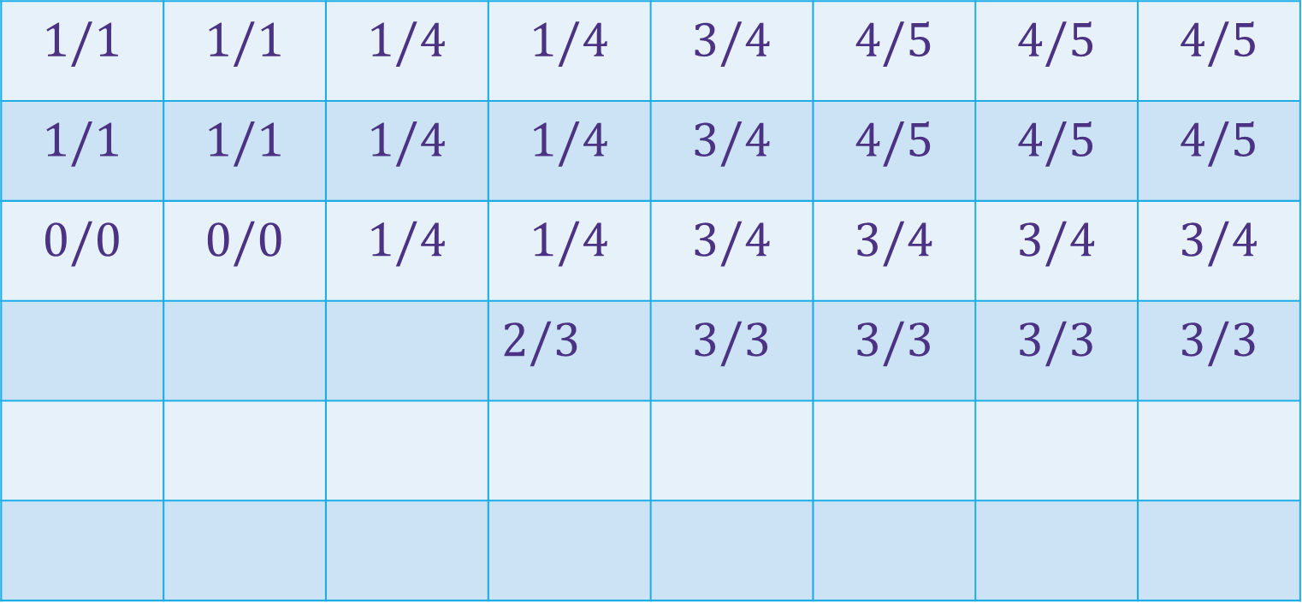
















Baby Yoda Searching
(c-1,r-1)
$$1/1$$ | $$1/1$$ | $$1/4$$ | $$1/4$$ | $$3/4$$ | $$4/5$$ | $$4/5$$ | $$4/5$$
$$1/1$$ | $$1/1$$ | $$1/4$$ | $$1/4$$ | $$3/4$$ | $$4/5$$ | $$4/5$$ | $$4/5$$
$$0/0$$ | $$0/0$$ | $$1/4$$ | $$1/4$$ | $$3/4$$ | $$3/4$$ | $$3/4$$ | $$3/4$$
 |  |  | $2/3$ | $$3/3$$ | $$3/3$$ | $$3/3$$ | $$3/3$$
r-1
What can we fill in?
Again from left to right, bottom to top, now filling in
Y-coordinate
$$0/0$$
$$1/1$$
$$−∞/3$$
$$0/0$$
$$1/1$$
$$2/2$$
$$2/2$$
$$2/2$$
$$2/2$$
$$2/2$$
$$2/2$$
0
$$0/0$$
$$1/1$$
$$2/2$$
$$2/2$$
$$2/2$$
$$2/2$$
$$2/2$$
$$2/2$$
X-coordinate
0
c-1
Notes:
https://1.bp.blogspot.com/-XxfNI65zLnU/Xc98O96LVnI/AAAAAAAAGFY/Xsmd7IMlIrEltYONCdGKk1hqPw1BgL3ggCLcBGAsYHQ/s1600/Mandalorian.jpg
http://www.pngmart.com/image/161116/png/161115
https://www.pikpng.com/pngvi/hiTxbbR_clip-art-rock-rock-clipart-transparent-background-png-download/

Slide 20
Dynamic Programming Process
1. Define the object you’re looking for
2. Write a recurrence to say how to find it
3. Design a memoization structure
4. Write an iterative algorithm

Slide 21
Bells,Whistles, and optimiziation

Slide 22
Baby Yoda Searching
(c-1,r-1)
$$1/1$$ | $$1/1$$ | $$1/4$$ | $$1/4$$ | $$3/4$$ | $$4/5$$ | $$4/5$$ | $$4/5$$
$$1/1$$ | $$1/1$$ | $$1/4$$ | $$1/4$$ | $$3/4$$ | $$4/5$$ | $$4/5$$ | $$4/5$$
$$0/0$$ | $$0/0$$ | $$1/4$$ | $$1/4$$ | $$3/4$$ | $$3/4$$ | $$3/4$$ | $$3/4$$
 |  |  | $2/3$ | $$3/3$$ | $$3/3$$ | $$3/3$$ | $$3/3$$
r-1
So should Baby Yoda go left or down?
Y-coordinate
$$0/0$$
$$1/1$$
$$−∞/3$$
$$0/0$$
$$1/1$$
$$2/2$$
$$2/2$$
$$2/2$$
$$2/2$$
$$2/2$$
$$2/2$$
0
$$0/0$$
$$1/1$$
$$2/2$$
$$2/2$$
$$2/2$$
$$2/2$$
$$2/2$$
$$2/2$$
X-coordinate
0
c-1
Notes:
https://1.bp.blogspot.com/-XxfNI65zLnU/Xc98O96LVnI/AAAAAAAAGFY/Xsmd7IMlIrEltYONCdGKk1hqPw1BgL3ggCLcBGAsYHQ/s1600/Mandalorian.jpg
http://www.pngmart.com/image/161116/png/161115
https://www.pikpng.com/pngvi/hiTxbbR_clip-art-rock-rock-clipart-transparent-background-png-download/

Slide 23
Which Way to Go
When you’re taking the max in the recursive case, you can also record which option gave you the max.
That’s the way to go.
We’ll ask you to do that once…but for the most part we’ll just have you find the number.

Slide 24
Optimizing
Do we need all that memory?
Let’s go back to the simple version (no using the Force)

Slide 25
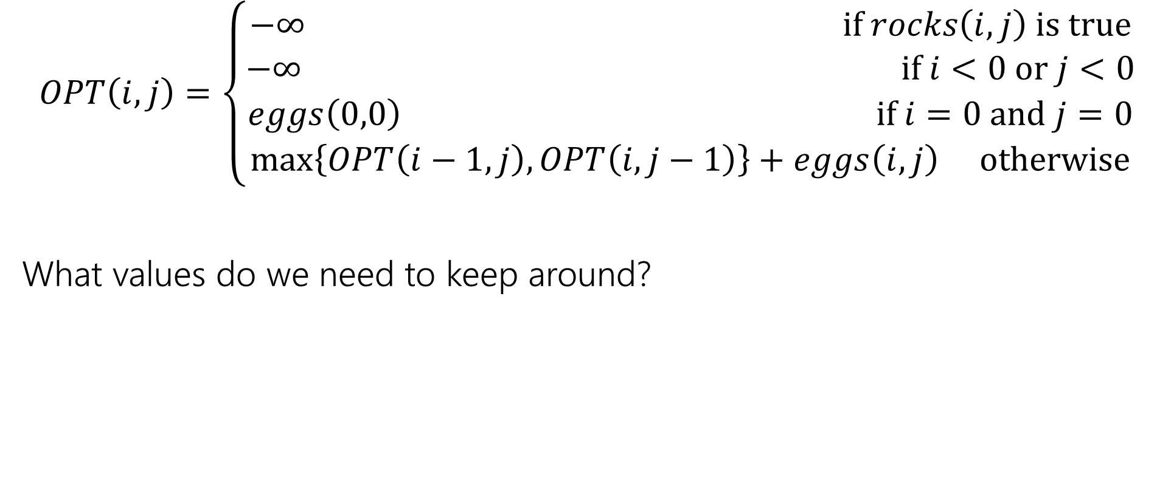
Recurrence Form
$$OPT\left(i,j\right)=\left\{\begin{aligned}−∞ if rocks\left(i,j\right) is true \\ −∞ if i<0 or j<0 \\ eggs\left(0,0\right) if i=0 and j=0 \\ \max\left\{OPT\left(i−1,j\right), OPT\left(i,j−1\right)\right\}+eggs\left(i,j\right) otherwise\end{aligned}\right.$$
What values do we need to keep around?

Slide 26
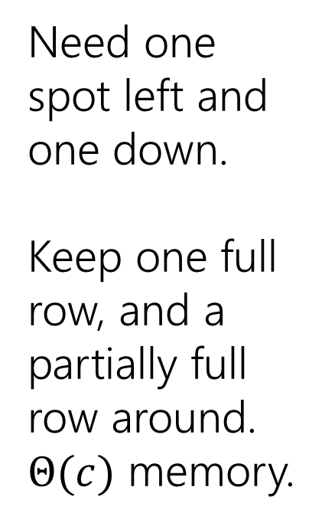
Baby Yoda Searching
(c-1,r-1)
$$1$$ | $$1$$ | $$1$$ | $$2$$ | $$3$$ | $$4$$ | $$4$$ | $$4$$
$$1$$ | $$1$$ | $$1$$ | $$2$$ | $$3$$ | $$4$$ | $$4$$ | $$4$$
$$0$$ | $$0$$ | $$1$$ | $$2$$ | $$3$$ | $$3$$ | $$3$$ | $$3$$
 |  |  | $$−∞$$ | $$3$$ | $$3$$ | $$3$$ | $$3$$
r-1
Need one spot left and one down.
Keep one full row, and a partially full row around.
$Θ(c)$ memory.
Y-coordinate
$$0$$
$$−∞$$
$$−∞$$
$$0$$
$$1$$
$$−∞$$
$$2$$
$$2$$
$$2$$
$$2$$
$$2$$
0
$$0$$
$$1$$
$$2$$
$$2$$
$$2$$
$$2$$
$$2$$
$$2$$
X-coordinate
0
c-1
Notes:
https://1.bp.blogspot.com/-XxfNI65zLnU/Xc98O96LVnI/AAAAAAAAGFY/Xsmd7IMlIrEltYONCdGKk1hqPw1BgL3ggCLcBGAsYHQ/s1600/Mandalorian.jpg
http://www.pngmart.com/image/161116/png/161115
https://www.pikpng.com/pngvi/hiTxbbR_clip-art-rock-rock-clipart-transparent-background-png-download/

Slide 27
More Problems

Slide 28

Maximum Contiguous Subarray Sum
We saw an $O(n\log{n)}$divide and conquer algorithm.
Can we do better with DP?
Given: Array $A$[]
Output: $i,j$ such that $A\left[i\right]+A\left[i+1\right]+…+A[j]$ is maximized.

Slide 29
Dynamic Programming Process
1. Define the object you’re looking for
2. Write a recurrence to say how to find it
3. Design a memoization structure
4. Write an iterative algorithm

Slide 30
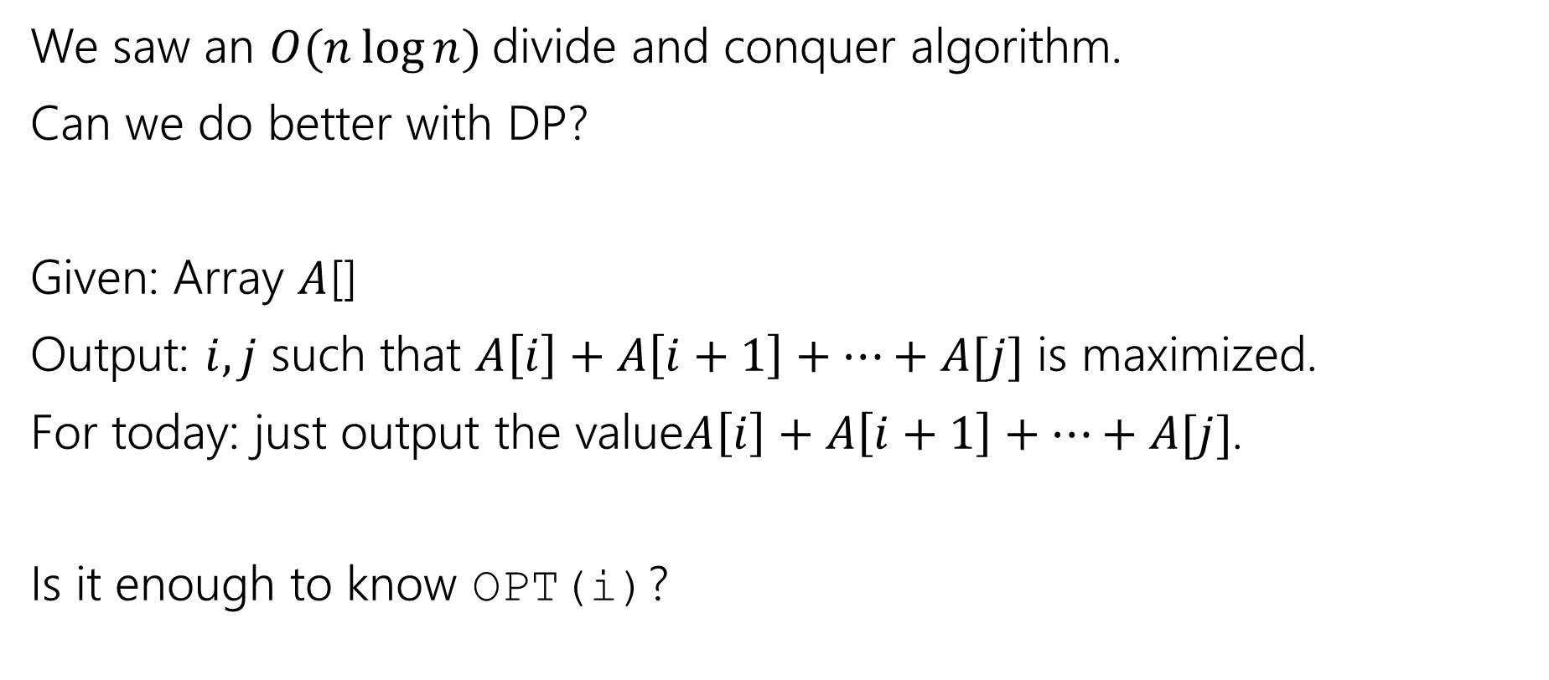
Maximum Contiguous Subarray Sum
We saw an $O(n\log{n)}$divide and conquer algorithm.
Can we do better with DP?
Given: Array $A$[]
Output: $i,j$ such that $A\left[i\right]+A\left[i+1\right]+…+A[j]$ is maximized.
For today: just output the value$A\left[i\right]+A\left[i+1\right]+…+A[j]$.
Is it enough to know OPT(i)?

Slide 31
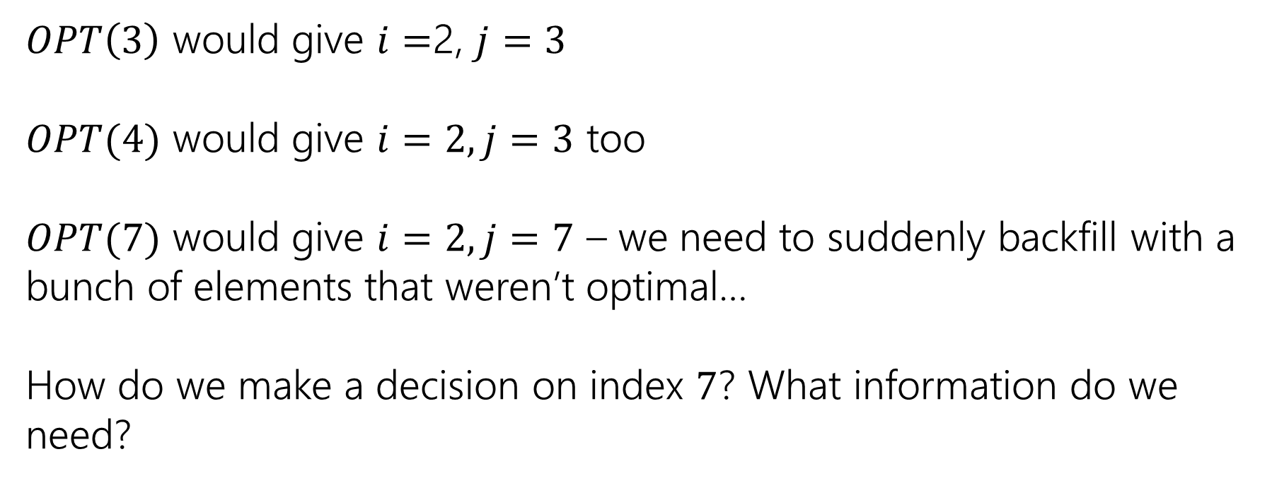
Trying to Recurse
0 | 1 | 2 | 3 | 4 | 5 | 6 | 7
5 | -6 | 3 | 4 | -5 | 2 | 2 | 4
$OPT\left(3\right)$ would give $i=$2, $j=3$
$OPT(4)$ would give $i=2, j=3$ too
$OPT(7)$ would give $i=2, j=7$ – we need to suddenly backfill with a bunch of elements that weren’t optimal…
How do we make a decision on index $7$? What information do we need?

Slide 32
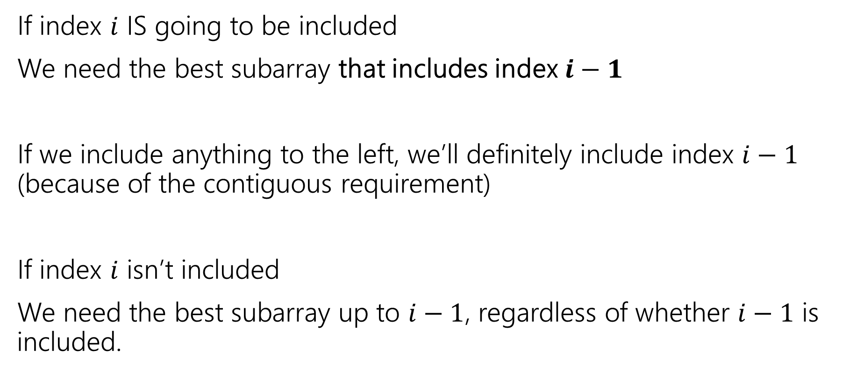
What do we need for recursion?
If index $i$ IS going to be included
We need the best subarray that includes index $i−1$
If we include anything to the left, we’ll definitely include index $i−1$ (because of the contiguous requirement)
If index $i$ isn’t included
We need the best subarray up to $i−1$, regardless of whether $i−1$ is included.

Slide 33
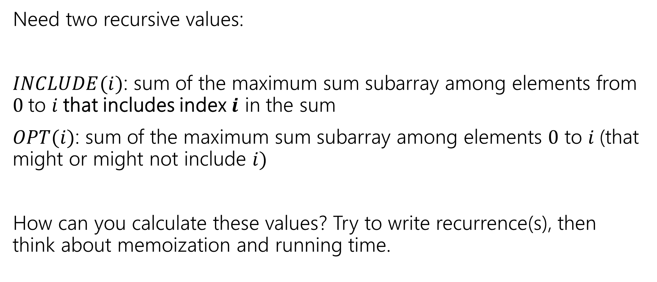
Two Values
Pollev.com/robbie
Need two recursive values:
$INCLUDE(i)$: sum of the maximum sum subarray among elements from $0$to $i$that includes index $i$ in the sum
$OPT(i)$: sum of the maximum sum subarray among elements $0$ to $i$(that might or might not include $i)$
How can you calculate these values? Try to write recurrence(s), then think about memoization and running time.

Slide 34
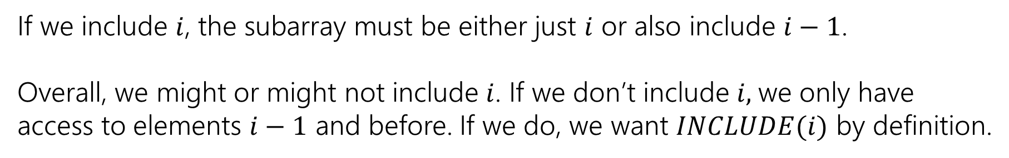

Recurrences
$INCLUDE\left(i\right)=\left\{\begin{aligned}\max\left\{A\left[i\right], A\left[i\right]+INLCUDE\left(i−1\right)\right\} if i≥0 \\ 0 otherwise\end{aligned}\right.$
$OPT\left(i\right)=\left\{\begin{aligned}\max\left\{INCLUDE\left(i\right),OPT\left(i−1\right)\right\} if i≥0 \\ 0 otherwise\end{aligned}\right.$
If we include $i$, the subarray must be either just $i$ or also include $i−1$.
Overall, we might or might not include $i$. If we don’t include $i,$we only have access to elements $i−1$ and before. If we do, we want $INCLUDE(i)$ by definition.

Slide 35



Example
$$A$$
0 | 1 | 2 | 3 | 4 | 5 | 6 | 7
5 | -6 | 3 | 4 | -5 | 2 | 2 | 4
$$OPT(i)$$
0 | 1 | 2 | 3 | 4 | 5 | 6 | 7
5
0 | 1 | 2 | 3 | 4 | 5 | 6 | 7
5
$$INCLUDE(i)$$

Slide 36
Example
$$A$$
0 | 1 | 2 | 3 | 4 | 5 | 6 | 7
5 | -6 | 3 | 4 | -5 | 2 | 2 | 4
$$OPT(i)$$
0 | 1 | 2 | 3 | 4 | 5 | 6 | 7
5 | 5
0 | 1 | 2 | 3 | 4 | 5 | 6 | 7
5 | -1
$$INCLUDE(i)$$

Slide 37
Example
$$A$$
0 | 1 | 2 | 3 | 4 | 5 | 6 | 7
5 | -6 | 3 | 4 | -5 | 2 | 2 | 4
$$OPT(i)$$
0 | 1 | 2 | 3 | 4 | 5 | 6 | 7
5 | 5 | 5 | 7 | 7 | 7 | 7 | 10
0 | 1 | 2 | 3 | 4 | 5 | 6 | 7
5 | -1 | 3 | 7 | 2 | 4 | 6 | 10
$$INCLUDE(i)$$

Slide 38
Pseudocode
int maxSubarraySum(int[] A)
int n=A.length
int[] OPT = new int[n]
int[] Inc = new int[n]
inc[0]=A[0]; OPT[0] = max{A[0],0}
for(int i=0;i<n;i++)
inc[i]=max{A[i], A[i]+inc[i-1]}
OPT[i]=max{inc[i], opt[i-1]}
endFor
return OPT[n-1]

Slide 39
Recursive Thinking In General
As before, the hardest part is designing the recurrence.
It sometimes helps to think from multiple different angles.
Top-down: What’s the first step to take?
Baby Yoda will first go left or down. Use recursion to find out which of left or down is better.
The farthest right operation in the string transformation will be one of insert, delete, substitute, match for free. Use recursion to find out which is best.

Slide 40
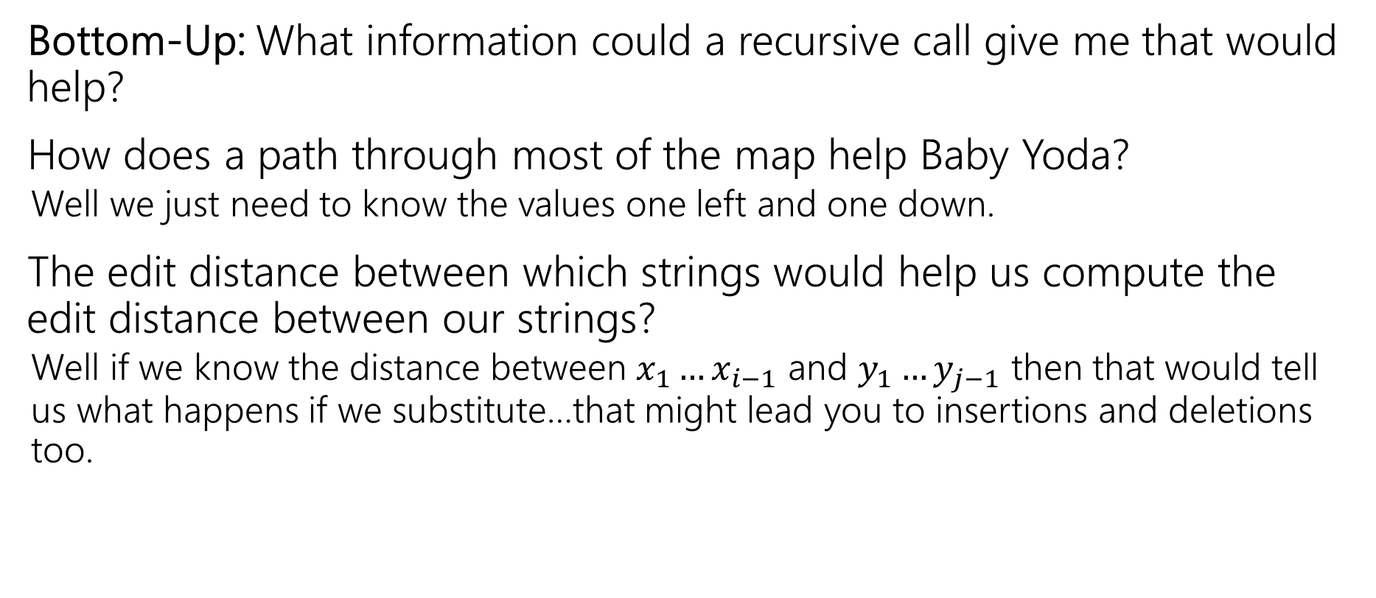
Recursive Thinking In General
Bottom-Up: What information could a recursive call give me that would help?
How does a path through most of the map help Baby Yoda?
Well we just need to know the values one left and one down.
The edit distance between which strings would help us compute the edit distance between our strings?
Well if we know the distance between $x_{1}…x_{i−1}$ and $y_{1}…y_{j−1}$ then that would tell us what happens if we substitute…that might lead you to insertions and deletions too.

Slide 41
Recursive Thinking In General
Some people refer to the “Optimal Substructure Property”
From the optimum (most eggs, fewest number of string operations) for a slightly smaller problem (Baby Yoda starting closer to the end, slightly smaller strings), we need to be able to build up the optimum for the full problem.

Slide 42
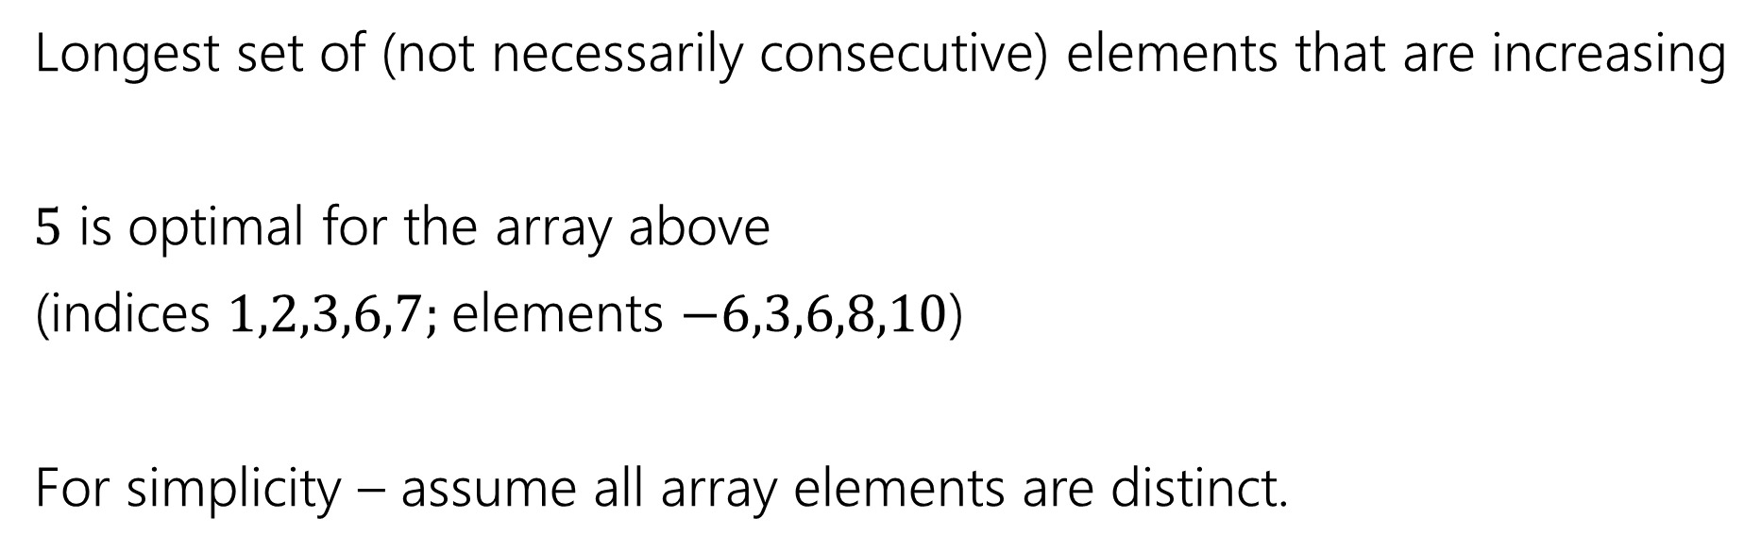
Longest Increasing Subsequence
0 | 1 | 2 | 3 | 4 | 5 | 6 | 7
5 | -6 | 3 | 6 | -5 | 2 | 8 | 10
Longest set of (not necessarily consecutive) elements that are increasing
$5$ is optimal for the array above
(indices $1,2,3,6,7;$elements $−6,3,6,8,10$)
For simplicity – assume all array elements are distinct.

Slide 43
A Real-World Problem

Slide 44

Edit Distance
Given two strings $x$ and $y,$we’d like to tell how close they are.
Applications?
Spelling suggestions
DNA comparison

Slide 45
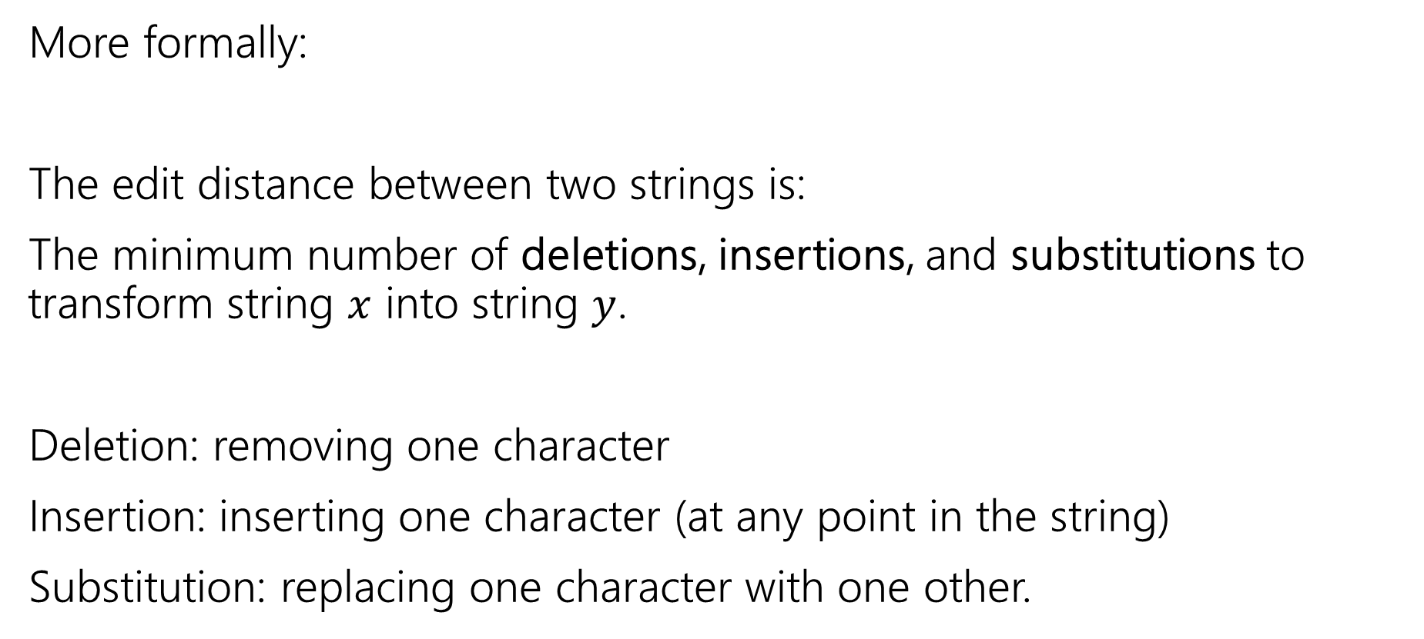
Edit Distance
More formally:
The edit distance between two strings is:
The minimum number of deletions, insertions, and substitutions to transform string $x$ into string $y$.
Deletion: removing one character
Insertion: inserting one character (at any point in the string)
Substitution: replacing one character with one other.

Slide 46
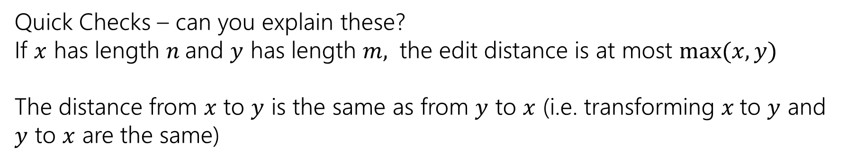
Example
What’s the distance between babyyodas and tastysoda?
B | A | B |  | Y | Y | O | D | A | S
sub |  | sub | ins |  | sub |  |  |  | del
T | A | S | T | Y | S | O | D | A
Distance: 5, one point for each colored box
Quick Checks – can you explain these?
If $x$ has length $n$and $y$ has length $m,$ the edit distance is at most $\max{(x,y)}$
The distance from $x$ to $y$ is the same as from $y$ to $x$ (i.e. transforming $x$to $y$ and $y$ to $x$ are the same)

Slide 47
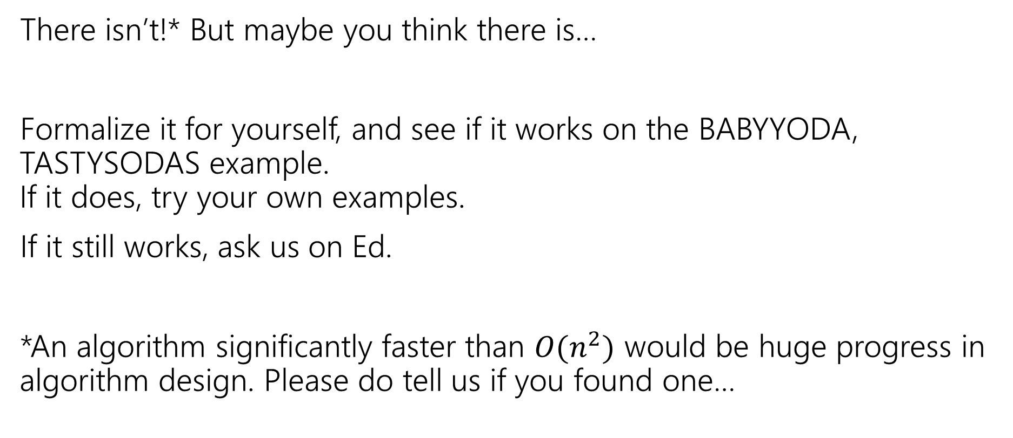
Is there a greedy algorithm?
There isn’t!* But maybe you think there is…
Formalize it for yourself, and see if it works on the BABYYODA, TASTYSODAS example. If it does, try your own examples.
If it still works, ask us on Ed.
*An algorithm significantly faster than $O(n^{2})$ would be huge progress in algorithm design. Please do tell us if you found one…

Slide 48
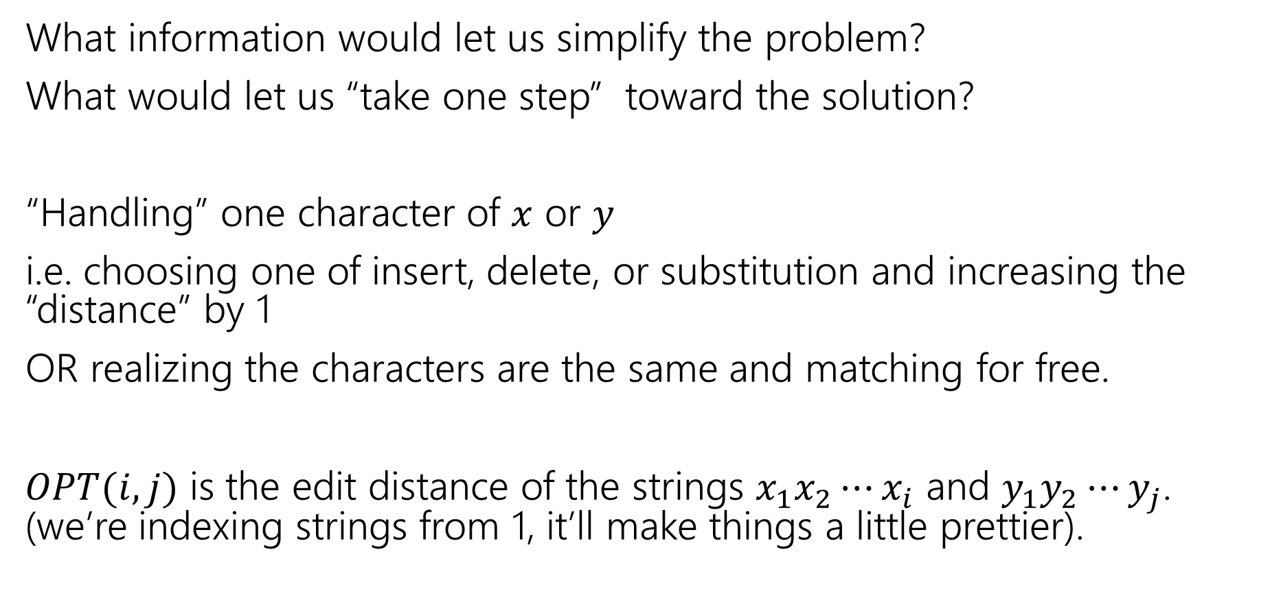
Finding a recurrence
What information would let us simplify the problem?
What would let us “take one step” toward the solution?
“Handling” one character of $x$ or $y$
i.e. choosing one of insert, delete, or substitution and increasing the “distance” by 1
OR realizing the characters are the same and matching for free.
$OPT(i,j)$ is the edit distance of the strings $x_{1}x_{2}⋯x_{i}$ and $y_{1}y_{2}⋯y_{j}$. (we’re indexing strings from 1, it’ll make things a little prettier).

Slide 49
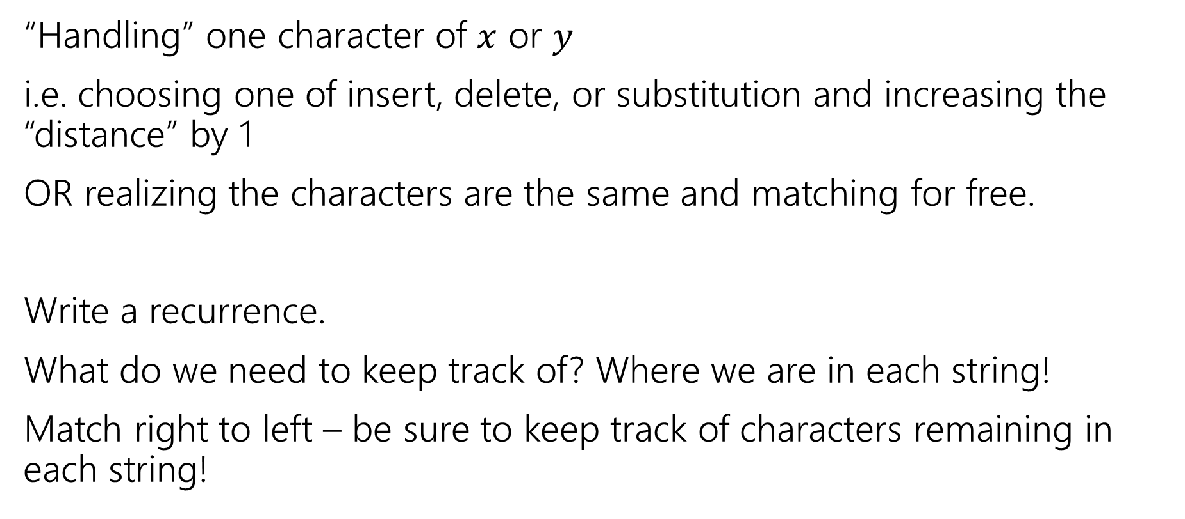
The recurrence
Poll at Pollev.com/robbie
“Handling” one character of $x$ or $y$
i.e. choosing one of insert, delete, or substitution and increasing the “distance” by 1
OR realizing the characters are the same and matching for free.
Write a recurrence.
What do we need to keep track of? Where we are in each string!
Match right to left – be sure to keep track of characters remaining in each string!

Slide 50
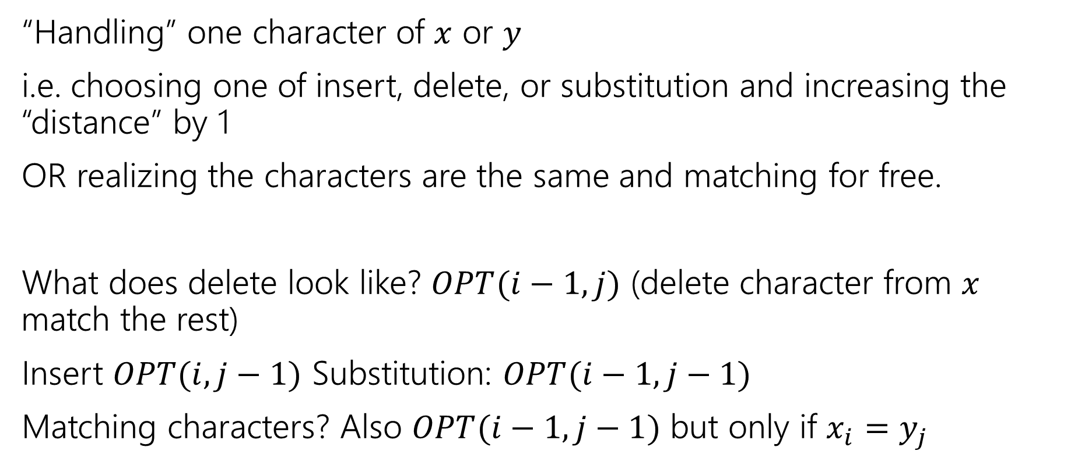
The recurrence
“Handling” one character of $x$ or $y$
i.e. choosing one of insert, delete, or substitution and increasing the “distance” by 1
OR realizing the characters are the same and matching for free.
What does delete look like? $OPT(i−1, j)$ (delete character from $x$ match the rest)
Insert $OPT(i,j−1)$ Substitution: $OPT(i−1,j−1)$
Matching characters? Also $OPT(i−1,j−1)$ but only if $x_{i}=y_{j}$

Slide 51
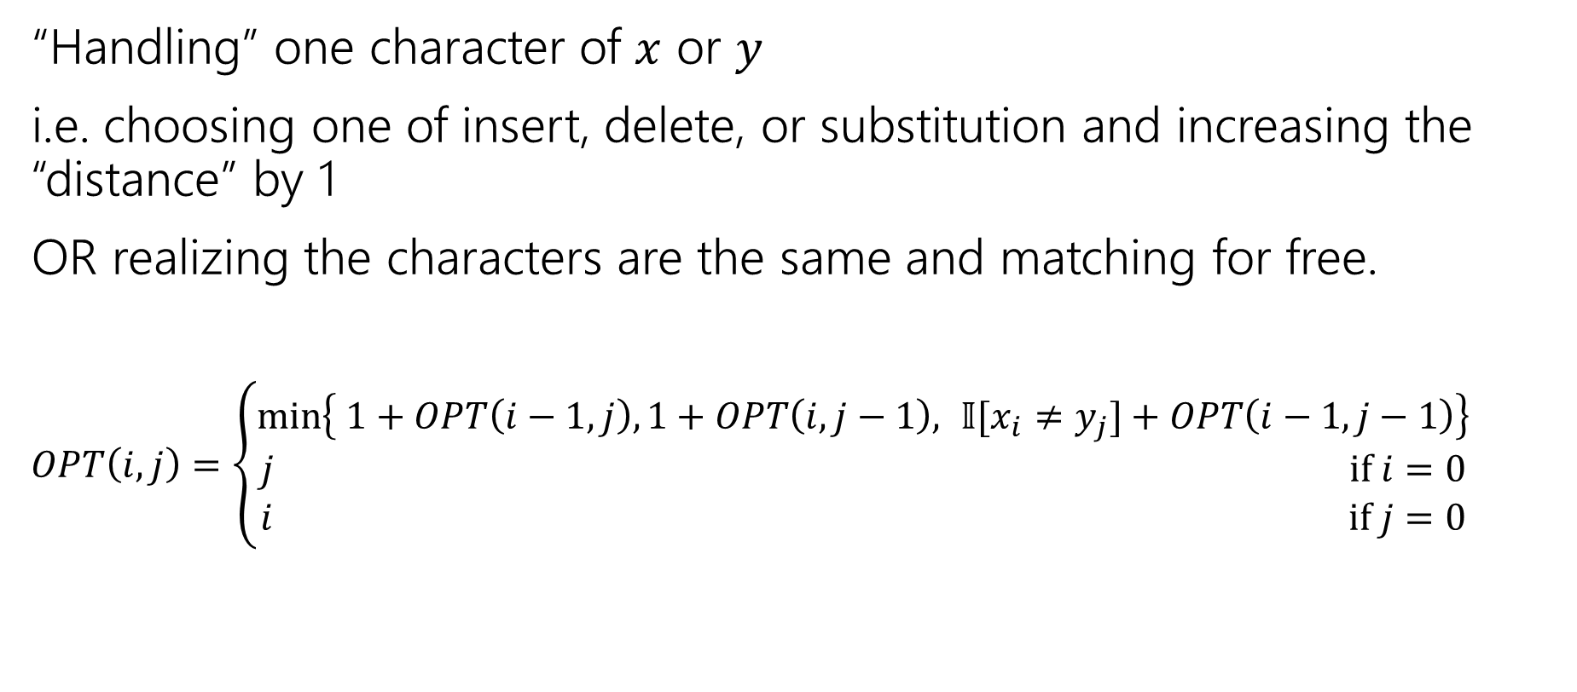
The recurrence
“Handling” one character of $x$ or $y$
i.e. choosing one of insert, delete, or substitution and increasing the “distance” by 1
OR realizing the characters are the same and matching for free.
$OPT\left(i,j\right)=\left\{\begin{aligned}\min\left\{ 1+OPT\left(i−1,j\right), 1+OPT\left(i,j−1\right), 𝕀[x_{i}≠y_{j}]+OPT\left(i−1,j−1\right)\right\} \\ j if i=0 \\ i if j=0\end{aligned}\right.$
Delete
Insert
Sub and matching
“Indicator” – math for “cast bool to int”

Slide 52
Dynamic Programming Process
1. Define the object you’re looking for
2. Write a recurrence to say how to find it
3. Design a memoization structure
4. Write an iterative algorithm
Minimum Edit Distance between $x$ and $y$
✅

Slide 53

Memoization
$OPT\left(i,j\right)=\left\{\begin{aligned}\min\left\{ 1+OPT\left(i−1,j\right), 1+OPT\left(i,j−1\right), 𝕀[x_{i}≠y_{j}]+OPT\left(i−1,j−1\right)\right\} \\ j if i=0 \\ i if j=0\end{aligned}\right.$
2D array $n$ by $m$
OPT[i][j] is $OPT(i,j)$

Slide 54
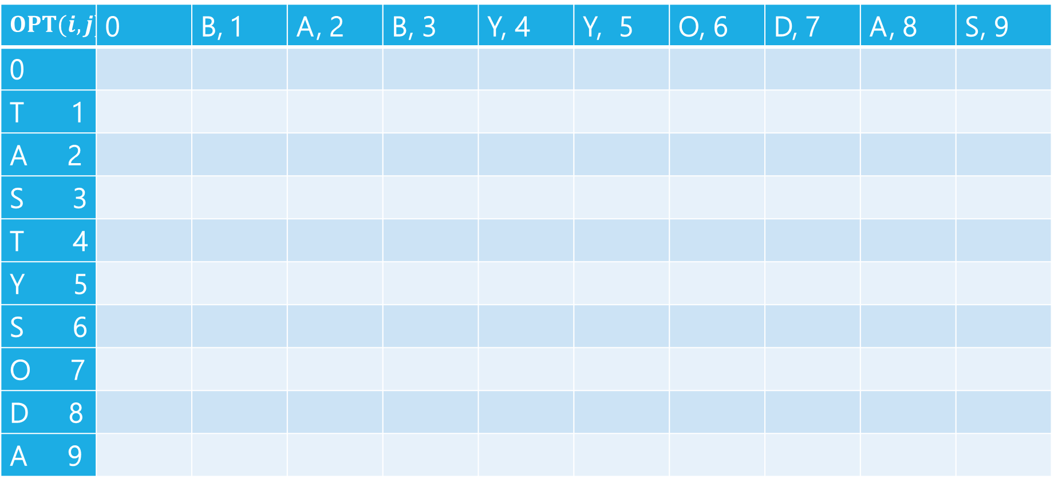
Edit Distance
$$OPT(i,j)$$ | 0 | B, 1 | A, 2 | B, 3 | Y, 4 | Y, 5 | O, 6 | D, 7 | A, 8 | S, 9
0
T 1
A 2
S 3
T 4
Y 5
S 6
O 7
D 8
A 9

Slide 55
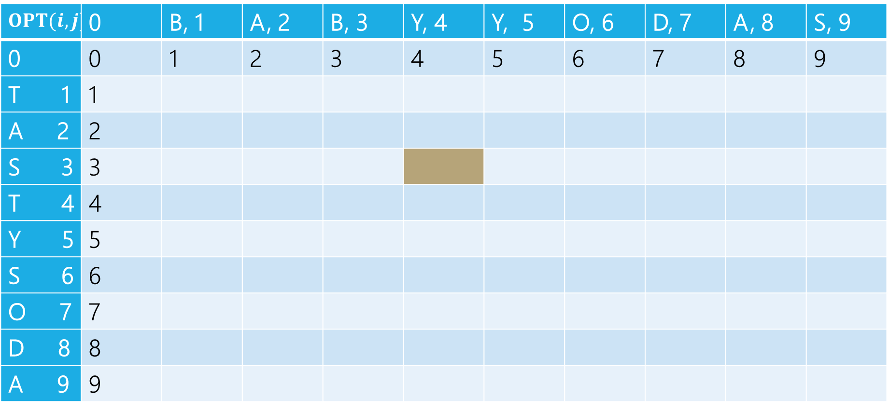
Edit Distance
B | A | B | Y
T | A | S
Current subproblem: edit dist between BABY and TAS
$$OPT(i,j)$$ | 0 | B, 1 | A, 2 | B, 3 | Y, 4 | Y, 5 | O, 6 | D, 7 | A, 8 | S, 9
0 | 0 | 1 | 2 | 3 | 4 | 5 | 6 | 7 | 8 | 9
T 1 | 1
A 2 | 2
S 3 | 3
T 4 | 4
Y 5 | 5
S 6 | 6
O 7 | 7
D 8 | 8
A 9 | 9

Slide 56
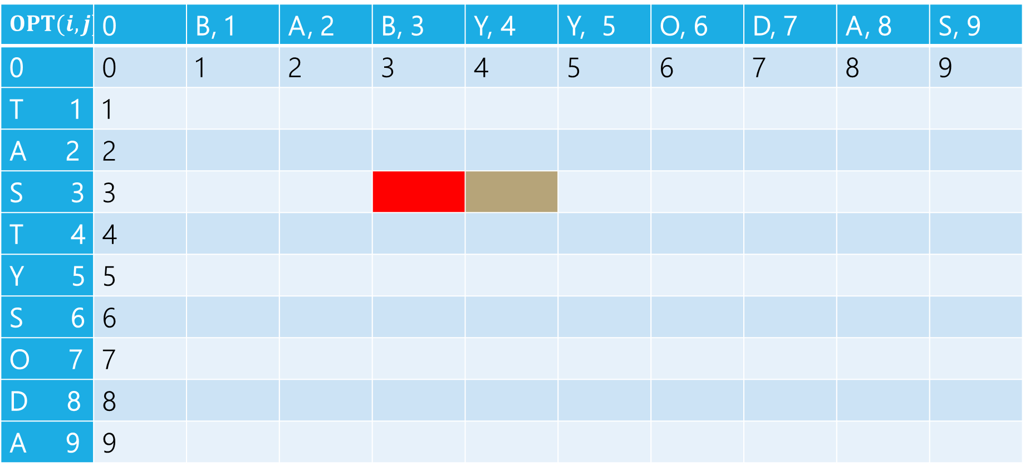
Edit Distance
B | A | B | Y
T | A | S
Delete: get rid of Y (cost 1)
BAB
TAS
$$OPT(i,j)$$ | 0 | B, 1 | A, 2 | B, 3 | Y, 4 | Y, 5 | O, 6 | D, 7 | A, 8 | S, 9
0 | 0 | 1 | 2 | 3 | 4 | 5 | 6 | 7 | 8 | 9
T 1 | 1
A 2 | 2
S 3 | 3
T 4 | 4
Y 5 | 5
S 6 | 6
O 7 | 7
D 8 | 8
A 9 | 9

Slide 57
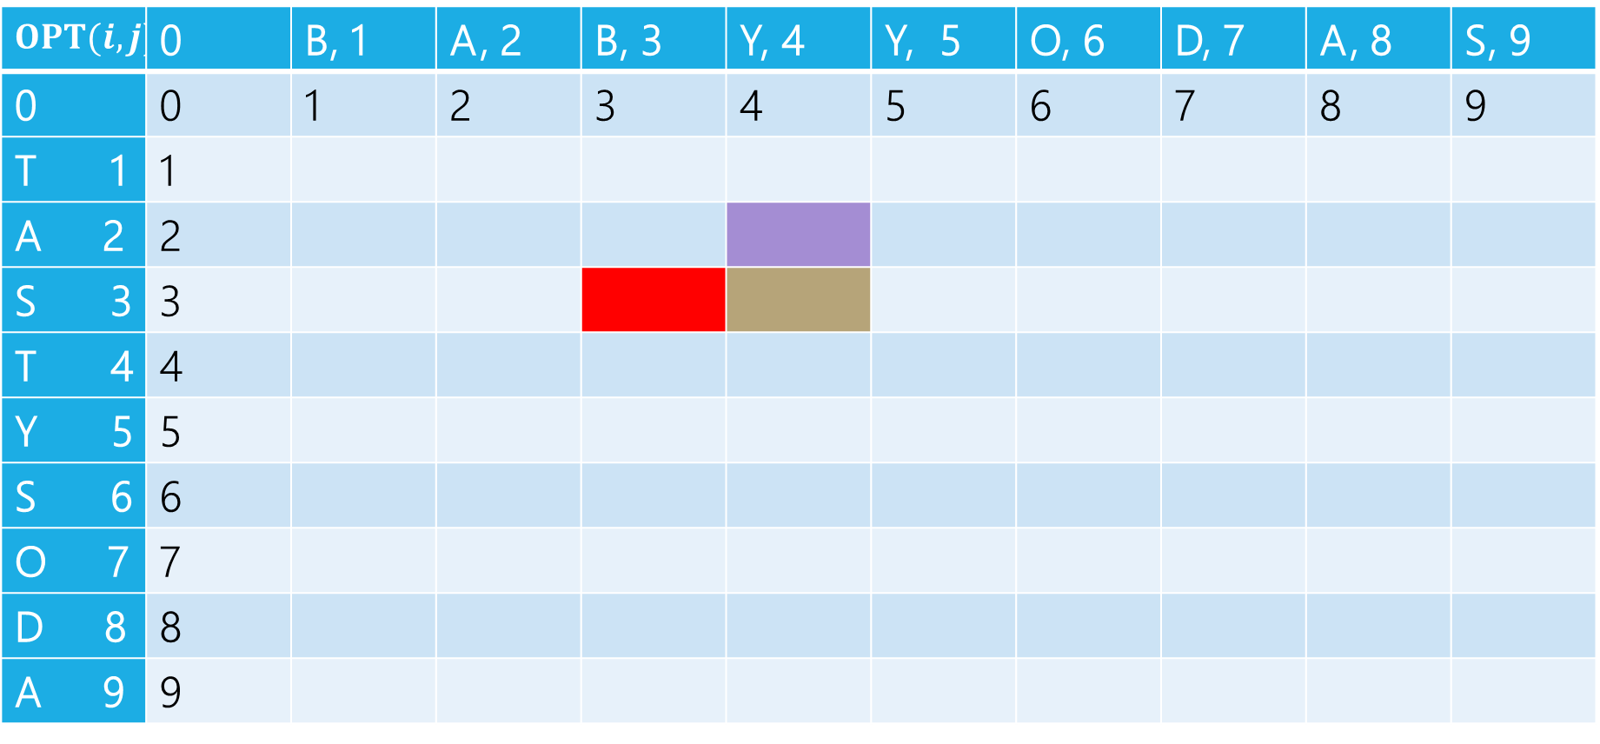
Edit Distance
B | A | B | Y
T | A | S
Insert: insert S (cost 1)
BABY
TA
$$OPT(i,j)$$ | 0 | B, 1 | A, 2 | B, 3 | Y, 4 | Y, 5 | O, 6 | D, 7 | A, 8 | S, 9
0 | 0 | 1 | 2 | 3 | 4 | 5 | 6 | 7 | 8 | 9
T 1 | 1
A 2 | 2
S 3 | 3
T 4 | 4
Y 5 | 5
S 6 | 6
O 7 | 7
D 8 | 8
A 9 | 9

Slide 58
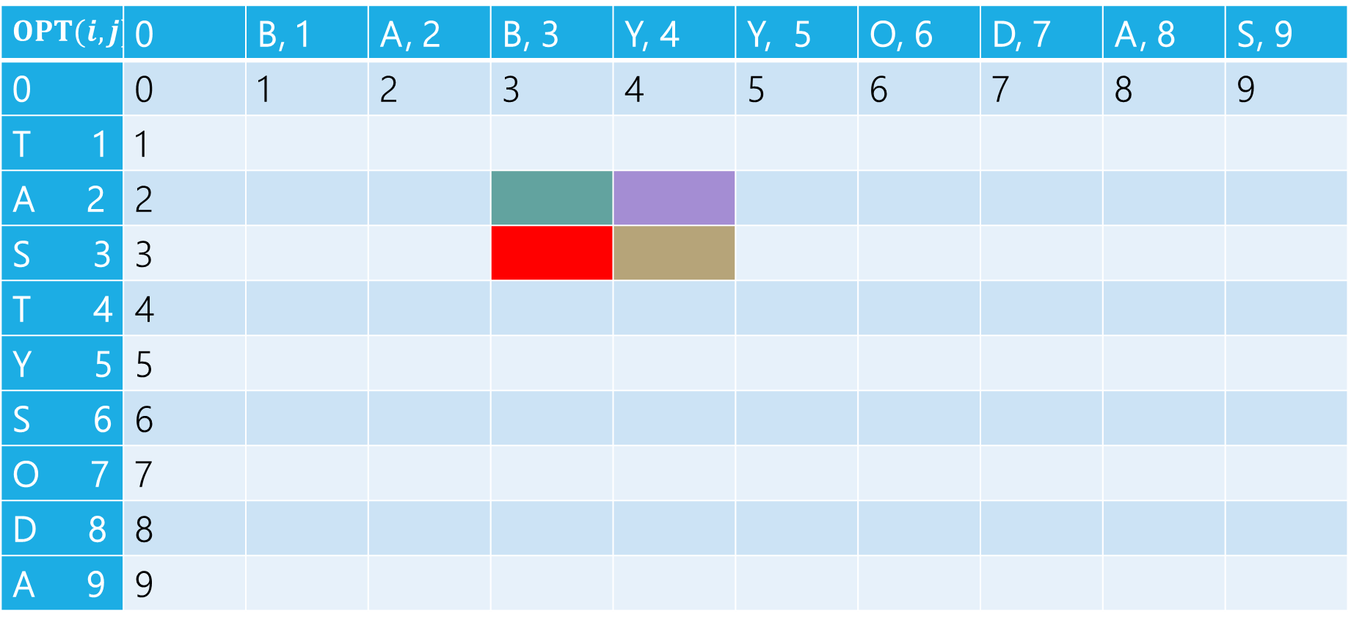
Edit Distance
B | A | B | Y
T | A | S
Sub: Transform Y to S (cost 1)
BAB
TA
$$OPT(i,j)$$ | 0 | B, 1 | A, 2 | B, 3 | Y, 4 | Y, 5 | O, 6 | D, 7 | A, 8 | S, 9
0 | 0 | 1 | 2 | 3 | 4 | 5 | 6 | 7 | 8 | 9
T 1 | 1
A 2 | 2
S 3 | 3
T 4 | 4
Y 5 | 5
S 6 | 6
O 7 | 7
D 8 | 8
A 9 | 9

Slide 59
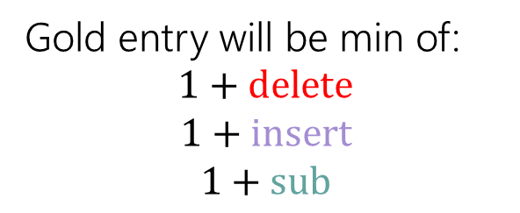
Edit Distance
Gold entry will be min of:
$$1+delete$$
$$1+insert$$
$$1+sub$$
B | A | B | Y
T | A | S
$$OPT(i,j)$$ | 0 | B, 1 | A, 2 | B, 3 | Y, 4 | Y, 5 | O, 6 | D, 7 | A, 8 | S, 9
0 | 0 | 1 | 2 | 3 | 4 | 5 | 6 | 7 | 8 | 9
T 1 | 1
A 2 | 2
S 3 | 3
T 4 | 4
Y 5 | 5
S 6 | 6
O 7 | 7
D 8 | 8
A 9 | 9

Slide 60
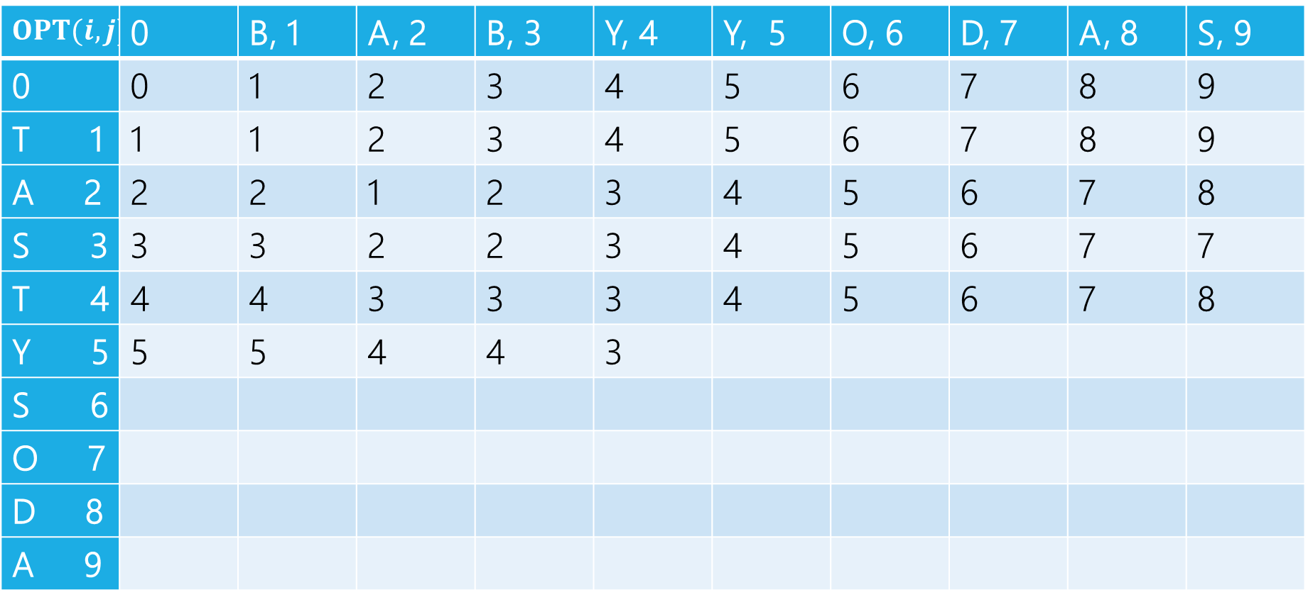

Edit Distance
$$1+2$$
$$1+3$$
$$1+2$$
Min: $3$
Gold entry will be min of:
$$1+delete$$
$$1+insert$$
$$1+sub$$
$$OPT(i,j)$$ | 0 | B, 1 | A, 2 | B, 3 | Y, 4 | Y, 5 | O, 6 | D, 7 | A, 8 | S, 9
0 | 0 | 1 | 2 | 3 | 4 | 5 | 6 | 7 | 8 | 9
T 1 | 1 | 1 | 2 | 3 | 4 | 5 | 6 | 7 | 8 | 9
A 2 | 2 | 2 | 1 | 2 | 3 | 4 | 5 | 6 | 7 | 8
S 3 | 3 | 3 | 2 | 2 | 3 | 4 | 5 | 6 | 7 | 7
T 4 | 4 | 4 | 3 | 3 | 3 | 4 | 5 | 6 | 7 | 8
Y 5 | 5 | 5 | 4 | 4 | 3
S 6
O 7
D 8
A 9

Slide 61
Edit Distance
Fill in the next two entries. Be careful with the sub/match distinction!
$$OPT(i,j)$$ | 0 | B, 1 | A, 2 | B, 3 | Y, 4 | Y, 5 | O, 6 | D, 7 | A, 8 | S, 9
0 | 0 | 1 | 2 | 3 | 4 | 5 | 6 | 7 | 8 | 9
T 1 | 1 | 1 | 2 | 3 | 4 | 5 | 6 | 7 | 8 | 9
A 2 | 2 | 2 | 1 | 2 | 3 | 4 | 5 | 6 | 7 | 8
S 3 | 3 | 3 | 2 | 2 | 3 | 4 | 5 | 6 | 7 | 7
T 4 | 4 | 4 | 3 | 3 | 3 | 4 | 5 | 6 | 7 | 8
Y 5 | 5 | 5 | 4 | 4 | 3
S 6
O 7
D 8
A 9

Slide 62
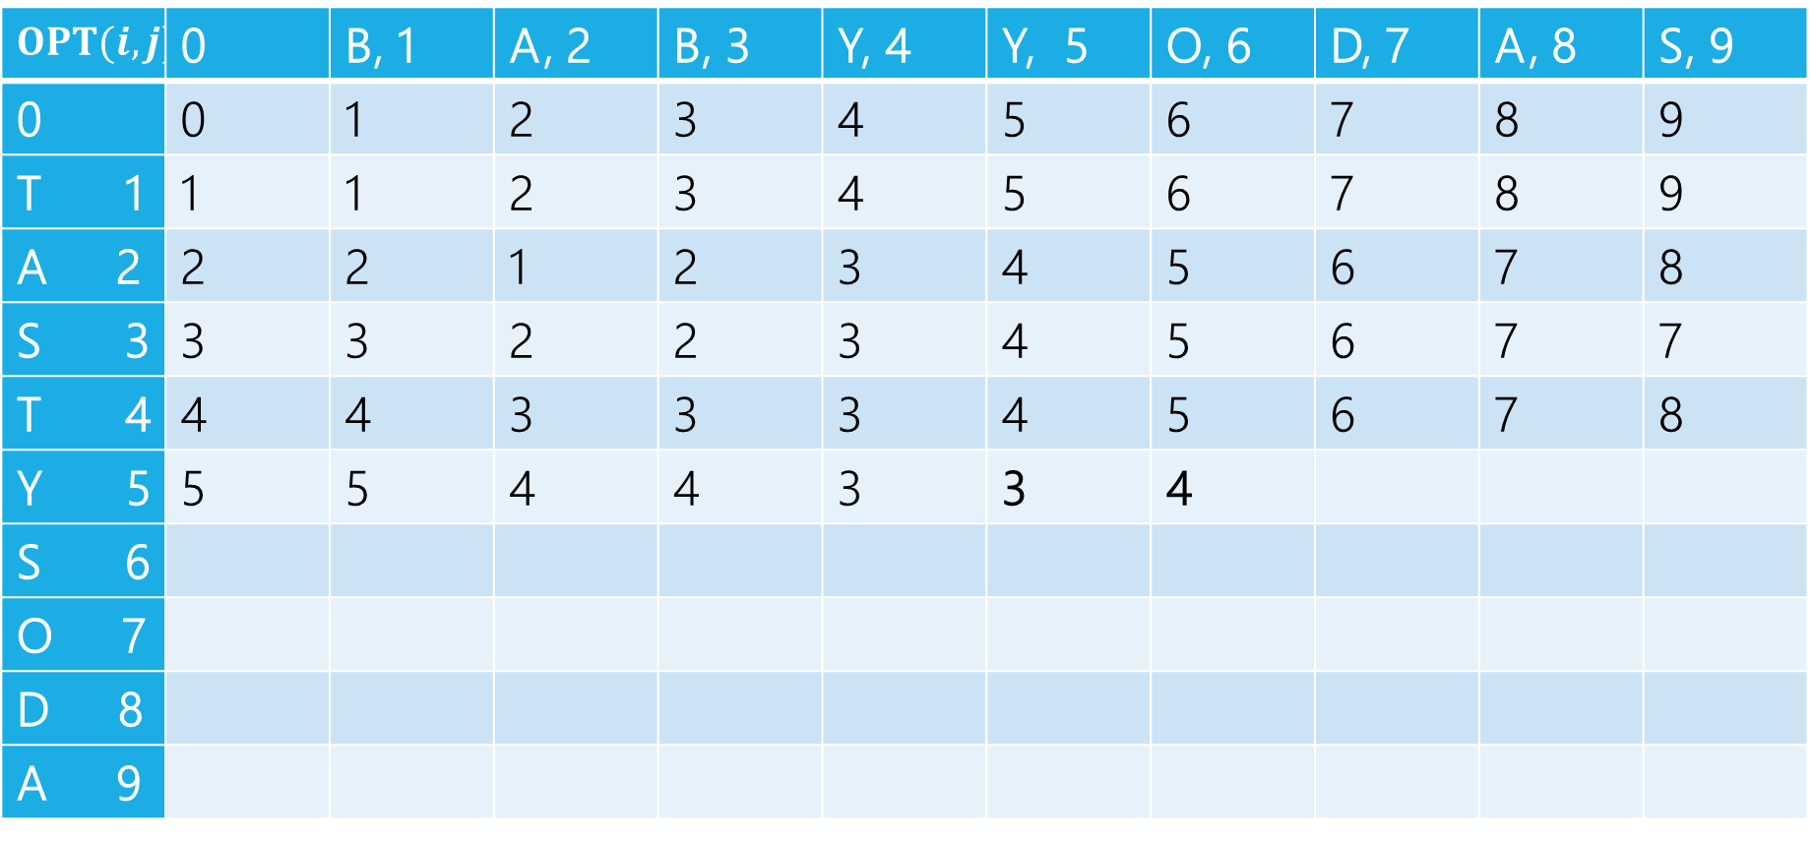
Edit Distance
Fill in the next two entries. Be careful with the sub/match distinction!
$$OPT(i,j)$$ | 0 | B, 1 | A, 2 | B, 3 | Y, 4 | Y, 5 | O, 6 | D, 7 | A, 8 | S, 9
0 | 0 | 1 | 2 | 3 | 4 | 5 | 6 | 7 | 8 | 9
T 1 | 1 | 1 | 2 | 3 | 4 | 5 | 6 | 7 | 8 | 9
A 2 | 2 | 2 | 1 | 2 | 3 | 4 | 5 | 6 | 7 | 8
S 3 | 3 | 3 | 2 | 2 | 3 | 4 | 5 | 6 | 7 | 7
T 4 | 4 | 4 | 3 | 3 | 3 | 4 | 5 | 6 | 7 | 8
Y 5 | 5 | 5 | 4 | 4 | 3 | 3 | 4
S 6
O 7
D 8
A 9
Y’s match, so sub is free!

Slide 63

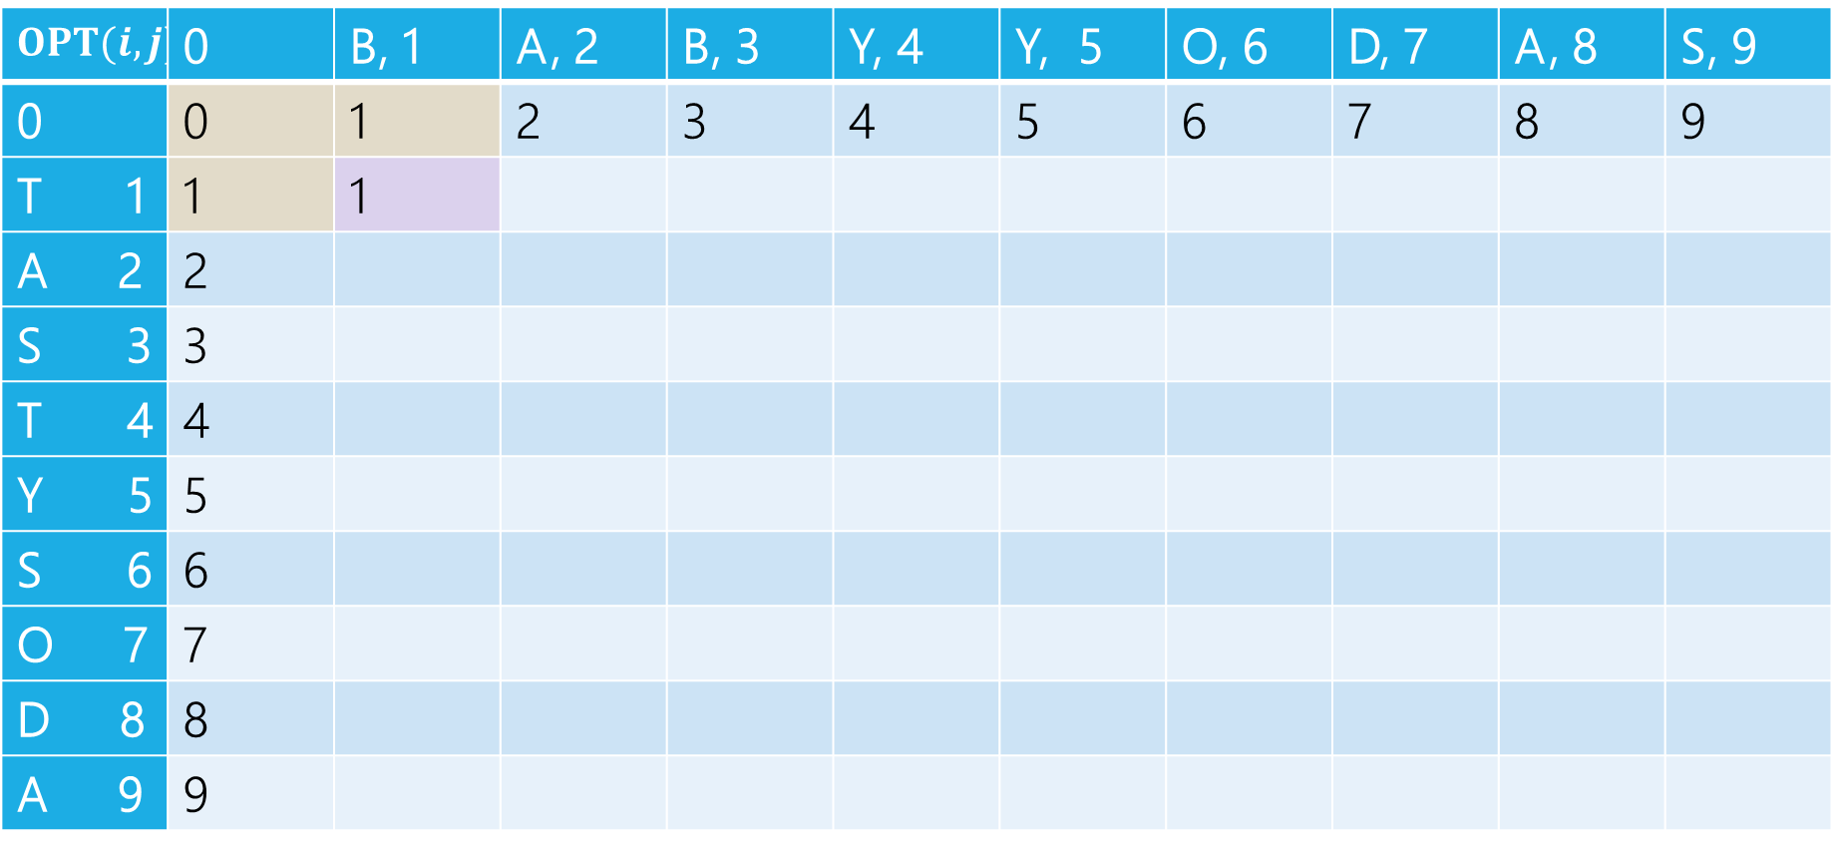
Edit Distance
$$OPT(i,j)$$ | 0 | B, 1 | A, 2 | B, 3 | Y, 4 | Y, 5 | O, 6 | D, 7 | A, 8 | S, 9
0 | 0 | 1 | 2 | 3 | 4 | 5 | 6 | 7 | 8 | 9
T 1 | 1 | 1
A 2 | 2
S 3 | 3
T 4 | 4
Y 5 | 5
S 6 | 6
O 7 | 7
D 8 | 8
A 9 | 9
$1+1 \left(left, delete\right)$
$1+1\left(up, insert\right)$
$0+1(diag,sub)$

Slide 64

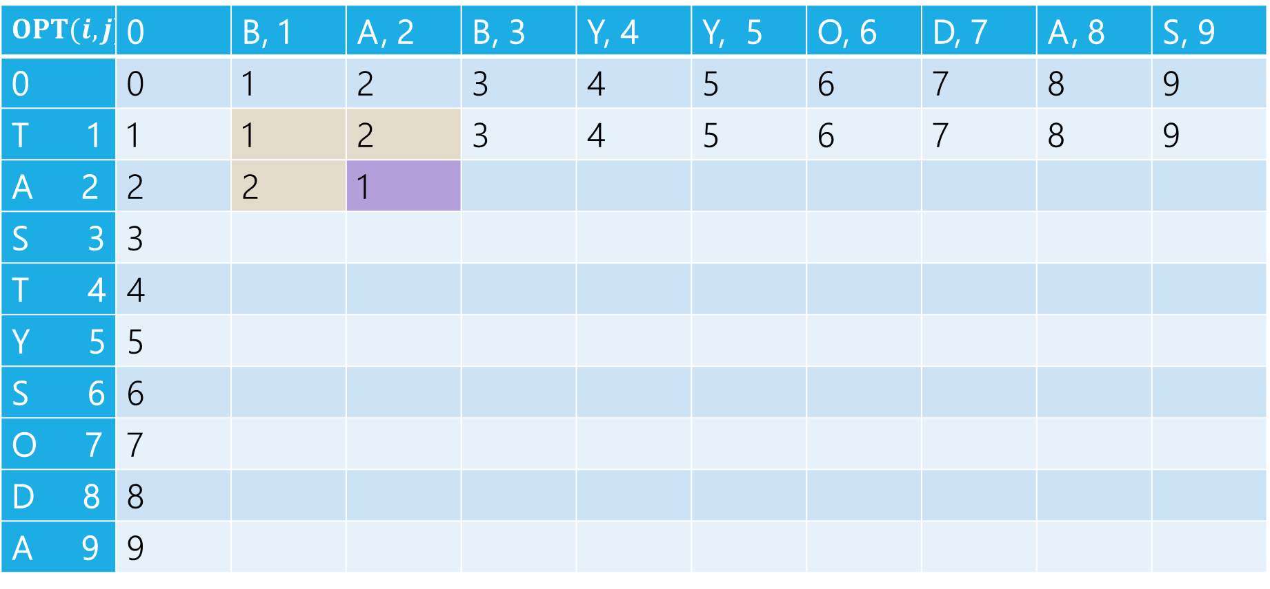
Edit Distance
$$OPT(i,j)$$ | 0 | B, 1 | A, 2 | B, 3 | Y, 4 | Y, 5 | O, 6 | D, 7 | A, 8 | S, 9
0 | 0 | 1 | 2 | 3 | 4 | 5 | 6 | 7 | 8 | 9
T 1 | 1 | 1 | 2 | 3 | 4 | 5 | 6 | 7 | 8 | 9
A 2 | 2 | 2 | 1
S 3 | 3
T 4 | 4
Y 5 | 5
S 6 | 6
O 7 | 7
D 8 | 8
A 9 | 9
$2+1 \left(left, delete\right)$
$2+1\left(up, insert\right)$
$1+0(diag,sub)$

Slide 65
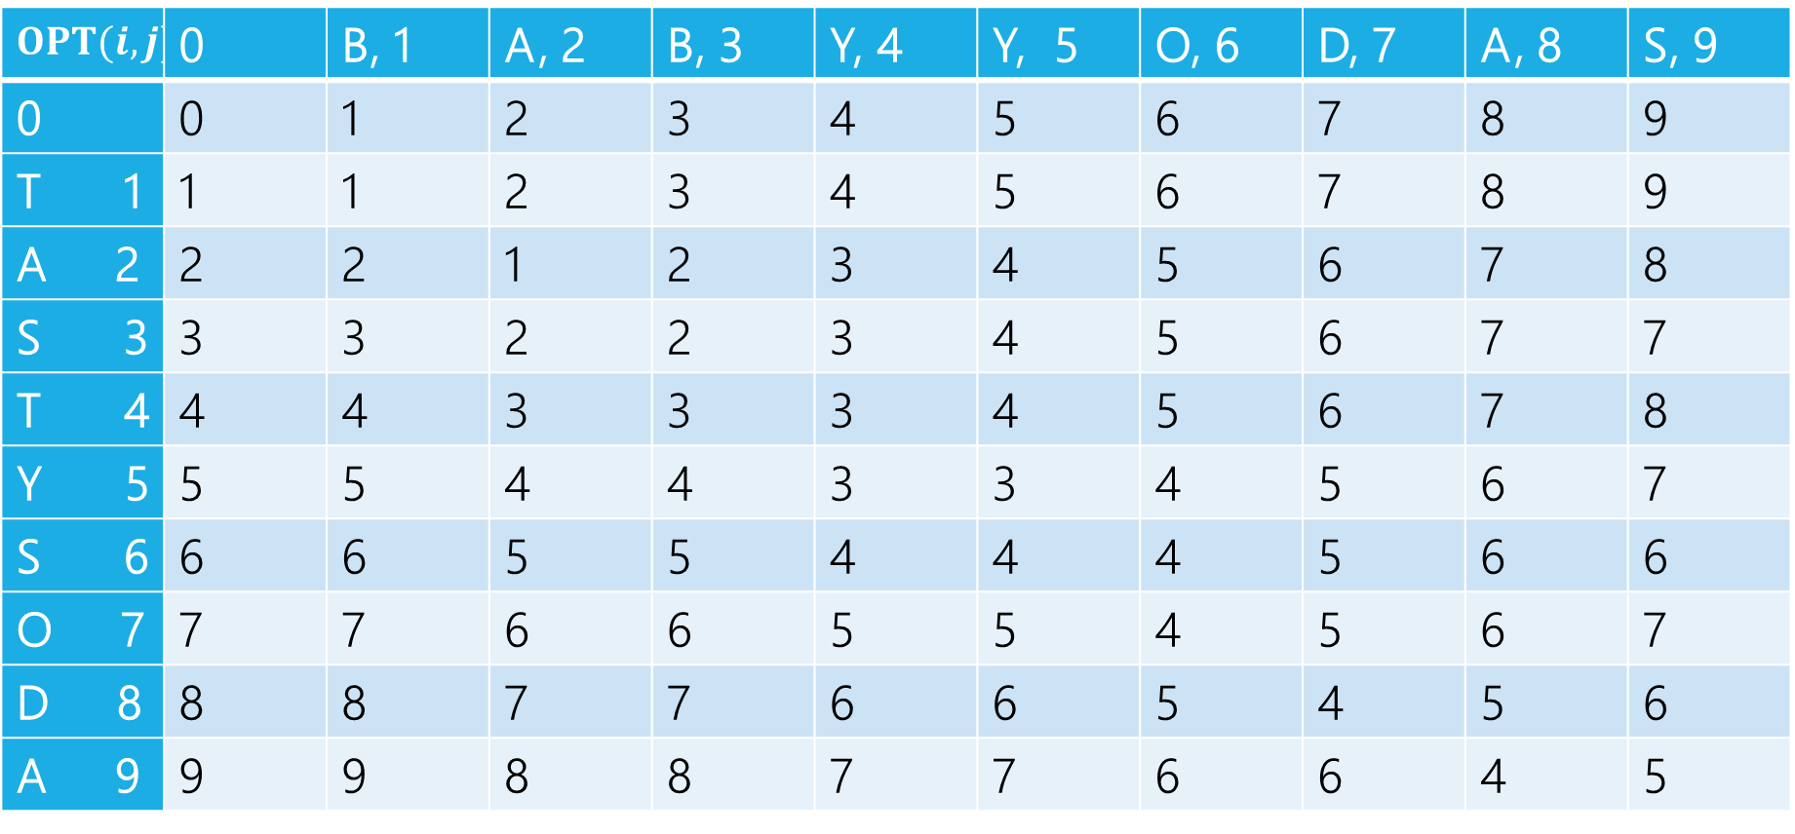
Edit Distance
$$OPT(i,j)$$ | 0 | B, 1 | A, 2 | B, 3 | Y, 4 | Y, 5 | O, 6 | D, 7 | A, 8 | S, 9
0 | 0 | 1 | 2 | 3 | 4 | 5 | 6 | 7 | 8 | 9
T 1 | 1 | 1 | 2 | 3 | 4 | 5 | 6 | 7 | 8 | 9
A 2 | 2 | 2 | 1 | 2 | 3 | 4 | 5 | 6 | 7 | 8
S 3 | 3 | 3 | 2 | 2 | 3 | 4 | 5 | 6 | 7 | 7
T 4 | 4 | 4 | 3 | 3 | 3 | 4 | 5 | 6 | 7 | 8
Y 5 | 5 | 5 | 4 | 4 | 3 | 3 | 4 | 5 | 6 | 7
S 6 | 6 | 6 | 5 | 5 | 4 | 4 | 4 | 5 | 6 | 6
O 7 | 7 | 7 | 6 | 6 | 5 | 5 | 4 | 5 | 6 | 7
D 8 | 8 | 8 | 7 | 7 | 6 | 6 | 5 | 4 | 5 | 6
A 9 | 9 | 9 | 8 | 8 | 7 | 7 | 6 | 6 | 4 | 5

Slide 66
Edit Distance
Can recover the choices, just like with Baby Yoda.
$$OPT(i,j)$$ | 0 | B, 1 | A, 2 | B, 3 | Y, 4 | Y, 5 | O, 6 | D, 7 | A, 8 | S, 9
0 | 0 | 1 | 2 | 3 | 4 | 5 | 6 | 7 | 8 | 9
T 1 | 1 | 1 | 2 | 3 | 4 | 5 | 6 | 7 | 8 | 9
A 2 | 2 | 2 | 1 | 2 | 3 | 4 | 5 | 6 | 7 | 8
S 3 | 3 | 3 | 2 | 2 | 3 | 4 | 5 | 6 | 7 | 7
T 4 | 4 | 4 | 3 | 3 | 3 | 4 | 5 | 6 | 7 | 8
Y 5 | 5 | 5 | 4 | 4 | 3 | 3 | 4 | 5 | 6 | 7
S 6 | 6 | 6 | 5 | 5 | 4 | 4 | 4 | 5 | 6 | 6
O 7 | 7 | 7 | 6 | 6 | 5 | 5 | 4 | 5 | 6 | 7
D 8 | 8 | 8 | 7 | 7 | 6 | 6 | 5 | 4 | 5 | 6
A 9 | 9 | 9 | 8 | 8 | 7 | 7 | 6 | 6 | 4 | 5

Slide 67
Edit Distance
When there are ties, there may be more than one set of choices.
$$OPT(i,j)$$ | 0 | B, 1 | A, 2 | B, 3 | Y, 4 | Y, 5 | O, 6 | D, 7 | A, 8 | S, 9
0 | 0 | 1 | 2 | 3 | 4 | 5 | 6 | 7 | 8 | 9
T 1 | 1 | 1 | 2 | 3 | 4 | 5 | 6 | 7 | 8 | 9
A 2 | 2 | 2 | 1 | 2 | 3 | 4 | 5 | 6 | 7 | 8
S 3 | 3 | 3 | 2 | 2 | 3 | 4 | 5 | 6 | 7 | 7
T 4 | 4 | 4 | 3 | 3 | 3 | 4 | 5 | 6 | 7 | 8
Y 5 | 5 | 5 | 4 | 4 | 3 | 3 | 4 | 5 | 6 | 7
S 6 | 6 | 6 | 5 | 5 | 4 | 4 | 4 | 5 | 6 | 6
O 7 | 7 | 7 | 6 | 6 | 5 | 5 | 4 | 5 | 6 | 7
D 8 | 8 | 8 | 7 | 7 | 6 | 6 | 5 | 4 | 5 | 6
A 9 | 9 | 9 | 8 | 8 | 7 | 7 | 6 | 6 | 4 | 5

Slide 68
Dynamic Programming Process
1. Define the object you’re looking for
2. Write a recurrence to say how to find it
3. Design a memoization structure
4. Write an iterative algorithm
Minimum Edit Distance between $x$ and $y$
✅
$m×n$ Array
Outer loop: increasing rows (starting from 1)
Inner loop: increasing column (starting from 1)

