Slide 1
Greedy Approximation Algorithims
CSE 421 Winter 2023
Lecture 7

Slide 2
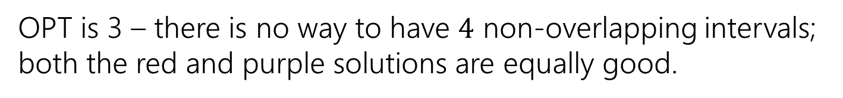
Interval Scheduling
You have a single processor, and a set of jobs with fixed start and end times.
Your goal is to maximize the number of jobs you can process.
I.e. choose the maximum number of non-overlapping intervals.
OPT is 3 – there is no way to have $4$ non-overlapping intervals; both the red and purple solutions are equally good.

Slide 3
Greedy Algorithm
Earliest end time
Latest end time
Earliest start time
Latest start time
Shortest interval
Fewest overlaps (with remaining intervals)

Slide 4

Earliest End Time
Intuition: If $u$ has the earliest end time, and $u$ overlaps with $v$ and $w$ then $v$ and $w$ also overlap.
Why?

Slide 5
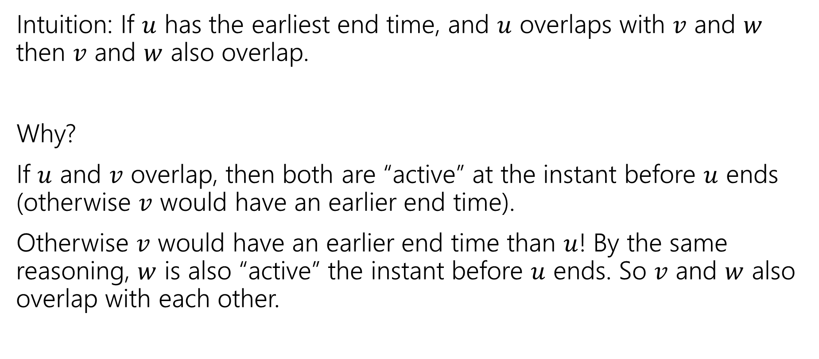
Earliest End Time
Intuition: If $u$ has the earliest end time, and $u$ overlaps with $v$ and $w$ then $v$ and $w$ also overlap.
Why?
If $u$ and $v$ overlap, then both are “active” at the instant before $u$ ends (otherwise $v$ would have an earlier end time).
Otherwise $v$ would have an earlier end time than $u$! By the same reasoning, $w$ is also “active” the instant before $u$ ends. So $v$ and $w$ also overlap with each other.

Slide 6
Earliest End Time
Can you prove it correct?
Do you want to use
Structural Result
Exchange Argument
Greedy Stays Ahead

Slide 7
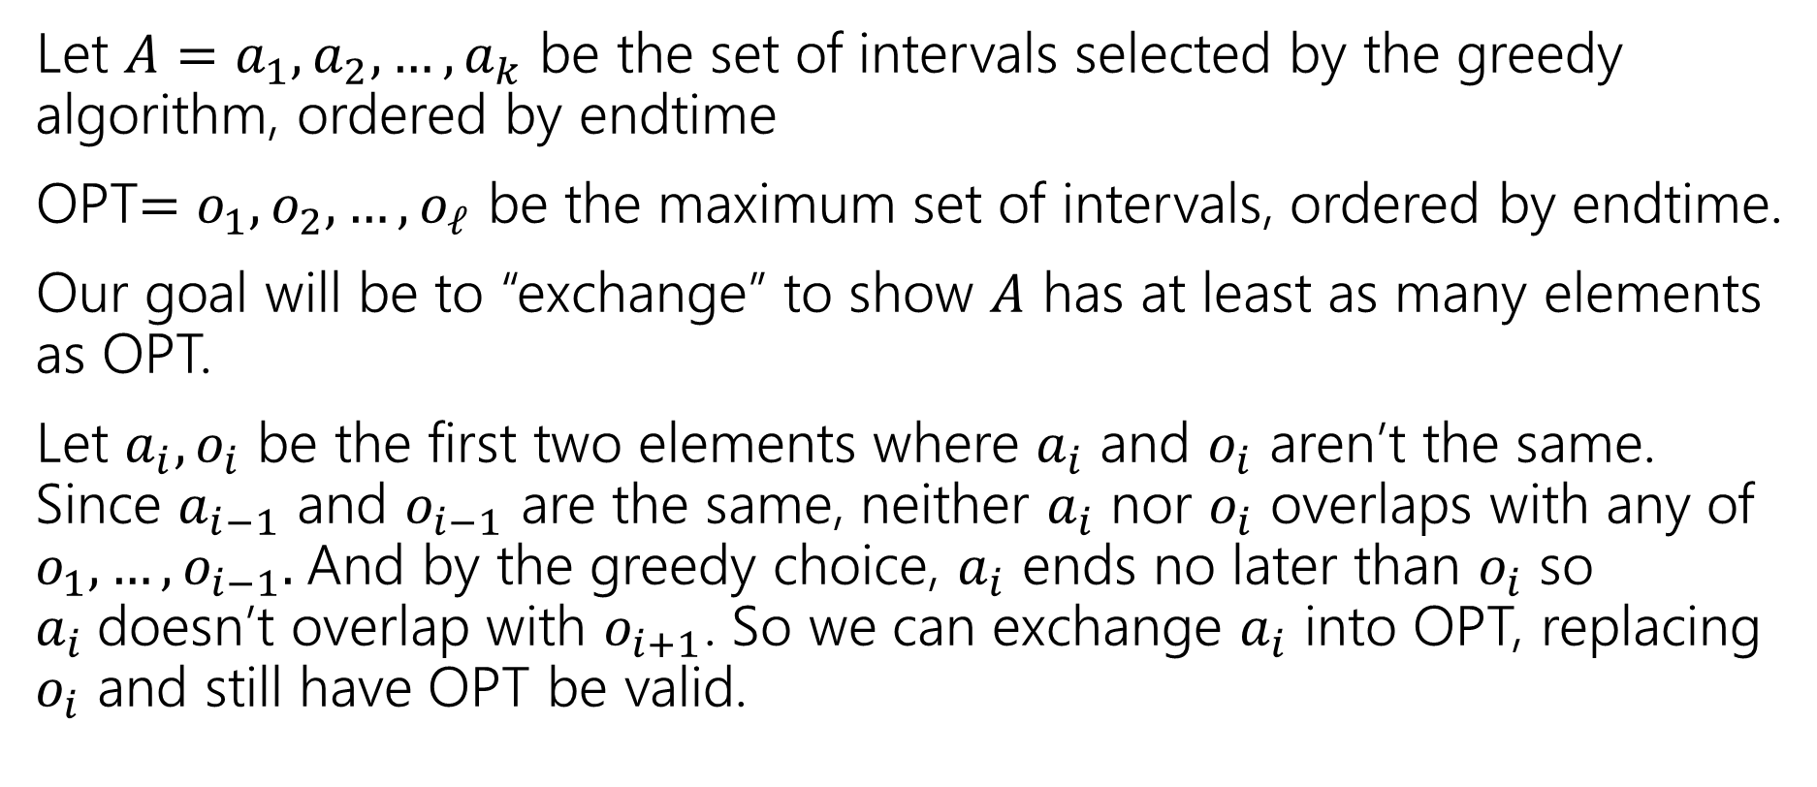
Exchange Argument
Let $A=a_{1},a_{2},…,a_{k}$ be the set of intervals selected by the greedy algorithm, ordered by endtime
OPT$=o_{1},o_{2},…,o_{ℓ}$ be the maximum set of intervals, ordered by endtime.
Our goal will be to “exchange” to show $A$ has at least as many elements as OPT.
Let $a_{i},o_{i}$ be the first two elements where $a_{i}$ and $o_{i}$ aren’t the same. Since $a_{i−1}$ and $o_{i−1}$ are the same, neither $a_{i}$ nor $o_{i}$ overlaps with any of $o_{1},…,o_{i−1}.$And by the greedy choice, $a_{i}$ ends no later than $o_{i}$ so $a_{i}$doesn’t overlap with $o_{i+1}$. So we can exchange $a_{i}$ into OPT, replacing $o_{i}$ and still have OPT be valid.

Slide 8
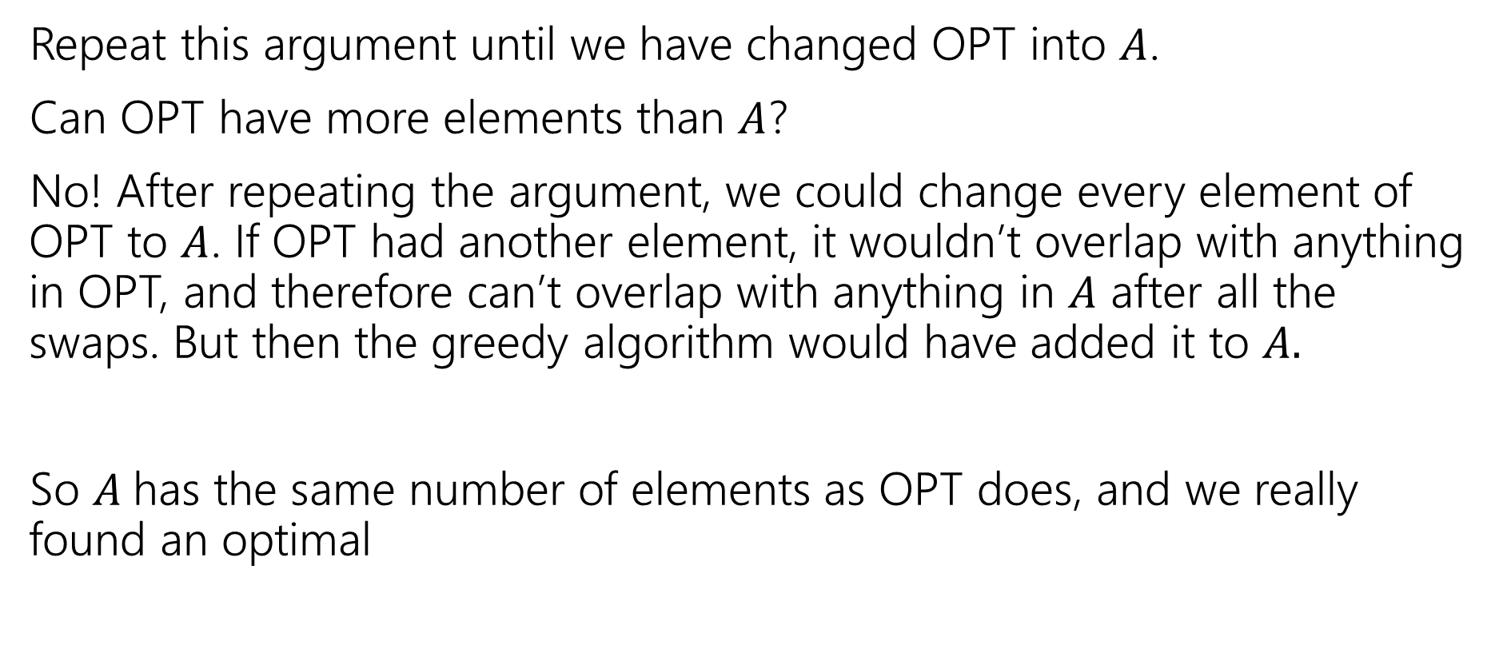
Exchange Argument
Repeat this argument until we have changed OPT into $A$.
Can OPT have more elements than $A$?
No! After repeating the argument, we could change every element of OPT to $A$. If OPT had another element, it wouldn’t overlap with anything in OPT, and therefore can’t overlap with anything in $A$ after all the swaps. But then the greedy algorithm would have added it to $A.$
So $A$has the same number of elements as OPT does, and we really found an optimal

Slide 9
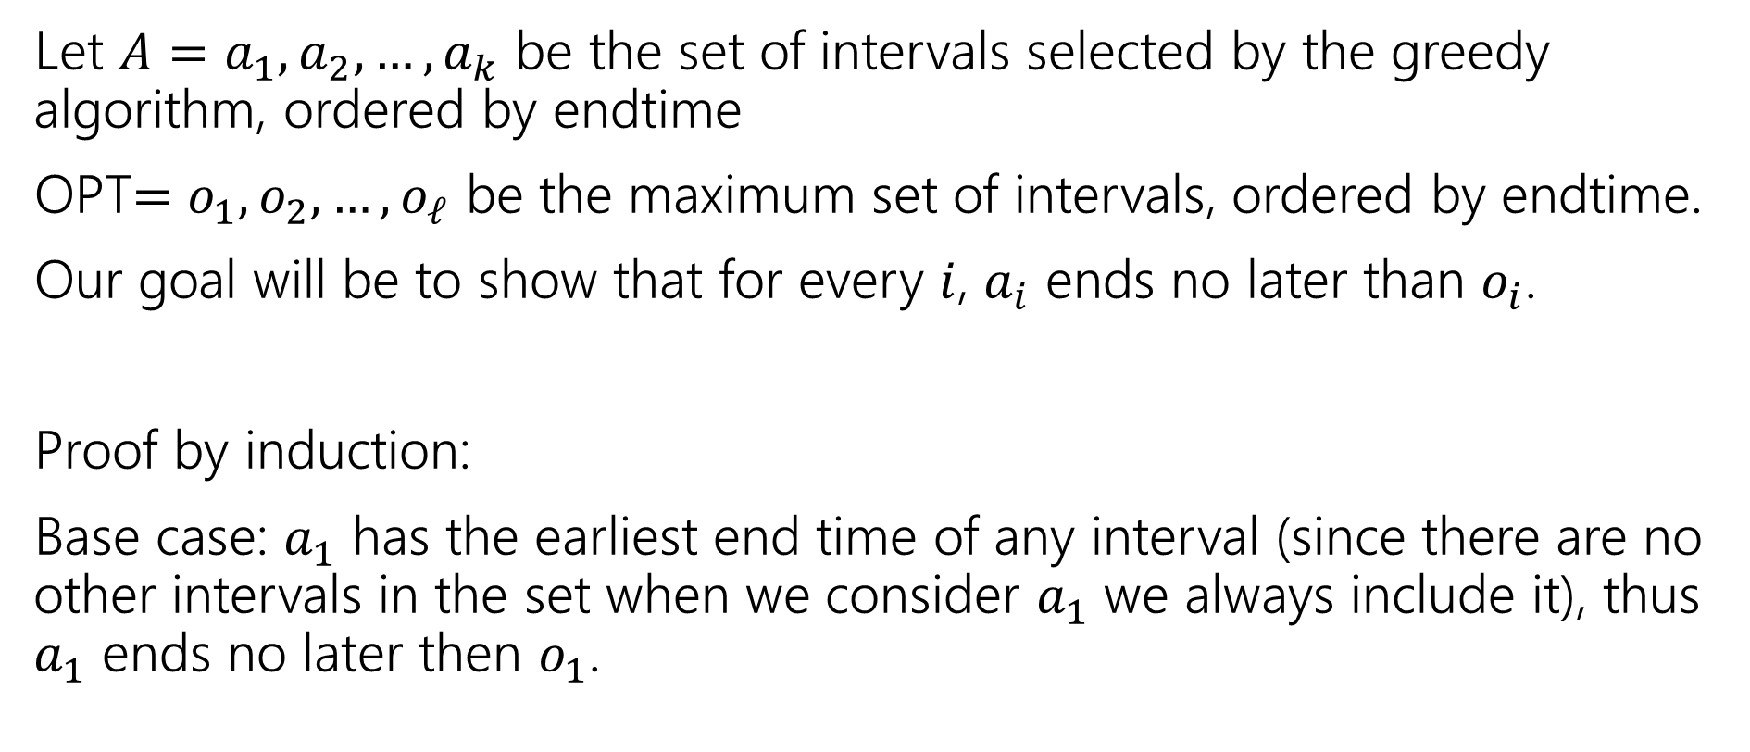
Greedy Stays Ahead
Let $A=a_{1},a_{2},…,a_{k}$ be the set of intervals selected by the greedy algorithm, ordered by endtime
OPT$=o_{1},o_{2},…,o_{ℓ}$ be the maximum set of intervals, ordered by endtime.
Our goal will be to show that for every $i$, $a_{i}$ ends no later than $o_{i}$.
Proof by induction:
Base case: $a_{1}$ has the earliest end time of any interval (since there are no other intervals in the set when we consider $a_{1}$ we always include it), thus $a_{1}$ ends no later then $o_{1}$.

Slide 10
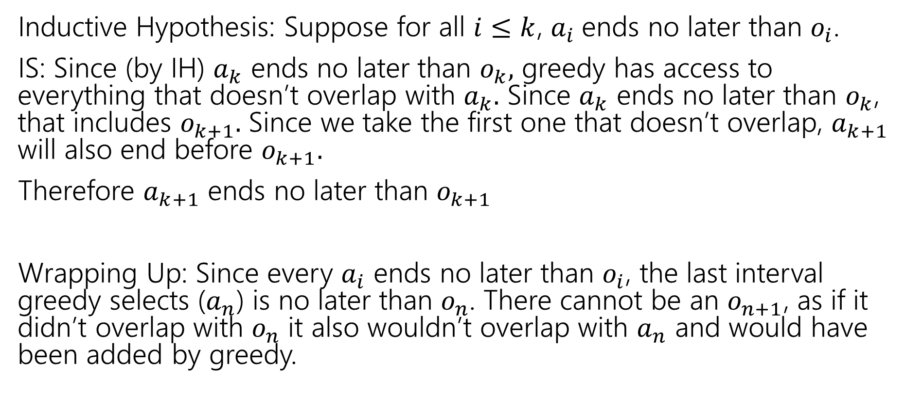
Greedy Stays Ahead
Inductive Hypothesis: Suppose for all $i≤k$, $a_{i}$ends no later than $o_{i}$.
IS: Since (by IH) $a_{k}$ ends no later than $o_{k},$ greedy has access to everything that doesn’t overlap with $a_{k}.$ Since $a_{k}$ ends no later than $o_{k}$, that includes $o_{k+1}.$ Since we take the first one that doesn’t overlap, $a_{k+1}$ will also end before $o_{k+1}.$
Therefore $a_{k+1}$ ends no later than $o_{k+1}$
Wrapping Up: Since every $a_{i}$ ends no later than $o_{i}$, the last interval greedy selects ($a_{n}$) is no later than $o_{n}$. There cannot be an $o_{n+1}$, as if it didn’t overlap with $o_{n}$ it also wouldn’t overlap with $a_{n}$ and would have been added by greedy.

Slide 11

Greedy Algorithm
Earliest end time
Latest end time
Earliest start time
Latest start time
Shortest interval
Fewest overlaps (with remaining intervals)

Slide 12
Other Greedy Algorithms
It turns out latest start time also works.
Latest start time is actually the same as earliest end time (imagine “reflecting” all the jobs along the time axis – the one with the earliest end time ends up having the last start time).
What about fewest overlaps?
Doesn’t work. ☹ Counter-examples are a little more complicated than the others.

Slide 13
Greedy Algorithm
Earliest end time
Latest end time
Earliest start time
Latest start time
Shortest interval
Fewest overlaps (with remaining intervals)

Slide 14
Summary
Greedy algorithms
You’ll probably have 2 (or 3…or 6) ideas for greedy algorithms. Check some simple examples before you implement!
Greedy algorithms rarely work.
When they work AND you can prove they work, they’re great!
Proofs are often tricky
Structural results are the hardest to come up with, but the most versatile.
Greedy stays ahead usually use induction
Exchange start with the first difference between greedy and optimal.

Slide 15
Approximation Algorithms

Slide 16
Approximation Algorithms
In 332 you learned about “NP-hard” problems. These are problems where we don’t have (or expect to ever have) polynomial time algorithms.
So what do you do if you really want to solve an NP-hard problem?
Sometimes you want an approximation algorithm!

Slide 17
Approximation Algorithms
What makes an approximation algorithm good?
Speed: We usually require approximation algorithms to run in polynomial time.
Accuracy:
NP-completeness will say that we can’t solve the problem exactly in polynomial-time, but (without more thinking/proofs) it doesn’t say we couldn’t efficiently get a solution that’s, say within 1% of the best solution.

Slide 18
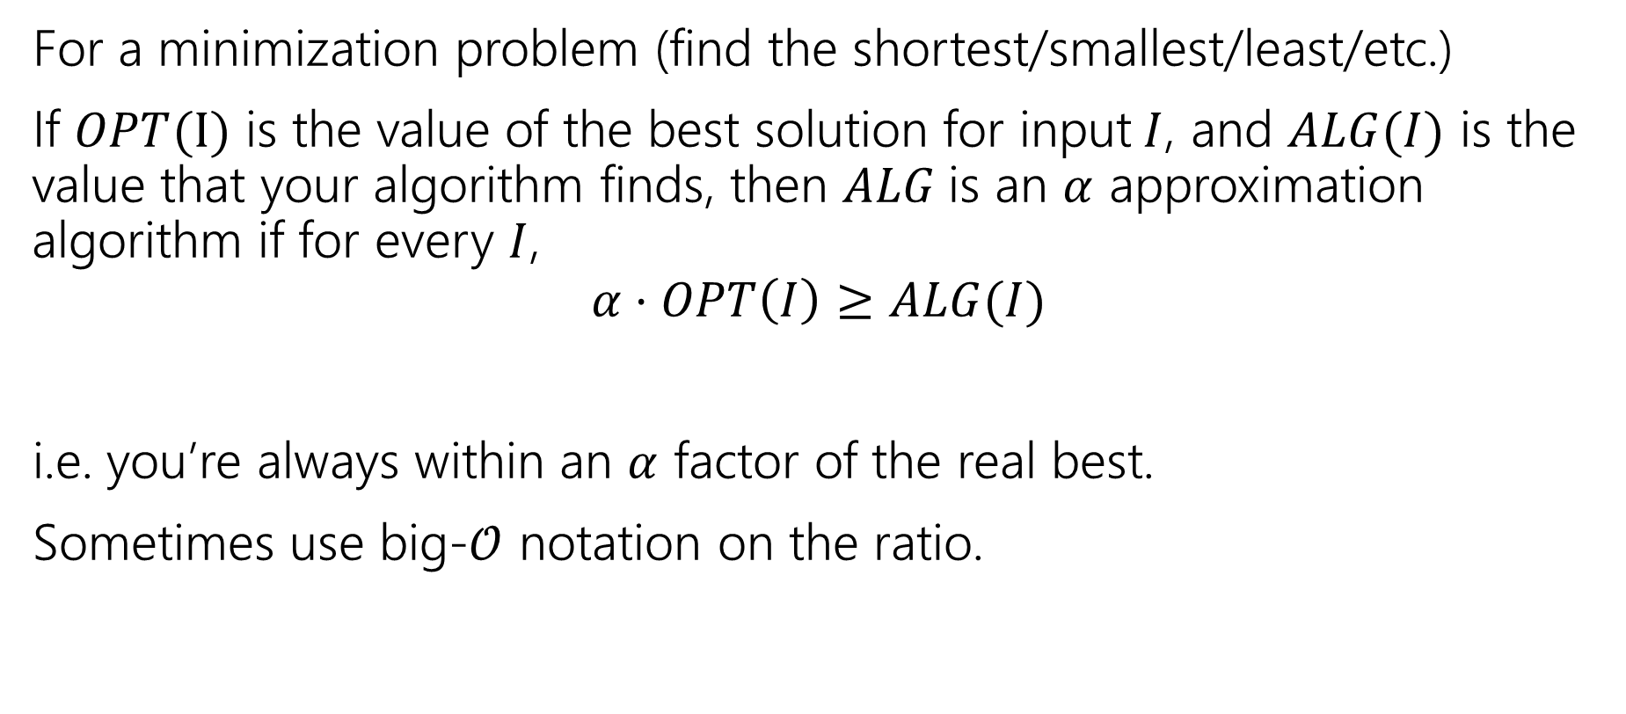
Approximation Ratio
For a minimization problem (find the shortest/smallest/least/etc.)
If $OPT(I)$ is the value of the best solution for input$I$, and $ALG(I)$ is the value that your algorithm finds, then $ALG$is an $α$ approximation algorithm if for every $I$,
$$α⋅OPT\left(I\right)≥ALG(I)$$
i.e. you’re always within an $α$ factor of the real best.
Sometimes use big-$𝒪$ notation on the ratio.

Slide 19
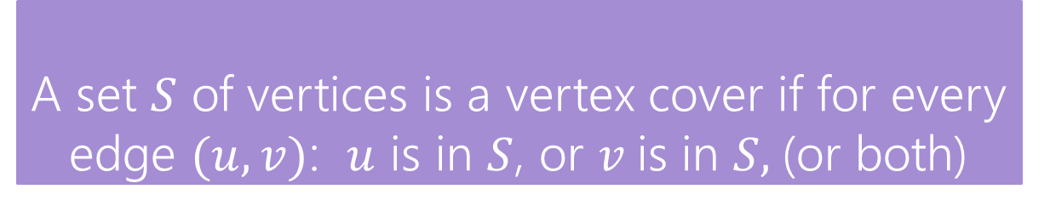
Vertex Cover
Vertex Cover
A set $S$ of vertices is a vertex cover if for every edge $(u,v)$: $u$ is in $S$, or $v$is in $S,$(or both)
Find the minimum vertex cover in a graph.
We’re picking a set of vertices so that the vertices cover every edge.

Slide 20
Vertex Cover
Vertex Cover
A set $S$ of vertices is a vertex cover if for every edge $(u,v)$: $u$ is in $S$, or $v$is in $S,$(or both)
Find the minimum vertex cover in a graph.
We’re picking a set of vertices so that the vertices cover every edge.
A valid vertex cover! (just take everything)
Definitely not the minimum though.

Slide 21
Vertex Cover
Vertex Cover
A set $S$ of vertices is a vertex cover if for every edge $(u,v)$: $u$ is in $S$, or $v$is in $S,$(or both)
Find the minimum vertex cover in a graph.
We’re picking a set of vertices so that the vertices cover every edge.
A better vertex cover – size 2 (only 2 vertices)

Slide 22
Vertex Cover
Take a moment, think of greedy ideas that might work for finding a small vertex cover.

Slide 23
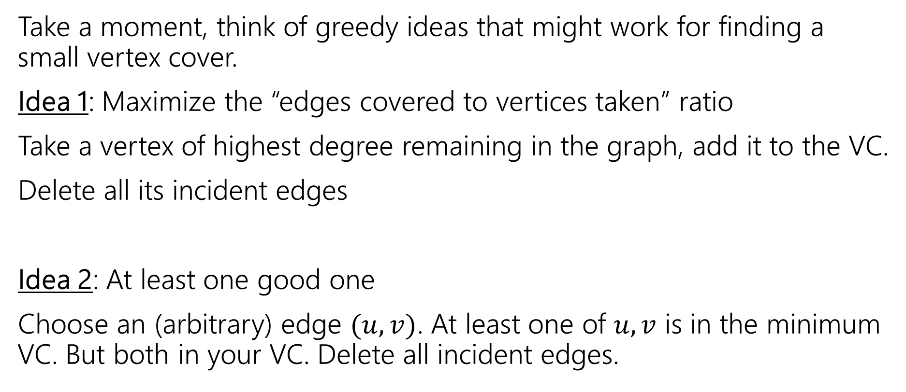
Vertex Cover
Take a moment, think of greedy ideas that might work for finding a small vertex cover.
Idea 1: Maximize the “edges covered to vertices taken” ratio
Take a vertex of highest degree remaining in the graph, add it to the VC.
Delete all its incident edges
Idea 2: At least one good one
Choose an (arbitrary) edge $(u,v)$. At least one of $u,v$ is in the minimum VC. But both in your VC. Delete all incident edges.

Slide 24
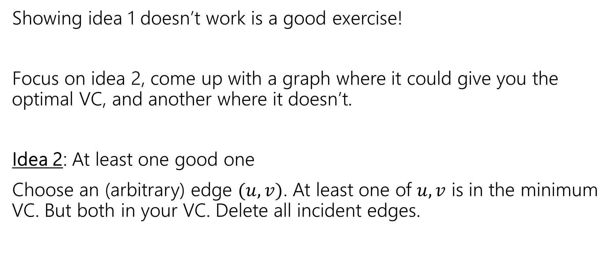
Non-optimal
Showing idea 1 doesn’t work is a good exercise!
Focus on idea 2, come up with a graph where it could give you the optimal VC, and another where it doesn’t.
Idea 2: At least one good one
Choose an (arbitrary) edge $(u,v)$. At least one of $u,v$ is in the minimum VC. But both in your VC. Delete all incident edges.

Slide 26
Any first edge will add two to the VC, and leave the opposite edge uncovered.
The algorithm finds a VC of size 4.
The optimal is 2.
If the algorithm selects the central edge, we get the optimal VC.

Slide 27
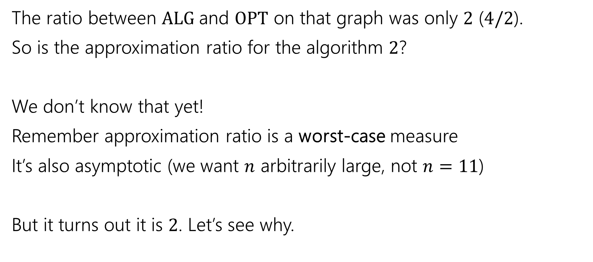
Approximation Ratio
The ratio between $ALG$and $OPT$ on that graph was only $2$ ($4/2$).
So is the approximation ratio for the algorithm $2$?
We don’t know that yet!
Remember approximation ratio is a worst-case measure
It’s also asymptotic (we want $n$ arbitrarily large, not $n=11$)
But it turns out it is $2$. Let’s see why.

Slide 28
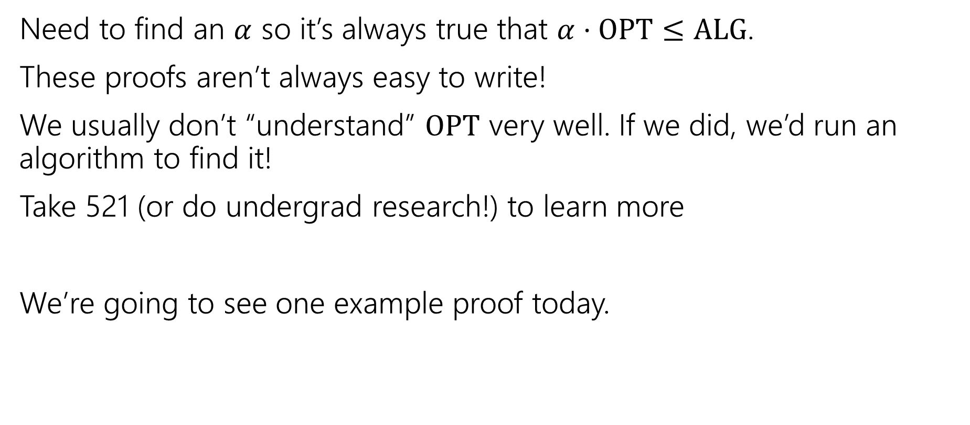
How do we analyze an approximation algorithm?
Need to find an $α$ so it’s always true that $α⋅OPT≤ALG$.
These proofs aren’t always easy to write!
We usually don’t “understand” $OPT$ very well. If we did, we’d run an algorithm to find it!
Take 521 (or do undergrad research!) to learn more
We’re going to see one example proof today.

Slide 29
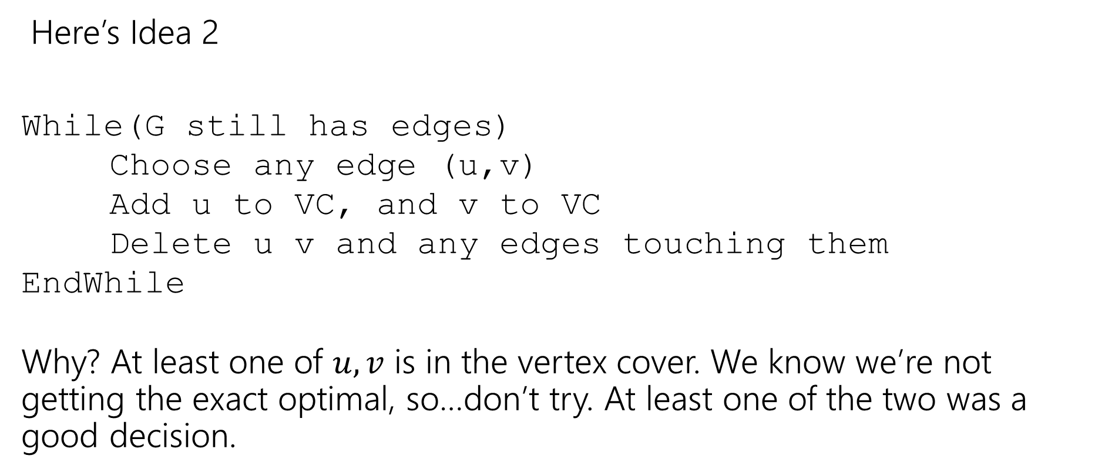
Finding an approximation for Vertex Cover
Here’s Idea 2
While(G still has edges)
Choose any edge (u,v)
Add u to VC, and v to VC
Delete u v and any edges touching them
EndWhile
Why? At least one of $u,v$ is in the vertex cover. We know we’re not getting the exact optimal, so…don’t try. At least one of the two was a good decision.

Slide 30
Does it work?
Do we find a vertex cover? (Is the solution valid?)
Is it close to the smallest one? (Is the solution good?)
But first, let’s notice – this is a polynomial-time algorithm!
If we’re going to take exponential time, we can get the exact answer. We want something fast if we’re going to settle for a worse answer.

Slide 31
Do we find a vertex cover?
Observe that we only delete an edge after we have ensured it will be covered.
When we delete an edge, the edge is covered by whichever endpoint caused it to be deleted (because we added both vertices of the chosen edge to the vertex cover).
And we only stop the algorithm when every edge has been deleted. So every edge is covered (i.e. we really have a vertex cover).

Slide 32
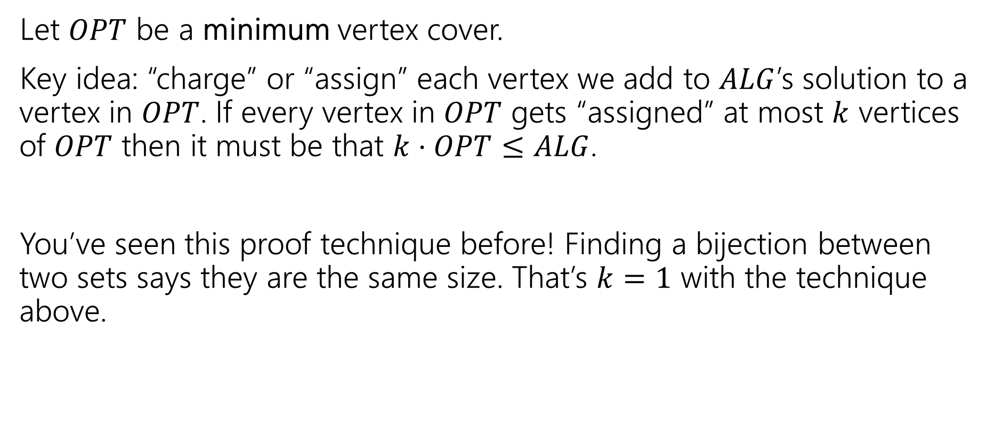
How big is it?
Let $OPT$ be a minimum vertex cover.
Key idea: “charge” or “assign” each vertex we add to $ALG$’s solution to a vertex in $OPT$. If every vertex in $OPT$ gets “assigned” at most $k$ vertices of $OPT$ then it must be that $k⋅OPT≤ALG$.
You’ve seen this proof technique before! Finding a bijection between two sets says they are the same size. That’s $k=1$ with the technique above.

Slide 33
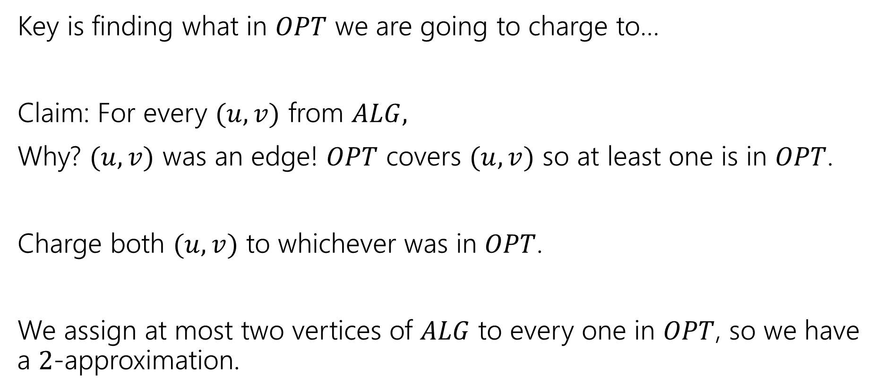
What assignment do we pick?
Key is finding what in $OPT$ we are going to charge to…
Claim: For every $(u,v)$ from $ALG,$
Why? $(u,v)$ was an edge! $OPT$ covers $(u,v)$ so at least one is in $OPT$.
Charge both $(u,v)$ to whichever was in $OPT$.
We assign at most two vertices of $ALG$ to every one in $OPT$, so we have a $2$-approximation.

Slide 34
Greedy Approximation Algs
Greedy Algorithms are a very common source for approximation algorithms!
Since you’re making an optimal “local” choice, it’s not likely to be a terrible solution (even if it’s rarely the absolute best one).
It’s still simple to implement and fast!
And the proofs aren’t nearly as hard anymore!!

Slide 35
Optional Content
A similar problem: Set cover

Slide 36
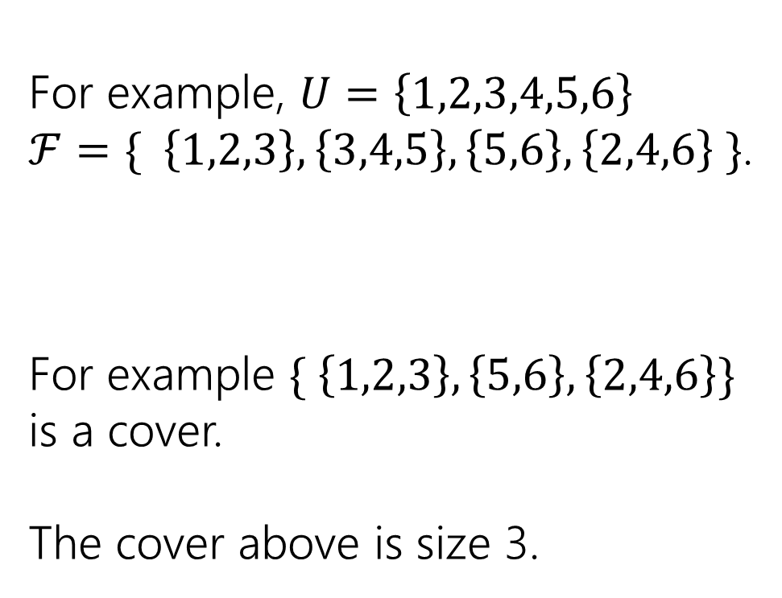
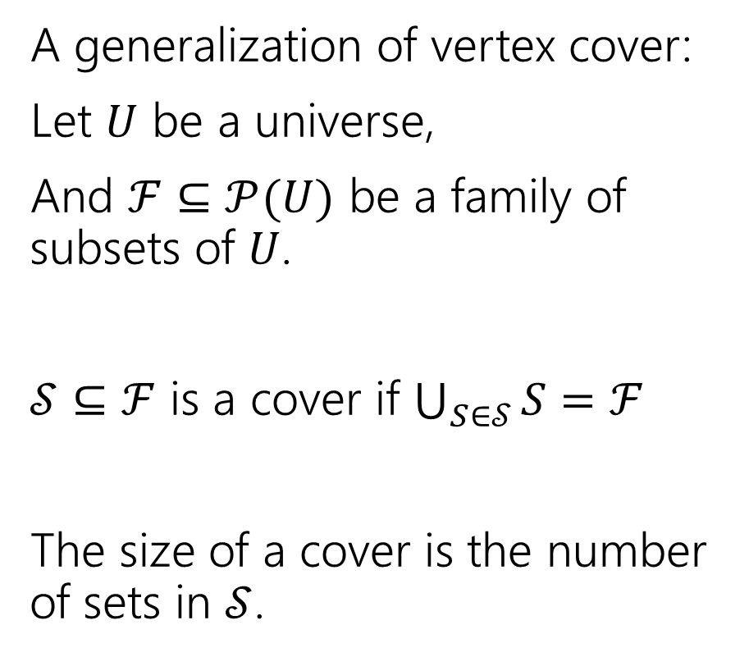
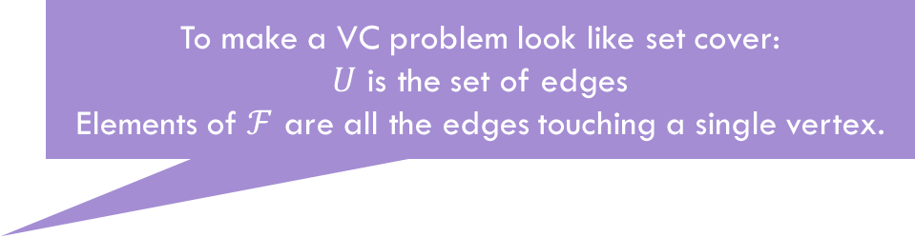
Set Cover
To make a VC problem look like set cover:
$U$ is the set of edges
Elements of $ℱ$ are all the edges touching a single vertex.
A generalization of vertex cover:
Let $U$ be a universe,
And $ℱ⊆𝒫(U)$ be a family of subsets of $U$.
$𝒮⊆ℱ$ is a cover if $\bigcup_{S∈𝒮}{S}=ℱ$
The size of a cover is the number of sets in $𝒮$.
For example, $U=\left\{1,2,3,4,5,6\right\}$
$ℱ=\{ \left\{1,2,3\right\}, \left\{3,4,5\right\}, \left\{5,6\right\}, \left\{2,4,6\right\} \}$.
For example $\{ \left\{1,2,3\right\}, \left\{5,6\right\}, \left\{2,4,6\right\}\}$ is a cover.
The cover above is size 3.

Slide 37

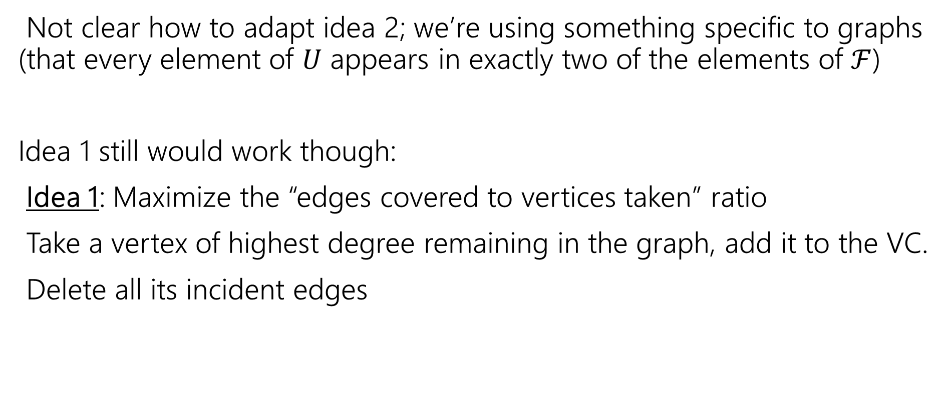

Set Cover
Not clear how to adapt idea 2; we’re using something specific to graphs (that every element of $U$ appears in exactly two of the elements of $ℱ$)
Idea 1 still would work though:
Idea 1: Maximize the “edges covered to vertices taken” ratio
Take a vertex of highest degree remaining in the graph, add it to the VC.
Delete all its incident edges
Elements of $U$
sets
Set with maximum number of uncovered elements
SC
Newly covered elements of $U$

Slide 38

Run the greedy algorithm
Let $U=\{1,2,3,4,5,6,7,8\}$
$S=\{ \left\{1,2,3\right\}, \left\{2,4\right\}, \left\{6,8\right\}, \left\{3,5,7\right\}, \left\{5,7,8\right\}, \left\{2,5,6\right\}, \left\{4\right\} \}$

Slide 39
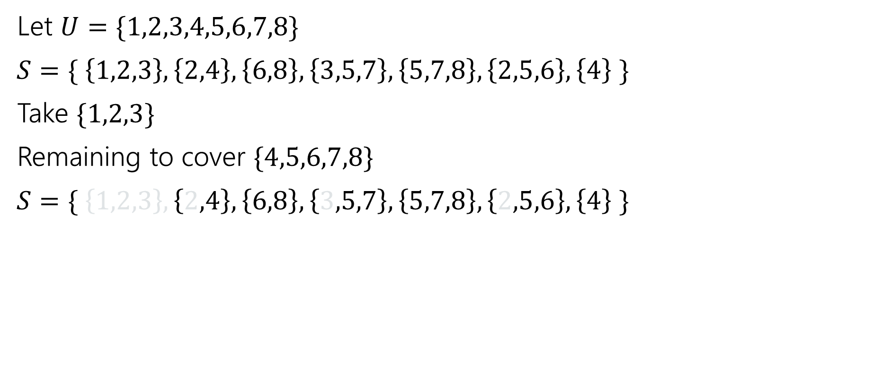
Run the greedy algorithm
Let $U=\{1,2,3,4,5,6,7,8\}$
$S=\{ \left\{1,2,3\right\}, \left\{2,4\right\}, \left\{6,8\right\}, \left\{3,5,7\right\}, \left\{5,7,8\right\}, \left\{2,5,6\right\}, \left\{4\right\} \}$
Take $\{1,2,3\}$
Remaining to cover $\{4,5,6,7,8\}$
$S=\{ \left\{1,2,3\right\}, \left\{2,4\right\}, \left\{6,8\right\}, \left\{3,5,7\right\}, \left\{5,7,8\right\}, \left\{2,5,6\right\}, \left\{4\right\} \}$

Slide 40
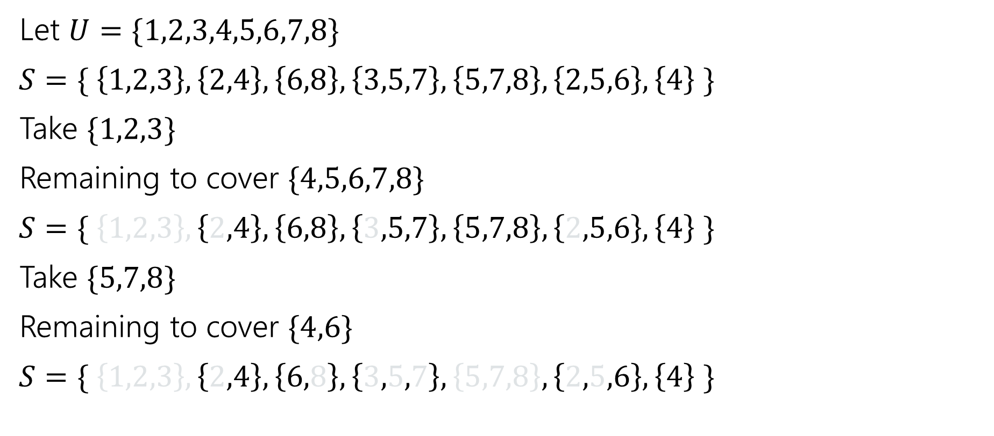
Run the greedy algorithm
Let $U=\{1,2,3,4,5,6,7,8\}$
$S=\{ \left\{1,2,3\right\}, \left\{2,4\right\}, \left\{6,8\right\}, \left\{3,5,7\right\}, \left\{5,7,8\right\}, \left\{2,5,6\right\}, \left\{4\right\} \}$
Take $\{1,2,3\}$
Remaining to cover $\{4,5,6,7,8\}$
$S=\{ \left\{1,2,3\right\}, \left\{2,4\right\}, \left\{6,8\right\}, \left\{3,5,7\right\}, \left\{5,7,8\right\}, \left\{2,5,6\right\}, \left\{4\right\} \}$
Take $\{5,7,8\}$
Remaining to cover $\{4,6\}$
$S=\{ \left\{1,2,3\right\}, \left\{2,4\right\}, \left\{6,8\right\}, \left\{3,5,7\right\}, \left\{5,7,8\right\}, \left\{2,5,6\right\}, \left\{4\right\} \}$

Slide 41
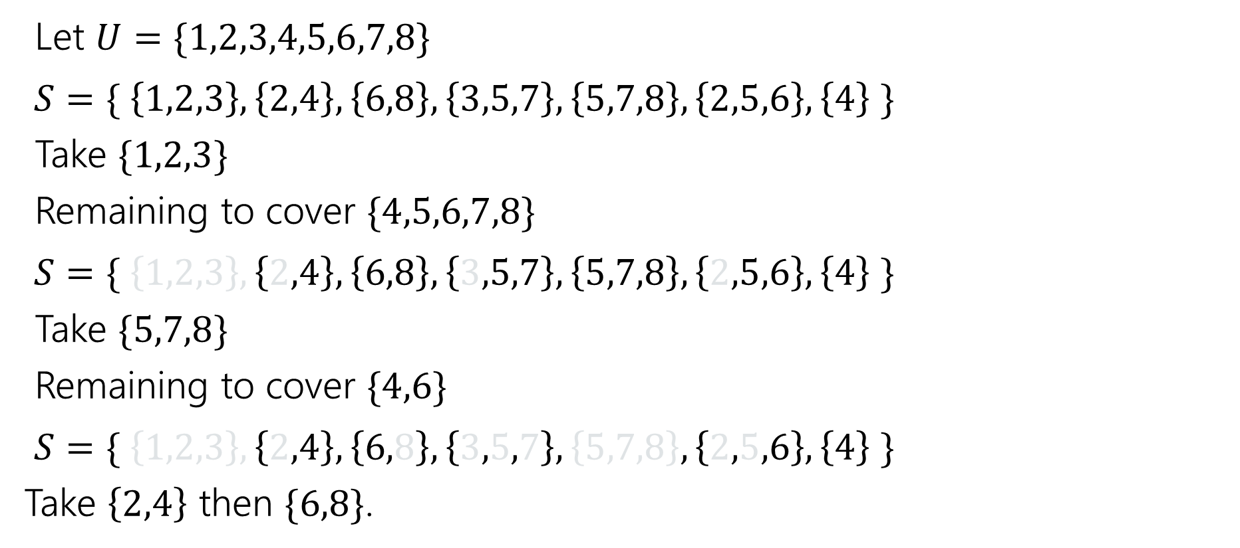
Run the greedy algorithm
Let $U=\{1,2,3,4,5,6,7,8\}$
$S=\{ \left\{1,2,3\right\}, \left\{2,4\right\}, \left\{6,8\right\}, \left\{3,5,7\right\}, \left\{5,7,8\right\}, \left\{2,5,6\right\}, \left\{4\right\} \}$
Take $\{1,2,3\}$
Remaining to cover $\{4,5,6,7,8\}$
$S=\{ \left\{1,2,3\right\}, \left\{2,4\right\}, \left\{6,8\right\}, \left\{3,5,7\right\}, \left\{5,7,8\right\}, \left\{2,5,6\right\}, \left\{4\right\} \}$
Take $\{5,7,8\}$
Remaining to cover $\{4,6\}$
$S=\{ \left\{1,2,3\right\}, \left\{2,4\right\}, \left\{6,8\right\}, \left\{3,5,7\right\}, \left\{5,7,8\right\}, \left\{2,5,6\right\}, \left\{4\right\} \}$
Take $\left\{2,4\right\}$ then $\{6,8\}$.

Slide 42
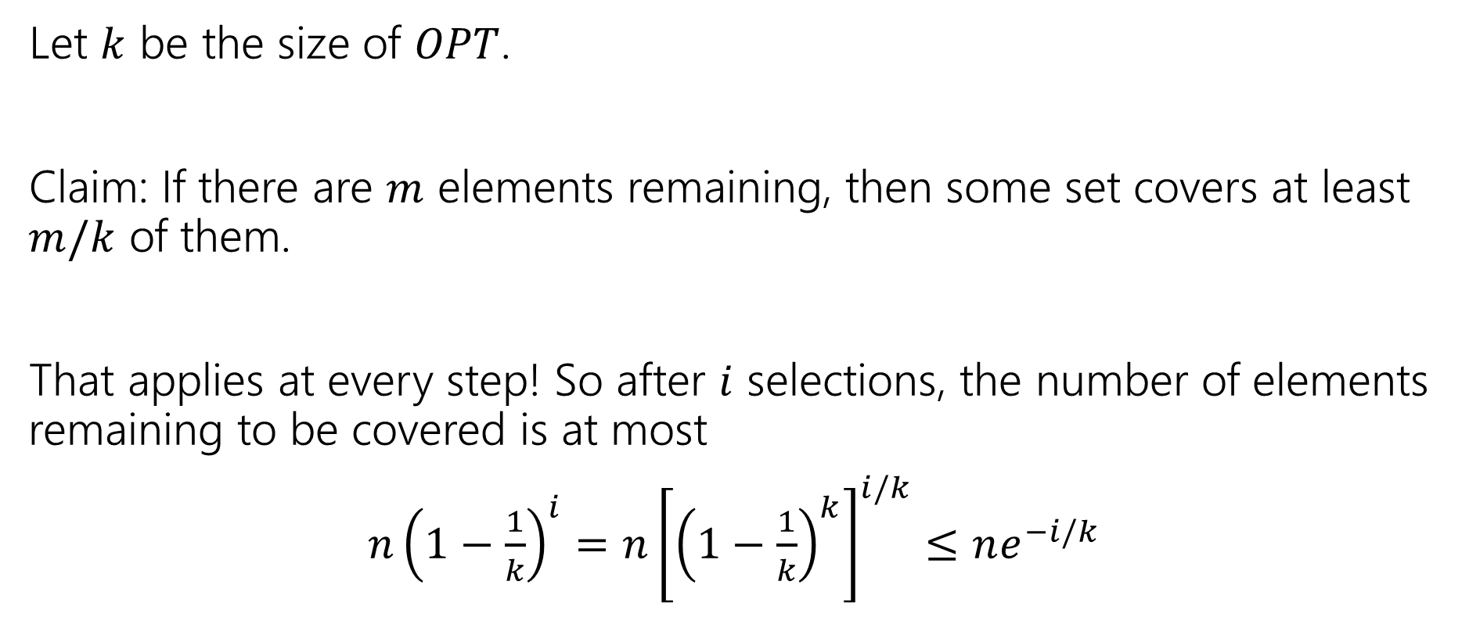
Approximation Ratio?
Let $k$ be the size of $OPT$.
Claim: If there are $m$ elements remaining, then some set covers at least $m/k$ of them.
That applies at every step! So after $i$ selections, the number of elements remaining to be covered is at most
$n{\left(1−\frac{1}{k}\right)}^{i}=n{\left[{\left(1−\frac{1}{k}\right)}^{k}\right]}^{i/k}≤ne^{−i/k}$

Slide 43
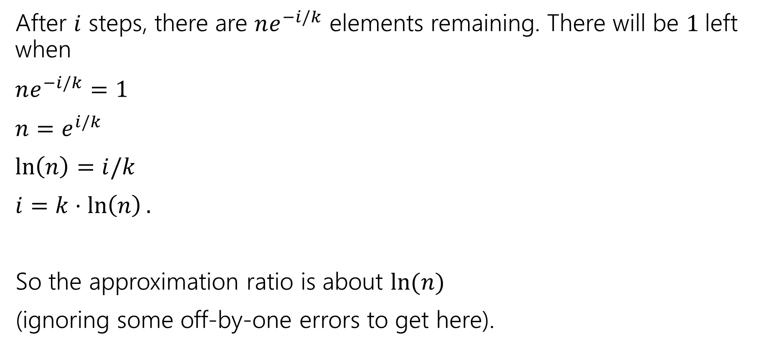
Approximation Ratio?
After $i$ steps, there are $ne^{−i/k}$ elements remaining. There will be $1$left when
$ne^{−i/k}=1$
$n=e^{i/k}$
$\ln\left(n\right)=i/k$
$i=k⋅\ln\left(n\right).$
So the approximation ratio is about $\ln{(n)}$
(ignoring some off-by-one errors to get here).

Slide 44
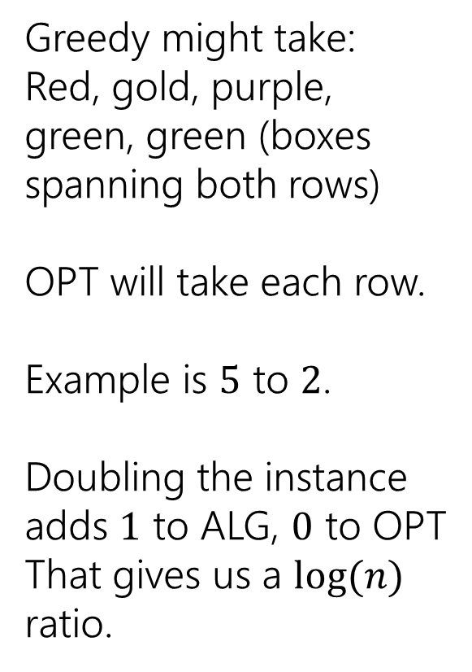
A Bad Example
Greedy might take:
Red, gold, purple, green, green (boxes spanning both rows)
OPT will take each row.
Example is $5$ to $2$.
Doubling the instance adds $1$ to ALG, $0$ to OPT
That gives us a $log⁡(n)$ ratio.

