Slide 1
More Greedy Algorithms
CSE 421 23WI
Lecture 6

Slide 2
Announcements
No handouts today.
Homework 2 deadline is delayed until tomorrow 11:59 PM (late problems still last 48 hours so go until Thursday).
We’re working to get you at least one of the bigger problems back; in the meantime solutions will go on Ed tonight.
In general: Our solutions will fit in one (typed) page; pretty soon we’ll start requiring yours fit in two typed pages.

Slide 3
Outline
Last Time
  What is a greedy algorithm? A “structural” argument.
Today
  Other styles of greedy proof (exchange, greedy stays ahead)
  Practice generating a greedy algorithm from start to (as far as we get)
Section Tomorrow
  Practice yourself; general problem solving process you’ll continue to use all quarter.
  Friday
  Finish the problem we started today
  Greedy algorithms as approximation algorithms

Slide 4
An Exchange Argument

Slide 5
What about Kruskal’s?
Exchange argument:
General outline:
Suppose, you didn’t find the best one.
Suppose there’s a better MST
Then there’s something in the algorithm’s solution that doesn’t match OPT. (an edge that isn’t a safe edge/that’s heavier than it needs to be)
Swap (exchange) them, and finish the proof (arrive at a contradiction or show that your solution is equal in quality)!

Slide 6
Exchange Arguments
You almost always want the “extremality” trick.
Don’t just suppose “something is different”
Suppose something is different and focus on the first spot where the greedy algorithm made a different decision.
The next two slides are what happen when you don’t use the extremality trick. You end up finding “earlier and earlier counter-examples”

Slide 7
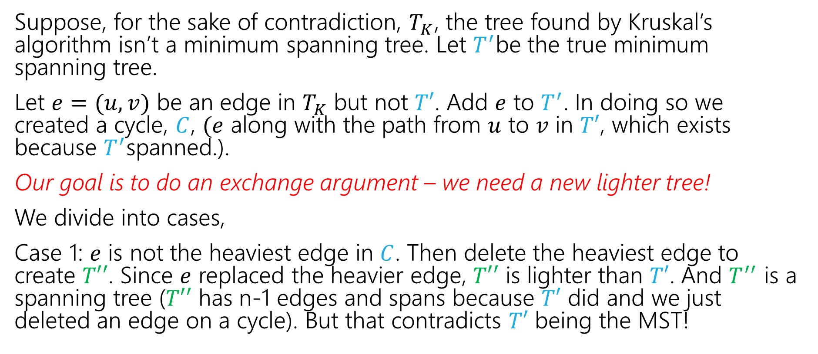
Kruskal’s Proof (v1)
Suppose, for the sake of contradiction, $T_{K}$, the tree found by Kruskal’s algorithm isn’t a minimum spanning tree. Let $T^{′}$be the true minimum spanning tree.
Let $e=(u,v)$ be an edge in $T_{K}$ but not $T′$. Add $e$ to $T^{′}$. In doing so we created a cycle, $C$, $(e$ along with the path from $u$ to $v$ in $T′$, which exists because $T^{′}$spanned.).
Our goal is to do an exchange argument – we need a new lighter tree!
We divide into cases,
Case 1: $e$ is not the heaviest edge in $C$. Then delete the heaviest edge to create $T′′$. Since $e$ replaced the heavier edge, $T′′$ is lighter than $T′$. And $T^{′′}$ is a spanning tree ($T′′$ has n-1 edges and spans because $T′$ did and we just deleted an edge on a cycle). But that contradicts $T′$ being the MST!

Slide 8
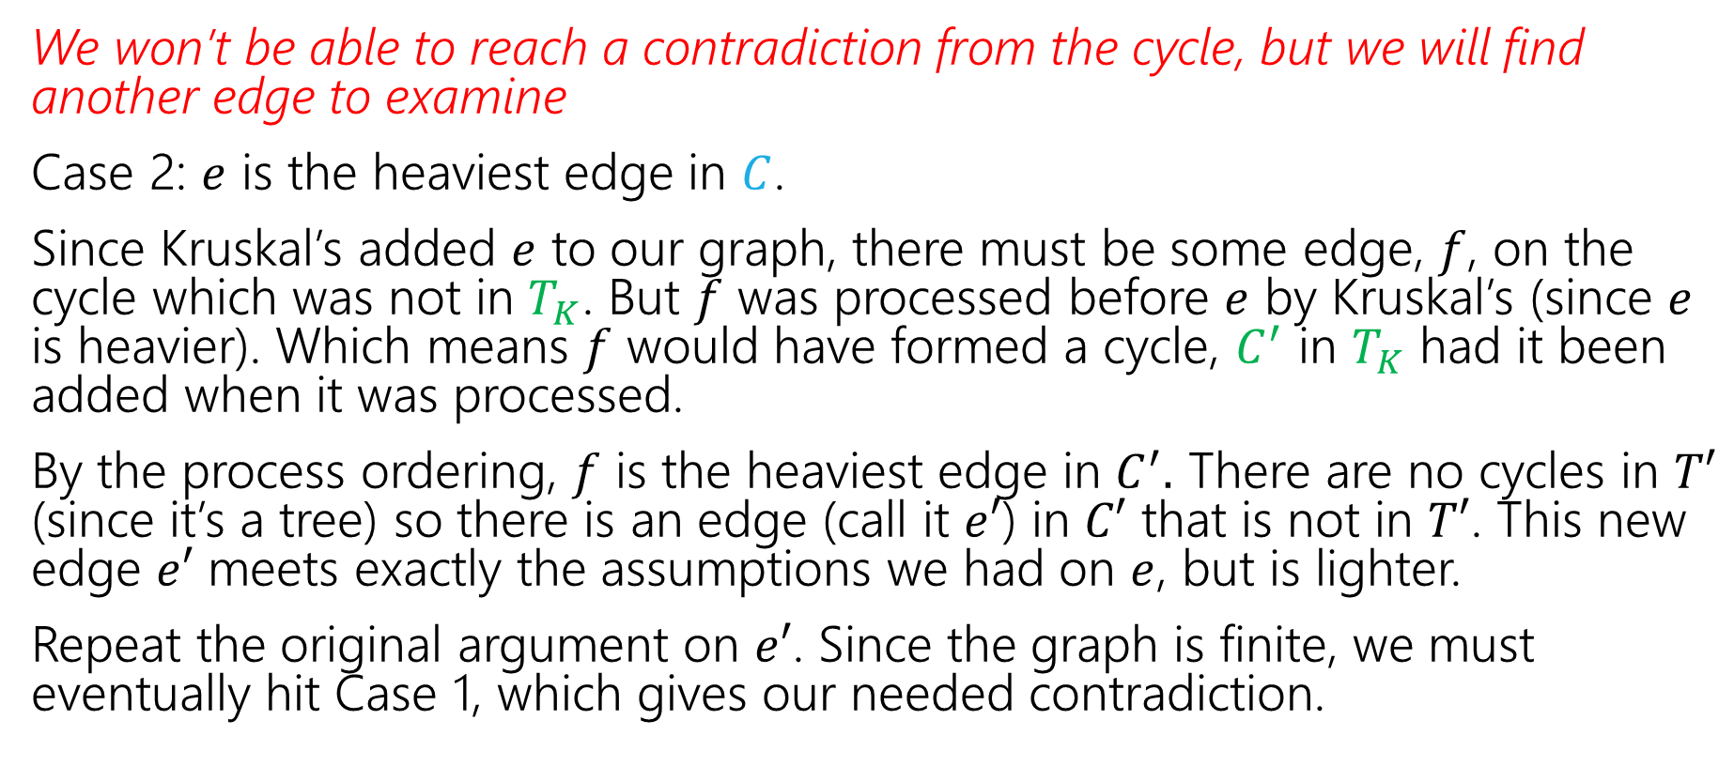
Kruskal’s Proof (v1, cont.)
We won’t be able to reach a contradiction from the cycle, but we will find another edge to examine
Case 2: $e$ is the heaviest edge in $C$.
Since Kruskal’s added $e$ to our graph, there must be some edge, $f$, on the cycle which was not in $T_{K}$. But $f$ was processed before $e$ by Kruskal’s (since $e$ is heavier). Which means $f$ would have formed a cycle, $C^{′}$ in $T_{K}$ had it been added when it was processed.
By the process ordering, $f$ is the heaviest edge in $C^{′}.$ There are no cycles in $T′$ (since it’s a tree) so there is an edge (call it $e′$) in $C′$ that is not in $T′$. This new edge $e′$ meets exactly the assumptions we had on $e$, but is lighter.
Repeat the original argument on $e′$. Since the graph is finite, we must eventually hit Case 1, which gives our needed contradiction.

Slide 9

Kruskal’s Proof (pretty version)
Suppose, for the sake of contradiction, $T_{K}$, the tree found by Kruskal’s algorithm isn’t a minimum spanning tree. Let $T^{′}$be the true minimum spanning tree.
Let $e=(u,v)$ be the lightest edge in $T_{K}$ but not in $T^{′}$.

Slide 10
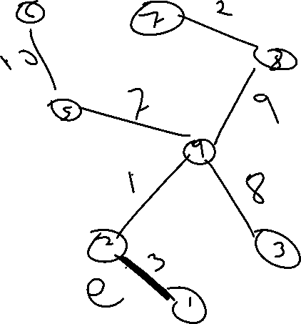
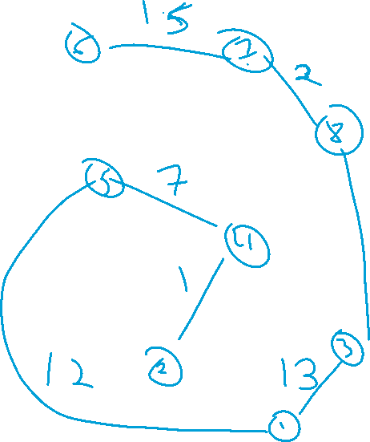


Slide 11
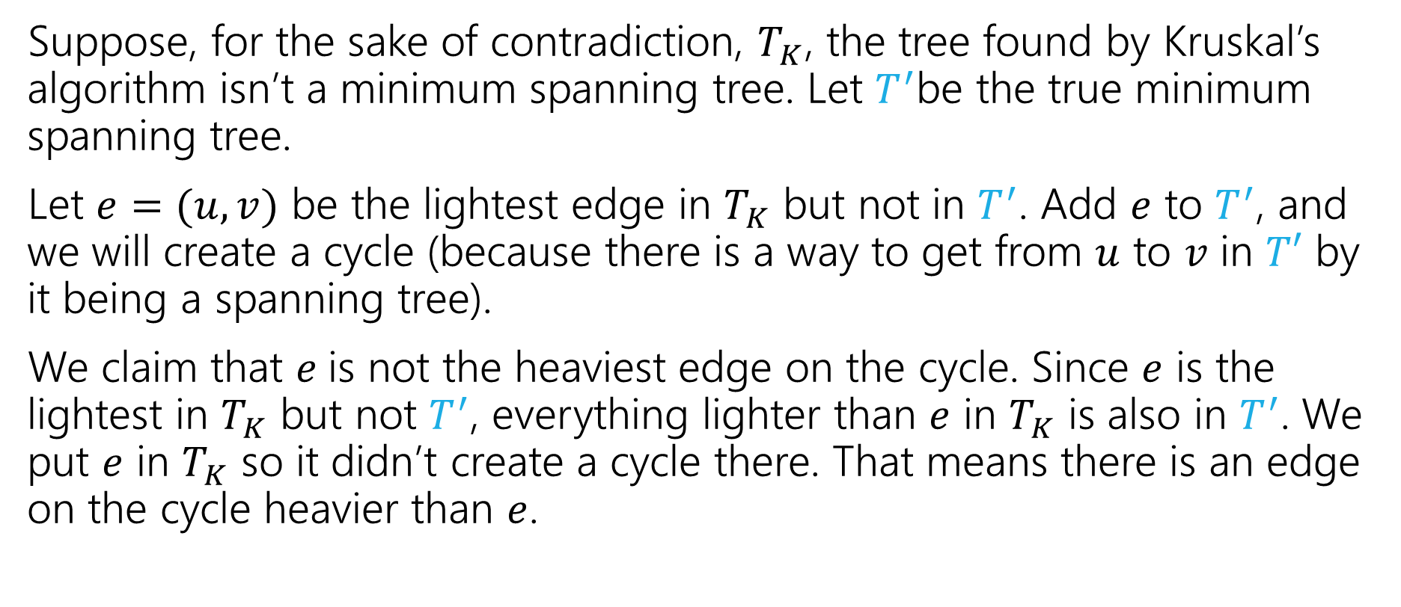
Kruskal’s Proof (pretty version)
Suppose, for the sake of contradiction, $T_{K}$, the tree found by Kruskal’s algorithm isn’t a minimum spanning tree. Let $T^{′}$be the true minimum spanning tree.
Let $e=(u,v)$ be the lightest edge in $T_{K}$ but not in $T^{′}$. Add $e$ to $T^{′}$, and we will create a cycle (because there is a way to get from $u$ to $v$ in $T′$ by it being a spanning tree).
We claim that $e$is not the heaviest edge on the cycle. Since $e$ is the lightest in $T_{K}$ but not $T^{′}$, everything lighter than $e$ in $T_{K}$ is also in $T^{′}$. We put $e$ in $T_{K}$ so it didn’t create a cycle there. That means there is an edge on the cycle heavier than $e$.

Slide 12
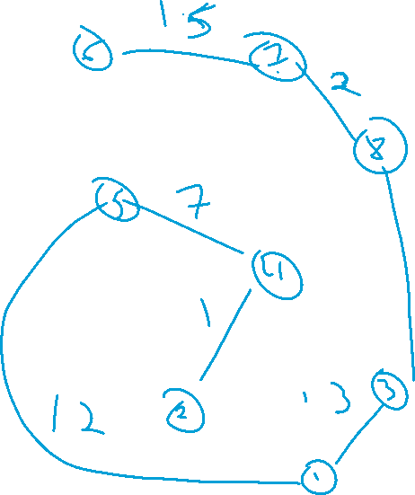
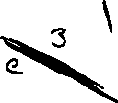

Slide 13
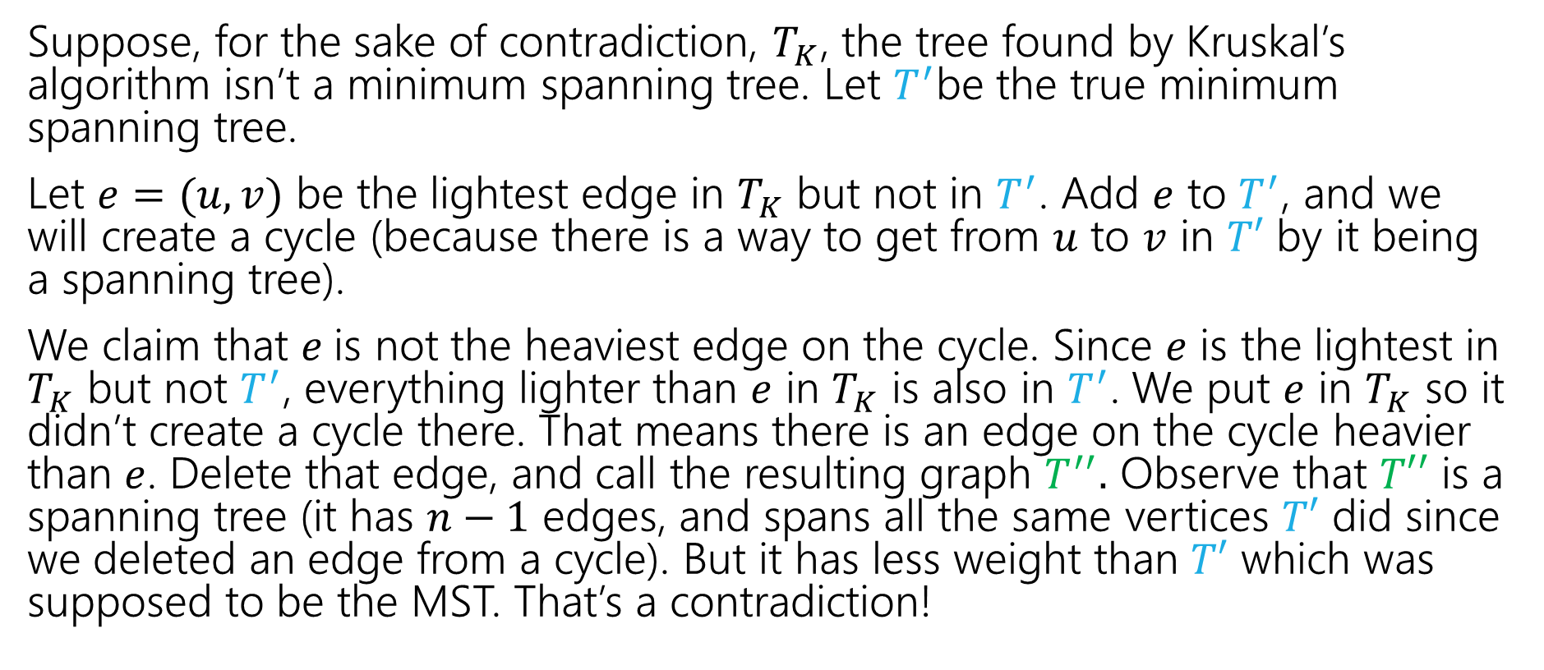
Kruskal’s Proof (pretty version)
Suppose, for the sake of contradiction, $T_{K}$, the tree found by Kruskal’s algorithm isn’t a minimum spanning tree. Let $T^{′}$be the true minimum spanning tree.
Let $e=(u,v)$ be the lightest edge in $T_{K}$ but not in $T^{′}$. Add $e$ to $T^{′}$, and we will create a cycle (because there is a way to get from $u$ to $v$ in $T′$ by it being a spanning tree).
We claim that $e$is not the heaviest edge on the cycle. Since $e$ is the lightest in $T_{K}$ but not $T^{′}$, everything lighter than $e$ in $T_{K}$ is also in $T^{′}$. We put $e$ in $T_{K}$ so it didn’t create a cycle there. That means there is an edge on the cycle heavier than $e$. Delete that edge, and call the resulting graph $T^{′′}.$ Observe that $T′′$ is a spanning tree (it has $n−1$ edges, and spans all the same vertices $T′$ did since we deleted an edge from a cycle). But it has less weight than $T′$ which was supposed to be the MST. That’s a contradiction!

Slide 14
Hey…Wait a minute
That was pretty similar to last time. They both used an “exchange” idea.
The boundaries between the proof principles are a little blurry…
They’re meant to be useful for you for thinking about “where to start” with a proof, not be a beautiful taxonomy of exactly what you do in every possible proof.

Slide 15
Greedy Stays Ahead

Slide 16
Trip Planning
Your goal is to follow a pre-set route from New York to Los Angeles.
You can drive 500 miles in a day, but you need to make sure you can stop at a hotel every night (all possibilities premarked on your map)
You’d like to stop for the fewest number of nights possible – what should you plan?
Greedy: Go as far as you can every night.
Is greedy optimal?
Or is there some reason to “stop short” that might let you go further the next night?

Slide 17
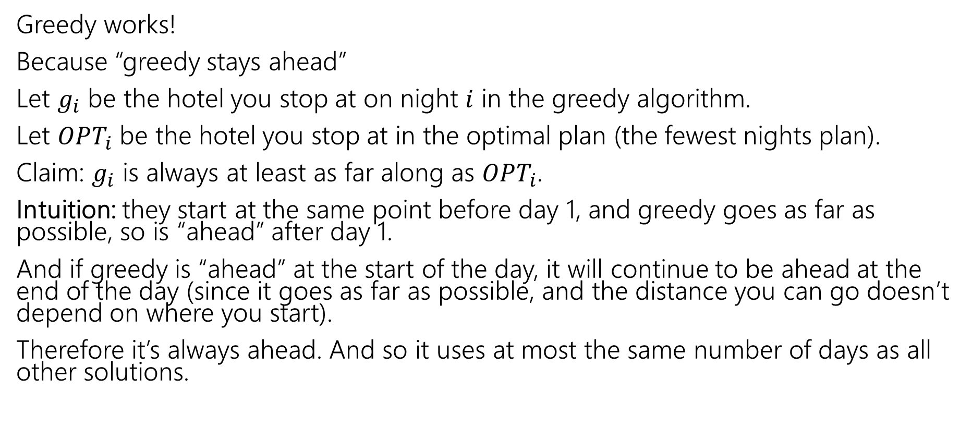
Trip Planning
Greedy works!
Because “greedy stays ahead”
Let $g_{i}$ be the hotel you stop at on night $i$ in the greedy algorithm.
Let $OPT_{i}$ be the hotel you stop at in the optimal plan (the fewest nights plan).
Claim: $g_{i}$ is always at least as far along as $OPT_{i}$.
Intuition: they start at the same point before day 1, and greedy goes as far as possible, so is “ahead” after day 1.
And if greedy is “ahead” at the start of the day, it will continue to be ahead at the end of the day (since it goes as far as possible, and the distance you can go doesn’t depend on where you start).
Therefore it’s always ahead. And so it uses at most the same number of days as all other solutions.

Slide 18
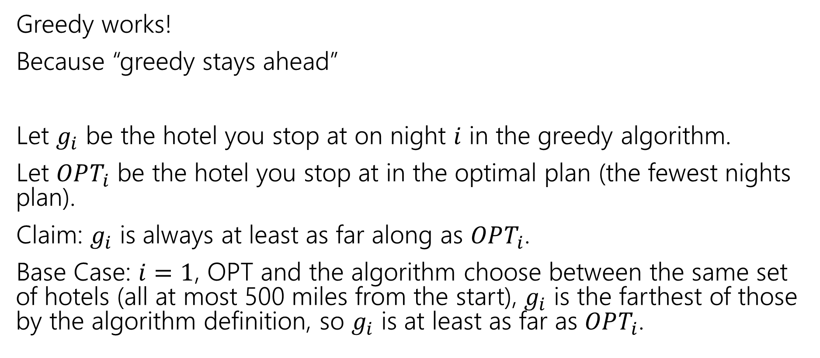
Trip Planning
Greedy works!
Because “greedy stays ahead”
Let $g_{i}$ be the hotel you stop at on night $i$ in the greedy algorithm.
Let $OPT_{i}$ be the hotel you stop at in the optimal plan (the fewest nights plan).
Claim: $g_{i}$ is always at least as far along as $OPT_{i}$.
Base Case: $i=1$, OPT and the algorithm choose between the same set of hotels (all at most 500 miles from the start), $g_{i}$ is the farthest of those by the algorithm definition, so $g_{i}$ is at least as far as $OPT_{i}$.

Slide 19
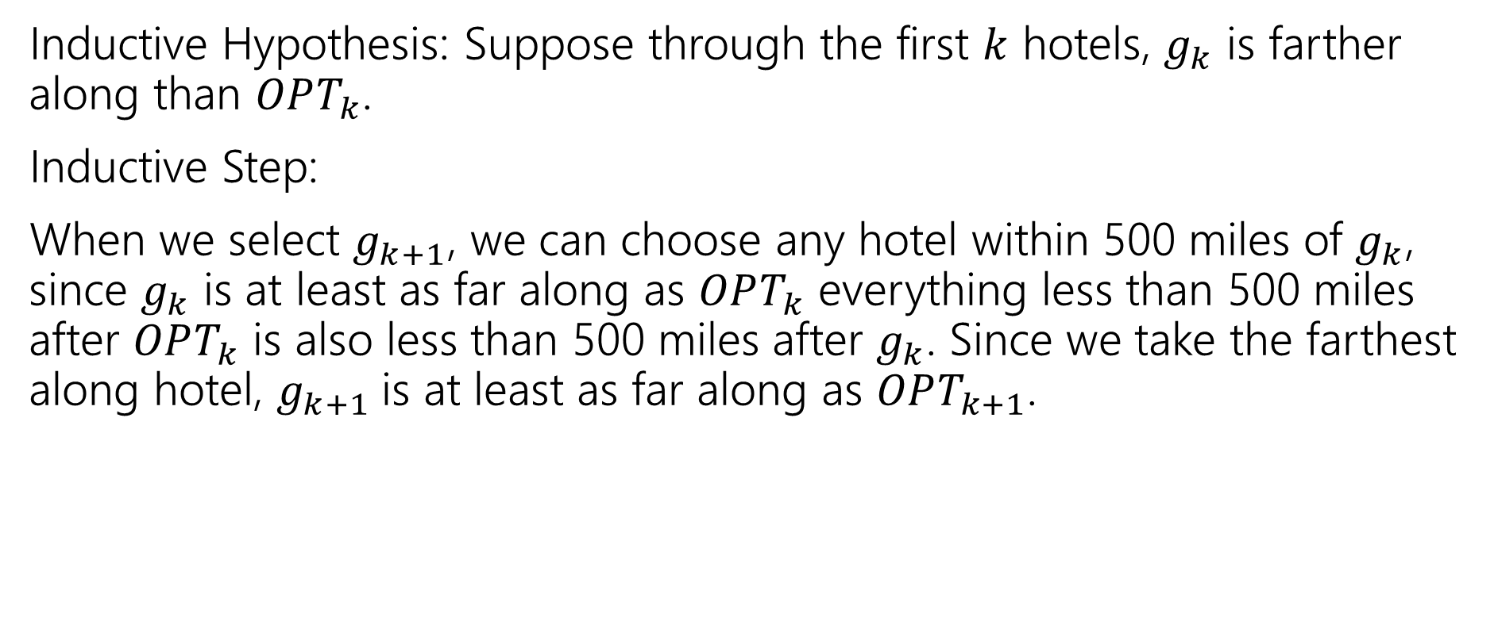
Trip Planning
Inductive Hypothesis: Suppose through the first $k$ hotels, $g_{k}$ is farther along than $OPT_{k}$.
Inductive Step:
When we select $g_{k+1}$, we can choose any hotel within 500 miles of $g_{k}$, since $g_{k}$ is at least as far along as $OPT_{k}$ everything less than 500 miles after $OPT_{k}$ is also less than 500 miles after $g_{k}$. Since we take the farthest along hotel, $g_{k+1}$is at least as far along as $OPT_{k+1}$.

Slide 20
Interval Scheduling
From problem statement to algorithm ideas to algorithm to proof

Slide 21
Interval Scheduling
You have a single processor, and a set of jobs with fixed start and end times.
Your goal is to maximize the number of jobs you can process.
I.e. choose the maximum number of non-overlapping intervals.

Slide 22
Interval Scheduling
You have a single processor, and a set of jobs with fixed start and end times.
Your goal is to maximize the number of jobs you can process.
I.e. choose the maximum number of non-overlapping intervals.
3 non-overlapping intervals

Slide 23
Interval Scheduling
You have a single processor, and a set of jobs with fixed start and end times.
Your goal is to maximize the number of jobs you can process.
I.e. choose the maximum number of non-overlapping intervals.
3 other non-overlapping intervals

Slide 24
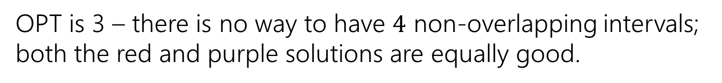
Interval Scheduling
You have a single processor, and a set of jobs with fixed start and end times.
Your goal is to maximize the number of jobs you can process.
I.e. choose the maximum number of non-overlapping intervals.
OPT is 3 – there is no way to have $4$ non-overlapping intervals; both the red and purple solutions are equally good.

Slide 25
Greedy Ideas
To specify a greedy algorithm, we need to:
Order the elements (intervals)
Choose a rule for deciding whether to add.
Rule: Add interval as long as it doesn’t overlap with those we’ve already selected.
What ordering should we use?
Think of at least two orderings you think might work.

Slide 26
Greedy Algorithm
Some possibilities
Earliest end time (add if no overlap with previous selected)
Latest end time
Earliest start time
Latest start time
Shortest interval
Fewest overlaps (with remaining intervals)

Slide 27
Greedy
That list slide is the real difficulty with greedy algorithms.
All of those look at least somewhat plausible at first glance.
With MSTs that was fine – those ideas all worked!
It’s not fine here.
They don’t all work.
As a first step – try to find counter-examples to narrow down

Slide 28
Greedy Algorithm
Earliest end time
Latest end time
Earliest start time
Latest start time
Shortest interval
Fewest overlaps (with remaining intervals)

Slide 29
Take Earliest Start Time – Counter Example

Slide 30
Take Earliest Start Time – Counter Example
Algorithm finds
Optimum
Taking the one with the earliest start time doesn’t give us the best answer.

Slide 31
Shortest Interval

Slide 32
Shortest Interval
Algorithm finds
Optimum
Taking the shortest interval first doesn’t give us the best answer

Slide 33
Greedy Algorithm
Earliest end time
Latest end time
Earliest start time
Latest start time
Shortest interval
Fewest overlaps (with remaining intervals)

Slide 34
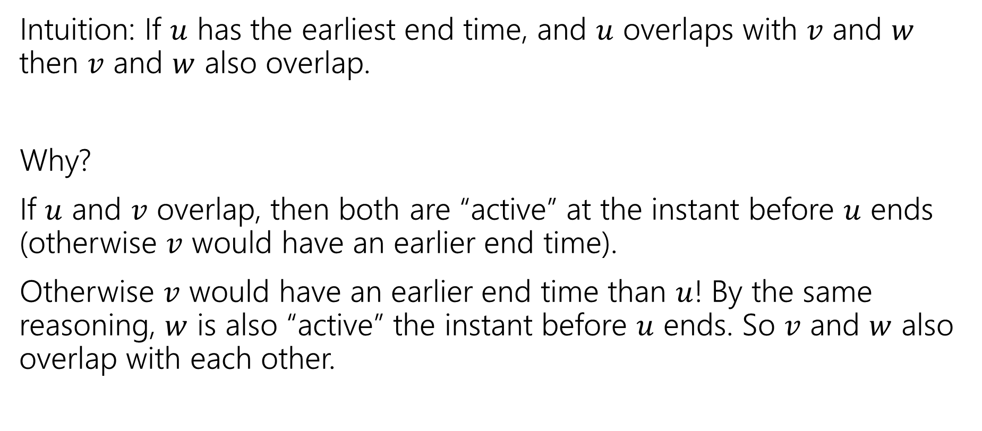
Earliest End Time
Intuition: If $u$ has the earliest end time, and $u$ overlaps with $v$ and $w$ then $v$ and $w$ also overlap.
Why?
If $u$ and $v$ overlap, then both are “active” at the instant before $u$ ends (otherwise $v$ would have an earlier end time).
Otherwise $v$ would have an earlier end time than $u$! By the same reasoning, $w$ is also “active” the instant before $u$ ends. So $v$ and $w$ also overlap with each other.

Slide 35
Earliest End Time
Can you prove it correct?
Do you want to use
Structural Result
Exchange Argument
Greedy Stays Ahead

Slide 36
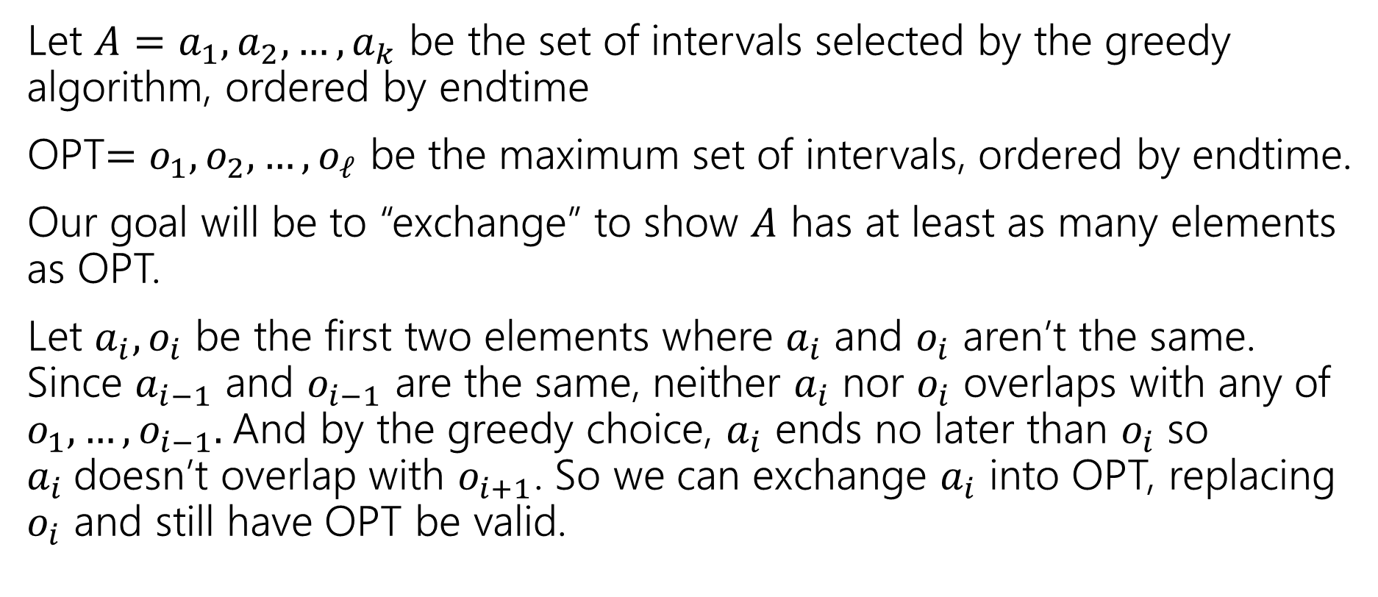
Exchange Argument
Let $A=a_{1},a_{2},…,a_{k}$ be the set of intervals selected by the greedy algorithm, ordered by endtime
OPT$=o_{1},o_{2},…,o_{ℓ}$ be the maximum set of intervals, ordered by endtime.
Our goal will be to “exchange” to show $A$ has at least as many elements as OPT.
Let $a_{i},o_{i}$ be the first two elements where $a_{i}$ and $o_{i}$ aren’t the same. Since $a_{i−1}$ and $o_{i−1}$ are the same, neither $a_{i}$ nor $o_{i}$ overlaps with any of $o_{1},…,o_{i−1}.$And by the greedy choice, $a_{i}$ ends no later than $o_{i}$ so $a_{i}$doesn’t overlap with $o_{i+1}$. So we can exchange $a_{i}$ into OPT, replacing $o_{i}$ and still have OPT be valid.

Slide 37
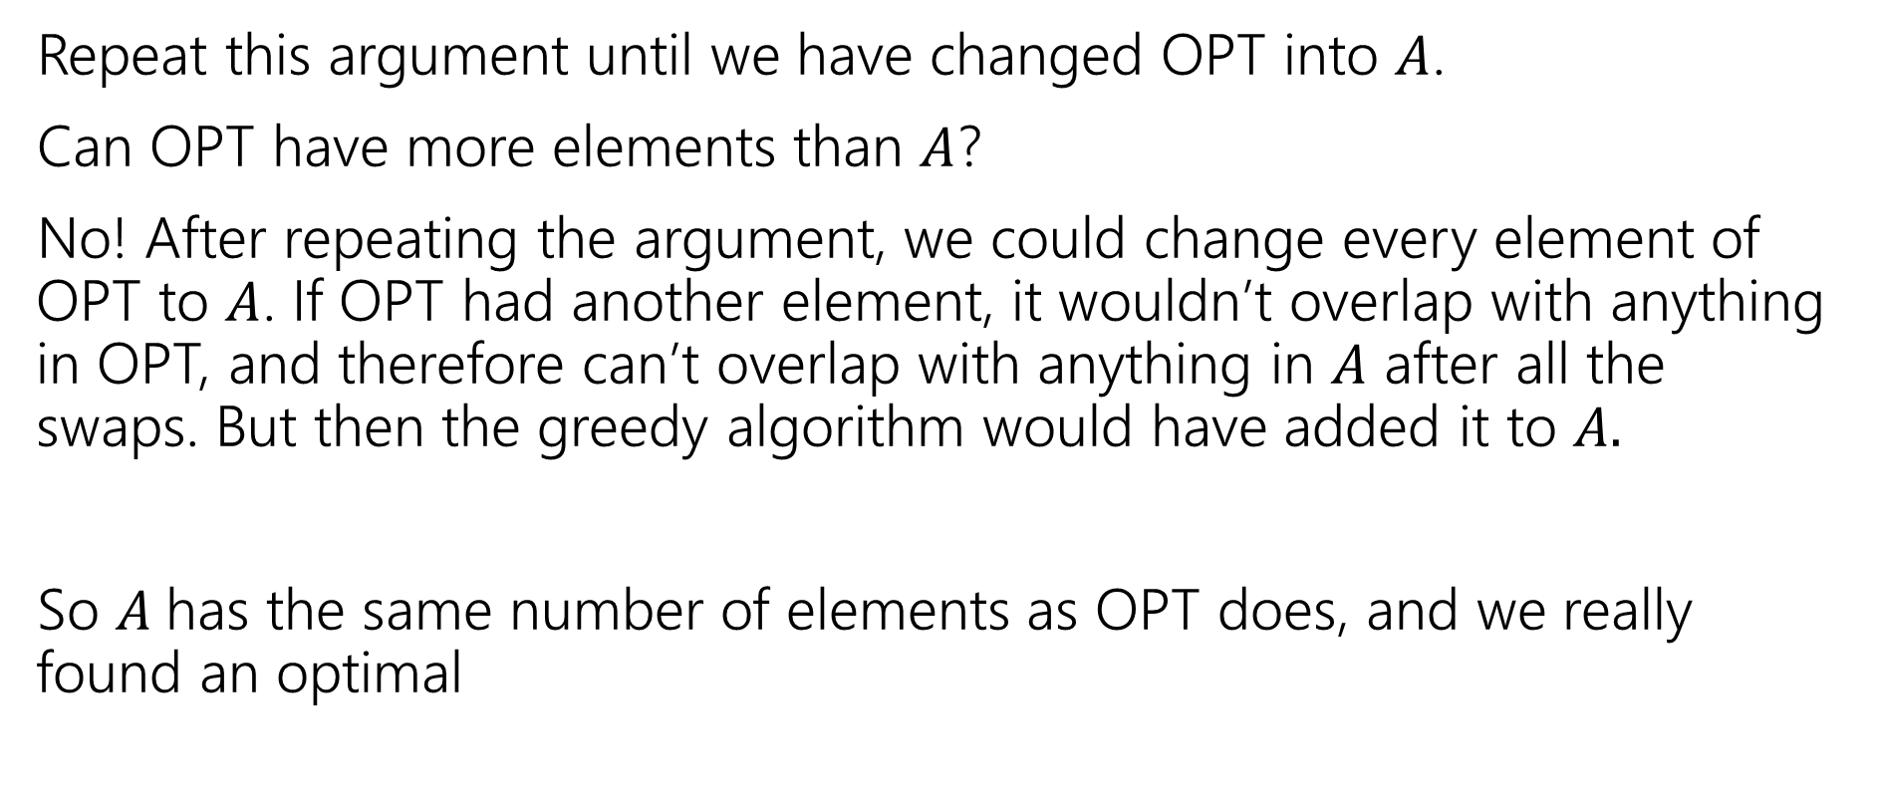
Exchange Argument
Repeat this argument until we have changed OPT into $A$.
Can OPT have more elements than $A$?
No! After repeating the argument, we could change every element of OPT to $A$. If OPT had another element, it wouldn’t overlap with anything in OPT, and therefore can’t overlap with anything in $A$ after all the swaps. But then the greedy algorithm would have added it to $A.$
So $A$has the same number of elements as OPT does, and we really found an optimal

Slide 38
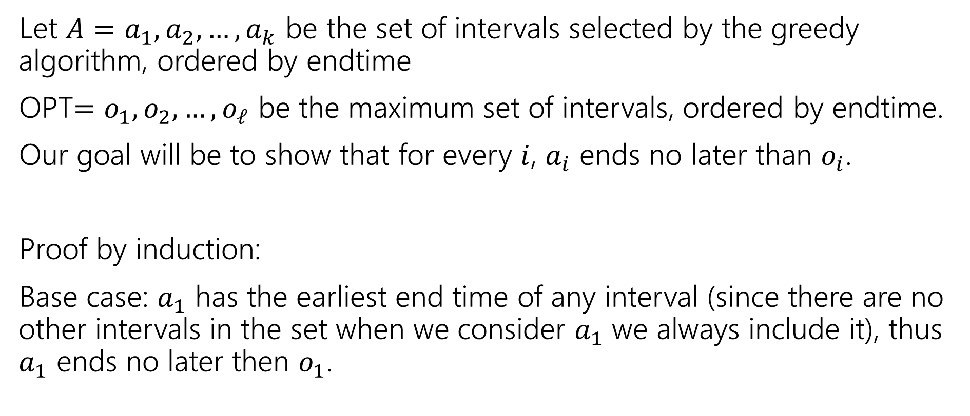
Greedy Stays Ahead
Let $A=a_{1},a_{2},…,a_{k}$ be the set of intervals selected by the greedy algorithm, ordered by endtime
OPT$=o_{1},o_{2},…,o_{ℓ}$ be the maximum set of intervals, ordered by endtime.
Our goal will be to show that for every $i$, $a_{i}$ ends no later than $o_{i}$.
Proof by induction:
Base case: $a_{1}$ has the earliest end time of any interval (since there are no other intervals in the set when we consider $a_{1}$ we always include it), thus $a_{1}$ ends no later then $o_{1}$.

Slide 39
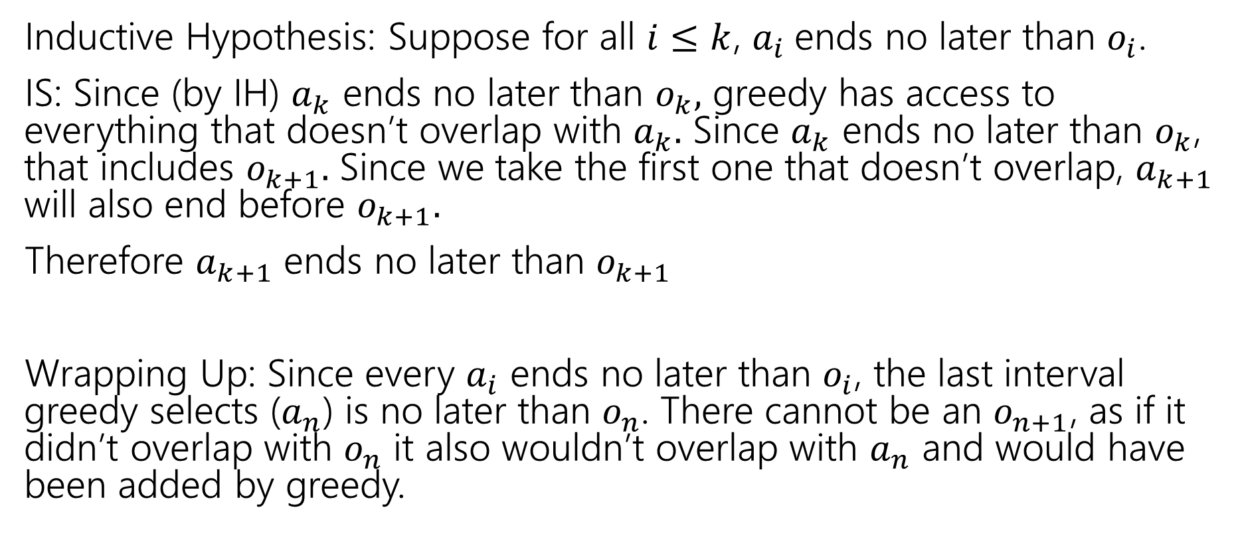
Greedy Stays Ahead
Inductive Hypothesis: Suppose for all $i≤k$, $a_{i}$ends no later than $o_{i}$.
IS: Since (by IH) $a_{k}$ ends no later than $o_{k},$ greedy has access to everything that doesn’t overlap with $a_{k}.$ Since $a_{k}$ ends no later than $o_{k}$, that includes $o_{k+1}.$ Since we take the first one that doesn’t overlap, $a_{k+1}$ will also end before $o_{k+1}.$
Therefore $a_{k+1}$ ends no later than $o_{k+1}$
Wrapping Up: Since every $a_{i}$ ends no later than $o_{i}$, the last interval greedy selects ($a_{n}$) is no later than $o_{n}$. There cannot be an $o_{n+1}$, as if it didn’t overlap with $o_{n}$ it also wouldn’t overlap with $a_{n}$ and would have been added by greedy.

Slide 40

Greedy Algorithm
Earliest end time
Latest end time
Earliest start time
Latest start time
Shortest interval
Fewest overlaps (with remaining intervals)

Slide 41
Other Greedy Algorithms
It turns out latest start time also works.
Latest start time is actually the same as earliest end time (imagine “reflecting” all the jobs along the time axis – the one with the earliest end time ends up having the last start time).
What about fewest overlaps?
Doesn’t work. ☹ Counter-examples are a little more complicated than the others.

Slide 42
Greedy Algorithm
Earliest end time
Latest end time
Earliest start time
Latest start time
Shortest interval
Fewest overlaps (with remaining intervals)

Slide 43
Summary
Greedy algorithms
You’ll probably have 2 (or 3…or 6) ideas for greedy algorithms. Check some simple examples before you implement!
Greedy algorithms rarely work.
When they work AND you can prove they work, they’re great!
Proofs are often tricky
Structural results are the hardest to come up with, but the most versatile.
Greedy stays ahead usually use induction
Exchange start with the first difference between greedy and optimal.

