Slide 1
CSE 421
Greedy Algorithms / Dijkstra’s Algorithm
Yin Tat Lee

Slide 2
Homework 1 Comments
Except for EC, each question should take less than 1 page.
(You don’t have so much time in midterm/final/interviews)
Q2: ${(log{n})}^{\sqrt{\log{n}}}<2^{{\left(\log{n}\right)}^{2/3}}$
${(log{n})}^{\sqrt{\log{n}}}=2^{\sqrt{\log{n}}\log{\log{n}}}\sim 2^{\sqrt{\log{n}}}$. $\sqrt{\log{n}}$ is less than ${\left(\log{n}\right)}^{2/3}$
Q3: Instead of $(n−1)/3$, one can get $(n−1)/5$
Induction on the number of vertices.
Q4: Reduction-type Question
Algo: Transform input. Call the class algorithm. Transform output.
Proof: Why the input is valid. Why the output is what we want.

Slide 3
Office Hour
Please do HW earlier.
You can start doing HW once it is announced. (I won’t ask things that hasn’t covered)
HW3 is out
If no time slot works for you,
fill in this https://bit.ly/3fCEgaU
Why YinTat has hair?
TAs and YinTat are lonely

Slide 4
Experiment Y
Axiom:
My teaching needs improvement.
I care about teaching.
Improvements are possible.
Algorithm:
For each week
I will make a poll to collect suggestions.
I will implement the suggestion with the most hearts.
For the benefit of everyone, please participate.

Slide 5
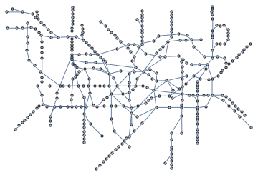
Single Source Shortest Path
Given an (un)directed graph $G=(V,E)$ with non-negative
edge weights $c_{e}≥0$ and a start vertex $s$.
Find length of shortest paths from $s$ to each vertex in $G$
$$s$$

Slide 6
Dijkstra($G,c,s$) {
Initialize set of explored nodes $S←\{s\}$
// Maintain distance from $s$ to each vertices in $S$
$d\left[s\right]←0$
while ($S≠V$)
{
Pick an edge $(u,v)$ such that $u∈S$ and $v∉S$ and
$d[u]+c_{(u,v)}$ is as small as possible.
Add $v$ to $S$ and define $d[v]=d[u]+c_{(u,v)}$.
$Parent\left(v\right)←u$.
}
Set $S$ is all vertices to which we have found the shortest path.

Slide 7
Dijkstra’s Algorithm: Example
s
0
2
4
∞
5
∞
7
∞
3
1
4
∞
6
3
5
∞
∞
∞
8
1
9
8
∞
∞
∞
4
∞
5
2
10
∞

Slide 8
Dijkstra’s Algorithm: Example
s
0
2
4
2
5
4
7
∞
3
1
4
∞
6
3
5
∞
∞
∞
8
1
9
8
∞
∞
∞
4
∞
5
2
10
∞

Slide 9
Dijkstra’s Algorithm: Example
s
0
2
4
2
5
4
7
∞
3
1
4
∞
6
3
5
∞
∞
∞
8
1
9
8
∞
∞
∞
4
∞
5
2
10
∞

Slide 10
Dijkstra’s Algorithm: Example
s
0
2
4
2
5
4
7
9
3
1
4
∞
6
3
5
∞
∞
∞
8
1
9
8
∞
∞
∞
4
∞
5
2
10
∞

Slide 11
Dijkstra’s Algorithm: Example
s
0
2
4
2
5
4
7
9
3
1
4
∞
6
3
5
∞
∞
∞
8
1
9
8
∞
∞
∞
4
∞
5
2
10
∞

Slide 12
Dijkstra’s Algorithm: Example
s
0
2
4
2
5
4
7
9
3
1
4
7
6
3
5
5
∞
8
8
1
9
8
∞
∞
∞
4
∞
5
2
10
∞

Slide 13
Dijkstra’s Algorithm: Example
s
0
2
4
2
5
4
7
9
3
1
4
7
6
3
5
5
∞
8
8
1
9
8
∞
∞
∞
4
∞
5
2
10
∞

Slide 14
Dijkstra’s Algorithm: Example
s
0
2
4
2
5
4
7
9
3
1
4
7
6
3
5
5
∞
8
8
1
9
8
13
∞
∞
4
∞
5
2
10
∞

Slide 15
Dijkstra’s Algorithm: Example
s
0
2
4
2
5
4
7
9
3
1
4
7
6
3
5
5
∞
8
8
1
9
8
13
∞
∞
4
∞
5
2
10
∞

Slide 16
Dijkstra’s Algorithm: Example
s
0
2
4
2
5
4
7
9
3
1
4
7
6
3
5
5
∞
8
8
1
9
8
13
∞
∞
4
∞
5
2
10
∞

Slide 17
Dijkstra’s Algorithm: Example
s
0
2
4
2
5
4
7
9
3
1
4
7
6
3
5
5
∞
8
8
1
9
8
13
∞
16
4
∞
5
2
10
∞

Slide 18
Dijkstra’s Algorithm: Example
s
0
2
4
2
5
4
7
9
3
1
4
7
6
3
5
5
∞
8
8
1
9
8
13
∞
16
4
∞
5
2
10
∞

Slide 19
Dijkstra’s Algorithm: Example
s
0
2
4
2
5
4
7
9
3
1
4
7
6
3
5
5
15
8
8
1
9
8
13
∞
16
4
10
5
2
10
∞

Slide 20
Dijkstra’s Algorithm: Example
s
0
2
4
2
5
4
7
9
3
1
4
7
6
3
5
5
15
8
8
1
9
8
13
∞
16
4
10
5
2
10
∞

Slide 21
Dijkstra’s Algorithm: Example
s
0
2
4
2
5
4
7
9
3
1
4
7
6
3
5
5
15
8
8
1
9
8
13
14
16
4
10
5
2
10
20

Slide 22
Dijkstra’s Algorithm: Example
s
0
2
4
2
5
4
7
9
3
1
4
7
6
3
5
5
15
8
8
1
9
8
13
14
16
4
10
5
2
10
20

Slide 23
Dijkstra’s Algorithm: Example
s
0
2
4
2
5
4
7
9
3
1
4
7
6
3
5
5
15
8
8
1
9
8
13
14
16
4
10
5
2
10
19

Slide 24
Dijkstra’s Algorithm: Example
s
0
2
4
2
5
4
7
9
3
1
4
7
6
3
5
5
15
8
8
1
9
8
13
14
16
4
10
5
2
10
19

Slide 25
Dijkstra’s Algorithm: Example
s
0
2
4
2
5
4
7
9
3
1
4
7
6
3
5
5
15
8
8
1
9
8
13
14
16
4
10
5
2
10
18

Slide 26
Dijkstra’s Algorithm: Example
s
0
2
4
2
5
4
7
9
3
1
4
7
6
3
5
5
15
8
8
1
9
8
13
14
16
4
10
5
2
10
Dijkstra’s Algorithm outputs a tree.
18

Slide 27
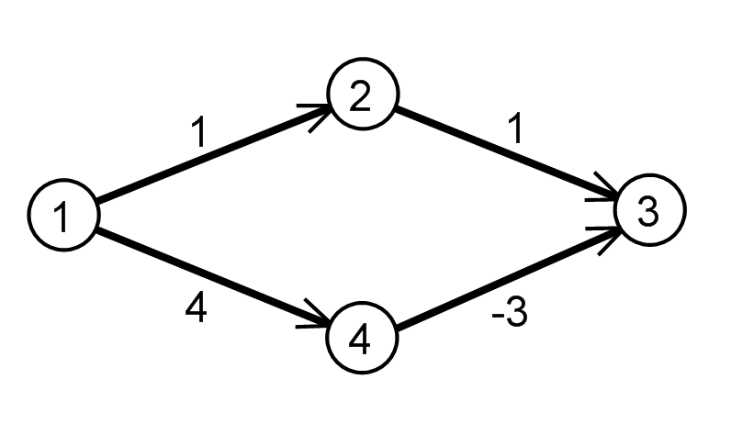
Remarks on Dijkstra’s Algorithm
Algorithm works on directed graph (with nonnegative weights)
Algorithm produces a tree of shortest paths to $s$ following Parent links (for undirected graph)
The algorithm fails with negative edge weights.
Why does it fail?
For unit length graph, Dijkstra’s algorithm is same as BFS.

Slide 28
Implementing Dijkstra’s Algorithm
Priority Queue: Elements each with an associated key Operations
Insert
Find-min
Return the element with the smallest key
Delete-min
Return the element with the smallest key and delete it from the data structure
Decrease-key
Decrease the key value of some element
Implementations
Binary Heaps:
$O(log⁡n)$ time insert/decrease-key/delete-min,
$O(1)$ time find-min
Fibonacci heap:
$O(1)$ time insert/decrease-key
$O(log⁡n)$ delete-min
O(1) time find-min

Slide 29
Dijkstra($G,c,s$) {
Initialize set of explored nodes $S←\{s\}$
// Maintain distance from $s$ to each vertices in $S$
$d\left[s\right]←0$
Insert all neighbors $v$ of s into a priority queue with value $c_{(s,v)}$.
while ($S≠V$)
{
// Pick an edge $(u,v)$ such that $u∈S$ and $v∉S$ and
// $d[u]+c_{(u,v)}$ is as small as possible.
u ← delete min element from $Q$
Add $v$ to $S$ and define $d[v]=d[u]+c_{(u,v)}$.
$Parent\left(v\right)←u$.
foreach (edge $e=(v,w)$ incident to $v$)
if ($w∉ S$)
if ($w$ is not in the $Q$)
Insert $w$ into $Q$ with value $d\left[v\right]+c_{(v,w)}$
else (the key of $w$ > $d\left[v\right]+c_{(v,w)}$)
Decrease key of $v$ to $d[v]+c_{(v,w)}$.
}
$O(n)$ of insert,
each in $O(1)$
$O(n)$ of delete min,
each in $O(log⁡n)$
$O(m)$ of decrease/insert key,
each runs in $O(1)$

Slide 30
Disjkstra’s Algorithm: Correctness
Theorem: For any $u∈S$, the path $P_{u}$ on the tree is the shortest path from $s$ to $u$ on $G$. (For all $u∈S,d\left(u\right)=dist(s,u)$.)
Proof: Induction on $\left|S\right|=k$.
Base Case: This is always true when $S=\left\{s\right\}.$
Inductive Step: Say $v$ is the ${\left(k+1\right)}^{st}$ vertex that we add to S.
Let $(u,v)$ be last edge on $P_{v}.$
If $P_{v}$ is not the shortest path, there is a shorter path $P$ to $S$.
Consider the first time that $P$ leaves $S$ with edge $(x,y)$.
So, $c\left(P\right)≥d\left(x\right)+c_{x,y}≥d\left(u\right)+c_{u,v}=d\left(v\right)=c\left(P_{v}\right).$
A contradiction.
S
y
$P$ is the shorter path.
Due to the choice of $v$
s
$$P$$
x
u
v
$$P_{v}$$

Slide 32
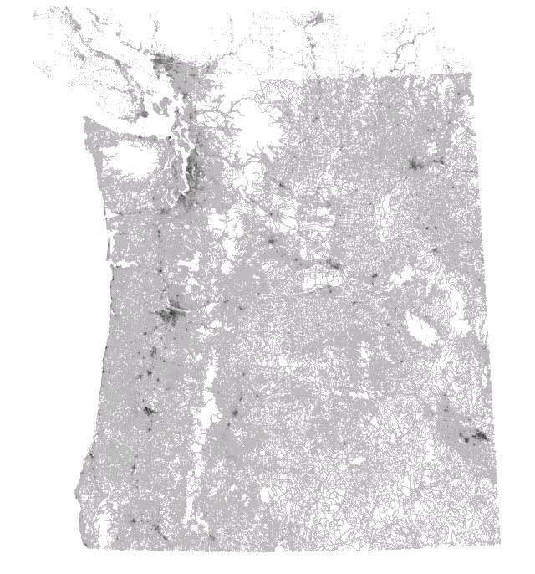
Dijkstra Example
1.6 million vertices
3.8 million edges
Distance = travel time.
Images comes from A.V. Goldberg

Slide 33
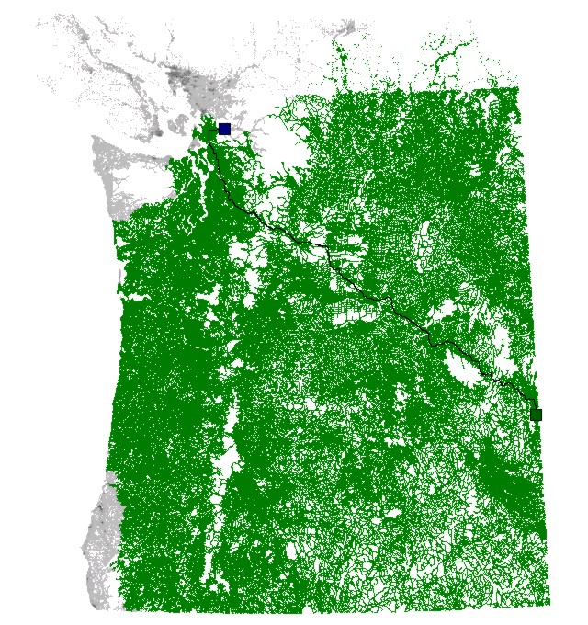
Dijkstra Example
Searched Area
(starting from green point)
Problem of Dijkstra:
Didn’t take account of where is $t$

Slide 34
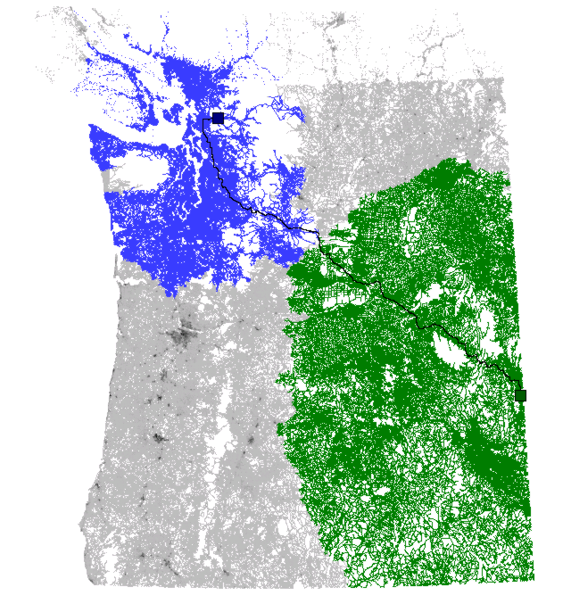
Bidirectional Dijkstra
340ms
Forward search
Backward search
Problem of Bidirectional Dijkstra:
Forward search did not take account of $t$
Backward search did not take account of $s$.

Slide 35
$A^{∗}$ Search
AStar($G,c,s,t$) {
Initialize set of explored nodes $S←\{s\}$
// Maintain distance from $s$ to each vertices in $S$
$d\left[s\right]←0$
while ($S≠V$)
{
Pick an edge $(u,v)$ such that $u∈S$ and $v∉S$ and
$d\left[u\right]+c_{\left(u,v\right)}+h(v)$ is as small as possible.
Add $v$ to $S$ and define $d[v]=d[u]+c_{(u,v)}$.
$Parent\left(v\right)←u$.
}
BFS
Dijkstra
$$A^{∗}$$
$h\left(v\right)$ is the estimate of distance from $v$ to $t$
If $h(v)$ is exactly the shortest distance from $v$ to $t$, then the algorithm would go directly to $t$.

Slide 36
$A^{∗}$ Search
Let $h(v)$ be the estimate distance from $v$ to $t$.
Define the reduced cost ${\tilde{c}}_{u,v}=c_{u,v}−h\left(u\right)+h(v)$.
Claim 1: Shortest path on $\tilde{c}$ is same as shortest path on $c$.
Claim 2: If the reduced cost ${\tilde{c}}_{u,v}$ is non-negative,
Dijkstra on $\tilde{c}$ is equivalent to $A^{∗}$ on $c$ with the estimate $h$.
Therefore, $A^{∗}$ is correct.

Slide 37
Estimating the distance
Euclidean bounds:
Limited applicability, not very good for driving directions.
Triangle inequality:
Let $dist(x,y)$ be the shortest path distance from $x$ to $y$.
For any node $l$, we can estimate the distance $dist\left(x,t\right)$ by
$$dist\left(x,l\right)−dist\left(t,l\right).$$
Note that $dist\left(x,t\right)+dist\left(t,l\right)≥dist\left(x,l\right)$. (Triangle inequality)
So, $dist\left(x,l\right)−dist\left(t,l\right)$ is a lower bound for $dist(x,t)$!
Algorithm: Select landmarks $l_{i}$, define
$$h\left(v\right)=\max_{i}{dist\left(x,l_{i}\right)−dist\left(t,l_{i}\right)}.$$

Slide 38
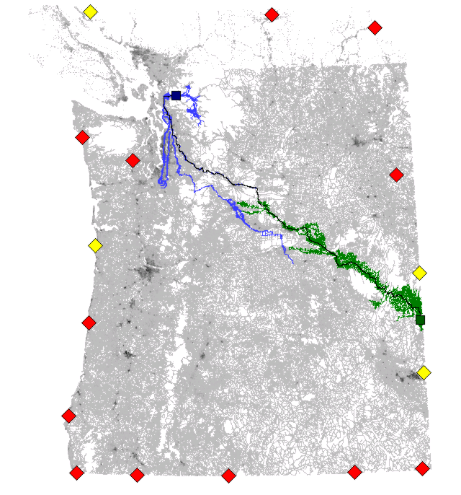
$A^{∗}$ + Landmarks + Triangle equality (ATL)
12ms
Forward search
Backward search
Inactive landmarks
Active landmarks
Problem of ATL:
We should stick with highway!
From now on, we allow to preprocess the graph.

Slide 39
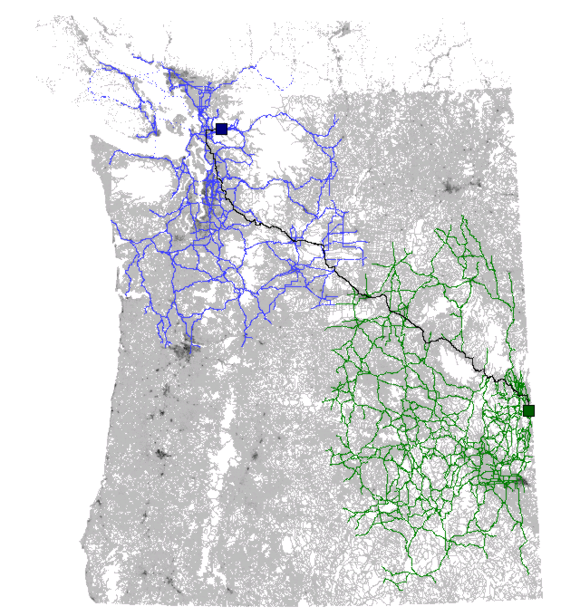
Reach Algorithm
30ms
Use highway except for the beginning and the end of the journey!
Forward search
Backward search

Slide 40
Creating shortcut in the graph
When you are on the highway, don’t need to keep checking the map until you are nearby!

Slide 41
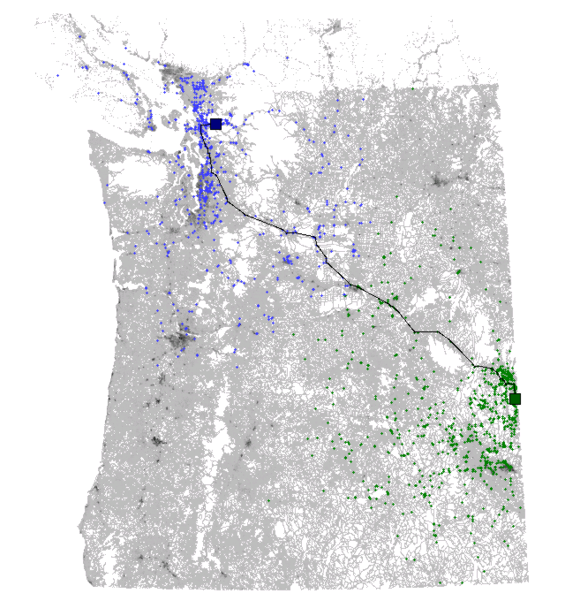
Reach + Shortcut Algorithm
2ms
Forward search
Backward search

Slide 42
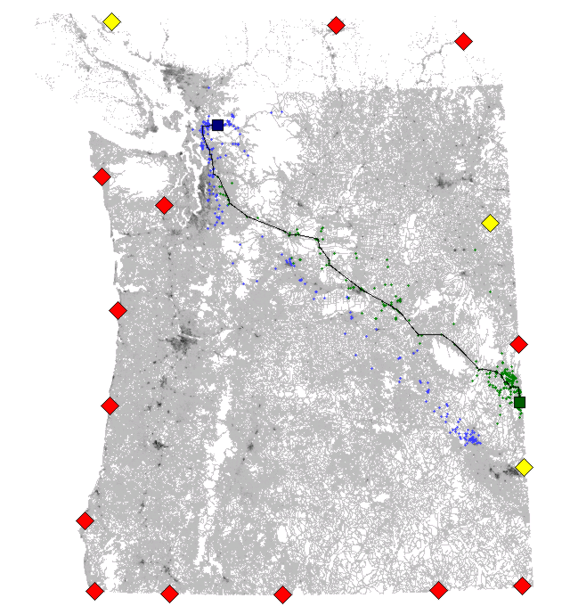
Reach + Shortcut + ATL Algorithm
0.7ms

