Slide 1

CSE 421
Final Review
Yin Tat Lee
Please fill in the evaluation.
Response rate is 33% only.
https://uw.iasystem.org/survey/253736

Slide 2
Final Exam
Format:
~20% True / False
~20% Fill in the blank
~60% 5 questions (1 question no proof)
Time: 2:30-4:20 (Mon, Mar 14) (110min)
Location: CSE2 G20 (same room)
Open book, open note.
Coverage: Lecture 1 – 24 (everything up to NP completeness)
Topics: Graph, Greedy, Divide and Conquer, Dynamic Programming, Maxflow, NP completeness.
Tips:
Please come up some algorithms for all questions (even if it is slower or may not work.)
Knowing how to greedy in real life is important.

Slide 3
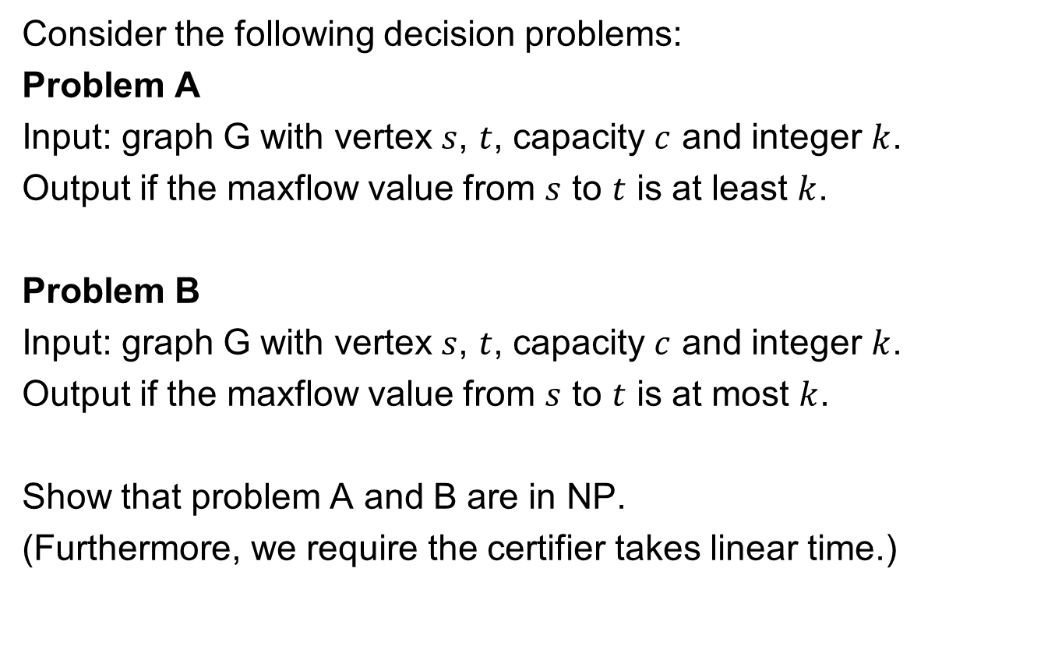
Question
Consider the following decision problems:
Problem A
Input: graph G with vertex $s$, $t$, capacity $c$ and integer $k$.
Output if the maxflow value from $s$ to $t$ is at least $k$.
Problem B
Input: graph G with vertex $s$, $t$, capacity $c$ and integer $k$.
Output if the maxflow value from $s$ to $t$ is at most $k$.
Show that problem A and B are in NP.
(Furthermore, we require the certifier takes linear time.)

Slide 4
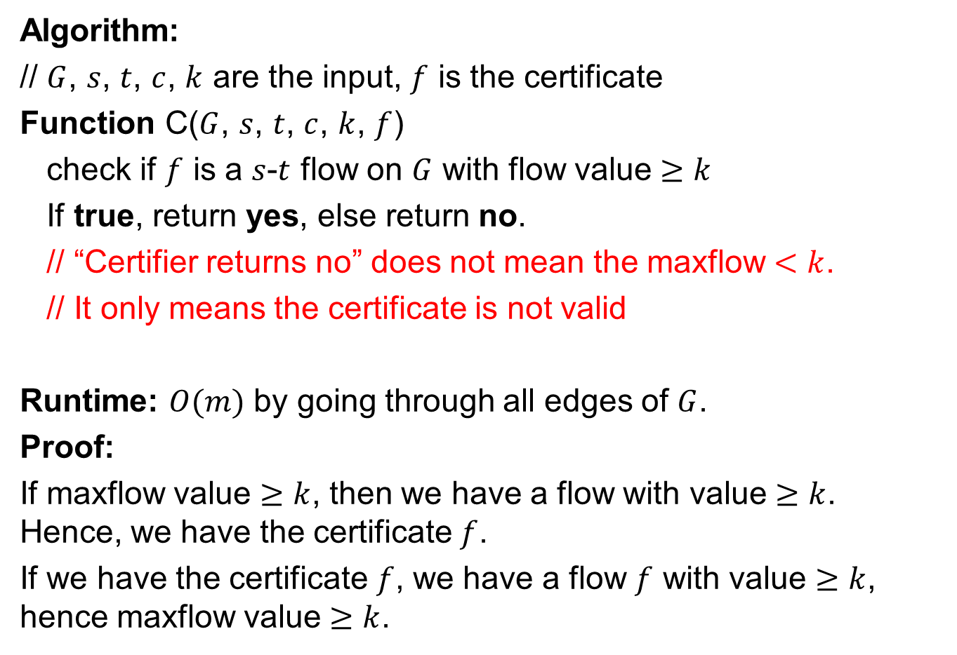
Answer for problem A
Algorithm:
// $G$, $s$, $t$, $c$, $k$ are the input, $f$ is the certificate
Function C($G$, $s$, $t$, $c$, $k$, $f$)
check if $f$ is a $s$-$t$ flow on $G$ with flow value $≥k$
If true, return yes, else return no.
// “Certifier returns no” does not mean the maxflow $<k$.
// It only means the certificate is not valid
Runtime: $O(m)$ by going through all edges of $G$.
Proof:
If maxflow value $≥k$, then we have a flow with value $≥k$. Hence, we have the certificate $f$.
If we have the certificate $f$, we have a flow $f$ with value $≥k$, hence maxflow value $≥k$.

Slide 5
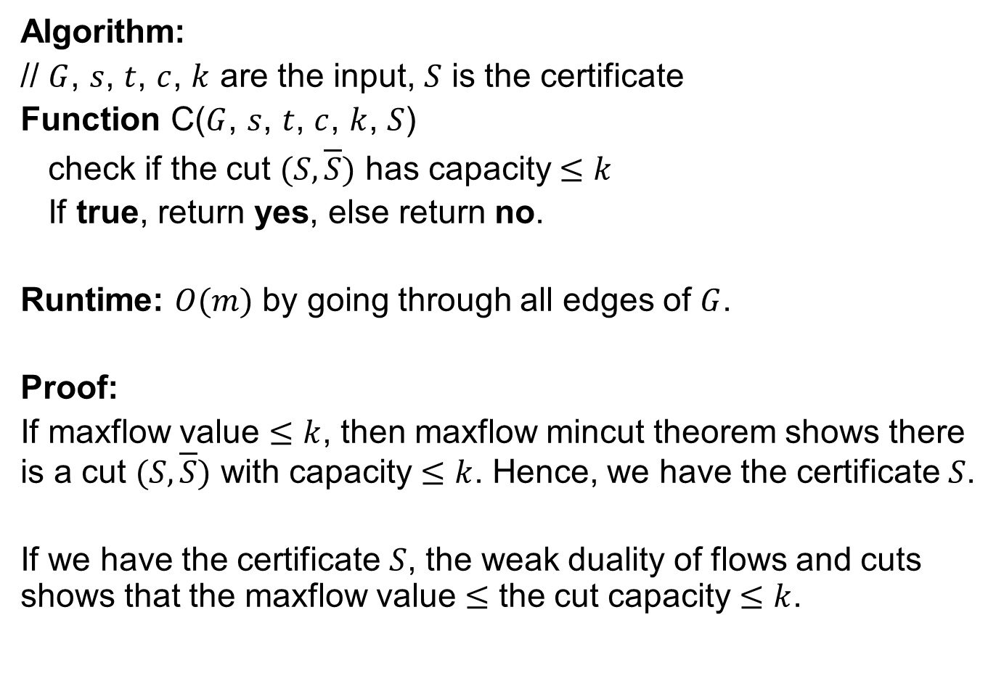
Answer for problem B
Algorithm:
// $G$, $s$, $t$, $c$, $k$ are the input, $S$ is the certificate
Function C($G$, $s$, $t$, $c$, $k$, $S$)
check if the cut $(S,\overline{S})$ has capacity $≤k$
If true, return yes, else return no.
Runtime: $O(m)$ by going through all edges of $G$.
Proof:
If maxflow value $≤k$, then maxflow mincut theorem shows there is a cut $(S,\overline{S})$ with capacity $≤$ $k$. Hence, we have the certificate $S$.
If we have the certificate $S$, the weak duality of flows and cuts shows that the maxflow value $≤$ the cut capacity $≤k$.

Slide 6
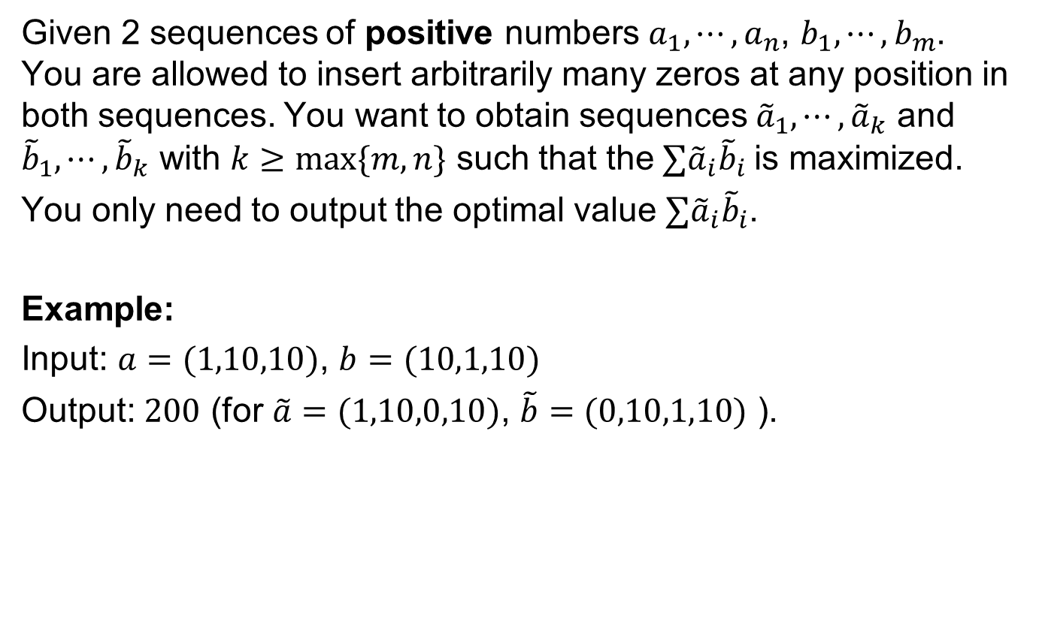
Question
Given 2 sequences of positive numbers $a_{1},⋯,a_{n}$, $b_{1},⋯,b_{m}$. You are allowed to insert arbitrarily many zeros at any position in both sequences. You want to obtain sequences ${\tilde{a}}_{1},⋯,{\tilde{a}}_{k}$ and ${\tilde{b}}_{1},⋯,{\tilde{b}}_{k}$ with $k≥max⁡\{m,n\}$ such that the$∑{\tilde{a}}_{i}{\tilde{b}}_{i}$ is maximized.
You only need to output the optimal value $∑{\tilde{a}}_{i}{\tilde{b}}_{i}$.
Example:
Input: $a=(1,10,10)$, $b=(10,1,10)$
Output: $200$ (for $\tilde{a}=(1,10,0,10)$, $\tilde{b}=(0,10,1,10)$ ).

Slide 7
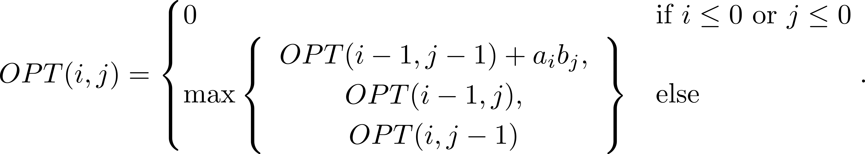
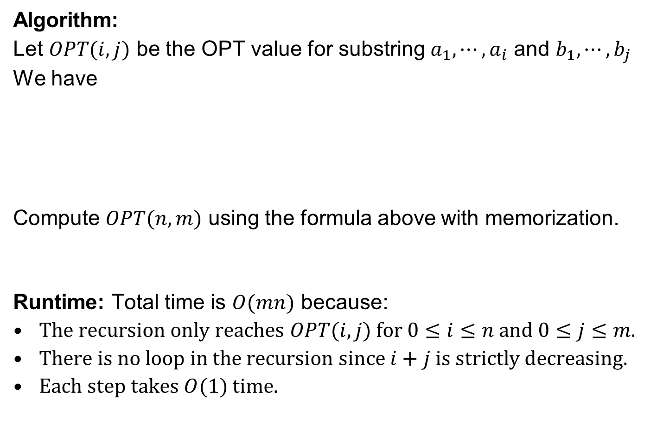
Answer
Algorithm:
Let $OPT(i,j)$ be the OPT value for substring $a_{1},⋯,a_{i}$ and $b_{1},⋯,b_{j}$
We have
Compute $OPT(n,m)$ using the formula above with memorization.
Runtime: Total time is $O(mn)$ because:
The recursion only reaches $OPT(i,j)$ for $0≤i≤n$ and $0≤j≤m$.
There is no loop in the recursion since $i+j$ is strictly decreasing.
Each step takes $O(1)$ time.

Slide 8
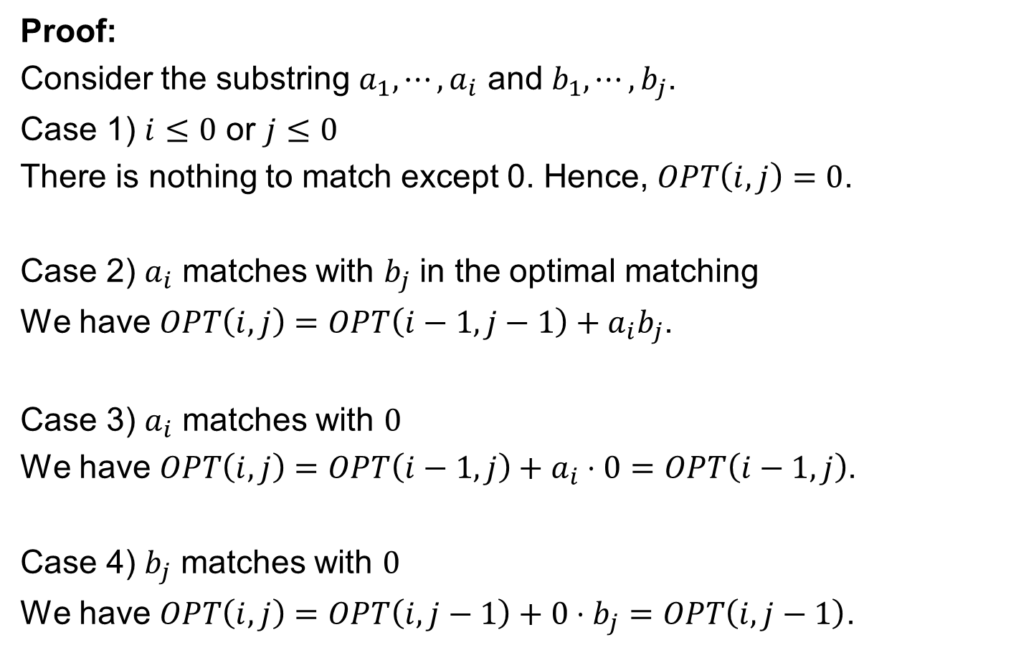
Answer
Proof:
Consider the substring $a_{1},⋯,a_{i}$ and $b_{1},⋯,b_{j}$.
Case 1) $i≤0$ or $j≤0$
There is nothing to match except 0. Hence, $OPT\left(i,j\right)=0$.
Case 2) $a_{i}$ matches with $b_{j}$ in the optimal matching
We have $OPT\left(i,j\right)=OPT\left(i−1,j−1\right)+a_{i}b_{j}$.
Case 3) $a_{i}$ matches with $0$
We have $OPT\left(i,j\right)=OPT\left(i−1,j\right)+a_{i}⋅0=OPT\left(i−1,j\right)$.
Case 4) $b_{j}$ matches with $0$
We have $OPT\left(i,j\right)=OPT\left(i,j−1\right)+0⋅b_{j}=OPT\left(i,j−1\right)$.

Slide 9

Question
Assume P = NP. Given a composite number $N$. Find a factor $a$ that divides $N$ with $a≠1$ and $a≠N$ in time $\log^{O(1)}{N}$.

Slide 10
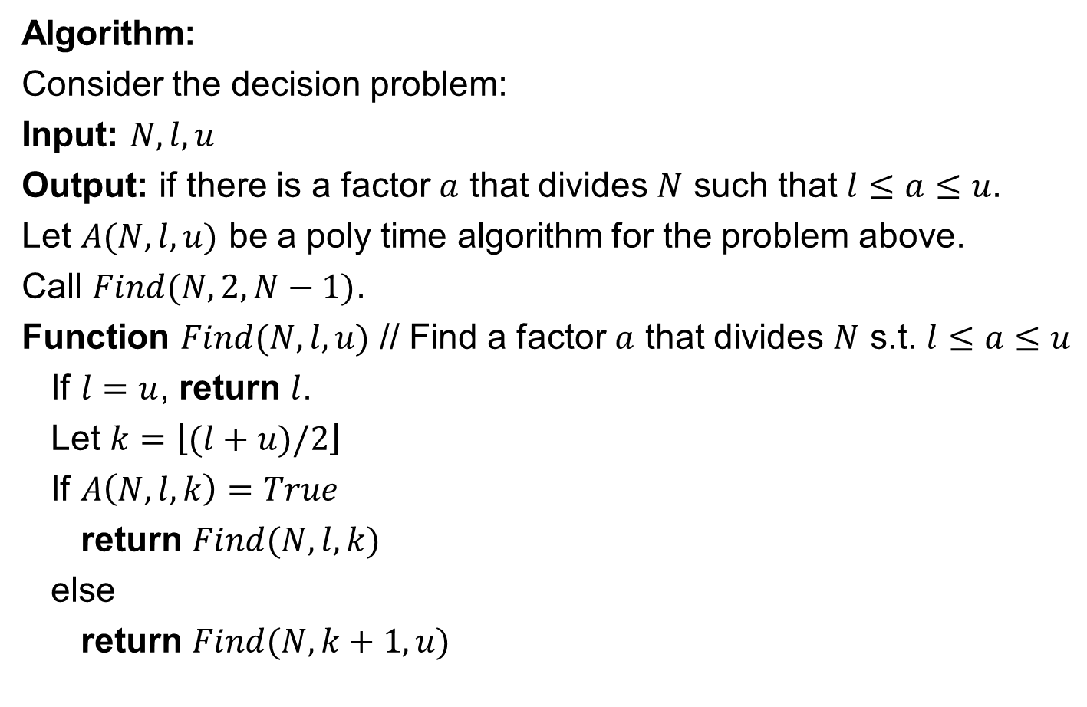
Answer
Algorithm:
Consider the decision problem:
Input: $N,l,u$
Output: if there is a factor $a$ that divides $N$ such that $l≤a≤u$.
Let $A(N,l,u)$ be a poly time algorithm for the problem above.
Call $Find(N,2,N−1)$.
Function $Find(N,l,u)$ // Find a factor $a$ that divides $N$ s.t. $l≤a≤u$
If $l=u$, return $l$.
Let $k=\left\lfloor (l+u)/2\right\rfloor$
If $A\left(N,l,k\right)=True$
return $Find(N,l,k)$
else
return $Find(N,k+1,u)$

Slide 11
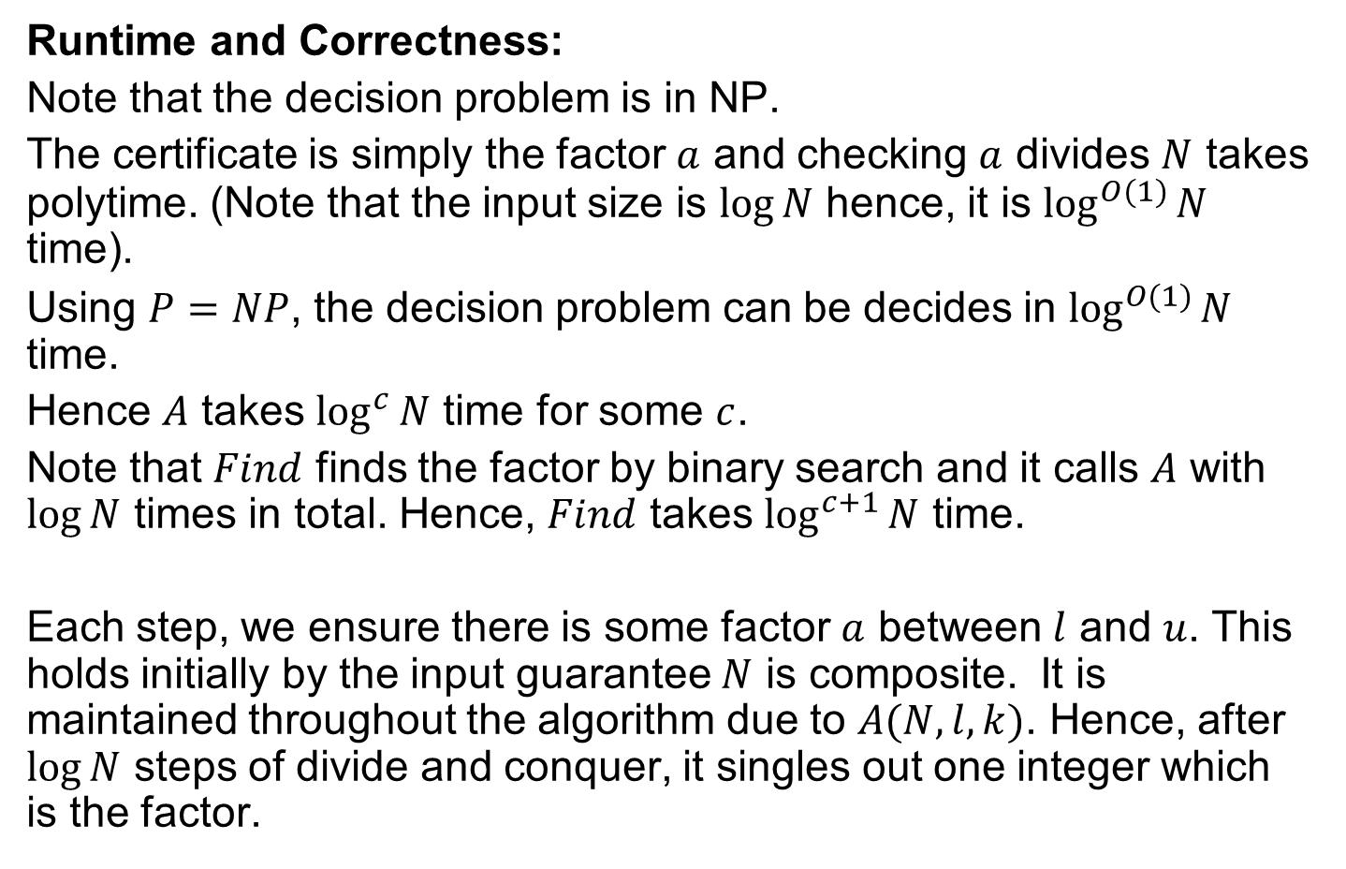
Answer
Runtime and Correctness:
Note that the decision problem is in NP.
The certificate is simply the factor $a$ and checking $a$ divides $N$ takes polytime. (Note that the input size is $\log{N}$ hence, it is $\log^{O(1)}{N}$ time).
Using $P=NP$, the decision problem can be decides in $\log^{O(1)}{N}$ time.
Hence $A$ takes $\log^{c}{N}$ time for some $c$.
Note that $Find$ finds the factor by binary search and it calls $A$ with $\log{N}$ times in total. Hence, $Find$ takes $\log^{c+1}{N}$ time.
Each step, we ensure there is some factor $a$ between $l$ and $u$. This holds initially by the input guarantee $N$ is composite. It is maintained throughout the algorithm due to $A(N,l,k)$. Hence, after $\log{N}$ steps of divide and conquer, it singles out one integer which is the factor.

Slide 12
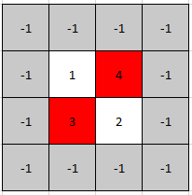
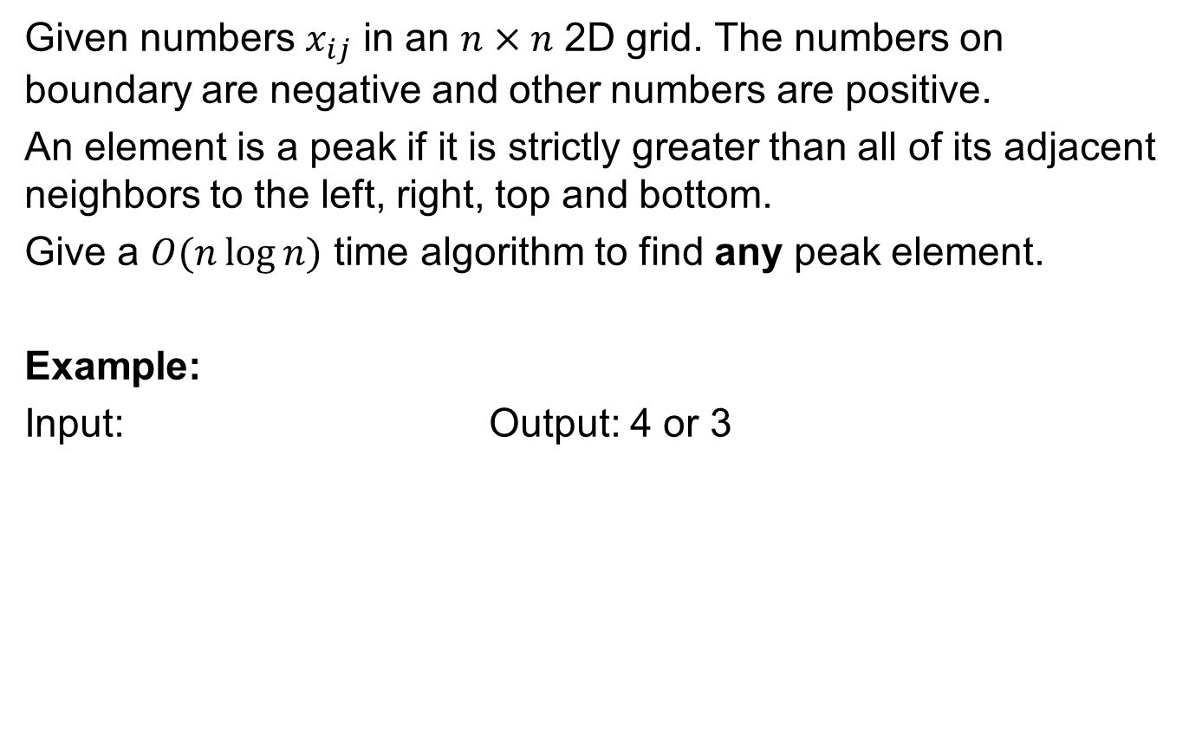
Question
Given numbers $x_{ij}$ in an $n×n$ 2D grid. The numbers on boundary are negative and other numbers are positive.
An element is a peak if it is strictly greater than all of its adjacent neighbors to the left, right, top and bottom.
Give a $O(n\log{n})$ time algorithm to find any peak element.
Example:
Input: Output: 4 or 3

Slide 13
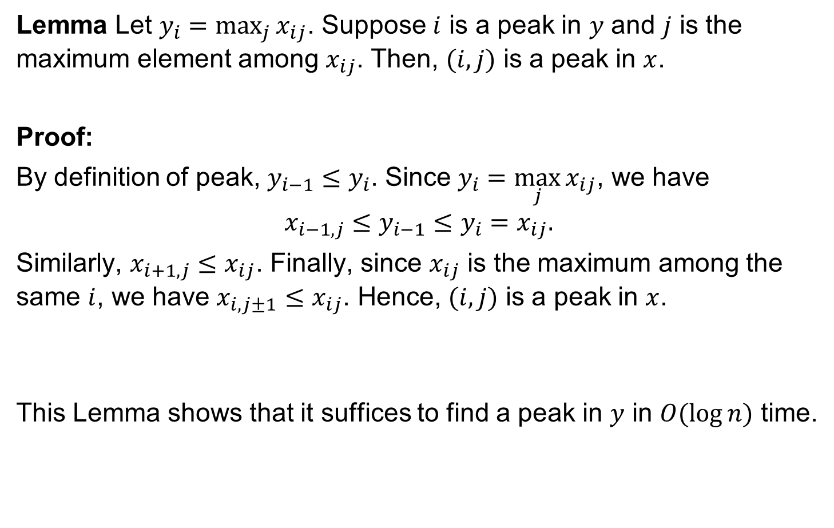
Answer
Lemma Let $y_{i}=\max_{j}{x_{ij}}$. Suppose $i$ is a peak in $y$ and $j$ is the maximum element among $x_{ij}$. Then, $(i,j)$ is a peak in $x$.
Proof:
By definition of peak, $y_{i−1}≤y_{i}$. Since $y_{i}=\max_{j}{x_{ij}}$, we have
$$x_{i−1,j}≤y_{i−1}≤y_{i}=x_{ij}.$$
Similarly, $x_{i+1,j}≤x_{ij}$. Finally, since $x_{ij}$ is the maximum among the same $i$, we have $x_{i,j±1}≤x_{ij}$. Hence, $(i,j)$ is a peak in $x$.
This Lemma shows that it suffices to find a peak in $y$ in $O(\log{n})$ time.

Slide 14


Answer
Algorithm:
Call $Find(2,n−1)$
Function $Find(l,u)$
If $l=u$, return $l$.
Let $k=\left\lfloor (l+u)/2\right\rfloor$
If $y_{k}≤y_{k+1}$
return $Find(k+1,u)$
else
return $Find(l,k)$
Runtime: $O(n\log{n})$ time because of $O(\log{n})$ step, each step involves computing $y$ that takes $O(n)$ time.
Correctness:
We maintain that
$y_{l−1}≤y_{l}$ and $y_{u}≥y_{u+1}$
This is true initially because boundary numbers are negative.
In each step, we recurse according to $y_{k}≤y_{k+1}$ or $y_{k}≥y_{k+1}$. Hence, this is maintained.
At the end, we have $l=u$ and hence
$y_{l−1}≤y_{l}$ and $y_{l}≥y_{l+1}$
Therefore, $y_{l}$ is a peak.

Slide 15

Question
Given a graph $G$ with possible negative length. Suppose that there are only $k$ edges with negative length. Given some vertex $s$, show how to compute the shortest path length from $s$ to every other vertex in $O(mk+kn\log{n})$ time.
You can assume there is no negative cycle.

Slide 16
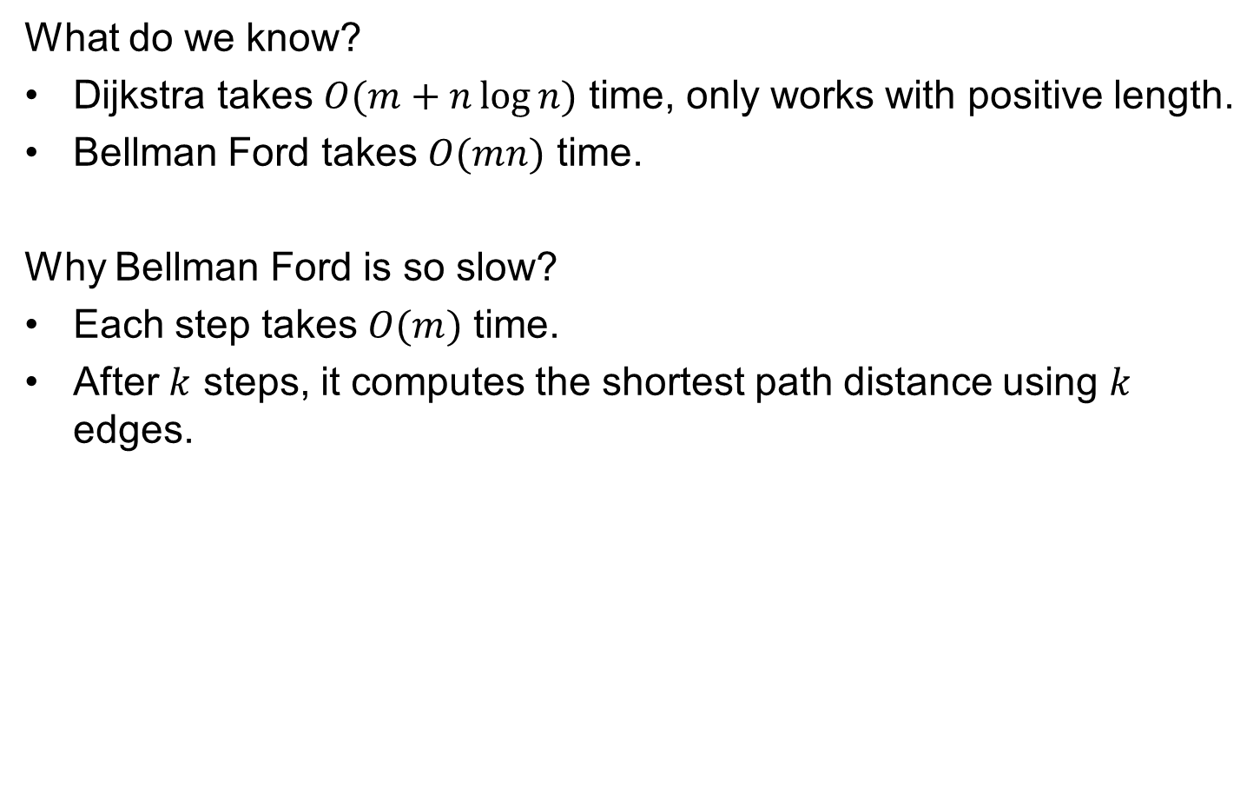
Answer
What do we know?
Dijkstra takes $O(m+n\log{n})$ time, only works with positive length.
Bellman Ford takes $O(mn)$ time.
Why Bellman Ford is so slow?
Each step takes $O(m)$ time.
After $k$ steps, it computes the shortest path distance using $k$ edges.

Slide 17

d = Dijkstra($G,c,s,d$) {
Initialize set of explored nodes $S←\{s\}$
// Maintain distance from $s$ to each vertices in $S$
$d\left[s\right]←0$
Insert all neighbors $v$ of s into a priority queue with value $c_{(s,v)}$.
while ($S≠V$)
{
// Pick an edge $(u,v)$ such that $u∈S$ and $v∉S$ and
// $d[u]+c_{(u,v)}$ is as small as possible.
u ← delete min element from $Q$
Add $v$ to $S$ and define $d[v]=min(d\left[v\right],d[u]+c_{\left(u,v\right)})$.
$Parent\left(v\right)←u$.
foreach (edge $e=(v,w)$ incident to $v$)
if ($w∉ S$)
if ($w$ is not in the $Q$)
Insert $w$ into $Q$ with value $d\left[v\right]+c_{(v,w)}$
else (the key of $w$ > $d\left[v\right]+c_{(v,w)}$)
Decrease key of $v$ to $d[v]+c_{(v,w)}$.
}

Slide 18
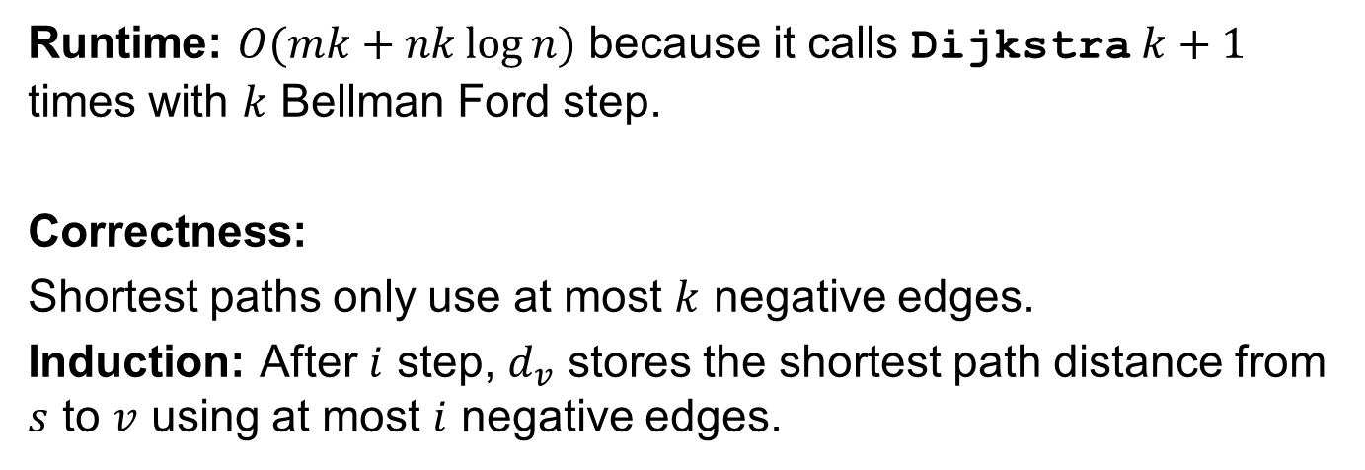
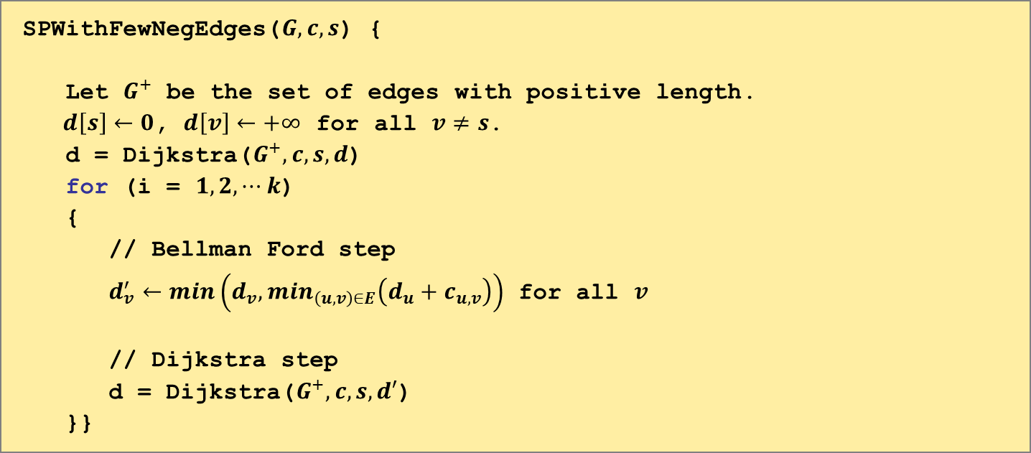
SPWithFewNegEdges($G,c,s$) {
Let $G^{+}$ be the set of edges with positive length.
$d\left[s\right]←0$, $d\left[v\right]←+∞$ for all $v≠s$.
d = Dijkstra($G^{+},c,s,d$)
for (i = $1,2,⋯k$)
{
// Bellman Ford step
$d_{v}^{′}←min\left(d_{v},min_{\left(u,v\right)∈E}\left(d_{u}+c_{u,v}\right)\right)$ for all $v$
// Dijkstra step
d = Dijkstra($G^{+},c,s,d′$)
}}
Runtime: $O(mk+nk\log{n})$ because it calls Dijkstra $k+1$ times with $k$ Bellman Ford step.
Correctness:
Shortest paths only use at most $k$ negative edges.
Induction: After $i$ step, $d_{v}$ stores the shortest path distance from $s$ to $v$ using at most $i$ negative edges.
You can give proof very succinctly and only get deduct very minor points.

Slide 19
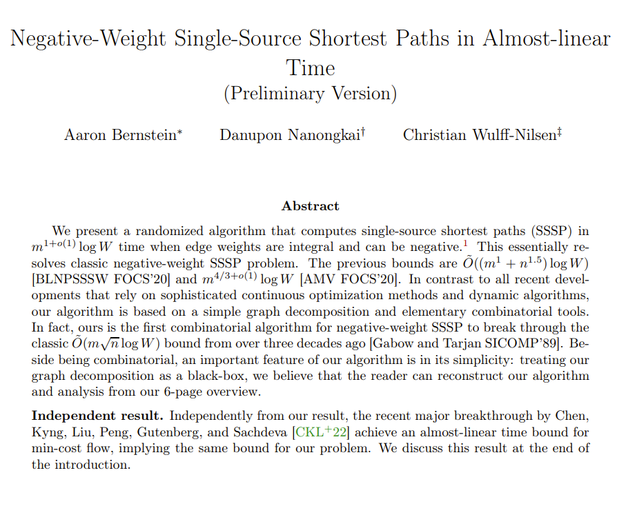
Answer
See more details in appendix of https://arxiv.org/abs/2203.03456.
They get almost linear time for negative shortest path.
(Opened for decades)
This question is a subroutine.
This Monday!

