Slide 1
CSE 421
NP-Completeness
Yin Tat Lee

Slide 2
Computational Complexity
Goal: Classify problems according to the amount of computational resources used by the best algorithms that solve them
Here we focus on time complexity
Recall: worst-case running time of an algorithm
max # steps algorithm takes on any input of size n

Slide 3
Relative Complexity of Problems
Want a notion that allows us to compare the complexity of problems
Want to be able to make statements of the form
    “If we could solve problem B in polynomial time then we can solve problem A in polynomial time”
    “Problem B is at least as hard as problem A”

Slide 4
Polynomial Time Reduction
Def A ≤_{P} B: if there is an algorithm for problem A using a ‘black box’ (subroutine) that solve problem B s.t.,
Algorithm uses only a polynomial number of steps
Makes only a polynomial number of calls to a subroutine for B
So,
Conversely,
In words, B is as hard as A (it can be even harder)
B is Polynomial
time solvable
A is Polynomial
time solvable
No efficient
Algorithm for A
No efficient
Algorithm for B

Slide 5

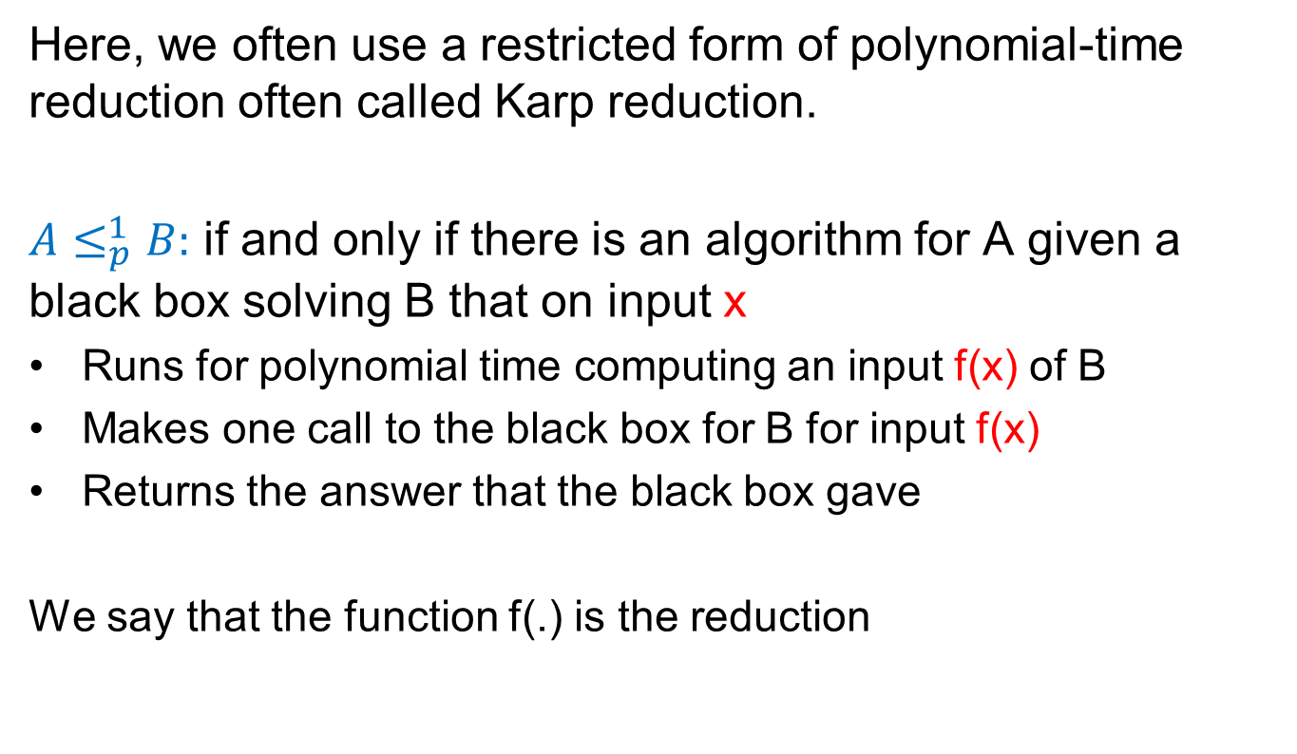
$≤_{p}^{1}$ Reductions
Here, we often use a restricted form of polynomial-time reduction often called Karp reduction.
$A≤_{p}^{1}B:$ if and only if there is an algorithm for A given a black box solving B that on input x
Runs for polynomial time computing an input f(x) of B
Makes one call to the black box for B for input f(x)
Returns the answer that the black box gave
We say that the function f(.) is the reduction

Slide 6
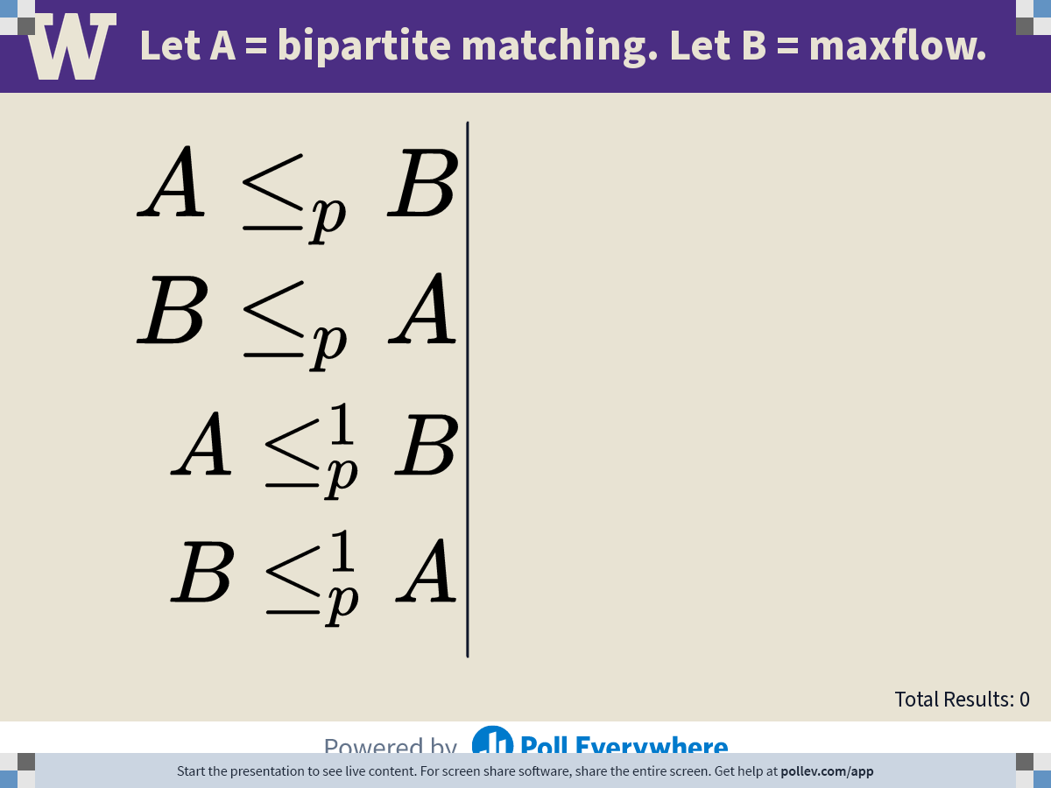
Notes:
Poll Title: Do not modify the notes in this section to avoid tampering with the Poll Everywhere activity.
More info at polleverywhere.com/support
Let A = shortest path problem. Let B = maxflow problem.
https://www.polleverywhere.com/multiple_choice_polls/90W62wRwpFt3xa7VmT0xu?state=opened&flow=Default&onscreen=persist

Slide 7
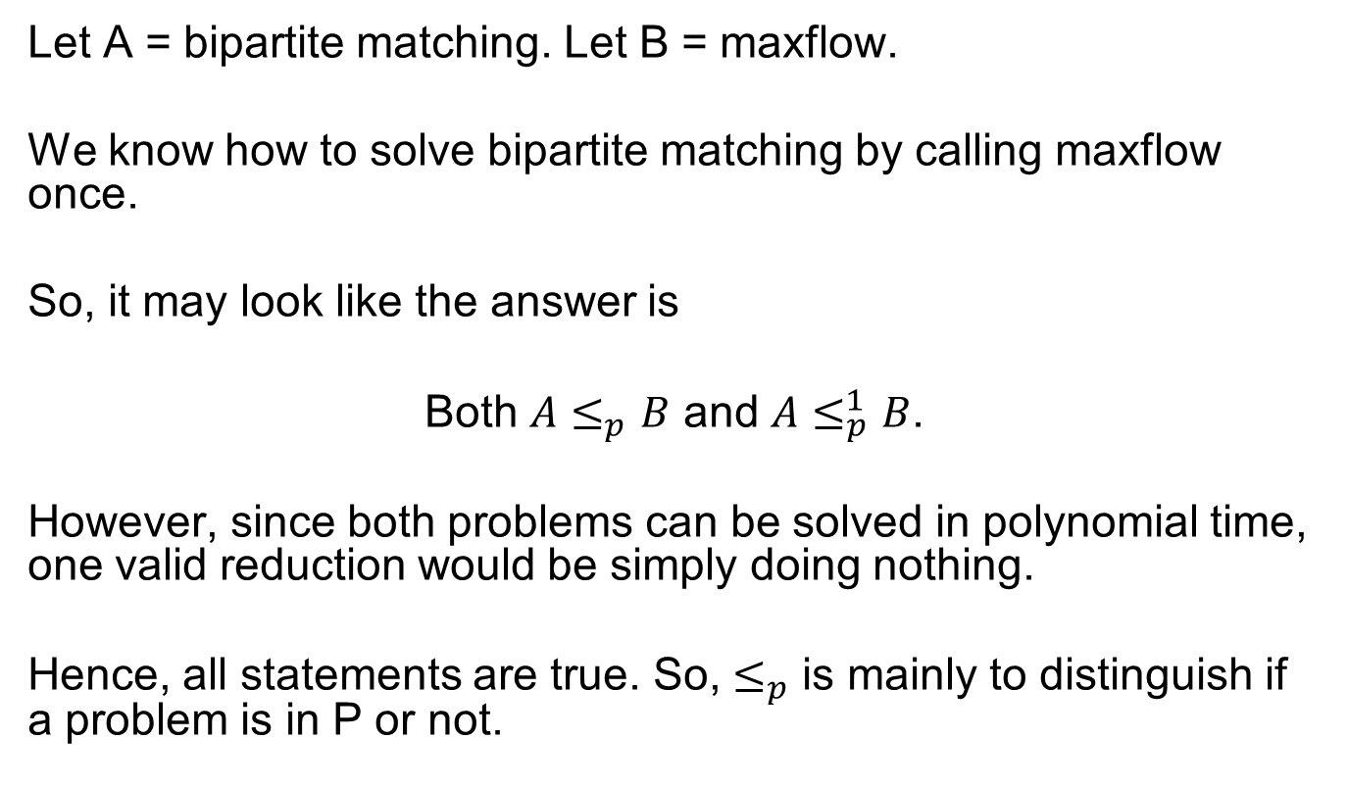
Answer
Let A = bipartite matching. Let B = maxflow.
We know how to solve bipartite matching by calling maxflow once.
So, it may look like the answer is
Both $A≤_{p}B$ and $A≤_{p}^{1}B$.
However, since both problems can be solved in polynomial time, one valid reduction would be simply doing nothing.
Hence, all statements are true. So, $≤_{p}$ is mainly to distinguish if a problem is in P or not.

Slide 8
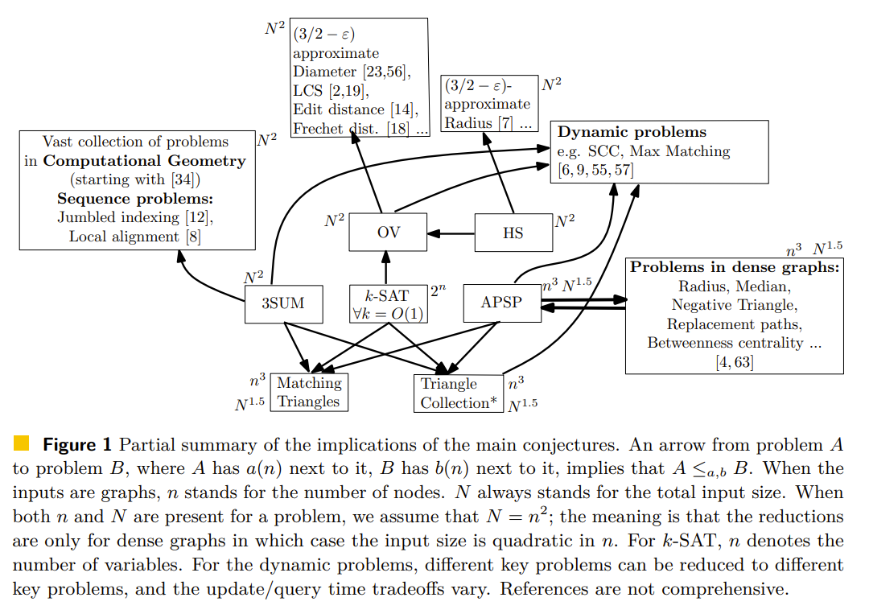
Fine-Grained Complexity
There are recent work on distinguishing different polytime.

Slide 9
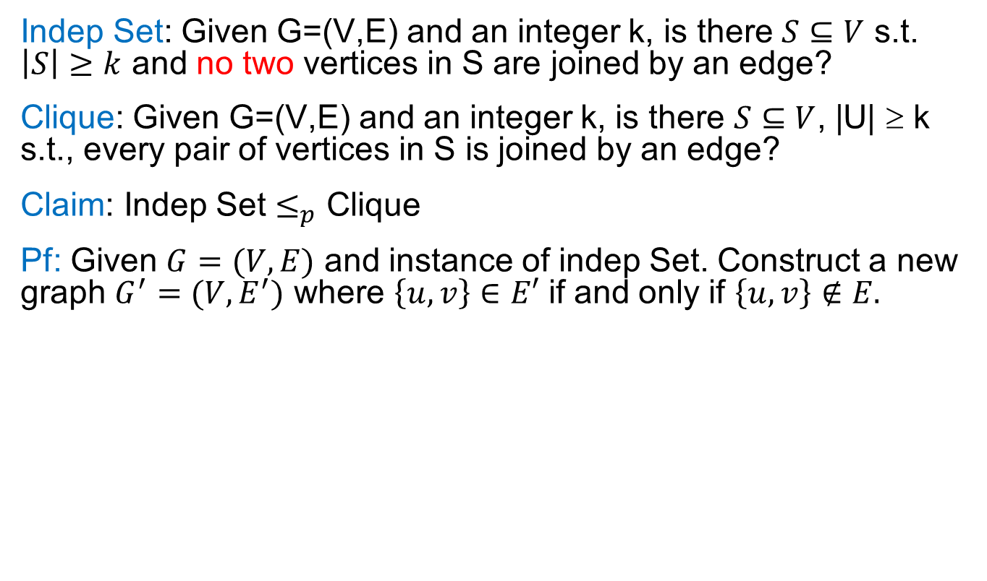

Example 1: Indep Set $≤_{p}$ Clique
Indep Set: Given G=(V,E) and an integer k, is there $S⊆V$ s.t. $\left|S\right|≥k$ and no two vertices in S are joined by an edge?
Clique: Given G=(V,E) and an integer k, is there $S⊆V$, |U| ≥ k s.t., every pair of vertices in S is joined by an edge?
Claim: Indep Set $≤_{p}$ Clique
Pf: Given $G=(V,E)$ and instance of indep Set. Construct a new graph $G^{′}=(V,E^{′})$ where $\left\{u,v\right\}∈E′$ if and only if $\left\{u,v\right\}∉E.$
1
1
2
5
2
5
3
4
3
4
S is an indep set
in G
S is a clique
in G’

Slide 10
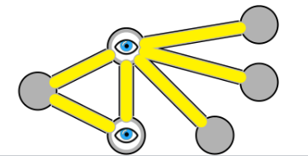

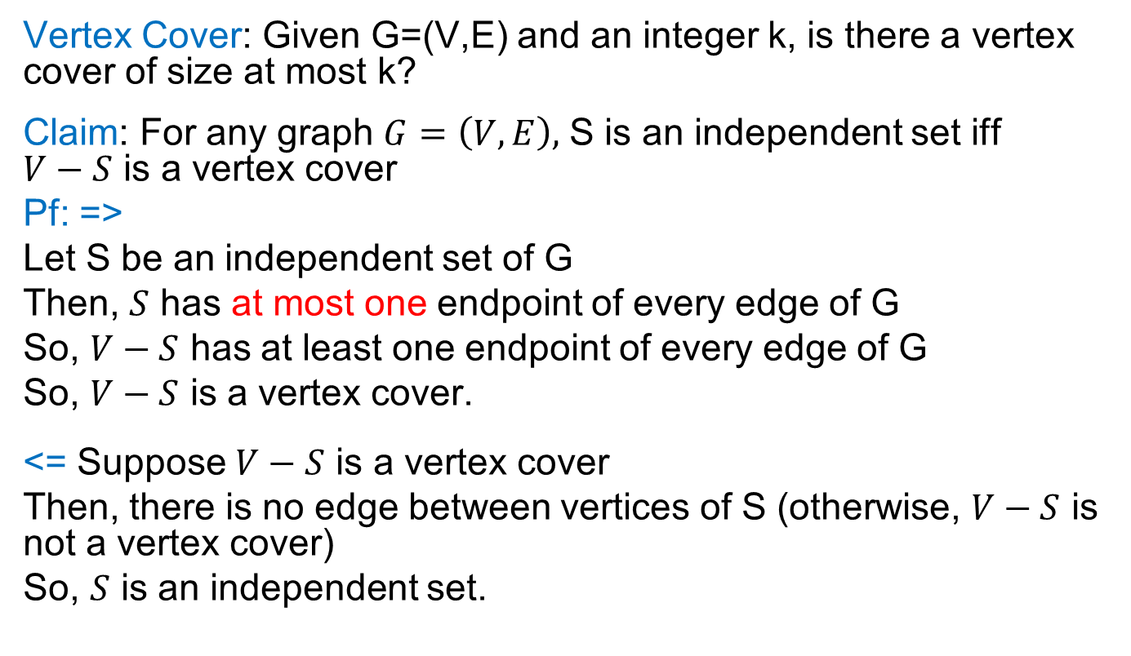
Example 2: Vertex Cover $≤_{p}$ Indep Set
Vertex Cover: Given G=(V,E) and an integer k, is there a vertex cover of size at most k?
Claim: For any graph $G=\left(V,E\right),$ S is an independent set iff $V−S$ is a vertex cover
Pf: =>
Let S be an independent set of G
Then, $S$ has at most one endpoint of every edge of G
So, $V−S$ has at least one endpoint of every edge of G
So, $V−S$ is a vertex cover.
<= Suppose $V−S$ is a vertex cover
Then, there is no edge between vertices of S (otherwise, $V−S$ is not a vertex cover)
So, $S$ is an independent set.

Slide 11

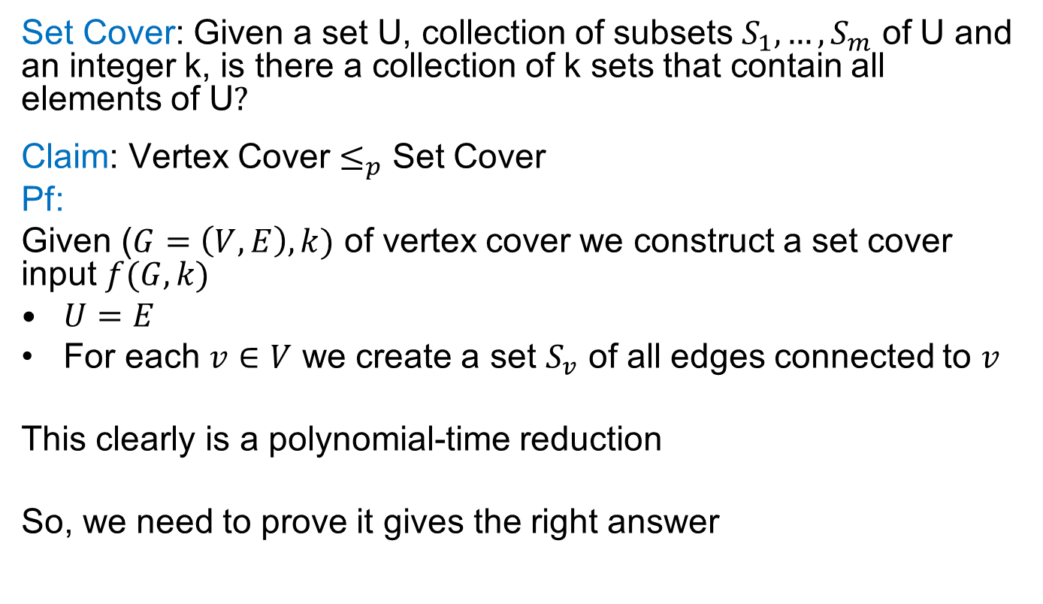
Example 3: Vertex Cover $≤_{p}$ Set Cover
Set Cover: Given a set U, collection of subsets $S_{1},…,S_{m}$ of U and an integer k, is there a collection of k sets that contain all elements of U$?$
Claim: Vertex Cover $≤_{p}$ Set Cover
Pf:
Given ($G=\left(V,E\right),k)$ of vertex cover we construct a set cover input $f(G,k)$
$U=E$
For each $v∈V$ we create a set $S_{v}$ of all edges connected to $v$
This clearly is a polynomial-time reduction
So, we need to prove it gives the right answer

Slide 12
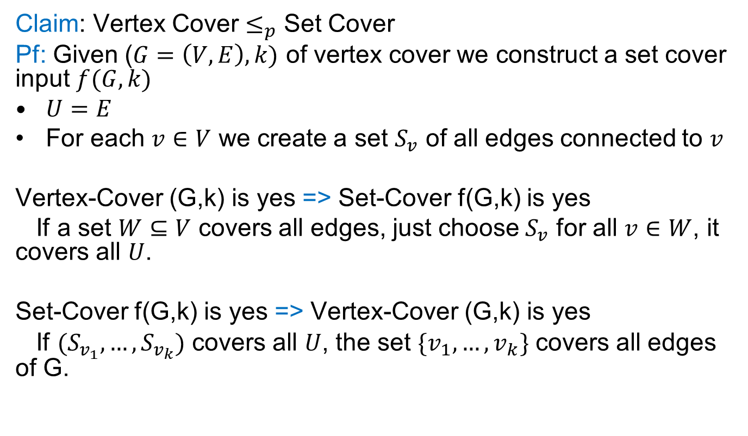
Example 3: Vertex Cover $≤_{p}$ Set Cover
Claim: Vertex Cover $≤_{p}$ Set Cover
Pf: Given ($G=\left(V,E\right),k)$ of vertex cover we construct a set cover input $f(G,k)$
$U=E$
For each $v∈V$ we create a set $S_{v}$ of all edges connected to $v$
Vertex-Cover (G,k) is yes => Set-Cover f(G,k) is yes
If a set $W⊆V$ covers all edges, just choose $S_{v}$ for all $v∈W$, it covers all $U$.
Set-Cover f(G,k) is yes => Vertex-Cover (G,k) is yes
If $(S_{v_{1}},…,S_{v_{k}})$ covers all $U$, the set $\{v_{1},…,v_{k}\}$ covers all edges of G.

Slide 13
Decision Problems
A decision problem is a computational problem where the answer is just yes/no
Here, we study computational complexity of decision Problems.
Why?
Simpler to deal with
Decision version is not harder than Search version, so it gives a lower bound for Decision version
usually, you can use decider multiple times to find an answer.

Slide 14
Polynomial Time
Define P (polynomial-time) to be the set of all decision problems solvable by algorithms whose worst-case running time is bounded by some polynomial in the input size.
Do we understand P?
We can prove that a problem is in P by exhibiting a polynomial time algorithm
It is in most cases very hard to prove a problem is not in P.

Slide 15
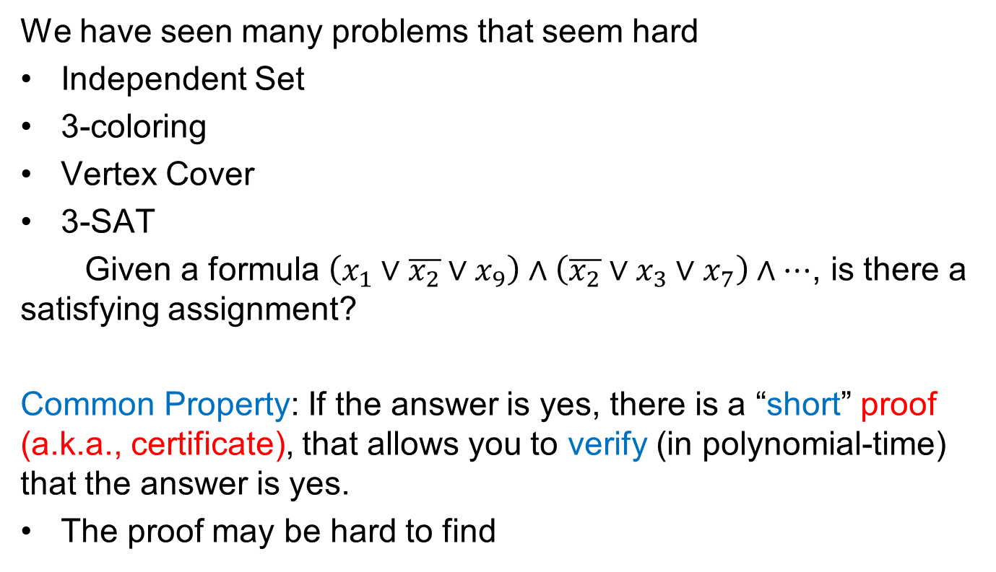
Beyond P?
We have seen many problems that seem hard
Independent Set
3-coloring
Vertex Cover
3-SAT
Given a formula $\left(x_{1}∨\overline{x_{2}}∨x_{9}\right)∧\left(\overline{x_{2}}∨x_{3}∨x_{7}\right)∧…$, is there a satisfying assignment?
Common Property: If the answer is yes, there is a “short” proof (a.k.a., certificate), that allows you to verify (in polynomial-time) that the answer is yes.
The proof may be hard to find
The independent set S
The 3-coloring
The vertex cover S
The T/F assignment
Notes:
conjunctive normal form (CNF)

Slide 16
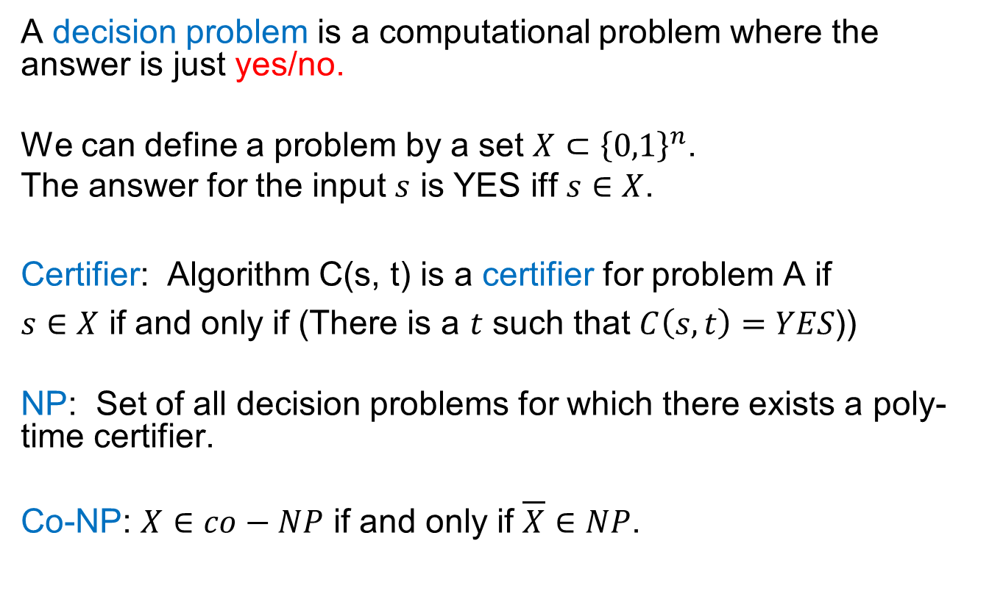
Decision Problems
A decision problem is a computational problem where the answer is just yes/no.
We can define a problem by a set $X⊂{\left\{0,1\right\}}^{n}$.
The answer for the input $s$ is YES iff $s∈X$.
  Certifier: Algorithm C(s, t) is a certifier for problem A if
  $s∈X$ if and only if (There is a $t$ such that $C\left(s,t\right)=YES$))
NP: Set of all decision problems for which there exists a poly-time certifier.
Co-NP: $X∈co−NP$ if and only if $\overline{X}∈NP$.

Slide 17
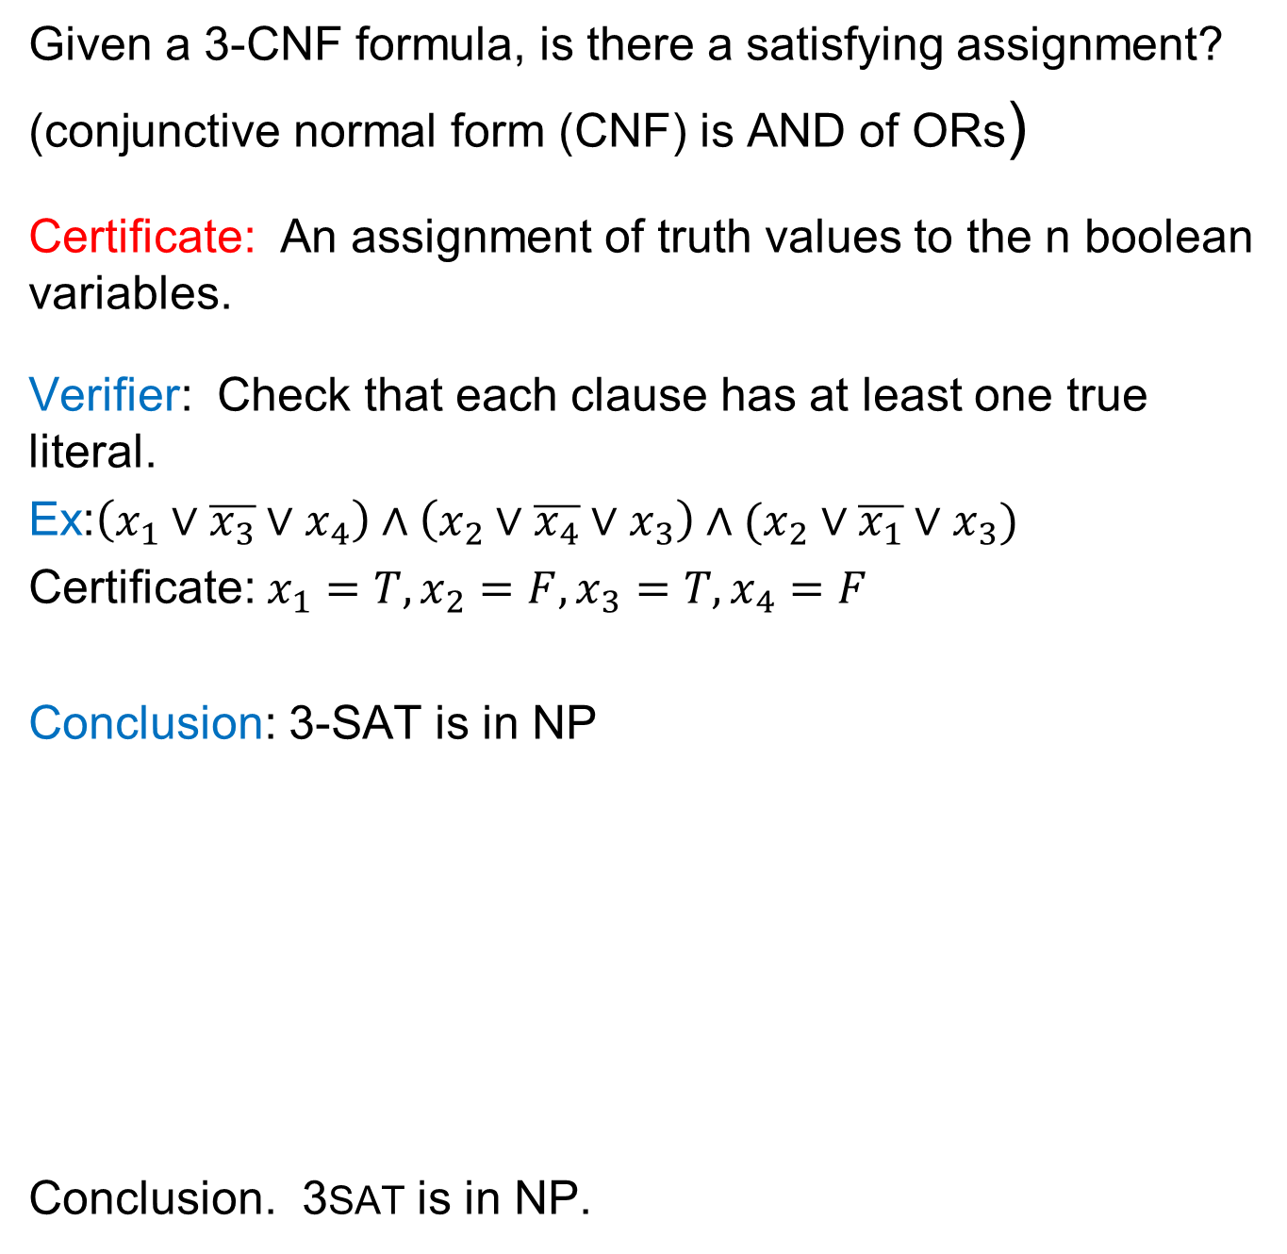
Example: 3SAT is in NP
Given a 3-CNF formula, is there a satisfying assignment?
(conjunctive normal form (CNF) is AND of ORs)
Certificate: An assignment of truth values to the n boolean variables.
Verifier: Check that each clause has at least one true literal.
Ex:$\left(x_{1}∨\overline{x_{3}}∨x_{4}\right)∧\left(x_{2}∨\overline{x_{4}}∨x_{3}\right)∧(x_{2}∨\overline{x_{1}}∨x_{3})$
Certificate: $x_{1}=T,x_{2}=F,x_{3}=T,x_{4}=F$
Conclusion: 3-SAT is in NP
Conclusion. 3SAT is in NP.

Slide 18
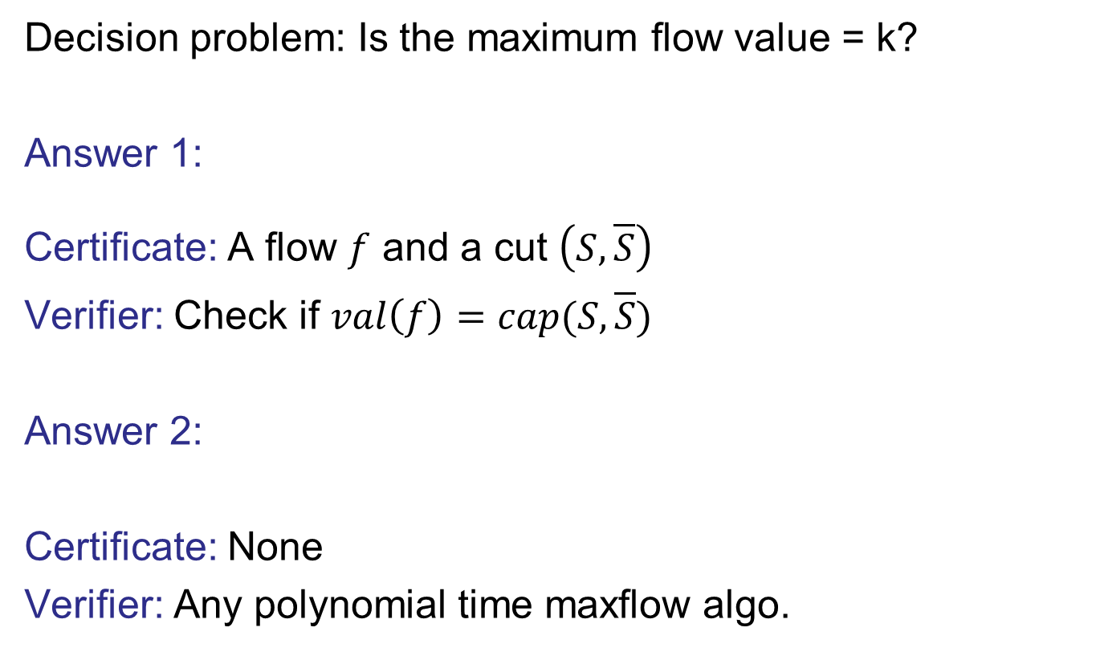
Question: Is Maxflow is in NP?
Decision problem: Is the maximum flow value = k?
Answer 1:
Certificate: A flow $f$ and a cut $\left(S,\overline{S}\right)$
Verifier: Check if $val\left(f\right)=cap(S,\overline{S})$
Answer 2:
Certificate: None
Verifier: Any polynomial time maxflow algo.

Slide 19
What do we know about NP?
Nobody knows if all problems in NP can be done in polynomial time, i.e. does P=NP?
  one of the most important open questions in all of science.
  Huge practical implications specially if answer is yes
Every problem in P is in NP
  one doesn’t even need a certificate for problems in P so just ignore any hint you are given
Every problem in NP is in exponential time
Some problems in NP seem really hard
  nobody knows how to prove that they are really hard to solve, i.e. $P≠NP$

Slide 20
NP Completeness
Complexity Theorists Approach: We don’t know how to prove any problem in NP is hard. So, let’s find hardest problems in NP.
NP-hard: A problem B is NP-hard iff for any problem $A∈NP$, we have $A≤_{p}B$
NP-Completeness: A problem B is NP-complete iff B is NP-hard and $B∈NP$.
Motivations:
If $P≠NP,$ then every NP-Complete problems is not in P. So, we shouldn’t try to design Polytime algorithms
To show $P=NP$, it is enough to design a polynomial time algorithm for just one NP-complete problem.

Slide 21
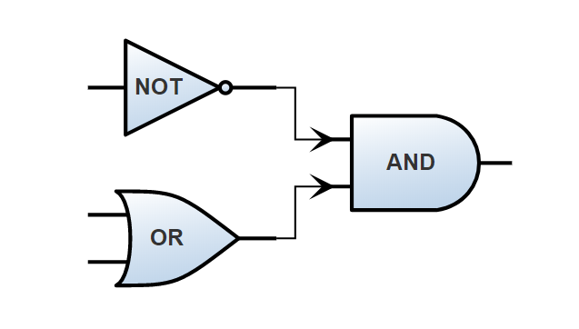
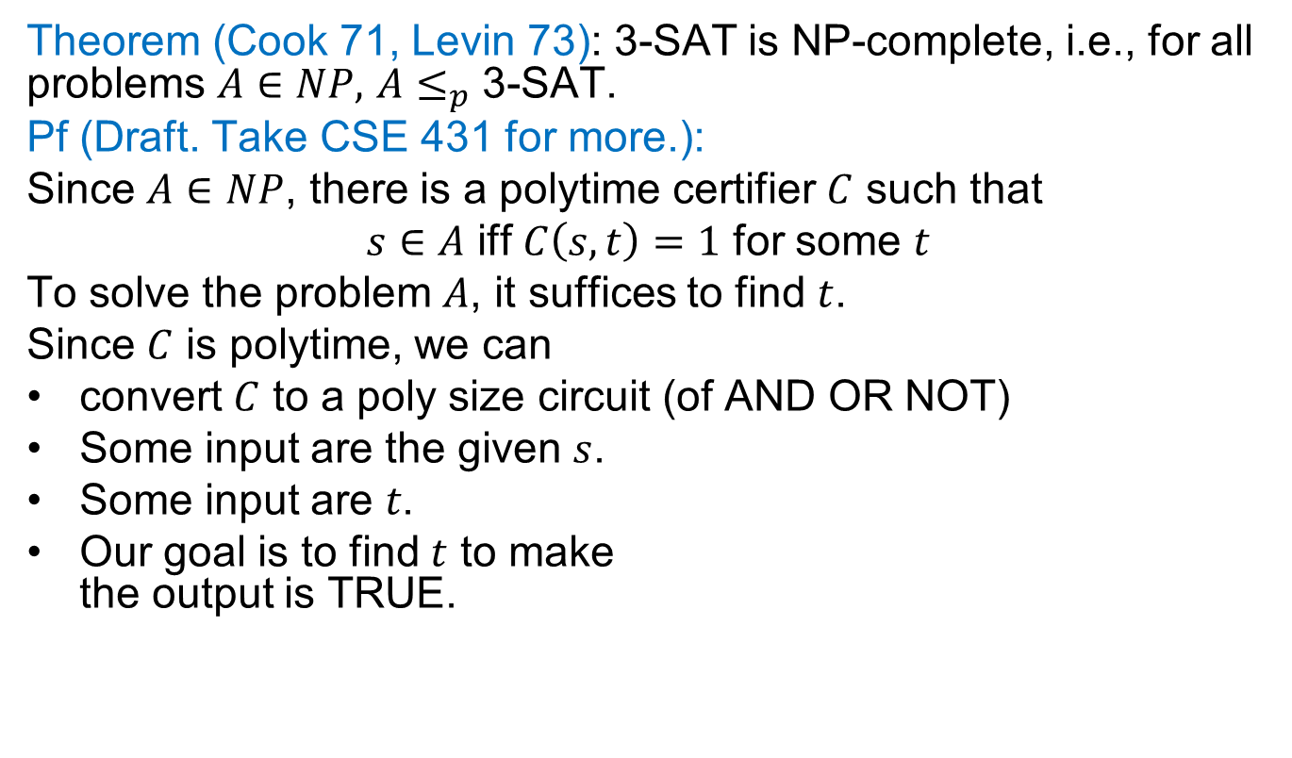
Cook-Levin Theorem
Theorem (Cook 71, Levin 73): 3-SAT is NP-complete, i.e., for all problems $A∈NP,$ $A≤_{p}$ 3-SAT.
Pf (Draft. Take CSE 431 for more.):
Since $A∈NP$, there is a polytime certifier $C$ such that
$s∈A$ iff $C\left(s,t\right)=1$ for some $t$
To solve the problem $A$, it suffices to find $t$.
Since $C$ is polytime, we can
convert $C$ to a poly size circuit (of AND OR NOT)
Some input are the given $s$.
Some input are 𝑡.
Our goal is to find $t$ to make
the output is TRUE.

Slide 22
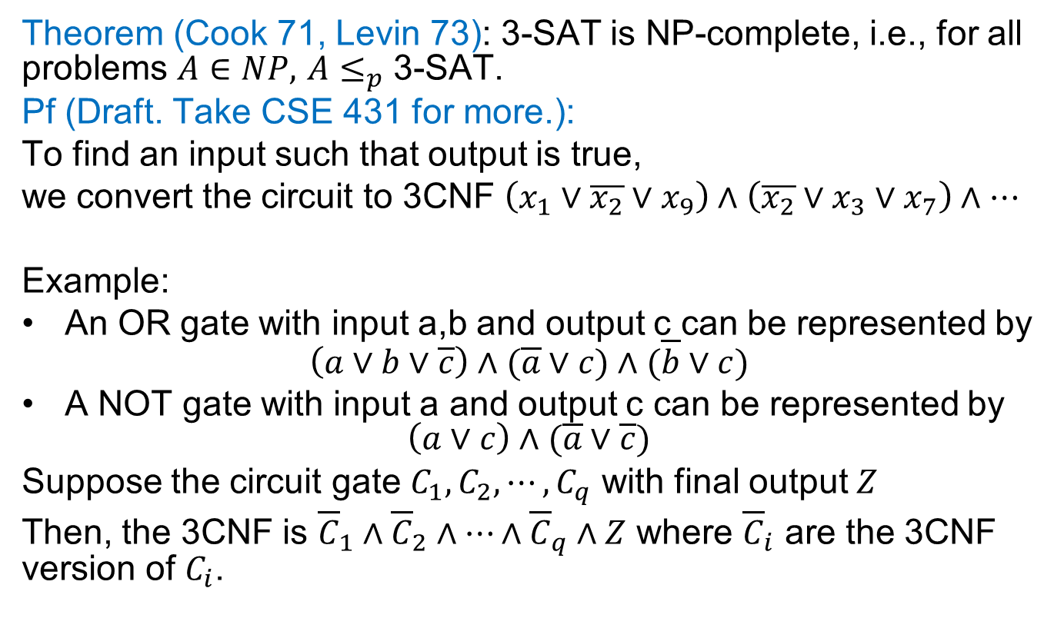
Cook-Levin Theorem
Theorem (Cook 71, Levin 73): 3-SAT is NP-complete, i.e., for all problems $A∈NP,$ $A≤_{p}$ 3-SAT.
Pf (Draft. Take CSE 431 for more.):
To find an input such that output is true,
we convert the circuit to 3CNF $\left(x_{1}∨\overline{x_{2}}∨x_{9}\right)∧\left(\overline{x_{2}}∨x_{3}∨x_{7}\right)∧…$
Example:
An OR gate with input a,b and output c can be represented by
$$\left(a∨b∨\overline{c}\right)∧(\overline{a}∨c)∧(\overline{b}∨c)$$
A NOT gate with input a and output c can be represented by
$$\left(a∨c\right)∧(\overline{a}∨\overline{c})$$
Suppose the circuit gate $C_{1},C_{2},⋯,C_{q}$ with final output $Z$
Then, the 3CNF is ${\overline{C}}_{1}∧{\overline{C}}_{2}∧⋯∧{\overline{C}}_{q}∧Z$ where ${\overline{C}}_{i}$ are the 3CNF version of $C_{i}$.

Slide 23
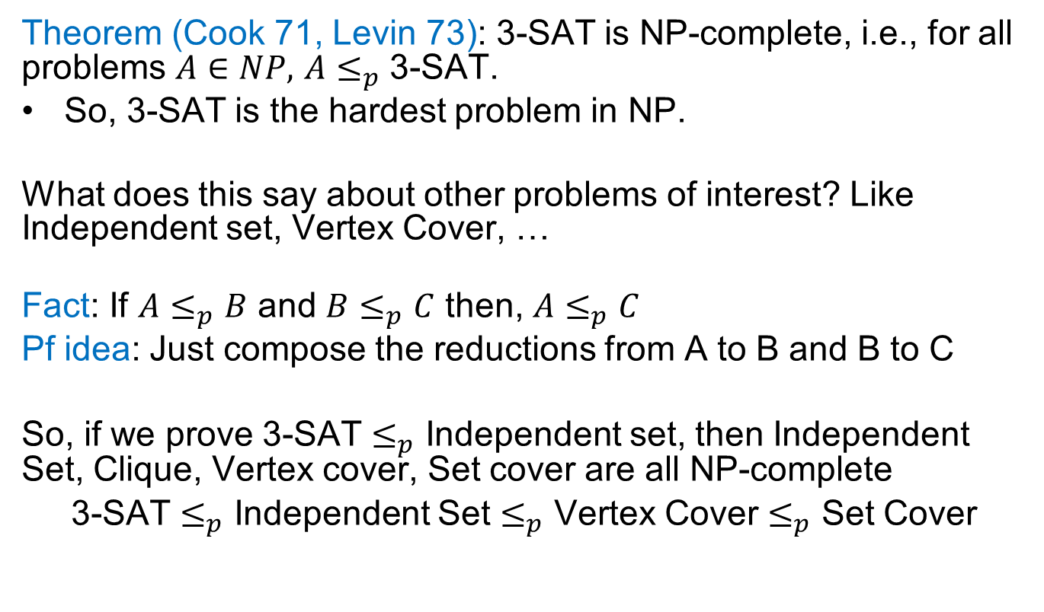
Cook-Levin Theorem
Theorem (Cook 71, Levin 73): 3-SAT is NP-complete, i.e., for all problems $A∈NP,$ $A≤_{p}$ 3-SAT.
So, 3-SAT is the hardest problem in NP.
What does this say about other problems of interest? Like Independent set, Vertex Cover, …
Fact: If $A≤_{p}B$ and $B≤_{p}C$ then, $A≤_{p}C$
Pf idea: Just compose the reductions from A to B and B to C
So, if we prove 3-SAT $≤_{p}$ Independent set, then Independent Set, Clique, Vertex cover, Set cover are all NP-complete
3-SAT $≤_{p}$ Independent Set $≤_{p}$ Vertex Cover $≤_{p}$ Set Cover

Slide 24
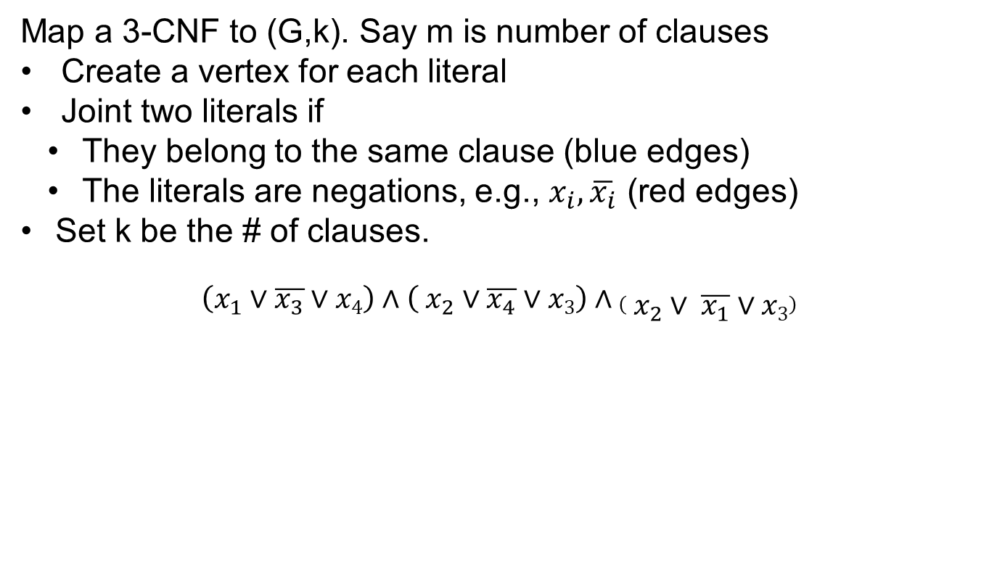
3-SAT $≤_{p}$ Independent Set
Map a 3-CNF to (G,k). Say m is number of clauses
Create a vertex for each literal
Joint two literals if
  They belong to the same clause (blue edges)
  The literals are negations, e.g., $x_{i}, \overline{x_{i}}$ (red edges)
Set k be the # of clauses.
$$\left(x_{1}∨\overline{x_{3}}∨x4\right)∧\left( x_{2}∨\overline{x_{4}}∨x3\right)∧\left( x_{2}∨ \overline{x_{1}}∨x3\right)$$
$$x_{1}$$
$$x_{2}$$
$$x_{2}$$
Polynomial-Time Reduction
$$\overline{x_{3}}$$
$$\overline{x_{4}}$$
$$\overline{x_{1}}$$
$$x_{4}$$
$$x_{3}$$
$$x_{3}$$

Slide 25
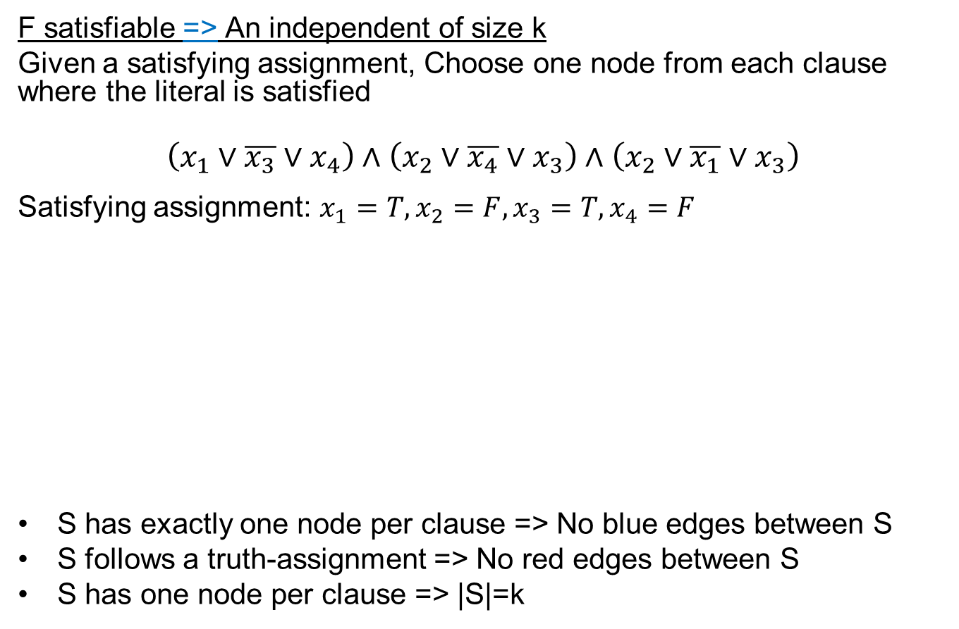
Correctness of 3-SAT $≤_{p}$ Indep Set
F satisfiable => An independent of size k
Given a satisfying assignment, Choose one node from each clause where the literal is satisfied
$$\left(x_{1}∨\overline{x_{3}}∨x_{4}\right)∧\left(x_{2}∨\overline{x_{4}}∨x_{3}\right)∧\left(x_{2}∨\overline{x_{1}}∨x_{3}\right)$$
Satisfying assignment: $x_{1}=T,x_{2}=F,x_{3}=T,x_{4}=F$
S has exactly one node per clause => No blue edges between S
S follows a truth-assignment => No red edges between S
S has one node per clause => |S|=k
$$x_{1}$$
$$x_{2}$$
$$x_{2}$$
$$\overline{x_{3}}$$
$$\overline{x_{4}}$$
$$\overline{x_{1}}$$
$$x_{4}$$
$$x_{3}$$
$$x_{3}$$

Slide 26

Correctness of 3-SAT $≤_{p}$ Indep Set
An independent set of size k => A satisfying assignment
Given an independent set S of size k.
S has exactly one vertex per clause (because of blue edges)
S does not have $x_{i},\overline{x_{i}}$ (because of red edges)
So, S gives a satisfying assignment
Satisfying assignment: $x_{1}=F,x_{2}=?,x_{3}=T,x_{4}=T$
$$\left(x_{1}∨\overline{x_{3}}∨x_{4}\right)∧\left(x_{2}∨\overline{x_{4}}∨x_{3}\right)∧\left(x_{2}∨\overline{x_{1}}∨x_{3}\right)$$
$$x_{1}$$
$$x_{2}$$
$$x_{2}$$
$$\overline{x_{3}}$$
$$\overline{x_{4}}$$
$$\overline{x_{1}}$$
$$x_{4}$$
$$x_{3}$$
$$x_{3}$$

Slide 27
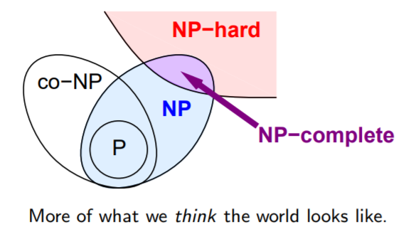
Summary
If a problem is NP-hard it does not mean that all instances are hared, e.g., Vertex-cover has a polynomial-time algorithm in trees
We learned the crucial idea of polynomial-time reduction. This can be even used in algorithm design, e.g., we know how to solve max-flow so we reduce image segmentation to max-flow
NP-Complete problems are the hardest problem in NP
NP-hard problems may not necessarily belong to NP.
Polynomial-time reductions are transitive relations

