Slide 1
Victory Lap
CSE 421 Fall 2022
Lecture 30

Slide 2
Announcements
Please fill out course evals!
https://uw.iasystem.org/survey/263630
First time this course has been 4 credit hours and sections
First time I’ve taught this course.
We want to hear what to change
  and we’re teaching it again next quarter.

Slide 3
What have we seen this quarter?
Stable Matchings
Graph Search
  BFS/DFS
  Graph modeling
Greedy Algorithms
Divide and Conquer
Dynamic Programming
  DP on arrays
  Adding parameters
  DP on trees
Network Flow
  Using Max-Flow
  Using Min Cuts
  Assignment problems
  NP-completeness
  Reductions
  Showing a problem is NP-hard
  P vs. NP
  Approximation Algorithms
  A Randomized Algorithm

Slide 4
Stable Matchings
Modeling matters!
  It’s better to be a proposer than a chooser!
Algorithms can be used to prove ‘non-computational’ facts
  Stable Matchings always exist is easiest to prove by saying “here’s how to find one.”
Reductions
  Sometimes there’s a clever way to use an existing library (we’ll need these a lot later in the quarter).

Slide 5
Graph Search
BFS and DFS search through a graph differently
  So you can adapt them to solve different problems!
Use libraries
Finding SCCs and Topological sorting are “almost free” preprocessing
2-Coloring can be performed in linear time.

Slide 6
Greedy
Code is easy; proofs are hard.
Generating examples is extremely important.
To frame your thinking for proofs
  Greedy stays ahead
  Exchange argument
  Structural result

Slide 7
Divide and Conquer
Trust the recursion.
Don’t be afraid to change what the recursive call gives you!
  Add extra parameters!
State in English what the recursive call gives you.
In your “combine” step, make sure you’re beating baseline!

Slide 8
Dynamic Programming
Focus on solving the problem recursively; everything else is (mostly) formulaic once you’ve done that.
Write exactly the problem you’re solving in English.
It’s better to get down a “guess” at the problem and then see where you get stuck.
  Don’t be afraid to add a second recurrence or extra parameters.
Don’t try to cleverly figure out which option is best. Try them all.
  The magic of recursion tells you which is best for a particular situation.
  DP is very useful on trees!

Slide 9
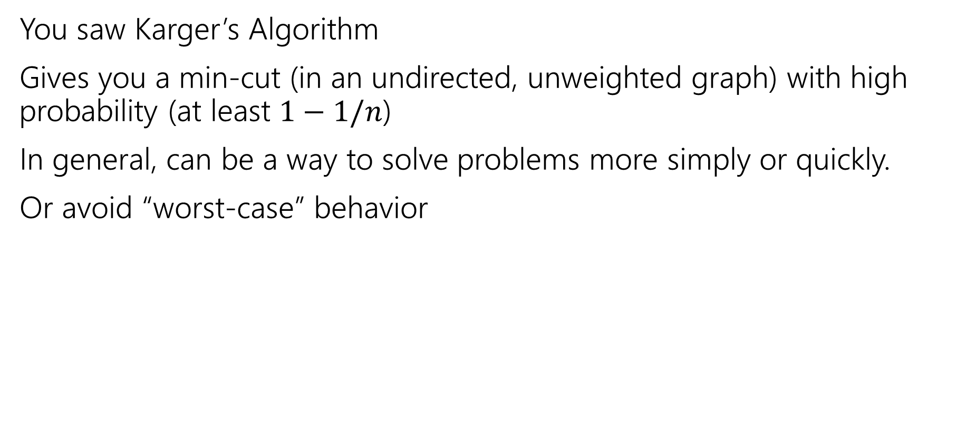
(one) Randomized Algorithm
You saw Karger’s Algorithm
Gives you a min-cut (in an undirected, unweighted graph) with high probability (at least $1−1/n$)
In general, can be a way to solve problems more simply or quickly.
Or avoid “worst-case” behavior

Slide 10
Network Flow
The value of the maximum flow is always equal to the capacity of the minimum cut.
  Ford-Fulkerson finds you both.
Useful for modeling (“assigning” things)
  Can the Mariners make the playoffs? (Assign who wins games)
  Who does which chores?
And solving other problems
  Especially on bipartite graphs, like vertex cover and maximum matching.

Slide 11
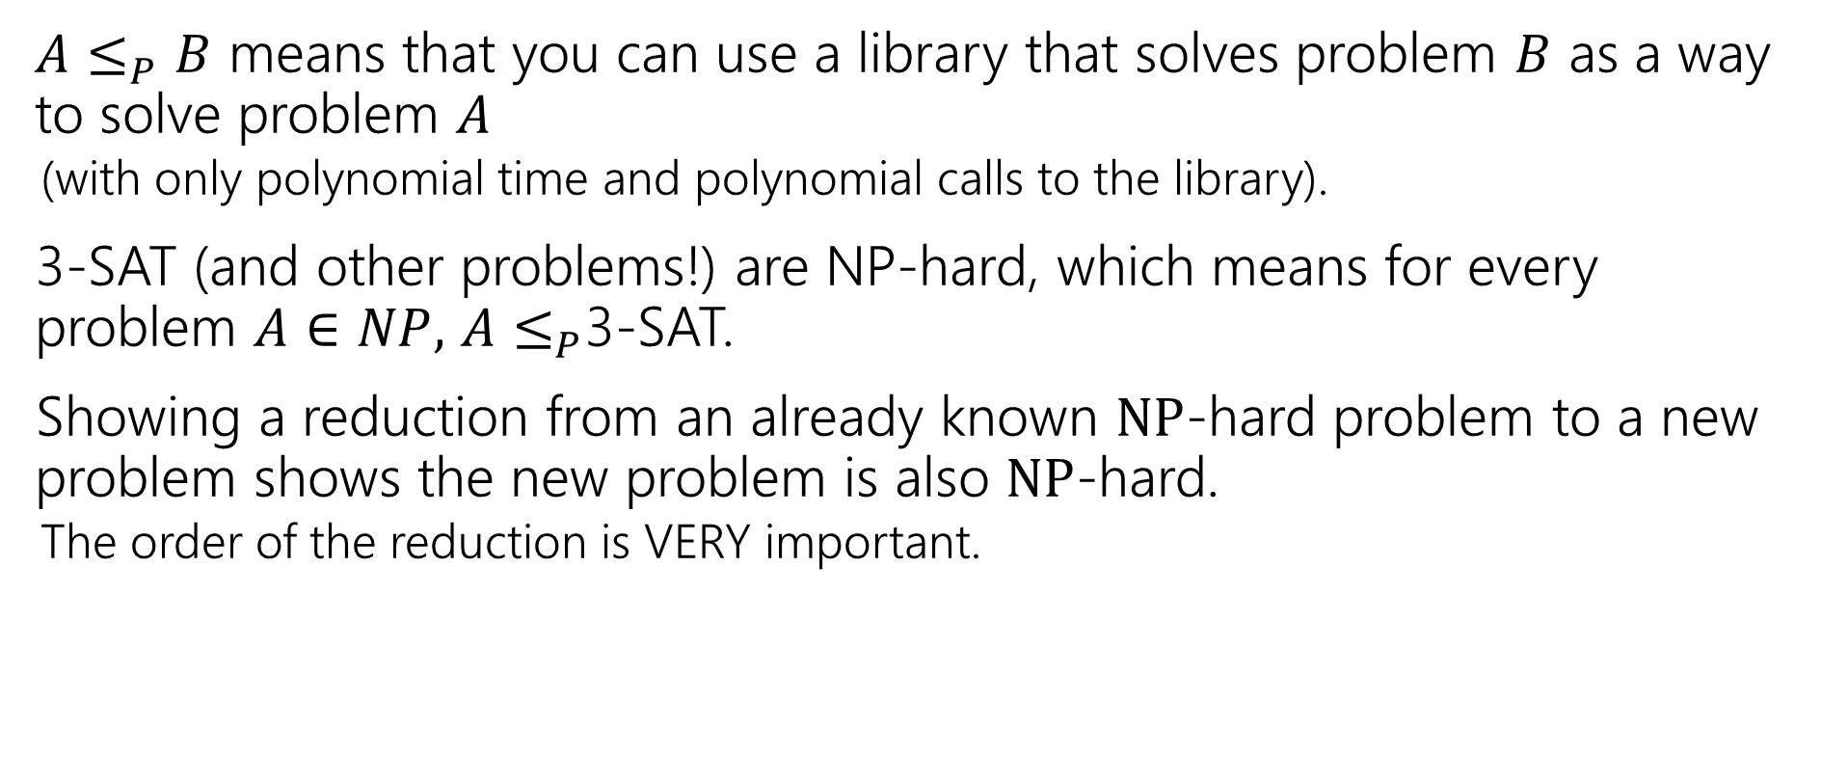
NP-completeness
$A≤_{P}B$ means that you can use a library that solves problem $B$ as a way to solve problem $A$
  (with only polynomial time and polynomial calls to the library).
3-SAT (and other problems!) are NP-hard, which means for every problem $A∈NP,$ $A≤_{P}$3-SAT.
Showing a reduction from an already known $NP$-hard problem to a new problem shows the new problem is also $NP$-hard.
  The order of the reduction is VERY important.

Slide 12
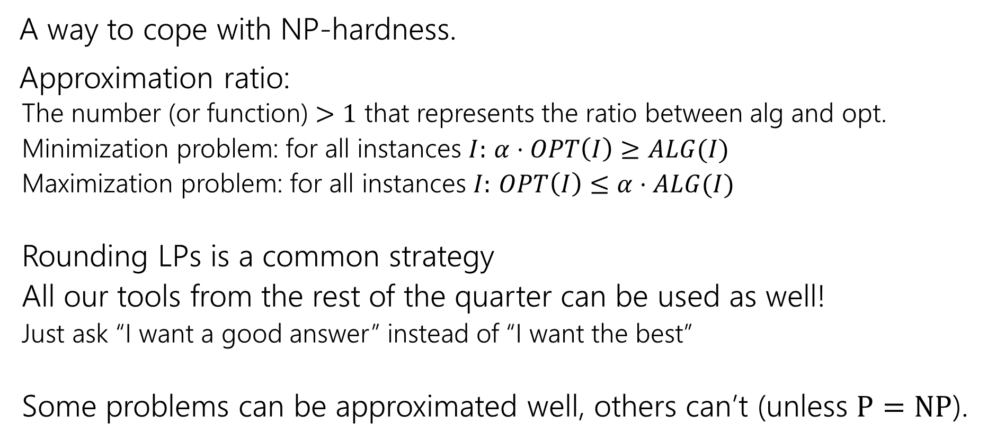
Approximation Algorithms
A way to cope with NP-hardness.
Approximation ratio:
  The number (or function) $>1$ that represents the ratio between alg and opt.
  Minimization problem: for all instances $I:$ $α⋅OPT\left(I\right)≥ALG(I)$
  Maximization problem: for all instances $I:$ $OPT\left(I\right)≤α⋅ALG(I)$
  Rounding LPs is a common strategy
  All our tools from the rest of the quarter can be used as well!
  Just ask “I want a good answer” instead of “I want the best”
  Some problems can be approximated well, others can’t (unless $P=NP$).

Slide 13
How To Approach Problems
In section, we’ve made you follow these steps:
1. Read the problem carefully (make sure you know what problem you’re actually solving)
2. Make some sample inputs/outputs
3. Set a “baseline.”
4. Then try to generate the algorithm.
It’s hard to take the time to do these in an exam, but at least make sure you do #1. Solving the wrong problem is not good for test-taking.
PLEASE do these steps in real life.

Slide 14
What have you learned?
Algorithm design techniques/paradigms
  Ways to frame your thinking to design a new algorithm
Methods of modeling new problems in terms of familiar ones.
  Solve a new problem without (many) new ideas.
How to approach a problem
  Techniques to avoid getting stuck or get yourself un-stuck.
Some famous algorithms
  You’ll know Ford-Fulkerson, Bellman-Ford, etc. when you see them in libraries.
  Or at least where to look them up.

Slide 15
What should you do next?
CSE 431 (complexity theory)
  What can’t you do? (in polynomial time, at all, or in limited memory)
CSE 422
  Toolkit for modern algorithms: algorithmic principles behind modern stats and ML
CSE 426 [490C]
  Cryptography: a mix of math, algorithms, and complexity.
CSE 521 and 525
  Graduate level courses in algorithms and randomized algorithms.
  Look ahead! These courses usually run once-per-year.

