Slide 1
Matchings and Covers
(Via Flow)
CSE 421 22Au
Lecture 23

Slide 2
Today
One last day of max-flow.
Two new problems we can solve with max-flow/min-cut.
Today’s proofs are short but subtle; I’m intentionally taking us through slowly. Please ask questions.

Slide 3
A (possibly) simple problem
Given a bipartite graph, find a maximum matching.
Think of it as matching the endpoints of the edges to each other.
A stable matching is a particular matching on a complete bipartite graph.
A matching is a set of edges that do not share an endpoint.

Slide 4
A (possibly) simple problem
Given a bipartite graph, find a maximum matching.
For example, on this graph the red edges are a maximum matching. There is no way to get 4 edges in a matching.
A matching is a set of edges that do not share an endpoint.

Slide 5
A (possibly) simple problem
Design an algorithm to find a maximum matching on a bipartite graph.
(hint: what if the vertices on one side are chores and the other are housemates).

Slide 6
Algorithm for Bipartite Maximum Matching
Use the “tuple selection/assignment” we did last week!

Slide 7
Algorithm for Bipartite Maximum Matching
Add a dummy source and sink. Attach each to one side.

Slide 8
Algorithm for Bipartite Maximum Matching
Add a dummy source and sink. Attach each to one side.
Direct (previously undirected) edges toward sink

Slide 9


Algorithm for Bipartite Maximum Matching
Add a dummy source and sink. Attach each to one side.
Direct (previously undirected) edges toward sink.
Capacity 1 entering and leaving each (real) vertex ensures matching
$$?/1$$
$$?/1$$

Slide 10
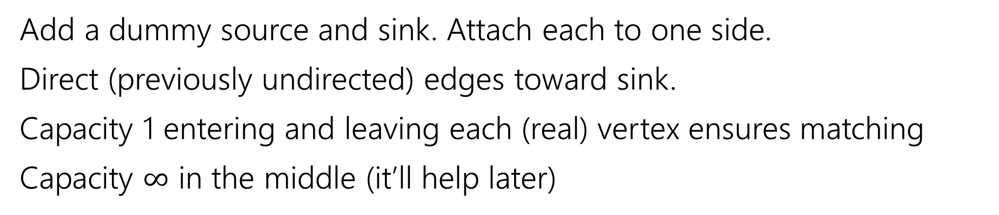

Algorithm for Bipartite Maximum Matching
Add a dummy source and sink. Attach each to one side.
Direct (previously undirected) edges toward sink.
Capacity 1 entering and leaving each (real) vertex ensures matching
Capacity $∞$ in the middle (it’ll help later)
$$?/∞$$
$$?/1$$
$$?/1$$

Slide 11
Algorithm for Bipartite Maximum Matching
Add a dummy source and sink. Attach each to one side.
Direct (previously undirected) edges toward sink.
Capacity 1 entering and leaving each (real) vertex ensures matching
Capacity $∞$ in the middle (it’ll help later)
$$?/∞$$
$$?/1$$
$$?/1$$

Slide 12
Algorithm for Bipartite Maximum Matching
Add a dummy source and sink. Attach each to one side.
Direct (previously undirected) edges toward sink.
Capacity 1 entering and leaving each (real) vertex ensures matching
Capacity $∞$ in the middle (it’ll help later)
Red edges have flow.
Take edges with flow for the matching.
$$?/∞$$
$$?/1$$
$$?/1$$

Slide 13
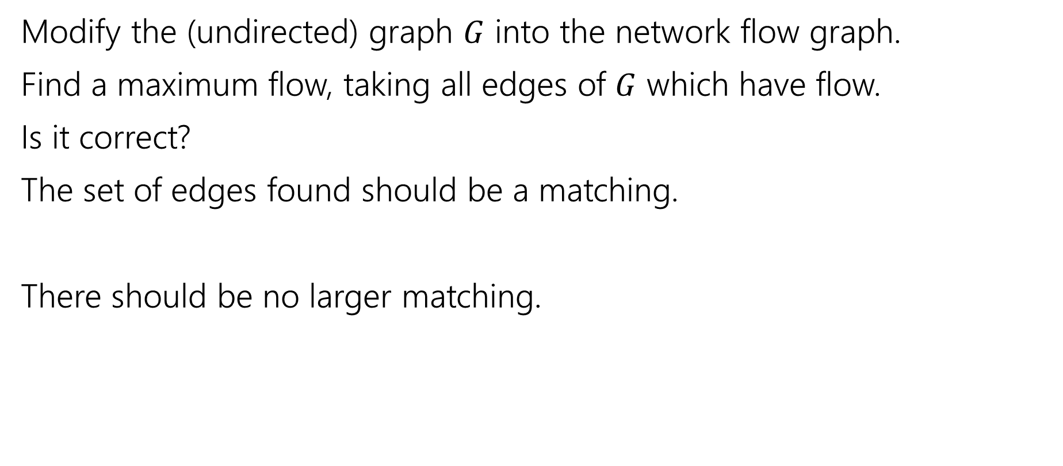
Algorithm for Bipartite Matching
Modify the (undirected) graph $G$ into the network flow graph.
Find a maximum flow, taking all edges of $G$ which have flow.
Is it correct?
The set of edges found should be a matching.
There should be no larger matching.

Slide 14
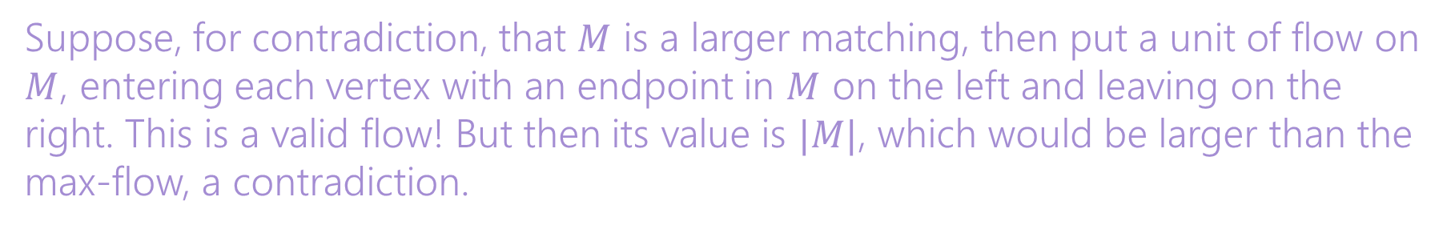
Algorithm for Bipartite Matching
Modify the (undirected) graph $G$ into the network flow graph.
Find a maximum flow, taking all edges of $G$ which have flow.
Is it correct?
The set of edges found should be a matching.
There should be no larger matching.
Capacities ensure no edge has more than one unit of flow through it. By integrality of flow, we have only one edge.
Suppose, for contradiction, that $M$ is a larger matching, then put a unit of flow on $M$, entering each vertex with an endpoint in $M$ on the left and leaving on the right. This is a valid flow! But then its value is $|M|$, which would be larger than the max-flow, a contradiction.

Slide 15

Solving a new problem (with matchings)
Let $G$ be an undirected graph.
A minimum vertex cover is the smallest set of vertices such that every edge has at least one of its endpoints in the set.
Here’s an[other] algorithm to find a minimum vertex cover in a bipartite graph…

Slide 16
Vertex Cover
How to find a vertex cover?
Well a max-flow says “you can’t use this edge; (at least) one of its endpoints is already used by the matching.
Here’s a vertex cover (in gold). Notice something about it?
$$?/∞$$
$$?/1$$
$$?/1$$

Slide 17
Vertex Cover
Here’s a vertex cover (in gold). Find the min-cut (write residual graph)
$$?/∞$$
$$?/1$$
$$?/1$$

Slide 18
Vertex Cover
$$?/∞$$
Flow graph
$$?/1$$
$$?/1$$
Residual;
Cut in blue X’s

Slide 19
Vertex Cover
How to find a vertex cover?
Well a max-flow says “you can’t use this unsaturated edge; (at least) one of its endpoints is already used by the matching.
Here’s a vertex cover (in gold). Notice something about it? It looks a lot like the min cut.
$$?/∞$$
$$?/1$$
$$?/1$$

Slide 20

Vertex Cover
Let $A$ be the left bipartition, $B$ the right side. Let $(S,T)$ be the min-cut.
$A_{S}=A∩S;$ $A_{T},B_{S},B_{T}$ defined correspondingly.
Here, $A_{T}$ and $B_{S}$ form a vertex cover
$$?/∞$$
$$?/1$$
$$?/1$$

Slide 21

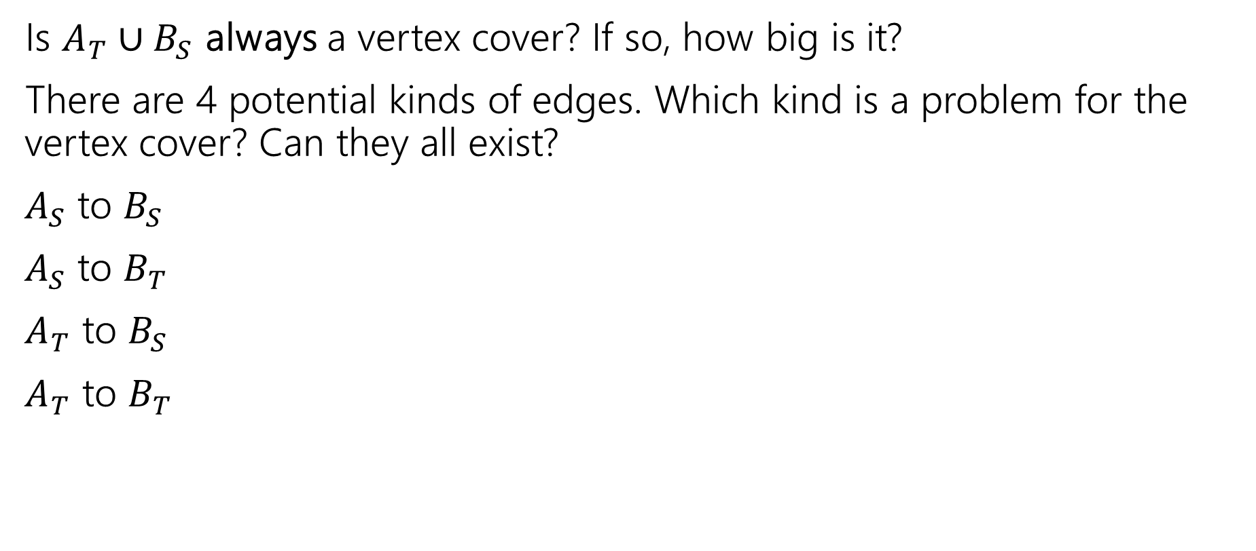


Vertex Cover
Is $A_{T}∪B_{S}$ always a vertex cover? If so, how big is it?
There are 4 potential kinds of edges. Which kind is a problem for the vertex cover? Can they all exist?
$A_{S}$ to $B_{S}$
$A_{S}$ to $B_{T}$
$A_{T}$ to $B_{S}$
$A_{T}$ to $B_{T}$
$$?/∞$$
$$?/1$$
$$?/1$$

Slide 22

Vertex Cover
Is $A_{T}∪B_{S}$ always a vertex cover? If so, how big is it?
There are 4 potential kinds of edges. Which kind is a problem for the vertex cover? Can they all exist?
$A_{S}$ to $B_{S}$
$A_{S}$ to $B_{T}$
$A_{T}$ to $B_{S}$
$A_{T}$ to $B_{T}$
Only kind we have to worry about!!
But you can’t have an edge from $S$ to $T$! We have a vertex cover.
$$?/∞$$
$$?/1$$
$$?/1$$

Slide 23

Vertex Cover
How big is $A_{T}∪B_{S}$?
Well, it looks a lot like the min-cut. $\left(s,A_{T}\right)$ and $(B_{S},t)$ are cut.
Each of those edges is capacity $1$. Each has an endpoint we put in the vertex cover! $\left|A_{T}∪B_{S}\right|=cap\left(S,T\right)=|f|$.
$$?/∞$$
$$?/1$$
$$?/1$$

Slide 24

But is it a minimum VC?
So it’s a vertex cover, of size equal to the min-cut…what if there’s a smaller vertex cover?
Let $X$ be any vertex cover, define $A_{X},B_{X}$ as before.

Slide 25
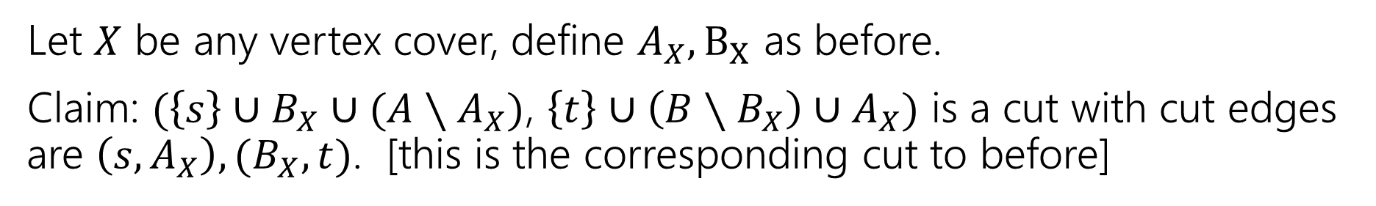
No smaller VC
Let $X$ be any vertex cover, define $A_{X},B_{X}$ as before.
Claim: $(\left\{s\right\}∪B_{X}∪(A∖A_{X})$, $\left\{t\right\}∪\left(B∖B_{X}\right)∪A_{X})$ is a cut with cut edges are $\left(s,A_{X}\right),(B_{X},t)$. [this is the corresponding cut to before]
$$?/∞$$
$$?/1$$
$$?/1$$

Slide 26
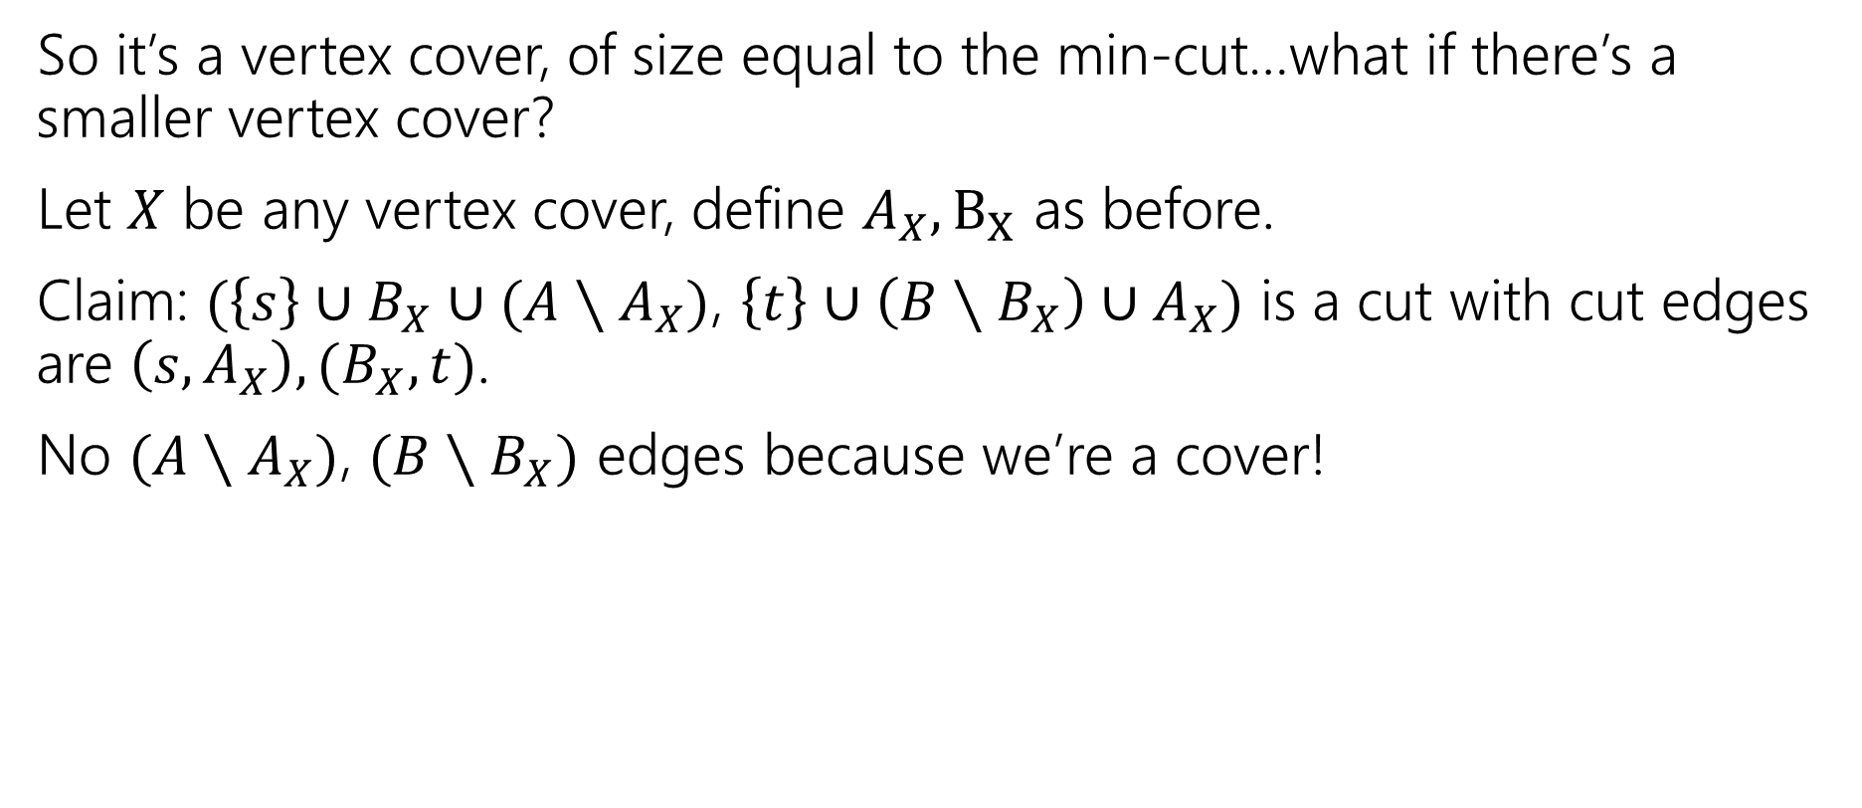
But is it a minimum VC?
So it’s a vertex cover, of size equal to the min-cut…what if there’s a smaller vertex cover?
Let $X$ be any vertex cover, define $A_{X},B_{X}$ as before.
Claim: $(\left\{s\right\}∪B_{X}∪(A∖A_{X})$, $\left\{t\right\}∪\left(B∖B_{X}\right)∪A_{X})$ is a cut with cut edges are $\left(s,A_{X}\right),(B_{X},t)$.
No $(A∖A_{X})$, $(B∖B_{X})$ edges because we’re a cover!

Slide 27
No smaller VC
Every vertex cover lets you discover a cut of the same size.
Our algorithm found a VC of size equal to the minimum cut! A smaller VC would give a smaller cut! But there isn’t one. So we have found the min VC.
$$?/∞$$
$$?/1$$
$$?/1$$

Slide 28
Wrapping it up
You can find the following of a bipartite graph (using only flow)
Maximum matching
Minimum Vertex cover
And their value is equal to the size of the max-flow (and the min-cut) in the modified graph.
“Kőnig’s Theorem” (aka Kőnig-Egevary Theorem)
In a bipartite graph, the size of the maximum matching is equal to the size of the minimum vertex cover.

Slide 29
Wrapping It Up
We’ve found maximum matchings and minimum vertex covers in bipartite graphs using flow.
If your graph isn’t bipartite:
Efficiently finding a maximum matching is still possible.
  but more complicated. Look up “Edmond’s Blossom Algorithm”
Efficiently finding a minimum vertex cover, is a taller task.
  It’s an NP-complete problem. We’ll more clearly define what that means and

Slide 30
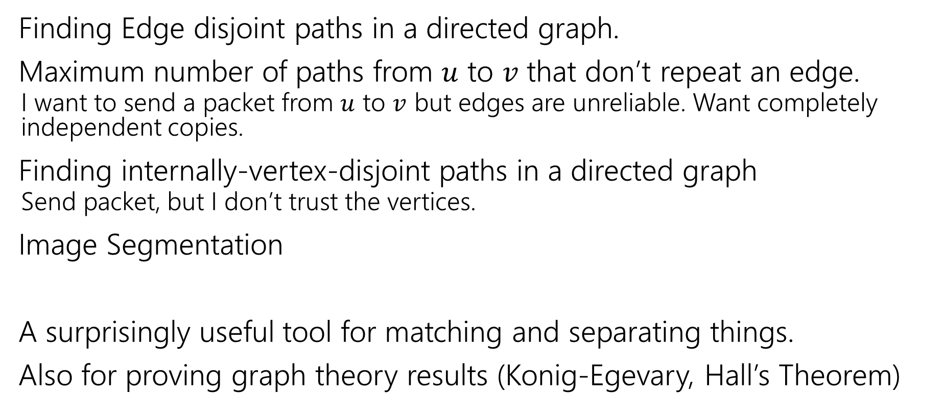
But Wait, There’s More Applications!
Finding Edge disjoint paths in a directed graph.
Maximum number of paths from $u$ to $v$ that don’t repeat an edge.
  I want to send a packet from $u$ to $v$ but edges are unreliable. Want completely independent copies.
Finding internally-vertex-disjoint paths in a directed graph
  Send packet, but I don’t trust the vertices.
Image Segmentation
A surprisingly useful tool for matching and separating things.
Also for proving graph theory results (Konig-Egevary, Hall’s Theorem)

