Slide 1
Max Flow Min Cut Modeling
CSE 421 Fall 22
Lecture 22

Slide 2








Some Small Examples
$$?/5$$
s
a
$$?/4$$
$$?/2$$
b
c
$$?/1$$
$$?/2$$
$$?/1$$
$$?/2$$
d
t
$$?/2$$

Slide 3




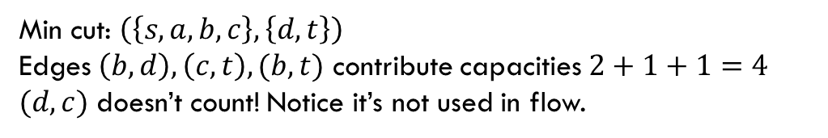















Some Small Examples
$$1/5$$
$$4$$
s
a
s
a
$$1$$
$$3/4$$
$$1/2$$
$$1$$
$$3$$
$$1$$
$$1$$
b
c
b
c
$$1/1$$
$$1$$
$$2/2$$
$$1/1$$
$$2$$
$$1$$
$$0/2$$
$$2$$
d
t
d
t
$$2/2$$
$$2$$
Min cut: $\left(\left\{s,a,b,c\right\},\left\{d,t\right\}\right)$
Edges $\left(b,d\right),\left(c,t\right),(b,t)$ contribute capacities $2+1+1=4$
$(d,c)$ doesn’t count! Notice it’s not used in flow.

Slide 4
Some Small Examples
$$1/5$$
$$4$$
s
a
s
a
$$1$$
$$3/4$$
$$1/2$$
$$1$$
$$3$$
$$1$$
$$1$$
b
c
b
c
$$1/1$$
$$1$$
$$2/2$$
$$1/1$$
$$2$$
$$1$$
$$0/2$$
$$2$$
d
t
d
t
$$2/2$$
$$2$$
Min cut: $\left(\left\{s,a,b,c\right\},\left\{d,t\right\}\right)$
Edges $\left(b,d\right),\left(c,t\right),(b,t)$ contribute capacities $2+1+1=4$
$(d,c)$ doesn’t count! Notice it’s not used in flow.

Slide 5













Some Small Examples
Multiple equivalent max-flows is possible.
Sometimes they give the same min-cut.
$$1/5$$
$$0/5$$
s
a
s
a
$$3/4$$
$$1/1$$
$$4/4$$
$$0/1$$
b
c
b
c
$$1/1$$
$$1/1$$
$$2/3$$
$$1/1$$
$$3/3$$
$$1/1$$
$$0/2$$
$$1/2$$
d
t
d
t
$$2/2$$
$$2/2$$

Slide 6








Using The Min Cut
From last time, imagine we’re doing 2 days worth of chores.
Want everyone to still do 2
Every chore done twice
Have to get different chores (variety)
A
1
$$?/2$$
$$?/2$$
$$?/1$$
$$?/2$$
B
$$?/2$$
s
2
t
$$?/2$$
$$?/2$$
C
$$?/2$$
3
D

Slide 7



Using The Min Cut
From last time, imagine we’re doing 2 days worth of chores.
Want everyone to still do 2
Every chore done twice
Have to get different chores (variety)
A
1
$$?/2$$
$$2/2$$
$$2/2$$
B
$$?/2$$
s
2
t
$$2/2$$
$$?/2$$
C
$$?/2$$
3
D

Slide 8

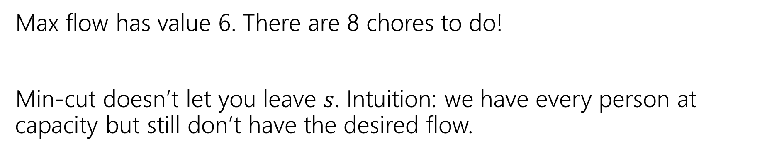



Using The Min Cut
Max flow has value 6. There are 8 chores to do!
Min-cut doesn’t let you leave $s$. Intuition: we have every person at capacity but still don’t have the desired flow.
A
1
$$1/2$$
$$2/2$$
$$2/2$$
B
$$2/2$$
s
2
t
$$2/2$$
$$2/2$$
C
$$1/2$$
3
D

Slide 9


Using The Min Cut
Edit a little to see a different cut…
A
1
$$?/2$$
$$?/2$$
$$?/1$$
$$?/2$$
B
$$?/2$$
s
2
t
$$?/2$$
$$?/2$$
C
$$?/2$$
3
$$?/2$$
D
4

Slide 10


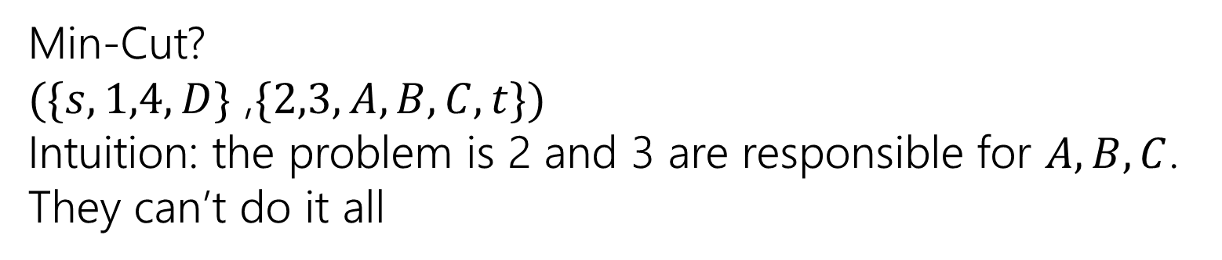



Using The Min Cut
Edit a little to see a different cut…
Min-Cut?
$(\{s,1,4,D\}$ ,$\{2,3,A,B,C,t\})$
Intuition: the problem is 2 and 3 are responsible for $A,B,C$. They can’t do it all
A
1
$$2/2$$
$$1/2$$
$$?/1$$
$$2/2$$
B
$$2/2$$
s
2
t
$$2/2$$
$$0/2$$
C
$$2/2$$
3
$$1/2$$
D
4

Slide 11
One More Application
A classic example
We’ll also be able to use the min-cut in addition to the flow!
Question: Can the Mariners still win* the division?
*or at least tie for first place.
And if they can’t, can you explain why.

Slide 12
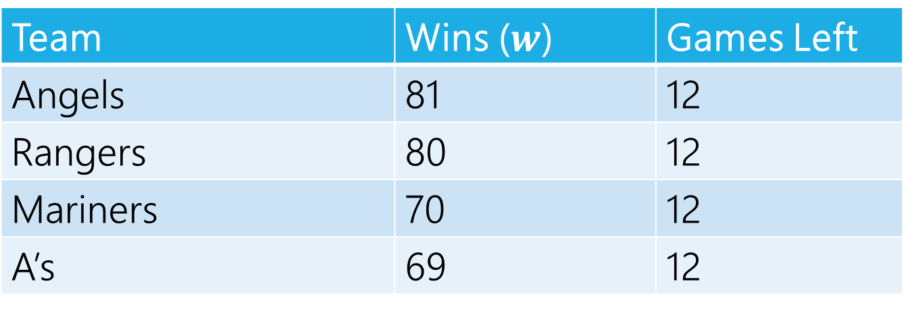
Can The Mariners Win The Division?
It’s late at night September 14, 1998.
You’re working for the Seattle Times.
The Mariners won! But the Angels did too.
How do you frame the Mariners current situation in your postgame article?
Team | Wins ($w$) | Games Left
Angels | 81 | 12
Rangers | 80 | 12
Mariners | 70 | 12
A’s | 69 | 12
MLB rules say all games will be played (if they end up mattering) so you can assume those will happen.

Slide 13
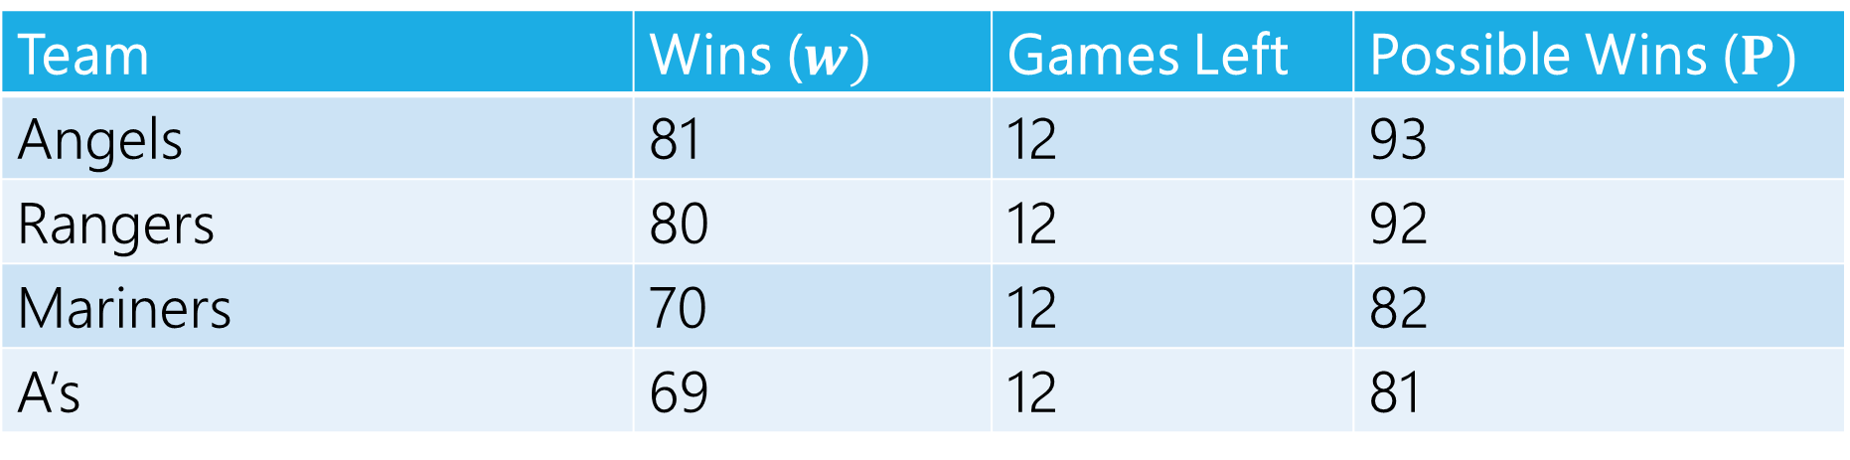
Can The Mariners Win The Division?
Team | Wins ($w)$ | Games Left | Possible Wins ($P)$
Angels | 81 | 12 | 93
Rangers | 80 | 12 | 92
Mariners | 70 | 12 | 82
A’s | 69 | 12 | 81
$P_{MARINERS}≥w_{i}$ for all $i$, so the Mariners can win the division, right?

Slide 14
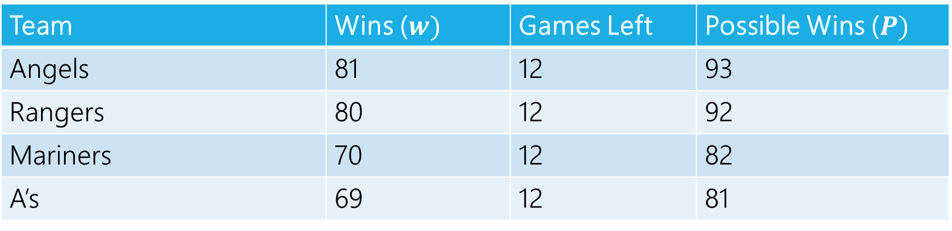
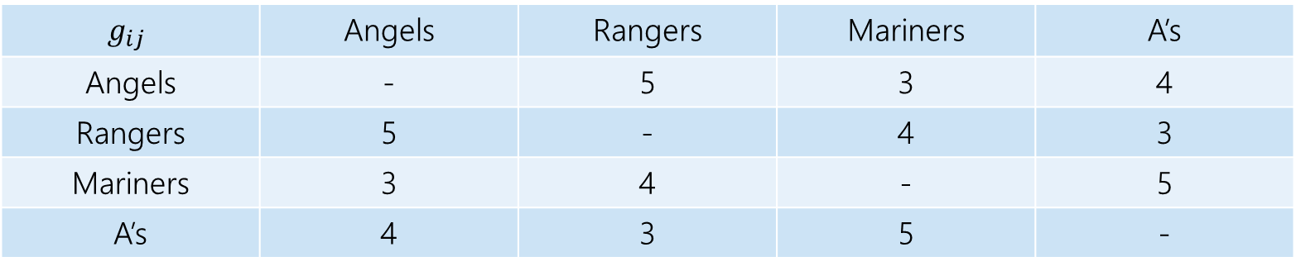
Well…No
The teams will play each other, here are the number of games to be played against each other.
$$g_{ij}$$ | Angels | Rangers | Mariners | A’s
Angels | - | 5 | 3 | 4
Rangers | 5 | - | 4 | 3
Mariners | 3 | 4 | - | 5
A’s | 4 | 3 | 5 | -
Team | Wins ($w)$ | Games Left | Possible Wins ($P)$
Angels | 81 | 12 | 93
Rangers | 80 | 12 | 92
Mariners | 70 | 12 | 82
A’s | 69 | 12 | 81

Slide 15
Well…No
At least one of the Angels and Rangers is going to win at least 83 games
  someone wins at least three of the five they play against each other.
The Mariners can only win 82 games.

Slide 16
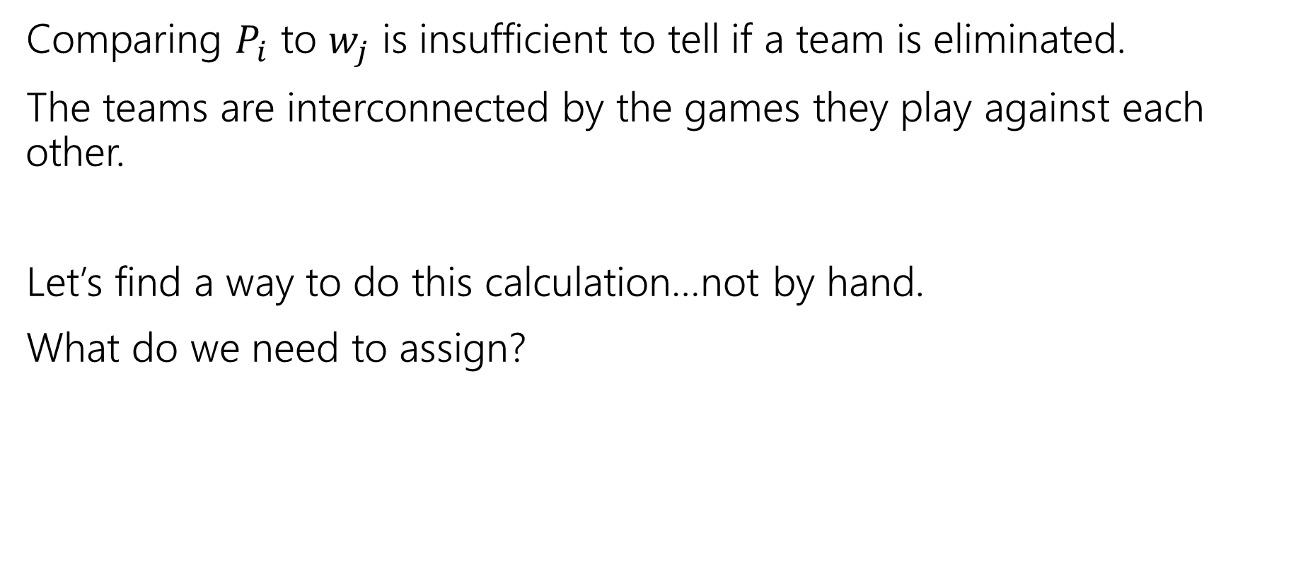
Lessons
Comparing $P_{i}$ to $w_{j}$ is insufficient to tell if a team is eliminated.
The teams are interconnected by the games they play against each other.
Let’s find a way to do this calculation…not by hand.
What do we need to assign?

Slide 17
Assignment
We need to assign who wins each of the remaining games.
Safe to assume the Mariners will win them all.
Just need to figure out the others.
One unit of flow represents one win.

Slide 18
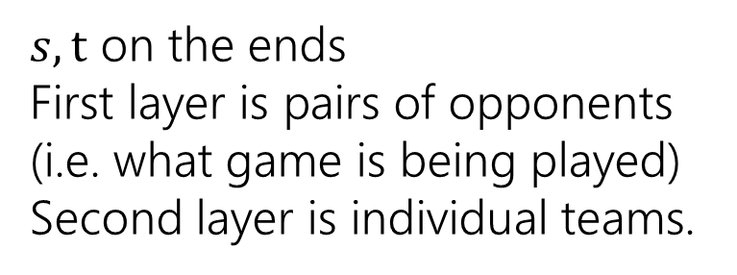
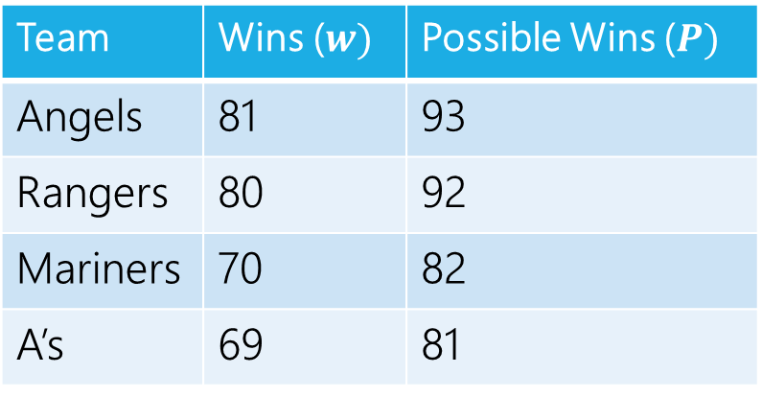
Making a Network
 | Angels | Rangers | Mariners | A’s
Angels | - | 5 | 3 | 4
Rangers | 5 | - | 4 | 3
Mariners | 3 | 4 | - | 5
A’s | 4 | 3 | 5 | -
Angels vs. Rangers
Angels
Team | Wins ($w)$ | Possible Wins ($P)$
Angels | 81 | 93
Rangers | 80 | 92
Mariners | 70 | 82
A’s | 69 | 81
Angels vs.
A’s
Rangers
$s,t$ on the ends
First layer is pairs of opponents (i.e. what game is being played)
Second layer is individual teams.
Rangers vs.
A’s
A’s

Slide 19
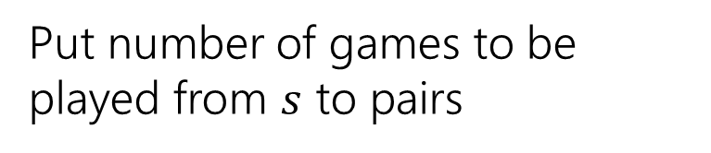
Making a Network
 | Angels | Rangers | Mariners | A’s
Angels | - | 5 | 3 | 4
Rangers | 5 | - | 4 | 3
Mariners | 3 | 4 | - | 5
A’s | 4 | 3 | 5 | -
Angels vs. Rangers
Angels
Team | Wins ($w)$ | Possible Wins ($P)$
Angels | 81 | 93
Rangers | 80 | 92
Mariners | 70 | 82
A’s | 69 | 81
5
Angels vs.
A’s
Rangers
4
Put number of games to be played from $s$ to pairs
3
Rangers vs.
A’s
A’s

Slide 20
Making a Network
 | Angels | Rangers | Mariners | A’s
Angels | - | 5 | 3 | 4
Rangers | 5 | - | 4 | 3
Mariners | 3 | 4 | - | 5
A’s | 4 | 3 | 5 | -
Angels vs. Rangers
Angels
Team | Wins ($w)$ | Possible Wins ($P)$
Angels | 81 | 93
Rangers | 80 | 92
Mariners | 70 | 82
A’s | 69 | 81
5
Angels vs.
A’s
Rangers
4
How do we make sure Mariners win? They’ll end the season with 82 wins (current + games left).
How many more can each team win?
Mariners poss total – team current
3
Rangers vs.
A’s
A’s

Slide 21
Making a Network
 | Angels | Rangers | Mariners | A’s
Angels | - | 5 | 3 | 4
Rangers | 5 | - | 4 | 3
Mariners | 3 | 4 | - | 5
A’s | 4 | 3 | 5 | -
Angels have 81 wins, 1 more is ok (total matches Mariners possible) 2 is not. Capacity is 1.
Angels vs. Rangers
Angels
Team | Wins ($w)$ | Possible Wins ($P)$
Angels | 81 | 93
Rangers | 80 | 92
Mariners | 70 | 82
A’s | 69 | 81
5
1
Angels vs.
A’s
Rangers
4
How do we make sure Mariners win? They’ll end the season with 82 wins (current + games left).
How many more can each team win?
Mariners poss total – team current
3
Rangers vs.
A’s
A’s

Slide 22
Making a Network
 | Angels | Rangers | Mariners | A’s
Angels | - | 5 | 3 | 4
Rangers | 5 | - | 4 | 3
Mariners | 3 | 4 | - | 5
A’s | 4 | 3 | 5 | -
Angels vs. Rangers
Angels
Team | Wins ($w)$ | Possible Wins ($P)$
Angels | 81 | 93
Rangers | 80 | 92
Mariners | 70 | 82
A’s | 69 | 81
5
1
Angels vs.
A’s
Rangers
4
2
How do we make sure Mariners win? They’ll end the season with 82 wins (current + games left).
How many more can each team win?
Mariners poss total – team current
13
3
Rangers vs.
A’s
A’s

Slide 23
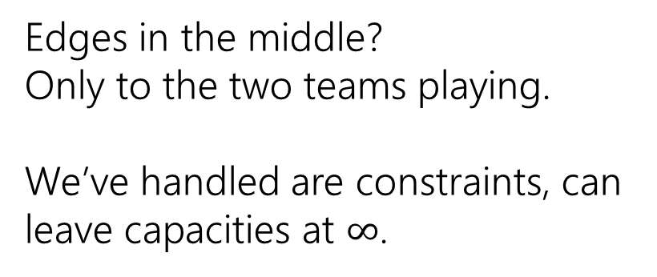
Making a Network
 | Angels | Rangers | Mariners | A’s
Angels | - | 5 | 3 | 4
Rangers | 5 | - | 4 | 3
Mariners | 3 | 4 | - | 5
A’s | 4 | 3 | 5 | -
Angels vs. Rangers
Angels
Team | Wins ($w)$ | Possible Wins ($P)$
Angels | 81 | 93
Rangers | 80 | 92
Mariners | 70 | 82
A’s | 69 | 81
5
1
Angels vs.
A’s
Rangers
4
2
Edges in the middle?
Only to the two teams playing.
We’ve handled are constraints, can leave capacities at $∞$.
13
3
Rangers vs.
A’s
A’s

Slide 24






Making a Network
 | Angels | Rangers | Mariners | A’s
Angels | - | 5 | 3 | 4
Rangers | 5 | - | 4 | 3
Mariners | 3 | 4 | - | 5
A’s | 4 | 3 | 5 | -
Angels vs. Rangers
Angels
Team | Wins ($w)$ | Possible Wins ($P)$
Angels | 81 | 93
Rangers | 80 | 92
Mariners | 70 | 82
A’s | 69 | 81
$$∞$$
$$∞$$
1
5
$$∞$$
Angels vs.
A’s
Rangers
4
2
$$∞$$
Edges in the middle?
Only to the two teams playing.
We’ve handled are constraints, can leave capacities at $∞$.
$$∞$$
13
3
Rangers vs.
A’s
A’s
$$∞$$

Slide 25
Making a Network
 | Angels | Rangers | Mariners | A’s
Angels | - | 5 | 3 | 4
Rangers | 5 | - | 4 | 3
Mariners | 3 | 4 | - | 5
A’s | 4 | 3 | 5 | -
Angels vs. Rangers
Angels
Team | Wins ($w)$ | Possible Wins ($P)$
Angels | 81 | 93
Rangers | 80 | 92
Mariners | 70 | 82
A’s | 69 | 81
$$∞$$
$$∞$$
1
5
$$∞$$
Angels vs.
A’s
Rangers
4
2
$$∞$$
We’re done!
$$∞$$
13
3
Rangers vs.
A’s
A’s
$$∞$$

Slide 26

Why are all the constraints met?
How many games are there to play? Equal to the capacities leaving $s$.
Why will the Mariners win with this assignment?
No “half-wins” or anything weird?

Slide 27
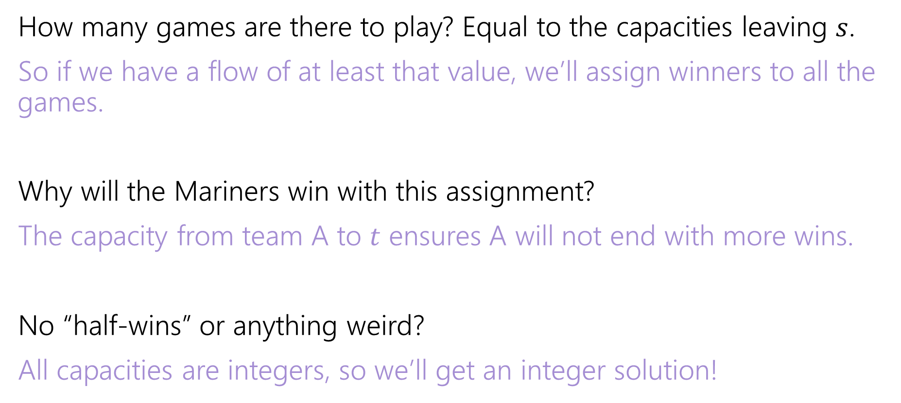
Why are all the constraints met?
How many games are there to play? Equal to the capacities leaving $s$.
So if we have a flow of at least that value, we’ll assign winners to all the games.
Why will the Mariners win with this assignment?
The capacity from team A to $t$ ensures A will not end with more wins.
No “half-wins” or anything weird?
All capacities are integers, so we’ll get an integer solution!

Slide 28
Interpreting the answer
If the max flow has value equal to number of games, we know how the Mariners can still win the division.
If the max flow is less than that, the Mariners can’t win the division!
(if they could win the division, then there is a way that the remaining games could play out with the mariners having as many wins as anyone else, but then we could make a feasible flow by assigning a unit of flow for each winner).

Slide 29






Max Flow
 | Angels | Rangers | Mariners | A’s
Angels | - | 5 | 3 | 4
Rangers | 5 | - | 4 | 3
Mariners | 3 | 4 | - | 5
A’s | 4 | 3 | 5 | -
Angels vs. Rangers
Angels
Team | Wins ($w)$ | Possible Wins ($P)$
Angels | 81 | 93
Rangers | 80 | 92
Mariners | 70 | 82
A’s | 69 | 81
1/
$$∞$$
$$∞$$
2/
1/
3/
1
5
$$∞$$
Angels vs.
A’s
Rangers
4/
4
2
2/
$$∞$$
This is the maximum flow. What’s the min-cut?
{s, Angels vs. Rangers, Angels, Rangers} is one side of the cut.
The Angels and Rangers were enough to prove that the Mariners couldn’t win!
7/
4/
13
3/
$$∞$$
3
Rangers vs.
A’s
A’s
3/
$$∞$$

Slide 30
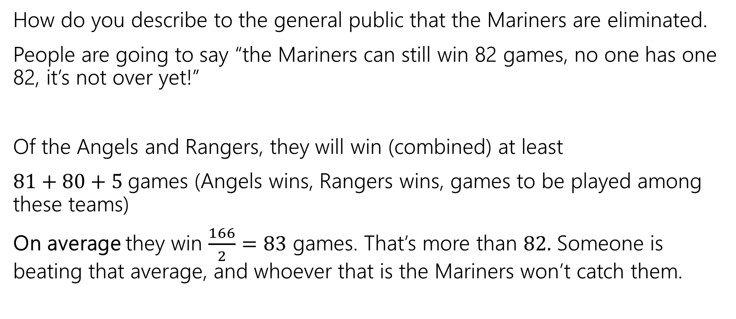
Generating Proof that you’re eliminated
How do you describe to the general public that the Mariners are eliminated.
People are going to say “the Mariners can still win 82 games, no one has one 82, it’s not over yet!”
Of the Angels and Rangers, they will win (combined) at least
$81+80+5$games (Angels wins, Rangers wins, games to be played among these teams)
On average they win $\frac{166}{2}=83$ games. That’s more than $82.$ Someone is beating that average, and whoever that is the Mariners won’t catch them.

Slide 31
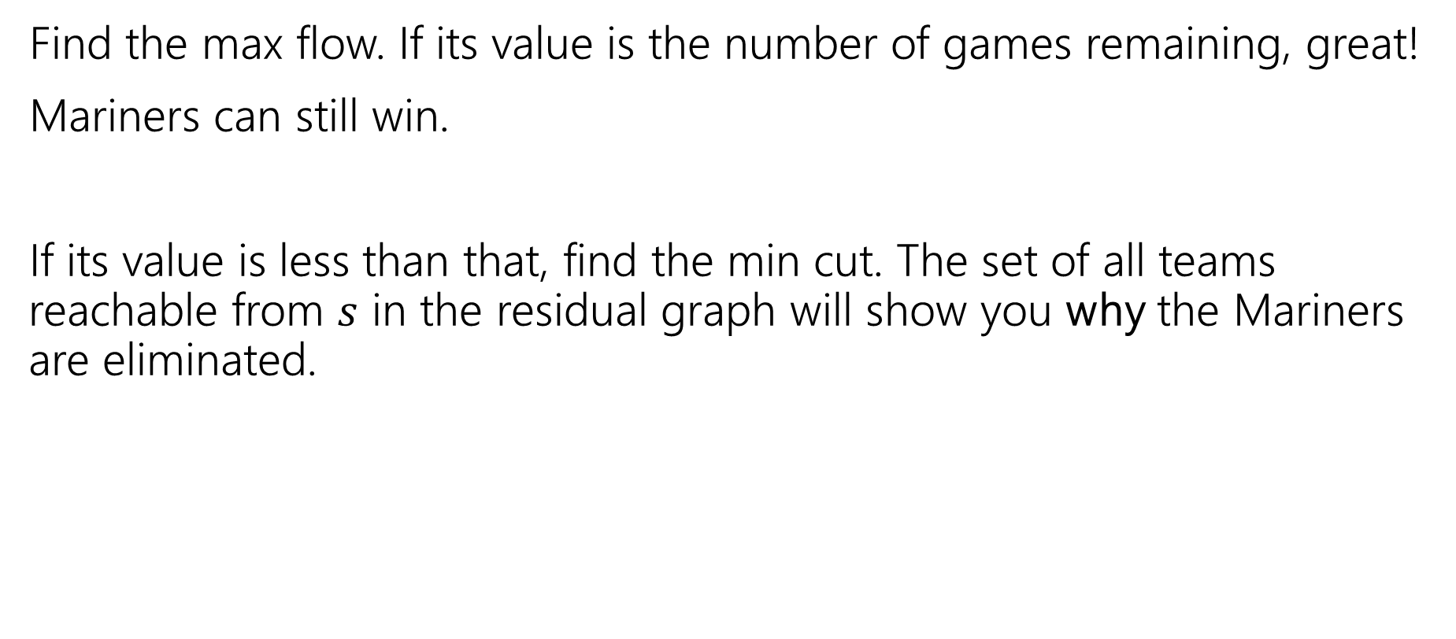
In General
Find the max flow. If its value is the number of games remaining, great!
Mariners can still win.
If its value is less than that, find the min cut. The set of all teams reachable from $s$ in the residual graph will show you why the Mariners are eliminated.

Slide 32
Takeaways
If you want to “assign” things, max-flow might be a good option.
If you say “at most” you can probably just make a capacity constraint
Once you can do an “exactly equal” or “at least” by checking the value of the max-flow.
Sometimes you want an extra layer or two if you have a multiple types of assignments.
Sometimes you can convert an “at least” in one group into an “at most” on another group.

Slide 33
Why is there always an explanation?

Slide 34



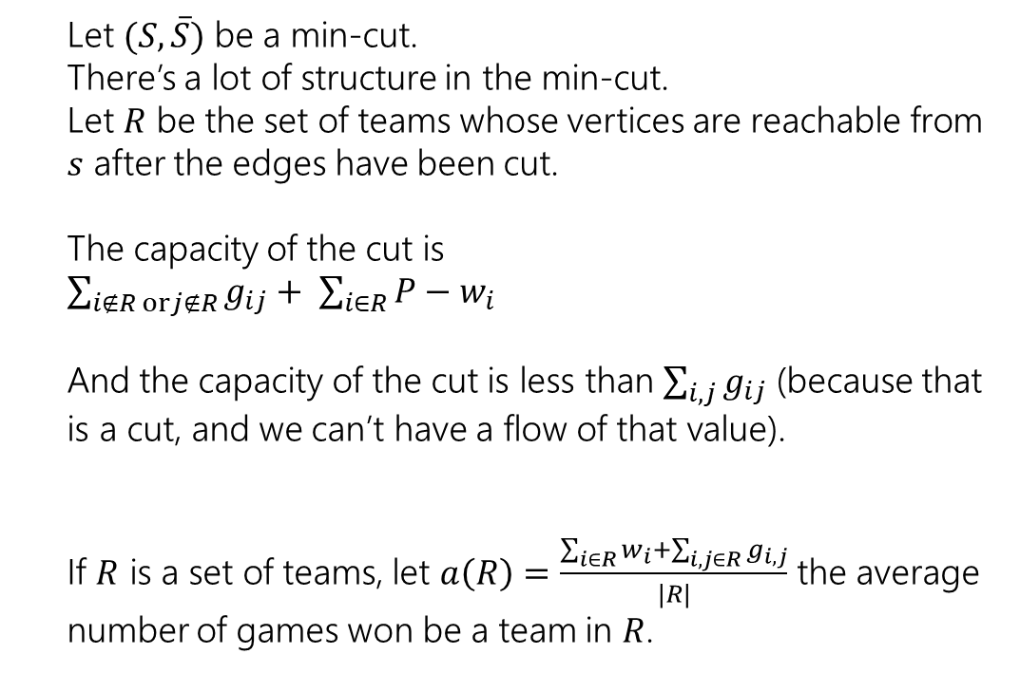



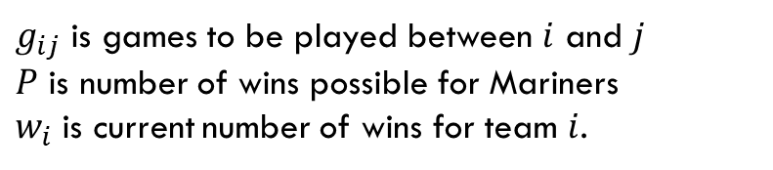
An Explanation Always Exists
$g_{ij}$ is games to be played between $i$ and $j$
$P$ is number of wins possible for Mariners
$w_{i}$ is current number of wins for team $i$.
Let $(S, \overline{S})$ be a min-cut.
There’s a lot of structure in the min-cut.
Let $R$ be the set of teams whose vertices are reachable from $s$ after the edges have been cut.
The capacity of the cut is
$\sum_{i∉R orj∉R}{g_{ij}}+ \sum_{i∈R}{P−w_{i}}$
And the capacity of the cut is less than $\sum_{i,j}{g_{ij}}$ (because that is a cut, and we can’t have a flow of that value).
If $R$ is a set of teams, let $a\left(R\right)=\frac{\sum_{i∈R}{w_{i}}+\sum_{i,j∈R}{g_{i,j}}}{|R|}$ the average number of games won be a team in $R$.
Angels vs. Rangers
Angels
$$∞$$
$$∞$$
1
5
$$∞$$
Angels vs.
A’s
Rangers
4
2
$$∞$$
$$∞$$
13
3
Rangers vs.
A’s
A’s
$$∞$$

Slide 35
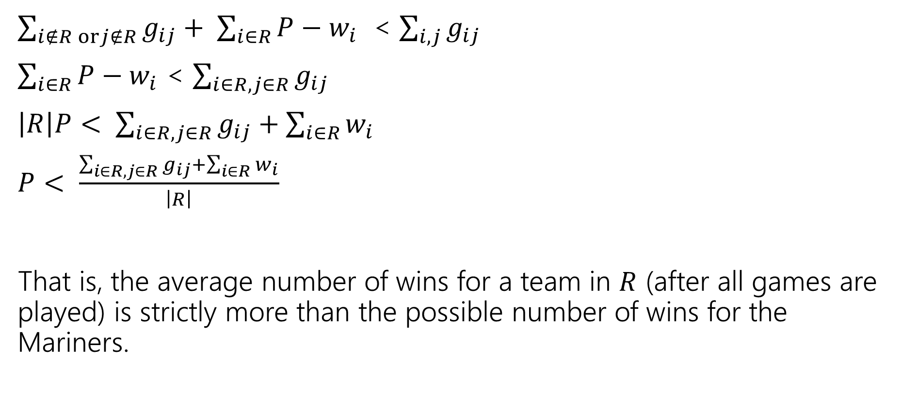
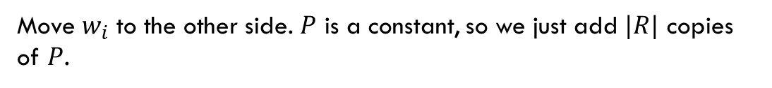
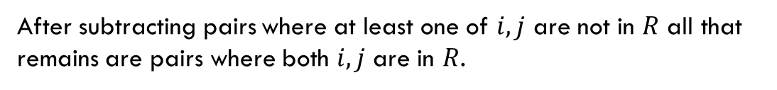
An Explanation Always Exists
$g_{ij}$ is games to be played between $i$ and $j$
$P$ is number of wins possible for Mariners
$w_{i}$ is current number of wins for team $i$.
$\sum_{i∉R orj∉R}{g_{ij}}+ \sum_{i∈R}{P−w_{i}}$ < $\sum_{i,j}{g_{ij}}$
$\sum_{i∈R}{P−w_{i}}$ < $\sum_{i∈R, j∈R}{g_{ij}}$
$\left|R\right|P< \sum_{i∈R, j∈R}{g_{ij}}+\sum_{i∈R}{w_{i}}$
$P< \frac{\sum_{i∈R, j∈R}{g_{ij}}+\sum_{i∈R}{w_{i}}}{\left|R\right|}$
That is, the average number of wins for a team in $R$ (after all games are played) is strictly more than the possible number of wins for the Mariners.
After subtracting pairs where at least one of $i,j$ are not in $R$ all that remains are pairs where both $i,j$ are in $R$.
Move $w_{i}$ to the other side. $P$ is a constant, so we just add $|R|$ copies of $P$.

Slide 36

Summary
To tell whether your favorite team is eliminated, you can run a max-flow computation on a graph with $O(n^{2})$ vertices and $O(n^{2})$ edges.
If your team is eliminated, there is a witness set of teams that must average more wins than is possible for your team.

Slide 37
More Practice

Slide 38
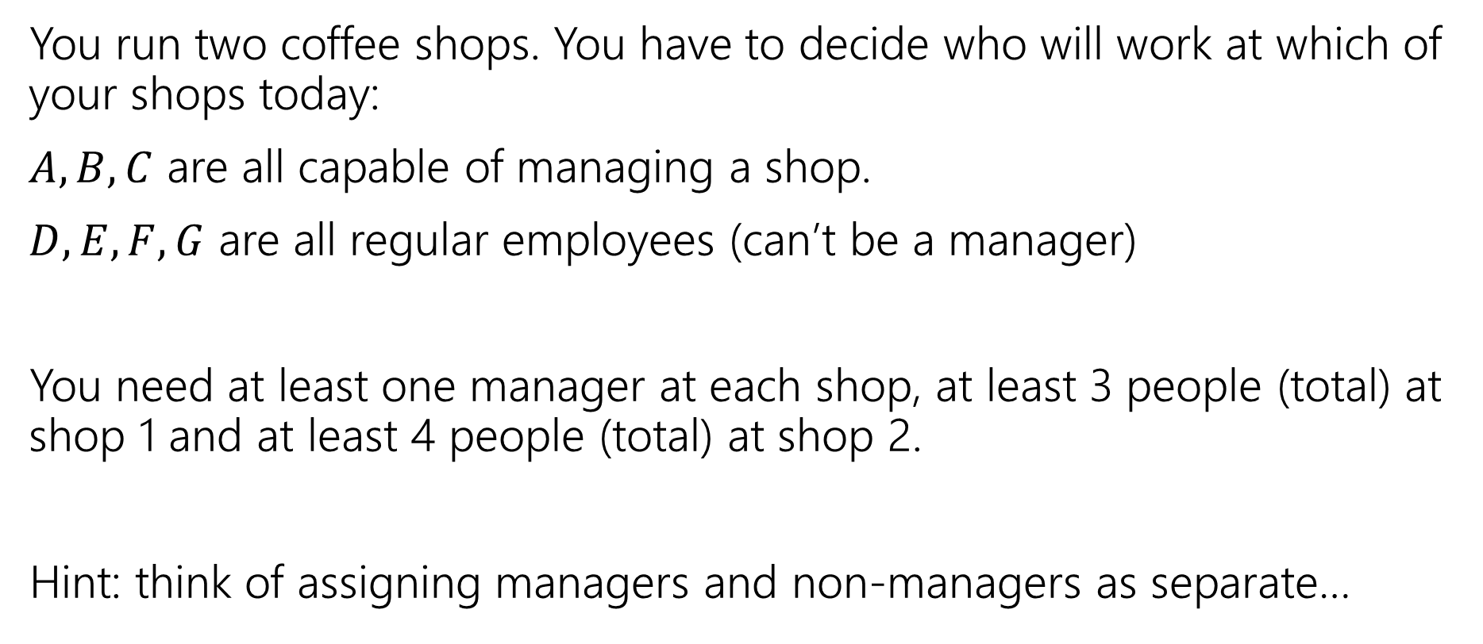
Another Problem
You run two coffee shops. You have to decide who will work at which of your shops today:
$A,B,C$ are all capable of managing a shop.
$D,E,F,G$ are all regular employees (can’t be a manager)
You need at least one manager at each shop, at least 3 people (total) at shop 1 and at least 4 people (total) at shop 2.
Hint: think of assigning managers and non-managers as separate…

Slide 39
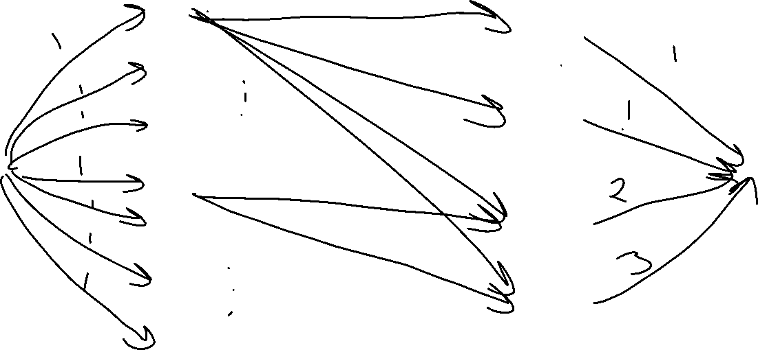
A
Manage
1
B
Manage
2
C
D
Work
1
E
F
Work
2
G

Slide 40
Key Ideas
Use different vertices to represent different jobs (even if they look related).
You can (once per problem) use the value of the flow to evaluate whether you’ve met some minimum number (one “at least” or “exactly equal to” requirement)
Otherwise, use capacities to limit the options. One unit of flow usually represents one “assignment.”

