Slide 1
More Network Flow
CSE 417 Fall 22
Lecture 21

Slide 2
Announcements
Midterm is back.
Solutions on Ed
Overall the class did well! The median, mean were 79, 77.3 respectively
  This wasn’t an easy exam.
  You had just learned DP and the counter-example question was difficult, too.
  Thinking about/concerned about grades? There’s a pinned Ed post.
  If that doesn’t answer your questions, send me an email.

Slide 3
Announcements
We’ve been hearing two sources of stress on homework
1. There’s a lot of work
2. If you have one or two topics that don’t click right away, your homework score isn’t as high as you hoped.
It’s hard to address both of these sources of stress simultaneously.
Here’s my best attempt:
We’ll have two optional problems come out this weekend that can replace old (25-point problem) scores. Due last day of classes
  A programming question
  An “in the real world” question
  Both are optional. If you have scores you real want to replace, do one (or both); or if you’re interested in them. If not, you can ignore them; we still count your top 20 25-point problems.

Slide 4
Announcements
Some themes we’ve seen in OH/one-on-one:
If you’re frequently “stuck” on homework problems and “don’t know where to start”
Follow the problems solving steps in the section handouts!
reread the problem, make examples, etc.
Visit office hours
Set yourself concrete questions
If you’re struggling on proofs, or not writing correct algorithms
The proof is your chance to check your work!
It’s not (just) a chance to practice proof-writing.

Slide 5
Upcoming Schedule
We’re wrapping up some old grading tasks this week
  HW5 P1, P4; old regrade requests; solutions submitted in the wrong box; etc.
HW6 now due Friday
HW7 will come out today(-ish), due Wed Nov. 30th.
HW8 will be due Wed. Dec 7th.
Wednesday Nov. 23rd Alicia will guest lecture.

Slide 6


















Flows
A flow moves units of water from $s$ to $t.$
Water can only be created at $s$ and only disappear at $t$.
And you cannot move more water than the capacity on any edge.
$$1/2$$
$$v$$
$$2/4$$
$$1/1$$
$$t$$
$$2/2$$
$$s$$
$$x$$
$$0/2$$
$$1/2$$
$$1/1$$
$$2/5$$
$$2/4$$
$$u$$
$$w$$
$$y$$
$$1/2$$

Slide 7
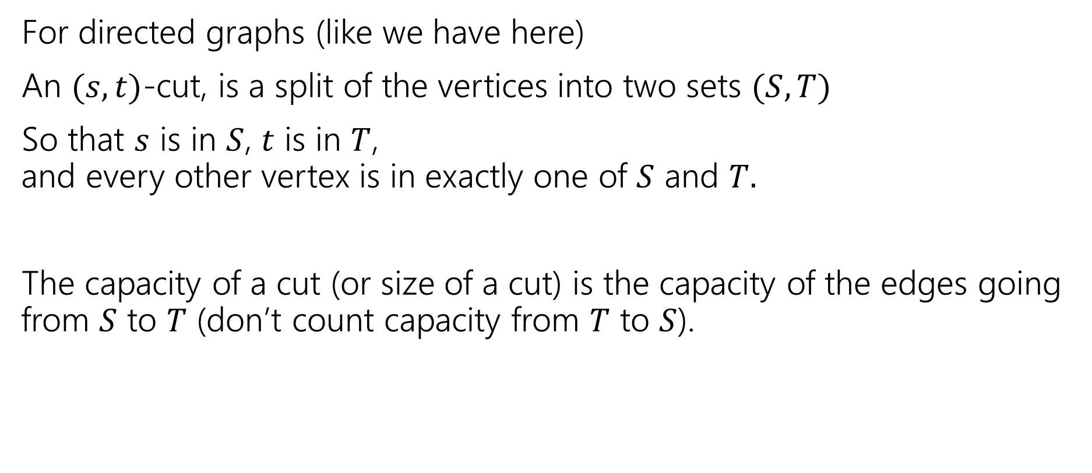
What’s a Cut?
For directed graphs (like we have here)
An $(s,t)$-cut, is a split of the vertices into two sets $(S,T)$
So that $s$ is in $S$, $t$ is in $T$,
and every other vertex is in exactly one of $S$ and $T.$
The capacity of a cut (or size of a cut) is the capacity of the edges going from $S$ to $T$ (don’t count capacity from $T$ to $S$).

Slide 8
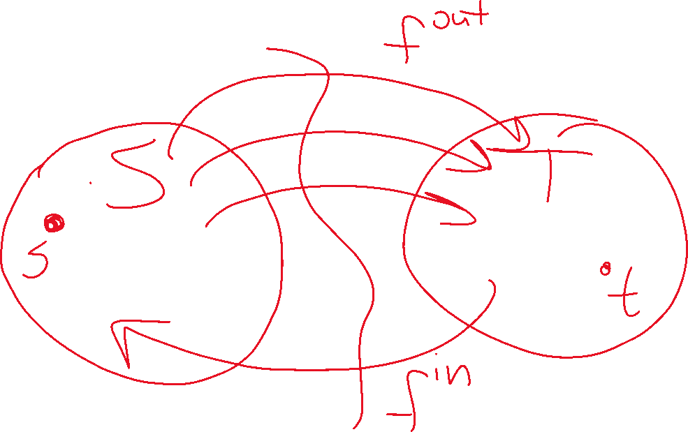

Slide 9
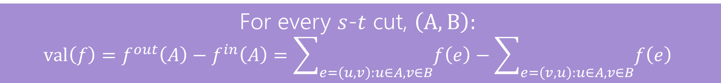
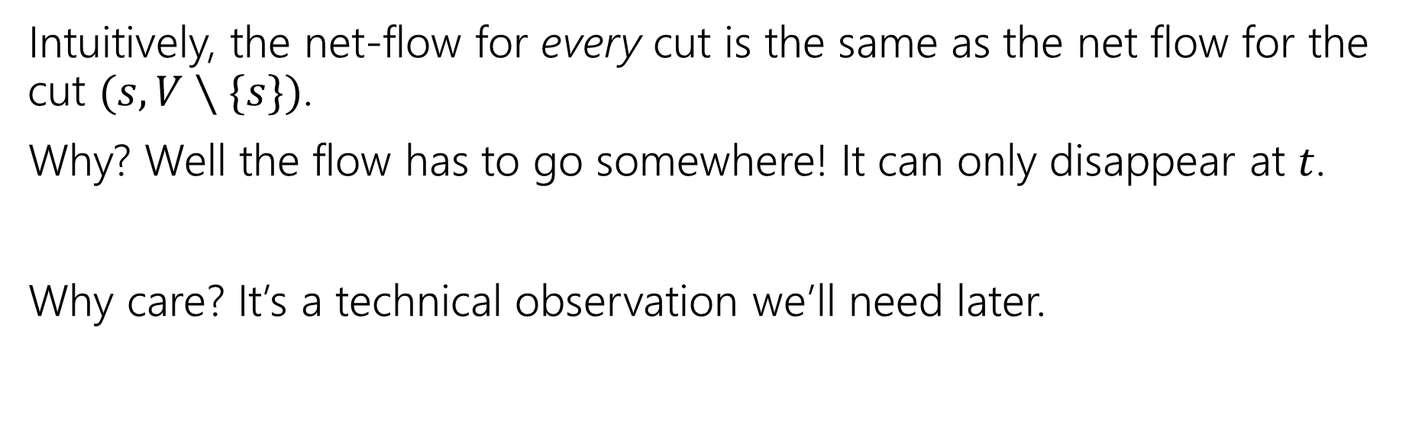
Step 1: The Flow Goes Somewhere
For every $s$-$t$ cut, $\left(A,B\right):$
$$val\left(f\right)=f^{out}\left(A\right)−f^{in}\left(A\right)=\sum_{e=\left(u,v\right):u∈A,v∈B}{f\left(e\right)}−\sum_{e=\left(v,u\right):u∈A,v∈B}{f\left(e\right)}$$
Intuitively, the net-flow for every cut is the same as the net flow for the cut $(s,V∖\{s\})$.
Why? Well the flow has to go somewhere! It can only disappear at $t$.
Why care? It’s a technical observation we’ll need later.

Slide 10

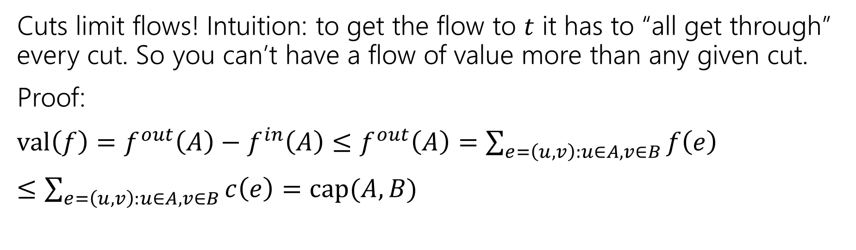
Step 2: Cuts limit flows (‘weak duality’)
Let $f$ be any $s$-$t$ flow, and $(A,B)$ be any $s$-$t$ cut.
Then $val\left(f\right)≤cap(A,B)$
Cuts limit flows! Intuition: to get the flow to $t$ it has to “all get through” every cut. So you can’t have a flow of value more than any given cut.
Proof:
$val\left(f\right)=f^{out}\left(A\right)−f^{in}\left(A\right)≤f^{out}\left(A\right)=\sum_{e=\left(u,v\right):u∈A,v∈B}{f\left(e\right)}$
$≤\sum_{e=\left(u,v\right):u∈A,v∈B}{c\left(e\right)}=cap(A,B)$

Slide 11

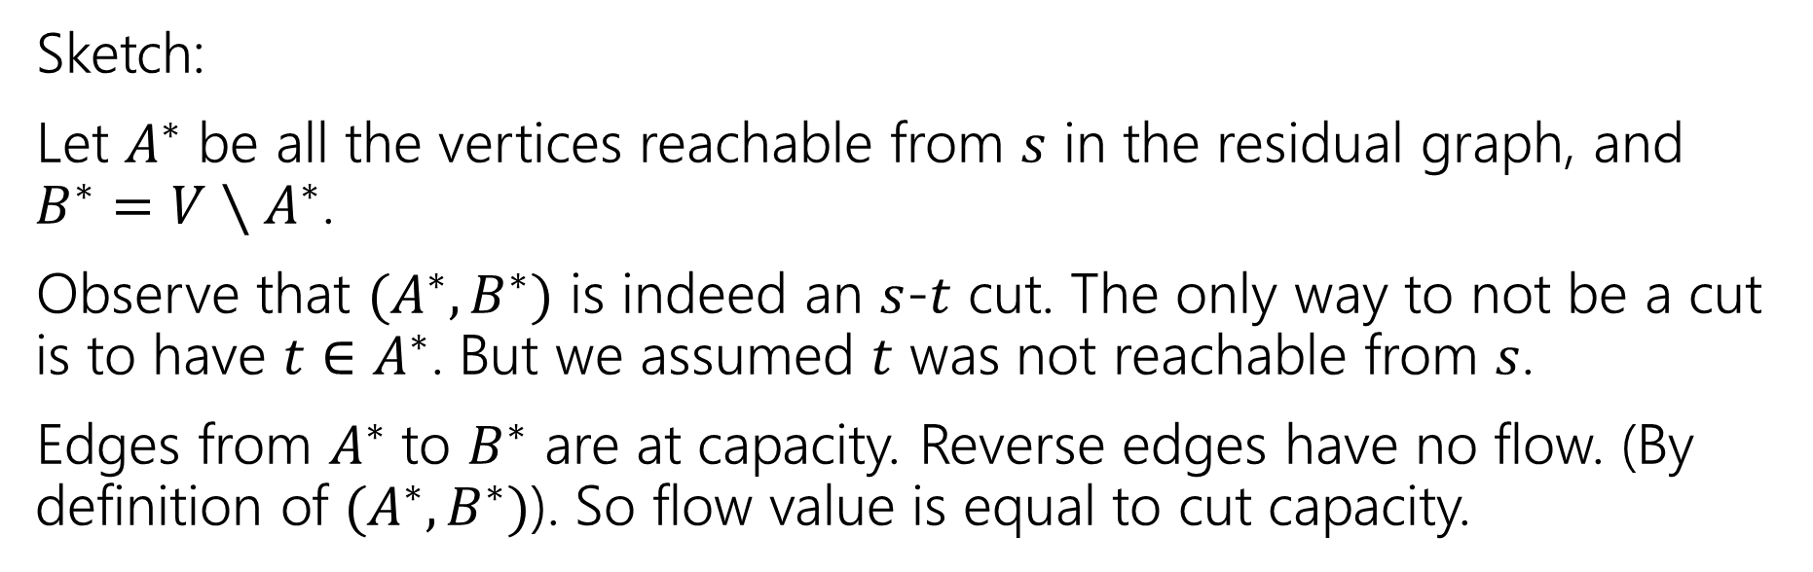
Step 3: Cuts are the only things that limit flows
Let $f^{∗}$ be an $s$-$t$ flow such that there is no $s$-$t$ path in the residual graph.
Then there is a cut $(A^{∗},B^{∗})$ such that $val\left(f^{∗}\right)=cap(A^{∗},B^{∗})$
Sketch:
Let $A^{∗}$ be all the vertices reachable from $s$ in the residual graph, and $B^{∗}=V∖A^{∗}$.
Observe that $(A^{∗},B^{∗})$ is indeed an $s$-$t$ cut. The only way to not be a cut is to have $t∈A^{∗}$. But we assumed $t$ was not reachable from $s$.
Edges from $A^{∗}$ to $B^{∗}$ are at capacity. Reverse edges have no flow. (By definition of $(A^{∗},B^{∗})$). So flow value is equal to cut capacity.

Slide 12
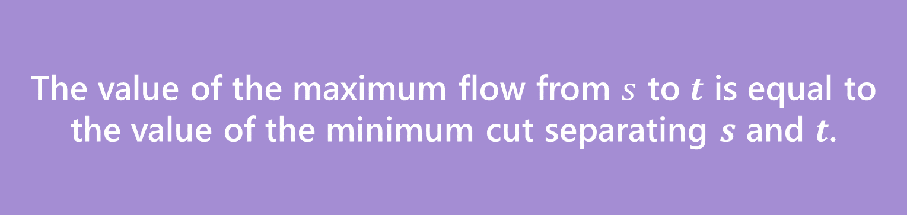
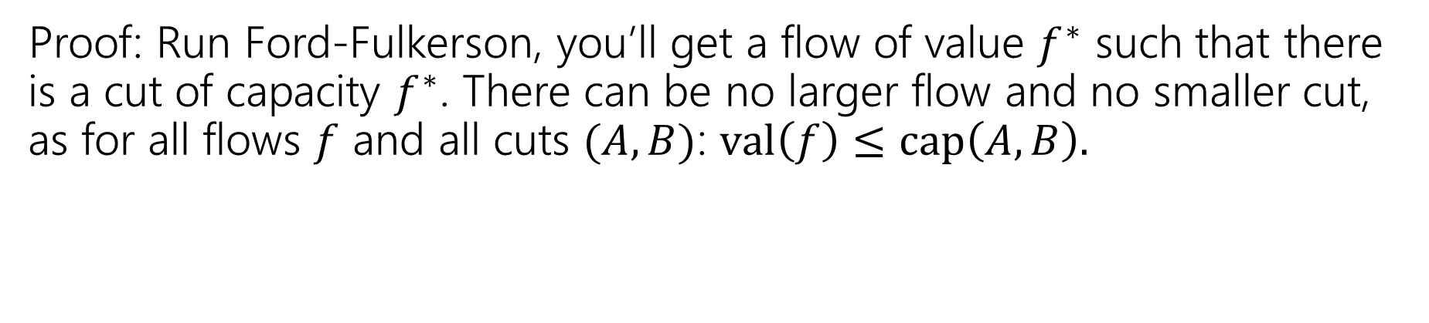
Concluding The Theorem
The value of the maximum flow from $s$ to $t$ is equal to the value of the minimum cut separating $s$ and $t$.
Max-Flow-Min-Cut Theorem
Proof: Run Ford-Fulkerson, you’ll get a flow of value $f^{∗}$ such that there is a cut of capacity $f^{∗}$. There can be no larger flow and no smaller cut, as for all flows $f$ and all cuts $(A,B)$: $val\left(f\right)≤cap\left(A,B\right).$

Slide 13
Isn’t This Cool?
Another instance where we prove a big theorem using an algorithm.
The max-flow min-cut theorem doesn’t mention an algorithm, but it can be proved via analyzing Ford-Fulkerson!

Slide 14
So What?
Great quick check for if you’ve found the maximum flow (or min-cut).
  Check the other and see if the value is the same!
We’ll see examples of max-flow used for modeling. In those cases the min-cut can be interpreted as a “barrier” to a good assignment.
It’s also a nice example of duality
If you know what a “dual linear program” is – flows and cuts are dual LPs.

Slide 15
Applications

Slide 16
Applications of Max-Flow-Min-Cut
Max-Flow and Min-Cut are useful if you work for the water company…
But they’re also useful if you don’t.
The most common application is assignment problems.
You have jobs and people who can do jobs – who is going to do which?
Big idea:
Let one unit of flow mean “assigning” one job to a person.

Slide 17
Hey Wait…
Isn’t this what stable matching is for?
Stable matching is very versatile, and it lets you encode preferences.
Max-flow assignment is even more versatile on the types of assignments.
But there’s not an easy way to encode preferences.

Slide 18
Example Problem
You and your housemates need to decide who is going to do each of the chores this week.
Some of your housemates are unable to do some chores.
Housemates: 1,2,3
Chores:
Arrange furniture, clean the Bathroom, Cook dinner, do the Dishes
Housemate 1 is unable to arrange furniture, 2 is unable to cook.

Slide 19
Example Problem
Housemate 1 is unable to arrange furniture, 2 is unable to cook.
Vertex for each housemate and chore.
Edge if the housemate could do the chore
A
1
B
2
C
3
D

Slide 20
Example Problem
Housemate 1 is unable to arrange furniture, 2 is unable to cook.
Vertex for each housemate and chore.
Edge if the housemate could do the chore
A
1
B
2
C
3
D

Slide 21
Example Problem
Housemate 1 is unable to arrange furniture, 2 is unable to cook.
Vertex for each housemate and chore.
Edge if the housemate could do the chore
A
1
B
2
C
3
D

Slide 22
Example Problem
Housemate 1 is unable to arrange furniture, 2 is unable to cook.
Vertex for each housemate and chore.
Edge if the housemate could do the chore
A
1
B
2
C
3
D

Slide 23
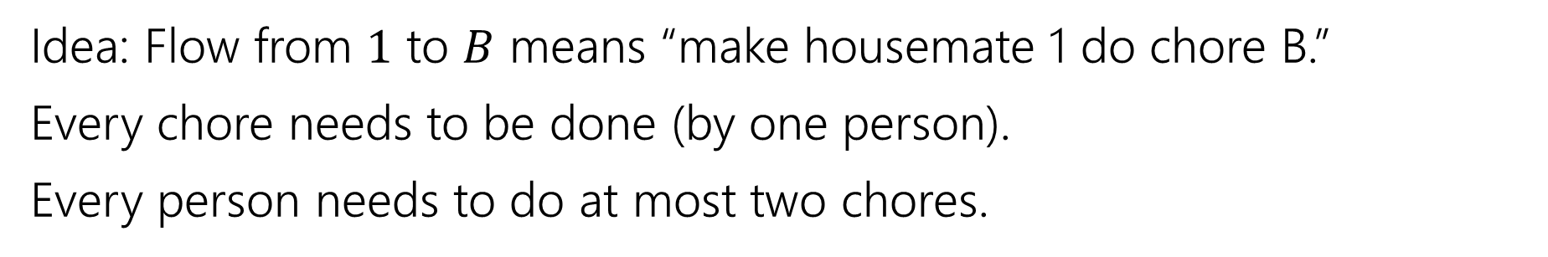
Example Problem
Idea: Flow from $1$ to $B$ means “make housemate 1 do chore B.”
Every chore needs to be done (by one person).
Every person needs to do at most two chores.
A
1
B
2
C
3
D

Slide 24
Example Problem
Idea: Flow from $1$ to $B$ means “make housemate 1 do chore B.”
Every chore needs to be done (by one person).
Every person needs to do at most two chores.
A
1
“dummy” source
B
s
2
t
C
3
“dummy” target
D

Slide 25

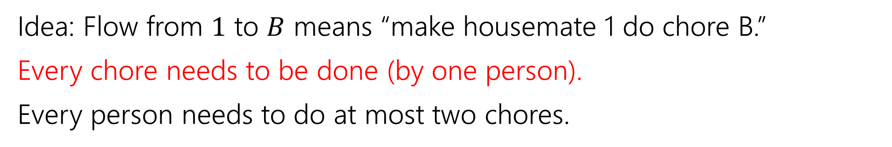



Example Problem
Idea: Flow from $1$ to $B$ means “make housemate 1 do chore B.”
Every chore needs to be done (by one person).
Every person needs to do at most two chores.
A
1
$$?/1$$
B
$$?/1$$
s
2
t
$$?/1$$
C
$$?/1$$
3
D

Slide 26



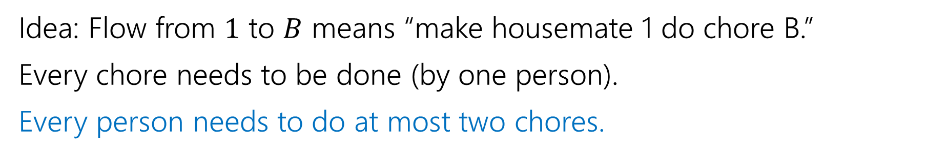




Example Problem
Idea: Flow from $1$ to $B$ means “make housemate 1 do chore B.”
Every chore needs to be done (by one person).
Every person needs to do at most two chores.
A
1
$$?/1$$
$$?/2$$
$$?/2$$
B
$$?/1$$
s
2
t
$$?/2$$
$$?/1$$
C
$$?/1$$
3
D

Slide 27


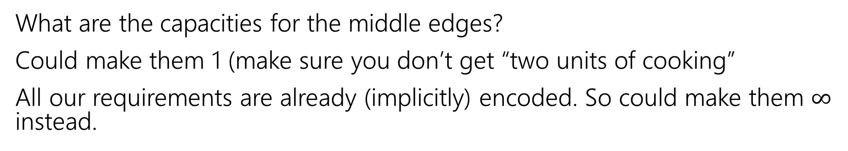

Example Problem
What are the capacities for the middle edges?
Could make them 1 (make sure you don’t get “two units of cooking”
All our requirements are already (implicitly) encoded. So could make them $∞$ instead.
A
1
$$?/1$$
$$?/2$$
$$?/2$$
B
$$?/1$$
s
2
t
$$?/2$$
$$?/1$$
C
$$?/1$$
3
D

Slide 28







Example Problem
Find a max flow…And read off the assignment!
Full color: 1 unit of flow, faded: 0 units of flow
1 cleans the bathroom and does the dishes, 2 arranges furniture, 3 cooks.
A
1
$$1/1$$
$$2/2$$
$$1/2$$
B
$$1/1$$
s
2
t
$$1/2$$
$$1/1$$
C
$$1/1$$
3
D

Slide 29
Why are all of our constraints met?
Every chore gets done
No one does more than 2 chores
People only do chores they’re capable of

Slide 30
Why are all of our constraints met?
Every chore gets done
No one does more than 2 chores
People only do chores they’re capable of
A flow of value 4 sends one unit of flow through each of A,B,C,D (because the edges to $t$ are all capacity $1$), so a max-flow ensures if possible we’ll find an assignment.
Only 2 units of flow can go through any person vertex (because edges from $s$ to people are all capacity $2).$
There is only an edge from a person to a chore if they can do that chore.

Slide 31
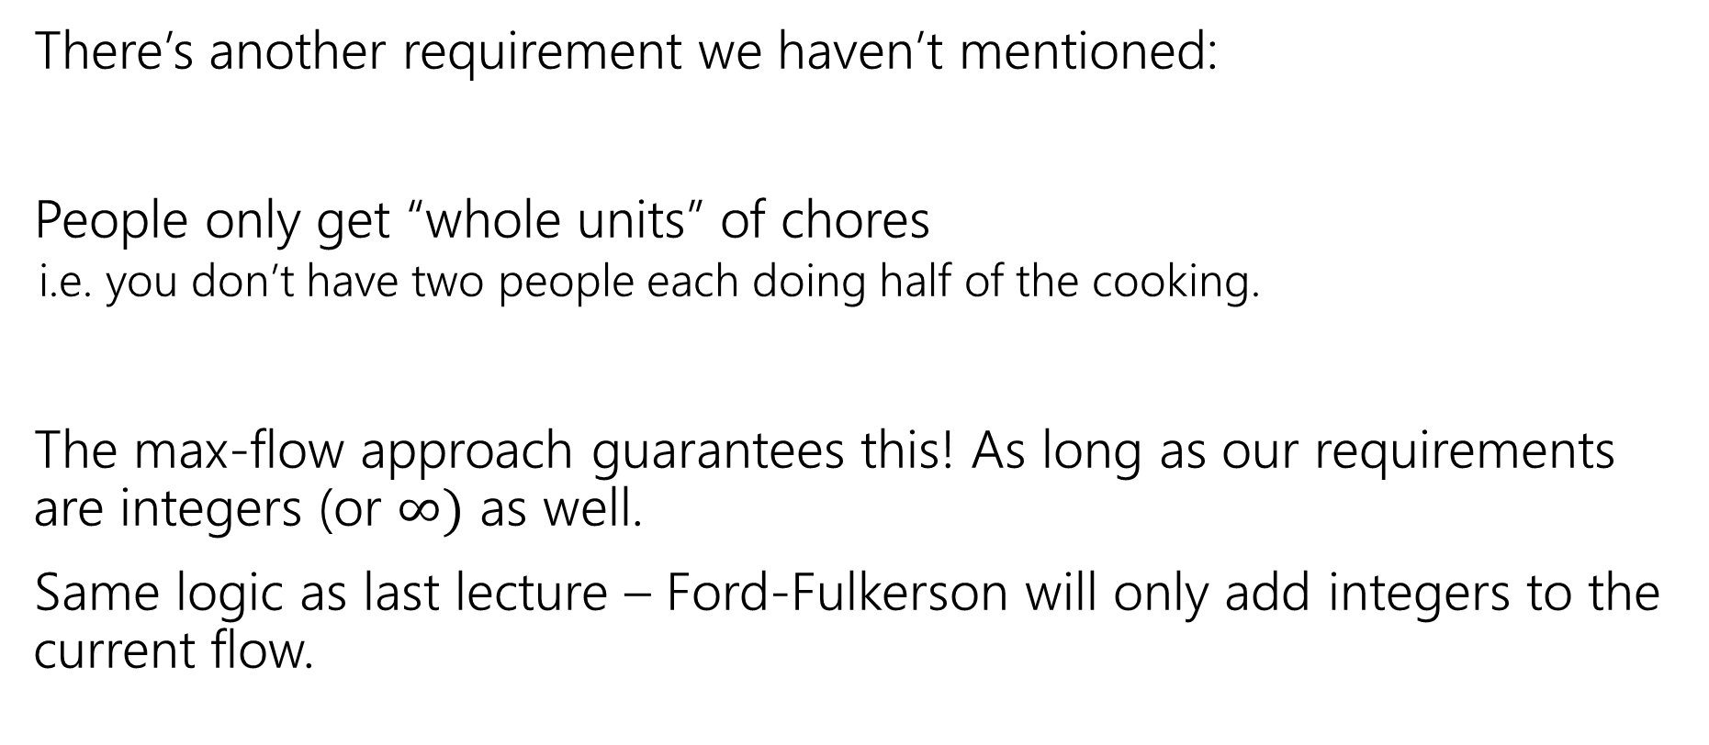
One More Requirement…
There’s another requirement we haven’t mentioned:
People only get “whole units” of chores
  i.e. you don’t have two people each doing half of the cooking.
The max-flow approach guarantees this! As long as our requirements are integers (or $∞)$ as well.
Same logic as last lecture – Ford-Fulkerson will only add integers to the current flow.

Slide 32
Key Ideas
Use different vertices to represent different jobs (even if they look related).
You can (once per problem) use the value of the flow to evaluate whether you’ve met some minimum number (one “at least” or “exactly equal to” requirement)
Otherwise, use capacities to limit the options. One unit of flow usually represents one “assignment.”

Slide 33
One More Example
A classic example
We’ll also be able to use the min-cut in addition to the flow!
Question: Can the Mariners still win* the division?
*or at least tie for first place.
And if they can’t, can you explain why.

Slide 34
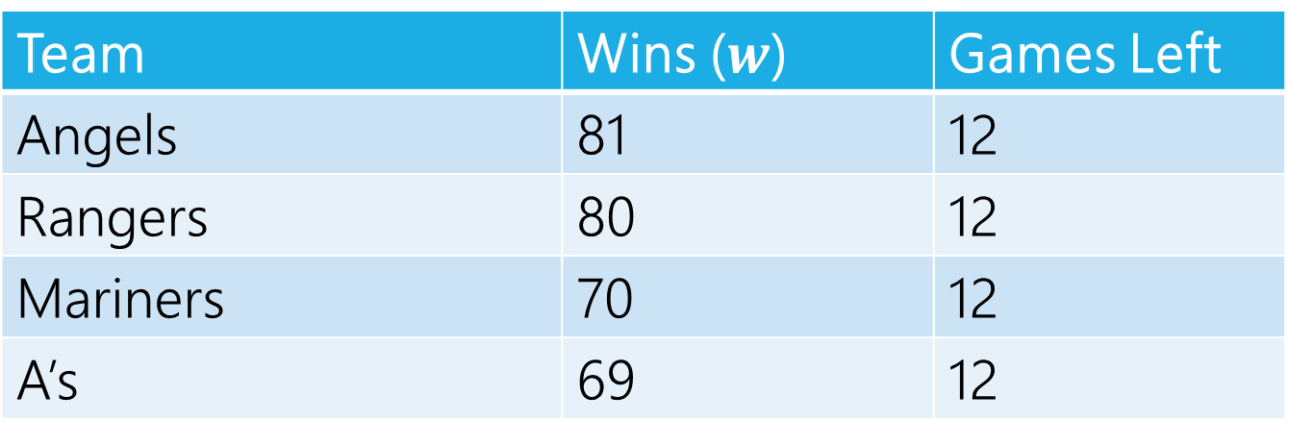
Can The Mariners Win The Division?
It’s late at night September 14, 1998.
You’re working for the Seattle Times.
The Mariners won! But the Angels did too.
How do you frame the Mariners current situation in your postgame article?
Team | Wins ($w$) | Games Left
Angels | 81 | 12
Rangers | 80 | 12
Mariners | 70 | 12
A’s | 69 | 12
MLB rules say all games will be played (if they end up mattering) so you can assume those will happen.

Slide 35
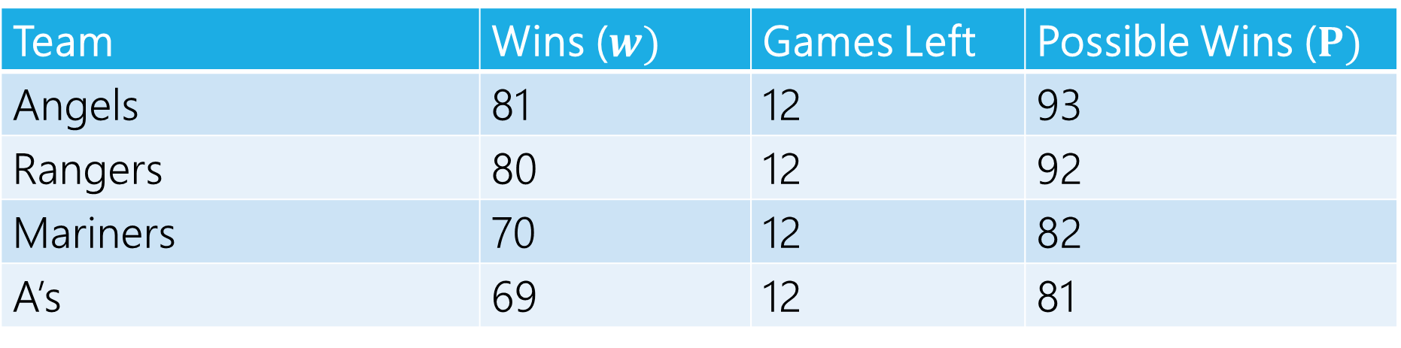
Can The Mariners Win The Division?
Team | Wins ($w)$ | Games Left | Possible Wins ($P)$
Angels | 81 | 12 | 93
Rangers | 80 | 12 | 92
Mariners | 70 | 12 | 82
A’s | 69 | 12 | 81
$P_{MARINERS}≥w_{i}$ for all $i$, so the Mariners can win the division, right?

Slide 36
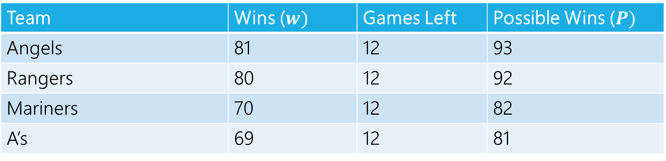
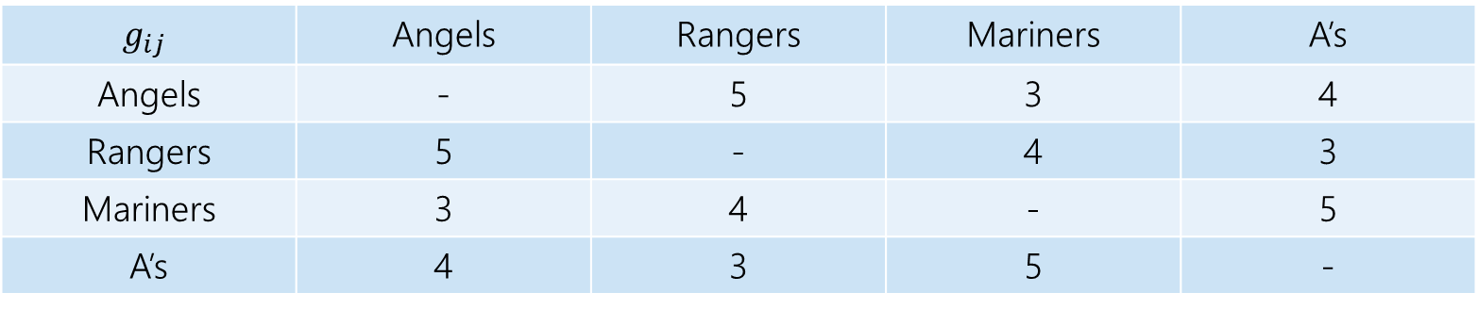
Well…No
The teams will play each other, here are the number of games to be played against each other.
$$g_{ij}$$ | Angels | Rangers | Mariners | A’s
Angels | - | 5 | 3 | 4
Rangers | 5 | - | 4 | 3
Mariners | 3 | 4 | - | 5
A’s | 4 | 3 | 5 | -
Team | Wins ($w)$ | Games Left | Possible Wins ($P)$
Angels | 81 | 12 | 93
Rangers | 80 | 12 | 92
Mariners | 70 | 12 | 82
A’s | 69 | 12 | 81

Slide 37
Well…No
At least one of the Angels and Rangers is going to win at least 83 games
  someone wins at least three of the five they play against each other.
The Mariners can only win 82 games.

Slide 38
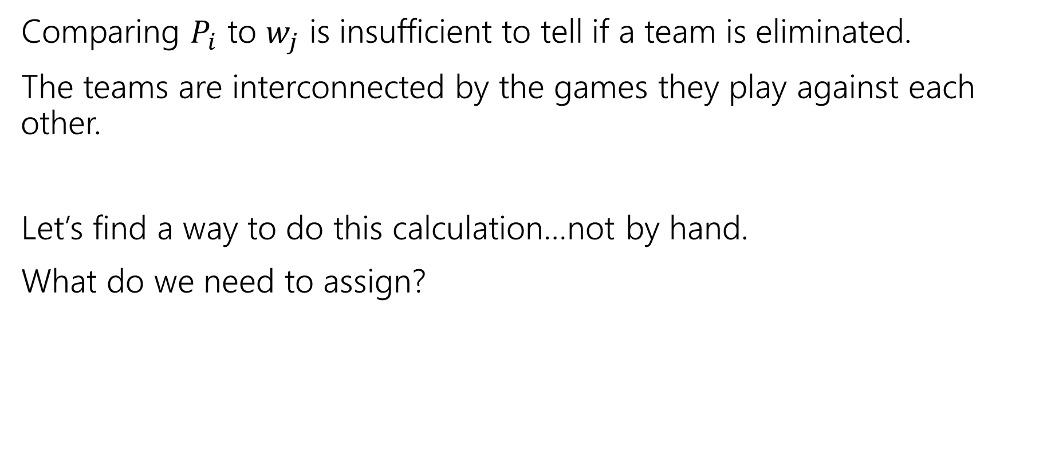
Lessons
Comparing $P_{i}$ to $w_{j}$ is insufficient to tell if a team is eliminated.
The teams are interconnected by the games they play against each other.
Let’s find a way to do this calculation…not by hand.
What do we need to assign?

Slide 39
Assignment
We need to assign who wins each of the remaining games.
Safe to assume the Mariners will win them all.
Just need to figure out the others.
One unit of flow represents one win.

Slide 40
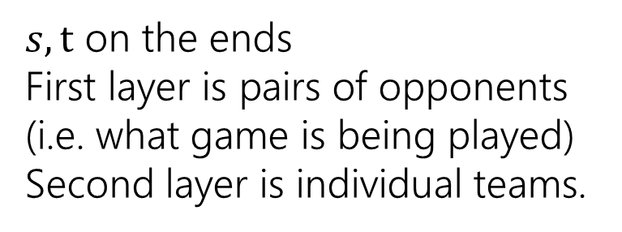
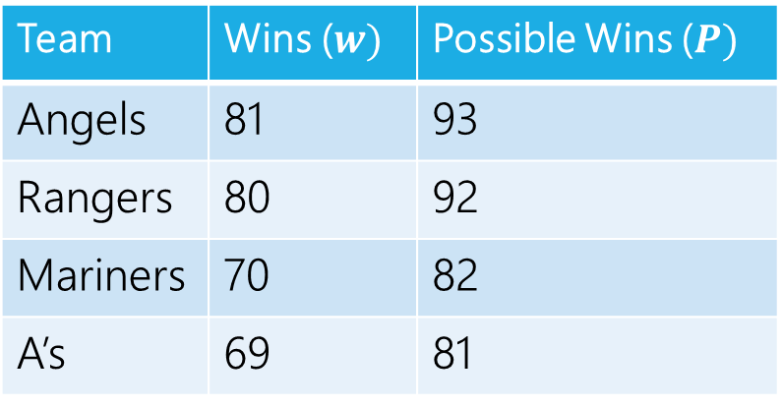
Making a Network
 | Angels | Rangers | Mariners | A’s
Angels | - | 5 | 3 | 4
Rangers | 5 | - | 4 | 3
Mariners | 3 | 4 | - | 5
A’s | 4 | 3 | 5 | -
Angels vs. Rangers
Angels
Team | Wins ($w)$ | Possible Wins ($P)$
Angels | 81 | 93
Rangers | 80 | 92
Mariners | 70 | 82
A’s | 69 | 81
Angels vs.
A’s
Rangers
$s,t$ on the ends
First layer is pairs of opponents (i.e. what game is being played)
Second layer is individual teams.
Rangers vs.
A’s
A’s

Slide 41
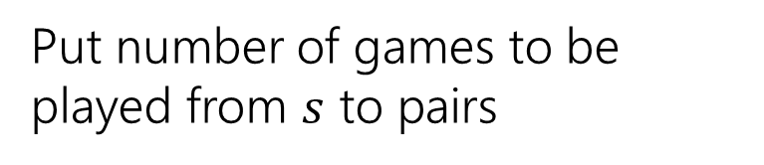
Making a Network
 | Angels | Rangers | Mariners | A’s
Angels | - | 5 | 3 | 4
Rangers | 5 | - | 4 | 3
Mariners | 3 | 4 | - | 5
A’s | 4 | 3 | 5 | -
Angels vs. Rangers
Angels
Team | Wins ($w)$ | Possible Wins ($P)$
Angels | 81 | 93
Rangers | 80 | 92
Mariners | 70 | 82
A’s | 69 | 81
5
Angels vs.
A’s
Rangers
4
Put number of games to be played from $s$ to pairs
3
Rangers vs.
A’s
A’s

Slide 42
Making a Network
 | Angels | Rangers | Mariners | A’s
Angels | - | 5 | 3 | 4
Rangers | 5 | - | 4 | 3
Mariners | 3 | 4 | - | 5
A’s | 4 | 3 | 5 | -
Angels vs. Rangers
Angels
Team | Wins ($w)$ | Possible Wins ($P)$
Angels | 81 | 93
Rangers | 80 | 92
Mariners | 70 | 82
A’s | 69 | 81
5
Angels vs.
A’s
Rangers
4
How do we make sure Mariners win? They’ll end the season with 82 wins (current + games left).
How many more can each team win?
Mariners poss total – team current
3
Rangers vs.
A’s
A’s

Slide 43
Making a Network
 | Angels | Rangers | Mariners | A’s
Angels | - | 5 | 3 | 4
Rangers | 5 | - | 4 | 3
Mariners | 3 | 4 | - | 5
A’s | 4 | 3 | 5 | -
Angels have 81 wins, 1 more is ok (total matches Mariners possible) 2 is not. Capacity is 1.
Angels vs. Rangers
Angels
Team | Wins ($w)$ | Possible Wins ($P)$
Angels | 81 | 93
Rangers | 80 | 92
Mariners | 70 | 82
A’s | 69 | 81
5
1
Angels vs.
A’s
Rangers
4
How do we make sure Mariners win? They’ll end the season with 82 wins (current + games left).
How many more can each team win?
Mariners poss total – team current
3
Rangers vs.
A’s
A’s

Slide 44
Making a Network
 | Angels | Rangers | Mariners | A’s
Angels | - | 5 | 3 | 4
Rangers | 5 | - | 4 | 3
Mariners | 3 | 4 | - | 5
A’s | 4 | 3 | 5 | -
Angels vs. Rangers
Angels
Team | Wins ($w)$ | Possible Wins ($P)$
Angels | 81 | 93
Rangers | 80 | 92
Mariners | 70 | 82
A’s | 69 | 81
5
1
Angels vs.
A’s
Rangers
4
2
How do we make sure Mariners win? They’ll end the season with 82 wins (current + games left).
How many more can each team win?
Mariners poss total – team current
13
3
Rangers vs.
A’s
A’s

Slide 45
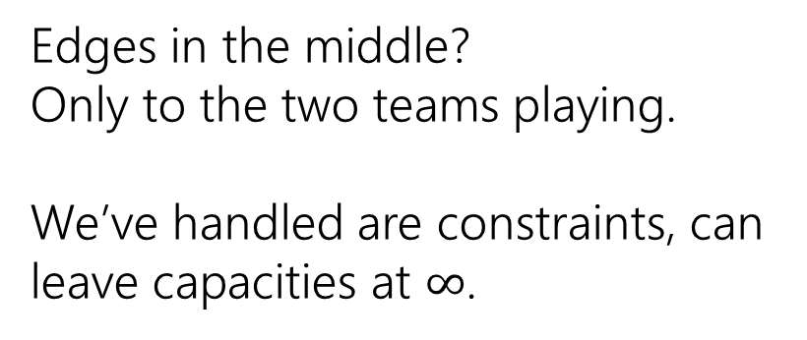
Making a Network
 | Angels | Rangers | Mariners | A’s
Angels | - | 5 | 3 | 4
Rangers | 5 | - | 4 | 3
Mariners | 3 | 4 | - | 5
A’s | 4 | 3 | 5 | -
Angels vs. Rangers
Angels
Team | Wins ($w)$ | Possible Wins ($P)$
Angels | 81 | 93
Rangers | 80 | 92
Mariners | 70 | 82
A’s | 69 | 81
5
1
Angels vs.
A’s
Rangers
4
2
Edges in the middle?
Only to the two teams playing.
We’ve handled are constraints, can leave capacities at $∞$.
13
3
Rangers vs.
A’s
A’s

Slide 46






Making a Network
 | Angels | Rangers | Mariners | A’s
Angels | - | 5 | 3 | 4
Rangers | 5 | - | 4 | 3
Mariners | 3 | 4 | - | 5
A’s | 4 | 3 | 5 | -
Angels vs. Rangers
Angels
Team | Wins ($w)$ | Possible Wins ($P)$
Angels | 81 | 93
Rangers | 80 | 92
Mariners | 70 | 82
A’s | 69 | 81
$$∞$$
$$∞$$
1
5
$$∞$$
Angels vs.
A’s
Rangers
4
2
$$∞$$
Edges in the middle?
Only to the two teams playing.
We’ve handled are constraints, can leave capacities at $∞$.
$$∞$$
13
3
Rangers vs.
A’s
A’s
$$∞$$

Slide 47
Making a Network
 | Angels | Rangers | Mariners | A’s
Angels | - | 5 | 3 | 4
Rangers | 5 | - | 4 | 3
Mariners | 3 | 4 | - | 5
A’s | 4 | 3 | 5 | -
Angels vs. Rangers
Angels
Team | Wins ($w)$ | Possible Wins ($P)$
Angels | 81 | 93
Rangers | 80 | 92
Mariners | 70 | 82
A’s | 69 | 81
$$∞$$
$$∞$$
1
5
$$∞$$
Angels vs.
A’s
Rangers
4
2
$$∞$$
We’re done!
$$∞$$
13
3
Rangers vs.
A’s
A’s
$$∞$$

Slide 48
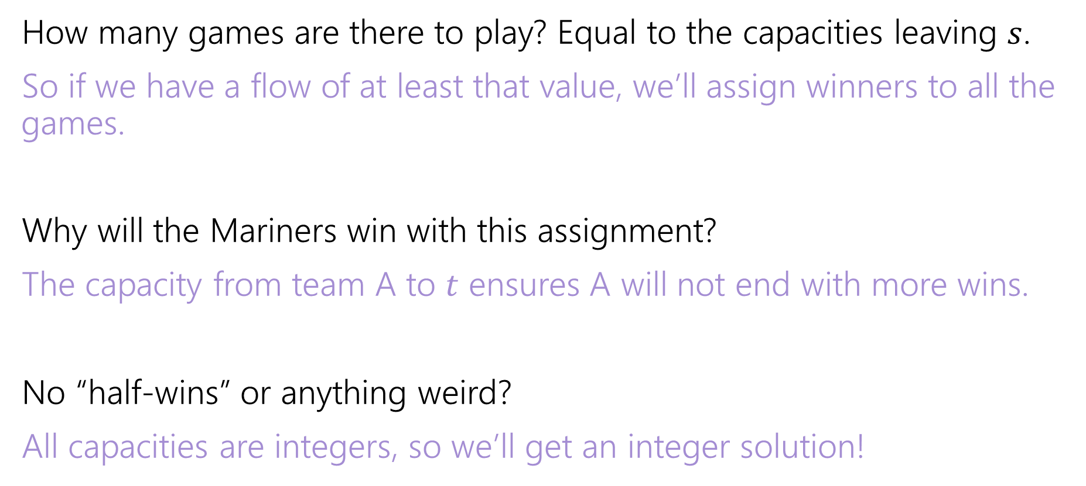
Why are all the constraints met?
How many games are there to play? Equal to the capacities leaving $s$.
So if we have a flow of at least that value, we’ll assign winners to all the games.
Why will the Mariners win with this assignment?
The capacity from team A to $t$ ensures A will not end with more wins.
No “half-wins” or anything weird?
All capacities are integers, so we’ll get an integer solution!

Slide 49
Interpreting the answer
If the max flow has value equal to number of games, we know how the Mariners can still win the division.
If the max flow is less than that, the Mariners can’t win the division!
(if they could win the division, then there is a way that the remaining games could play out with the mariners having as many wins as anyone else, but then we could make a feasible flow by assigning a unit of flow for each winner).

Slide 50






Max Flow
 | Angels | Rangers | Mariners | A’s
Angels | - | 5 | 3 | 4
Rangers | 5 | - | 4 | 3
Mariners | 3 | 4 | - | 5
A’s | 4 | 3 | 5 | -
Angels vs. Rangers
Angels
Team | Wins ($w)$ | Possible Wins ($P)$
Angels | 81 | 93
Rangers | 80 | 92
Mariners | 70 | 82
A’s | 69 | 81
1/
$$∞$$
$$∞$$
2/
1/
3/
1
5
$$∞$$
Angels vs.
A’s
Rangers
4/
4
2
2/
$$∞$$
This is the maximum flow. What’s the min-cut?
{s, Angels vs. Rangers, Angels, Rangers} is one side of the cut.
The Angels and Rangers were enough to prove that the Mariners couldn’t win!
7/
4/
13
3/
$$∞$$
3
Rangers vs.
A’s
A’s
3/
$$∞$$

Slide 51
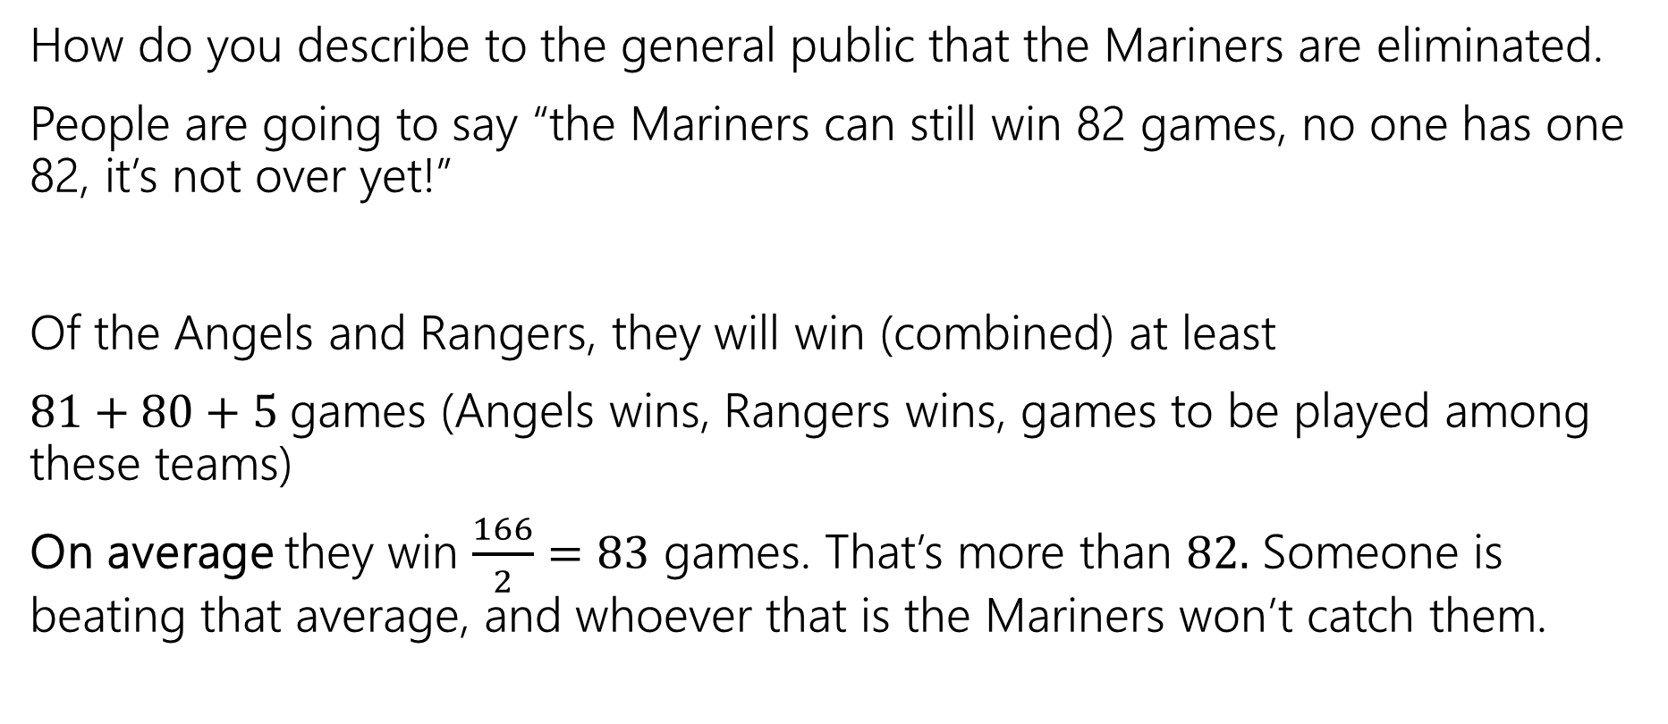
Generating Proof that you’re eliminated
How do you describe to the general public that the Mariners are eliminated.
People are going to say “the Mariners can still win 82 games, no one has one 82, it’s not over yet!”
Of the Angels and Rangers, they will win (combined) at least
$81+80+5$games (Angels wins, Rangers wins, games to be played among these teams)
On average they win $\frac{166}{2}=83$ games. That’s more than $82.$ Someone is beating that average, and whoever that is the Mariners won’t catch them.

Slide 52
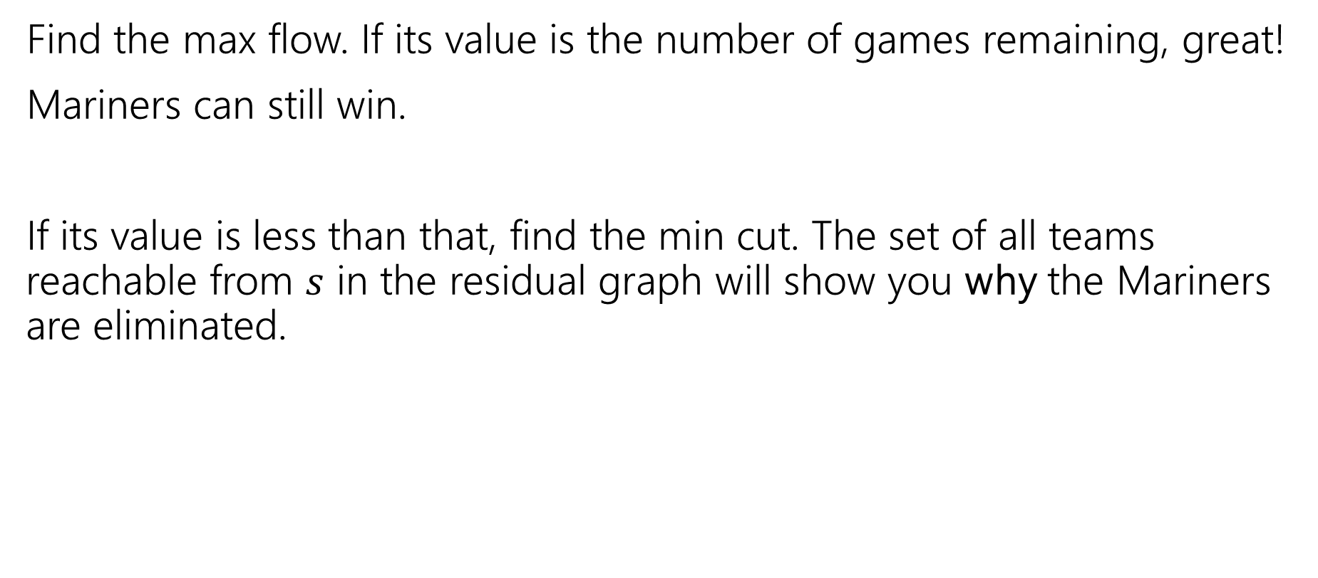
In General
Find the max flow. If its value is the number of games remaining, great!
Mariners can still win.
If its value is less than that, find the min cut. The set of all teams reachable from $s$ in the residual graph will show you why the Mariners are eliminated.

Slide 53
Takeaways
If you want to “assign” things, max-flow might be a good option.
If you say “at most” you can probably just make a capacity constraint
Once you can do an “exactly equal” or “at most” by checking the value of the max-flow.
Sometimes you want an extra layer or two if you have a multiple types of assignments.
Sometimes you can convert an “at least” in one group into an “at most” on another group.

Slide 54
Optional – Why is there always an explanation?

Slide 55



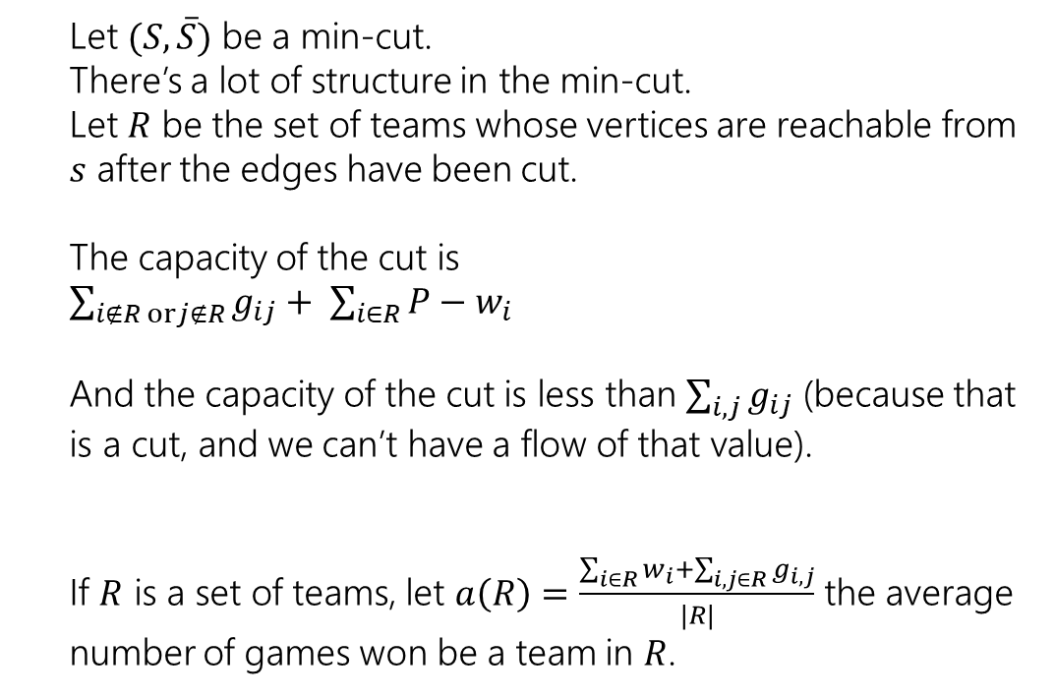



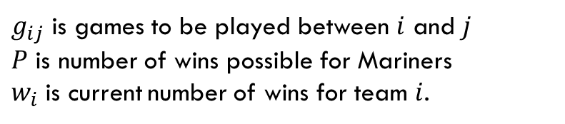
An Explanation Always Exists
$g_{ij}$ is games to be played between $i$ and $j$
$P$ is number of wins possible for Mariners
$w_{i}$ is current number of wins for team $i$.
Let $(S, \overline{S})$ be a min-cut.
There’s a lot of structure in the min-cut.
Let $R$ be the set of teams whose vertices are reachable from $s$ after the edges have been cut.
The capacity of the cut is
$\sum_{i∉R orj∉R}{g_{ij}}+ \sum_{i∈R}{P−w_{i}}$
And the capacity of the cut is less than $\sum_{i,j}{g_{ij}}$ (because that is a cut, and we can’t have a flow of that value).
If $R$ is a set of teams, let $a\left(R\right)=\frac{\sum_{i∈R}{w_{i}}+\sum_{i,j∈R}{g_{i,j}}}{|R|}$ the average number of games won be a team in $R$.
Angels vs. Rangers
Angels
$$∞$$
$$∞$$
1
5
$$∞$$
Angels vs.
A’s
Rangers
4
2
$$∞$$
$$∞$$
13
3
Rangers vs.
A’s
A’s
$$∞$$

Slide 56
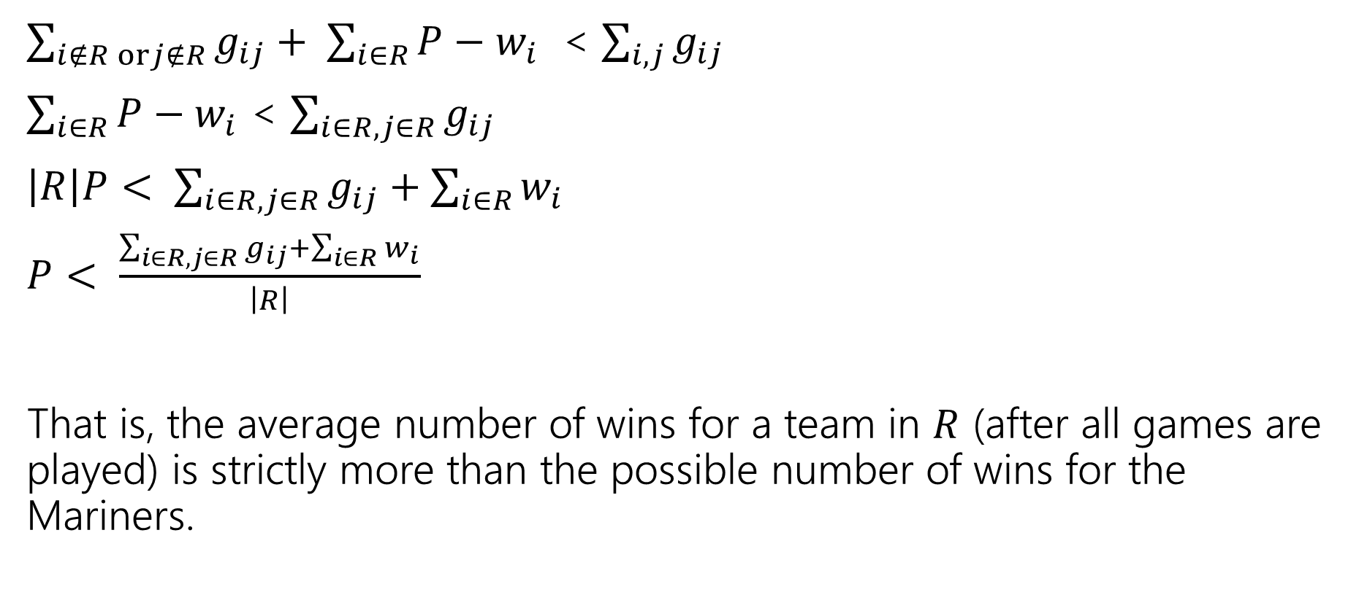
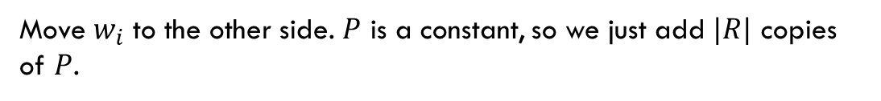
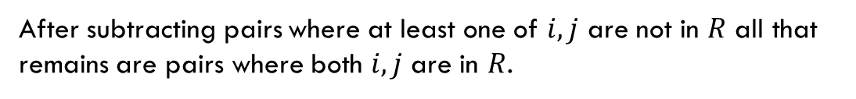
An Explanation Always Exists
$g_{ij}$ is games to be played between $i$ and $j$
$P$ is number of wins possible for Mariners
$w_{i}$ is current number of wins for team $i$.
$\sum_{i∉R orj∉R}{g_{ij}}+ \sum_{i∈R}{P−w_{i}}$ < $\sum_{i,j}{g_{ij}}$
$\sum_{i∈R}{P−w_{i}}$ < $\sum_{i∈R, j∈R}{g_{ij}}$
$\left|R\right|P< \sum_{i∈R, j∈R}{g_{ij}}+\sum_{i∈R}{w_{i}}$
$P< \frac{\sum_{i∈R, j∈R}{g_{ij}}+\sum_{i∈R}{w_{i}}}{\left|R\right|}$
That is, the average number of wins for a team in $R$ (after all games are played) is strictly more than the possible number of wins for the Mariners.
After subtracting pairs where at least one of $i,j$ are not in $R$ all that remains are pairs where both $i,j$ are in $R$.
Move $w_{i}$ to the other side. $P$ is a constant, so we just add $|R|$ copies of $P$.

Slide 57

Summary
To tell whether your favorite team is eliminated, you can run a max-flow computation on a graph with $O(n^{2})$ vertices and $O(n^{2})$ edges.
If your team is eliminated, there is a witness set of teams that must average more wins than is possible for your team.

