Slide 1
Linear Programming
CSE 421 22AU
Lecture 19

Slide 2
Announcements
Still no discussion of the midterm yet (some people still need to take it).
We’ll release solutions once they’re all taken (early next week?)
HW6 (more DP!) is coming out tonight, due in one week.

Slide 3
Today
Everything we can cover about a topic in one day.
Linear programming!
They may come back at the end of the quarter (for approximation algorithms); goal today is just understand what they are and why they might be interesting.

Slide 4
Linear Programming
Used WIDELY in business and operations research.
Excel has a linear program solver.
A very expressive language for problem-solving
Can represent a wide-variety of problems, including some we’ve already seen.
Deep, beautiful theory…that we do not have time to cover.

Slide 5
Outline of LPs
What is a linear program?
A simple example LP
Computational Issues
An application – Vertex Cover on trees (again)
In a few weeks, we might return to LPs as a method of approximating NP-hard problems.

Slide 6
Example Problem
You’re laying down soil for a bunch of new gardens. You got a few big piles of soil delivered (more than enough to cover the gardens)
$1.5/unit
1.5
$2/unit
7
5
$4/unit
$4/unit
10
$1.5/unit
$3/unit
$8/unit
4
$2/unit
2.5
3
$4.5/unit

Slide 7
Example Problem
What variables should we use?
$1.5/unit
1.5
$2/unit
7
5
$4/unit
$4/unit
10
$1.5/unit
$3/unit
$8/unit
4
$2/unit
2.5
3
$4.5/unit

Slide 8

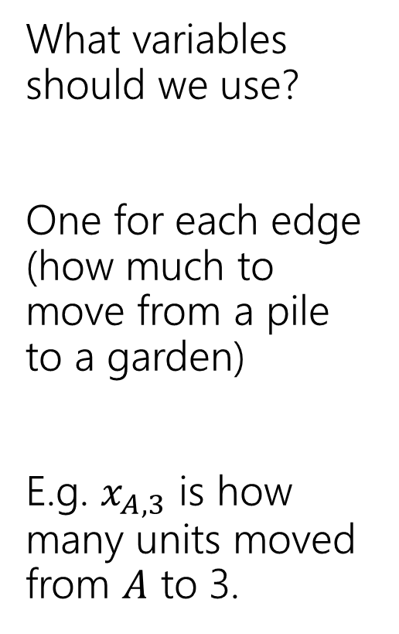
Example Problem
What variables should we use?
One for each edge (how much to move from a pile to a garden)
E.g. $x_{A,3}$ is how many units moved from $A$ to 3.
3
$$x_{A,3}$$
$1.5/unit
1.5
A
$2/unit
7
5
C
$4/unit
$4/unit
2
10
$1.5/unit
$3/unit
$8/unit
4
4
$2/unit
2.5
1
3
B
$4.5/unit

Slide 9
Example Problem
What constraints are there on the variables?
3
$$x_{A,3}$$
$1.5/unit
1.5
A
$2/unit
7
5
C
$4/unit
$4/unit
2
10
$1.5/unit
$3/unit
$8/unit
4
4
$2/unit
2.5
1
3
B
$4.5/unit

Slide 10
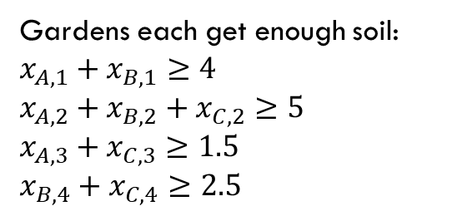
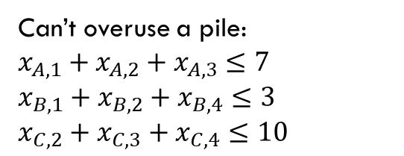
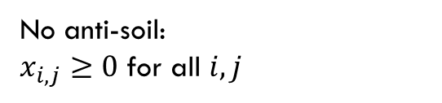
Example Problem
Gardens each get enough soil:
$x_{A,1}+x_{B,1}≥4$
$x_{A,2}+x_{B,2}+x_{C,2}≥5$
$x_{A,3}+x_{C,3}≥1.5$
$x_{B,4}+x_{C,4}≥2.5$
No anti-soil:
$x_{i,j}≥0$ for all $i,j$
What constraints are there on the variables?
Can’t overuse a pile:
$x_{A,1}+x_{A,2}+x_{A,3}≤7$
$x_{B,1}+x_{B,2}+x_{B,4}≤3$
$x_{C,2}+x_{C,3}+x_{C,4}≤10$
3
$$x_{A,3}$$
$1.5/unit
1.5
A
$2/unit
7
5
C
$4/unit
$4/unit
2
10
$1.5/unit
$3/unit
$8/unit
4
4
$2/unit
2.5
1
3
B
$4.5/unit

Slide 11
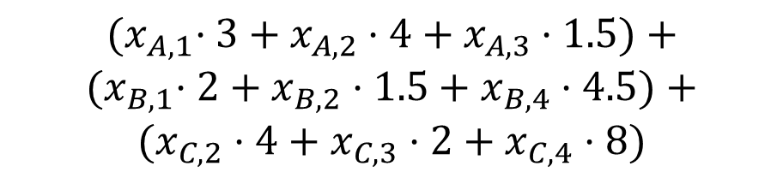
Example Problem
$${(x}_{A,1}⋅3+x_{A,2}⋅4+x_{A,3}⋅1.5)+$$
$${(x}_{B,1}⋅2+x_{B,2}⋅1.5+x_{B,4}⋅4.5)+$$
$$(x_{C,2}⋅4+x_{C,3}⋅2+x_{C,4}⋅8)$$
What’s the cost (in terms of the variables)?
Sum cost*var for all the variables
3
$$x_{A,3}$$
$1.5/unit
1.5
A
$2/unit
7
5
C
$4/unit
$4/unit
2
10
$1.5/unit
$3/unit
$8/unit
4
4
$2/unit
2.5
1
3
B
$4.5/unit

Slide 12

Full Definition
Minimize: ${(x}_{A,1}⋅3+x_{A,2}⋅4+x_{A,3}⋅1.5)+{(x}_{B,1}⋅2+x_{B,2}⋅1.5+x_{B,4}⋅4.5)+(x_{C,2}⋅4+x_{C,3}⋅2+x_{C,4}⋅8)$
Subject To:
$x_{A,1}+x_{B,1}≥4$
$x_{A,2}+x_{B,2}+x_{C,2}≥5$
$x_{A,3}+x_{C,3}≥1.5$
$x_{B,4}+x_{C,4}≥2.5$
$x_{A,1}+x_{A,2}+x_{A,3}≤7$
$x_{B,1}+x_{B,2}+x_{B,4}≤3$
$x_{C,2}+x_{C,3}+x_{C,4}≤10$
$x_{i,j}≥0$ for all $i,j$

Slide 13


A Linear Program
A linear program is defined by:
Real-valued variables
Subject to satisfying everything in a list of linear constraints
Maximizing or minimizing a linear objective function
A linear constraint is a statement of the form: $∑a_{i}x_{i}≤c_{i}$
where $a_{i}$ are constants, the $x_{i}$ are variables and $c_{i}$ is a constant.
A linear objective function is a function of the form: $∑b_{i}x_{i}$
where $b_{i}$ are constants and the $x_{i}$ are variables.

Slide 14

Linear constraints
Pollev.com/robbie
Can you write each of these requirements as linear constraint(s)?
Some of these are tricks…
$x_{i}$ times $x_{j}$ is at least $5$
${5x}_{i}$ is equal to $1$
$x_{i}≤5$ OR $x_{i}≥7$
$x_{i}$ is non-negative.
$x_{i}$ is an integer.

Slide 15
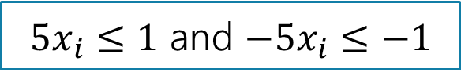

Linear constraints
Can you write each of these requirements as linear constraint(s)?
Some of these are tricks…
$x_{i}$ times $x_{j}$ is at least $5$
${5x}_{i}$ is equal to $1$
$x_{i}≤5$ OR $x_{i}≥7$
$x_{i}$ is non-negative.
$x_{i}$ is an integer.
No way to represent ☹
$5x_{i}≤1$ and $−5x_{i}≤−1$
No way to represent ☹
$$x_{i}≥0$$
No way to represent ☹

Slide 16
What are we looking for?
A solution (or point) is a setting of all the variables
A feasible point is a point that satisfies all the constraints.
An optimal point is a point that is feasible and has at least as good of an objective value as every other feasible point.

Slide 17
Example Problem
Gardens each get enough soil:
$x_{A,1}+x_{B,1}≥4$
$x_{A,2}+x_{B,2}+x_{C,2}≥5$
$x_{A,3}+x_{C,3}≥1.5$
$x_{B,4}+x_{C,4}≥2.5$
No anti-soil:
$x_{i,j}≥0$ for all $i,j$
Can’t overuse a pile:
$x_{A,1}+x_{A,2}+x_{A,3}≤7$
$x_{B,1}+x_{B,2}+x_{B,4}≤3$
$x_{C,2}+x_{C,3}+x_{C,4}≤10$
3
A
$1.5/unit
1.5
1.5
A feasible point.
Objective: 55
$2/unit
7
5
5
C
$4/unit
$4/unit
2
10
$1.5/unit
$3/unit
2.5
$8/unit
4
4
4
$2/unit
2.5
1
3
B
$4.5/unit

Slide 18
Example Problem
Gardens each get enough soil:
$x_{A,1}+x_{B,1}≥4$
$x_{A,2}+x_{B,2}+x_{C,2}≥5$
$x_{A,3}+x_{C,3}≥1.5$
$x_{B,4}+x_{C,4}≥2.5$
No anti-soil:
$x_{i,j}≥0$ for all $i,j$
Can’t overuse a pile:
$x_{A,1}+x_{A,2}+x_{A,3}≤7$
$x_{B,1}+x_{B,2}+x_{B,4}≤3$
$x_{C,2}+x_{C,3}+x_{C,4}≤10$
3
1.5
$1.5/unit
1.5
A
A feasible point.
Objective: 44.25
$2/unit
7
5
C
$4/unit
$4/unit
2
10
0.5
4.5
This is an optimal point. There are others!
$1.5/unit
$3/unit
$8/unit
4
4
4
$2/unit
2.5
2.5
1
3
B
$4.5/unit

Slide 19
Example Problem
Gardens each get enough soil:
$x_{A,1}+x_{B,1}≥4$
$x_{A,2}+x_{B,2}+x_{C,2}≥5$
$x_{A,3}+x_{C,3}≥1.5$
$x_{B,4}+x_{C,4}≥2.5$
No anti-soil:
$x_{i,j}≥0$ for all $i,j$
Can’t overuse a pile:
$x_{A,1}+x_{A,2}+x_{A,3}≤7$
$x_{B,1}+x_{B,2}+x_{B,4}≤3$
$x_{C,2}+x_{C,3}+x_{C,4}≤10$
3
1.5
$1.5/unit
1.5
A
A feasible point.
Objective: 44.25
$2/unit
7
1
5
C
$4/unit
$4/unit
2
10
0.5
3.5
Here’s another optimal point!!
$1.5/unit
$3/unit
$8/unit
4
4
4
$2/unit
2.5
2.5
1
3
B
$4.5/unit

Slide 20
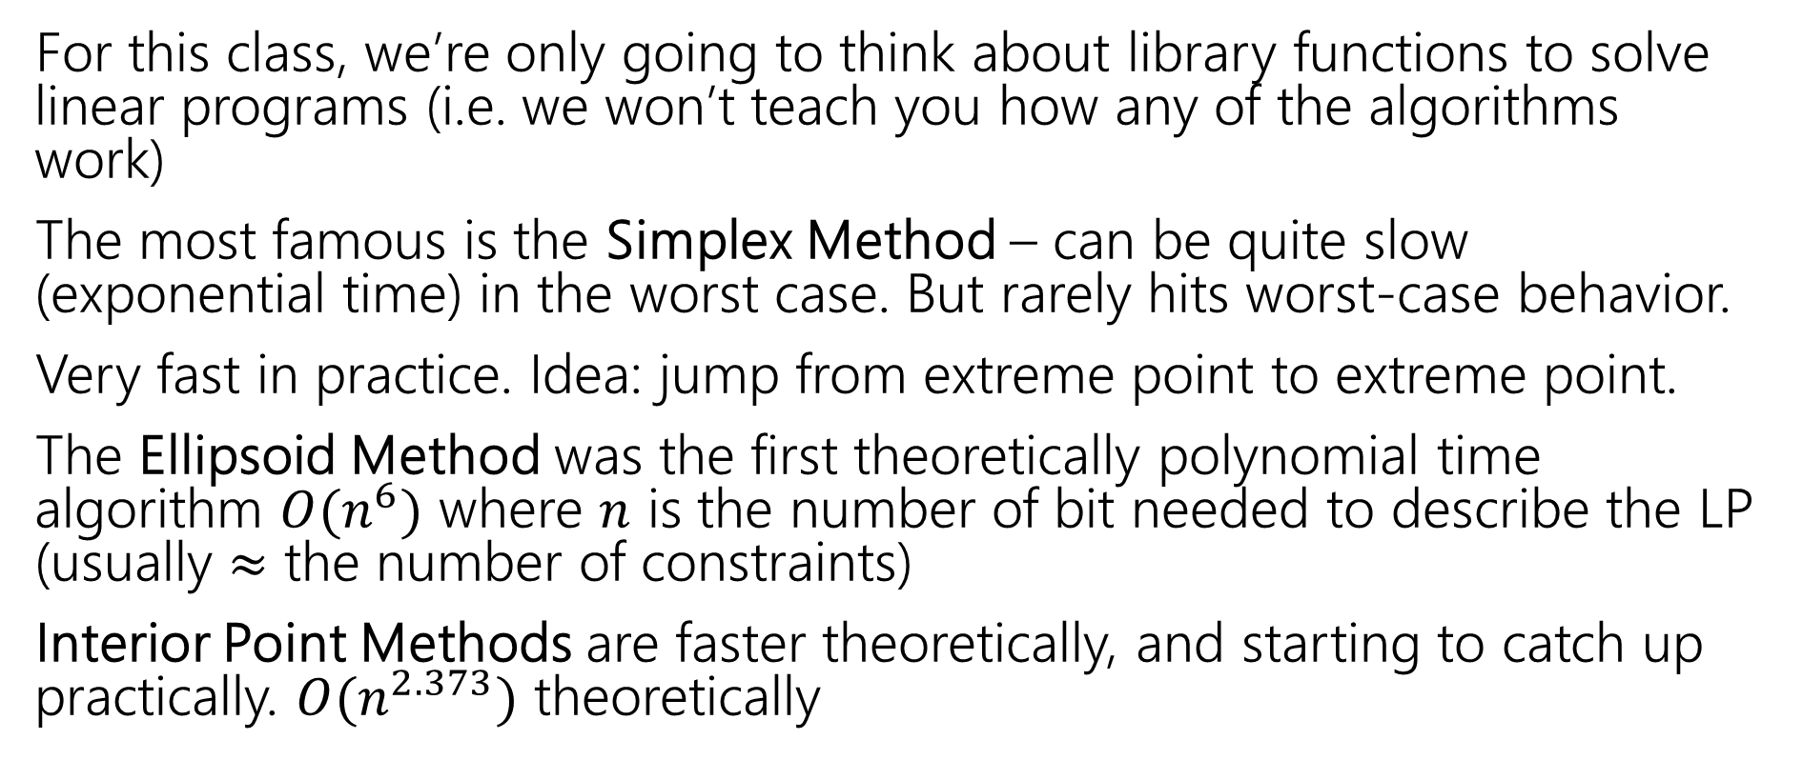
Solving LPs
For this class, we’re only going to think about library functions to solve linear programs (i.e. we won’t teach you how any of the algorithms work)
The most famous is the Simplex Method – can be quite slow (exponential time) in the worst case. But rarely hits worst-case behavior.
Very fast in practice. Idea: jump from extreme point to extreme point.
The Ellipsoid Method was the first theoretically polynomial time algorithm $O(n^{6})$ where $n$ is the number of bit needed to describe the LP (usually $≈$ the number of constraints)
Interior Point Methods are faster theoretically, and starting to catch up practically. $O(n^{2.373})$ theoretically

Slide 21
Another Question
Change the problem
Instead of infinitely divisible dirt…
What if instead we’re moving whole unit things (the dirt is in bags we can’t open or we’re moving bikes or plants or anything else that can’t be split)
Or if we’re assigning people to shifts (can have 1/3 of a person on a shift)
Well, the constraints will change (your “demand” and “supplies” will be integers)

Slide 22
Non-Integrality
Some linear programs only have optimal solutions that have some (or all) variables as non-integers (even with only integers in the objective function and constraints).
For dirt or water or anything arbitrarily divisible, no big deal!
For cell phones or bicycles…only possibly a big deal!
  In practice: if the optimal thing to manufacture 999,999.8 widgets per day, rounding up or down probably isn’t going to make a huge difference in your profits.
  But sometimes rounding isn’t ok…

Slide 23
What do you do if you need integers?
Integer Programs are linear programs where you can mark some variables as needing to be integers.
In practice – often still solvable (Excel also has a solver for these problems). But no longer guaranteed to be efficient.
Lots of theory has been done for when the optimum will be all integers. (MATH 407 or MATH 514)
But sometimes you get a fractional solution…what can you do?

Slide 24
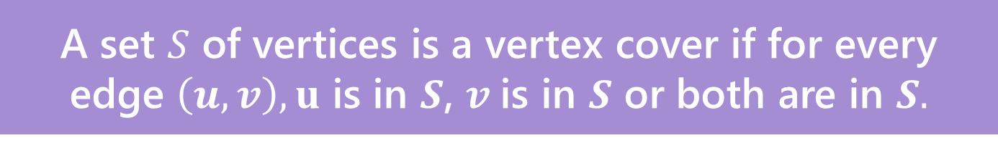
A nicer example
Sometimes we can round fractional solutions into integral ones.
Minimum Weight Vertex Cover
We’ve seen how to solve the problem with DP on trees.
Let’s try it now with linear programming.
A set $S$ of vertices is a vertex cover if for every edge $\left(u,v\right), u$ is in $S$, $v$is in $S$ or both are in $S.$

Slide 25

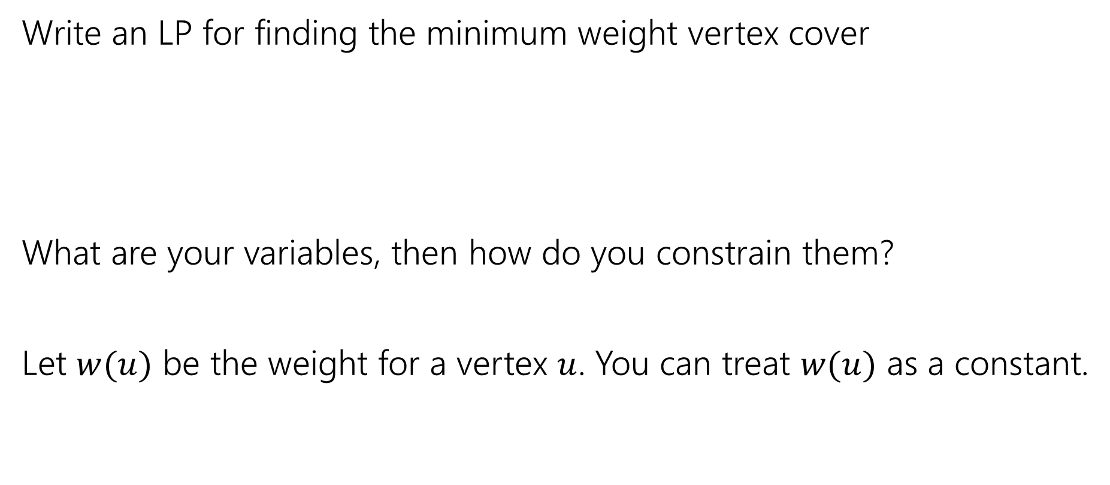
Vertex Cover LP
Pollev.com/robbie
Write an LP for finding the minimum weight vertex cover
What are your variables, then how do you constrain them?
Let $w(u)$ be the weight for a vertex $u$. You can treat $w(u)$ as a constant.
A set $S$ of vertices is a vertex cover if for every edge $\left(u,v\right), u$ is in $S$, $v$is in $S$ or both are in $S.$

Slide 26

Vertex Cover LP
Minimize $∑w\left(u\right)⋅x_{u}$
Subject to:
$x_{u}+x_{v}≥1$ for all $\left(u,v\right)∈E$
$0≤x_{u}≤1$ for all $u$.

Slide 27

Integrality
We need an integral solution
Having $\frac{1}{3}$ of $u$ in the set doesn’t make sense.
How do we make the variables integral?

Slide 28
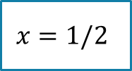



What do we do
Let’s try an example first
Suppose your LP gave you this solution on this graph. How would you round it (i.e. convert to a valid vertex cover)?
1
1
1
1
$$x=1/2$$
$$x=1/2$$
$$x=1/2$$
$$x=1/2$$

Slide 29
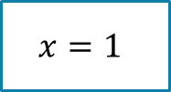
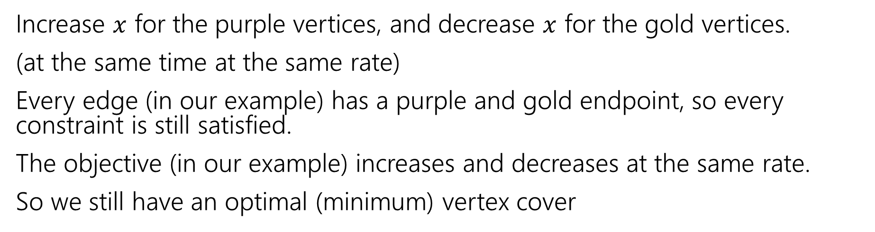
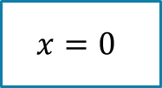
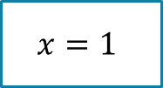

What do we do
Increase $x$ for the purple vertices, and decrease $x$ for the gold vertices.
(at the same time at the same rate)
Every edge (in our example) has a purple and gold endpoint, so every constraint is still satisfied.
The objective (in our example) increases and decreases at the same rate.
So we still have an optimal (minimum) vertex cover
1
1
1
1
$$x=1$$
$$x=0$$
$$x=1$$
$$x=0$$

Slide 30
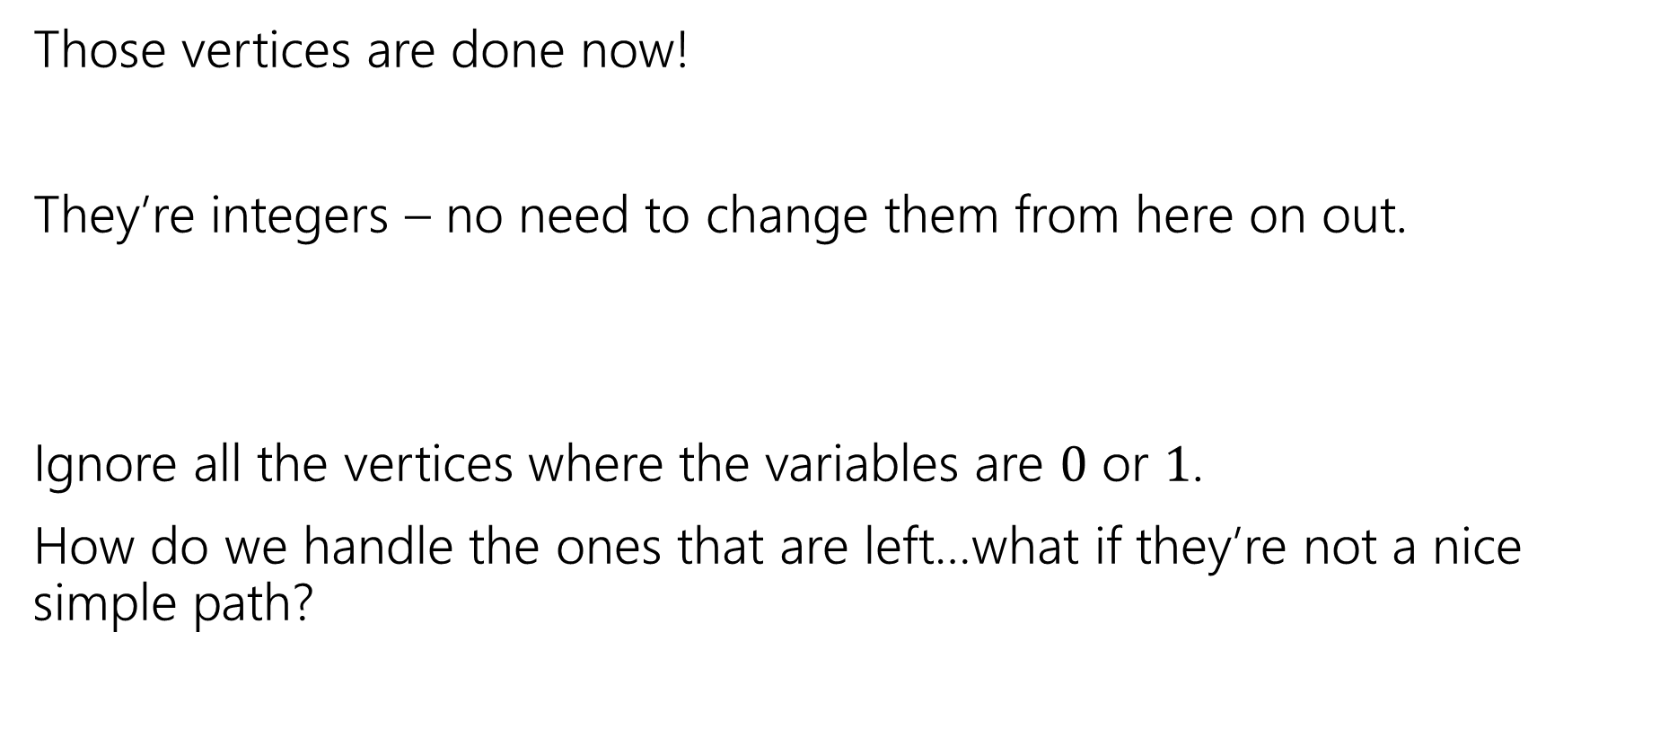
What do we do
Those vertices are done now!
They’re integers – no need to change them from here on out.
Ignore all the vertices where the variables are $0$ or $1$.
How do we handle the ones that are left…what if they’re not a nice simple path?

Slide 31
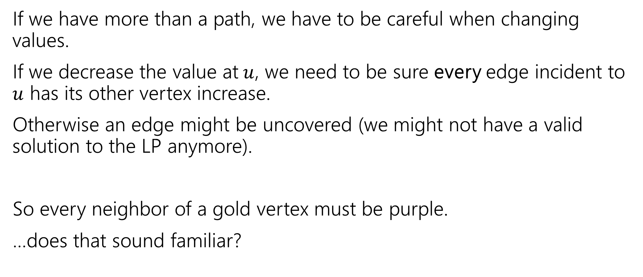
In General
If we have more than a path, we have to be careful when changing values.
If we decrease the value at$u$, we need to be sure every edge incident to $u$ has its other vertex increase.
Otherwise an edge might be uncovered (we might not have a valid solution to the LP anymore).
So every neighbor of a gold vertex must be purple.
…does that sound familiar?

Slide 32
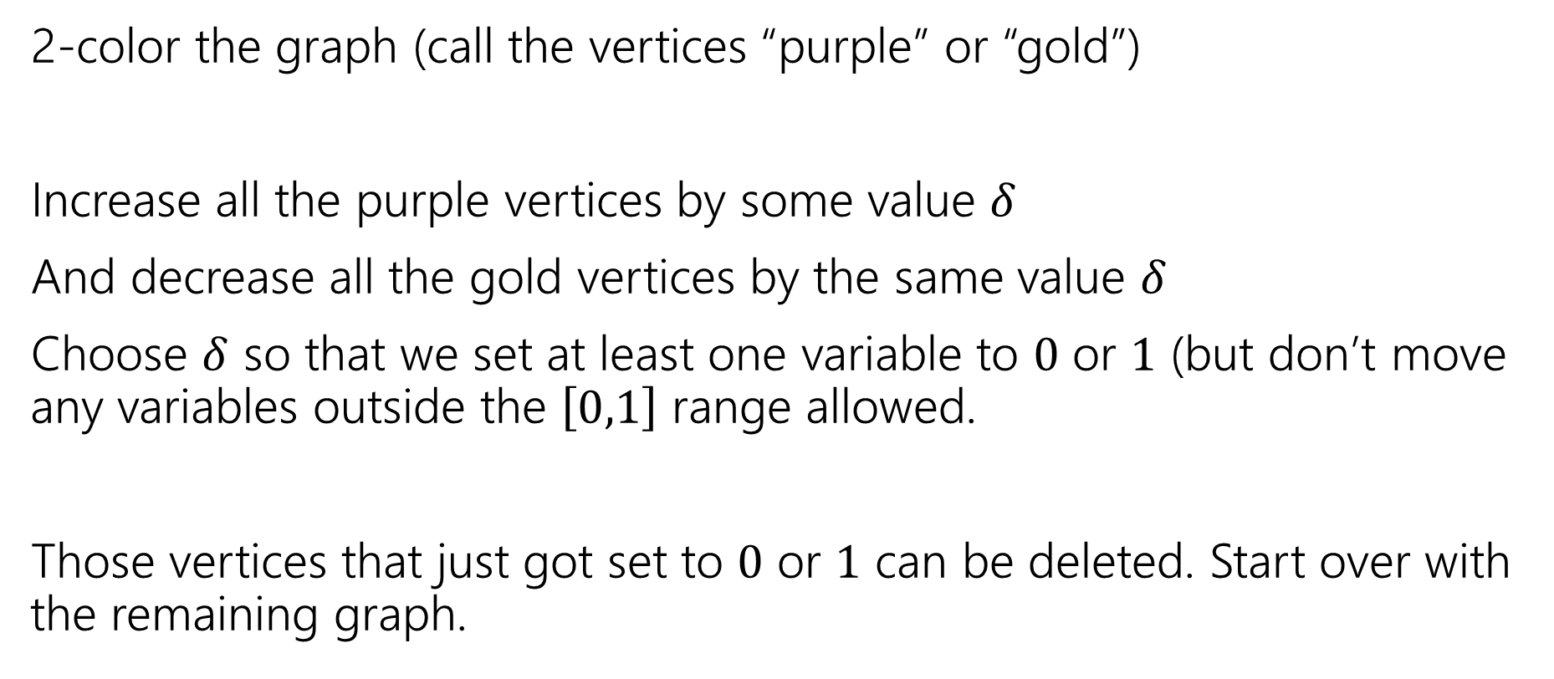
In General…
2-color the graph (call the vertices “purple” or “gold”)
Increase all the purple vertices by some value $δ$
And decrease all the gold vertices by the same value $δ$
Choose $δ$ so that we set at least one variable to $0$ or $1$ (but don’t move any variables outside the $\left[0,1\right]$ range allowed.
Those vertices that just got set to $0$ or $1$ can be deleted. Start over with the remaining graph.

Slide 33
In General…
But wait!
What if we’re increasing the objective value? (i.e. what if there’s more weight on the purple vertices than gold).
We won’t increase:
If we were, then switch purple and gold. Then we’d be decreasing the objective…but we were at the minimum!
So we’re really getting a minimum vertex cover.

Slide 34
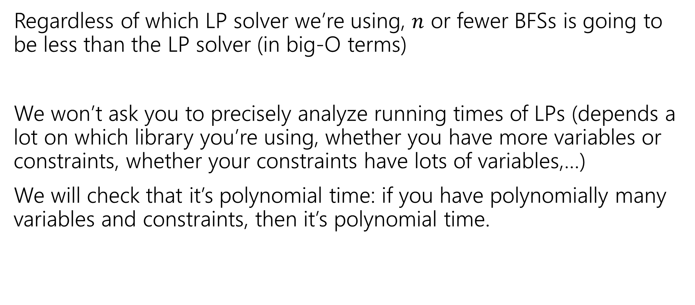
Running Time
Regardless of which LP solver we’re using, $n$ or fewer BFSs is going to be less than the LP solver (in big-O terms)
We won’t ask you to precisely analyze running times of LPs (depends a lot on which library you’re using, whether you have more variables or constraints, whether your constraints have lots of variables,…)
We will check that it’s polynomial time: if you have polynomially many variables and constraints, then it’s polynomial time.

Slide 35

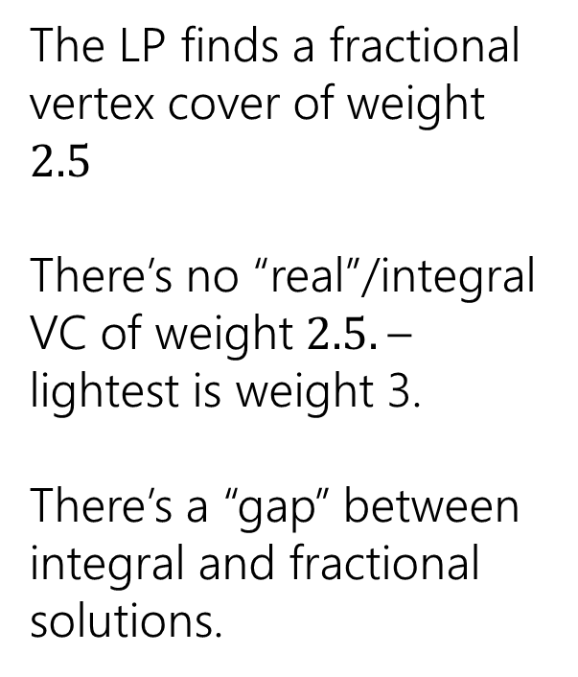
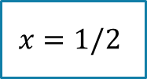

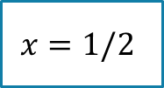

Non-Bipartite
We needed the graph to be bipartite to be able to 2-color it.
What if our original graph isn’t bipartite?
The LP finds a fractional vertex cover of weight $2.5$
There’s no “real”/integral VC of weight $2.5.$– lightest is weight 3.
There’s a “gap” between integral and fractional solutions.
1
1
$$x=1/2$$
1
$$x=1/2$$
$$x=1/2$$
1
1
$$x=1/2$$
$$x=1/2$$

Slide 36
Summary
With dynamic programming, we could find the minimum weight vertex cover on trees.
With linear programming, we can find the minimum weight vertex cover on any bipartite graph (trees and other graphs!).
But LPs don’t always give you a fractional solution that’s helpful for finding an integral one. On non-bipartite graphs, we’ll need to do something else. (More in a few weeks).

