Slide 1
Graph DP
Mid-Quarter Summary
CSE 421 22AU
Lecture 17

Slide 2
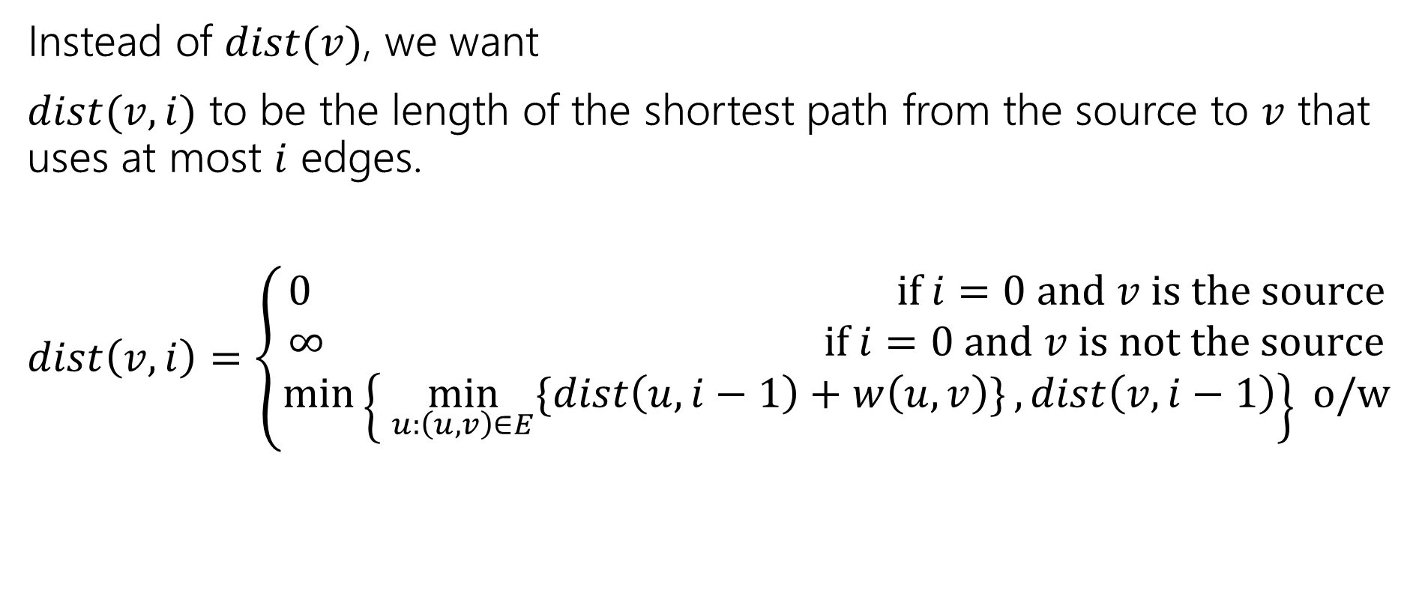
Ordering
Instead of $dist(v)$, we want
$dist(v,i)$ to be the length of the shortest path from the source to $v$ that uses at most $i$ edges.
$dist\left(v,i\right)=\left\{\begin{aligned}0 if i=0 and v is the source \\ ∞ if i=0 and v is not the source \\ \min\left\{\min_{u:\left(u,v\right)∈E}{\{dist\left(u,i−1\right)+w\left(u,v\right)\}}, dist\left(v,i−1\right)\right\} o/w\end{aligned}\right.$

Slide 3
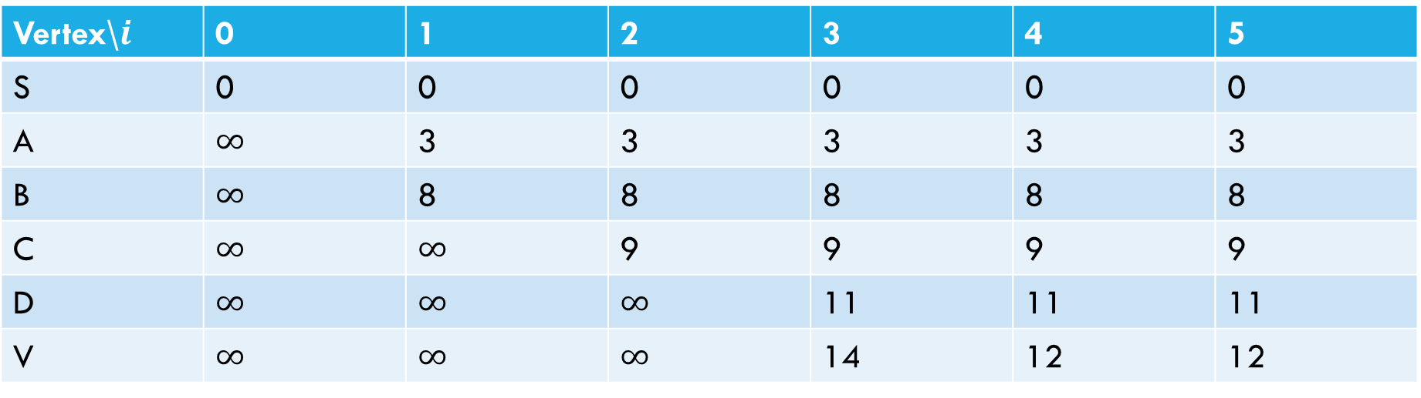
Sample calculation
6
a
5
3
c
v
3
2
s
1
8
b
d
4
Vertex\$i$ | 0 | 1 | 2 | 3 | 4 | 5
S | 0 | 0 | 0 | 0 | 0 | 0
A | $∞$ | 3 | 3 | 3 | 3 | 3
B | $∞$ | 8 | 8 | 8 | 8 | 8
C | $∞$ | $∞$ | 9 | 9 | 9 | 9
D | $∞$ | $∞$ | $∞$ | 11 | 11 | 11
V | $∞$ | $∞$ | $∞$ | 14 | 12 | 12

Slide 4
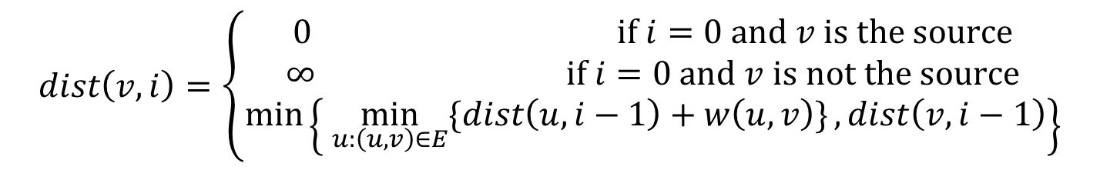
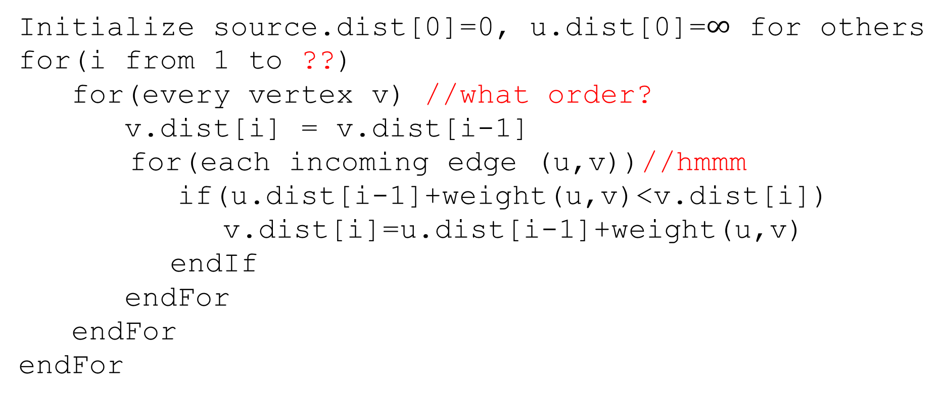
Pseudocode
Initialize source.dist[0]=0, u.dist[0]=$∞$ for others
for(i from 1 to ??)
for(every vertex v) //what order?
v.dist[i] = v.dist[i-1]
for(each incoming edge (u,v))//hmmm
if(u.dist[i-1]+weight(u,v)<v.dist[i])
v.dist[i]=u.dist[i-1]+weight(u,v)
endIf
endFor
endFor
endFor
$$dist\left(v,i\right)=\left\{\begin{aligned}0 if i=0 and v is the source \\ ∞ if i=0 and v is not the source \\ \min\left\{\min_{u:\left(u,v\right)∈E}{\{dist\left(u,i−1\right)+w\left(u,v\right)\}}, dist\left(v,i−1\right)\right\}\end{aligned}\right.$$

Slide 5

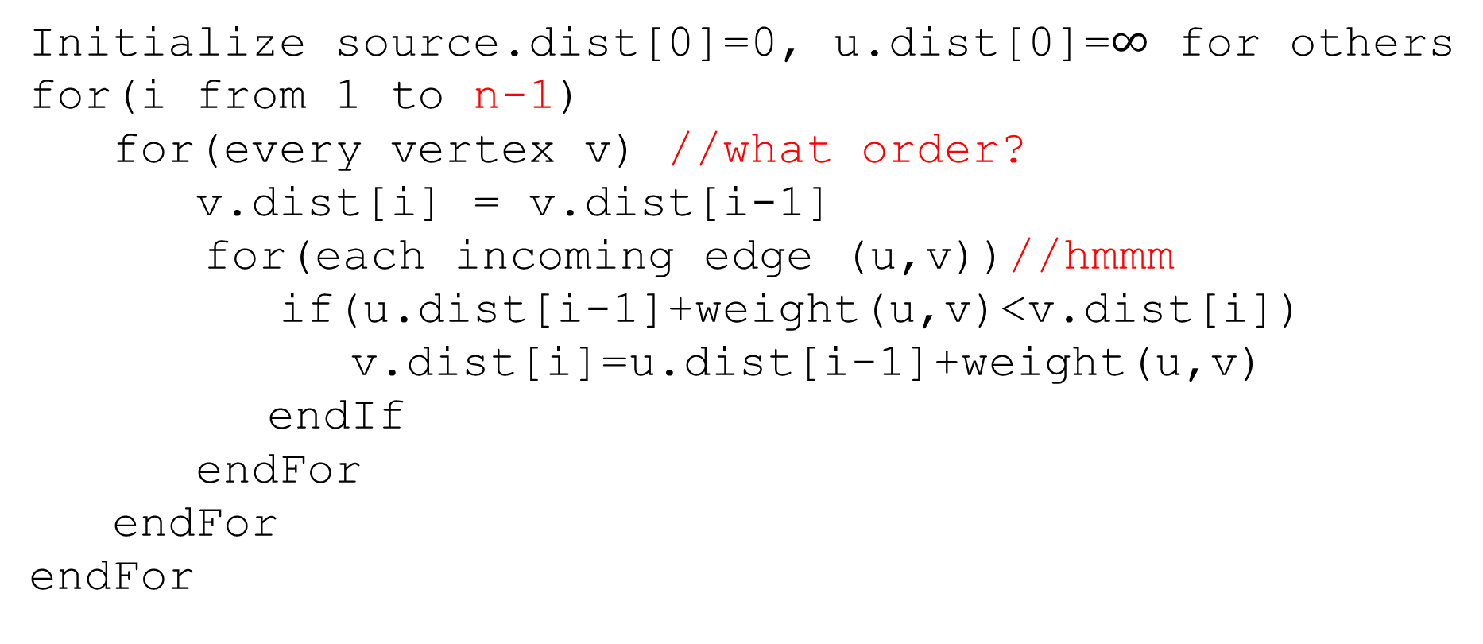
Pseudocode
Initialize source.dist[0]=0, u.dist[0]=$∞$ for others
for(i from 1 to n-1)
for(every vertex v) //what order?
v.dist[i] = v.dist[i-1]
for(each incoming edge (u,v))//hmmm
if(u.dist[i-1]+weight(u,v)<v.dist[i])
v.dist[i]=u.dist[i-1]+weight(u,v)
endIf
endFor
endFor
endFor
The shortest path will never need more than $n−1$ edges
(more than that and you’ve got a cycle)

Slide 6
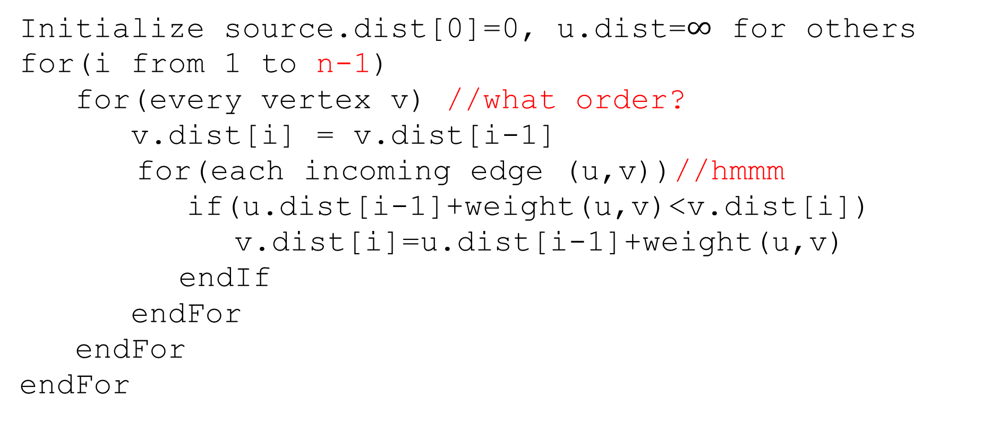
Pseudocode
Only ever need values from the previous iteration
Order doesn’t matter!!
Initialize source.dist[0]=0, u.dist=$∞$ for others
for(i from 1 to n-1)
for(every vertex v) //what order?
v.dist[i] = v.dist[i-1]
for(each incoming edge (u,v))//hmmm
if(u.dist[i-1]+weight(u,v)<v.dist[i])
v.dist[i]=u.dist[i-1]+weight(u,v)
endIf
endFor
endFor
endFor

Slide 7
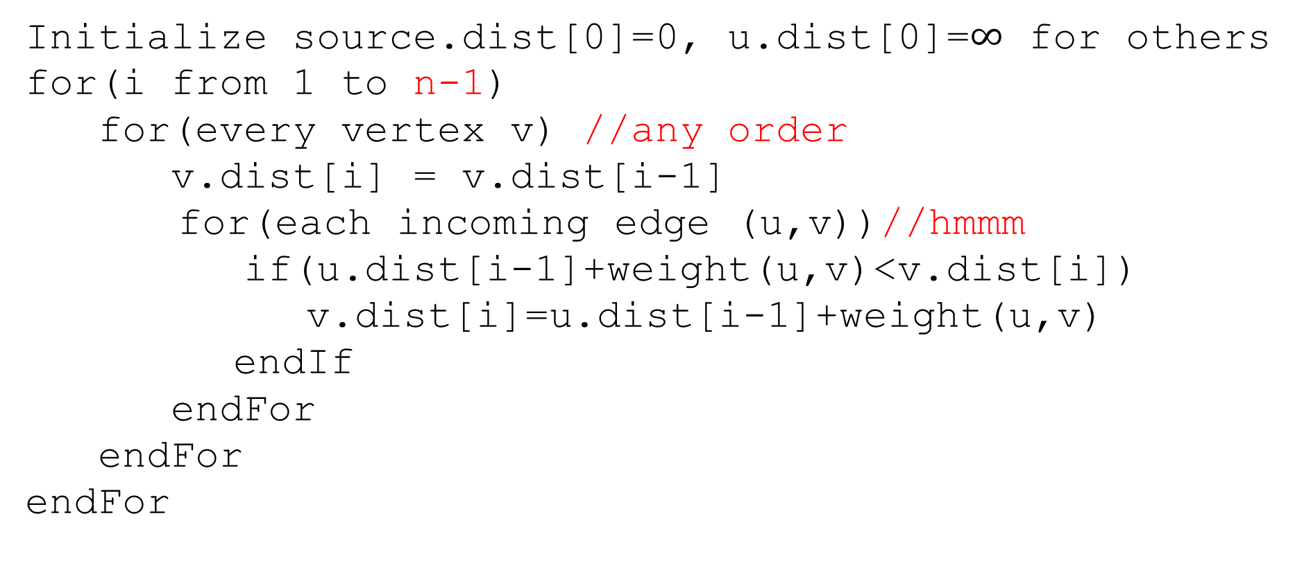
Pseudocode
Initialize source.dist[0]=0, u.dist[0]=$∞$ for others
for(i from 1 to n-1)
for(every vertex v) //any order
v.dist[i] = v.dist[i-1]
for(each incoming edge (u,v))//hmmm
if(u.dist[i-1]+weight(u,v)<v.dist[i])
v.dist[i]=u.dist[i-1]+weight(u,v)
endIf
endFor
endFor
endFor
Graphs don’t usually have easy access to their incoming edges (just the outgoing ones)

Slide 8
Pseudocode
Initialize source.dist[0]=0, u.dist[0]=$∞$ for others
for(i from 1 to n-1)
for(every vertex v) //any order
v.dist[i] = v.dist[i-1]
for(each incoming edge (u,v))//hmmm
if(u.dist[i-1]+weight(u,v)<v.dist[i])
v.dist[i]=u.dist[i-1]+weight(u,v)
endIf
endFor
endFor
endFor
But the order doesn’t matter – as long as we check every edge, the processing order is irrelevant.
So if we only have access to outgoing edges…

Slide 9
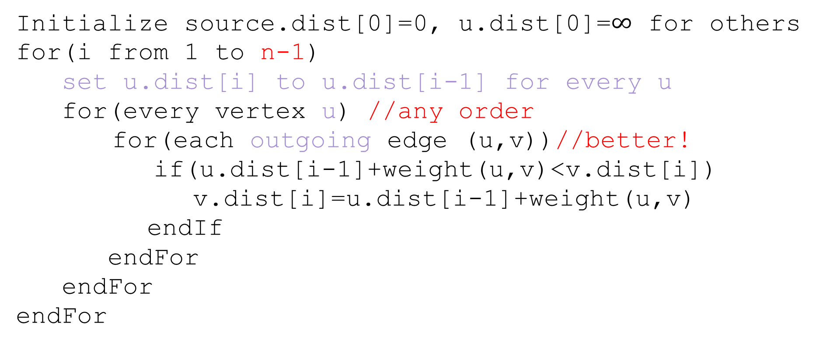
Pseudocode
Initialize source.dist[0]=0, u.dist[0]=$∞$ for others
for(i from 1 to n-1)
set u.dist[i] to u.dist[i-1] for every u
for(every vertex u) //any order
for(each outgoing edge (u,v))//better!
if(u.dist[i-1]+weight(u,v)<v.dist[i])
v.dist[i]=u.dist[i-1]+weight(u,v)
endIf
endFor
endFor
endFor

Slide 10
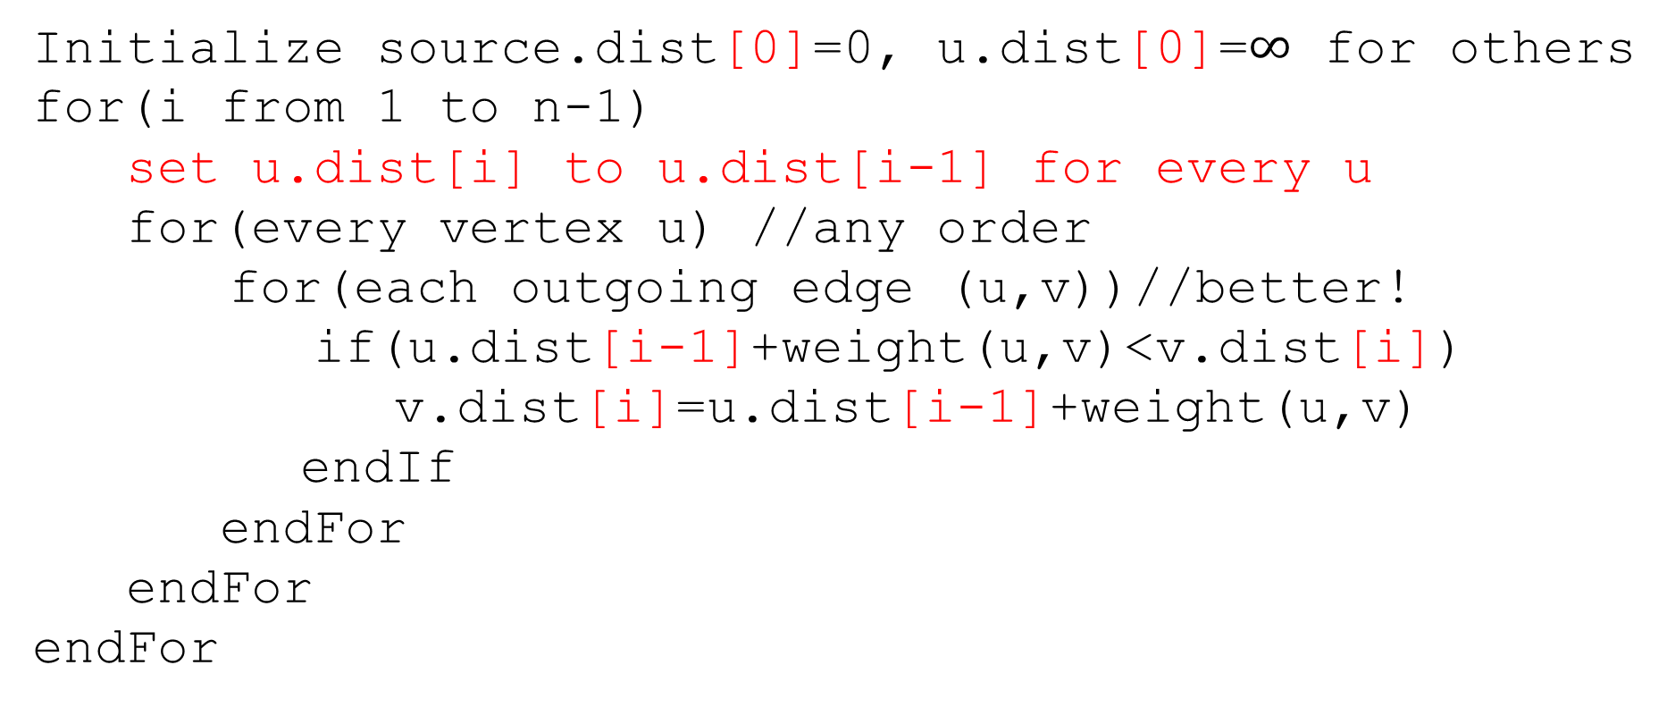
Pseudocode
Initialize source.dist[0]=0, u.dist[0]=$∞$ for others
for(i from 1 to n-1)
set u.dist[i] to u.dist[i-1] for every u
for(every vertex u) //any order
for(each outgoing edge (u,v))//better!
if(u.dist[i-1]+weight(u,v)<v.dist[i])
v.dist[i]=u.dist[i-1]+weight(u,v)
endIf
endFor
endFor
endFor
We don’t really need all the different values…
Just the most recent value.

Slide 11
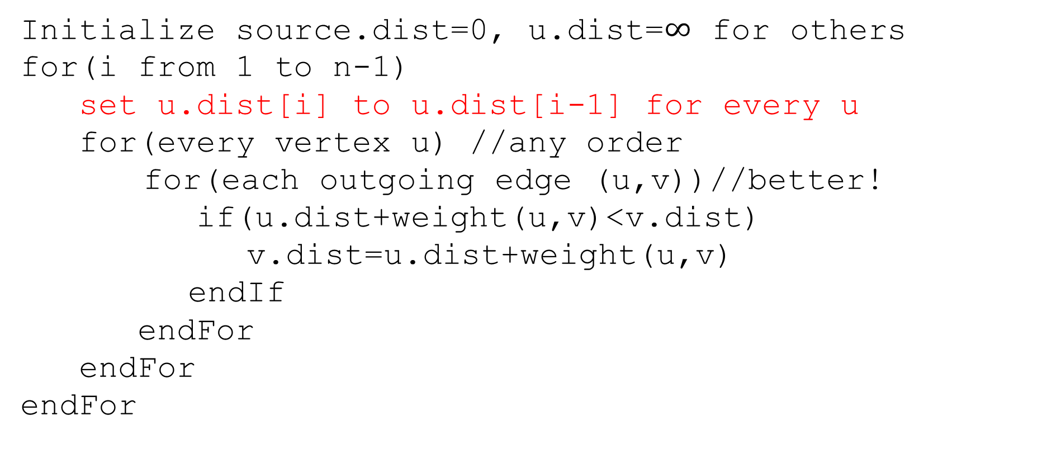
Pseudocode
Initialize source.dist=0, u.dist=$∞$ for others
for(i from 1 to n-1)
set u.dist[i] to u.dist[i-1] for every u
for(every vertex u) //any order
for(each outgoing edge (u,v))//better!
if(u.dist+weight(u,v)<v.dist)
v.dist=u.dist+weight(u,v)
endIf
endFor
endFor
endFor
We don’t really need all the different values…
Just the most recent value.

Slide 12
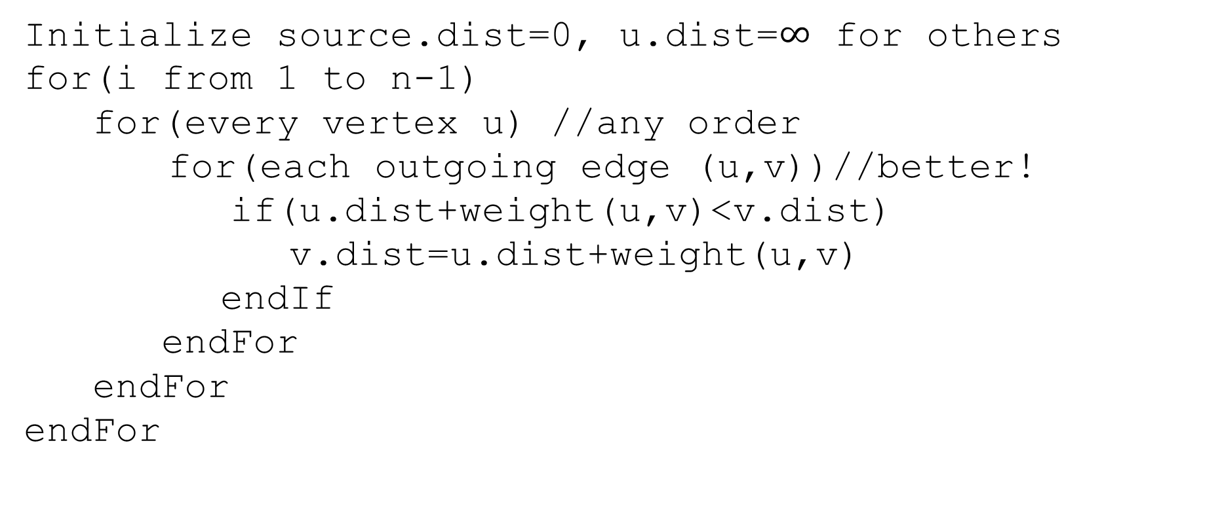
Pseudocode
Initialize source.dist=0, u.dist=$∞$ for others
for(i from 1 to n-1)
for(every vertex u) //any order
for(each outgoing edge (u,v))//better!
if(u.dist+weight(u,v)<v.dist)
v.dist=u.dist+weight(u,v)
endIf
endFor
endFor
endFor
We don’t really need all the different values…
Just the most recent value.

Slide 13
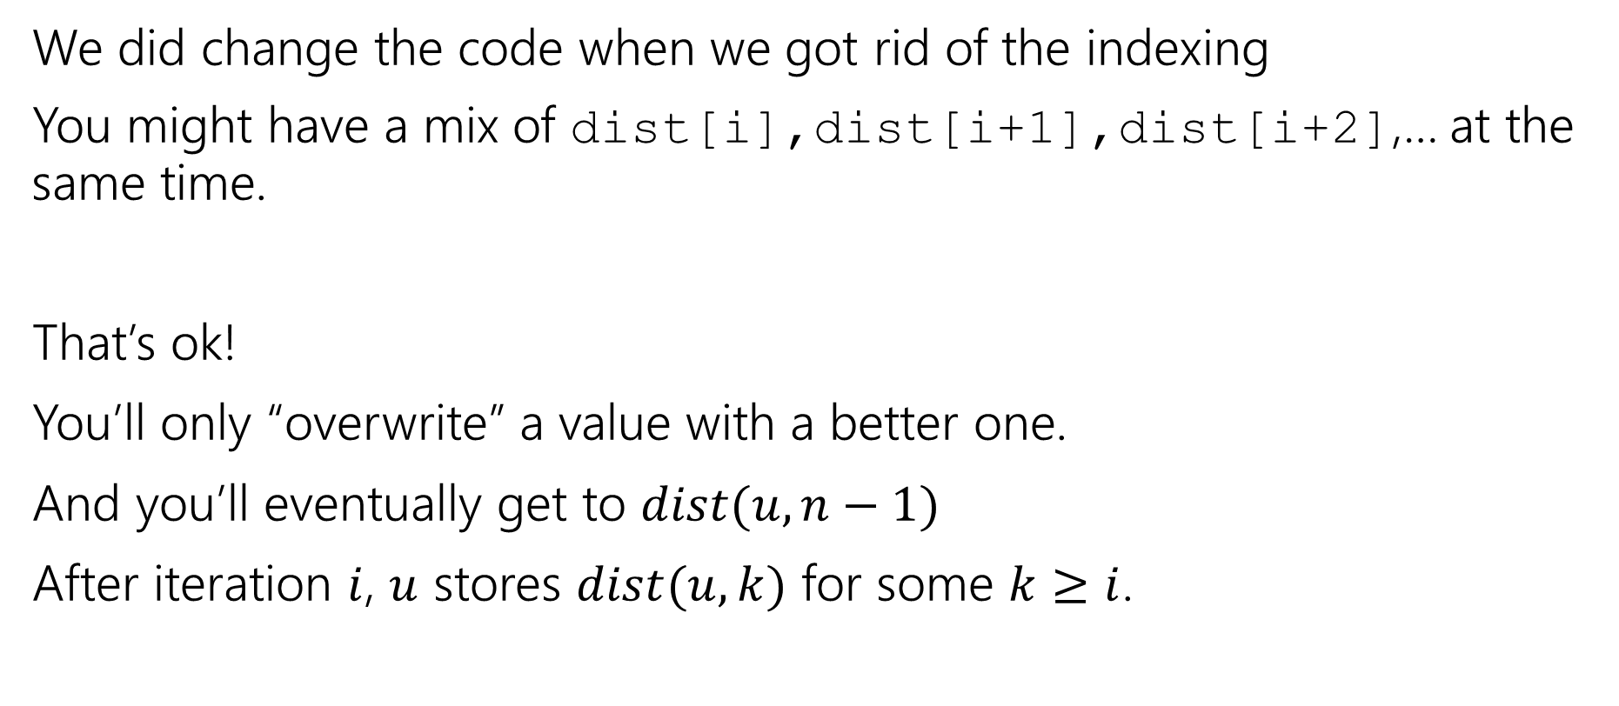
A Caution
We did change the code when we got rid of the indexing
You might have a mix of dist[i],dist[i+1],dist[i+2],… at the same time.
That’s ok!
You’ll only “overwrite” a value with a better one.
And you’ll eventually get to $dist(u,n−1)$
After iteration $i$, $u$ stores $dist(u,k)$ for some $k≥i$.

Slide 14
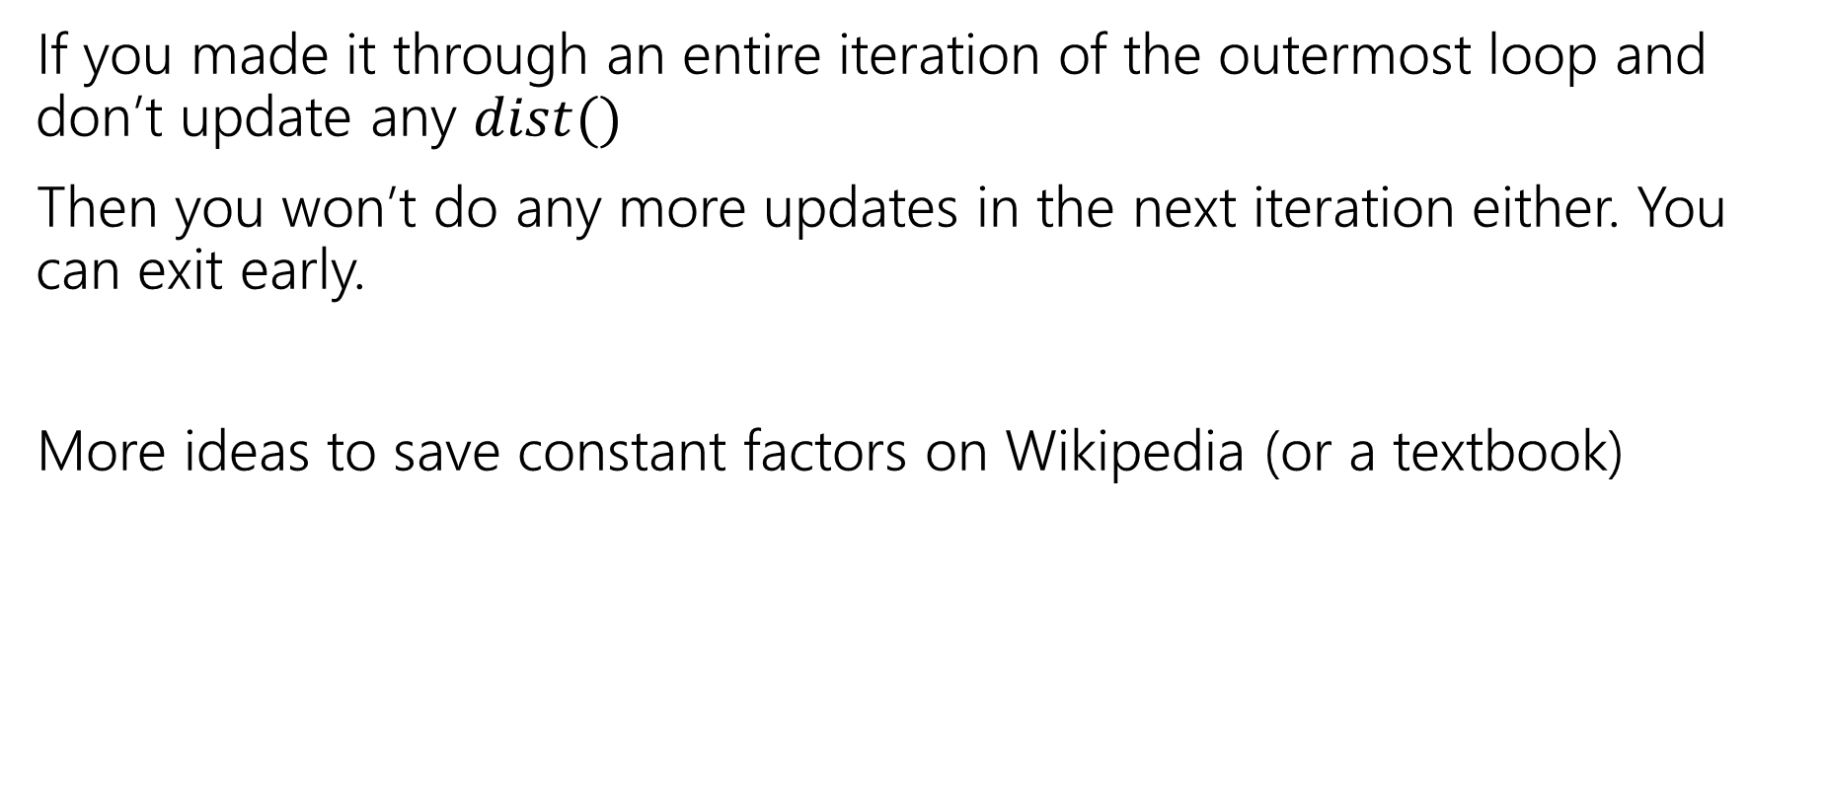
Exit early
If you made it through an entire iteration of the outermost loop and don’t update any $dist()$
Then you won’t do any more updates in the next iteration either. You can exit early.
More ideas to save constant factors on Wikipedia (or a textbook)
Notes:
Observe that if v’s distance doesn’t change then we don’t need to check (v,w) for any w. Some other clever ideas on Wikipedia.

Slide 15
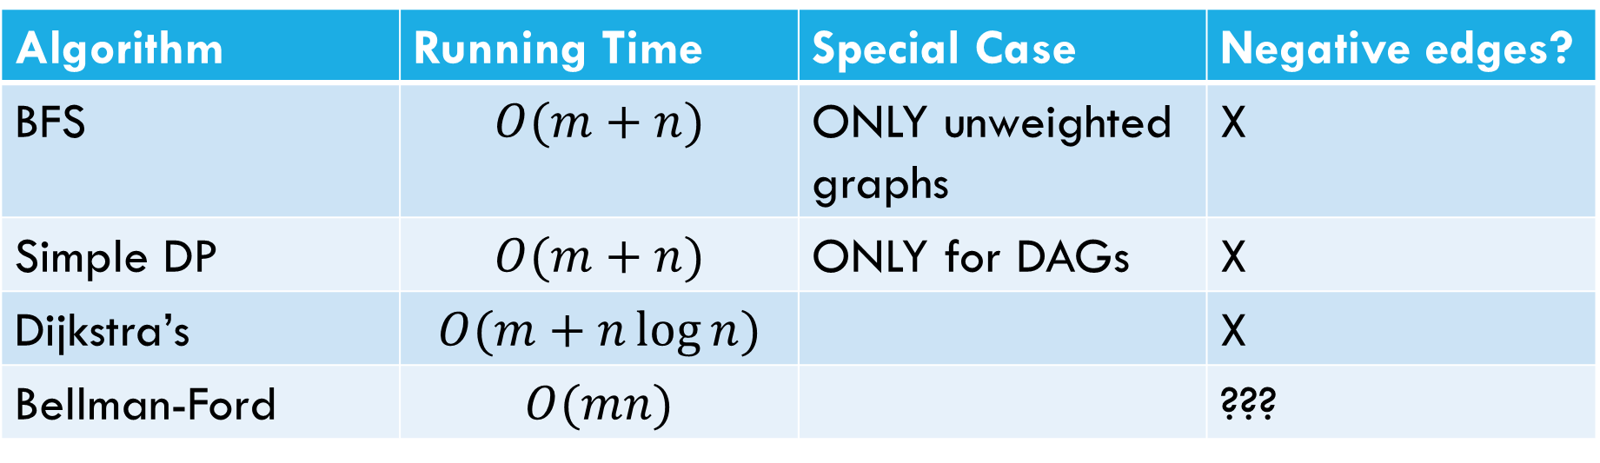
Laundry List of shortest pairs (so far)
Algorithm | Running Time | Special Case | Negative edges?
BFS | $$O(m+n)$$ | ONLY unweighted graphs | X
Simple DP | $$O(m+n)$$ | ONLY for DAGs | X
Dijkstra’s | $$O(m+n\log{n)}$$ |  | X
Bellman-Ford | $$O(mn)$$ |  | ???

Slide 16
Pseudocode
Initialize source.dist=0, u.dist=$∞$ for others
for(i from 1 to n-1)
for(every vertex u) //any order
for(each outgoing edge (u,v))//better!
if(u.dist+weight(u,v)<v.dist)
v.dist=u.dist+weight(u,v)
endIf
endFor
endFor
endFor
What happens if there’s a negative cycle?

Slide 17
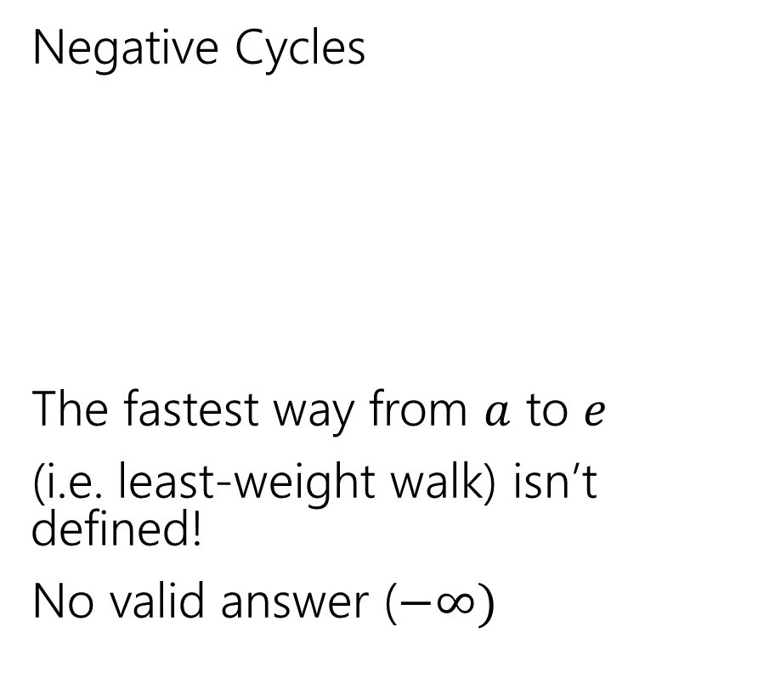
Negative Edges
Negative Cycles
The fastest way from $a$ to $e$
(i.e. least-weight walk) isn’t defined!
No valid answer ($−∞)$
Negative edges, but only non-negative cycles
Dijkstra’s might fail
But the shortest path IS defined.
There is an answer
a
6
5
c
e
a
6
5
c
e
3
2
3
2
1
b
d
1
-8
b
d
-3

Slide 18
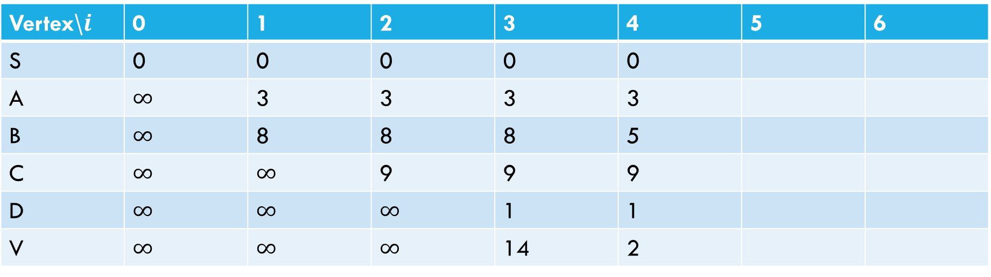
Negative Cycle
Pollev.com/Robbie
6
a
5
3
c
v
3
-8
s
1
8
b
d
4
Vertex\$i$ | 0 | 1 | 2 | 3 | 4 | 5 | 6
S | 0 | 0 | 0 | 0 | 0
A | $∞$ | 3 | 3 | 3 | 3
B | $∞$ | 8 | 8 | 8 | 5
C | $∞$ | $∞$ | 9 | 9 | 9
D | $∞$ | $∞$ | $∞$ | 1 | 1
V | $∞$ | $∞$ | $∞$ | 14 | 2

Slide 19
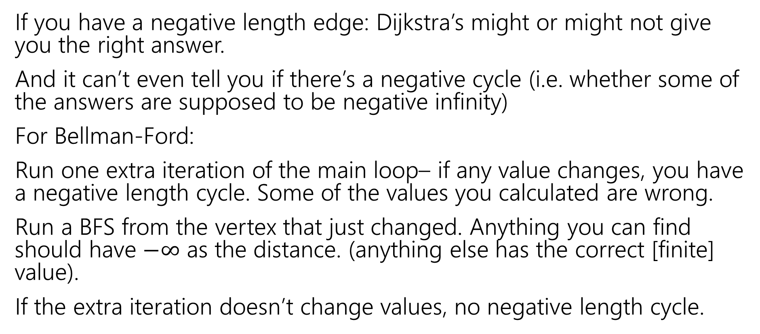
Negative Cycles
If you have a negative length edge: Dijkstra’s might or might not give you the right answer.
And it can’t even tell you if there’s a negative cycle (i.e. whether some of the answers are supposed to be negative infinity)
For Bellman-Ford:
Run one extra iteration of the main loop– if any value changes, you have a negative length cycle. Some of the values you calculated are wrong.
Run a BFS from the vertex that just changed. Anything you can find should have $−∞$ as the distance. (anything else has the correct [finite] value).
If the extra iteration doesn’t change values, no negative length cycle.

Slide 20
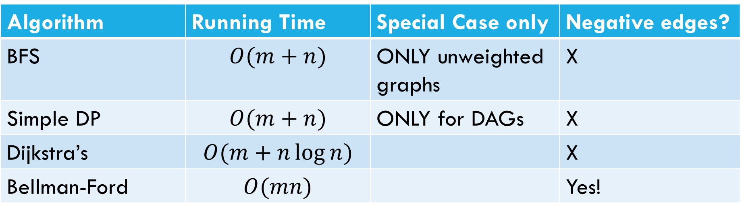
Laundry List of shortest pairs (so far)
Algorithm | Running Time | Special Case only | Negative edges?
BFS | $$O(m+n)$$ | ONLY unweighted graphs | X
Simple DP | $$O(m+n)$$ | ONLY for DAGs | X
Dijkstra’s | $$O(m+n\log{n)}$$ |  | X
Bellman-Ford | $$O(mn)$$ |  | Yes!

Slide 21
All Pairs Shortest Paths

Slide 22
All Pairs
For Dijkstra’s or Bellman-Ford we got the distances from the source to every vertex.
What if we want the distances from every vertex to every other vertex?

Slide 23
All Pairs
For Dijkstra’s or Bellman-Ford we got the distances from the source to every vertex.
What if we want the distances from every vertex to every other vertex?
Why? Most commonly pre-computation.
Imagine you’re google maps – you could run Dijkstra’s every time anyone anywhere asks for directions…
Or store how to get between transit hubs and only use Dijkstra’s locally.

Slide 24
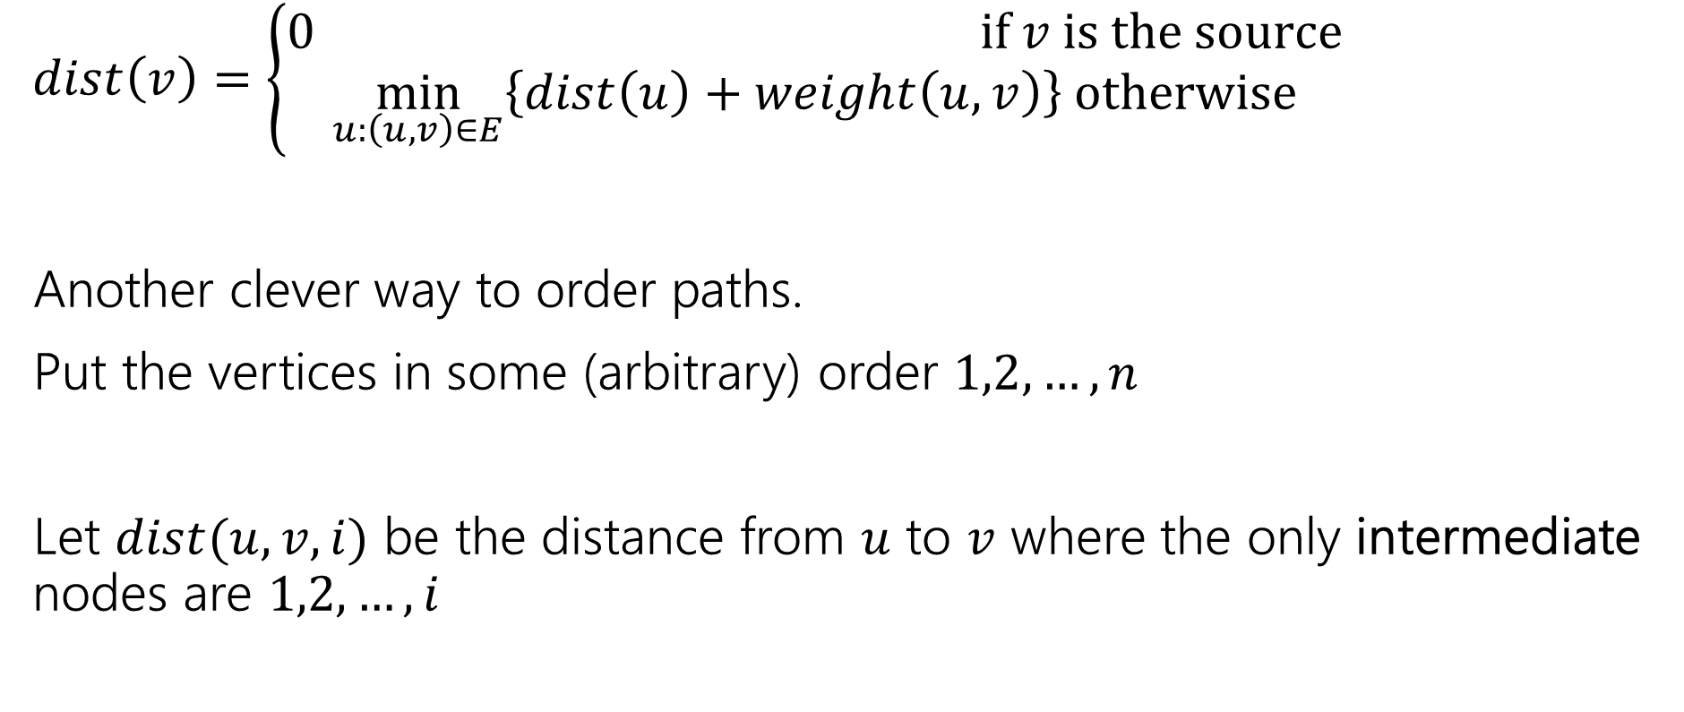
Another Recurrence
$dist\left(v\right)=\left\{\begin{aligned}0 if v is the source \\ \min_{u:\left(u,v\right)∈E}\left\{dist\left(u\right)+weight\left(u,v\right)\right\} otherwise\end{aligned}\right.$
Another clever way to order paths.
Put the vertices in some (arbitrary) order $1,2,…,n$
Let $dist(u,v,i)$ be the distance from $u$ to $v$ where the only intermediate nodes are $1,2,…,i$

Slide 25
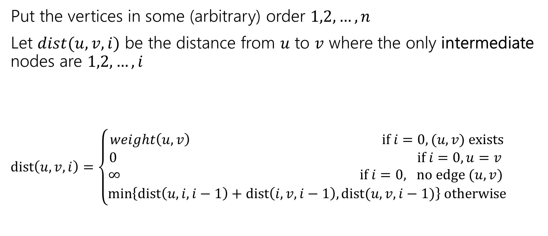
Another Recurrence
Put the vertices in some (arbitrary) order $1,2,…,n$
Let $dist(u,v,i)$ be the distance from $u$ to $v$ where the only intermediate nodes are $1,2,…,i$
$dist\left(u,v,i\right)=\left\{\begin{aligned}weight\left(u,v\right) if i=0, (u,v) exists \\ 0 if i=0, u=v \\ ∞ if i=0, no edge (u,v) \\ \min\left\{dist\left(u,i,i−1\right)+dist\left(i,v,i−1\right), dist(u,v,i−1)\right\} otherwise\end{aligned}\right.$

Slide 26

Pseudocode
dist[][] = new int[n-1][n-1]
for(int i=0; i<n; i++)
for(int j=0; j<n; j++)
dist[i][j] = edge(i,j) ? weight(i,j) : $∞$
for(int i=0; i<n; i++)
dist[i][i] = 0
for every vertex $r$
for every vertex $u$
for every vertex $v$
if(dist[u][r] + dist[r][v] < dist[u][v])
  dist[u][v]=dist[u][r] + dist[r][v]
“standard” form of the “Floyd-Warshall” algorithm. Similar to Bellman-Ford, you can get rid of the last entry of the recurrence (only need 2D array, not 3D array).

Slide 27

Running Time
$O\left(n^{3}\right)$
How does that compare to Dijkstra’s?

Slide 28
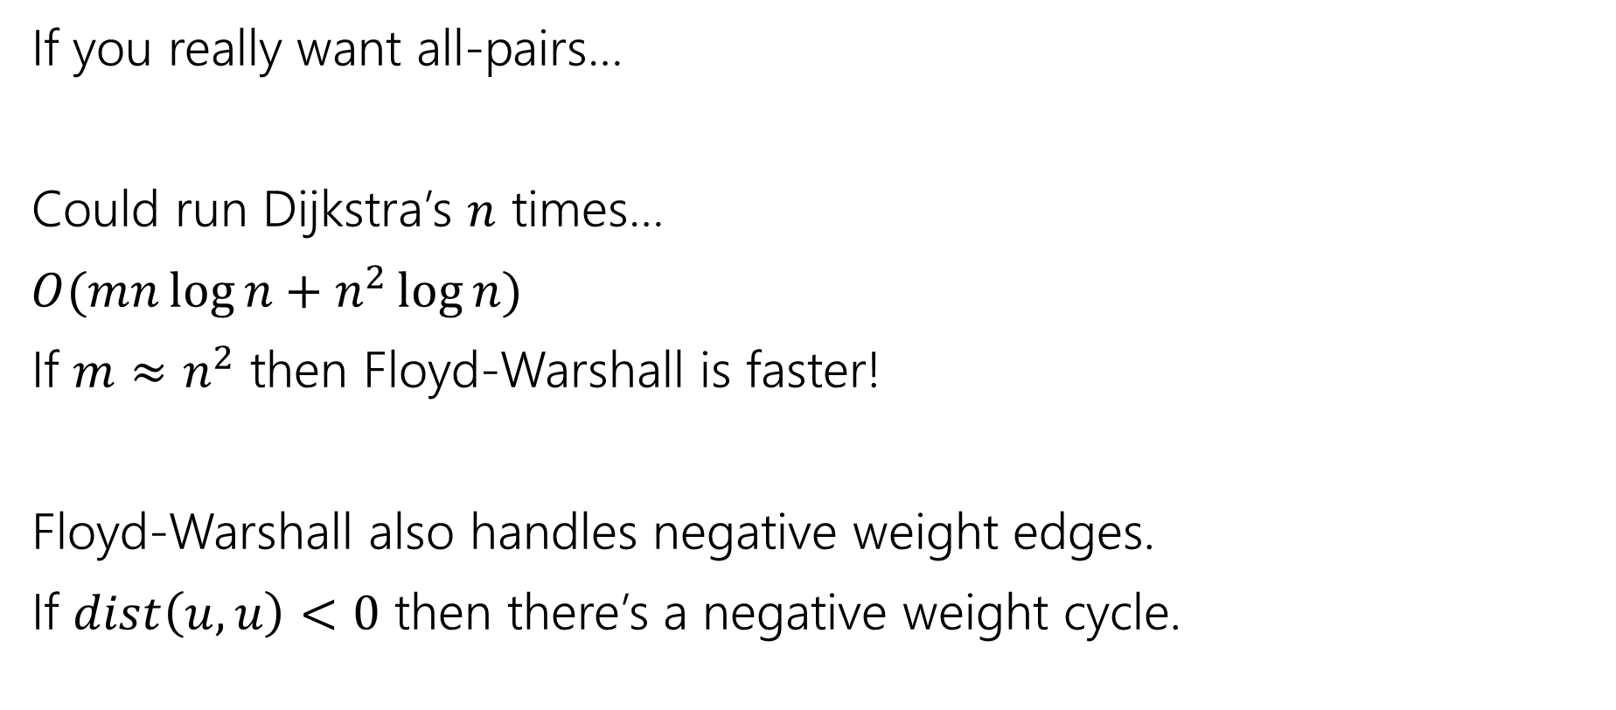
Running Time
If you really want all-pairs…
Could run Dijkstra’s $n$ times…
$O(mn\log{n}+n^{2}\log{n})$
If $m≈n^{2}$ then Floyd-Warshall is faster!
Floyd-Warshall also handles negative weight edges.
If $dist\left(u,u\right)<0$ then there’s a negative weight cycle.

Slide 29
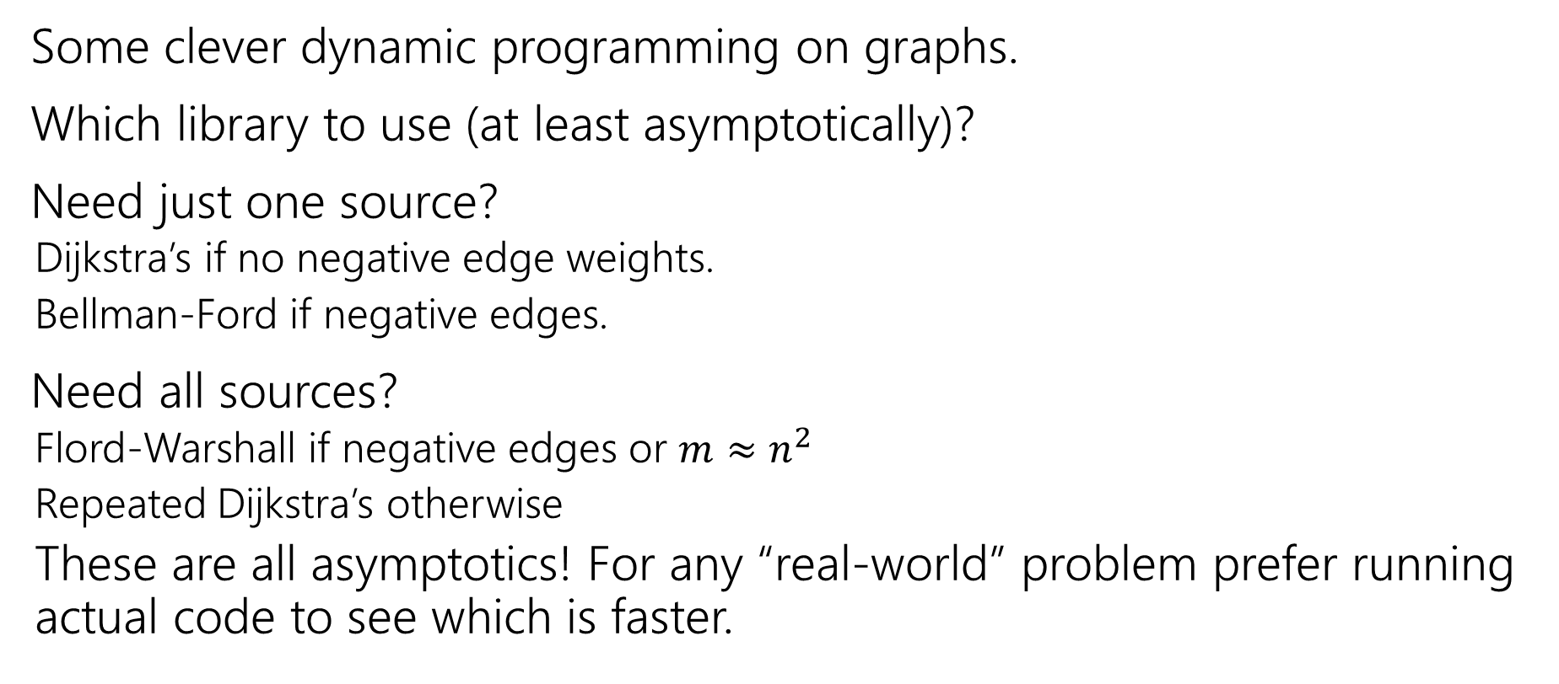
Takeaways
Some clever dynamic programming on graphs.
Which library to use (at least asymptotically)?
Need just one source?
  Dijkstra’s if no negative edge weights.
  Bellman-Ford if negative edges.
Need all sources?
  Flord-Warshall if negative edges or $m≈n^{2}$
  Repeated Dijkstra’s otherwise
  These are all asymptotics! For any “real-world” problem prefer running actual code to see which is faster.

Slide 30
DP Context

Slide 31
DP history
So…why is it called “dynamic programming?”
“programming” is an old-timey meaning of the word.
It means “scheduling”
Like a conference has a “program” of who speaks where when.
Or a television executive decides on the nightly programming (what show airs when).

Slide 32
DP history
So…dynamic?
The phrase “dynamic programming” was popularized by Richard Bellman.
He was a researcher, funded by the U.S. military….
But the Secretary of Defense [as Bellman tells it] hated research. And hated math even more.
So Bellman needed a description of his research that everyone would approve of.

Slide 33
DP history
Dynamic
Is actually an accurate adjective – what we think is the best option (include/exclude) can change over time.
Even better
“It’s impossible to use the word ‘dynamic’ in a pejorative sense”
“It was something not even a Congressman could object to.”

Slide 34
Techniques So Far

Slide 35
What have we seen so far?
Stable Matchings
Graph Search
  BFS/DFS
  Graph modeling
Greedy Algorithms
Divide and Conquer
Dynamic Programming

Slide 36
Stable Matchings
Modeling matters!
  It’s better to be a proposer than a chooser!
Algorithms can be used to prove ‘non-computational’ facts
  Stable Matchings always exist is easiest to prove by saying “here’s how to find one.”
Reductions
  Sometimes there’s a clever way to use an existing library (we’ll need these a lot later in the quarter).

Slide 37
Graph Search
BFS and DFS search through a graph differently
  So you can adapt them to solve different problems!
Use libraries
Finding SCCs and Topological sorting are “almost free” preprocessing
2-Coloring can be performed in linear time.

Slide 38
Greedy
Code is easy; proofs are hard.
Generating examples is extremely important.
To frame your thinking for proofs
  Greedy stays ahead
  Exchange argument
  Structural result

Slide 39
Divide and Conquer
Trust the recursion.
Don’t be afraid to change what the recursive call gives you!
  Add extra parameters!
State in English what the recursive call gives you.
In your “combine” step, make sure you’re beating baseline!

Slide 40
Dynamic Programming
Focus on solving the problem recursively; everything else is (mostly) formulaic once you’ve done that.
Write exactly the problem you’re solving in English.
It’s better to get down a “guess” at the problem and then see where you get stuck.
  Don’t be afraid to add a second recurrence or extra parameters.
Don’t try to cleverly figure out which option is best. Try them all.
  The magic of recursion tells you which is best for a particular situation.

Slide 41
How To Approach Problems
In section, we’ve made you follow these steps:
1. Read the problem carefully (make sure you know what problem you’re actually solving)
2. Make some sample inputs/outputs
3. Set a “baseline.”
4. Then try to generate the algorithm.
It’s hard to take the time to do these in an exam, but at least make sure you do #1. Solving the wrong problem is not good for test-taking.

