Slide 1
Still not done with DP
Hidden Parameters; Trees
CSE 421 22AU
Lecture 15

Slide 2
Midterm Information
Practice Midterm will be posted tonight, along with some other resources.
  Section Thursday will be “pick what problems you want to practice”
  Second-half of Friday’s lecture will be a “what have we seen so far?” review (not new problems, but at least a list of what you’ve seen).
  Monday, the TAs will spend the lecture slot answering questions on the practice midterm (or anything else you want to ask about).
Please fill out the conflict form today so we can work on scheduling.
If you are sick for the exam, we’ll schedule a conflict once you’re well (we’ll have a separate mode of telling us, not that form).

Slide 3
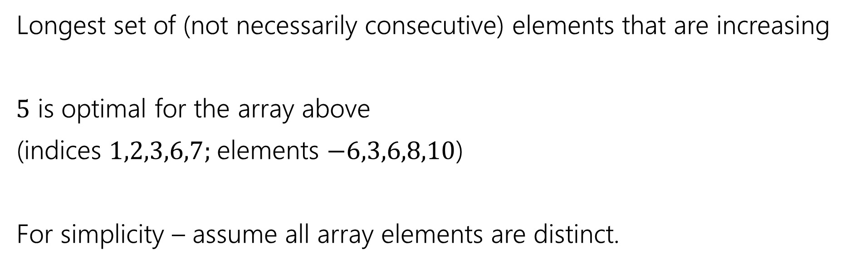
Longest Increasing Subsequence
0 | 1 | 2 | 3 | 4 | 5 | 6 | 7
5 | -6 | 3 | 6 | -5 | 2 | 8 | 10
Longest set of (not necessarily consecutive) elements that are increasing
$5$ is optimal for the array above
(indices $1,2,3,6,7;$elements $−6,3,6,8,10$)
For simplicity – assume all array elements are distinct.

Slide 4

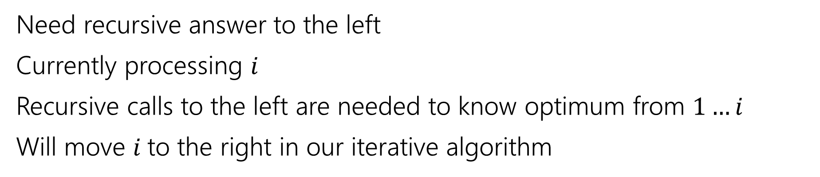
Recurrence
0 | 1 | 2 | 3 | 4 | 5 | 6 | 7
5 | -6 | 3 | 6 | -5 | 2 | 8 | 10
Recursive call is best value in this area
Current $i$
Ignored for now.
Need recursive answer to the left
Currently processing $i$
Recursive calls to the left are needed to know optimum from $1…i$
Will move $i$to the right in our iterative algorithm

Slide 5
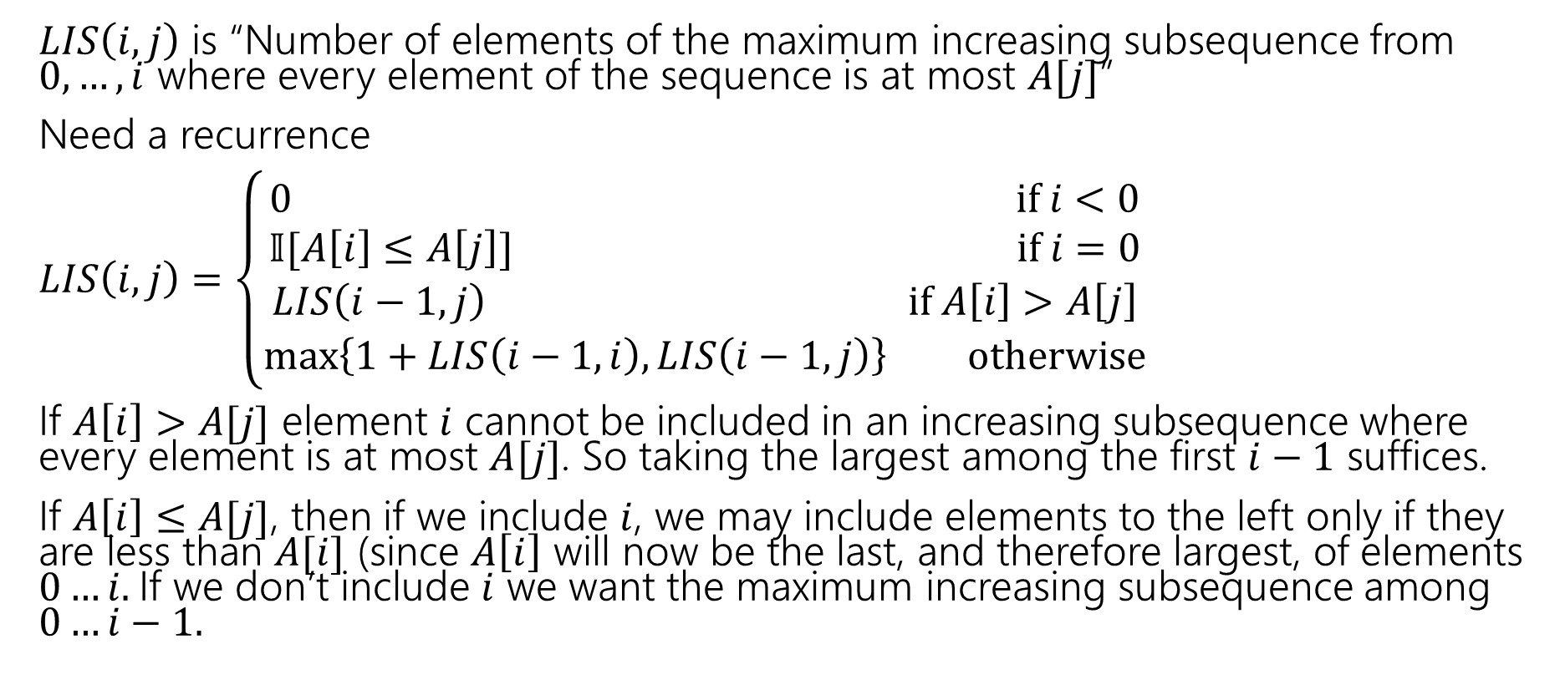
Longest Increasing Subsequence
$LIS\left(i,j\right)$ is “Number of elements of the maximum increasing subsequence from $0,…,i$ where every element of the sequence is at most $A[j]$”
Need a recurrence
$LIS\left(i,j\right)=\left\{\begin{aligned}0 if i<0 \\ 𝕀[A\left[i\right]≤A\left[j\right]] if i=0 \\ LIS\left(i−1,j\right) if A\left[i\right]>A\left[j\right] \\ \max\left\{1+LIS\left(i−1,i\right), LIS\left(i−1,j\right)\right\} otherwise\end{aligned}\right.$
If $A\left[i\right]>A[j]$ element $i$ cannot be included in an increasing subsequence where every element is at most $A[j]$. So taking the largest among the first $i−1$ suffices.
If $A\left[i\right]≤A[j]$, then if we include $i$, we may include elements to the left only if they are less than $A[i]$ (since $A\left[i\right]$ will now be the last, and therefore largest, of elements $0…i.$If we don’t include $i$ we want the maximum increasing subsequence among $0…i−1.$

Slide 6

Longest Increasing Subsequence
$LIS\left(i,j\right)=\left\{\begin{aligned}0 if i<0 \\ 𝕀[A\left[i\right]≤A\left[j\right]] if i=0 \\ LIS\left(i−1,j\right) if A\left[i\right]>A\left[j\right] \\ \max\left\{1+LIS\left(i−1,i\right), LIS\left(i−1,j\right)\right\} otherwise\end{aligned}\right.$
Memoization structure? $n×n$ array.
Filling order?

Slide 7


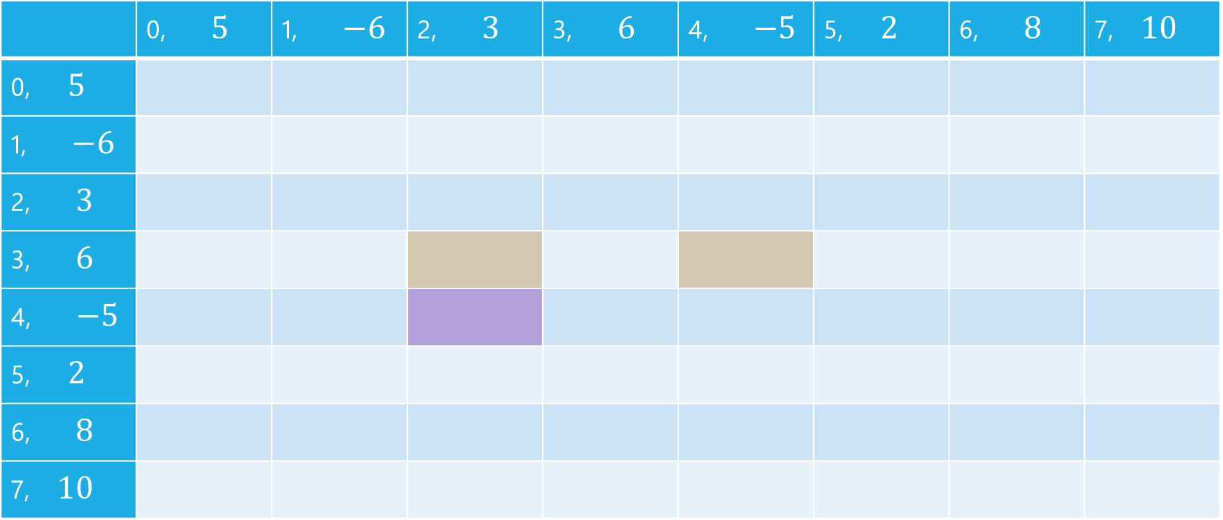


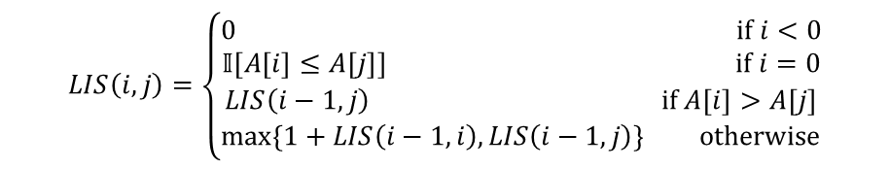
LIS
$$LIS\left(i,j\right)=\left\{\begin{aligned}0 if i<0 \\ 𝕀[A\left[i\right]≤A\left[j\right]] if i=0 \\ LIS\left(i−1,j\right) if A\left[i\right]>A\left[j\right] \\ \max\left\{1+LIS\left(i−1,i\right), LIS\left(i−1,j\right)\right\} otherwise\end{aligned}\right.$$
$$j$$
 | 0, $5$ | 1, $−6$ | 2, $3$ | 3, $6$ | 4, $−5$ | 5, $2$ | 6, $8$ | 7, $10$
0, $5$
1, $−6$
2, $3$
3, $6$
4, $−5$
5, $2$
6, $8$
7, $10$
$$i$$

Slide 8
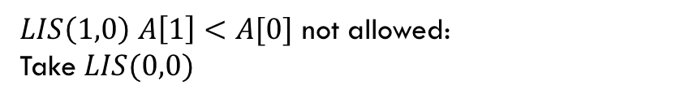
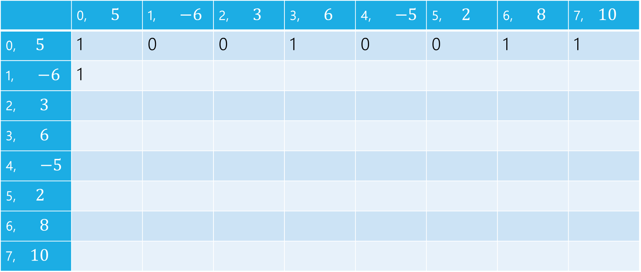
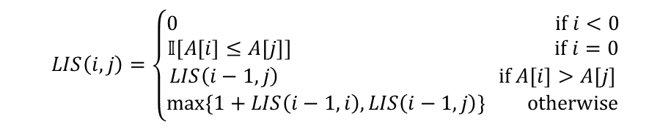
LIS
$LIS\left(1,0\right)$ $A\left[1\right]<A[0]$ not allowed:
Take $LIS(0,0)$
$$LIS\left(i,j\right)=\left\{\begin{aligned}0 if i<0 \\ 𝕀[A\left[i\right]≤A\left[j\right]] if i=0 \\ LIS\left(i−1,j\right) if A\left[i\right]>A\left[j\right] \\ \max\left\{1+LIS\left(i−1,i\right), LIS\left(i−1,j\right)\right\} otherwise\end{aligned}\right.$$
$$j$$
 | 0, $5$ | 1, $−6$ | 2, $3$ | 3, $6$ | 4, $−5$ | 5, $2$ | 6, $8$ | 7, $10$
0, $5$ | 1 | 0 | 0 | 1 | 0 | 0 | 1 | 1
1, $−6$ | 1
2, $3$
3, $6$
4, $−5$
5, $2$
6, $8$
7, $10$
$$i$$

Slide 9

LIS
$LIS\left(1,1\right)$ $A\left[1\right]≤A[1]$ can add, $1+LIS(0,1)$ or $LIS(0,1)$
$$LIS\left(i,j\right)=\left\{\begin{aligned}0 if i<0 \\ 𝕀[A\left[i\right]≤A\left[j\right]] if i=0 \\ LIS\left(i−1,j\right) if A\left[i\right]>A\left[j\right] \\ \max\left\{1+LIS\left(i−1,i\right), LIS\left(i−1,j\right)\right\} otherwise\end{aligned}\right.$$
$$j$$
 | 0, $5$ | 1, $−6$ | 2, $3$ | 3, $6$ | 4, $−5$ | 5, $2$ | 6, $8$ | 7, $10$
0, $5$ | 1 | 0 | 0 | 1 | 0 | 0 | 1 | 1
1, $−6$ | 1 | 1
2, $3$
3, $6$
4, $−5$
5, $2$
6, $8$
7, $10$
$$i$$

Slide 10

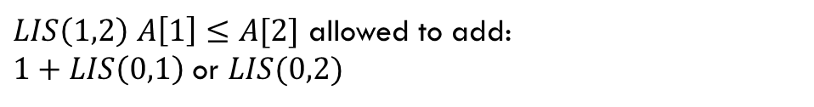
LIS
$LIS\left(1,2\right)$ $A\left[1\right]≤A[2]$ allowed to add:
$1+LIS\left(0,1\right)$ or $LIS(0,2)$
$$LIS\left(i,j\right)=\left\{\begin{aligned}0 if i<0 \\ 𝕀[A\left[i\right]≤A\left[j\right]] if i=0 \\ LIS\left(i−1,j\right) if A\left[i\right]>A\left[j\right] \\ \max\left\{1+LIS\left(i−1,i\right), LIS\left(i−1,j\right)\right\} otherwise\end{aligned}\right.$$
$$j$$
 | 0, $5$ | 1, $−6$ | 2, $3$ | 3, $6$ | 4, $−5$ | 5, $2$ | 6, $8$ | 7, $10$
0, $5$ | 1 | 0 | 0 | 1 | 0 | 0 | 1 | 1
1, $−6$ | 1 | 1 | 1
2, $3$
3, $6$
4, $−5$
5, $2$
6, $8$
7, $10$
$$i$$

Slide 11
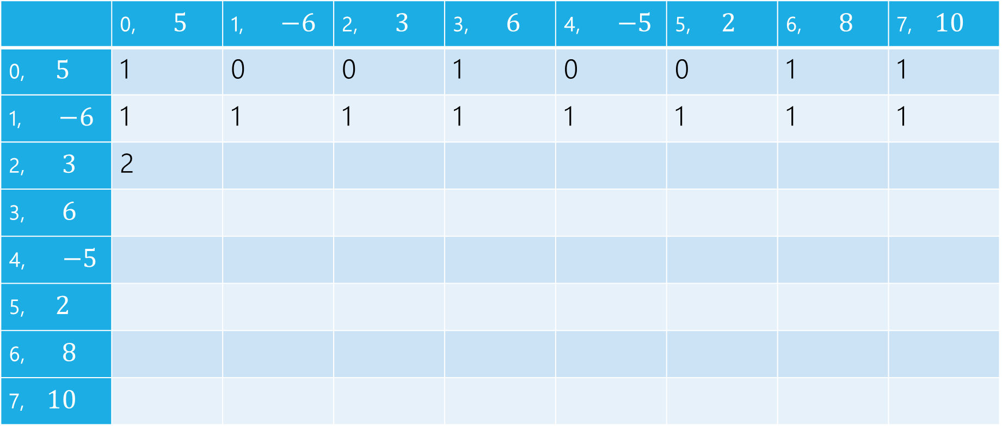
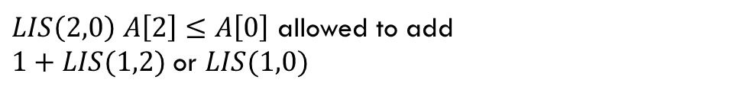
LIS
$LIS\left(2,0\right)$ $A\left[2\right]≤A\left[0\right]$ allowed to add
$1+LIS(1,2)$ or $LIS(1,0)$
$$LIS\left(i,j\right)=\left\{\begin{aligned}0 if i<0 \\ 𝕀[A\left[i\right]≤A\left[j\right]] if i=0 \\ LIS\left(i−1,j\right) if A\left[i\right]>A\left[j\right] \\ \max\left\{1+LIS\left(i−1,i\right), LIS\left(i−1,j\right)\right\} otherwise\end{aligned}\right.$$
$$j$$
 | 0, $5$ | 1, $−6$ | 2, $3$ | 3, $6$ | 4, $−5$ | 5, $2$ | 6, $8$ | 7, $10$
0, $5$ | 1 | 0 | 0 | 1 | 0 | 0 | 1 | 1
1, $−6$ | 1 | 1 | 1 | 1 | 1 | 1 | 1 | 1
2, $3$ | 2
3, $6$
4, $−5$
5, $2$
6, $8$
7, $10$
$$i$$

Slide 12
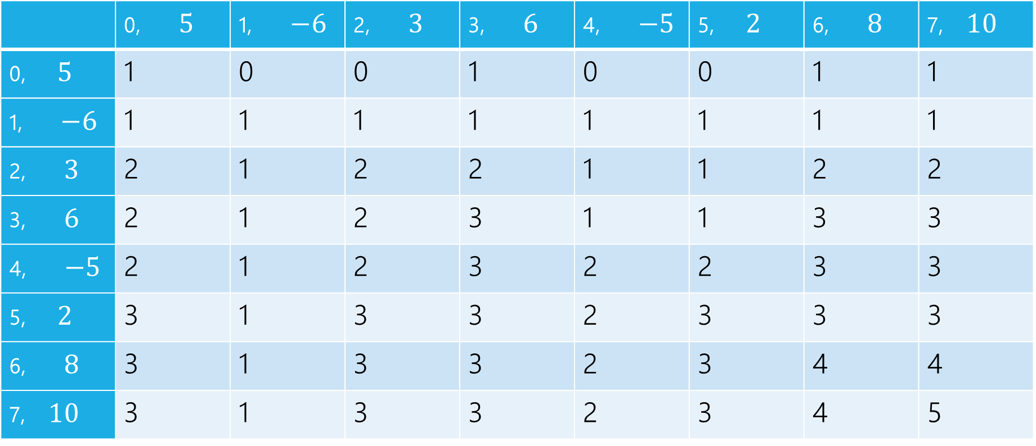
LIS
$$LIS\left(i,j\right)=\left\{\begin{aligned}0 if i<0 \\ 𝕀[A\left[i\right]≤A\left[j\right]] if i=0 \\ LIS\left(i−1,j\right) if A\left[i\right]>A\left[j\right] \\ \max\left\{1+LIS\left(i−1,i\right), LIS\left(i−1,j\right)\right\} otherwise\end{aligned}\right.$$
$$j$$
 | 0, $5$ | 1, $−6$ | 2, $3$ | 3, $6$ | 4, $−5$ | 5, $2$ | 6, $8$ | 7, $10$
0, $5$ | 1 | 0 | 0 | 1 | 0 | 0 | 1 | 1
1, $−6$ | 1 | 1 | 1 | 1 | 1 | 1 | 1 | 1
2, $3$ | 2 | 1 | 2 | 2 | 1 | 1 | 2 | 2
3, $6$ | 2 | 1 | 2 | 3 | 1 | 1 | 3 | 3
4, $−5$ | 2 | 1 | 2 | 3 | 2 | 2 | 3 | 3
5, $2$ | 3 | 1 | 3 | 3 | 2 | 3 | 3 | 3
6, $8$ | 3 | 1 | 3 | 3 | 2 | 3 | 4 | 4
7, $10$ | 3 | 1 | 3 | 3 | 2 | 3 | 4 | 5
$$i$$

Slide 13
pseudocode
//real code snippet that actually generated the table on the last slide
for(int j=0; j < n; j++){
vals[0][j] = (A[0] <= A[j]) ? 1 : 0;
}
for(int i = 1; i < 8; i++){
for(int j = 0; j < n; j++){
if(A[i] > A[j])
vals[i][j] = vals[i-1][j];
else{
vals[i][j] = Math.max(1+vals[i-1][i], vals[i-1][j]);
}
}
}

Slide 14
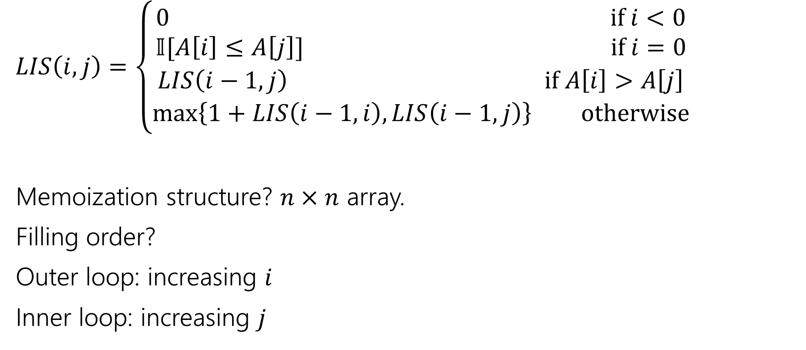
Longest Increasing Subsequence
$LIS\left(i,j\right)=\left\{\begin{aligned}0 if i<0 \\ 𝕀[A\left[i\right]≤A\left[j\right]] if i=0 \\ LIS\left(i−1,j\right) if A\left[i\right]>A\left[j\right] \\ \max\left\{1+LIS\left(i−1,i\right), LIS\left(i−1,j\right)\right\} otherwise\end{aligned}\right.$
Memoization structure? $n×n$ array.
Filling order?
Outer loop: increasing $i$
Inner loop: increasing $j$

Slide 15
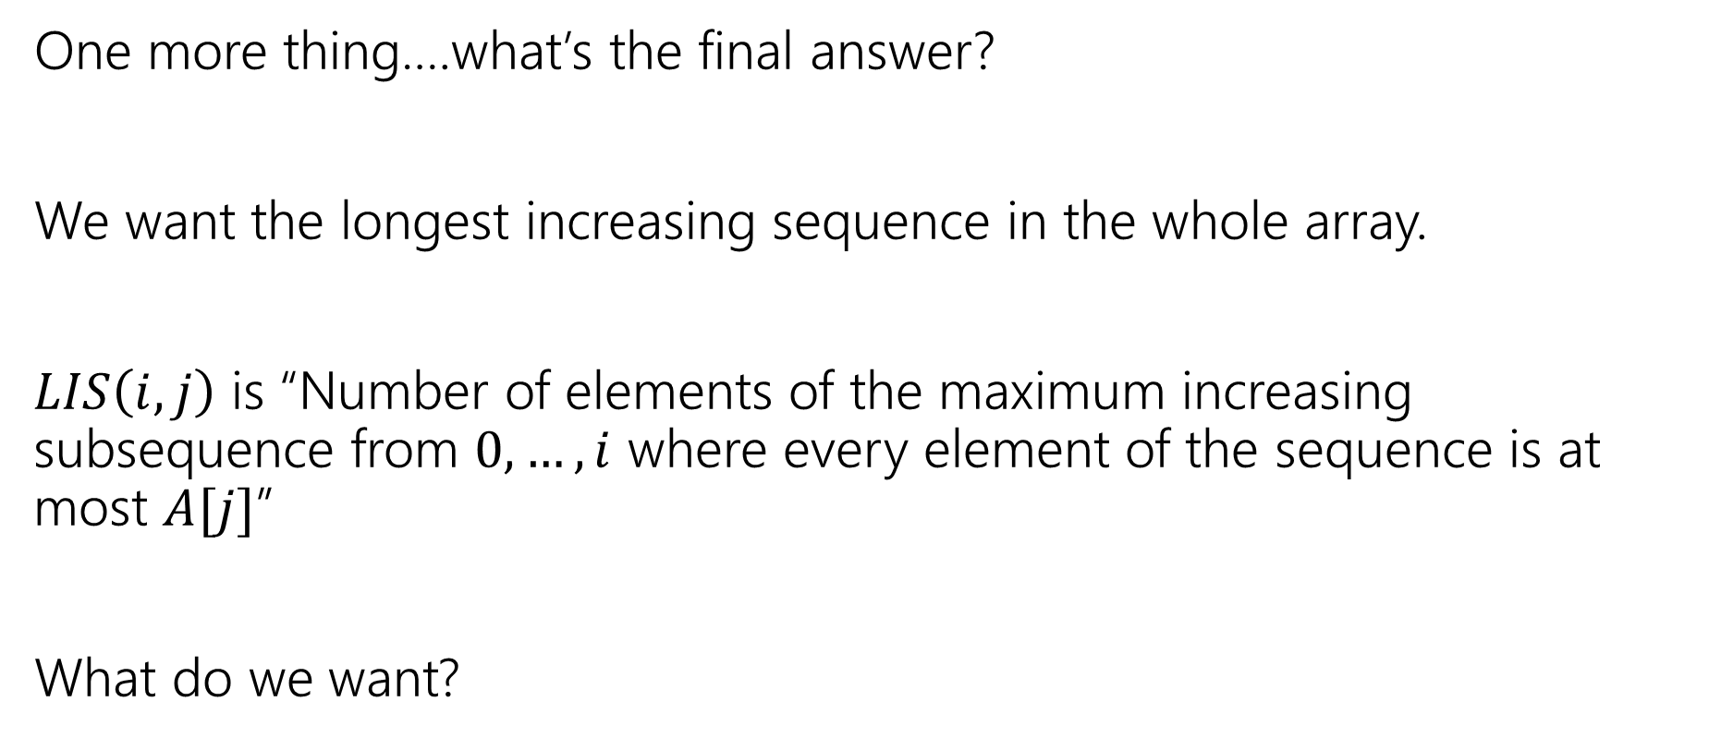
LIS
One more thing….what’s the final answer?
We want the longest increasing sequence in the whole array.
$LIS\left(i,j\right)$ is “Number of elements of the maximum increasing subsequence from $0,…,i$ where every element of the sequence is at most $A[j]$”
What do we want?

Slide 16
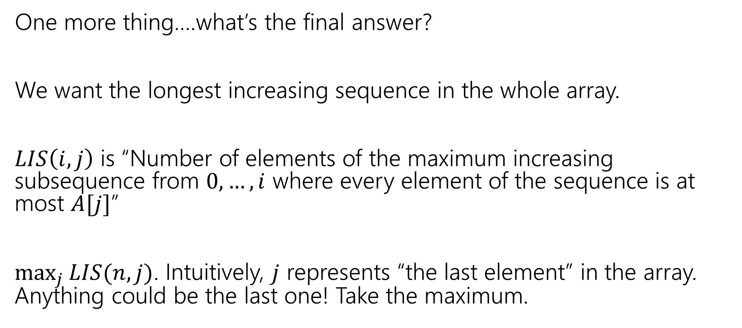
LIS
One more thing….what’s the final answer?
We want the longest increasing sequence in the whole array.
$LIS\left(i,j\right)$ is “Number of elements of the maximum increasing subsequence from $0,…,i$ where every element of the sequence is at most $A[j]$”
$\max_{j}{LIS(n,j)}$. Intuitively, $j$ represents “the last element” in the array. Anything could be the last one! Take the maximum.

Slide 17
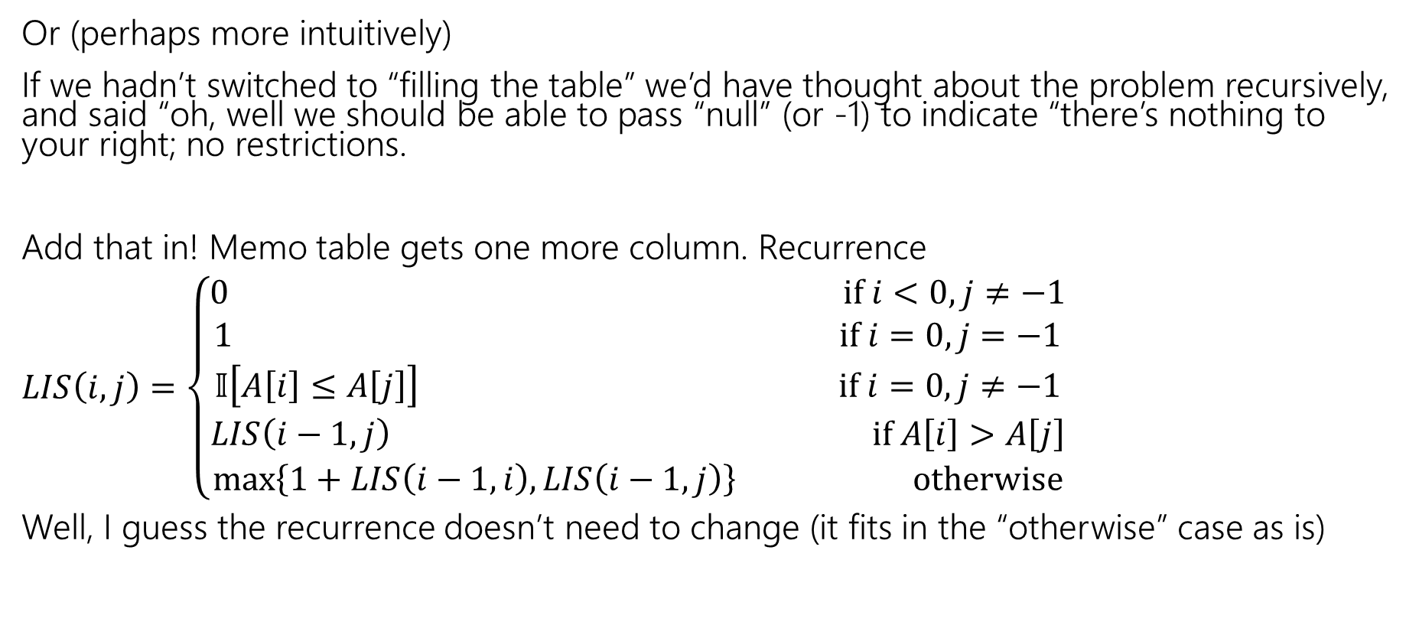
LIS
Or (perhaps more intuitively)
If we hadn’t switched to “filling the table” we’d have thought about the problem recursively, and said “oh, well we should be able to pass “null” (or -1) to indicate “there’s nothing to your right; no restrictions.
Add that in! Memo table gets one more column. Recurrence
$LIS\left(i,j\right)=\left\{\begin{aligned}0 if i<0,j≠−1 \\ 1 if i=0,j=−1 \\ 𝕀\left[A\left[i\right]≤A\left[j\right]\right] if i=0,j≠−1 \\ LIS\left(i−1,j\right) if A\left[i\right]>A\left[j\right] \\ \max\left\{1+LIS\left(i−1,i\right), LIS\left(i−1,j\right)\right\} otherwise\end{aligned}\right.$
Well, I guess the recurrence doesn’t need to change (it fits in the “otherwise” case as is)

Slide 18
DP on Trees

Slide 19
DP on Trees
Trees are recursive structures
A tree is a root node, with zero or more children
Each of which are roots of trees
Since DP is “smart recursion” (recursion where we save values)
Recursive functions/calculations are really common.

Slide 20
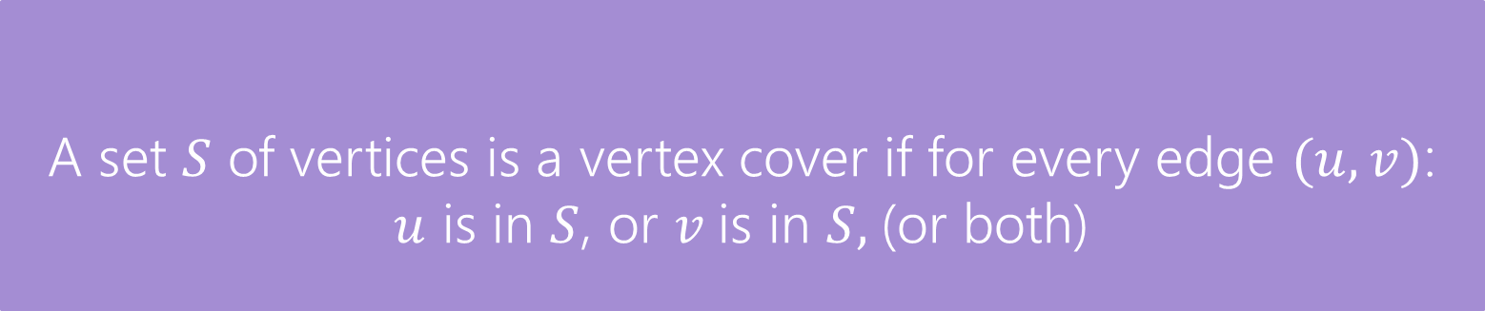
DP on Trees
Find the minimum vertex cover in a tree.
Give every vertex a weight, find the minimum weight vertex cover
Vertex Cover
A set $S$ of vertices is a vertex cover if for every edge $(u,v)$:
$u$ is in $S$, or $v$is in $S,$(or both)
The weight of a vertex cover is just the sum of the weights of the vertices in the set.
We want to find the minimum weight vertex cover.

Slide 21
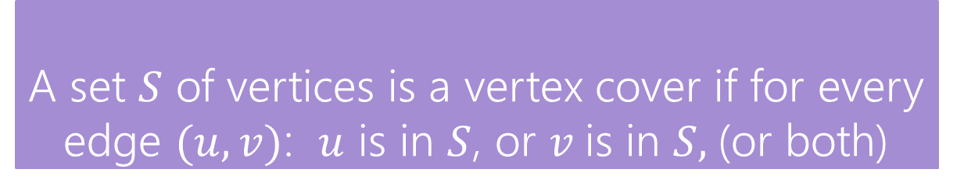
Vertex Cover
Vertex Cover
A set $S$ of vertices is a vertex cover if for every edge $(u,v)$: $u$ is in $S$, or $v$is in $S,$(or both)
Find the minimum vertex cover in a tree.
Give every vertex a weight, find the minimum weight vertex cover
1
10
8
5
3
20

Slide 22
Vertex Cover
Vertex Cover
A set $S$ of vertices is a vertex cover if for every edge $(u,v)$: $u$ is in $S$, or $v$is in $S,$(or both)
Find the minimum vertex cover in a tree.
Give every vertex a weight, find the minimum weight vertex cover
1
10
8
A valid vertex cover! (just take everything)
Definitely not the minimum though.
5
3
20

Slide 23
Vertex Cover
Vertex Cover
A set $S$ of vertices is a vertex cover if for every edge $(u,v)$: $u$ is in $S$, or $v$is in $S,$(or both)
Find the minimum vertex cover in a tree.
Give every vertex a weight, find the minimum weight vertex cover
1
10
8
A better vertex cover – weight 18
5
3
20

Slide 24
Vertex Cover
Vertex Cover
A set $S$ of vertices is a vertex cover if for every edge $(u,v)$: $u$ is in $S$, or $v$is in $S,$(or both)
Find the minimum vertex cover in a tree.
Give every vertex a weight, find the minimum weight vertex cover
1
10
8
The minimum vertex cover: weight 17
5
3
20

Slide 25
Vertex Cover
Vertex Cover
A set $S$ of vertices is a vertex cover if for every edge $(u,v)$: $u$ is in $S$, or $v$is in $S,$(or both)
Notice, the minimum weight vertex cover might have both endpoints of some edges
Even though only one of 1, 8 is required on the edge between them, they are both required for other edges.
1
10
8
5
3
20

Slide 26
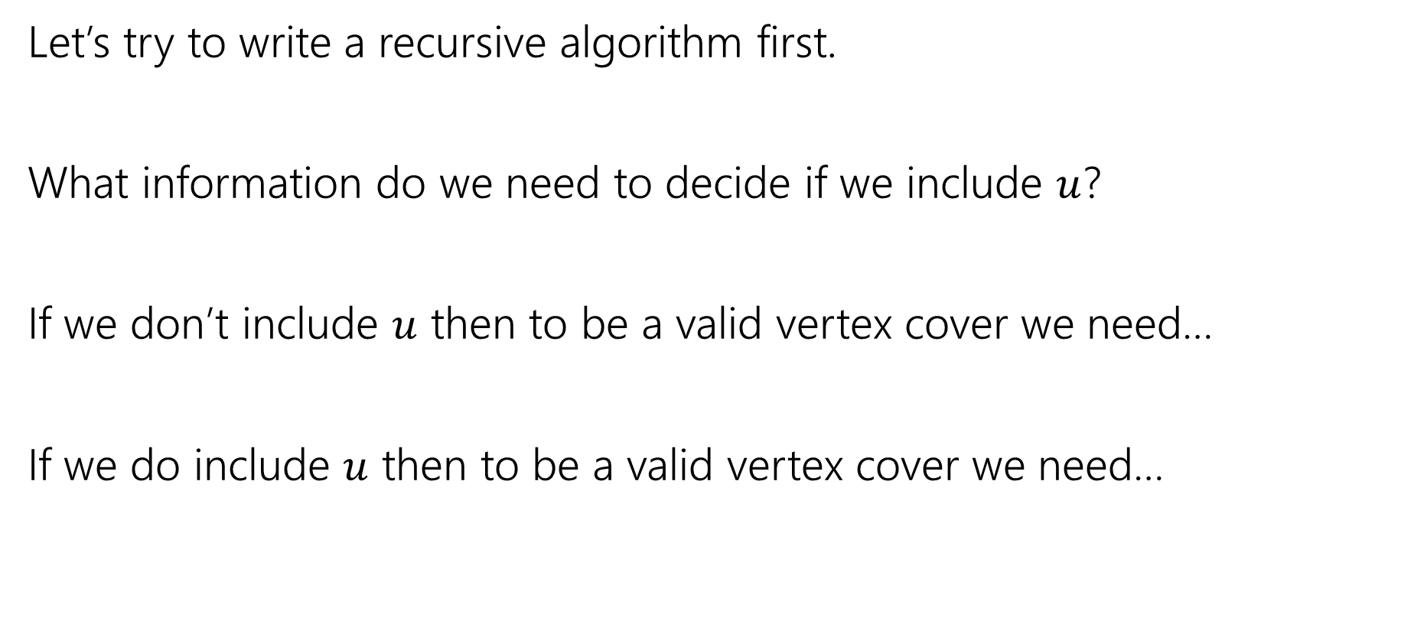
Vertex Cover – Recursively
Let’s try to write a recursive algorithm first.
What information do we need to decide if we include $u$?
If we don’t include $u$ then to be a valid vertex cover we need…
If we do include $u$ then to be a valid vertex cover we need…

Slide 27
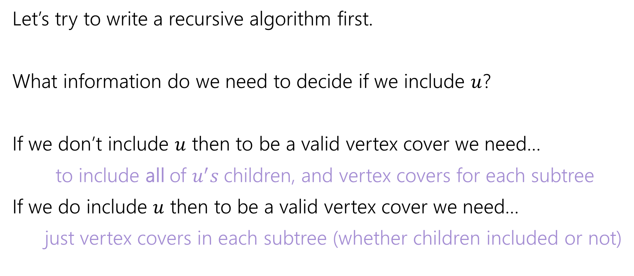
Vertex Cover – Recursively
Let’s try to write a recursive algorithm first.
What information do we need to decide if we include $u$?
If we don’t include $u$ then to be a valid vertex cover we need…
to include all of $u^{′}s$children, and vertex covers for each subtree
If we do include $u$ then to be a valid vertex cover we need…
just vertex covers in each subtree (whether children included or not)

Slide 28

Recurrence
Let $OPT(v)$ be the weight of a minimum weight vertex cover for the subtree rooted at $v$.
Write a recurrence for $OPT()$
Then figure out how to calculate it

Slide 29
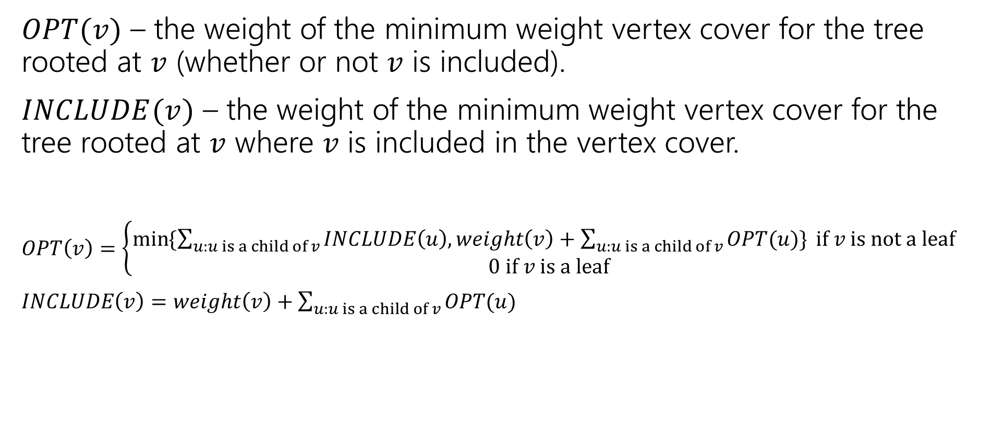
Recurrence
$OPT(v)$ – the weight of the minimum weight vertex cover for the tree rooted at $v$ (whether or not $v$ is included).
$INCLUDE(v)$ – the weight of the minimum weight vertex cover for the tree rooted at $v$ where $v$ is included in the vertex cover.
$OPT\left(v\right)=\left\{\begin{aligned}\min{⁡\{\sum_{u:u is a child of v}{INCLUDE\left(u\right), weight\left(v\right)+\sum_{u:u is a child of v}{OPT(u)\}} if v is not a leaf} } \\ 0 if v is a leaf\end{aligned}\right.$
$INCLUDE\left(v\right)=weight\left(v\right)+\sum_{u:u is a child of v}{OPT(u)}$

Slide 30
Vertex Cover Dynamic Program
What memoization structure should we use?
What code should we write?
What’s the running time?

Slide 31
Vertex Cover Dynamic Program
What memoization structure should we use?
the tree itself!
What code should we write?
What’s the running time?

Slide 32
Vertex Cover
What order do we do the calculation?
1
10
8
5
3
20

Slide 33
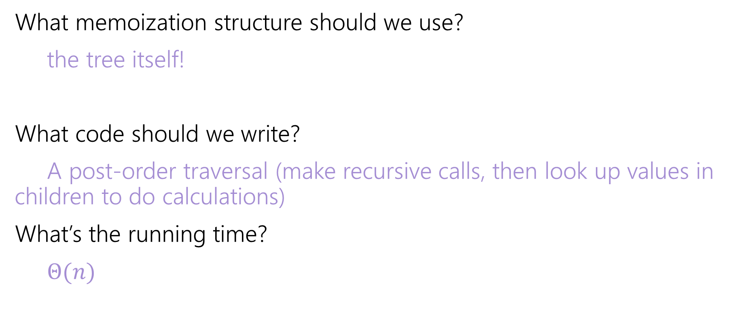
Vertex Cover Dynamic Program
What memoization structure should we use?
the tree itself!
What code should we write?
A post-order traversal (make recursive calls, then look up values in children to do calculations)
What’s the running time?
$Θ(n)$

Slide 34
DP Context

Slide 35
DP Design Notes
We haven’t done a single proof for DP…
We won’t ask you to do one.
DP proofs are almost always just “the code does the recurrence”
But that just moves the correctness question – why is the recurrence correct?
And the proof of the recurrence being correct is almost always “I included all the cases”
I’d rather you focus on checking it than trying to explain it.

Slide 36
DP history
So…why is it called “dynamic programming?”
“programming” is an old-timey meaning of the word.
It means “scheduling”
Like a conference has a “program” of who speaks where when.
Or a television executive decides on the nightly programming (what show airs when).

Slide 37
DP history
So…dynamic?
The phrase “dynamic programming” was popularized by Richard Bellman (we’ll see one of his algorithms on Wednesday)
He was a researcher, funded by the U.S. military….
But the Secretary of Defense [as Bellman tells it] hated research. And hated math even more.
So Bellman needed a description of his research that everyone would approve of.

Slide 38
DP history
Dynamic
Is actually an accurate adjective – what we think is the best option (include/exclude) can change over time.
Even better
“It’s impossible to use the word ‘dynamic’ in a pejorative sense”
“It was something not even a Congressman could object to.”

