Slide 1
Even More
Dynamic Programming
CSE 421 Fall 22
Lecture 13

Slide 2
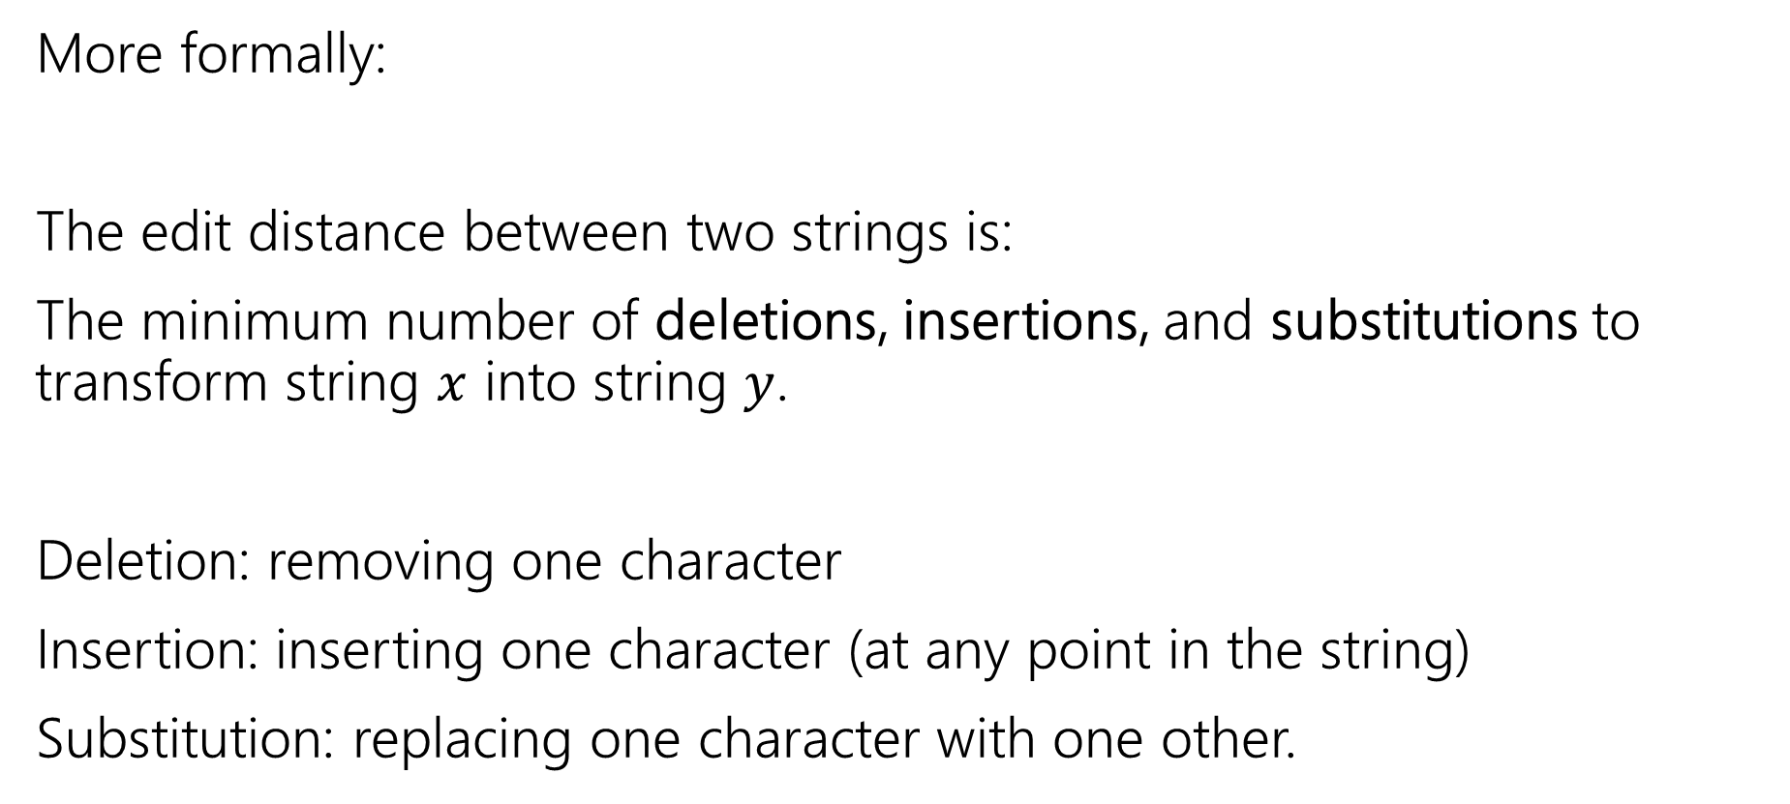
Edit Distance
More formally:
The edit distance between two strings is:
The minimum number of deletions, insertions, and substitutions to transform string $x$ into string $y$.
Deletion: removing one character
Insertion: inserting one character (at any point in the string)
Substitution: replacing one character with one other.

Slide 3
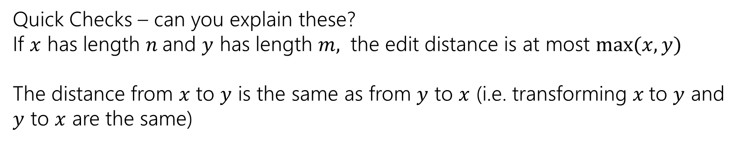
Example
What’s the distance between babyyodas and tastysoda?
B | A | B |  | Y | Y | O | D | A | S
sub |  | sub | ins |  | sub |  |  |  | del
T | A | S | T | Y | S | O | D | A
Distance: 5, one point for each colored box
Quick Checks – can you explain these?
If $x$ has length $n$and $y$ has length $m,$ the edit distance is at most $\max{(x,y)}$
The distance from $x$ to $y$ is the same as from $y$ to $x$ (i.e. transforming $x$to $y$ and $y$ to $x$ are the same)

Slide 4
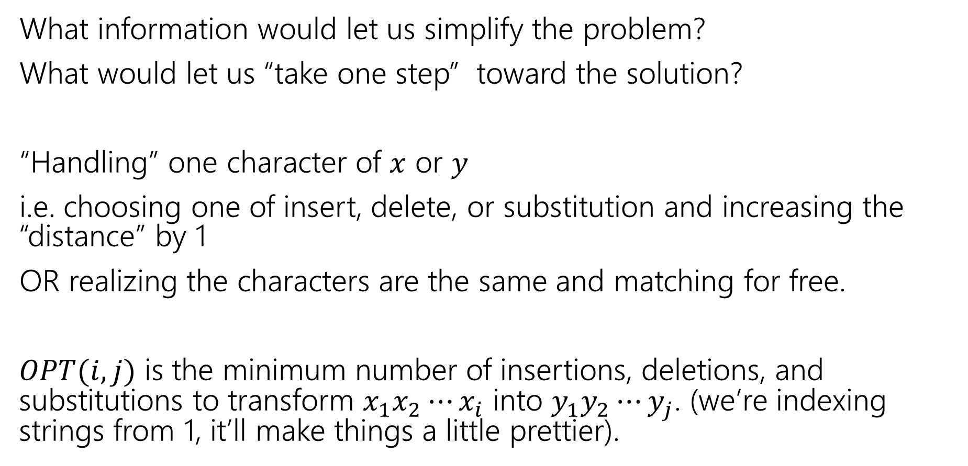
Finding a recurrence
What information would let us simplify the problem?
What would let us “take one step” toward the solution?
“Handling” one character of $x$ or $y$
i.e. choosing one of insert, delete, or substitution and increasing the “distance” by 1
OR realizing the characters are the same and matching for free.
$OPT(i,j)$ is the minimum number of insertions, deletions, and substitutions to transform $x_{1}x_{2}⋯x_{i}$ into $y_{1}y_{2}⋯y_{j}$. (we’re indexing strings from 1, it’ll make things a little prettier).

Slide 5
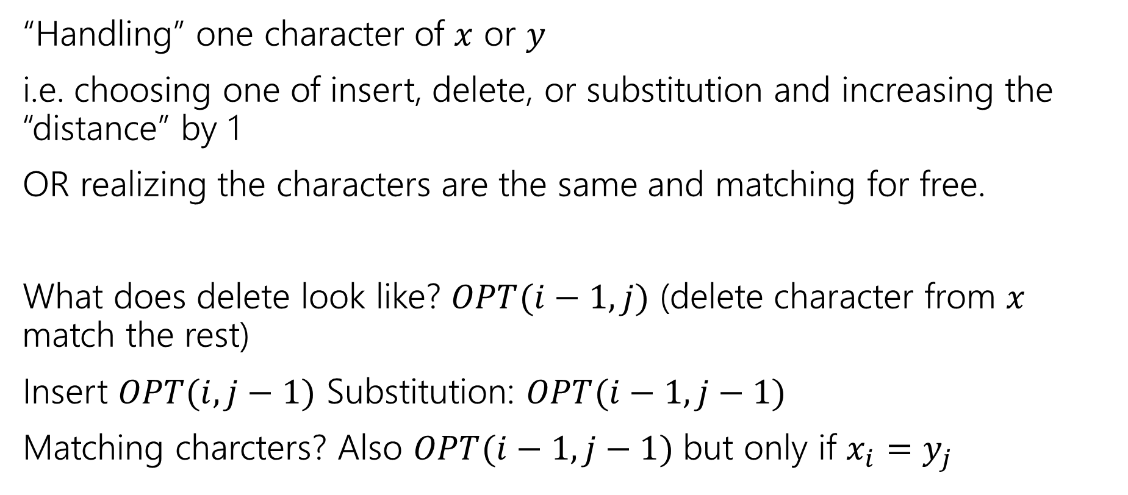
The recurrence
“Handling” one character of $x$ or $y$
i.e. choosing one of insert, delete, or substitution and increasing the “distance” by 1
OR realizing the characters are the same and matching for free.
What does delete look like? $OPT(i−1, j)$ (delete character from $x$ match the rest)
Insert $OPT(i,j−1)$ Substitution: $OPT(i−1,j−1)$
Matching charcters? Also $OPT(i−1,j−1)$ but only if $x_{i}=y_{j}$

Slide 6
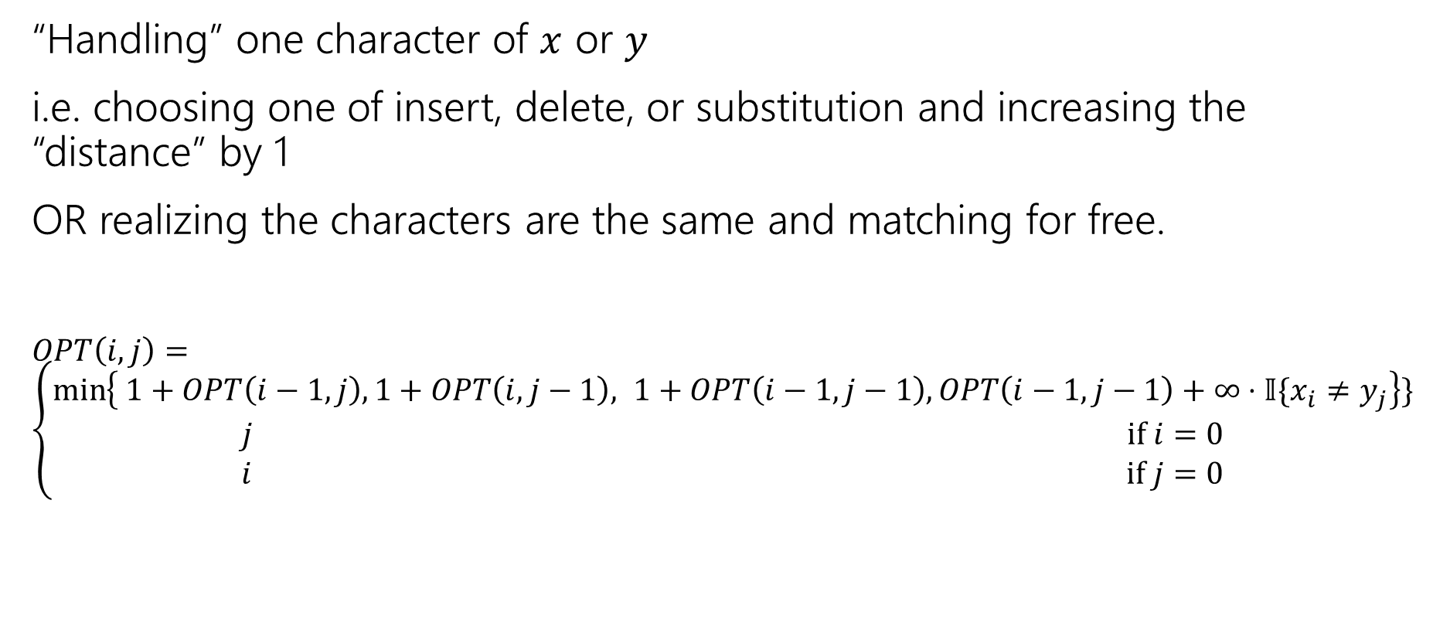
The recurrence (v1, we’ll improve soon)
“Handling” one character of $x$ or $y$
i.e. choosing one of insert, delete, or substitution and increasing the “distance” by 1
OR realizing the characters are the same and matching for free.
$OPT\left(i,j\right)=\left\{\begin{aligned}\min\left\{ 1+OPT\left(i−1,j\right), 1+OPT\left(i,j−1\right), 1+OPT\left(i−1,j−1\right), OPT\left(i−1,j−1\right)+∞⋅𝕀\{x_{i}≠y_{j}\right\}\} \\ j if i=0 \\ i if j=0\end{aligned}\right.$
Delete
Insert
Substitution
TODO: Just Match

Slide 7
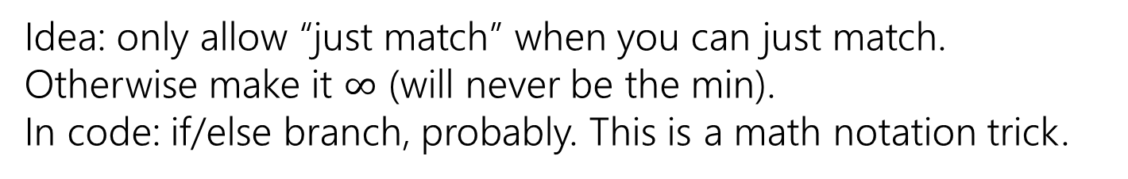
The recurrence (v1, we’ll improve soon)
“Handling” one character of $x$ or $y$
i.e. choosing one of insert, delete, or substitution and increasing the “distance” by 1
OR realizing the characters are the same and matching for free.
$OPT\left(i,j\right)=\left\{\begin{aligned}\min\left\{ 1+OPT\left(i−1,j\right), 1+OPT\left(i,j−1\right), 1+OPT\left(i−1,j−1\right), OPT\left(i−1,j−1\right)+∞⋅𝕀\{x_{i}≠y_{j}\right\}\} \\ j if i=0 \\ i if j=0\end{aligned}\right.$
Delete
Insert
Substitution
Just Match
Idea: only allow “just match” when you can just match. Otherwise make it $∞$ (will never be the min).
In code: if/else branch, probably. This is a math notation trick.
“Indicator” like from 312

Slide 8
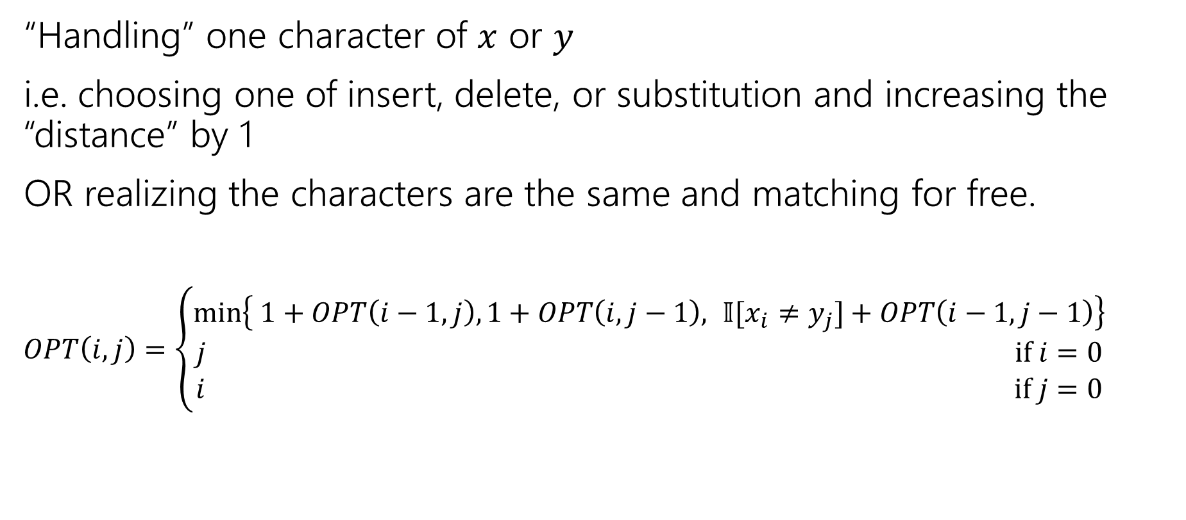
The recurrence
“Handling” one character of $x$ or $y$
i.e. choosing one of insert, delete, or substitution and increasing the “distance” by 1
OR realizing the characters are the same and matching for free.
$OPT\left(i,j\right)=\left\{\begin{aligned}\min\left\{ 1+OPT\left(i−1,j\right), 1+OPT\left(i,j−1\right), 𝕀[x_{i}≠y_{j}]+OPT\left(i−1,j−1\right)\right\} \\ j if i=0 \\ i if j=0\end{aligned}\right.$
Delete
Insert
Sub and matching
When we could match, we will never substitute; matching will always give us a better score! Still have to check delete, insert (those could be better).

Slide 9
The recurrence
“Handling” one character of $x$ or $y$
i.e. choosing one of insert, delete, or substitution and increasing the “distance” by 1
OR realizing the characters are the same and matching for free.
$OPT\left(i,j\right)=\left\{\begin{aligned}\min\left\{ 1+OPT\left(i−1,j\right), 1+OPT\left(i,j−1\right), 𝕀[x_{i}≠y_{j}]+OPT\left(i−1,j−1\right)\right\} \\ j if i=0 \\ i if j=0\end{aligned}\right.$
Delete
Insert
Sub and matching

Slide 10
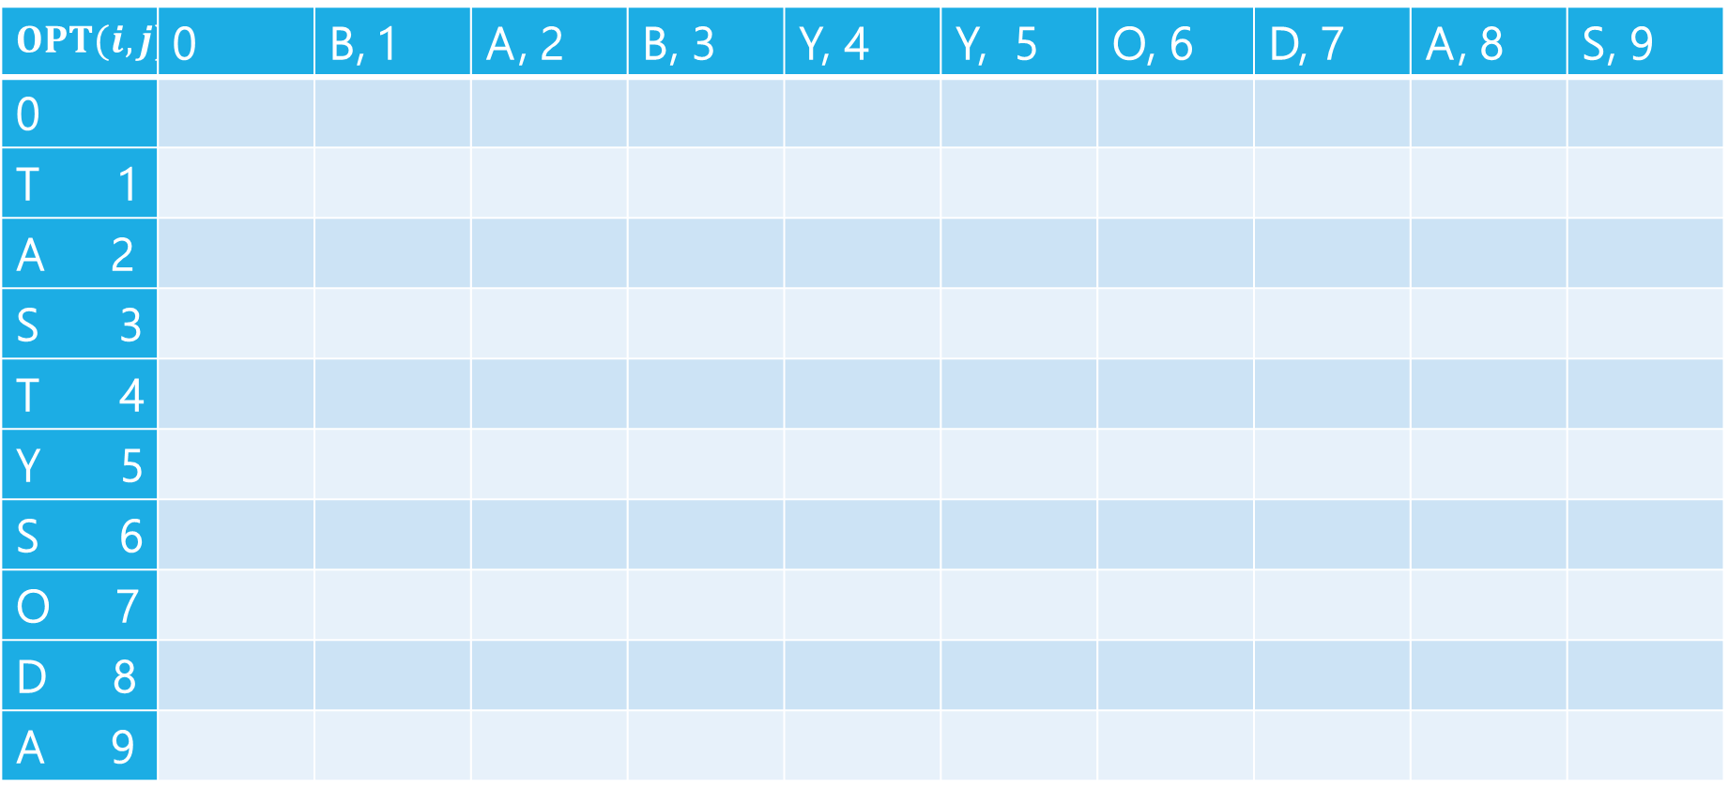
Edit Distance
$$OPT(i,j)$$ | 0 | B, 1 | A, 2 | B, 3 | Y, 4 | Y, 5 | O, 6 | D, 7 | A, 8 | S, 9
0
T 1
A 2
S 3
T 4
Y 5
S 6
O 7
D 8
A 9

Slide 11
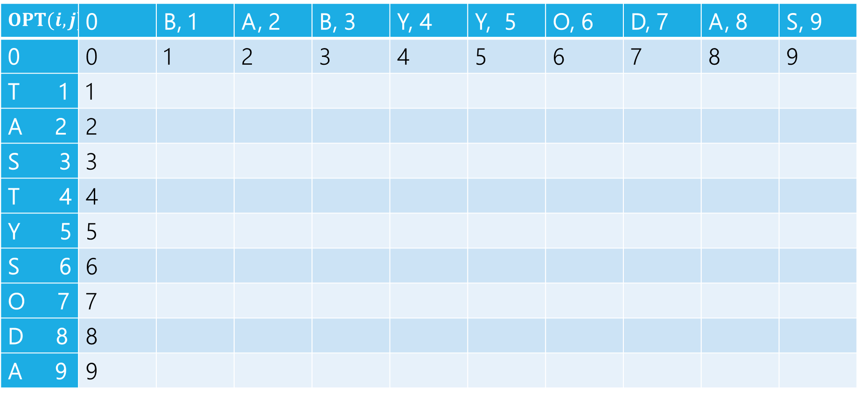
Edit Distance
$$OPT(i,j)$$ | 0 | B, 1 | A, 2 | B, 3 | Y, 4 | Y, 5 | O, 6 | D, 7 | A, 8 | S, 9
0 | 0 | 1 | 2 | 3 | 4 | 5 | 6 | 7 | 8 | 9
T 1 | 1
A 2 | 2
S 3 | 3
T 4 | 4
Y 5 | 5
S 6 | 6
O 7 | 7
D 8 | 8
A 9 | 9

Slide 12
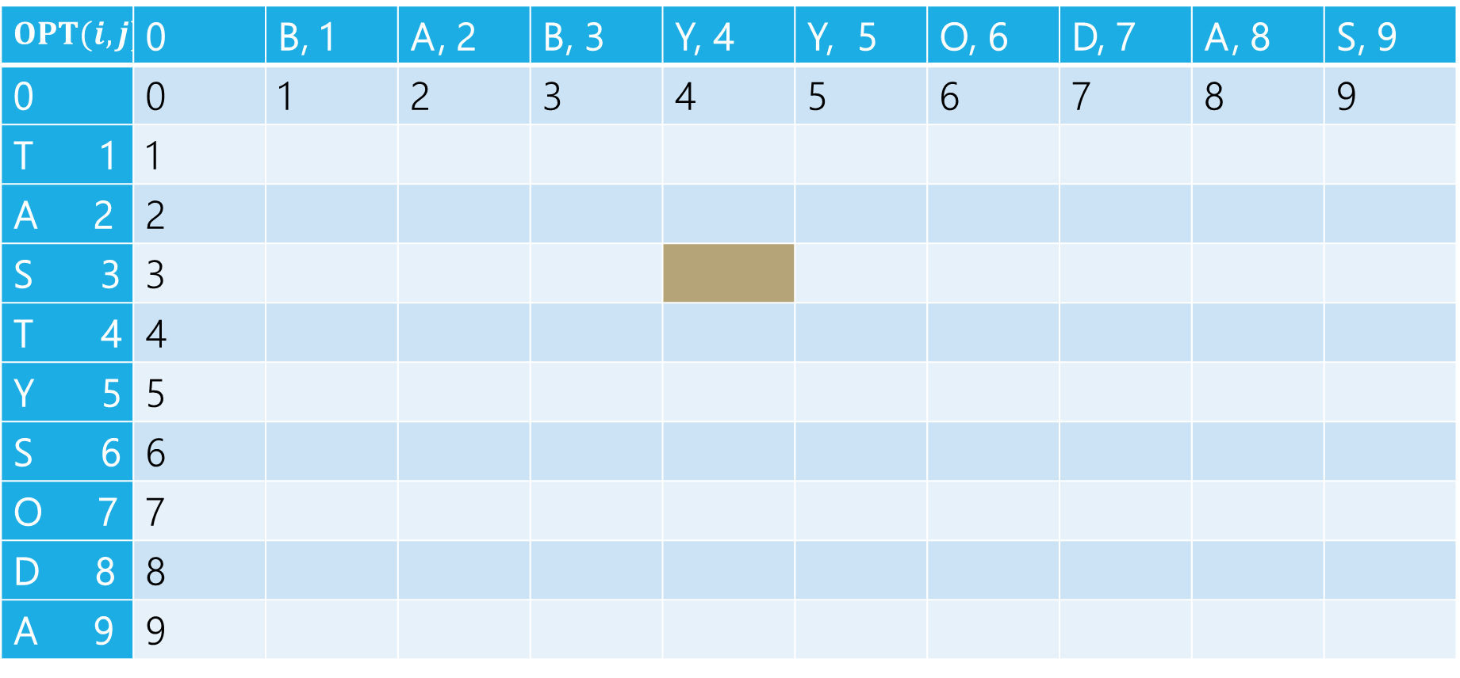
Edit Distance
B | A | B | Y
T | A | S
Current subproblem: edit dist between BABY and TAS
$$OPT(i,j)$$ | 0 | B, 1 | A, 2 | B, 3 | Y, 4 | Y, 5 | O, 6 | D, 7 | A, 8 | S, 9
0 | 0 | 1 | 2 | 3 | 4 | 5 | 6 | 7 | 8 | 9
T 1 | 1
A 2 | 2
S 3 | 3
T 4 | 4
Y 5 | 5
S 6 | 6
O 7 | 7
D 8 | 8
A 9 | 9

Slide 13
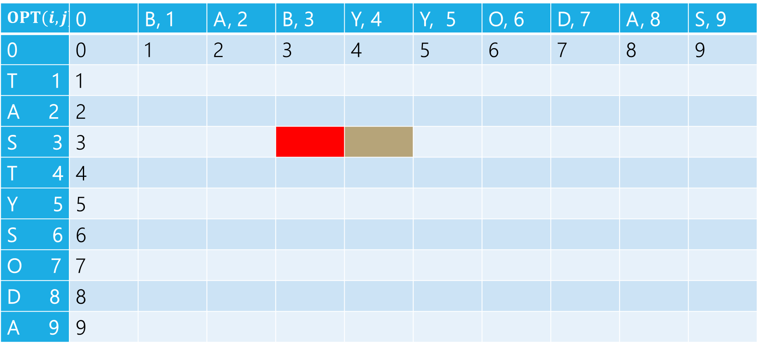
Edit Distance
B | A | B | Y
T | A | S
Delete: get rid of Y (cost 1)
BAB
TAS
$$OPT(i,j)$$ | 0 | B, 1 | A, 2 | B, 3 | Y, 4 | Y, 5 | O, 6 | D, 7 | A, 8 | S, 9
0 | 0 | 1 | 2 | 3 | 4 | 5 | 6 | 7 | 8 | 9
T 1 | 1
A 2 | 2
S 3 | 3
T 4 | 4
Y 5 | 5
S 6 | 6
O 7 | 7
D 8 | 8
A 9 | 9

Slide 14
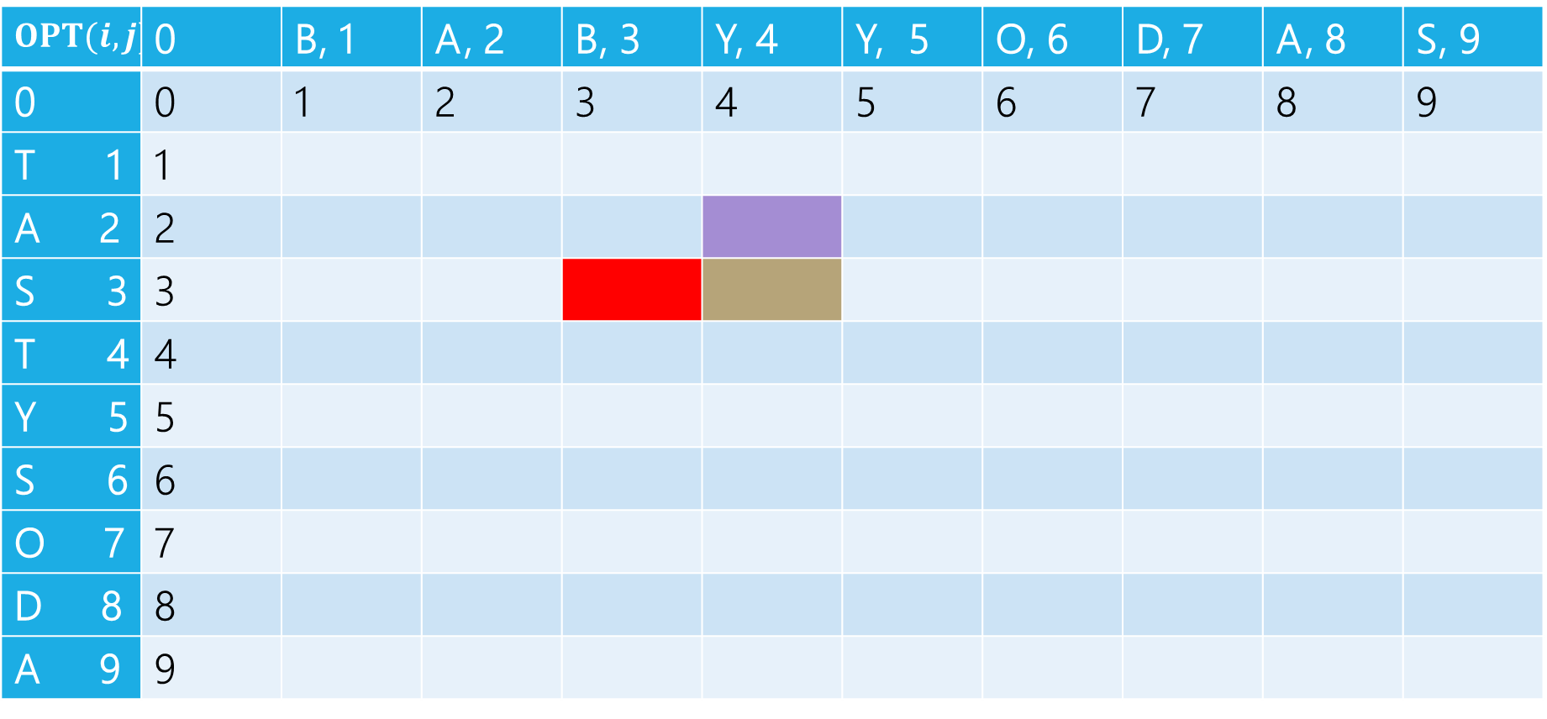
Edit Distance
B | A | B | Y
T | A | S
Insert: insert S (cost 1)
BABY
TA
$$OPT(i,j)$$ | 0 | B, 1 | A, 2 | B, 3 | Y, 4 | Y, 5 | O, 6 | D, 7 | A, 8 | S, 9
0 | 0 | 1 | 2 | 3 | 4 | 5 | 6 | 7 | 8 | 9
T 1 | 1
A 2 | 2
S 3 | 3
T 4 | 4
Y 5 | 5
S 6 | 6
O 7 | 7
D 8 | 8
A 9 | 9

Slide 15
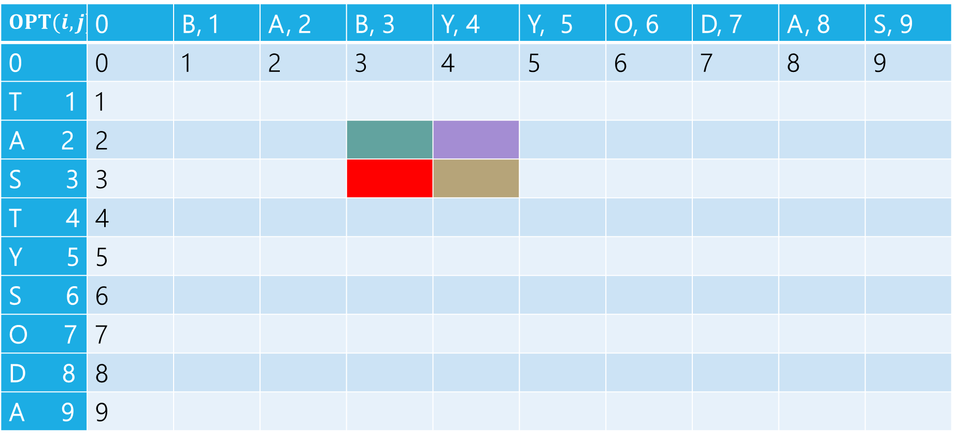
Edit Distance
B | A | B | Y
T | A | S
Sub: Transform Y to S (cost 1)
BAB
TA
$$OPT(i,j)$$ | 0 | B, 1 | A, 2 | B, 3 | Y, 4 | Y, 5 | O, 6 | D, 7 | A, 8 | S, 9
0 | 0 | 1 | 2 | 3 | 4 | 5 | 6 | 7 | 8 | 9
T 1 | 1
A 2 | 2
S 3 | 3
T 4 | 4
Y 5 | 5
S 6 | 6
O 7 | 7
D 8 | 8
A 9 | 9

Slide 16
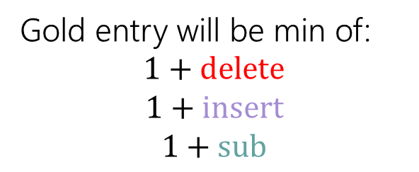
Edit Distance
Gold entry will be min of:
$$1+delete$$
$$1+insert$$
$$1+sub$$
B | A | B | Y
T | A | S
$$OPT(i,j)$$ | 0 | B, 1 | A, 2 | B, 3 | Y, 4 | Y, 5 | O, 6 | D, 7 | A, 8 | S, 9
0 | 0 | 1 | 2 | 3 | 4 | 5 | 6 | 7 | 8 | 9
T 1 | 1
A 2 | 2
S 3 | 3
T 4 | 4
Y 5 | 5
S 6 | 6
O 7 | 7
D 8 | 8
A 9 | 9

Slide 17
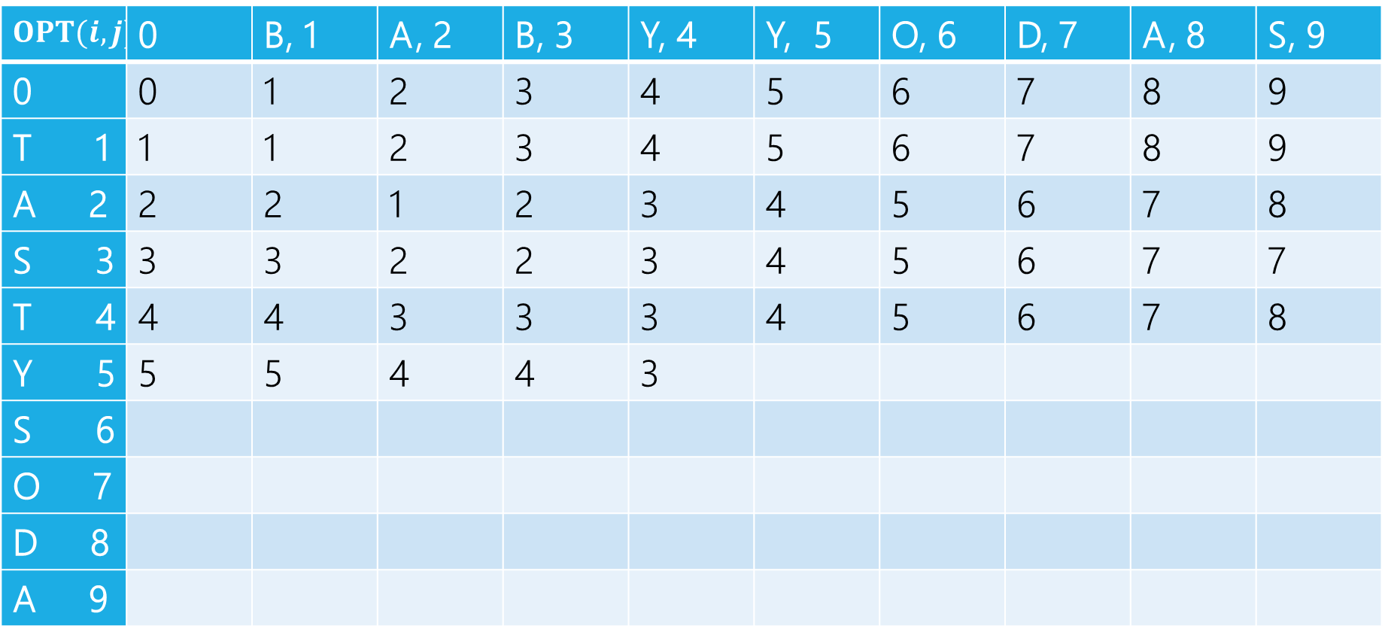

Edit Distance
$$1+2$$
$$1+3$$
$$1+2$$
Min: $3$
Gold entry will be min of:
$$1+delete$$
$$1+insert$$
$$1+sub$$
$$OPT(i,j)$$ | 0 | B, 1 | A, 2 | B, 3 | Y, 4 | Y, 5 | O, 6 | D, 7 | A, 8 | S, 9
0 | 0 | 1 | 2 | 3 | 4 | 5 | 6 | 7 | 8 | 9
T 1 | 1 | 1 | 2 | 3 | 4 | 5 | 6 | 7 | 8 | 9
A 2 | 2 | 2 | 1 | 2 | 3 | 4 | 5 | 6 | 7 | 8
S 3 | 3 | 3 | 2 | 2 | 3 | 4 | 5 | 6 | 7 | 7
T 4 | 4 | 4 | 3 | 3 | 3 | 4 | 5 | 6 | 7 | 8
Y 5 | 5 | 5 | 4 | 4 | 3
S 6
O 7
D 8
A 9

Slide 18
Edit Distance
Fill in the next two entries. Be careful with the sub/match distinction!
$$OPT(i,j)$$ | 0 | B, 1 | A, 2 | B, 3 | Y, 4 | Y, 5 | O, 6 | D, 7 | A, 8 | S, 9
0 | 0 | 1 | 2 | 3 | 4 | 5 | 6 | 7 | 8 | 9
T 1 | 1 | 1 | 2 | 3 | 4 | 5 | 6 | 7 | 8 | 9
A 2 | 2 | 2 | 1 | 2 | 3 | 4 | 5 | 6 | 7 | 8
S 3 | 3 | 3 | 2 | 2 | 3 | 4 | 5 | 6 | 7 | 7
T 4 | 4 | 4 | 3 | 3 | 3 | 4 | 5 | 6 | 7 | 8
Y 5 | 5 | 5 | 4 | 4 | 3
S 6
O 7
D 8
A 9

Slide 19
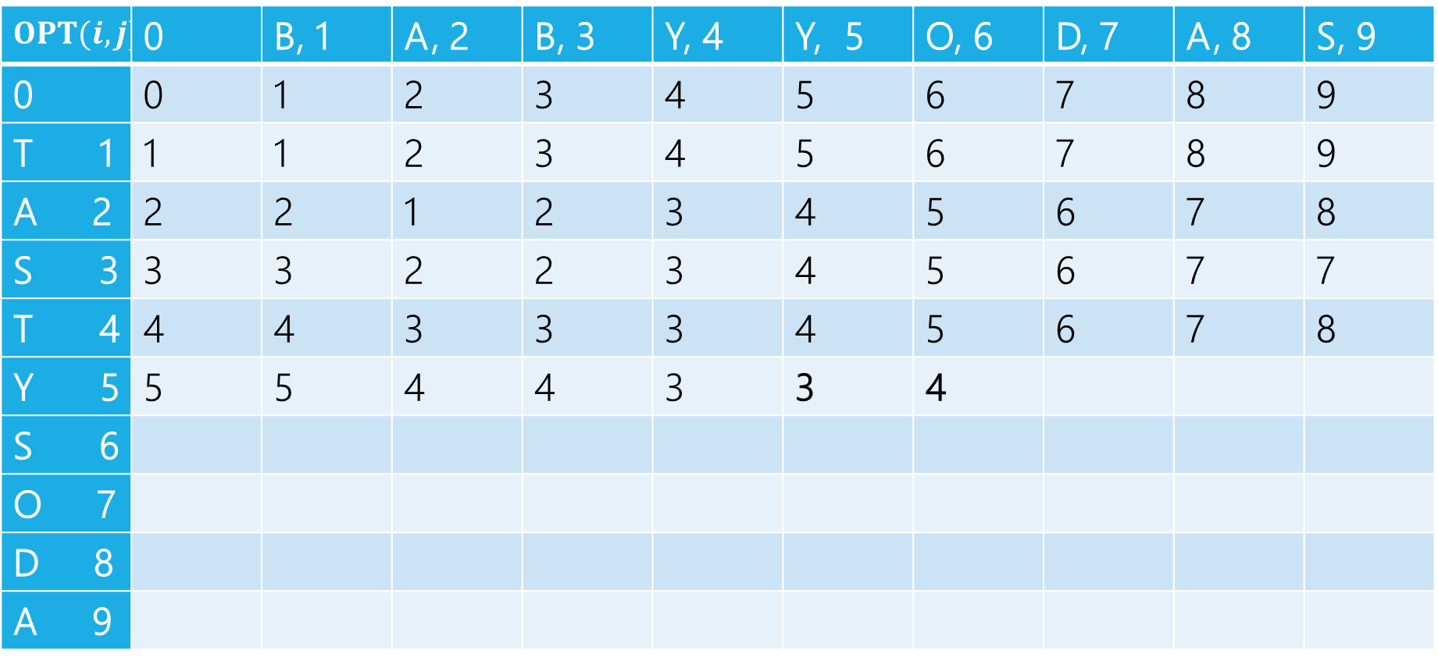
Edit Distance
Fill in the next two entries. Be careful with the sub/match distinction!
$$OPT(i,j)$$ | 0 | B, 1 | A, 2 | B, 3 | Y, 4 | Y, 5 | O, 6 | D, 7 | A, 8 | S, 9
0 | 0 | 1 | 2 | 3 | 4 | 5 | 6 | 7 | 8 | 9
T 1 | 1 | 1 | 2 | 3 | 4 | 5 | 6 | 7 | 8 | 9
A 2 | 2 | 2 | 1 | 2 | 3 | 4 | 5 | 6 | 7 | 8
S 3 | 3 | 3 | 2 | 2 | 3 | 4 | 5 | 6 | 7 | 7
T 4 | 4 | 4 | 3 | 3 | 3 | 4 | 5 | 6 | 7 | 8
Y 5 | 5 | 5 | 4 | 4 | 3 | 3 | 4
S 6
O 7
D 8
A 9
Y’s match, so sub is free!

Slide 20
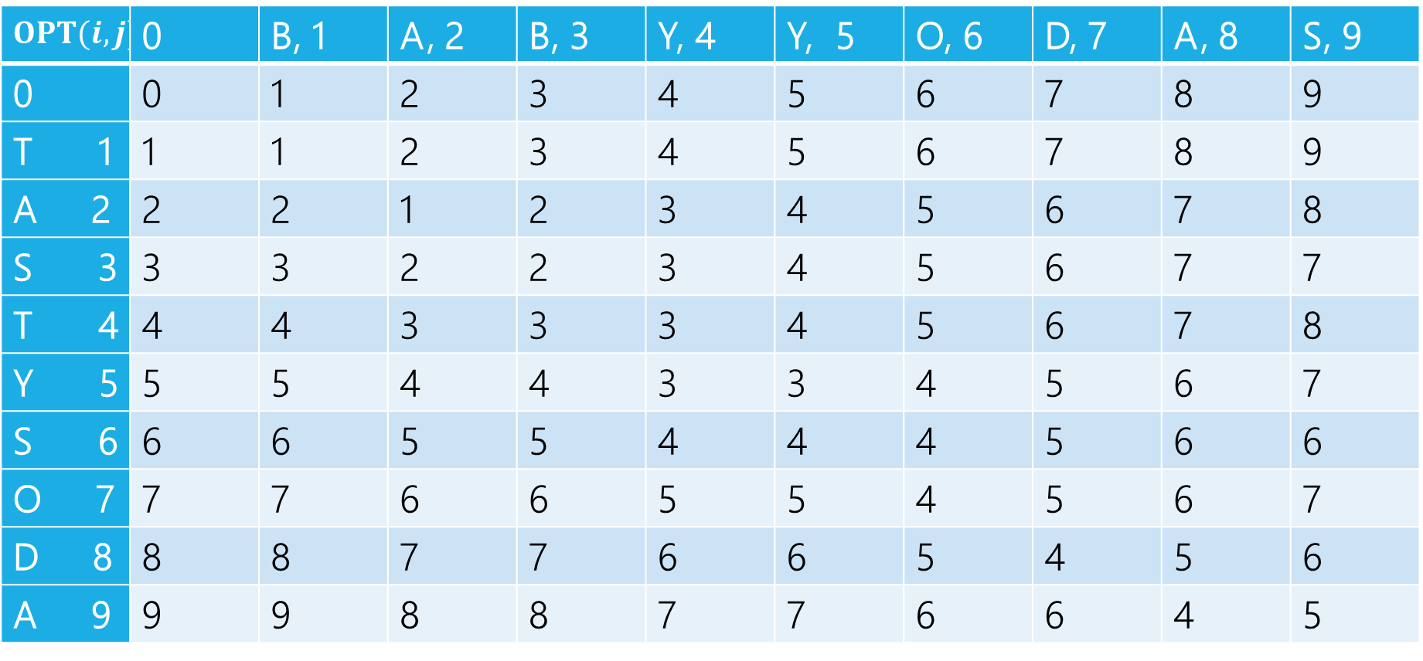
Edit Distance
$$OPT(i,j)$$ | 0 | B, 1 | A, 2 | B, 3 | Y, 4 | Y, 5 | O, 6 | D, 7 | A, 8 | S, 9
0 | 0 | 1 | 2 | 3 | 4 | 5 | 6 | 7 | 8 | 9
T 1 | 1 | 1 | 2 | 3 | 4 | 5 | 6 | 7 | 8 | 9
A 2 | 2 | 2 | 1 | 2 | 3 | 4 | 5 | 6 | 7 | 8
S 3 | 3 | 3 | 2 | 2 | 3 | 4 | 5 | 6 | 7 | 7
T 4 | 4 | 4 | 3 | 3 | 3 | 4 | 5 | 6 | 7 | 8
Y 5 | 5 | 5 | 4 | 4 | 3 | 3 | 4 | 5 | 6 | 7
S 6 | 6 | 6 | 5 | 5 | 4 | 4 | 4 | 5 | 6 | 6
O 7 | 7 | 7 | 6 | 6 | 5 | 5 | 4 | 5 | 6 | 7
D 8 | 8 | 8 | 7 | 7 | 6 | 6 | 5 | 4 | 5 | 6
A 9 | 9 | 9 | 8 | 8 | 7 | 7 | 6 | 6 | 4 | 5

Slide 21
Edit Distance – what operations?
$$OPT(i,j)$$ | 0 | B, 1 | A, 2 | B, 3 | Y, 4 | Y, 5 | O, 6 | D, 7 | A, 8 | S, 9
0 | 0 | 1 | 2 | 3 | 4 | 5 | 6 | 7 | 8 | 9
T 1 | 1 | 1 | 2 | 3 | 4 | 5 | 6 | 7 | 8 | 9
A 2 | 2 | 2 | 1 | 2 | 3 | 4 | 5 | 6 | 7 | 8
S 3 | 3 | 3 | 2 | 2 | 3 | 4 | 5 | 6 | 7 | 7
T 4 | 4 | 4 | 3 | 3 | 3 | 4 | 5 | 6 | 7 | 8
Y 5 | 5 | 5 | 4 | 4 | 3 | 3 | 4 | 5 | 6 | 7
S 6 | 6 | 6 | 5 | 5 | 4 | 4 | 4 | 5 | 6 | 6
O 7 | 7 | 7 | 6 | 6 | 5 | 5 | 4 | 5 | 6 | 7
D 8 | 8 | 8 | 7 | 7 | 6 | 6 | 5 | 4 | 5 | 6
A 9 | 9 | 9 | 8 | 8 | 7 | 7 | 6 | 6 | 4 | 5

Slide 22
Edit Distance – what operations?
$$OPT(i,j)$$ | 0 | B, 1 | A, 2 | B, 3 | Y, 4 | Y, 5 | O, 6 | D, 7 | A, 8 | S, 9
0 | 0 | 1 | 2 | 3 | 4 | 5 | 6 | 7 | 8 | 9
T 1 | 1 | 1 | 2 | 3 | 4 | 5 | 6 | 7 | 8 | 9
A 2 | 2 | 2 | 1 | 2 | 3 | 4 | 5 | 6 | 7 | 8
S 3 | 3 | 3 | 2 | 2 | 3 | 4 | 5 | 6 | 7 | 7
T 4 | 4 | 4 | 3 | 3 | 3 | 4 | 5 | 6 | 7 | 8
Y 5 | 5 | 5 | 4 | 4 | 3 | 3 | 4 | 5 | 6 | 7
S 6 | 6 | 6 | 5 | 5 | 4 | 4 | 4 | 5 | 6 | 6
O 7 | 7 | 7 | 6 | 6 | 5 | 5 | 4 | 5 | 6 | 7
D 8 | 8 | 8 | 7 | 7 | 6 | 6 | 5 | 4 | 5 | 6
A 9 | 9 | 9 | 8 | 8 | 7 | 7 | 6 | 6 | 4 | 5

Slide 23
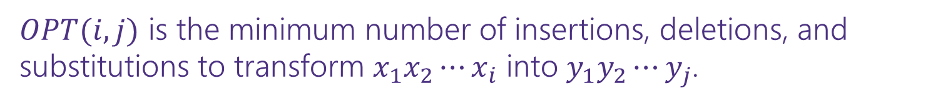
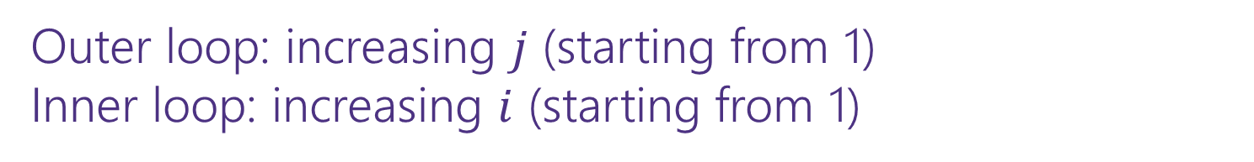
Dynamic Programming Process
1. Define the object you’re looking for
2. Write a recurrence to say how to find it
3. Design a memoization structure
4. Write an iterative algorithm
$OPT(i,j)$ is the minimum number of insertions, deletions, and substitutions to transform $x_{1}x_{2}⋯x_{i}$ into $y_{1}y_{2}⋯y_{j}$.
✅
$m×n$ Array
Outer loop: increasing $j$ (starting from 1)
Inner loop: increasing $i$ (starting from 1)

Slide 24
DP Proofs
We generally won’t ask you for proofs of correctness on dynamic programming problems.
Why?
The proofs are always inductive proofs where you say
“my recurrence checks all the possibilities” or, equivalently
“The maximum thing has to be made up of the best thing for all these other subproblems.“
The proof itself is very difficult to write clearly (you have to differentiate between your recurrence and what your recurrence intends to calculate, which can be

Slide 25
DP Proofs
We’ll include an example proof sometime in the next few week so you know what you’re (not) missing.
Instead, we’re going to ask for your intuition on what your recurrence is doing (what do all the cases correspond to/why are they exhaustive)?
The proof is just a lot of formalism on that key idea. So we’re going to have you focus on the idea, not the formalism.

Slide 26
Goal of DP
Just try all the (reasonable) possibilities.
Don’t worry about greedily choosing the best, use recursion to “look ahead” for all the best options, and pick the best one.
There is a “greedy-ish” alteration to the Edit Distance recurrence…
It turns out, if the two characters match, that will always be at least as good as the insert/delete options.
But it’s fine to not notice! And if you thought it was safe but wasn’t, well….

Slide 27
More Problems

Slide 28

Maximum Contiguous Subarray Sum
We saw an $O(n\log{n)}$divide and conquer algorithm.
Can we do better with DP?
Given: Array $A$[]
Output: $i,j$ such that $A\left[i\right]+A\left[i+1\right]+…+A[j]$ is maximized.

Slide 29
Dynamic Programming Process
1. Define the object you’re looking for
2. Write a recurrence to say how to find it
3. Design a memoization structure
4. Write an iterative algorithm

Slide 30
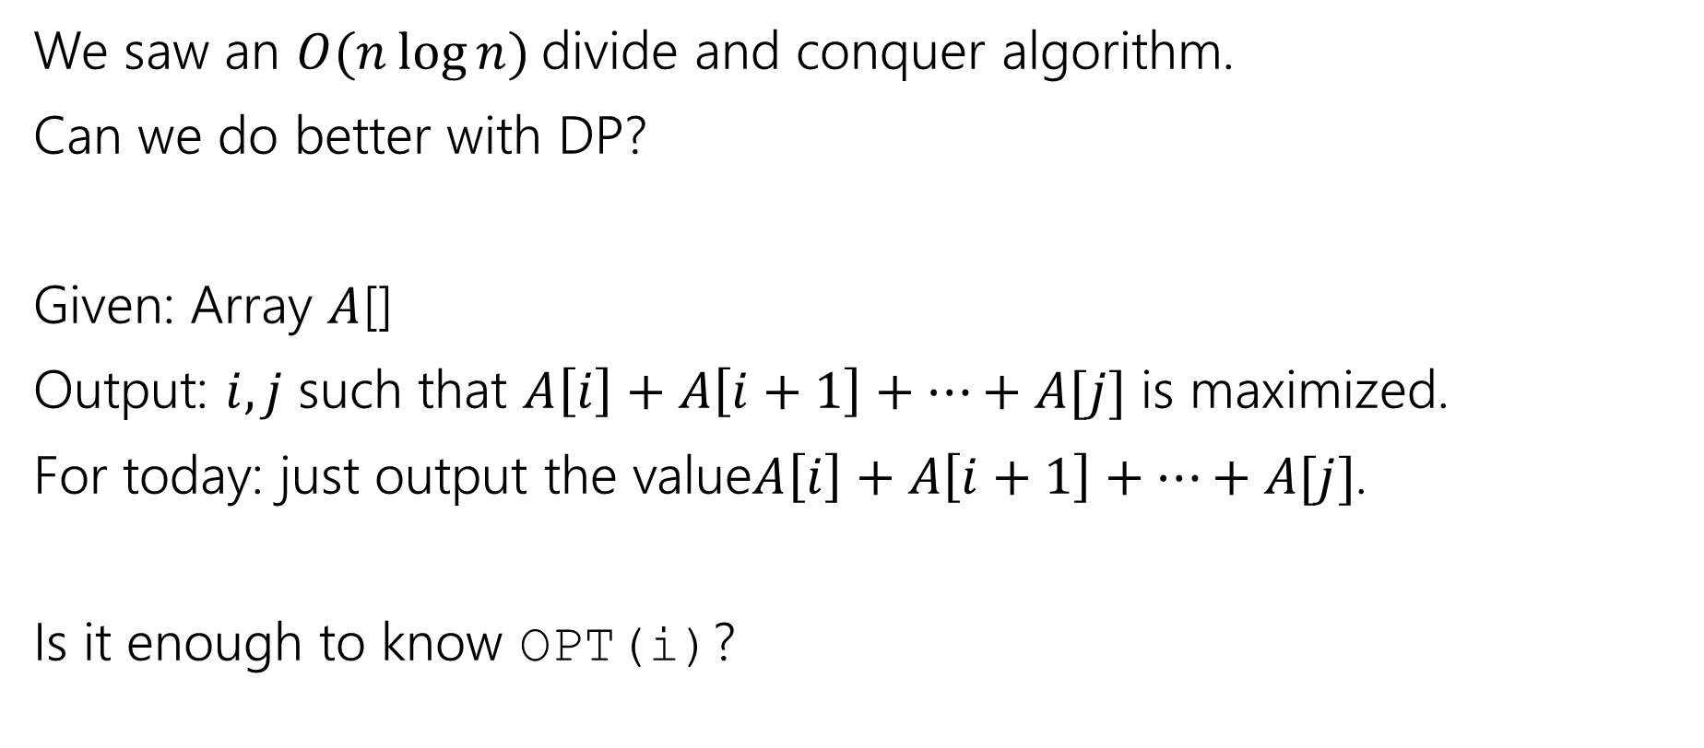
Maximum Contiguous Subarray Sum
We saw an $O(n\log{n)}$divide and conquer algorithm.
Can we do better with DP?
Given: Array $A$[]
Output: $i,j$ such that $A\left[i\right]+A\left[i+1\right]+…+A[j]$ is maximized.
For today: just output the value$A\left[i\right]+A\left[i+1\right]+…+A[j]$.
Is it enough to know OPT(i)?

Slide 31
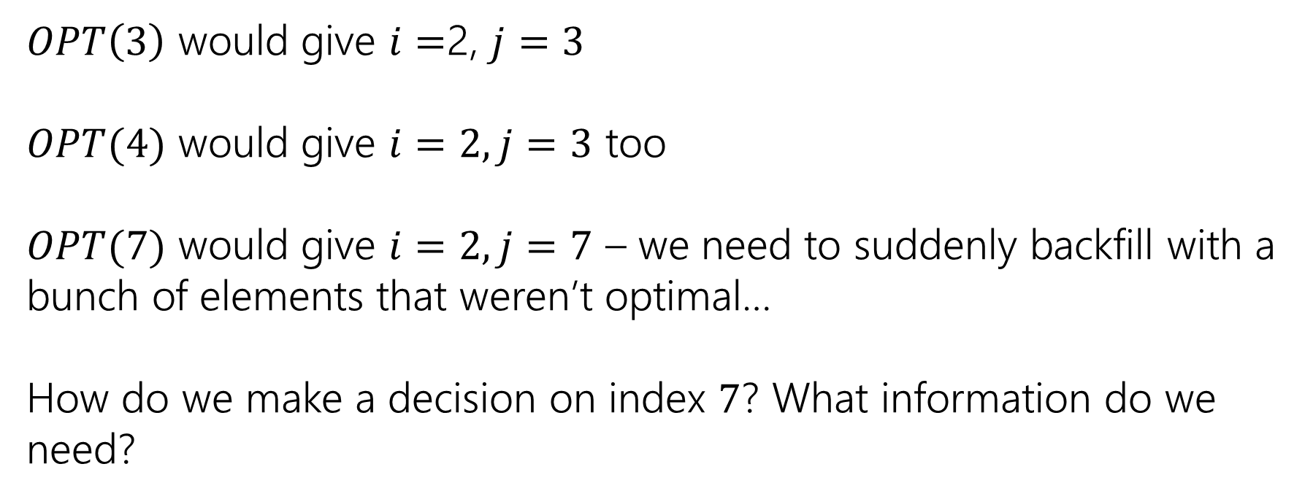
Trying to Recurse
0 | 1 | 2 | 3 | 4 | 5 | 6 | 7
5 | -6 | 3 | 4 | -5 | 2 | 2 | 4
$OPT\left(3\right)$ would give $i=$2, $j=3$
$OPT(4)$ would give $i=2, j=3$ too
$OPT(7)$ would give $i=2, j=7$ – we need to suddenly backfill with a bunch of elements that weren’t optimal…
How do we make a decision on index $7$? What information do we need?

Slide 32
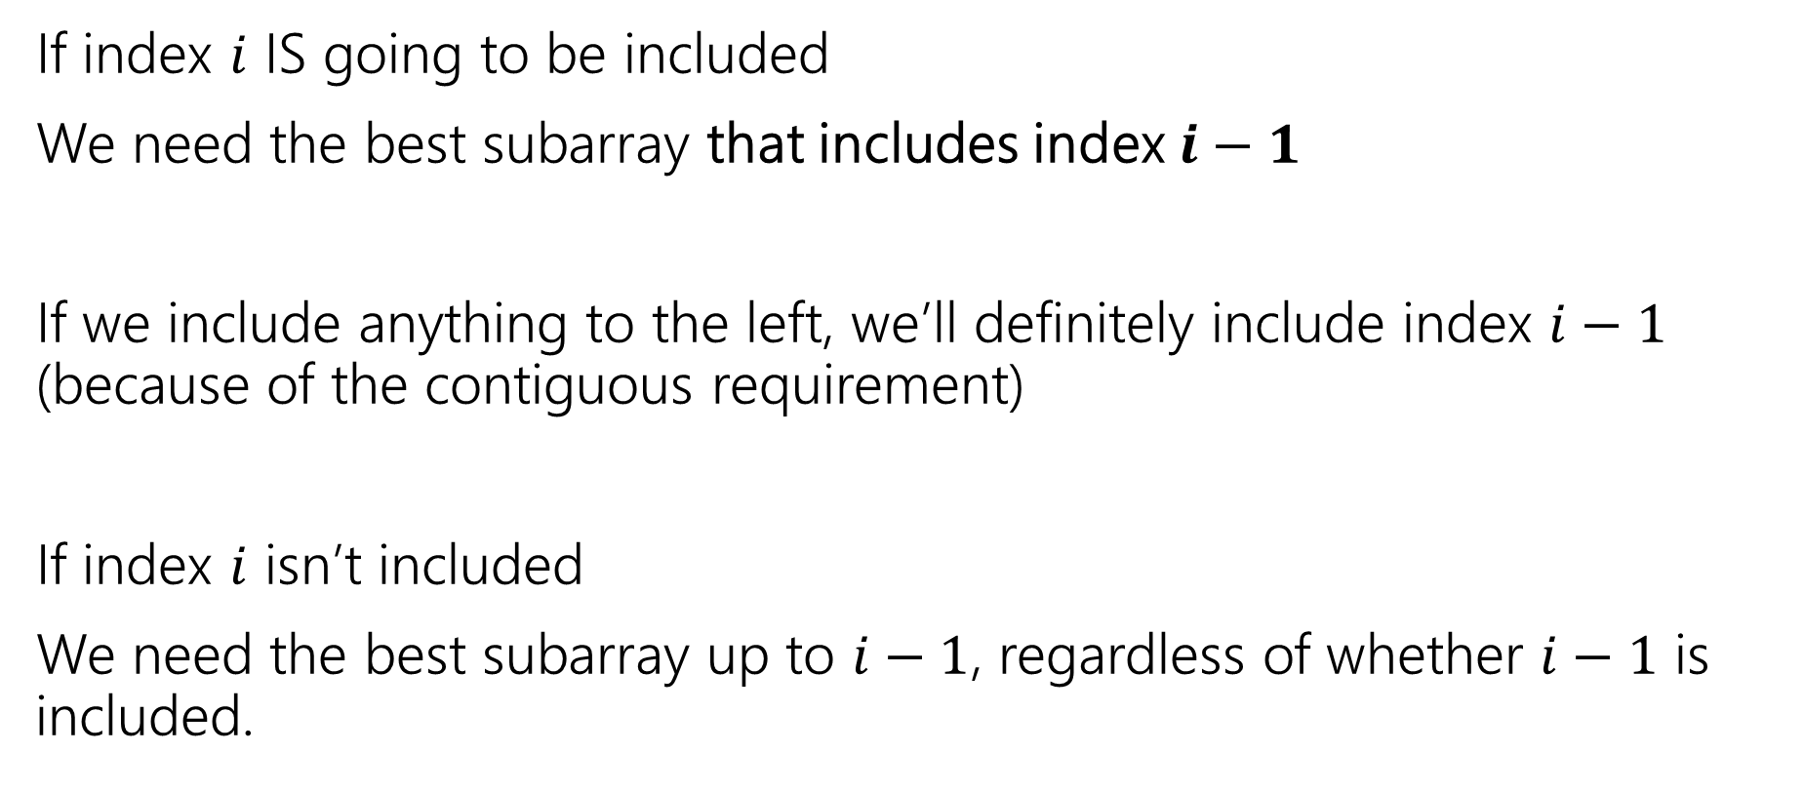
What do we need for recursion?
If index $i$ IS going to be included
We need the best subarray that includes index $i−1$
If we include anything to the left, we’ll definitely include index $i−1$ (because of the contiguous requirement)
If index $i$ isn’t included
We need the best subarray up to $i−1$, regardless of whether $i−1$ is included.

Slide 33
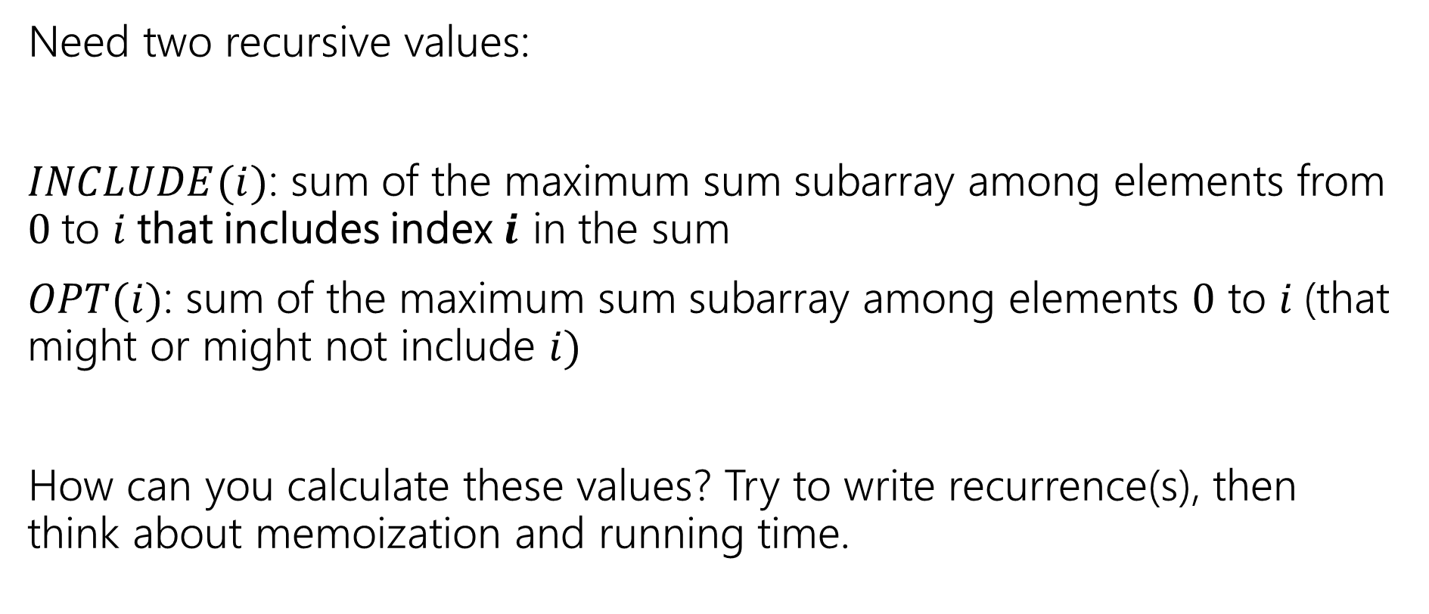
Two Values
Pollev.com/robbie
Need two recursive values:
$INCLUDE(i)$: sum of the maximum sum subarray among elements from $0$to $i$that includes index $i$ in the sum
$OPT(i)$: sum of the maximum sum subarray among elements $0$ to $i$(that might or might not include $i)$
How can you calculate these values? Try to write recurrence(s), then think about memoization and running time.

Slide 34
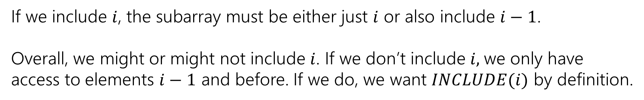

Recurrences
$INCLUDE\left(i\right)=\left\{\begin{aligned}\max\left\{A\left[i\right], A\left[i\right]+INLCUDE\left(i−1\right)\right\} if i≥0 \\ 0 otherwise\end{aligned}\right.$
$OPT\left(i\right)=\left\{\begin{aligned}\max\left\{INCLUDE\left(i\right),OPT\left(i−1\right)\right\} if i≥0 \\ 0 otherwise\end{aligned}\right.$
If we include $i$, the subarray must be either just $i$ or also include $i−1$.
Overall, we might or might not include $i$. If we don’t include $i,$we only have access to elements $i−1$ and before. If we do, we want $INCLUDE(i)$ by definition.

Slide 35



Example
$$A$$
0 | 1 | 2 | 3 | 4 | 5 | 6 | 7
5 | -6 | 3 | 4 | -5 | 2 | 2 | 4
$$OPT(i)$$
0 | 1 | 2 | 3 | 4 | 5 | 6 | 7
5
0 | 1 | 2 | 3 | 4 | 5 | 6 | 7
5
$$INCLUDE(i)$$

Slide 36
Example
$$A$$
0 | 1 | 2 | 3 | 4 | 5 | 6 | 7
5 | -6 | 3 | 4 | -5 | 2 | 2 | 4
$$OPT(i)$$
0 | 1 | 2 | 3 | 4 | 5 | 6 | 7
5 | 5
0 | 1 | 2 | 3 | 4 | 5 | 6 | 7
5 | -1
$$INCLUDE(i)$$

Slide 37
Example
$$A$$
0 | 1 | 2 | 3 | 4 | 5 | 6 | 7
5 | -6 | 3 | 4 | -5 | 2 | 2 | 4
$$OPT(i)$$
0 | 1 | 2 | 3 | 4 | 5 | 6 | 7
5 | 5 | 5 | 7 | 7 | 7 | 7 | 10
0 | 1 | 2 | 3 | 4 | 5 | 6 | 7
5 | -1 | 3 | 7 | 2 | 4 | 6 | 10
$$INCLUDE(i)$$

Slide 38
Pseudocode
int maxSubarraySum(int[] A)
int n=A.length
int[] OPT = new int[n]
int[] Inc = new int[n]
inc[0]=A[0]; OPT[0] = max{A[0],0}
for(int i=0;i<n;i++)
inc[i]=max{A[i], A[i]+inc[i-1]}
OPT[i]=max{inc[i], opt[i-1]}
endFor
return OPT[n-1]

Slide 39
Recursive Thinking In General
As before, the hardest part is designing the recurrence.
It sometimes helps to think from multiple different angles.
Top-down: What’s the first step to take?
Baby Yoda will first go left or down. Use recursion to find out which of left or down is better.
The farthest right operation in the string transformation will be one of insert, delete, substitute, match for free. Use recursion to find out which is best.

Slide 40
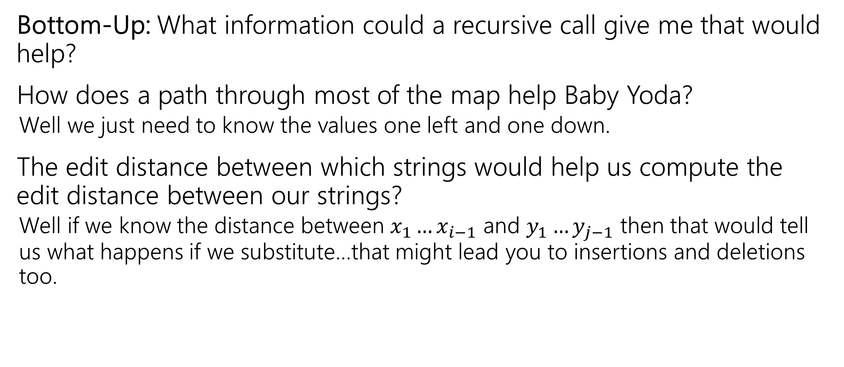
Recursive Thinking In General
Bottom-Up: What information could a recursive call give me that would help?
How does a path through most of the map help Baby Yoda?
  Well we just need to know the values one left and one down.
The edit distance between which strings would help us compute the edit distance between our strings?
  Well if we know the distance between $x_{1}…x_{i−1}$ and $y_{1}…y_{j−1}$ then that would tell us what happens if we substitute…that might lead you to insertions and deletions too.

Slide 41
Recursive Thinking In General
Some people refer to the “Optimal Substructure Property”
From the optimum (most eggs, fewest number of string operations) for a slightly smaller problem (Baby Yoda starting closer to the end, slightly smaller strings), we need to be able to build up the optimum for the full problem.

Slide 42
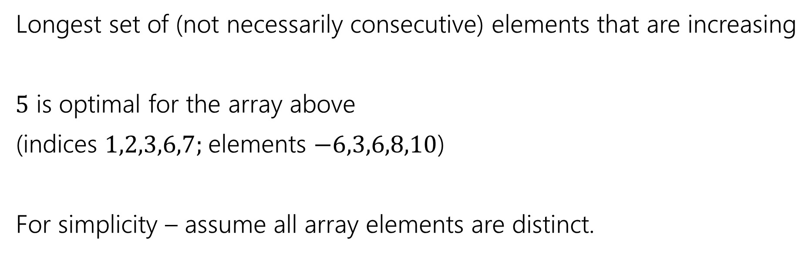
Longest Increasing Subsequence
0 | 1 | 2 | 3 | 4 | 5 | 6 | 7
5 | -6 | 3 | 6 | -5 | 2 | 8 | 10
Longest set of (not necessarily consecutive) elements that are increasing
$5$ is optimal for the array above
(indices $1,2,3,6,7;$elements $−6,3,6,8,10$)
For simplicity – assume all array elements are distinct.

