Slide 1
More Dynamic Programming
CSE 421 Fall 22
Lecture 12

Slide 2
Announcements
The midterm exam is two weeks from today.
Remember it’s in the evening. 90 minutes, 6-7:30 PM.
We’ll be in GWN 301.
  210 seats (so about 1.5x the number of students)
  Long Tables! (not folding-
Form to let us know if you can’t make the main exam
  Request a conflict (work/family responsibilities or something else immovable)
  Have a COVID-related reason to not be in a big lecture hall? We’ll see what we can do.

Slide 3
Announcements
We’ll have a reference sheet for you for the midterm (including, e.g., a list of some algorithms from 332 that you’ve been able to reference)
You’ll also be able to bring your own 8.5x11 inch piece of paper with handwritten notes.
Practice materials, topics list, contents of the provided reference, etc. all coming next week.

Slide 4
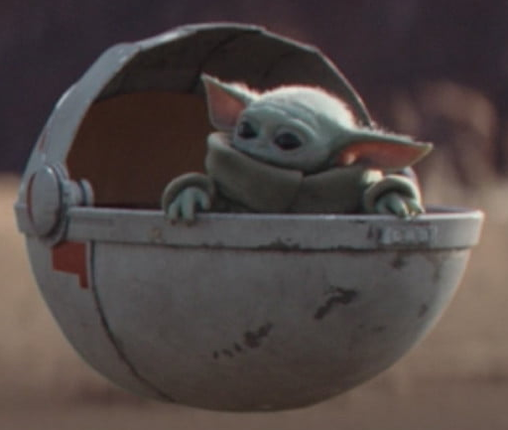
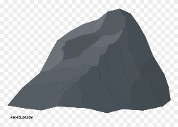
Baby Yoda Searching
Baby Yoda has to get from the upper-right corner to the lower left.
His cradle will only let him go left and down.
He can’t get past the rocks (too high) – he has to go around them (but still only going left and down)
As usual…he’s hungry.
He wants to eat as many frog eggs as possible on the way.

Slide 5
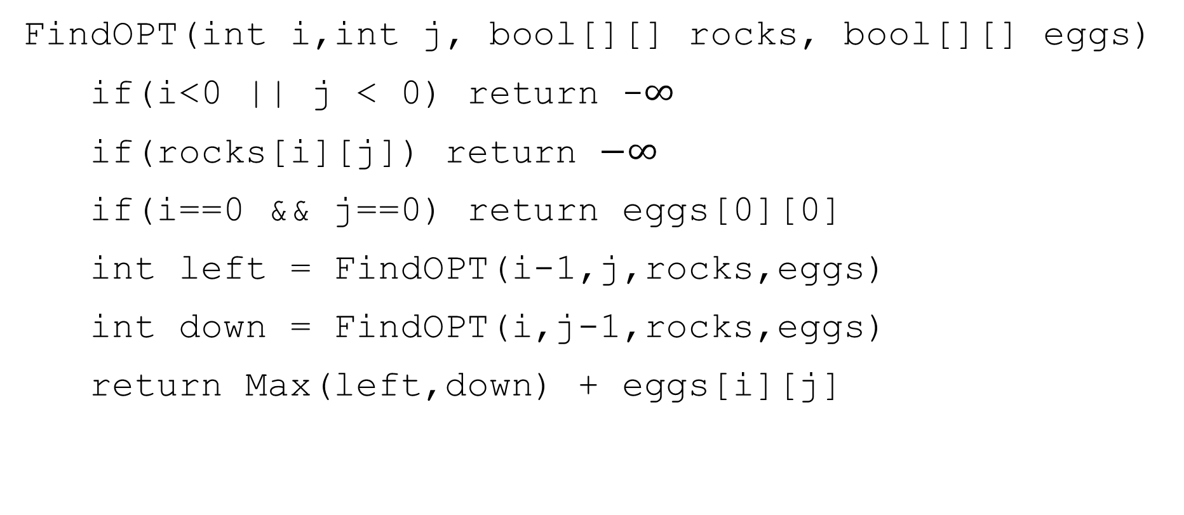
A Recursive Function
FindOPT(int i,int j, bool[][] rocks, bool[][] eggs)
if(i<0 || j < 0) return -$∞$
if(rocks[i][j]) return $−∞$
if(i==0 && j==0) return eggs[0][0]
int left = FindOPT(i-1,j,rocks,eggs)
int down = FindOPT(i,j-1,rocks,eggs)
return Max(left,down) + eggs[i][j]

Slide 6
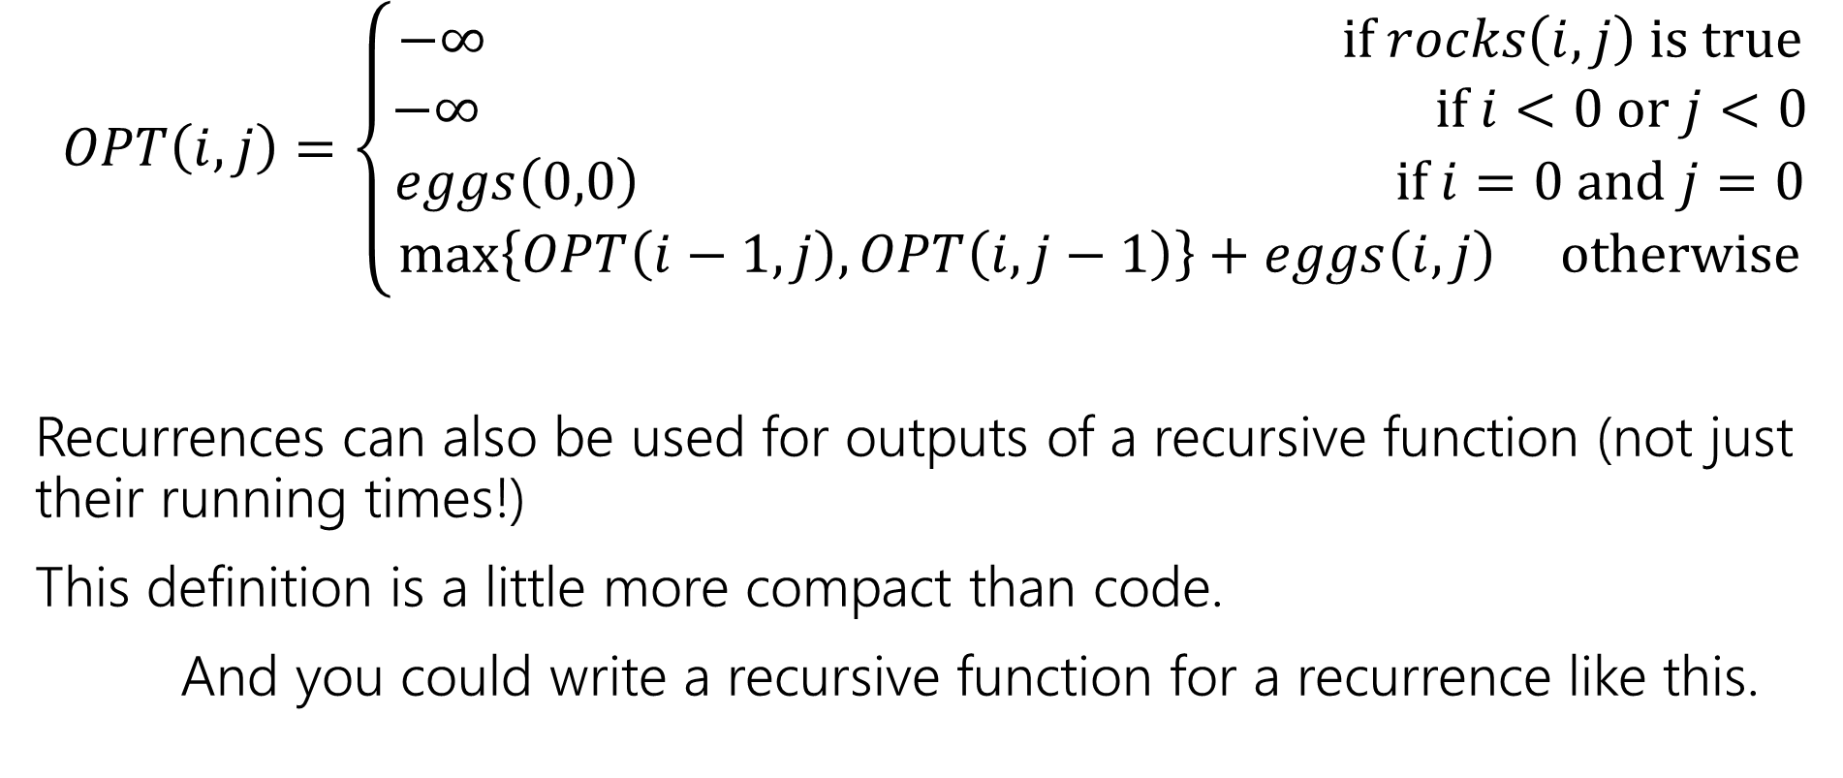
Recurrence Form
$$OPT\left(i,j\right)=\left\{\begin{aligned}−∞ if rocks\left(i,j\right) is true \\ −∞ if i<0 or j<0 \\ eggs\left(0,0\right) if i=0 and j=0 \\ \max\left\{OPT\left(i−1,j\right), OPT\left(i,j−1\right)\right\}+eggs\left(i,j\right) otherwise\end{aligned}\right.$$
Recurrences can also be used for outputs of a recursive function (not just their running times!)
This definition is a little more compact than code.
And you could write a recursive function for a recurrence like this.

Slide 7
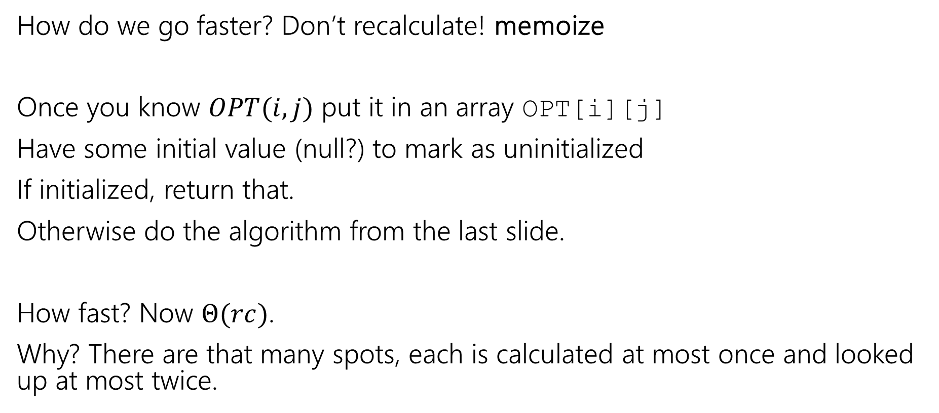
Speedup
How do we go faster? Don’t recalculate! memoize
Once you know $OPT(i,j)$ put it in an array OPT[i][j]
Have some initial value (null?) to mark as uninitialized
If initialized, return that.
Otherwise do the algorithm from the last slide.
How fast? Now $Θ(rc)$.
Why? There are that many spots, each is calculated at most once and looked up at most twice.

Slide 8
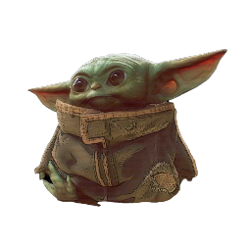



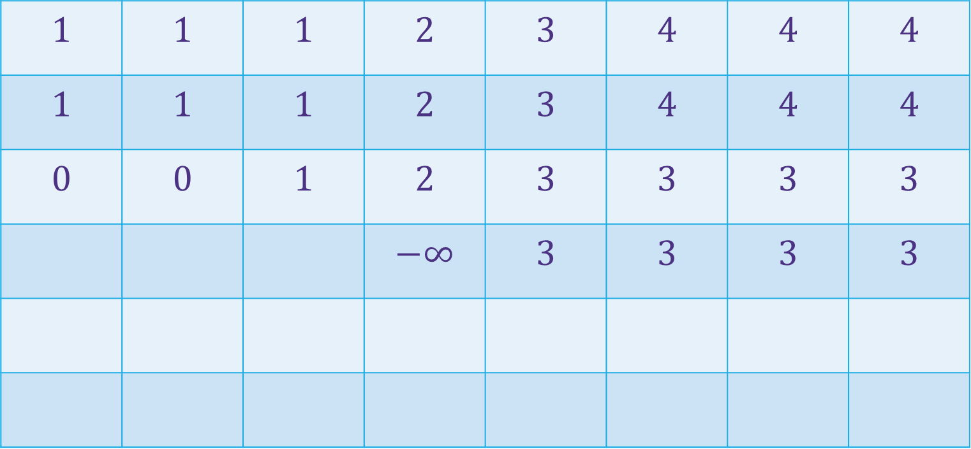
















Baby Yoda Searching
(c-1,r-1)
$$1$$ | $$1$$ | $$1$$ | $$2$$ | $$3$$ | $$4$$ | $$4$$ | $$4$$
$$1$$ | $$1$$ | $$1$$ | $$2$$ | $$3$$ | $$4$$ | $$4$$ | $$4$$
$$0$$ | $$0$$ | $$1$$ | $$2$$ | $$3$$ | $$3$$ | $$3$$ | $$3$$
 |  |  | $$−∞$$ | $$3$$ | $$3$$ | $$3$$ | $$3$$
r-1
Where’s the final answer?
In the top right. Where Baby Yoda starts.
Y-coordinate
$$0$$
$$−∞$$
$$−∞$$
$$0$$
$$1$$
$$−∞$$
$$2$$
$$2$$
$$2$$
$$2$$
$$2$$
0
$$0$$
$$1$$
$$2$$
$$2$$
$$2$$
$$2$$
$$2$$
$$2$$
X-coordinate
0
c-1
Notes:
https://1.bp.blogspot.com/-XxfNI65zLnU/Xc98O96LVnI/AAAAAAAAGFY/Xsmd7IMlIrEltYONCdGKk1hqPw1BgL3ggCLcBGAsYHQ/s1600/Mandalorian.jpg
http://www.pngmart.com/image/161116/png/161115
https://www.pikpng.com/pngvi/hiTxbbR_clip-art-rock-rock-clipart-transparent-background-png-download/

Slide 9
Going Bottom-up
So how does that recursion work?
What’s the first entry of the table that we fill?
OPT[0][0]
Why not just start filling in there?

Slide 10
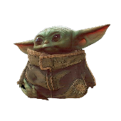




Baby Yoda Searching
(c-1,r-1)
r-1
What else can we fill in?
Y-coordinate
(0,2)
(0,1)
(1,1)
0
$$0$$
$$1$$
$$2$$
$$2$$
$$2$$
$$2$$
$$2$$
$$2$$
(0,0)
X-coordinate
0
c-1
Notes:
https://1.bp.blogspot.com/-XxfNI65zLnU/Xc98O96LVnI/AAAAAAAAGFY/Xsmd7IMlIrEltYONCdGKk1hqPw1BgL3ggCLcBGAsYHQ/s1600/Mandalorian.jpg
http://www.pngmart.com/image/161116/png/161115
https://www.pikpng.com/pngvi/hiTxbbR_clip-art-rock-rock-clipart-transparent-background-png-download/

Slide 11



Baby Yoda Searching
(c-1,r-1)
r-1
What else can we fill in?
Y-coordinate
(0,2)
$$0$$
$$1$$
$$−∞$$
$$2$$
$$2$$
$$2$$
$$2$$
$$2$$
(0,1)
(1,1)
0
$$0$$
$$1$$
$$2$$
$$2$$
$$2$$
$$2$$
$$2$$
$$2$$
X-coordinate
0
c-1
Notes:
https://1.bp.blogspot.com/-XxfNI65zLnU/Xc98O96LVnI/AAAAAAAAGFY/Xsmd7IMlIrEltYONCdGKk1hqPw1BgL3ggCLcBGAsYHQ/s1600/Mandalorian.jpg
http://www.pngmart.com/image/161116/png/161115
https://www.pikpng.com/pngvi/hiTxbbR_clip-art-rock-rock-clipart-transparent-background-png-download/

Slide 12
Baby Yoda Searching
(c-1,r-1)
r-1
What else can we fill in?
Y-coordinate
$$0$$
$$−∞$$
$$0$$
$$1$$
$$−∞$$
$$2$$
$$2$$
$$2$$
$$2$$
$$2$$
0
$$0$$
$$1$$
$$2$$
$$2$$
$$2$$
$$2$$
$$2$$
$$2$$
X-coordinate
0
c-1
Notes:
https://1.bp.blogspot.com/-XxfNI65zLnU/Xc98O96LVnI/AAAAAAAAGFY/Xsmd7IMlIrEltYONCdGKk1hqPw1BgL3ggCLcBGAsYHQ/s1600/Mandalorian.jpg
http://www.pngmart.com/image/161116/png/161115
https://www.pikpng.com/pngvi/hiTxbbR_clip-art-rock-rock-clipart-transparent-background-png-download/

Slide 13
Baby Yoda Searching
(c-1,r-1)
$$1$$ | $$1$$ | $$1$$ | $$2$$ | $$3$$ | $$4$$ | $$4$$ | $$4$$
$$1$$ | $$1$$ | $$1$$ | $$2$$ | $$3$$ | $$4$$ | $$4$$ | $$4$$
$$0$$ | $$0$$ | $$1$$ | $$2$$ | $$3$$ | $$3$$ | $$3$$ | $$3$$
 |  |  | $$−∞$$ | $$3$$ | $$3$$ | $$3$$ | $$3$$
r-1
Where’s the final answer?
In the top right. Where Baby Yoda starts.
Y-coordinate
$$0$$
$$−∞$$
$$−∞$$
$$0$$
$$1$$
$$−∞$$
$$2$$
$$2$$
$$2$$
$$2$$
$$2$$
0
$$0$$
$$1$$
$$2$$
$$2$$
$$2$$
$$2$$
$$2$$
$$2$$
X-coordinate
0
c-1
Notes:
https://1.bp.blogspot.com/-XxfNI65zLnU/Xc98O96LVnI/AAAAAAAAGFY/Xsmd7IMlIrEltYONCdGKk1hqPw1BgL3ggCLcBGAsYHQ/s1600/Mandalorian.jpg
http://www.pngmart.com/image/161116/png/161115
https://www.pikpng.com/pngvi/hiTxbbR_clip-art-rock-rock-clipart-transparent-background-png-download/

Slide 14
What order?
Fill in a row at a time (left to right)
Going up to the next row once a level is done.
In actual code, probably easier to handle edges first
Avoid the index-out-of-bound exceptions.

Slide 15
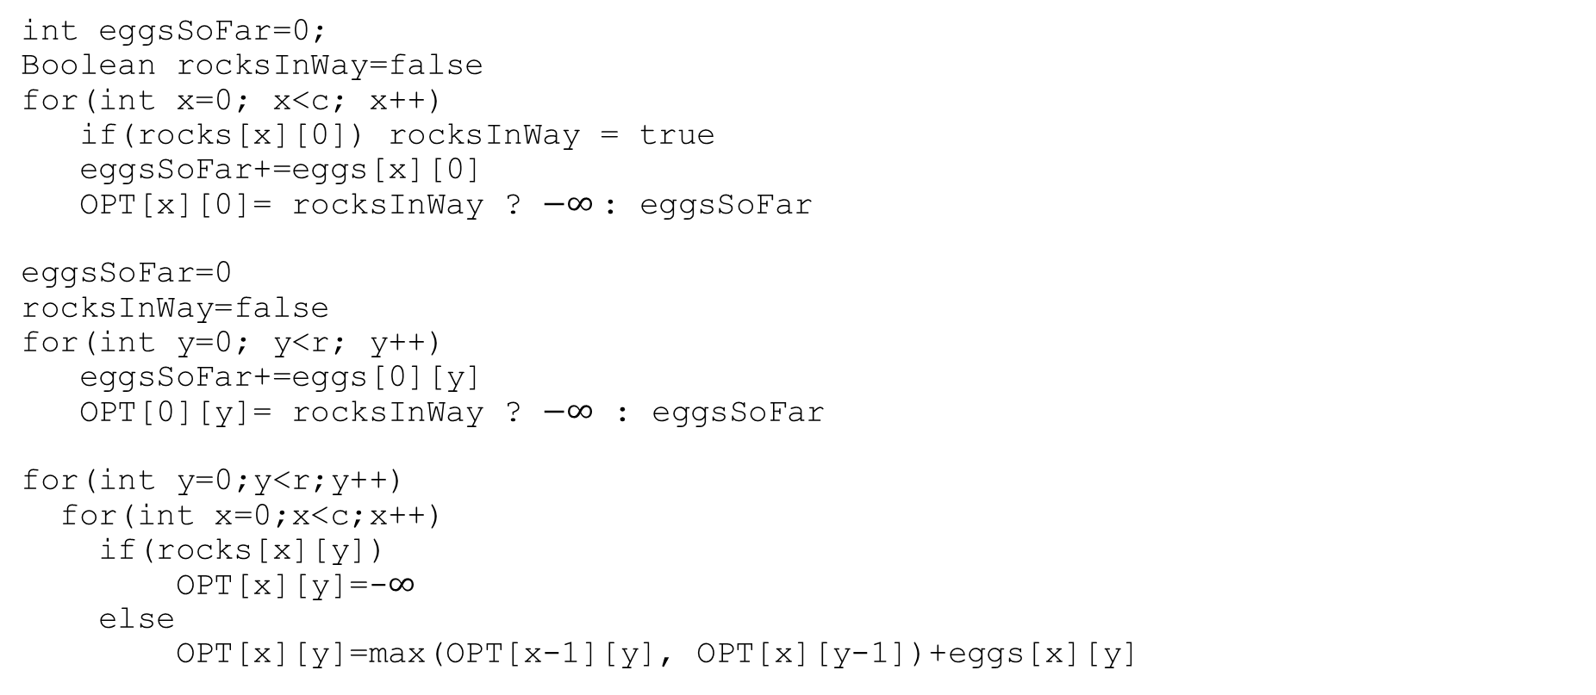
Pseudocode
int eggsSoFar=0;
Boolean rocksInWay=false
for(int x=0; x<c; x++)
if(rocks[x][0]) rocksInWay = true
eggsSoFar+=eggs[x][0]
OPT[x][0]= rocksInWay ? $−∞$: eggsSoFar
eggsSoFar=0
rocksInWay=false
for(int y=0; y<r; y++)
eggsSoFar+=eggs[0][y]
OPT[0][y]= rocksInWay ? $−∞$ : eggsSoFar
for(int y=0;y<r;y++)
for(int x=0;x<c;x++)
if(rocks[x][y])
OPT[x][y]=-$∞$
else
OPT[x][y]=max(OPT[x-1][y], OPT[x][y-1])+eggs[x][y]

Slide 16
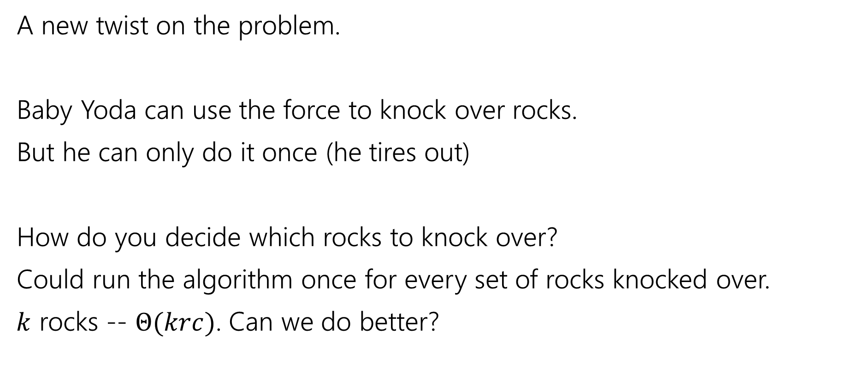
Updating the Problem
A new twist on the problem.
Baby Yoda can use the force to knock over rocks.
But he can only do it once (he tires out)
How do you decide which rocks to knock over?
Could run the algorithm once for every set of rocks knocked over.
$k$ rocks -- $Θ(krc)$. Can we do better?

Slide 17
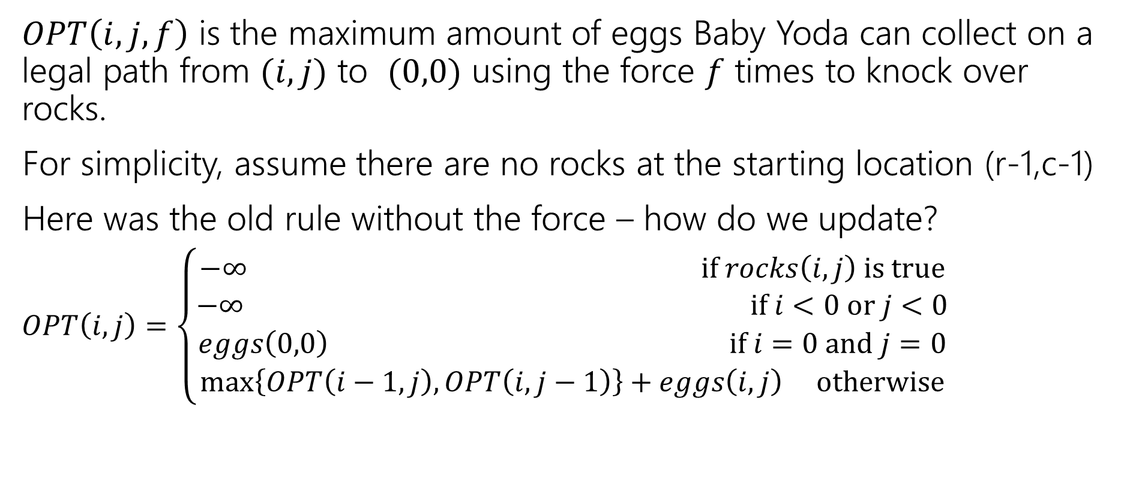
Updating the Problem
$OPT\left(i,j,f\right)$ is the maximum amount of eggs Baby Yoda can collect on a legal path from $(i,j)$ to $(0,0)$ using the force $f$ times to knock over rocks.
For simplicity, assume there are no rocks at the starting location (r-1,c-1)
Here was the old rule without the force – how do we update?
$OPT\left(i,j\right)=\left\{\begin{aligned}−∞ if rocks\left(i,j\right) is true \\ −∞ if i<0 or j<0 \\ eggs\left(0,0\right) if i=0 and j=0 \\ \max\left\{OPT\left(i−1,j\right), OPT\left(i,j−1\right)\right\}+eggs\left(i,j\right) otherwise\end{aligned}\right.$

Slide 18
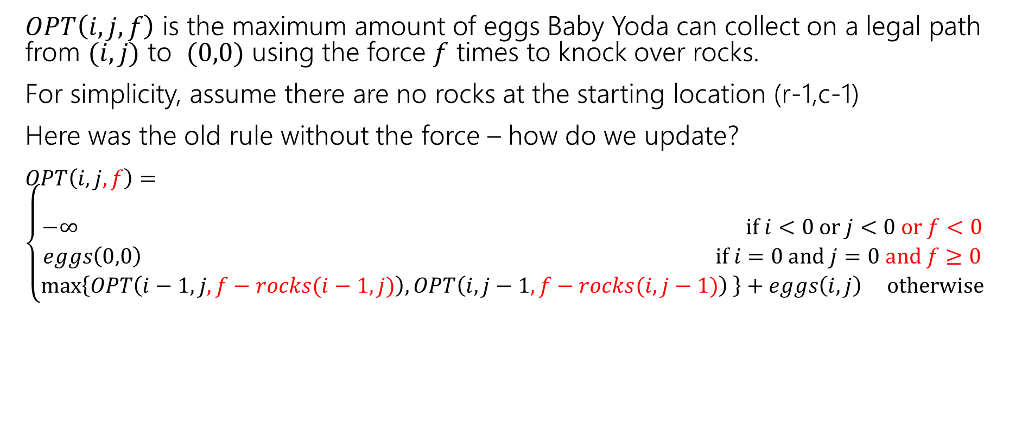
Updating the Problem
$OPT\left(i,j,f\right)$ is the maximum amount of eggs Baby Yoda can collect on a legal path from $(i,j)$ to $(0,0)$ using the force $f$ times to knock over rocks.
For simplicity, assume there are no rocks at the starting location (r-1,c-1)
Here was the old rule without the force – how do we update?
$OPT\left(i,j,f\right)=\left\{\begin{aligned} \\ −∞ if i<0 or j<0 or f<0 \\ eggs\left(0,0\right) if i=0 and j=0 and f≥0 \\ \max\left\{OPT\left(i−1,j,f−rocks(i−1,j)\right), OPT\left(i,j−1,f−rocks(i,j−1)\right) \right\}+eggs\left(i,j\right) otherwise\end{aligned}\right.$
Casting Boolean as an integer
(subtract 1 if you would need to knock over rocks)

Slide 19
Updating the Problem
$OPT\left(i,j,f\right)$ is the maximum amount of eggs Baby Yoda can collect on a legal path from $(i,j)$ to $(0,0)$ using the force $f$ times to knock over rocks.
For simplicity, assume there are no rocks at the starting location (r-1,c-1)
Here was the old rule without the force – how do we update?
$OPT\left(i,j,f\right)=\left\{\begin{aligned} \\ −∞ if i<0 or j<0 or f<0 \\ eggs\left(0,0\right) if i=0 and j=0 and f≥0 \\ \max\left\{OPT\left(i−1,j,f−rocks(i−1,j)\right), OPT\left(i,j−1,f−rocks(i,j−1)\right) \right\}+eggs\left(i,j\right) otherwise\end{aligned}\right.$
rocks(i,j) doesn’t guarantee $−∞$ anymore. Only if you were out of force uses before trying to jump onto that location.

Slide 20
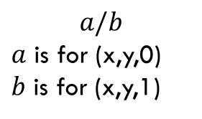
Baby Yoda Searching
(c-1,r-1)
r-1
What can we fill in?
Y-coordinate
$$a/b$$
$a$ is for (x,y,0)
$b$ is for (x,y,1)
0
X-coordinate
0
c-1
Notes:
https://1.bp.blogspot.com/-XxfNI65zLnU/Xc98O96LVnI/AAAAAAAAGFY/Xsmd7IMlIrEltYONCdGKk1hqPw1BgL3ggCLcBGAsYHQ/s1600/Mandalorian.jpg
http://www.pngmart.com/image/161116/png/161115
https://www.pikpng.com/pngvi/hiTxbbR_clip-art-rock-rock-clipart-transparent-background-png-download/

Slide 21








Baby Yoda Searching
(c-1,r-1)
r-1
What can we fill in?
Y-coordinate
$$a/b$$
$a$ is for (x,y,0)
$b$ is for (x,y,1)
0
$$0/?$$
$$1/?$$
$$2/?$$
$$2/?$$
$$2/?$$
$$2/?$$
$$2/?$$
$$2/?$$
X-coordinate
0
c-1
Notes:
https://1.bp.blogspot.com/-XxfNI65zLnU/Xc98O96LVnI/AAAAAAAAGFY/Xsmd7IMlIrEltYONCdGKk1hqPw1BgL3ggCLcBGAsYHQ/s1600/Mandalorian.jpg
http://www.pngmart.com/image/161116/png/161115
https://www.pikpng.com/pngvi/hiTxbbR_clip-art-rock-rock-clipart-transparent-background-png-download/

Slide 22





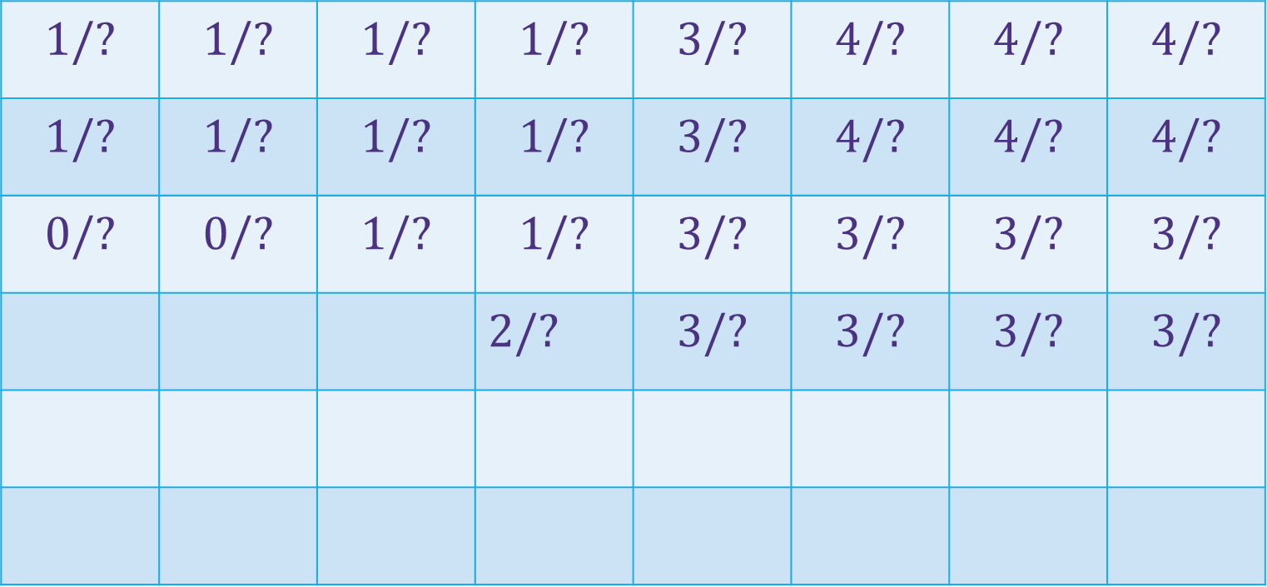





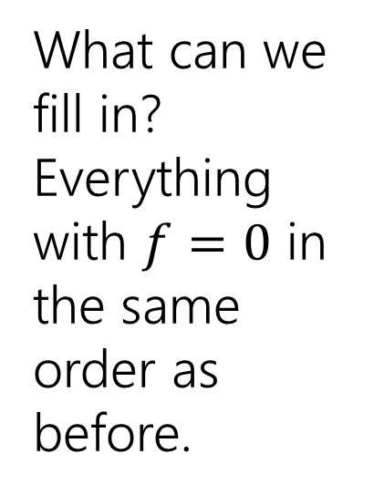







Baby Yoda Searching
(c-1,r-1)
$$1/?$$ | $$1/?$$ | $$1/?$$ | $$1/?$$ | $$3/?$$ | $$4/?$$ | $$4/?$$ | $$4/?$$
$$1/?$$ | $$1/?$$ | $$1/?$$ | $$1/?$$ | $$3/?$$ | $$4/?$$ | $$4/?$$ | $$4/?$$
$$0/?$$ | $$0/?$$ | $$1/?$$ | $$1/?$$ | $$3/?$$ | $$3/?$$ | $$3/?$$ | $$3/?$$
 |  |  | $2/?$ | $$3/?$$ | $$3/?$$ | $$3/?$$ | $$3/?$$
r-1
What can we fill in?
Everything with $f=0$ in the same order as before.
Y-coordinate
$$0/?$$
$$1/?$$
$$−∞/?$$
$$0/?$$
$$1/?$$
$$2/?$$
$$2/?$$
$$2/?$$
$$2/?$$
$$2/?$$
$$2/?$$
0
$$0/?$$
$$1/?$$
$$2/?$$
$$2/?$$
$$2/?$$
$$2/?$$
$$2/?$$
$$2/?$$
Entries are slightly different – we’re handling rocks differently.
X-coordinate
0
c-1
Notes:
https://1.bp.blogspot.com/-XxfNI65zLnU/Xc98O96LVnI/AAAAAAAAGFY/Xsmd7IMlIrEltYONCdGKk1hqPw1BgL3ggCLcBGAsYHQ/s1600/Mandalorian.jpg
http://www.pngmart.com/image/161116/png/161115
https://www.pikpng.com/pngvi/hiTxbbR_clip-art-rock-rock-clipart-transparent-background-png-download/

Slide 23
Baby Yoda Searching
(c-1,r-1)
$$1/?$$ | $$1/?$$ | $$1/?$$ | $$1/?$$ | $$3/?$$ | $$4/?$$ | $$4/?$$ | $$4/?$$
$$1/?$$ | $$1/?$$ | $$1/?$$ | $$1/?$$ | $$3/?$$ | $$4/?$$ | $$4/?$$ | $$4/?$$
$$0/?$$ | $$0/?$$ | $$1/?$$ | $$1/?$$ | $$3/?$$ | $$3/?$$ | $$3/?$$ | $$3/?$$
 |  |  | $2/?$ | $$3/?$$ | $$3/?$$ | $$3/?$$ | $$3/?$$
r-1
What can we fill in?
Again from left to right, bottom to top, now filling in
Y-coordinate
$$0/?$$
$$1/?$$
$$−∞/?$$
$$0/?$$
$$1/?$$
$$2/?$$
$$2/?$$
$$2/?$$
$$2/?$$
$$2/?$$
$$2/?$$
0
$$0/?$$
$$1/?$$
$$2/?$$
$$2/?$$
$$2/?$$
$$2/?$$
$$2/?$$
$$2/?$$
X-coordinate
0
c-1
Notes:
https://1.bp.blogspot.com/-XxfNI65zLnU/Xc98O96LVnI/AAAAAAAAGFY/Xsmd7IMlIrEltYONCdGKk1hqPw1BgL3ggCLcBGAsYHQ/s1600/Mandalorian.jpg
http://www.pngmart.com/image/161116/png/161115
https://www.pikpng.com/pngvi/hiTxbbR_clip-art-rock-rock-clipart-transparent-background-png-download/

Slide 24



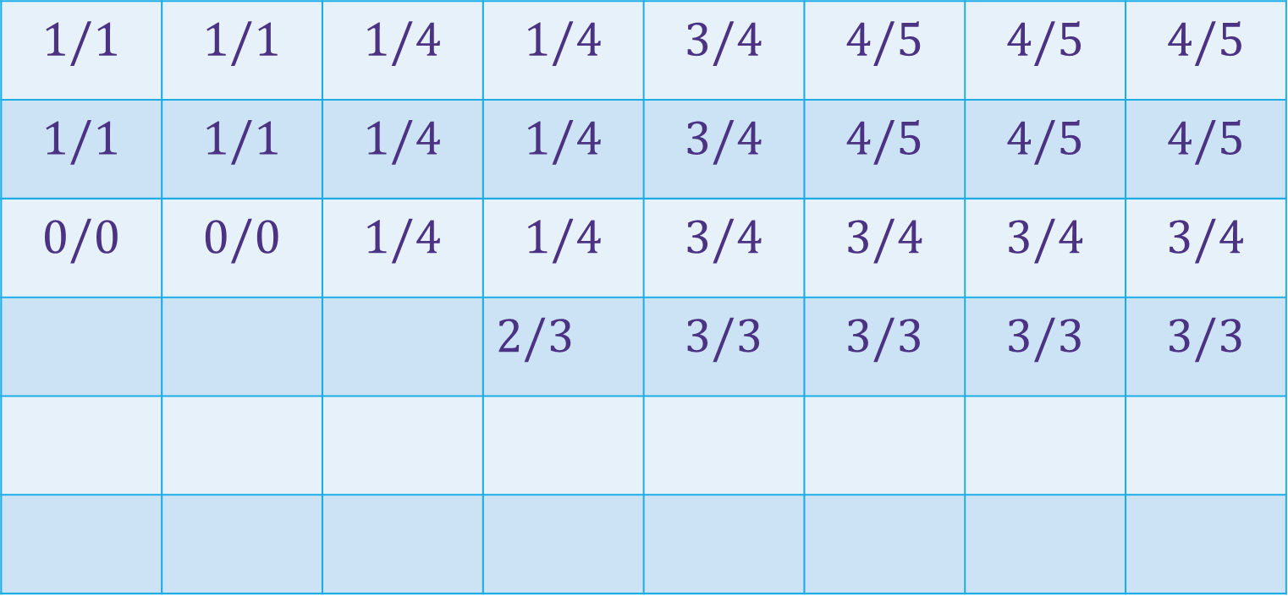
















Baby Yoda Searching
(c-1,r-1)
$$1/1$$ | $$1/1$$ | $$1/4$$ | $$1/4$$ | $$3/4$$ | $$4/5$$ | $$4/5$$ | $$4/5$$
$$1/1$$ | $$1/1$$ | $$1/4$$ | $$1/4$$ | $$3/4$$ | $$4/5$$ | $$4/5$$ | $$4/5$$
$$0/0$$ | $$0/0$$ | $$1/4$$ | $$1/4$$ | $$3/4$$ | $$3/4$$ | $$3/4$$ | $$3/4$$
 |  |  | $2/3$ | $$3/3$$ | $$3/3$$ | $$3/3$$ | $$3/3$$
r-1
What can we fill in?
Again from left to right, bottom to top, now filling in
Y-coordinate
$$0/0$$
$$1/1$$
$$−∞/3$$
$$0/0$$
$$1/1$$
$$2/2$$
$$2/2$$
$$2/2$$
$$2/2$$
$$2/2$$
$$2/2$$
0
$$0/0$$
$$1/1$$
$$2/2$$
$$2/2$$
$$2/2$$
$$2/2$$
$$2/2$$
$$2/2$$
X-coordinate
0
c-1
Notes:
https://1.bp.blogspot.com/-XxfNI65zLnU/Xc98O96LVnI/AAAAAAAAGFY/Xsmd7IMlIrEltYONCdGKk1hqPw1BgL3ggCLcBGAsYHQ/s1600/Mandalorian.jpg
http://www.pngmart.com/image/161116/png/161115
https://www.pikpng.com/pngvi/hiTxbbR_clip-art-rock-rock-clipart-transparent-background-png-download/

Slide 25
Dynamic Programming Process
1. Define the object you’re looking for
2. Write a recurrence to say how to find it
3. Design a memoization structure
4. Write an iterative algorithm

Slide 26
Bells,Whistles, and optimiziation

Slide 27
Baby Yoda Searching
(c-1,r-1)
$$1/1$$ | $$1/1$$ | $$1/4$$ | $$1/4$$ | $$3/4$$ | $$4/5$$ | $$4/5$$ | $$4/5$$
$$1/1$$ | $$1/1$$ | $$1/4$$ | $$1/4$$ | $$3/4$$ | $$4/5$$ | $$4/5$$ | $$4/5$$
$$0/0$$ | $$0/0$$ | $$1/4$$ | $$1/4$$ | $$3/4$$ | $$3/4$$ | $$3/4$$ | $$3/4$$
 |  |  | $2/3$ | $$3/3$$ | $$3/3$$ | $$3/3$$ | $$3/3$$
r-1
So should Baby Yoda go left or down?
Y-coordinate
$$0/0$$
$$1/1$$
$$−∞/3$$
$$0/0$$
$$1/1$$
$$2/2$$
$$2/2$$
$$2/2$$
$$2/2$$
$$2/2$$
$$2/2$$
0
$$0/0$$
$$1/1$$
$$2/2$$
$$2/2$$
$$2/2$$
$$2/2$$
$$2/2$$
$$2/2$$
X-coordinate
0
c-1
Notes:
https://1.bp.blogspot.com/-XxfNI65zLnU/Xc98O96LVnI/AAAAAAAAGFY/Xsmd7IMlIrEltYONCdGKk1hqPw1BgL3ggCLcBGAsYHQ/s1600/Mandalorian.jpg
http://www.pngmart.com/image/161116/png/161115
https://www.pikpng.com/pngvi/hiTxbbR_clip-art-rock-rock-clipart-transparent-background-png-download/

Slide 28
Which Way to Go
When you’re taking the max in the recursive case, you can also record which option gave you the max.
That’s the way to go.
We’ll ask you to do that once…but for the most part we’ll just have you find the number.

Slide 29
Optimizing
Do we need all that memory?
Let’s go back to the simple version (no using the Force)

Slide 30
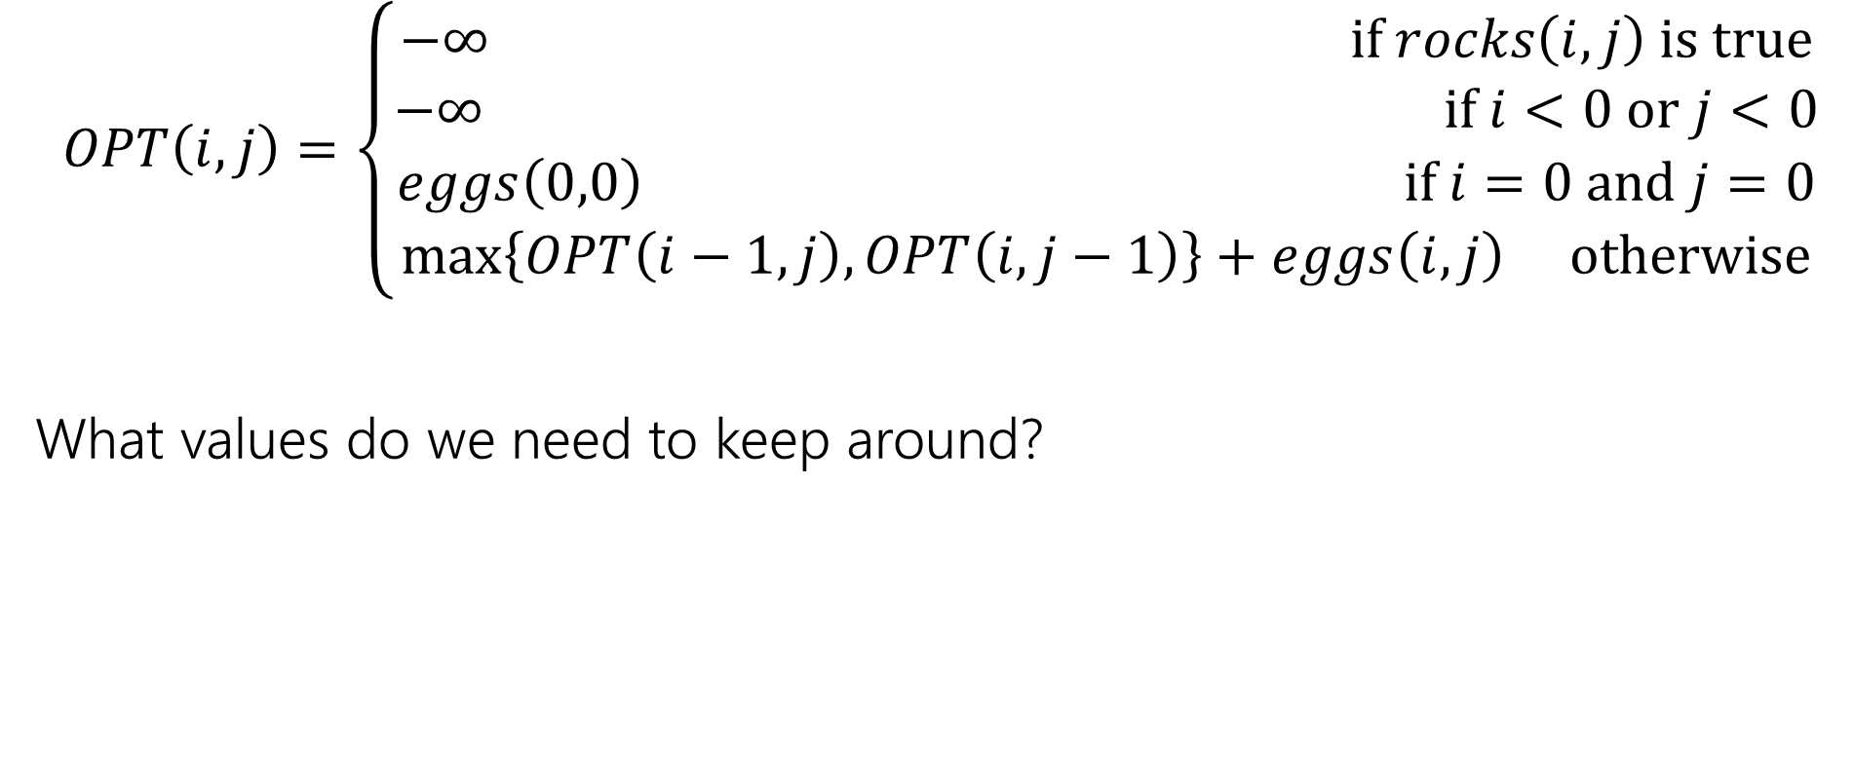
Recurrence Form
$$OPT\left(i,j\right)=\left\{\begin{aligned}−∞ if rocks\left(i,j\right) is true \\ −∞ if i<0 or j<0 \\ eggs\left(0,0\right) if i=0 and j=0 \\ \max\left\{OPT\left(i−1,j\right), OPT\left(i,j−1\right)\right\}+eggs\left(i,j\right) otherwise\end{aligned}\right.$$
What values do we need to keep around?

Slide 31
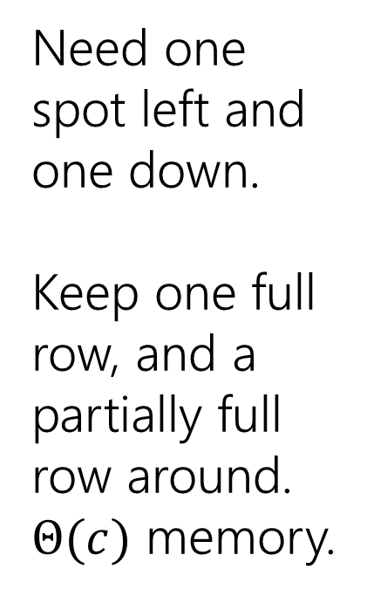
Baby Yoda Searching
(c-1,r-1)
$$1$$ | $$1$$ | $$1$$ | $$2$$ | $$3$$ | $$4$$ | $$4$$ | $$4$$
$$1$$ | $$1$$ | $$1$$ | $$2$$ | $$3$$ | $$4$$ | $$4$$ | $$4$$
$$0$$ | $$0$$ | $$1$$ | $$2$$ | $$3$$ | $$3$$ | $$3$$ | $$3$$
 |  |  | $$−∞$$ | $$3$$ | $$3$$ | $$3$$ | $$3$$
r-1
Need one spot left and one down.
Keep one full row, and a partially full row around.
$Θ(c)$ memory.
Y-coordinate
$$0$$
$$−∞$$
$$−∞$$
$$0$$
$$1$$
$$−∞$$
$$2$$
$$2$$
$$2$$
$$2$$
$$2$$
0
$$0$$
$$1$$
$$2$$
$$2$$
$$2$$
$$2$$
$$2$$
$$2$$
X-coordinate
0
c-1
Notes:
https://1.bp.blogspot.com/-XxfNI65zLnU/Xc98O96LVnI/AAAAAAAAGFY/Xsmd7IMlIrEltYONCdGKk1hqPw1BgL3ggCLcBGAsYHQ/s1600/Mandalorian.jpg
http://www.pngmart.com/image/161116/png/161115
https://www.pikpng.com/pngvi/hiTxbbR_clip-art-rock-rock-clipart-transparent-background-png-download/

Slide 32
More Practical Problems

Slide 33

Edit Distance
Given two strings $x$ and $y,$we’d like to tell how close they are.
Applications?
Spelling suggestions
DNA comparison

Slide 34
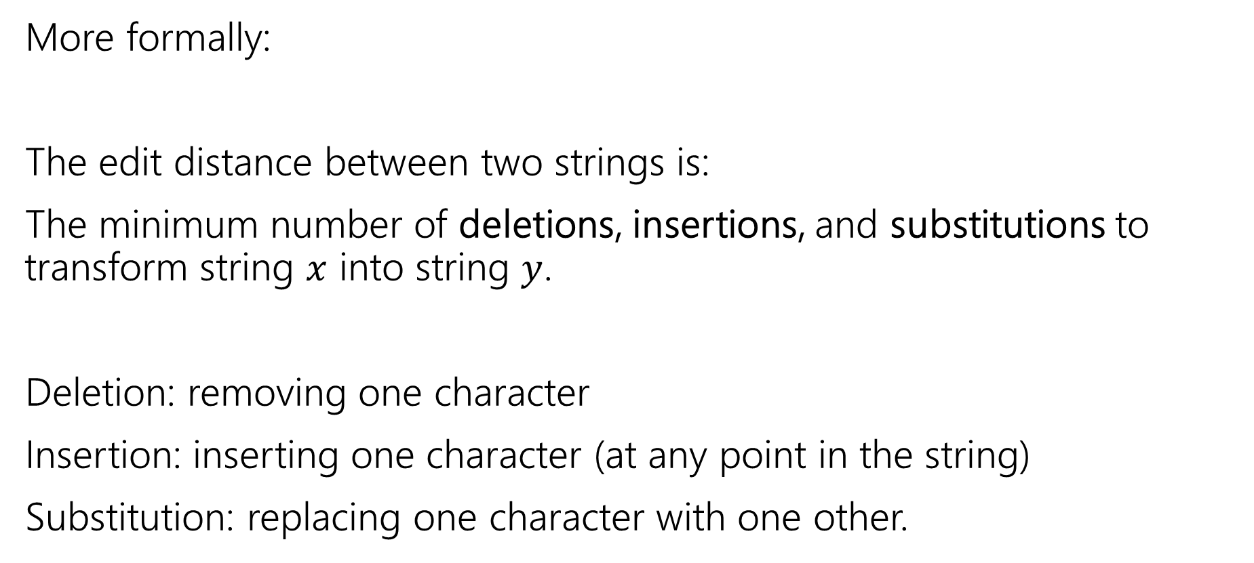
Edit Distance
More formally:
The edit distance between two strings is:
The minimum number of deletions, insertions, and substitutions to transform string $x$ into string $y$.
Deletion: removing one character
Insertion: inserting one character (at any point in the string)
Substitution: replacing one character with one other.

Slide 35
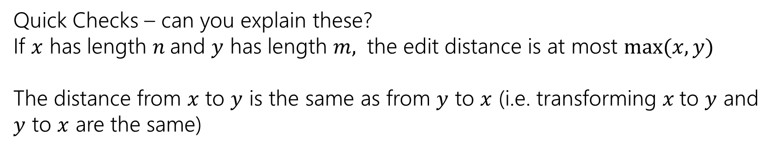
Example
What’s the distance between babyyodas and tastysoda?
B | A | B |  | Y | Y | O | D | A | S
sub |  | sub | ins |  | sub |  |  |  | del
T | A | S | T | Y | S | O | D | A
Distance: 5, one point for each colored box
Quick Checks – can you explain these?
If $x$ has length $n$and $y$ has length $m,$ the edit distance is at most $\max{(x,y)}$
The distance from $x$ to $y$ is the same as from $y$ to $x$ (i.e. transforming $x$to $y$ and $y$ to $x$ are the same)

Slide 36
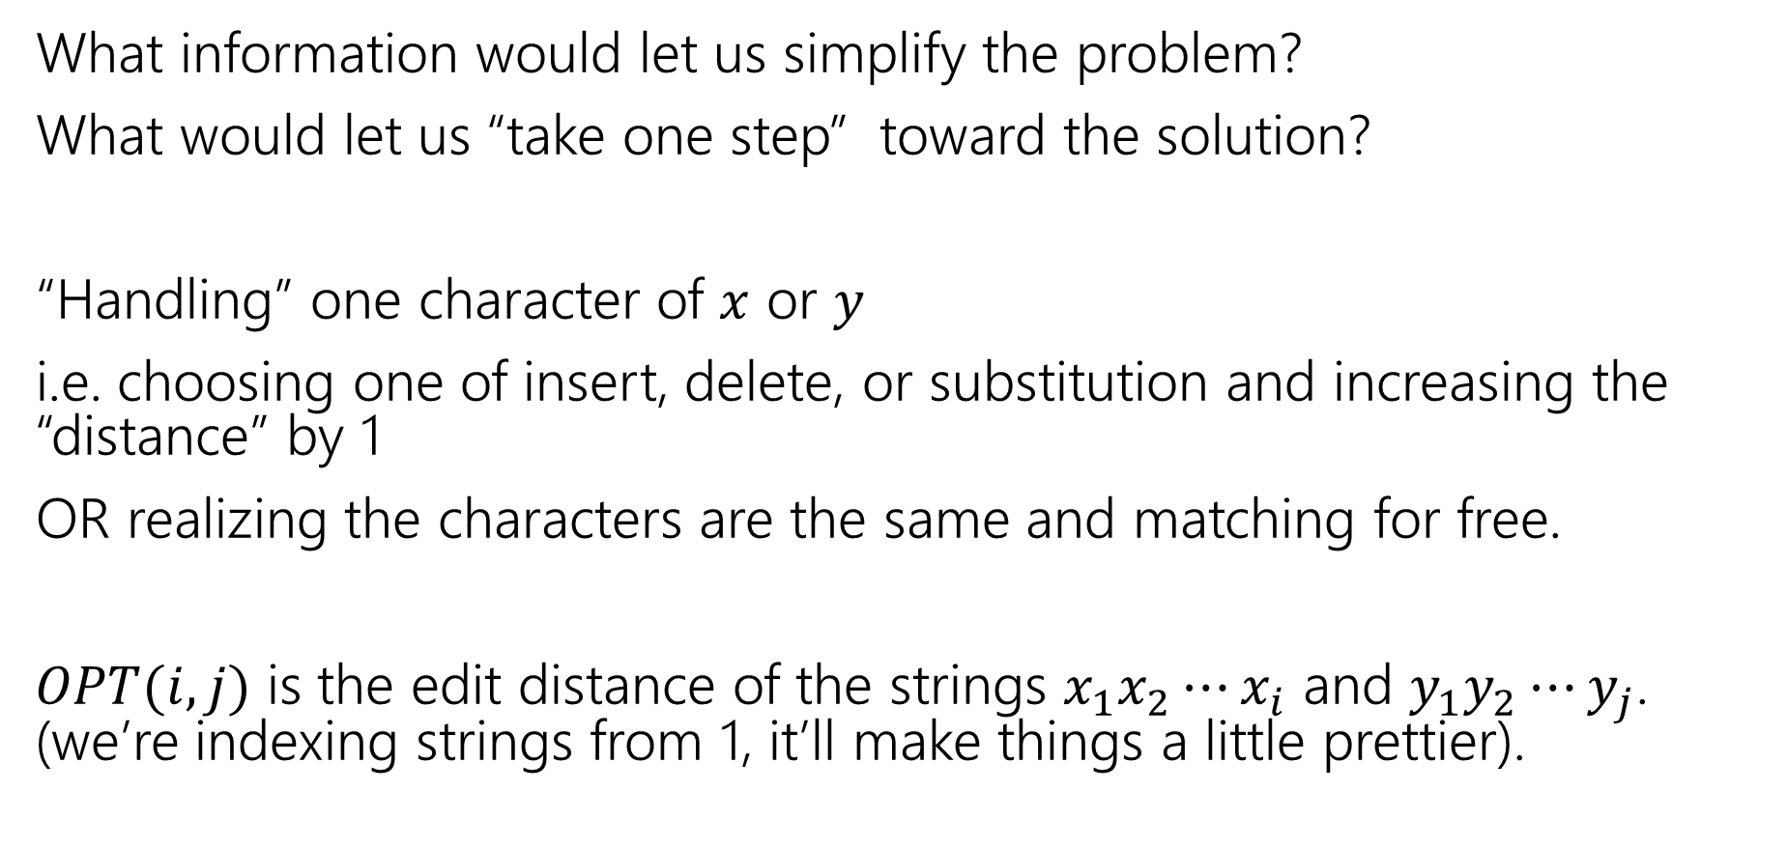
Finding a recurrence
What information would let us simplify the problem?
What would let us “take one step” toward the solution?
“Handling” one character of $x$ or $y$
i.e. choosing one of insert, delete, or substitution and increasing the “distance” by 1
OR realizing the characters are the same and matching for free.
$OPT(i,j)$ is the edit distance of the strings $x_{1}x_{2}⋯x_{i}$ and $y_{1}y_{2}⋯y_{j}$. (we’re indexing strings from 1, it’ll make things a little prettier).

Slide 37
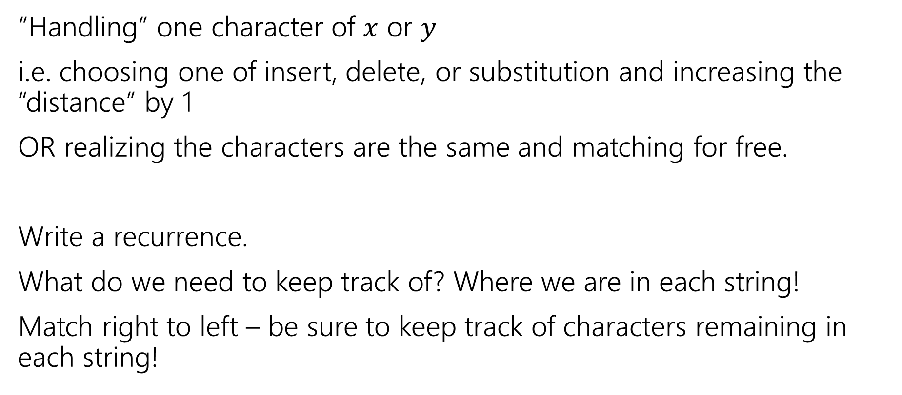
The recurrence
Poll at Pollev.com/robbie
“Handling” one character of $x$ or $y$
i.e. choosing one of insert, delete, or substitution and increasing the “distance” by 1
OR realizing the characters are the same and matching for free.
Write a recurrence.
What do we need to keep track of? Where we are in each string!
Match right to left – be sure to keep track of characters remaining in each string!

Slide 38
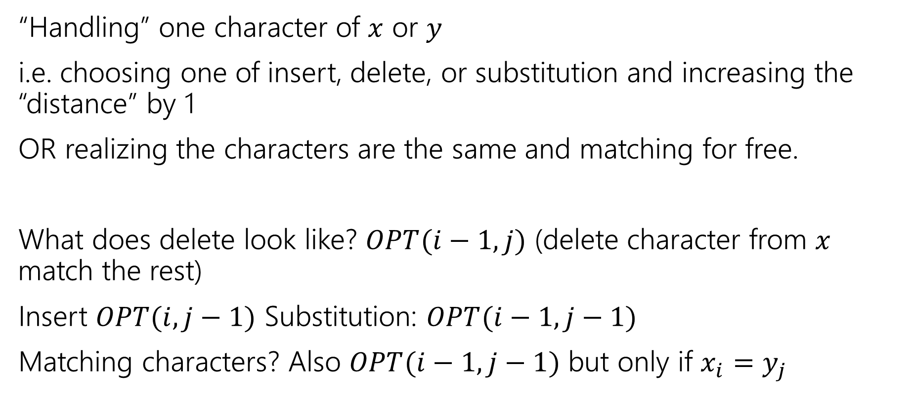
The recurrence
“Handling” one character of $x$ or $y$
i.e. choosing one of insert, delete, or substitution and increasing the “distance” by 1
OR realizing the characters are the same and matching for free.
What does delete look like? $OPT(i−1, j)$ (delete character from $x$ match the rest)
Insert $OPT(i,j−1)$ Substitution: $OPT(i−1,j−1)$
Matching characters? Also $OPT(i−1,j−1)$ but only if $x_{i}=y_{j}$

Slide 39
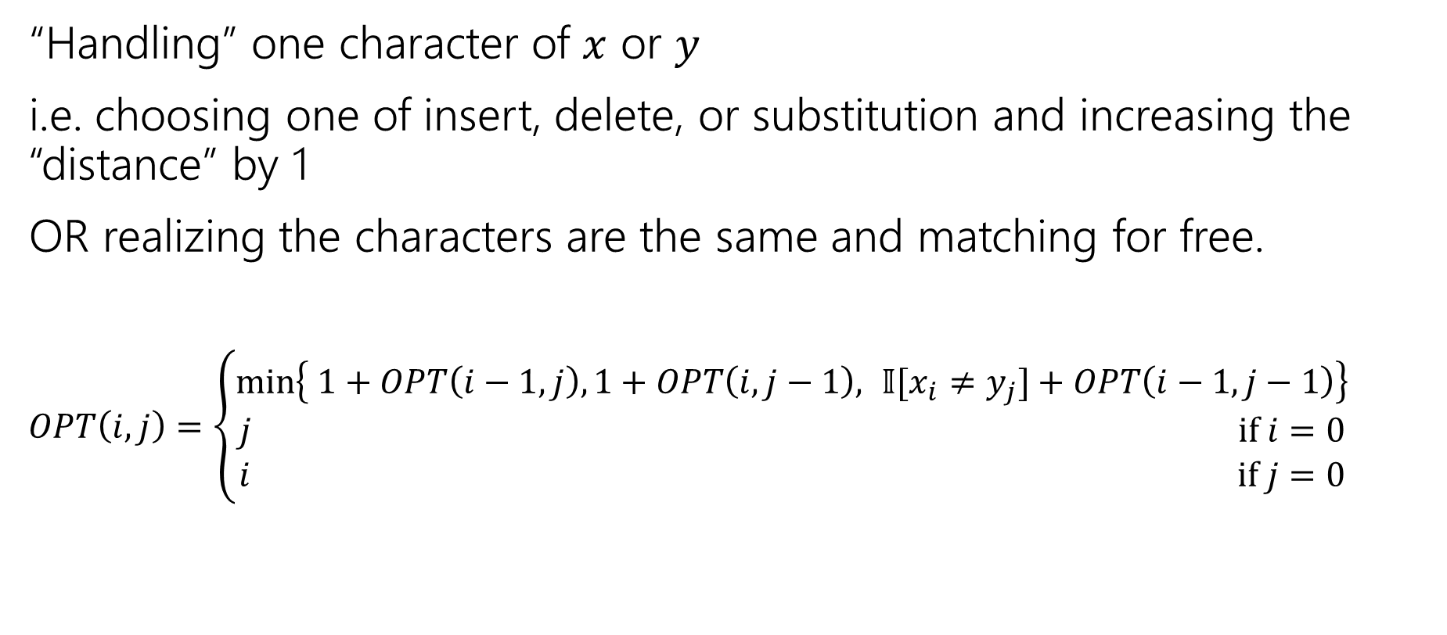
The recurrence
“Handling” one character of $x$ or $y$
i.e. choosing one of insert, delete, or substitution and increasing the “distance” by 1
OR realizing the characters are the same and matching for free.
$OPT\left(i,j\right)=\left\{\begin{aligned}\min\left\{ 1+OPT\left(i−1,j\right), 1+OPT\left(i,j−1\right), 𝕀[x_{i}≠y_{j}]+OPT\left(i−1,j−1\right)\right\} \\ j if i=0 \\ i if j=0\end{aligned}\right.$
Delete
Insert
Sub and matching
“Indicator” – math for “cast bool to int”

Slide 40
Dynamic Programming Process
1. Define the object you’re looking for
2. Write a recurrence to say how to find it
3. Design a memoization structure
4. Write an iterative algorithm
Minimum Edit Distance between $x$ and $y$
✅

Slide 41

Memoization
$OPT\left(i,j\right)=\left\{\begin{aligned}\min\left\{ 1+OPT\left(i−1,j\right), 1+OPT\left(i,j−1\right), 𝕀[x_{i}≠y_{j}]+OPT\left(i−1,j−1\right)\right\} \\ j if i=0 \\ i if j=0\end{aligned}\right.$
2D array $n$ by $m$
OPT[i][j] is $OPT(i,j)$

Slide 42
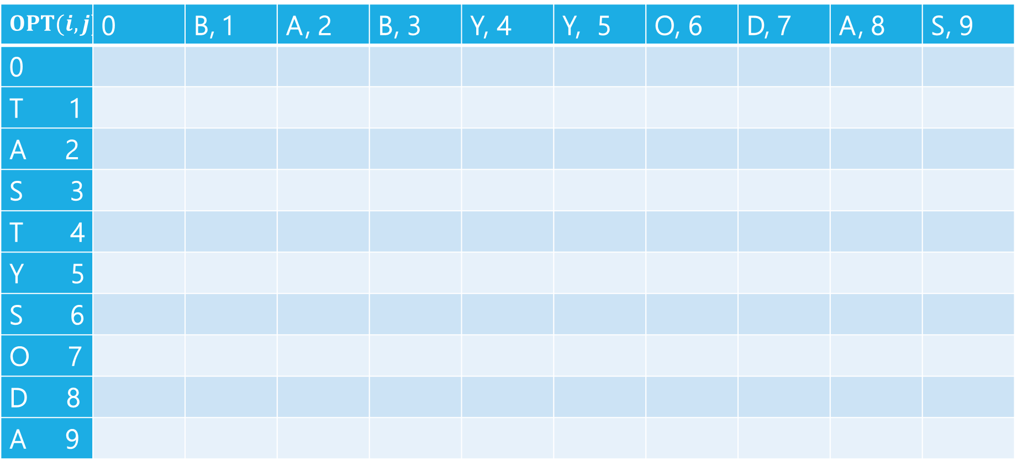
Edit Distance
$$OPT(i,j)$$ | 0 | B, 1 | A, 2 | B, 3 | Y, 4 | Y, 5 | O, 6 | D, 7 | A, 8 | S, 9
0
T 1
A 2
S 3
T 4
Y 5
S 6
O 7
D 8
A 9

Slide 43
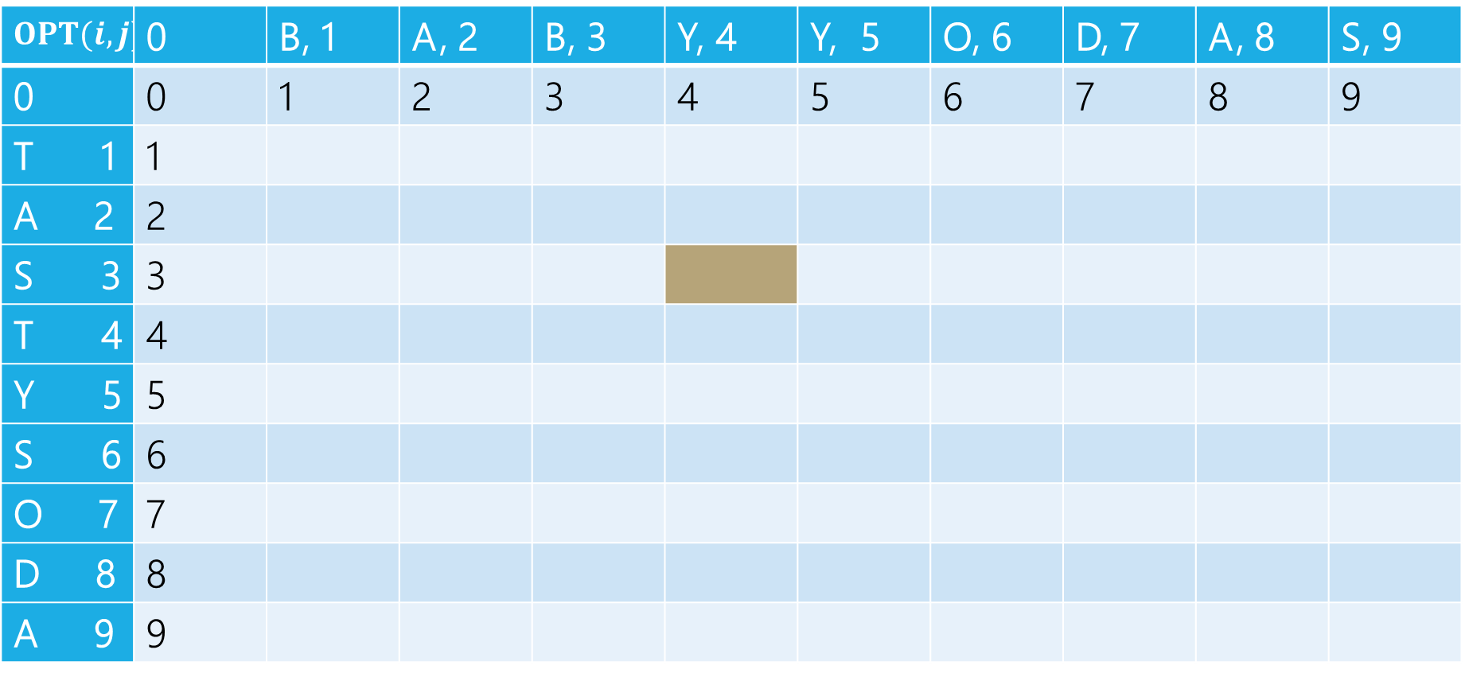
Edit Distance
B | A | B | Y
T | A | S
Current subproblem: edit dist between BABY and TAS
$$OPT(i,j)$$ | 0 | B, 1 | A, 2 | B, 3 | Y, 4 | Y, 5 | O, 6 | D, 7 | A, 8 | S, 9
0 | 0 | 1 | 2 | 3 | 4 | 5 | 6 | 7 | 8 | 9
T 1 | 1
A 2 | 2
S 3 | 3
T 4 | 4
Y 5 | 5
S 6 | 6
O 7 | 7
D 8 | 8
A 9 | 9

Slide 44
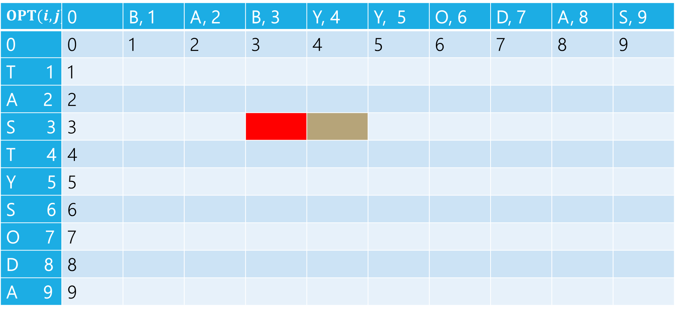
Edit Distance
B | A | B | Y
T | A | S
Delete: get rid of Y (cost 1)
BAB
TAS
$$OPT(i,j)$$ | 0 | B, 1 | A, 2 | B, 3 | Y, 4 | Y, 5 | O, 6 | D, 7 | A, 8 | S, 9
0 | 0 | 1 | 2 | 3 | 4 | 5 | 6 | 7 | 8 | 9
T 1 | 1
A 2 | 2
S 3 | 3
T 4 | 4
Y 5 | 5
S 6 | 6
O 7 | 7
D 8 | 8
A 9 | 9

Slide 45
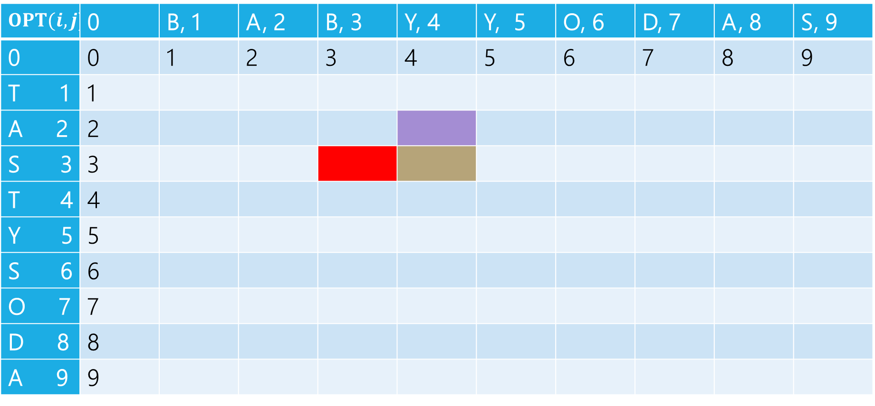
Edit Distance
B | A | B | Y
T | A | S
Insert: insert S (cost 1)
BABY
TA
$$OPT(i,j)$$ | 0 | B, 1 | A, 2 | B, 3 | Y, 4 | Y, 5 | O, 6 | D, 7 | A, 8 | S, 9
0 | 0 | 1 | 2 | 3 | 4 | 5 | 6 | 7 | 8 | 9
T 1 | 1
A 2 | 2
S 3 | 3
T 4 | 4
Y 5 | 5
S 6 | 6
O 7 | 7
D 8 | 8
A 9 | 9

Slide 46
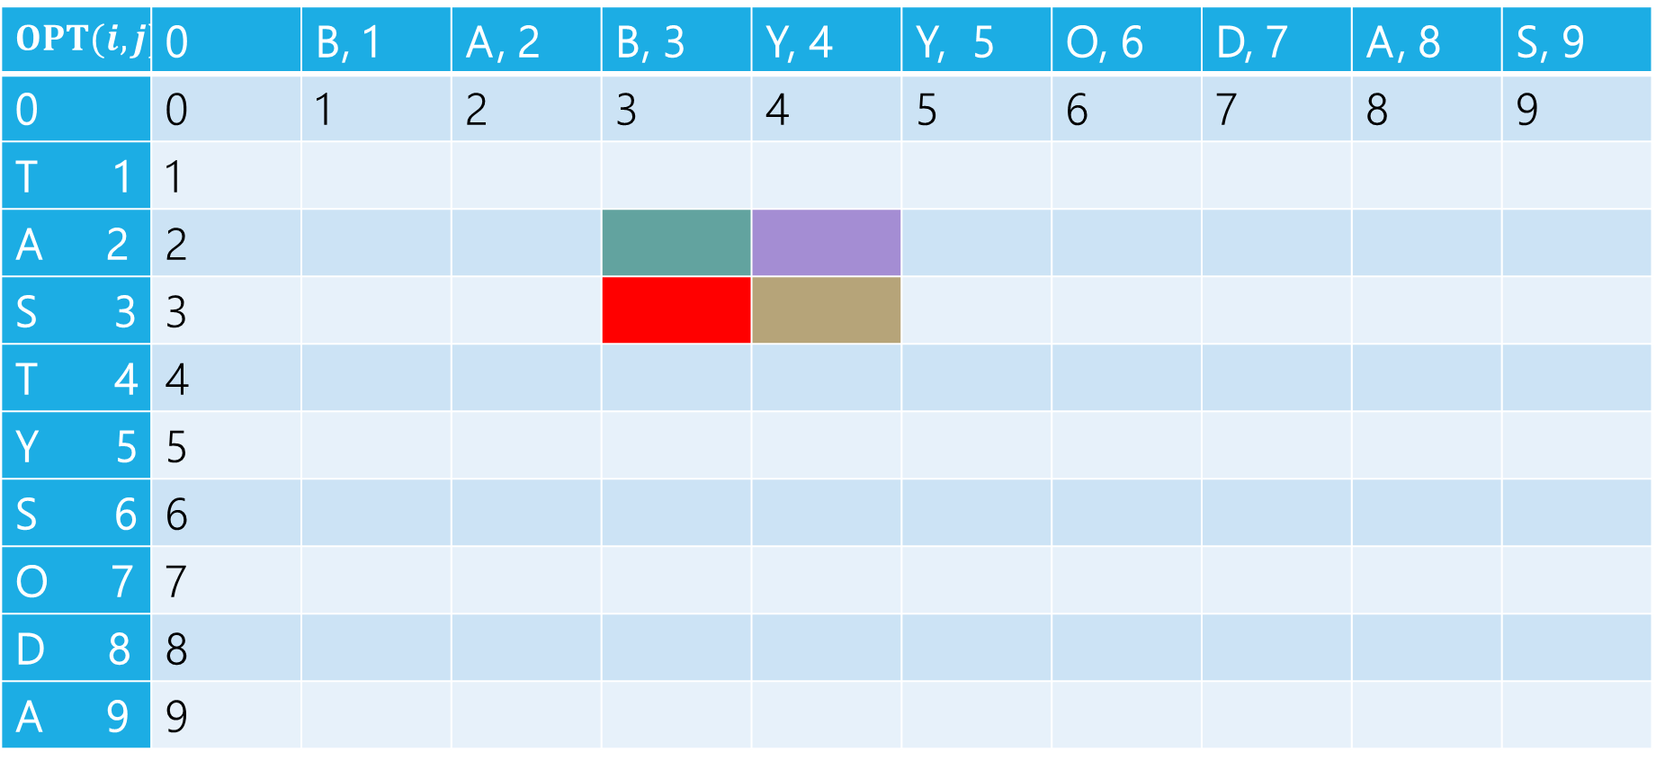
Edit Distance
B | A | B | Y
T | A | S
Sub: Transform Y to S (cost 1)
BAB
TA
$$OPT(i,j)$$ | 0 | B, 1 | A, 2 | B, 3 | Y, 4 | Y, 5 | O, 6 | D, 7 | A, 8 | S, 9
0 | 0 | 1 | 2 | 3 | 4 | 5 | 6 | 7 | 8 | 9
T 1 | 1
A 2 | 2
S 3 | 3
T 4 | 4
Y 5 | 5
S 6 | 6
O 7 | 7
D 8 | 8
A 9 | 9

Slide 47
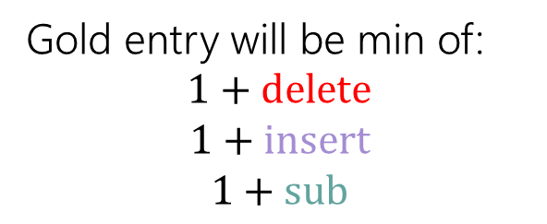
Edit Distance
Gold entry will be min of:
$$1+delete$$
$$1+insert$$
$$1+sub$$
B | A | B | Y
T | A | S
$$OPT(i,j)$$ | 0 | B, 1 | A, 2 | B, 3 | Y, 4 | Y, 5 | O, 6 | D, 7 | A, 8 | S, 9
0 | 0 | 1 | 2 | 3 | 4 | 5 | 6 | 7 | 8 | 9
T 1 | 1
A 2 | 2
S 3 | 3
T 4 | 4
Y 5 | 5
S 6 | 6
O 7 | 7
D 8 | 8
A 9 | 9

Slide 48
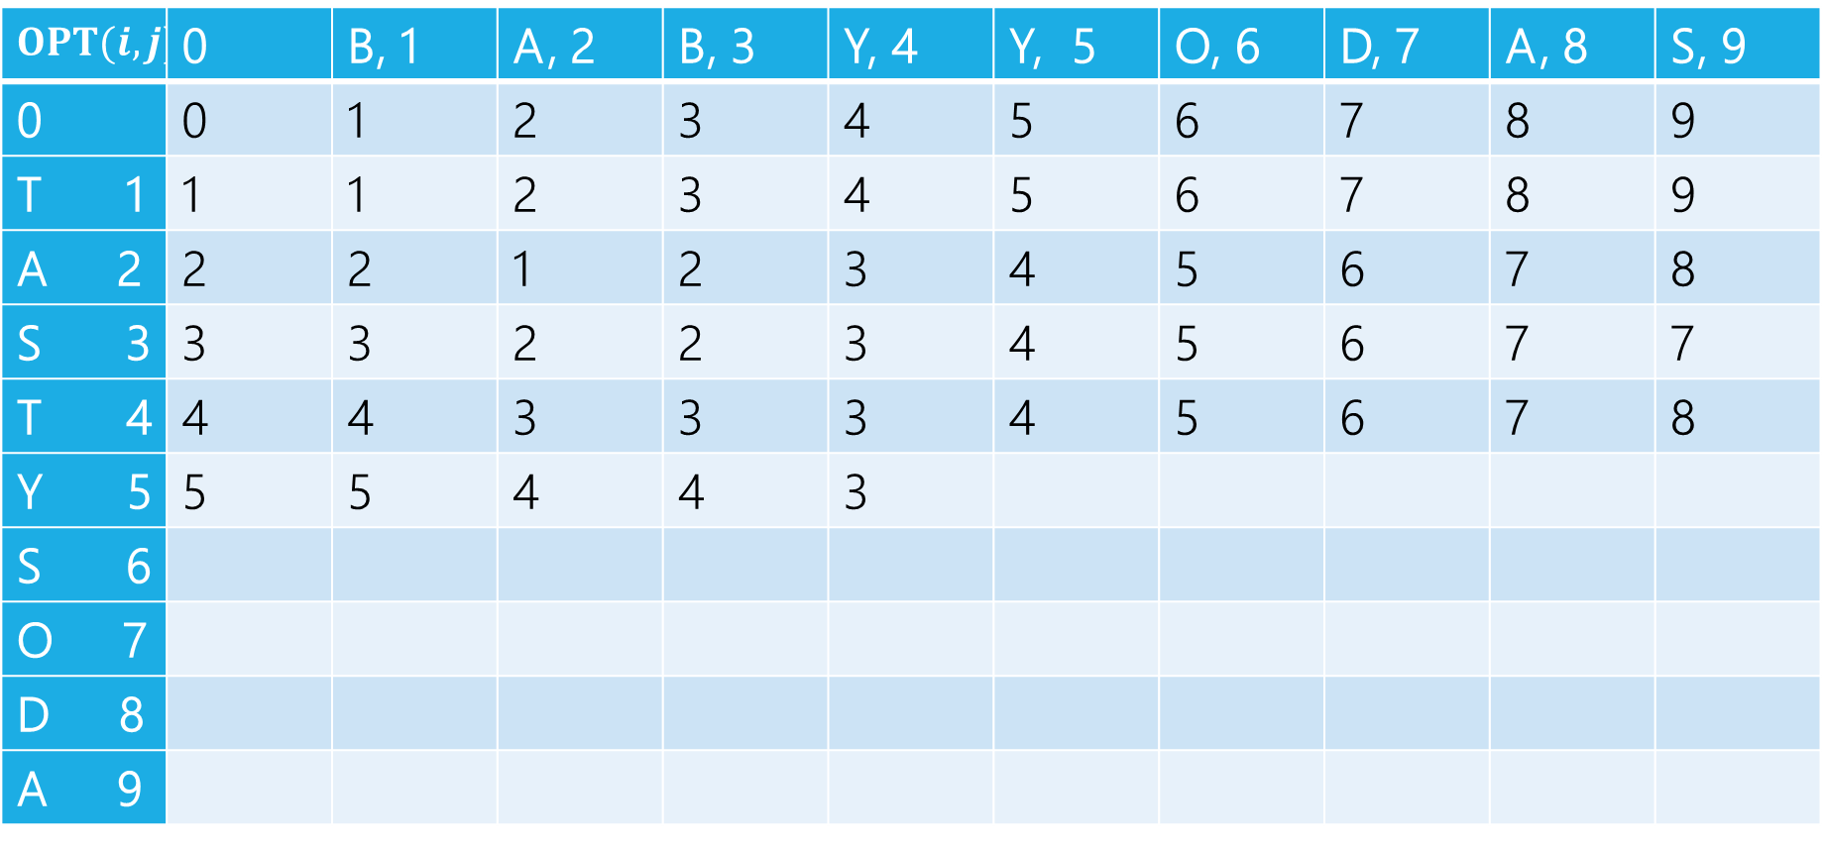

Edit Distance
$$1+2$$
$$1+3$$
$$1+2$$
Min: $3$
Gold entry will be min of:
$$1+delete$$
$$1+insert$$
$$1+sub$$
$$OPT(i,j)$$ | 0 | B, 1 | A, 2 | B, 3 | Y, 4 | Y, 5 | O, 6 | D, 7 | A, 8 | S, 9
0 | 0 | 1 | 2 | 3 | 4 | 5 | 6 | 7 | 8 | 9
T 1 | 1 | 1 | 2 | 3 | 4 | 5 | 6 | 7 | 8 | 9
A 2 | 2 | 2 | 1 | 2 | 3 | 4 | 5 | 6 | 7 | 8
S 3 | 3 | 3 | 2 | 2 | 3 | 4 | 5 | 6 | 7 | 7
T 4 | 4 | 4 | 3 | 3 | 3 | 4 | 5 | 6 | 7 | 8
Y 5 | 5 | 5 | 4 | 4 | 3
S 6
O 7
D 8
A 9

Slide 49
Edit Distance
Fill in the next two entries. Be careful with the sub/match distinction!
$$OPT(i,j)$$ | 0 | B, 1 | A, 2 | B, 3 | Y, 4 | Y, 5 | O, 6 | D, 7 | A, 8 | S, 9
0 | 0 | 1 | 2 | 3 | 4 | 5 | 6 | 7 | 8 | 9
T 1 | 1 | 1 | 2 | 3 | 4 | 5 | 6 | 7 | 8 | 9
A 2 | 2 | 2 | 1 | 2 | 3 | 4 | 5 | 6 | 7 | 8
S 3 | 3 | 3 | 2 | 2 | 3 | 4 | 5 | 6 | 7 | 7
T 4 | 4 | 4 | 3 | 3 | 3 | 4 | 5 | 6 | 7 | 8
Y 5 | 5 | 5 | 4 | 4 | 3
S 6
O 7
D 8
A 9

Slide 50
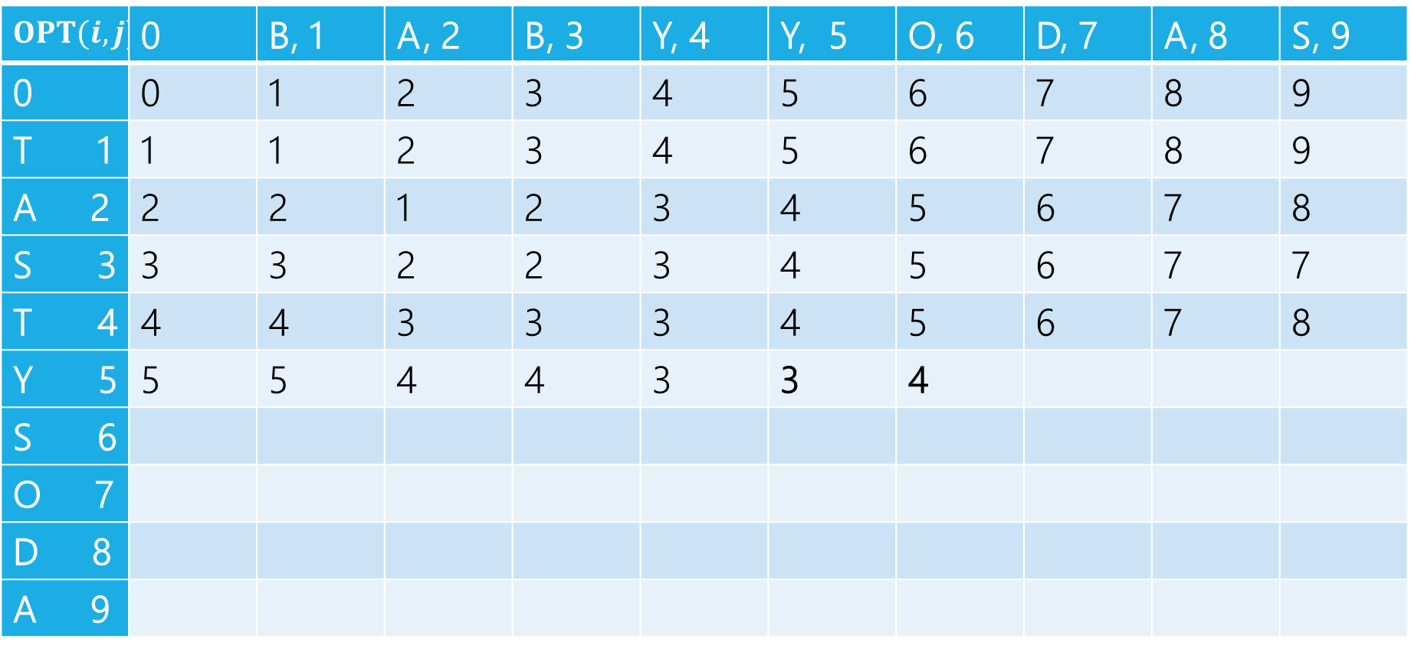
Edit Distance
Fill in the next two entries. Be careful with the sub/match distinction!
$$OPT(i,j)$$ | 0 | B, 1 | A, 2 | B, 3 | Y, 4 | Y, 5 | O, 6 | D, 7 | A, 8 | S, 9
0 | 0 | 1 | 2 | 3 | 4 | 5 | 6 | 7 | 8 | 9
T 1 | 1 | 1 | 2 | 3 | 4 | 5 | 6 | 7 | 8 | 9
A 2 | 2 | 2 | 1 | 2 | 3 | 4 | 5 | 6 | 7 | 8
S 3 | 3 | 3 | 2 | 2 | 3 | 4 | 5 | 6 | 7 | 7
T 4 | 4 | 4 | 3 | 3 | 3 | 4 | 5 | 6 | 7 | 8
Y 5 | 5 | 5 | 4 | 4 | 3 | 3 | 4
S 6
O 7
D 8
A 9
Y’s match, so sub is free!

Slide 51

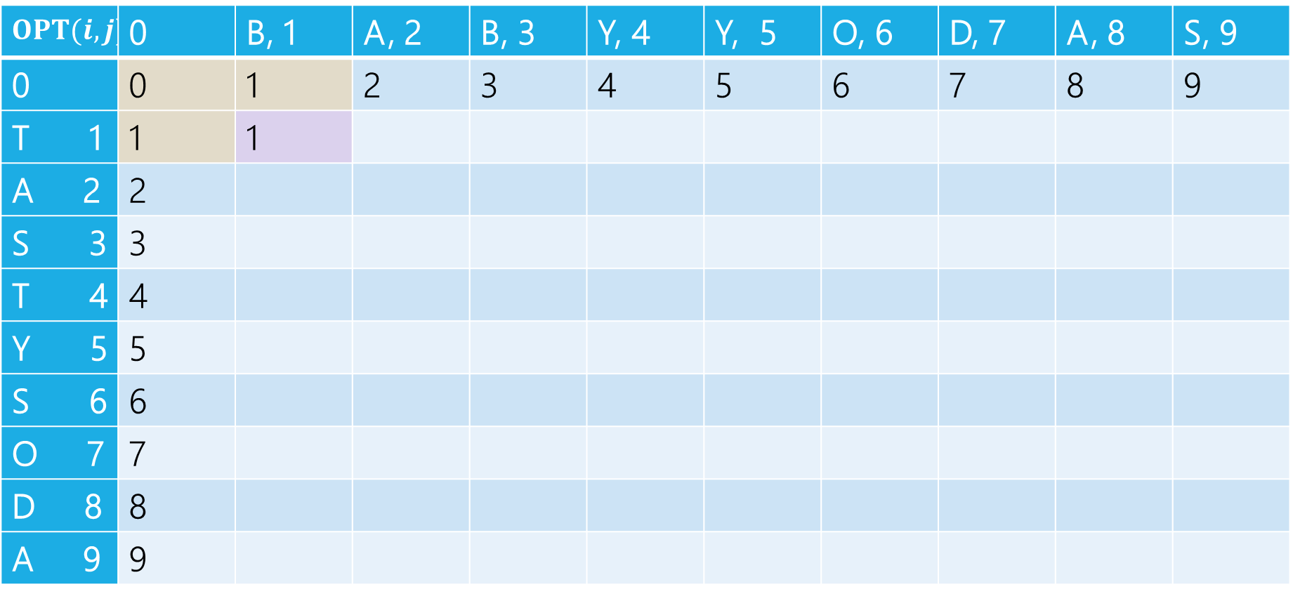
Edit Distance
$$OPT(i,j)$$ | 0 | B, 1 | A, 2 | B, 3 | Y, 4 | Y, 5 | O, 6 | D, 7 | A, 8 | S, 9
0 | 0 | 1 | 2 | 3 | 4 | 5 | 6 | 7 | 8 | 9
T 1 | 1 | 1
A 2 | 2
S 3 | 3
T 4 | 4
Y 5 | 5
S 6 | 6
O 7 | 7
D 8 | 8
A 9 | 9
$1+1 \left(left, delete\right)$
$1+1\left(up, insert\right)$
$0+1(diag,sub)$

Slide 52

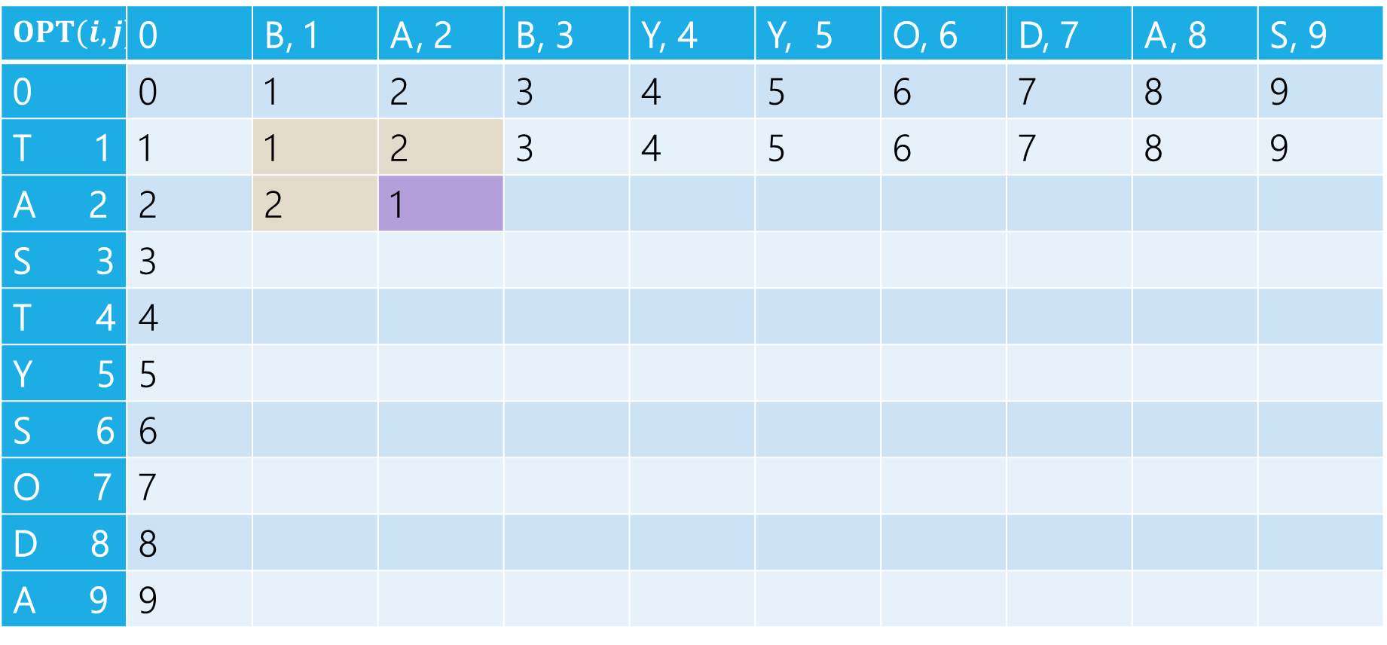
Edit Distance
$$OPT(i,j)$$ | 0 | B, 1 | A, 2 | B, 3 | Y, 4 | Y, 5 | O, 6 | D, 7 | A, 8 | S, 9
0 | 0 | 1 | 2 | 3 | 4 | 5 | 6 | 7 | 8 | 9
T 1 | 1 | 1 | 2 | 3 | 4 | 5 | 6 | 7 | 8 | 9
A 2 | 2 | 2 | 1
S 3 | 3
T 4 | 4
Y 5 | 5
S 6 | 6
O 7 | 7
D 8 | 8
A 9 | 9
$2+1 \left(left, delete\right)$
$2+1\left(up, insert\right)$
$1+0(diag,sub)$

Slide 53
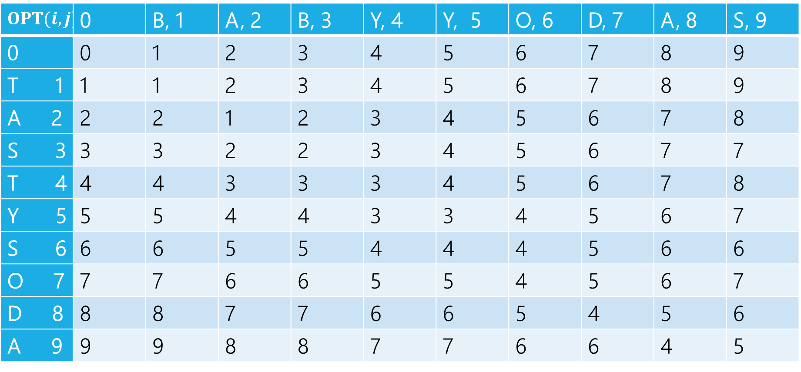
Edit Distance
$$OPT(i,j)$$ | 0 | B, 1 | A, 2 | B, 3 | Y, 4 | Y, 5 | O, 6 | D, 7 | A, 8 | S, 9
0 | 0 | 1 | 2 | 3 | 4 | 5 | 6 | 7 | 8 | 9
T 1 | 1 | 1 | 2 | 3 | 4 | 5 | 6 | 7 | 8 | 9
A 2 | 2 | 2 | 1 | 2 | 3 | 4 | 5 | 6 | 7 | 8
S 3 | 3 | 3 | 2 | 2 | 3 | 4 | 5 | 6 | 7 | 7
T 4 | 4 | 4 | 3 | 3 | 3 | 4 | 5 | 6 | 7 | 8
Y 5 | 5 | 5 | 4 | 4 | 3 | 3 | 4 | 5 | 6 | 7
S 6 | 6 | 6 | 5 | 5 | 4 | 4 | 4 | 5 | 6 | 6
O 7 | 7 | 7 | 6 | 6 | 5 | 5 | 4 | 5 | 6 | 7
D 8 | 8 | 8 | 7 | 7 | 6 | 6 | 5 | 4 | 5 | 6
A 9 | 9 | 9 | 8 | 8 | 7 | 7 | 6 | 6 | 4 | 5

Slide 54
Edit Distance
Can recover the choices, just like with Baby Yoda.
$$OPT(i,j)$$ | 0 | B, 1 | A, 2 | B, 3 | Y, 4 | Y, 5 | O, 6 | D, 7 | A, 8 | S, 9
0 | 0 | 1 | 2 | 3 | 4 | 5 | 6 | 7 | 8 | 9
T 1 | 1 | 1 | 2 | 3 | 4 | 5 | 6 | 7 | 8 | 9
A 2 | 2 | 2 | 1 | 2 | 3 | 4 | 5 | 6 | 7 | 8
S 3 | 3 | 3 | 2 | 2 | 3 | 4 | 5 | 6 | 7 | 7
T 4 | 4 | 4 | 3 | 3 | 3 | 4 | 5 | 6 | 7 | 8
Y 5 | 5 | 5 | 4 | 4 | 3 | 3 | 4 | 5 | 6 | 7
S 6 | 6 | 6 | 5 | 5 | 4 | 4 | 4 | 5 | 6 | 6
O 7 | 7 | 7 | 6 | 6 | 5 | 5 | 4 | 5 | 6 | 7
D 8 | 8 | 8 | 7 | 7 | 6 | 6 | 5 | 4 | 5 | 6
A 9 | 9 | 9 | 8 | 8 | 7 | 7 | 6 | 6 | 4 | 5

Slide 55
Edit Distance
When there are ties, there may be more than one set of choices.
$$OPT(i,j)$$ | 0 | B, 1 | A, 2 | B, 3 | Y, 4 | Y, 5 | O, 6 | D, 7 | A, 8 | S, 9
0 | 0 | 1 | 2 | 3 | 4 | 5 | 6 | 7 | 8 | 9
T 1 | 1 | 1 | 2 | 3 | 4 | 5 | 6 | 7 | 8 | 9
A 2 | 2 | 2 | 1 | 2 | 3 | 4 | 5 | 6 | 7 | 8
S 3 | 3 | 3 | 2 | 2 | 3 | 4 | 5 | 6 | 7 | 7
T 4 | 4 | 4 | 3 | 3 | 3 | 4 | 5 | 6 | 7 | 8
Y 5 | 5 | 5 | 4 | 4 | 3 | 3 | 4 | 5 | 6 | 7
S 6 | 6 | 6 | 5 | 5 | 4 | 4 | 4 | 5 | 6 | 6
O 7 | 7 | 7 | 6 | 6 | 5 | 5 | 4 | 5 | 6 | 7
D 8 | 8 | 8 | 7 | 7 | 6 | 6 | 5 | 4 | 5 | 6
A 9 | 9 | 9 | 8 | 8 | 7 | 7 | 6 | 6 | 4 | 5

Slide 56
Dynamic Programming Process
1. Define the object you’re looking for
2. Write a recurrence to say how to find it
3. Design a memoization structure
4. Write an iterative algorithm
Minimum Edit Distance between $x$ and $y$
✅
$m×n$ Array
Outer loop: increasing rows (starting from 1)
Inner loop: increasing column (starting from 1)

