Slide 1
Dynamic Programming
CSE 421 22AU
Lecture 11

Slide 2
Divide And Conquer Summary
Takeaways from D&C:
Recursive thinking can let us solve problems faster!
When solving a recursive problem, state precisely what the recursive call is giving back to you.
Use the values of the recursive call (or at least the fact you’ve made recursive calls) when designing the combine step
  If your “combine” step isn’t faster than baseline, your whole algorithm isn’t better than the baseline!

Slide 3
How Were We Solving All Those Recurrences?
The techniques from CSE 332 (unrolling and/or recursion trees) still work!
But now that you’ve done them a bunch in 332, we’ll give you a shortcut…

Slide 4

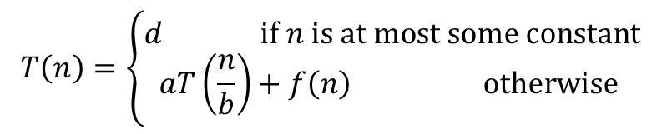
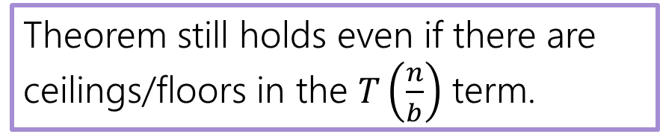

Master Theorem
Given a recurrence of the following form, where $a,b,c,$ and $d$ are constants:
$$T\left(n\right)=\left\{\begin{aligned}d if n is at most some constant \\ aT\left(\frac{n}{b}\right)+f\left(n\right) otherwise \end{aligned}\right.$$
Where $f\left(n\right)$ is $Θ\left(n^{c}\log^{k}{n}\right)$ for $k≥0$, $a∈ℤ^{+}$, $c≥1$
If
$$\log_{b}{a}<c$$
then
$$T\left(n\right)∈Θ\left(n^{c}⋅\log^{k}{n}\right)$$
If
$$\log_{b}{a}=c$$
then
$$T\left(n\right)∈Θ\left(n^{c}\log^{k+1}{n}\right)$$
If
$$\log_{b}{a}>c$$
then
$$T\left(n\right)∈Θ\left(n^{\log_{b}{a}}\right)$$
Theorem still holds even if there are ceilings/floors in the $T\left(\frac{n}{b}\right)$ term.

Slide 5
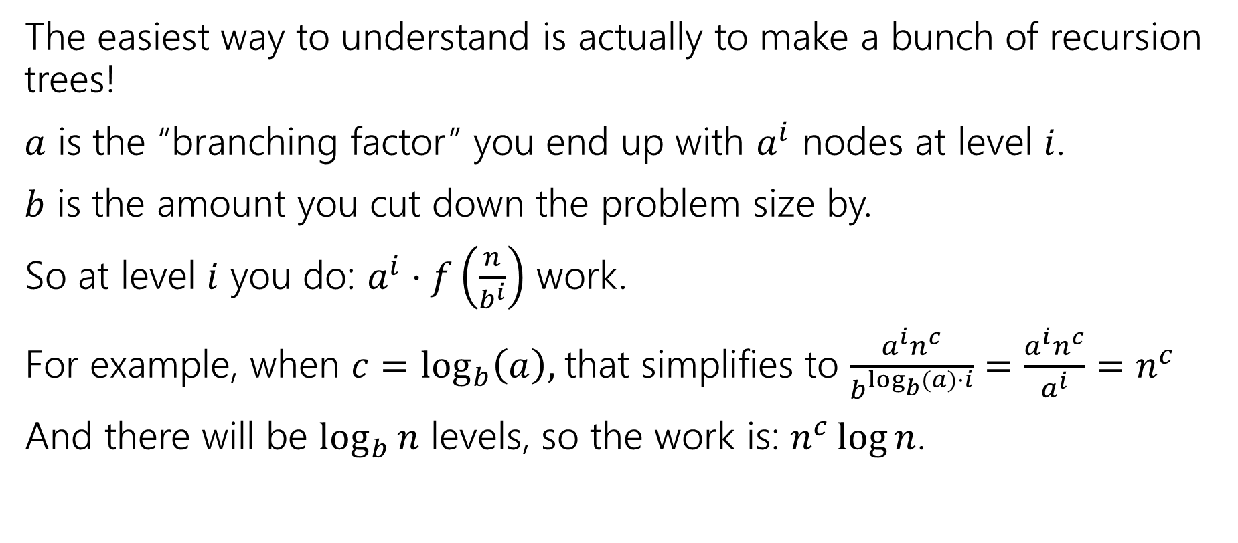
Proof?
The easiest way to understand is actually to make a bunch of recursion trees!
$a$ is the “branching factor” you end up with $a^{i}$ nodes at level $i$.
$b$ is the amount you cut down the problem size by.
So at level $i$ you do: $a^{i}⋅f\left(\frac{n}{b^{i}}\right)$ work.
For example, when $c=\log_{b}\left(a\right),$that simplifies to $\frac{a^{i}n^{c}}{b^{\log_{b}{(a})⋅i}}=\frac{a^{i}n^{c}}{a^{i}}=n^{c}$
And there will be $\log_{b}{n}$ levels, so the work is: $n^{c}\log{n}$.

Slide 6
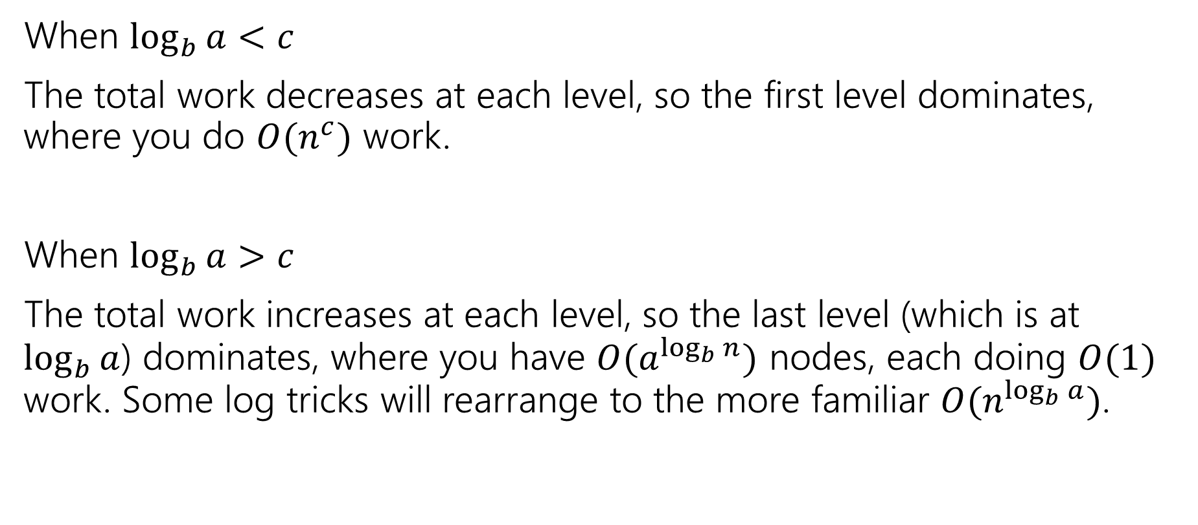
Proof?
When $\log_{b}{a}<c$
The total work decreases at each level, so the first level dominates, where you do $O(n^{c})$ work.
When $\log_{b}{a}>c$
The total work increases at each level, so the last level (which is at $\log_{b}{a}$) dominates, where you have $O(a^{\log_{b}{n}})$ nodes, each doing $O(1)$ work. Some log tricks will rearrange to the more familiar $O(n^{\log_{b}{a}})$.

Slide 7
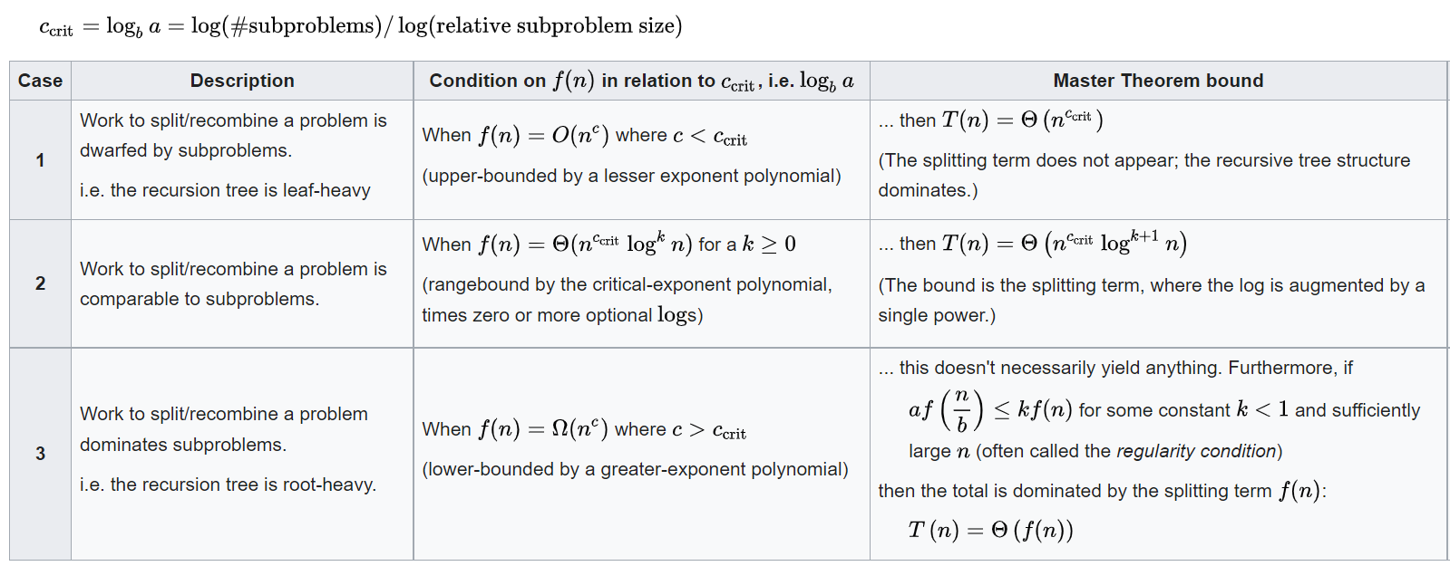
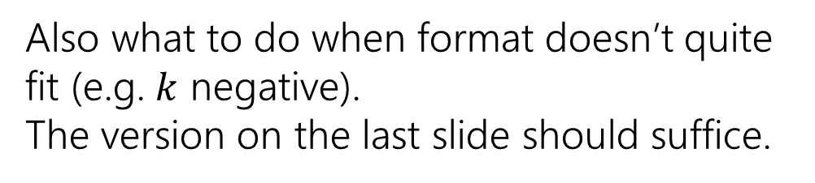
A stronger version
Also what to do when format doesn’t quite fit (e.g. $k$ negative).
The version on the last slide should suffice.
From Wikipedia

Slide 8
Dynamic Programming

Slide 9
Dynamic Programming
The most robust algorithm design paradigm we’ll study this quarter.
Small changes in the problem usually lead to small changes in the algorithm.

Slide 10
Classic DP
This problem is going to look silly (and it is)
But it is going to make it much easier to do the hard DP problems next week.

Slide 11
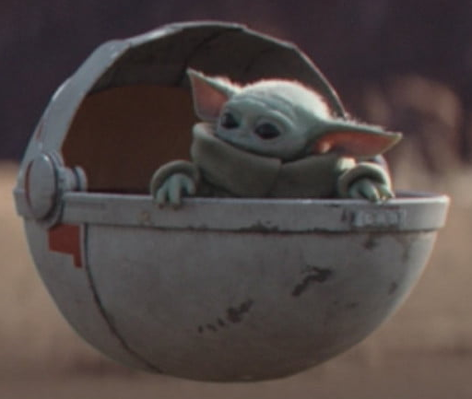

Baby Yoda Searching
Baby Yoda has to get from the upper-right corner to the lower left.
His cradle will only let him go left and down.
He can’t get past the rocks (too high) – he has to go around them (but still only going left and down)
As usual…he’s hungry.
He wants to eat as many frog eggs as possible on the way.

Slide 12
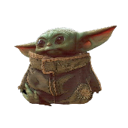
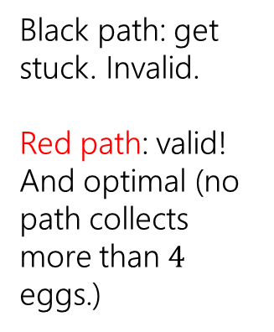
Baby Yoda Searching
Black path: get stuck. Invalid.
Red path: valid! And optimal (no path collects more than $4$ eggs.)
Notes:
https://1.bp.blogspot.com/-XxfNI65zLnU/Xc98O96LVnI/AAAAAAAAGFY/Xsmd7IMlIrEltYONCdGKk1hqPw1BgL3ggCLcBGAsYHQ/s1600/Mandalorian.jpg
http://www.pngmart.com/image/161116/png/161115
https://www.pikpng.com/pngvi/hiTxbbR_clip-art-rock-rock-clipart-transparent-background-png-download/

Slide 13
Baby Yoda Searching
Might get us stuck between rocks.
Or pass up a series of eggs we can’t see.
Can we greedily head to the next accessible egg?
Notes:
https://1.bp.blogspot.com/-XxfNI65zLnU/Xc98O96LVnI/AAAAAAAAGFY/Xsmd7IMlIrEltYONCdGKk1hqPw1BgL3ggCLcBGAsYHQ/s1600/Mandalorian.jpg
http://www.pngmart.com/image/161116/png/161115
https://www.pikpng.com/pngvi/hiTxbbR_clip-art-rock-rock-clipart-transparent-background-png-download/

Slide 14
Baby Yoda Searching
Best left-side path might start at a place inaccessible to end of best right-side path.
Could make a subproblem for each start and ending spot?
Can we divide and conquer?
Notes:
https://1.bp.blogspot.com/-XxfNI65zLnU/Xc98O96LVnI/AAAAAAAAGFY/Xsmd7IMlIrEltYONCdGKk1hqPw1BgL3ggCLcBGAsYHQ/s1600/Mandalorian.jpg
http://www.pngmart.com/image/161116/png/161115
https://www.pikpng.com/pngvi/hiTxbbR_clip-art-rock-rock-clipart-transparent-background-png-download/

Slide 15
Baby Yoda Searching
Notes:
https://1.bp.blogspot.com/-XxfNI65zLnU/Xc98O96LVnI/AAAAAAAAGFY/Xsmd7IMlIrEltYONCdGKk1hqPw1BgL3ggCLcBGAsYHQ/s1600/Mandalorian.jpg
http://www.pngmart.com/image/161116/png/161115
https://www.pikpng.com/pngvi/hiTxbbR_clip-art-rock-rock-clipart-transparent-background-png-download/

Slide 16
Baby Yoda Searching
So what should we do?
Let’s try to use recursion.
What should our recursive calls be finding?
What recursive calls do we need?

Slide 17
Define the problem
Let OPT(i,j) be the maximum number of eggs we can get on a legal path from (i,j) to (0,0)(including the egg in (i,j) if there is one)
What recursive calls do we need?
Don’t try to divide & conquer, think closer to home…
We have to decide whether to go down or left…
“How could we take one step toward the solution?”

Slide 18
Baby Yoda Searching
(c-1,r-1)
r-1
Y-coordinate
(0,2)
(0,1)
(1,1)
0
(0,0)
X-coordinate
0
c-1
Notes:
https://1.bp.blogspot.com/-XxfNI65zLnU/Xc98O96LVnI/AAAAAAAAGFY/Xsmd7IMlIrEltYONCdGKk1hqPw1BgL3ggCLcBGAsYHQ/s1600/Mandalorian.jpg
http://www.pngmart.com/image/161116/png/161115
https://www.pikpng.com/pngvi/hiTxbbR_clip-art-rock-rock-clipart-transparent-background-png-download/

Slide 19
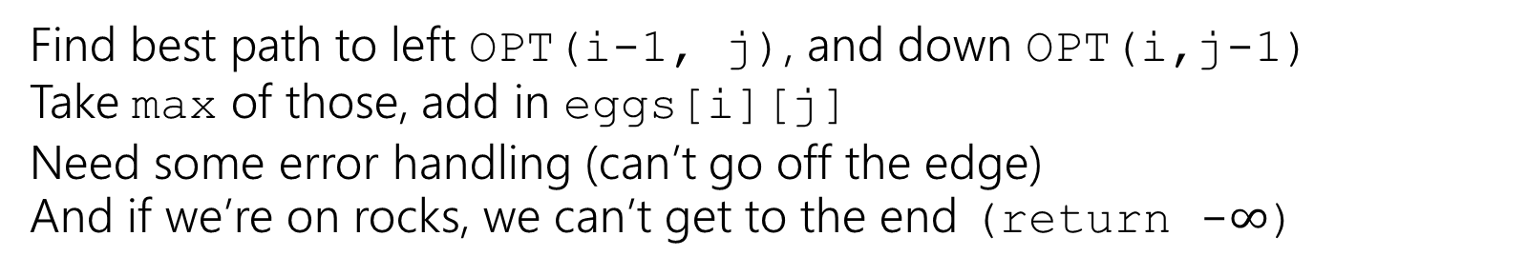
Recursive Baby Yoda
Let OPT(i,j) be the maximum number of eggs we can get on a legal path from (i,j) to (0,0)(including the egg in (i,j) if there is one)
Base Case?
Recursive case?
At (0,0), nowhere to go, return eggs[0][0]
Find best path to left OPT(i-1, j), and down OPT(i,j-1)
Take max of those, add in eggs[i][j]
Need some error handling (can’t go off the edge)
And if we’re on rocks, we can’t get to the end (return -$∞$)

Slide 20
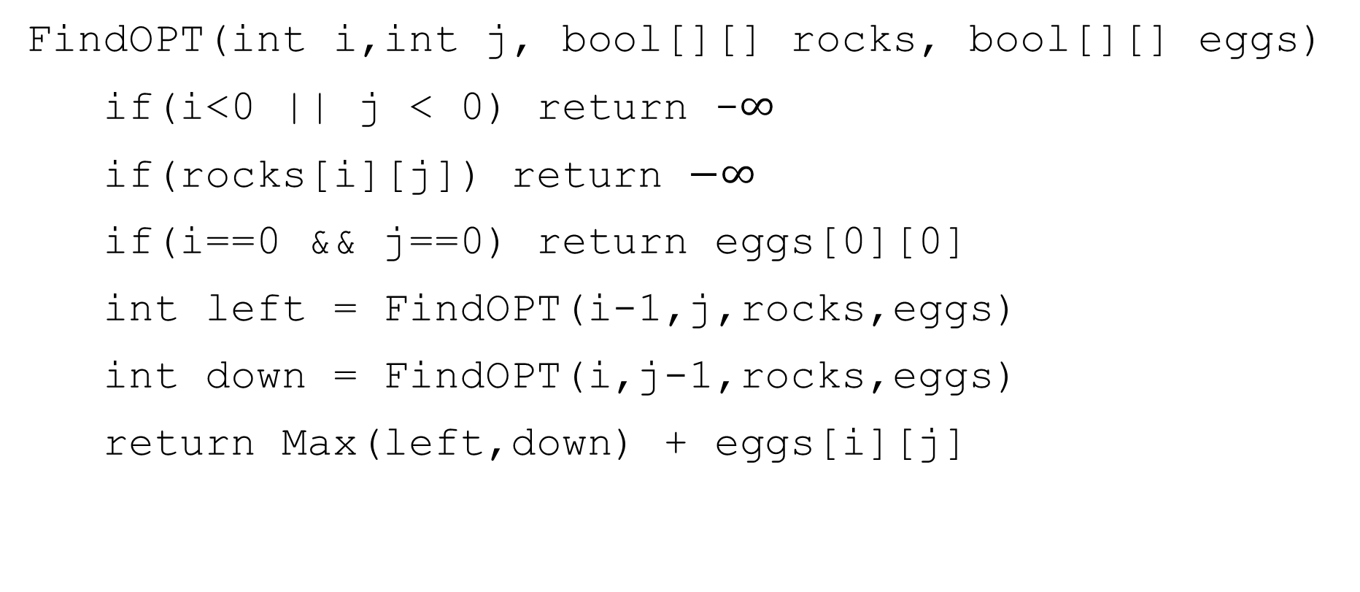
A Recursive Function
FindOPT(int i,int j, bool[][] rocks, bool[][] eggs)
if(i<0 || j < 0) return -$∞$
if(rocks[i][j]) return $−∞$
if(i==0 && j==0) return eggs[0][0]
int left = FindOPT(i-1,j,rocks,eggs)
int down = FindOPT(i,j-1,rocks,eggs)
return Max(left,down) + eggs[i][j]

Slide 21
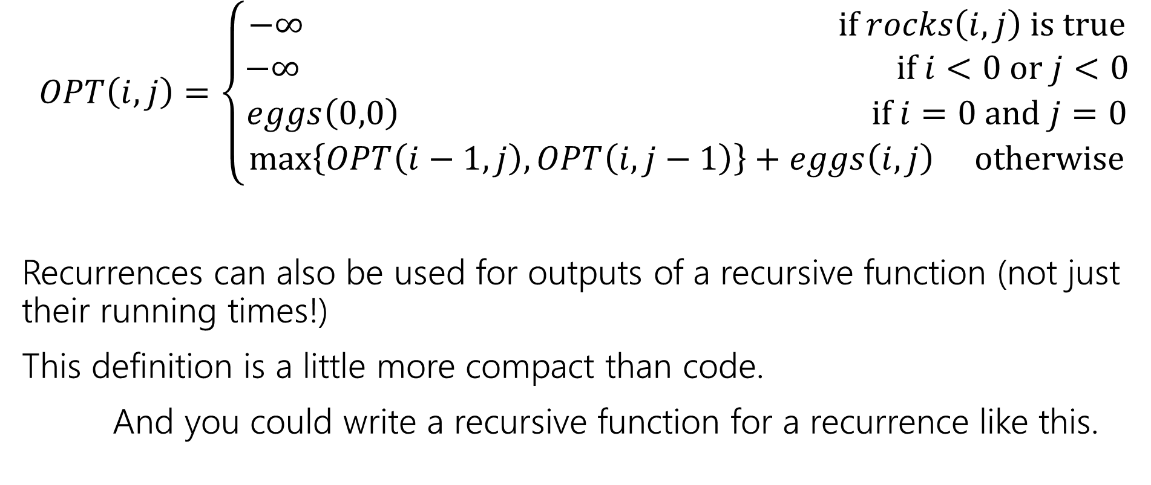
Recurrence Form
$$OPT\left(i,j\right)=\left\{\begin{aligned}−∞ if rocks\left(i,j\right) is true \\ −∞ if i<0 or j<0 \\ eggs\left(0,0\right) if i=0 and j=0 \\ \max\left\{OPT\left(i−1,j\right), OPT\left(i,j−1\right)\right\}+eggs\left(i,j\right) otherwise\end{aligned}\right.$$
Recurrences can also be used for outputs of a recursive function (not just their running times!)
This definition is a little more compact than code.
And you could write a recursive function for a recurrence like this.

Slide 22

Analyzing the recursive function
So…how does the code work? What’s its running time?
$T\left(c,r\right)=\left\{\begin{aligned}T\left(c−1,r\right)+T\left(c,r−1\right)+Θ\left(n\right) if r≥0 and c≥0 \\ Θ\left(1\right) otherwise\end{aligned}\right.$
Master Theorem says…

Slide 23
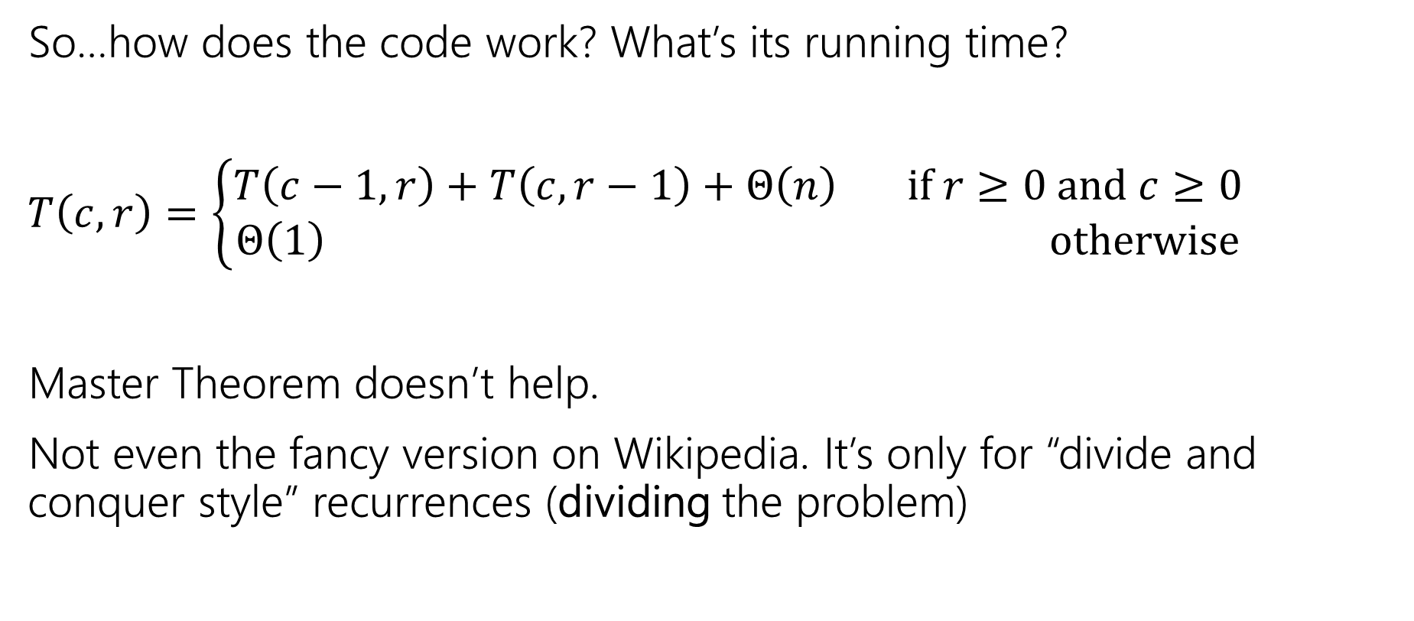
Analyzing the recursive function
So…how does the code work? What’s its running time?
$T\left(c,r\right)=\left\{\begin{aligned}T\left(c−1,r\right)+T\left(c,r−1\right)+Θ\left(n\right) if r≥0 and c≥0 \\ Θ\left(1\right) otherwise\end{aligned}\right.$
Master Theorem doesn’t help.
Not even the fancy version on Wikipedia. It’s only for “divide and conquer style” recurrences (dividing the problem)

Slide 24

Tree Method, Maybe…
OPT
(r,c)
OPT
(r-1,c)
OPT
(r,c-1)
OPT
(r-2,c)
OPT
(r-1,c-1)
OPT
(r-1,c-1)
OPT
(r,c-2)
…
…
…
…
When do we hit the base case?
Sometime between $min⁡(r,c)$ and $r+c$ levels.

Slide 25
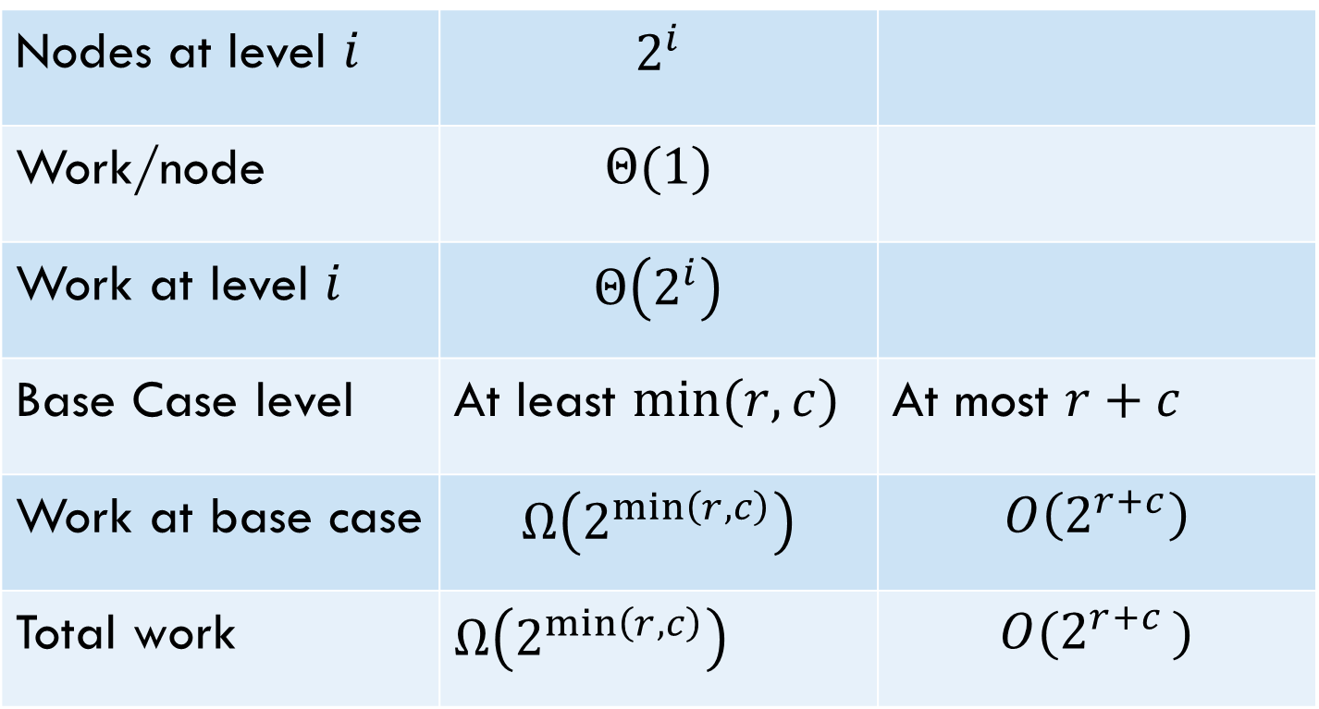
Tree Method
Nodes at level $i$ | $$2^{i}$$
Work/node | $$Θ(1)$$
Work at level $i$ | $$Θ\left(2^{i}\right)$$
Base Case level | At least $min⁡(r,c)$ | At most $r+c$
Work at base case | $$Ω\left(2^{\min\left(r,c\right)}\right)$$ | $$O\left(2^{r+c}\right)$$
Total work | $Ω\left(2^{\min\left(r,c\right)}\right)$ | $$O(2^{r+c })$$
Overall work is sum over all levels – each level has twice the work as the last, so the last level is about half the total work.
Tight big-O depends on relationship between $r$ and $c$…but regardless – it’s slow.

Slide 26
Speedup
That’s way too slow…but it doesn’t have to be.
OPT
(r,c)
OPT
(r-1,c)
OPT
(r,c-1)
OPT
(r-2,c)
OPT
(r-1,c-1)
OPT
(r-1,c-1)
OPT
(r,c-2)
…
…
…
…

Slide 27
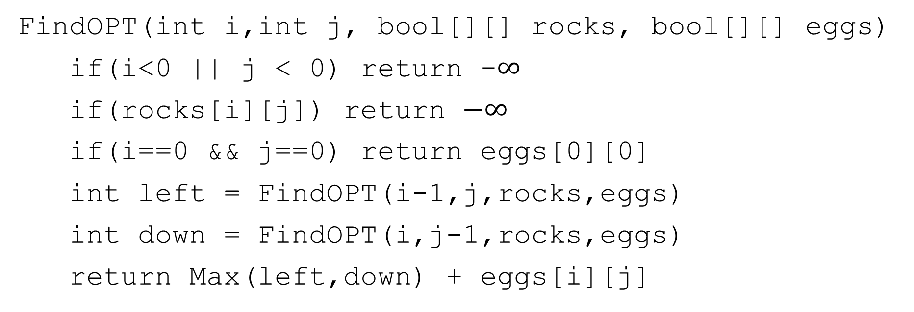
Activity
Fill out the question at pollev.com/robbie
Figure out how to take advantage of the repeated calculation.
What do you think the running time will be of your new algorithm?
FindOPT(int i,int j, bool[][] rocks, bool[][] eggs)
if(i<0 || j < 0) return -$∞$
if(rocks[i][j]) return $−∞$
if(i==0 && j==0) return eggs[0][0]
int left = FindOPT(i-1,j,rocks,eggs)
int down = FindOPT(i,j-1,rocks,eggs)
return Max(left,down) + eggs[i][j]

Slide 28
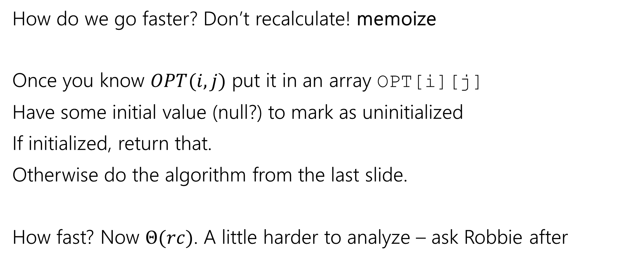
Speedup
Not a typo! We’re leaving ourselves a memo.
How do we go faster? Don’t recalculate! memoize
Once you know $OPT(i,j)$ put it in an array OPT[i][j]
Have some initial value (null?) to mark as uninitialized
If initialized, return that.
Otherwise do the algorithm from the last slide.
How fast? Now $Θ(rc)$. A little harder to analyze – ask Robbie after

Slide 29
Baby Yoda Searching
(c-1,r-1)
r-1
Y-coordinate
(0,2)
(0,1)
(1,1)
0
(0,0)
X-coordinate
0
c-1
Notes:
https://1.bp.blogspot.com/-XxfNI65zLnU/Xc98O96LVnI/AAAAAAAAGFY/Xsmd7IMlIrEltYONCdGKk1hqPw1BgL3ggCLcBGAsYHQ/s1600/Mandalorian.jpg
http://www.pngmart.com/image/161116/png/161115
https://www.pikpng.com/pngvi/hiTxbbR_clip-art-rock-rock-clipart-transparent-background-png-download/

Slide 30
Going Bottom-up
So how does that recursion work?
What’s the first entry of the table that we fill?
OPT[0][0]
Why not just start filling in there?

Slide 31








Baby Yoda Searching
(c-1,r-1)
r-1
What else can we fill in?
Y-coordinate
(0,2)
(0,1)
(1,1)
0
$$0$$
$$1$$
$$2$$
$$2$$
$$2$$
$$2$$
$$2$$
$$2$$
(0,0)
X-coordinate
0
c-1
Notes:
https://1.bp.blogspot.com/-XxfNI65zLnU/Xc98O96LVnI/AAAAAAAAGFY/Xsmd7IMlIrEltYONCdGKk1hqPw1BgL3ggCLcBGAsYHQ/s1600/Mandalorian.jpg
http://www.pngmart.com/image/161116/png/161115
https://www.pikpng.com/pngvi/hiTxbbR_clip-art-rock-rock-clipart-transparent-background-png-download/

Slide 32











Baby Yoda Searching
(c-1,r-1)
r-1
What else can we fill in?
Y-coordinate
(0,2)
$$0$$
$$1$$
$$−∞$$
$$2$$
$$2$$
$$2$$
$$2$$
$$2$$
(0,1)
(1,1)
0
$$0$$
$$1$$
$$2$$
$$2$$
$$2$$
$$2$$
$$2$$
$$2$$
X-coordinate
0
c-1
Notes:
https://1.bp.blogspot.com/-XxfNI65zLnU/Xc98O96LVnI/AAAAAAAAGFY/Xsmd7IMlIrEltYONCdGKk1hqPw1BgL3ggCLcBGAsYHQ/s1600/Mandalorian.jpg
http://www.pngmart.com/image/161116/png/161115
https://www.pikpng.com/pngvi/hiTxbbR_clip-art-rock-rock-clipart-transparent-background-png-download/

Slide 33





Baby Yoda Searching
(c-1,r-1)
r-1
What else can we fill in?
Y-coordinate
$$0$$
$$−∞$$
$$0$$
$$1$$
$$−∞$$
$$2$$
$$2$$
$$2$$
$$2$$
$$2$$
0
$$0$$
$$1$$
$$2$$
$$2$$
$$2$$
$$2$$
$$2$$
$$2$$
X-coordinate
0
c-1
Notes:
https://1.bp.blogspot.com/-XxfNI65zLnU/Xc98O96LVnI/AAAAAAAAGFY/Xsmd7IMlIrEltYONCdGKk1hqPw1BgL3ggCLcBGAsYHQ/s1600/Mandalorian.jpg
http://www.pngmart.com/image/161116/png/161115
https://www.pikpng.com/pngvi/hiTxbbR_clip-art-rock-rock-clipart-transparent-background-png-download/

Slide 34
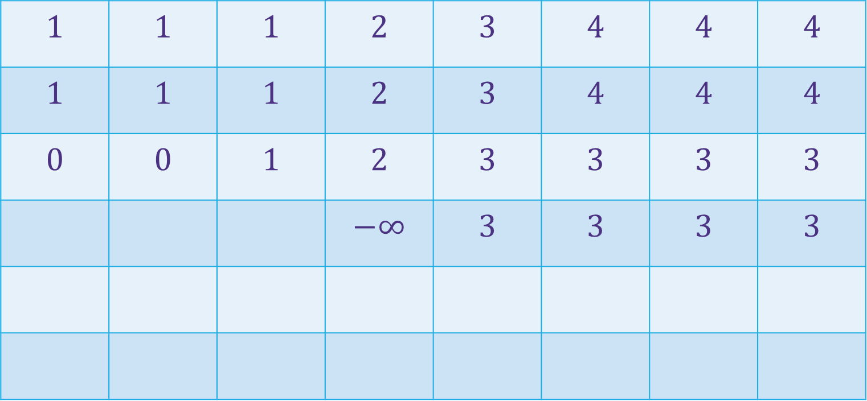

Baby Yoda Searching
(c-1,r-1)
$$1$$ | $$1$$ | $$1$$ | $$2$$ | $$3$$ | $$4$$ | $$4$$ | $$4$$
$$1$$ | $$1$$ | $$1$$ | $$2$$ | $$3$$ | $$4$$ | $$4$$ | $$4$$
$$0$$ | $$0$$ | $$1$$ | $$2$$ | $$3$$ | $$3$$ | $$3$$ | $$3$$
 |  |  | $$−∞$$ | $$3$$ | $$3$$ | $$3$$ | $$3$$
r-1
Where’s the final answer?
In the top right. Where Baby Yoda starts.
Y-coordinate
$$0$$
$$−∞$$
$$−∞$$
$$0$$
$$1$$
$$−∞$$
$$2$$
$$2$$
$$2$$
$$2$$
$$2$$
0
$$0$$
$$1$$
$$2$$
$$2$$
$$2$$
$$2$$
$$2$$
$$2$$
X-coordinate
0
c-1
Notes:
https://1.bp.blogspot.com/-XxfNI65zLnU/Xc98O96LVnI/AAAAAAAAGFY/Xsmd7IMlIrEltYONCdGKk1hqPw1BgL3ggCLcBGAsYHQ/s1600/Mandalorian.jpg
http://www.pngmart.com/image/161116/png/161115
https://www.pikpng.com/pngvi/hiTxbbR_clip-art-rock-rock-clipart-transparent-background-png-download/

Slide 35
What order?
Fill in a row at a time (left to right)
Going up to the next row once a level is done.
In actual code, probably easier to handle edges first
Avoid the index-out-of-bound exceptions.

Slide 36

Pseudocode
int eggsSoFar=0;
Boolean rocksInWay=false
for(int x=0; x<c; x++)
if(rocks[x][0]) rocksInWay = true
eggsSoFar+=eggs[x][0]
OPT[x][0]= rocksInWay ? $−∞$: eggsSoFar
eggsSoFar=0
rocksInWay=false
for(int y=0; y<r; y++)
if(rocks[0][y]) rocksInWay = true
eggsSoFar+=eggs[0][y]
OPT[0][y]= rocksInWay ? $−∞$ : eggsSoFar
for(int y=0;y<r;y++)
for(int x=0;x<c;x++)
if(rocks[x][y])
OPT[x][y]=-$∞$
else
OPT[x][y]=max(OPT[x-1][y], OPT[x][y-1])+eggs[x][y]

